Slide 1

Procurement and (UK) Industry at CERN
Christopher Hartley, Head of Industry, Procurement and Knowledge Transfer (IPT) Department
27 January 2025

Slide 2

CERN is entitled to establish its own internal rules necessary for its proper functioning, including:
Procurement Rules
Safety Rules
Staff Regulation of its own personnel

Slide 3
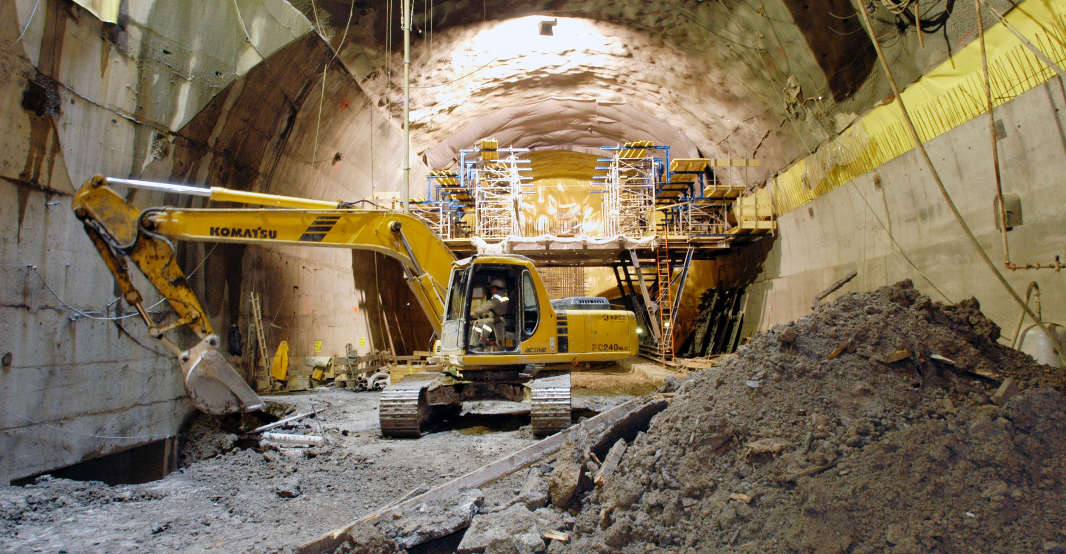
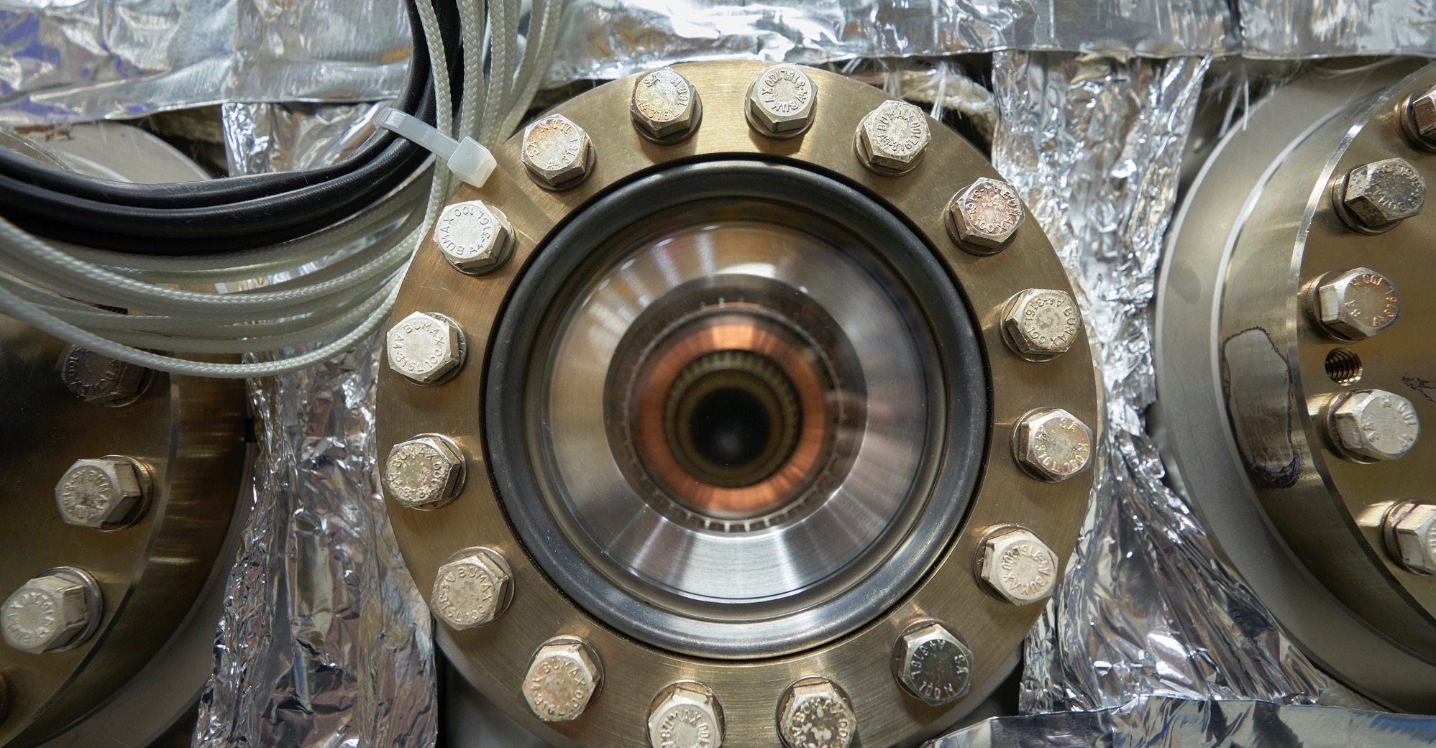
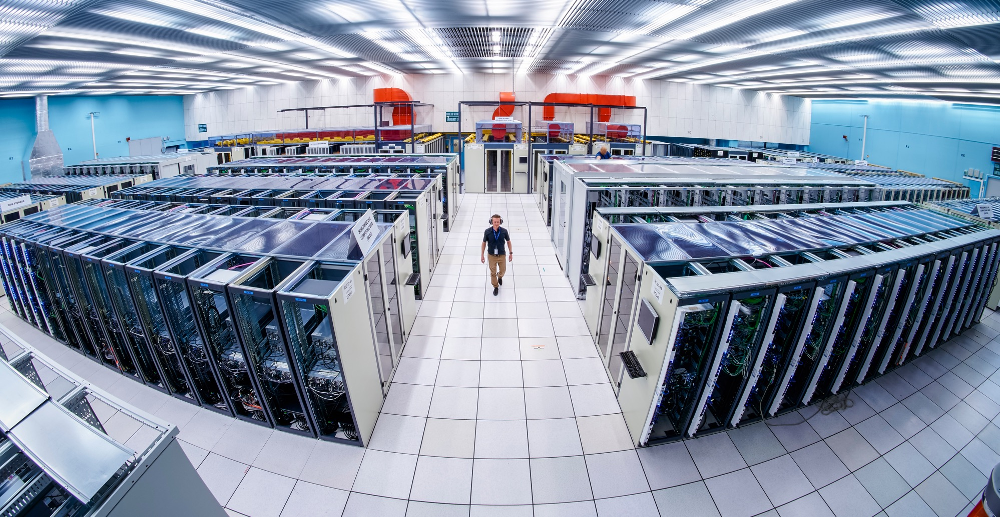
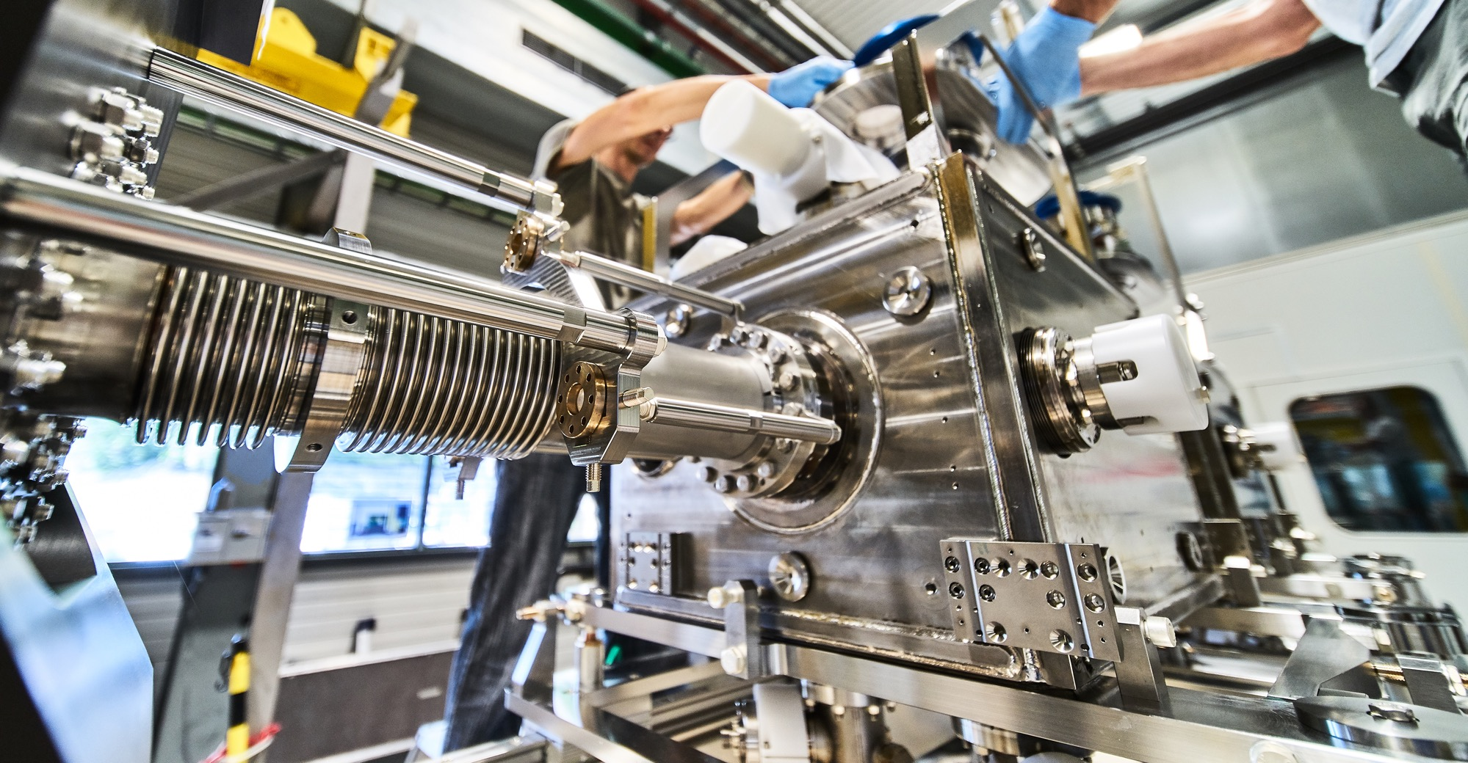
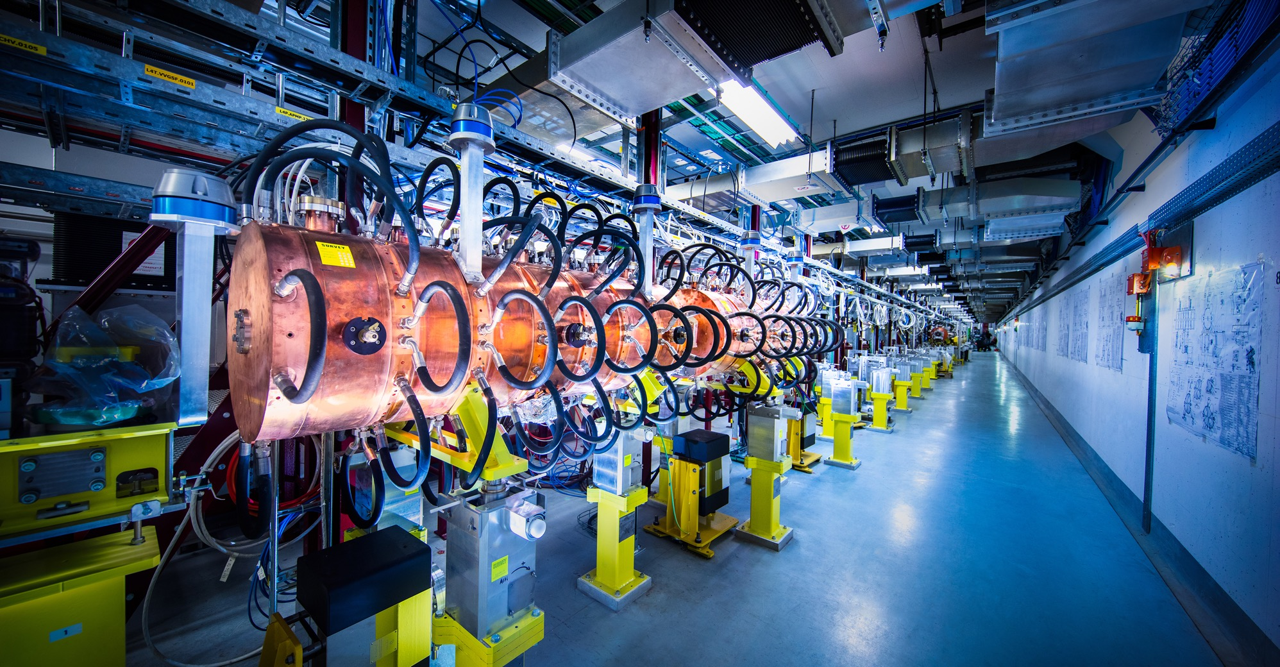
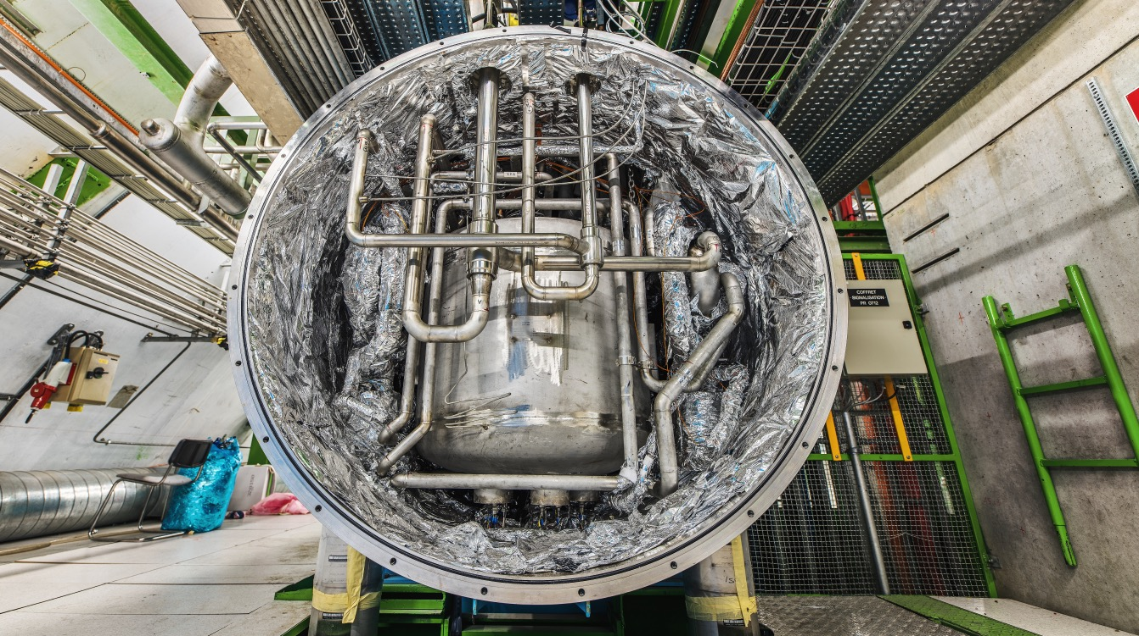
What do we buy?
Civil engineering
Cooling and ventilation
equipment
Electrical engineering and magnets
ICT
Mechanical engineering and raw materials
Electronics and radiofrequency equipment
Cryogenic and vacuum equipment
Etc….

Slide 4

How do we buy?
  Off-the shelf or non-standard products which can be produced with existing manufacturing techniques or technologies:
  Functional specification
  Non-standard products where industry has neither the required know-how nor the interest to develop and design the products:
  Build-to-Print specification
Prototypes and or Pre-series might be required.

Slide 5
How do we buy?
  Supplies
  Different contract types for one off or repeat purchases
  Usually on a Lowest Compliant Offer basis
  Services:
  Typically multi year contracts
  Extendable
  Usually on a Best Value For Money (BVFM) basis
  Who do we buy from?
  Where possible, from companies/organisations in our Member States
  Suitable companies in our supplier database - accurate registration helps
  Declare upcoming opportunities on our website, but also email companies known to us, including with input from the Industrial Liaison Officer
  Increasing interest in sustainable procurement – policy under development
  Always happy to extend our supplier base – and provide support for newcomers

Slide 6
Procurement Expenditure

Slide 7
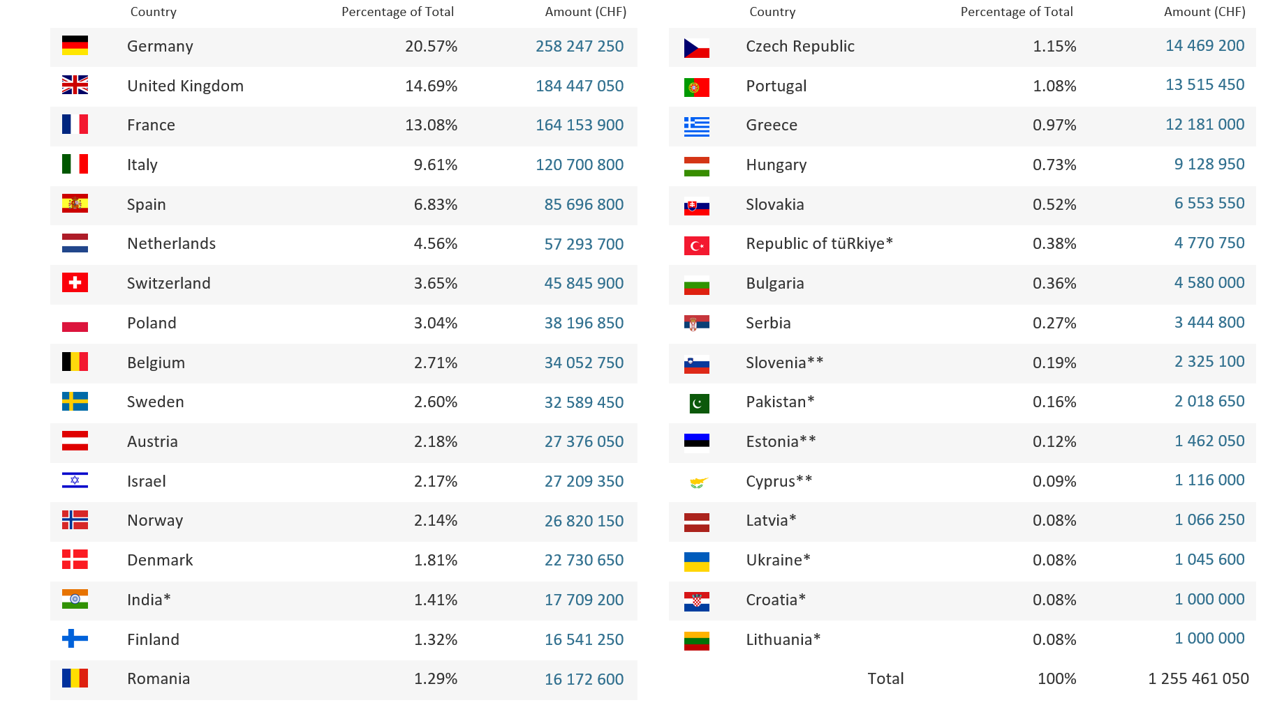
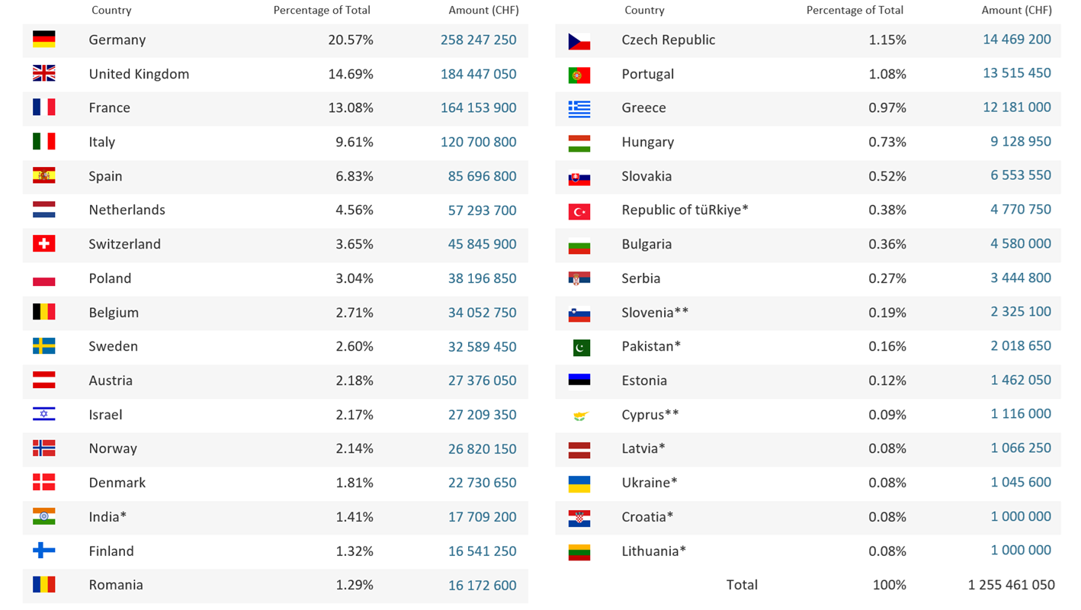
Yearly Budget (contributions 2024)*
*Brazil joined as an Associate Member State on 13 March 2024

Slide 8
UK Engagement With CERN - Strategy
The UK was one of the 12 founding members of CERN in 1954 and is now the second largest contributor to the CERN budget with a subscription of around £160 million per year.
The UK is committed to CERN, however our current return on investment needs improvement.
It sets out our ambitions to maximise the benefits of investment in CERN, both economically and more broadly, over the next 10 years. This will be advantageous not only for the UK but also for CERN as an organisation, its communities and the other member states.
UK CERN Engagement Strategy

Slide 9
UK Industrial Return – Status Improving
  UK return on Service contracts is good and better than most MS (SERCO)
  Why is the UK return Poor on Supply contracts?
  Uncompetitive on Lowest Compliant Offer basis may be due to:
    cost of production (wages)
    Transport
    No opportunity premium – sufficient local market in UK
  Reluctance to bid
  Barriers – real and perceived including:
    Distance
    Language
    Local partnerships needed
    Specific conditions such as bank guarantees, or challenges for SMEs

Slide 10
UK Industrial Return – Improvement Actions
  Co-operation with the UK (STFC) to improve outreach – identifying, encouraging and supporting potential UK winners
  More active use of Limited Tendering – where sufficient competition exists in VPBMS – most notably IT - but became no longer available in 2024
  Awareness – specific checks for UK involvement
  Address Barriers – real and perceived
  Data Analysis
  However, more remains to be done, especially with a view to widening the field of UK supplies, which is currently IT heavy

Slide 11
Procurement Rules Changes in 2024
  Approval thresholds doubled (main thresholds last changed in 1965)
  Best Value for Money (BVFM) adjudication of Supply contracts no longer requires prior approval of Finance Committee
  Aspects such as environmental responsibility recognized in BVFM
  Updating of many rules, including changes to reporting on Associate Member States :
    Window to establish 4 year coefficient
    When ceiling is reached (HR plus procurement spend > contribution)
  Rules changes were unanimously approved by Council
    Importance of co-operation with Member States – especially Industrial Liaison Officers
    Changes the mindset – Rules can be modified

Slide 12
Limited Tendering
Countries eligible for LT
Belgium
Brazil
Cyprus
Denmark
Greece
India
Israel
Norway
Romania
Serbia
Sweden
Ukraine
United Kingdom
«Limited tendering is foreseen by the CERN Procurement Rules to improve the industrial return of very poorly balanced Member States»
Conditions
Twelve Member States with the lowest industrial Return Coefficient for Supply Contracts
Used in case where there is sufficient competition;
ILO can ask to add firms, provided they are established in one of the eligible countries.
Bids shall only be considered where a minimum of 60% of their value originates in any combination of the twelve Member States communicated by CERN

Slide 13
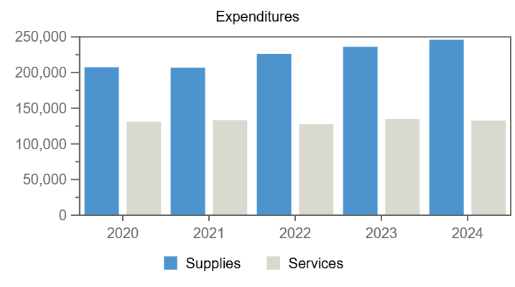
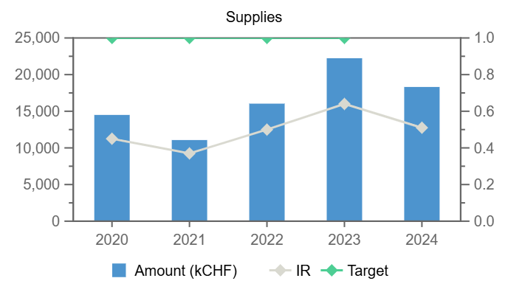
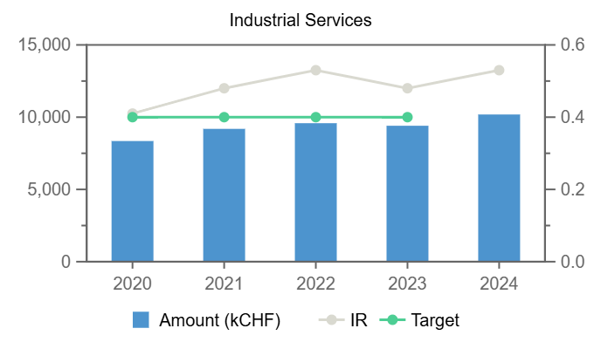
Procurement**
No data available in table
Remaining
Personnel
Expenditures (United Kingdom, kCHF)
Year
*Provisional figure based on commitments
Annual contributions and industrial returns for United Kingdom
Contributions (kCHF)
Expenditures (All countries totals, kCHF)
Expenditures (United Kingdom, kCHF)
Year
Country Contribution
All Countries
%
Year
Supplies
Services
Year
Supplies
Services
2020
184 949
1 196 893
15.45
2020
207 407
131 216
2020
14 497
8 348
2021
173 742
1 199 321
14.49
2021
206 717
133 358
2021
11 070
9 190
2022
171 219
1 206 284
14.19
2022
226 311
127 469
2022
16 037
9 583
2023
180 006
1 230 382
14.63
2023
236 125
134 661
2023
22 236
9 405
2024
184 447
1 266 086
14.57
2024
245 910
132 742
2024
18 314
10 185
2025
185 444
1 267 457
14.63
Industrial Return
Annual Industrial Return
Supplies
Services
Year
Ratio
Target
Ratio
Target
2020
0.45
1
0.41
0.4
2021
0.37
1
0.48
0.4
2022
0.5
1
0.53
0.4
2023
0.64
1
0.48
0.4

Slide 14
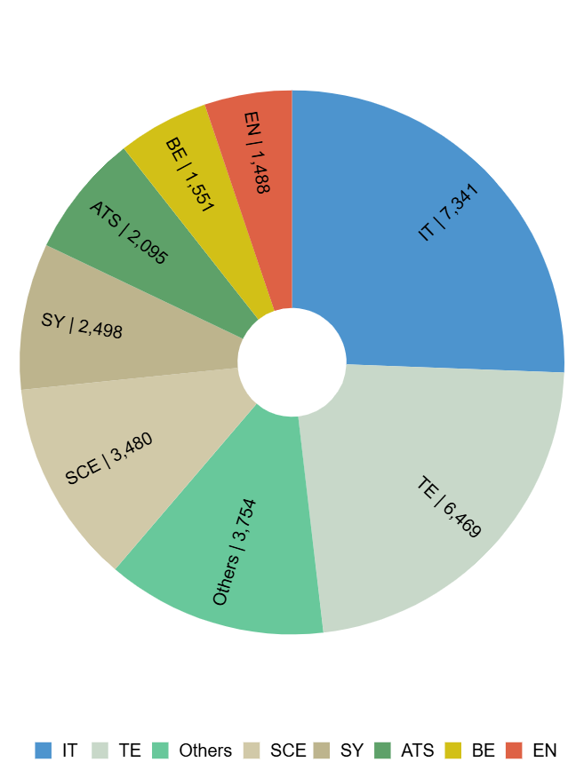
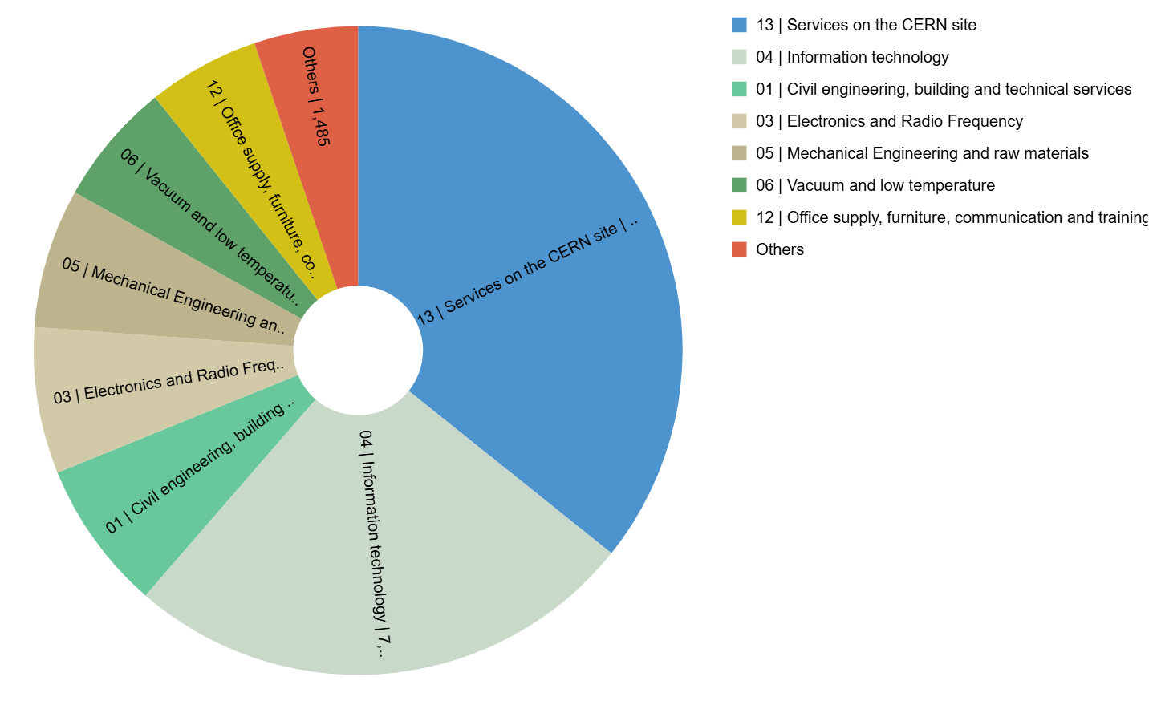
Expenditure by department and procurement codes for United Kingdom
Expenditure by Department (kCHF)
Expenditure by (Activity|Procurement) Code (kCHF)

Slide 15
CERN Procurement Tomorrow – with a UK eye
  Environmentally Responsible Procurement
  Policy being implemented progressively
  Total cost of ownership (TCO) – financial and environmental
  Best Value for Money may be used more
  Build relationships not just deals
  Look at real TCO – personnel savings?
  Change in procurement mix
  Utilities – prices and origin
  Future Circular Collider – civil engineering
  IT

Slide 16
CERN Procurement Tomorrow – with a UK eye
  UK quite well placed on environment
  Creativity, education – bring to marketplace – Government policy?
  Horizon Europe membership confirmed
  UK strong in IT – closely tied to USA +/-?
  Civil engineering expertise but encouragement needed
  Closer alignment between CERN innovation and procurement can lead to real opportunities, with UK being well placed
  Strong links with UK Industrial Liaison – richard.farrow@stfc.ukri.org
  Knowledge Transfer activities
    new CERN Venture Connect programme
    UK Universities (Cockroft – Unis Lancaster, Liverpool, Manchester and Strathclyde & STFC)
    Campus development

Slide 17

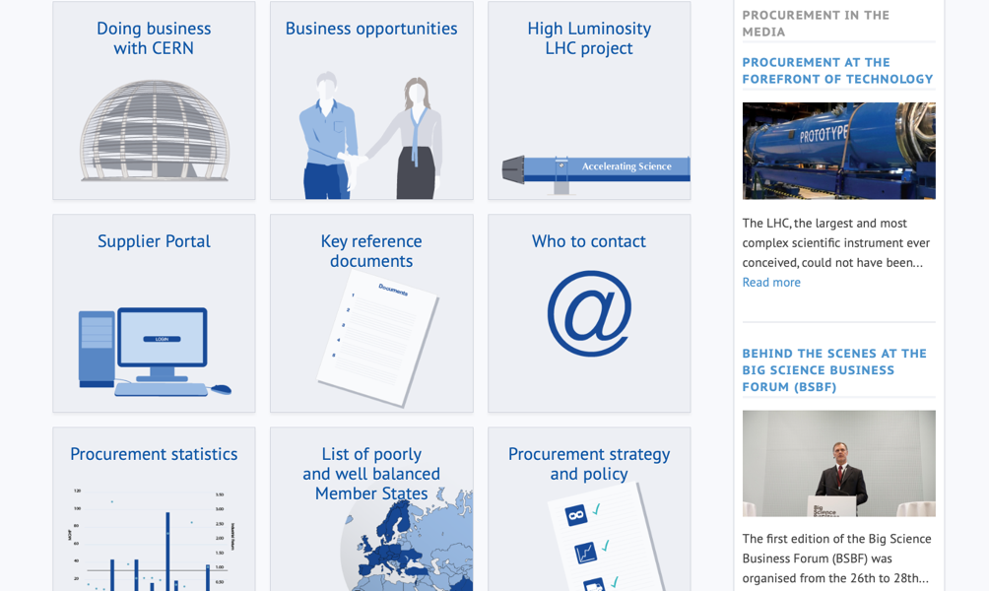
Procurement
website
http://procurement.web.cern.ch

Slide 18
Thank you

