Slide 1
Heat Transfer Analysis
Pixel Luminosity Ring
University of Oslo

Slide 2
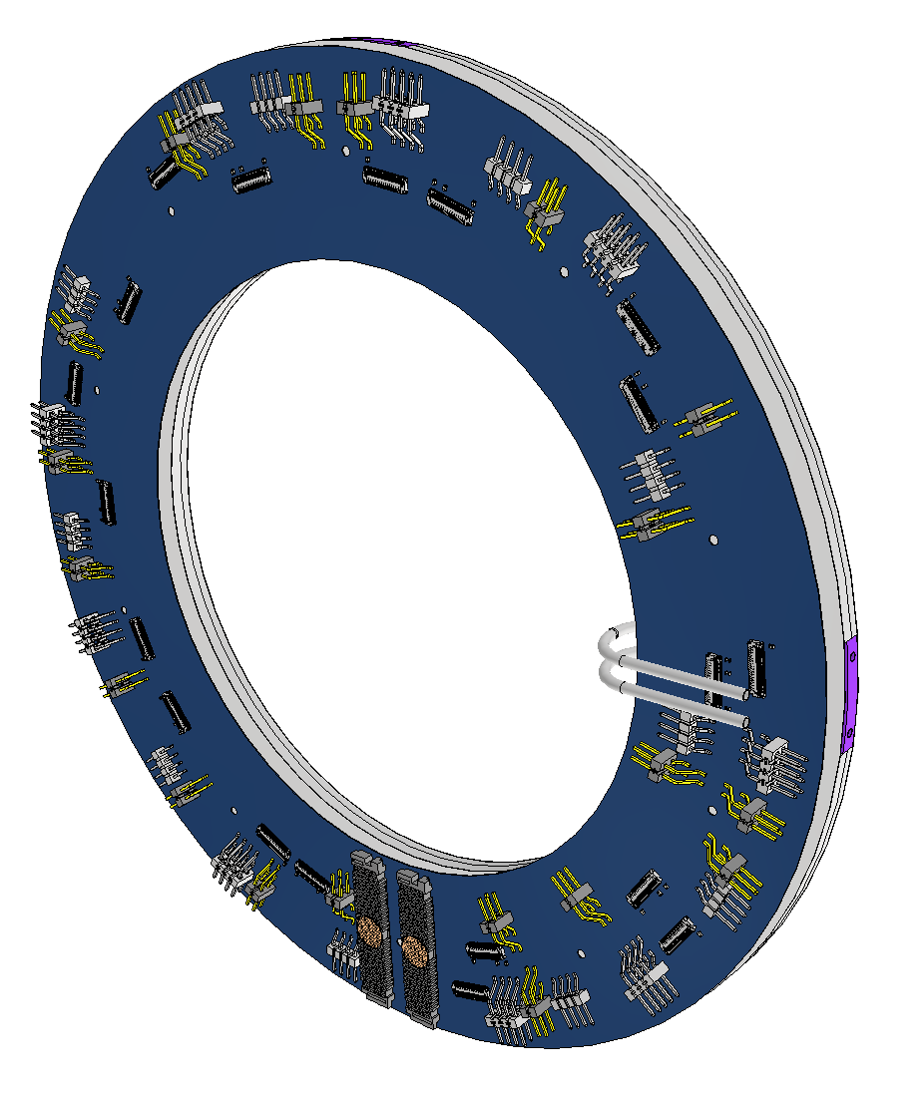
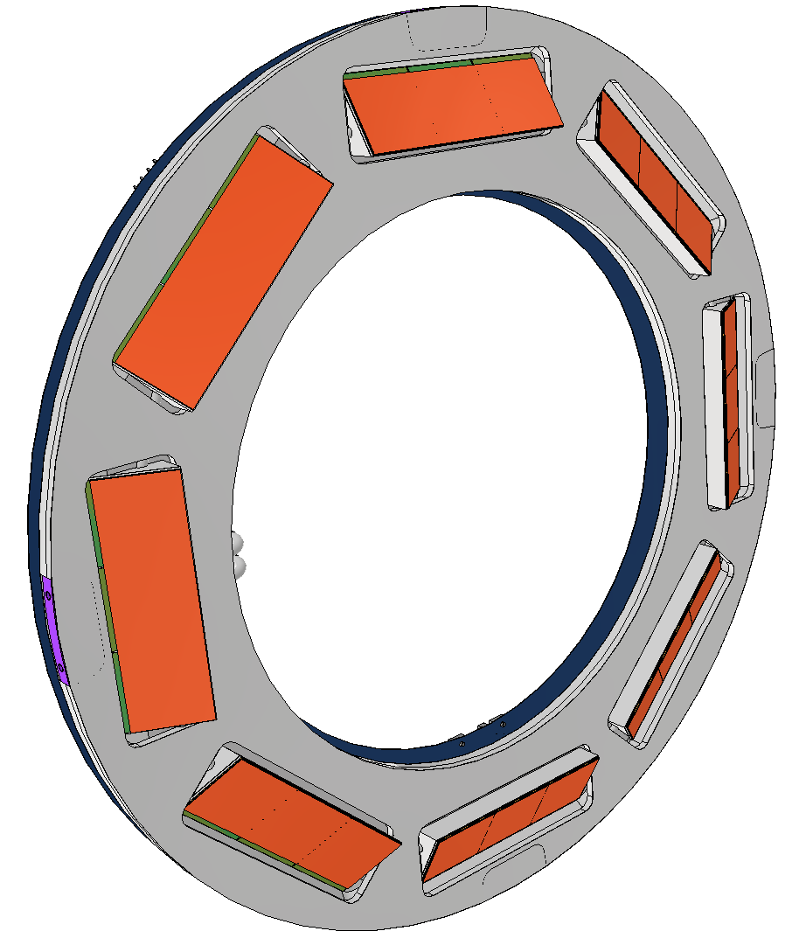
Purpose of analysis
Evaluate design for luminosity detector, which needs sufficient cooling.

Slide 3
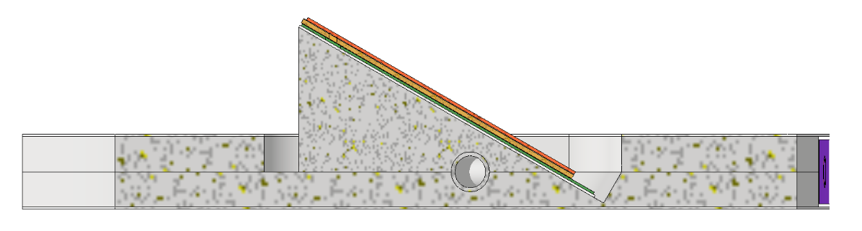
simulation model
The simulations are run in Autodesk CFD software.
For initial simulations, only a section of the PLR is used. This is the same model that was used to assess and decide optimal tilt angle of 30˚.

Slide 4
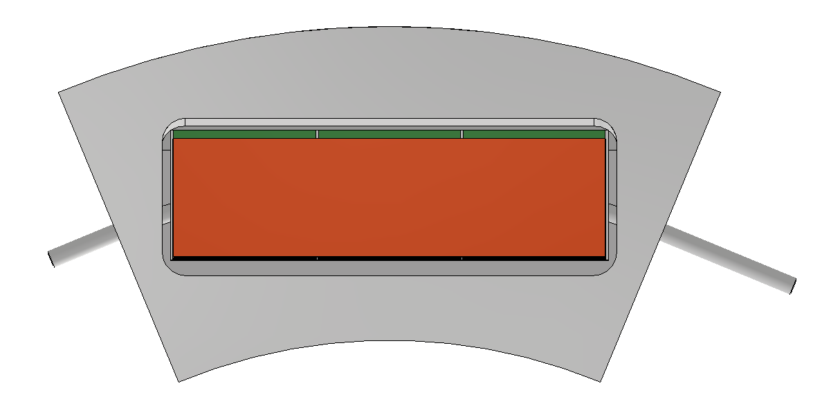
CO₂ cooling pipe
Latest simulations are run with constant cooling pipe temperature.
In case future analysis will include flow:
  Cooling inlet and outlet have been extended, in order to optimize model for correct flow simulations.

Slide 5
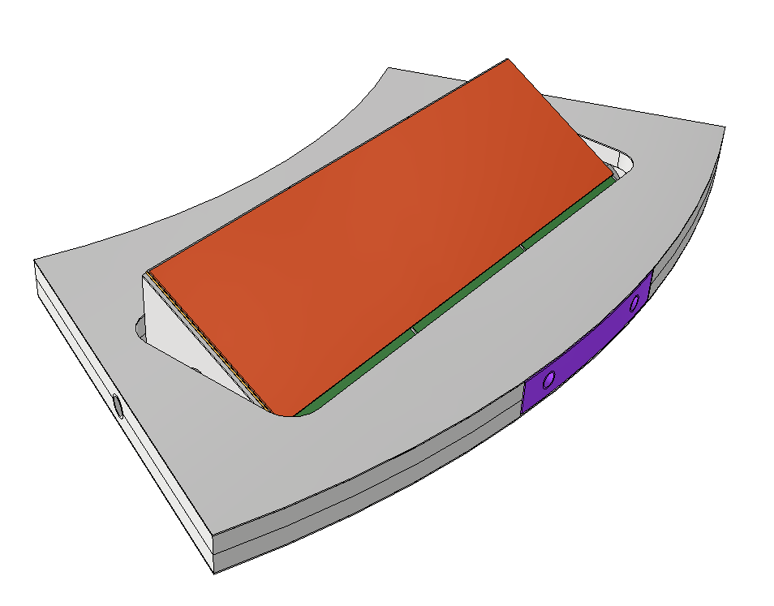
Material
Values from previous simulations:
  ”Normal” values for facesheets
  Foam k of 40 W/mK
  Glue k of 2 W/mK
  Hybrid k of 0.8 W/mK (Kapton)

Slide 6

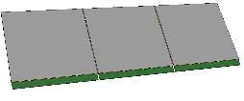










Material
Parts | Figure | Assigned material in Autodesk CFD
Detector hybrid |  | Kapton 0.8 W/mK
Linear triplet modules |  | Glue 2 W/mK
Linear triplet modules - Detector sensor |  | Silisium/Silicon
Linear triplet modules - Soldering |  | Tinn: 66,6 W/mK K/20 = 3,33 W/mK
Face-sheet |  | 7 W/mK
Carbon-foam wedge |  | Foam 40 W/mK
Backside and active side foam |  | Foam 40 W/mK
CO₂ cooling pipe in the Quad ring. |  | Titan 21,9 W/mK

Slide 7
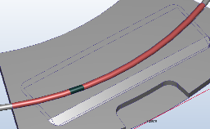
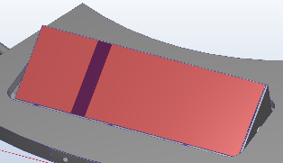
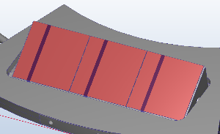
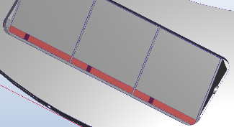
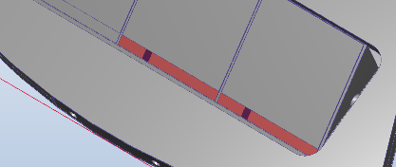
Boundary conditions
Part | Material | Figure | Value
Cooling | CO₂ |  | Temperature -25°C
Flex | Kapton |  | 770 W/m²
Sensor | Silisium/ Silicon |  | 3448 W/m²
End of chip | Silisium/ Silicon |  | Normal operation case: 37500 W/m²
 |  |  | Failure case: 106 000 W/m²

Slide 8
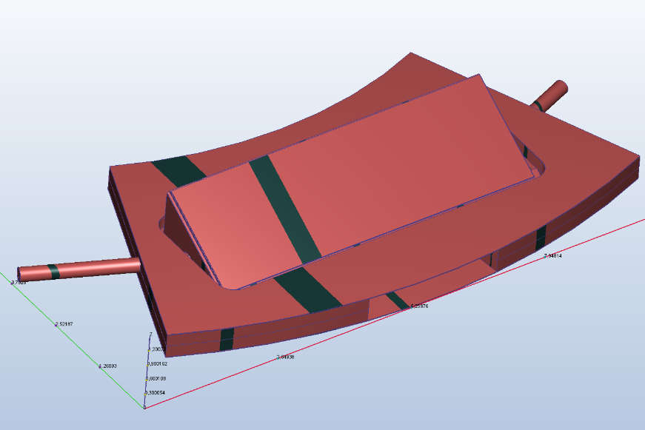
Initial conditions
Part | Material | Figure | Value
Overall structure | All |  | Initial volume temp: 0°C

Slide 9
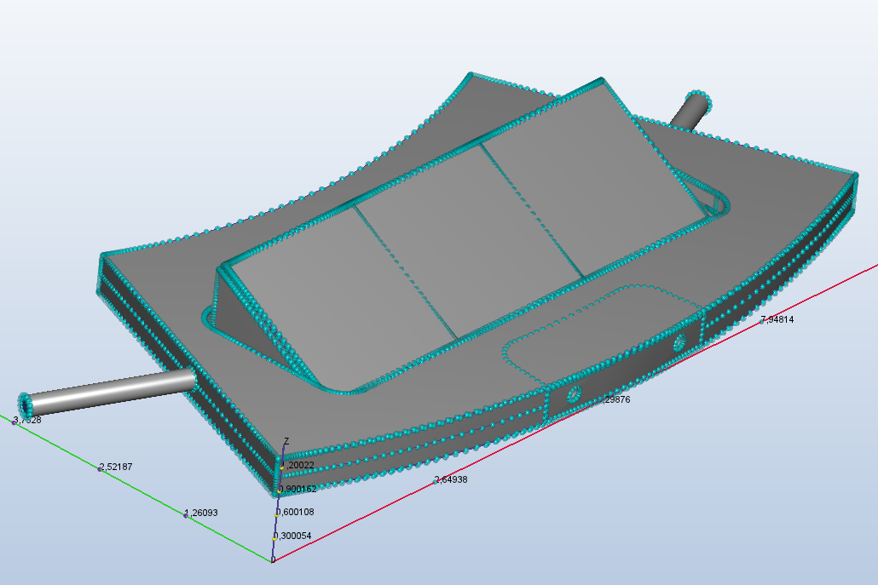
Mesh

Slide 10
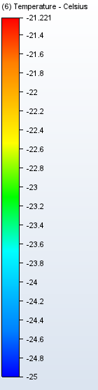
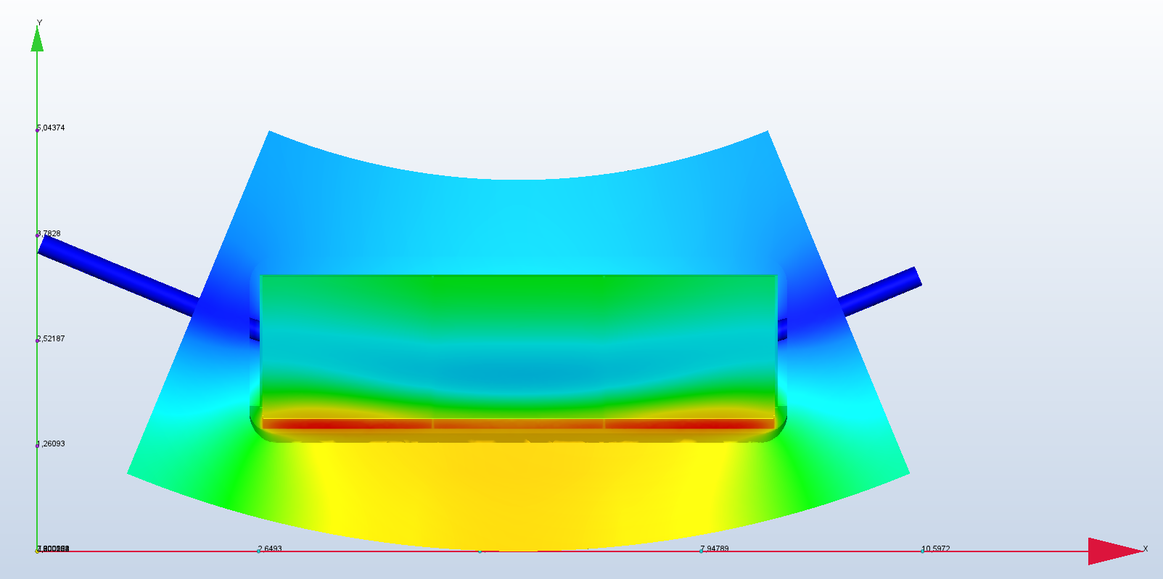
Preliminary results
Case 2 - Normal operation scenario
Fixed -25˚C CO₂ cooling temperature has been used

Slide 11
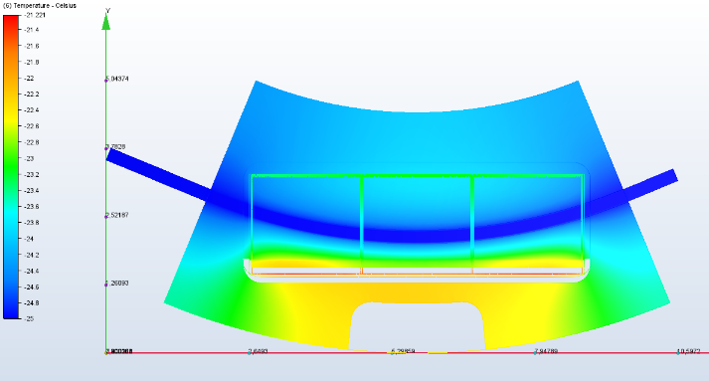
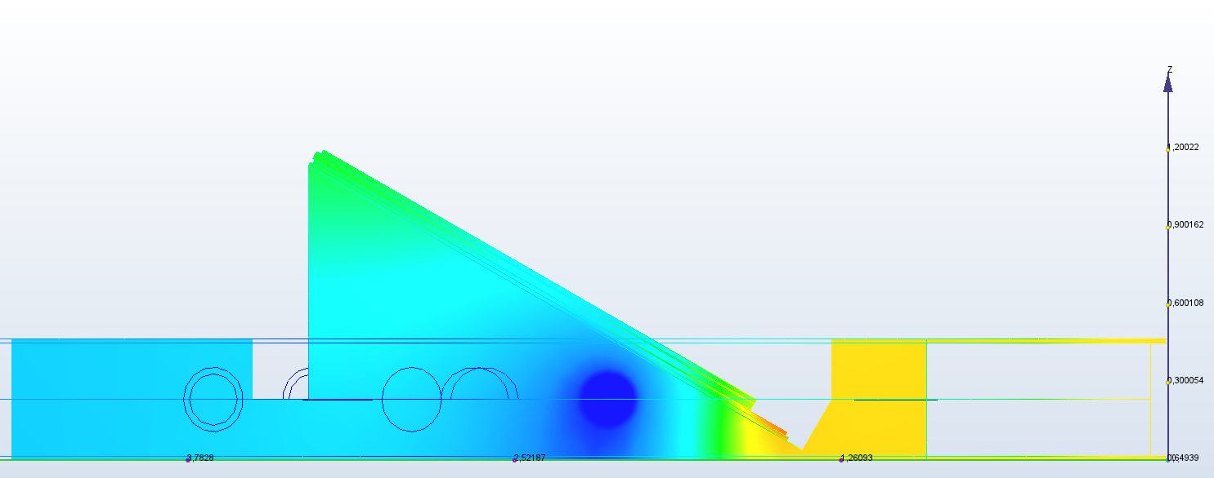
Preliminary results
Case 2 - Normal operation scenario
Fixed -25˚C CO₂ cooling temperature has been used

Slide 12
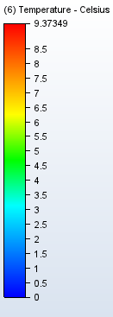
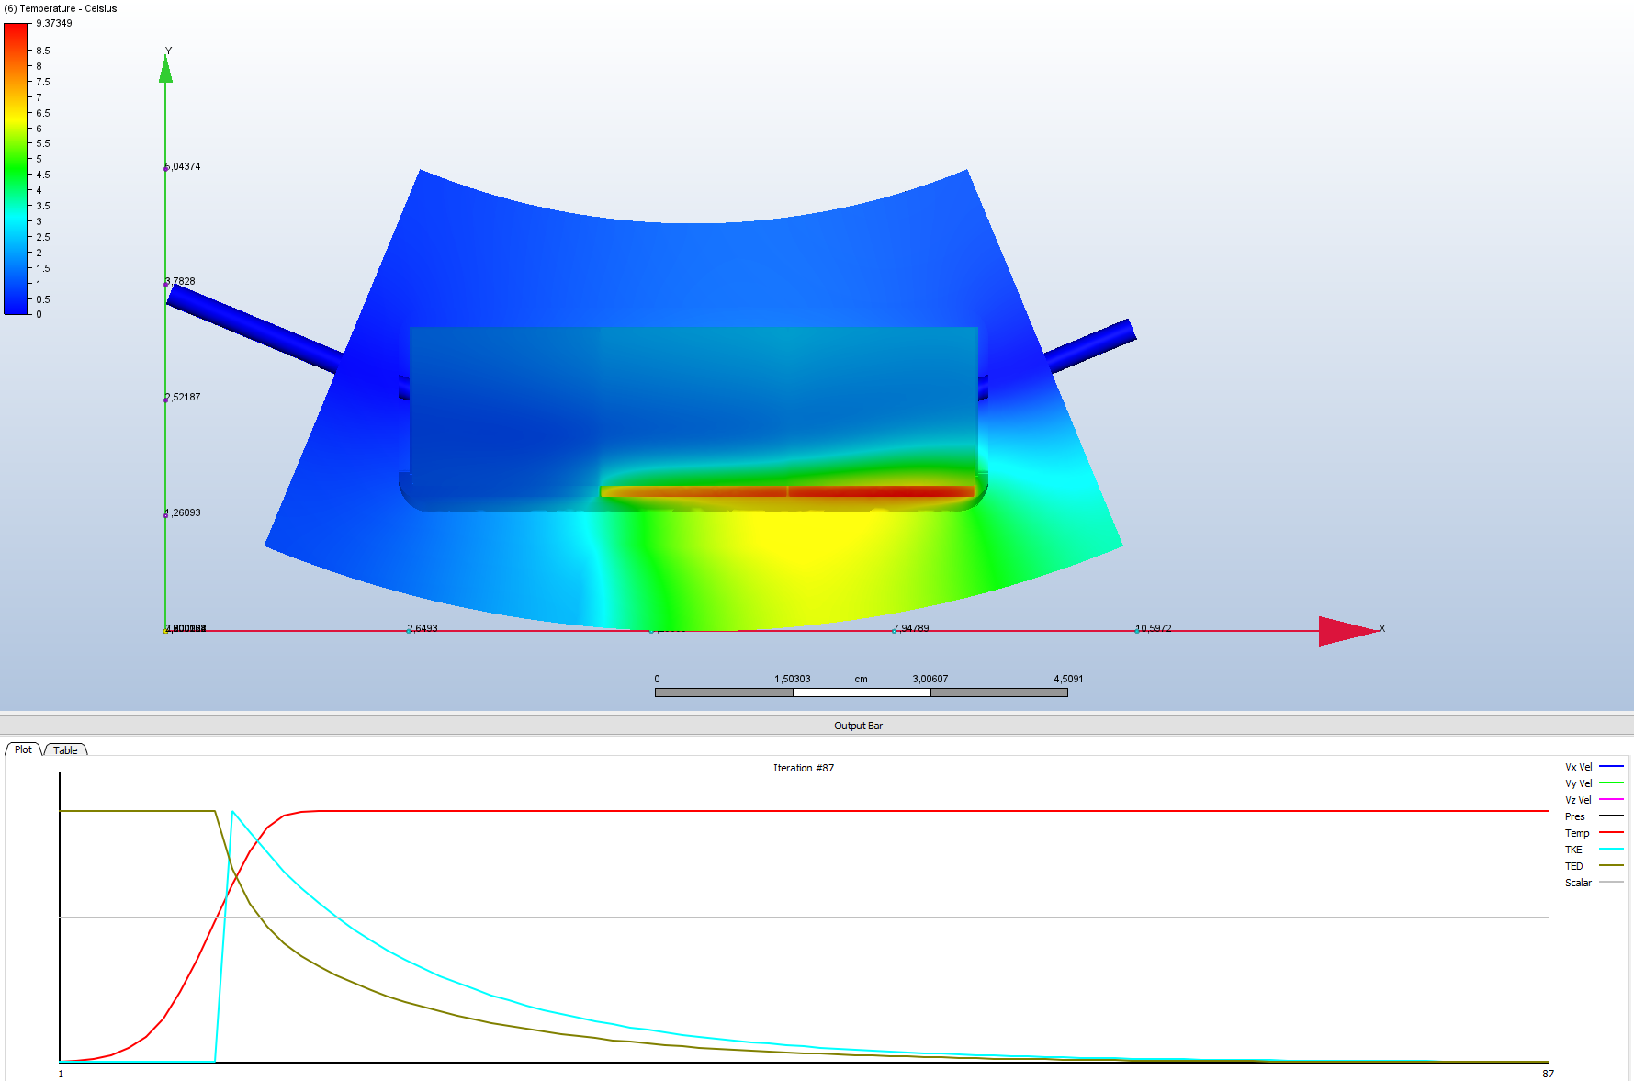
Preliminary results
Case 4a – One ASIC open failure mode scenario
Fixed 0˚C CO₂ cooling temperature has been used

Slide 13

Preliminary results
Case 4a – One ASIC open failure mode scenario
Fixed 0˚C CO₂ cooling temperature has been used
Convergence plot

Slide 14
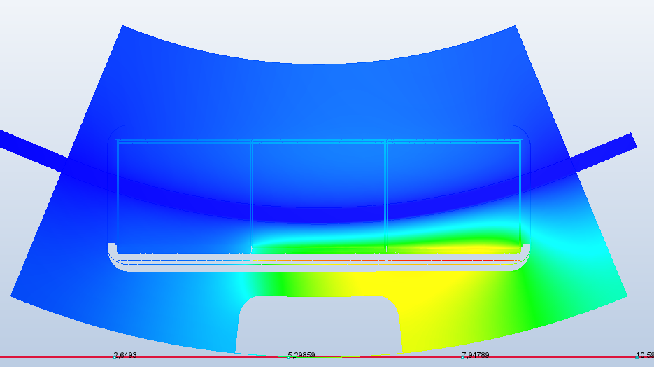
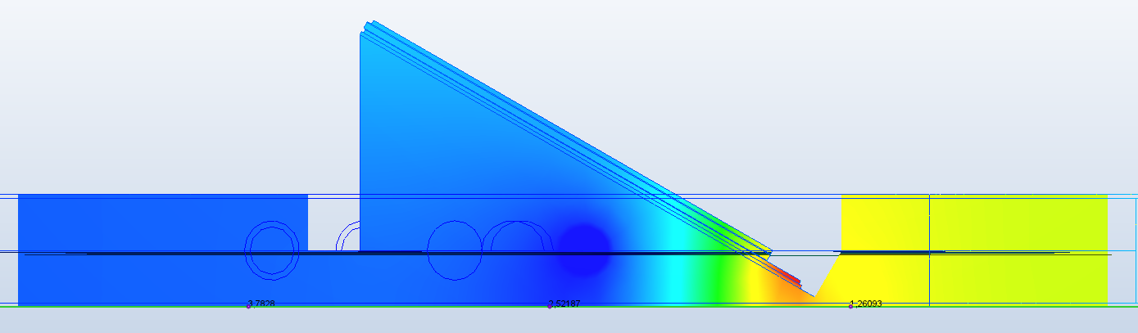
Preliminary results
Case 4a – One ASIC open failure mode scenario
Fixed 0˚C CO₂ cooling temperature has been used

Slide 15
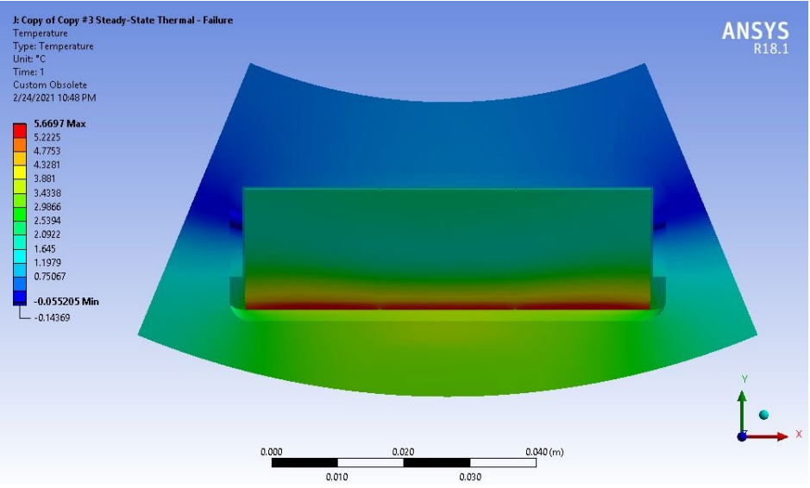
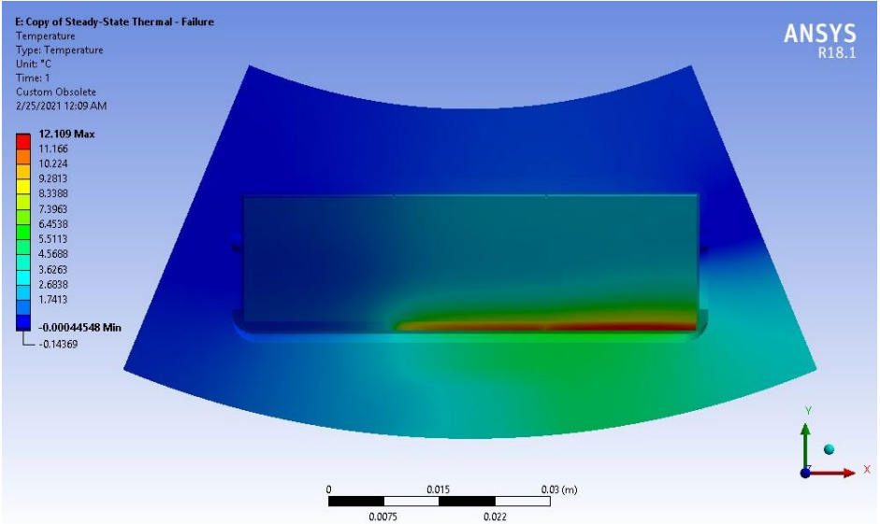
Questions for discussion
Thermal simulation report / documentation from earlier simulations?
Normal operation scenario for the Shunt-LDOs.
One-ASIC-open failure mode scenario for the Shunt-LDOs.

Slide 16
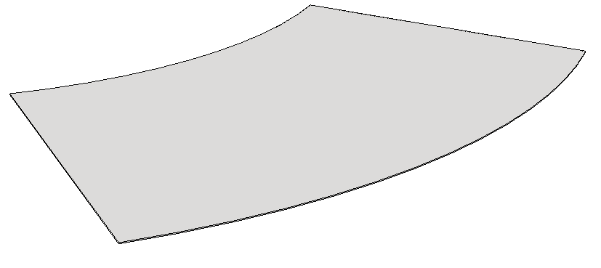
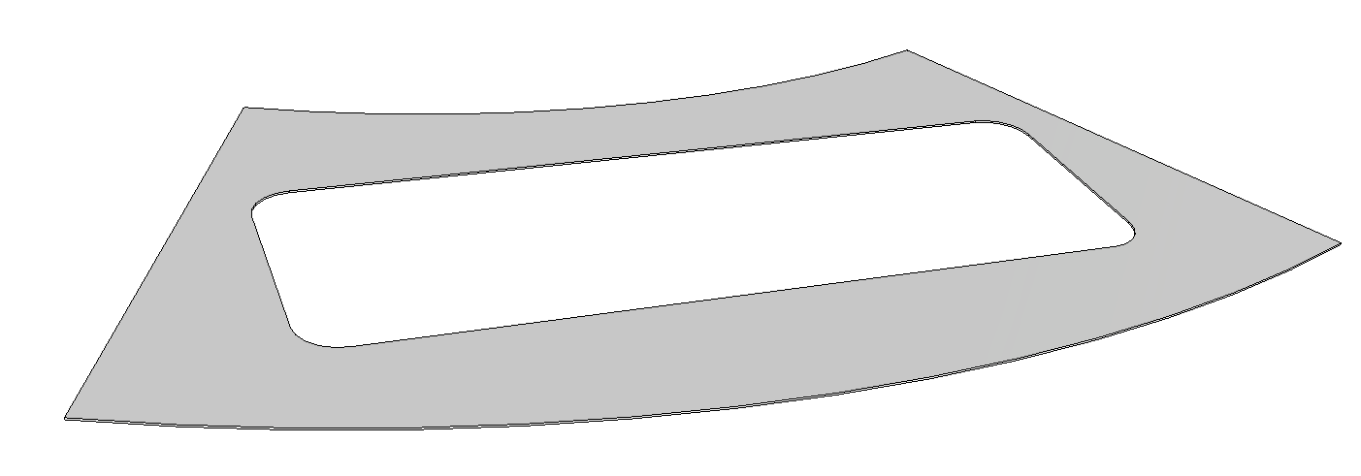
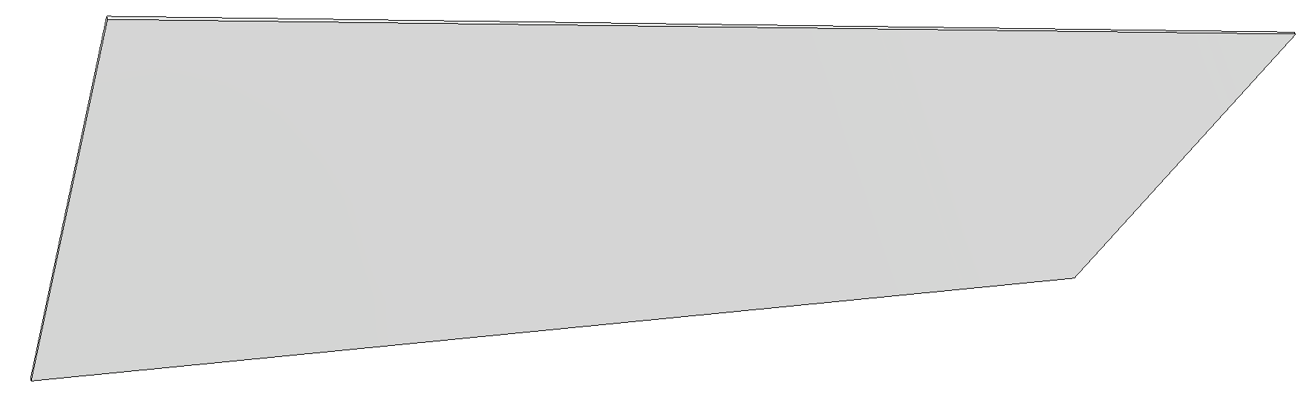
Questions for discussion
”Normal” values for facesheets?
  Need to verify what values to use
  Kxx 90 W/mK , Kyy 180 W/mK and Kzz 1,2 W/mK
    Ref. AT2-IP-ER-0029

Slide 17
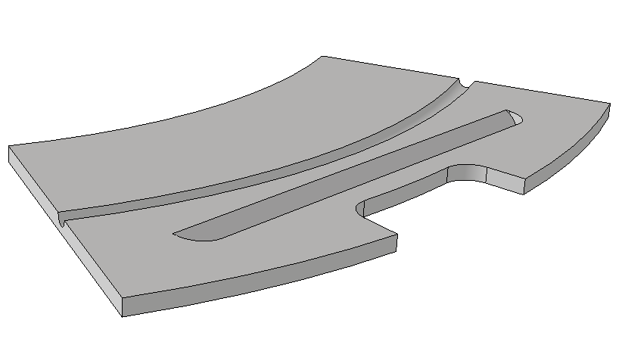
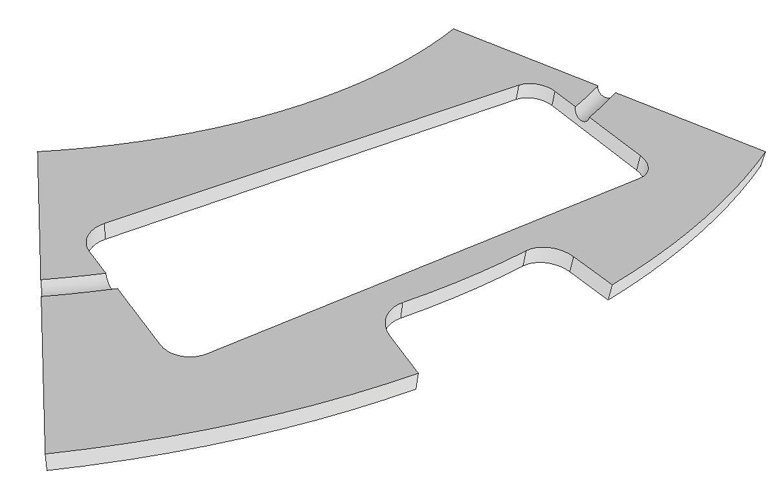
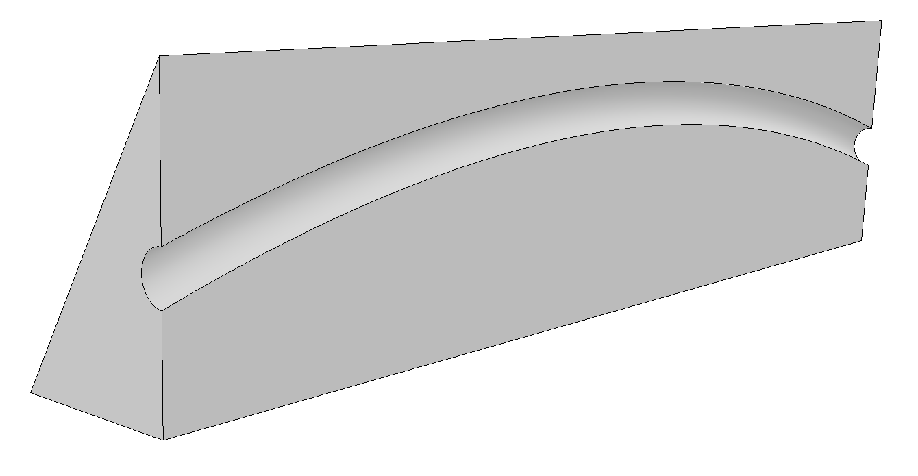
Questions for discussion
Carbon-foam wedge
  Same thermal properties as active side foam and backside foam?
    K=40 W/mK

