Slide 1
PLR Loading Considerations
Neal Hartman, LBNL
31 October 2024

Slide 2
Summary
Being based on IS modules, it is clear that IS loading techniques are most pertinent to (eventual) loading of the PLR
A loading precision spec should be set
  It is entirely possible that modules could be loaded by eye, by hand with minimal tooling
  With that said, loading with a modified IS loading setup is also reasonable
Following is a small intro to IS loading tooling

Slide 3
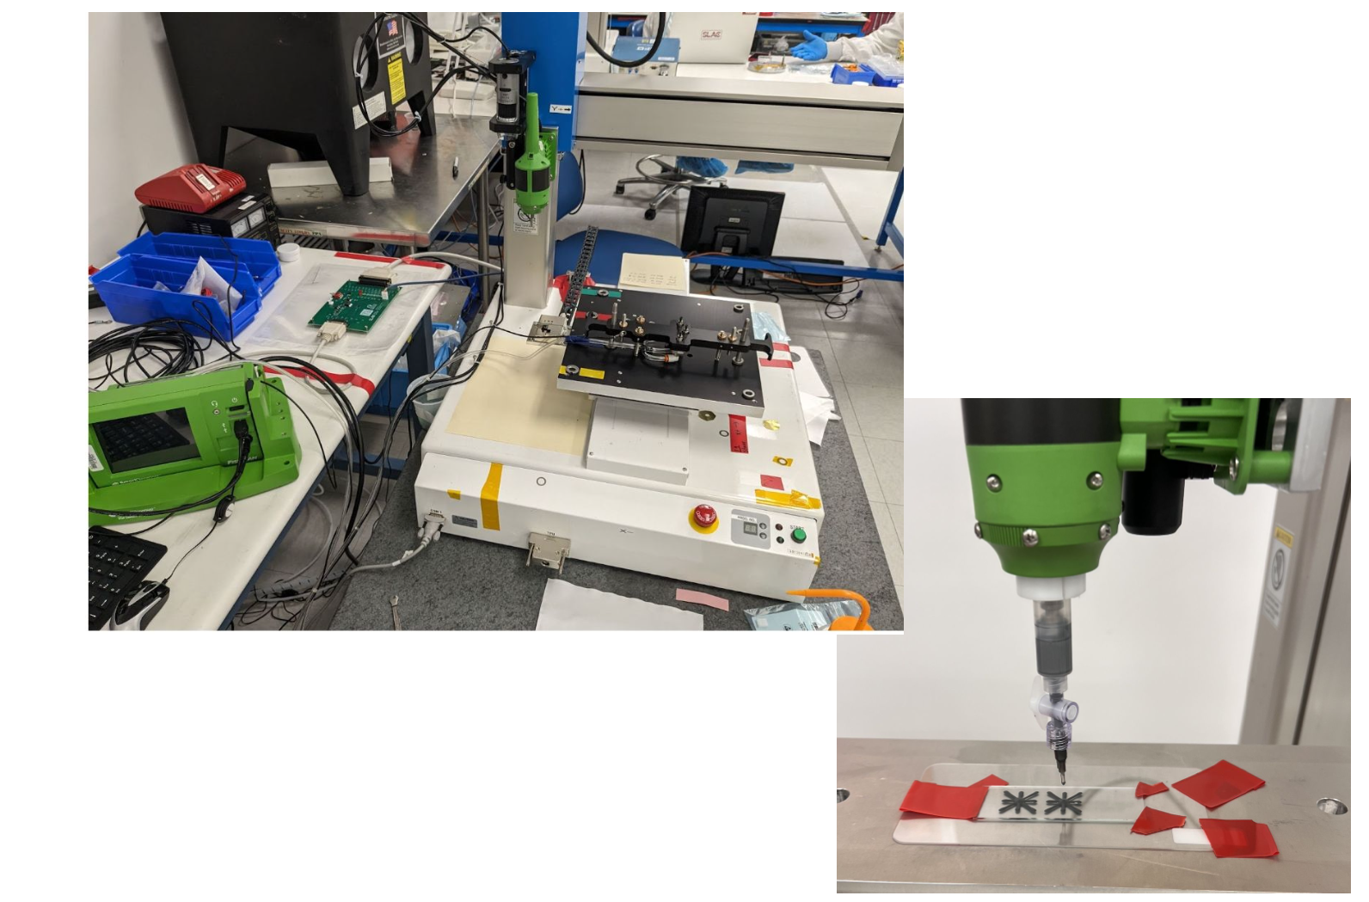
SE4445 Deposited Directly on Module with volumetric tip in star pattern

Slide 4
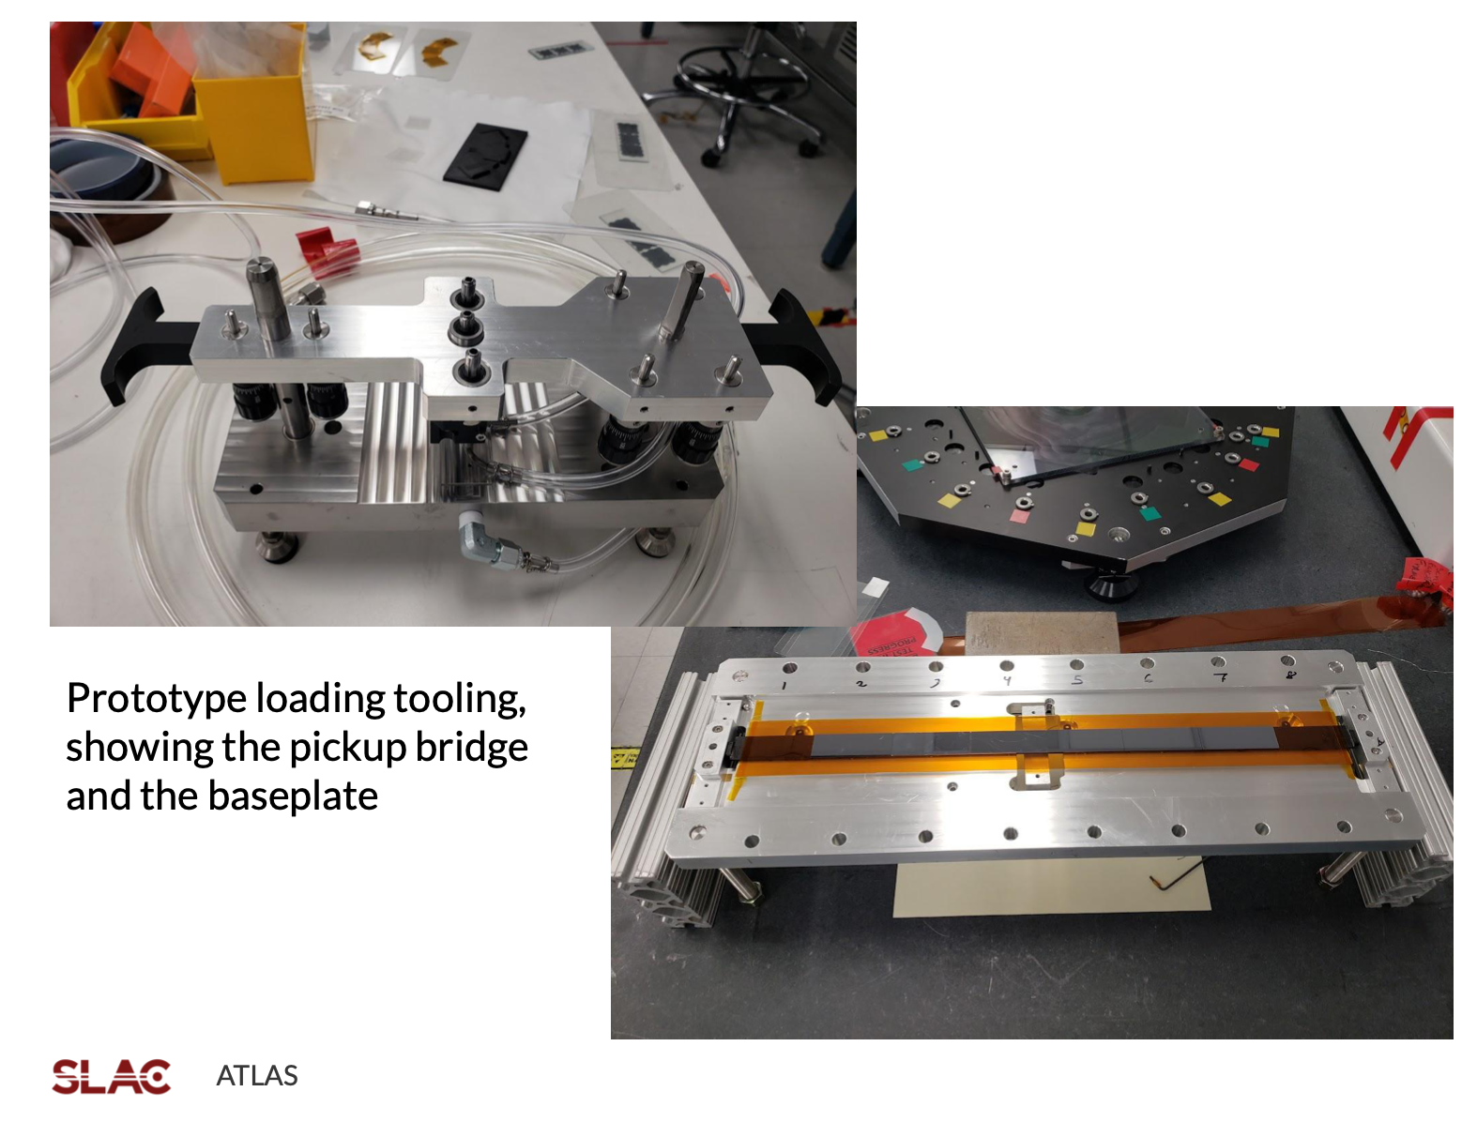
Linear Triplet Loading Tooling

Slide 5
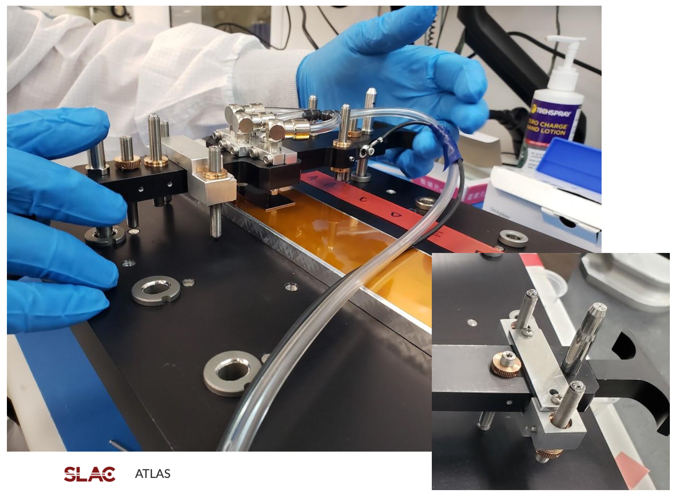
Bridge and Module being Applied (to test structure)

Slide 6
Potential Loading Tooling for PLR
Option 1
  Load glue on module with bridge and robot
  Use hand-vacuum pickup to load module onto PLR ring
Option 2
  Load glue on module with bridge and robot
  Hold PLR ring in a 30-degree angled tooling setup that allows bridge to cross over ring wedge
  Load module with this loading tooling (must produce new tool)

Slide 7
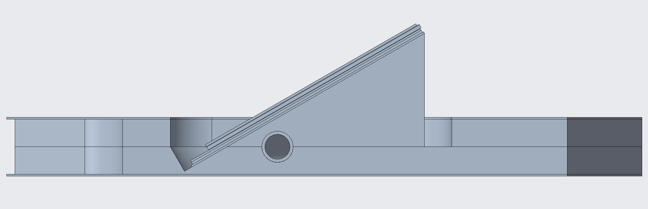
Schematic of PLR Loading
Bridge spans ring opening
Relieve to allow normal access
Baseplate holds ring at 30 degrees

Slide 8
Conclusions
Loading, even with new tooling, should be very straightforward
Seems lower risk to have US do the loading before shipping to Norway
However, project-wise would need to figure out how this could be possible
Potentially, Purdue could do loading with old tooling of ours while making PLR supports…

