Slide 1

Space Charge in Circular Machines
Foteini Asvesta
CAS: Intensity Limitations in Hadron Beams
Borovets, Bulgaria, 15–27 Jun 2025

Slide 2
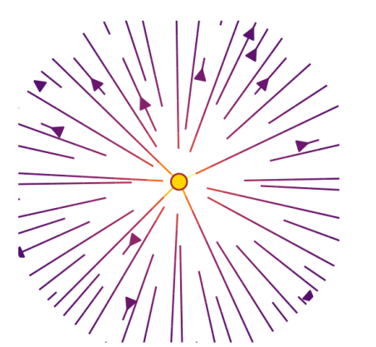
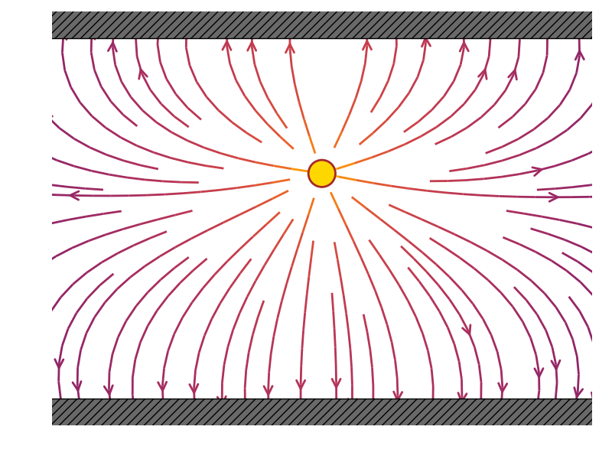
Introduction: Reminder / Disclaimer
Space charge
Too complex to fully cover…
Different effects
Direct
(charges in free space)
Indirect
(interaction with environment)
K. Li, Collective effects
K. Li, Collective effects

Slide 3
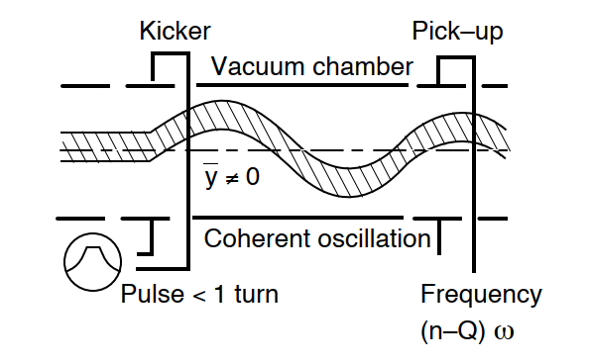
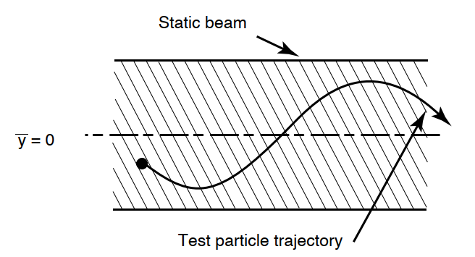
Introduction: Reminder / Disclaimer
Space charge
Too complex to fully cover…
Different effects
Different type of responses
Coherent
(instabilities ….)
Incoherent
(tail generation ….)
K. Schindl, "Space Charge"
K. Schindl, "Space Charge"

Slide 4
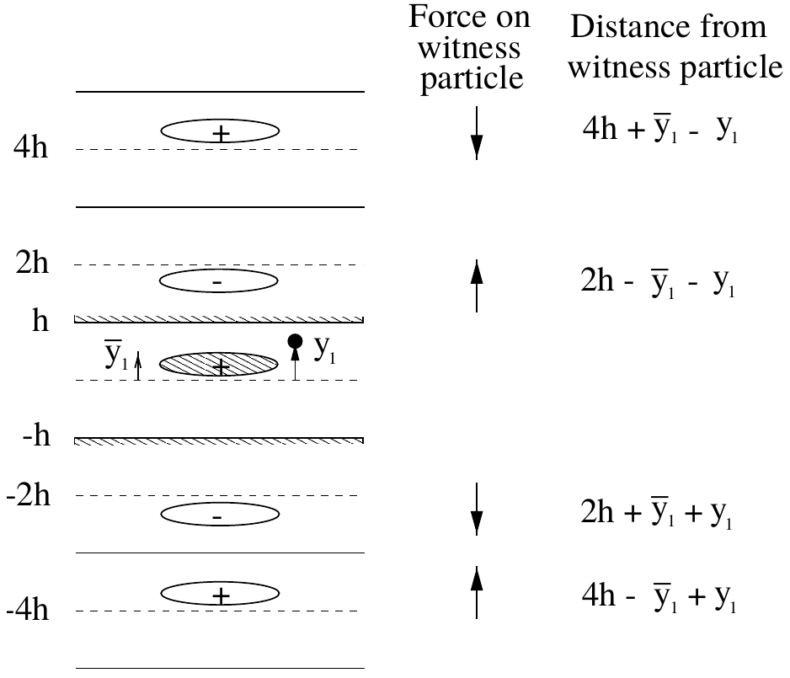
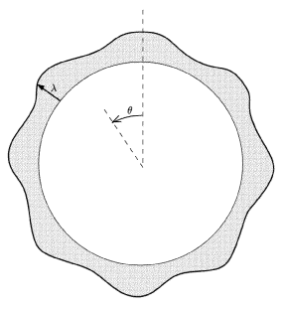
Introduction: Reminder / Disclaimer
Space charge
Too complex to fully cover…
Different effects
Different type of responses
Affects all planes of motion
Transverse
(Laslett coefficients….)
Longitudinal
(Negative mass instability….)
L. J. Laslett (1963)
E. Wilson, An introduction to particle accelerators

Slide 5
Introduction: This course
Space charge
Previous courses
Today
K. Li
“Collective effects”
CAS 2024
G. Rumolo,
H. Bartosik & K. Li
“Space charge”
USPAS 2015
G. Franchetti
“Space Charge in Circular Machines”
CAS 2015
Aim at giving more detailed descriptions of some advanced topics
Detailed introduction to all space charge effects
Gets into several advanced topics

Slide 6
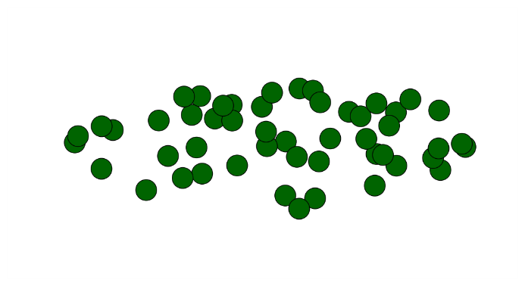
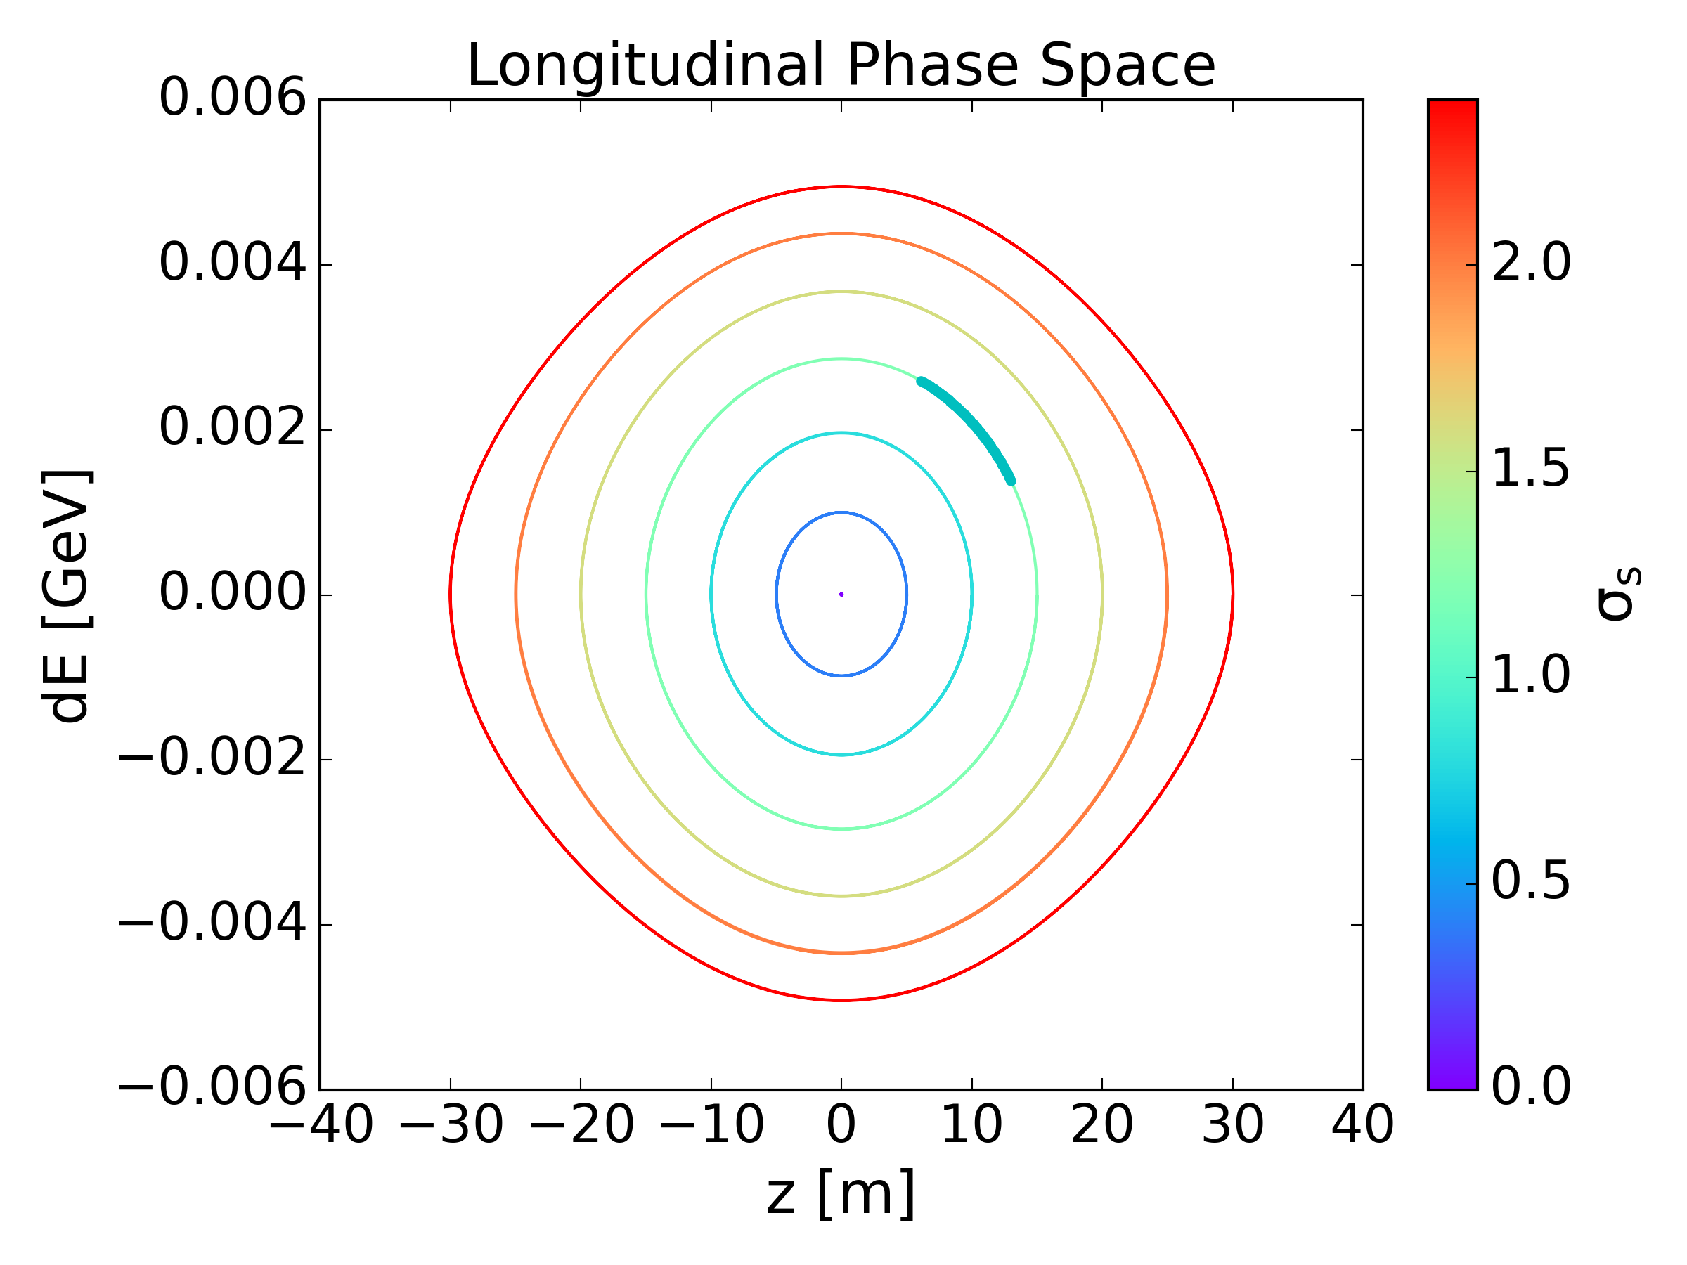
Introduction: This course
Direct space charge
(Indirect space charge: can be treated similarly to impedance, wakes etc)
Incoherent perspective
  Dominant in operational conditions (Bunched beams, Gaussian distributions)
  Coherent response can dominate under certain conditions (Coasting beam, Waterbag or KV distribution, etc)
Interplay between transverse & longitudinal planes of motion
  Synchrotron motion heavily impacts the transverse dynamics under space charge
Simulating space charge in rings
PIC & Analytic solvers
Direct
(charges in free space
Incoherent
(tail generation ….)
Interplay
Transverse – Longitudinal
(Impact of synchrotron motion)

Slide 7
Direct Space Charge
Charges in free space
Consider two point-like charges with the same charge q
  Both particles experience only the repulsive Coulomb force
Consider the two point-like charges move with the same velocity v on parallel trajectories
  The particles represent two parallel currents which attract each other by the induced magnetic field
Electromagnetic self-fields are induced by the moving particles
  The Coulomb repulsion & the magnetic attraction cancel out at the speed of light
K. Schindl, "Space Charge"

Slide 8
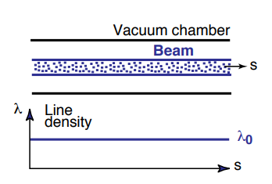
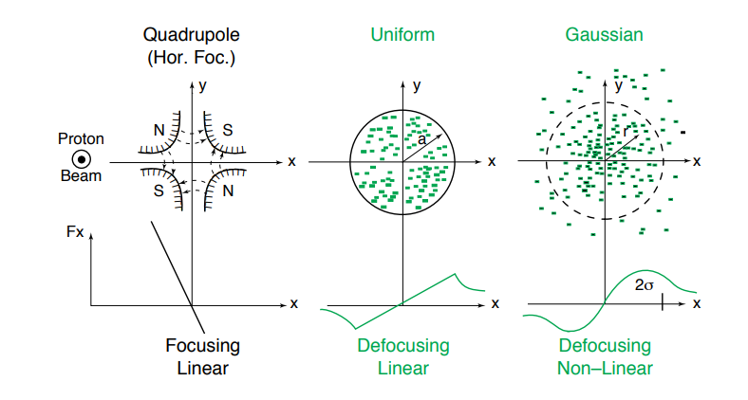
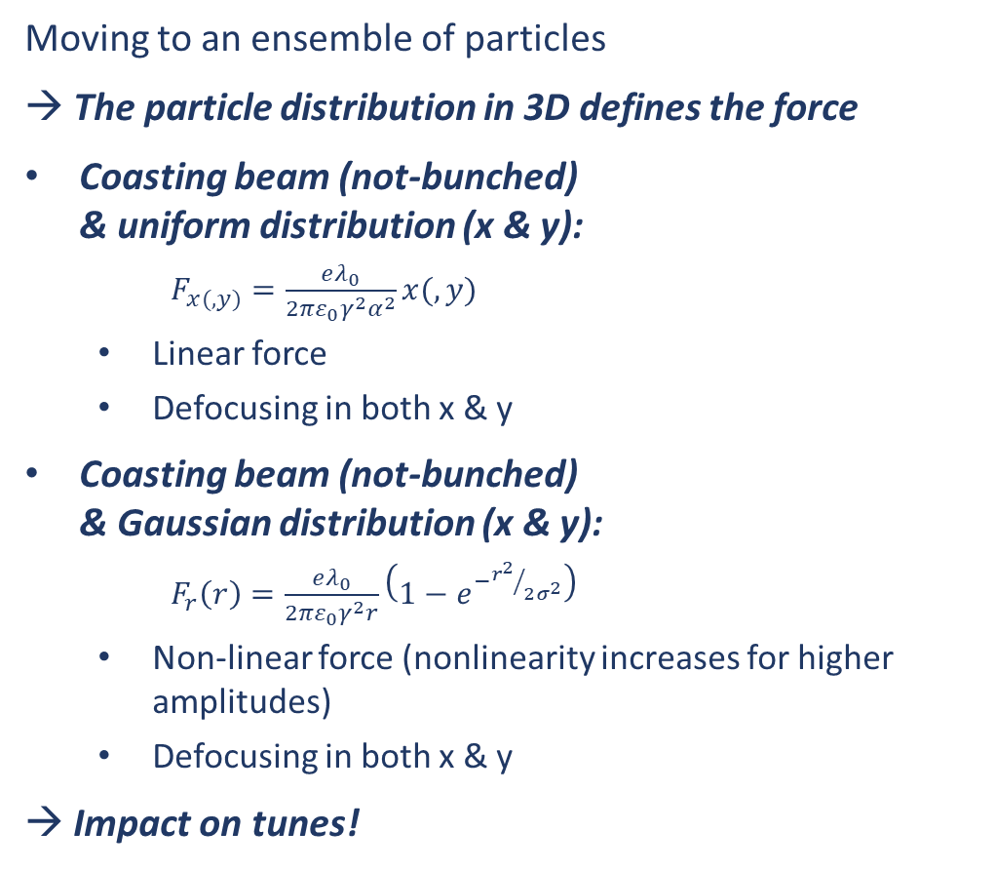
Direct Space Charge
Moving to an ensemble of particles
→ The particle distribution in 3D defines the force
Coasting beam (not-bunched)
& uniform distribution (x & y):
  $F_{x(,y)}=\frac{eλ_{0}}{2πε_{0}γ^{2}α^{2}}x(,y)$
  Linear force
  Defocusing in both x & y
Coasting beam (not-bunched)
& Gaussian distribution (x & y):
  $F_{r}\left(r\right)=\frac{eλ_{0}}{2πε_{0}γ^{2}r}\left(1−e^{−{r^{2}}/{2σ^{2}}}\right)$
  Non-linear force (nonlinearity increases for higher amplitudes)
  Defocusing in both x & y
→ Impact on tunes!
Q_{y}
Q_{y}
tune shift
tune spread!
Q_{x}
Q_{x}
H. Bartosik, "Space Charge"

Slide 9
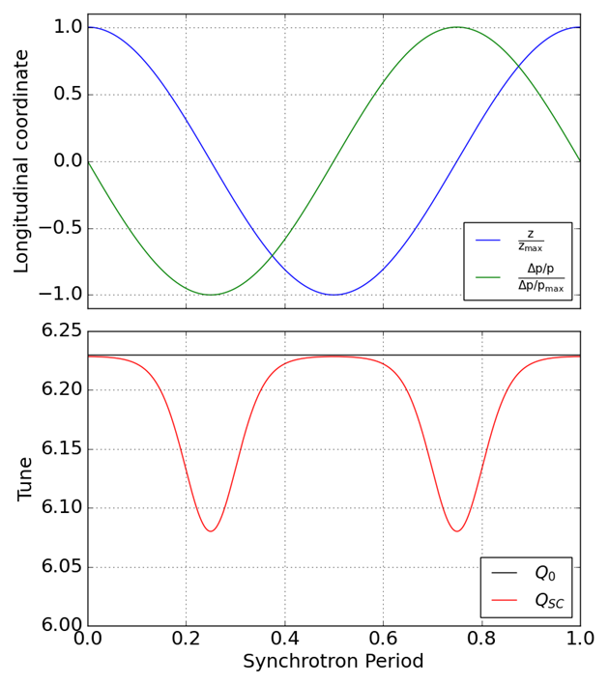
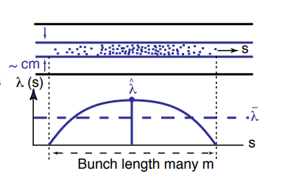

Direct Space Charge
Moving to an ensemble of particles
Bunched beam:
  Longitudinal line density, $λ$, is not constant
Space charge changes along the bunch
→ Tune spread changes!
Space charge changes due to the synchrotron motion
  Moving from the edges of the bucket towards the center
  → charge density increases
  → Tune spread modulates!
K. Schindl, "Space Charge"

Slide 10
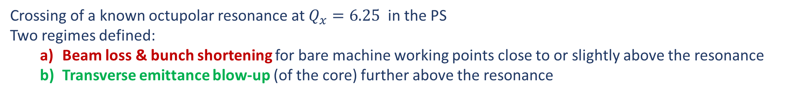
Impact on the beam
Crossing of a known octupolar resonance at $Q_{x}=6.25$ in the PS
Two regimes defined:
  Beam loss & bunch shortening for bare machine working points close to or slightly above the resonance
  Transverse emittance blow-up (of the core) further above the resonance
a
b
G. Franchetti et al. (2003)
E. Metral et al. (2006)

Slide 11
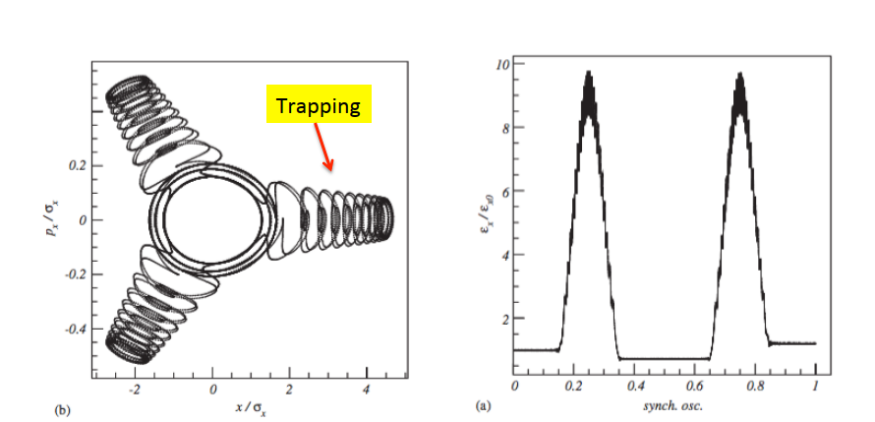
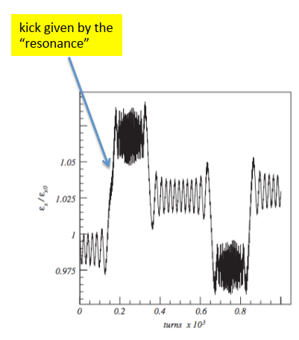
Impact on the beam
The dynamic process leading to these regimes of losses & blow-up in the presence of space charge was identified as the “periodic resonance crossing”. This arises from the longitudinal dependency of space charge.
As the tune modulates with the synchrotron period:
  particles approach a driven resonance
  The emittance (action) of the particles modulates when the particles are trapped in the resonance
  The process repeats with 2x the synchrotron oscillation period
  Alternatively, particles can get scattered instead of trapped, for fast synchrotron motion resulting in non-adiabatic crossing
This behaviour can be described with the incoherent space charge effects
scattering
G. Franchetti et al. (2003)
G. Franchetti, I. Hofmann (2006)

Slide 12
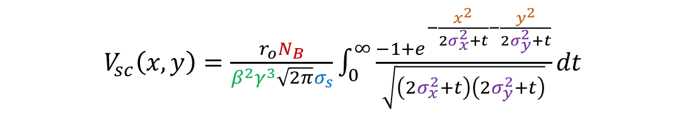
The incoherent approach
Study of individual particles under the influence of the collective space charge force
The analysis can be done using the Hamiltonian formalism
The collective space charge effect can be included in the Hamiltonian as a potential
  For Gaussian distributions in x,y & z, the potential is (S. Kheifets):
All the dependencies can be identified in the above equation:
  Transverse Action (Amplitude)
  Energy
  Transverse Beam Size
  Bunch Intensity
  Longitudinal Parameters/Action
$V_{sc}\left(x,y\right)=\frac{r_{o}N_{B}}{β^{2}γ^{3}\sqrt{2π}σ_{s}}\int_{0}^{∞}{\frac{−1+e^{−\frac{x^{2}}{2σ_{x}^{2}+t}−\frac{y^{2}}{2σ_{y}^{2}+t}}}{\sqrt{\left(2σ_{x}^{2}+t\right)\left(2σ_{y}^{2}+t\right)}}dt}$

Slide 13
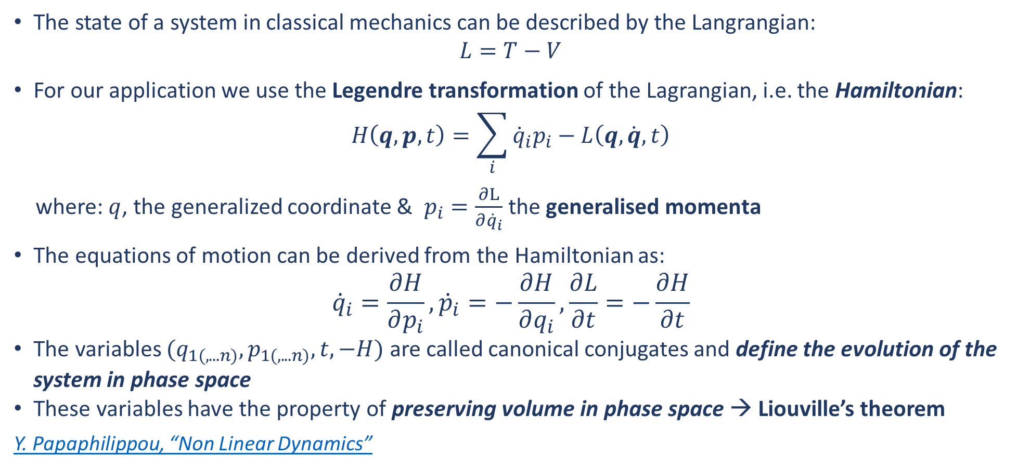
The Hamiltonian Formalism
The state of a system in classical mechanics can be described by the Langrangian:
$$L=T−V$$
For our application we use the Legendre transformation of the Lagrangian, i.e. the Hamiltonian:
$$H\left(q,p,t\right)=\sum_{i}{{\dot{q}}_{i}p_{i}}−L\left(q,\dot{q},t\right)$$
where: $q$, the generalized coordinate & $p_{i}=\frac{∂L}{∂{\dot{q}}_{i}}$the generalised momenta
The equations of motion can be derived from the Hamiltonian as:
$${\dot{q}}_{i}=\frac{∂H}{∂p_{i}},{\dot{p}}_{i}=−\frac{∂H}{∂q_{i}},\frac{∂L}{∂t}=−\frac{∂H}{∂t}$$
The variables $(q_{1(,...n)},p_{1(,...n)}, t, −H)$ are called canonical conjugates and define the evolution of the system in phase space
These variables have the property of preserving volume in phase space → Liouville’s theorem
Y. Papaphilippou, “Non Linear Dynamics”

Slide 14
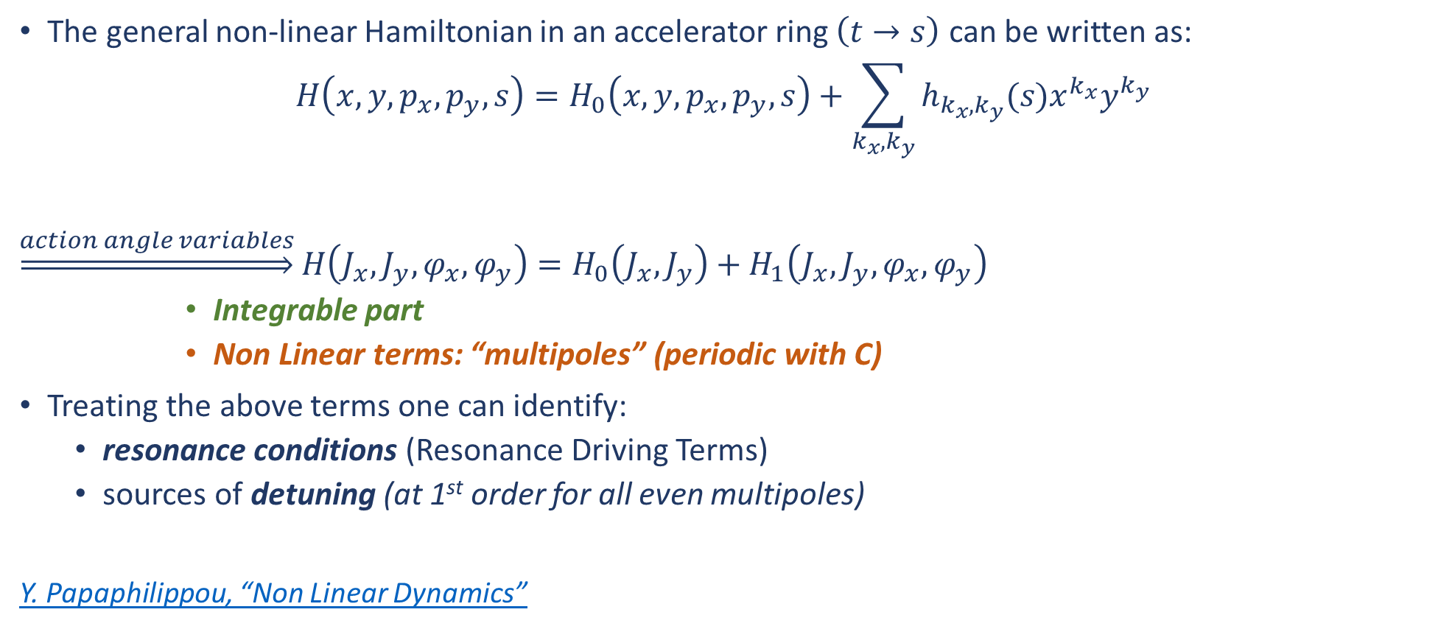
The Hamiltonian Formalism
The general non-linear Hamiltonian in an accelerator ring $\left(t→s\right)$ can be written as:
$$H\left(x,y,p_{x},p_{y},s\right)=H_{0}\left(x,y,p_{x},p_{y},s\right)+\sum_{k_{x},k_{y}}{h_{k_{x},k_{y}}(s)x^{k_{x}}y^{k_{y}}}$$
$\underset{⇒}{action angle variables}$ $H\left(J_{x},J_{y},φ_{x},φ_{y}\right)=H_{0}\left(J_{x},J_{y}\right)+H_{1}\left(J_{x},J_{y},φ_{x},φ_{y}\right)$
      Integrable part
      Non Linear terms: “multipoles” (periodic with C)
Treating the above terms one can identify:
  resonance conditions (Resonance Driving Terms)
  sources of detuning (at 1st order for all even multipoles)
Y. Papaphilippou, “Non Linear Dynamics”

Slide 15
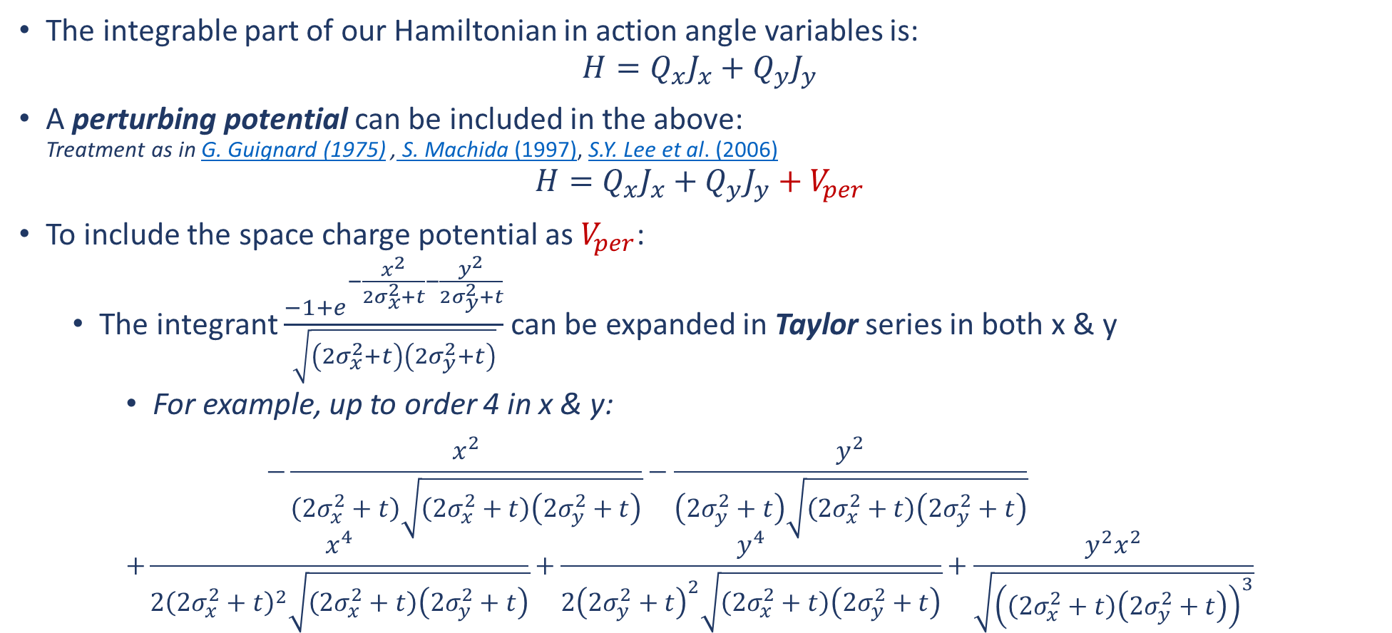
The Hamiltonian Formalism
The integrable part of our Hamiltonian in action angle variables is:
$$H=Q_{x}J_{x}+Q_{y}J_{y}$$
A perturbing potential can be included in the above:
Treatment as in G. Guignard (1975) , S. Machida (1997), S.Y. Lee et al. (2006)
$$H=Q_{x}J_{x}+Q_{y}J_{y}+V_{per}$$
To include the space charge potential as $V_{per}$:
  The integrant $\frac{−1+e^{−\frac{x^{2}}{2σ_{x}^{2}+t}−\frac{y^{2}}{2σ_{y}^{2}+t}}}{\sqrt{\left(2σ_{x}^{2}+t\right)\left(2σ_{y}^{2}+t\right)}}$ can be expanded in Taylor series in both x & y
    For example, up to order 4 in x & y:
    $$−\frac{x^{2}}{\left(2σ_{x}^{2}+t\right)\sqrt{\left(2σ_{x}^{2}+t\right)\left(2σ_{y}^{2}+t\right)}}−\frac{y^{2}}{\left(2σ_{y}^{2}+t\right)\sqrt{\left(2σ_{x}^{2}+t\right)\left(2σ_{y}^{2}+t\right)}}$$
    $$+\frac{x^{4}}{2{\left(2σ_{x}^{2}+t\right)}^{2}\sqrt{\left(2σ_{x}^{2}+t\right)\left(2σ_{y}^{2}+t\right)}}+\frac{y^{4}}{2{\left(2σ_{y}^{2}+t\right)}^{2}\sqrt{\left(2σ_{x}^{2}+t\right)\left(2σ_{y}^{2}+t\right)}}+\frac{y^{2}x^{2}}{\sqrt{{\left(\left(2σ_{x}^{2}+t\right)\left(2σ_{y}^{2}+t\right)\right)}^{3}}}$$

Slide 16
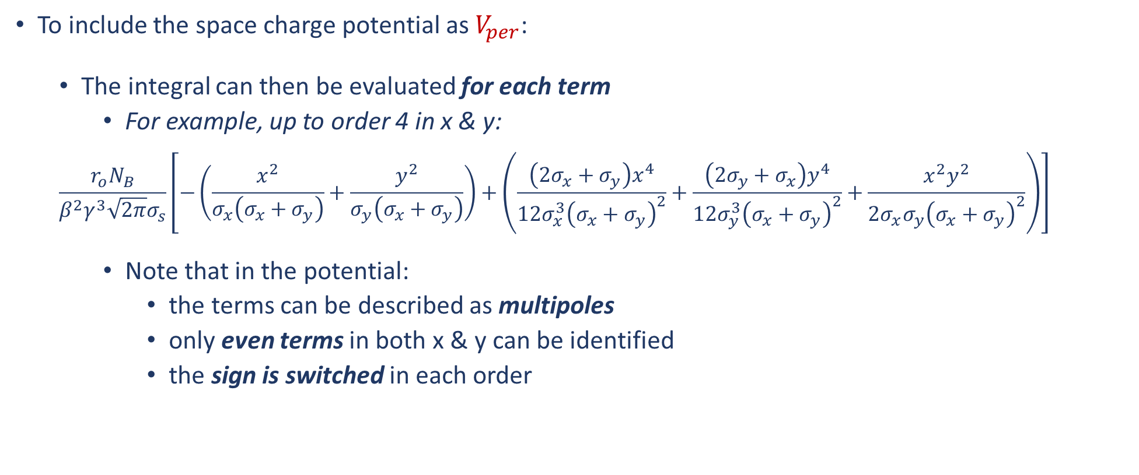
The Hamiltonian Formalism
To include the space charge potential as $V_{per}$:
  The integral can then be evaluated for each term
    For example, up to order 4 in x & y:
  $$\frac{r_{o}N_{B}}{β^{2}γ^{3}\sqrt{2π}σ_{s}}\left[−\left(\frac{x^{2}}{σ_{x}\left(σ_{x}+σ_{y}\right)}+\frac{y^{2}}{σ_{y}\left(σ_{x}+σ_{y}\right)}\right)+\left(\frac{\left(2σ_{x}+σ_{y}\right)x^{4}}{12σ_{x}^{3}{\left(σ_{x}+σ_{y}\right)}^{2}}+\frac{\left(2σ_{y}+σ_{x}\right)y^{4}}{12σ_{y}^{3}{\left(σ_{x}+σ_{y}\right)}^{2}}+\frac{x^{2}y^{2}}{{2σ_{x}σ_{y}\left(σ_{x}+σ_{y}\right)}^{2}}\right)\right]$$
    Note that in the potential:
      the terms can be described as multipoles
      only even terms in both x & y can be identified
      the sign is switched in each order

Slide 17
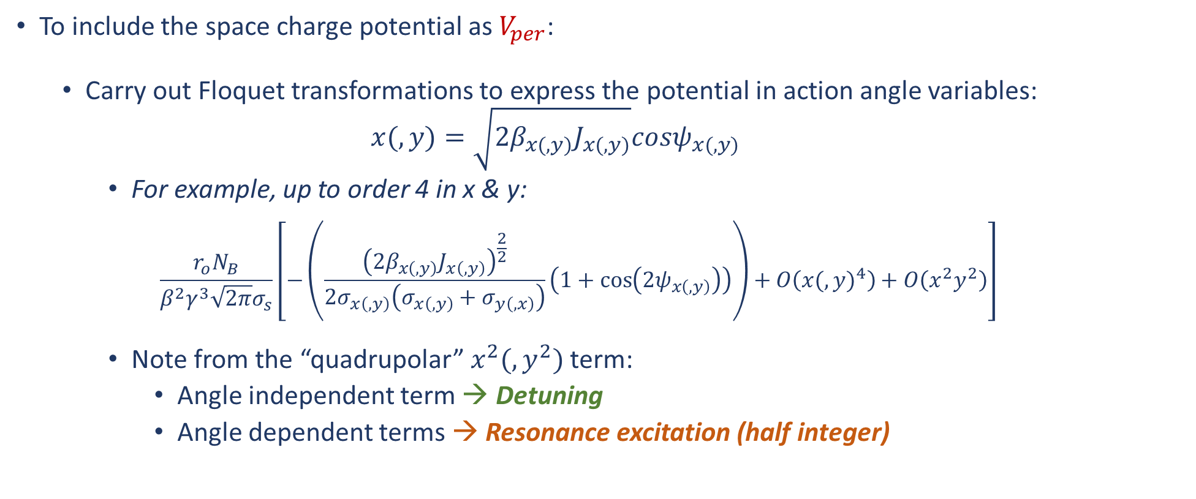
The Hamiltonian Formalism
To include the space charge potential as $V_{per}$:
  Carry out Floquet transformations to express the potential in action angle variables:
    $$x(,y)=\sqrt{2β_{x(,y)}J_{x(,y)}}cosψ_{x(,y)}$$
    For example, up to order 4 in x & y:
  $$\frac{r_{o}N_{B}}{β^{2}γ^{3}\sqrt{2π}σ_{s}}\left[−\left(\frac{{\left(2β_{x\left(,y\right)}J_{x\left(,y\right)}\right)}^{\frac{2}{2}}}{2σ_{x\left(,y\right)}\left(σ_{x\left(,y\right)}+σ_{y\left(,x\right)}\right)}\left(1+\cos\left({2ψ}_{x\left(,y\right)}\right)\right)\right)+O\left({x(,y)}^{4}\right)+O\left(x^{2}y^{2}\right)\right]$$
    Note from the “quadrupolar”$x^{2}(,y^{2})$ term:
      Angle independent term → Detuning
      Angle dependent terms → Resonance excitation (half integer)

Slide 18
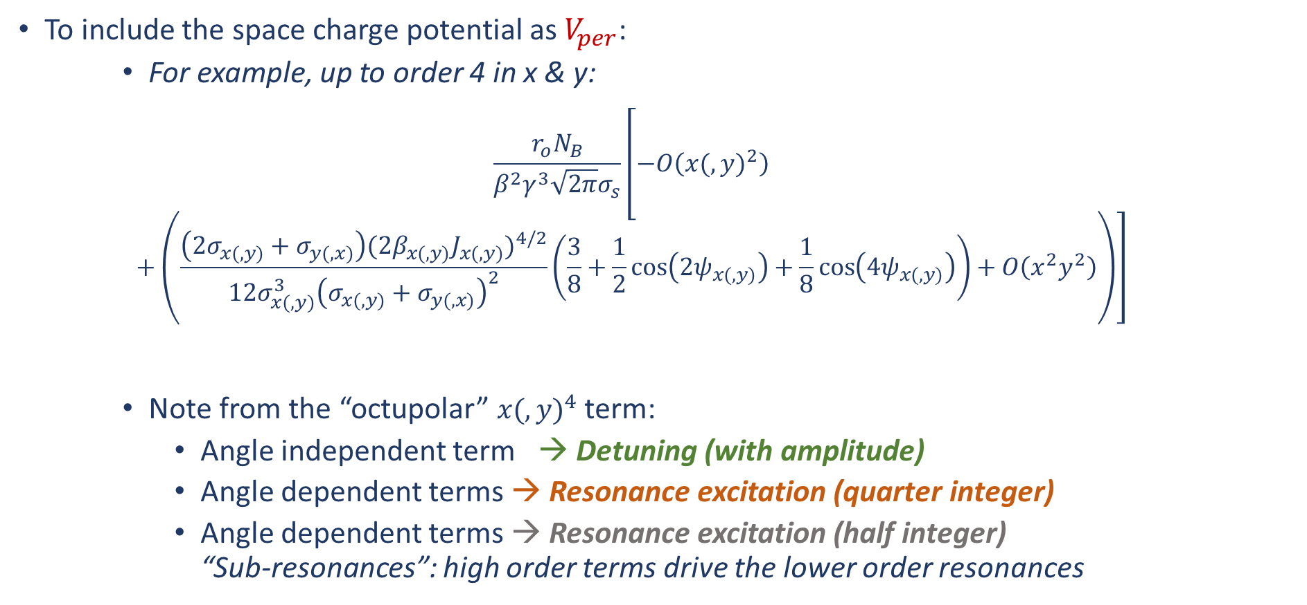
The Hamiltonian Formalism
To include the space charge potential as $V_{per}$:
    For example, up to order 4 in x & y:
  $$\frac{r_{o}N_{B}}{β^{2}γ^{3}\sqrt{2π}σ_{s}}\left[−O\left({x(,y)}^{2}\right)+\left(\frac{\left(2σ_{x(,y)}+σ_{y(,x)}\right){(2β_{x(,y)}J_{x(,y)})}^{4/2}}{12σ_{x(,y)}^{3}{\left(σ_{x(,y)}+σ_{y(,x)}\right)}^{2}}\left(\frac{3}{8}+\frac{1}{2}\cos\left({2ψ}_{x(,y)}\right)+\frac{1}{8}\cos\left({4ψ}_{x(,y)}\right)\right)+O\left(x^{2}y^{2}\right)\right)\right]$$
    Note from the “octupolar” ${x(,y)}^{4}$term:
      Angle independent term → Detuning (with amplitude)
      Angle dependent terms → Resonance excitation (quarter integer)
      Angle dependent terms → Resonance excitation (half integer)
      “Sub-resonances”: high order terms drive the lower order resonances

Slide 19
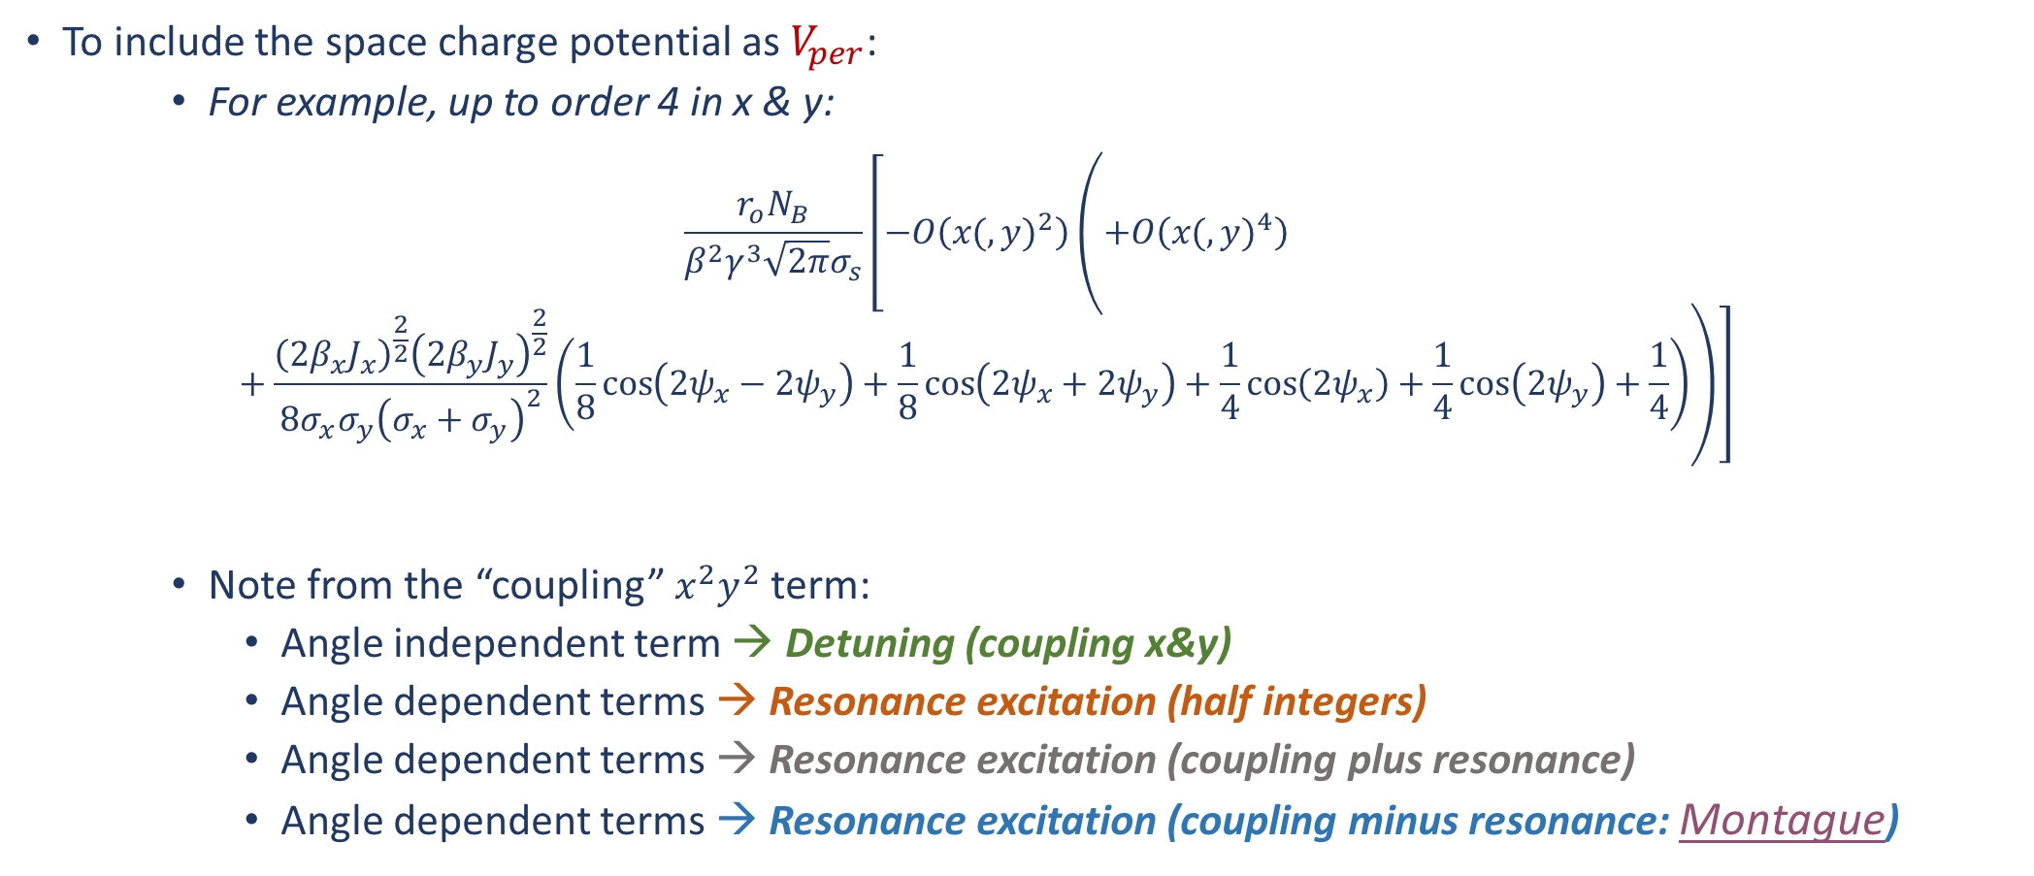
The Hamiltonian Formalism
To include the space charge potential as $V_{per}$:
    For example, up to order 4 in x & y:
  $$\frac{r_{o}N_{B}}{β^{2}γ^{3}\sqrt{2π}σ_{s}}\left[−O\left({x(,y)}^{2}\right)\left(+O\left({x(,y)}^{4}\right)+\frac{{\left(2β_{x}J_{x}\right)}^{\frac{2}{2}}{\left(2β_{y}J_{y}\right)}^{\frac{2}{2}}}{{8σ_{x}σ_{y}\left(σ_{x}+σ_{y}\right)}^{2}}\left(\frac{1}{8}\cos\left({2ψ}_{x}−{2ψ}_{y}\right)+\frac{1}{8}\cos\left({2ψ}_{x}+{2ψ}_{y}\right)+\frac{1}{4}\cos\left({2ψ}_{x}\right)+\frac{1}{4}\cos\left({2ψ}_{y}\right)+\frac{1}{4}\right)\right)\right]$$
    Note from the “coupling” $x^{2}y^{2}$ term:
      Angle independent term → Detuning (coupling x&y)
      Angle dependent terms → Resonance excitation (half integers)
      Angle dependent terms → Resonance excitation (coupling plus resonance)
      Angle dependent terms → Resonance excitation (coupling minus resonance: Montague)

Slide 20
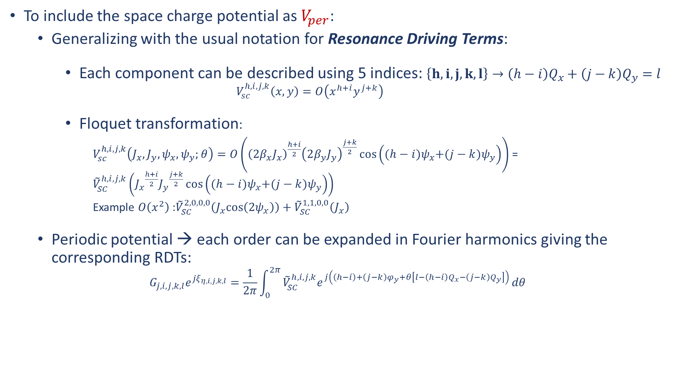
The Hamiltonian Formalism
To include the space charge potential as $V_{per}$:
  Generalizing with the usual notation for Resonance Driving Terms:
    Each component can be described using 5 indices: $\left\{h,i,j,k,l\right\}→{\left(h−i\right)Q}_{x}+{\left(j−k\right)Q}_{y}=l$
      $$V_{sc}^{h,i,j,k}\left(x,y\right)=O\left(x^{h+i}y^{j+k}\right)$$
    Floquet transformation:
      $V_{sc}^{h,i,j,k}\left(J_{x},J_{y},ψ_{x},ψ_{y};θ\right)=O\left({\left(2β_{x}J_{x}\right)}^{\frac{h+i}{2}}{\left(2β_{y}J_{y}\right)}^{\frac{j+k}{2}}\cos\left({(h−i)ψ}_{x}+{(j−k)ψ}_{y}\right)\right)$ = ${\tilde{V}}_{SC}^{h,i,j,k}\left({J_{x}}^{\frac{h+i}{2}}{J_{y}}^{\frac{j+k}{2}}\cos\left({(h−i)ψ}_{x}+{(j−k)ψ}_{y}\right)\right)$
      Example $O\left(x^{2}\right)$:${\tilde{V}}_{SC}^{2,0,0,0}\left(J_{x}cos\left({2ψ}_{x}\right)\right)+{\tilde{V}}_{SC}^{1,1,0,0}\left(J_{x}\right)$
  Periodic potential → each order can be expanded in Fourier harmonics giving the corresponding RDTs:
  $$G_{j,i,j,k,l}e^{{jξ}_{η,i,j,k,l}}=\frac{1}{2π}\int_{0}^{2π}{{\tilde{V}}_{SC}^{h,i,j,k}e^{j\left(\left(h−i\right)+\left(j−k\right)φ_{y}+θ\left[l−{\left(h−i\right)Q}_{x}−{\left(j−k\right)Q}_{y}\right]\right)}}dθ$$

Slide 21
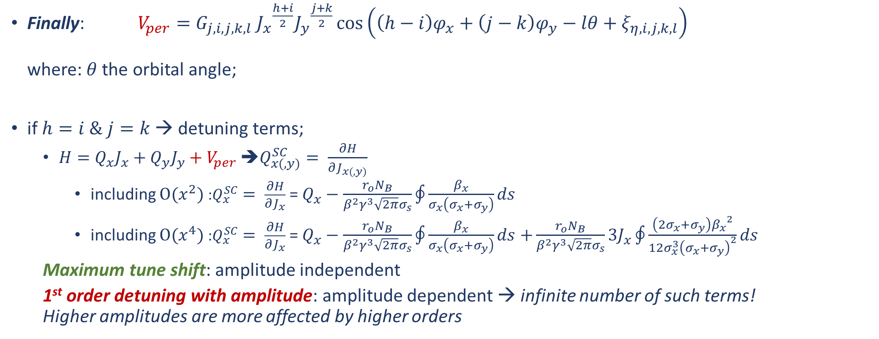
The Hamiltonian Formalism
Finally: $V_{per}=G_{j,i,j,k,l}$ ${J_{x}}^{\frac{h+i}{2}}{J_{y}}^{\frac{j+k}{2}}\cos\left({\left(h−i\right)φ}_{x}+{\left(j−k\right)φ}_{y}−lθ+ξ_{η,i,j,k,l}\right)$
where: $θ$the orbital angle;
if $h=i \& j=k$ → detuning terms;
  $H=Q_{x}J_{x}+Q_{y}J_{y}+V_{per}$ ➔$Q_{x(,y)}^{SC}= \frac{∂H}{∂J_{x(,y)}}$
    including $O(x^{2})$ :$Q_{x}^{SC}= \frac{∂H}{∂J_{x}}$ = $Q_{x}−\frac{r_{o}N_{B}}{β^{2}γ^{3}\sqrt{2π}σ_{s}}\oint{\frac{β_{x}}{σ_{x}\left(σ_{x}+σ_{y}\right)}ds}$
    including $O(x^{4})$ :$Q_{x}^{SC}= \frac{∂H}{∂J_{x}}$ = $Q_{x}−\frac{r_{o}N_{B}}{β^{2}γ^{3}\sqrt{2π}σ_{s}}\oint{\frac{β_{x}}{σ_{x}\left(σ_{x}+σ_{y}\right)}ds}$ $+\frac{r_{o}N_{B}}{β^{2}γ^{3}\sqrt{2π}σ_{s}}3J_{x}\oint{\frac{\left(2σ_{x}+σ_{y}\right){β_{x}}^{2}}{12σ_{x}^{3}{\left(σ_{x}+σ_{y}\right)}^{2}}ds}$
  Maximum tune shift: amplitude independent
  1st order detuning with amplitude: amplitude dependent → infinite number of such terms!
  Higher amplitudes are more affected by higher orders

Slide 22
The Hamiltonian Formalism: Summary
Including the space charge potential in the Hamiltonian:
    Angle dependent terms:
      Resonance excitation: {h,0,i,0,l}
      e.g. Octupole-like drives 4th order resonance
      “Sub-resonance” excitation: {h,i,j,k,l}
      e.g. Octupole-like drives 2nd order resonance
      Coupling resonances (plus & minus) included
    Angle independent terms:
      Detuning (shift)
      Detuning with amplitude
      Detuning (coupling x & y)
Tools based on this analytical approach can be used together with simulations to better understand the incoherent response of space charge.
Space charge driven resonances
Space charge tune spread

Slide 23
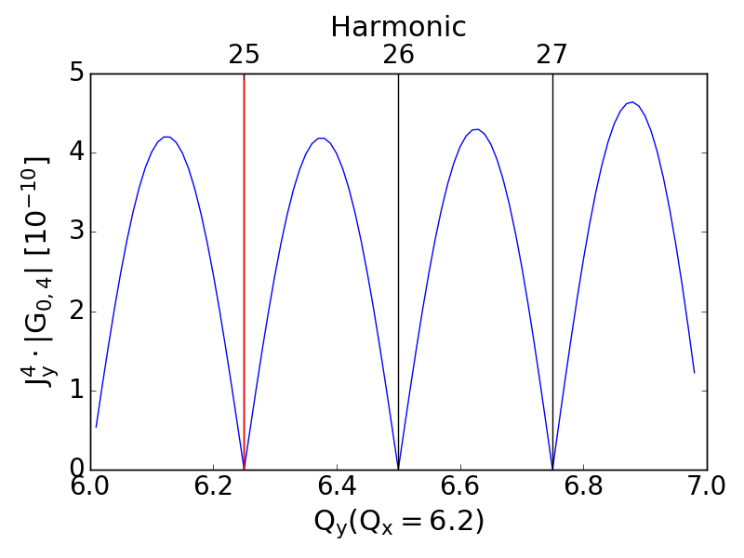
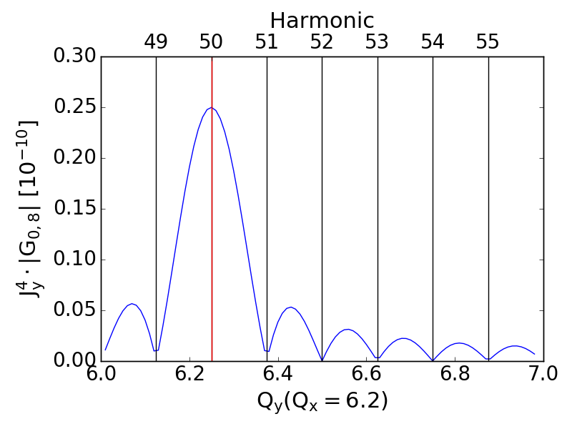
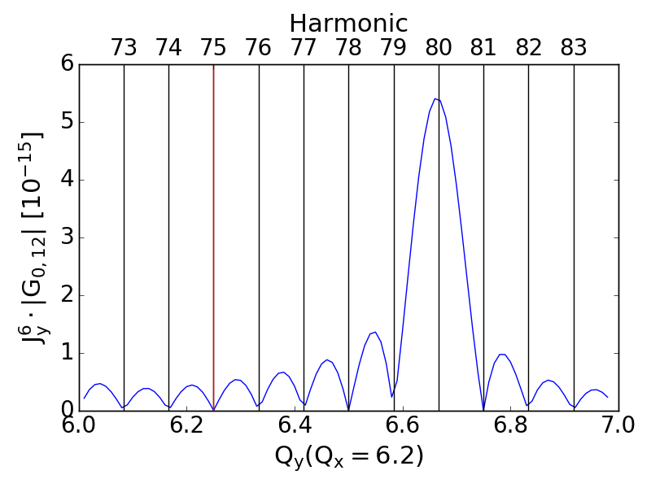
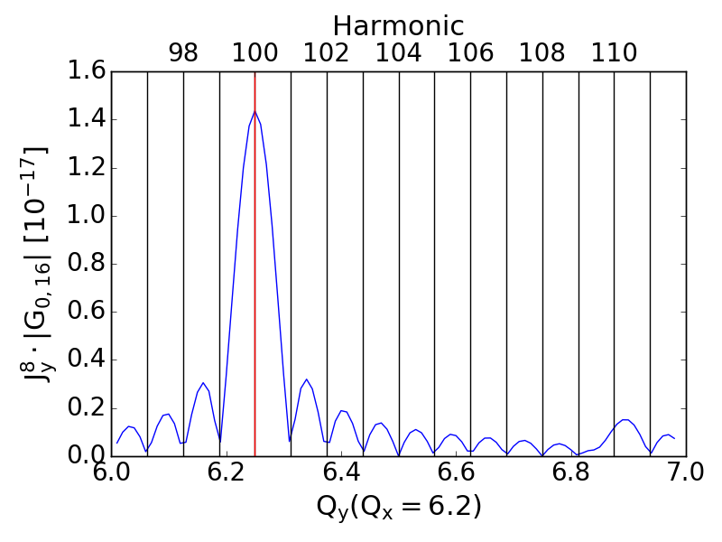

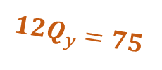

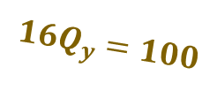
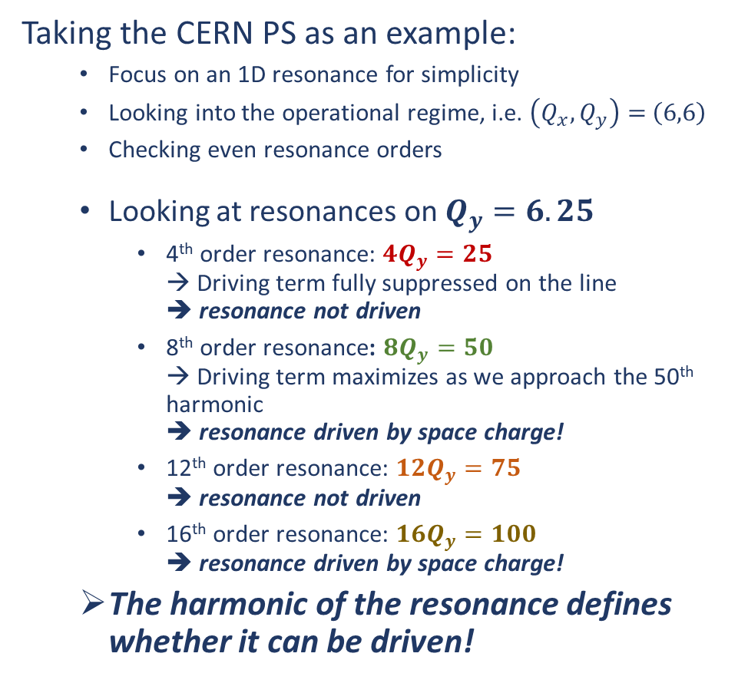
Space charge driven resonances
Taking the CERN PS as an example:
  Focus on an 1D resonance for simplicity
  Looking into the operational regime, i.e. $\left(Q_{x},Q_{y}\right)=$ $\left(6,6\right)$
  Checking even resonance orders
  Looking at resonances on $Q_{y}=6.25$
    4th order resonance: ${4Q}_{y}=25$
    → Driving term fully suppressed on the line
    ➔ resonance not driven
    8th order resonance: ${8Q}_{y}=50$
    → Driving term maximizes as we approach the 50th harmonic
    ➔ resonance driven by space charge!
    12th order resonance: ${12Q}_{y}=75$
    ➔ resonance not driven
    16th order resonance: ${16Q}_{y}=100$
    ➔ resonance driven by space charge!
  The harmonic of the resonance defines whether it can be driven!
${4Q}_{y}=25$
${8Q}_{y}=50$
${16Q}_{y}=100$
${12Q}_{y}=75$

Slide 24
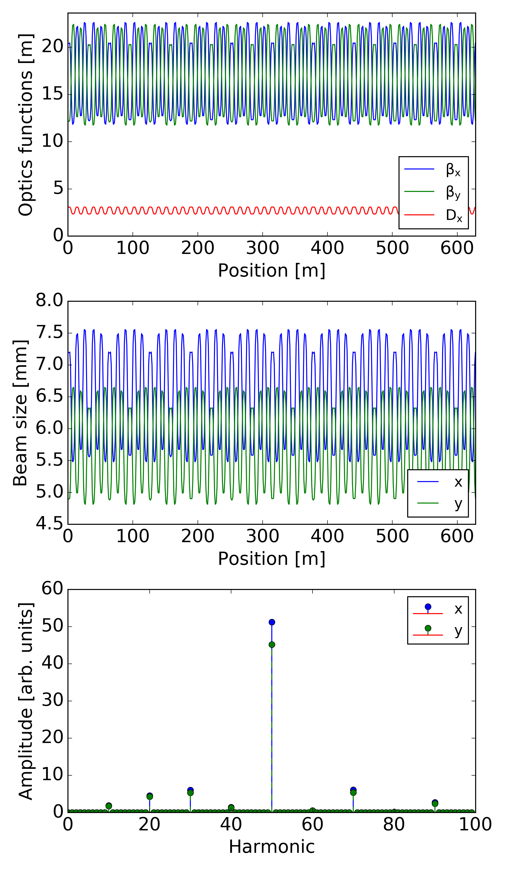
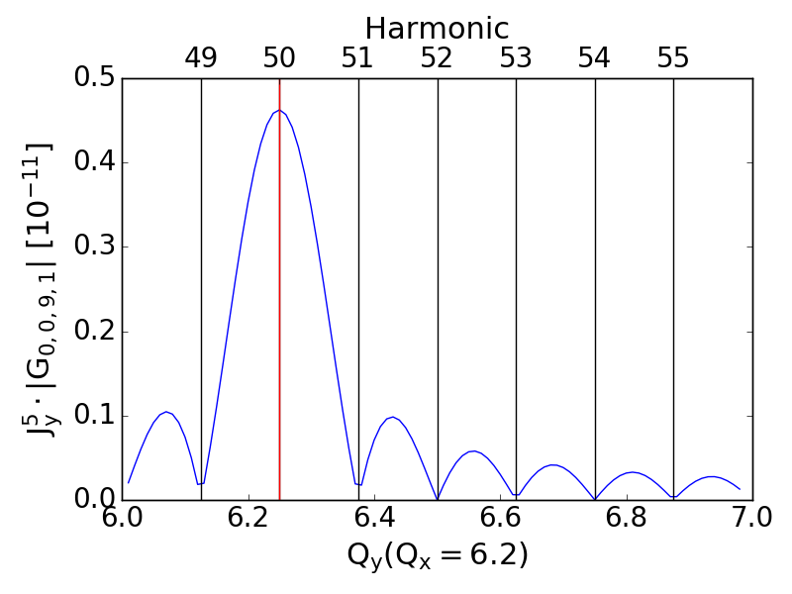




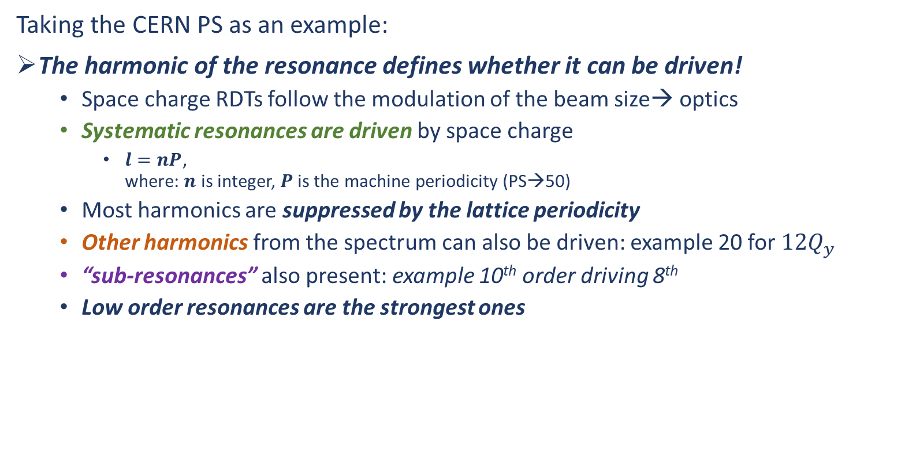
Space charge driven resonances
Taking the CERN PS as an example:
The harmonic of the resonance defines whether it can be driven!
  Space charge RDTs follow the modulation of the beam size→ optics
  Systematic resonances are driven by space charge
    $l=nP$,
    where: $n$ is integer, $P$ is the machine periodicity (PS→50)
  Most harmonics are suppressed by the lattice periodicity
  Other harmonics from the spectrum can also be driven: example 20 for ${12Q}_{y}$
  “sub-resonances” also present: example 10th order driving 8th
  Low order resonances are the strongest ones
${4Q}_{y}=25$
${8Q}_{y}=50$
${16Q}_{y}=100$
Sub-resonance
${12Q}_{y}=75$

Slide 25
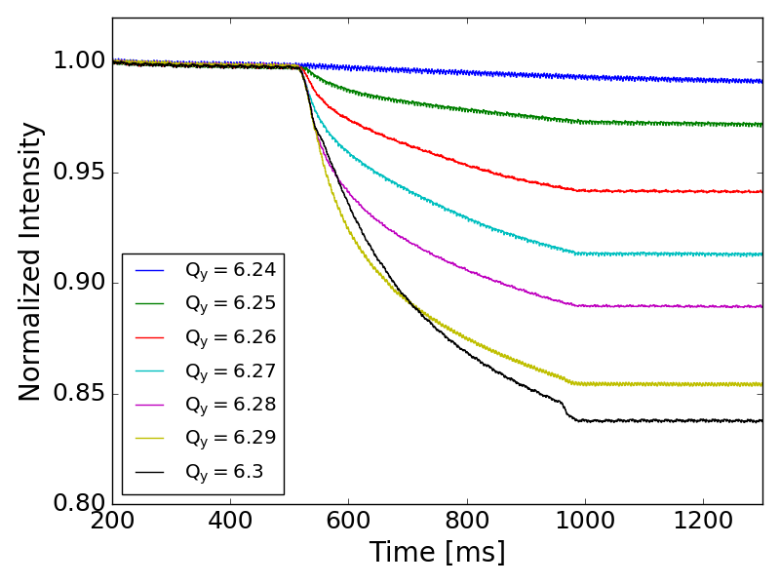
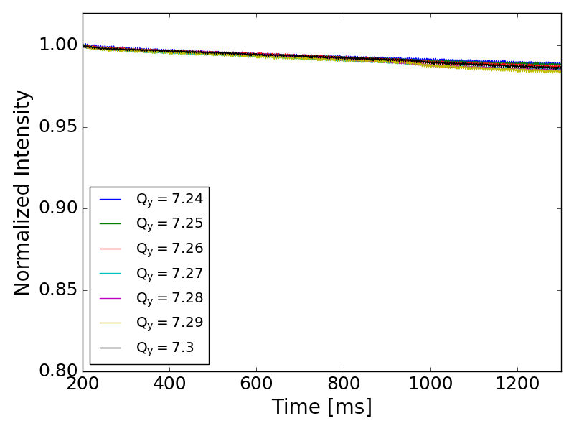
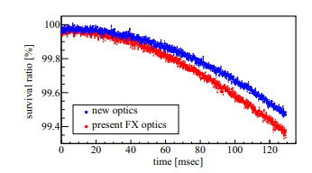


Space charge driven resonances: Mitigation
Space charge driven resonances:
  Can be very strong for high intensity & high brightness machines (dependency on beam characteristics)
  Can be of high order → no correctors available in most machines
  Change with the energy of the machine
  Can be experienced differently for each particle
Regular resonance compensation techniques cannot really be applied!
  Changing operational regime can mitigate losses
  PS: can be tested in MDs but cannot used operationally
  Modifying the optics (phase advance) to minimize the driving term
  JPARC: reduced resonance width by a factor 4
  → ~20% impact on measured losses
  T. Yasui, Y. Kurimoto (2022)
PS: $\left(6,6\right)$
PS: $\left(5,7\right)$
JPARC

Slide 26
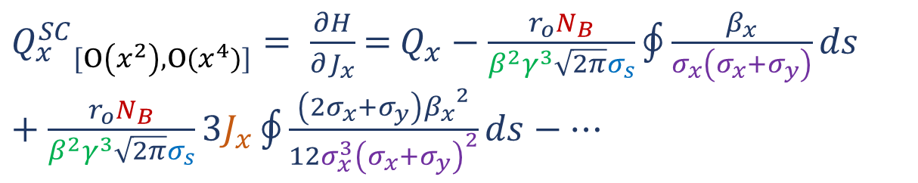
Space charge tune spread
The spread in the tunes is a result of all the detuning terms of the space charge potential:
  Detuning (shift)
  Detuning with amplitude
  Detuning (coupling x & y)
Contrary to space charge driven resonances the tune spread can cause issues in all machines in the presence of errors (lattice driven resonances)
The dependency of space charge on several parameters can be visualized through the treatment of the tune spread:
  Transverse Action (Amplitude)
  Energy
  Transverse Beam Size
  Bunch Intensity
  Longitudinal Parameters/Action
${Q_{x}^{SC}}_{[O\left(x^{2}\right),O(x^{4})]}= \frac{∂H}{∂J_{x}}$ = $Q_{x}−\frac{r_{o}N_{B}}{β^{2}γ^{3}\sqrt{2π}σ_{s}}\oint{\frac{β_{x}}{σ_{x}\left(σ_{x}+σ_{y}\right)}ds}$ $+\frac{r_{o}N_{B}}{β^{2}γ^{3}\sqrt{2π}σ_{s}}3J_{x}\oint{\frac{\left(2σ_{x}+σ_{y}\right){β_{x}}^{2}}{12σ_{x}^{3}{\left(σ_{x}+σ_{y}\right)}^{2}}ds}−…$

Slide 27
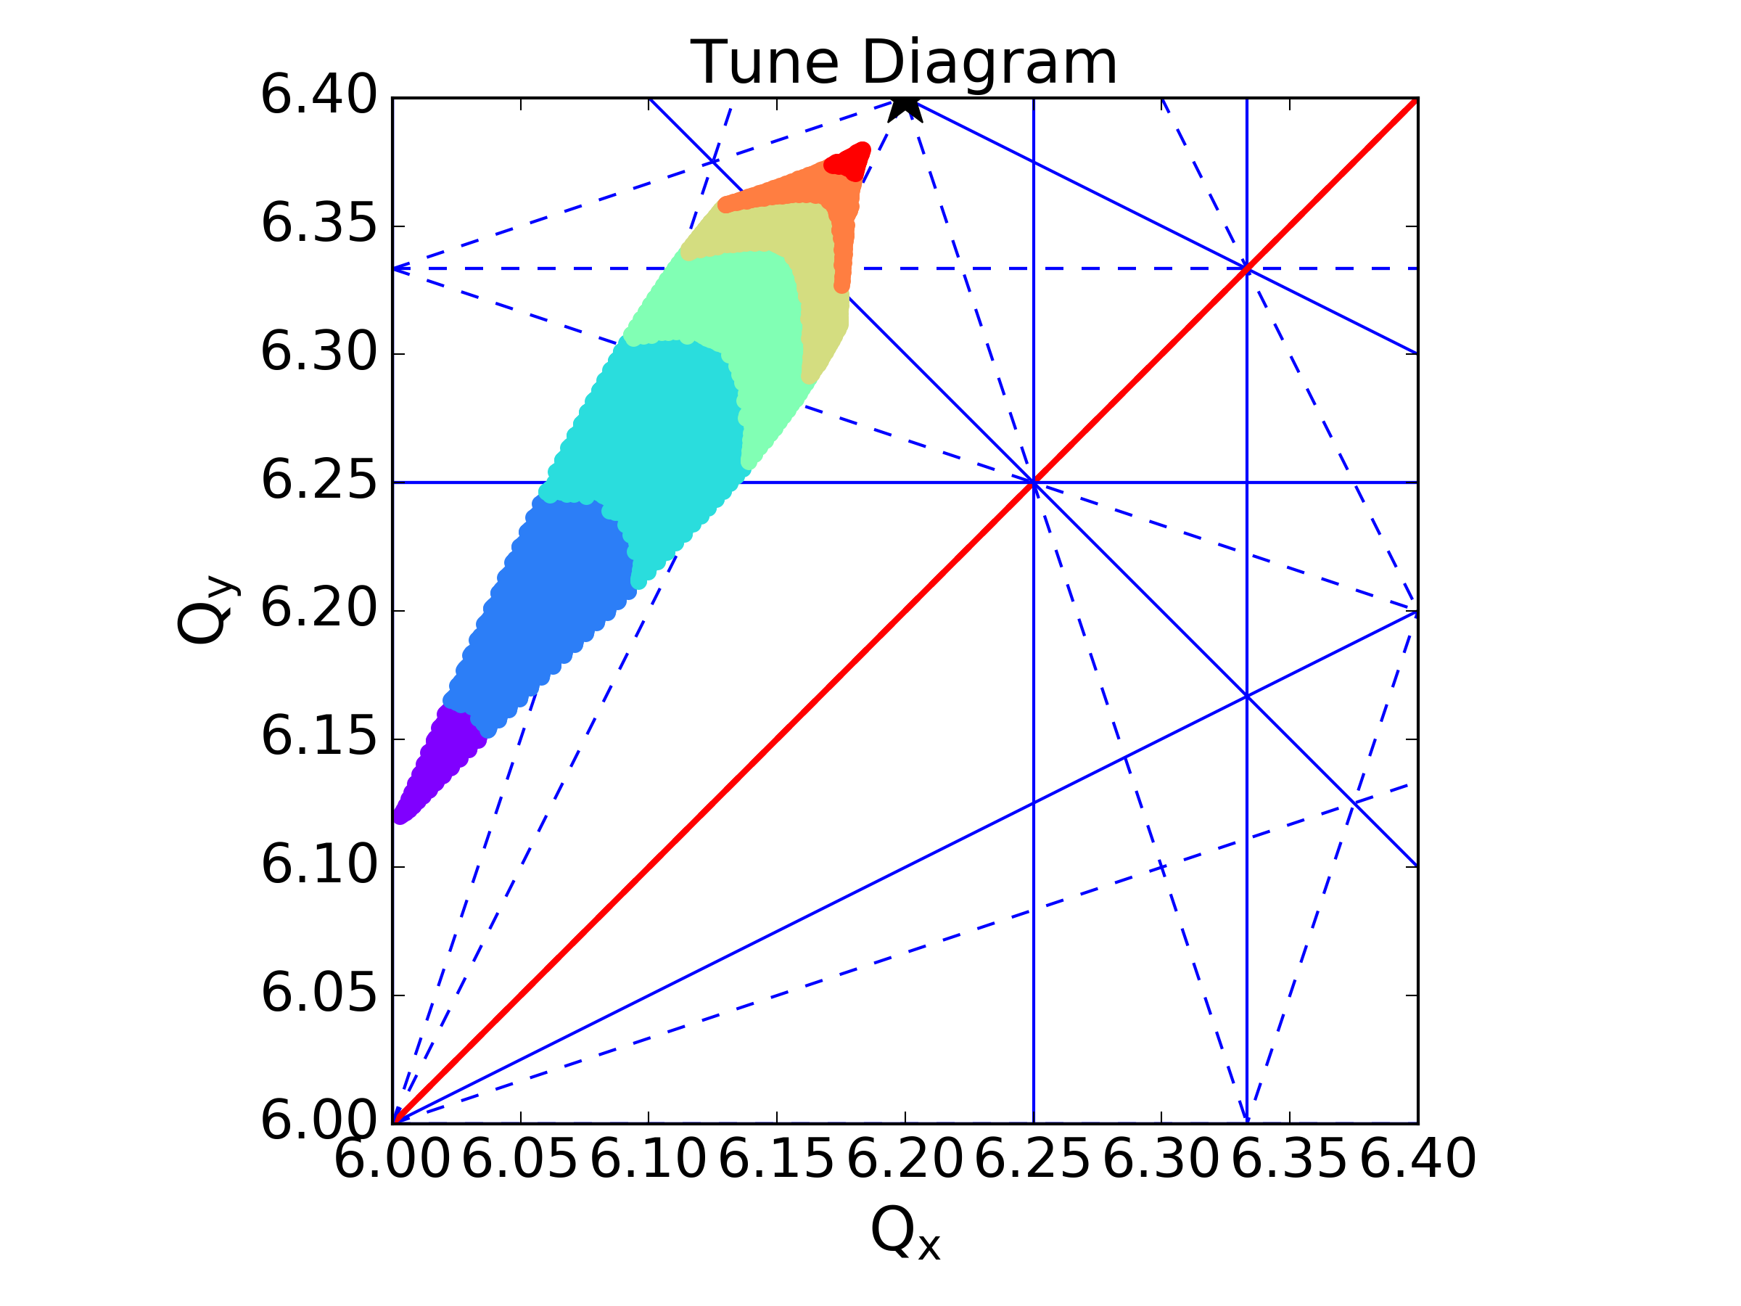
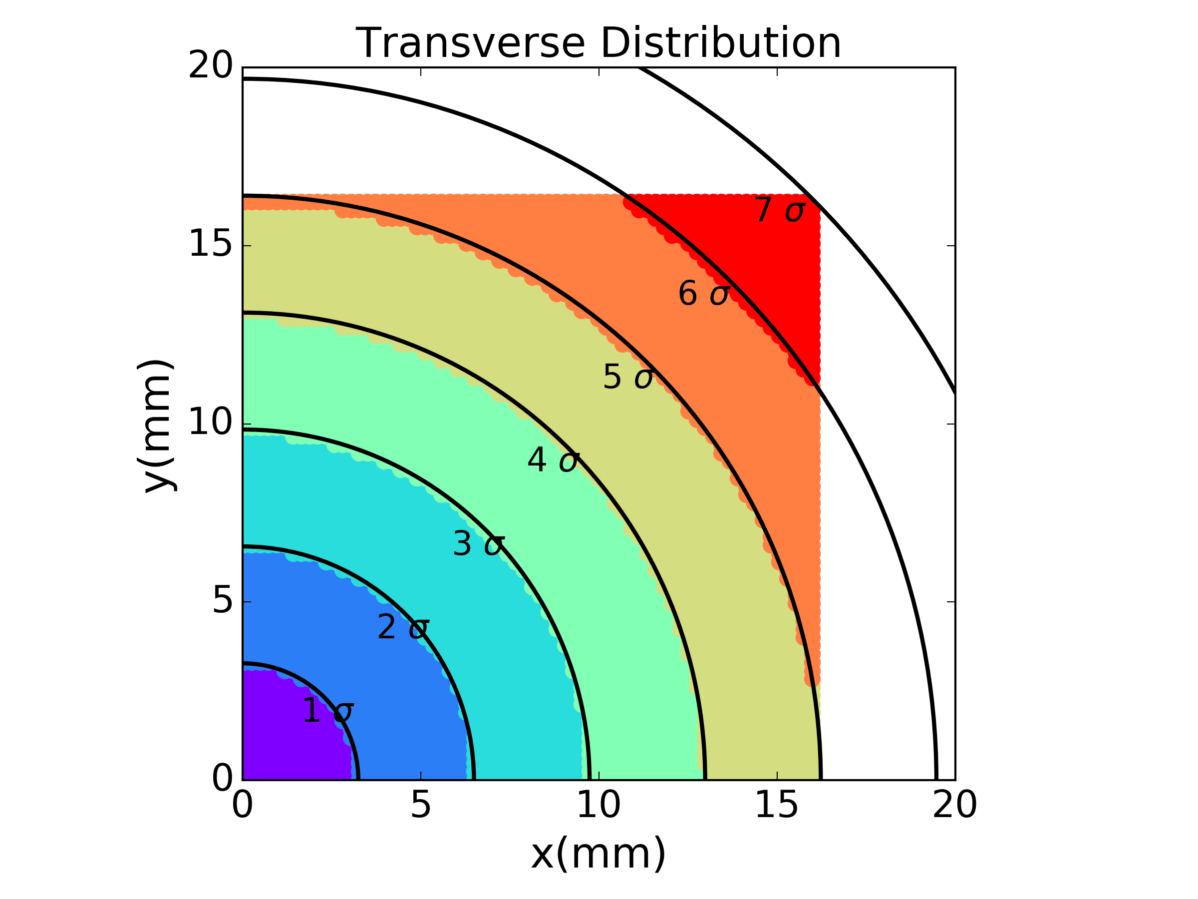
Space charge tune spread
Transverse Action (Amplitude)
  Low amplitude particles: maximum tune shift – dominated by the quadrupolar part
  High amplitude particles: tunes approaching set tune – dominated by the higher orders

Slide 28
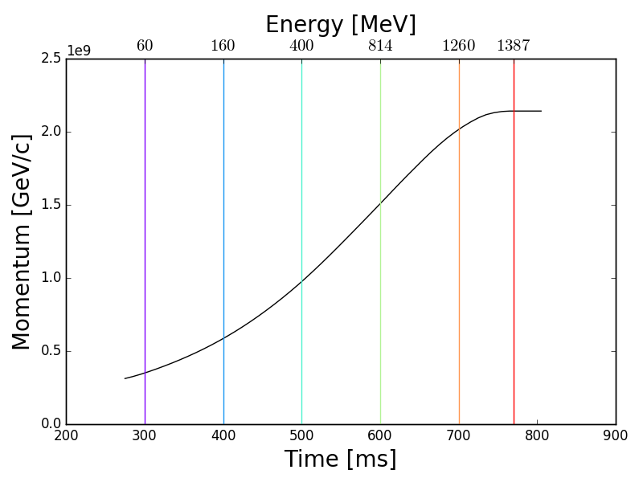
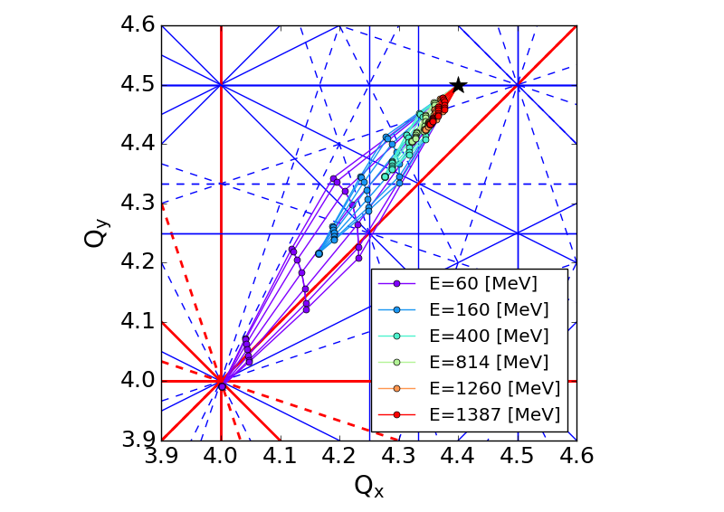
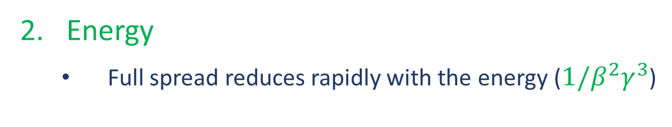
Space charge tune spread
Energy
  Full spread reduces rapidly with the energy (${1/β}^{2}γ^{3}$)

Slide 29
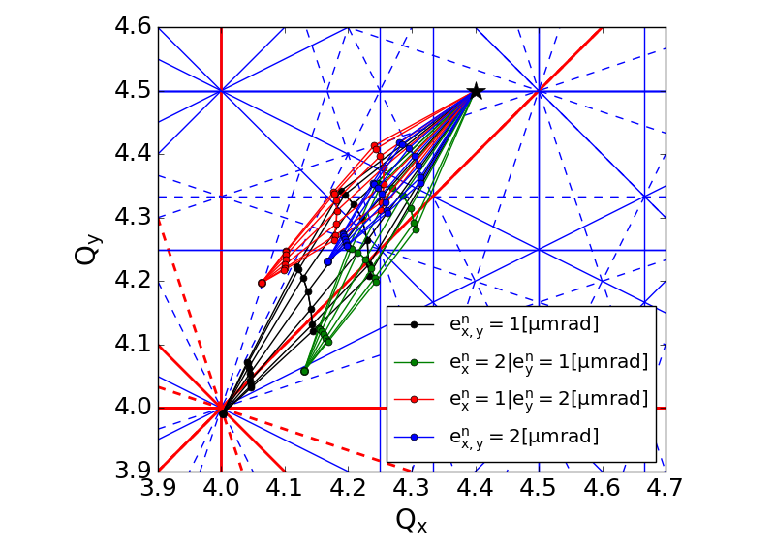
Space charge tune spread
Transverse Beam Size (/emittance)
  Change of the emittance in either plane affects the spread in both
  The orientation of the spread changes depending on the emittance ratios
Emittance x (mm mrad) | Emittance y (mm mrad)
1 | 1
2 | 1
1 | 2
2 | 2

Slide 30
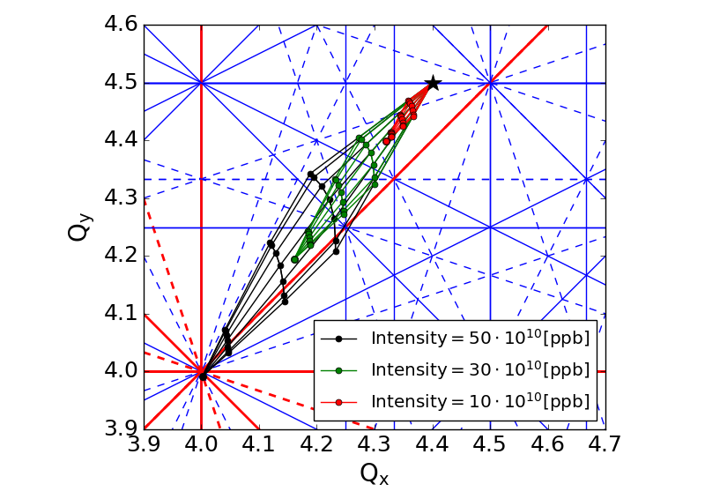
Space charge tune spread
Bunch Intensity
  Full spread scales with intensity
Intensity (10¹⁰ ppb)
50
30
10

Slide 31
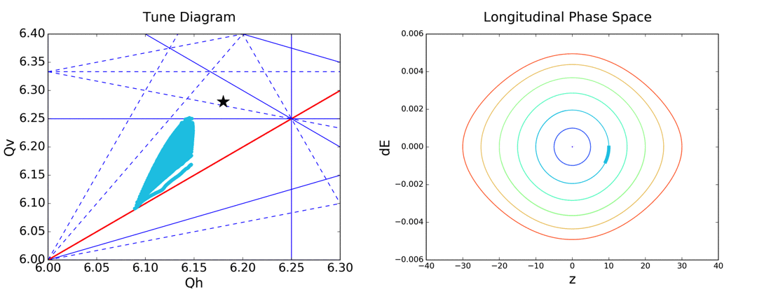
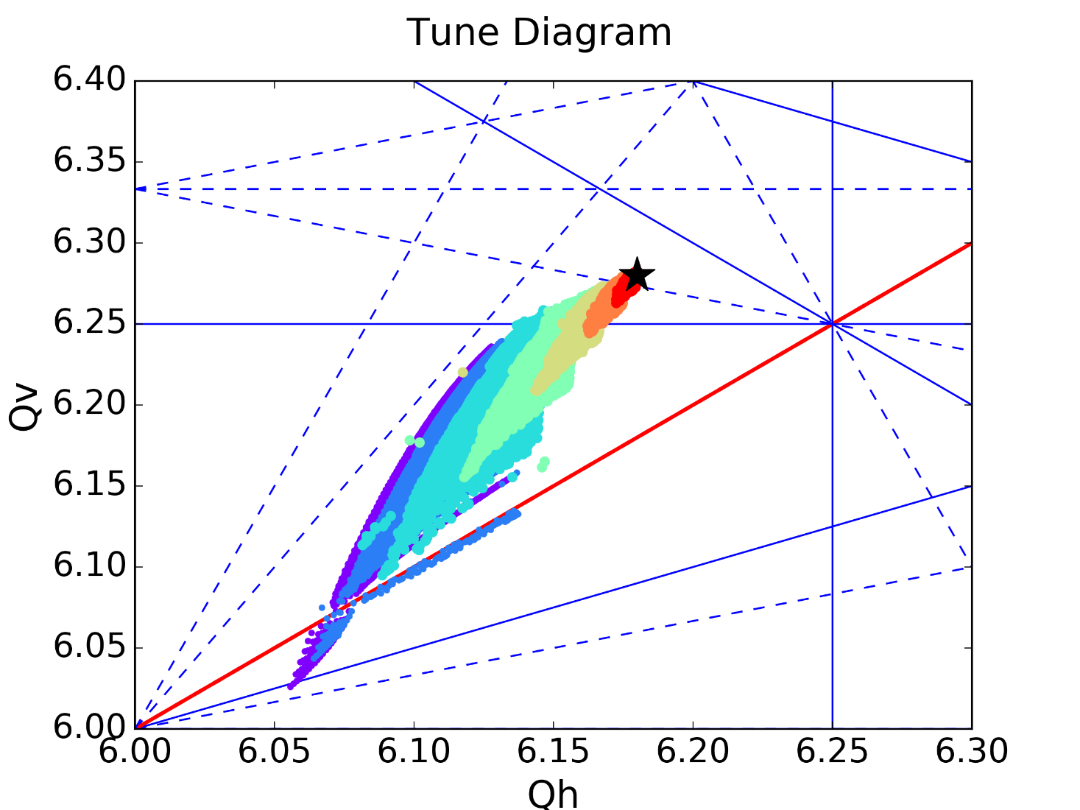



Space charge tune spread
Longitudinal Parameters/Action
  Full spread scales with the longitudinal action depending on the line density
  The full spread moves in the tune space depending on the synchrotron motion due to the line
  density modulation

Slide 32












Space Charge & Resonances
To identify the impact of a resonance (space charge or error driven) on particles :
  Tracking with space charge
  Working point in the vicinity of a driven resonance (1D for simplicity)
  Changing the tune ($Q_{y}$) we observe the phase space of the particles (up to 5σ)
  Starting below the resonance we increase the tune until the full tune spread is not affected by the resonance
Tune below the resonance
$Q_{y}=6.325$
  No particles affected
  No observations in the phase space
Single particle tunes below the resonance due to large tune suppression (space charge)
$Q_{y}=6.33−6.34$
  No particles affected
  No observations in the phase space
Spread overlapping resonance
$Q_{y}=6.345$
  High amplitude particles (~5σ) approaching
  the resonance
  Distortion of the phase space

Slide 33

























Space Charge & Resonances
To identify the impact of a resonance (space charge or error driven) on particles :
  Tracking with space charge
  Working point in the vicinity of a driven resonance (1D for simplicity)
  Changing the tune ($Q_{y}$) we observe the phase space of the particles (up to 5σ)
  Starting below the resonance we increase the tune until the full tune spread is not affected by the resonance
Spread overlapping resonance
$Q_{y}=6.35$
  High amplitude particles (~5σ) on the resonance
  Island formation in the phase space
$$Q_{y}=6.355$$
  More high amplitude particles on the resonance
  More particles trapped on the islands
$$Q_{y}=6.36−6.44$$
  Different particles on the resonance
  Islands moving towards the centre
  Islands get smaller

Slide 34










Space Charge & Resonances
To identify the impact of a resonance (space charge or error driven) on particles:
  Tracking with space charge
  Working point in the vicinity of a driven resonance (1D for simplicity)
  Changing the tune ($Q_{y}$) we observe the phase space of the particles (up to 5σ)
  Starting below the resonance we increase the tune until the full tune spread is not affected by the resonance
Spread overlapping resonance
$Q_{y}≥6.445$
  Low amplitude particles on the resonance
  Islands even closer to the centre & smaller
  → no longer distinguishable in the plot

Slide 35


Space Charge & Resonances
To identify the impact of a resonance (space charge or machine driven) on particles:
  Tracking with space charge
  Working point in the vicinity of a driven resonance (1D for simplicity)
  Changing the tune ($Q_{y}$) we observe the phase space of the particles (up to 5σ)
  Starting below the resonance we increase the tune until the full tune spread is not affected by the resonance
As the tune increases
  Resonant islands move inwards closer to the centre
  Islands grow smaller
  Less particles trapped moving towards low amplitudes
  Tune ↑ - Islands ↓

Slide 36

Space Charge & Resonances
To identify the impact of a resonance (space charge or machine driven) on particles:
  Tracking with space charge
  Working point in the vicinity of a driven resonance (1D for simplicity)
  Changing the tune ($Q_{y}$) we observe the phase space of the particles (up to 5σ)
  Starting below the resonance we increase the tune until the full tune spread is not affected by the resonance
As the tune decreases
  Resonant islands move outwards
  Islands grow larger
  More particles trapped moving towards high amplitudes
  Tune ↓ - Islands ↑

Slide 37





Space Charge & Resonances: “loss & blow-up regime”
1
2
3
4
Almost no particles are crossing the resonance
Particles at the edge of the bunch cross the resonance → HIGH LOSSES
Particles closer to the centre of the distribution cross the resonance → FEW LOSSES AND LARGE BLOW UP
Particles at the core of the bunch on the resonance → RESIDUAL BLOW UP

Slide 38



Space Charge & Resonances: “loss & blow-up regime”
Overlapping resonances with the lower part of the tune spread, i.e. the core of the beam
significant emittance blow-up
Tune spread shrinks until it’s above the resonance
Emittance blow-up
Tail content only slightly affected

Slide 39



Space Charge & Resonances: “loss & blow-up regime”
Overlapping resonances with the upper part of the tune spread, i.e. the tails of the beam
Losses and(/or) transverse tails population
Particles “pushed” above the resonance
Large transverse tails are formed

Slide 40
Space Charge & Resonances: “Periodic crossing”
As the tune increases
  Resonant islands move inwards closer to the centre
  Islands grow smaller
  Less particles trapped moving towards low amplitudes
  Tune ↑ - Islands ↓
As the tune decreases
  Resonant islands move outwards
  Islands grow larger
  More particles trapped moving towards high amplitudes
  Tune ↓ - Islands ↑
Space charge modulates the tunes of the particles through the synchrotron motion making them go from one regime to the other

Slide 41



Space Charge & Resonances: “Periodic crossing”
Ideally we expect the tune to modulate with the synchrotron motion as the line density changes
Tune modulated as expected from space charge & the synchrotron motion
→No observation in the phase space
Crossing the resonance the particle gets scattered
→Phase space distorted
Tune away from the resonance
Scattering again during crossing
Tune away from the resonance
Trapping on the resonance (sc, δp/p ↑)
→Islands in phase space move outwards
Trapping on the resonance (sc, δp/p ↓)
→Islands in phase space move inwards
Ideal
The process repeats over several synchrotron periods leading to losses of trapped/scattered particles
Ideal

Slide 42


Space Charge & Resonances: Mitigation
Operating in a large space charge tune spread regime can lead to periodic resonance crossing and:
  Limit the maximum brightness
  Limit the intensity
  Complicate the choice for working point
Dependency on energy:
  New/upgraded injector (Linac or ring) to increase injection energy
  example: LIU project at CERN:
  Linac 4 (160 MeV) from Linac 2 (50 MeV)
  → ~ 2x gain in brightness for the PSB!
  Higher ramp rate
  → Space charge tune spread shrinks faster, limiting the time the particles spend in high space charge regime

Slide 43





Space Charge & Resonances: Mitigation
Operating in a large space charge tune spread regime can lead to periodic resonance crossing and:
  Limit the maximum brightness
  Limit the intensity
  Complicate the choice for working point
Dependency on longitudinal parameters
  Manipulation of the line density modifying the RF bucket:
    Including higher order harmonics the bucket elongates
    The line density is reduced
  Space charge tune spread is minimized!
  Operationally deployed or studied in several machines like: J-PARC RCS, CERN PSB, Fermilab Booster, CSNS RCS
S. Albright et al.

Slide 44




Space Charge & Resonances: Mitigation
Operating in a large space charge tune spread regime can lead to periodic resonance crossing and:
  Limit the maximum brightness
  Limit the intensity
  Complicate the choice for working point
Resonance compensation
  The effects can also be mitigated by correcting the errors driving resonances:
    Through loss measurements (CERN-PSB)
    Through RDT measurements
    (C. E. Gonzalez-Ortiz (2023))
  Losses from resonances suppressed using suitable corrector magnets for a full region or for certain resonances
CERN-PSB
Fermilab recycler

Slide 45
Space Charge Simulations
Simulations including space charge are essential for low-energy, high-brightness rings:
During the design phase to identify potential limitations
(space charge driven resonances, “space charge limit” etc)
During regular operations to optimize beam conditions according to requirements and improve the non-linear model of the machine (including errors etc)
Space Charge Solvers
Particle In Cell
Analytical or “Frozen”

Slide 46
Space Charge Simulations
Space Charge Solvers
The field is evaluated using the Poisson equation on a grid
The evaluation is done:
  Every turn
  In several locations on the lattice
  For several longitudinal “slices” (3D)
  Projected on a single longitudinal slice & then scaled with the line density (2.5D)
The space charge “kicks” are then applied on the corresponding particles every time
Particle In Cell
Computationally expensive
(large number of macroparticles required)
Noise effects on the grid
(I. Hofmann and O. Boine-Frankenheim, 2014)
Halo formation can introduce errors
(especially for 3D due to small number of particles in certain cells)
Indirect space charge can be included including boundary conditions
Both coherent & incoherent response of the beam can be studied
Self-consistent

Slide 47

Space Charge Simulations
Space Charge Solvers
Solver using the Basseti Erskine formula describing electric field for bi-Gaussian charge distribution
Similar treatment to the analytical approach we showed today
The evaluation is done using macroscopic beam characteristics:
  Transverse emittances, intensity, ${{Δp}/p}_{rms}$, peak line density and the lattice functions at each lattice location
  The longitudinal line density used for scaling
  The evaluation can be updated over certain number of turns
Analytical or “Frozen”
Only direct space charge is modeled
Only incoherent effects can be studied
Non-Gaussian distributions cannot be included
Not self-consistent
Can overestimate the effects in case of fast changes
(losses or blow-up compared to update)
Incoherent nonlinear behaviour can be described
Fast simulation times
Even sample particles can be tracked

Slide 48
Space Charge Simulations
Space Charge Solvers
Particle In Cell
Analytical or “Frozen”
Both solvers can be valuable for space charge studies, and the choice depends on each specific case:
Examples for PIC:
Simulating processes for which space charge changes in very short time scale
(Multi-turn injection, interaction with strong, low-order resonances)
Studies of coherent effects
Examples for Analytical:
Characterization of nonlinear incoherent effects (like FMAs etc)
Simulations of long storage times

Slide 49
Summary
Space charge refers to the effects developing due to the moving particles of the bunch
  Direct: charges in free space
  Indirect: interaction with the beam surroundings (perfect conducting vacuum chambers, magnet poles)
Dominant effect for low-energy, high-brightness operations
From the incoherent perspective:
  Space charge can drive systematic resonances
  Space charge introduces significant tune spread
Operations in a space charge dominated regime in the presence of resonances
  Different regions of losses and emittance blow-up can be identified in the tune space
  Periodic resonance crossing through the synchrotron period is the mechanism leading to losses and/or emittance blow-up
Simulations with space charge can be conducted using different solvers depending on applications:
  PIC: can describe the full effects but can be computationally expensive
  Analytic: only an approximation for Gaussian bunches but can be very useful for understanding the non-linear effects

Slide 50
Thank you!
Many thanks to:
H. Bartosik, G. Franchetti, K. Li, Y. Papaphilippou

Slide 51
References
Courses:
K. Li, “Collective effects”, CAS 2024
G. Rumolo, H. Bartosik & K. Li, “Space charge”, USPAS 2015
G. Franchetti, “Space Charge in Circular Machines”, CAS 2015
Y. Papaphilippou, “Non Linear Dynamics”, CAS 2024
Other material:
L. J. Laslett, 1963 eConf C630610 324
B. W. Montague, 1968 CERN-68-38
G. Guignard, 1975 CERN-ISR-MA-75-23
S. Kheifets, 1976 PETRA Note 119
M. Bassetti and G. A. Erskine, 1980 CERN-ISR-TH-80-06
S. Machida, 1997 Nucl. Instrum. Methods Phys. Res., Sect. A 384, 316
K. Schindl, 1999 CERN-PS-99-012-DI.
G. Franchetti, I. Hofmann, M. Giovannozzi, M. Martini, and E. Métral, 2003 Phys Rev. ST Accel. Beams 6, 124201
S. Y. Lee, G. Franchetti, I. Hofmann, F. Wang, and L. Yang, 2006 New J. Phys. 8, 291
E. Métral, G. Franchetti, M. Giovannozzi, I. Hofmann, M. Martini, and R. Steerenberg, 2006 Nucl. Instrum. Methods Phys. Res., Sect. A 561, 257
G. Franchetti and I. Hofmann, 2006 Nucl. Instrum. Methods Phys. Res., Sect. A 561, 195
I. Hofmann and O. Boine-Frankenheim, 2014 Phys. Rev. ST Accel. Beams 17, 124201
F. Asvesta, H. Bartosik, 2019 CERN-ACC-NOTE-2019-0046 (code)
F. Asvesta, H. Bartosik, S. Gilardoni, A. Huschauer, S. Machida, Y. Papaphilippou, and R. Wasef, 2020 Phys. Rev. Accel. Beams 23, 091001
F. Asvesta, S. Albright, F. Antoniou, H. Bartosik, C. Bracco, G. P. Di Giovanni, E. H. Maclean, B. Mikulec, T. Prebibaj , E. Renner, 2021 HB2021
T. Yasui and Y. Kurimoto, 2022 PhysRevAccelBeams.25.121001
S. Albright, F. Asvesta, L. Kennedy, 2022 5th ICFA Mini-Workshop on Space Charge
F. Asvesta, S. Albright, H. Bartosik, C. Bracco, G. P. Di Giovanni, T. Prebibaj, 2023 HB2023
C. E. Gonzalez-Ortiz, P. N. Ostroumov , R. Ainsworth, 2023 HB2023

Slide 52
Back-up

Slide 53

The Hamiltonian Formalism
To include the space charge potential as $V_{per}$:
  For off-momentum particles & in the presence of dispersion
    The Floquet transformation:
    $$x=\sqrt{2β_{x}J_{x}}cosψ_{x}+D\frac{Δp}{p}$$
    For example, the order $O\left(x^{2}\right)$:
  $$\left[−\left(\frac{1}{2σ_{x}\left(σ_{x}+σ_{y}\right)}\left({\left(2β_{x}J_{x}\right)}^{\frac{2}{2}}+2{\left(D\frac{Δp}{p}\right)}^{2}+{\left(2β_{x}J_{x}\right)}^{\frac{2}{2}}cos\left({2ψ}_{x}\right)+4\sqrt{2β_{x}J_{x}}D\frac{Δp}{p}cosψ_{x}\right)\right)\right]$$
    Note for from the “quadrupolar” $x^{2}$ term :
      Angle independent term → Detuning (shift)
      Angle dependent terms → Resonance excitation (half integers)
      Angle dependent terms → Resonance excitation (integer)
      off-momentum & dispersion leads to Feed-Down & odd order resonances!

Slide 54




Tune Spread
Simulation Data
Simulation Data & Analytical Estimation
Dependency on transverse amplitude (action)
Tracking of on-momentum $\left({Δp}/p=0\right)$ test particles
The tunes are calculated from the turn-by-turn data and color-coded with the initial transverse positions
Perfect agreement between the analytical calculations (PySCRDT) and the simulations
Justifies the use of the space charge potential as a perturbation on the linear Hamiltonian
Potentials up to 20th order used, higher amplitudes require more orders
The detuning is maximum for the lowest amplitude particles
Spread of the tunes on a large diamond like shape in the tune space,
Space charge footprint

Slide 55





Indirect effect on resonances
a
b
a
b
  Space charge defines two different regions
    Losses regime
    Blow-up regime
Space charge strength (Brightness) affects:
Distance of highest losses from resonance
Width of resonance effect
Impact of the resonance on the beam observables

Slide 56





Resonances: Machine Periodicity
Non-Systematic Resonance
3rd Order Skew Resonance
$$3Q_{v}$$
$$3∗4.3\overline{3}=13$$
$16$ cells
Representation of the kick (orientation and amplitude) of each individual skew sextupole

Slide 57




Resonances: Machine Periodicity
Systematic Resonance
3rd Order Skew Resonance
$$3Q_{v}$$
$$3∗5.3\overline{3}=16$$
$16$ cells
Representation of the kick (orientation and amplitude) of each individual skew sextupole

Slide 58



Resonance Compensation – individual
We monitor particles for multiple turns mapping out the horizontal phase space
Color code: d (diffusion) chaos indicator
Driven resonance
Formation of 4 islands
Corrector settings
Formation of 4 islands with a different orientation
Compensation (resonance+correctors)
Island formation suppressed

Slide 59


Resonance compensation in the PSB
1. Natural Excitation
3. Corrector currents scan
Experimentally identify optimal configuration
Provide compensation values for all resonances & rings
4. Corrections Applied
2. Resonance Driving Terms
For each resonance observed:
Calculate RDTs
using MADX-PTC
Identify suitable corrector pairs

Slide 60
Resonance Compensation
To compensate any resonance one would have to know the vector (RDT) that characterizes it and create the opposite one using the available magnets in the lattice.
If the vector is not known the resonance can be compensated by this procedure:
Identify the resonances of interest
Choose the magnets that are most effective for the correction
Blow-up the emittances to disentangle resonant effects and space charge
Dynamically cross the resonance
Scan the currents of the magnets to minimize the losses

Slide 61










Space Charge & Resonances
To identify the impact of a resonance (error driven same behaviour for sc driven):
  Tracking with space charge
  Working point in the vicinity of a driven resonance (1D for simplicity)
  Changing the tune ($Q_{y}$) we observe the phase space of the particles (up to 5σ)
  Starting below the resonance we increase the tune until the full tune spread is not affected by the resonance
Tune below the resonance
$Q_{y}=6.245$
  No particles affected
  No observations in the phase space
Single particle tunes below the resonance due to large tune suppression (space charge)
$Q_{y}=6.25−6.255$
  No particles affected
  No observations in the phase space
Spread overlapping resonance
$Q_{y}=6.26$
  High amplitude particles (~5σ) approaching
  the resonance
  Distortion of the phase space

Slide 62



















Space Charge & Resonances
To identify the impact of a resonance (space charge or machine driven) on particles:
  Tracking with space charge
  Working point in the vicinity of a driven resonance (1D for simplicity)
  Changing the tune ($Q_{y}$) we observe the phase space of the particles (up to 5σ)
  Starting below the resonance we increase the tune until the full tune spread is not affected by the resonance
Spread overlapping resonance
$Q_{y}=6.26$5
  High amplitude particles (~5σ) on the resonance
  Island formation in the phase space
$$Q_{y}=6.27$$
  More high amplitude particles on the resonance
  More particles trapped on the islands
$$Q_{y}=6.275−6.335$$
  Different particles on the resonance
  Islands moving towards the centre
  Islands get smaller

Slide 63









Space Charge & Resonances
To identify the impact of a resonance (space charge or machine driven) on particles:
  Tracking with space charge
  Working point in the vicinity of a driven resonance (1D for simplicity)
  Changing the tune ($Q_{y}$) we observe the phase space of the particles (up to 5σ)
  Starting below the resonance we increase the tune until the full tune spread is not affected by the resonance
Spread overlapping resonance
$Q_{y}≥6.34$
  Low amplitude particles on the resonance
  Islands even closer to the centre & smaller
  → no longer distinguishable in the plot

Slide 64


Space Charge & Resonances
To identify the impact of a resonance (space charge or machine driven) on particles:
  Tracking with space charge
  Working point in the vicinity of a driven resonance (1D for simplicity)
  Changing the tune ($Q_{y}$) we observe the phase space of the particles (up to 5σ)
  Starting below the resonance we increase the tune until the full tune spread is not affected by the resonance
As the tune increases
  Resonant islands move inwards closer to the centre
  Islands grow smaller
  Less particles trapped moving towards low amplitudes
  Tune ↑ - Islands ↓
As the tune decreases
  Resonant islands move outwards
  Islands grow larger
  More particles trapped moving towards high amplitudes
  Tune ↓ - Islands ↑

