Slide 1

Fixed Field Alternating Gradient Accelerator FFA
Mike Seidel
Paul Scherrer Institute and EPFL, Switzerland
CERN Accelerator School – Specialised Course
June 20, 2025
Borovets Bulgaria
S. Machida et. al.
Nature Physics 8, 243–247 (2012)

Slide 2
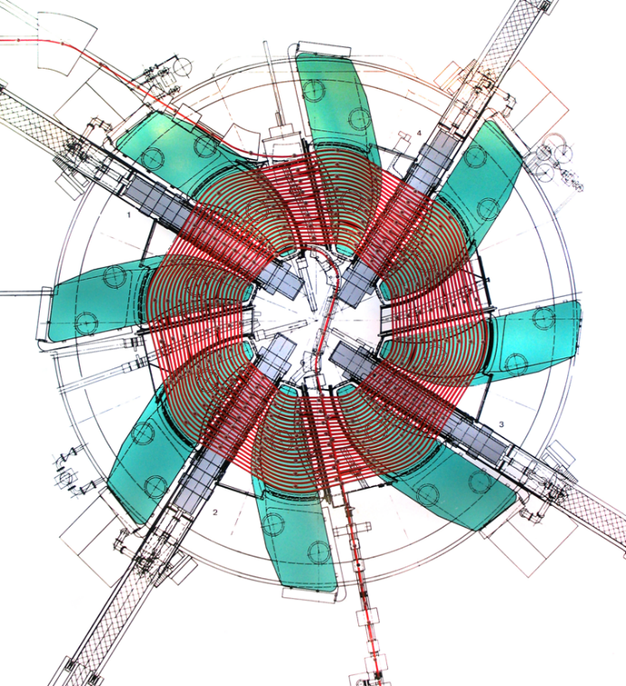
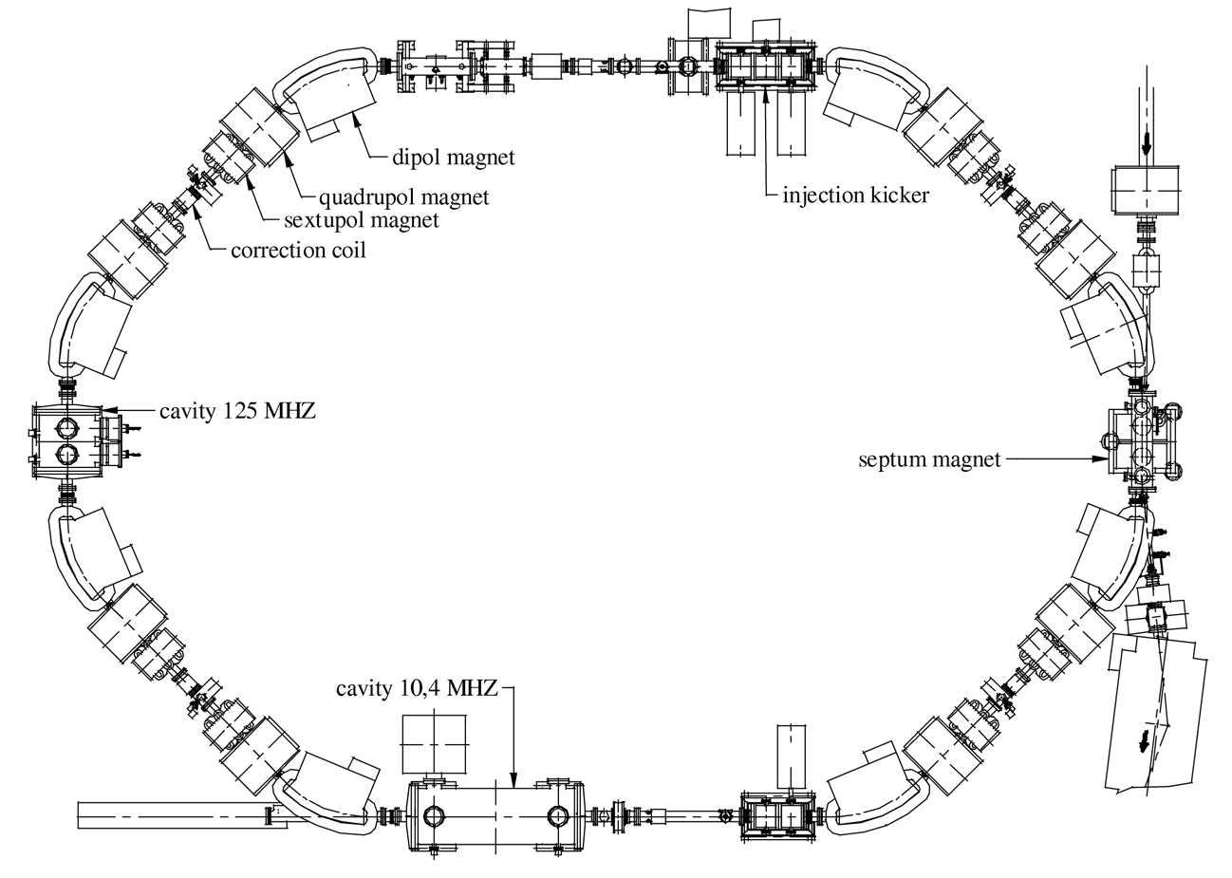
A Circular Accelerator in-between Cyclotron and Synchrotron
FFA
?
synchrotron
cyclotrotron

Slide 3
Fixed Field Alternating Gradient Accelerator (FFA) and the challenge of high intensity
the ideal high intensity accelerator is a circular machine with small orbit motion (compactnes / economy) without any cycling (continuous beam)
 | Magnets | Radiofrequency | Focusing
Cyclotron | no cycling | no cycling | weak, AVF
FFA | no cycling | cycling (most schemes) | strong, AG
Synchrotron | cycling | cycling (if low E₀) | strong, AG

Slide 4
Fixed Field Alternating Gradient Accelerator (FFA)
isochr. cyclotron: no cycling, intense CW beam
repetition rate
FFA: fast cycling of RF frequency ∼ kHz
synchrotron: slow cycling of magnets, ≤ ∼ 50Hz
FFA:
… a concept in-between cyclotron and synchrotron; FFA = FFAG
strong focusing (a. gradient) compared to cyclotrons (flutter & edge focusing)
constant magnet strength over time, but frequency often ramped
types of FFA: different scaling of field index k with particular implications …
applications: particle therapy, muon acceleration, high intensity
motivation FFA: high intensity, large transverse + longitudinal acceptance

Slide 5
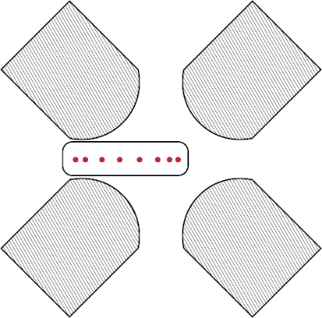
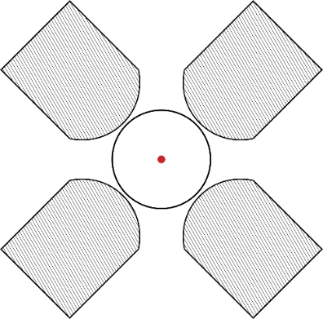
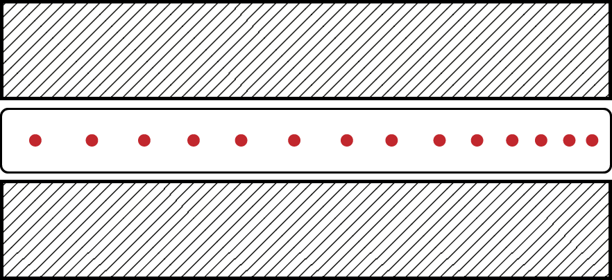
Cyclotron, FFA, Synchrotron – Qualitative Comparison
 | AVF Cyclotron | FFA | Synchrotron
orbit variation? | large | small | none
main focusing mechanism? | edge focusing | alternate gradient | alternate gradient
magnets ramped? | no | no | yes
frequency ramped? | no | yes, no in some designs | no
section sketch

Slide 6
FFA developments over time
1956: Symon, Kerst et al (US), Ohkawa (JP), Kolomensky (SU)
1950-60: MURA Group (Mid-western Universities Research Association), electron models
from 2003: Y.Mori et al, Univ. Kyoto proton accelerators
recently: EMMA electron model non-scaling FFA in Daresbury
MURA 50 MeV electron model
20 MeV booster & 150MeV main ring, Kyoto University
EMMA: 10-20 MeV electron linear non-scaling FFA

Slide 7
Scaling FFA
concept
circulation time

Slide 8
scaling FFA
invariance of field index k
and
similarity of closed orbits
invariance of betatron oscillations
combined function magnet lattice with longer F magnet
self similar closed orbits during acceleration process
[courtesy M.Craddock]

Slide 9
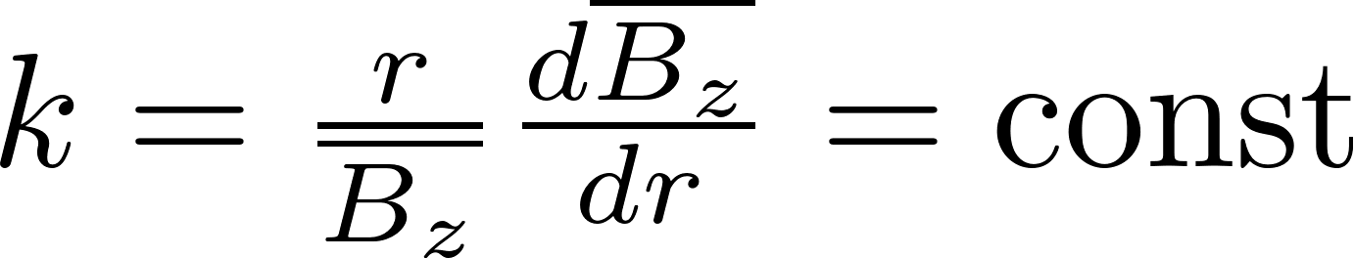
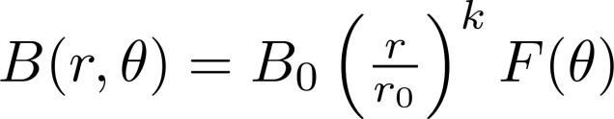
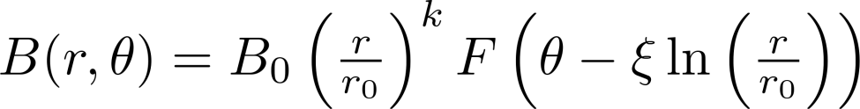
scaling FFA (cont.)
idea: keep field index k constant
const tune, no resonance crossing
zero chromaticity, large acceptance
but not isochronous, need f-sweep !
field index
sector type
spiral type, ξ = spiral angle

Slide 10
How large is the required change in RF frequency / circulation time during the course of acceleration?
reminder on longitudinal dynamics aspects (common to synchrotrons):
dispersive orbits → path length vs momentum → momentum compaction factor α_{c}
circulation time vs momentum → path length and relativistic velocity → slippage factor η_{c}
.. and relation RF frequency / circulation time = harmonic number h
arrive at relation of frequency/energy cycle with field index k as parameter
… next slides

Slide 11
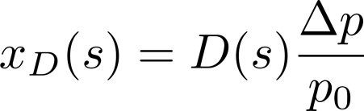
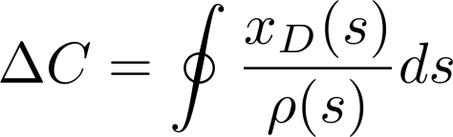
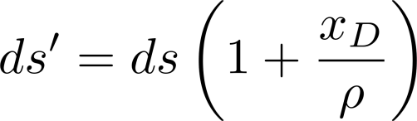

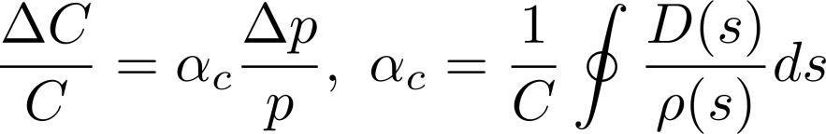
Path Length Change with Momentum
for an off-momentum particle the path length changes; consider a particle on a closed dispersion trajectory, i.e. no betatron oscillation: J=0, but Δp ≠0
the change in circumference for this particle is:
x
ρ
we introduce the momentum compaction factor α_{c}:
see Wiedemann sec. 8.4.6

Slide 12
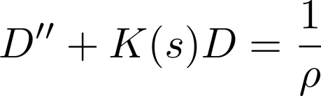
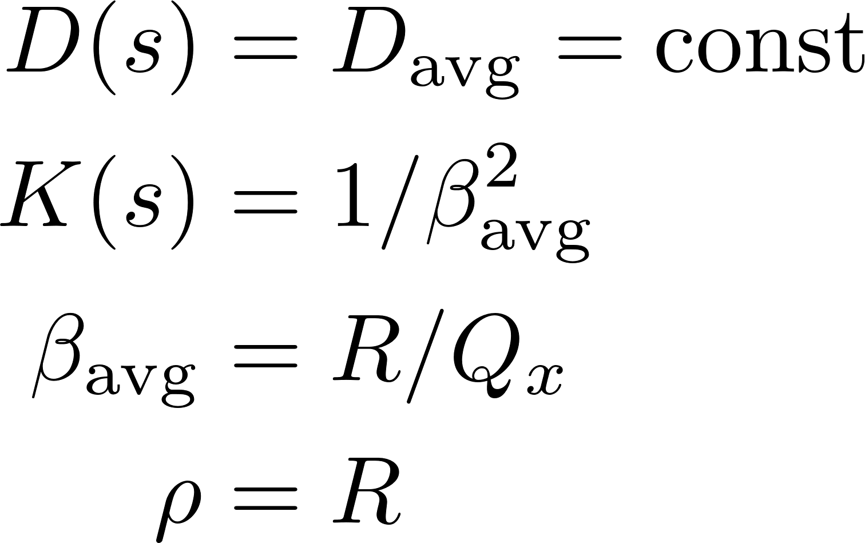
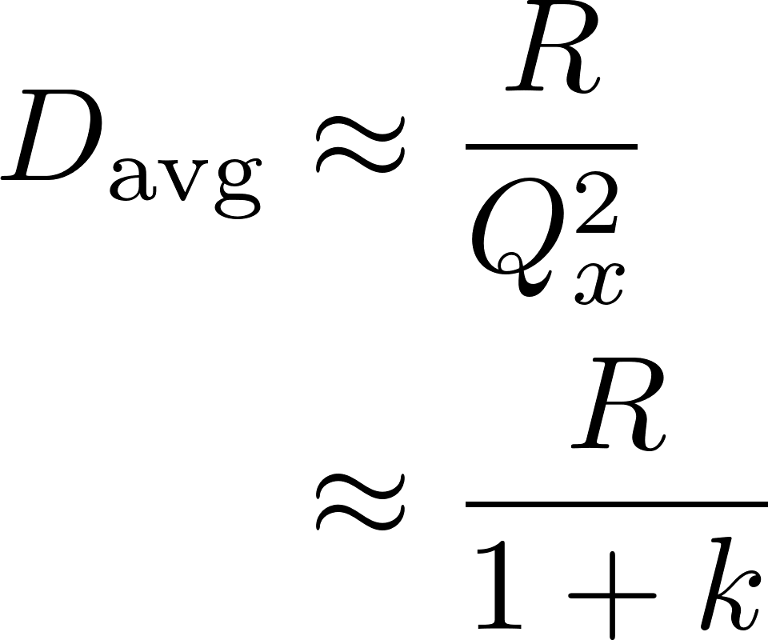
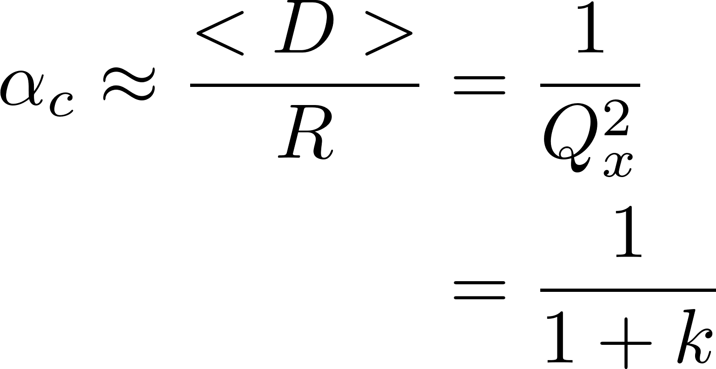
Smooth Approximation – Dispersion, M.Compaction
Differential Equation for D:
simplifying assumptions:
(R = avg. radius)

Slide 13
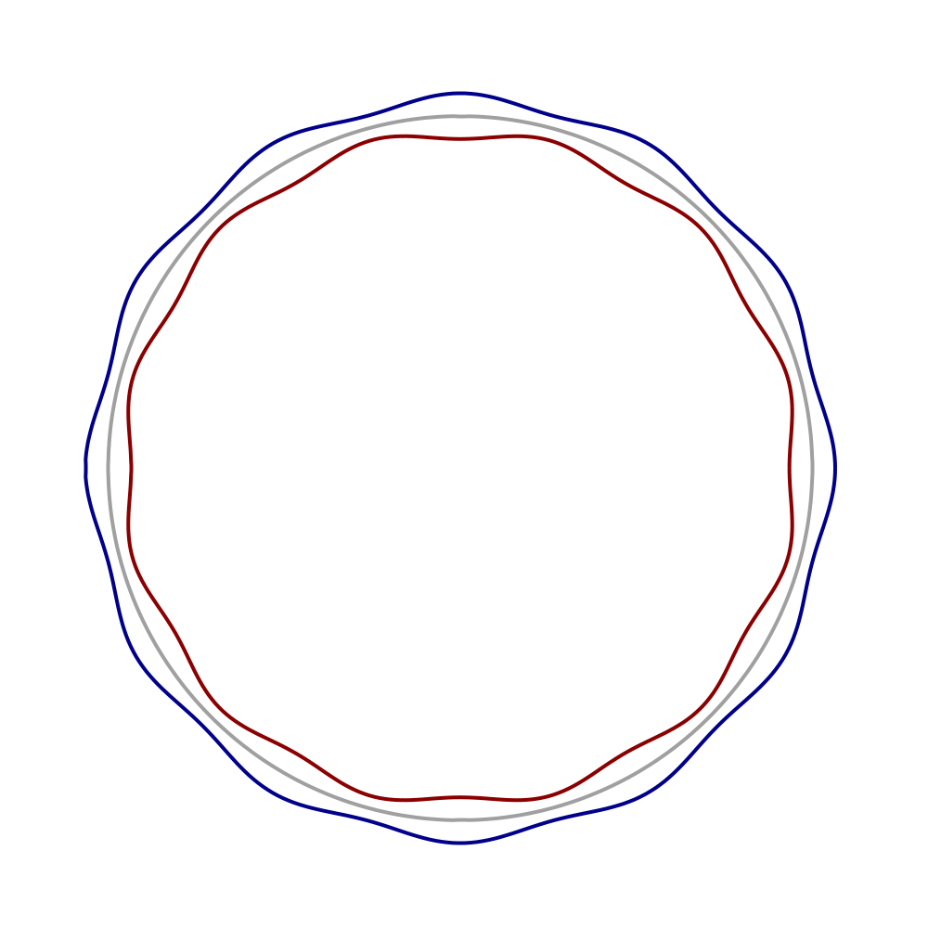
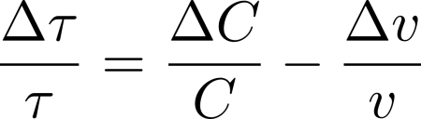
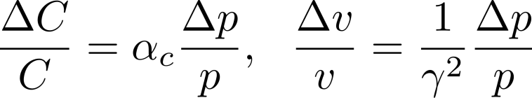
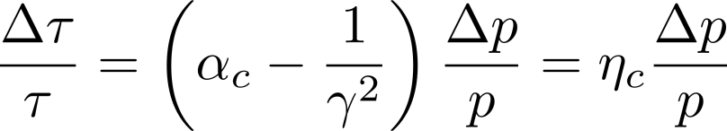
Circulation Time
the circulation time τ of particles varies due to:
varying velocity v
varying path length C
qualitative particle paths with p-Δp, p, p+Δ
we use the momentum compaction factor α_{c}:
time delay vs momentum deviation through slip factor η_{c}:
note definition of η_{c} in some literature with opposite sign!

Slide 14
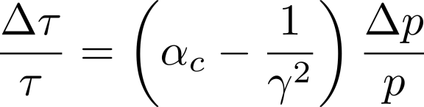

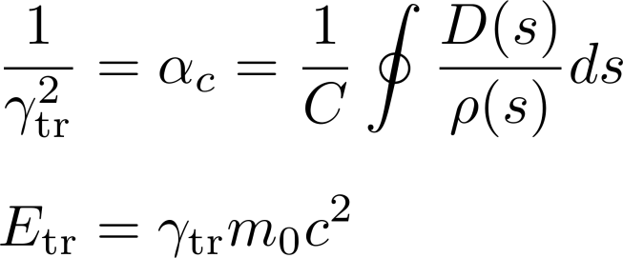
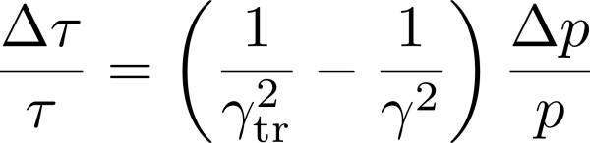
Transition Energy
τ = circulation time
p = momentum
the α_{c} in this formula can be expressed by a transition energy:
the transition energy is a parameter of the magnet lattice
see also Wiedemann sec. 9.2.2

Slide 15
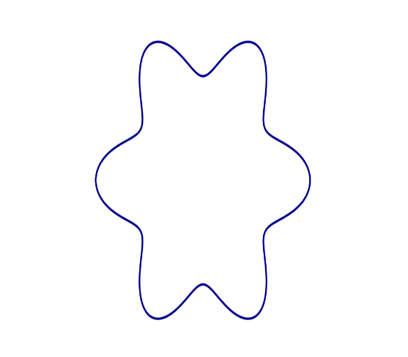
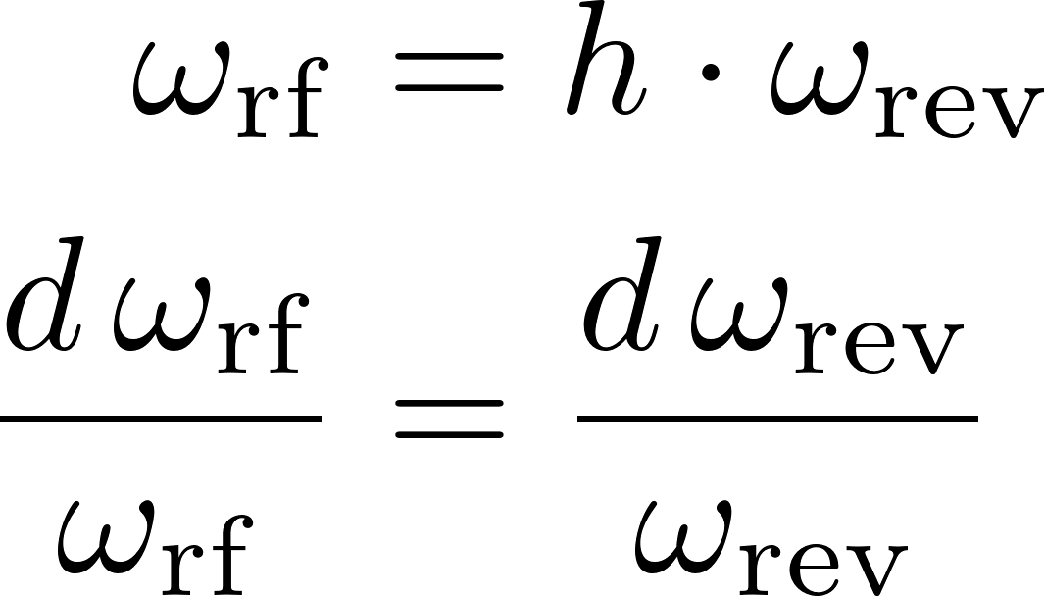
Harmonic Number relates Revolution- and RF Frequency
the RF frequency must be a multiple of the revolution frequency
the harmonic number h denotes the number of RF buckets for ring and is an integer number
h = 6
see also Wiedemann sec. 3.4.5

Slide 16
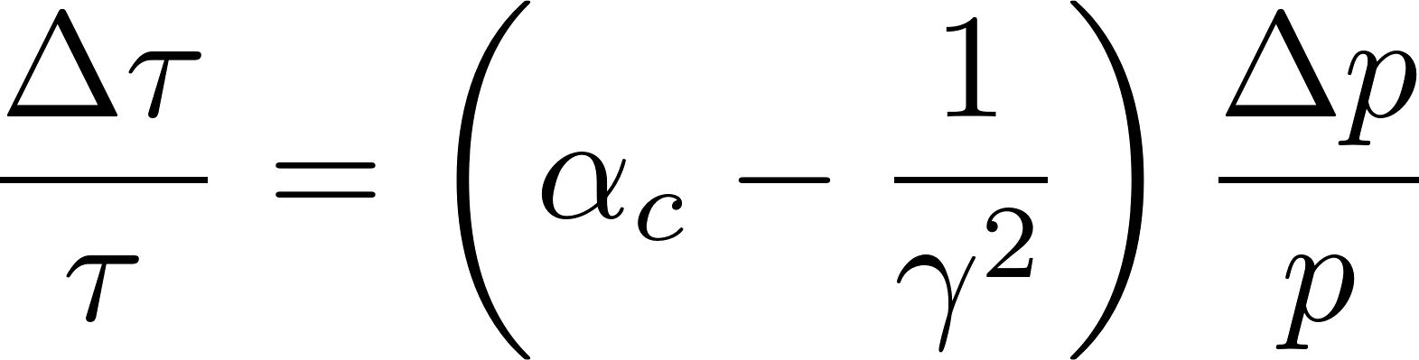
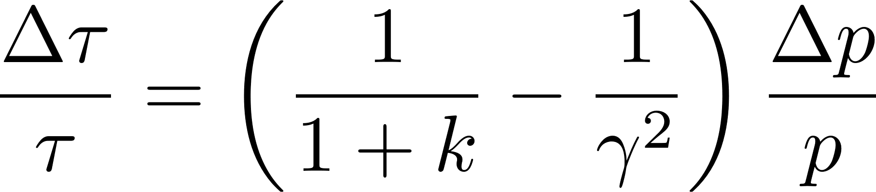
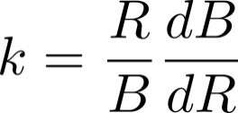
Slip Factor in Cyclotrons / FFA
classical use of slip factor (synchrotrons):
use of smooth approximation and field index k:
= 0 for isochronous cyclotron
field index

Slide 17
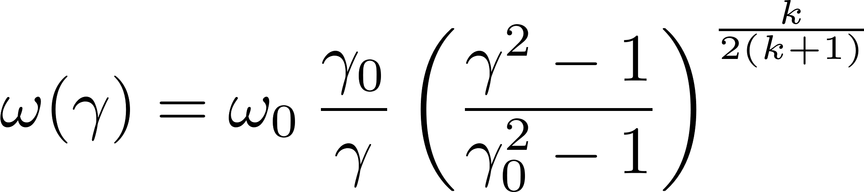
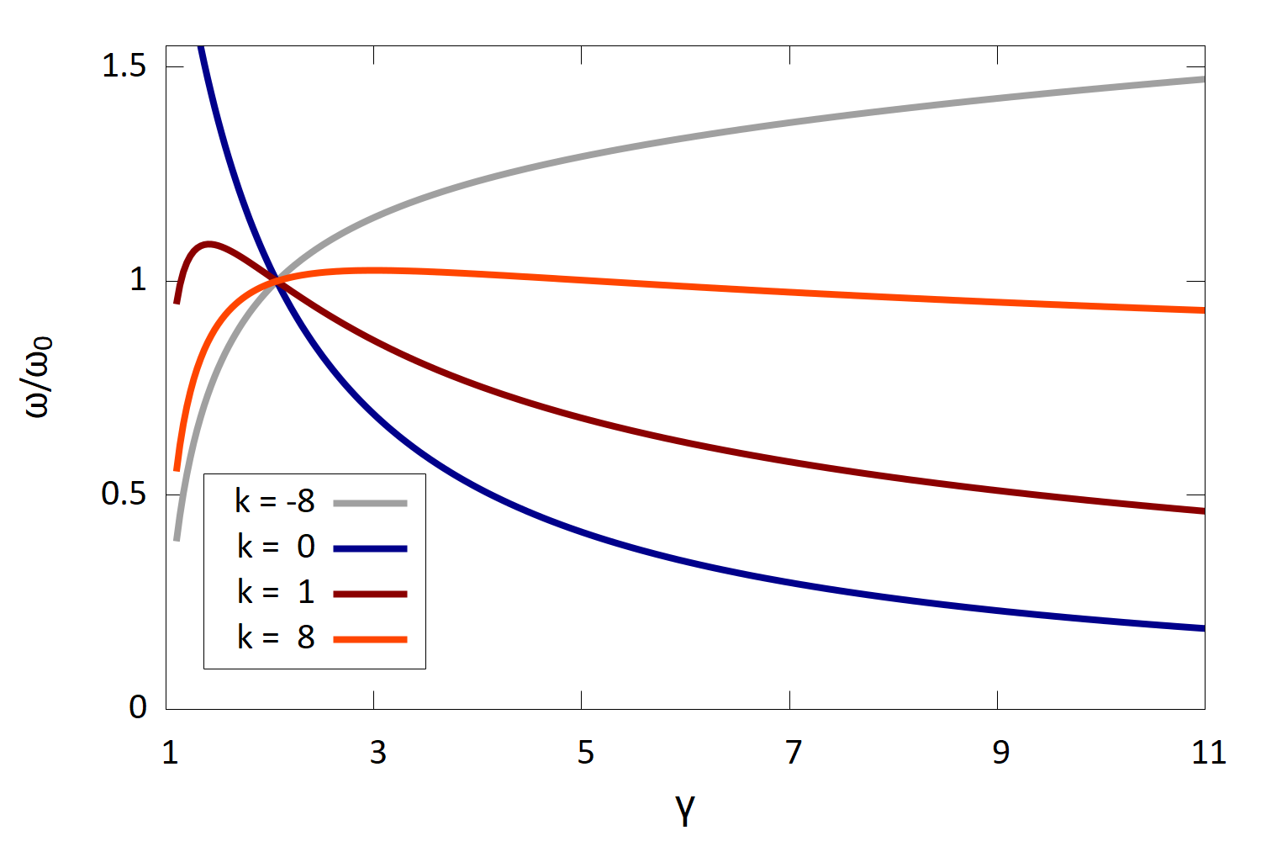
Revolution Frequency Variation in Scaling FFA
Revolution frequency variation as a function of γ in a scaling FFA for several field indices k. A reference energy is chosen at 1 GeV.
the RF frequency can be expressed as function of γ only:
small Δω for large k
using a “steep” magnetic field, i.e. high k, the frequency variation can be minimized
the maximum of the function corresponds to the transition energy

Slide 18
magnets for scaling FFA
RF systems for vaying frequency

Slide 19
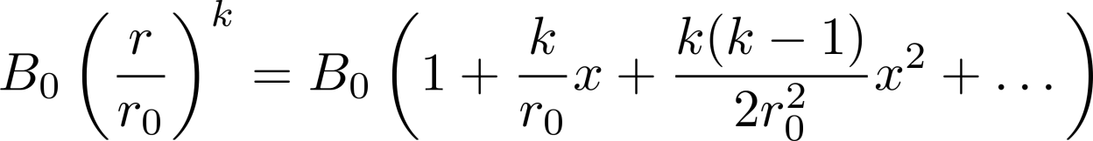
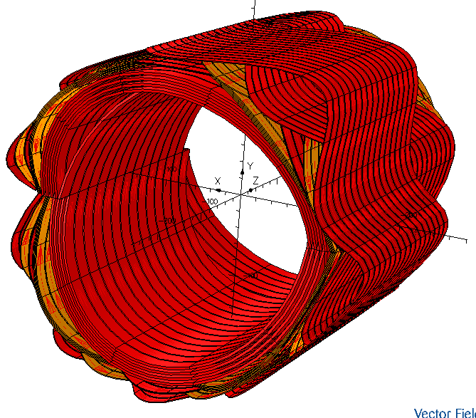
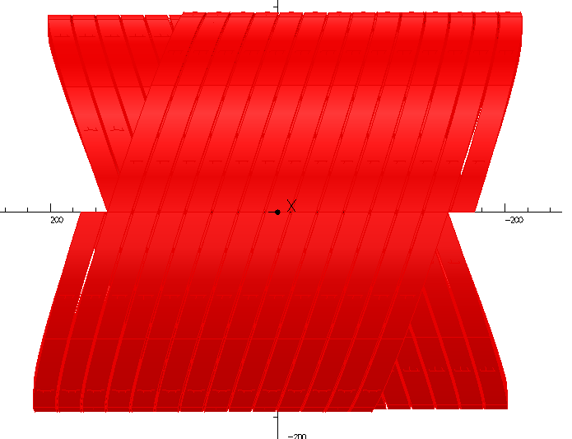
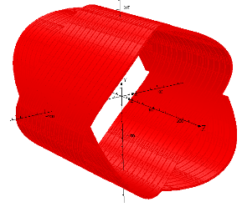
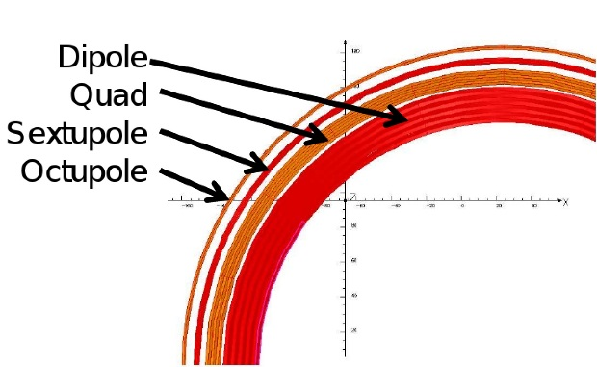
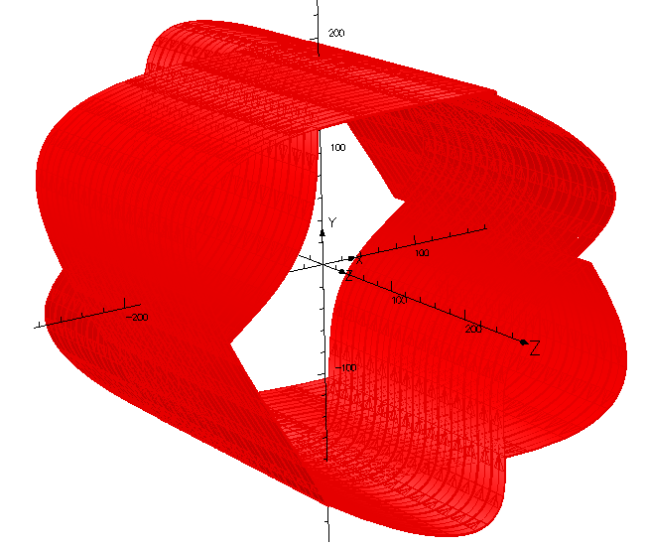
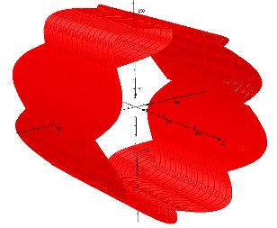
scaling FFA magnet design
helical coils, known as Canted Cosine Theta (CCT), can provide pure multipole fields
in superposition truncated Taylor expansion of r^{k} scaling → compact FFA magnet
55cm
Dipole
Quadrupole
~23cm
Sectapole
Octapole
By H. Witte, courtesy T.Yokoi, FFAG’09

Slide 20
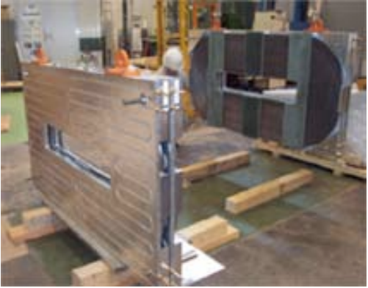
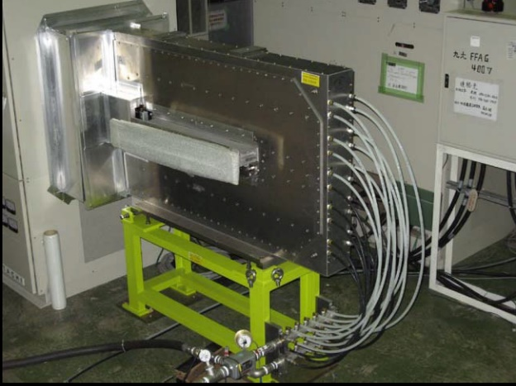
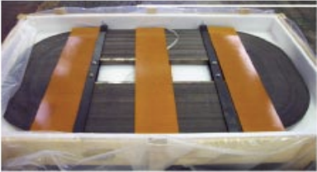
Variable Frequency RF for scaling FFA
example RF system:
Kyoto University FFA, 150MeV
high-permeability soft magnetic alloy core
low Q = 0.47 @ 2.7 MHz
high power broadband amplifier
Number of Cavities | 2
Gap Voltage | 4.0 kV/cavity
RF frequency | 1.5 – 4.2 MHz
RF output power | 200 kW
Core material | FINEMET (FT-3M)
repetition rate | 100 Hz
kinetic energy (p) | 10 – 125 MeV
radius variation | 4.47 - 5.20 m
Image credit: A.Takagi, Y.Mori

Slide 21
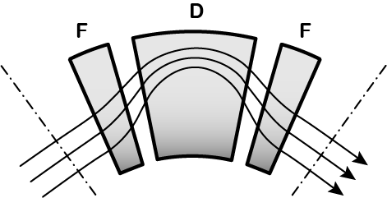
Further generalisation of FFA concepts
Scaling FFA:
constant optics but frequency change and difficult magnet properties
Linear Non-Scaling FFA:
only quadrupole fields but with strong gradients
momentum compaction α_{c}∝ p, thus C ∝ p²
use high acceleration voltages, thus resonances are less a danger and can be crossed
qualitative example of non-scaling orbits in an FFA cell
Nonlinear Non-Scaling FFA:
higher order non-linear fields, thus more degrees of freedom
optics can vary with energy

Slide 22
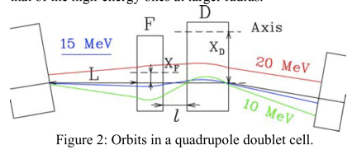
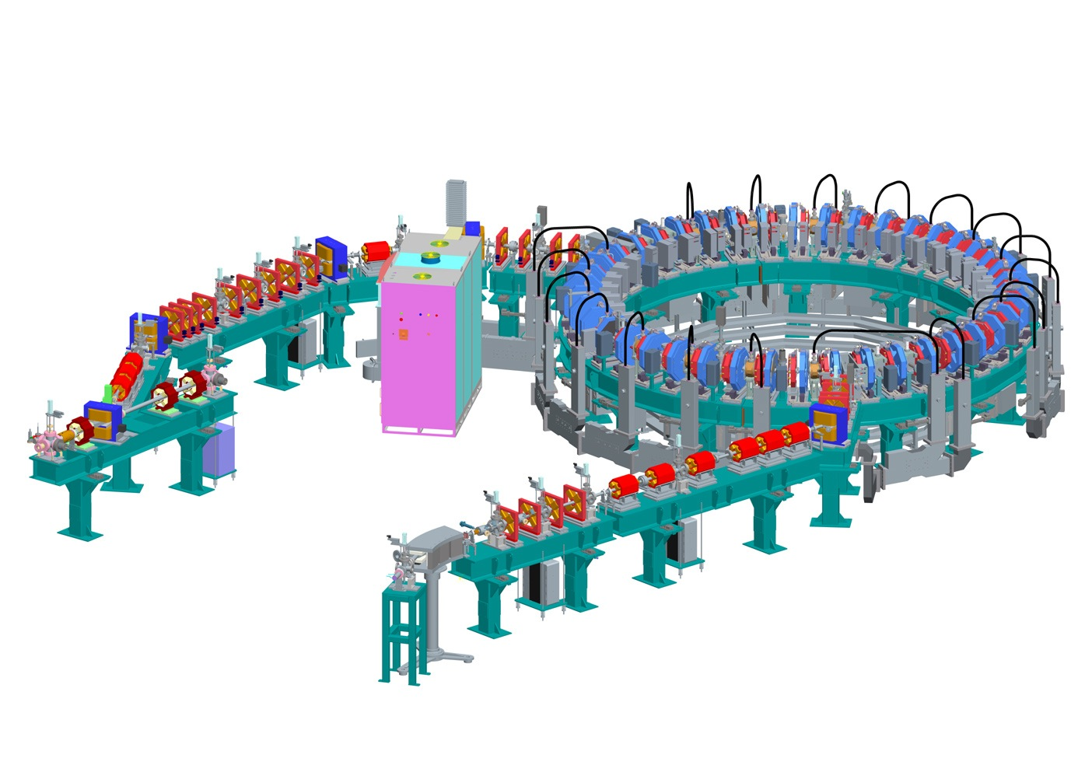
non-scaling FFA
k ≠ const. , but fast resonance crossing
simpler magnets, flexible optics
solutions with fixed RF frequency
linear scaling with k=1 is important sub-class, but many proposals
example: EMMA electron model
Energy | 10-20 MeV
Circumference | 16.57 m
Cells | 42
F quad length | 5.88 cm
D quad length | 7.57 cm
RF frequency | 1.3 GHz
Cavities | 19 x 120 kV

Slide 23
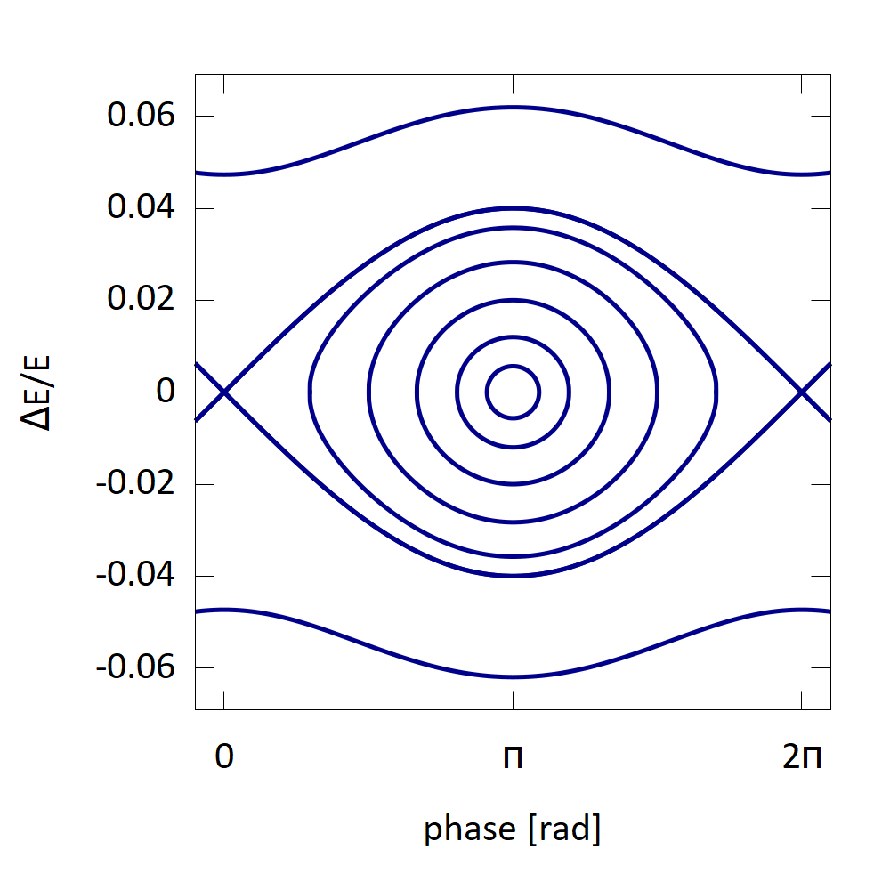
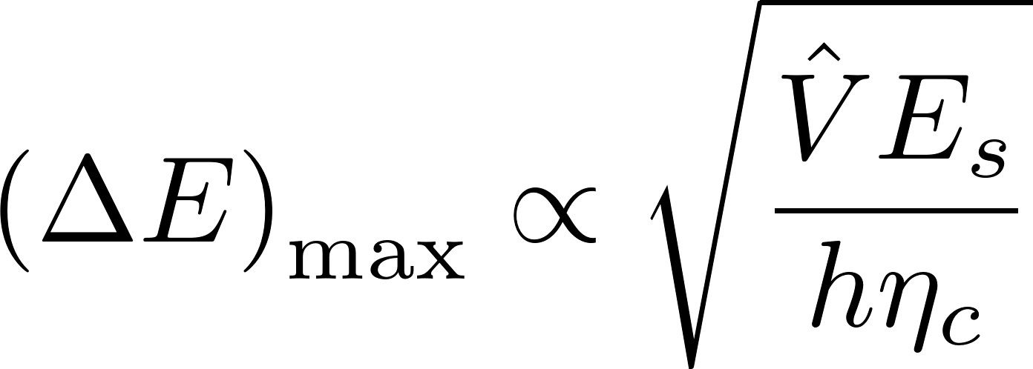
Reminder: Stationary Bucket in Synchrotron
synchrotron oscillation is slow, e.g. Qs=0.01, i.e. many turns per complete cycle
maximum energy acceptance on separatrix
circular trajectories for small φ
numbers are realistic for a small electron synchrotron
see also Wiedemann sec. 9.3.2

Slide 24
Next Slides: The quest for fixed frequency acceleration, 3 proposed schemes
very high voltage (or low turn number) acceleration in scaling FFA, allowing phase variation
serpentine acceleration (in-between buckets !) in non-scaling FFA
harmonic number jump, i.e. using several harmonic numbers during course of acceleration
all such schemes are challenging to be realised, particlularly for high intensity beams with losses limited to 10⁻⁴ range
another challenge is the clean extraction of high intensity beams, a topic not much addressed by design proposals

Slide 25
Scheme I: very high voltage acceleration in scaling FFA at fixed frequency
extraction
large bucket height required
6 turn muon acceleration in 3.6 – 12.6 GeV scaling FFA with 1.8GV RF voltage
injection
Planche, Mori et al. IPAC’10

Slide 26

Scheme II: Linear Nonscaling FFA: serpentine acceleration
acceleration within a few turns (no time for resonances) → allows fixed frequency!
along a serpentine path in long. phase space (ensure acceleration at all times)
path length varies little, but limited overall energy gain compared to synchrotron, e.g. factor 4 maximum
concept demonstrated in EMMA
compare Nature title: «Acceleration without Scaling»

Slide 27
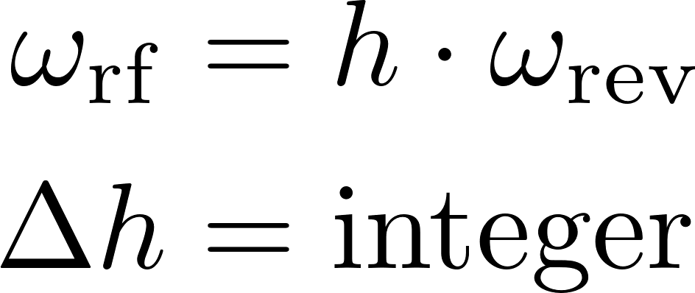
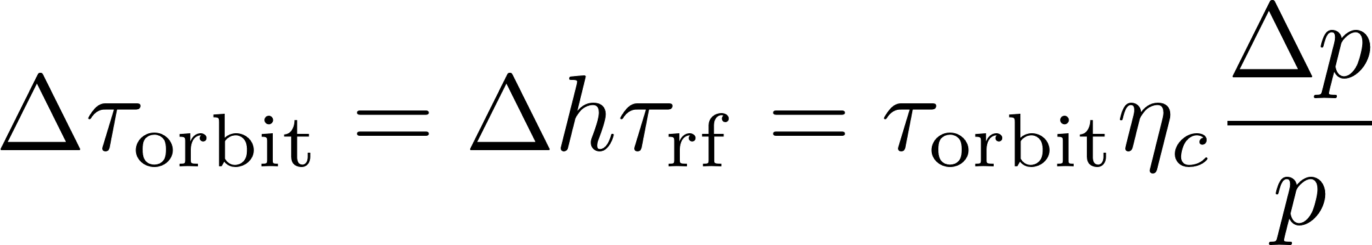
Scheme III: Harmonic Number Jump (HNJ)
→ when h is changed by an integer (e.g. 1) from turn to turn, the RF phase for the particles stays constant and the frequency must not be changed
h = 2,3,4
in general the circulation time changes with increasing momentum (see slip factor)
this change must be adjusted such (through the beam optics) that it results in integer changes of h

Slide 28
three examples of advanced FFA designs
scaling high power FFA for CSNS
high power non-linear nonscaling FFA for neutrino source
isochronous (!) FFA for muon acceleration

Slide 29
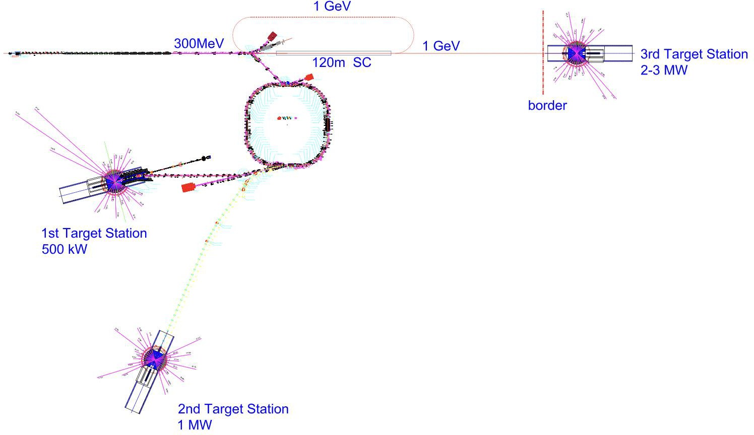
Upgrade of China Spallation Neutron Source (CSNS), Wu Bin et al
CSNS-III:
  High Repetition Rate All-Superconducting Linear Injector
  Repetition Rate:
    Significant increase: 100Hz+
  Beam Power:
    Significant increase: 2MW+
  System Simplification:
    Simplified magnets, power supplies
The FFAG accelerator scheme appears to be the best technically feasible solution!
It is essential to undertake technical research related to high-intensity FFAG accelerators.
comment M.S.:
FFA accelerates from 300 to 600MeV
scaling FFA with spiral magnets
orbit radius varies, but ΔR<0.6m
RF frequency 3.66…4.23MHz
rep.rate: 250 Hz

Slide 30
An FFAG Proton Driver for a Neutrino Factory, GH.Rees
high power pulsed proton driver accelerator
non-linear and non-scaling, cell focusing structure
energy 3-10 GeV, cells N = 66
circumference C = 801 m; max. separation: Δr=33cm
rep. rate 50 Hz; path length variation: <10⁻³
tunes constant(!); beam power 4 MW
building blocks: 5-magnet “pumplet¹” cells
variations in field gradient and sign enable each magnet’s function to vary with radius
1 termed pumplets from the Welsh word for five, pump - pronounced pimp
ICFA Beam Dynamics Newsletter 43

Slide 31
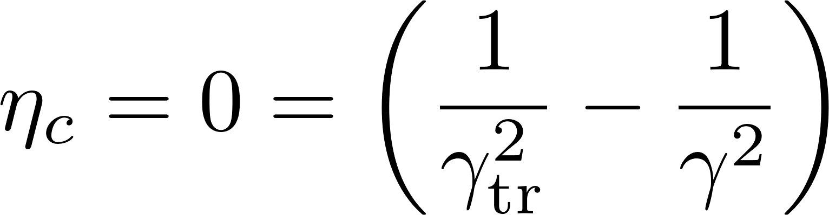

Isochronous FFAG for Muon acceleration, GH.Rees
motivation: the FFA allows more turns than a re-cycling linac, is thus cost efficient
however, the design is challenging and the author suggests to build and test an electron model first
conceptual study of muon FFA
non-linear and non-scaling, cell focusing structure
energy 8-20 GeV, γ= 76…190
cells N = 123
circumference C = 1254 m
orbit separation during acceleration: <30cm
isochronous:
→ this can be achieved by adjusting the gradient at the position of each orbit in non-linear magnets
ICFA Beam Dynamics Newsletter 43

Slide 32
finally: discussion
  comparison of circular accelerators
  suitability of cyclotrons and FFA for applications
  some literature

Slide 33
classification of circular accelerators
 | bending radius vs. time | bending field vs. time | bending field vs. radius | RF frequency vs. time | operation mode (pulsed/CW)
classical cyclotron |  |  |  |  |  | simple, but limited E_{k}
isochronous (AVF) cyclotron |  |  |  |  |  | suited for high power!
synchro- cyclotron |  |  |  |  |  | higher E_{k}, but low P
FFA |  |  |  |  |  | strong focusing!
a.g. synchrotron |  |  |  |  |  | high E_{k}, strong focus

Slide 34
Summary FFA
FFA‘s operate with a fixed magnetic field → fast acceleration cycles, high average intensity possible
orbit motion can be compressed and magnets be compact, as compared to cyclotrons
scaling FFA‘s have self similar orbits and constant tunes → no resonance crossing; but this results in challanges for the magnets
non-scaling FFA‘s (linear and non-linear) have more flexible options, but resonances are crossed and acceleration must be fast
RF frequency must be ramped in general; few schemes promise constant RF frequency (serpentine, HNJ) but these are challenging and still under study

Slide 35
pro and contra cyclotron / FFA
limitations of cyclotrons | typical utilization of cyclotrons
energy ≤1GeV (relat. effects) weak focusing: space charge, 10mA? tuning difficult; field shape; many turns; limited diagnostics wide vacuum vessel (radius variation) | medical applications; plenty intensity isotope production: several 10MeV acceleration of heavy ions (e.g. RIKEN) very high intensity proton beams (PSI:1.4MW, TRIUMF: 100kW )
Fixed Focus Alternating Gradient Accelerator (FFA)
strong focusing, compact magnets & chamber
large acceptance, e.g. 10.000 mm mrad
but:
CW operation difficult (serpentine, HNJ …)
low loss extraction difficult (high rep., fast kicker ?)
no demonstrator for high intensity after many years of discussion …

