Slide 1
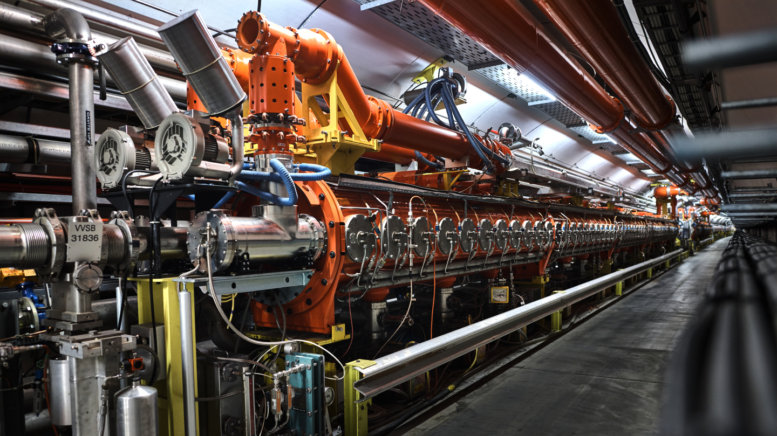


Longitudinal high-intensity beam instabilities + mitigations in synchrotrons
Ivan Karpov
CERN, SY-RF-BR
Intensity Limitations in Hadron Beams, 20.06.2025

Slide 2
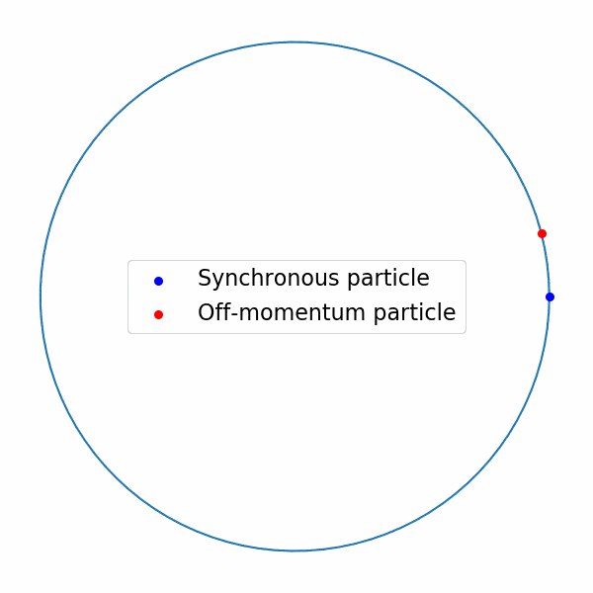
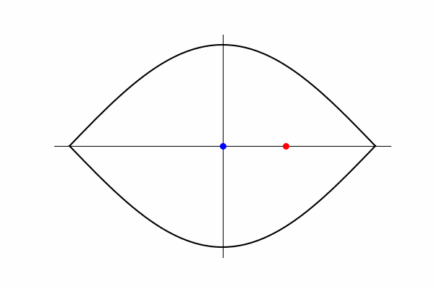





Longitudinal high-intensity beam instabilities + mitigations in synchrotrons
Revolution frequency
$$ω_{0}=\frac{2π}{T_{0}}$$
Synchrotron frequency
$$ω_{s}=Q_{s}ω_{0}$$
$$ΔE$$
Revolution period
Example for $Q_{s}=0.2$
$$φ$$
Particles perform synchrotron oscillations around the synchronous particle

Slide 3
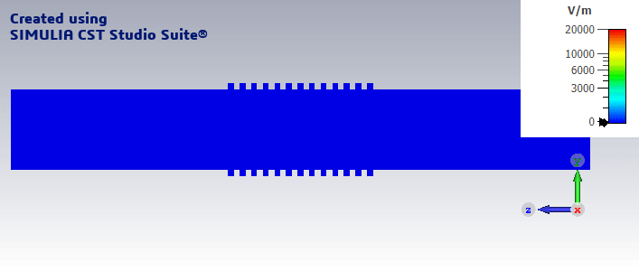
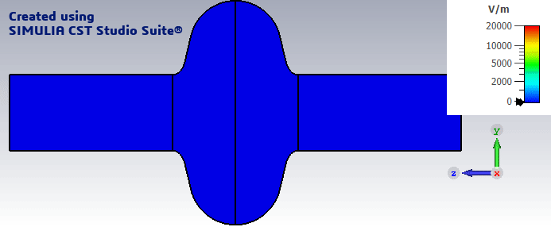
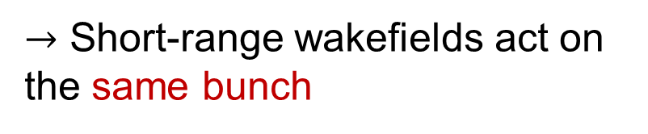
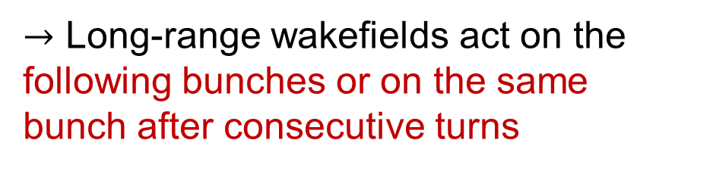
Longitudinal high-intensity beam instabilities + mitigations in synchrotrons
Non-resonant objects (e.g., bellows)
$→$ Short-range wakefields act on the same bunch
Resonant objects (e.g., RF cavities)
$→$ Long-range wakefields act on the following bunches or on the same bunch after consecutive turns
Instability can be driven by electromagnetic interaction with accelerator components

Slide 4
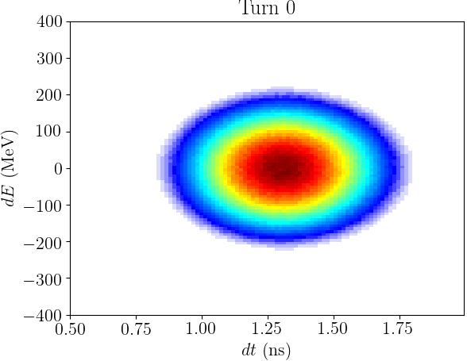
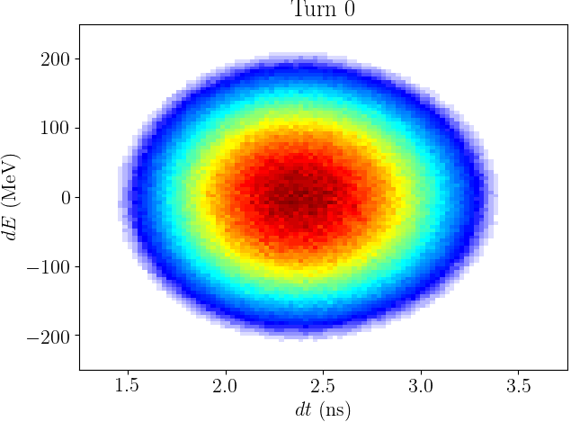
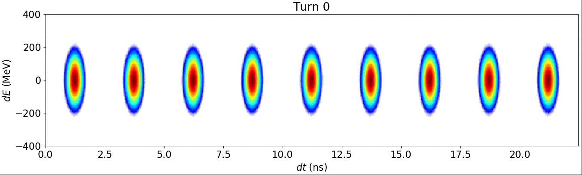
Longitudinal high-intensity beam instabilities + mitigations in synchrotrons
Undamped oscillations
Mode-coupling instabilities
Single-bunch collective effects
Coupled-bunch instabilities
Multi-bunch collective effects

Slide 5
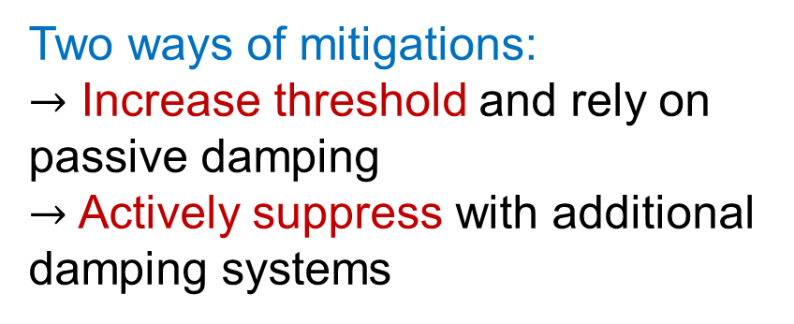

Longitudinal high-intensity beam instabilities + mitigations in synchrotrons
Most instabilities have a finite threshold bunch intensity defined by
Beam and accelerator parameters
Total impedance
Recent Super Proton Synchrotron (SPS) impedance model
$$k=\frac{ω}{ω_{0}}$$
Two ways of mitigations:
$→$ Increase threshold and rely on passive damping
$→$ Actively suppress with additional damping systems

Slide 6
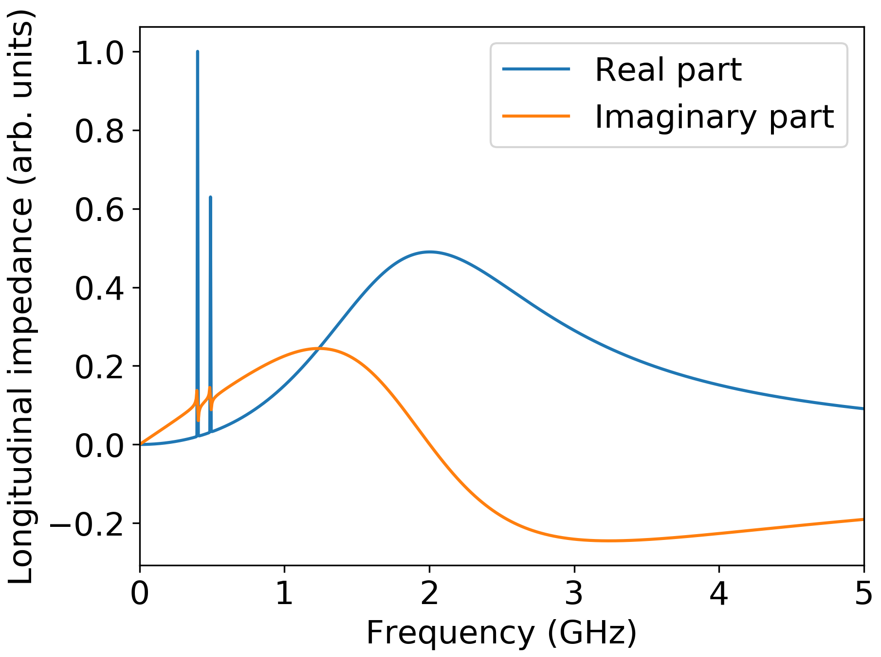
Recipe for (in)stability analysis
Step 1: Clearly define initial conditions (stationary distribution)
Step 2: Introduce a small perturbation and see what happens
90% of a man’s success in business is perspiration
Thomas Edison
Toy impedance model
We apply this procedure for a toy model (scaled LHC):
- single or nine equispaced bunches
- above transition energy
- no acceleration
400 MHz
RF cavities
Higher-order mode (HOM)
Broad-band contribution
Parameter | LHC | Toy LHC
Circumference (m) | 26659.86 | 6.73
Harmonic number | 35640 | 9
RF frequency (MHz) | 400.79 | 400.79

Slide 7
Outline
Main definitions
  Stationary distribution
  Perturbation analysis
Single-bunch collective effects and possible mitigations
  Loss of Landau damping
  Mode-coupling instabilities
Multi-bunch collective effects and possible mitigations
  Higer-order or fundamental mode driven instabilities
  Impact of broadband impedance
First lecture
Second lecture

Slide 8

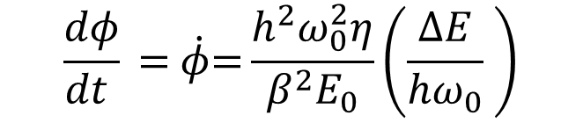

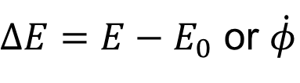

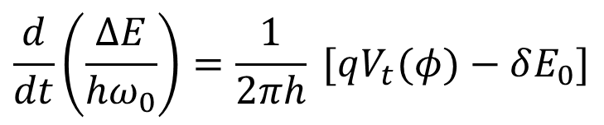
Equations of motion
Longitudinal phase space
Particle charge
Energy gain only for acceleration
$ΔE=E−E_{0}$ or $\dot{φ}$
$$\frac{d}{dt}\left(\frac{ΔE}{{hω}_{0}}\right)=\frac{1}{2πh} [qV_{t}(φ)−δE_{0}]$$
“Kick”:
Particle phase
Slip factor $η= \frac{1}{γ_{t}^{2}}−\frac{1}{γ^{2}}$
$$\frac{dφ}{dt } \text{=} \dot{φ}\text{=}\frac{{h^{2}ω}_{0}^{2}η}{β^{2}E_{0}}\left(\frac{ΔE}{{hω}_{0}} \right)$$
$$φ=φ−φ_{s0}$$
“Drift”:
Synchronous phase without induced voltage
Energy of synchronous particle
Total voltage is a sum of RF and beam induced voltage
$$V_{t}=V_{rf}+V_{ind}$$
In this lecture (mostly) $δE_{0}=0$, $η>0$ (i.e., $φ_{s0}=π$), $V_{rf}\left(φ\right)=−V_{0}\sin{φ}$

Slide 9
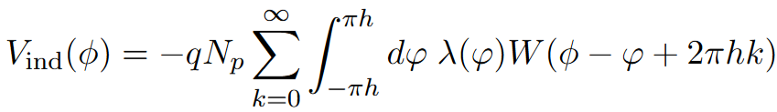

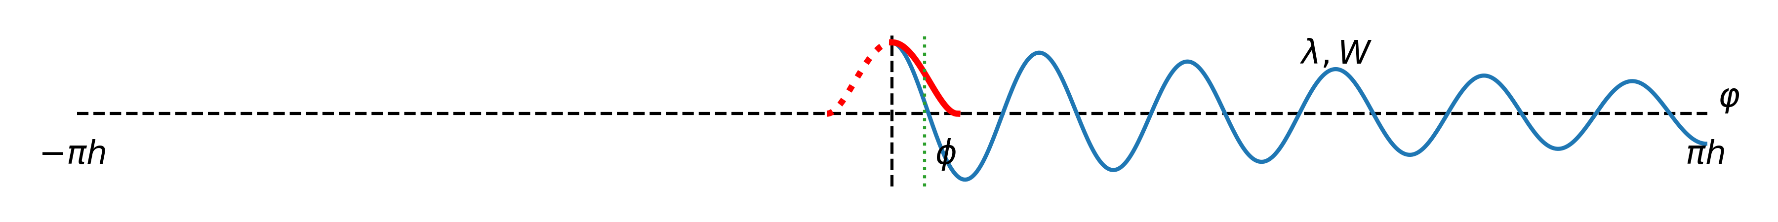
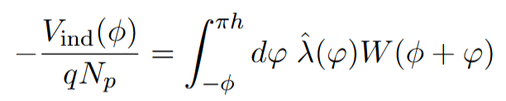
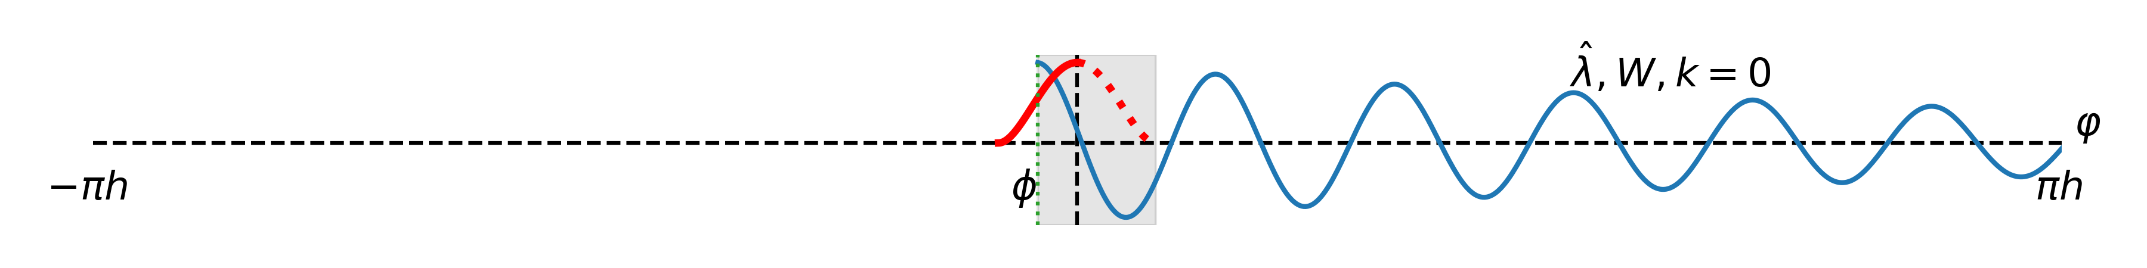
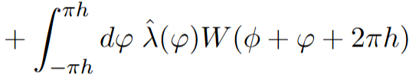
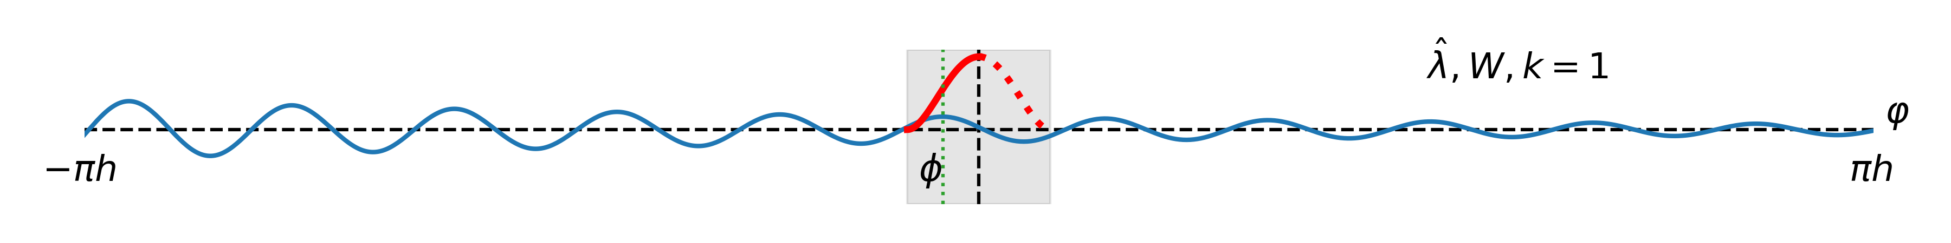
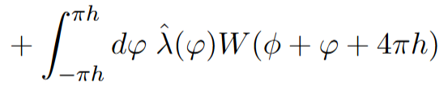
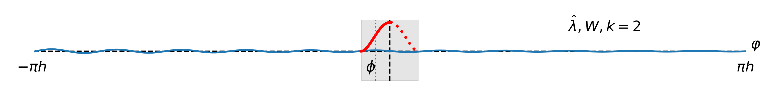

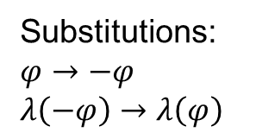
Single-bunch induced voltage (via wake function)
Stationary voltage:
One turn delay
Substitutions:
$φ→−φ$
$λ\left(−φ\right)→λ\left(φ\right)$
Number of particles
Line density
Wake function

Slide 10
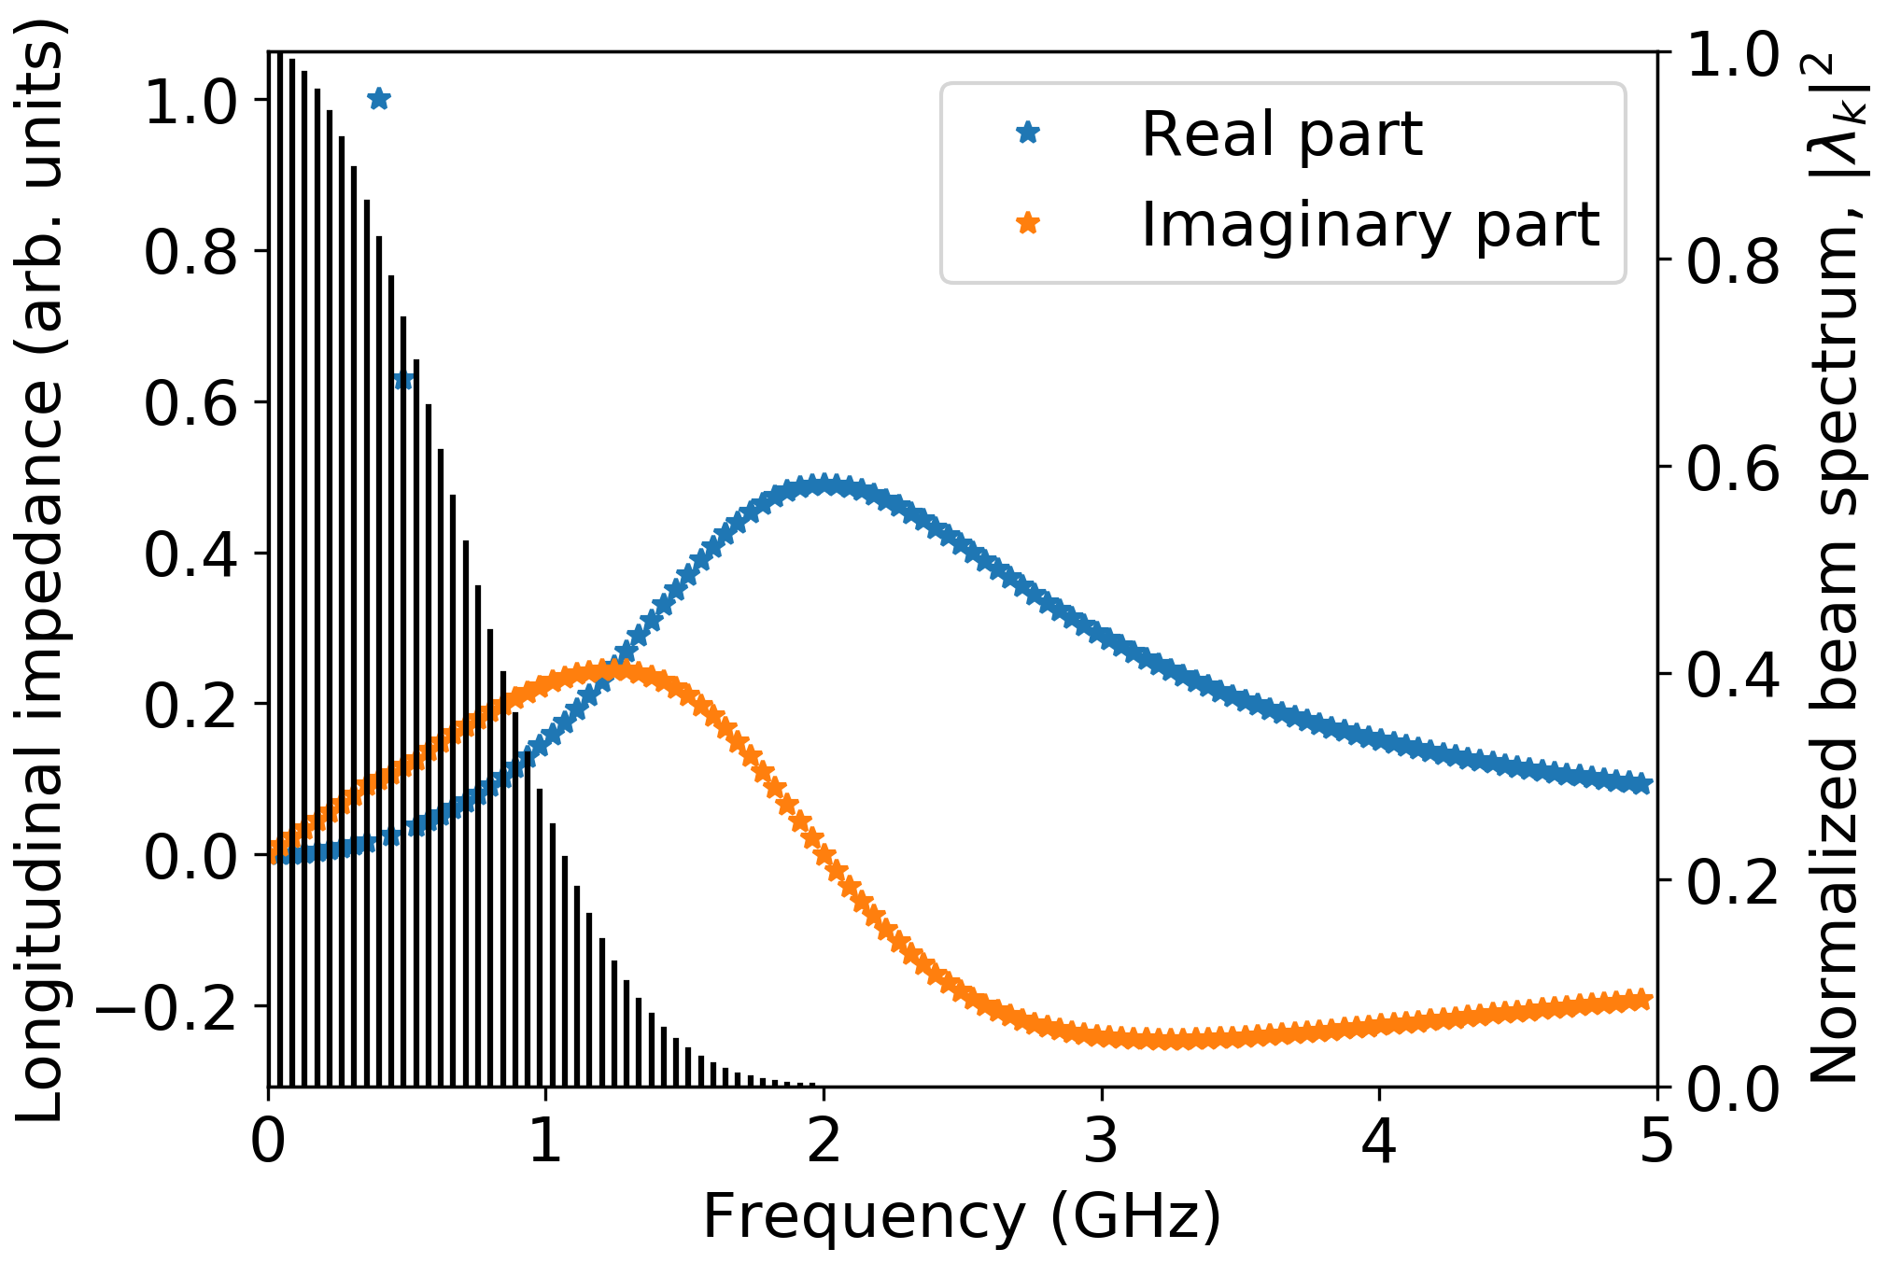

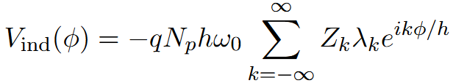
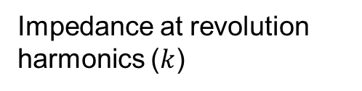


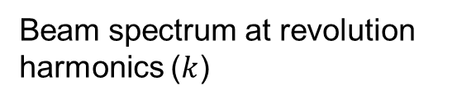
Single-bunch induced voltage (via wake function)
Stationary voltage:
One turn delay
Number of particles
Line density
Wake function
Following convention in lectures of A. Mostacci
Impedance & single-bunch beam spectrum
Wake function:
Impedance at revolution harmonics ($k$)
$$Z_{k}=Z(kω_{0})$$
Beam spectrum at revolution harmonics ($k$)
$→$ Only revolution harmonics contribute to stationary induced voltage

Slide 11
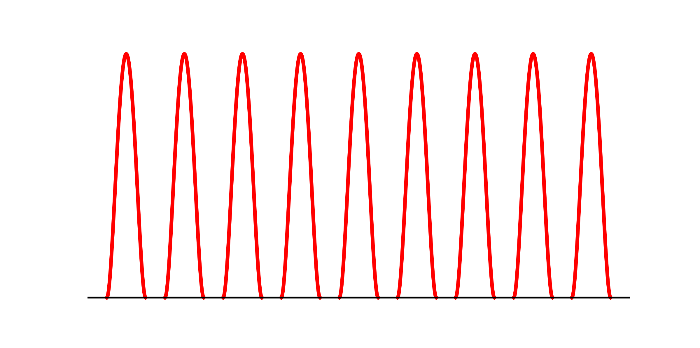
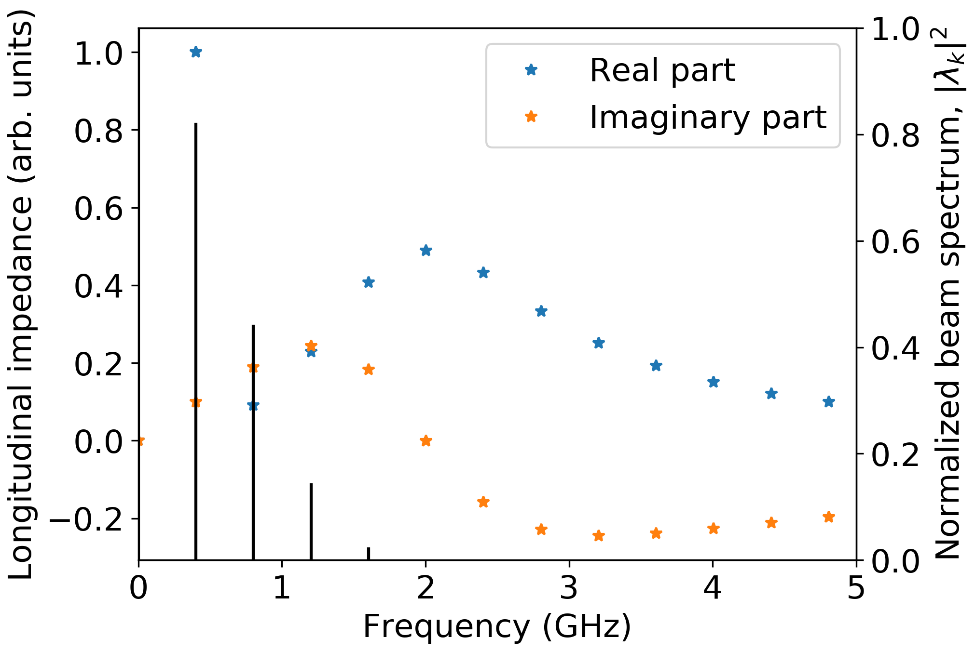
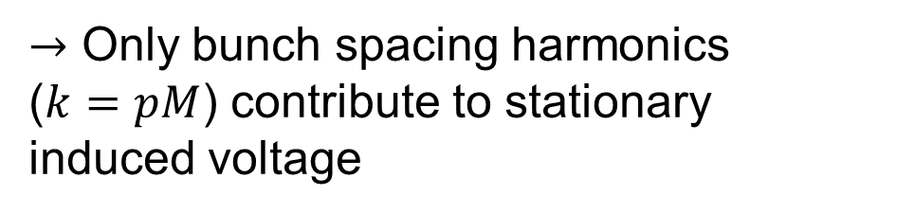
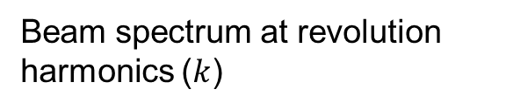
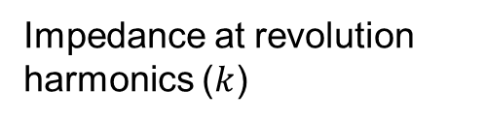

Note on multi-bunch case
Periodicity is defined by bunch spacing: $2πh/M$, $M$ – number of bunches
Impedance & nine-bunch beam spectrum
Impedance at revolution harmonics ($k$)
$$Z_{k}=Z(kω_{0})$$
Beam spectrum at revolution harmonics ($k$)
$→$ Only bunch spacing harmonics
($k=pM$) contribute to stationary induced voltage

Slide 12
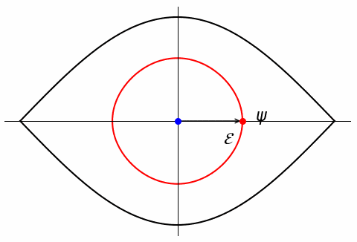
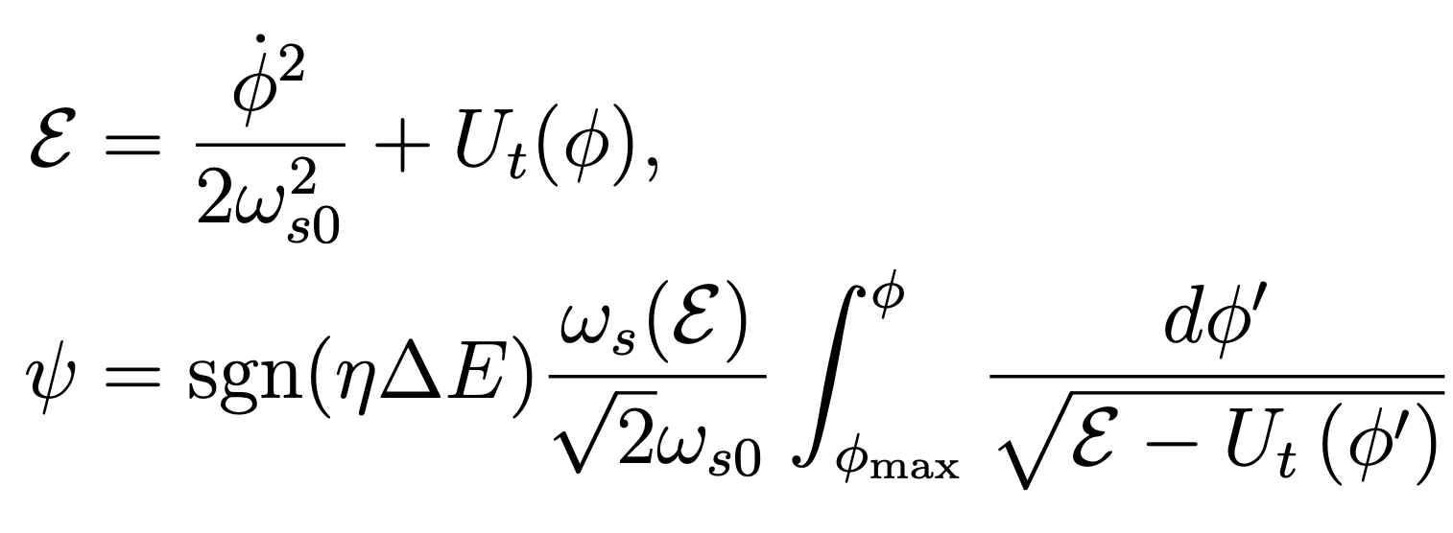
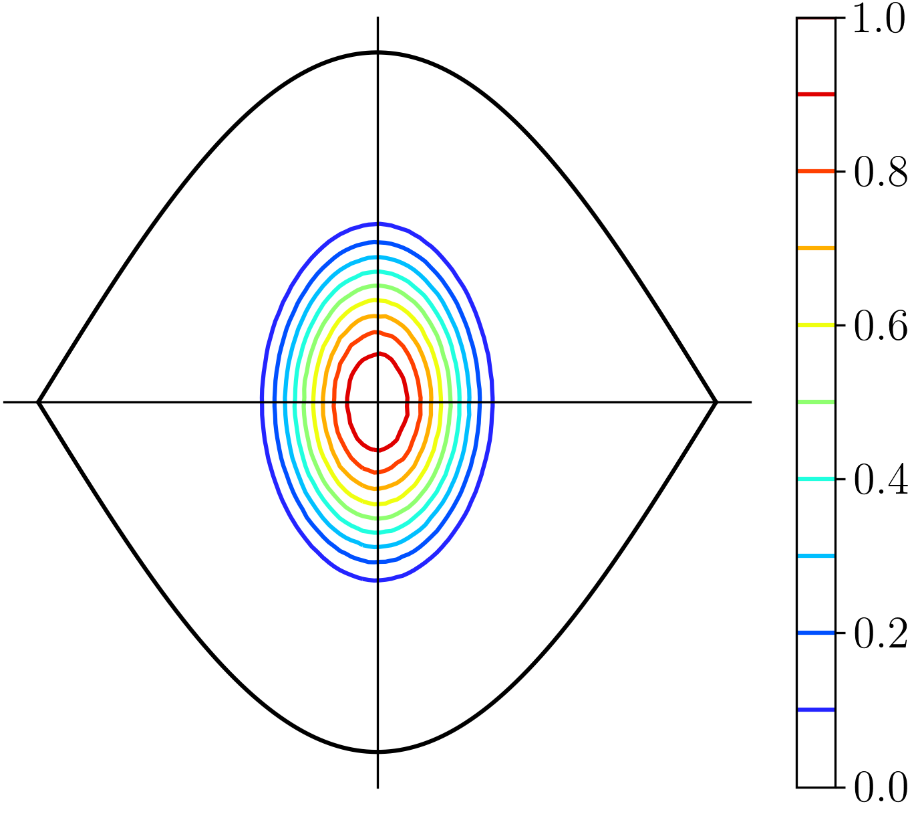
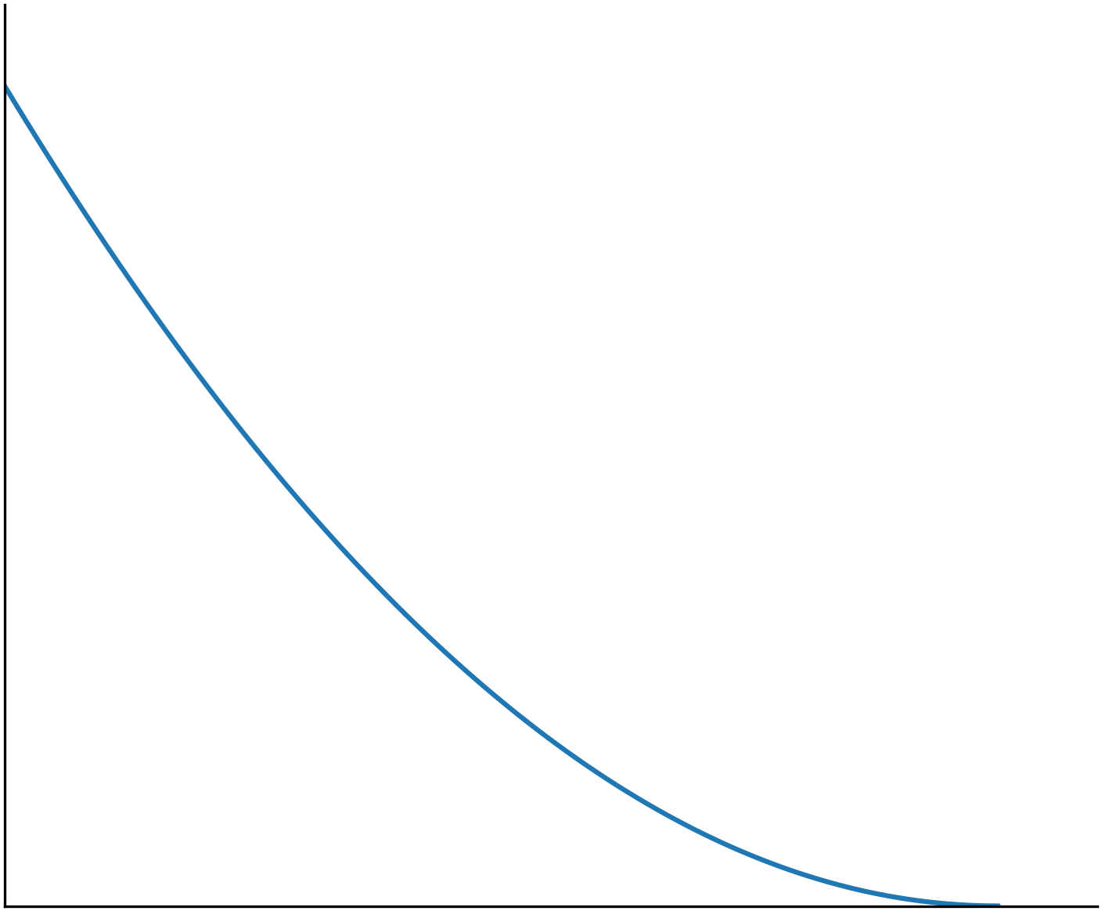


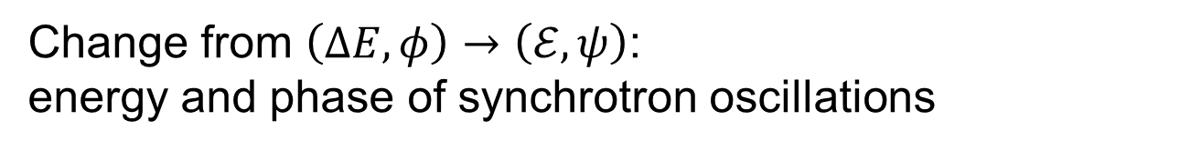







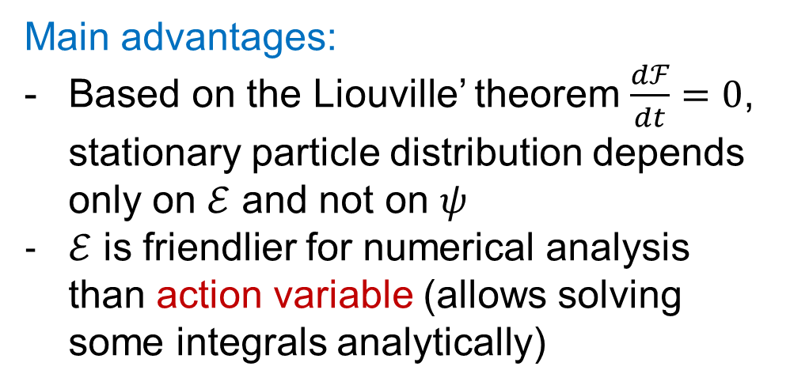
New variables
$$ΔE,\dot{φ}$$
Change from $\left(ΔE,φ\right)→\left(ℰ,ψ\right)$:
energy and phase of synchrotron oscillations
$$φ_{max}$$
$$φ$$
Total potential $U_{rf}+U_{ind}$
Small amplitude synchrotron frequency
Main advantages:
Based on the Liouville’ theorem $\frac{dℱ}{dt}=0$, stationary particle distribution depends only on $ℰ$ and not on $ψ$
$ℰ$ is friendlier for numerical analysis than action variable (allows solving some integrals analytically)
$$ΔE,\dot{φ}$$
$$ℱ\left(ΔE,φ\right)=ℱ\left(ℰ\right)$$
Norm. density levels
$$φ$$
$$ℰ$$
$$ℰ_{max}$$

Slide 13
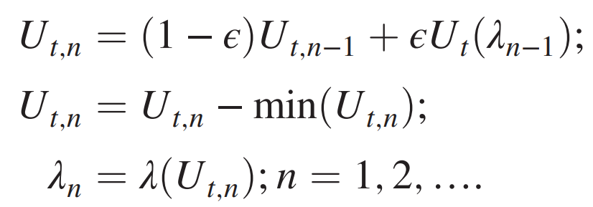
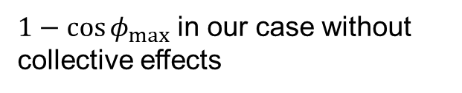

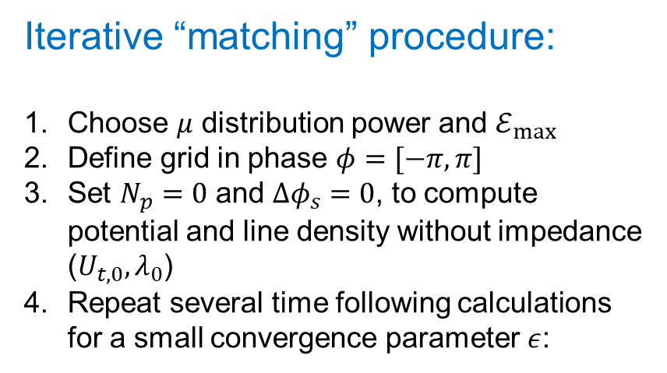
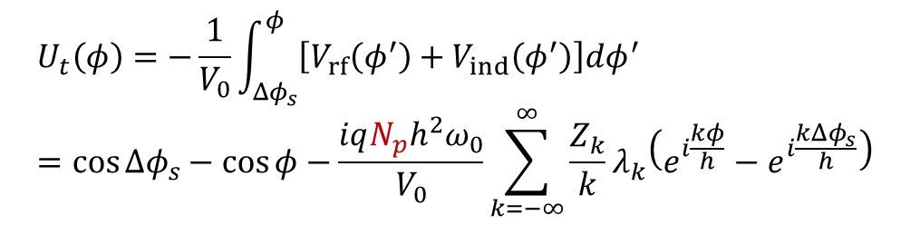

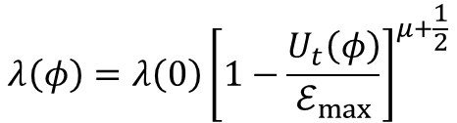
Stationary distribution
Some explicit forms:
Iterative “matching” procedure:
Choose $μ$ distribution power and $ℰ_{max}$
Define grid in phase $φ=[−π,π]$
Set $N_{p}=0$ and $Δφ_{s}=0$, to compute potential and line density without impedance ($U_{t,0}, λ_{0}$)
Repeat several time following calculations for a small convergence parameter $ε$:
Total potential
$$U_{t}\left(φ\right)=−\frac{1}{V_{0}}\int_{Δφ_{s}}^{φ}{\left[V_{rf}\left(φ^{′}\right)+V_{ind}\left(φ^{′}\right)\right]dφ^{′}}=\cos{Δφ_{s}}−\cos{φ}−\frac{iqN_{p}h^{2}ω_{0}}{V_{0}}\sum_{k=−∞}^{∞}{\frac{Z_{k}}{k}λ_{k}\left(e^{i\frac{kφ}{h}}−e^{i\frac{kΔφ_{s}}{h}}\right)}$$
Synchronous phase shift
IFFT$\left\{\frac{Z_{k}}{k}λ_{k}\right\}$
Line density for particle distribution $ℱ\left(ℰ\right)∝{\left(1−\frac{ℰ}{ℰ_{max}}\right)}^{μ}$:
$$λ\left(φ\right)=λ\left(0\right){\left[1−\frac{U_{t}\left(φ\right)}{ℰ_{max}}\right]}^{μ+\frac{1}{2}}$$
$λ_{k}$ = FFT$\left\{λ\left(φ\right)\right\}$
$1−\cos{φ_{max}}$ in our case without collective effects

Slide 14
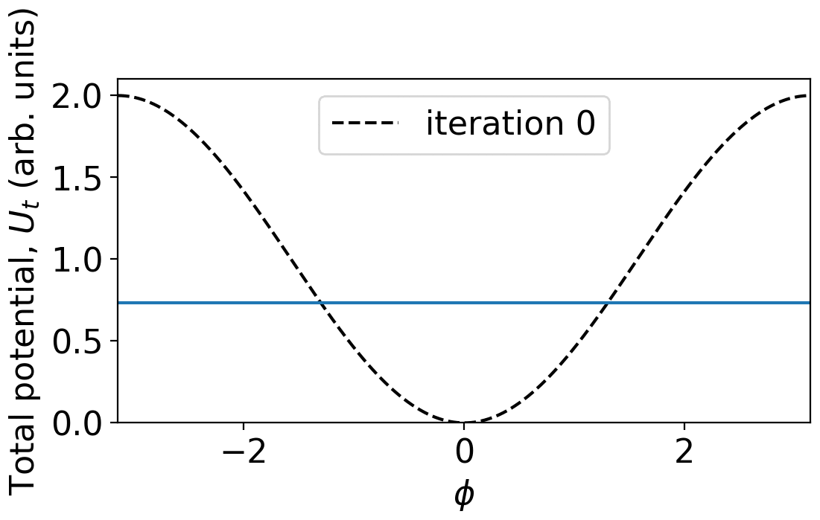
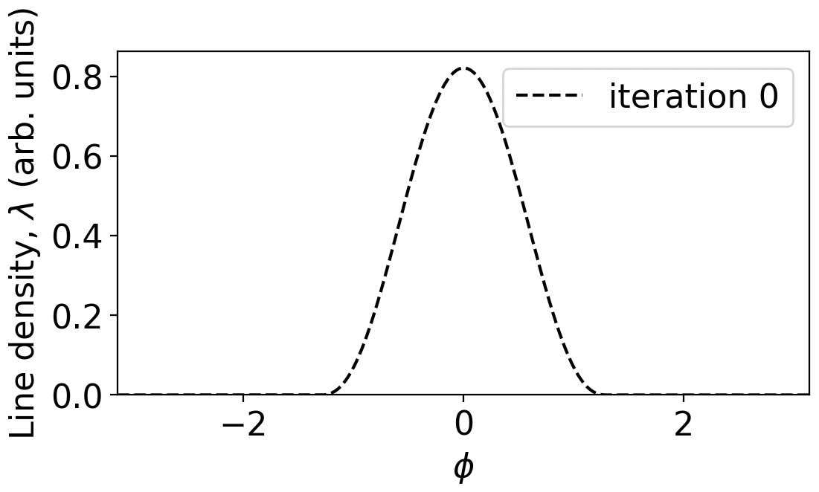
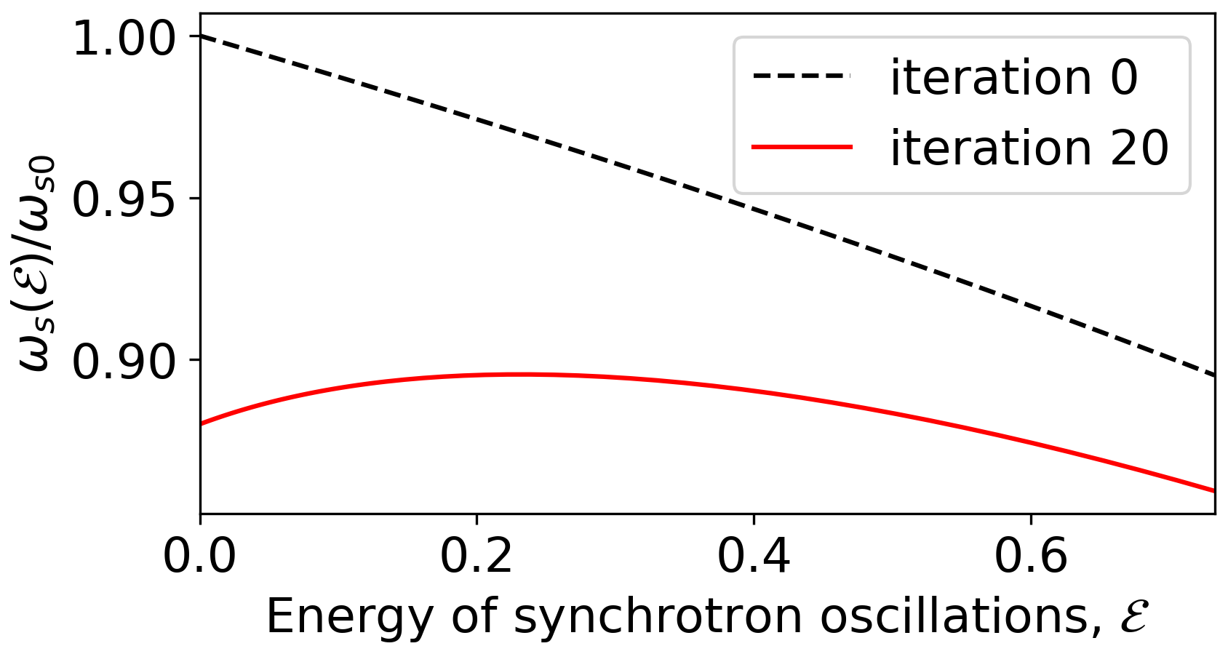

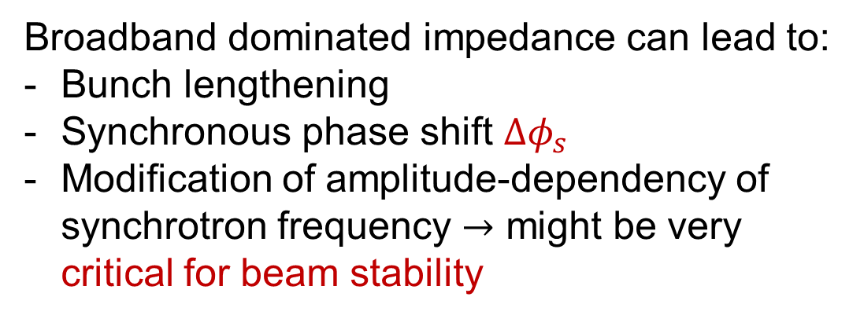
Potential-well distortion
Example for single bunch with $μ=2, φ_{max}=1.3 \left(ℰ_{max}=0.73\right)$, $N_{p} = 6×{10}^{11}$
$$ℰ_{max}$$
Broadband dominated impedance can lead to:
Bunch lengthening
Synchronous phase shift $Δφ_{s}$
Modification of amplitude-dependency of synchrotron frequency $→$ might be very critical for beam stability

Slide 15
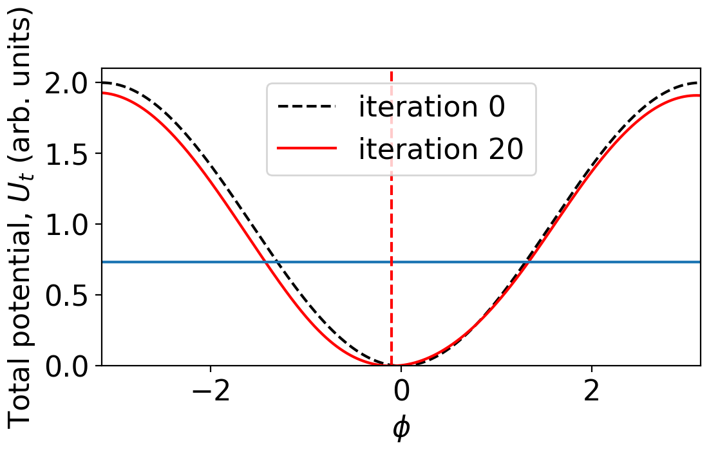

Potential-well distortion
Example for single bunch with $μ=2, φ_{max}=1.3 \left(ℰ_{max}=0.73\right)$, $N_{p} = 6×{10}^{11}$
$$ℰ_{max}$$
Broadband dominated impedance can lead to:
Bunch lengthening
Synchronous phase shift $Δφ_{s}$
Modification of amplitude-dependency of synchrotron frequency $→$ might be very critical for beam stability

Slide 16
Perturbation analysis

Slide 17



Phase kick
$$ℱ\left(ℰ\right)∝{\left(1−\frac{ℰ}{ℰ_{max}}\right)}^{μ}$$
Initial particle distribution
+
10-degree phase offset
Particle distribution
Line density

Slide 18



Rigid-dipole mode
Distribution function of perturbation $\tilde{ℱ}=ℱ_{current}−ℱ_{inital}∝e^{iΩt−iψ}$
Perturbed particle distribution $\tilde{ℱ}$
Perturbed line density
Lack of particles
Excess of particles
Perturbation after a kick excites a rigid-dipole mode

Slide 19


Linearized Vlasov equation
Initial evolution of unstable/undamped modes is governed by equation
$$\left[\frac{∂}{∂t}+ω_{s}\left(ℰ\right)\frac{∂}{∂ψ}\right]\tilde{ℱ}\left(ℰ,ψ,t\right)=ω_{s}\left(ℰ\right)\frac{∂{\tilde{U}}_{ind}\left(ℰ,ψ,t\right)}{∂ψ}\frac{dℱ\left(ℰ\right)}{dℰ}$$
We just evaluated ☺
Input function ☺
Azimuthal mode number
$$\tilde{ℱ}∝e^{iΩt}\sum_{m=1}^{∞}{{\tilde{C}}_{m}\left(ℰ,Ω\right)}×\left[\cos{mψ}−\frac{iΩ}{mω_{s}\left(ℰ\right)}\sin{mψ}\right]$$
Generalized Sacherer equation:
Interaction kernel
$$\left[\frac{Ω^{2}}{ω_{s0}^{2}}−\frac{m^{2}ω_{s}^{2}\left(ℰ\right)}{ω_{s0}^{2}}\right]{\tilde{C}}_{m}\left(ℰ,Ω\right)=−\frac{2iqN_{p}h^{2}ω_{0}}{V_{0}}\sum_{m^{′}=1}^{∞}{\int_{0}^{ℰ_{max}}{K_{mm^{′}}\left(ℰ,ℰ^{′}\right){\tilde{C}}_{m^{′}}\left(ℰ^{′},Ω\right)dℰ^{′}}}$$

Slide 20

Linearized Vlasov equation
Initial evolution of unstable/undamped modes is governed by equation
$$\left[\frac{∂}{∂t}+ω_{s}\left(ℰ\right)\frac{∂}{∂ψ}\right]\tilde{ℱ}\left(ℰ,ψ,t\right)=ω_{s}\left(ℰ\right)\frac{∂{\tilde{U}}_{ind}\left(ℰ,ψ,t\right)}{∂ψ}\frac{dℱ\left(ℰ\right)}{dℰ}$$
We just evaluated ☺
Input function ☺
Azimuthal mode number
$$\tilde{ℱ}∝e^{iΩt}\sum_{m=1}^{∞}{{\tilde{C}}_{m}\left(ℰ,Ω\right)}×\left[\cos{mψ}−\frac{iΩ}{mω_{s}\left(ℰ\right)}\sin{mψ}\right]$$
Generalized Sacherer equation:
Interaction kernel
$$\left[\frac{Ω^{2}}{ω_{s0}^{2}}−\frac{m^{2}ω_{s}^{2}\left(ℰ\right)}{ω_{s0}^{2}}\right]{\tilde{C}}_{m}\left(ℰ,Ω\right)=−\frac{2iqN_{p}h^{2}ω_{0}}{V_{0}}\sum_{m^{′}=1}^{∞}{\int_{0}^{ℰ_{max}}{K_{mm^{′}}\left(ℰ,ℰ^{′}\right){\tilde{C}}_{m^{′}}\left(ℰ^{′},Ω\right)dℰ^{′}}}$$

Slide 21

van Kampen modes
A similar equation describing oscillation modes in plasmas was solved
~70 years ago
Solutions described by generalized functions:
$${\tilde{C}}_{m}\left(ℰ,Ω\right)∝P\frac{1}{Ω^{2}−m^{2}ω_{s}^{2}\left(ℰ\right)}+α\left(ℰ,Ω\right)δ\left[Ω^{2}−m^{2}ω_{s}^{2}\left(ℰ\right)\right]$$
Principal value
Dirac delta function
They can be found using:
Oide-Yokoya method (1990) – powerful approach for numerical analysis
Lebedev equation (1967) – general formalism for (semi-)analytical studies
We will also discuss why not self-consistent approaches (e.g., Sacherer formalism) can lead to incorrect threshold predictions

Slide 22
Single-bunch collective effects:
Loss of Landau damping (LLD)

Slide 23




Examples of LLD in accelerators
Injection
RHIC
17 minutes later
Tevatron
LHC

Slide 24


Phase mixing (decoherence)
Longitudinal phase space
Average phase evolution
Phase mixing leads to “damping” of the average position

Slide 25



Low-intensity van Kampen modes
$${\tilde{C}}_{m}\left(ℰ,Ω\right)∝P\frac{1}{Ω^{2}−m^{2}ω_{s}^{2}\left(ℰ\right)}+α\left(ℰ,Ω\right)δ\left[Ω^{2}−m^{2}ω_{s}^{2}\left(ℰ\right)\right]$$
Mode phase space $\tilde{ℱ}$
Synchrotron frequency distribution

Slide 26

Low-intensity van Kampen modes
$${\tilde{C}}_{m}\left(ℰ,Ω\right)∝P\frac{1}{Ω^{2}−m^{2}ω_{s}^{2}\left(ℰ\right)}+α\left(ℰ,Ω\right)δ\left[Ω^{2}−m^{2}ω_{s}^{2}\left(ℰ\right)\right]$$
Mode phase space $\tilde{ℱ}$
Synchrotron frequency distribution
Each mode has its specific frequency

Slide 27

Landau damping in longitudinal plane
Rigid-dipole mode is a superposition of van Kampen modes

Slide 28


Landau damping in longitudinal plane
Rigid-dipole mode is a superposition of van Kampen modes
$→$ Landau damping is the phase mixing of van Kampen modes

Slide 29




Oide-Yokoya method
van Kampen modes can be obtained as eigenvalues and eigenvectors by discretizing the Generalized Sacherer equation on a grid in $ℰ$
$$ζ=\frac{qN_{p}h^{2}ω_{0}}{V_{0}}$$
$$M_{mm^{′}}^{nn^{′}}=\frac{m^{2}ω_{s}^{2}\left(ℰ_{n}\right)}{ω_{s0}^{2}}δ_{nn^{′}}δ_{mm^{′}}−2iζ\sqrt{Δℰ_{n}Δℰ_{n^{′}}}K_{mm^{′}}\left(ℰ_{n},ℰ_{n^{′}}\right)$$
Stripe width
$$K_{mm^{′}}\left(ℰ,ℰ^{′}\right)=\sum_{k=−∞}^{∞}{\frac{Z_{k}}{hk}m\sqrt{−ω_{s}\left(ℰ\right)\frac{dℱ\left(ℰ\right)}{dℰ}}I_{mk}\left(ℰ\right)}$$
$$×m^{′}\sqrt{−ω_{s}\left(ℰ^{′}\right)\frac{dℱ\left(ℰ^{′}\right)}{dℰ^{′}}}I_{m^{′}k}^{∗}\left(ℰ^{′}\right)$$
?

Slide 30






$I_{mk}$ functions
Transformation from revolution harmonics $k$ to azimuthal mode index $m$
$$I_{mk}\left(ℰ\right)=\frac{1}{2π}\int_{−π}^{π}{e^{\frac{ik}{h}φ−imψ}dψ}$$
For short bunches in single RF
$$I_{mk}\left(ℰ\right)≈i^{m}J_{m}\left(\frac{k}{h}\sqrt{2ℰ}\right)$$
$$φ\left(ℰ,ψ\right)≈\sqrt{2ℰ}\cos{ψ}$$
Exact (solid lines) and approximate (dashed) functions
Bessel function of the 1st kind

Slide 31





Loss of Landau damping
Example for single bunch with $μ=2, φ_{max}=1.3 \left(ℰ_{max}=0.73\right)$ for toy model without RF cavity and HOM impedance
van Kampen modes vs bunch intensity
Increasing bunch intensity $N_{p}$ ↑:
- Synchrotron frequency spread changes due to potential-well distortion
- Mode detaches above certain
intensity
- It is described by a regular
function
$$N_{LLD}≈5.7×{10}^{10}$$
Undamped mode
$→$ LLD threshold $Ω=\max{[ω_{s}\left(ℰ\right)]}$
Can we compute it analytically?

Slide 32




Lebedev equation
A system of equations for line-density harmonics ${\tilde{λ}}_{k}$ for mode $Ω$
Impedance at $kω_{0}+Ω$
$$\sum_{k=−∞}^{∞}{\left[δ_{k^{′}k}+\frac{ζ}{h}{ G}_{k^{′}k}\left(Ω\right)\frac{Z_{k}\left(Ω\right)}{k}\right]} {\tilde{λ}}_{k}\left(Ω\right)=0$$
Beam transfer matrix
$→$ The mode $Ω$ is a solution if the determinant is zero
$$det\left[δ_{k^{′}k}+\frac{ζ}{h}{ G}_{k^{′}k}\left(Ω\right)\frac{Z_{k}\left(Ω\right)}{k}\right]=det\left(I−ζX\right)=0$$

Slide 33
Lebedev equation
A system of equations for line-density harmonics ${\tilde{λ}}_{k}$ for mode $Ω$
Impedance at $kω_{0}+Ω$
$$\sum_{k=−∞}^{∞}{\left[δ_{k^{′}k}+\frac{ζ}{h}{ G}_{k^{′}k}\left(Ω\right)\frac{Z_{k}\left(Ω\right)}{k}\right]} {\tilde{λ}}_{k}\left(Ω\right)=0$$
Beam transfer matrix
$→$ The mode $Ω$ is a solution if the determinant is zero
$$det\left[δ_{k^{′}k}+\frac{ζ}{h}{ G}_{k^{′}k}\left(Ω\right)\frac{Z_{k}\left(Ω\right)}{k}\right]=det\left(I−ζX\right)=0$$

Slide 34








Sacherer formalism
Replacing $I_{mk}\left(ℰ\right)$ by $i^{m}J_{m}\left(\frac{k}{h}\sqrt{2ℰ}\right)≈{\left(\frac{k}{h}\sqrt{2ℰ}\right)}^{m}\frac{1}{2^{m}m!}$ for $\frac{k}{h}\sqrt{2ℰ_{max}}<1$,
Lebedev equation becomes equivalent to Sacherer stability diagram
Mode shift without frequency spread
LLD threshold
$$ℱ\left(ℰ\right)∝\sqrt{1−ℰ/ℰ_{max} }$$
$$1=−\frac{ΔΩ_{1}}{W}\int_{0}^{ℰ_{max}}{\frac{ℰ}{Ω−ω_{s}(ℰ)}\frac{dℱ(ℰ)}{dℰ}dℰ}$$
Unstable
$$W=\int_{0}^{ℰ_{max}}{ℰ\frac{dℱ(ℰ)}{dℰ}dℰ}$$
$$Re\left[ΔΩ_{1}\right]$$
Stable
LLD threshold ≡ $ΔΩ_{1}$ is outside the stability region
$$Im\left[ΔΩ_{1}\right]$$

Slide 35





More accurate approximate solution
Equation to solve
$$det\left(I−ζX\right)=0$$
Eigenvalue problem
$$det\left(ν_{n}I−ζX\right)=0$$
Based on matrix trace property $tr\left(ζX\right)=\sum_{n}{ν_{n}}$ $→$ $ζ=\frac{1+σ}{tr\left(X\right)}$, with $σ=\sum_{n≠0}{ν_{n}}$
Assuming $σ<1$ the LLD threshold for dipole mode:
$$N_{LLD}≈\frac{V_{0}}{qω_{rf}}{\left[\sum_{k=−∞}^{∞}{G_{kk}\left(Ω\right)\frac{Z_{k}\left(Ω\right)}{k}}\right]}^{−1}$$
sum
sum
Since elements $G_{kk}$ saturate for $k→∞$
$→$ LLD threshold is zero for commonly used inductive impedance
$\frac{Z_{k}}{k}=iImZ/k=$ const

Slide 36








LLD threshold
One needs to introduce a cutoff frequency $f_{c}=k_{c}f_{0}$ and then
Function $χ_{μ}\left(y\right)$
$$N_{LLD}≈\frac{π}{32qhω_{rf}μ\left(μ+1\right)} \frac{V_{0}φ_{max}^{5}}{χ_{μ}\left(k_{c}φ_{m}/h\right)ImZ/k}$$
$$N_{LLD}≈\frac{π}{32qω_{rf}μ\left(μ+1\right)} \frac{V_{0}φ_{max}^{4}}{k_{c}ImZ/k}$$
For $f_{c}→∞$
so that $N_{LLD}∝ 1/f_{c}$ and$φ_{max}^{5}→φ_{max}^{4}$
$→$ $N_{LLD}$ based on Sacherer formalism is reproduced only for $f_{c}≈1/τ$ $(k_{c}φ_{m}≈π)$

Slide 37
Benchmarking LLD threshold formula
Example for LHC:
450 GeV, $μ=2$, truncated inductive impedance with $ImZ/k=0.07$ Ohm

Slide 38







Effective impedance for LLD
$$N_{LLD}≈\frac{V_{0}}{qω_{rf}}{\left[\sum_{k=−∞}^{∞}{G_{kk}\left(Ω\right)\frac{Z_{k}\left(Ω\right)}{k}}\right]}^{−1}$$
Since
All work with $k_{c}→k_{eff}$ & $ImZ/k{→\left(ImZ/k\right)}_{eff}$
Example for SPS at 450 GeV
$${\left(ImZ/k\right)}_{eff}=\frac{\sum_{k=1}^{k_{eff}}{G_{kk}Im(Z_{k}/k)}}{\sum_{k=1}^{k_{eff}}{G_{kk}}}$$
naturally
where $k_{eff}$ maximizes the nominator
$$μ=2, φ_{max}=1$$
Broadband resonator with $Q=1, f_{r}=10f_{rf}$

