Slide 1
Sustainability of Particle Accelerators with focus on high intensity
Mike Seidel
Paul Scherrer Institute and EPFL, Switzerland
CERN Accelerator School
June, 2025, Borovets

Slide 2
Sustainability = Meeting the needs of the present without compromising the ability of future generations.
(one of many debated formulations)
efficient technologies
mobility &
business travel
construction GHG emissions
research infrastructure system efficiency
energy related research
water consumption
life cycle management & recycling
office/lab energy consumption
energy sources / procurement
grid energy consumption
use of critical materials
heating & waste heat recycling

Slide 3
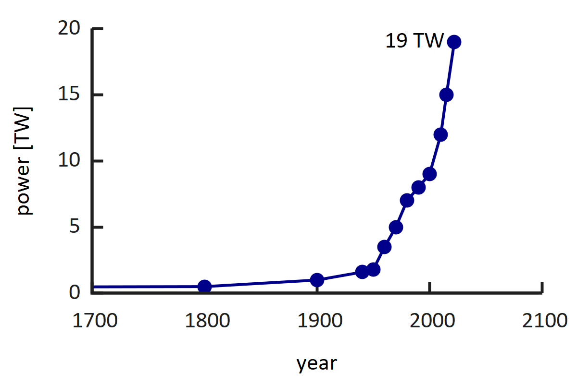

Energy Consumption - Motivation
The world energy consumption has been continuously rising, reaching ca 19 TW today.
As a science community we rather want to contribute to solutions and not be part of the problem.
includes all sources
example from nature:
the Earth-Moon system dissipates 3.8 TW power from the rotation energy of earth
[Williams, Boggs, 2016]
Tides
Earth
Moon
School Strike for Climate
Wikipedia

Slide 4



Community Activities on Sustainability
2014-17: EUCARD-2, WP Energy Efficient Accelerator Technologies
https://www.psi.ch/enefficient
2017–21: ARIES, Work Package Efficient Energy Management
https://www.psi.ch/aries-eem
2021–25: I.FAST, Work Package Sustainable Concepts
https://www.psi.ch/scat
→ consult websites for link collection to workshops and documentation
ICFA panel on sustainable accelerators, chair: Thomas Roser (BNL)
https://icfa.hep.net/icfa-panel-on-sustainable-accelerators-and-colliders/

Slide 5
Accelerator driven Research Infrastructures (RI)
primary beam
grid power
accelerator
conversion target
undulators/magnets
colliding beam insertion
…
radiation to
experiments
auxiliary systems
primary beam production
protons
ions
electrons
conversion to specific secondary radiation
neutrons, muons, neutrinos
exotic particles
X-rays
high level goal:
Science output per grid power, per operating/investment cost.

Slide 6
Accelerator Concepts and Technologies
[with emphasize on energy efficiency]
Proton Drivers with high intensity applications
Synchrotron Light Sources and FELs
Particle Colliders
concepts, RI‘s
Resonators and high Power RF Systems
Accelerator Magnets and Power Supplies
technologies
Cryogenic Systems
Component Cooling, Air Conditioning, Vacuum, Instrumentation … and other aux. systems

Slide 7
Proton Driver Accelerators
… and best attainable Grid-to-Beam efficiency?

Slide 8
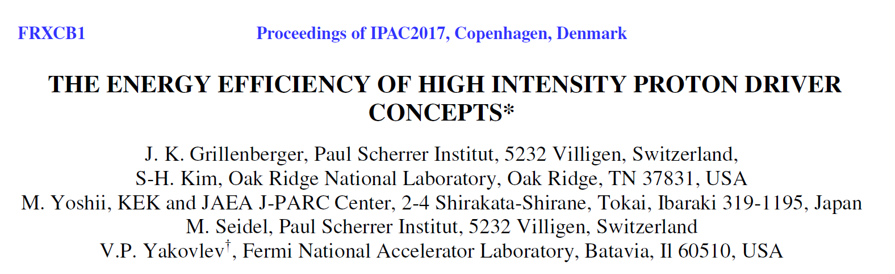
Megawatt Proton Driver Concepts
 | technology | application
spallation neutron source SNS | s.c. linac + accumulator ring | pulsed neutrons
J-PARC Complex | rapid cycling synchrotron 3GeV (and main ring 30GeV) | pulsed neutrons, neutrinos, muons and more …
PSI High Intensity Proton Accelerator | isochronous cyclotron | CW neutrons, muons, ultra cold neutrons
Workshop: Efficiency of Proton Driver Accelerators, 2016, PSI
https://indico.psi.ch/event/3848/
Yakovlev, FNAL, invited talk, IPAC 2017

Slide 9
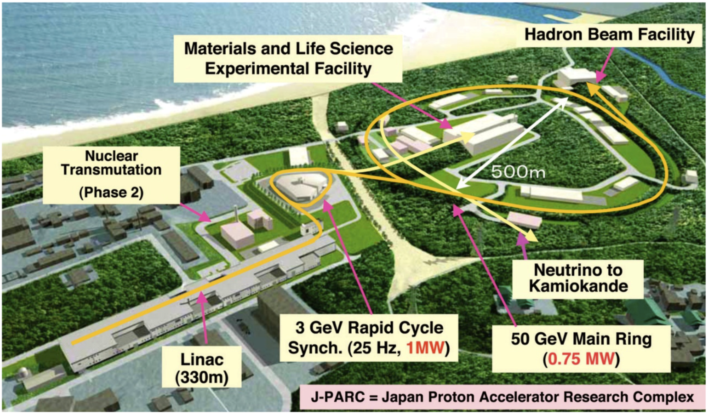
J-PARC Complex
RCS provides an economic solution to reach high energy of 3GeV; C=348m
is needed as injector for main ring to 50GeV
25Hz cycling allows to achieve 1MW for neutron and muon production
grid to beam efficiency is limited by losses from the cycling magnetic fields (ca 3%)

Slide 10
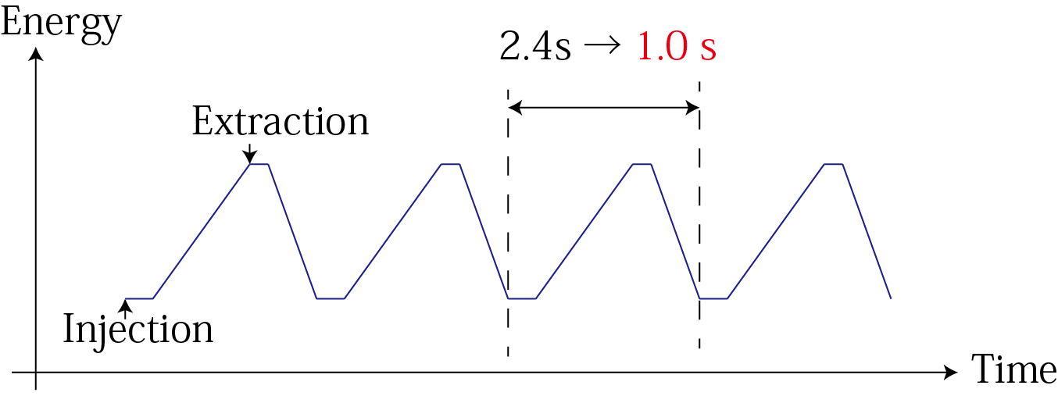
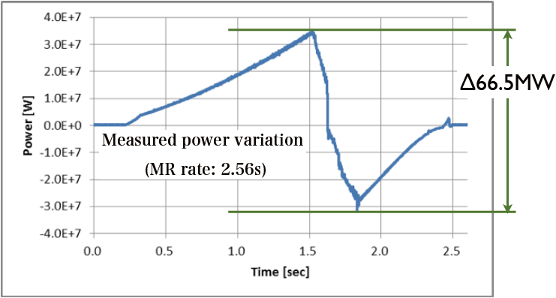
Mitigate energy loss in cycling synchrotrons (Yoshi Kurimoto,KEK)
concerns main ring in J-PARC, but applicable also to other cycling synchrotrons
use energy storage system to recover field energy from magnets
< 1.3 s
Increasing Repetition Rate from 0.4 Hz to approximately 1 Hz
Requirement : Energy Storage
Issue：Large power variation @ AC main grid $P=VI=\left(L\frac{dI}{dt}+RI\right)I$
2.56sec cycle
1sec cycle
磁気エネルギーの流れ
~Δ140MW
Not allowed by Tokyo Electric Power Company
Energy Recovery with Bank Capacitor

Slide 11
Spallation Neutron Source SNS (ORNL)
superconducting linac accelerates H- to 1GeV at 60Hz repetition rate
accumulator ring compresses the pulse from 1ms to 0.7μs by stripping injection of H-
pulsed neutrons are needed for many types of research and are advantageous over CW neutrons (reactor or PSI cyclotron)
however, grid to beam efficiency is limited by pulsed operation of s.c. linac (ca 9%)
→ see later discussion on s.c. linacs

Slide 12
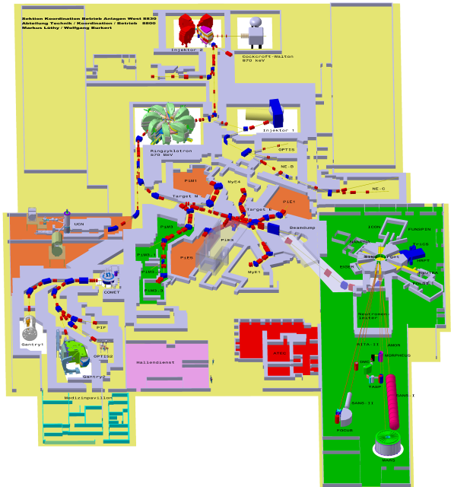
PSI High Intensity Proton Accelerator
isochronous cyclotron: no cycling of magnets/RF; but CW beam
low frequency RF, 50MHz, thus efficient
large and bulky magnets cover wide radius variation of beam (to R=4.5m)
1.4MW record beam power; low bunch charge through CW
Ring Cyclotron 590MeV
2.4mA / 1.4MW
diameter: 15m
SINQ
spallation source
meson production targets
proton therapie center [250MeV sc. cyclotron]
dimensions:
120 x 220m²

Slide 13
Power flow in PSI’s High Intensity Proton Accelerator
public grid ca. 10MW
required for p beam: 7.8MW
RF Systems 4.1MW
Beam on targets
1.4MW
neutrons
muons
Magnets
≈ 2.6MW
conversion chain to beam power
offset power for aux. systems
finally heat
aux.Systems
Instruments
≈ 3.3MW
cryogenics
heat → to river, to air

Slide 14
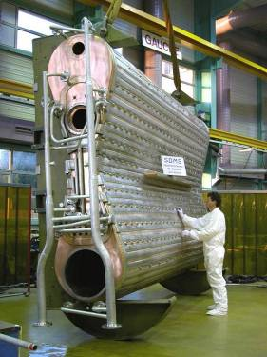
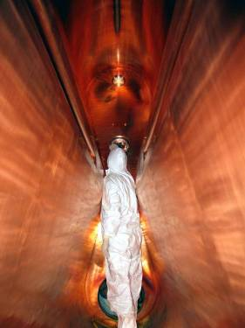
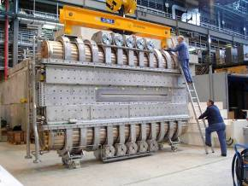
Copper Resonators in PSI’s Ring Cyclotron
f = 50.6MHz; Q₀ = 4,8⋅10⁴; U_{max}=1.2MV (presently 0.85MV)
transfer of up to 400kW power to the beam per cavity; a total of 4 cavities
Wall Plug to Beam Efficiency (RF Systems): 32% [AC/DC: 90%, DC/RF: 64%, RF/Beam: 55%]
resonator inside
hydraulic tuning devices (5x)

Slide 15
Comparison: Megawatt p-Drivers
590 MeV, 1.4 MW
Megawatt class facilities operating today:
optimized for application, not efficiency!
facility | accelerator type | Economy | Energy Reach | Power Reach | operational complexity | grid-to-beam Efficiency
SNS | superconducting linac | -- | ++ | ++ | ++ | 9%
J-PARC | rapid cycling synchrotron | ++ | ++ | - | - | 3%
PSI | isochronous cyclotron | + | -- | + | - | 18%

Slide 16
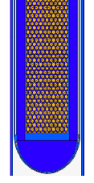
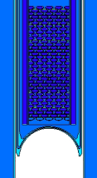
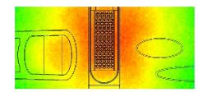
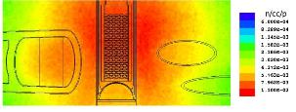
PSI: Improving Conversion Efficiency to secondary Radiation
old
new
Example: neutron production target at PSI
measure | gain
Zr cladding instead steel | 12%
more compact rod bundle | 5%
Pb reflector | 10%
inverted entrance window | 10%
total gain factor | 1.42
beam
beam
color code: neutron density on same scale (MCNPX)

Slide 17
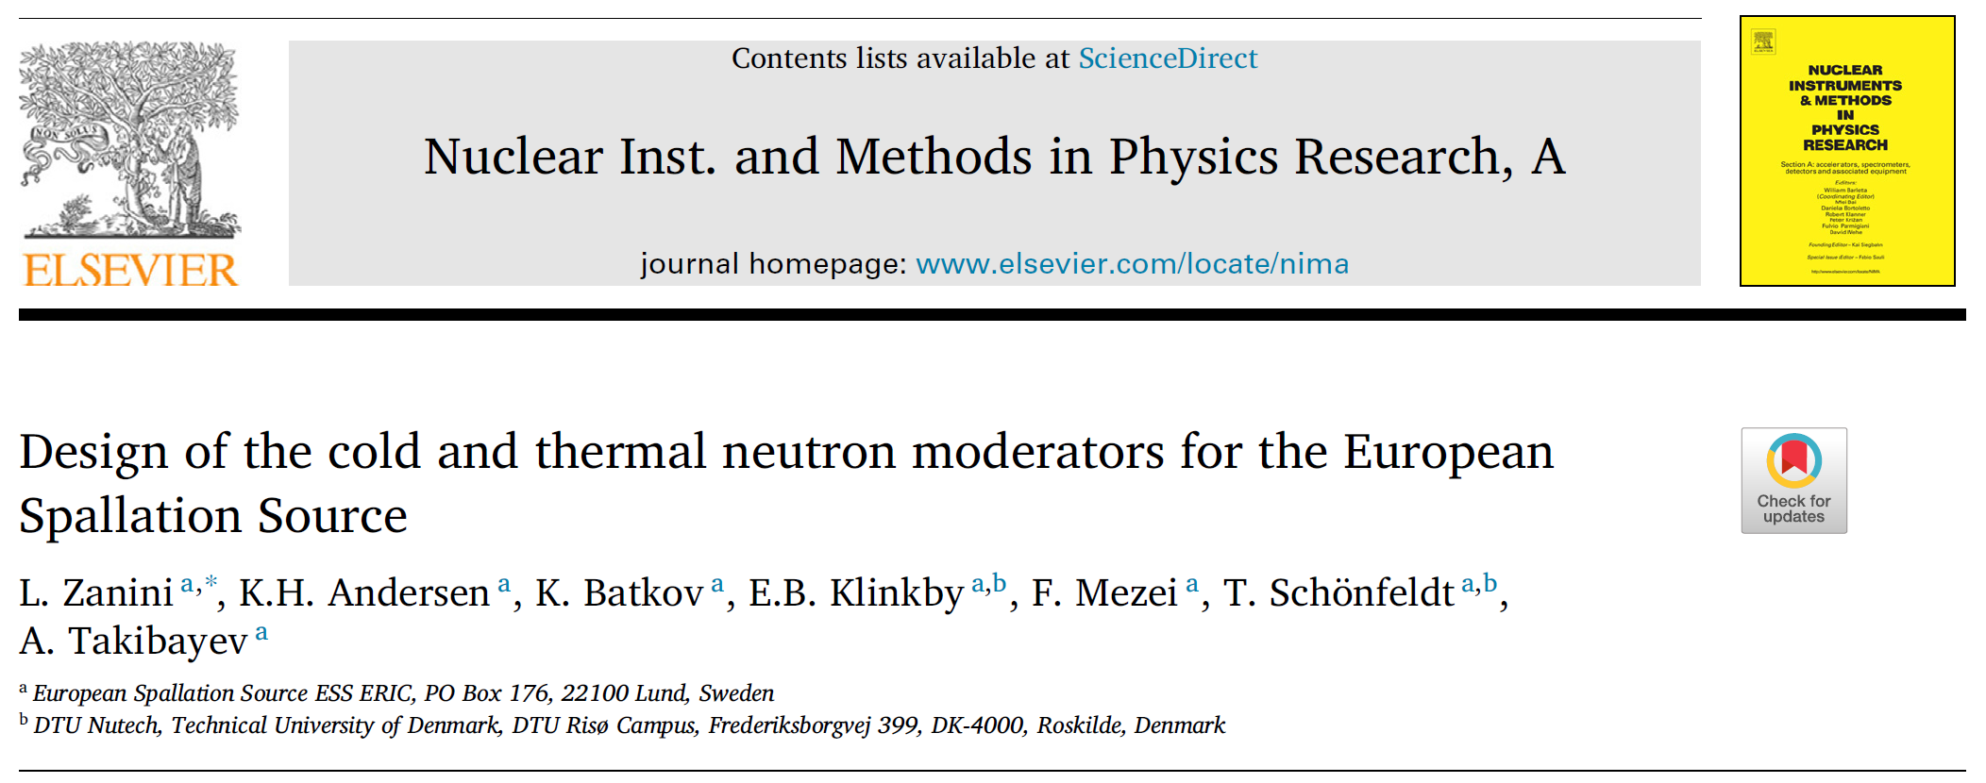
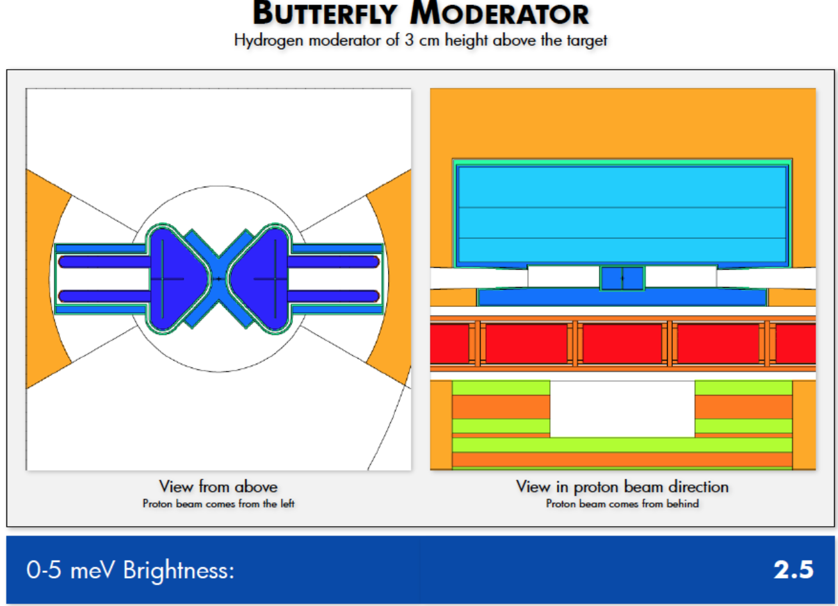
ESS: Improving Conversion Efficiency to secondary Radiation
Example: neutron production target at ESS
L.Zanini et al (2019):
Brightness increase by using low-dimensional moderators.
The flat moderators adopted for ESS offer a clear brightness increase with respect to the original TDR design based on volume moderators: the cold brightness increases by more than a factor of 2.5 with respect to the original design for ESS.

Slide 18
Best attainable Grid-to-Beam efficiency with superconducting linac technology.

Slide 19
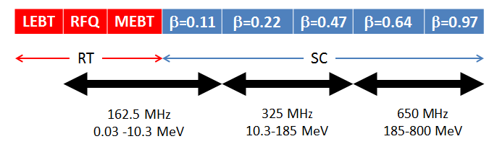
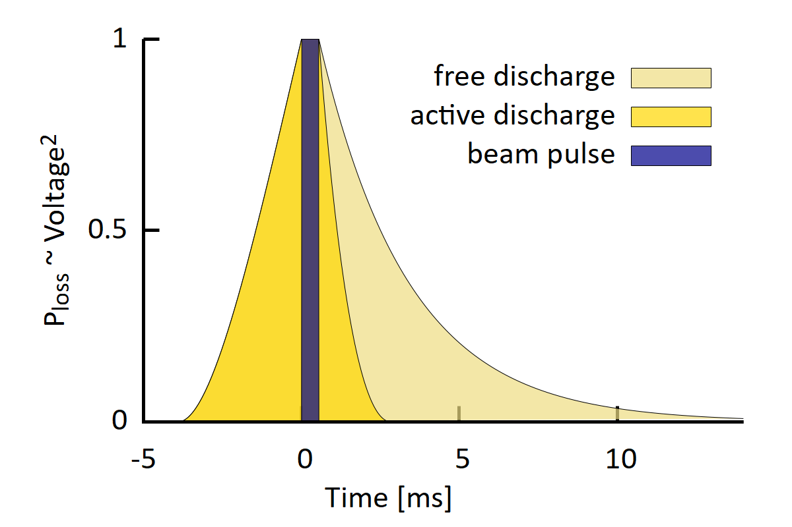
Superconducting Linac : High Efficiency Potential example: PIP-II design of Fermilab
PIP-II base parameters:
H⁻, 800MeV, 2.0mA, part of Fermilab complex
aim: neutrino production (1MW @ 60..120GeV)
CW operation as upgrade path
highest efficiency
not efficient in pulsed operation:
operating regime | avg. RF power | cryogenic power | avg. beam power | grid-to-beam Efficiency
PIP-II pulsed operation | 1.44MW | 1.19MW | 17.6kW | 0.7%
PIP-II CW operation | 9.10MW | 1.83MW | 1.60MW | 15%
[from presentation B.Chase, Y.Yakovlev, 2018]

Slide 20

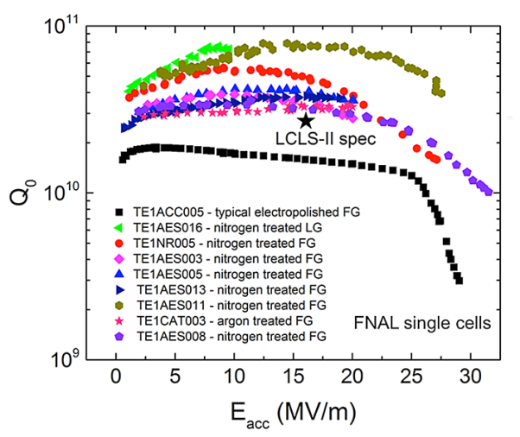
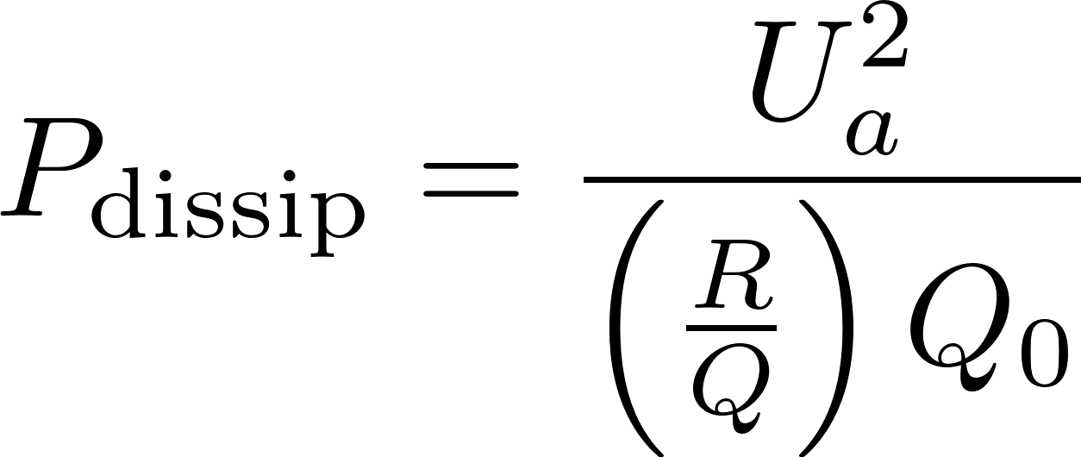
Low Loss Superconducting Resonators
high Q resonators, 1.3GHz, 2K, FNAL
[A.Grassellino, A.Romanenko et al, 2013]
10¹⁰
2×10¹⁰ s.c. resonator
Q₀ = quality factor
→ e-folding decay and resonance width
dissipated power:
10⁵
50‘000 Cu resonator
3‘000 church bell
example:
U_{a} = 20MV, (R/Q) = 609Ω, Q₀ = 2×10¹⁰, I_{b}=2mA
P_{dissip} = 33 W
P_{beam} = 40.000 W
1
but: cryogenic efficiency!

Slide 21
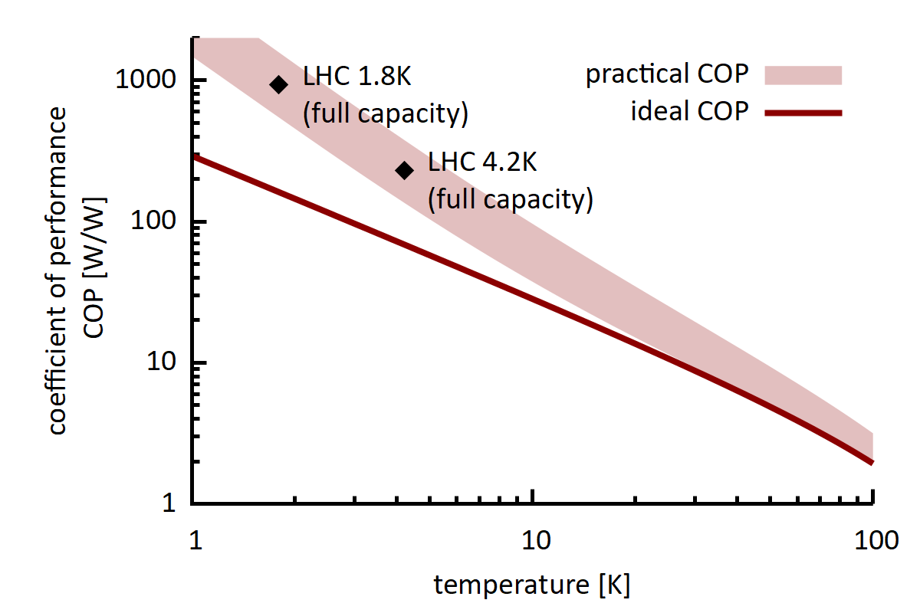
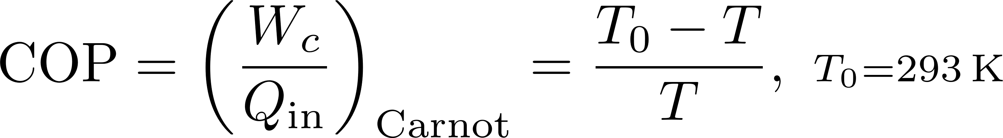

Cryogenic Efficiency
W_{c}
T₀ = 293K
Q_{in}
T = 2K
best possible coefficient of performance (COP):
factor 3!
W_{c} = amount of work required to remove heat Q_{in} at cold temperature T
[S.Claudet et al, CERN 2013]
→ lower COP is better !

Slide 22

COP Factor: compare heating of houses
W
T = 308K (35°C)
Q_{out}, Q_{in}
T₀ = 273K (0°C)
best possible coefficient of performance (COP):
in theory: COP_{Carnot} = 8.8
in practice: COP = 3…5
in this case → higher COP is better !

Slide 23
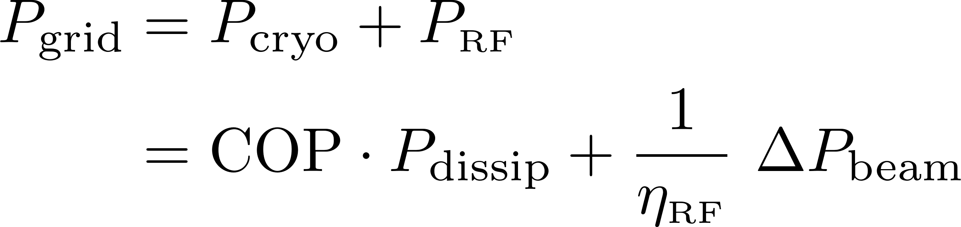

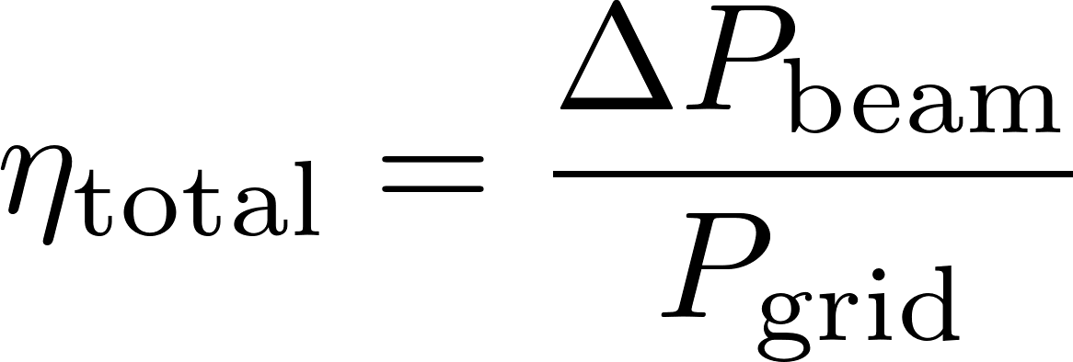
Powerflow s.c. Linac – Minimum System Example for a Single Cavity
power balance:
GRID
AC/DC/RF/guide
η_{RF} ≈ 0.4 .. 0.6
P_{RF}
cryogenics
COP ≈ 1000
P_{dissip}
beam
considered:
one 650MHz cavity
U_{a} = 20MV
l = 1.1m
ignored: cavity detuning, β<1, regulation overhead, aux. systems …
regime | I_{b} [mA] | Q₀ | η_{RF} | ΔP_{beam} [kW] | grid-to-beam Efficiency
TDR, CW | 2.0 | 2⋅10¹⁰ | 0.44 | 40.0 kW | 30%
high Q | 2.0 | 3⋅10¹⁰ | 0.44 | 40.0 kW | 33%
high current | 4.0 | 3⋅10¹⁰ | 0.65 | 80.0 kW | 50%
extrapolation

Slide 24
Energy Efficient Accelerator Technologies

Slide 25
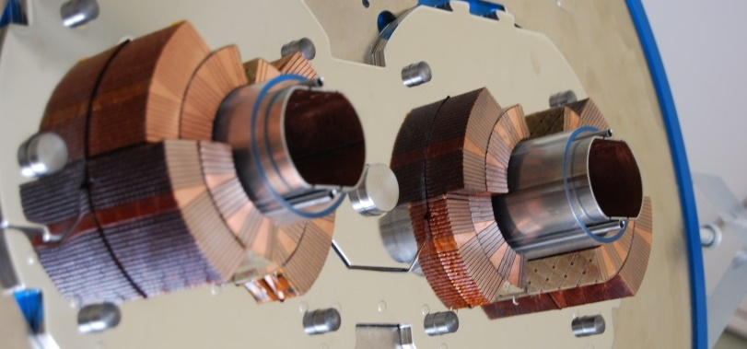
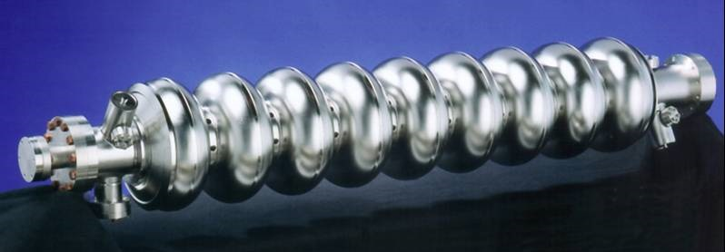
Supercondactivity in Particle Accelerators
the main concepts in accelerators: bending of trajectories and energy gain by RF fields, profit from energy efficient superconducting technology
Magnets
RF Resonators
DC field: cooper pairs move frictionless
zero losses
example: MRI magnet with cold switch
RF field: cooper pairs move frictionless, but carry mass that is accelerated back and forth
→ imperfect shielding of RF field in material
→ dissipation from «normal» electrons in RF field
→ very small but non-zero losses

Slide 26
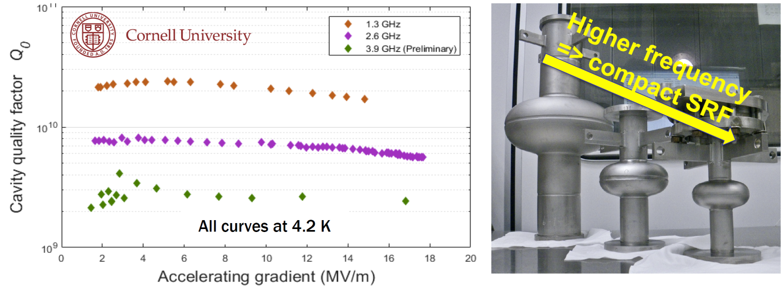
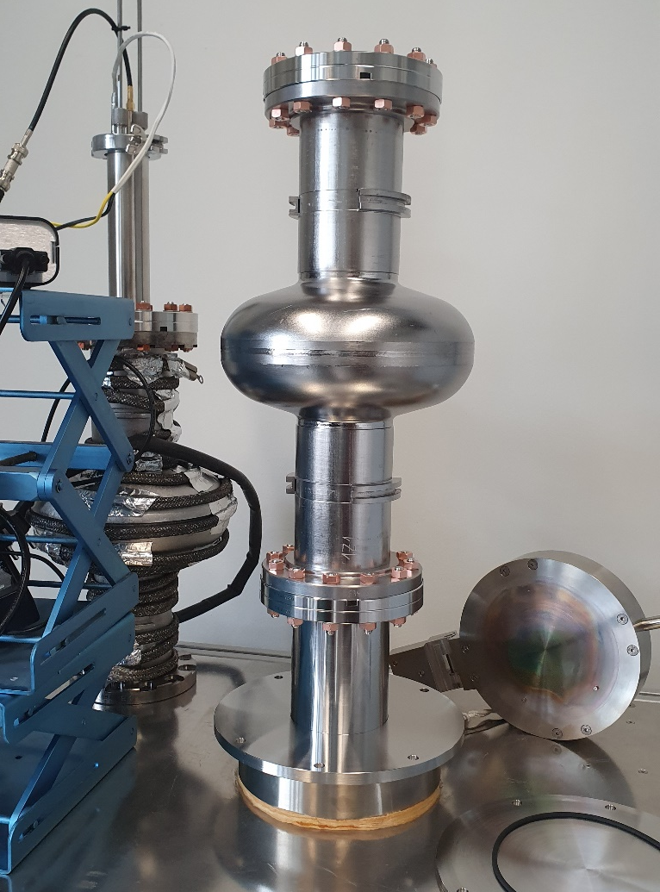
Technology R&D: Superconducting RF at higher temperature
promising R&D: Nb₃Sn coated cavities at Cornell
4.2 vs. 2.0K → efficiency
[M.Liepe, Cornell, IPAC‘19]
Cornell, FERMILAB
→ simplicity, cost, efficiency, smaller size
S Posen et al 2021 Supercond. Sci. Technol. 34 025007
record cw gradient in Nb₃Sn-coated, E_{acc} = 24 MV/m
SMART recipe leads to a T_{c} of 15.4 K on Nb-samples coated with 15 / 25 nm of AlN / NbTiN
DESY, Hamburg U.
aim for sustained SRF accelerator technology
10y Goal: >70 MV/m with a Q₀ of 1x10¹⁰ and at 4K
contact: M.Wenskat, DESY
To be published
G. Deyu et al., „Al₂O₃ coating of Superconducting Niobium Cavities with thermal ALD“, in preparation

Slide 27

Efficient RF Power Sources
Klystrons, η>70% within reach
e.g. CLIC two stage multi-beam klystron, J.Cai, I.Syratchev, IEEE Trans, 2020
Example: study 1GHz for CLIC drive beam; 6 cavities, 30 beamlets; 25+140kV; η_{sat}=82%
Magnetron, R&D at various groups, η=60-80% within reach
e.g. Wang et al, J-Lab, IPAC 2019; A.Dexter, Lancaster U., LINAC-2014; B.Chase, Fermilab, JINST-2015
Solid state amplifiers (SSA) at various groups, η=60-90% depending of freq.
Example: SSA for Isotope production Cyclotron, 98.5MHz, 12x1kW units, η_{D}=93% (90% with regulation overhead)
Uppsala group, WP in I.FAST program
I.FAST efficient RF workshop, July 23-25, 2024, Toledo:
https://indico.cern.ch/event/1407353/

Slide 28
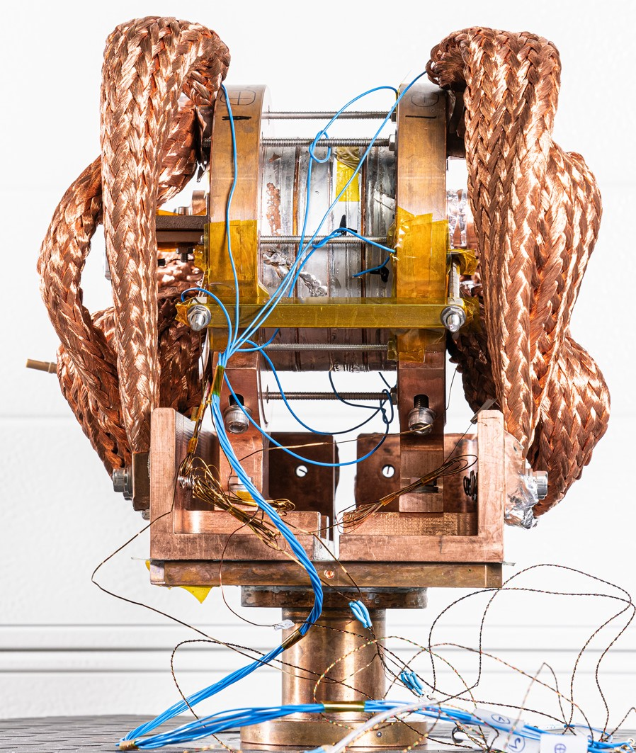
Accelerator Magnets with High Temperature Superconductor Coils
magnets with High Temperature Superconductor (HTS) coils:
medium fields for all applications (high fields in block config.)
ReBCO and Bi-2212 materials are studied
no ohmic losses, can replace power hungry large aperture dipoles/quads
cryogen free conduction-cooling possible (no He)
much improved cryogenic efficiency at elevated temperatures (e.g. 4.5K…15K instead 2K)
today expensive materials
field ramping and field quality difficult (wide tapes)
solenoid test magnet, 18T @ 12K
PSI/CHART, B.Auchmann et al

Slide 29
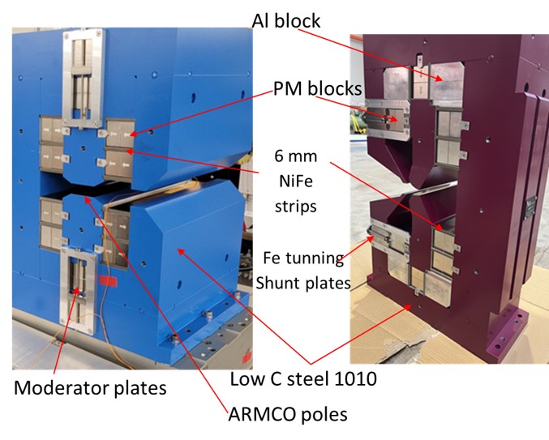
Accelerator Magnets with Permanent Magnet Material
Dipole and Quad for SLS2.0, S.Sanfilippo et al (PSI)
permanent magnets:
extremly compact → low emittance lattices
no power consumption
no cooling, thus no heat introduced, no vibrations from cooling loop
field tuning difficult
use of rare earth materials
B = 1.35 T g = -40.6 T/m

Slide 30
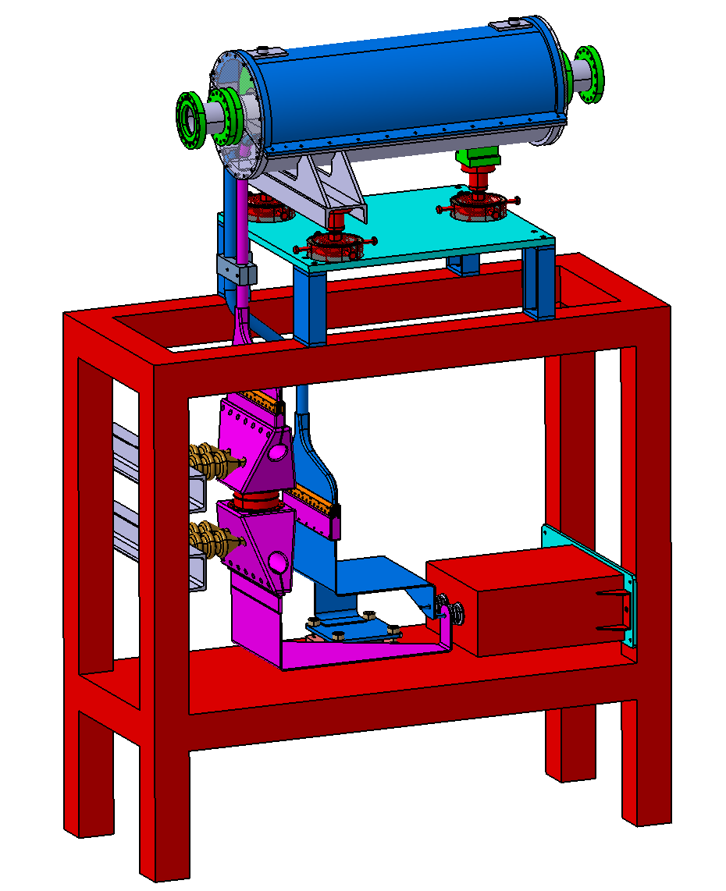
Pulsed Magnets for beam Transfer Channels in lead: GSI, S. Heberer, P. Gehrke, P.Spiller et al
low average power; high field; compact; energy recovery in capacitive storage (power supply)
complexity added by pulsing circuit; field precision potentially challenging
 | Prototype Quadrupole
Gradient | 80 T/m
Length | 0.65 m
Pulse length | 90 ms (beam 1 ms)
Peak current | 400 kA
Peak voltage | 17 kV
Energy @17 kV | 65 kJ
Inductivity | 535 nH
Capacitor | 450 mF
Forces | 200 kN
Engineering model of the prototype quadrupole magnet incl. support

Slide 31
other aspects of sustainability
- heat recovery
- rare earths, critical materials
- carbon footprint of components, construction, operation
- carbon footprint of tunnel dominates

Slide 32

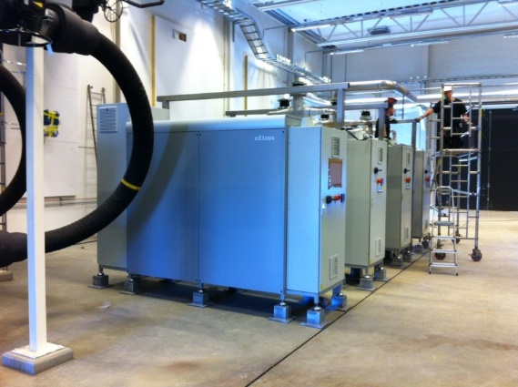

Recover High Quality Power from Heat?
the quality of power
produce work → electrical power?
example: T=40°C: efficiency 8%
T=95°C: efficiency 20%
1 [electrical power]
0.95 [mechanical power]
use heat directly at available temperature
example: T_{use}=50°C …80°C : heating
T_{use}=25°C…50°C: green houses, food production
convert heat to higher T level for heating purposes
0.3…0.4 [heat]
heat pumps at MAX-4
[Björn Eldvall / E.ON, Martin Gierow / Kraftringen]
example: T=40°C, T_{use} =80°C, COP=5: W=10kW, Q_{C}=40kW, Q_{H}=50kW
(availabe for heating)

Slide 33
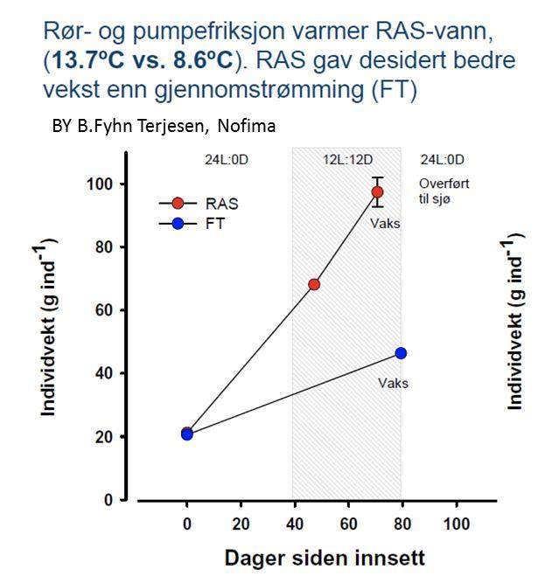
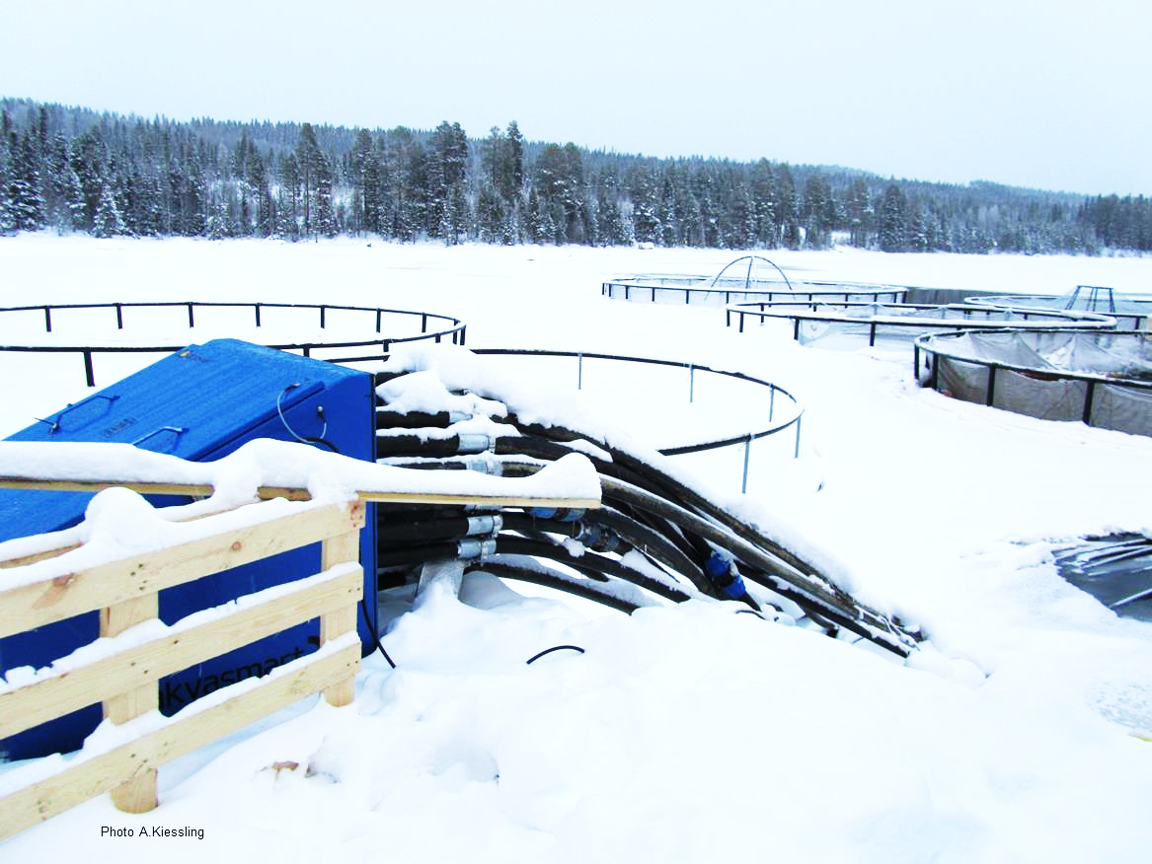

Biology/Nature is more efficient …
An increase in temperature from 8.6 to 13.7 ºC
doubled the growth rate in salmon smolt.
A.Kiessling
Τ = 5 C
Weight (average) in grams
Days

Slide 34
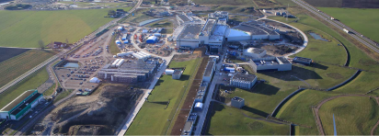

Powering accelerators from local PV renewable energy, C.Martins ESS
Concept:
Install PV panels near accelerators’ “wasted land”;
Connect them to main power converters for accelerator magnets or RF amplifiers, using high efficiency DC/DC conversion
can redirect the PV energy back to the AC grid when accelerator not running
Up to 15-20% renewable energy utilization possible with no transmission losses and high conversion efficiency
Lower capital cost & lower payback time
Feasibility study for ESS case: up-to 2MW installed PV
Conventional scheme:
PV injected into the AC grid (4 stages)
New scheme:
PV injected into power converters (2 stages)
Power Converter
load (magnets, RF amp’s)
Power Converter
load (magnets, RF amp’s)
AC grid
AC
DC
AC grid
DC
~
DC
~
DC
DC
AFE: Active Front End
η_{PV}≈0.98x0.97x0.97x0.95 = 87.6%
η_{PV}≈0.98x0.95 = 93.1%
AC
DC
For P=0.5MW ->
savings ≈ 20k€/year
DC
DC
DC
DC

Slide 35
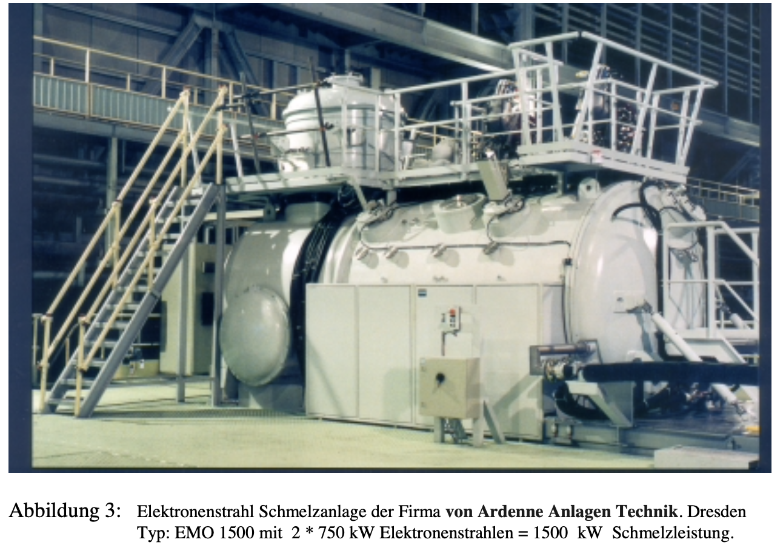
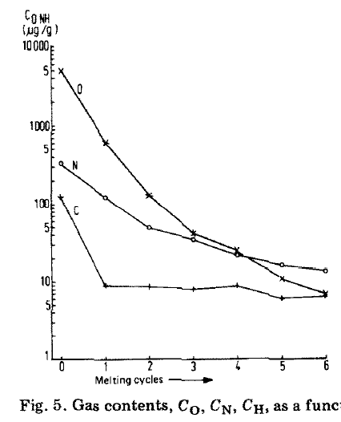
Critical Materials: Niobium for Superconducting Cavities, B.List, DESY
RRR (Residual Resistivity Ratio) is an indicator of purity
is defined as the ratio of its electrical resistivity at room temp 273 K to its resistivity at cryogenic temperature
RRR>=300 achieved by 6x vacuum remelting
estimate by B.List (DESY):
  Niobium RRR>300, from China: 98kg CO2-e / kg;
  (stainless steel ca 5..7 kg CO2 / kg)
  -> 10% of total GHG for ILC250 accelerator!
  -> large impact reduction potential
electron beam melting machine
cavities based on thin film superconductor can reduce CO2 footprint (and operate at higher temperature), but technology is not ready for large scale deployment today
M. Hörmann, J. Less-Common Met. 139(1988)1
DOI:10.1016/0022-5088(88)90324-4
impurities after n melting cycles

Slide 36
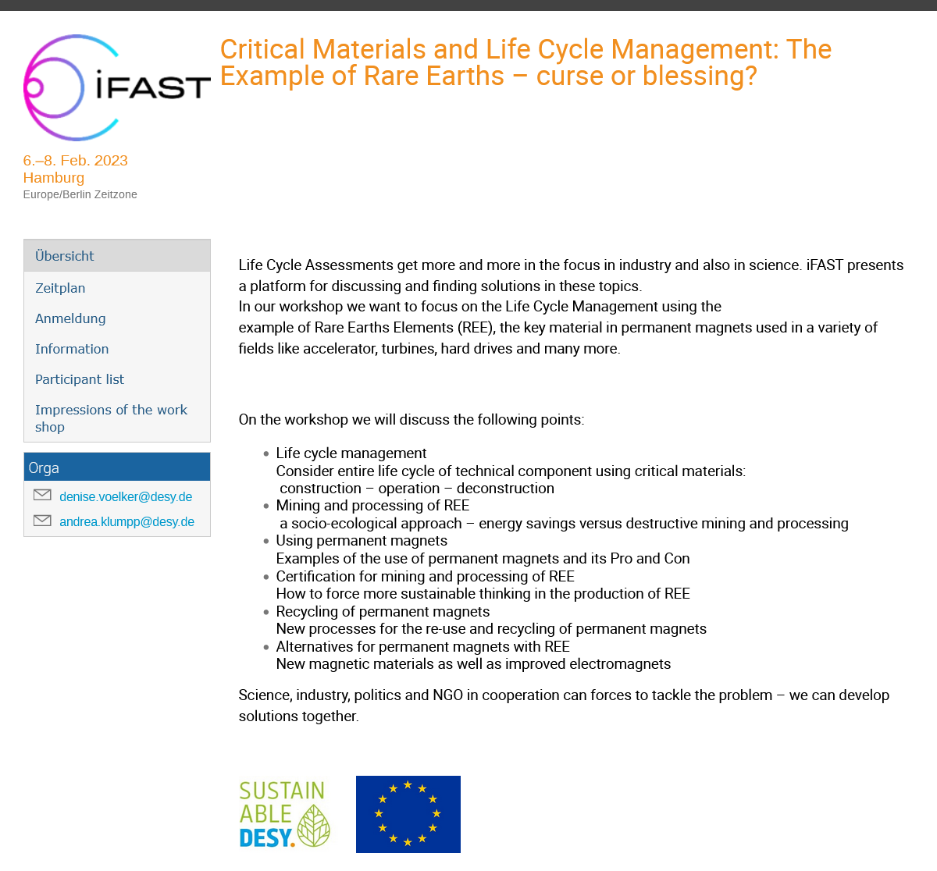

Topics:
rare earths: benefits and issues
assessing carbon footprint, env. impact, societal impact …
supply chains and certification
recycling
https://indico.desy.de/event/35655/

Slide 37
Introduction next slide - an example of the complex assessment of many factors for rare earth materials:
„normalised impacts“ per kWh generated from different types of wind power stations with/without rare earths from various sources
material mining: precarious conditions for workers
material mining: environmental pollution
material processing: pollution, toxicity
other materials needed … and more

Slide 38
excerpt: Comparison of Wind Generator Types, Petra Zapp (IEK-STE)
Influence of RE origin (ore type, mining location, specific site conditions) on environmental impacts per 1 kWh electricity generated by 3 MW wind power plant
2,5E-04
Electricity generation by DDPMSG with
aluminum
permanent Chinese RE normalized compared to
magnet produced
(Bayan Obo) has
from
higher
normalized impacts [PE]
2,0E-04
concrete
permanent magnet
environmental
impacts
1,5E-04
copper
U.S. Mountain Pass (→ 20%)
Mt. Weld (Aus) (→ 33%)
1,0E-04
cast iron, steel
stainless steel
5,0E-05
plastics & chemicals
Electricity generation by Australian DDPMSG is 8% better than by DFIG
0,0E+00
transport, energy & waste
DFIG
DDSG
DDPMSG DDPSMG DDPSMG
BO
magnet
MP
magnet
MW
magnet
DFIG: DDSG:
doubly-fed induction generator direct driven synchronous generator
A. Schreiber, J. Marx and P. Zapp: Comparative life cycle assessment of electricity generation by different wind turbine types; Journal of Cleaner Production 2019 Vol. 233 Pages 561-572
DDPMSG: electrically excited and direct drive permanent
magnet synchronous generator

Slide 39
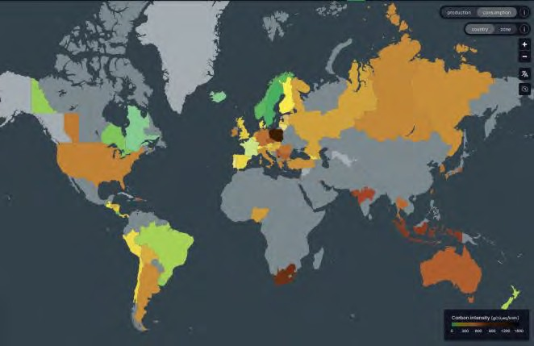
Electromagnet Operation vs. Manufacturing Footprint, B.Shepherd, STFC
600
500
400
300
200
100
0
Power usage at nominal operating point
  CLARA 1: 385 W
  CLARA 2: 2.01 kW
  FEBE: 3.72 kW
UK electricity carbon intensity 2022: 193 gCO₂e / kWh
(and improving every year!)
Carbon intensity
[gCO₂e/kWh]
2000
2005
2010
2015
2020
2025
Year
Highly dependent on fuel mix:
Sweden 21g; France 102g; USA 432g; Germany 481g; Switzerland 153g (source: Electricity Maps)
Assume operated for 5 years, 250 days per year, 16 hours per day
Total impact of operation (note: cooling not included)
CLARA 1: 1.49 tCO₂e
CLARA 2: 7.76 tCO₂e
FEBE: 14.4 tCO₂e
Much greater than manufacture impact
total impact over 5 years [tCO₂e]
6 8 10
0
2
4
12
14
16
CLARA 1
 |  |  | ma
nufacture operation
CLARA 2
FEBE
Ben Shepherd • Electromagnets vs Permanent Magnets • Rare Earth LCA workshop, 6-8 Feb 2023

Slide 40
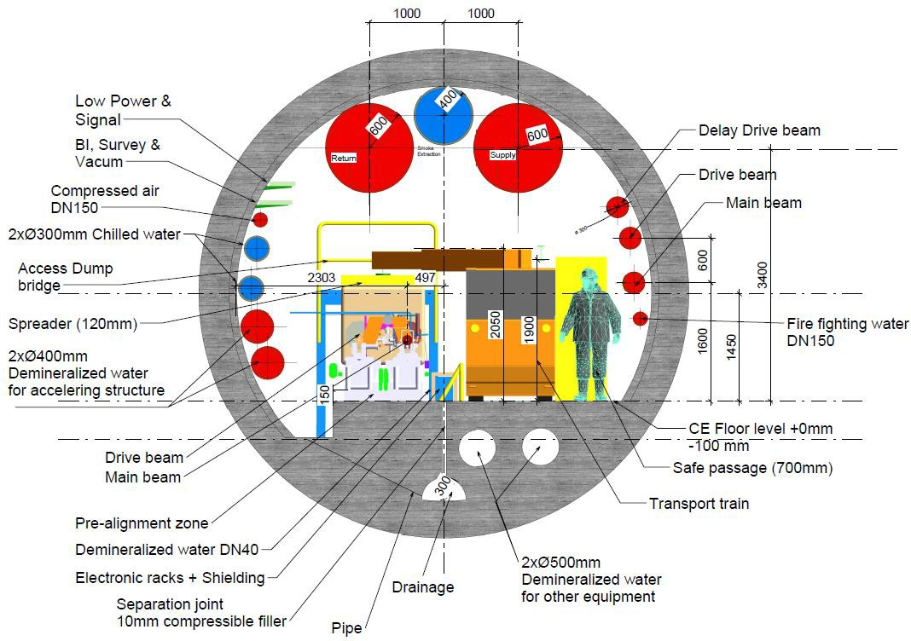
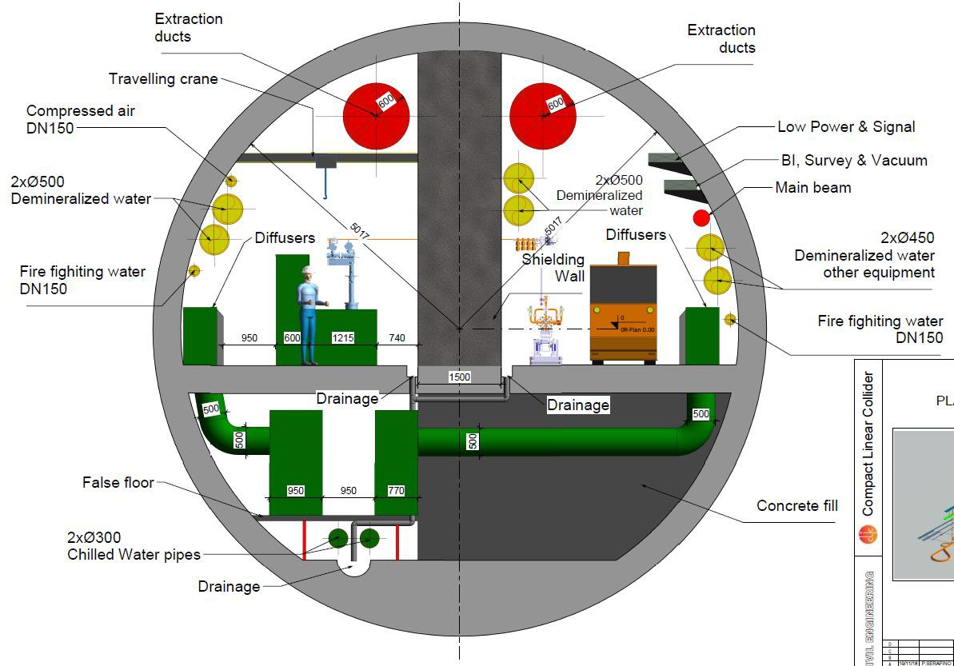
CO₂ Construction Footprint, example CLIC, B.List et al
CLIC tunnel (drive beam option), 5.6m diameter
CLIC tunnel (klystron option), 10m diameter
estimate: 12.4m² concrete
-> 31 t/m concrete
estimate: 44.8m² concrete
-> 112 t/m concrete
5

Slide 41
The Future – Fluctuating Energy Sources
simulation: April 2050, sustainable energy system, Germany
production of power
solar, wind
release from storage
variation: x5!
full RI operation at times of high grid production
reduced operation or standby modes with fast performance recovery otherwise
use of power
industry, traffic etc
energy storage
residual power
courtesy: FRAUNHOFER-INSTITUT FÜR SOLARE ENERGIESYSTEME ISE, Karlsruhe (2020)

Slide 42
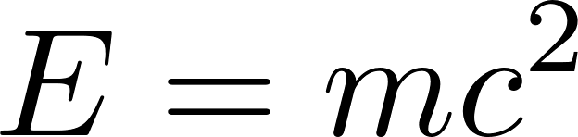
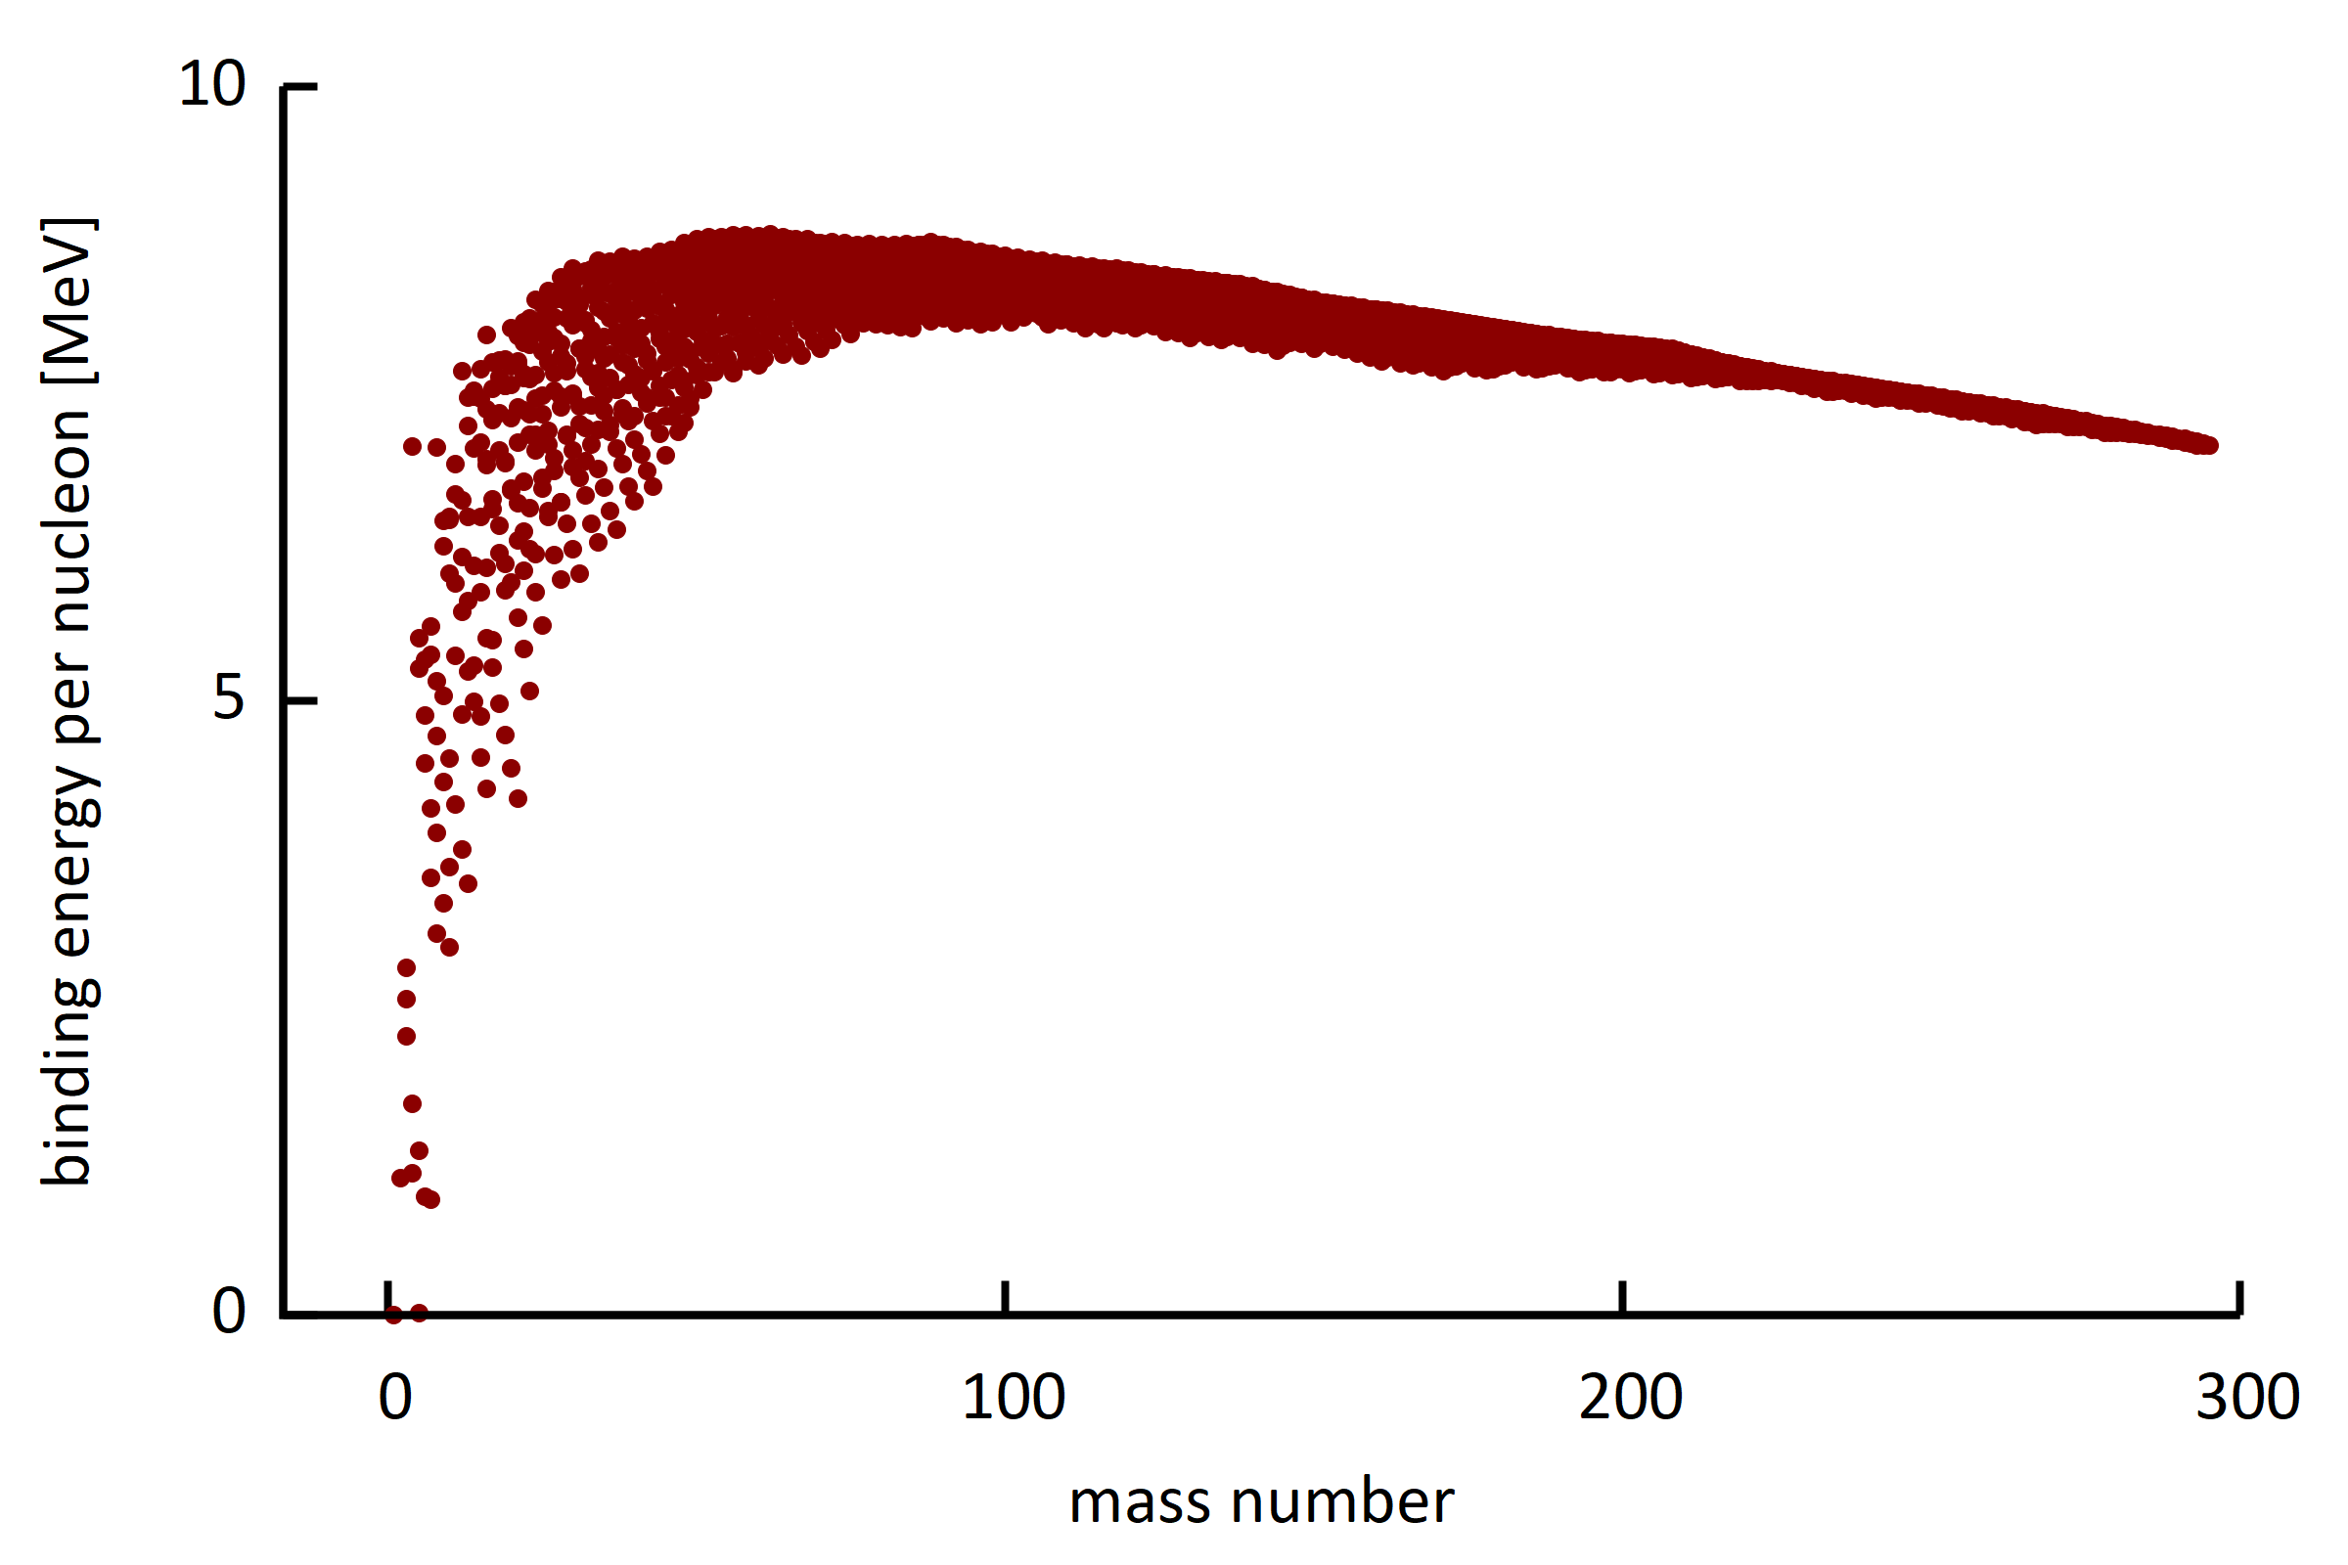
Comment on Energy Production (actually Conversion)
With accelerator driven systems (ADS) nuclear power can be made safer and more sustainable.
For fusion reactors synergetic R&D in the field of accelerators, like RF power generation, s.c. magnet - and vacuum technology.
binding energy of known isotopes
The Sun (:: wind, PV)
fusion reactor
fission reactor
radioactive decays (geothermal energy)

Slide 43
Summary High Intensity Particle Accelerators
Grid to Beam
State of the art 20%, up to 50% reachable for s.c. linacs & high beam power; cyclotrons provide solutions for E<1GeV, e.g. ADS systems
Technology
s.c. magnets & high Q cavities are efficient, higher temperature operation (HTS)
efficient RF sources, permanent magnets, heat recovery & photovoltaics
other: heat recovery, critical materials, managed lifecycle, carbon footprint, energy procurement, advanced energy production

Slide 44
Thank you for your attention.

