Slide 1


Beam Loading
H. Damerau
CERN
Intensity Limitations in Hadron Beams
22 June 2025

Slide 2
Outline
Introduction
RF cavity parameters
  Shunt impedance, beam loading, power coupling
Fundamental theorem of beam loading
Passage of a bunches through a cavity
  Single passage or bunches with large spacing
  Multiple bunch passages
Steady state beam loading and partial filling
  Few bunches with large spacing
Summary

Slide 3
Introduction

Slide 4
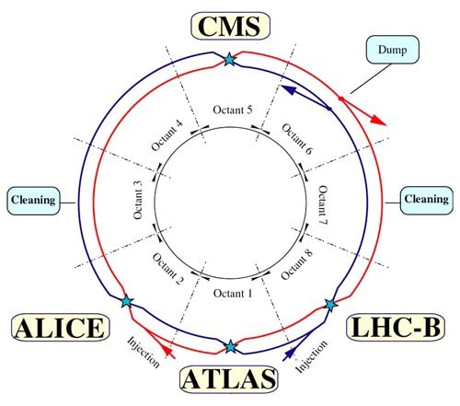
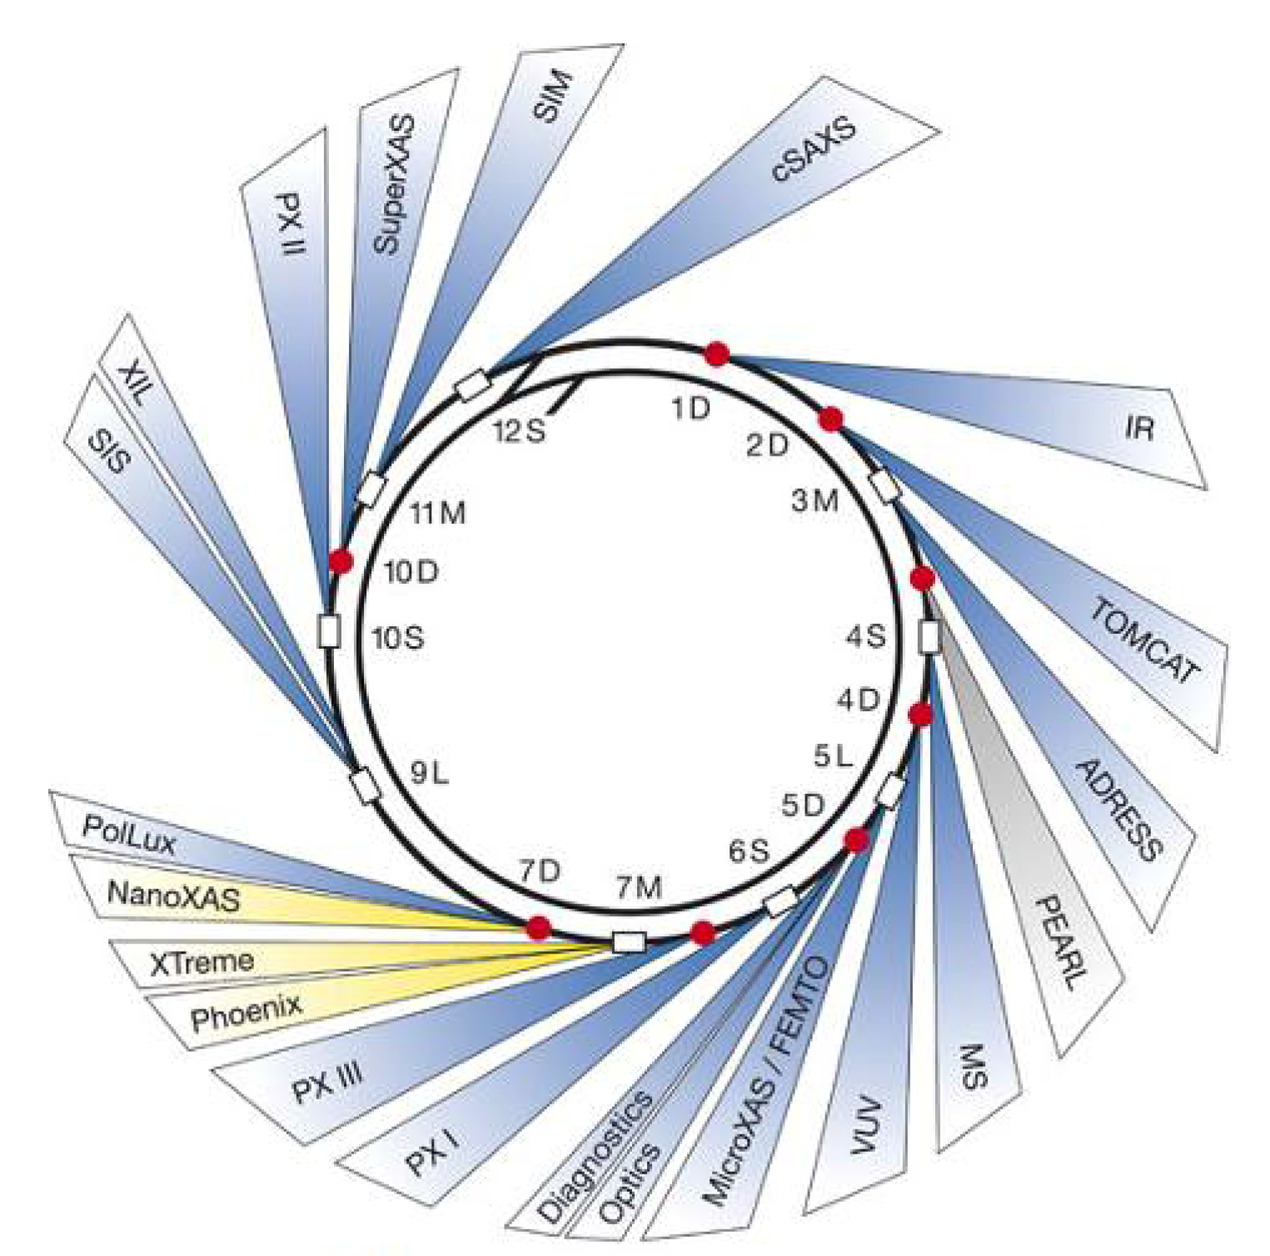
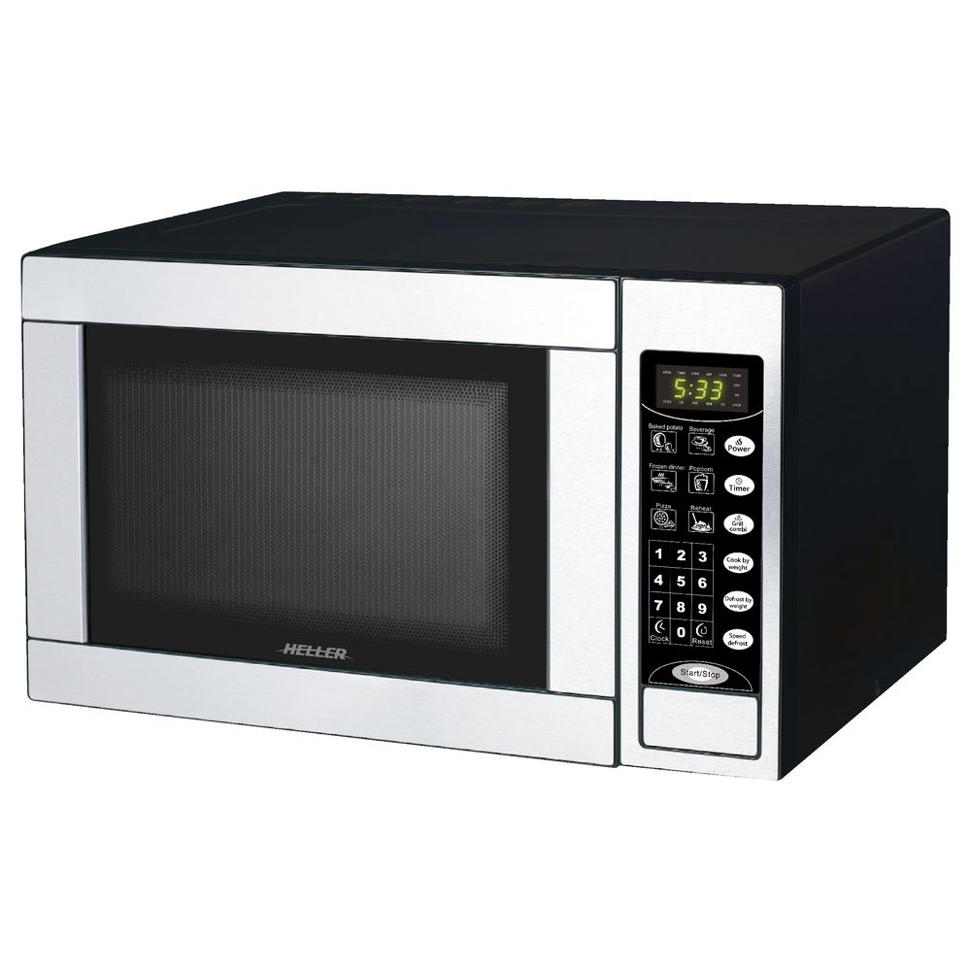
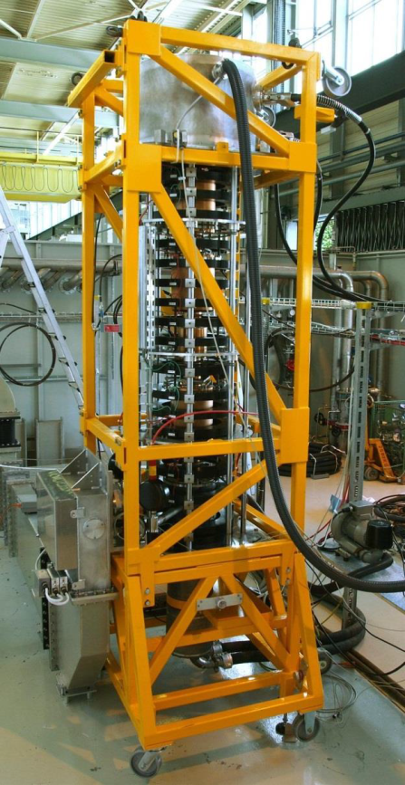
What do these devices in common?
Hadron collider
Electron storage ring
SLS
Klystron amplifier
Microwave oven
They all suffer from or make use of beam loading

Slide 5
Introduction
Low-level RF
The radiofrequency (RF) system should provide
  Energy to the beam
  Longitudinal focusing
Intended energy flow usually
from cavity to beam
But beam also likes to influence the field in the cavity
Power amplifier
Cavity
Beam

Slide 6
Introduction
Low-level RF
The radiofrequency (RF) system should provide
  Energy to the beam
  Longitudinal focusing
Intended energy flow usually
from cavity to beam
But beam also likes to influence the field in the cavity
Power amplifier
Cavity
Beam loading
Beam

Slide 7
RF cavity

Slide 8
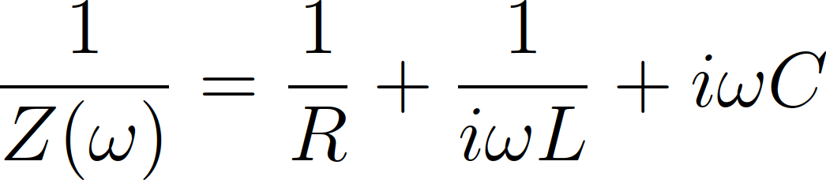
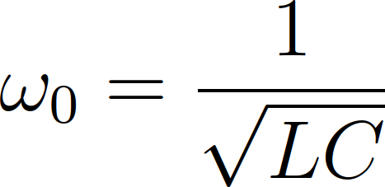
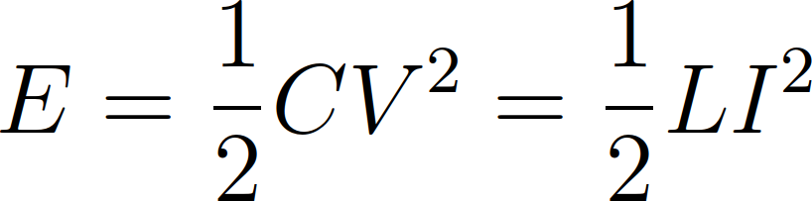
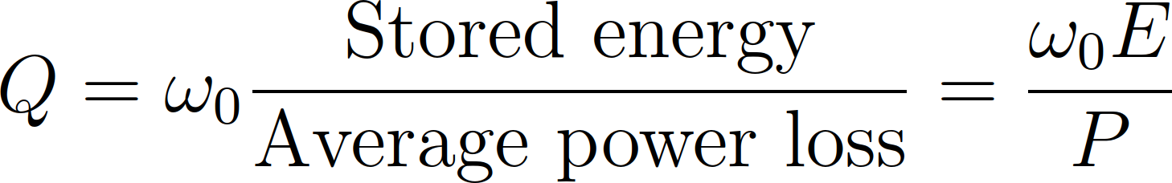
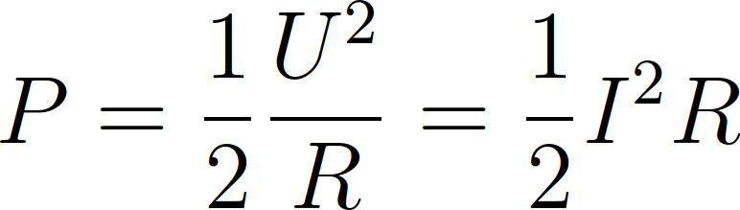
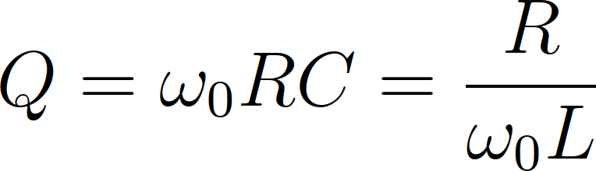
Cavity parameters
The resonance of a cavity can be understood as simple parallel resonant circuit described by R, L, C
L
R
C
Z(ω)
with

Slide 9
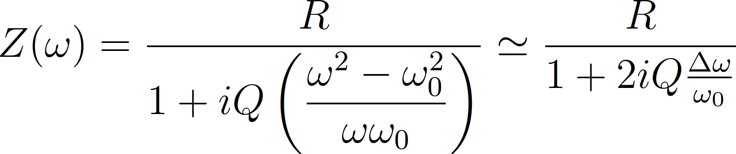
Cavity parameters
The resonance of a cavity can be understood as simple parallel resonant circuit described by R, L, C
Resonant circuit can also be described by R, R/Q, ω₀ or any other set of three parameters
L
R
C
Z(ω)
with

Slide 10
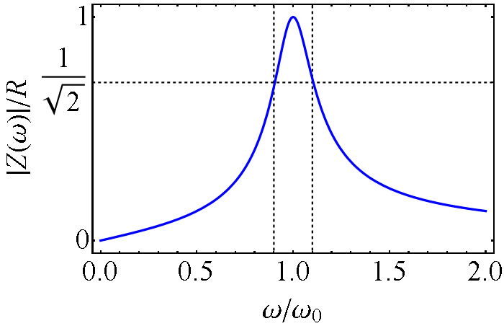
Cavity parameters
The resonance of a cavity can be understood as simple parallel resonant circuit described by R, L, C
Resonant circuit can also be described by R, R/Q, ω₀ or any other set of three parameters
L
R
C
Z(ω)
Δω_{-3dB}

Slide 11
Cavity parameters
Most common choice by cavity designers ω₀, R, R/Q – why?
Resonance frequency, ω₀
  Exactly defined for given application, e.g. hω_{rev}
Shunt impedance, R
  Power required to produce a given voltage without beam
“R-upon-Q”, R/Q
  Defined only by the cavity geometry
  Criterion to optimize a geometry
  Detuning with beam proportional to R/Q

Slide 12
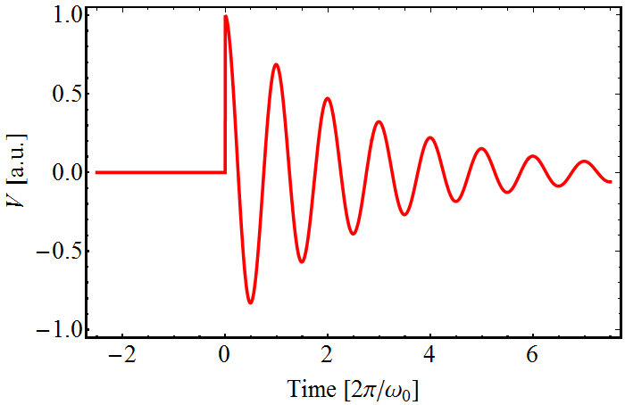

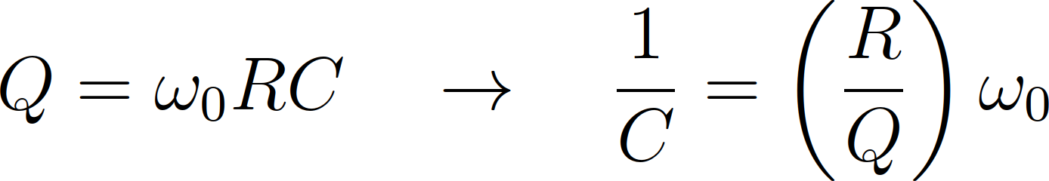
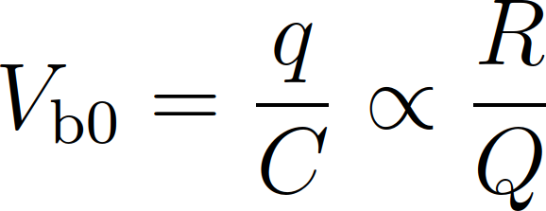
Why R/Q?
Charged particle experiences cavity gap as capacitor
Cavity geometry with small R/Q to reduce beam loading
Cavity
Beam induced voltage
q

Slide 13
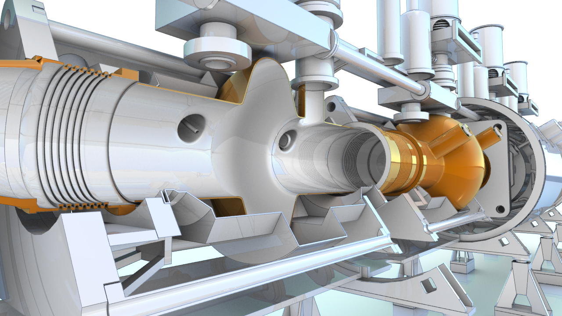
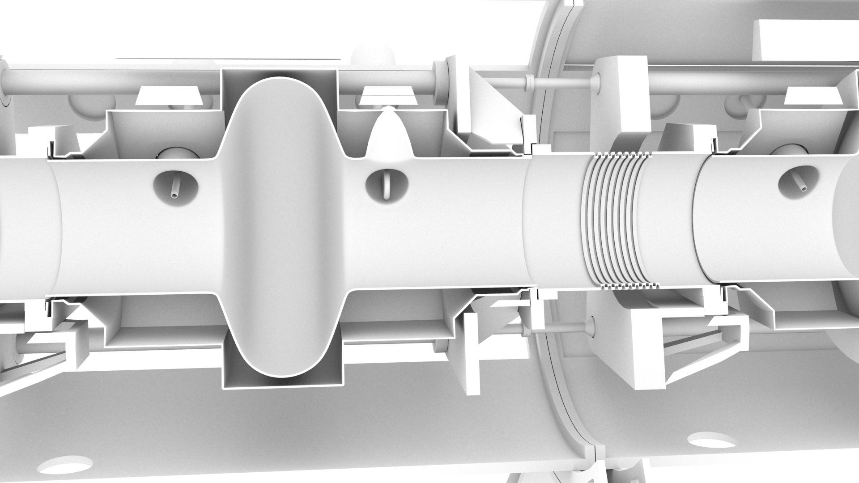
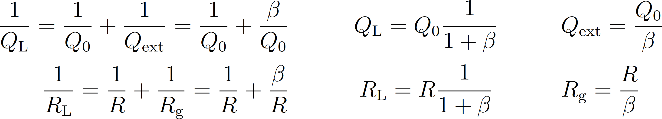
Example: 400 MHz cavities in LHC
Reduce beam loading in RF cavities
Shunt impedance, R, low for small R/Q with normal conducting cavities → superconducting cavities in LHC
Bell shape: R/Q ~ 44 Ω, 400 MHz
2×8 cavities, 5.3 MV/m
~o

Slide 14
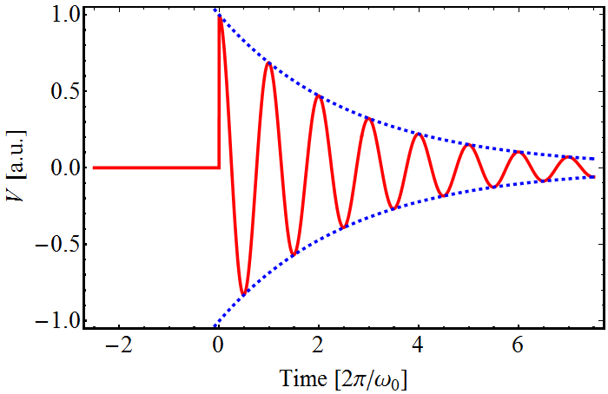
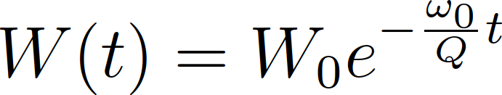
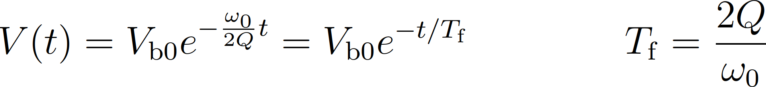
Field decay in cavity
After passage of charge: energy and fields decay exponentially
Energy:
Voltage: and
Filling time:
Cavity
Beam induced voltage
q

Slide 15
Coupling power into a cavity
Connection of cavity to power amplifier
  Capacitive: Capacitor coupling electrically to the gap
  Inductive: Coupling loop in region of large magnetic field
Cavity
I_{b}
L
R
C
Beam

Slide 16
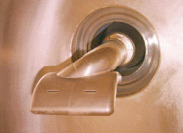
Coupling power into a cavity
Connection of cavity to power amplifier
  Capacitive: Capacitor coupling electrically to the gap
  Inductive: Coupling loop in region of large magnetic field
Cavity
I_{b}
L
R
C
C_{c}
Beam
RF power
Capacitive coupler
of CERN PS 40 MHz

Slide 17
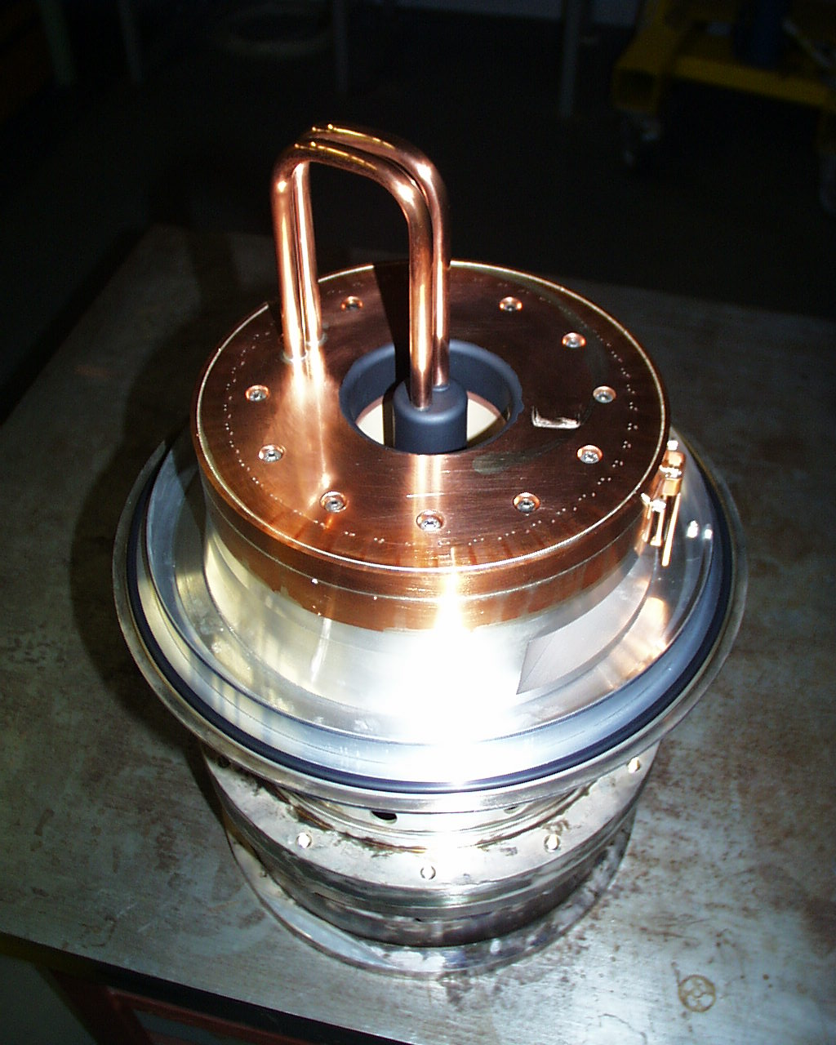
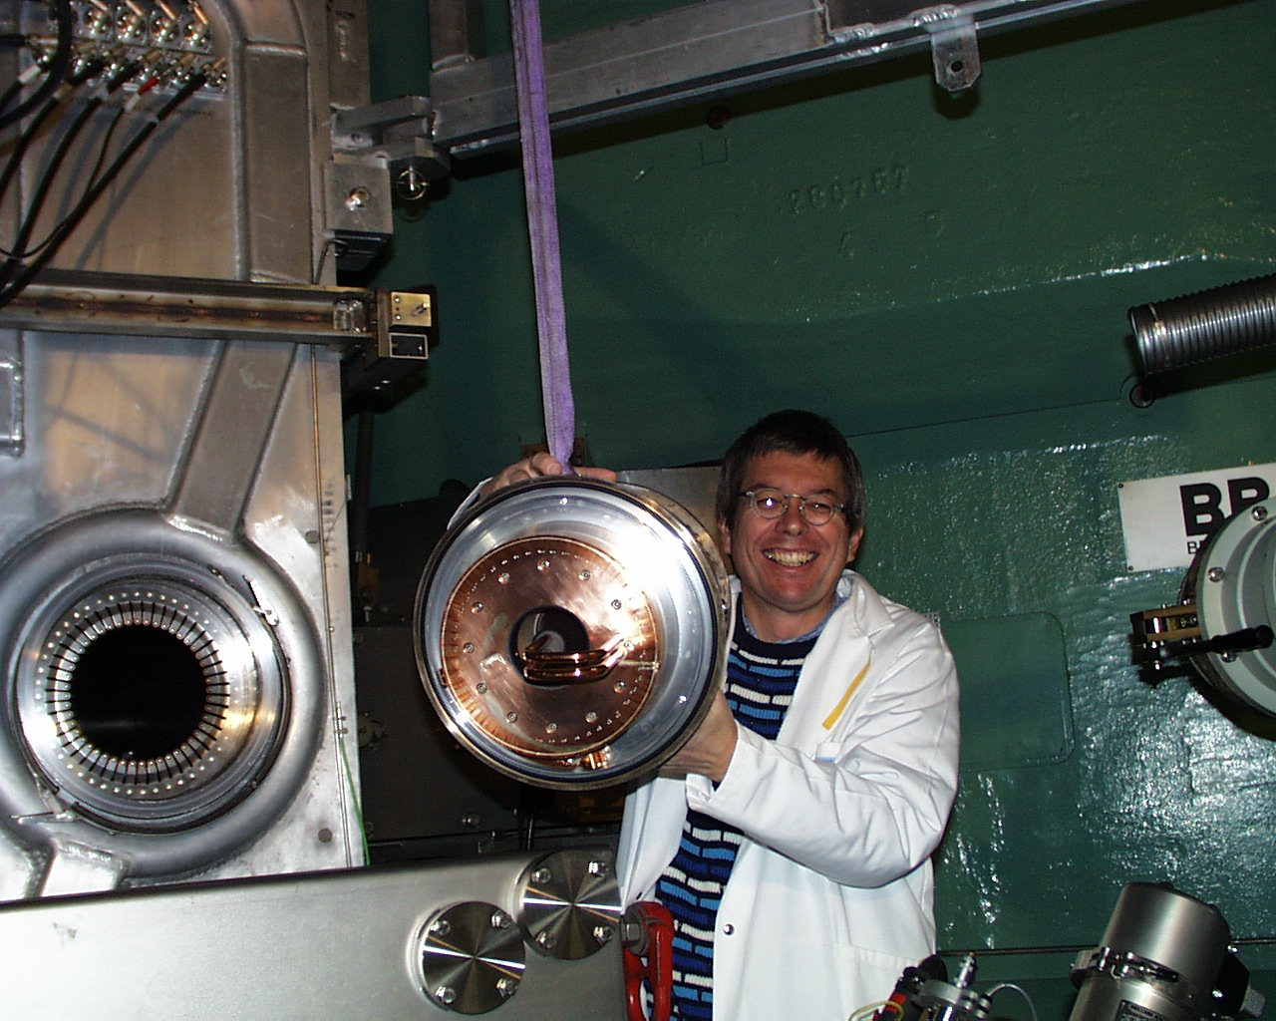
Coupling power into a cavity
Connection of cavity to power amplifier
  Capacitive: Capacitor coupling electrically to the gap
  Inductive: Coupling loop in region of large magnetic field
Cavity
I_{b}
L
R
C
Beam
RF power
L_{c}
M
L. Stingelin
Main coupler
PSI cyclotron

Slide 18
Coupling power into a cavity
Output impedance loads the resonant circuit: R_{g} || R
Reduction of quality factor: Q₀ → Q_{L}
Coupling coefficient, β, defines coupling ratio
I_{g}
Cavity
I_{b}
R_{g}
L
R
C
Generator
Beam

Slide 19
Coupling power into a cavity
Output impedance loads the resonant circuit: R_{g} || R
Reduction of quality factor: Q₀ → Q_{L}
Coupling coefficient, β, defines coupling ratio
Generator output impedance is not a physical resistor
  Generator does not experience own output impedance
Beam experiences output impedance of generator as resistor
  R_{g} || R relevant for beam loading
I_{g}
Cavity
I_{b}
R_{g}
L
R
C
Generator
Beam

Slide 20
Fundamental theorem
of beam loading

Slide 21
Initially empty cavity
Which fraction does a charge experience of its induced voltage?
Equal charges passing through cavity at distance λ₀/2 = πc₀/ω₀
and
Principles: energy conservation and superposition
Resonator
q
q
λ₀/2

Slide 22

After passage of first charge
1st charge passes through the cavity and induces voltage
Fraction, r describes part of induced voltage affecting itself:
and
Resonator
q
q
λ₀/2

Slide 23
Before passage of 2nd charge
2nd charge passes through the cavity
Affected by induced field of 1st charge
and
Resonator
q
q
λ₀/2

Slide 24
Passage of 2nd charge
2nd charge passes through the cavity
Affected by induced field of 1st charge and its own induced
and
Resonator
q
q
λ₀/2

Slide 25
After passage of first bunch
After passage of 2nd charge through the cavity
Takes the same energy as brought into cavity by 1st charge
and
Resonator
q
q
λ₀/2

Slide 26
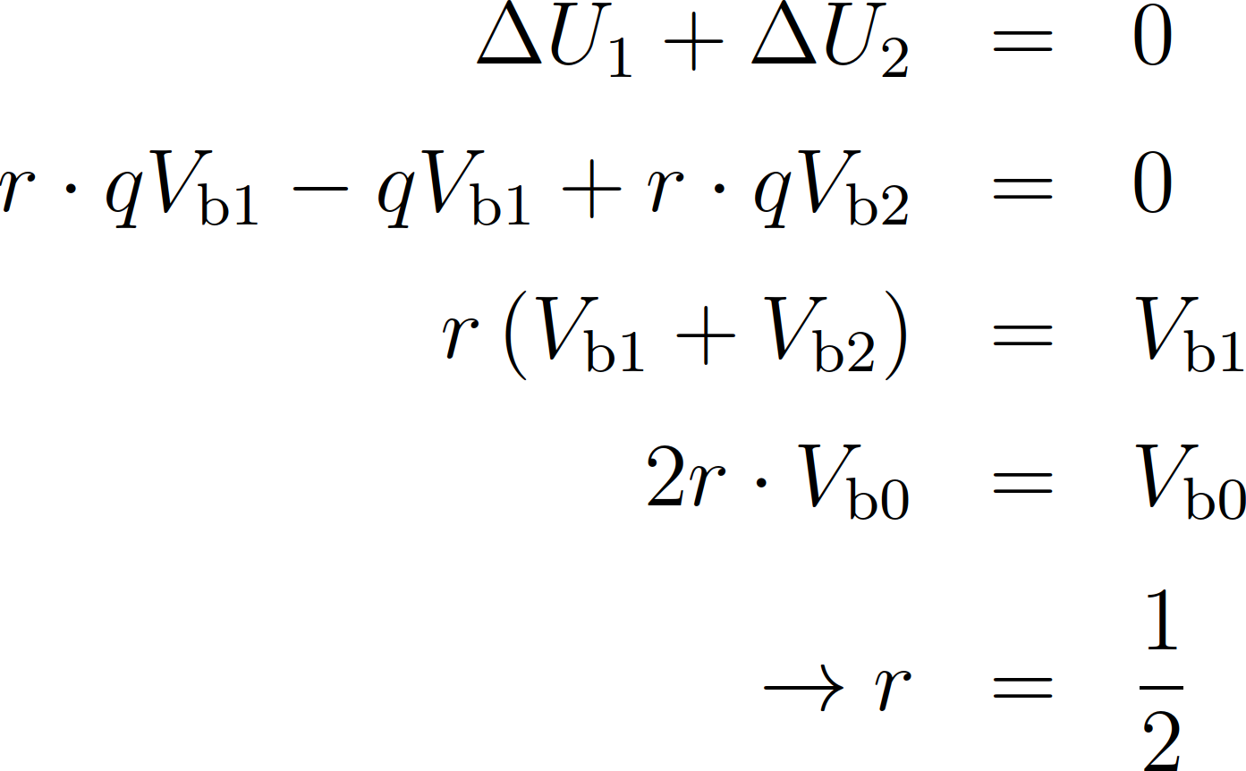
Ratio of induced field
Total energy brought in and taken out of cavity must be zero
Fundamental theorem of beam loading:
Charge passing through a resonator sees
½ of its induced voltage: V_{b} = ½ V_{b0}

Slide 27
Single passage
through a cavity

Slide 28
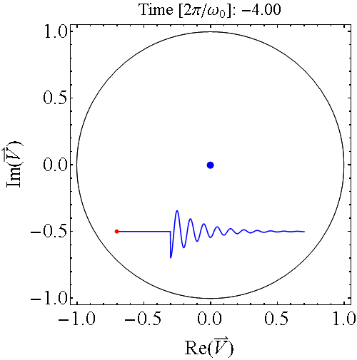
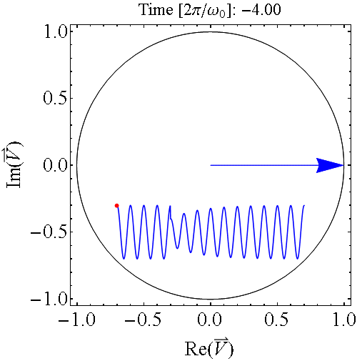
Vector representation
Passing charge induces voltage
Voltage vector rotates with resonance frequency of cavity
Vector rotation with ω₀ not relevant
Need cavity voltage at arrival of next charge
Cavity without external drive
Cavity driven by external source

Slide 29
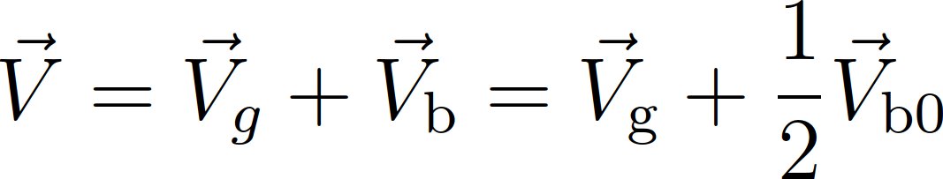
Single passage
Vector diagram at the instant of the bunch passage:
Vector sum:
Induced voltage changes cavity phase: detuning
De-phase generator to obtain expected net voltage
V_{g}
V_{b}
V
V_{b0}
I_{b}
V₋
φ_{S}
V_{g}: Generator driven voltage
before bunch passage
V₋: Voltage after bunch passage
V: Net voltage seen by beam

Slide 30
Multiple passages
through a cavity

Slide 31
Multiple passage of bunches
Resonator excited by chain of charges or particle bunches
Fields in resonator decay from one charge to the next
  Single passage case
Field from previous still present
  Accumulation of induced voltages
Resonator
q
q
q
q
T_{b}
T_{b}
T_{b}

Slide 32
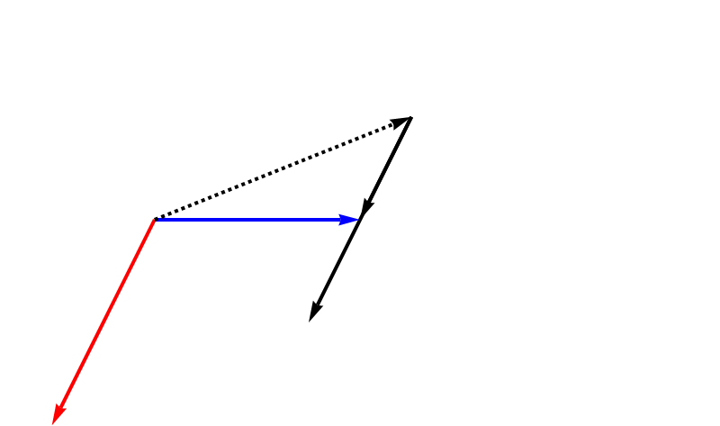
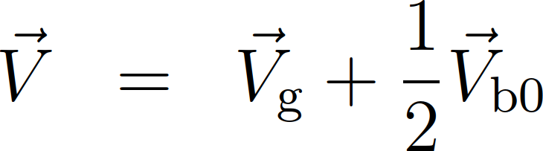
Multiple passages
Arrange generator phase and voltage for real net voltage
After 1st bunch passage
V_{g}
V_{b}
V
V_{b0}
V_{b}
I_{b}

Slide 33
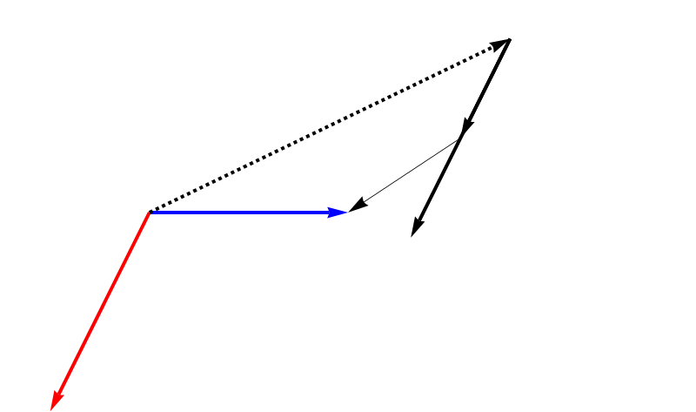
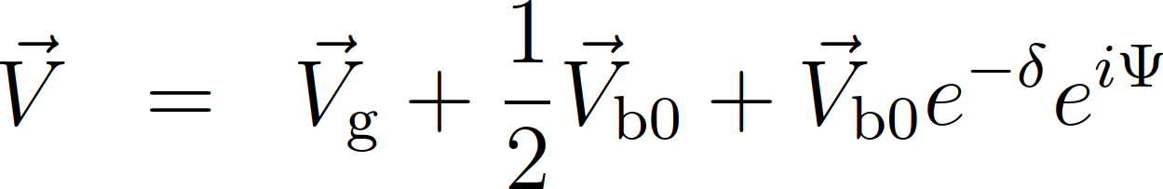
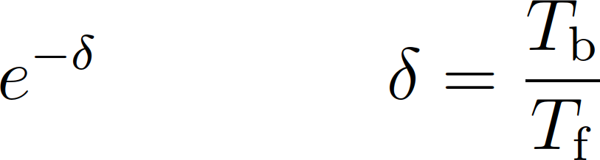
Multiple passages
Arrange generator phase and voltage for real net voltage
After 2nd bunch passage
Induced voltage of 1st passage decayed: with
Phase advance between two bunches: with
V_{g}
V_{b}
V_{b0}
V_{b}
V
I_{b}

Slide 34
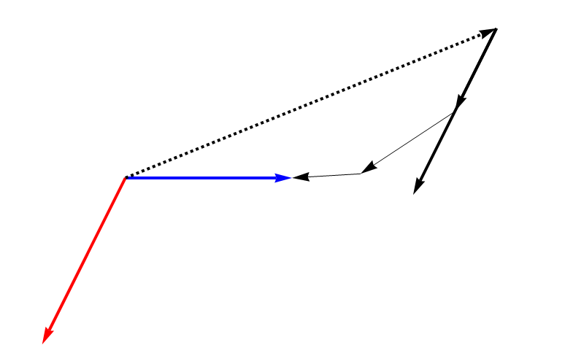
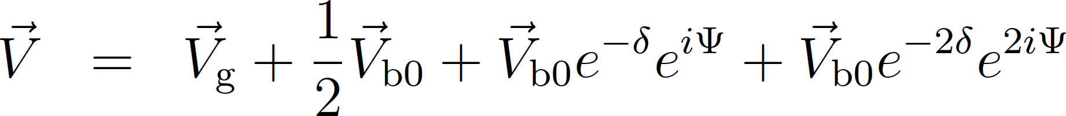
Multiple passages
Arrange generator phase and voltage for real net voltage
After 3rd bunch passage
V_{g}
V_{b}
V_{b0}
V_{b}
V
I_{b}

Slide 35
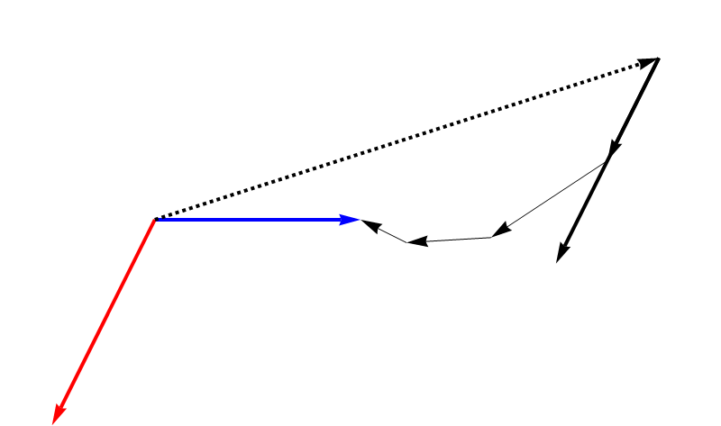
Multiple passages
Arrange generator phase and voltage for real net voltage
After 4th bunch passage
V_{g}
V_{b}
V_{b0}
V_{b}
V
I_{b}

Slide 36
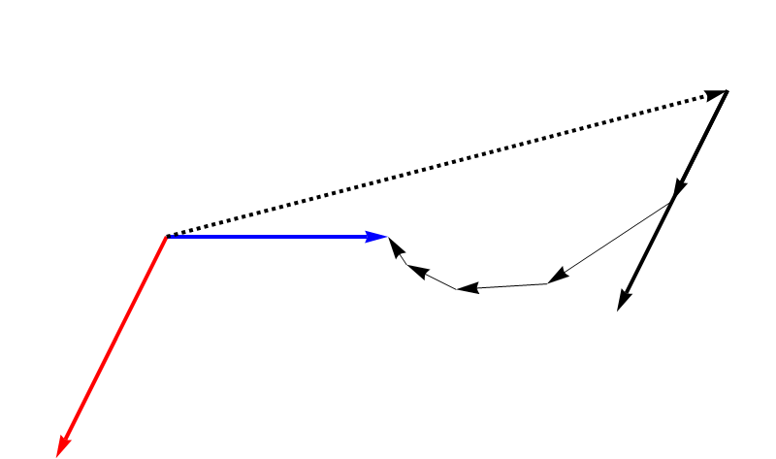
Multiple passages
Arrange generator phase and voltage for real net voltage
After 5th bunch passage
V_{g}
V_{b}
V_{b0}
V
V_{b}
I_{b}

Slide 37
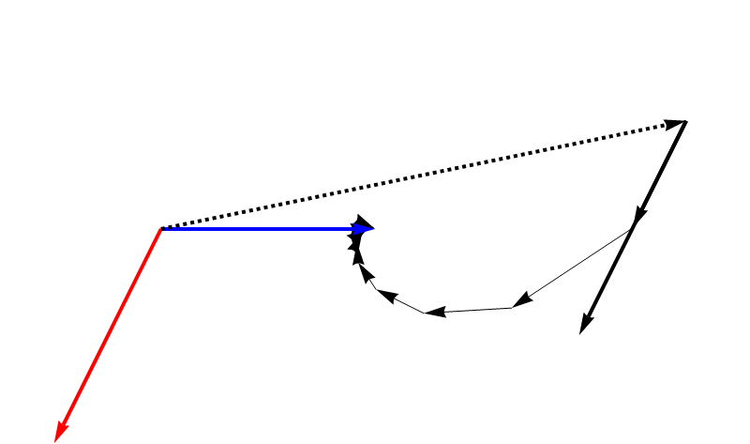
Multiple passages
Arrange generator phase and voltage for real net voltage
After 10th bunch passage
V_{g}
V_{b}
V
V_{b0}
V_{b}
I_{b}

Slide 38
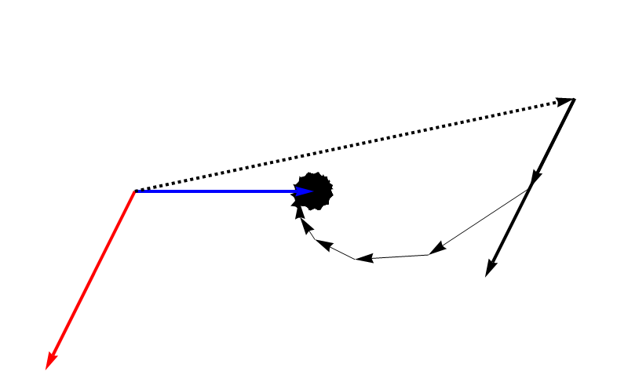
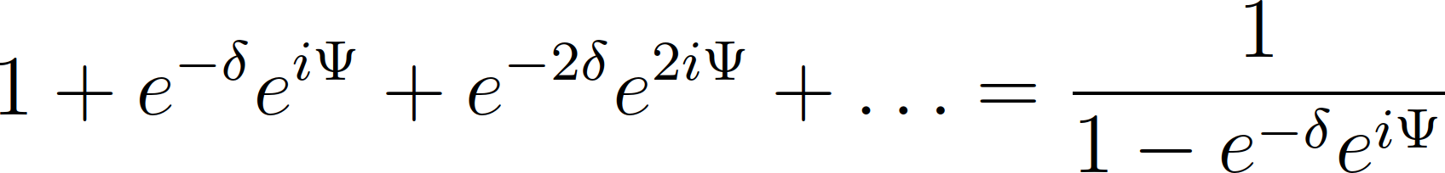
Multiple passages
Arrange generator phase and voltage for real net voltage
After 100th bunch passage
Infinite passages:
V_{g}
V_{b}
V
V_{b0}
V_{b}
I_{b}

Slide 39
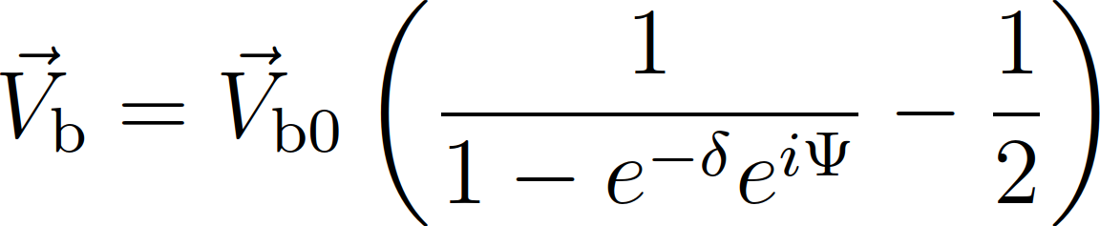
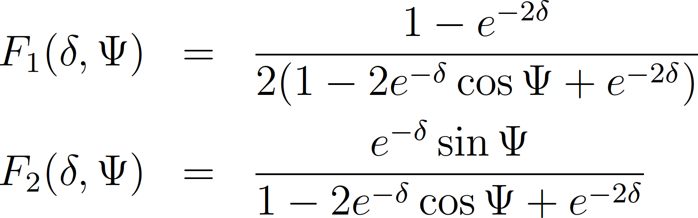
General beam induced voltage
Separate real and imaginary part:

Slide 40
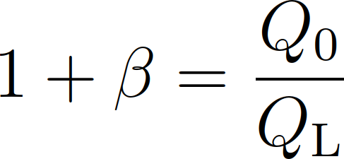
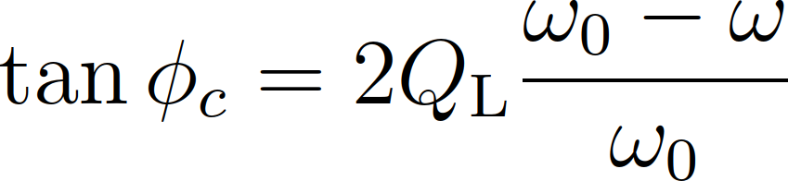
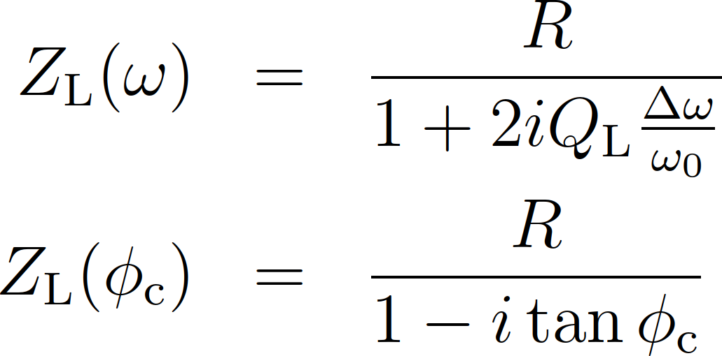
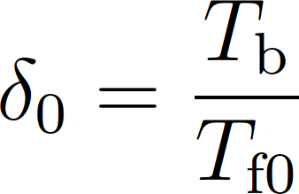
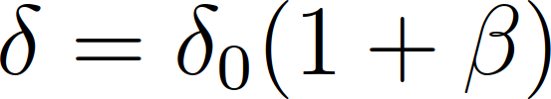
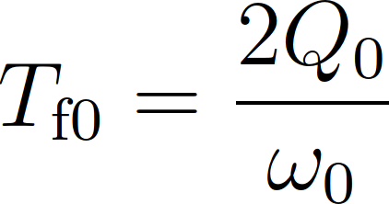

Change of variables
Variables for damping, δ, and bunch-by-bunch phase advance, Ψ, not very practical
New variables with RF system parameters:
Coupling coefficient, β
Cavity tuning angle, φ_{c}

Slide 41
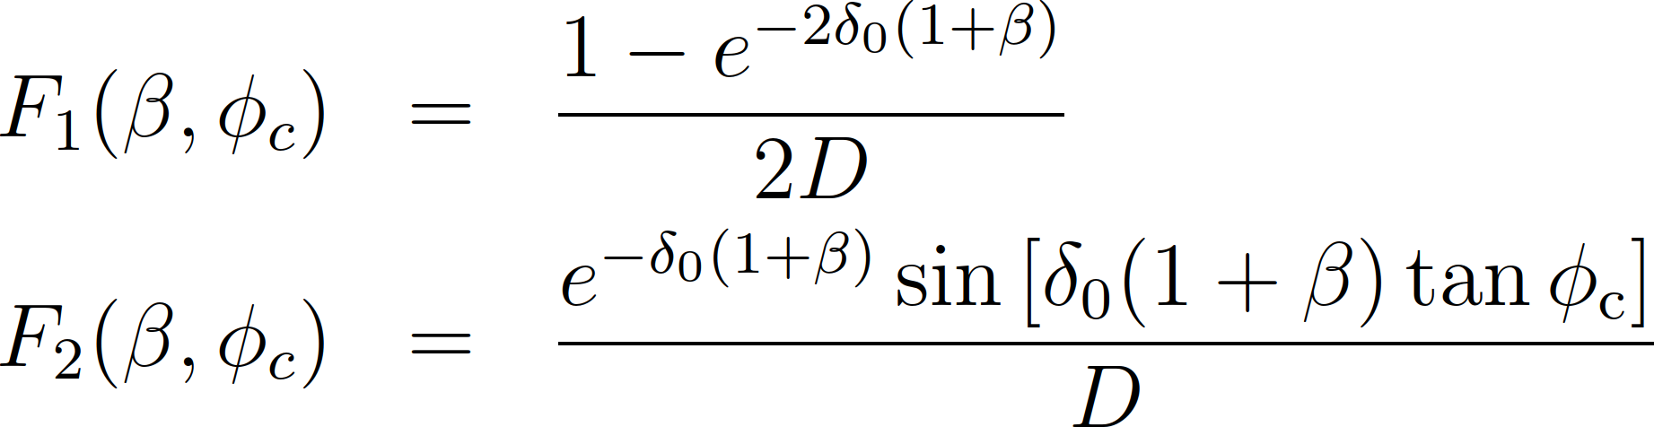

Beam induced voltage in new variables
with denominator
Numerical computations required for analysis
Let us look at a particularly relevant approximation:

Slide 42
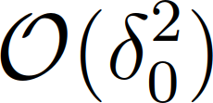

Approximation
Bunch distance short compared filling time:
Approximate terms including
T_{b}
Bunch train
RF envelope

Slide 43


Approximation
Bunch distance short compared filling time:
Approximate terms including
Ohm’s law for the loaded cavity impedance: steady state case

Slide 44
Steady state
beam loading

Slide 45


Equivalent circuit model
Lumped element circuit model for steady state case
Total current:
Power required from generator:
I_{g}
Cavity
I_{b}
R_{g}
L
R
C
Generator
Beam

Slide 46

Steady state
Vector diagram for passage of continuous bunch train
Parameters to achieve minimum generator current?
I_{g}
φ_{c}
V
I_{b}
I_{b}
I_{t}
φ_{S}
I_{g}: Generator current
I_{t}: Total current
V: Net voltage seen by beam

Slide 47


Steady state: minimum generator current
Vector diagram for passage of continuous bunch train
Generator current, I_{g}
I_{g}: Generator current
I_{t}: Total current
V: Net voltage seen by beam
Lowest power (current I_{g})
Generator current, I_{g} in phase with voltage
Resistive load with beam

Slide 48

Steady state: minimum generator current
Vector diagram for passage of continuous bunch train
I_{g}
φ_{c}
V
I_{b}
φ_{S}
I_{t}
I_{g}: Generator current
I_{t}: Total current
V: Net voltage seen by beam

Slide 49




Example: Cavity dephasing in PS
Voltage descent with beam:
Tuning loop recovers
cavity resonance frequency
Dephasing at low RF voltage
Voltage and phase vs. time
Voltage
Amplifier
Δφ
Phase
Phase versus voltage
Cavity driven by amplifier
Low-level RF
Cavity driven by beam

Slide 50




Steady state: minimum generator current
Minimum power:
Optimum detuning:
  Cavity and beam appear as resistive load to generator
  Automatically adjusted by cavity tuning loop
Optimum coupling:
  Usually mechanically fixed by construction
( )
short bunches
Resistive losses in cavity
Power delivered
to beam

Slide 51




Example: LHC power coupler
Control of both cavity resonance frequency and coupling
Optimize quality through Q_{ext} for injection and storage
~o
RF power
Loaded quality factor:
Mode | Q_{L,} Q_{ext} | Comment
Injection | ~2∙ 10⁴ | Suppress transients
Collision | ~6∙ 10⁴ | Maximum voltage
Movable antenna
Cavity side

Slide 52
Filling pattern
with gaps

Slide 53


Why leaving a gap and not filling full ring?
Electron storage rings: Clear ions attracted by electron beam
Hadron accelerator: Leave gap for kicker magnets at
injection/ejection
ESRF: 7/8 + 1 filling mode
LHC: original nominal
868 | 23 uA/b | 200 mA in 7/8 train
2 | 1 mA/b | Marker bunches
1 | 2 mA | Single bunch
2×62 | <2 pA/b | Gap
Δt₁
Δt₂
Δt₃
Δt₄
Δt₁ | 8 | SPS injection kickers
Δt₂ | 38 | SPS ejection and LHC injection kickers
Δt₃ | 39
Δt₄ | 119 | Abort kicker gap
72 bunches
1 turn

Slide 54






Beam loading with gaps
Limitations: , no acceleration, lossless cavity
Phase change due to cavity detuning:
Phase change due to induced voltage: with
                Total phase advance:

Slide 55



Beam loading with gaps
Periodicity condition to get average detuning
and phase along the circumference
Phase changes linearly for I_{b}(t) = const. during beam region

Slide 56


Maximum phase excursion
Maximum phase excursion
Displaces timing of synchrotron radiation pulses
Longitudinally moves collision point in collider
Compromise between RF power and collision point

Slide 57



Example: Electron storage ring
Transient beam loading in electron storage ring BESSY II
Synchrotron radiation light pulses slightly shifted in time
96 m
Bunch current of 2022 filling pattern
240 m
Bunch current [mA]
M. Ries, G. Rehm, A. Matveenko, G. Schiwietz et. al.
Bunch displacement with respect to reference
Bunch phase[ps]
~21°

Slide 58


Example: FCC-hh (hadron-hadron)
Proposed future circular collider
Batch of 2600 bunches with short gaps
Gap of ~60 empty bunch positions
91 km
Machine protection requires
  Four batches per turn
  Gaps of ~1.5 μs
Full-detuning causes a bunch phase modulation of ~2°
Position of collision point modulated
I. Karpov, P. Baudrenghien, IPAC19, MOPGW084

Slide 59


Example: high-intensity hadron collider
LHC, FCC-hh → Force bunches to reference phases
Control cavity voltage in amplitude and phase:
Cavity connected to power amplifier through feeder line
Reflected power, P_{r} is dumped in the amplifier or circulator
Power transferred to beam:
Generator
Cavity
I_{b}
Z_{g}
Feeder line
L
R
C
Z_{g}
Beam
P_{g}
P_{r}

Slide 60





Example: high-intensity hadron colliders
LHC, FCC-hh → Force bunches to reference phases
Control cavity voltage in amplitude and phase:
Half detuning: and adapted coupling,
Constant generator power:
Beam segment
Gap
Beam
Gap
(steady-state (approximation, (no acceleration)

Slide 61


Example: high-intensity hadron colliders
Half detuning → power to force bunches to reference phases
‘If you can't beat them, join them’
Let bunches slip in phase, only control amplitude:
Detune cavities to
Modulate RF phase to slip with the bunches
Without acceleration: steady-state RF power as without beam

Slide 62


Example: high-intensity hadron colliders
Half detuning → power to force bunches to reference phases
‘If you can't beat them, join them’
Let bunches slip in phase, only control amplitude:
Full detuning
https://lpc.web.cern.ch/schemeEditor.html, H. Timko

Slide 63
Beam loading in
microwave oven?

Slide 64



Beam loading in microwave oven?
Microwave ovens use magnetrons as RF power source
Anode block consists of ring of cavity
resonators
Electrons from the cathode accelerated
towards anode (cavities)
Perpendicular magnetic field causes
cyclotron motion
-
+
Anode
block
Cathode
B
RF output
Ch. Wolff, http://www.radartutorial.eu/08.transmitters/Magnetron.en.html

Slide 65



Beam loading in microwave oven?
Magnetron as RF power source
Electron flow from cathode to anode self-bunched under influence of oscillating fields in anode resonators
Bunched electrons excite RF fields → beam loading!
Food gets heated
Ch. Wolff, http://www.radartutorial.eu/08.transmitters/Magnetron.en.html

Slide 66
Summary
RF cavity parameters
  System of cavity, coupling and amplifier
Single and multi-passage of bunches through a cavity
  Fundamental theorem of beam loading
  Multiple passages limiting case of steady state
Steady state beam loading
  Minimize RF power by detuning and coupling
Partial filling
  Modulation of bunch phase and RF voltage
Magnetron principle
  Heating food with beam loading

Slide 67
A big Thank You
to all colleagues providing support, material and feedback
Philippe Baudrenghien, Thomas Bohl, Anny Gora, Wolfgang Höfle, Andreas Jankowiak, Erk Jensen, Ivan Karpov, AlexandreLasheen, Eric Montesinos, Elena Shaposhnikova, Lukas Stingelin, Frank Tecker, Helga Timko, Christian Wolff and many more…

Slide 68
Thank you very much for your attention!

Slide 69
References
P. B. Wilson, Beam Loading in High-Energy Storage Rings, HEACC1974, 1974, p. 57-62, http://inspirehep.net/record/92909/files/HEACC74_78-83.pdf
P. B. Wilson, Transient Beam Loading in Electron-positron Storage Rings, CERN-ISR-TH-78-23-rev, 1978, http://cds.cern.ch/record/119634/files/cer-000030126.pdf
P. B. Wilson, J. E. Griffin, High Energy Electron Linacs; Application to Storage Ring RF Systems and Linear Colliders, AIP Conf. Proc. 87 (1982) 564-582, https://aip.scitation.org/doi/pdf/10.1063/1.33620
D. Boussard, Beam Loading, CERN-87-03-V-2, 1987, http://cds.cern.ch/record/1246443/files/p626.pdf
D. Boussard, Design of a Ring RF System, CERN SL/91-2 (RFS, rev.), 1991, http://cds.cern.ch/record/1023436/files/CM-P00065157.pdf
R. Garoby, Beam Loading in RF cavities, Lect. Notes Phys. 400 (1992) 509-541, http://cds.cern.ch/record/220916/files/CM-P00059475.pdf
D. Boussard, Beam Loading, CERN-95-06, 1995, http://cds.cern.ch/record/302480/files/p415.pdf
J. Tückmantel, Optimum Cavity Detuning under Reactive Beam Loading with Accelerated Beams, AB-Note-2005-040 (RF), 2005, http://cds.cern.ch/record/910371/files/ab-note-2005-040.pdf
J. Tückmantel, Cavity-Beam-Transmitter Interaction Formula Collection with Derivation, CERN-ATS-Note-2011-002 TECH, 2011, http://cds.cern.ch/record/1323893/files/CERN-ATS-Note-2011-002%20TECH.pdf

Slide 70

Approximations
2nd order Taylor expansion for

Slide 71

Approximations: F₁
Simplification of real part F₁(β,φ_{c}) for

Slide 72

Approximations: F₂
Simplification of real part F₂(β,φ_{c}) for

Slide 73











Frequency and wavelength ranges
PS longitudi- nal damper
100 kHz
3 km
Long wave
1 MHz
300 m
PS main RF system
Medium/ short wave
10 MHz
30 m
100 MHz
3 m
SPS 200 MHz
1 GHz
30 cm
VHF
10 GHz
3 cm
100 GHz
3 mm
Microwave links
CLIC 12 GHz

Slide 74





Example: Electron storage ring
Transient beam loading in
electron storage ring SLS
Bunch charge
J. Kallestrup et al.
288 m
Bunch phase displacement

Slide 75


Transient beam loading between RF systems
Triple splitting of LHC-type beams in CERN PS requires three RF systems (h = 7, 14 and 21) in phase at degree level
Transient beam loading: relative phases different for 1st bunch
Bunch-by-bunch intensity variations in LHC
6 bunches split, one empty bucket
First bunch
Last bunch

Slide 76


Transient beam loading between RF systems
Fast phase measurement to directly observe relative changes
Cavity detuning not an option
  Would even enhance phase modulation along batch
Feedback systems
  Counteract beam loading with additional RF power
  Stabilize phase
Effect on bunch shape
Relative phase of 10 MHz and 20 MHz

