Slide 1


Hands-On
CAS Intensity Limitations in Hadron Beams
Alexandre Lasheen, Christine Vollinger, Elena de la Fuente, Heiko Damerau, Jake Flowerdew, Leandro Intelisano, Michela Neroni
(all at CERN)
22nd & 23rd June 2025

Slide 2
Case Study: SPS Beam Wire Scanners (BWS)
Brief recap of how rotational beam wire scanners works
Super Proton Synchrotron (SPS) BWS failures & beam parameters during
scrubbing run
BWS modifications in CST & consequences
All the wire scanner design has been carried out by experts in the
Beam Instrumentation Group at CERN and is their intellectual property.
BIG THANKS for letting us use this instrument as a CAS Hands-on example
and to the TF colleagues who let us use all their contributions!

Slide 3
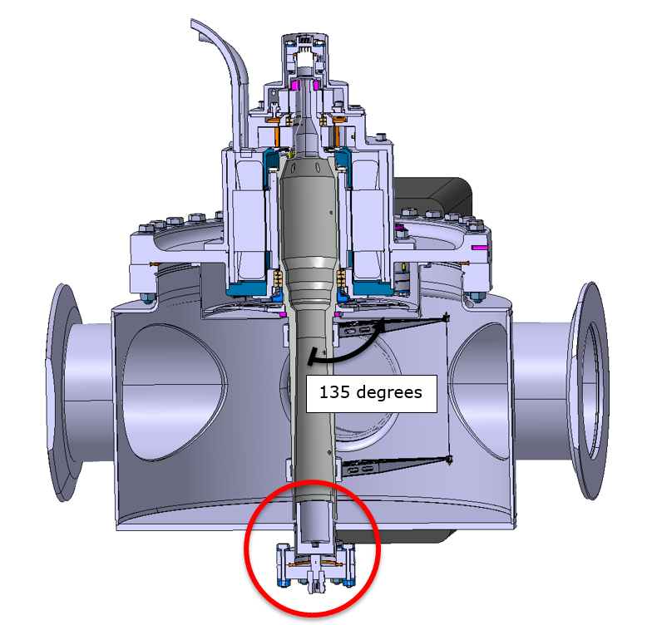
Case Study: SPS Beam Wire Scanners (BWS)
Brief recap of how rotational beam wire scanners works
Motor mechanism
(outside vacuum)
Fast rotation of the wire around 270 degrees at a speed of up to 20 ms⁻¹
Cutting through the beam leads to particle scattering, detected by downstream scintillators
From the scattering products, geometrical beam size and transverse emittance is determined.
SPS is equipped with 4 BWS,
2 horizontal scanners & 2 vertical scanners
Cylindrical
vacuum tank
Motor driven
hollow shaft
Beam
Carbon fiber (“wire”)
Titanium holders
(“forks”)
Beam vacuum pipe

Slide 4
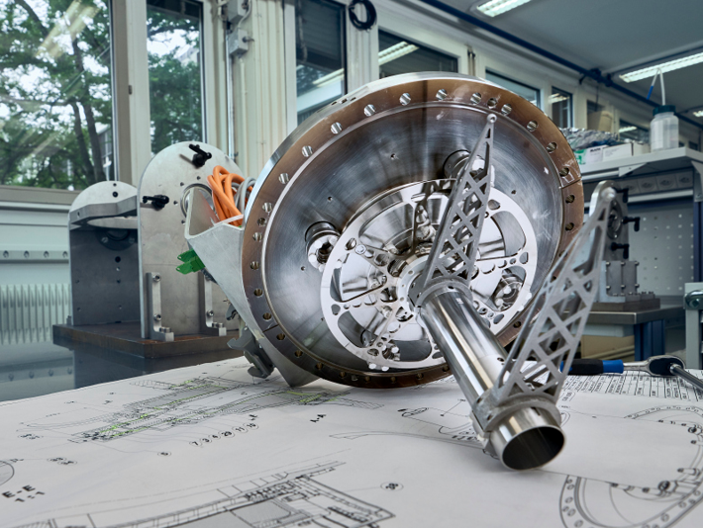
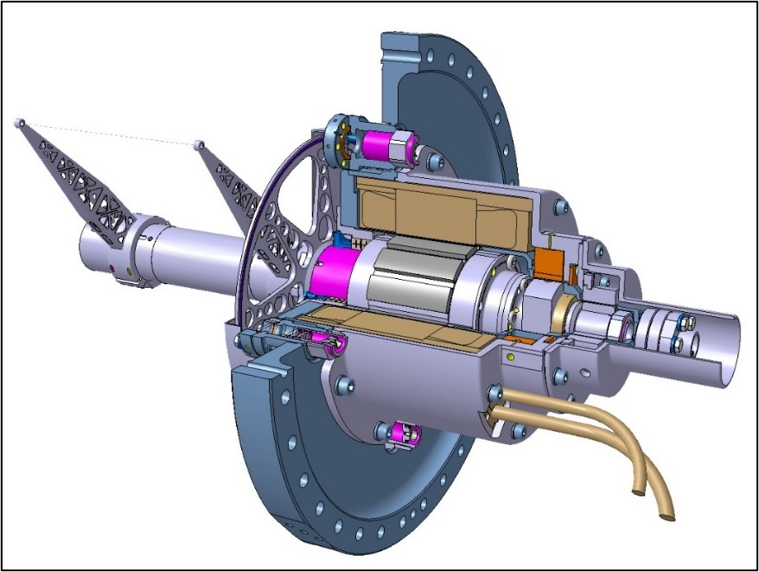
Case Study: SPS Beam Wire Scanners (BWS)
Brief recap of how rotational beam wire scanners works

Slide 5
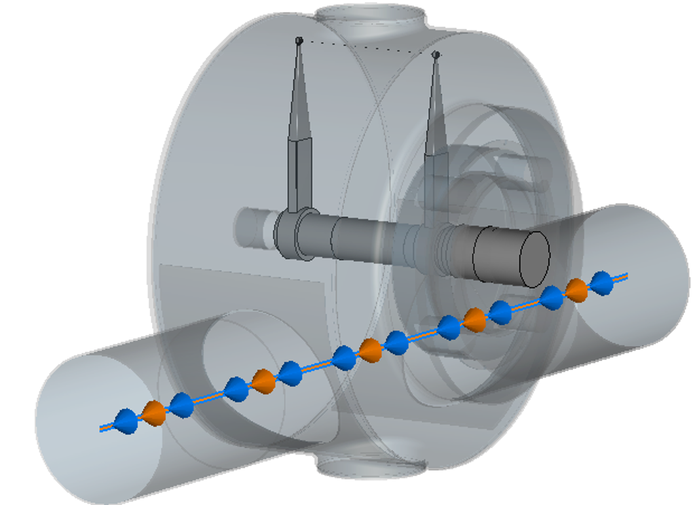
Case Study: SPS Beam Wire Scanners (BWS)
Brief recap of how rotational beam wire scanners works
Motor mechanism
(outside vacuum)
Particularly worrying:
The wire broke without contact to the beam in the so-called parking position.
Cylindrical
vacuum tank
Motor driven
hollow shaft
Beam
Beam
Carbon fiber (“wire”)
Titanium holders
(“forks”)
Beam vacuum pipe

Slide 6
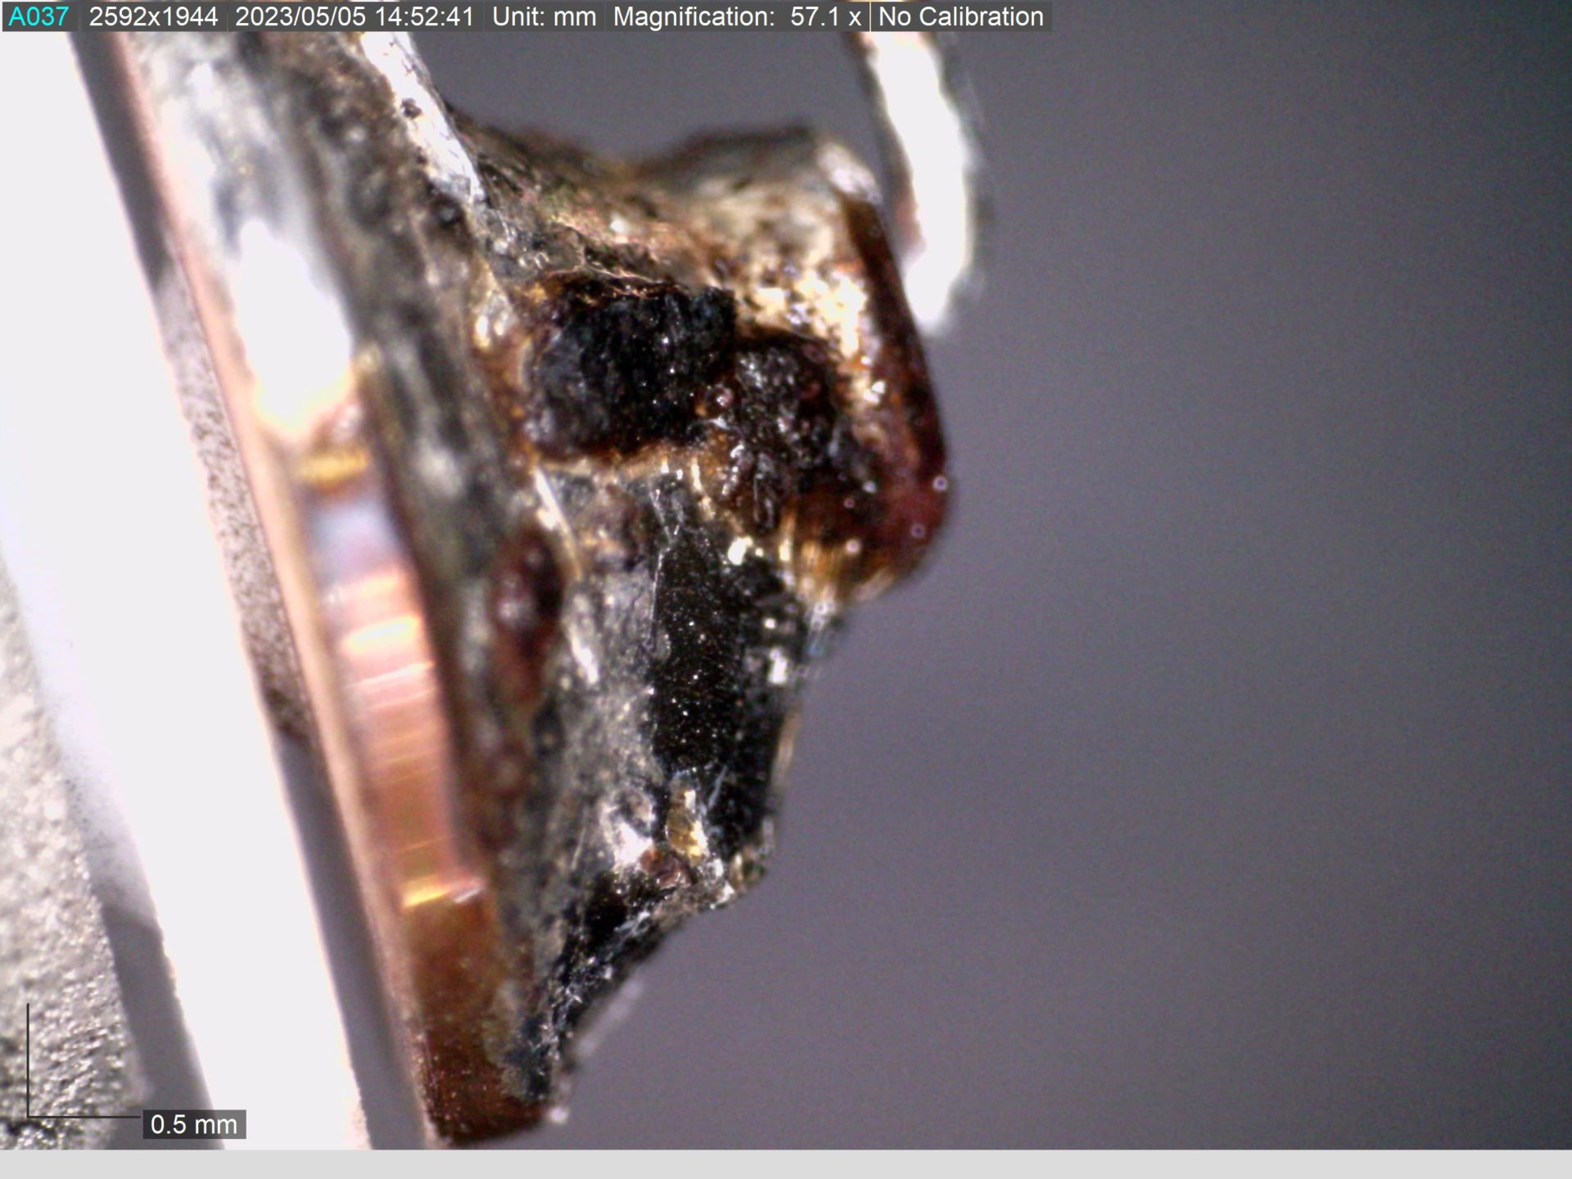
Case Study: SPS Beam Wire Scanners (BWS)
SPS BWS failures & beam parameters during scrubbing run
BWS have shown excellent performance with more than 70’000 scans during the first year!
Until… 12-April-23, when all 4 BWS failed simultaneously during a scrubbing run… WHAT HAPPENED?
What was observed after BWS opening:
No wire left, No remnants found.
(2) No other damage to the BWS body.
(3) Traces on the wire holding “forks” and the
connecting parts.
(4) No full logging data on the exact time of breakage...
Makes it difficult to identify the exact beam parameters.

Slide 7
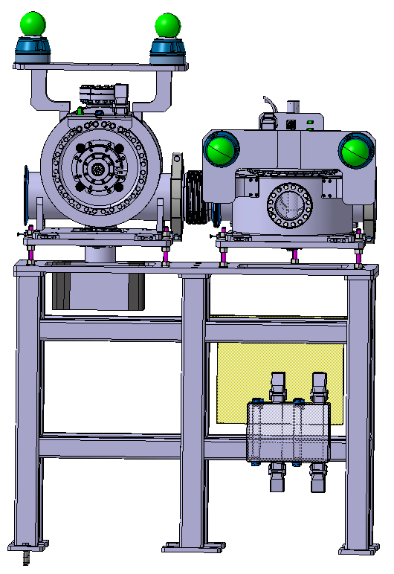
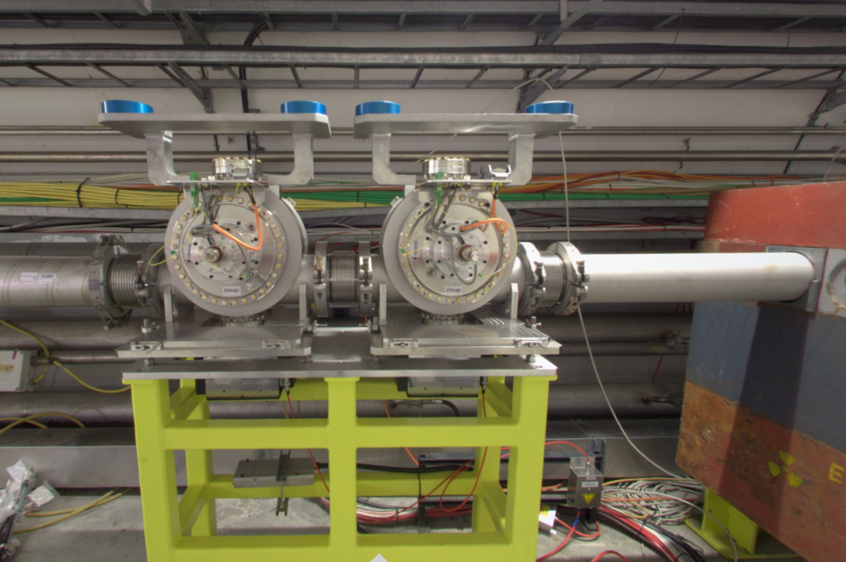
Case Study: SPS Beam Wire Scanners (BWS)
Wire scanners are installed in pairs: 2 horizontal and 2 vertical together.
Area of vertical BWS installation was not accessible due to radiation levels.
Changed installation configuration:
1 vertical WS and 1 horizontal BWS

Slide 8
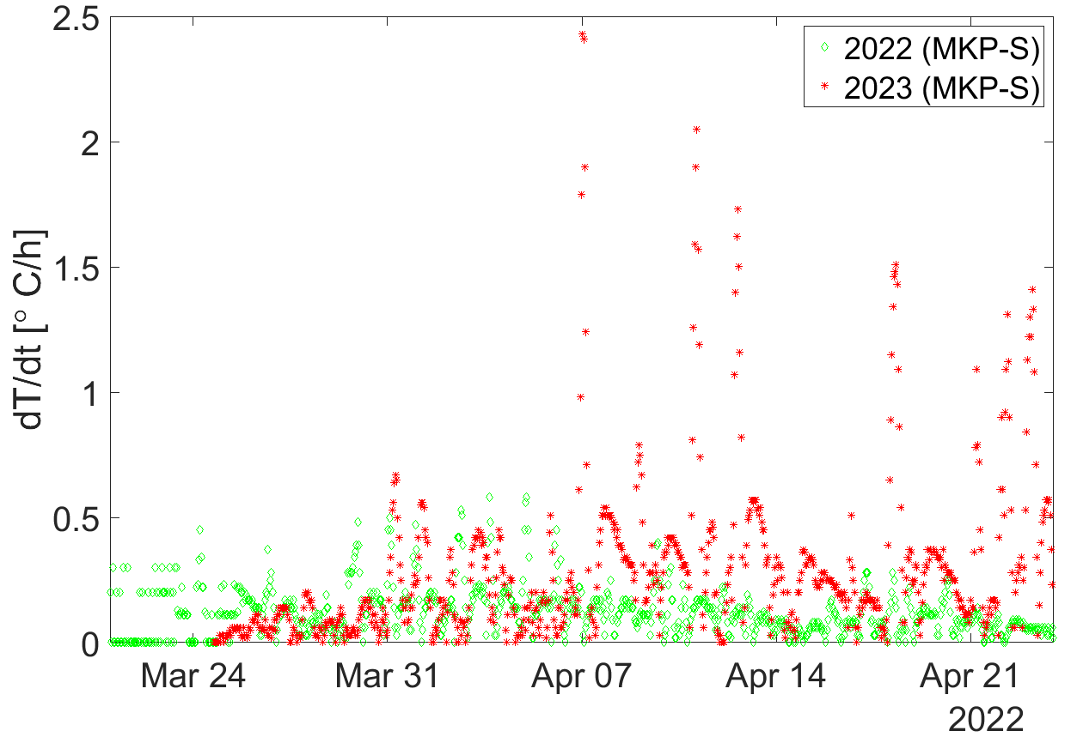

Measured thermal gradient on MKP-S
$$∝\frac{n_{bunches}⁢{N_{ppb}}^{2}}{{σ_{z}}^{2.6}}$$
4 BWS broke?
→ We use the MKP-S heating
rate as an indicator of the
beam parameters.
2 spare BWS were installed,
beam settings of the incident
were repeated:
wires broke almost “instantaneously”
but this time all beam parameters were logged.
2 newly installed BWS broke
4x72 bunches up to
2e11 ppb and σ_{z} ~1.6ns, Long FT
4x72 bunches up to
1.8e11 ppb and σ_{z} ~1.6 ns
Short FT

Slide 9
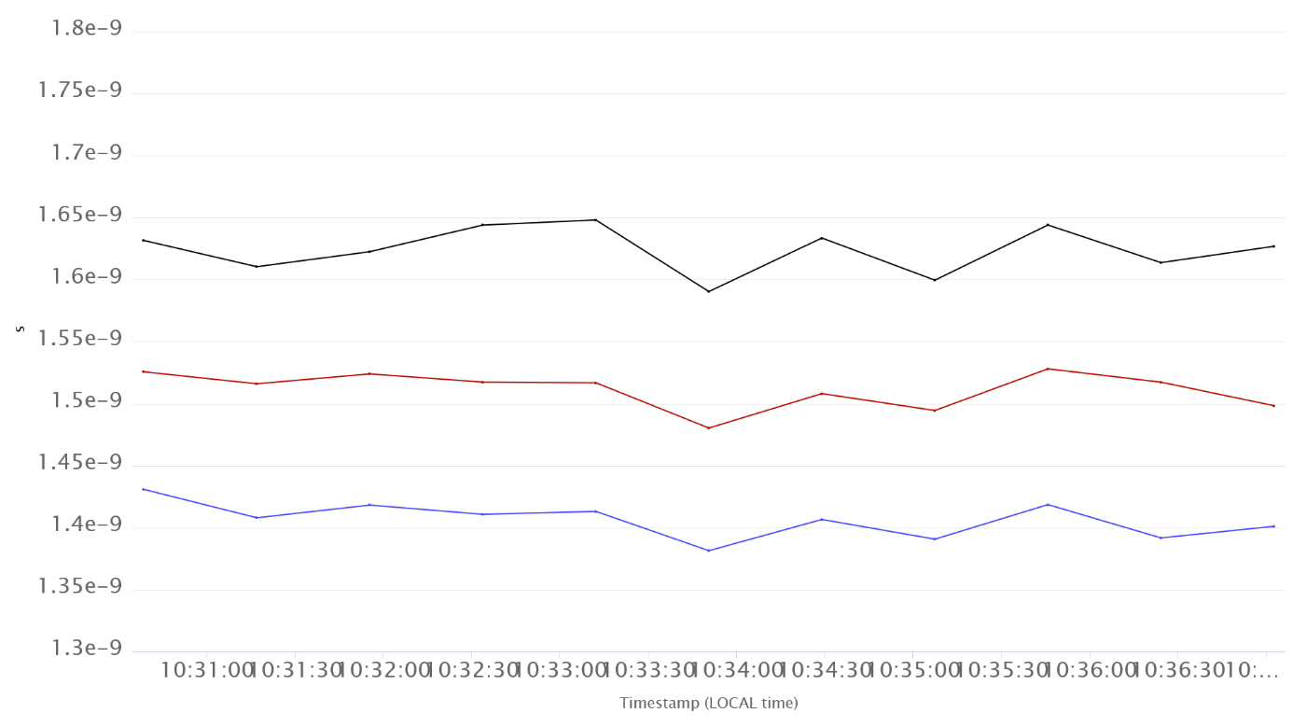
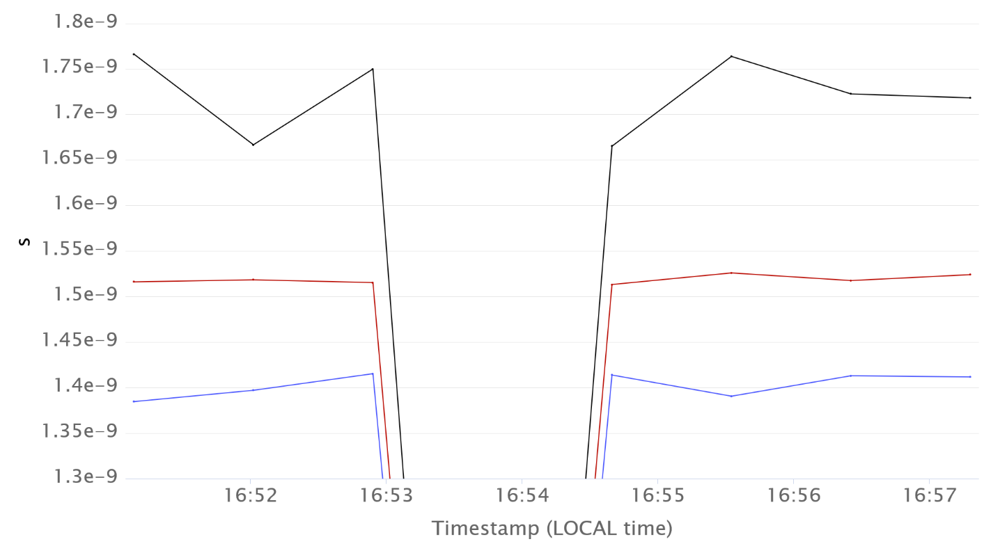

Comparisons of bunch parameters
SPS RF settings were restored to reproduce beam conditions during BWS breakage (22-Apr),
Bunch profiles were acquired with MD scope and Head-tail monitor,
Beam spectra around 800 MHz were recorded with a spectrum analyzer connected to AEW pick-up (= wall current monitor).
MD 04.05.2023
Logged data
MD 17.05.2023
$$\text{4}\text{x}\text{72 }\text{bunches} \text{with} \sim 1.35×{10}^{11}$$
4x72 bunches with $\sim 1.8×{10}^{11}$
max
max
BQM bunch length (s)
mean
BQM bunch length (s)
mean
min
min
$→$ Mean bunch lengths are very similar despite a slightly larger spread of maximum bunch length for higher intensity
$→$ Beam spectra acquired during both MDs should be sufficiently close

Slide 10
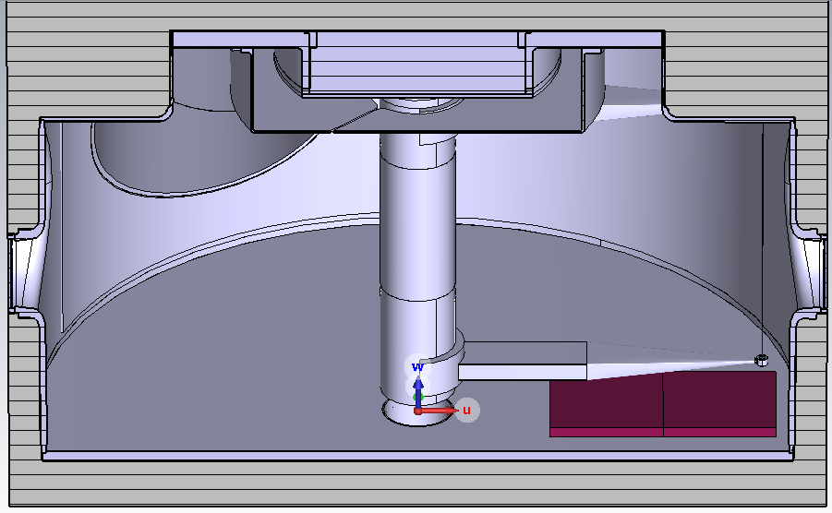
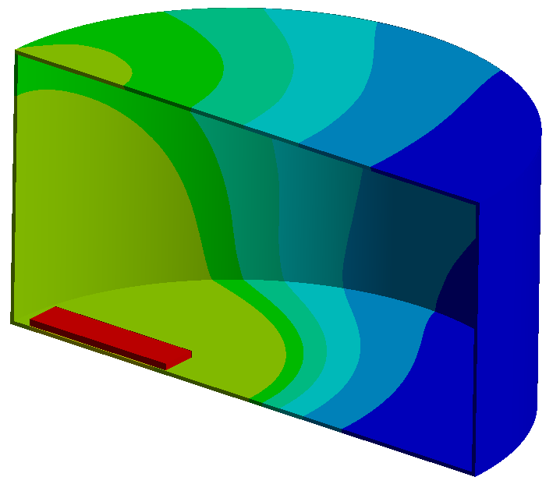
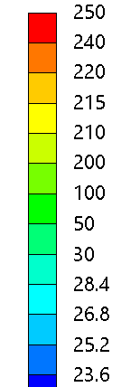
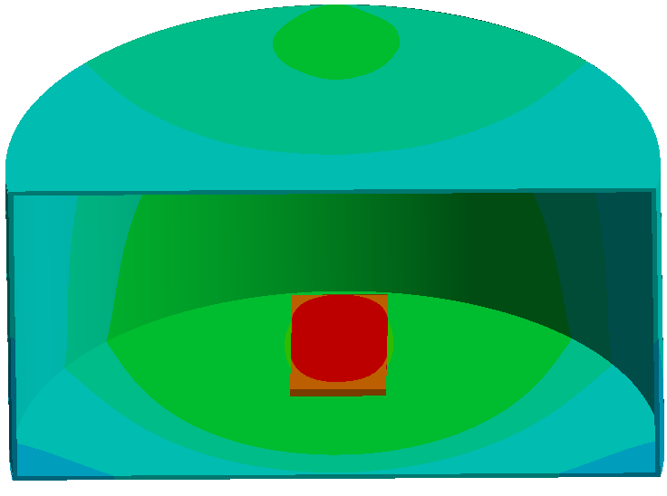
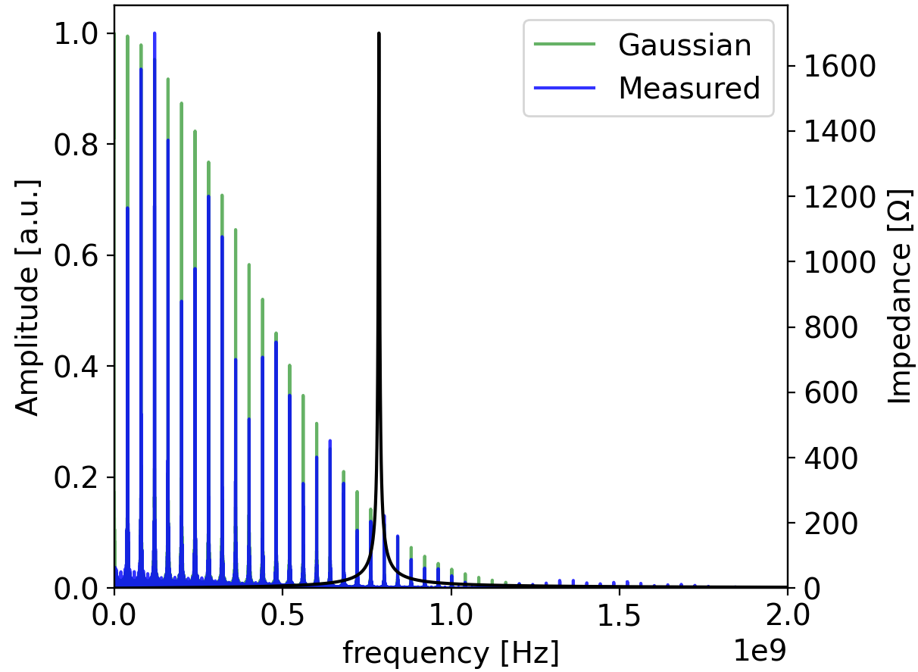
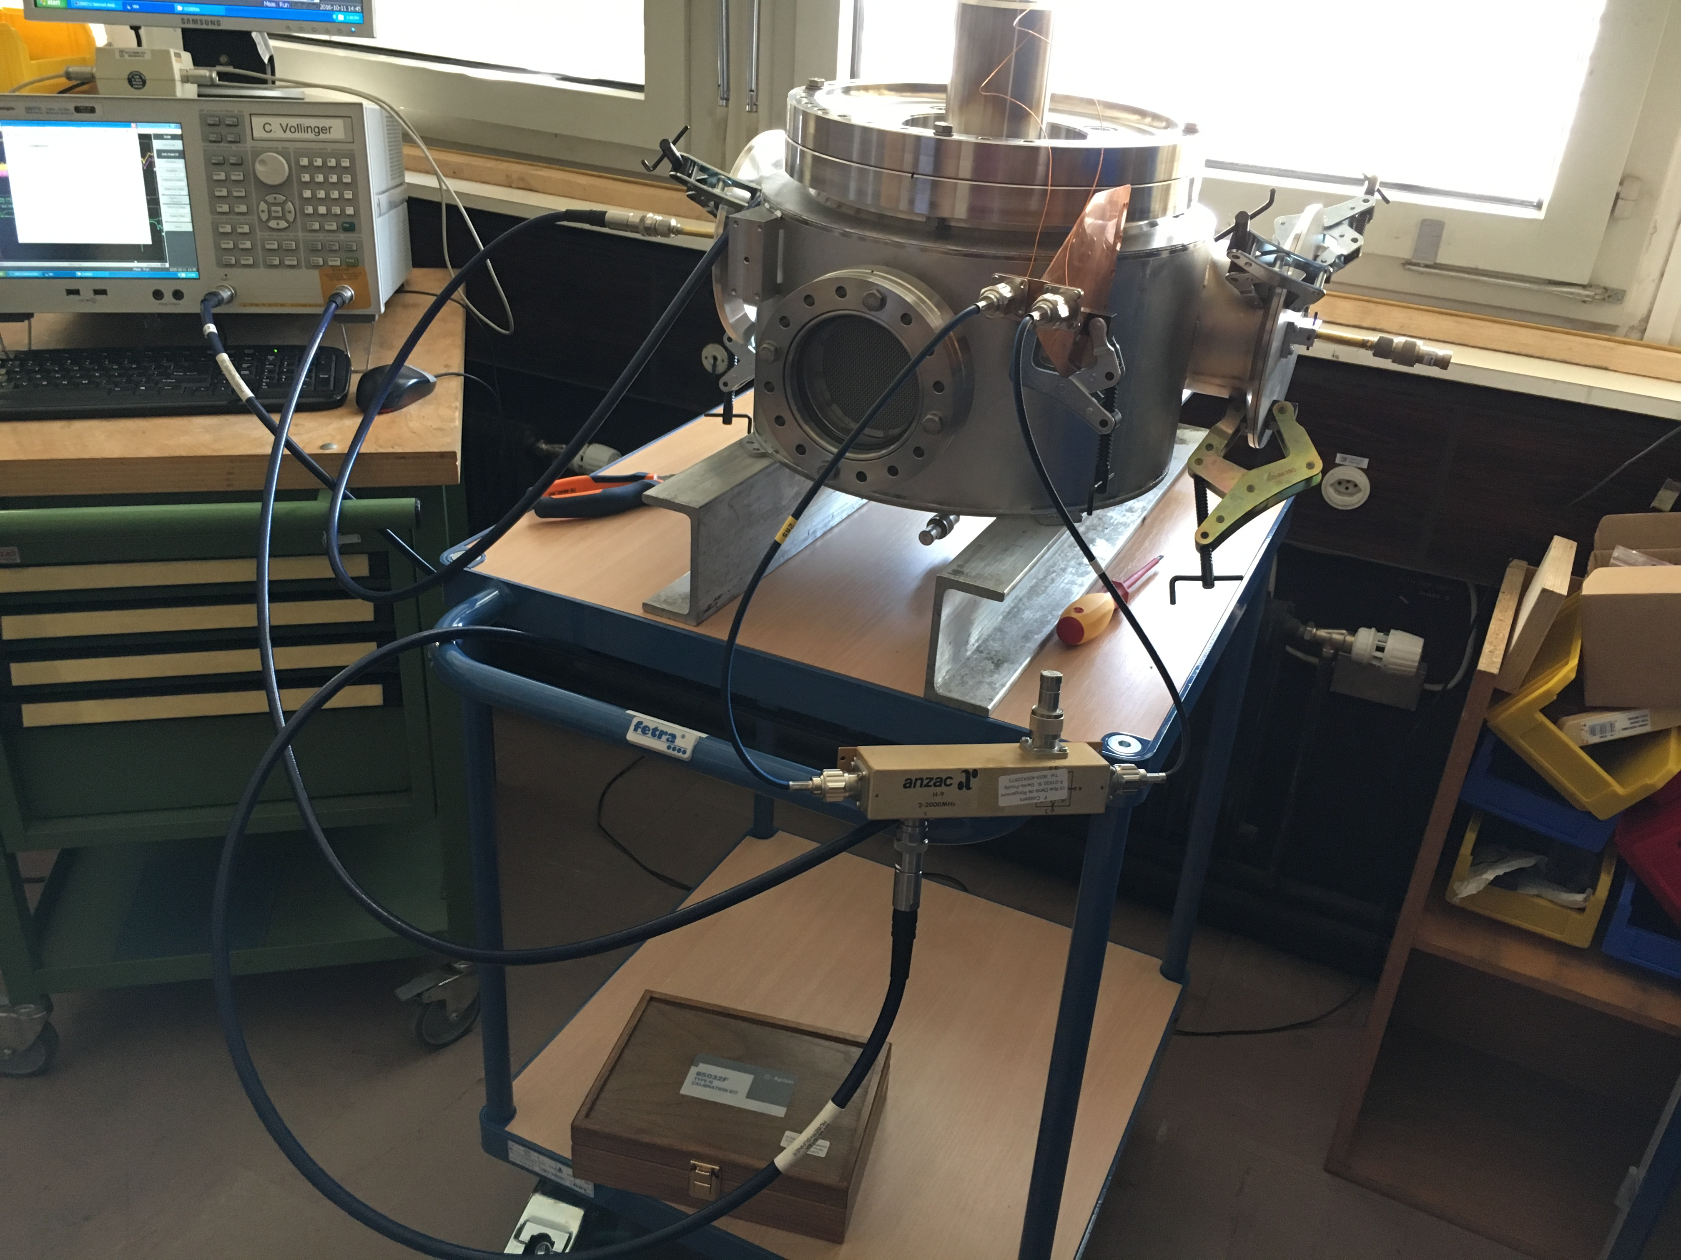
Task Force: SPS Beam Wire Scanners
EM Simulations targeting bci, and mitigation measures,
Update on operational beams, calculation of beam spectra
Heating and losses study,
RF measurements on a spare,
Thermal-mechanical simulations, post failure analysis, preparation for next intervention.
Not all this work of the task force can be repeated in this case study, of course, but we (you) will do:
EM Simulations targeting mitigation measures (CST hands-on),
Calculation of different beam spectra (Python hands-on),
Heating/Loss study (CST & Python hands-on “combined”).

Slide 11
Case Study: SPS Beam Wire Scanners (BWS)
Final solution – watch out – spoiler alert!

Slide 12
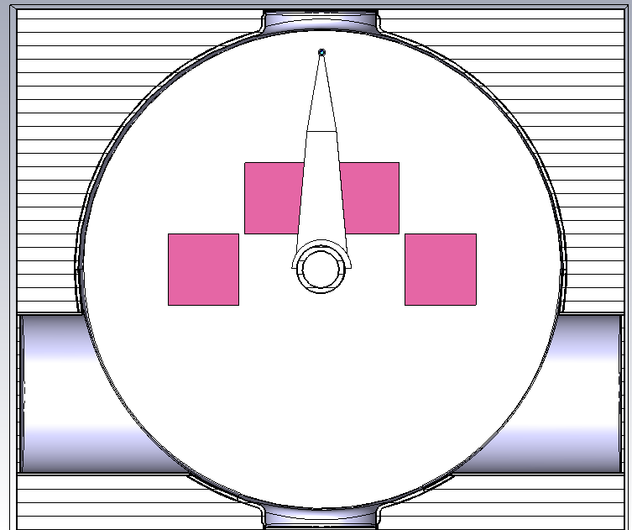
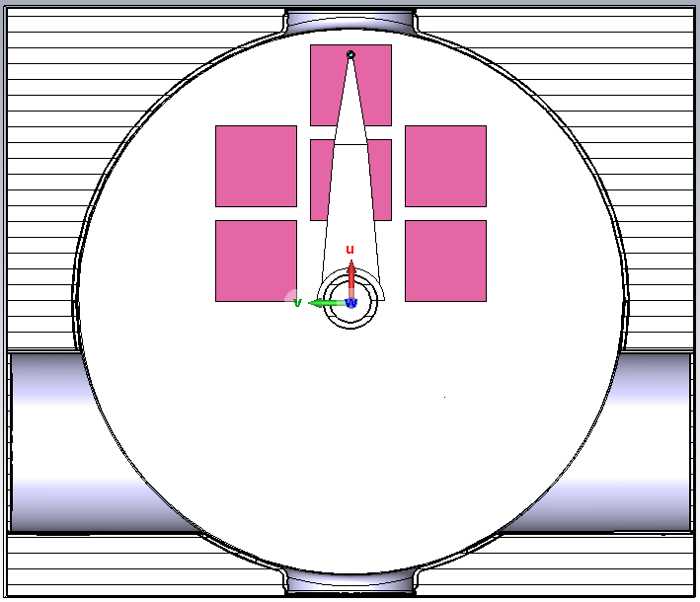
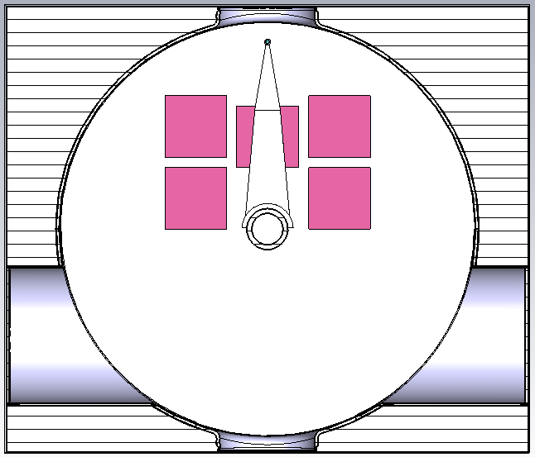
Case Study: SPS Beam Wire Scanners (BWS)
Quick mitigation was required without impacting on the BWS functionality, without compromising the vacuum
features, without leading to excessive heating,…
Decision to introduce a new loss mechanism by inserting (already know, vacuum tested & approved) lossy ferrite material with the goal to pull EM-fields “away” from the wire, re-distributing the losses.
Impact of ferrite installation on calculated impedance

Slide 13
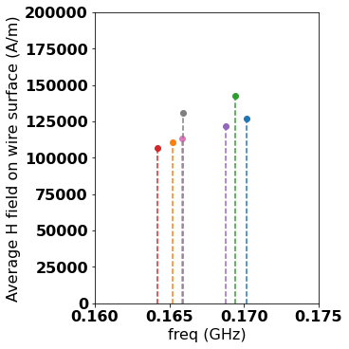
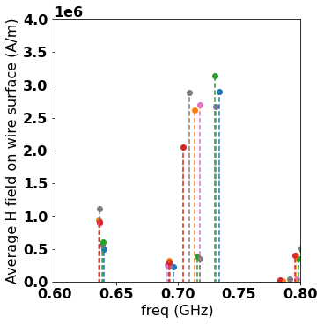
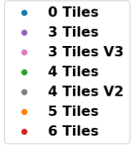
Case Study: SPS Beam Wire Scanners (BWS)
Impedance traces were used to determine the overall ferrite impact and the field distributions in the BWS tank.
H-field distribution on the wire surface was used as criteria to see the impact on the wire loss reduction.
Overall, the use of 5 tiles or 6 tiles showed to be the best solutions, however, each tile produces heating in the tank (so less ferrite use is desired), and
Both solutions have insufficient impact at low frequency!

Slide 14
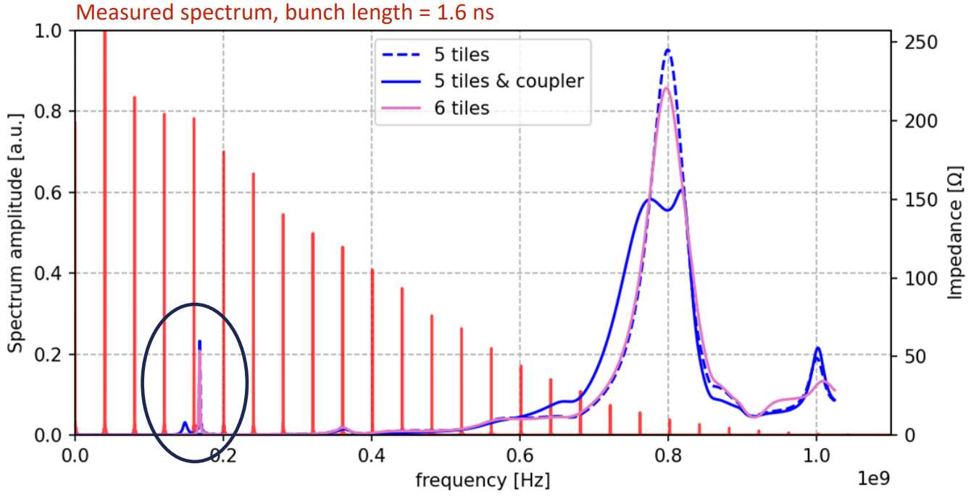
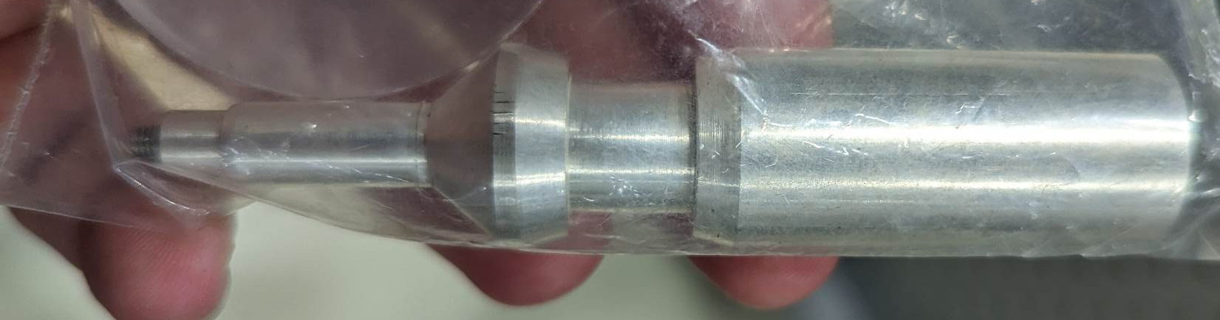
Case Study: SPS Beam Wire Scanners (BWS)
Beam spectrum was overlayed with the calculated impedance.
Several spectra were tested for compliance.
Heating in the ferrites was estimated.
Decision:
additional installation of an RF-coupler is required to impact on the one low frequency mode that could not be tackled with ferrite insertion.
RF-coupler impact

Slide 15
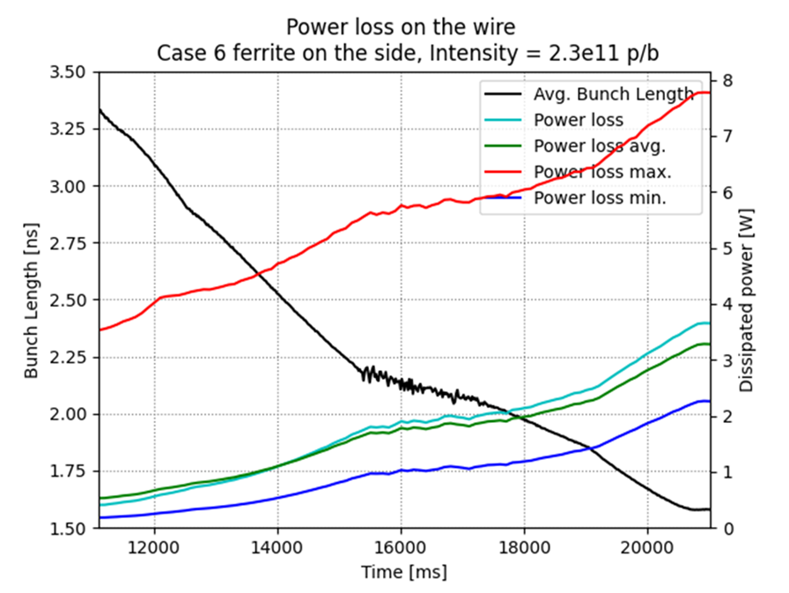
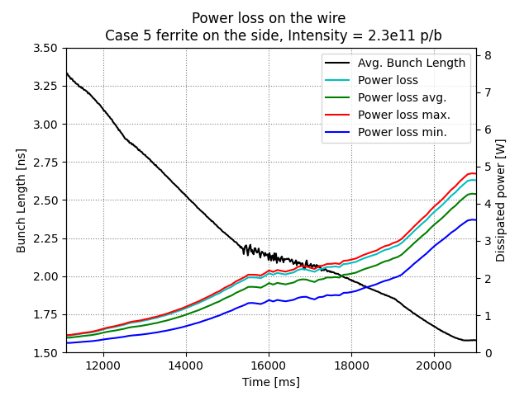
Case Study: SPS Beam Wire Scanners (BWS)
H-BWS: 6 Tiles
V-BWS: 5 Tiles + coupler
Power loss studies on the wire were carried out, to decide on the final solution.

Slide 16
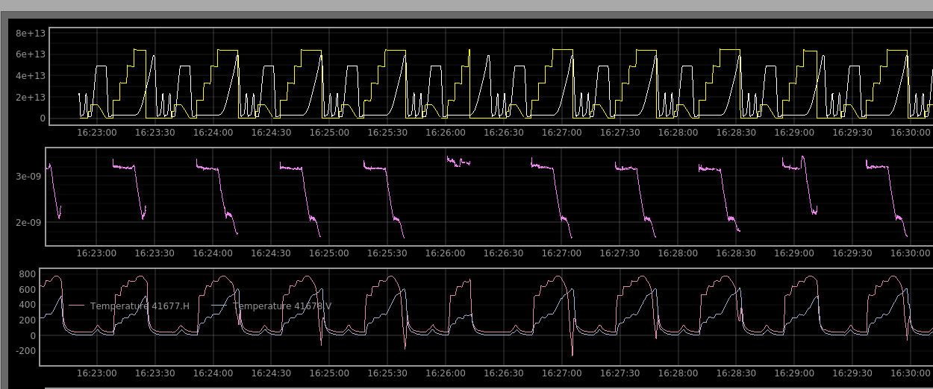
Some observations during MDs after installation of the two mitigated BWS
Case Study: SPS Beam Wire Scanners (BWS)
~2.2e11 ppb at FT with 4x72 bunches, standard FT
beam intensity
average bunch length
Temperature in the BWS

Slide 17
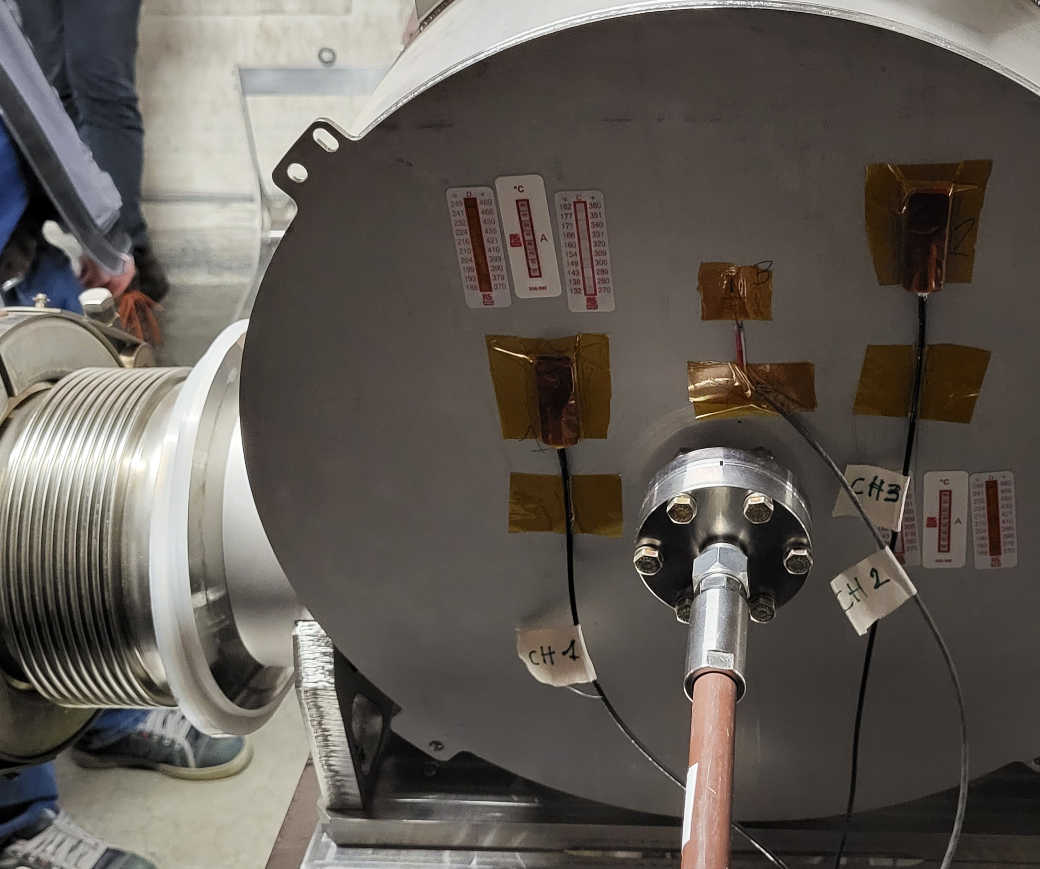
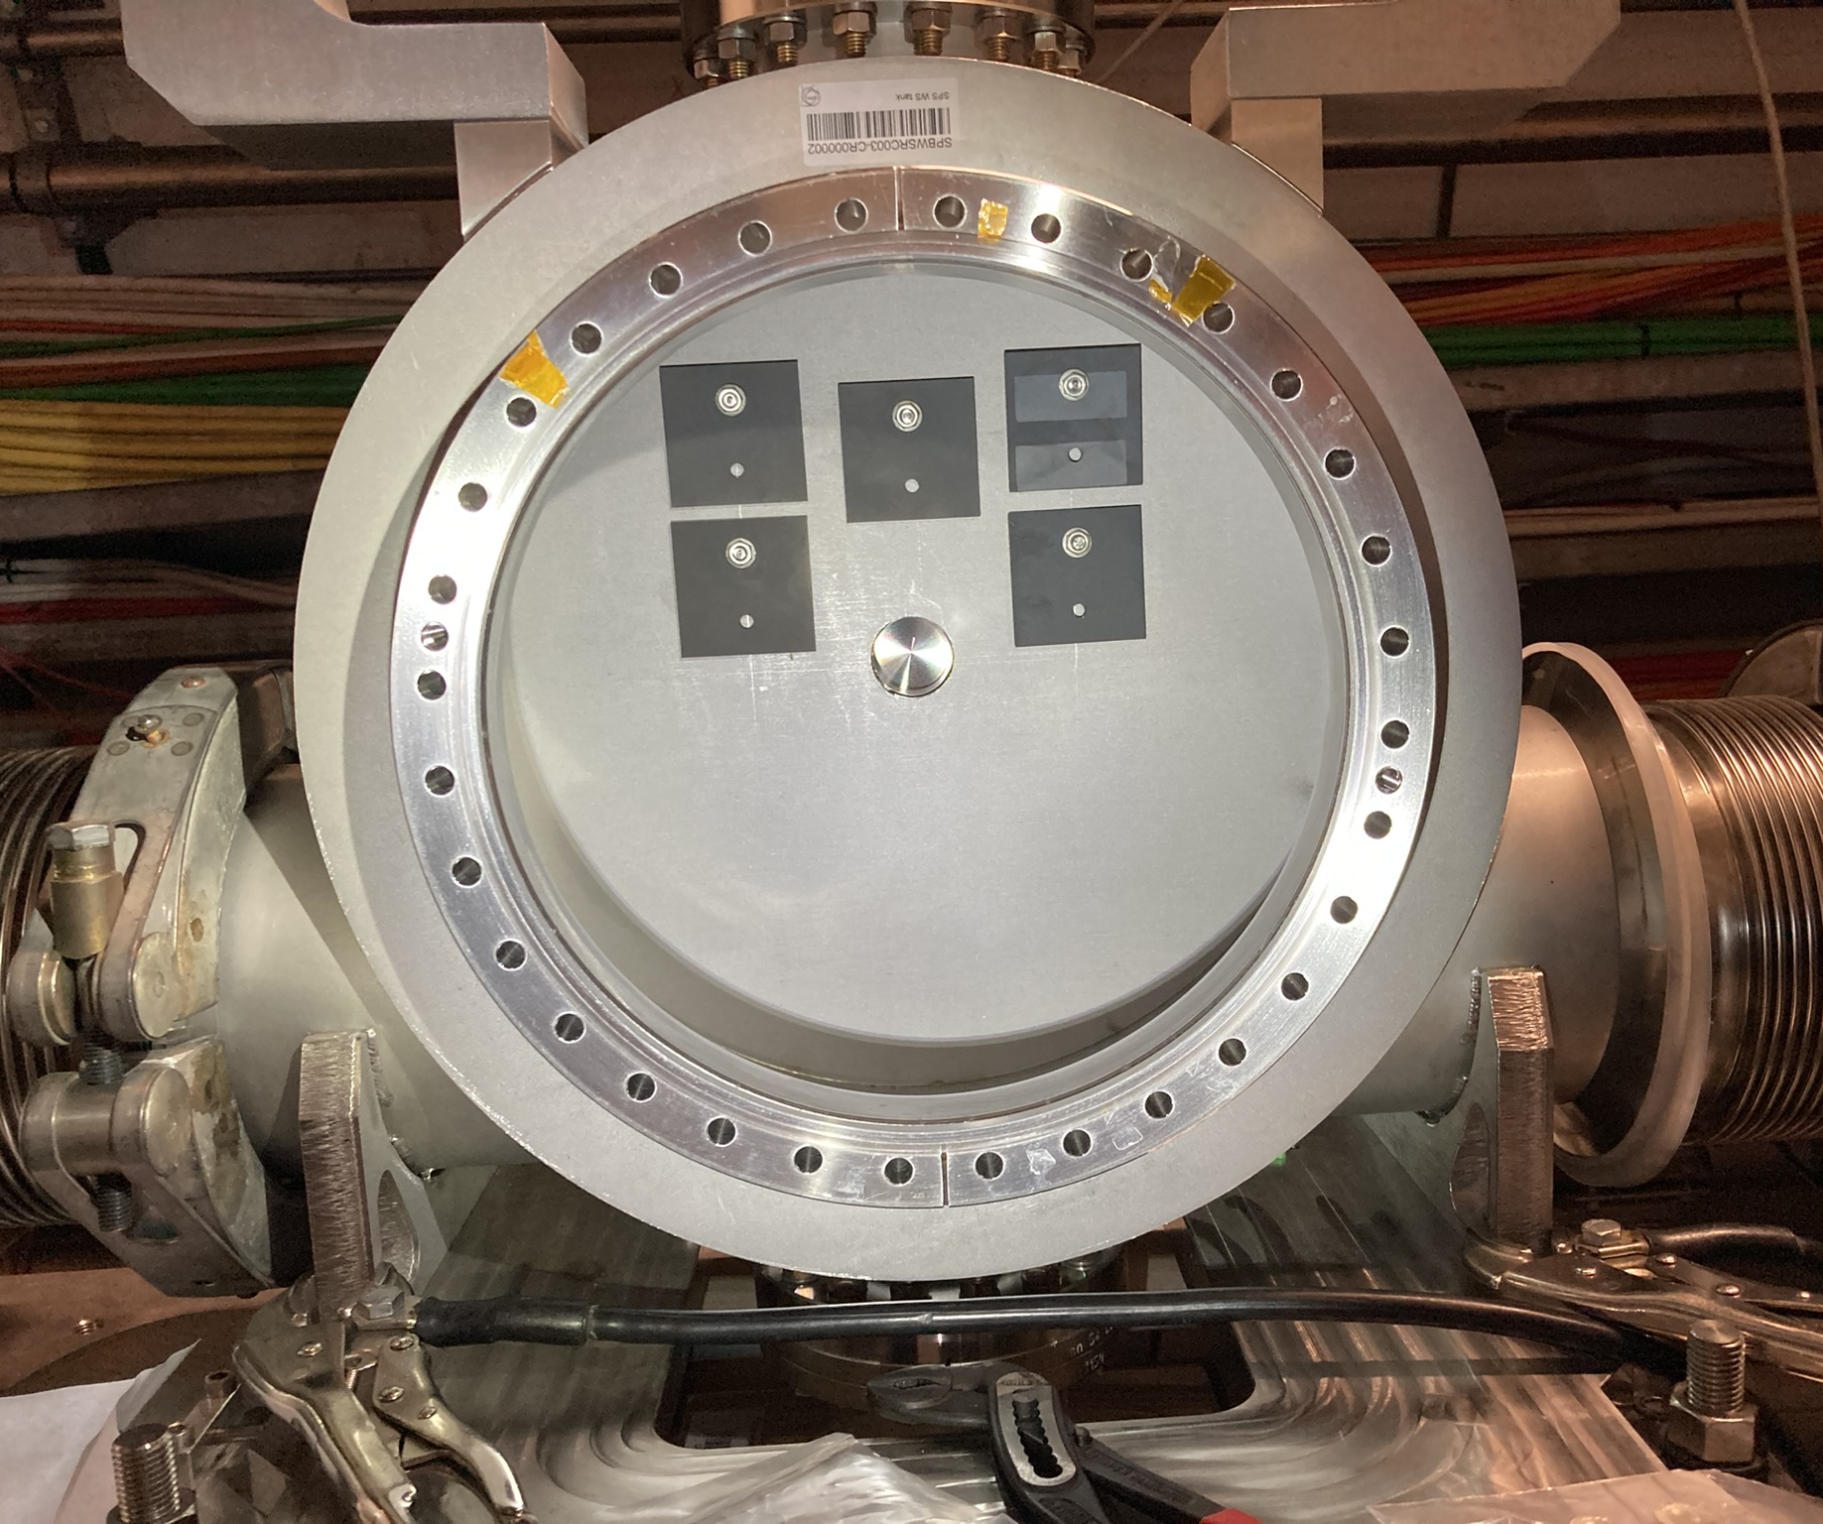
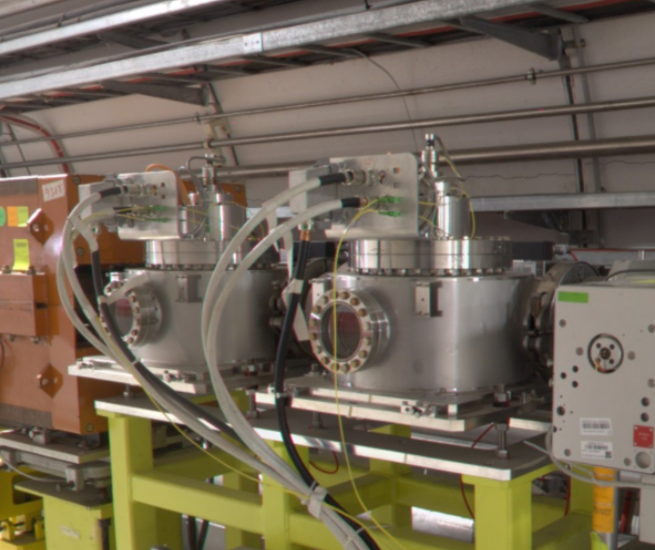
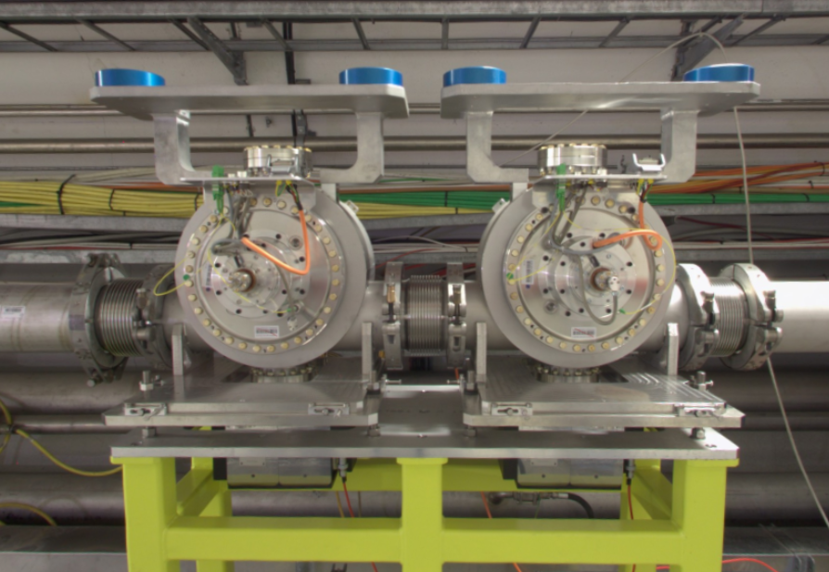
Case Study: SPS Beam Wire Scanners (BWS)
RF - COUPLER
FERRITES

Slide 18
SPS Beam Wire Scanners Task Force
Contributions from:
Alexandre Lasheen, Alexandre Mariet, Ana Guerrero, Anthony Harrison, Benoit Salvant, Carlo Zannini, Christine Vollinger, Elena de la Fuente, Federico Carra, Federico Roncarolo, Francesco Velotti, Giannis Papazoglou, Giulia Papotti, Heiko Damerau, Ivan Karpov, Jonathan Emery, Jose Antonio Ferreira Somoza, Kevin Li, Leonardo Sito, Michela Neroni, Michael Stephen Sullivan, Nabil El-Kassem, Raymond Veness, Thibaut Lefevre, William Andreazza
… and hopefully, I did not forget somebody.
Thank you for your attention!

