Slide 1
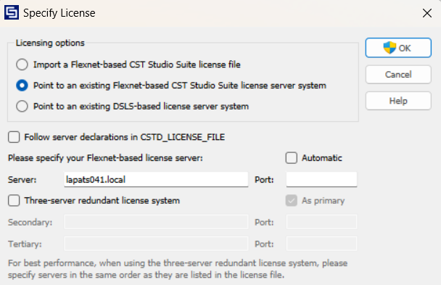
CST licence settings
Please remember to be connected to the “CAS-Router” or “CAS-Router_5G” WiFi!
Password: 85800120

