Slide 1


Impedance mitigation of SPS rotary beam wire scanners with CST Studio Suite
Heiko Damerau, Elena de la Fuente Garcia, Jake Flowerdew, Leandro Intelisano, Alexandre Lasheen, Michela Neroni*, Christine Vollinger
Based on the work of the SPS BWS Task Force
Many thanks to: A. Mostacci, L. Sito and all the SPS BWS Task Force contributors
*michela.neroni@cern.ch

Slide 2
References
    IPAC24 papers:
      R. Veness et al., “Overview of beam intensity issues and mitigations in the CERN-SPS fast wire scanners”, 10.18429/JACoW-IPAC2024-WEPG26
      L. Sito et al., “Impedance and thermal studies of the CERN SPS wire scanners and mitigation of wire heating”, 10.18429/JACoW-IPAC2024-WEPG29
      C. Vollinger et al., “Mitigation of beam coupling impedance for the wire scanners in the CERN Super Proton Synchrotron”, 10.18429/JACoW-IPAC2024-THPC51
    Additional material and presentations:
      SPS BWS Task Force meeting - 02062023
      SPS BWS Task Force meeting – 02082023
      SPS BWS Task Force meeting – 28082023
      SPS BWS Task Force meeting - 14112023

Slide 3

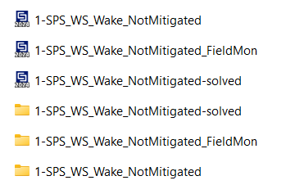
CST simulation files
Each folder contains three files
“1-SPS_WS_Wake_NotMitigated.cst” contains the component geometry.
“1-SPS_WS_Wake_NotMitigated_solved.cst” contains Wake Impedance results.
“1-SPS_WS_Wake_NotMitigated_FieldMon.cst” contains electric and magnetic Field Monitors solved.
N.B. Please do not run the simulations on your laptop during the tutorial!

Slide 4
1- Not mitigated case

Slide 5
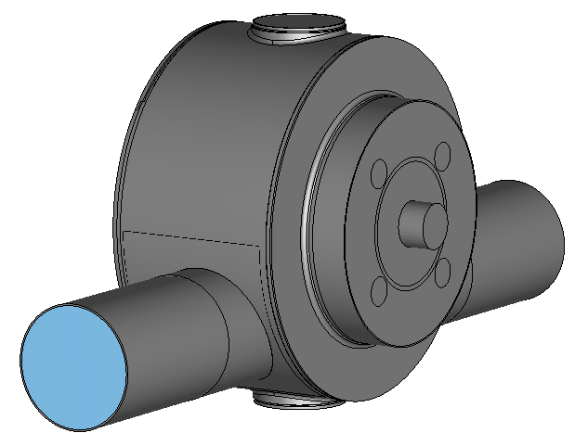
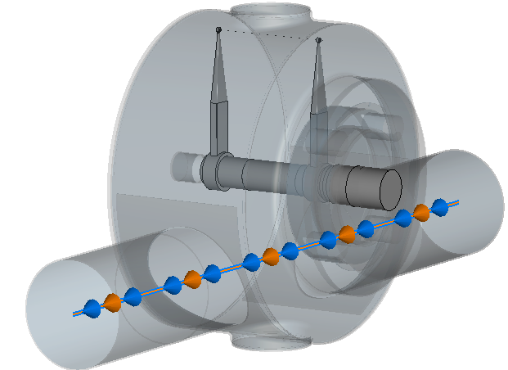
Rotary Beam Wire Scanner – 3D model
SPS beam wire scanner geometry as before the 2023 breakage, with fork in parking position:
Carbon wire
Stainless steel case
Rotating shaft (stainless-steel)
Particle beam

Slide 6
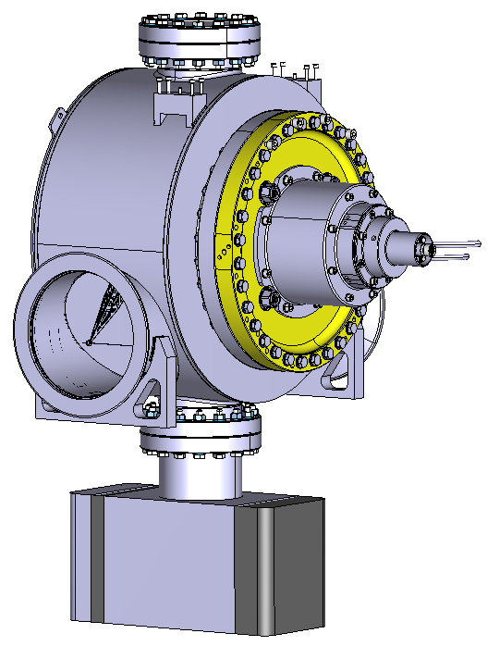
Rotary Beam Wire Scanner – 3D model
Simplification and/or rebuilding of geometrical shapes in CST

Slide 7
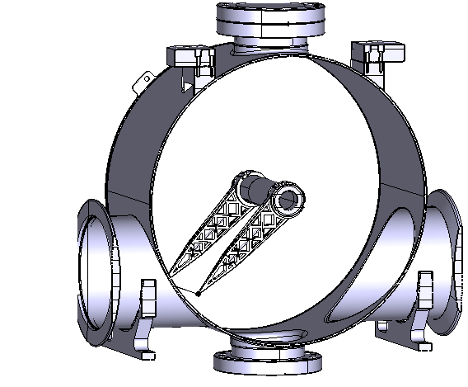
Rotary Beam Wire Scanner – 3D model
Simplification and/or rebuilding of geometrical shapes in CST
Fork in scan position
The modelling is not part of this tutorial → please have a look at the Simulation tutorial from RF CAS: “Numerical analysis of RF problems”

Slide 8
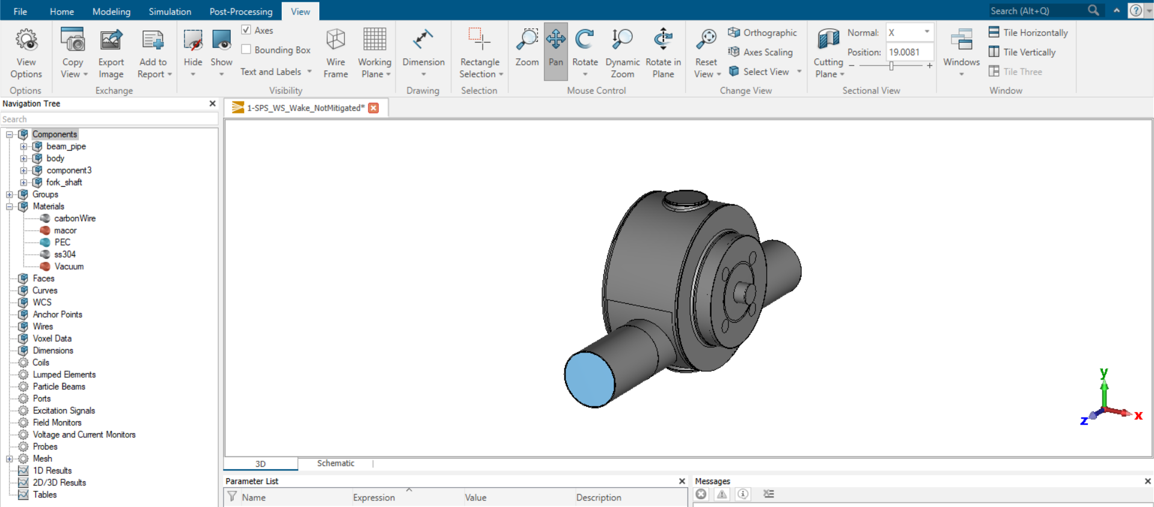
Rotary Beam Wire Scanner – 3D model
You can access components and materials from the Navigation Tree

Slide 9
Simulation settings
Definition of Particle beam
Mesh settings
Definition of Frequency range, Background material and Boundary conditions
Definition of Wakelength and frequency sampling of the impedance trace
Disclaimer: an example of simulation will be provided; different settings could lead to an equally accurate result.

Slide 10
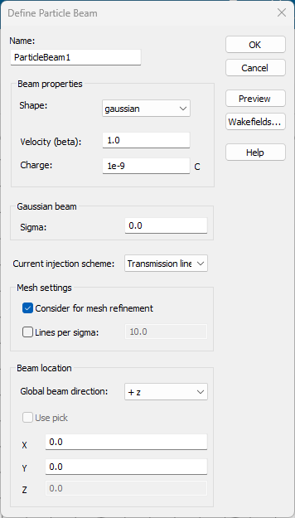
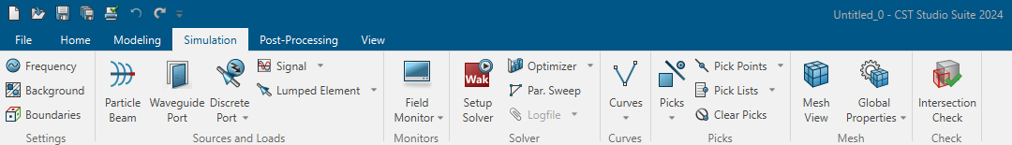
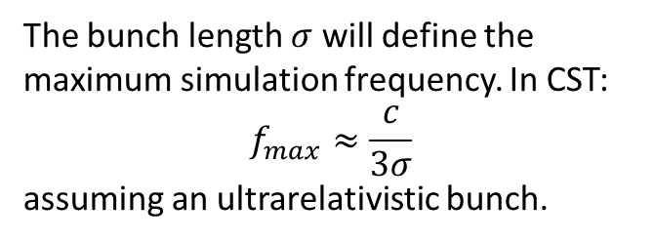
Simulation settings (1/4)
Tip
You can try to change the sigma to explore the higher frequency range.
Try to change the injection scheme to Analytics and see the changes.
Definition of Particle Beam:
To have a maximum frequency of 1 GHz
The bunch length $σ$ will define the maximum simulation frequency. In CST:
$$f_{max}≈\frac{c}{3σ}$$
assuming an ultrarelativistic bunch.
We select a sigma of 100 mm
To click on “Wakefields”

Slide 11
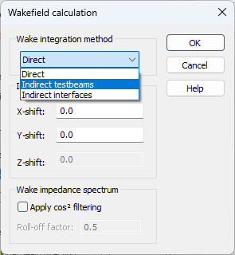
Simulation settings (1/4)
Definition of integration method:
To choose Indirect testbeams as integration method
N.B. If the structure does not allow the use of Indirect testbeams, like in this case, the solver will automatically select Direct integration method.

Slide 12
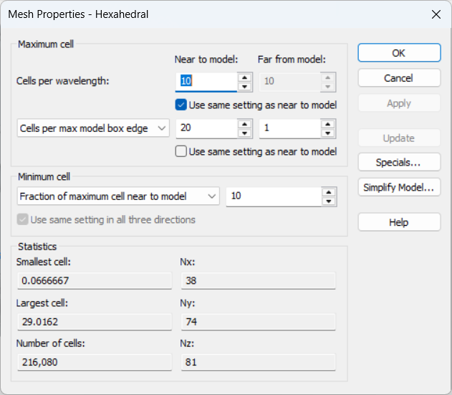
Simulation settings (2/4)
Time domain solvers use Hexahedral mesh type. Mesh settings:
10 cells per wavelength (default option)
Sub-optimal mesh definition introduced to reduce computational time.
Mesh convergence study, gradually increasing the number of mesh cells, is always needed to achieve accurate results.

Slide 13
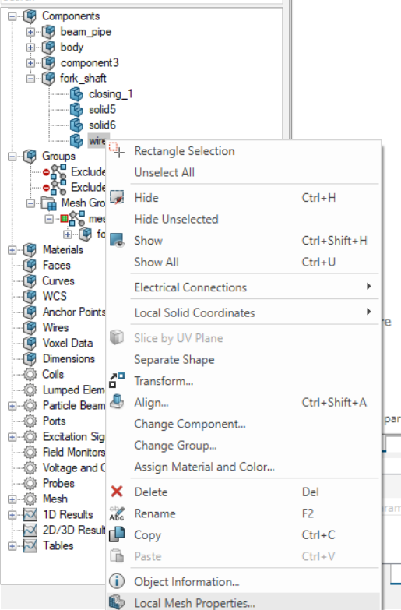
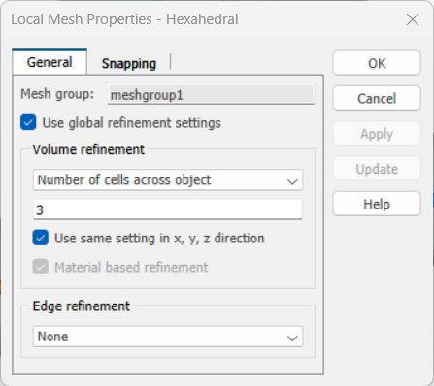
Simulation settings (2/4)
Mesh settings:
10 cells per wavelength (default option)
Local refinement on the wire → 3 cells across object in each direction

Slide 14
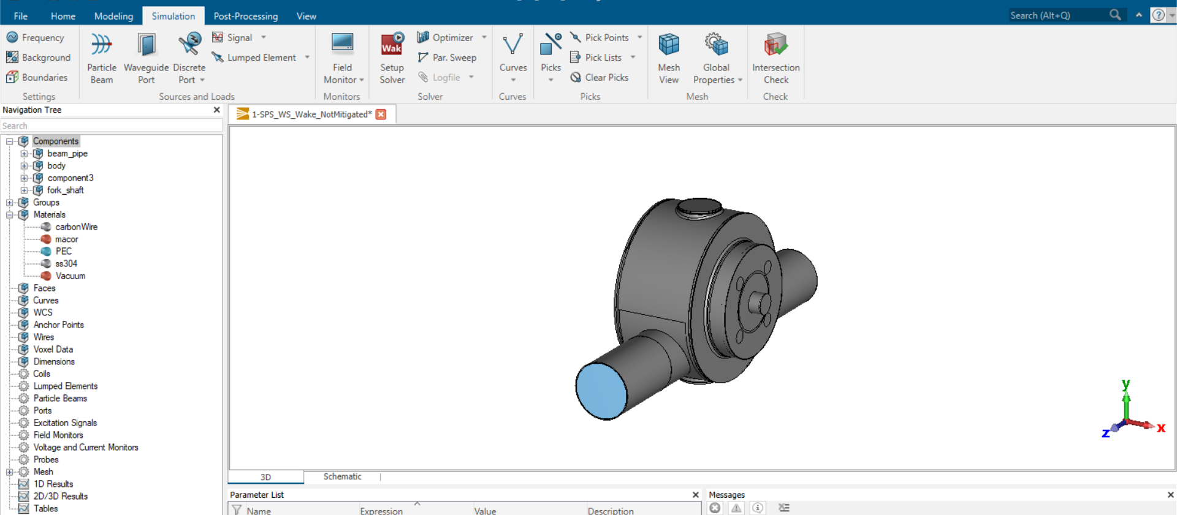
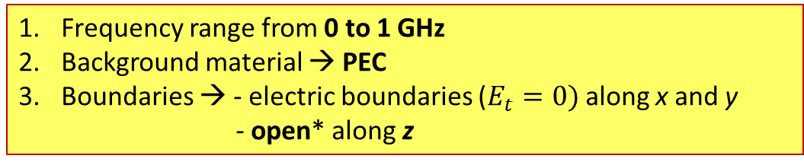
Simulation settings (3/4)
Frequency range from 0 to 1 GHz
Background material → PEC
Boundaries → - electric boundaries ($E_{t}=0)$along x and y
      - open* along z
*The open boundary extends the touching geometry virtually to infinity so that waves can pass this boundary with minimal reflections

Slide 15
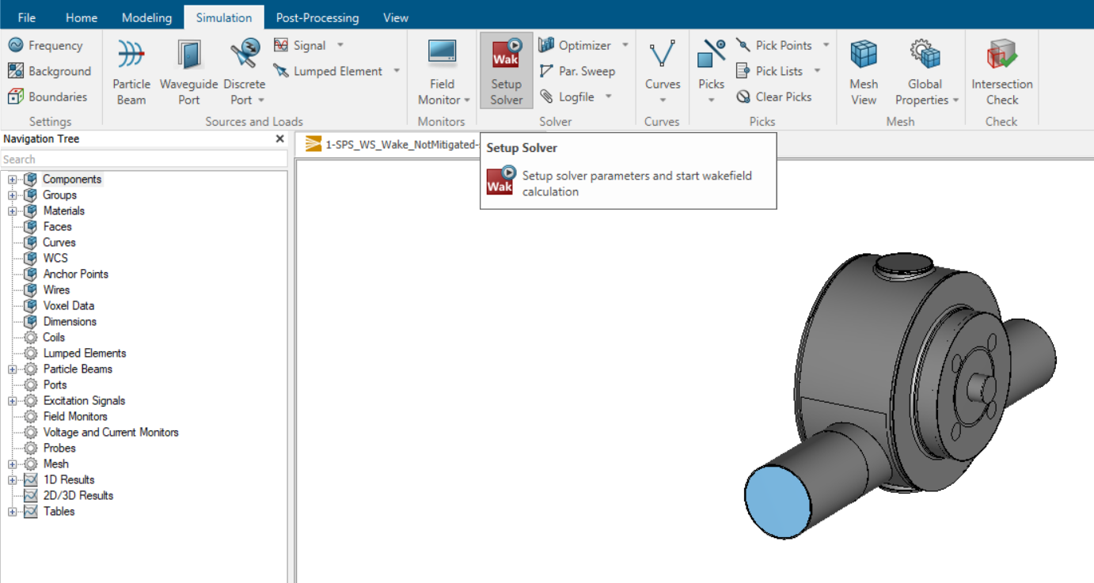
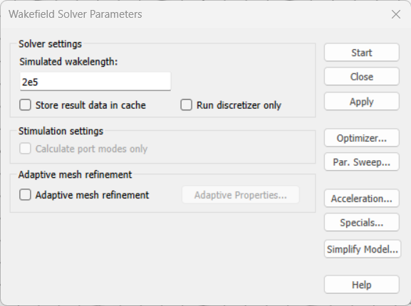
Simulation settings (4/4)
Setup of Wakefield solver:
Simulated wakelength = 200 m

Slide 16
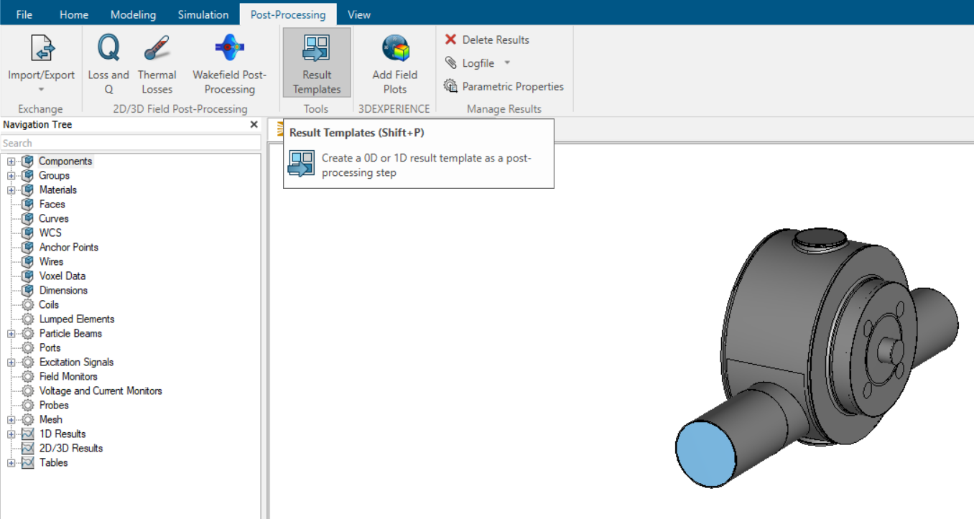
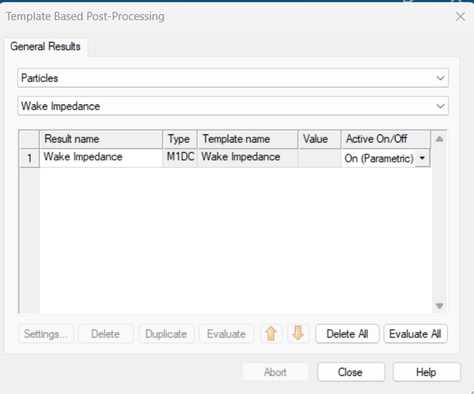
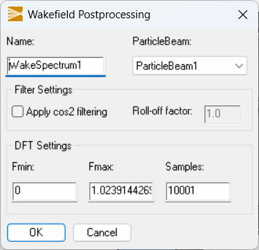
Simulation settings (4/4)
Selecting 10001 samples for impedance trace post-processing
The simulation can now be started.

Slide 17
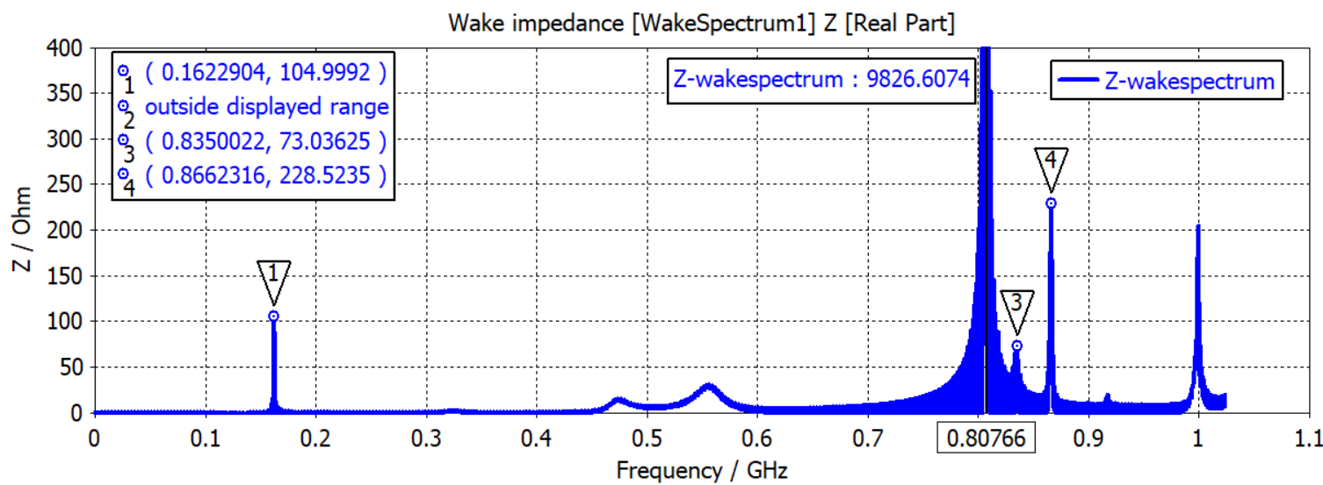
Longitudinal impedance result
Up to 10 kΩ
Impedance trace is not fully resolved and a longer wakelength would be needed. Truncation error leads to ripples according to the Fourier Transformation.

Slide 18
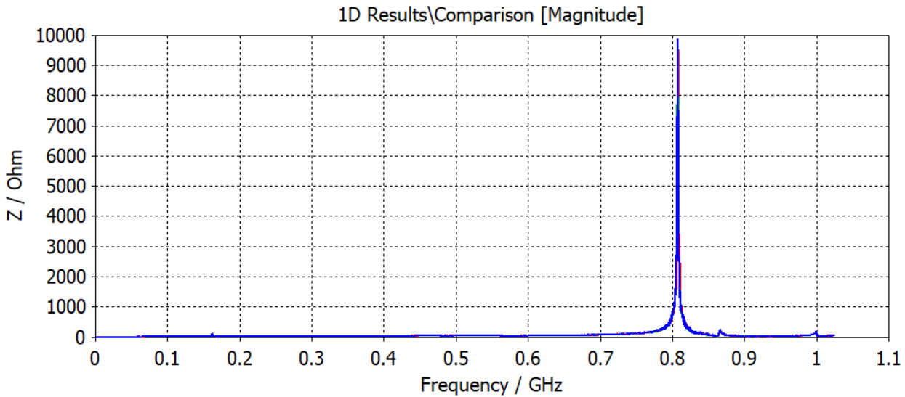
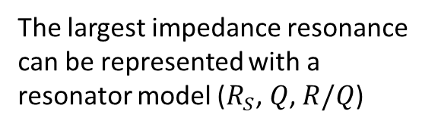
Longitudinal impedance result
The largest impedance resonance can be represented with a resonator model ($R_{S}$, $Q$, $R/Q$)
Used as impedance source for power loss computation (case study, part 2 by A. Lasheen et al.)

Slide 19
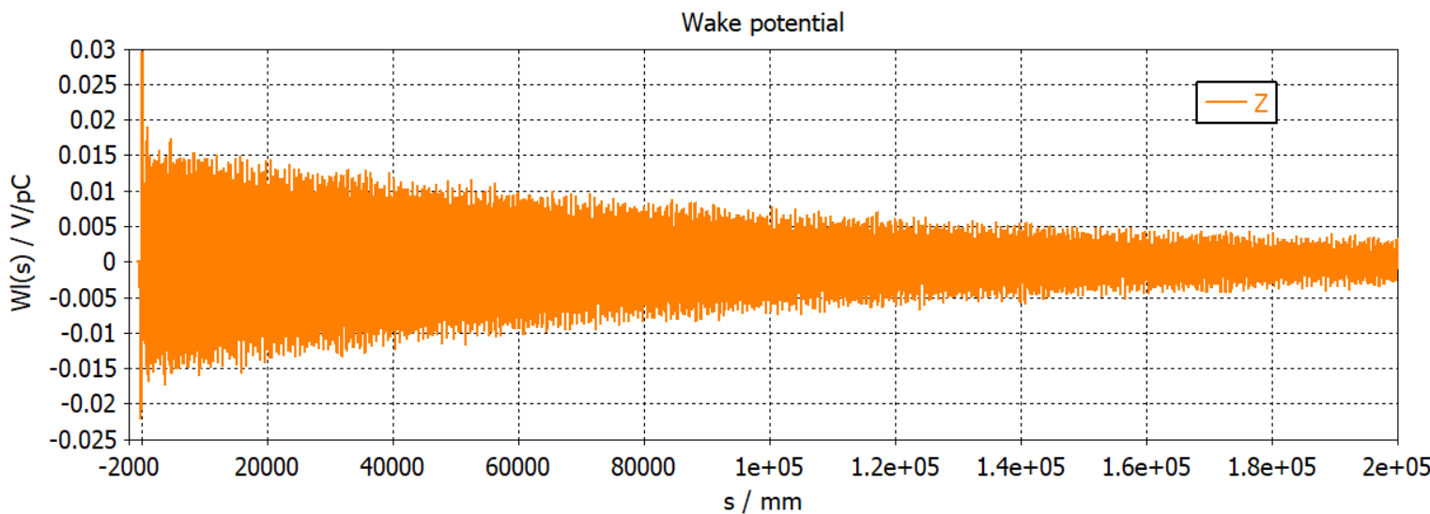
Longitudinal wake potential
The wake potential in CST corresponds to the wake function of a charge distribution (nomenclature used in A. Mostacci lectures)
An additional convergency check can be done by looking at the Energy under 1D results. Good convergency reached when energy is below -40 dB (rule of thumb)

Slide 20
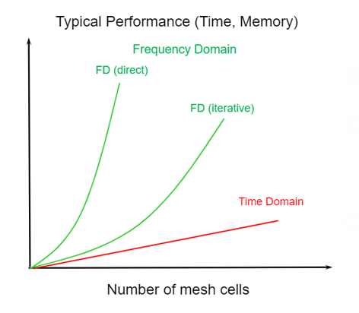
Computational resources vs. settings
Linear dependence on the number of mesh cells with the Time Domain solver
Linear dependence on the wakelength
Trade-off between the total number of mesh cells and the wakelength is needed!
© CST, Dassault Systèmes

Slide 21
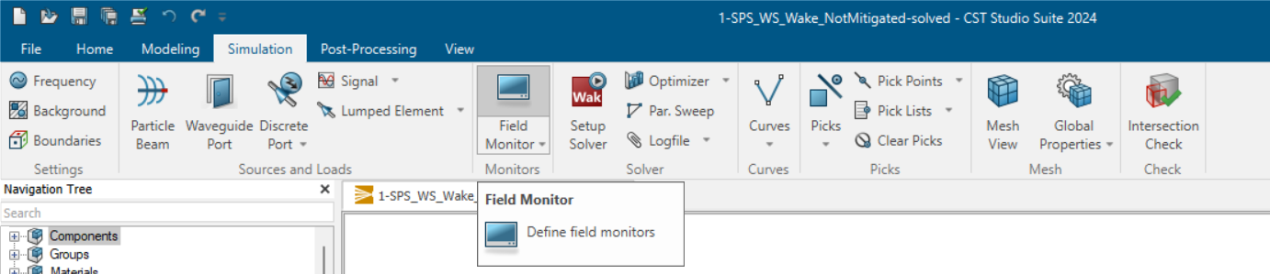
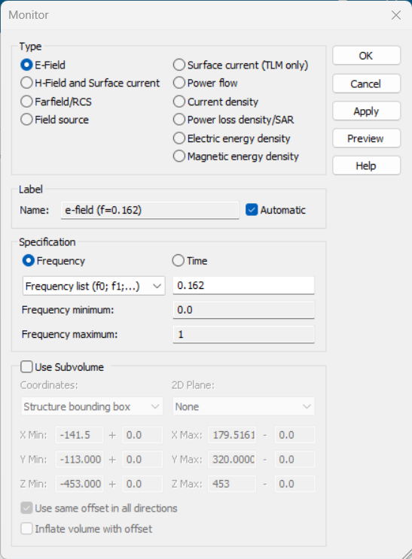
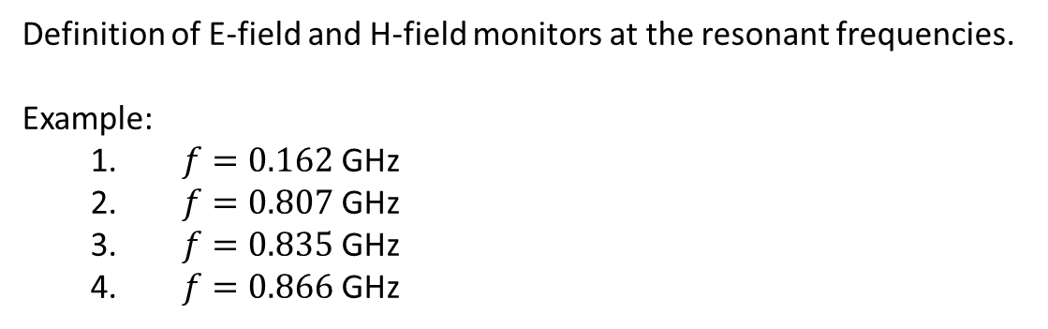
Field monitors – settings (1/2)
Definition of E-field and H-field monitors at the resonant frequencies.
Example:
$f=0.162$GHz
$f=0.807$GHz
$f=0.835$GHz
$f=0.866$GHz

Slide 22
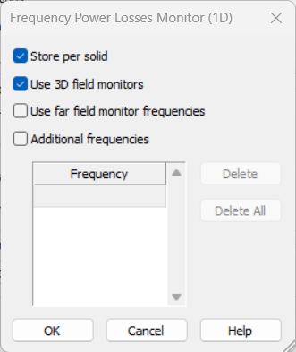

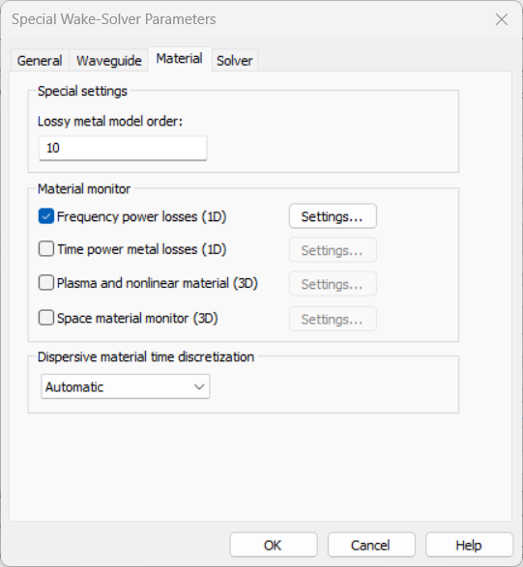
Field monitors – settings (2/2)
Shorter wakelength can be selected to solve field monitors.
Select “Store per solid” to obtain volume losses

Slide 23
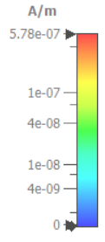
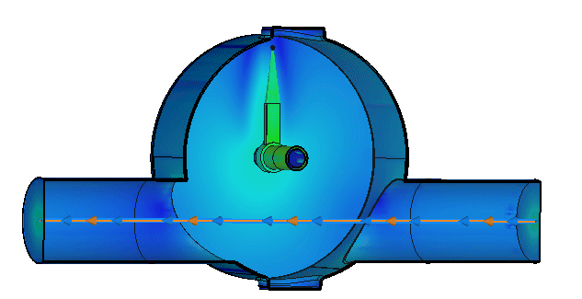
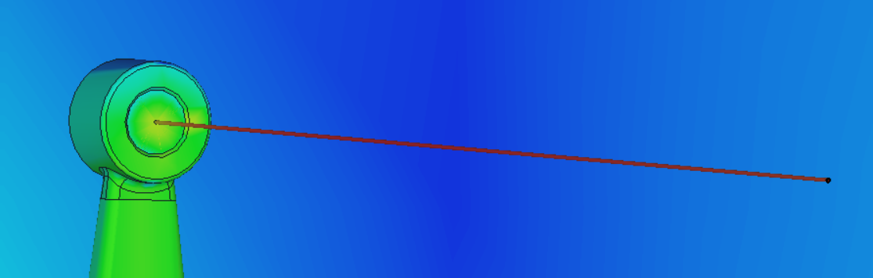
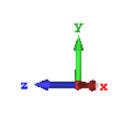

Field monitors - results
H-field monitor at $f=0.162$GHz

Slide 24
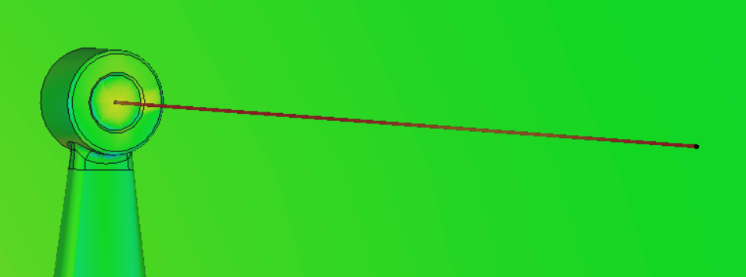
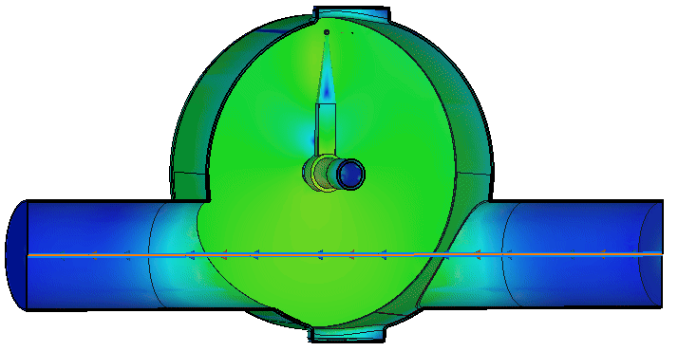

Field monitors - results
H-field monitor at $f=0.807$GHz

Slide 25
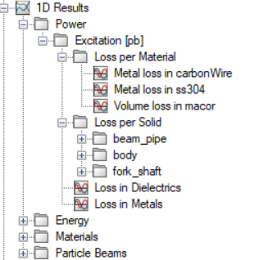
Material and solid losses
A summary of the computed losses can be found under 1D Results

Slide 26
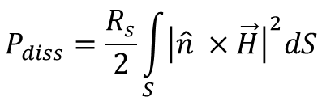
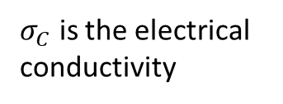
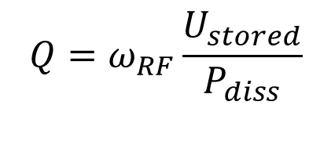

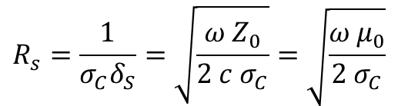
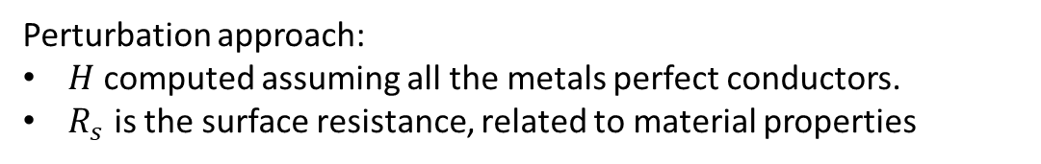
Surface losses
Surface losses are computed starting from H-field monitors and material properties:
$$Q=ω_{RF}\frac{U_{stored}}{P_{diss}}$$
Energy stored in the resonant structure
Power dissipated in the resonant structure. It is directly related to the magnetic field H:
$$P_{diss}=\frac{R_{s}}{2}\int_{S}{{\left|\hat{n} ×\vec{H}\right|}^{2}dS}$$
Perturbation approach:
$H$ computed assuming all the metals perfect conductors.
$R_{s}$ is the surface resistance, related to material properties
$$R_{s}=\frac{1}{σ_{C}δ_{S}}=\sqrt{\frac{ω Z_{0}}{2 c σ_{C}}}=\sqrt{\frac{ω μ_{0}}{2 σ_{C}}}$$
$σ_{C}$ is the electrical conductivity
$δ_{S}$ is the skin depth

Slide 27
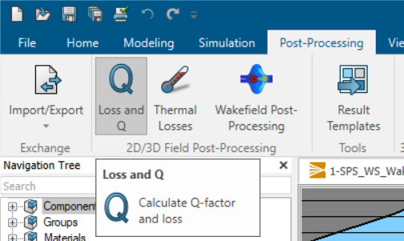
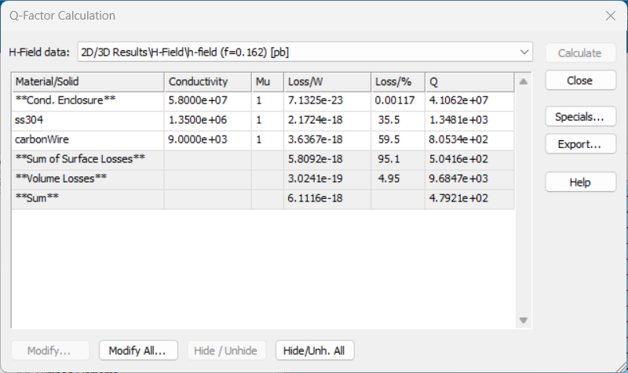
Surface losses
Percentage of losses for each material/solid can be extracted and they are used to rescale the impedance with respect to each material

Slide 28
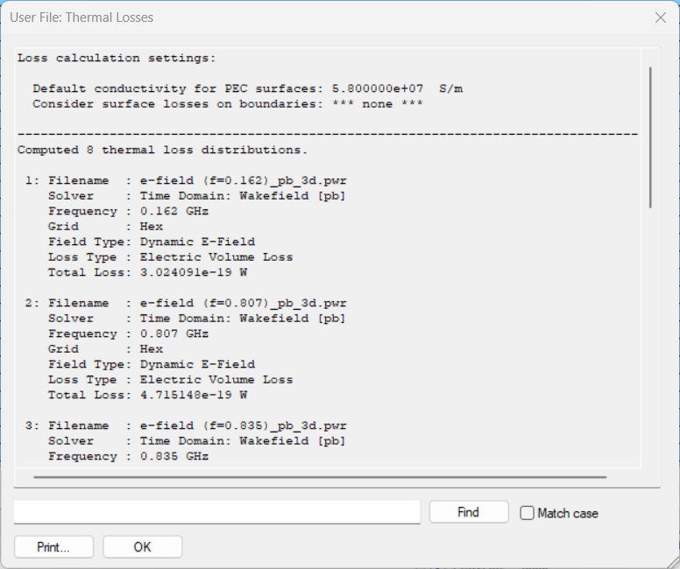
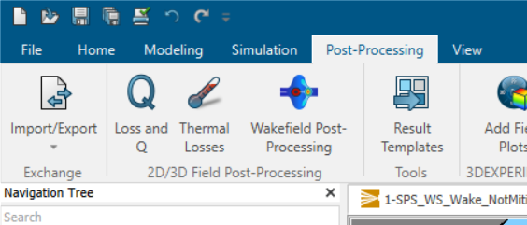
Thermal losses
The file will contain the Electric Volume Losses and Surface Losses computed for each field monitor at the specific frequency

Slide 29
2- Adding 5 Ferrite Tiles

Slide 30
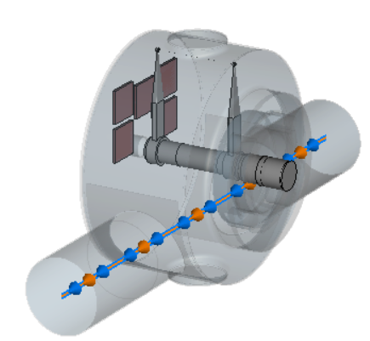
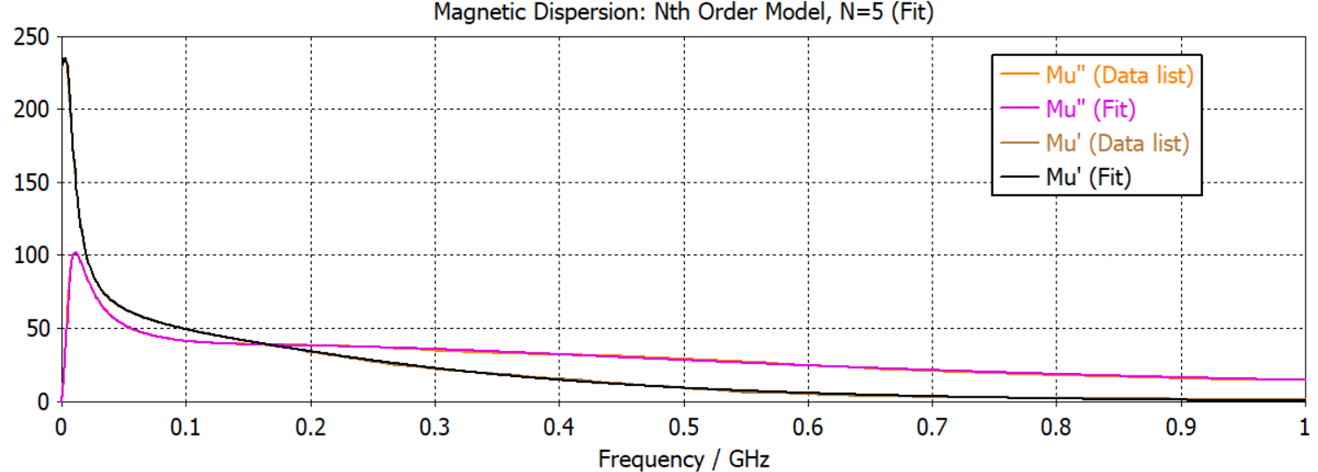
Adding 5 ferrite tiles – 3D model
Carbon wire
Assumption: placing ferrite tiles in regions with high magnetic field
Ferrite
Rotating shaft (stainless-steel)
Magnetic permeability versus frequency for ferrite material:
Particle beam

Slide 31
Simulation settings
Definition of Particle beam → same as Not Mitigated case
Mesh settings
Definition of Frequency range, Background material and Boundary conditions → same as Not Mitigated case
Definition of Wakelength and frequency sampling of the impedance trace

Slide 32
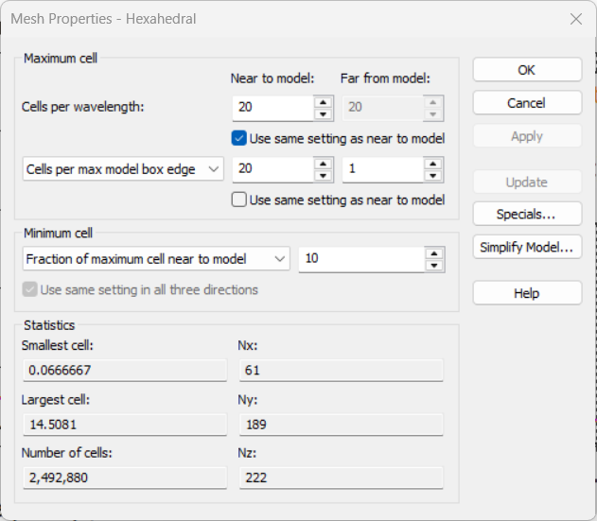
Simulation settings (2/4)
Time domain solvers use Hexahedral mesh type. Mesh settings:
20 cells per wavelength
Local refinement on the wire → 3 cells across object in each direction

Slide 33
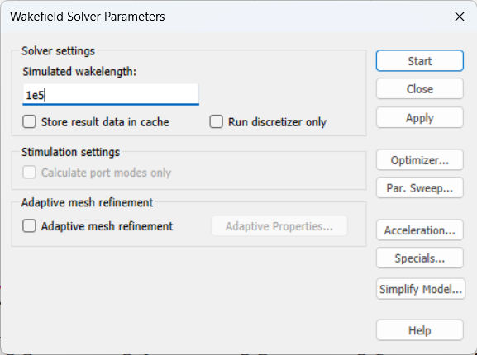
Simulation settings (4/4)
Setup of Wakefield solver:
Simulated wakelength = 100 m
To click on ”Special” → number of samples set to 6001

Slide 34

Longitudinal impedance result
Low frequency peak not fully resolved, the actual shunt impedance is higher
Field monitors can be defined at the frequencies of resonance

Slide 35

Comparison of longitudinal impedance traces

Slide 36





Field monitors - results
H-field monitor at $f=0.167$GHz
H-field monitor at $f=0.804$GHz
Losses are moved from the wire to the ferrite tiles

Slide 37
3- Adding 6 Ferrite Tiles

Slide 38

Adding 6 ferrite tiles – 3D model
Carbon wire
Ferrite
Rotating shaft (stainless-steel)
Assumption: adding one more ferrite tile (more losses), just below the carbon wire
Particle beam

Slide 39
Simulation settings
Definition of Particle beam → same as Not Mitigated case
Mesh settings
Definition of Frequency range, Background material and Boundary conditions → same as Not Mitigated case
Definition of Wakelength and frequency sampling of the impedance trace

Slide 40
Simulation settings (2/4)
Time domain solvers use Hexahedral mesh type. Mesh settings:
20 cells per wavelength
Local refinement on the wire → 3 cells across object in each direction

Slide 41
Simulation settings (4/4)
Setup of Wakefield solver:
Simulated wakelength = 100 m
To click on ”Special” → number of samples set to 6001

Slide 42

Longitudinal impedance result
Field monitors can be defined at the frequencies of resonance

Slide 43

Comparison of longitudinal impedance traces
Not much gain on the impedance reduction when adding one more ferrite tile.
Low frequency resonance is not touched with respect to the 5 tiles case.

Slide 44
3- Adding 5 Ferrite Tiles and RF coupler

Slide 45


Adding 5 Ferrite Tiles and RF coupler – 3D model
RF coupler
Vacuum
Carbon wire
Ferrite
Rotating shaft (stainless-steel)
Assumption: to use ferrite tiles and to add an RF coupler at the available port
Particle beam

Slide 46
Simulation settings
Definition of Particle beam → same as Not Mitigated case
Mesh settings
Definition of Frequency range, Background material and Boundary conditions → same as Not Mitigated case
Definition of Wakelength and frequency sampling of the impedance trace
Addition of a waveguide port

Slide 47
Simulation settings (2/5)
Time domain solvers use Hexahedral mesh type. Mesh settings:
20 cells per wavelength
Local refinement on the wire → 3 cells across object in each direction

Slide 48
Simulation settings (4/5)
Setup of Wakefield solver:
Simulated wakelength = 100 m
To click on ”Special” → number of samples set to 6001

Slide 49


Simulation settings (5/5)
Select the face at the coupler port → from the CST working plane, click “F” on your keyboard (shortcut)
Define a waveguide port

Slide 50

Longitudinal impedance result
Field monitors can be defined at the frequencies of resonance

Slide 51

Comparison of longitudinal impedance traces
The RF coupler is very effective in the low frequency range and it reduces further the impedance around 800 MHz.

Slide 52

Power outgoing from the coupler port

Slide 53



Field monitors - results
H-field monitor at low frequency (around 160 MHz)
Not mitigated
Mitigated case

Slide 54


Field monitors - results
H-field monitor at impedance peak around 800 MHz
Not mitigated
Mitigated case

Slide 55
Impedance comparison

Slide 56


Comparison of longitudinal impedance traces

Slide 57
Supporting slides
With material from A. Mostacci lecture on “Bench Measurements and Simulations of Beam Coupling Impedance”

Slide 58

The CST wakefield solver

Slide 59

The CST wakefield solver
Creation of a new CST file and selection of wakefield solver.

Slide 60

The CST wakefield solver
Creation of a new CST file and selection of wakefield solver.
Select Wakefield solver
Default background material (PEC) and units
You can click to make modifications

Slide 61

Definition of a particle beam

Slide 62

Selection of integration method

Slide 63


Mesh settings

Slide 64

Definition of wakelength
of a charge distribution

