Slide 1
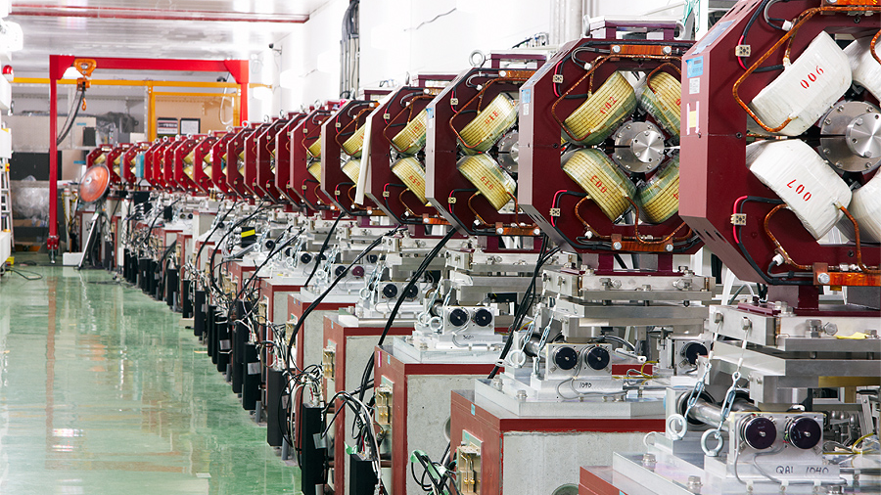







Collimation N. Fuster Martínez, IFIC-UV CSIC Material based on S. Redaelli CAS Collimation lecture 2024 Intensity Limitations in hadron beams Borovets, Bulgaria 24th June 2025

Slide 2
Introduction
Basic beam dynamics and definitions for collimation design
Recap on twiss functions, dispersion and beam size
Aperture model
Beam loss model
Collimation cleaning efficiency
Collimation design aspects for high power machines
Collimators shape
Single vs multi-stage collimation system
Collimation simulation tools
Material considerations
Mechanical design
The LHC collimation system: operational challenges
R&D on advance collimation techniques
Content

Slide 3
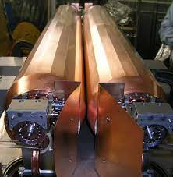
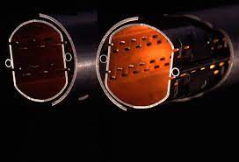
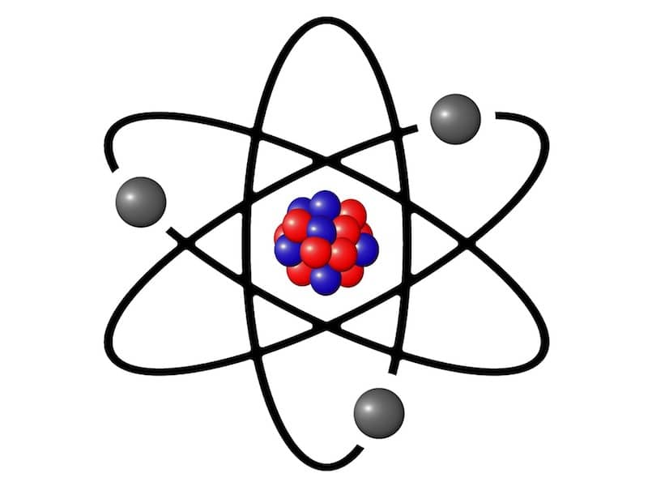

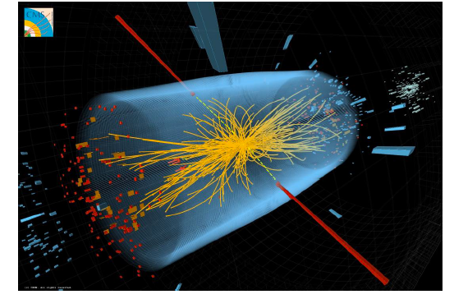
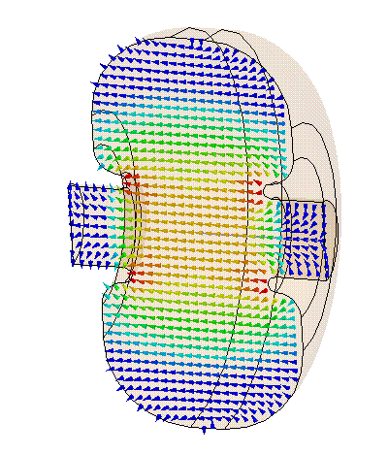
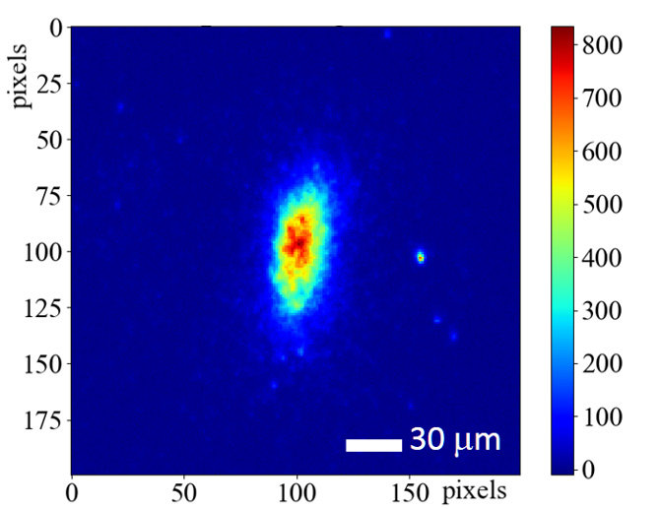

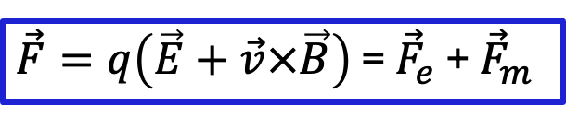
Broadly speaking, an accelerator is composed of...
Collimation systems
Vacuum beam pipes
Electric field sources
Particle sources
Magnetic field sources
Interaction point
$\vec{F}=q\left(\vec{E}+\vec{v}×\vec{B}\right)$ = ${\vec{F}}_{e}$ + ${\vec{F}}_{m}$
Diagnostics
Cooling, computing…

Slide 4
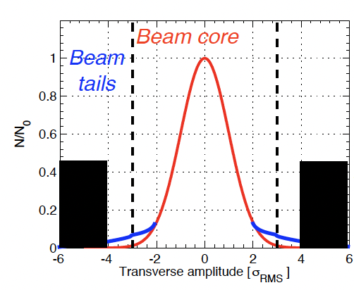
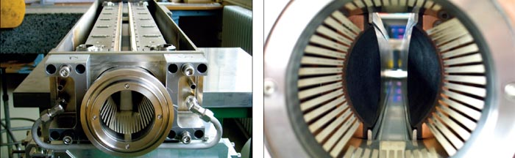
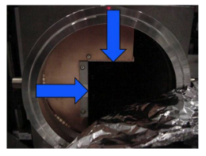
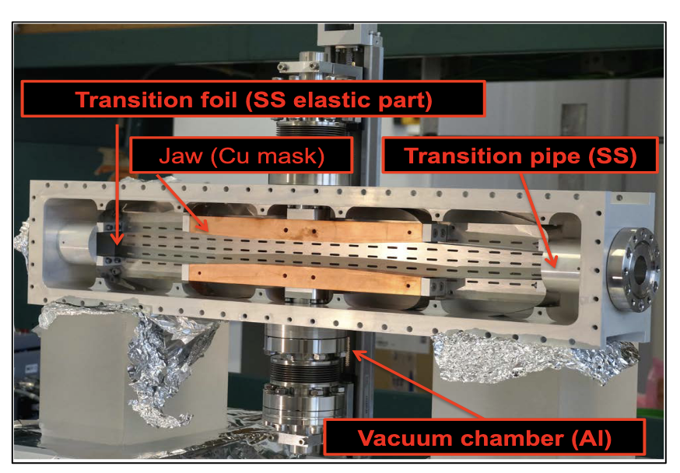
What is collimation?
Collimation is the process of shaping and controlling particle beam losses by removing or intercepting particles that stray from the ideal trajectory —beam halo or errant beam
Both transversally and off-momentum halo
This is done using devices called collimators, which are specially designed absorbers or jaws placed near the beam

Slide 5


For what do we need it?
Passive machine protection
To intercept regular and abnormal (failure scenarios) losses to protect sensitive components
Especially critical in superconducting (SC) and high-power accelerators (like the LHC), where even small losses can cause the SC magnet to quench affecting the accelerator operation
Radiation safety & activation control
To concentrate beam losses in well-shielded and controllable areas minimizing the activation of the rest of the accelerator, allowing more efficient maintenance and longer equipment lifetime
Becoming increasingly important in high power and big machines
Local protection of equipment
To shield equipment locally both movable or fixed collimators are installed
Collimators! Shields!

Slide 6

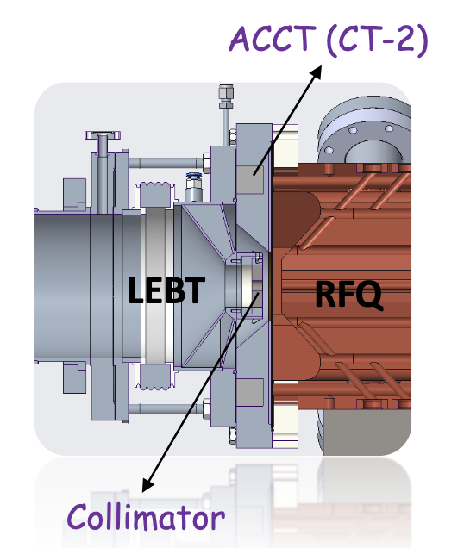
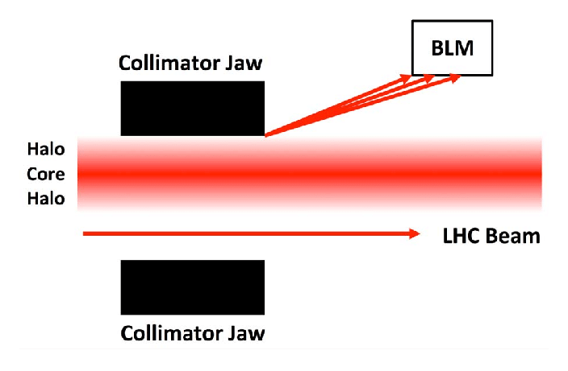
For what do we need it?
Beam shaping and emittance control
To improve beam shape before entering sensitive or high-precision sections (e.g., RFQ, other accelerators)
Limit emittance growth by defining beam boundaries early on
To define special beam shape for concreate applications (e. g. medicine)
Background reduction
To minimize the impact of halo losses near the detectors
Cleaning of collision products
To control the irradiation of other components coming from the collision's debris
Beam halo diagnostics
To measure beam halo
distribution
Collimation is the process of shaping and controlling a particle beam by removing or intercepting particles that stray from the ideal trajectory —beam halo. This is done using devices called collimators, which are specially designed absorbers or jaws placed near the beam.
Beam halo
a_{y}
L_{F}
Beam
spoiler
absorber
Interaction Region

Slide 7

Disclaimer
The goal as well as the design and operation challenges of a collimation system depends strongly on:
beam parameters (intensity, energy, type of particle…)
machine type (linear, circular, superconducting…)
machine application (particle physics, nuclear physics, medicine… )
Most of the examples and some concepts in this talk focus on collimation on high-energy circular colliders, as exploring these more challenging scenarios provides the necessary tools and insights to address a broad range of collimation design cases
The current most powerful circular machine, the LHC, can not work safely and efficiently without an optimized complex collimation system

Slide 8
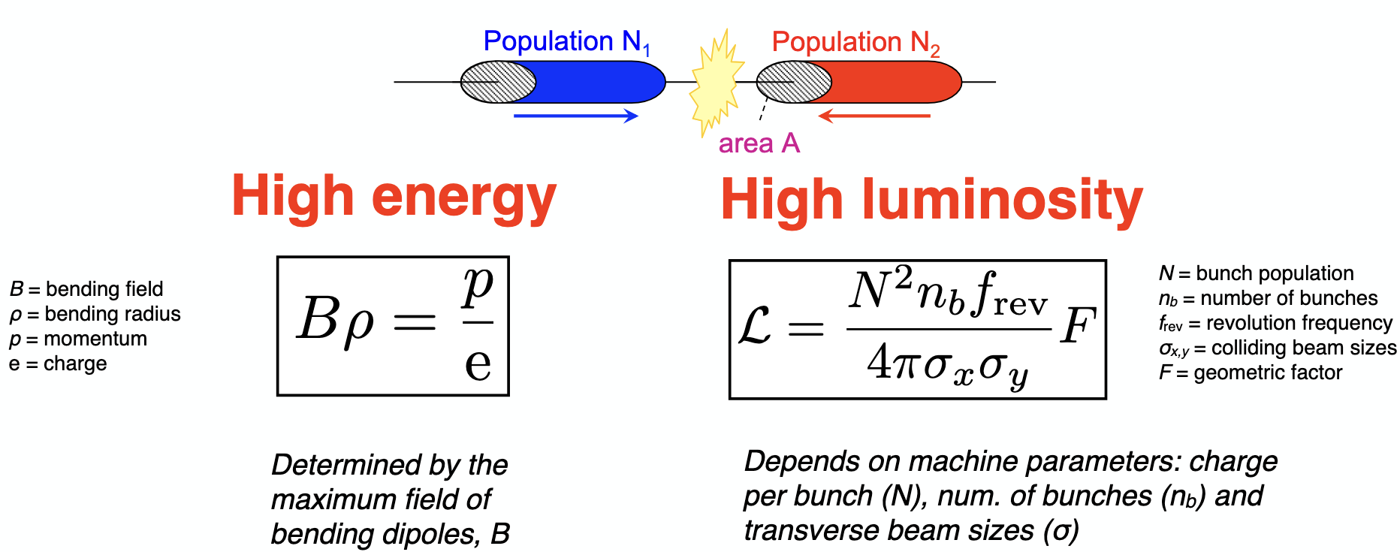
Why are they more challenging?
To boost the collider's ability to make new discoveries
Measure of how many particles pass through a unit area per unit time at the interaction point
Dipolos

Slide 9
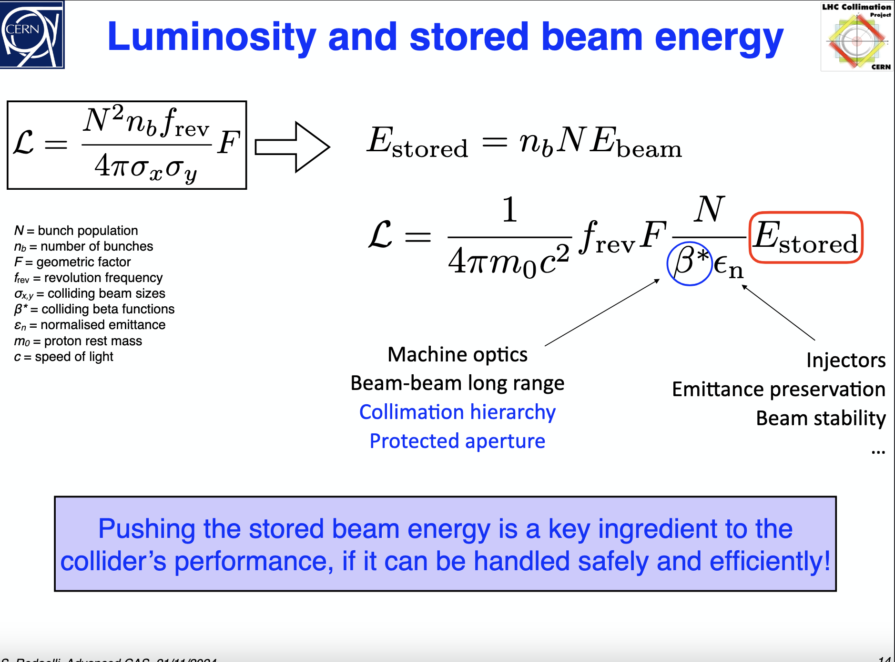
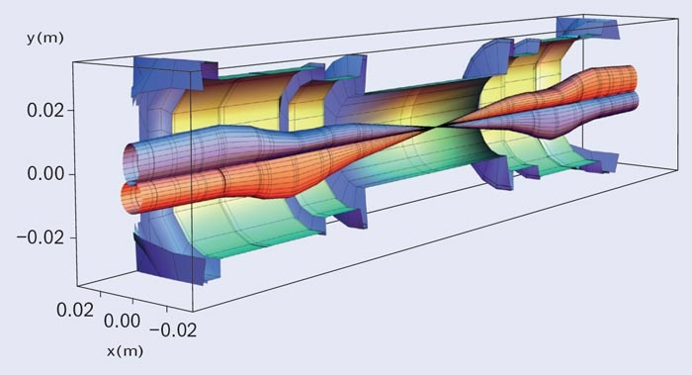
Why are they more challenging?
Protect the superconducting final focus magnets where large beam sizes are expected
Injectors,
emittance preservation,
beam stability…
Collimation plays a key role in pushing these parameters for higher collider’s performance
Pushing the stored beam energy is a key ingredient to the collider's performance, if it can be handled safely and efficiently!

Slide 10
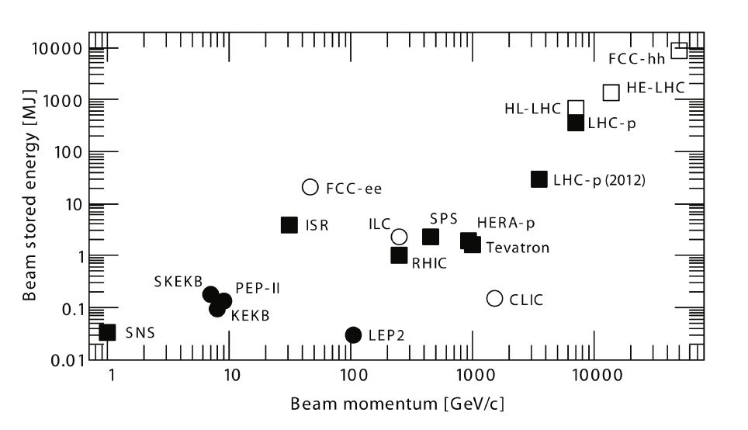

The stored energy challenge
High-power accelerators
80 Kg TNT
LHC:
Design E_{stored} = 360 MJ
Reached E_{stored} = 430 MJ
HL-LHC
Design E_{stored} = 700 MJ
S. Redaelli
Future machines
Past and current accelerators
The stored energy has been pushed, being the LHC requirements higher by orders of magnitude than in previous machines!
ESS
Spallation neutron sources

Slide 11
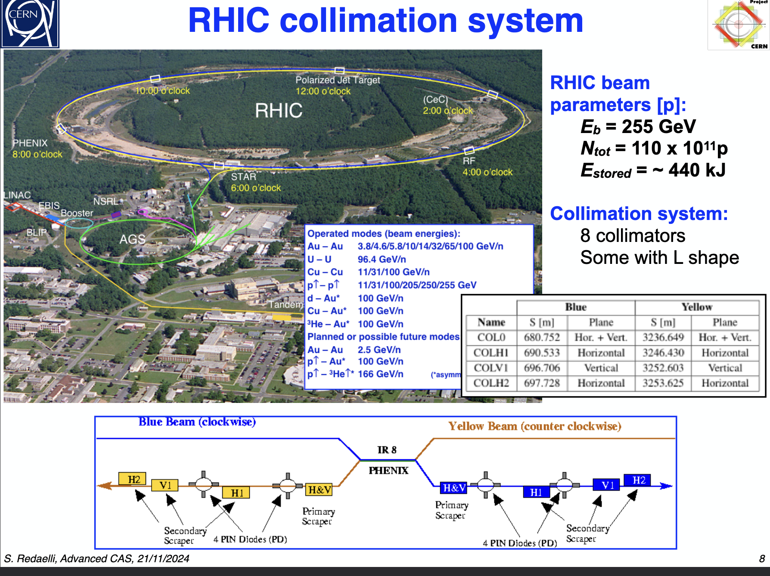
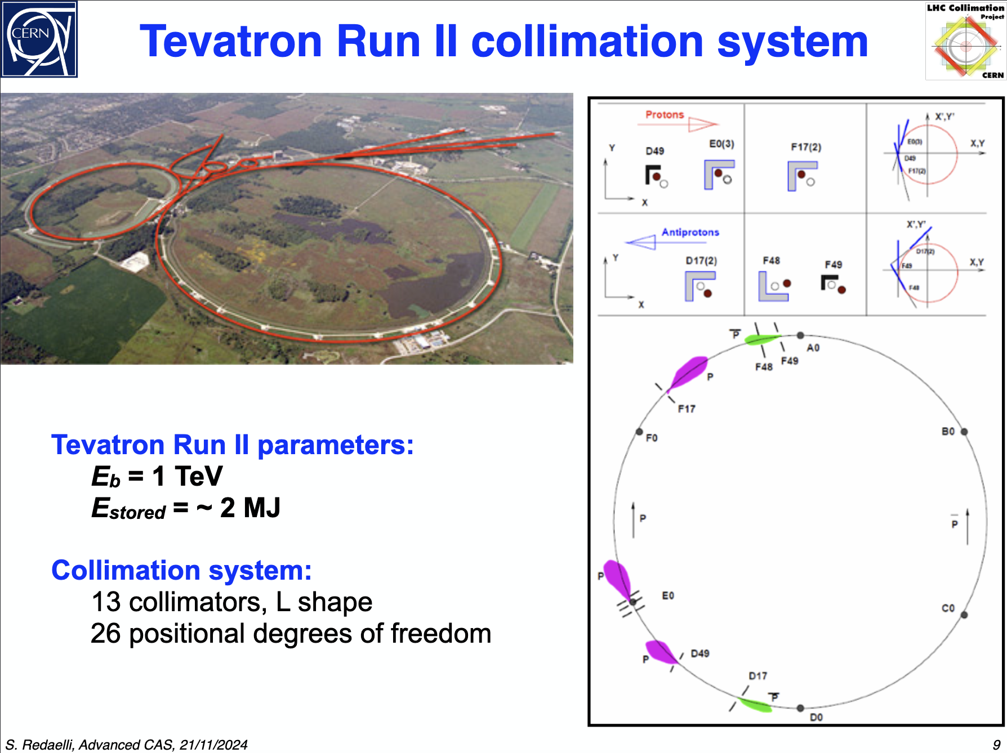
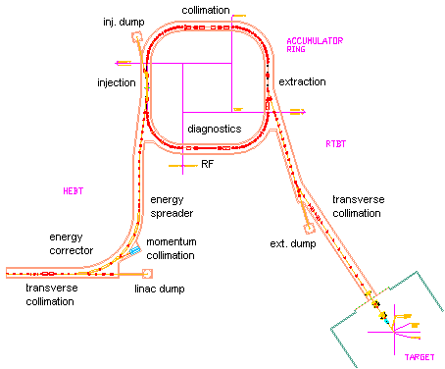
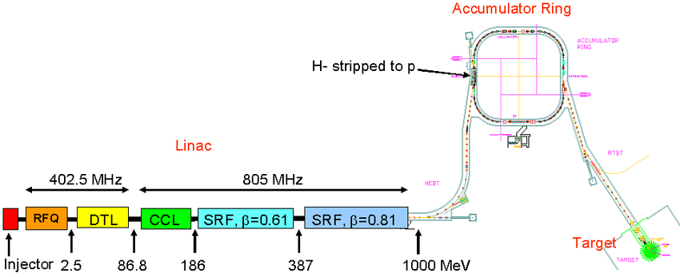
Examples I: SNS, RHIC, and Tevatron
Tevatron (operational period1985–2011)
RHIC (in operation)
SNS
E_{b} = 1.3 GeV
E_{stored} ~ 30 KJ
Collimation system
MEBT(2) HEBT (10) RING (7)
SNS Spallation source (in operation)
As we increase the stored energy, the number of collimators required increases!

Slide 12
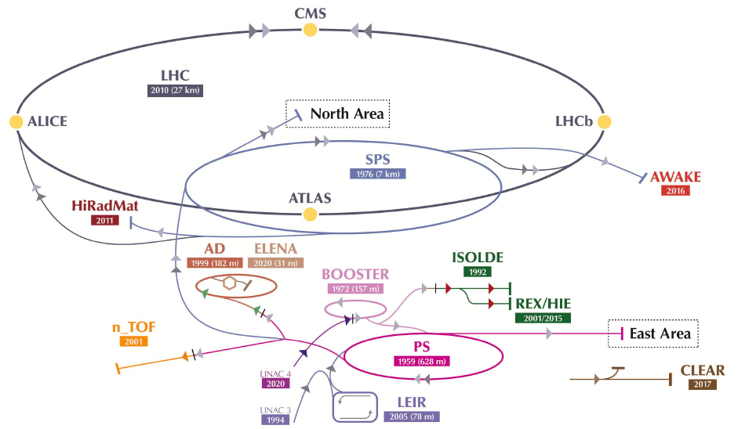
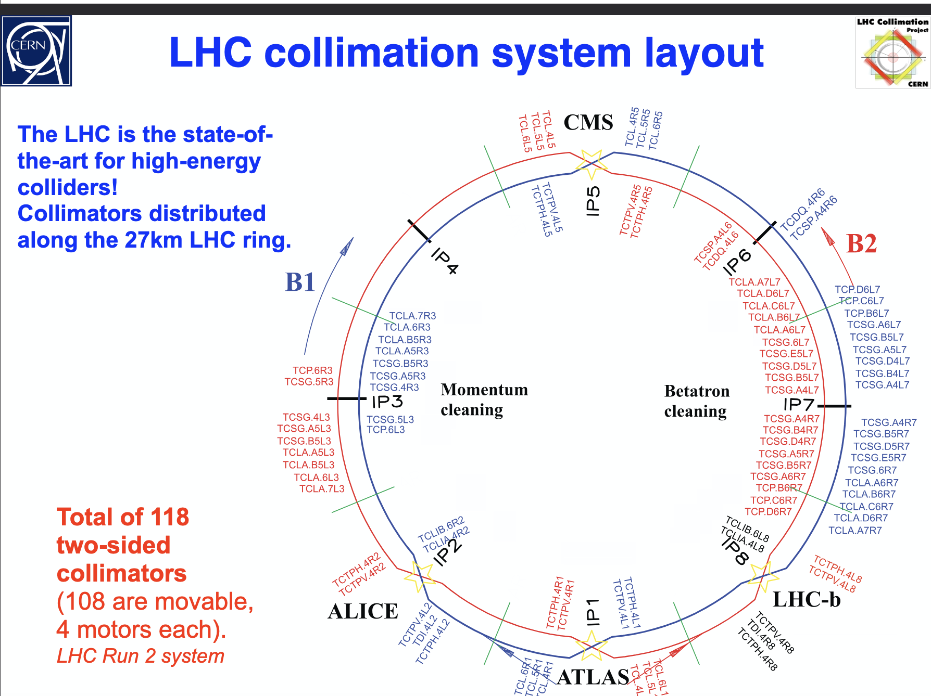
Examples II: the LHC
p
Total of 118 two-sided collimators (108 are movable)
Acelerador lineal (50 MeV)
Booster 1.4 GeV
PS 25 GeV
SPS 450 GeV
LHC 7 TeV
(E_{stored} = 360 MJ)
The LHC is the state-of-the-art for high-energy colliders!
Collimators are distributed along 27 Km in the LHC ring

Slide 13
Introduction
Basic beam dynamics and definitions for collimation design
Recap on twiss functions, dispersion and beam size
Aperture model
Beam loss model
Collimation cleaning efficiency
Collimation design aspects for high power machines
Collimators shape
Single vs multi-stage collimation system
Collimation simulation tools
Material considerations
Mechanical design
The LHC collimation system: operational challenges
R&D on advance collimation techniques
Content

Slide 14
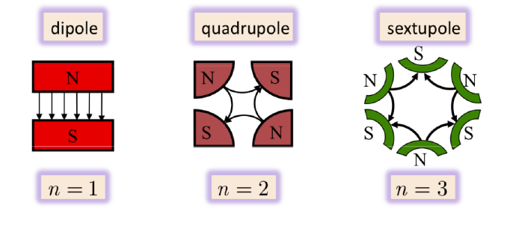
Basic beam dynamics and definitions for collimation design
Magnets are used in accelerators to guide, focus and correct the particles motion
…
n > 3
To curve the particle’s trajectory
To focus an keep the particles confined
For chromaticity correction
For higher order corrections

Slide 15
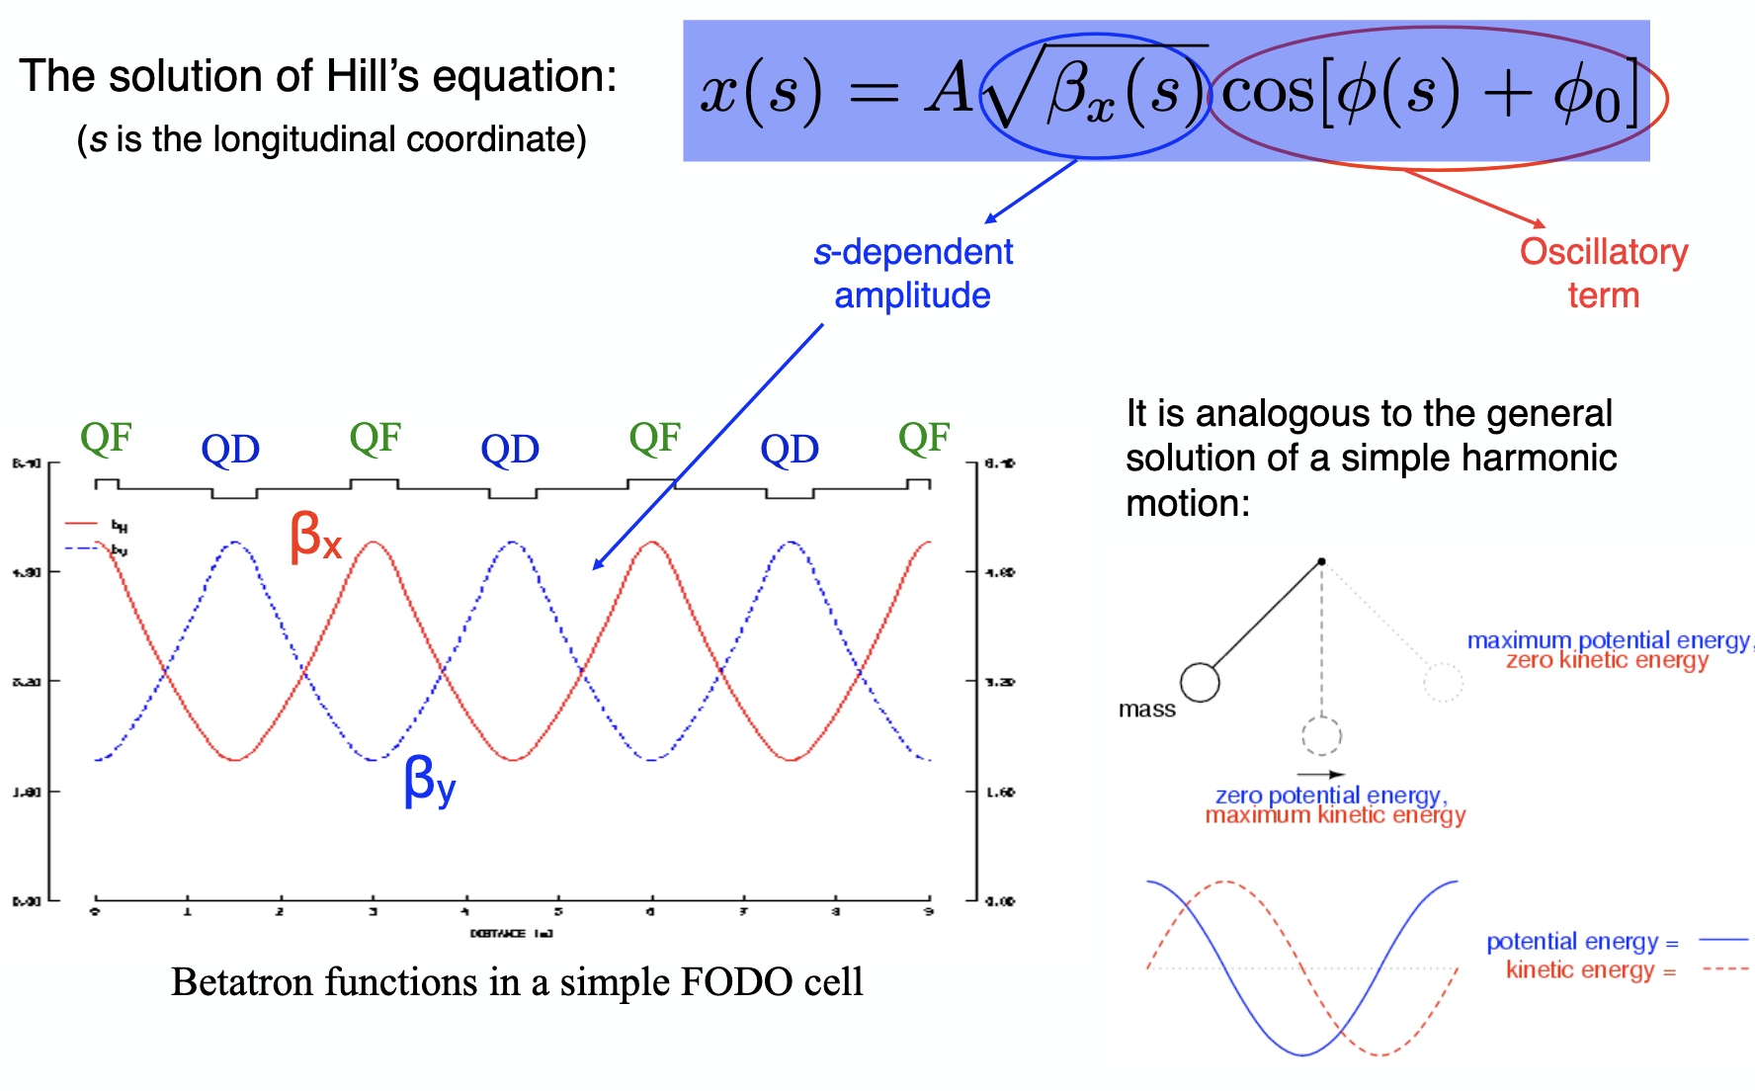
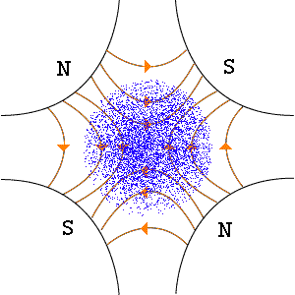
Recap on betatron motion, dispersion and beam size
Hill’s equation of motion described the motion of a charged particle under the effect of dipoles and quadrupoles
Betatron motion provides the foundation for understanding how particles move transversely through the accelerator lattice and where collimators could be placed for optimum performance

Slide 16
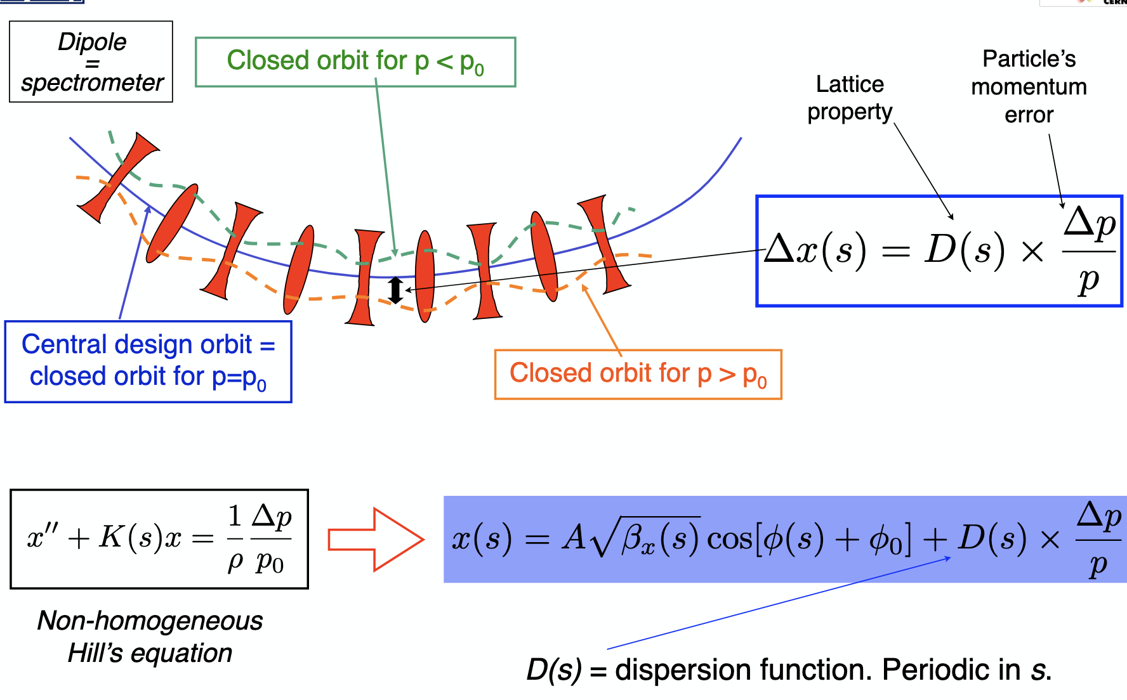
Recap on betatron motion, dispersion and beam size
For off-momentum particles…

Slide 17
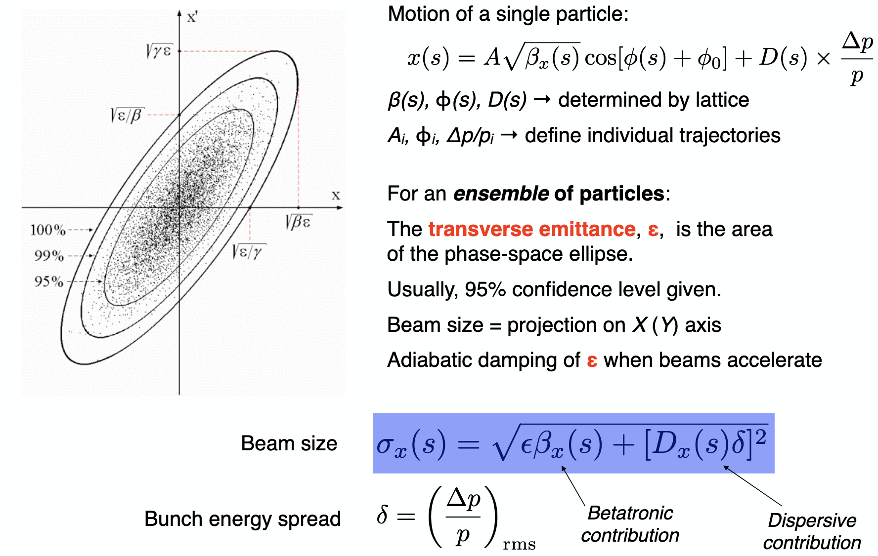
Recap on betatron motion, dispersion and beam size
Off-momentum halo collimation
D_{x} high compared to β_{x} contribution
Transverse halo collimation
D_{x} = 0
β_{x} high (smaller gap and lower transverse density of particles)

Slide 18
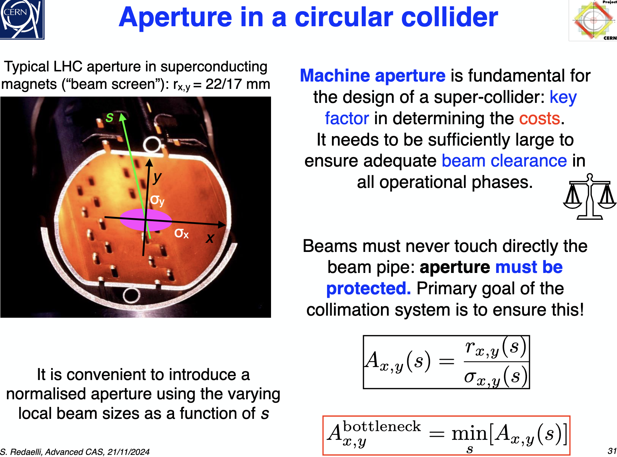

Aperture model
The normalized aperture — defined as the geometrical aperture divided by the beam size (σ)
Machine apertures and collimator settings are usually expressed (unless specified) in units of betatron beam size
$$σ_{x }\left(s\right)=\sqrt{εβ_{x }(s)}$$
Used in collimation system design because it provides a dimensionless, location-independent measure of how close a physical aperture is to the beam core

Slide 19
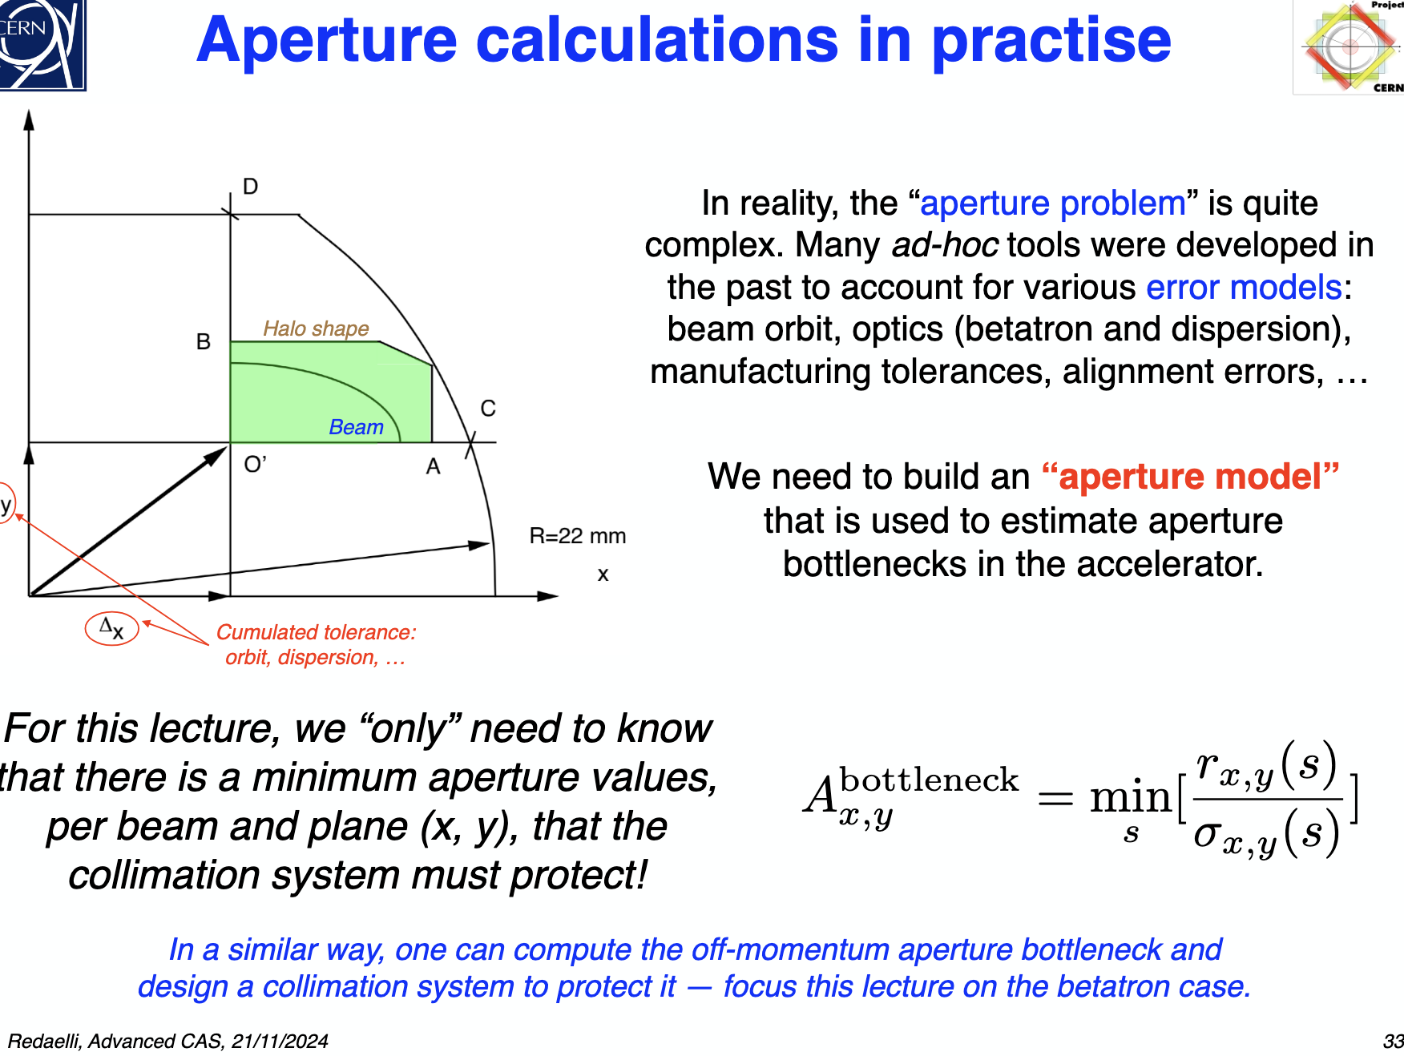
Aperture model
In circular high-intensity and high-energy super collider beams must never touch directly the beam pipe: the minimum aperture in the machine must be protected by the collimation system
An “Aperture model” is usually built and used to estimate the aperture bottleneck in an accelerator both betatron and off-momentum which must be protected by the collimation system
Quantifying the aperture bottleneck is not a simple problem. Many tools have been developed (MAD-X accelerator design aperture module)
Input parameters to build the aperture model:
geometry of the aperture (shape, dimension, location, orientation) of all elements in the machine
beam orbit,
optics (betatron and dispersion),
manufacturing tolerances,
alignment errors…

Slide 20
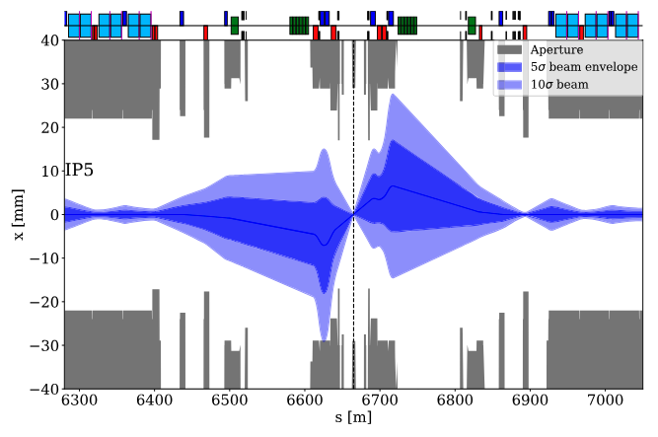
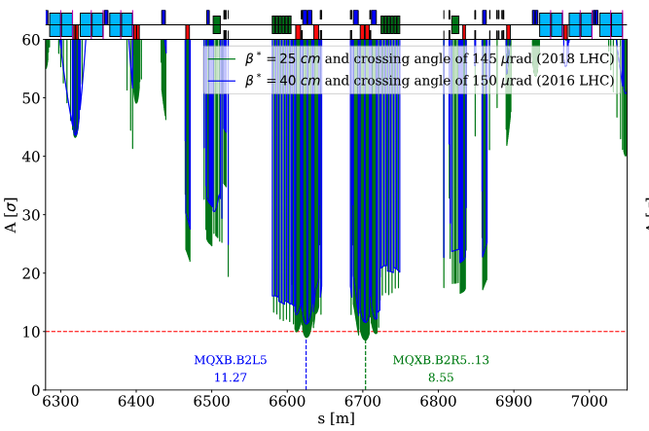
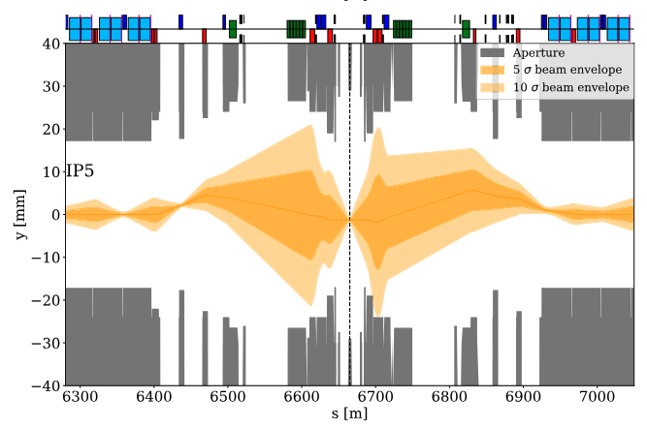
Aperture model
LHC Betatron bottleneck studies for β*= 25 and 40 cm in IR5
MAD-X accelerator design aperture module

Slide 21
Beam loss model
In an Ideal world (perfect machine): no beam losses throughout the operational cycle
No need of collimation system!
In real machines, several effects cause beam losses
Regular losses: unavoidable losses that occur in standard operation
Interaction with residual gas and intra-beam scattering
Beam instabilities (single-bunch, collective, beam-beam)
Dynamic changes during operational cycle (orbit drifts, optics changes, energy ramp…): operational losses
Transverse resonances
RF noise
Injection and dump process
Collisions in the interaction point (beam burn up)
Abnormal losses: caused by failure of accelerator systems or by wrong beam manipulation (human errors)
Example LHC worst scenario: Asynchronous firing of the dump kickers that can spray to large amplitude several bunches for a full turn around the machine before being dumped

Slide 22
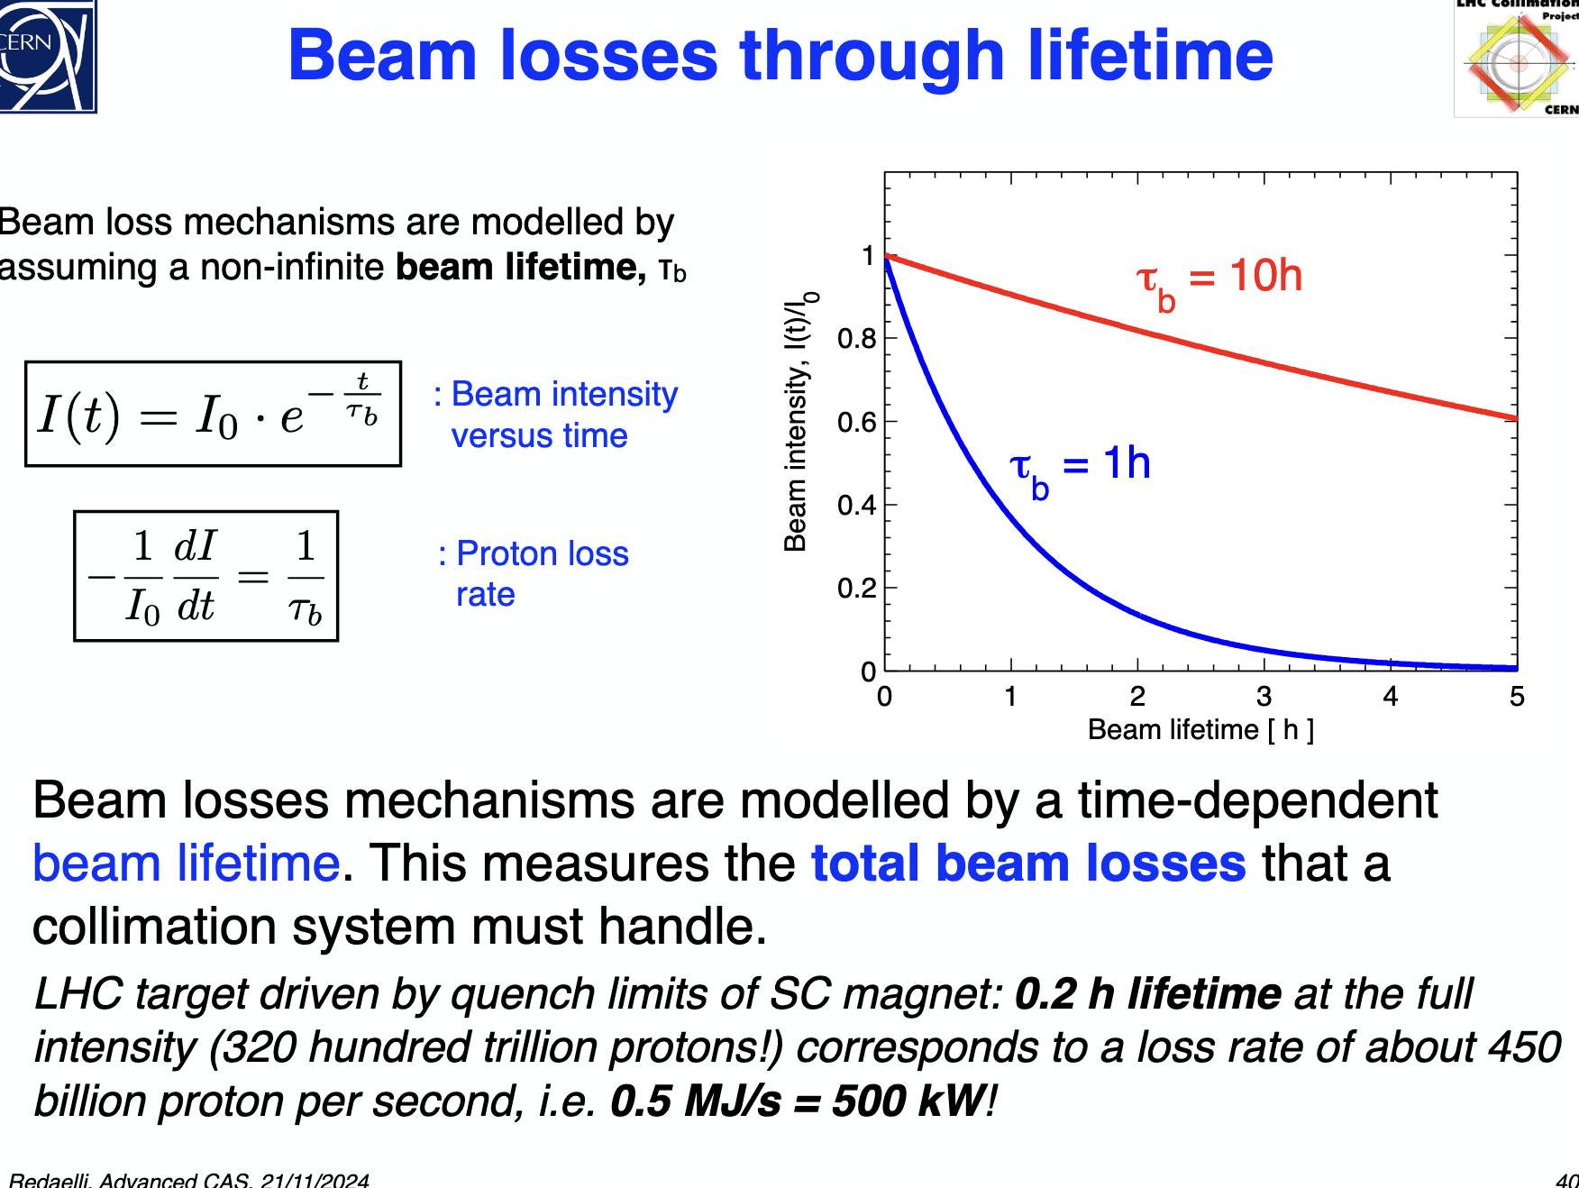
Beam loss model
For circular machines and considering only diffusive losses (transverse amplitude increase of particles per turn small) beam loss mechanisms can be modelled by an exponential decay function
I₀ : initial beam intensity
𝛕_{b} : beam lifetime (after a time 𝛕_{b} the beam current is reduced 37%)
Time (h)

Slide 23
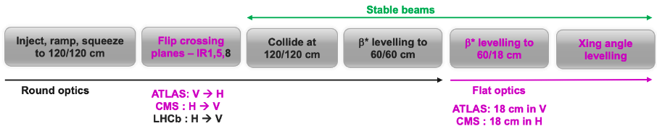
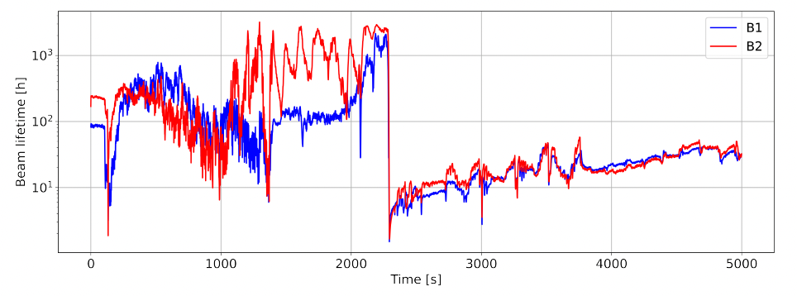
Beam loss model
For a given beam lifetime, we can compute the loss rate which can be used to evaluate the beam losses that a collimation system must handle in early design phases
𝛕_{b} (t) is a function of time and it is not constant through the operational cycle. The sources of beam losses can occur at different times
LHC example:
I₀ = 320 x 10¹² p
𝛕_{B} = 0.2 h lifetime at full intensity (minimum acceptable lifetime)
Proton rate = 450 x 10⁹ p/s
(7 TeV) 0.5 MJ/s = 500 kW
Collisions
S. Redaelli et al.

Slide 24
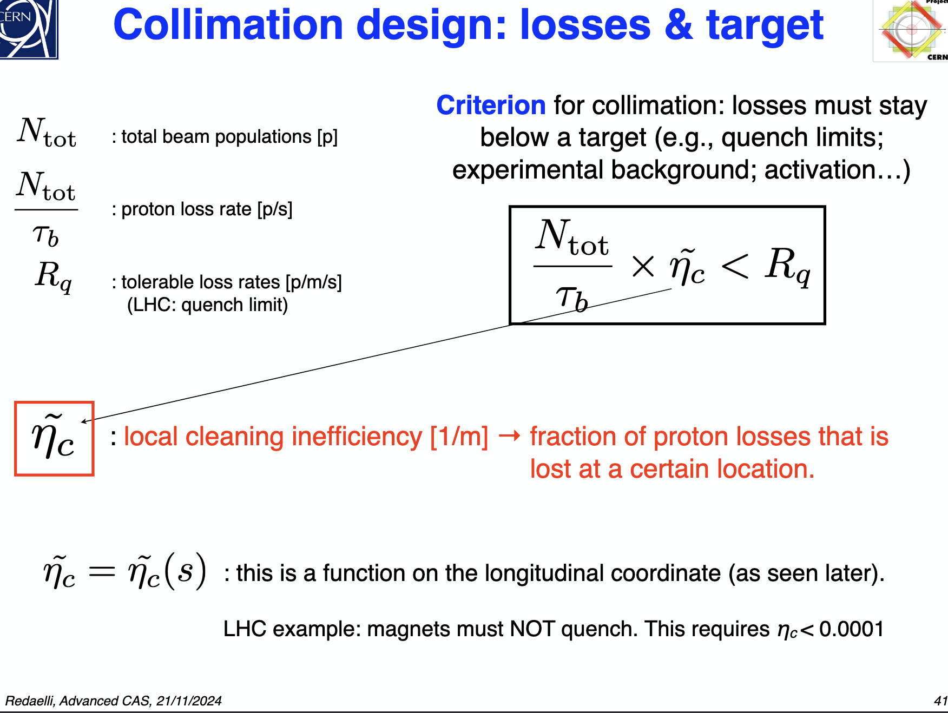
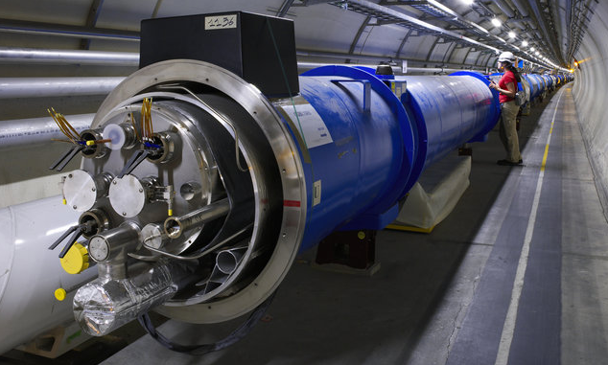

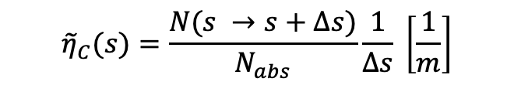

Collimation cleaning inefficiency
Cleaning inefficiency reflects how well the collimation system prevents unwanted beam losses in sensitive regions. It is defined by comparing the fraction of beam lost outside the collimators to that absorbed by them
$$η_{C}=\frac{A_{lost}}{A_{coll}}$$
Criterion for the collimation system: losses must stay below a target (e.g., quench limit of superconducting magnets, experimental background, activation…)
$${\tilde{η}}_{C}(s)=\frac{N(s →s+∆s)}{N_{abs}}\frac{1}{∆s} \left[\frac{1}{m}\right]$$
Early design phases: local cleaning inefficiency
$$\frac{N_{tot}}{τ_{b}}× {\tilde{η}}_{C}< R_{q}$$

Slide 25
Introduction
Basic beam dynamics and definitions for collimation design
Recap on twiss functions, dispersion and beam size
Aperture model
Beam loss model
Collimation cleaning efficiency
Collimation design aspects for high power machines
Collimators shape
Single vs multi-stage collimation system
Collimation simulation tools
Material considerations
Mechanical design
The LHC collimation system: operational challenges
R&D on advance collimation techniques
Content

Slide 26

Collimation design aspects for high power machines
Design workflow
1. First layout: shape, number of collimators, location, collimation depth, material
Initial understanding of the machine aperture and cleaning specifications
Aperture bottleneck location
Sensitive components to be protected
Cleaning efficiency required e.g. background levels, quench limits
2. Detailed simulations
Tracking + Monte Carlo simulations to assess accurate cleaning performance
Collimator robustness (detailed material analysis)
Beam dynamics studies for impedance contribution assessment
3. If issues in 2 are found review of collimation system layout, optics…and repeat (1 and 2)
4. Mechanical design
(cooling, supports, movement, vacuum…)
Beam los model
Notes:
Añadir apertura model

Slide 27
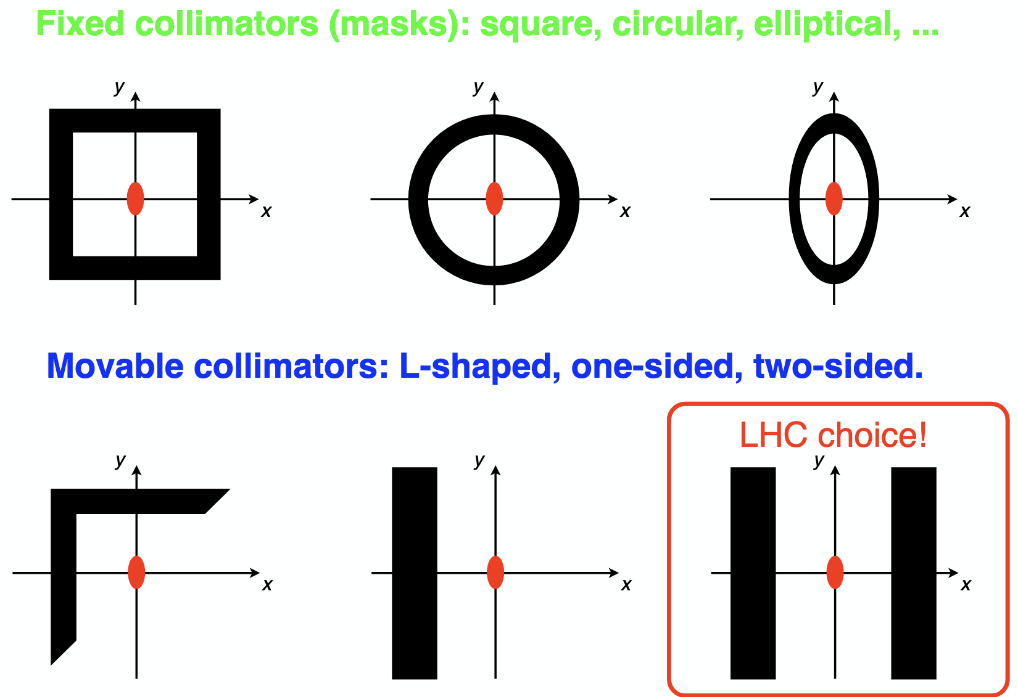
Collimators shape
For precise and redundancy alignment!

Slide 28
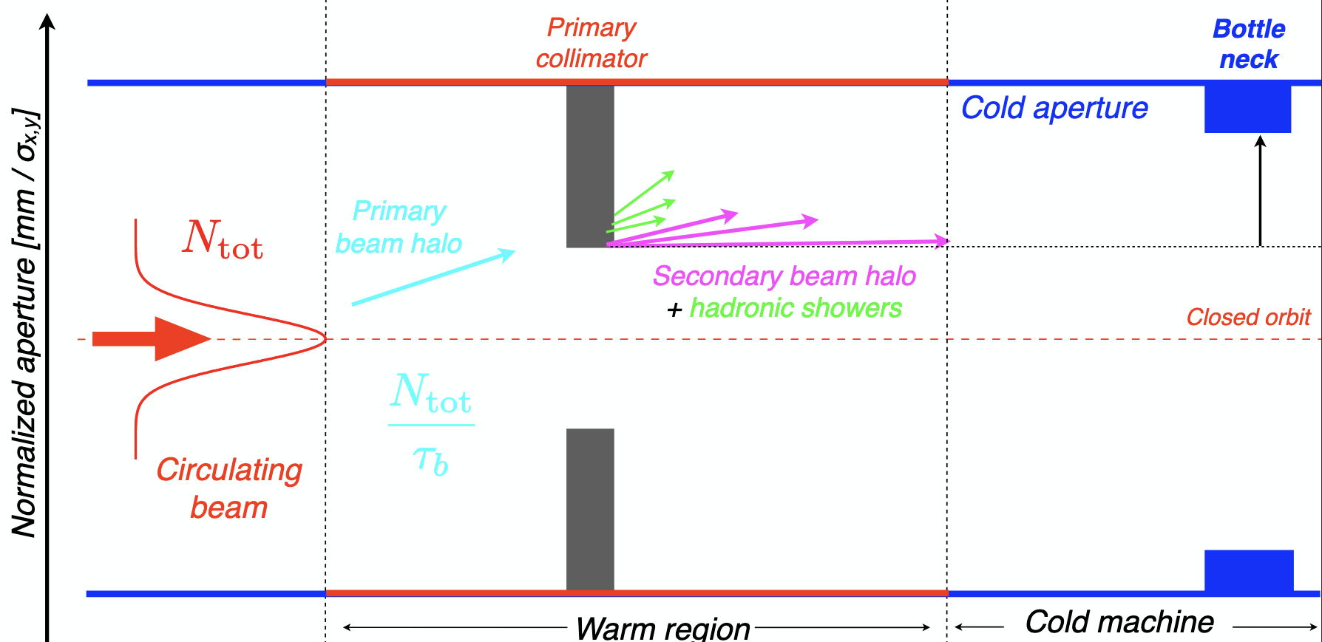


Single vs multi-stage collimation
Can we protect the machine bottleneck with only one collimator?
$$N_{σ}σ_{z}$$
$$n_{TCP}<n_{bottleneck}$$
Primary collimators are not black absorbers!
Part of the beam energy and a fraction of the incident particles escape from the collimator!

Slide 29
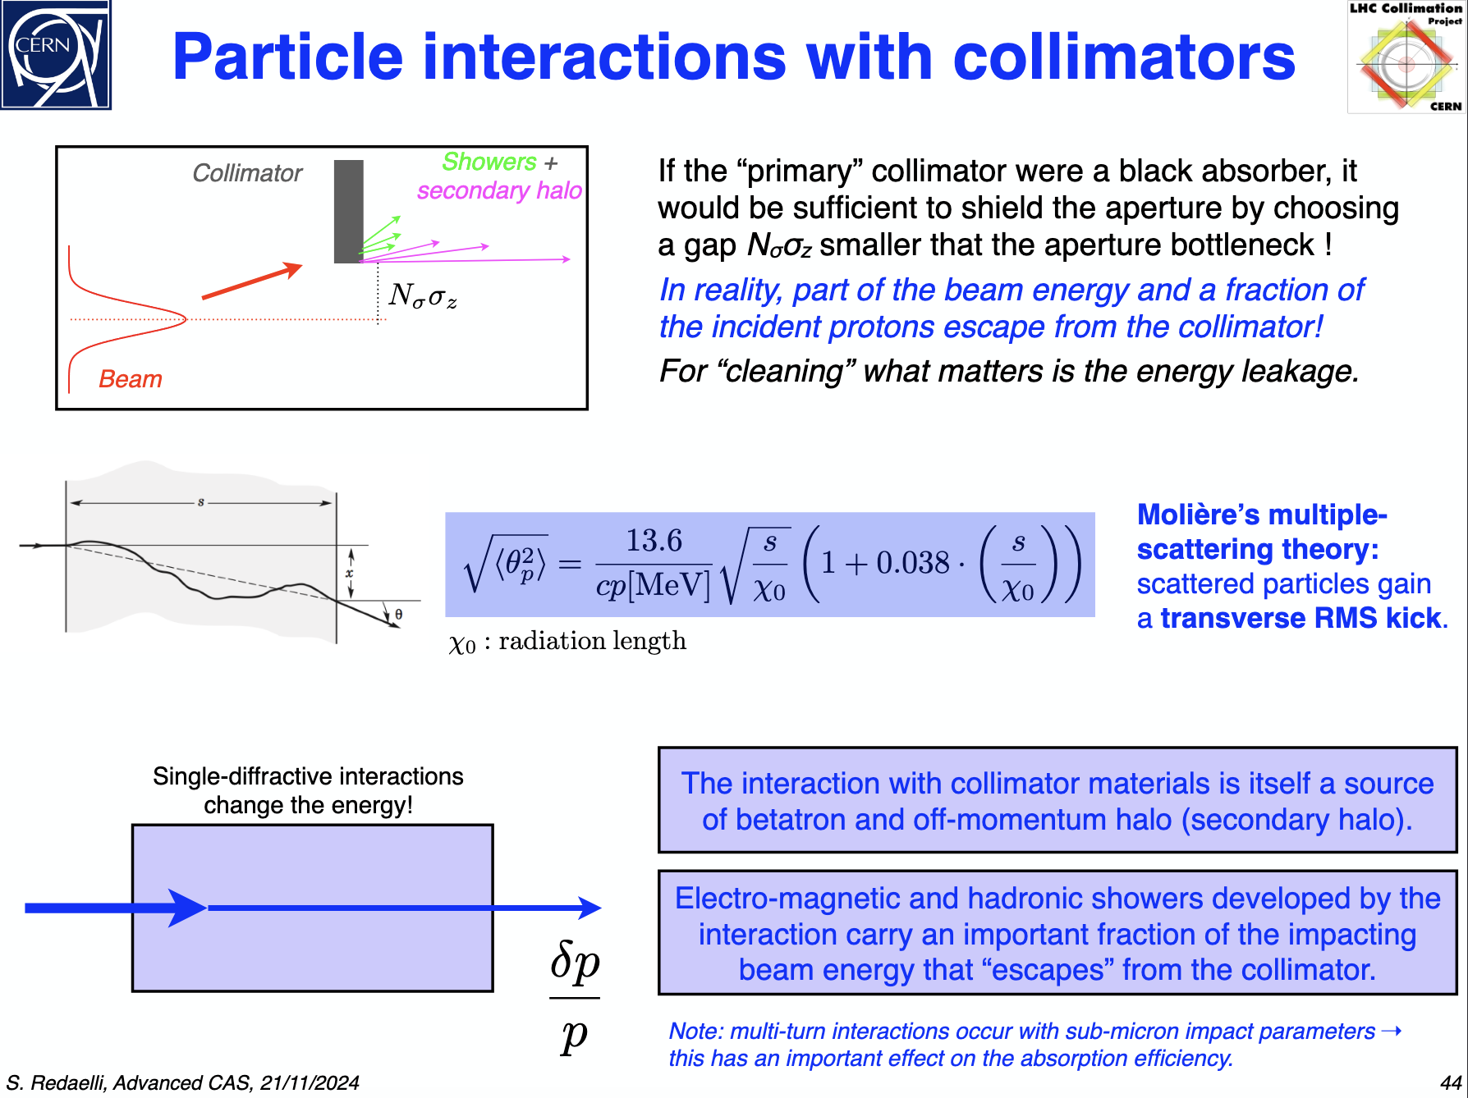
Single vs multi-stage collimation
The interaction with collimators is itself a source of betatron and off-momentum halo (secondary halo)
EM and hadronic showers develops in the interaction carry and important faction of the impacting beam energy that escapes from the collimators
Moliere’s multiple-scattering theory: scatters particles gain a transverse RMS kick
Single-diffractive interactions change the energy!

Slide 30
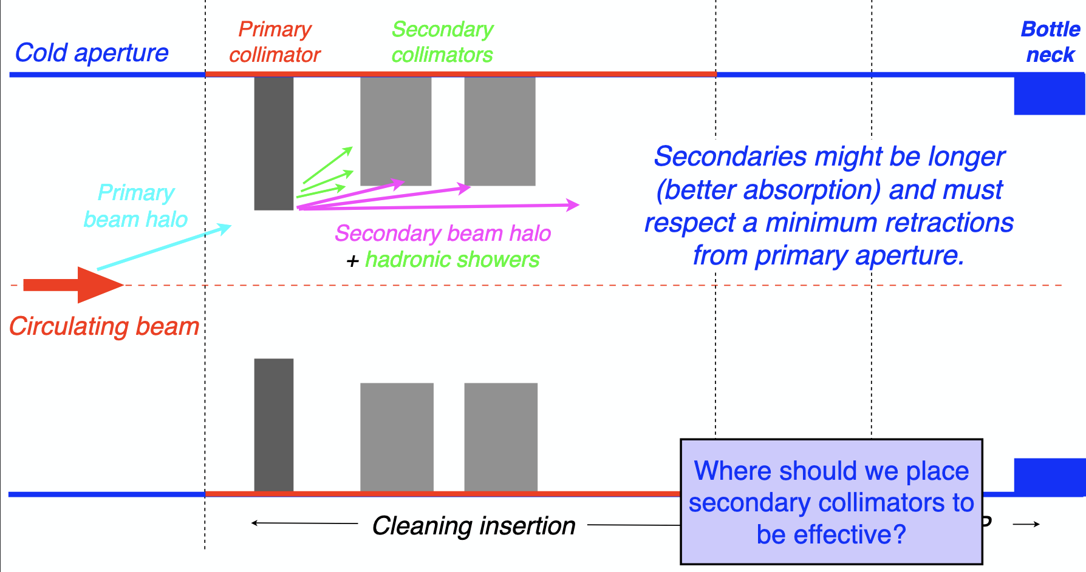
Single vs multi-stage collimation
How can we reduce the collimation inefficiency?
“Secondary collimators” can be added to intercept the secondary halo and the shower that leak out of the primary collimator

Slide 31
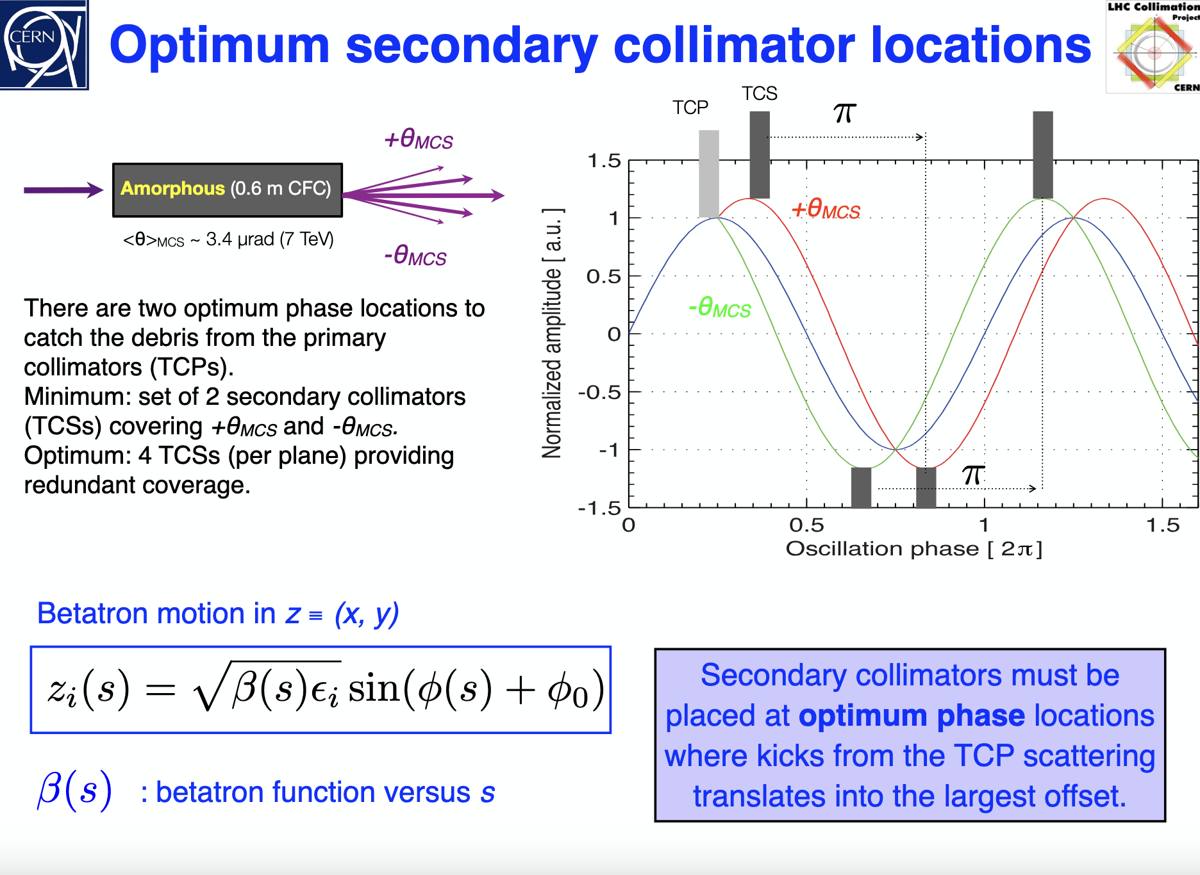
Single vs multi-stage collimation
Secondary collimators must be placed at optimum pase locations where kicks from TCP scattering translates into largest offsets
1D model: there are two optimum phase locations
Minimum set of 2 collimators for +θ_{MCS} and -θ_{MCS}
Optimum 4 TCTs (per plane) providing redundant coverage
Scattering occurs in all directions and a 1D model is thus not sufficient. 11 secondary collimators in the LHC betatron cleaning insertion per beam
Optics of a two-stage collimation system. J. B. Jeanneret. CERN CH-1211 Geneva Switzerland 1998

Slide 32
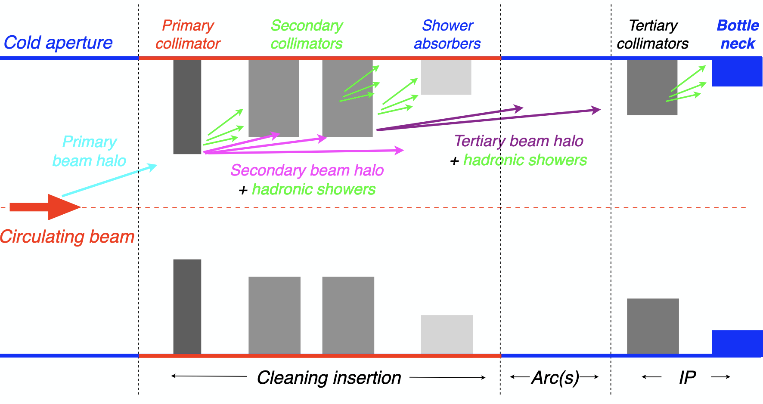
Single vs multi-stage collimation
Two–stage collimation in a single location is not sufficient for the LHC to absorb the EM showers and protect all the critical components.
A 5-stage cleaning is required!
The system performance relies on achieving the well-defined hierarchy between different collimator families and machine aperture
Dedicated momentum cleaning might also be needed. Special optics soluctions need to be developed and the same multi-stage collimation system approach can be used

Slide 33
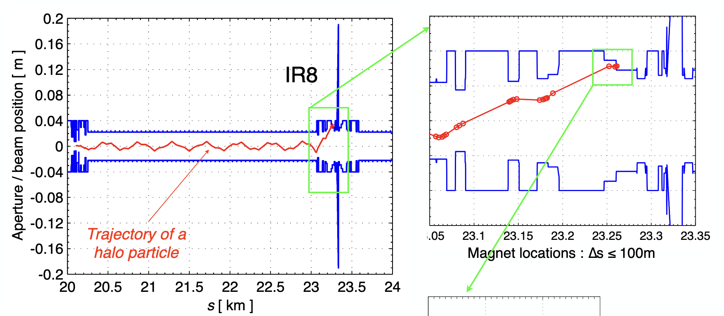
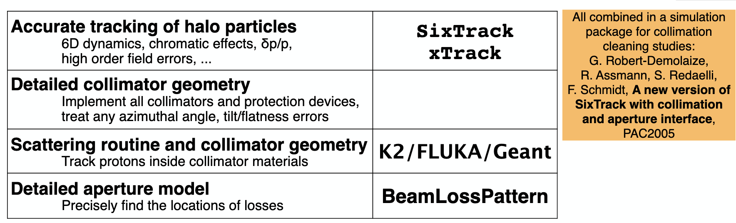

Collimation simulation tools
Simulation's goal: determine the energy lost in the machine for a given beam intensity
Simulation challenges :
Many collimators
Impact parameter in the sub-micron range
Beam scattering with different collimator materials
Need good statistics accuracy
Detailed description of the aperture
For LHC a 10 cm bin implies 270000 check points
Accuracy of tracking of halo particles
Need to model the relevant imperfections:
Surface roughness, tilts…
Large effort on developing sophisticated tools and currently ongoing effort on new tools
Available tools: SixTrack, Merlin, MAD-X, Sixtrack + FLUKA, BDSIM, Geant4, PyOrbit, TRACK, Elegant…

Slide 34
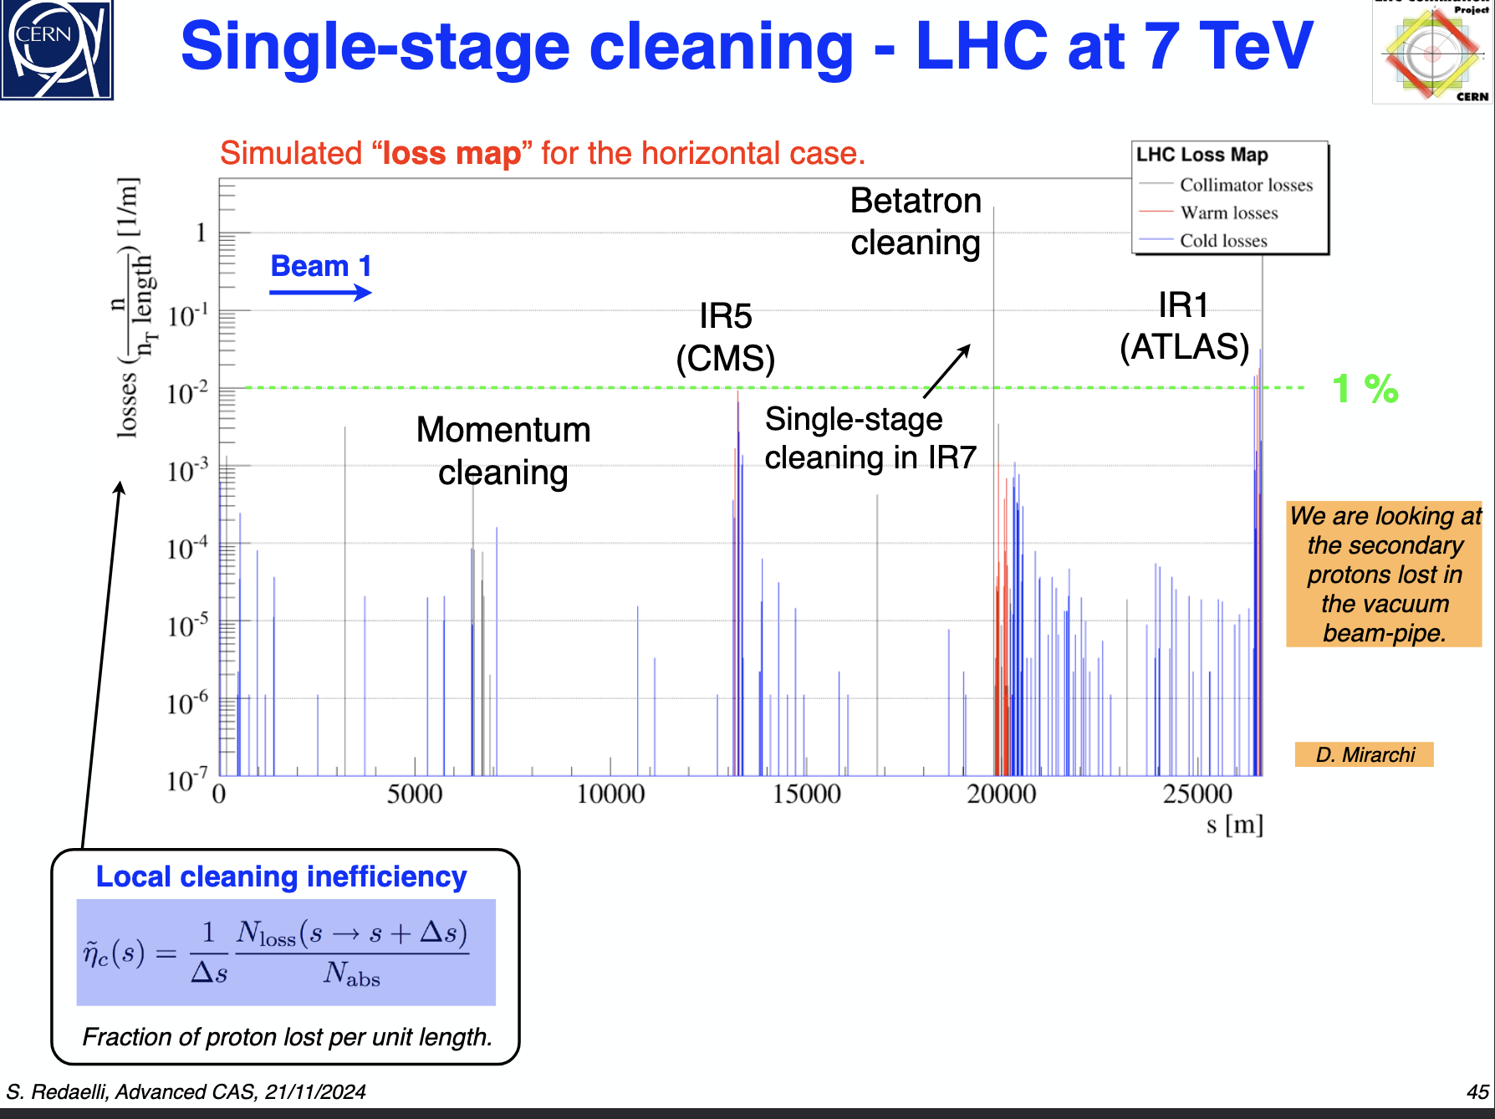

Collimation simulation tools: LHC SixTrack simulations
Single-stage cleaning
${\tilde{η}}_{C}(s)=$0.0001

Slide 35

Collimation simulation tools: LHC SixTrack simulations
Multi-stage cleaning

Slide 36


Collimation simulation tools: comparison with measurements
BLM signal is compared to numbers of protons touching the aperture!
D. Mirarchi
R. Bruce
Proton tracking alone is not sufficient to reproduce the deposited energy profile
Excellent qualitative agreement!

Slide 37


Collimation simulation tools: SixTrack + FLUKA simulations
Compared measured data from BLM’s in IR7 against doses from shower cascades
E. Skordis
Important immediate outcome: cross-calibration of loss measurements and peak deposited energy in the magnet coils for update quench limit estimates
Impressive agreement considering the complexity of the simulations behind!

Slide 38

Material considerations
Material challenges for high intensity and power machines:
1. Radiation Resistance
Materials must have high radiation tolerance and predictable lifetime under irradiation
2. Robustness to beam impacts
Materials need survivability under full beam impact and high energy absorption capacity
High thermal conductivity, low thermal expansion, strong mechanical resilience
4. Beam dynamics: low beam impedance
Preferred high electrical conductivity materials on the jaw surfaces
5. Machinability and geometrical precision
Materials should be easy to machine and compatible with vacuum
Material | Pros | Cons
Graphite / CFC | Radiation- and shock-resistant | Low density, lower absorption
Tungsten | High-Z, compact, good absorption | thermally sensitive
Copper | Low Wakefield impact | Radiation damage

Slide 39




Mechanical design
TCP is 1 m long jaw made of CFC specifications:
Flatness of 40 um
Roughness of 2 um
Position resolution of 5 um
Reproducibility < 20 um
Minimum gap 0.5 mm
Evacuated heat loads of 7 and 30 kW for steady-state scenario and transient regimes
Including vacuum pumps, cooling channels, BLMs and new ones also BPMs

Slide 40
Introduction
Basic beam dynamics and definitions for collimation design
Recap on twiss functions, dispersion and beam size
Aperture model
Beam loss model
Collimation cleaning efficiency
Collimation design aspects for high power machines
Collimators shape
Single vs multi-stage collimation system
Collimation simulation tools
Material considerations
Mechanical design
The LHC collimation system: operational challenges
R&D on advance collimation techniques
Content

Slide 41

The LHC collimation system: operational challenges

Slide 42
Collimation system commissioning
Collimation system operational settings set-up and commissioning measurements to be performed before every run an several times along the year
1. Aperture bottleneck measurements
2. Beam-based alignements
3. Collimator setting generation for operation
4. Loss map validation

Slide 43



Aperture bottleneck measurements
Different technqiues used in the LHC
Most used technique beam-blow-up technique using a transverse damper
Local orbit bumps
Need to measure in both beams and planes with low intensity beam
Opening the TCP
LHC measurments at injection enegy. Differences between years comes from changes on closed orbit, optics corrections nad re-alignement campaings

Slide 44




Beam-based collimators alignment
Could be integrated thanks to the BPM integrated design
Initially done manually, since 2018 fully automatic using ML application to detect the loss spikes measured by BLMs

Slide 45


Collimator settings generation for operation
Hierarchy must be kept between defined families to protect the smallest aperture
Movable collimator types are crucial for the LHC because even at injection energy of 450 GeV the beam can quench superconducting magnets and the damage that can cause is above the metal’s limit
Particularly challenging in the dynamic phases of the LHC cycle where high level of synchronization is required among different subsystems

Slide 46


Loss map validation
Internal system checks are crucial but not sufficient to validate the collimation cleaning performance.
Need of measurements with beam
A direct measurement is needed of what the beam will see and how the collimation system will behave in presence of high beam losses
Beam loss rates are abnormally increase in a controlled way to simulate large beam losses that may occur during operation

Slide 47
Introduction
Basic beam dynamics and definitions for collimation design
Recap on twiss functions, dispersion and beam size
Aperture model
Beam loss model
Collimation cleaning efficiency
Collimation design aspects for high power machines
Collimators shape
Single vs multi-stage collimation system
Collimation simulation tools
Material considerations
Mechanical design
The LHC collimation system: operational challenges
R&D on advance collimation techniques
Content

Slide 48






R&D on advanced collimation techniques
Cristal collimation: coherent deflection via channeling and multiple volumen reflection of halo particles Deep into secondary collimators.
Used in the 2023 operational run at the LHC with heavy ion
Tail folding technique. Non-linear collimation. Single octupole focus one plane defocus on diagonals. A doublet can focus on all directions
Can be used to relax collimators apertures
Being investigated for SuperKEKB and Future Colliders
Hollow electron lenses. Using a secondary electron beam as scraper
Tests with beam at RHIC
Phys. Rept. 815 (2019) 1-107
Phys. Rept. 27, 081001 (2024) S. Terui et al.
Jinst 16 P03042, ICFA Beam dynamics Newsletter. S. Redaelli et al.

Slide 49
Concluding remarks
Collimation is essential in modern high-power accelerators to safely manage unavoidable beam losses
We have explored the key parameters that define the collimation system design specifications, including beam intensity, energy, beam loss and aperture model, cleaning inefficiency and some of the available simulation tools
Single-stage collimation can achieve efficiencies of up to ~97–99%. If higher efficiency is required a multi-stage collimation system is required (99.993% achieved in the LHC!). Which can be used for both betatron and off-momentum collimation
The LHC collimation system represents an unprecedented level of complexity in the field of particle accelerators in terms of requirements, design and operation
The knowledge and experience gained as well as the tools developed are applicable to other high-power accelerators

Slide 50

Thank you very much for your attention!
nuria.fuster@ific.uv.es

Slide 51
Reference bibliography
CAS Advanced Accelerator Physics 6-18 November 2022 Sevrier France. “Collimation + technical implementation ” S. Redaelli
CAS Advanced Accelerator Physics, 10-22 November 2024, Spa, Belgium, “Collimation + technical implementation ” S. Redaelli
ICFA Mini-Workshop on Tracking for Collimation in Particle Accelerators, CERN, Geneva, Switzerland, 30 October 2015. CERN Yellow report. Conference Proceedings volume 2/2018. Editor: S. Redaelli

Slide 52
Abstract
Abstract — Introduction to Beam Collimation Systems in High-Intensity Hadron Accelerators
Collimation systems are essential in particle accelerators to safely and efficiently manage unavoidable beam losses during operation. These systems rely on collimators which are specially designed movable jaws or absorbers positioned close to the beam envelope to intercept and localize beam losses. Their role is particularly critical in high-intensity hadron machines, where uncontrolled losses can lead to equipment damage or operational downtime. While the specific requirements vary across accelerator types, circular accelerators, especially present and future high-energy colliders, cannot function safely without a well-optimized collimation system. This lecture offers an overview of the fundamental principles, design challenges and operational strategies for beam collimation, with emphasis on high-intensity hadron accelerators. The Large Hadron Collider (LHC), the most advanced example to date, will serve as the main reference for illustrating state-of-the-art collimation approaches and technologies.
keyword: collimation, high-intensity beams, beam losses

Slide 53

The LHC cycle
Physical Review Accelerators and Beams 24(3)
DOI:10.1103/PhysRevAccelBeams.24.034001

Slide 54

Future colliders

