Slide 2
Injection and extraction CAS on intensity limitations in hadrons beams – Part 1
Y. Dutheil, CERN, Geneva, Switzerland (SY-ABT-BTP) with material from past and current members of the ABT group as well as F. Tecker

Slide 3

Copyright statement and speaker’s release for video publishing
The author consents to the photographic, audio and video recording of this lecture at the CERN Accelerator School. The term “lecture” includes any material incorporated therein including but not limited to text, images and references.
The author hereby grants CERN a royalty-free license to use his image and name as well as the recordings mentioned above, in order to post them on the CAS website.
The material is used for the sole purpose of illustration for teaching or scientific research. The author hereby confirms that to his best knowledge the content of the lecture does not infringe the copyright, intellectual property or privacy rights of any third party. The author has cited and credited any third-party contribution in accordance with applicable professional standards and legislation in matters of attribution.

Slide 4
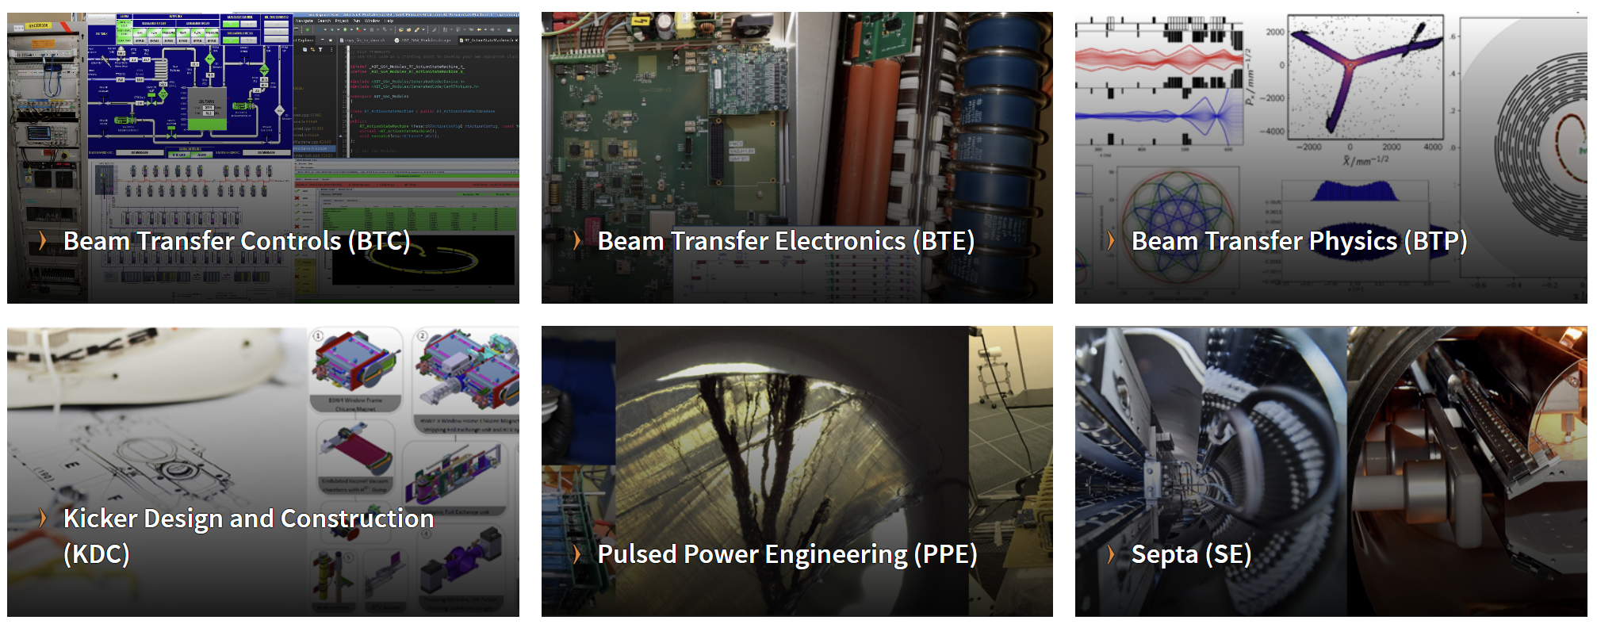
Injection-Extraction @CERN
CERN ABT group
Accelerator Beam Transfer, website
The ABT group is in charge of the design, development, construction, installation, exploitation and maintenance of injection and extraction related equipment and beam-transfer systems

Slide 5
Layout
Introduction
Basic principle of injection
Kicker and septum
Fast injection concept
Reminder on normalized phase space
Dipole error and filamentation
Betatron error and filamentation
Injection protection challenges at the LHC
Injection protection challenges at the FCC-hh
Multi-turn injection concept
Extraction
Transfer
Injection

Slide 6
Layout
Introduction
Basic principle of injection
Kicker and septum
Fast injection concept
Reminder on normalized phase space
Dipole error and filamentation
Betatron error and filamentation
Injection protection challenges at the LHC
Injection protection challenges at the FCC-hh
Multi-turn injection concept
Extraction
Transfer
Injection

Slide 7
Introduction
Accelerators have limited ranges of energies
A synchrotron have a typical range of energy of 20
LHC from 450GeV to 7000TeV for protons (x15)
SPS from 14GeV to 450GeV for protons (x30)
Particles get accelerated in a chain of accelerators
Injection and extraction between stage needs careful consideration
to maintain the beams properties, in particular brightness
To deliver beams with required properties to fixed target experiments
The focus of this lecture
General principle of injection/extraction for hadron synchrotrons
Focus on high-intensity applications
Second part focused on examples and experience from CERN complex

Slide 8
Layout
Introduction
Basic principle of injection
Kicker and septum
Fast injection concept
Reminder on normalized phase space
Dipole error and filamentation
Betatron error and filamentation
Injection protection challenges at the LHC
Injection protection challenges at the FCC-hh
Multi-turn injection concept
Extraction
Transfer
Injection

Slide 9
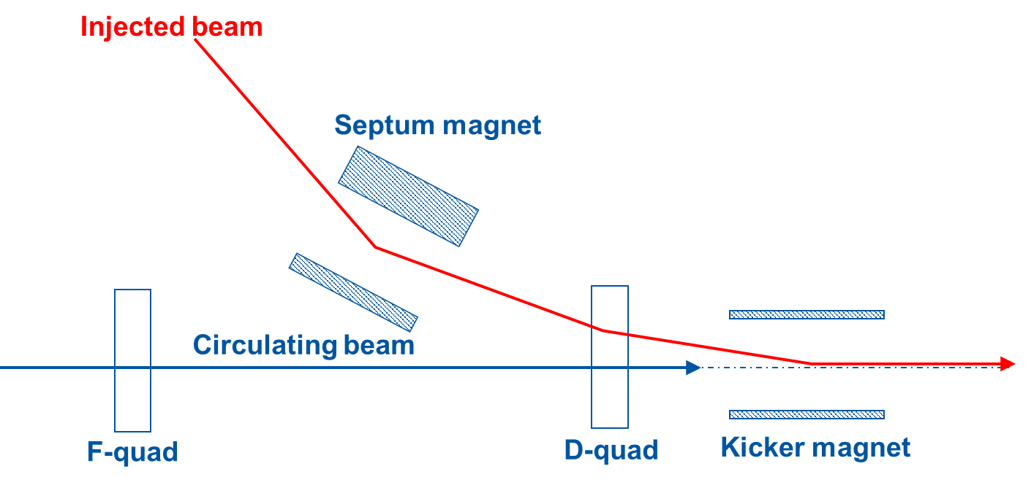
Basic principle of injection

Slide 10
Basic principle of injection
intensity
injected
beam
kicker field
t
Kickers produce fast pulses, rising their field within the particle-free gap in the circulating beam (temporal separation)

Slide 11
Basic principle: Kicker
Aperture dimensions constrained by beam size at kicker location.
Short rise time: < 100 ns –few μs: low inductance.
Maximise horizontal kick: small vertical aperture.
HV conductor
Return conductor
Ferrite
HV
Vertical aperture, V_{ap}
B
μ₀
μ_{r}
Horizontal
aperture, H_{ap}

Slide 12
Basic principle of injection
intensity
injected
beam
kicker field
t
Kickers produce fast pulses, rising their field within the particle-free gap in the circulating beam (temporal separation)
Septa compensate for the relatively low kicker strength, and approach closely the circulating beam (spatial separation)

Slide 13

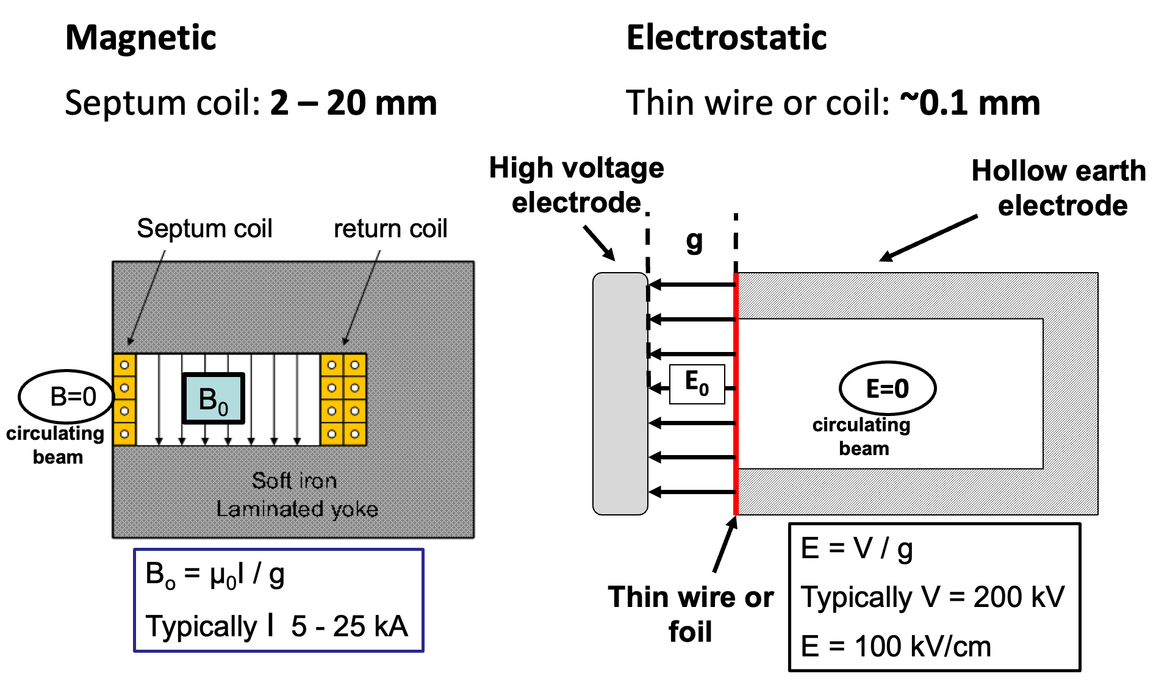
Basic principle: septum

Slide 14
Layout
Introduction
Basic principle of injection
Kicker and septum
Fast injection concept
Reminder on normalized phase space
Dipole error and filamentation
Betatron error and filamentation
Injection protection challenges at the LHC
Injection protection challenges at the FCC-hh
Multi-turn injection concept
Extraction
Transfer
Injection

Slide 15
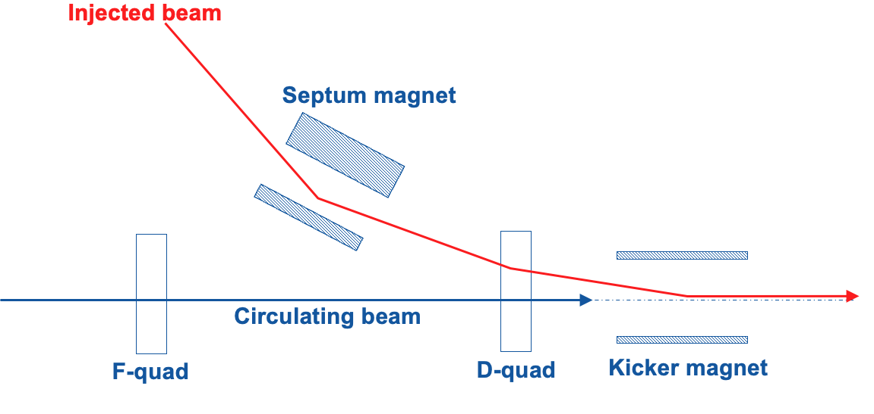
Fast injection: concept
‘boxcar’ stacking
intensity
injected
beam
kicker field
t
Septum + kicker work together to put beam onto reference trajectory.
Several trains can be stacked (e.g. from smaller ring to larger).
Slow bumpers may be used to minimize necessary kicks.
Applications: PS, SPS, LHC, etc. (“Bread and butter” of injection.)
Also applies to extraction systems

Slide 16
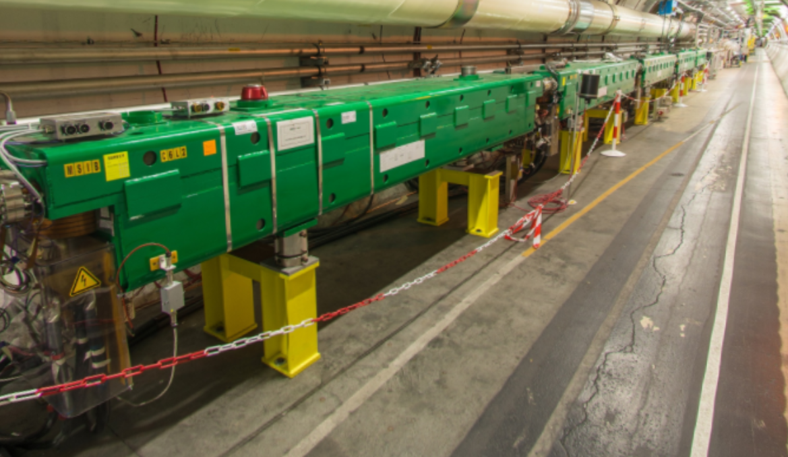
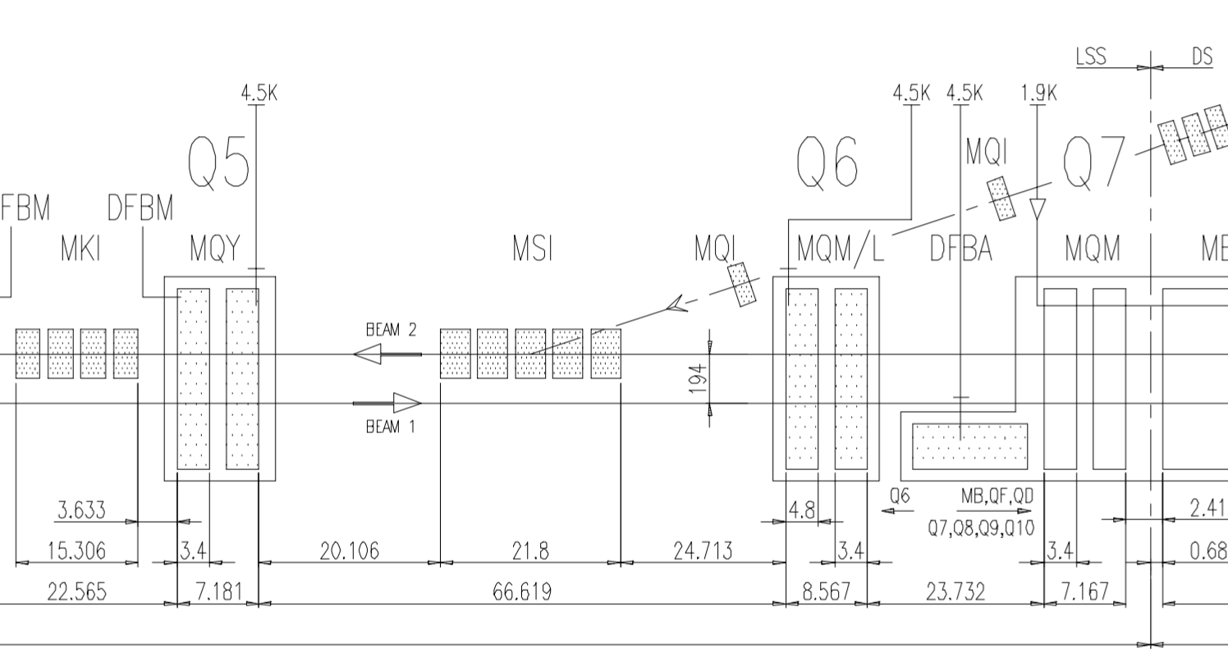
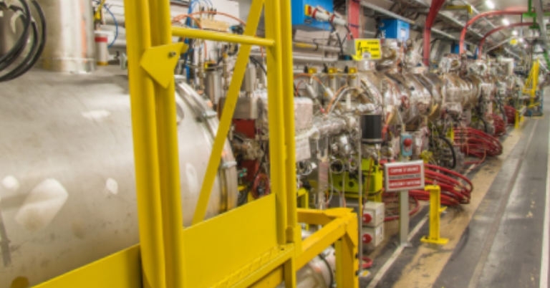
Injection techniques : Fast injection
Example of the LHC injection
MSIs (P8)
Injected beam
Kicker
Septum
MQY (superconducting LHC quadrupole)
MKIs

Slide 17
Layout
Introduction
Basic principle of injection
Kicker and septum
Fast injection concept
Reminder on normalized phase space
Dipole error and filamentation
Betatron error and filamentation
Injection protection challenges at the LHC
Injection protection challenges at the FCC-hh
Multi-turn injection concept
Extraction
Transfer
Injection

Slide 18
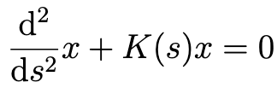
Normalized phase space: concept
E
E
Hill’s equation describes oscillator whose amplitude and frequency vary with s coordinate.
ds
~K(s0)
~K(s1)
x
x

Slide 19
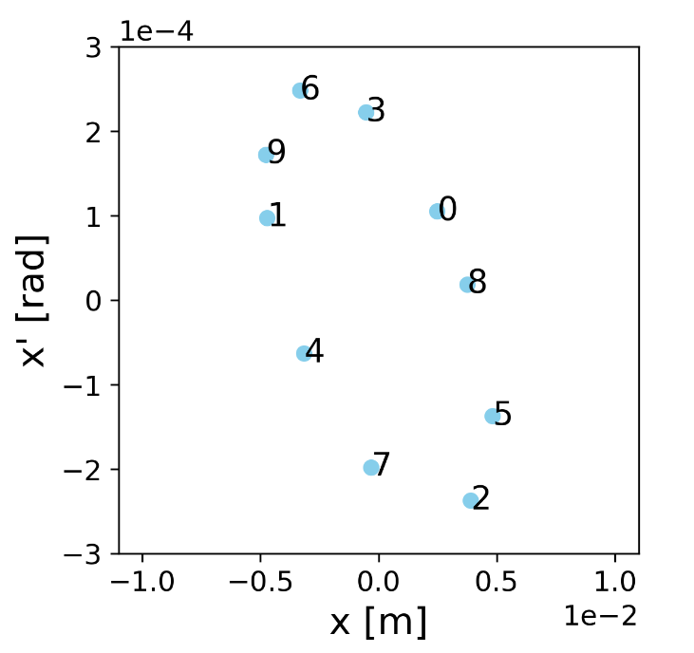
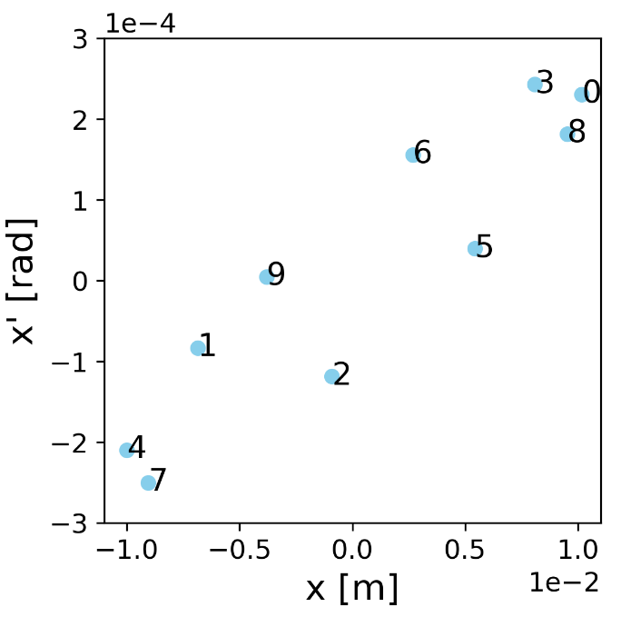
Normalized phase space: concept
E
E
Hill’s equation describes oscillator whose amplitude and frequency vary with s coordinate.
ds
~K(s0)
~K(s1)
x
x

Slide 20
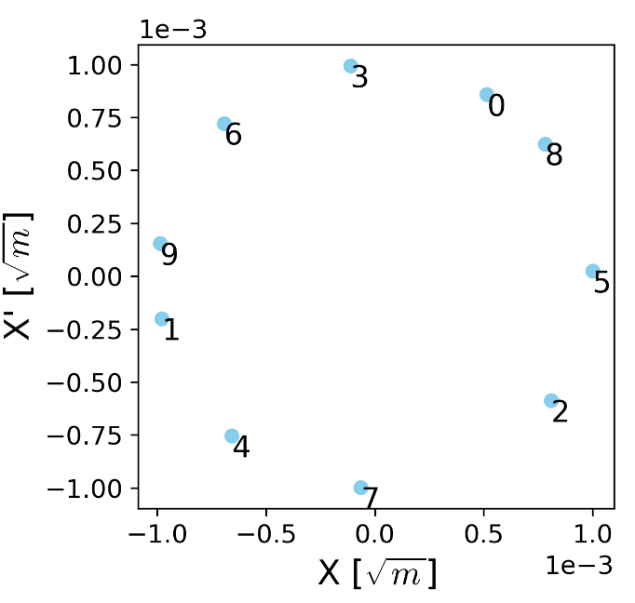
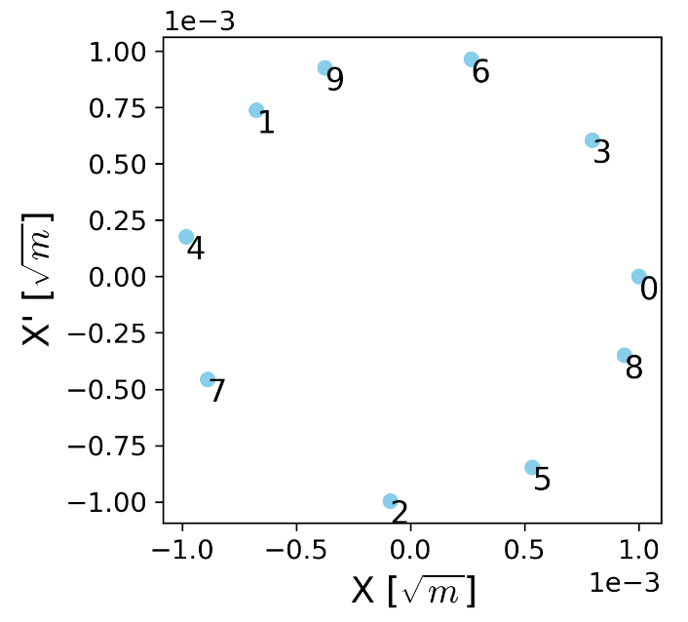
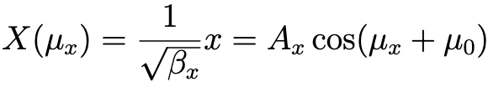
Normalized phase space: concept
E
E
Hill’s equation describes oscillator whose amplitude and frequency vary with s coordinate.
dμ
s0
s1
dμ
X
X

Slide 21
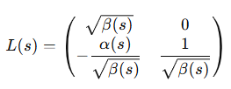
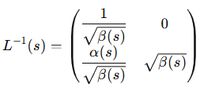
Normalized phase space: math
Real phase space
Normalised phase space
x’(s)
⇒
x(s)
Area = πε
Area = πε
⇒

Slide 22
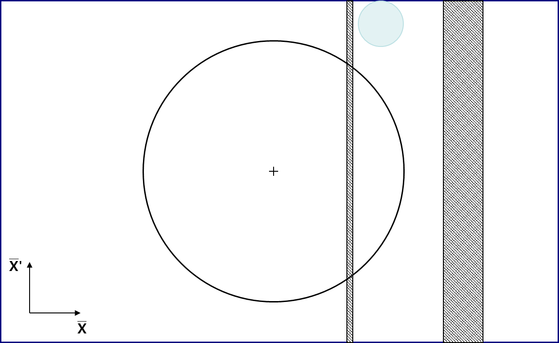
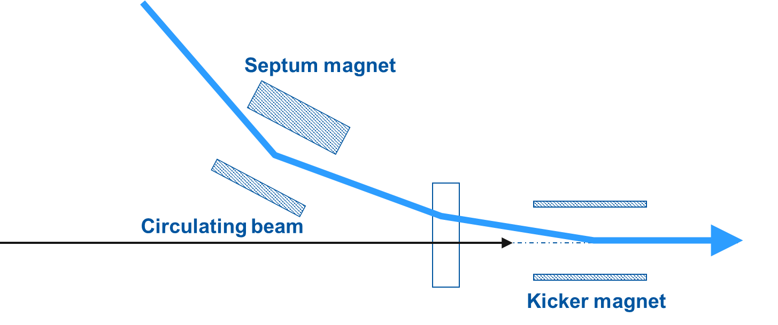
Fast injection: normalized phase space
Seen from the ring
in the normalized transverse phase space in the plane of injection

Slide 23
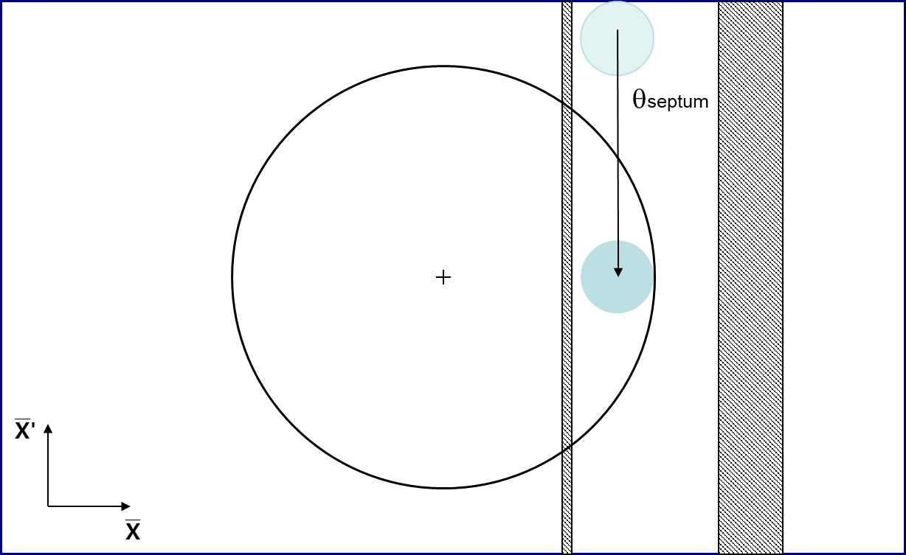
Fast injection: normalized phase space
Seen from the ring
in the normalized transverse phase space in the plane of injection

Slide 24
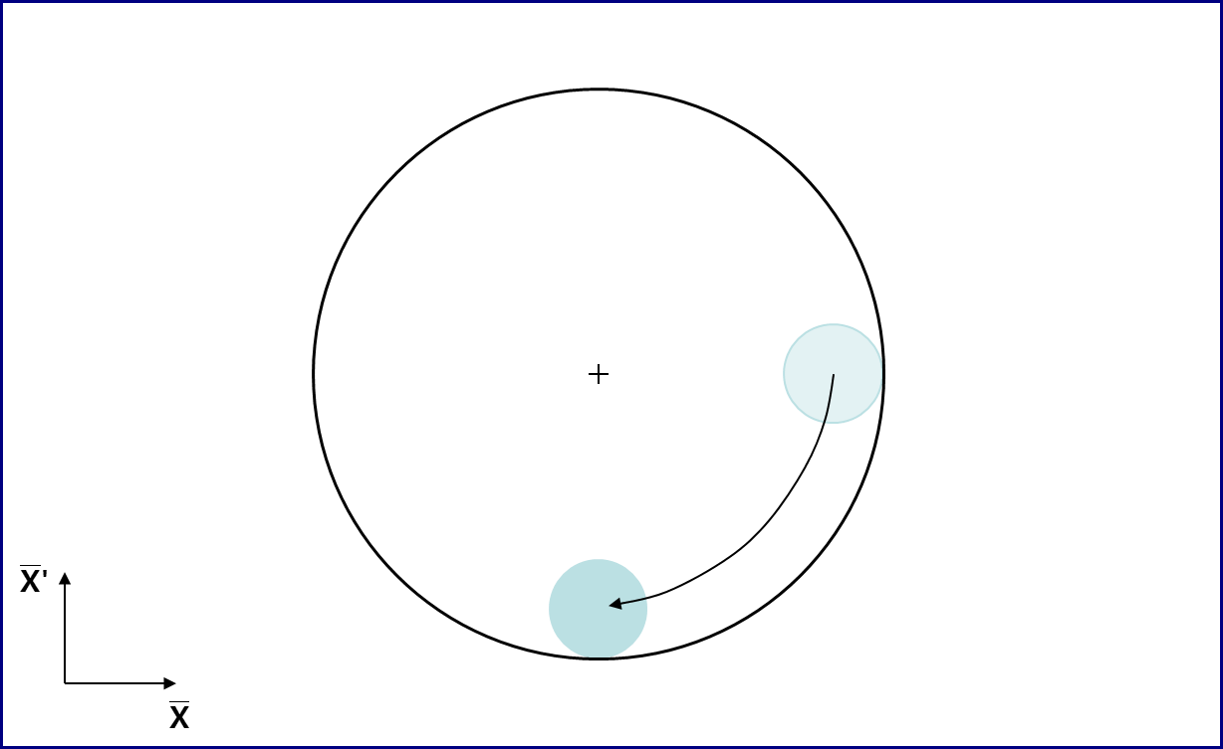
Fast injection: normalized phase space
Seen from the ring
in the normalized transverse phase space in the plane of injection

Slide 25
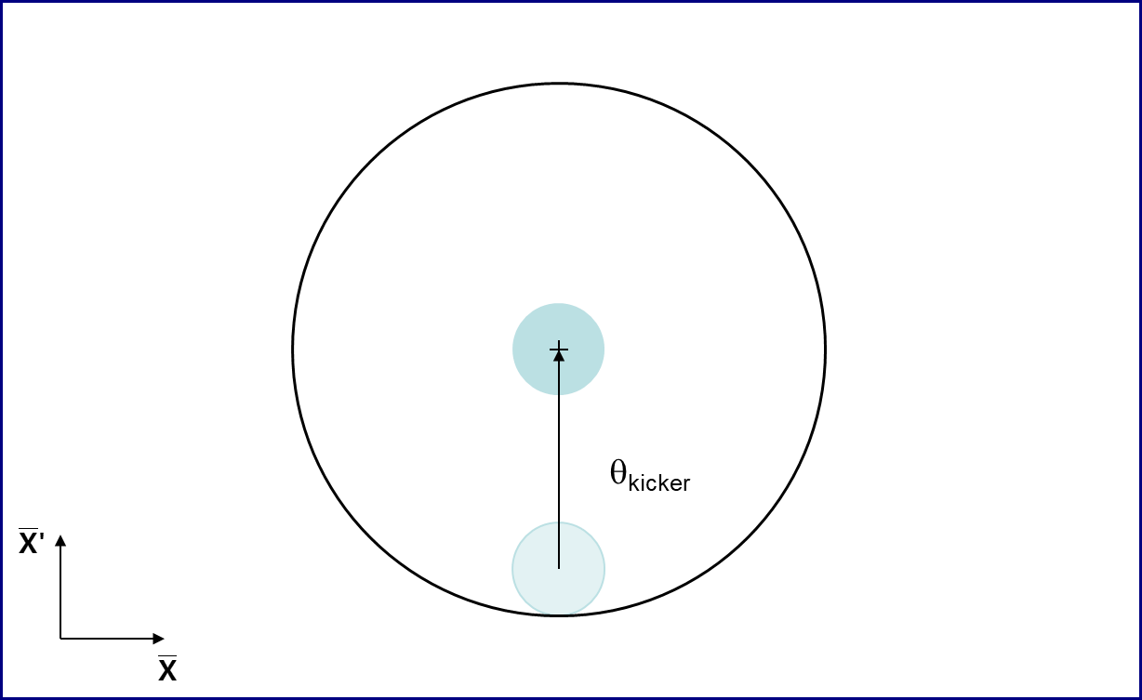
Fast injection: normalized phase space
Seen from the ring
in the normalized transverse phase space in the plane of injection

Slide 26
Layout
Introduction
Basic principle of injection
Kicker and septum
Fast injection concept
Reminder on normalized phase space
Dipole error and filamentation
Betatron error and filamentation
Injection protection challenges at the LHC
Injection protection challenges at the FCC-hh
Multi-turn injection concept
Extraction
Transfer
Injection

Slide 27
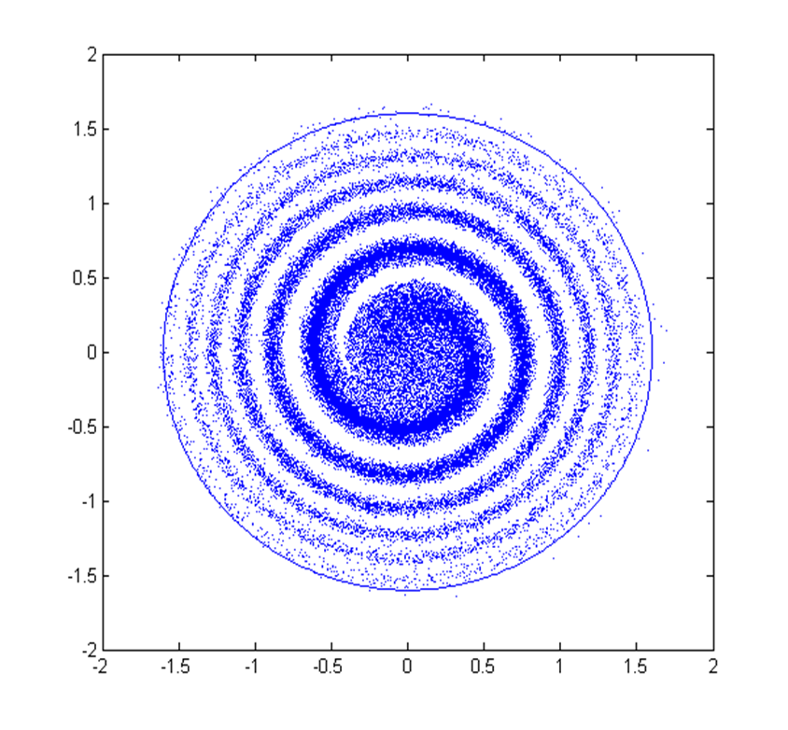
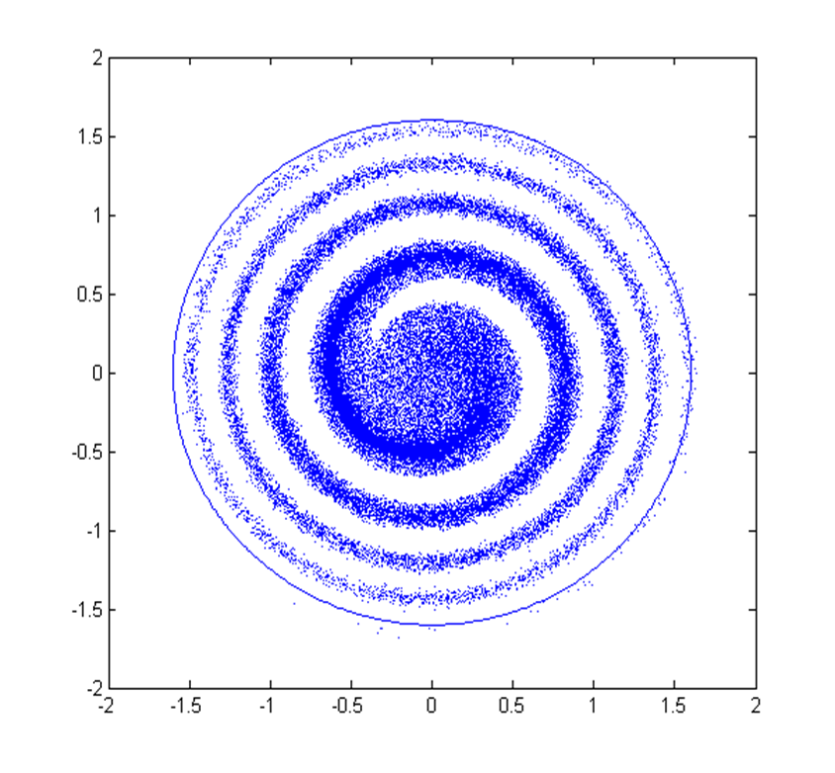
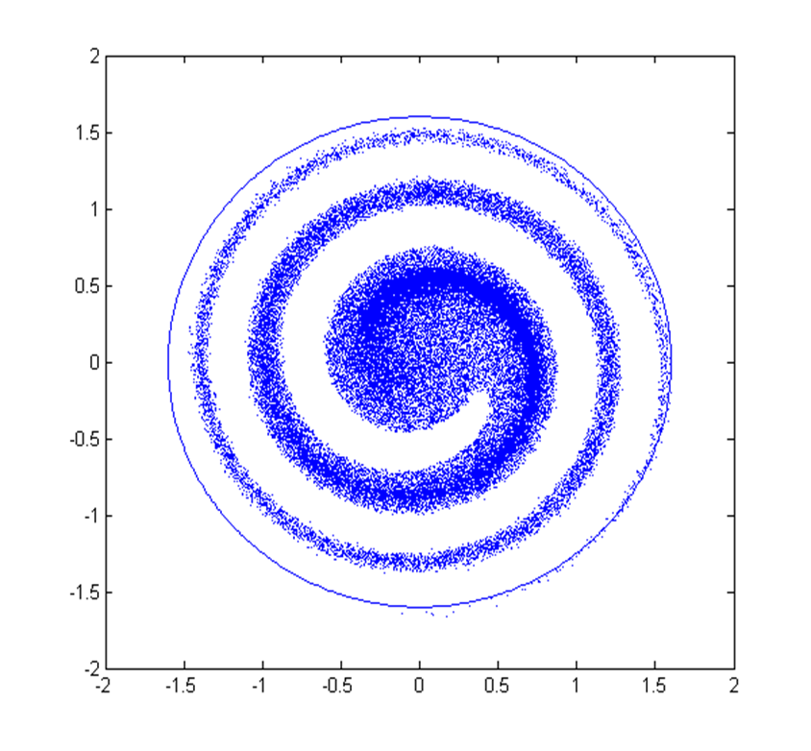
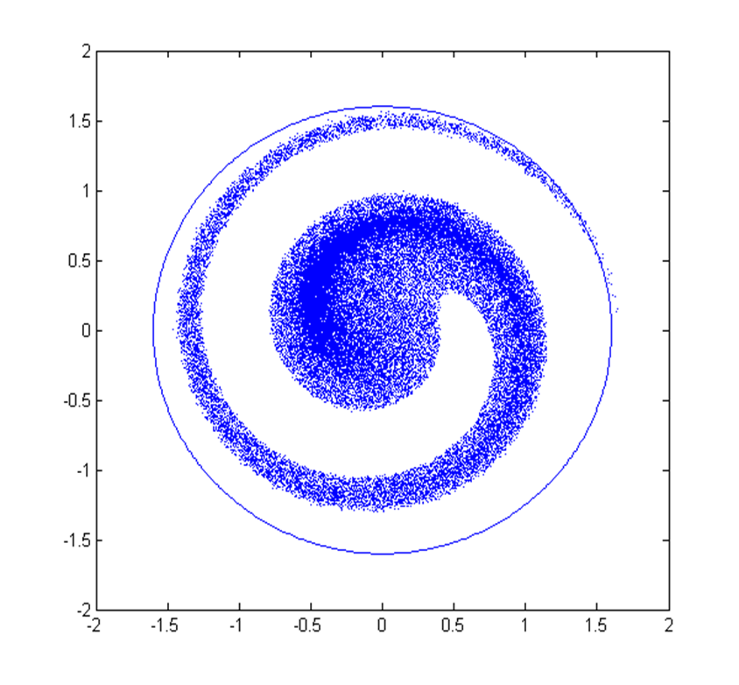
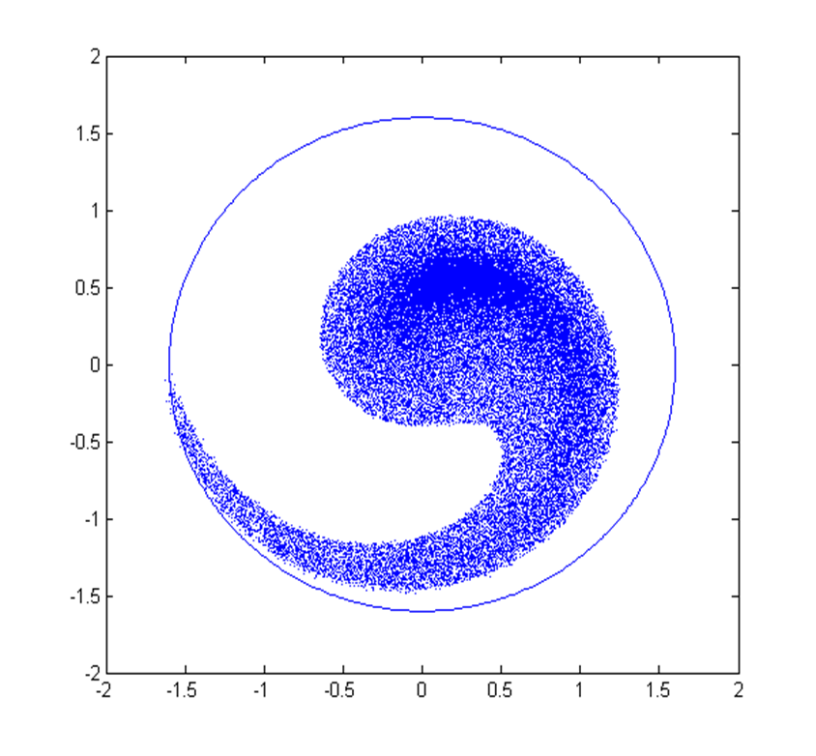
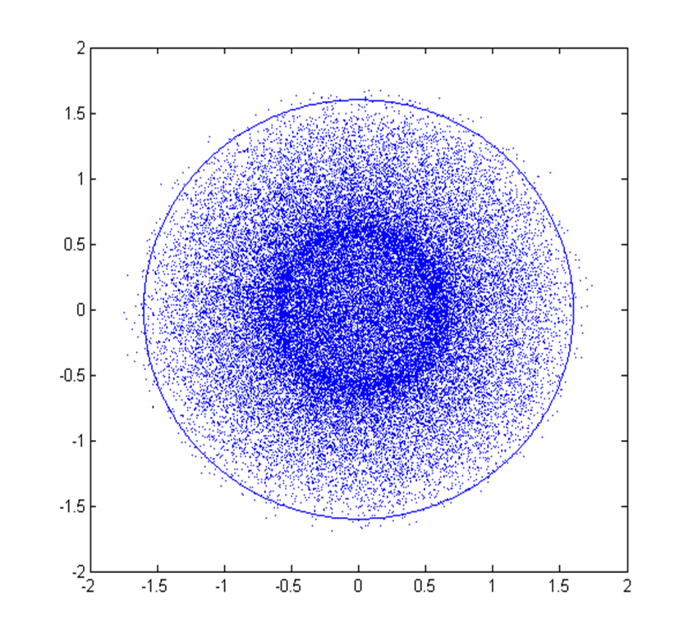
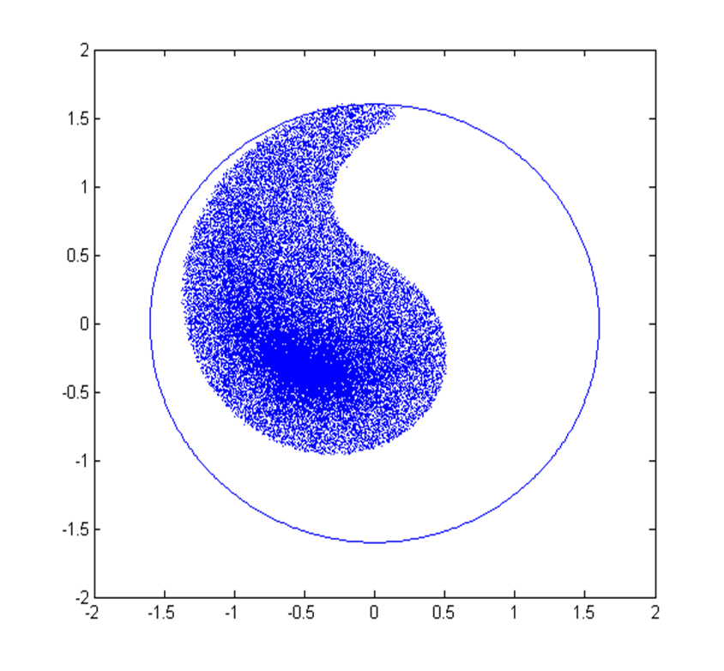
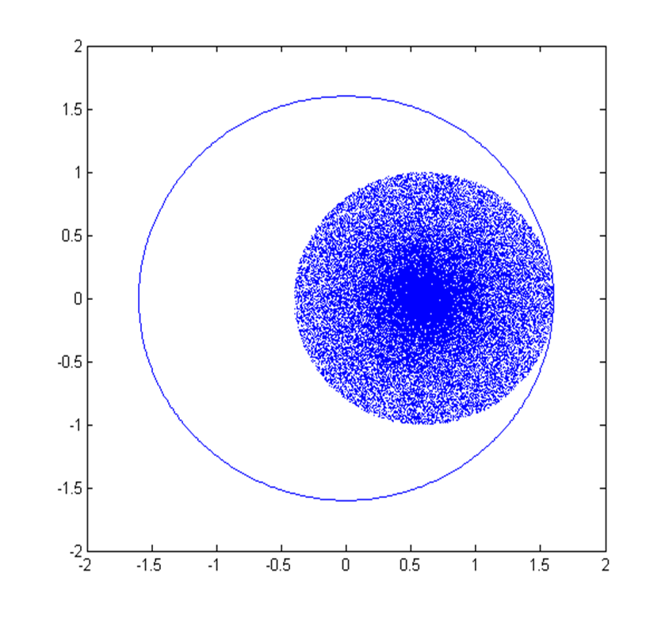
Dipole error and filamentation
Filamentation
Mismatch between the injected position and ring closed orbit leads to a dipole oscillation around the closed orbit
Mismatch between the injected shape and ring closed solution leads to a quadrupole oscillation of the beam
Both errors lead to filamentation, and a reduction of the beam brightness
Turn after turn the brightness of the beam decreases as its emittance increases
This effect is due to non-linear behaviour: particles at different distances from the center do no rotate at the same speed

Slide 28
Dipole error and filamentation
Filamentation
Mismatch between the injected position and ring closed orbit leads to a dipole oscillation around the closed orbit
Mismatch between the injected shape and ring closed solution leads to a quadrupole oscillation of the beam
Both errors lead to filamentation, and a reduction of the beam brightness
Turn after turn the brightness of the beam decreases as its emittance increases
This effect is due to non-linear behaviour: particles at different distances from the center do no rotate at the same speed

Slide 29
Dipole error and filamentation
Filamentation
Mismatch between the injected position and ring closed orbit leads to a dipole oscillation around the closed orbit
Mismatch between the injected shape and ring closed solution leads to a quadrupole oscillation of the beam
Both errors lead to filamentation, and a reduction of the beam brightness
Turn after turn the brightness of the beam decreases as its emittance increases
This effect is due to non-linear behaviour: particles at different distances from the center do no rotate at the same speed

Slide 30
Dipole error and filamentation
Filamentation
Mismatch between the injected position and ring closed orbit leads to a dipole oscillation around the closed orbit
Mismatch between the injected shape and ring closed solution leads to a quadrupole oscillation of the beam
Both errors lead to filamentation, and a reduction of the beam brightness
Turn after turn the brightness of the beam decreases as its emittance increases
This effect is due to non-linear behaviour: particles at different distances from the center do no rotate at the same speed

Slide 31
Dipole error and filamentation
Filamentation
Mismatch between the injected position and ring closed orbit leads to a dipole oscillation around the closed orbit
Mismatch between the injected shape and ring closed solution leads to a quadrupole oscillation of the beam
Both errors lead to filamentation, and a reduction of the beam brightness
Turn after turn the brightness of the beam decreases as its emittance increases
This effect is due to non-linear behaviour: particles at different distances from the center do no rotate at the same speed

Slide 32
Dipole error and filamentation
Filamentation
Mismatch between the injected position and ring closed orbit leads to a dipole oscillation around the closed orbit
Mismatch between the injected shape and ring closed solution leads to a quadrupole oscillation of the beam
Both errors lead to filamentation, and a reduction of the beam brightness
Turn after turn the brightness of the beam decreases as its emittance increases
This effect is due to non-linear behaviour: particles at different distances from the center do no rotate at the same speed

Slide 33
Dipole error and filamentation
Filamentation
Mismatch between the injected position and ring closed orbit leads to a dipole oscillation around the closed orbit
Mismatch between the injected shape and ring closed solution leads to a quadrupole oscillation of the beam
Both errors lead to filamentation, and a reduction of the beam brightness
Turn after turn the brightness of the beam decreases as its emittance increases
This effect is due to non-linear behaviour: particles at different distances from the center do no rotate at the same speed

Slide 34
Dipole error and filamentation
Filamentation
Mismatch between the injected position and ring closed orbit leads to a dipole oscillation around the closed orbit
Mismatch between the injected shape and ring closed solution leads to a quadrupole oscillation of the beam
Both errors lead to filamentation, and a reduction of the beam brightness
Turn after turn the brightness of the beam decreases as its emittance increases
This effect is due to non-linear behaviour: particles at different distances from the center do no rotate at the same speed

Slide 35
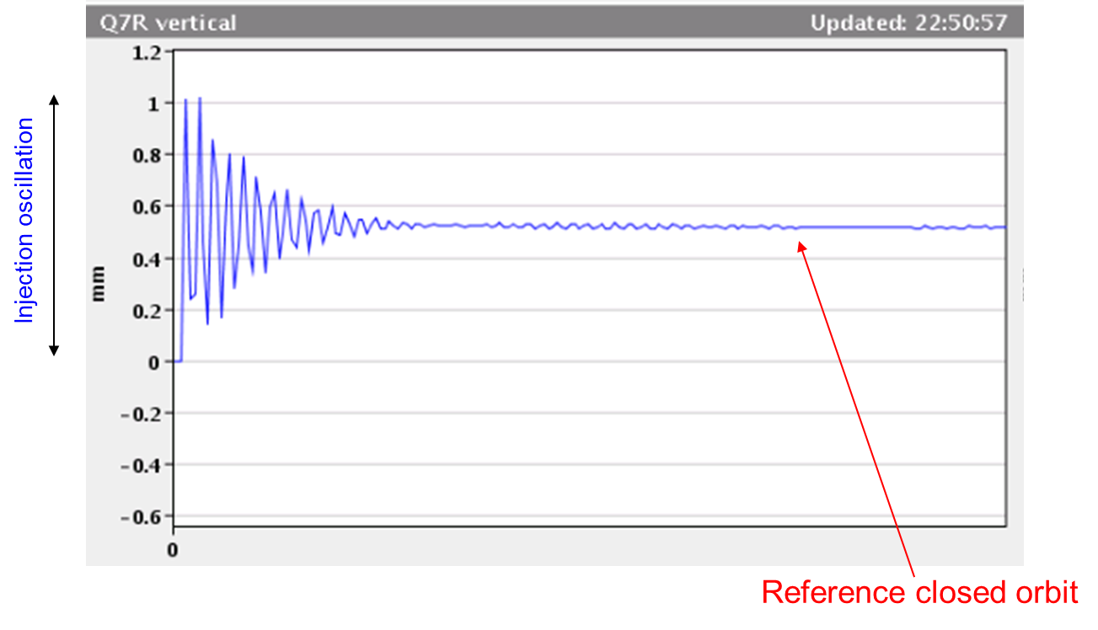
Dipole error and filamentation
If injection oscillation is left uncorrected, it might disappear after several turns.
BPM signal over many turns
Turn #

Slide 36
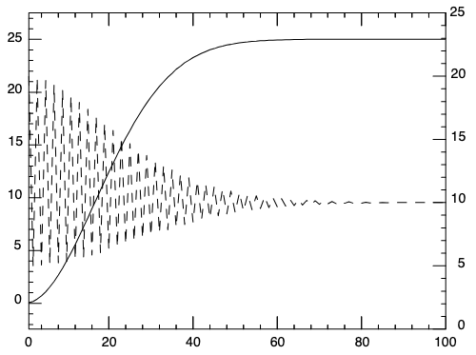
Dipole error and filamentation
If injection oscillation is left uncorrected, it might disappear after several turns.
However, it has been “exchanged” for an r.m.s. emittance blow-up.
BPM signal over many turns
emittance
orbit
Turn #
Turn #

Slide 37
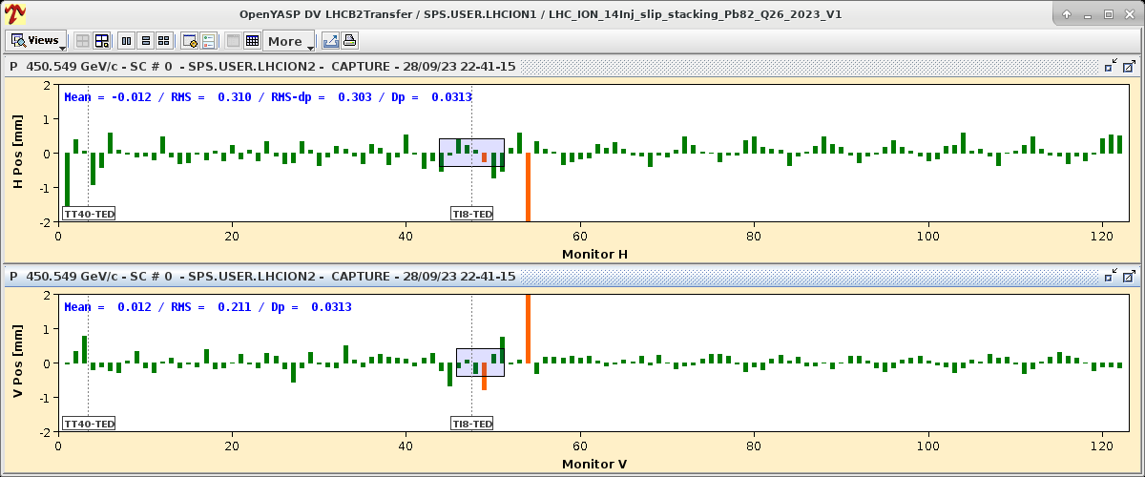
Dipole error and filamentation
Example of such effect observed, at the SPS to LHC injection
SPS
TI8 transfer line
First arc of LHC (P8 to P7)

Slide 38
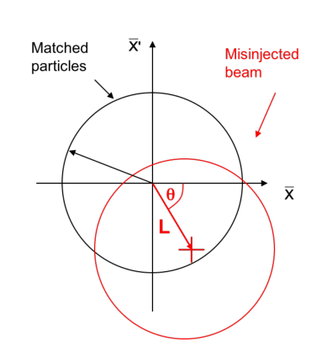


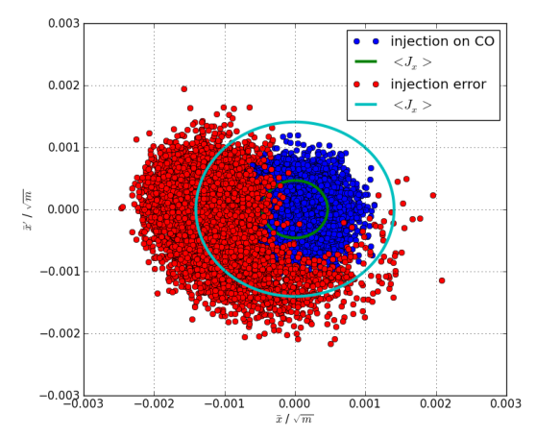

Dipole error and filamentation
In numbers the coordinates for the misinjected (new) beam are
The mean action over all the particles is
The emittance increase is
[1] V. Kain, Emittance Preservation, CAS17 injection/extraction, https://doi.org/10.23730/CYRSP-2018-005.507

Slide 39
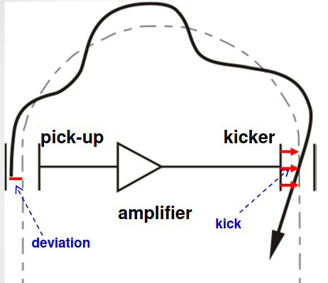

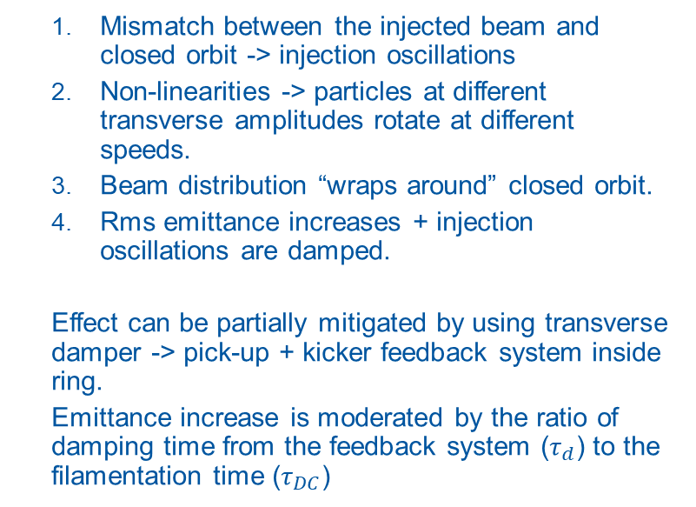
Dipole error and filamentation
Mismatch between the injected beam and closed orbit -> injection oscillations
Non-linearities -> particles at different transverse amplitudes rotate at different speeds.
Beam distribution “wraps around” closed orbit.
Rms emittance increases + injection oscillations are damped.
Effect can be partially mitigated by using transverse damper -> pick-up + kicker feedback system inside ring.
Emittance increase is moderated by the ratio of damping time from the feedback system ($τ_{d}$) to the filamentation time ($τ_{DC}$)
[1] V. Kain, Emittance Preservation, CAS17 injection/extraction, https://doi.org/10.23730/CYRSP-2018-005.507

Slide 40
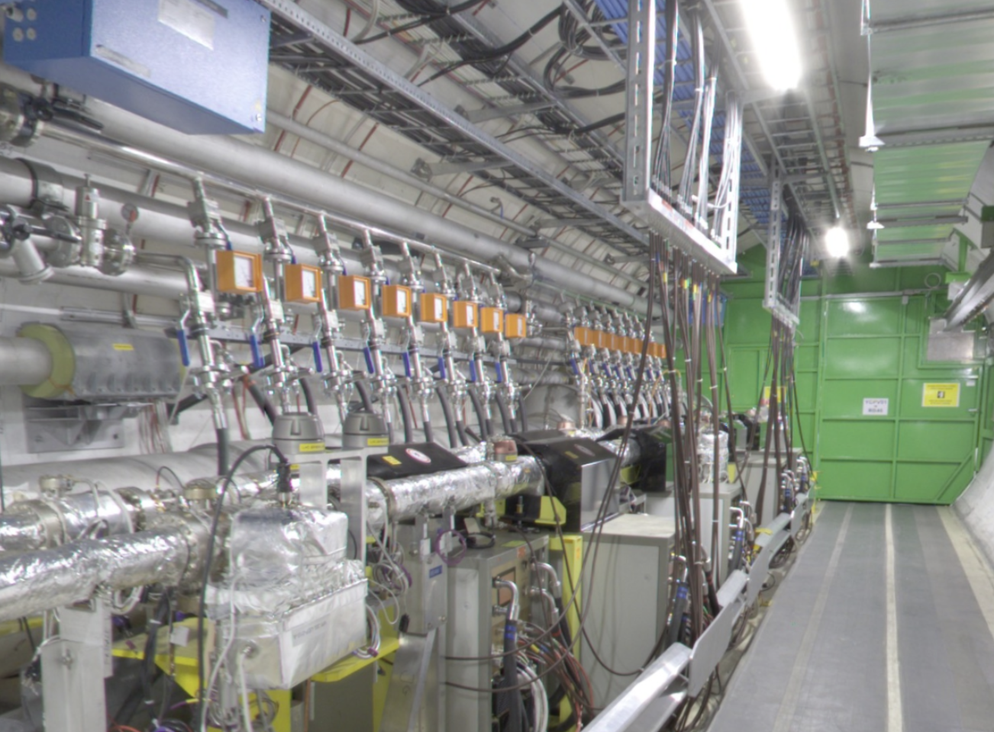
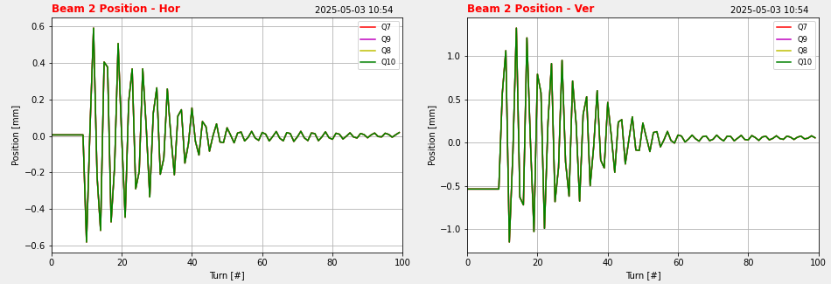
Dipole error and filamentation
Example of LHC damped injection oscillation from ADT system commissioning
LHC Damper in Cell 6, right of P4

Slide 41
Layout
Introduction
Basic principle of injection
Kicker and septum
Fast injection concept
Reminder on normalized phase space
Dipole error and filamentation
Betatron error and filamentation
Injection protection challenges at the LHC
Injection protection challenges at the FCC-hh
Multi-turn injection concept
Extraction
Transfer
Injection

Slide 42
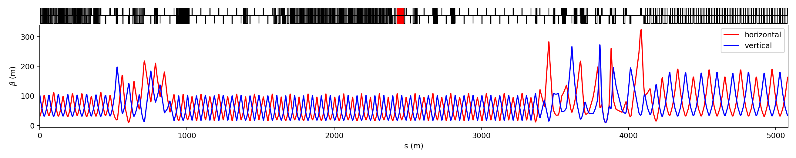
Betatron error and filamentation
Initial
matching
section
Final
matching
section
Independently powered (tuneable) quadrupoles
Independently powered (tuneable) quadrupoles and (in this case) passive protection devices
SPS
LHC
Regular lattice (FODO) (elements all powered in series with same strengths)
Extraction
point
SPS to LHC Transfer Line (3 km)
Injection
point

Slide 43
Betatron error and filamentation
Mismatch in optical parameters will lead to emittance blow-up via filamentation:
Time
Turn 0
Turn N
x’
x

Slide 44
Betatron error and filamentation
Mismatch in optical parameters will lead to emittance blow-up via filamentation:
Time
Turn 0
Turn N
x’
x

Slide 45
Betatron error and filamentation
Mismatch in optical parameters will lead to emittance blow-up via filamentation:
Time
Turn 0
Turn N
x’
x

Slide 46
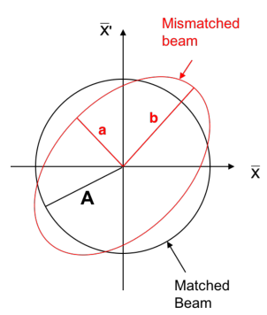

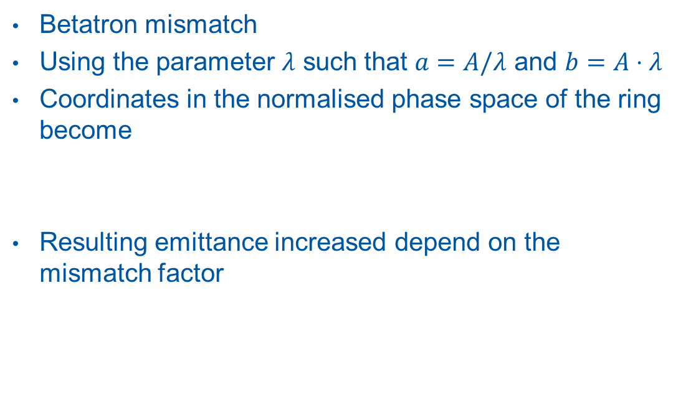
Betatron error and filamentation
Betatron mismatch
Using the parameter $λ$ such that $a=A/λ$ and $b=A⋅λ$
Coordinates in the normalised phase space of the ring become
Resulting emittance increased depend on the mismatch factor
[1] V. Kain, Emittance Preservation, CAS17 injection/extraction, https://doi.org/10.23730/CYRSP-2018-005.507

Slide 47
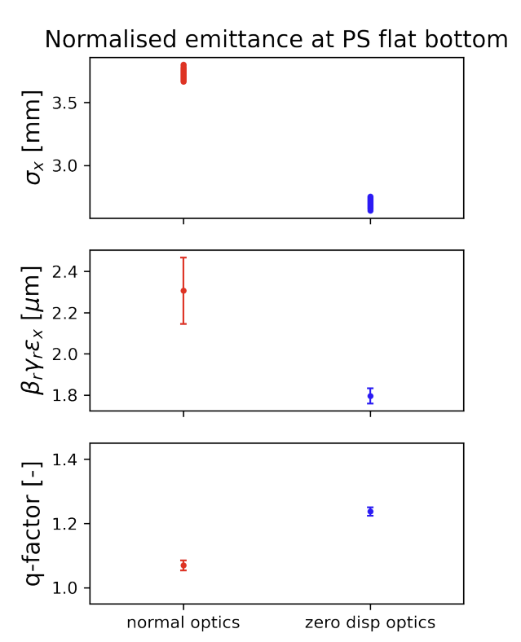
Betatron error and filamentation
Quadrupole pick-up measurement is vert challenging and not presently used at CERN [1]
Emittance measurement comparison between rings is particularly challenging
Example of emittance measurement in the PSB-to-PS using special optics [2]
Very small differences in the beam halo population measured between SPS and LHC could come from mismatch [3]
Intensity limitations
Intercepting measurements such as wire scanner cannot be used for the highest intensity beam [4-5]
[1]
[1] A. Sounas, M. Gasior, T. Lefevre, BPM TECHNOLOGIES FOR QUADRUPOLAR MOMENT MEASUREMENTS, HB2018, Daejeon, Korea
[2] W. Van Goethem*, E. Maclean, G. Franchetti, A. Huschauer, F. Asvesta, H. Rafique, Zero Dispersion Optics in the PS, July 2024, CERN, https://indico.cern.ch/event/1433323
[3] M. Rakic, Assessing the origin of the LHC beam halo, IPAC25, https://indico.cern.ch/event/1558252/#3-assessing-the-origin-of-the
[4] M. Sapinski∗, T. Kroyer, OPERATIONAL LIMITS OF WIRE SCANNER ON LHC BEAM , BIW08, Tahoe City, California
[5] E. de la Fuente, et. al., IMPEDANCE AND THERMAL STUDIES OF THE CERN SPS WIRE SCANNERS AND MITIGATION OF WIRE HEATING, IPAC24, Nashville, TN, USA

Slide 48
Layout
Introduction
Basic principle of injection
Kicker and septum
Fast injection concept
Reminder on normalized phase space
Dipole error and filamentation
Betatron error and filamentation
Injection protection challenges at the LHC
Injection protection challenges at the FCC-hh
Multi-turn injection concept
Extraction
Transfer
Injection

Slide 49
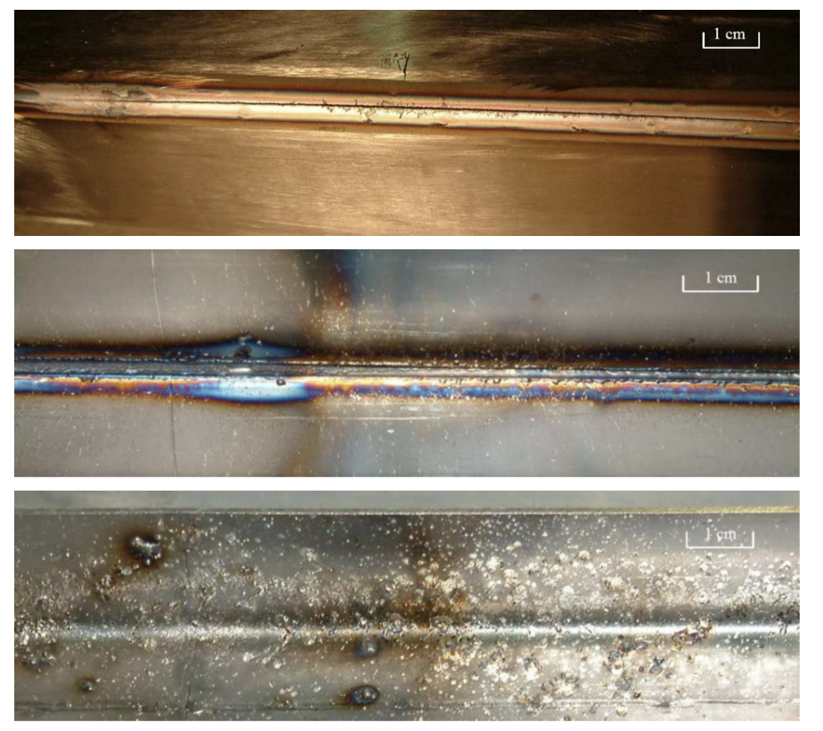
Injection protection challenges at the LHC
Transferred high intensity beam can be very destructive
LHC beam in numbers
Up to 4.8 MJ per injection (288 bunches at 2.3E11 ppb)
Up to ~700 MJ per extraction
Individual injection/extraction system failure must be accounted for
Outside of the vacuum chamber
Inside of the vacuum chamber, beam impact side
Inside of the vacuum chamber, side opposite to the beam impact
Damages on a vacuum chamber of TT40 magnet (SPS-LHC transfer line) [1]
[1] A Bertarelli, Beam-Induced Damage Mechanisms and their Calculation, 2014 Joint International Accelerator School: Beam Loss and Accelerator Protection, Newport Beach, CA, USA

Slide 50
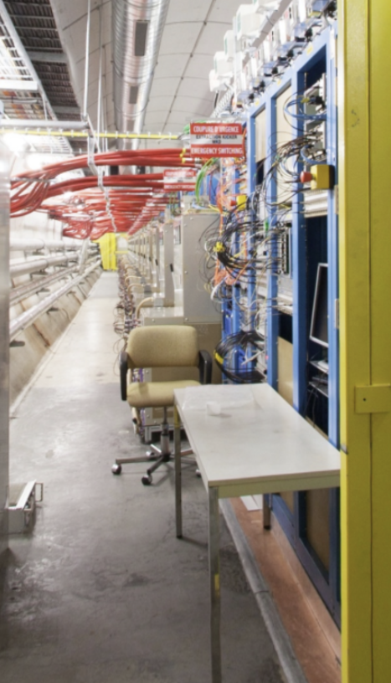
Injection protection challenges at the LHC
Prevention measures
Fast interlock where possible
Slow magnets and septa may fail slowly enough to be detected and inhibit the beam transfer >~1 ms
Slow changes in beam characteristics may be detected through beam loss measurement
Fail-safe kicker triggering design
Commissioning and setup with low intensity
All machines are commissioned, and systems functionality validate with low intensities (takes about 5 weeks for the LHC)
LHC control and power electronics for the dump system in UA63

Slide 51
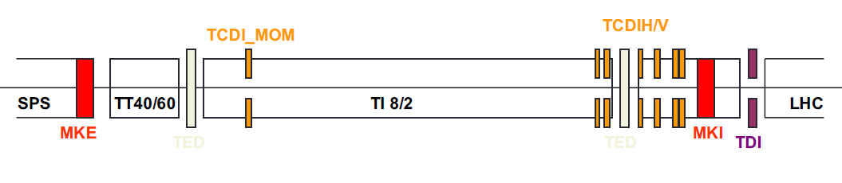
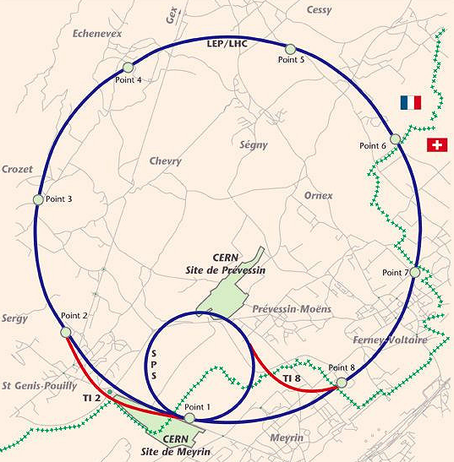
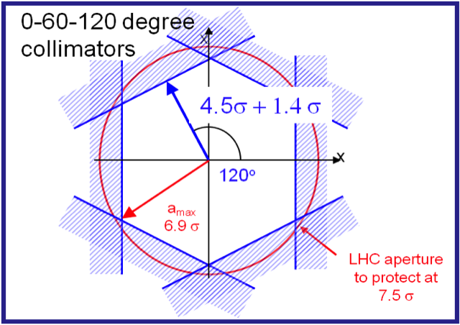
Injection protection challenges at the LHC [1]
A system of 3 collimators (2 jaws each) per plane at 60° phase advance from each other is installed at the end of the SPS-to-LHC TLs [2]
optimized ratio: provided protection/number of collimators.
Intercept large amplitude oscillations and attenuate escaping intensity below damage limit of LHC aperture ➔ collimator geometry (material and active length)
[1] C. Bracco, Injection: Hadron Beams, CAS Beam Injection, Extraction and Transfer, 2017, Erice, Italy
[2] V. Kain, “Machine protection and beam quality during the LHC injection process”, CERN-THESIS-2005-047

Slide 52
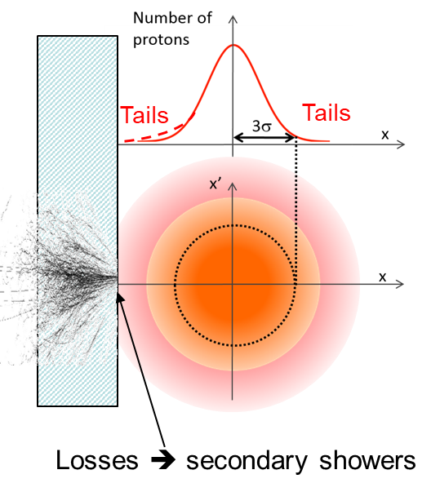
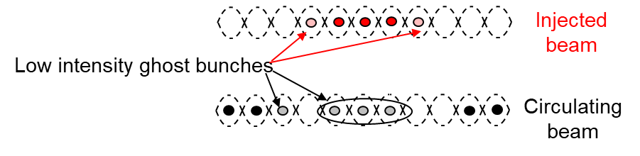

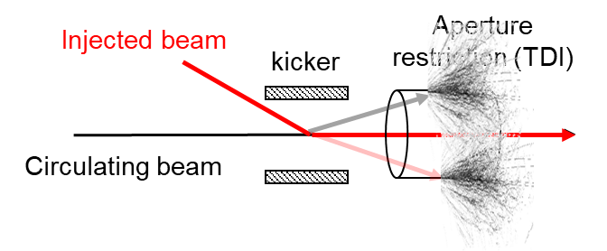
Injection protection challenges at the LHC [1]
Losses at injection beyond the core of the beam may be limiting
Injection losses limited LHC intensity in the early part of the proton run in 2023 due to losses of <0.1 % [2-3]
Transverse
Longitudinal
[1] C. Bracco, Injection: Hadron Beams, CAS Beam Injection, Extraction and Transfer, 2017, Erice, Italy
[2] B. Salvachua, STUDY OF THE PERFORMANCE AND BEAM LOSS LIMITATIONS DURING INJECTION OF HIGH-INTENSITY LHC PROTON BEAMS, IPAC24
[3] Y. Dutheil, Losses for LHC beams, up to LHC injection, JAP23, Montreux, Switzerland

Slide 53
Layout
Introduction
Basic principle of injection
Kicker and septum
Fast injection concept
Reminder on normalized phase space
Dipole error and filamentation
Betatron error and filamentation
Injection protection challenges at the LHC
Injection protection challenges at the FCC-hh
Multi-turn injection concept
Extraction
Transfer
Injection

Slide 54
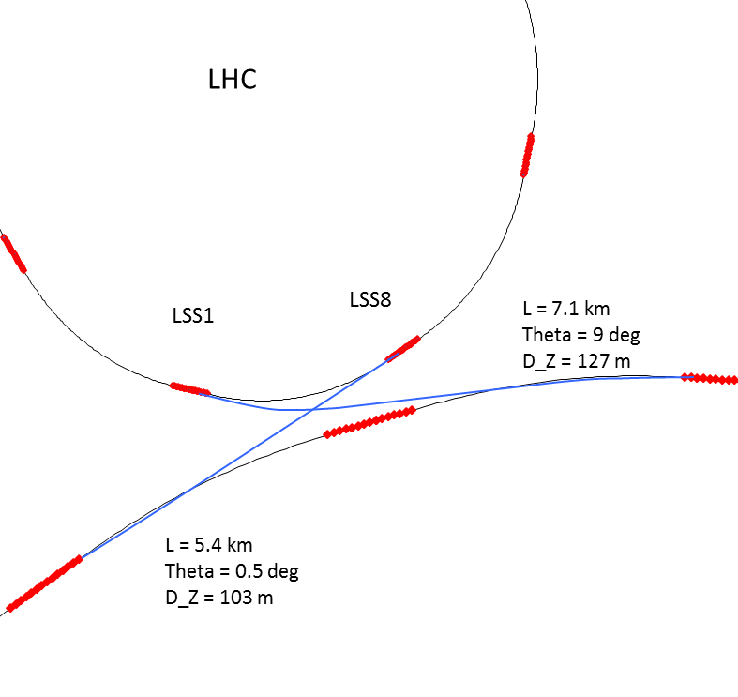

Injection protection challenges at the FCC-hh
Considerations
LHC used as injector for the FCC
Injection energy = 3.3 TeV (x7 HL-LHC)
Bunch population = 1.1E11 ppb
LHC can be filled with ~2800 bunches but, in order to limit the stored energy of the injected beam into the FCC to 5 MJ one can extract/inject 90 bunches at the time ➔ reduce kicker flattop! [6]
t_{rise} injection kicker defined by the target filling factor assuming a target filling factor of 80% ➔ 0.28 μs
The LHC is emptied to fill FCC by pulsing the extraction/injection kickers at high frequency. Required kicker recharging time driven by synchronisation of two machines to common frequency
[1] W. Bartmann, BEAM TRANSFER TO THE FCC-hh COLLIDER FROM A 3.3 TeV BOOSTER IN THE LHC TUNNEL, IPAC15, Richmond, VA, USA
[2] C. Bracco, Injection: Hadron Beams, CAS Beam Injection, Extraction and Transfer, 2017, Erice, Italy

Slide 55
Layout
Introduction
Basic principle of injection
Kicker and septum
Fast injection concept
Reminder on normalized phase space
Dipole error and filamentation
Betatron error and filamentation
Injection protection challenges at the LHC
Injection protection challenges at the FCC-hh
Multi-turn injection concept
Extraction
Transfer
Injection

Slide 56

Multi-turn injection concept
Principle
Injected beam is injected in a small part of the available phase space
The injected trajectory is moved relative to the closed orbit during the injection process
Allows to accumulate intensity and `paint` the phase space with a beam smaller than the available ring acceptance, typically from a linac to a ring
Challenges
Complex manipulation of the injected beam and ring closed orbit during the injection process
Applications
At CERN PSB until LS2
At GSI SIS18 heavy ions injection

Slide 57


Multi-turn injection concept
In the case of the PSB (pre-LS2) the beam is injected in the horizontal plane and the ring fractional tune is close to 0.25

Slide 58

Multi-turn injection concept
In the case of the PSB (pre-LS2) the beam is injected in the horizontal plane and the ring fractional tune is close to 0.25

Slide 59

Multi-turn injection concept
In the case of the PSB (pre-LS2) the beam is injected in the horizontal plane and the ring fractional tune is close to 0.25

Slide 60


Multi-turn injection concept [1]
Other example at the GSI SIS18, injection of heavy ions from the UNILAC
Conclusion
Disadvantages inherent in using an injection septum:
Width of several mm reduces aperture
Beam losses from circulating beam hitting septum:
Typically 30 – 40 % for the CERN PSB injection pre-LS2
Limits number of injected turns to 10 - 20
Allows to accumulate intensity into a ring, from a much smaller beam source, typically a linear accelerator
Is complex to optimize, with few observables as individual beamlets cannot be measured
[1]S. Appel, O. Boine-Frankenheim, and F. Petrov, ‘Injection optimization in a heavy-ion synchrotron using genetic algorithms’, Nuclear Instruments and Methods in Physics Research Section A: Accelerators, Spectrometers, Detectors and Associated Equipment, vol. 852, pp. 73–79, Apr. 2017, doi: 10.1016/j.nima.2016.11.069.

Slide 61
Further reading and ressources
ABT group is on the 865 building, my office 865/1D28
CAS 2017 on Beam injection, extraction and transfer at https://indico.cern.ch/event/451905/
Overlooked here, timing and synchronization by RF expert H. Damerau next week
Detailed talk on resonant slow extraction by P. Bryant https://indico.cern.ch/event/451905/contributions/2159064/
Exotic extraction methods that discuss all the possibilities overlooked here by B. Goddard https://indico.cern.ch/event/451905/contributions/2159103
This CAS lecture on Kickers and Septa by M. Barnes https://indico.cern.ch/event/1018359/contributions/4312229
CERN GIS machine portal https://gis.cern.ch/gisportal/Machine.htm

Slide 62
Thank you

