Slide 1
Beam Intercepting Devices at CERN Types, Challenges, Design, R&D and Operation
Antonio PERILLO MARCONE (SY-STI)
25th June 2025 Lecture 1/2

Slide 2
Disclaimer
These lectures will present a phenomenological and broader approach in the design, construction and operation of beam intercepting devices, focusing on requirements, technologies and operational constraints
Dedicated Accelerator Schools (CAS, USPAS, JAS, etc.) are available to expand the calculation part

Slide 3
Structure of the lectures
Lecture 1 will be focused on general concepts, definition and challenges in the design of beam intercepting devices
Lecture 2 will provide specific examples of advanced components recently built, in commissioning & in operation at CERN

Slide 4
Acknowledgments
Many thanks to several colleagues for their contribution and material
M. Calviani, A. Lechner, C. Torregrosa, R. Ximenes, F.-X. Nuiry, L. Salvatore Esposito, R. Rossi, O. Aberle
And material from A. Bertarelli, P. Hurh, B. Riemer, M. Wohlmuther & many others

Slide 5
Beam Intercepting Device – a possible definition
A beam intercepting device is a component that intercepts accelerated particle beams for diverse purposes, such as
Production of secondary particles (target)
Beam cleaning equipment (collimator)
Safe disposal (dump)
Protection of sensitive equipment (dumps, collimators)

Slide 6
Safety function
Beam stoppers
Beam cleaning & control
Collimators
Scrapers
Beam dumps
Strippers
Slits
Physics
Particle producing targets

Slide 7

Challenges to be faced (1/3)
Devices must be able to withstand operation and accident scenarios, whilst protecting sensitive equipment
Sometimes employed as “last line of defence” against component damage
Operational teams rely heavily on dependable components, whose failure often leads to long periods of downtime
BIDs are usually the most radioactive components in an accelerator complex (cool down, ALARA)
https://cerncourier.com/a/intercepting-the-beams/

Slide 8
Challenges to be faced (2/3)
Operation in Ultra High Vacuum (10⁻¹⁰ mbar)
Movable parts with extremely high precision and tight geometrical tolerances (e.g., flatness, alignment)
High energy densities (several kJ/cm³/pulse)
High power densities (~MW/cm³)

Slide 9
Challenges to be faced (3/3)
High beam kinetic energy (up 700 MJ)
High average deposited power (several hundreds of kW)
Physics requirements (sometimes implying materials with poor structural properties)
Impedance (especially for colliders)
Radiation damage – modification of thermo-physical and mechanical properties

Slide 10
BIDs lifecycle
Functional requirements
Conceptual design
R&D + prototype + testing
Advanced design
Procurement and construction
Operation / maintenance
Disposal
Commissioning
Lifecycle for the successful construction & operation of BIDs/Target Systems
Lessons learnt at every step …

Slide 11
Boundary conditions & constraints
Design is a complex and iterative process, which must satisfy multiple requirements with, in most cases, incomplete data to start with
Integration and localisation constraints (tunnels, alcoves, etc.)
Thermo-mechanical stability
Material damage (lifetime & reliability)
Operational availability
Safety for personnel and for machine
Handling, accessibility & maintenance considerations

Slide 12

Boundary conditions & constraints
Design is a complex and iterative process, which must satisfy multiple requirements with, in most cases, incomplete data to start with
Warning:
Unclear functional requirements may later affect performances, safety, reliability/maintainability and inspectability
Initial cost estimate must be carefully thought albeit lack of clear specifications

Slide 13
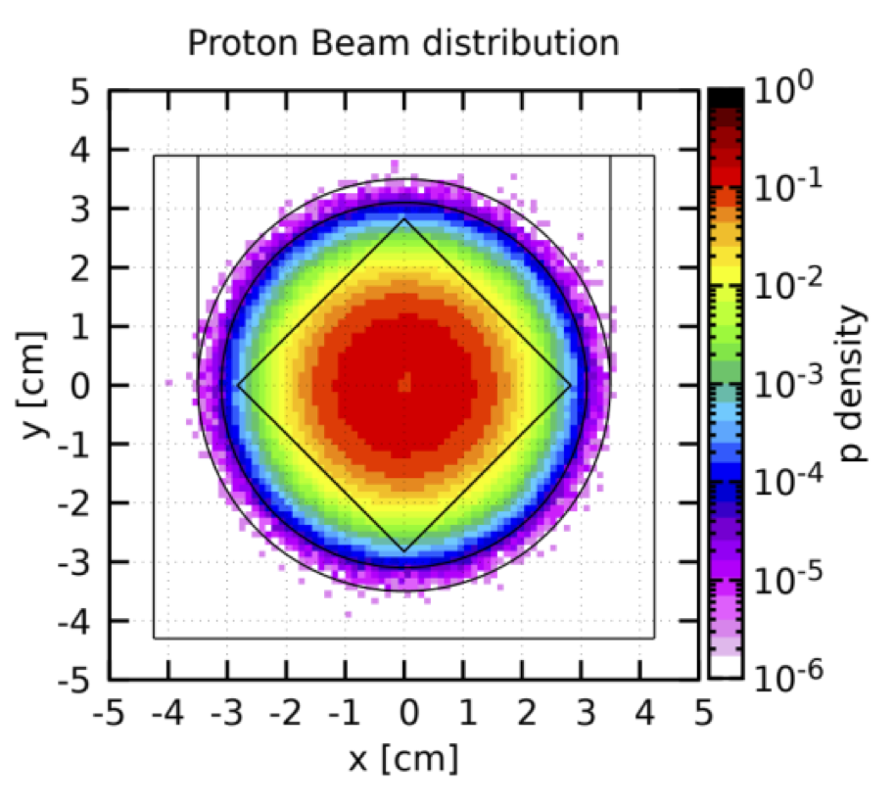
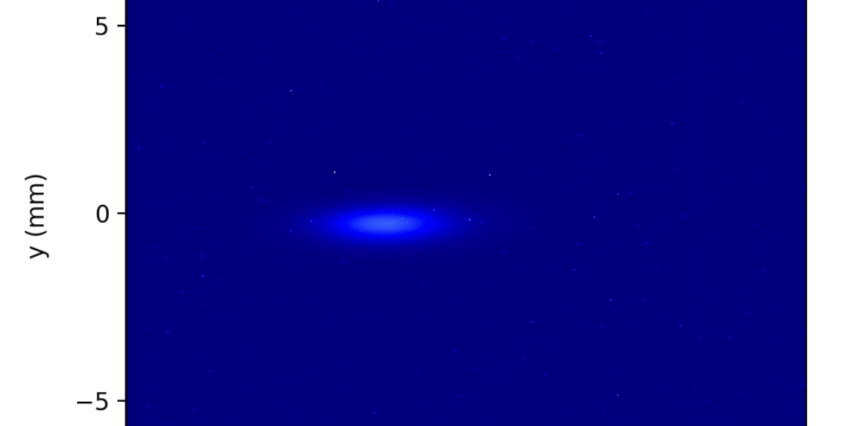
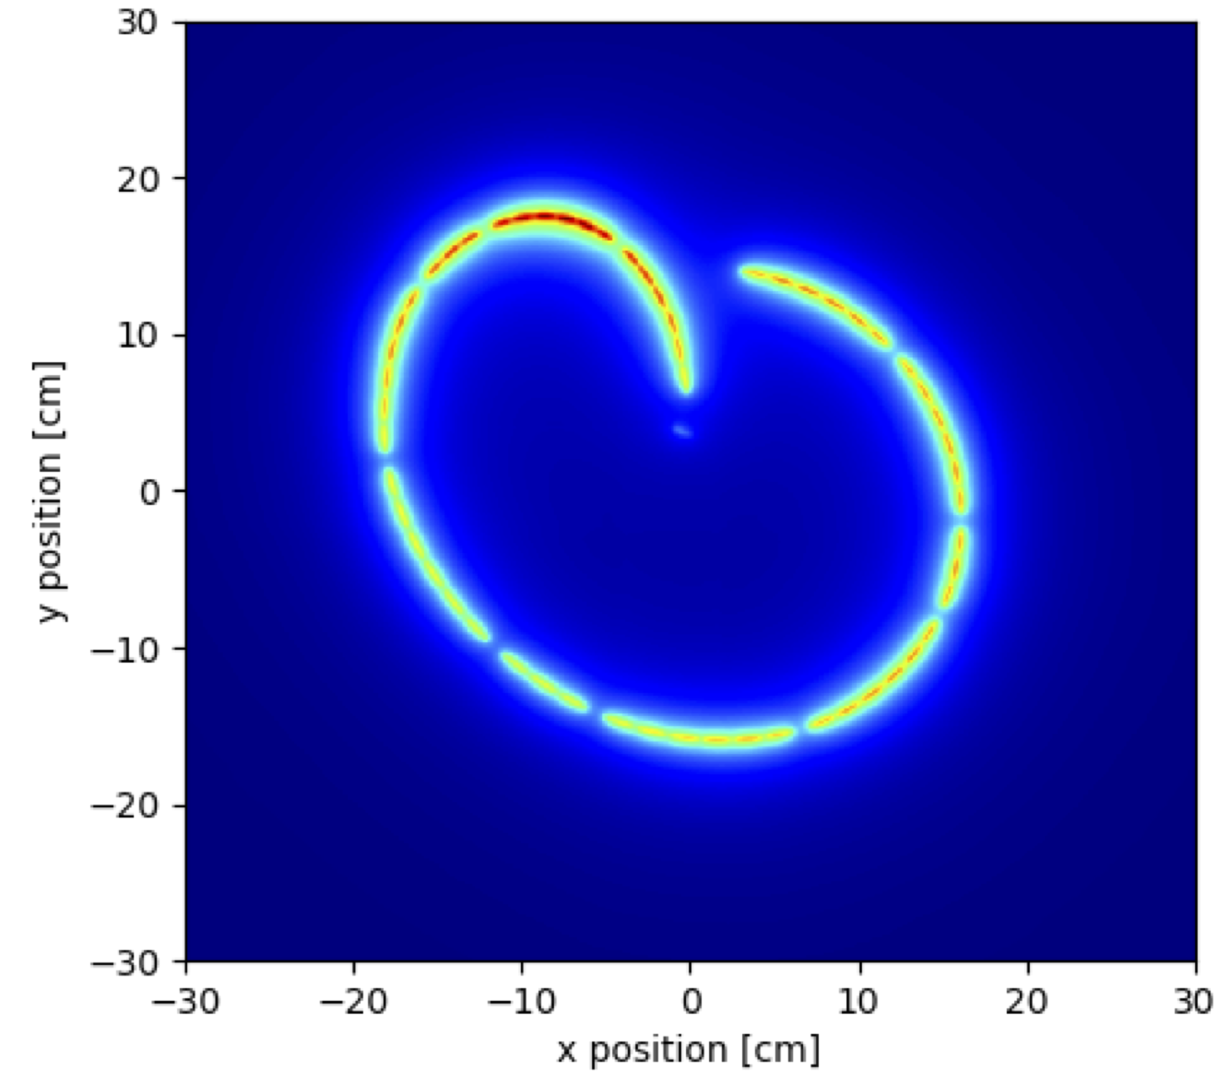
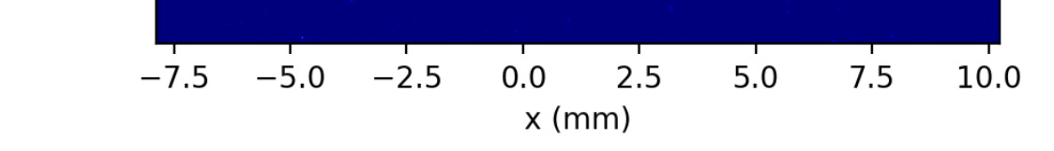
Knowledge of beam parameters impacting on BID
BID design parameters and constraints generally scale with particle peak intensity (e.g., protons per unit area)
Peak value can be highly dependent on the beam profile (e.g. gaussian, flat, or a combination, sweeps or rastered)

Slide 14
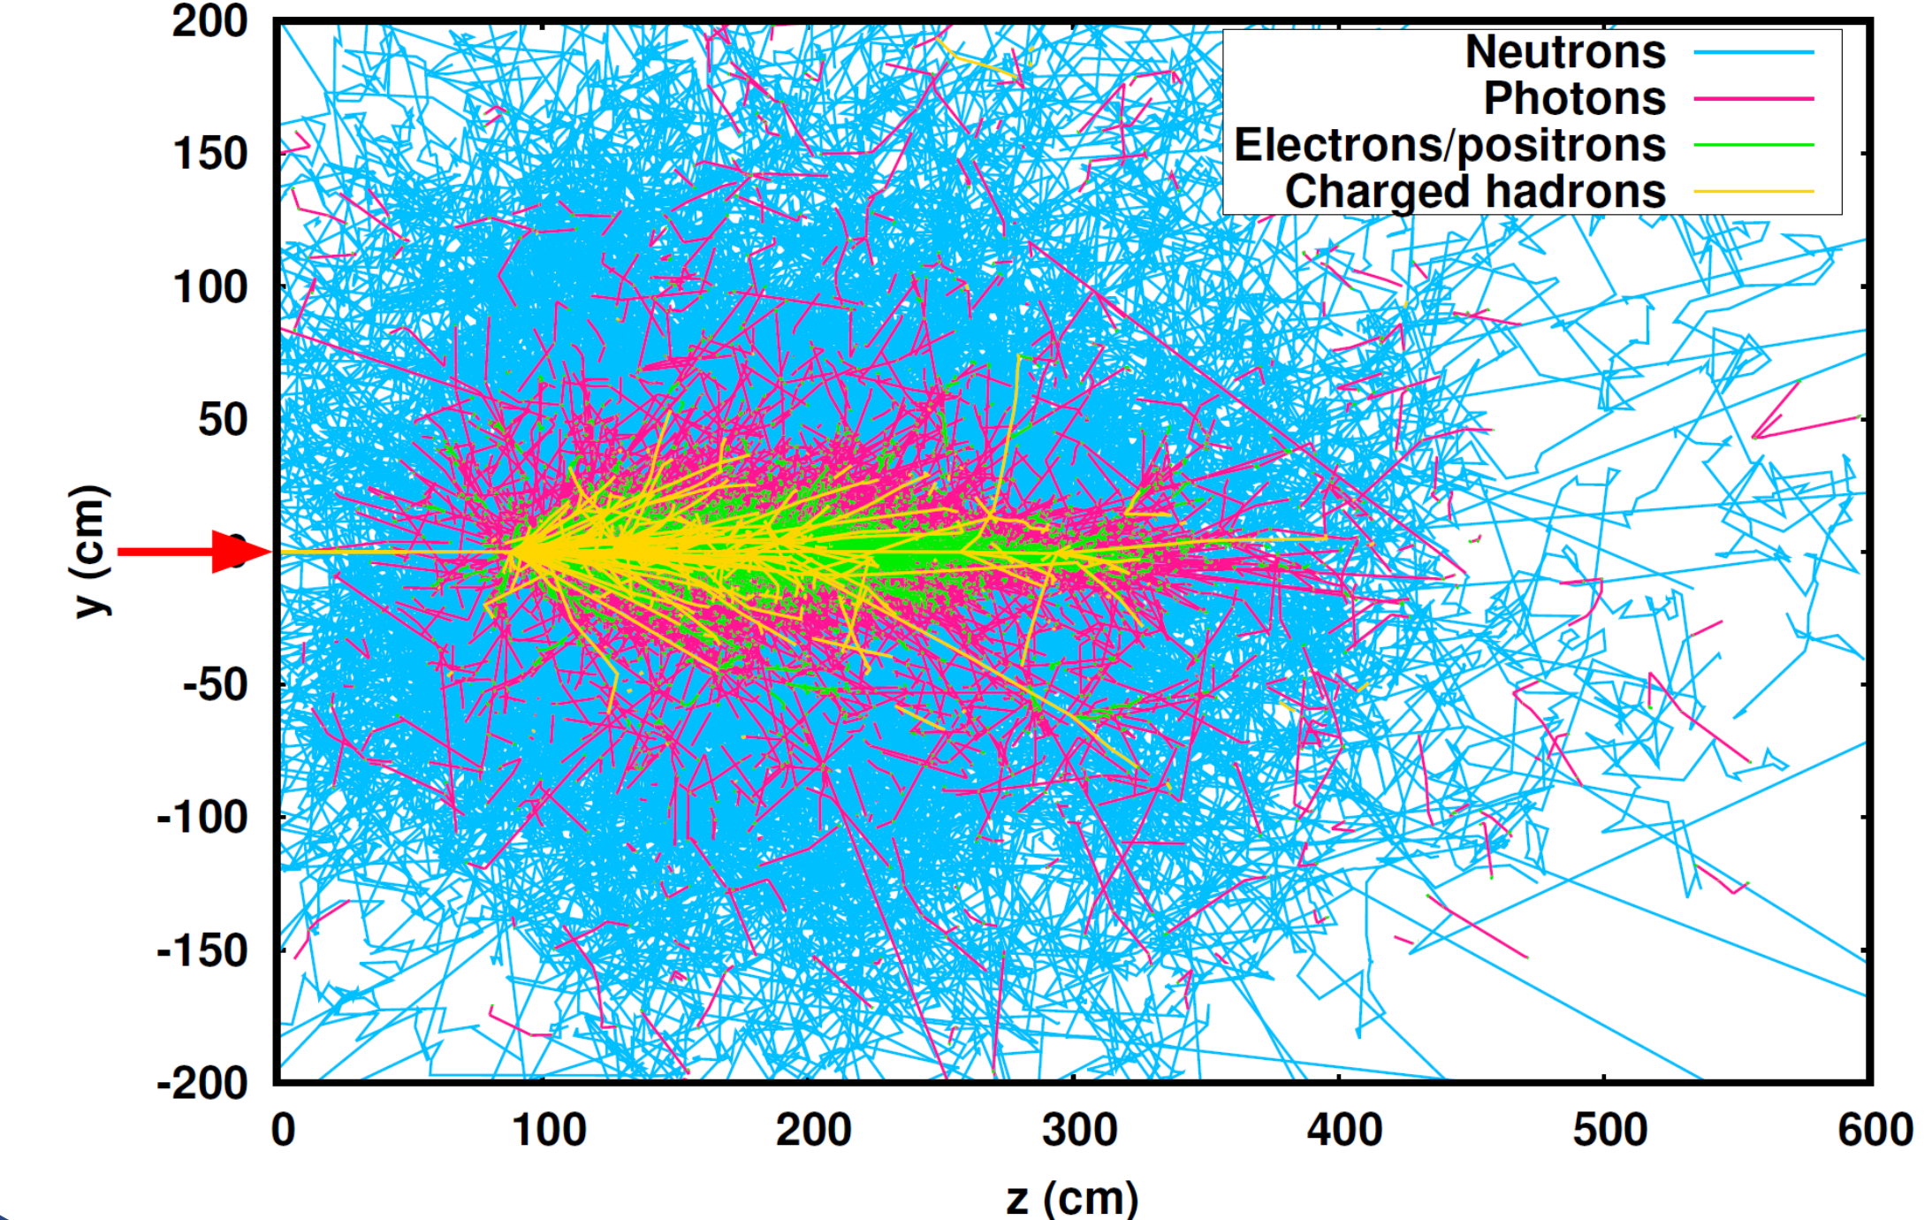
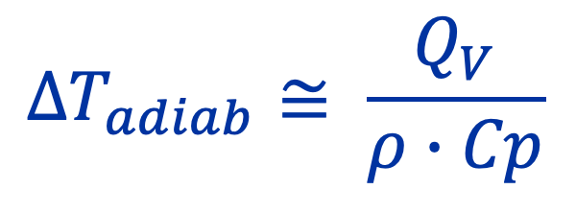
Beam-matter interaction simulations
Following material Coulomb interactions during the cascade, atoms & molecules vibrate and therefore T increase!
In engineering terms: part of the energy is lost in the BID and converted into thermal energy (heat!) – this occurs almost instantaneously
See presentation in this CAS by G. Lerner on 22/06
https://indi.to/6dFTv
Deposited energy (per unit volume)
[J cm⁻³]
$${ΔT}_{adiab}≅ \frac{Q_{V}}{ρ∙Cp}$$
Specific heat
[J g⁻¹ K⁻¹]
Density [g cm⁻³]
Courtesy A. Lechner
Notes:
In the adiabatic assumption, energy deposition shorter than diffusion time (e.g. microseconds)

Slide 15
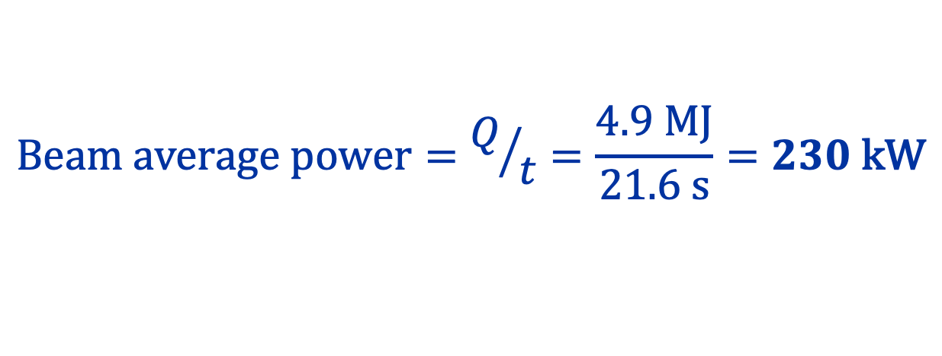
What are we talking about? SPS beam dump
A proton bunch has typical time duration of 1 ns
Pulses are constituted by bunches separated by tens of ns (25 ns)
$$\text{Beam} \text{kinetic} \text{energy}=n_{b} × I × E_{b}=288 × 2.4∙{10}^{11}×450=4.9\text{MJ}$$
Dumps (like targets) are made to sustain beam impacts repeatedly – in the case of SPS, every O(7.2) seconds
needs to be absorbed and dissipated!
$$\text{Beam} \text{average} \text{power}=Q/t=\frac{4.9 \text{MJ}}{21.6 \text{s}}=230 \text{kW}$$

Slide 16
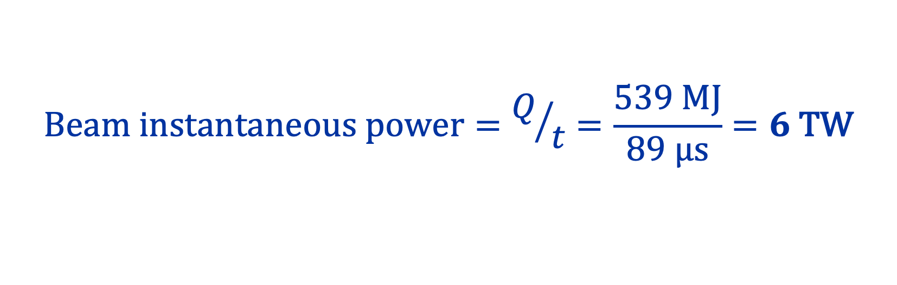

What are we talking about? LHC beam dump
Beam energy will be 6.8 TeV (6800 GeV) from 2022
N_{b} = 2748, with a bunch population up to 1.8x10¹¹
We will see tomorrow what are the effects of these quantities on large components and how to tackle them from an engineering standpoint
$$\text{Beam} \text{kinetic} \text{energy}=n_{b} × I × E_{b}=2748 × 1.8∙{10}^{11}× 6800=539 \text{MJ}$$
This is really a big value ☺
could melt 2.5 t of Cu
This enormous energy is deposited in 89 μs
$$\text{Beam} \text{instantaneous} \text{power}=Q/t=\frac{539 \text{MJ}}{89 \text{μs}}=6 \text{TW}$$

Slide 17
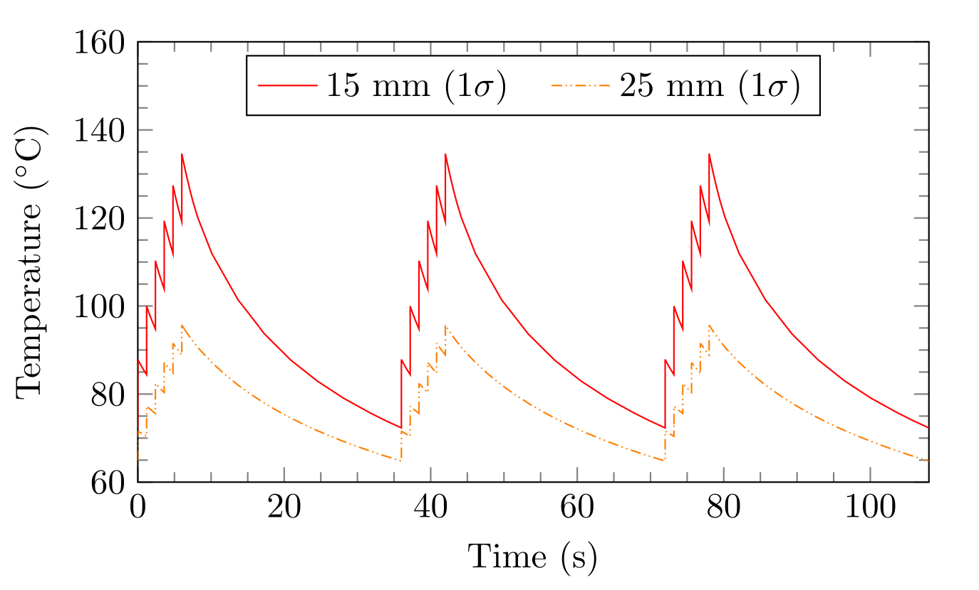
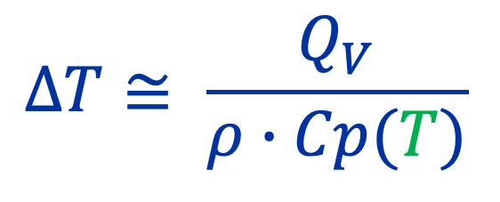
Thermal behaviour of BIDs
https://doi.org/10.1103/PhysRevAccelBeams.24.093001
For a pulsed beam, energy is generally deposited in a target material in a very short time
$$ΔT≅ \frac{Q_{V}}{ρ∙Cp(T)}$$
After the pulse, the energy diffuses through the material and the peak temperature drops
After several repeated pulses, the temperatures will rise until a “pseudo steady state” is reached ➔ quasi-static temperature profile

Slide 18
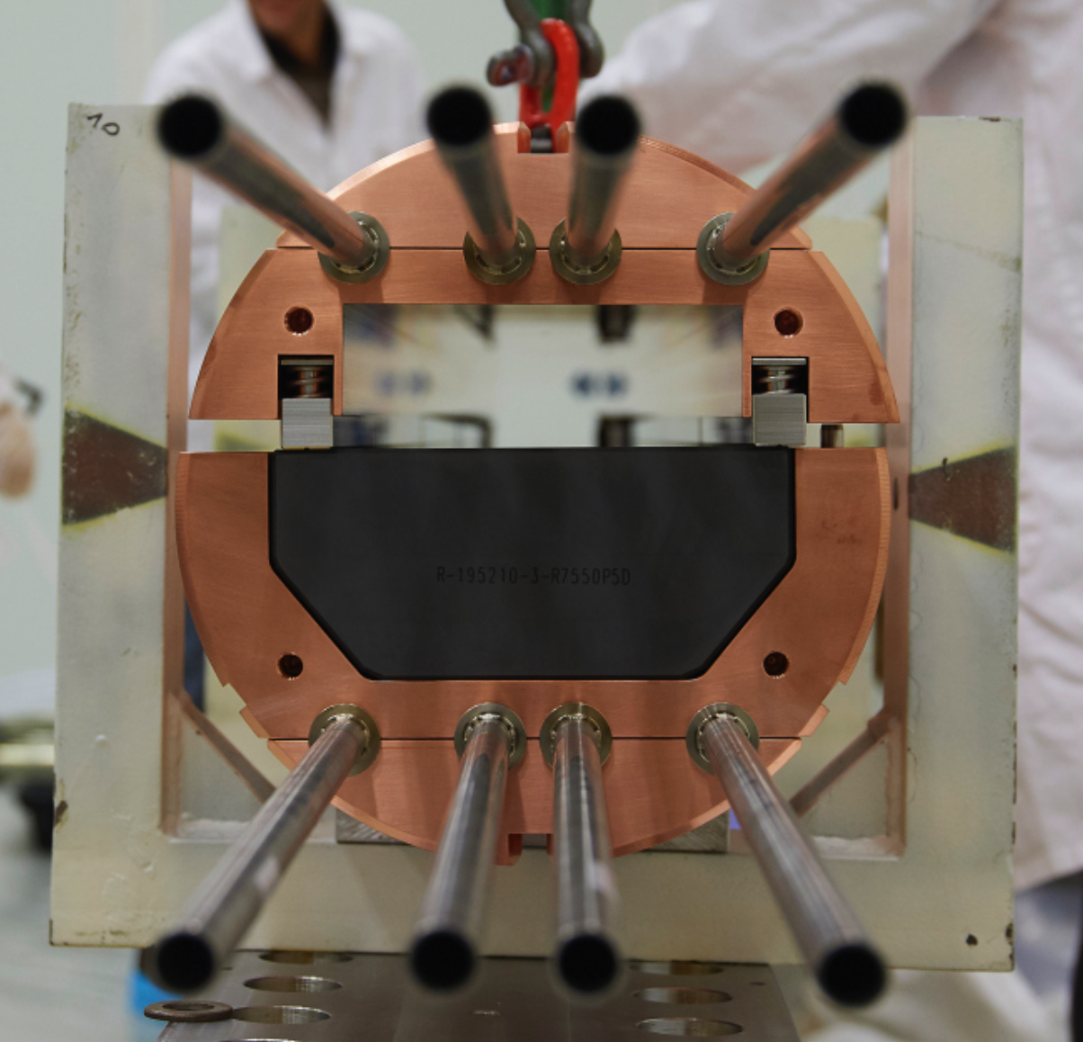

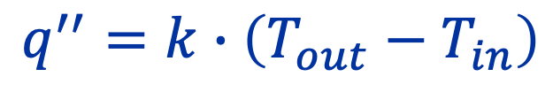
Heat diffusion mechanisms – conduction
Almost all BIDs use conduction to remove heat from heated volume to surface for cooling
Conduction is diffusion of heat via random molecular and/or atomic interactions
Heat conductivity
Heat flux
$$q^{′′}=k∙\left(T_{out}−T_{in}\right)$$
1st interface graphite/CuCrZr
2nd interface CuCrZr/316LN

Slide 19
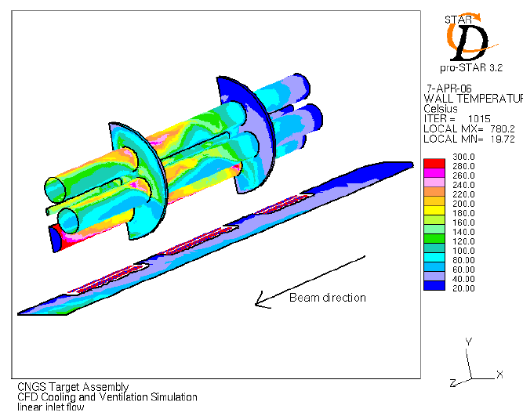
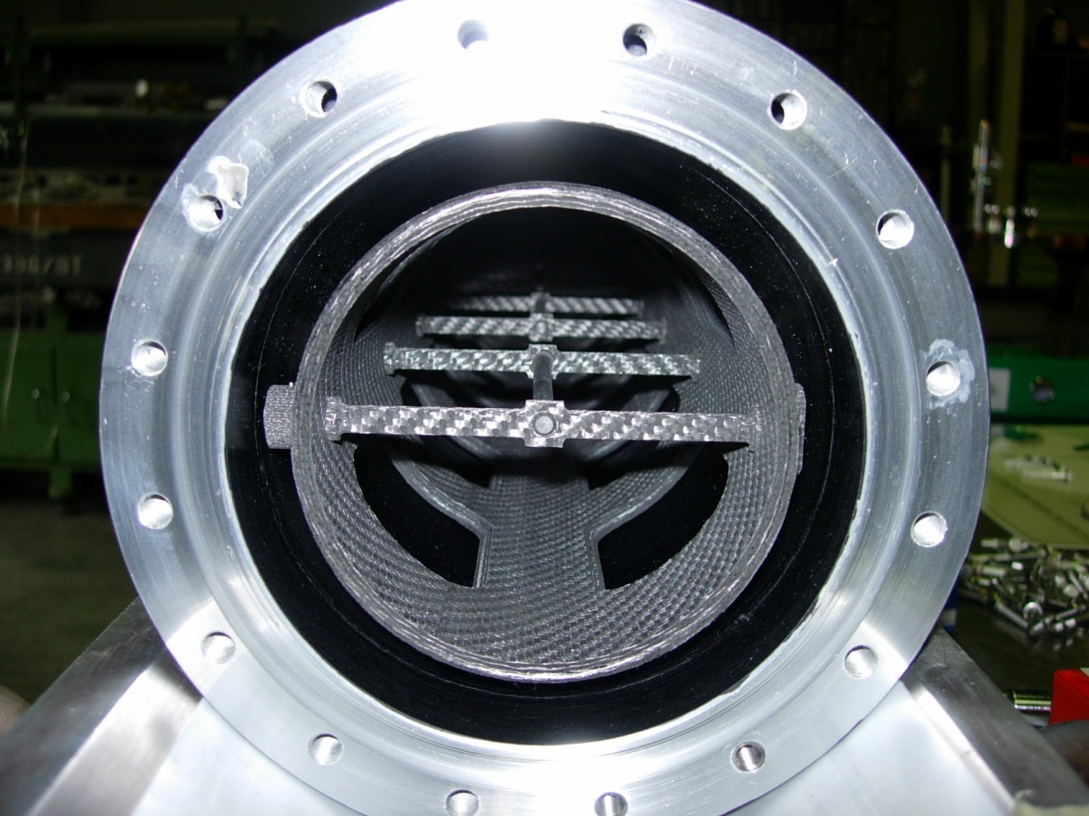
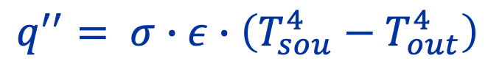
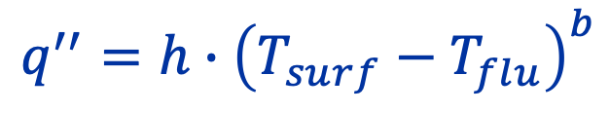
Other (conventional) heat transfer methods
HTC = heat transfer coefficient
Convection
Transfer heat from a surface into a fluid
Motion of the fluid & diffusion inside fluid
Radiative cooling
Via electromagnetic radiation → only effective at high T & ΔT
Convective boiling
E.g., hypervapotron systems
Not extensively employed in BIDs
$$q^{′′}=h∙{\left(T_{surf}−T_{flu}\right)}^{b}$$
$$q^{′′}= σ∙ε∙\left(T_{sou}^{4}−T_{out}^{4}\right)$$
Stefan-Boltzmann constant
emissivity
CNGS target

Slide 20
Selection of cooling methods for BIDs
Several considerations add up in the selection – all are related to each other and must be considered at the same time & links to material selection:
Operational requirements (what is the average power?)
Cooling requirements (heat removal, operating temperature)
Robustness (what are the risk associated with the cooling media)
Chemical reactions between fluid and material (corrosion, erosion, radiolysis)
Safety (radiological and conventional, water vs. air)

Slide 21
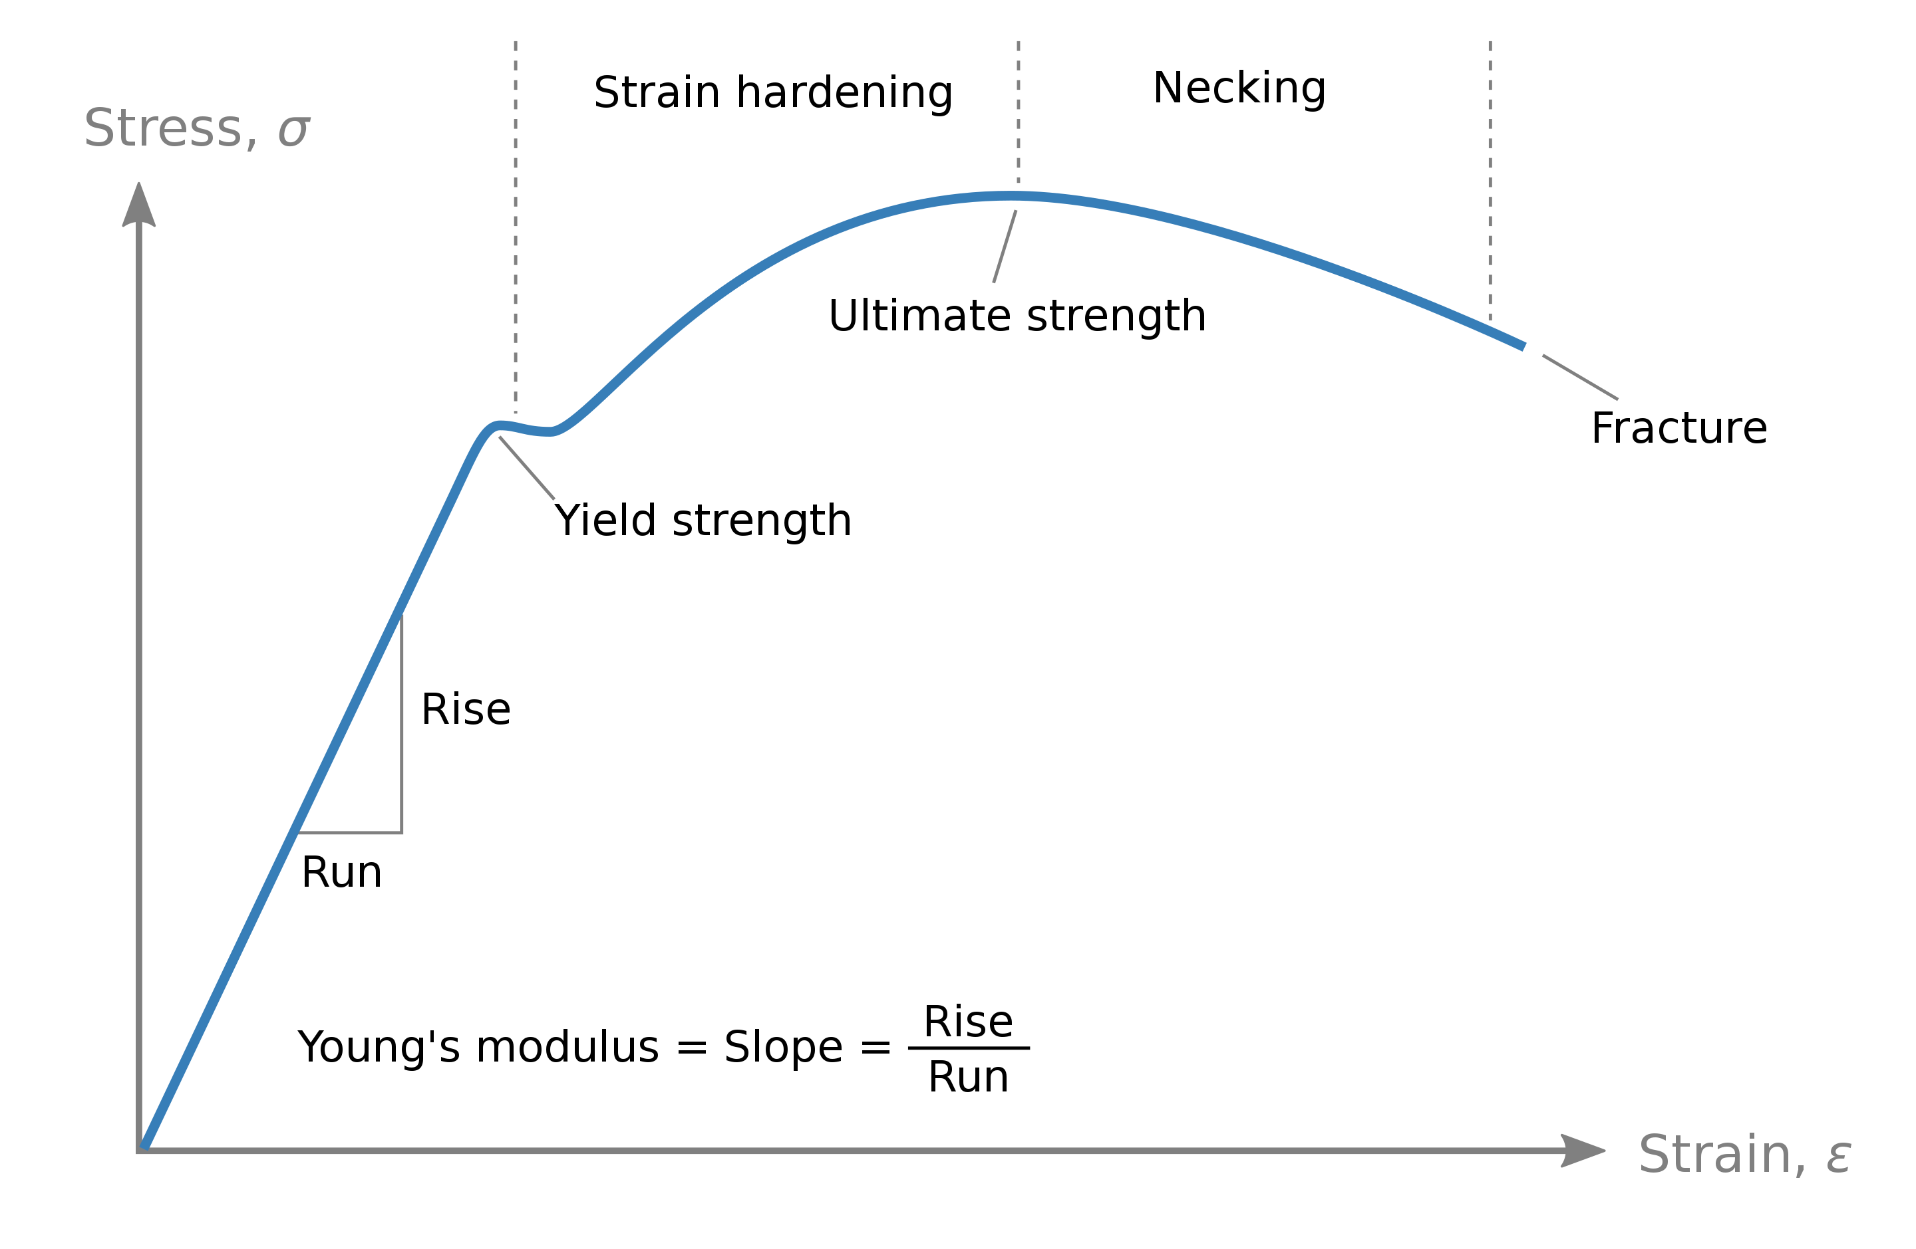
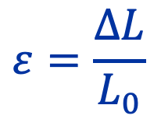
Basic mechanical property concepts
Young’s modulus describe a material stiffness (deformation for a given stress)
Material strength:
Yield
Ultimate
$$ε=\frac{ΔL}{L_{0}}$$
Relative deformation or change in shape and size of elastic or plastic nature under applied forces
We want typically BIDs to operate here
Notes:
In general we would like to have materials with low Young’s modulus, since deformation is determined by DeltaT while stress is proportional to the Y modulus.
However, materials with low E also have low yield, so we must find a compromise for all applications.

Slide 22
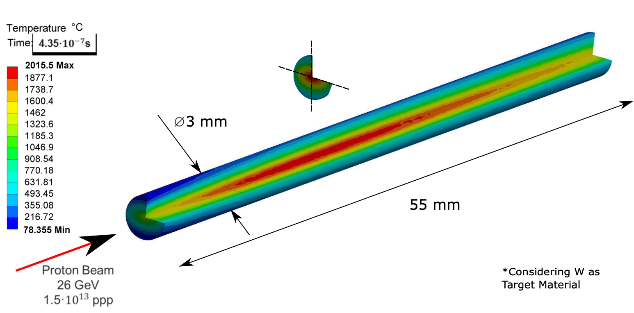
Finite Elements Methods for BIDs
Total stresses (force per unit area) inside a material can be generated by:
Mechanical loads
Thermal gradients (expansion)
Geometrical constraints
In BIDs, the main source of stress is generally the non-uniform temperature distribution generated by beam impact
Analytical methods exist for simple shapes, but generally dedicated codes are used (ANSYS, COMSOL, etc.)

Slide 23
Steps for Finite Element Modelling
Model setup
Geometry (e.g., from CAD) & definition of material properties (mostly varying with temperature) & mesh generation (important step)
Definition of loads (hence internal heat generation from MC codes) & boundary conditions
Thermal analysis (transient, steady-state…)
Structural analysis (static, dynamic)
Thermal-Structural coupling (complex analysis performed in some specific cases)

Slide 24
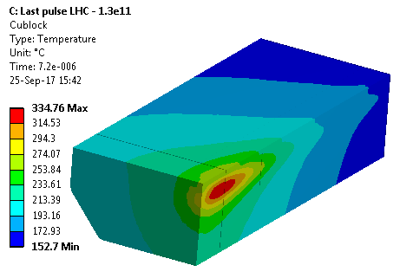
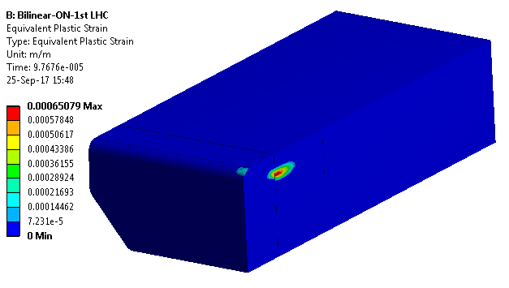
Example of material response
CuCr1Zr absorbing block from 4th generation SPS beam dump (see tomorrow)
T_{max}=335°C
~0.07% plastic deformation
T_{service CuCrZr}= 400°C
Yield strength= 280 MPa
Courtesy F.-X. Nuiry

Slide 25
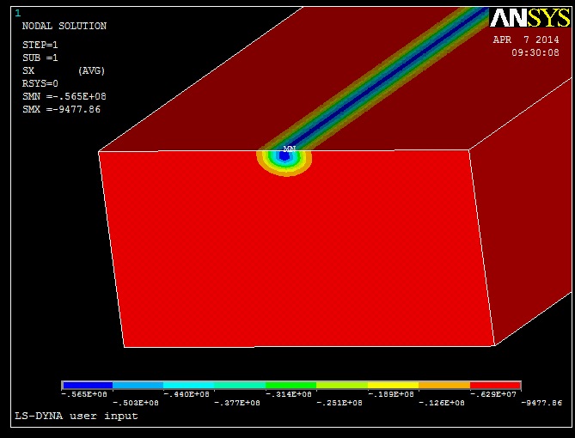

Example of material response
Elastic stress waves travelling at the speed of sound in the materials
Stiffness coefficient
$$c_{0}=\sqrt{\frac{K_{s}}{ρ}}$$
Density
Courtesy F.-X. Nuiry

Slide 26
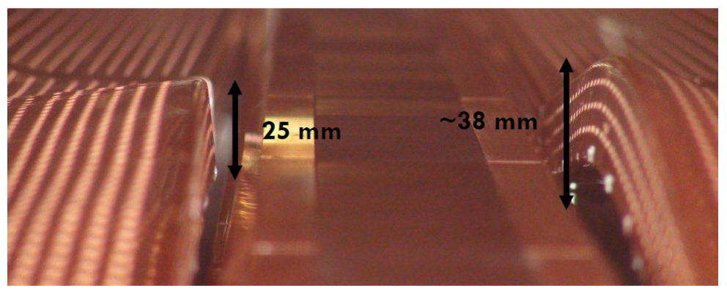
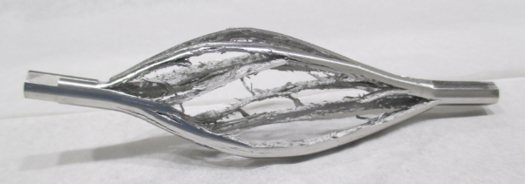
Dynamic regimes
BIDs for accelerators are generally designed to work in the elastic regime (deformation can recover) → reliability
Beam impact accidents (or even nominal operation) can provoke also permanent deformation of the component ➔ plastic regimes (irreversible damage)
Sometimes the effect is much more catastrophic, if instantaneous power is high enough ➔ quasi shockwave regime
Phys. Rev. Accel. Beams 22 013401 (2019)
Journal of Dynamic Behavior of Materials (2019) 5:266–295

Slide 27
Palette of absorbing materials employed at CERN
BIDs requires a variety of different materials, characterised by largely different parameters – some generalities of employed materials are reported
Graphitic materials (and CfC)
1-1.8 g/cm³
Aluminium alloys
2.7 g/cm³
Titanium & alloys
4.5 g/cm³
(Stainless) steels
7.5-8 g/cm³
Low CTE, good thermal conductivity, low ρ, very high service T, exceptional robustness to beam impact
Light structural materials, good thermal conductivity, low T_{m}, poor properties at high T
Exceptional strength while light, low CTE, low thermal conductivity
“king” of structural materials, low thermal conductivity

Slide 28
Palette of absorbing materials employed at CERN
Target material for pbars, poor mech. performances, very high ρ
Refractory metal, stable high, ductile, extreme corrosion resistance
Reasonably low CTE, relatively good strength
Mo-alloys and TZM
10.2 g/cm³
CuCrZr1 & Glidcop®
8.9 g/cm³
Tantalum
16.6 g/cm³
Tungsten and alloys
18-19.3 g/cm³
Lead
11.3 g/cm³
Iridium
22.6 g/cm³
Very good heat conductivity, good strength and stability at high T
Target material for neutron production, very low T_{m}, almost negligible strength
High ρ and related absorption power, alloyed-W has good machinability
Notes:
Glidcop is a family of copper-based metal matrix composite (MMC) alloys mixed primarily with small amounts of aluminium oxide ceramic particles
The aluminum oxide particles block dislocation creep, which retards recrystallization and prevents grain growth; thus preserving the metal's strength at high temperatures. They also protect the metal against radiation damage.[3] On the other hand, they exclude the possibly of heat treatment or hot working of the worked parts.

Slide 29
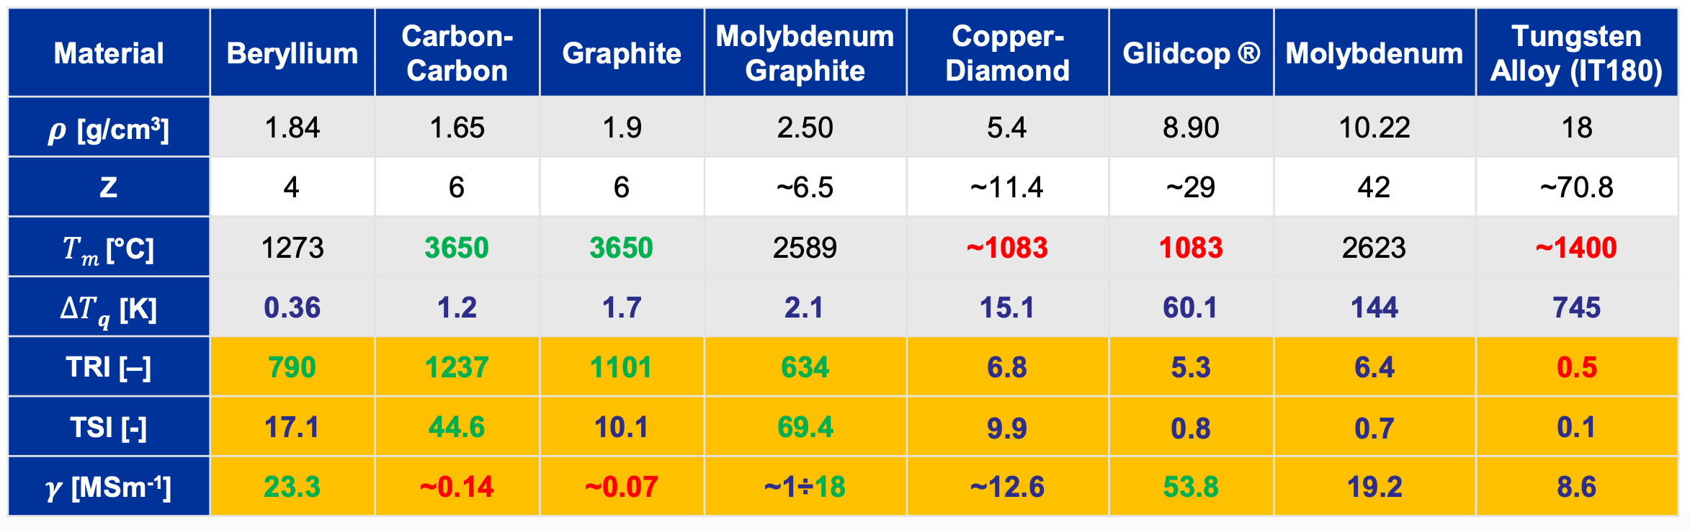
Figure of Merits
From: A. Bertarelli, Joint International Accelerator School (2014)
TSI = Thermal Stability Index
TRI = Thermomechanical Robustness Index

Slide 30

Selection for absorbing materials for BIDs
Physics requirements
Functional reliability / integrity
Operational safety (for personnel and machine)

Slide 31
Targets - Physics requirements
Different type of sources depending on experiments:
“Point-like” source (e.g., antiproton production), very dense with small physical dimensions
Massive target acting as dump (e.g., neutron production)
Long, narrow target (e.g., neutrino production), low density but several nuclear inelastic lengths
Refractory metals (e.g., RIB production), need to be heated “externally” to maximize effusion
Fusion-like neutron sources (14 MeV) need for example deuterons on Li target
Medical isotope production & harvesting (from U, water, etc.)
Constant iterations between physicists and engineers to find the right compromise between availability/reliability and physics output

Slide 32
Functional reliability / integrity
BIDs not to get damaged under load!
Strength, fatigue, cooling performance
Erosion, corrosion, wear
High temperature, high strain-rate performance
Complexity, repairability, repeatability, Quality Assurance
If special materials are employed, make sure it is available 5/10/15 years later (e.g. for refurbishments/replacements)

Slide 33
Operational safety
Safety critical components vs. replaceable components
Some components in a target facility are replaceable, hence expected to fail at a certain rate, posing little safety risk (e.g., pbar target)
Some components are part of a safety matrix (especially for personnel protection) (e.g., beam stoppers)
QA and conservative choices should be increased for safety critical components
Safety critical components should be “damage tolerant”, especially in the case of off-normal events. In these cases, ductility (ability to plastically deform without fracture) is highly desirable

Slide 34
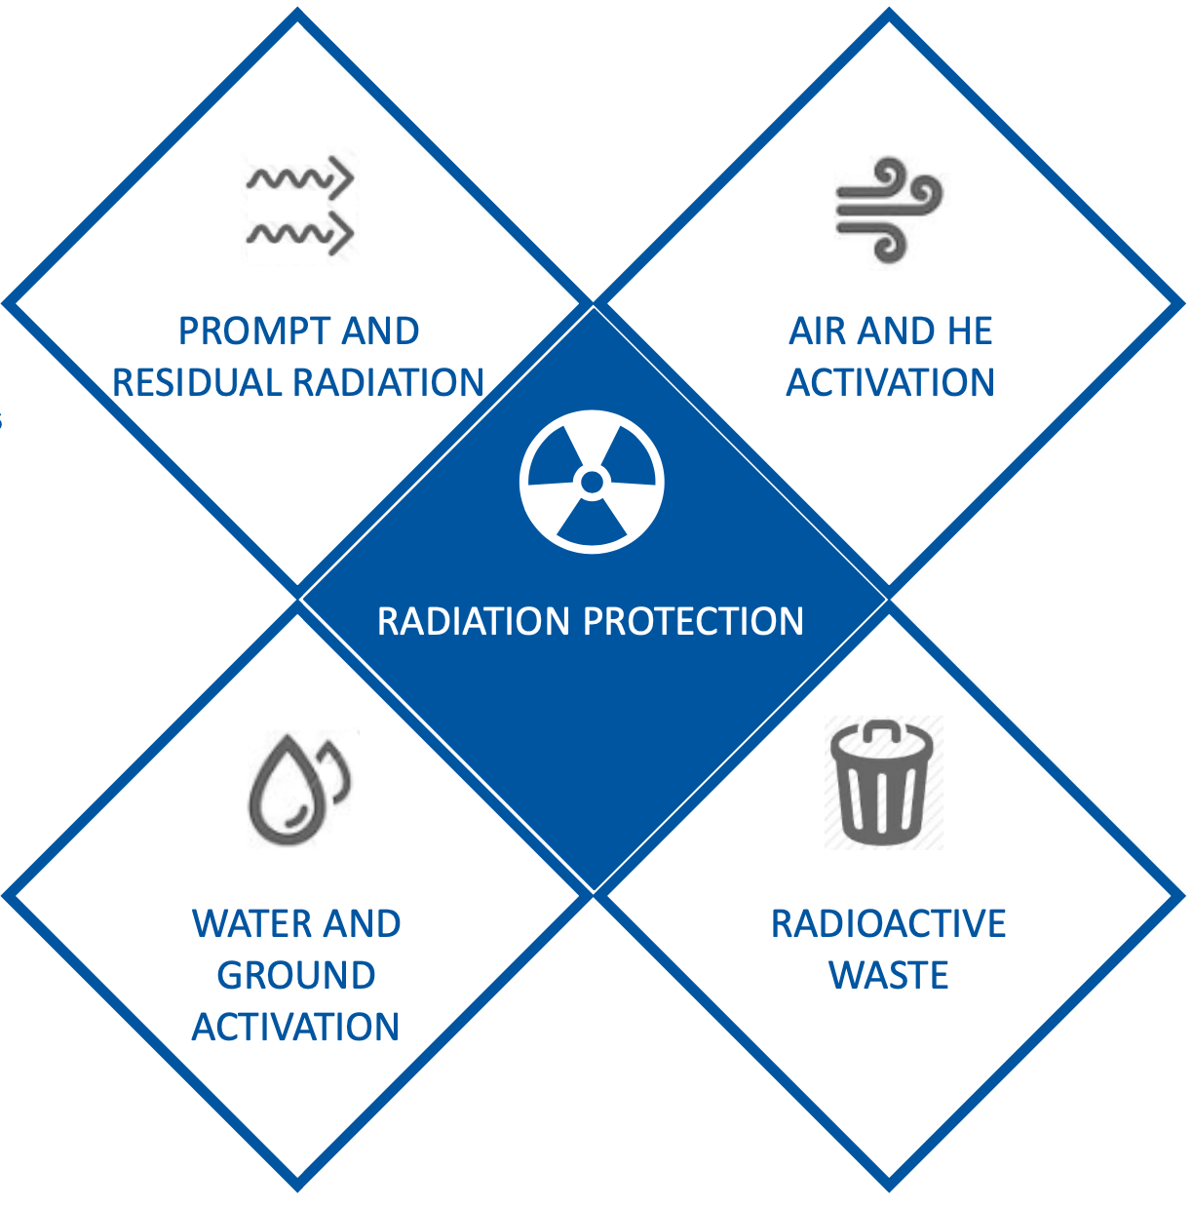
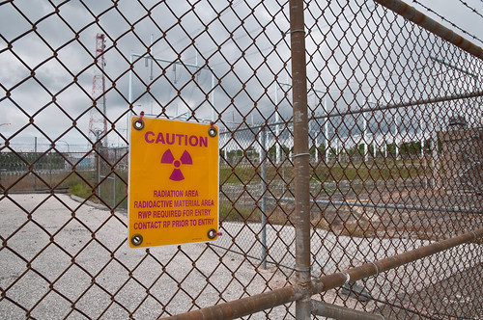
Radiation protection considerations
Radiation protection considerations are essential in the design iteration of beam intercepting devices – impact on
Operation – for intervention, exposure to personnel, downtime
Radioactive waste - long-term disposal & design must (start to) be part of the items to think to from the very beginning
General principles (when possible!):
Low activation materials (e.g., low-Co stainless steels)
Toxic materials to be avoided (beryllium, Pb)
Safe disposal

Slide 35
Ultra High Vacuum design for BIDs
As for other components that are installed in the machine’s Ultra High Vacuum, BIDs must also comply to requirements of UHV
Additional challenges for BIDs are generated by:
Movable parts, no lubrification allowed → not compatible with UHV
High temperatures during beam impact → increase outgassing
Use of graphitic materials → tendency to absorb and release gasses (outgassing issues)
QA steps and careful control of design processes is a fundamental aspects of BIDs design, construction and reliable operation

Slide 36
Ultra High Vacuum design for BIDs
Vacuum criteria
Leak tightness
(e.g. 1·10⁻¹⁰ mbar∙l∙s⁻¹)
Contamination
(hydrocarbons, CO/CO₂, higher Z – from cleaning or poor design)
Outgassing (from internal components)
(e.g. threshold 10⁻⁷ mbar∙l∙s⁻¹)
Virtual leaks (e.g. trapped pockets of gas)
(< 5∙10⁻⁹ mbar∙l∙s⁻¹)

Slide 37
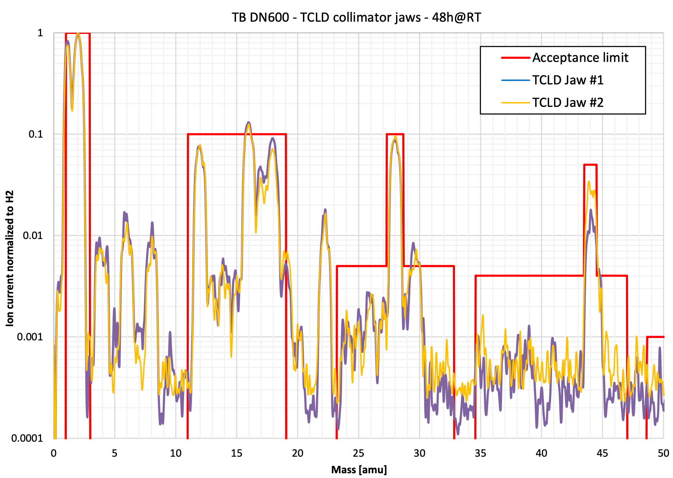
Residual Gas Analysis spectrum for a collimator jaw
48 hours at room T after a bake-out cycle at 250°C
Gas-rates normalized to H₂ and respective limits for different gas species
CH₄
CO
H₂O
CO₂

Slide 38
Beam impact experimental testing and validation
Validation of design often include the possibility of testing components or integral devices under beam impact
Sometimes devices and materials operate at the extreme – uncharted territory of temperature and stress (where EOS are not available)
Existing material constitutive models at extreme conditions are limited and mostly drawn from military research (e.g. Ta, Ir).
Dedicated tests allows for numerical vs. experimental cross-check

Slide 39
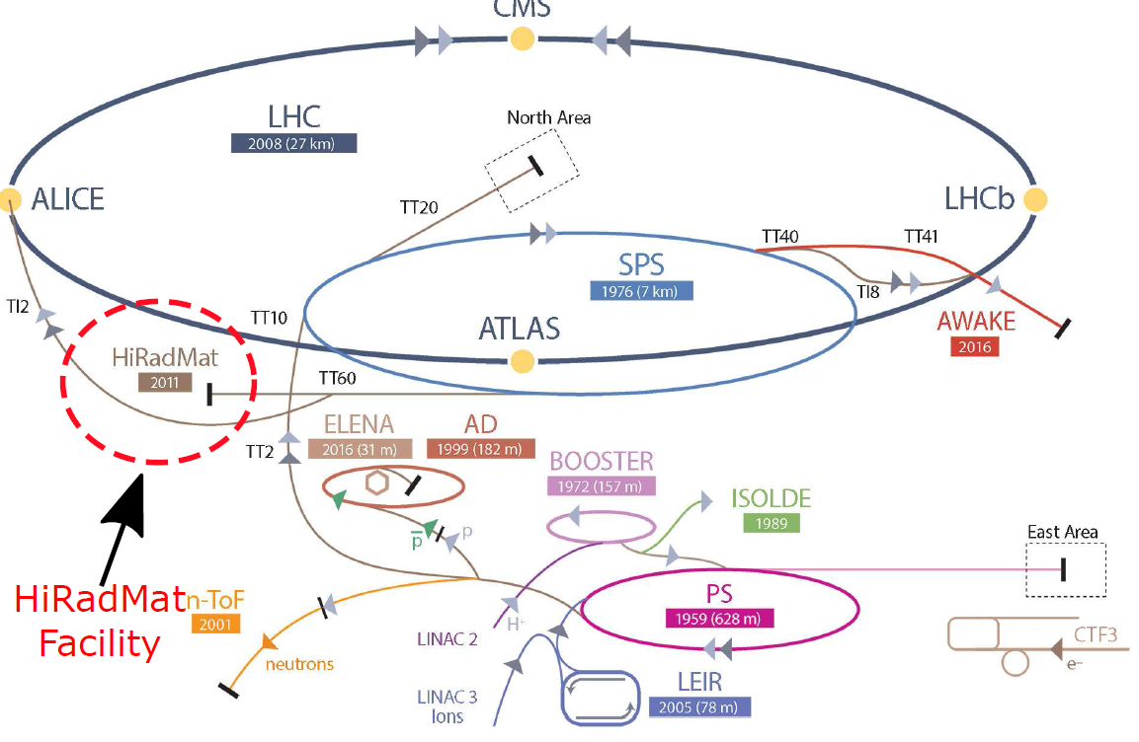
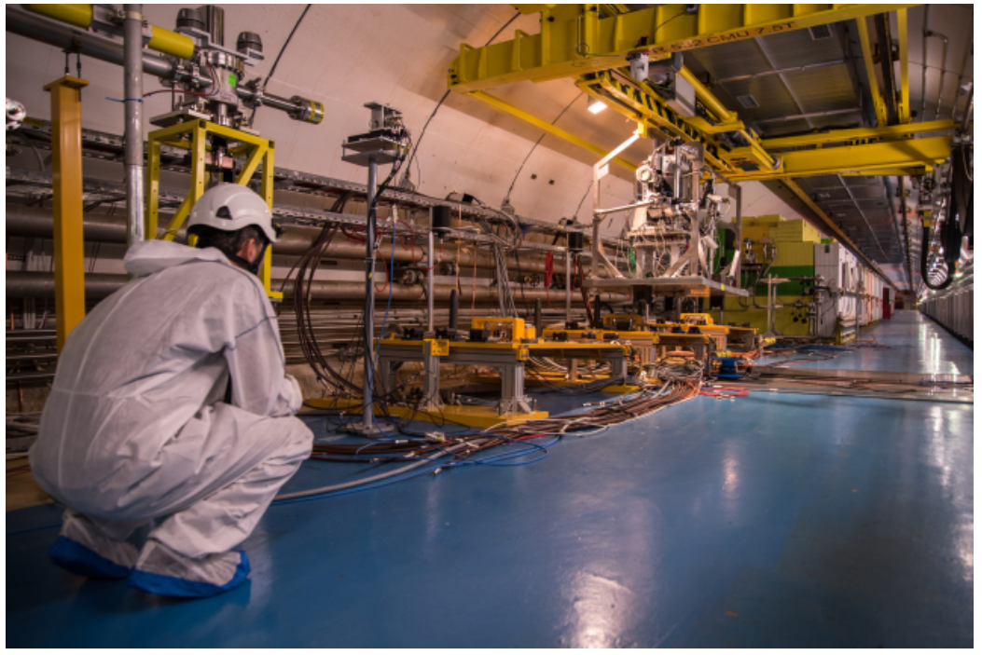
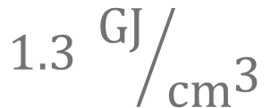
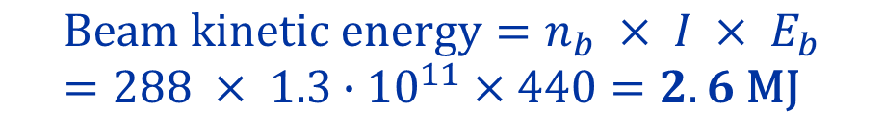
Integral and material testing at CERN HiRadMat facility
Dedicated facility for studying the impact of intense pulsed beams on materials
440 GeV/c, up to 288 bunches, 1.3*10¹¹ ppb
Pulse length: 5 ns – 7.2 μs
Beam radius: 0.25 mm – 4 mm
$$\text{Beam} \text{kinetic} \text{energy}=n_{b} × I × E_{b}=288 × 1.3∙{10}^{11}×440=2.6 \text{MJ}$$
$$1.3 {\text{GJ}}/{{\text{cm}}^{\text{3}}}$$
J. Phys.: Conf. Ser. 1350 012162

Slide 40
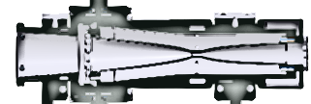
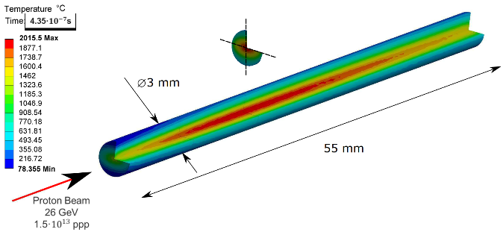
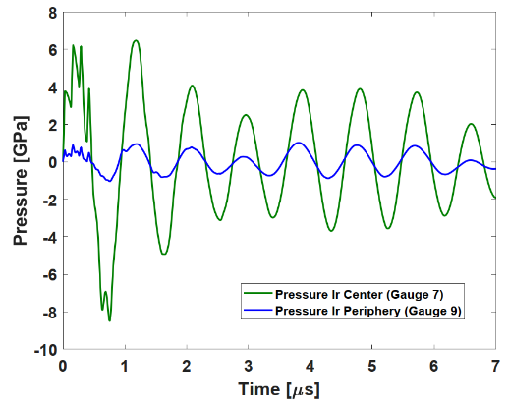


Application of HiRadMat to antiproton production
HORN
Antiprotons
$$\overline{p}$$
Efficient pbar production requires maximizing interaction in a short distance
AD-T core made of Ir (22.3 g/cm³), 3 mm diameter, 55 mm length
2000 ºC in 0.43 μs
TARGET CORE
Extreme dynamic response!
$${\dot{ε}}_{max}≈5∙{10}^{4} {\text{s}}^{−1}$$
Phys. Rev. Accel. Beams 19, 073402 (2016)

Slide 41
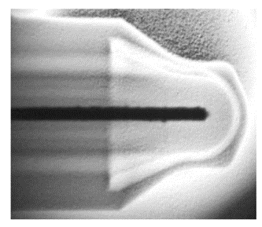
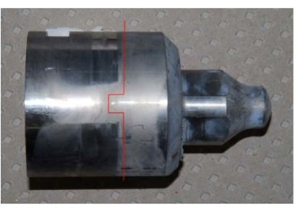
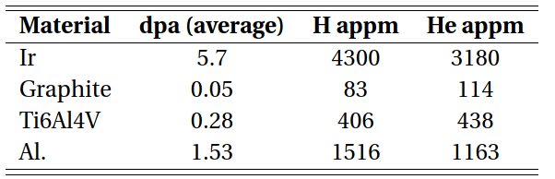
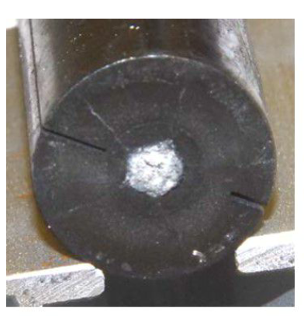
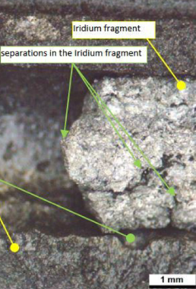
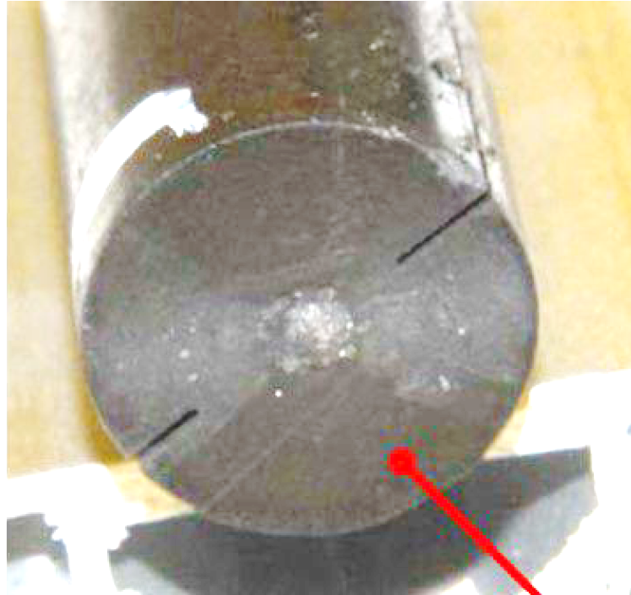
Relevance of post-irradiation examination
Irradiated AD-target (2000-2008), 1.6*10¹⁹ POT
ESTIMATED DPA
Upstream face
Mid face
Iridium core is an amalgam of broken, melted & re-solidified fragments
Cracks in the graphite matrix also observed

Slide 42
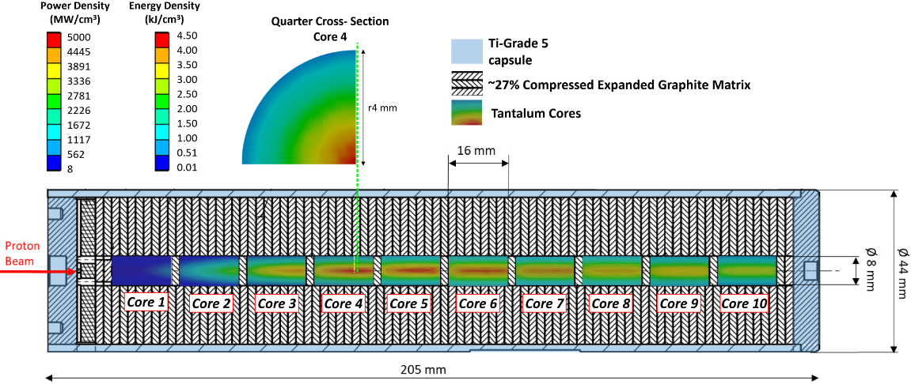
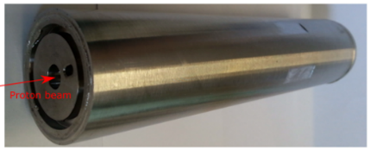
Application of HiRadMat to antiproton production
Target Core made of 10x Ta rods (un-annealed) 8 mm ⌀ by 16 mm in length
Embedded in a matrix made of compressed layers of Expanded Graphite (EG)
Encapsulated in Ti-6V-4Al e-beam welded container
x49 pulses impacted (ΔT_{max}/pulse = 1800 ºC)
Reliance on post-irradiation examination
Phys. Rev. Accel. Beams 21, 073001 (2018)

Slide 43
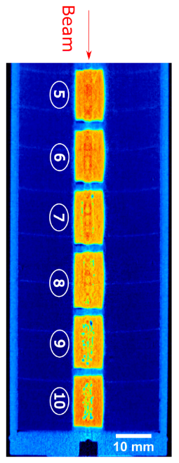
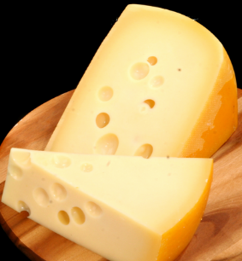
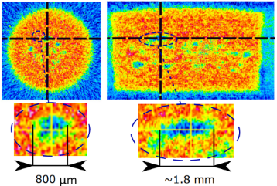
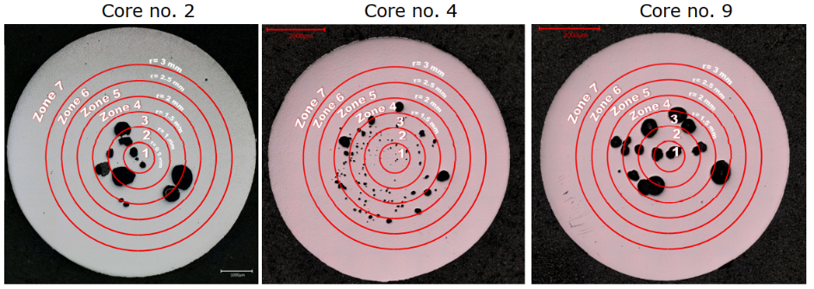
Post Irradiation Examination of Ta-irradiated sample
Neutron Tomography @PSI (NEUTRA)
Target opening and slicing cores at CERN
Observation of spalling voids
Tensile pressure shall be kept <2-3 GPa to avoid void nucleation
Phys. Rev. Accel. Beams 21, 073001 (2018)
European Journal of Mechanics / A Solids 85 (2021) 104149

Slide 44
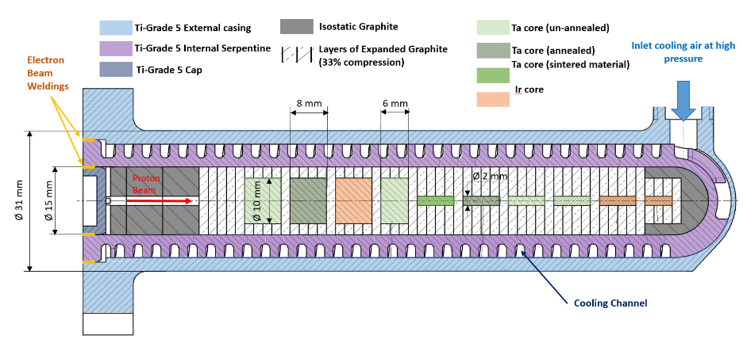
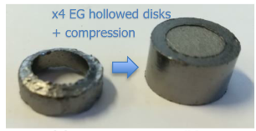

Application of HiRadMat to antiproton production New target design
Air cooled target
Sliced core, with different diameter and length
Matrix of different graphitic materials
Courtesy C. Torregrosa

Slide 45

Application of HiRadMat to antiproton production New target design – tested at HiRadMat
Courtesy C. Torregrosa

Slide 46




Application of HiRadMat to antiproton production Some results
Extensive Longitudinal cracks
Ø3 mm
Material displacement along the face
Longitudinal cracks in the isostatic-graphite matrix!
Courtesy C. Torregrosa

Slide 47





Application of HiRadMat to antiproton production Some results
Good behaviour of advanced materials
TFGR W-TiC in two different configurations
Courtesy C. Torregrosa

Slide 48
Long-term radiation damage
Irradiation of materials by particles causes microstructural defects (atomic displacements & transmutation products) → in turn creates macroscopic effects
Related to:
Ionizing energy losses/heating (i.e. electron stopping power)
Non-ionizing energy losses (energy transfer to atomic nuclei → displacement damage)
Gas production (mostly due to protons, ²H, ³H, ³He and alphas stopping in the target)
Additional variable to consider in the design of beam intercepting devices, especially targets and beam windows

Slide 49


Long-term radiation damage Thermo-physical effects
Embrittlement, creep, sweeling, fracture toughness reduction, thermal and electrical resistivity reduction, CTE, young’s modulus, transmutation products, etc.
Dependent on particle type, energy and rate of irradiation
10x reduction at 0.02 DPA
S. A. Malloy, et al., Journal of Nuclear Material, 2005. (LANSCE irradiations)
N. Maruyama and M. Harayama, “Neutron irradiation effect on … graphite materials,” Journal of Nuclear Materials, 195, 44-50 (1992)

Slide 50
Displacement per Atom
Is a measure of the amount of radiation damage in irradiated materials
For example, 3 DPA means each atom in the material has been displaced from its site within the structural lattice of the material an average of 3 times
Displacement damage can be induced by all particles produced in the hadronic cascade, including high energy photons, albeit on a smaller scale → directly related to energy transfers to atomic nuclei
Does not account for thermal annealing after the initial cascade and subsequent recombination
NB: it cannot be measured, only estimated via Monte Carlo codes (FLUKA, MARS, PHITS, etc.)

Slide 51




How can we test materials?
30 MeV (C-slot)
68 MeV
93 MeV
110 MeV
RbCl 2
RbCl 1
Proton beam
Target basket
Cooling water
BLIP irradiation @Brookhaven National Laboratory
Capsules containing graphitic materials irradiated at 0.1 DPA
Courtesy K. Doyhun (BNL) & N. Solieri (CERN)

Slide 52




Challenges of post-irradiation examination
Irradiation capsule are extremely radioactive, need a dedicated hot-cell and expertise to handle the samples
Mo-coated MoGR samples
Ta2.5W samples
Preliminary results indicate good adhesion of Mo-coating on graphitic materials, with hardening of bulk
Mo-coated CfC sample

Slide 53

Challenges for the future
Courtesy A. Lechner

Slide 54
Conclusions
Beam Intercepting Devices are multi-physics, multi-expertise systems combining challenging requirements
Reliable construction depends on a delicate balance of different requirements and constraints
Operational experience is a key aspect in the feedback loop – example of CERN’s devices in Lecture 2

