Slide 1
Case study: Impedance
Sergio Calatroni, Benoît Salvant, Chiara Antuono, Patrick Krkotić – CERN
With many thanks to Nicolas Mounet, David Amorim, Elena de la Fuente Garcia, Ingrid Mases Sole

Slide 2
Tutorial
Goals
  Get acquainted with the main concepts related to beam impedance effects on vacuum components
  Understand the effect of different materials, and different geometries
Means
  Experimental measurements with Vector Network Analyser (VNA):
    Dielectric resonator to test different materials and coatings
    Plug-In Module (PIM), RF finger bridge across LHC vacuum beam screen
  Short explanations of theoretical background
The students are divided in two groups:
  One group here, the other with Benoit Salvant for the second half of the case study, on numerical simulations

Slide 3
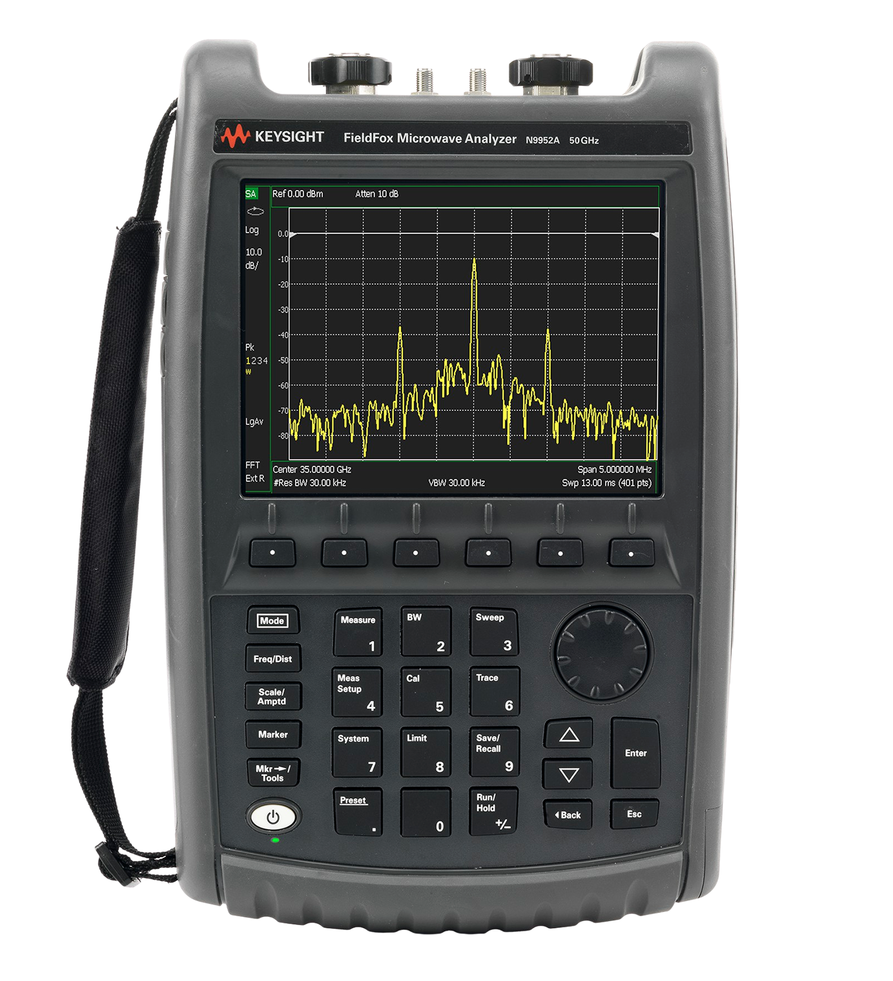
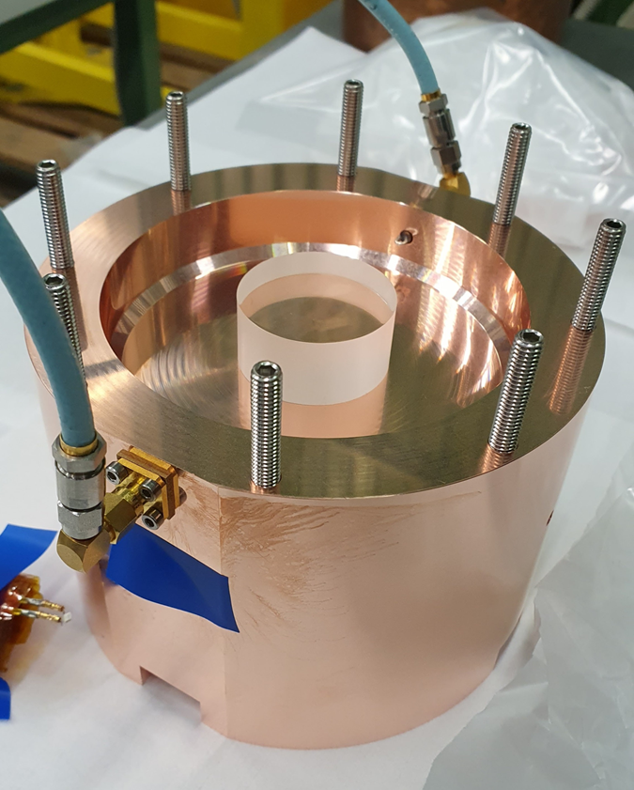
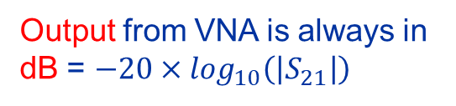

Dielectric resonator measurement at 3.4 GHz
Port 1
Forward power
Port 2 Transmitted power
Focus on S₂₁ (i.e. S_{2←1}), ratio of amplitudes of signals going from port 1 into port 2, in a frequency sweep
$S_{21}=\frac{a_{2}}{a_{1}}=\frac{a_{Transmitted}}{a_{Forward}}$
Output from VNA is always in dB = $−20×\log_{10}\left(\left|S_{21}\right|\right)$
We will measure the quality factor Q₀ of the resonance

Slide 4
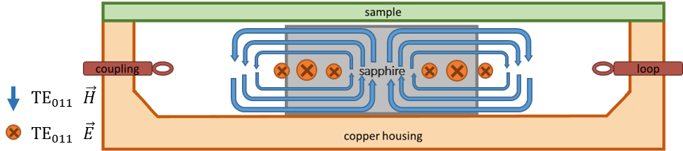
Dielectric resonator measurement at 3.4 GHz

Slide 5
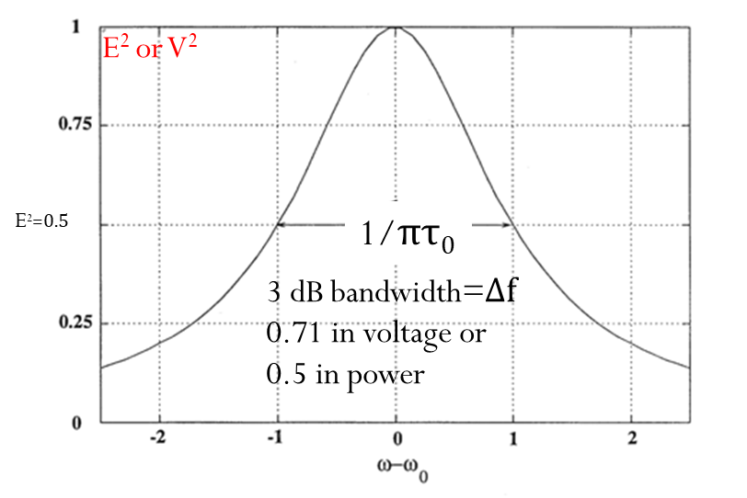
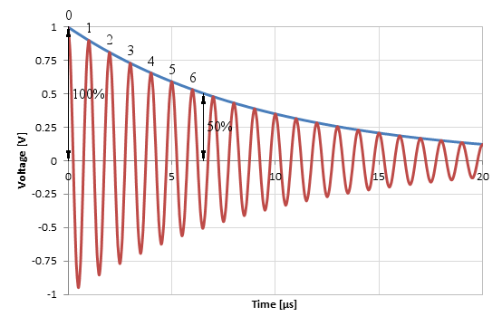
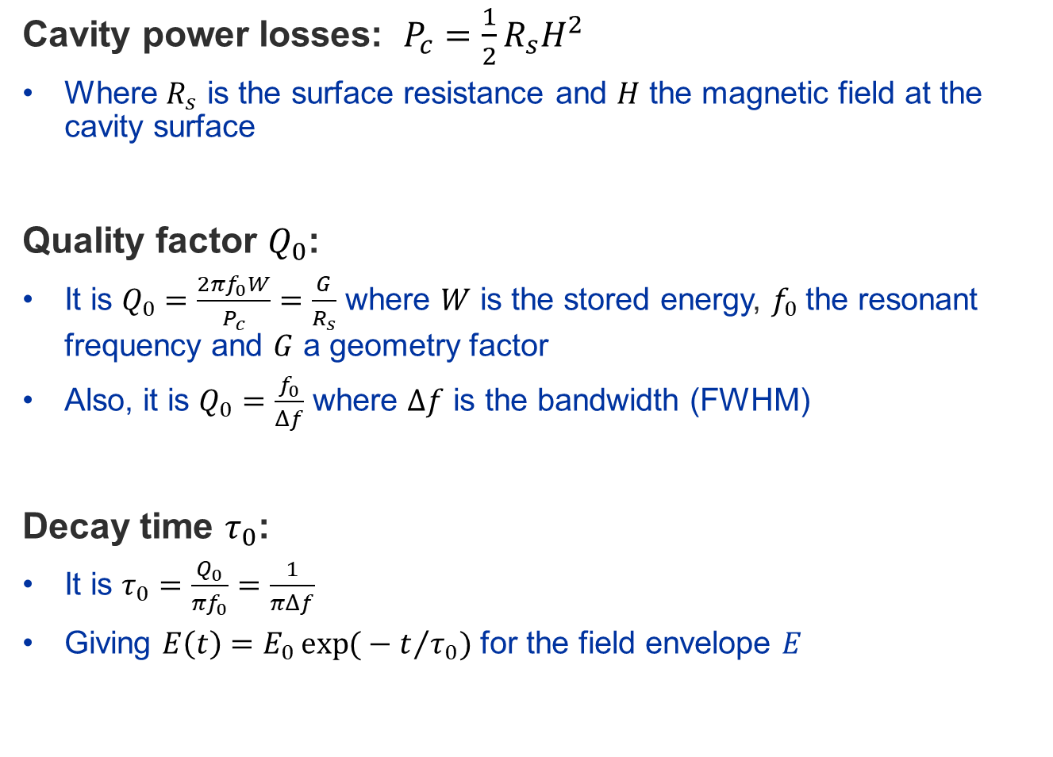
Quality factor: focus on the real part of impedance
Cavity power losses: $P_{c}=\frac{1}{2}R_{s}H^{2}$
  Where $R_{s}$ is the surface resistance and $H$ the magnetic field at the cavity surface
Quality factor $Q_{0}$:
  It is $Q_{0}=\frac{2πf_{0}W}{P_{c}}=\frac{G}{R_{s}}$ where $W$ is the stored energy, $f_{0}$the resonant frequency and $G$ a geometry factor
  Also, it is $Q_{0}=\frac{f_{0}}{Δf}$ where $Δf$ is the bandwidth (FWHM)
Decay time $τ_{0}$:
  It is $τ_{0}=\frac{Q_{0}}{πf_{0}}=\frac{1}{πΔf}$
  Giving ${E\left(t\right)=E}_{0}\exp{(}−t/{τ_{0})}$ for the field envelope $E$

Slide 6
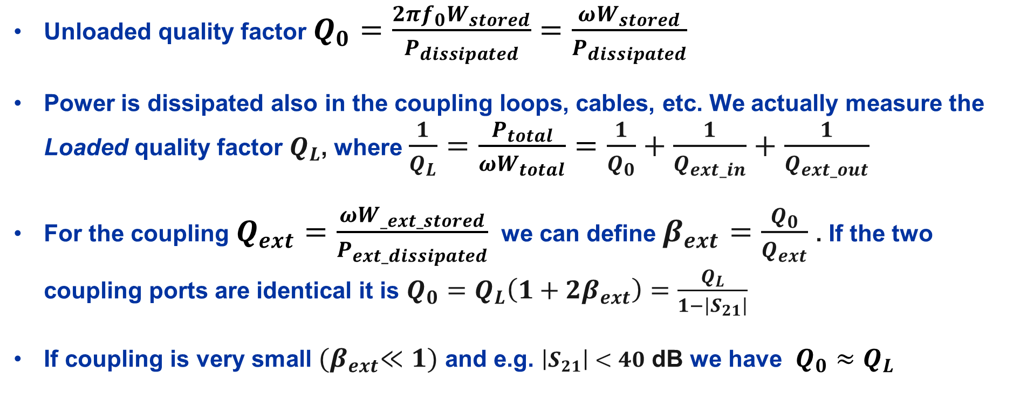
Quality factor measurement
(See note by P. Krkotić for further info)
Unloaded quality factor $Q_{0}=\frac{2πf_{0}W_{stored}}{P_{dissipated}}$ $=\frac{ωW_{stored}}{P_{dissipated}}$
Power is dissipated also in the coupling loops, cables, etc. We actually measure the Loaded quality factor $Q_{L}$, where $\frac{1}{Q_{L}}=$ $\frac{P_{total}}{ωW_{total}}=\frac{1}{Q_{0}}+\frac{1}{Q_{ext_in}}+\frac{1}{Q_{ext_out}}$
For the coupling $Q_{ext}=\frac{ωW_{_ext_stored}}{P_{ext_dissipated}}$ we can define $β_{ext}=\frac{Q_{0}}{Q_{ext}}$ . If the two coupling ports are identical it is $Q_{0}=Q_{L}\left(1+2β_{ext}\right)=\frac{Q_{L}}{1−\left|S_{21}\right|}$
If coupling is very small ${(β}_{ext}≪1)$ and e.g. $\left|S_{21}\right|<40$ dB we have $Q_{0}≈Q_{L}$

Slide 7

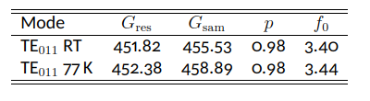
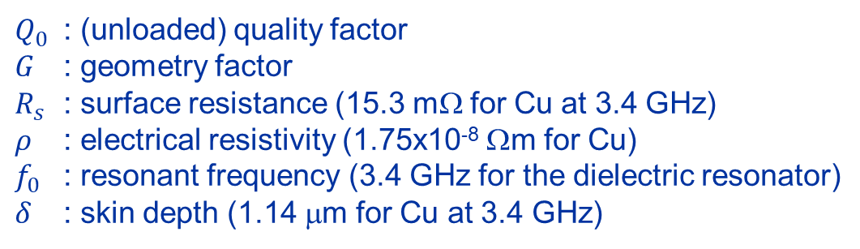

More on dielectric resonator
Our dielectric resonator is made of several parts, each can be considered to have its own geometry factor
$$\frac{1}{Q_{0}}=\frac{R_{s}}{G} ⇒$$
$Q_{0}$ : (unloaded) quality factor
$G$ : geometry factor
$R_{s}$ : surface resistance (15.3 mΩ for Cu at 3.4 GHz)
$ρ$ : electrical resistivity (1.75x10⁻⁸ Ωm for Cu)
$f_{0}$ : resonant frequency (3.4 GHz for the dielectric resonator)
$δ$ : skin depth (1.14 μm for Cu at 3.4 GHz)
Practice: open DR_calculations.xlsx

Slide 8


Square resistance and surface resistance
Consider a square sheet of metal and calculate its resistance to a transverse current flow:
This is the so-called square resistance often indicated as $R_{⊡}$ .
Power loss is: $P=R I^{2}=R{(J×ad)}^{2}$
a
a
Current $I$
d

Slide 9

Square resistance and surface resistance
And now instead of DC we have RF, and the RF current is confined in a skin depth:
This is a (simplified) definition of surface resistance R_{s}
Power loss (RMS!) is: $P=\frac{1}{2}R_{s} I^{2}=\frac{1}{2}R_{s}{(J×aδ)}^{2} ⇒ P=\frac{1}{2}R_{s}H^{2}a^{2}$ since $H=Jδ$
a
a
Current $I$
δ
d

Slide 10
Surface impedance has real and imaginary parts
For a bulk metal:
Thin film over a substrate (metal)? How are real and imaginary parts?
  Depends on substrate
  Depends on thickness d wrt skin depth δ
To learn more: open two-layers.xlsx
  Thanks to Patrick Krkotić and Uwe Niedermayer for the paper “Iterative Model for Calculating the Surface Impedance of Multilayers”, 2016

Slide 11
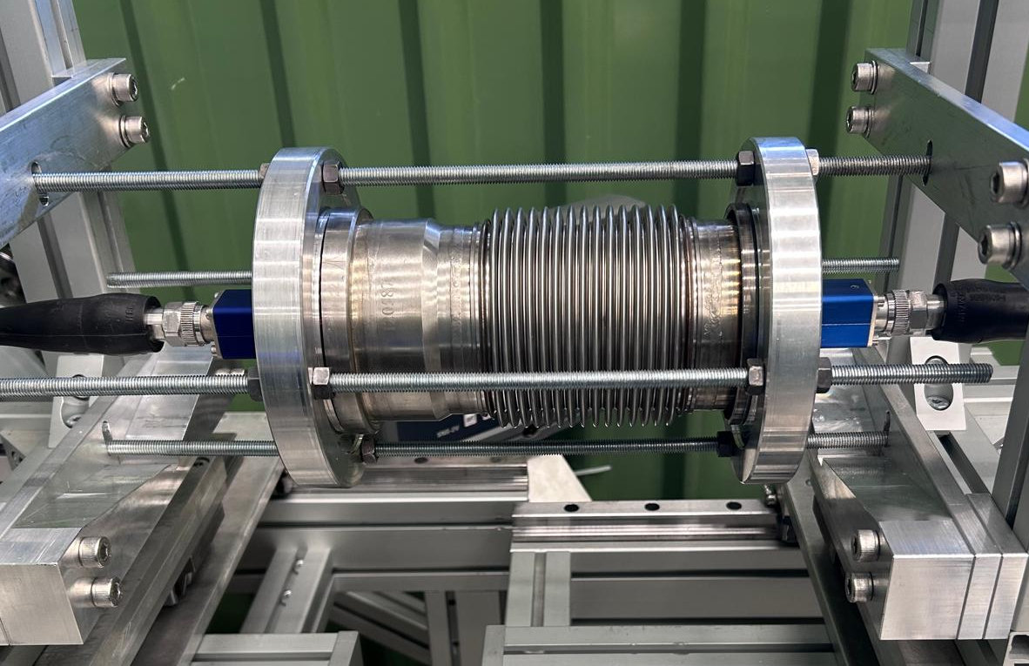
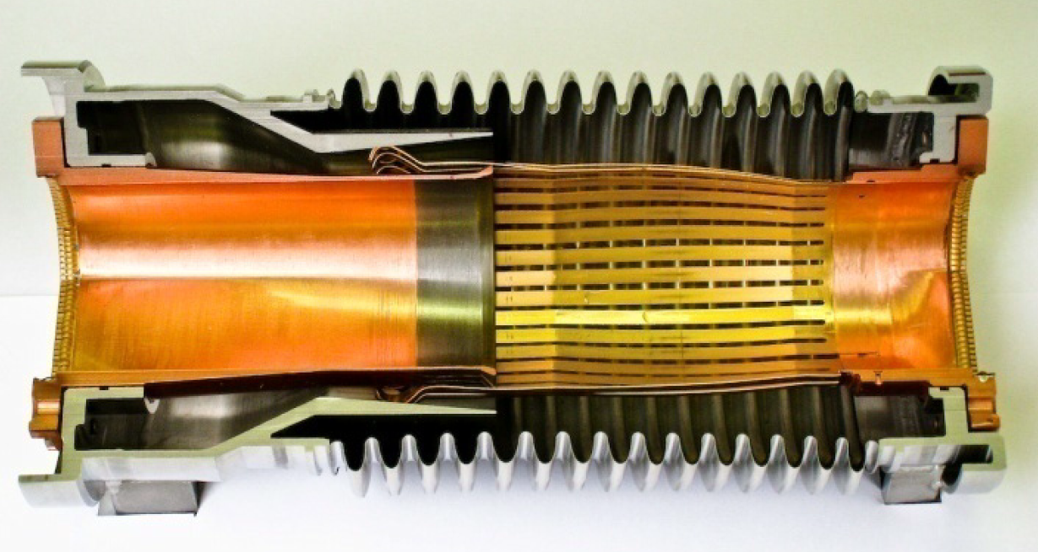
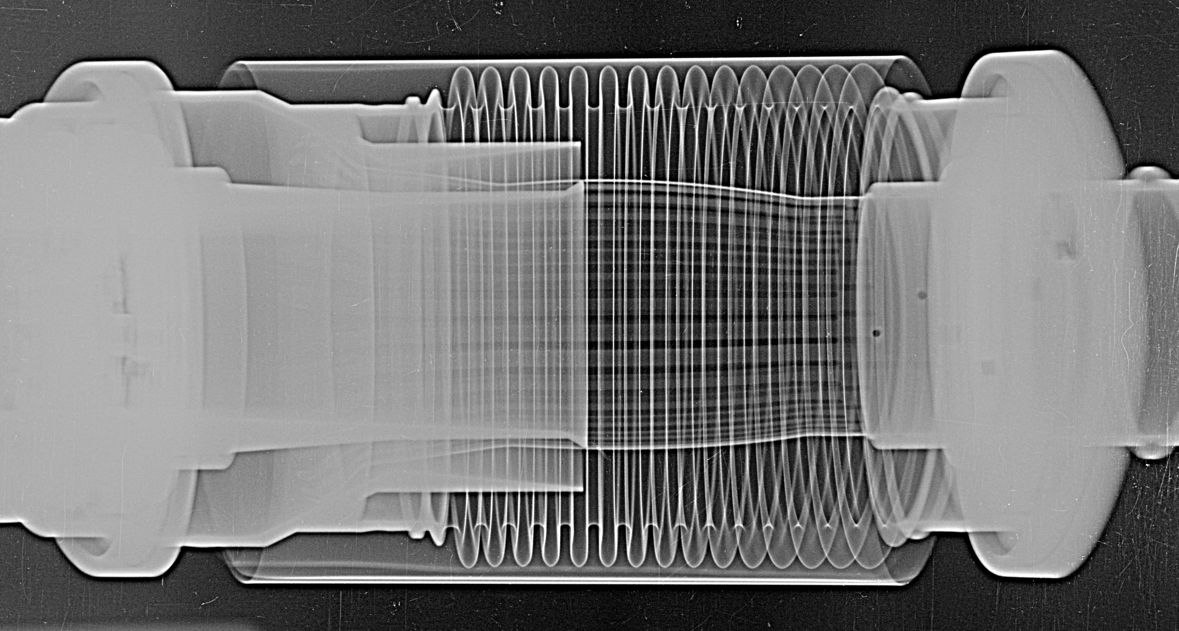
Cavity measurement with VNA up to 1.5 GHz
Port 1
Forward power
Port 2 Transmitted power
We will measure the frequency and the amplitude of the various resonances
With a wire !

Slide 12
Handover to Chiara

Slide 14
Impedance in accelerators
Extra slides

Slide 15
What is impedance?
A term with many meanings, depending on context
  Impedance in electrical circuits
  Impedance of materials
  Surface impedance
  Beam coupling impedance
There is a common rationale:
  Voltage and current flowing in the circuit, the material, the surface
  The beam current, and the potential it generates on the vacuum pipe

Slide 16
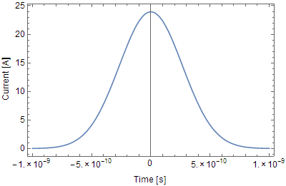
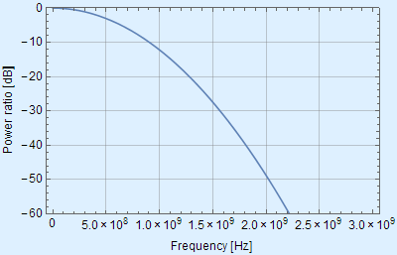
Bunch frequency spectrum: LHC case
Gaussian bunches of 10¹¹ protons, 8 cm long
Real bunches
Beam instantaneous image current
Frequency spectrum (Fourier transform)
Power dissipation from wakes is
where is a summation of
over the bunch frequency spectrum
( is the accelerator circumference)
( is the vacuum chamber circumference)
Line spacing: revolution frequency (11 KHz for LHC)
From: E. Métral

Slide 17
Transverse impedance
F. Sacherer in: Proceedings of the First Course of the International School of Particle Accelerators, CERN 77-13, p. 198

Slide 18
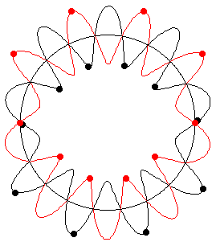
Betatron motion – simplified model
Unperturbed motion of single particle with and
Quadrupoles give the restoring (focussing) force -> harmonic oscillations
Adding a perturbation to the beam that changes focussing:
Growth rate of instability

Slide 19
From wakefields to impedance
Wakefields have an effect on beam stability, in particular the transverse plane
Risetime of resistive-wall instability depends on the transverse impedance
with at the frequency of the unstable mode

Slide 20
More theory on surface impedance
Extra slides

Slide 21
Surface impedance
V~
z
S=d²
x
;
y

Slide 22
Normal metals in the local limit
(in DC)

Slide 23
Limits for conductivity and skin effect
1. Normal skin effect if:
e.g.: high temperature, low frequency
2. Anomalous skin effect if:
e.g.: low temperature, high frequency
Note: 1 & 2 valid under the implicit assumption
1 & 2 can also be rewritten (in advanced theory) as:
It derives that 1 can be true for and also for

Slide 24
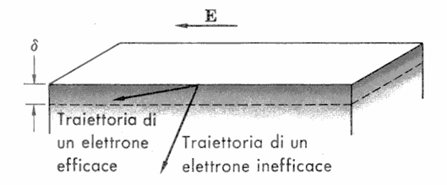
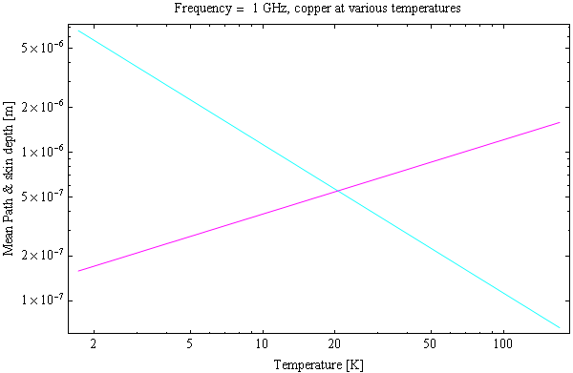
Mean free path and skin depth
Mean free path
Skin depth

Slide 25
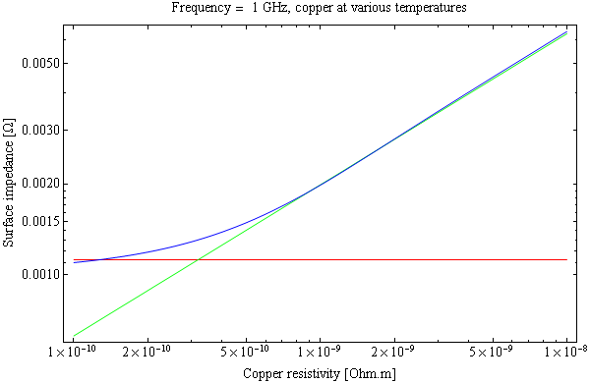
Anomalous skin effect
Anomalous skin effect
Asymptotic value
Normal skin effect
Understood by Pippard, Proc. Roy. Soc. A191 (1947) 370
Exact calculations Reuter, Sondheimer, Proc. Roy. Soc. A195 (1948) 336
Mathematica script

Slide 26
Two-layers
Extra slides

Slide 27
Iterative model

