Slide 1
Cooling of
High-Intensity Beams
M. Steck, GSI Darmstadt
Intensity Limitations in Hadron Beams,
Hotel Rila, Borovets, Bulgaria
15 - 27 June 2025

Slide 2
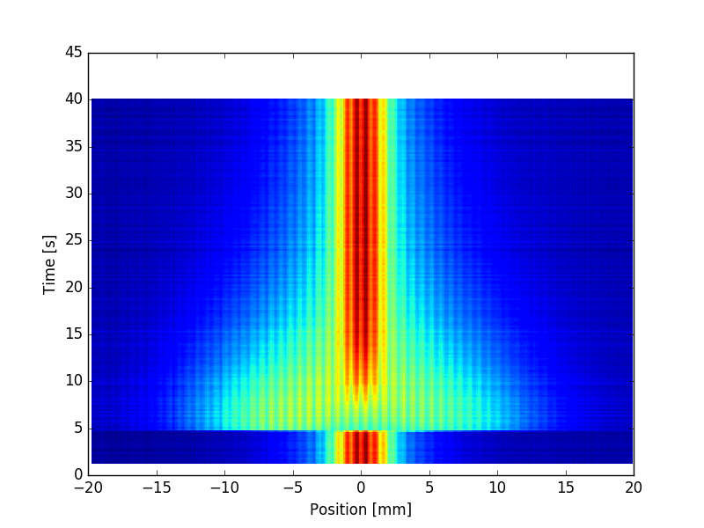
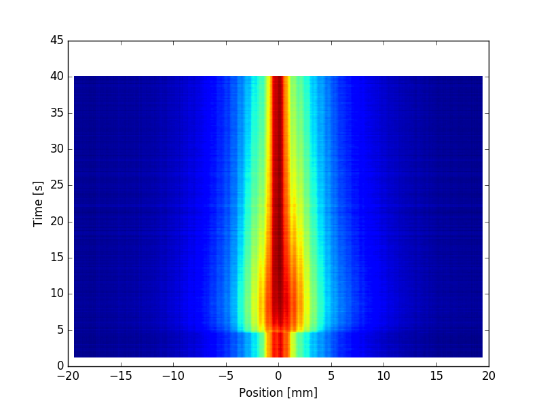
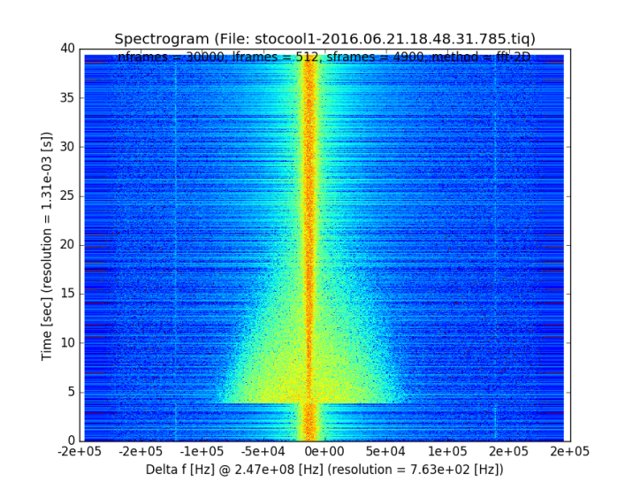
Observation of Cooling
Xe⁵⁴⁺ beam at 400 MeV/u cooled with electron current 200 mA
cooling in six-dimensional phase space
horizontal profile
(horizontal emittance)
vertical profile
(vertical emittance)
longitudinal
momentum distribution
time
injection
of new beam
measured with residual gas ionization beam profile monitor
longitudinal Schottky noise

Slide 3
Beam Cooling
Beam cooling is synonymous for a reduction of beam temperature.
Temperature is equivalent to terms as phase space volume,
emittance and momentum spread.
Beam Cooling processes are not following Liouville‘s Theorem:
` in a system where the particle motion is controlled by external
conservative forces the phase space density is conserved ´
(This neglects interactions between beam particles.)
Beam cooling techniques are non-Liouvillean processes which
violate the assumption of a conservative force.
e.g. interaction of the beam particles with other particles
(electrons, photons, matter)

Slide 4
Beam Cooling
Beam cooling increases the phase space density and can support an intensity increase of weak beams,
particularly secondary beams (rare isotopes, antiprotons).
It is not a technique to achieve ultimate intensities,
the cooled beam has smaller emittance and energy spread,
which makes it more susceptible to instabilities and results in stronger Coulomb interaction,
i.e. intrabeam scattering, space charge.
It can support techniques which require good beam quality for
efficient manipulation of the beam and improve performance,
an intensity increase can result due to improved efficiency of beam manipulations.

Slide 5
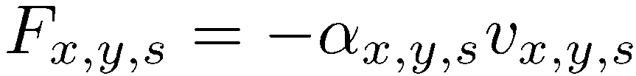

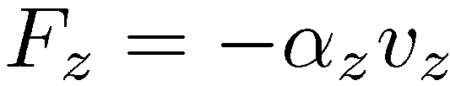


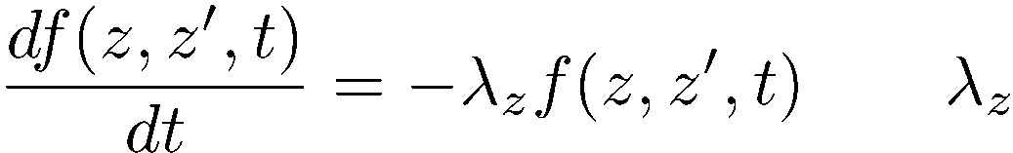
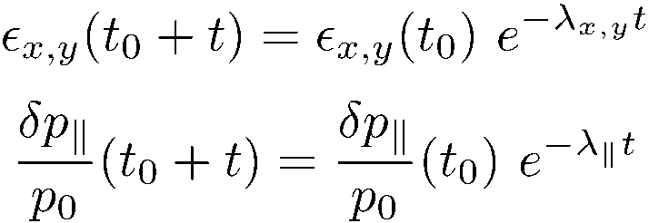
Cooling Force
Generic (simplest case of a) cooling force:
v_{x,y,s} velocity in the rest
frame of the beam
non conservative, cannot be described by a Hamiltonian
For a 2D subspace distribution function
cooling (damping) rate
in a circular accelerator:
Transverse (emittance) cooling
Longitudinal (momentum spread) cooling

Slide 6
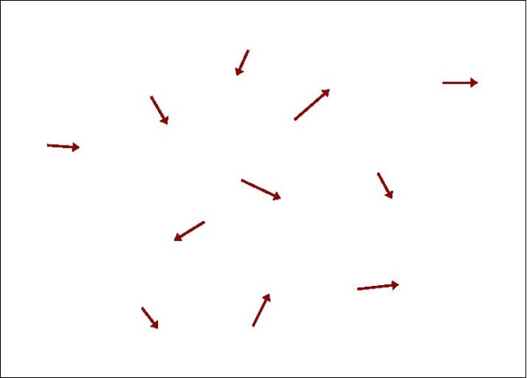
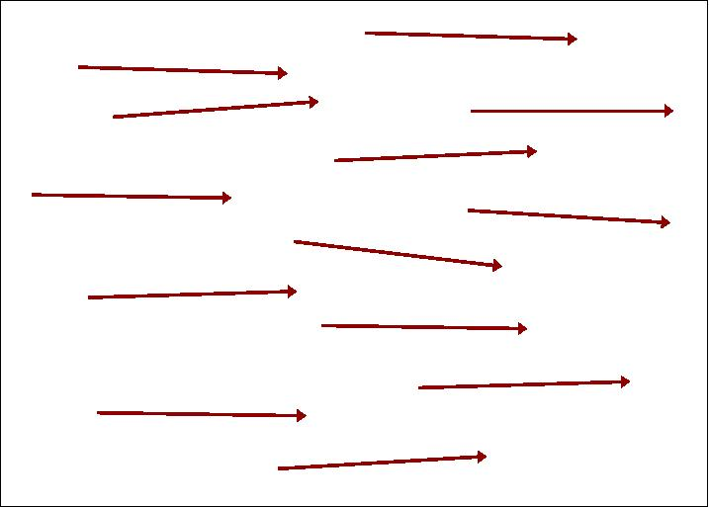

Beam Temperature
Where does the beam temperature originate from?
The beam particles are generated in a ‘hot’ source
at rest (source) at low energy at high energy
In a standard accelerator the beam temperature is not reduced
(thermal motion is superimposed the average motion after acceleration)
but: many processes can heat up the beam
e.g. heating by mismatch, space charge, intrabeam scattering,
internal targets, residual gas, external noise

Slide 7
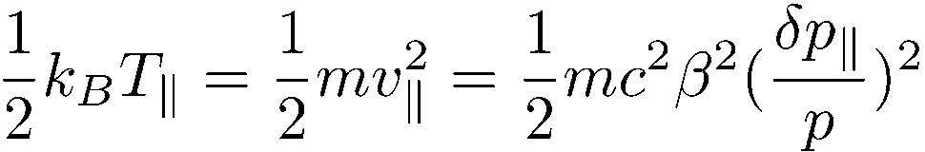
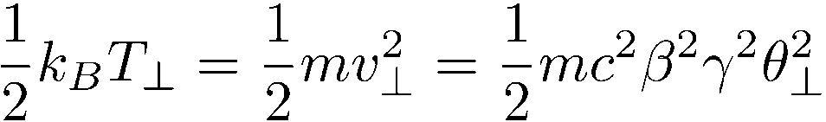
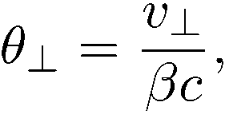
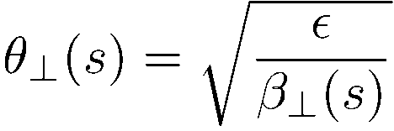
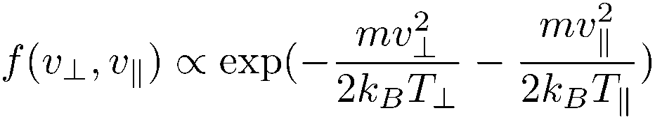

Beam Temperature Definition
Longitudinal beam temperature
Transverse beam temperature
Distribution function
dependent on s
Particle beams can be anisotropic:
e.g. due to different cooling strength in 2D subspaces
Don‘t confuse: beam energy ↔ beam temperature
(e.g. a beam of energy 100 GeV can have a temperature of 1 eV)

Slide 8
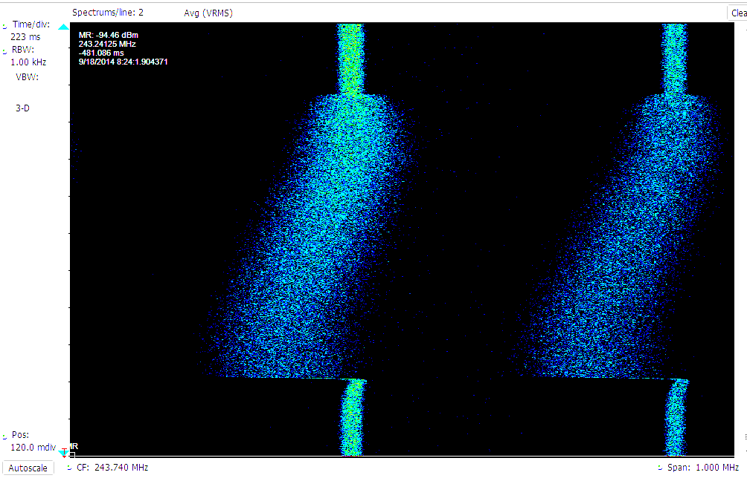
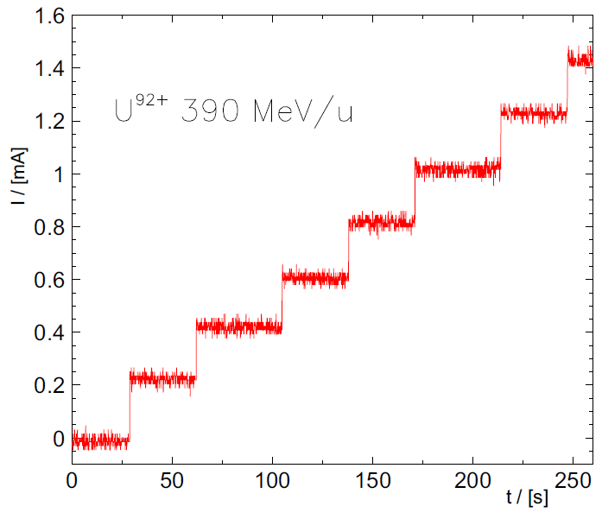
Benefits of Beam Cooling
Improved beam quality
  Precision experiments
  Luminosity increase
Compensation of heating
  Experiments with internal target
  Colliding beams
Intensity increase by accumulation
  Weak beams from the source
  can be enhanced
  Secondary beams
  (antiprotons, rare isotopes)
beam momentum
effect of
intrabeam scattering
and internal gas target
cooling
off
time
cooling
on
Xe⁵⁴⁺ 15 MeV/u

Slide 9
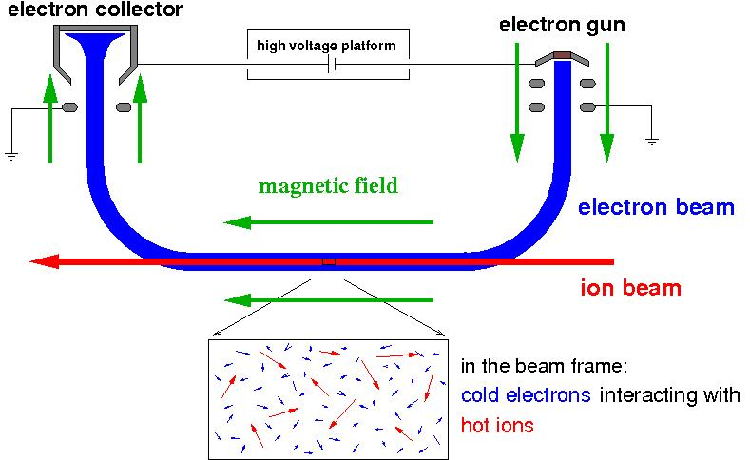
Electron Cooling
v_{e║} = β_{e}c= β_{i}c = v_{i║}
E_{e}=m_{e}/M_{i}⋅E_{i}
deceleration
section
acceleration
section
e.g.: 220 keV electrons
cool 400 MeV protons
or 400 MeV/u ions
electron temperature
k_{B}T⊥ ≈ 0.1 eV
k_{B}T║ ≈ 0.1 - 1 meV
superposition of a cold
intense electron beam
with the same velocity
momentum transfer by Coulomb collisions
cooling force results from energy loss
in the co-moving gas of free electrons

Slide 10
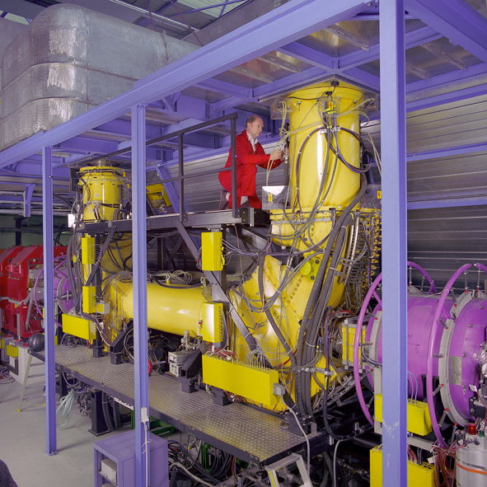
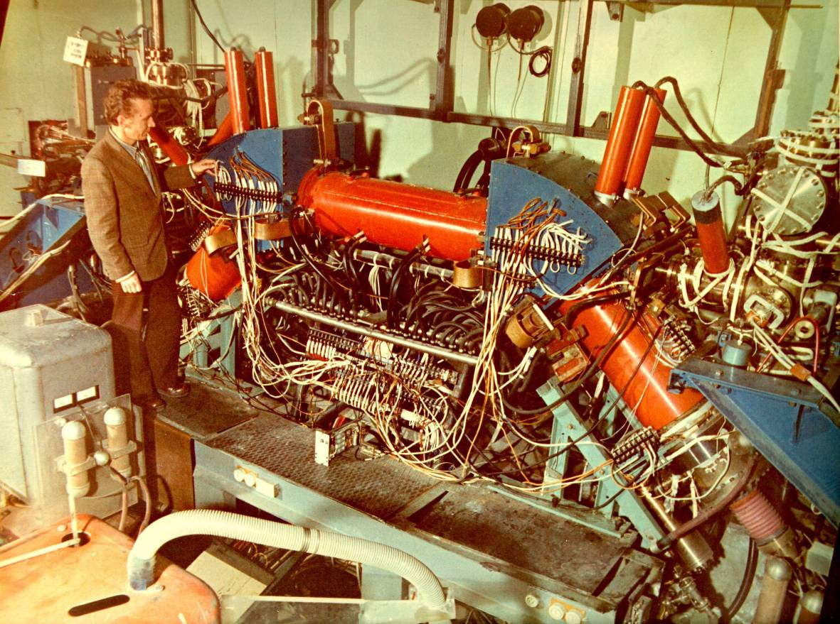
Electron Cooling Systems
proposed by G.I. Budker, Novosibirsk, in 1966
First Electron Cooling System
NAP-M/BINP
1974
Electron Energy: 35 keV
ESR Electron Cooler/GSI
1990
Medium Energy: 250 keV

Slide 11
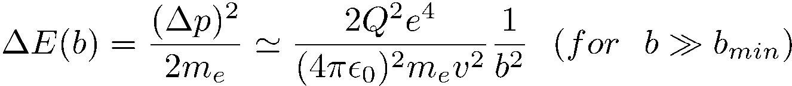
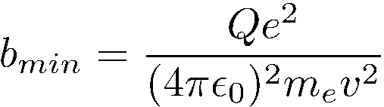

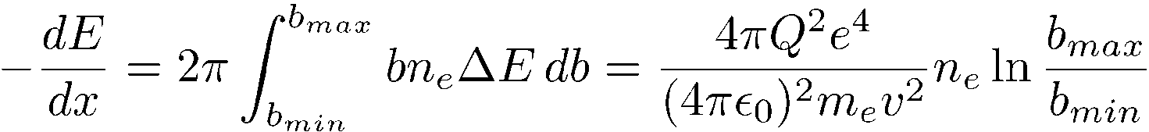
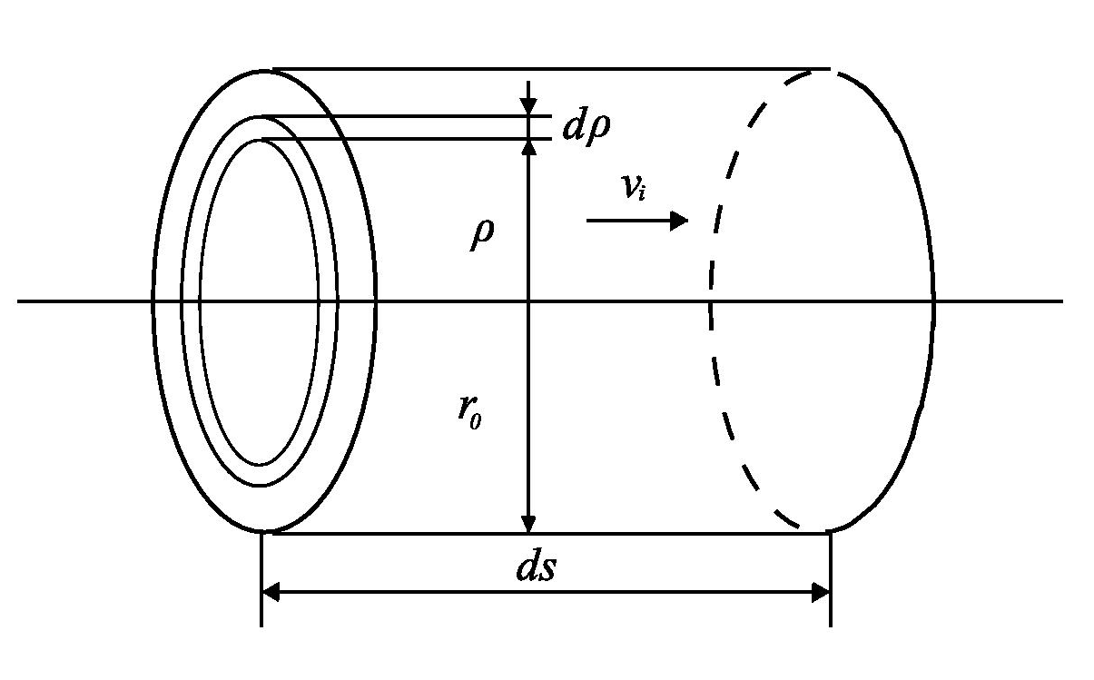
Simple Derivation of
the Electron Cooling Force
electron
target
in reference frame
of the beam
Analogy: energy loss in matter
(electrons in the shell)
faster ion
slower ion
Rutherford scattering:
Energy transfer:
Minimum impact parameter:
db
b
from:
Energy loss:
Coulomb logarithm L_{C}=ln (b_{max}/b_{min}) ≈10 (typical value)

Slide 12
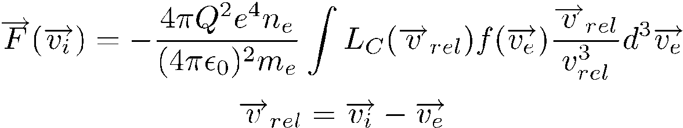
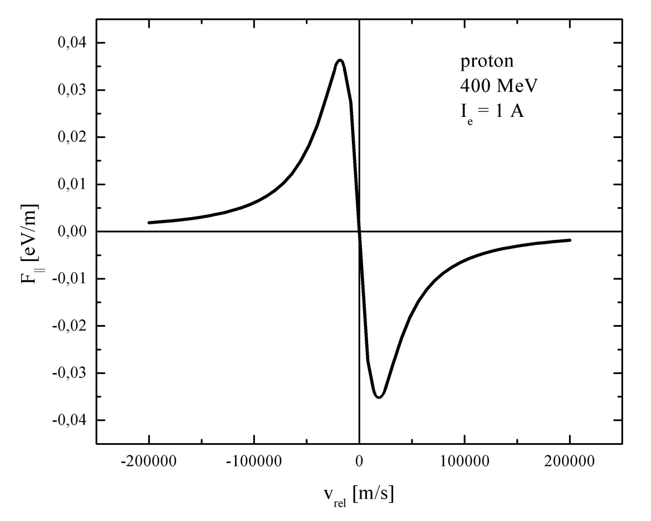
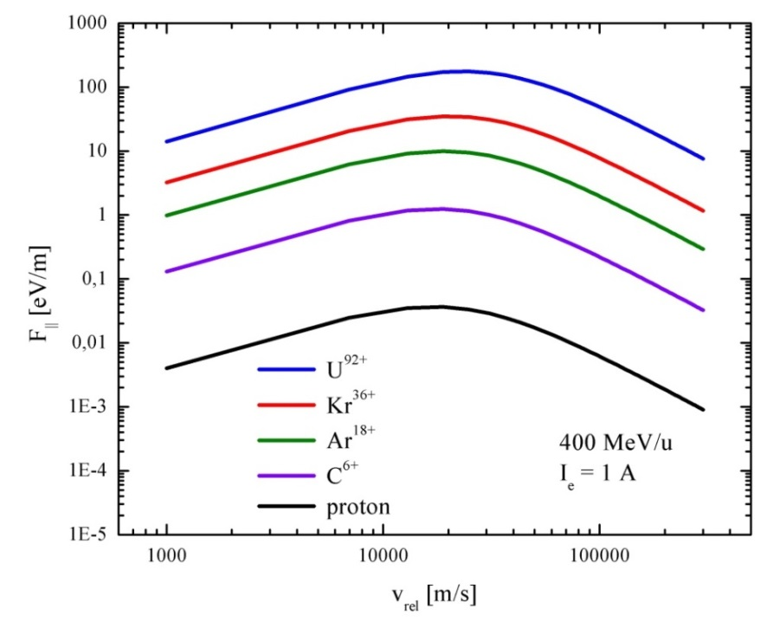
Characteristics of the
Electron Cooling Force
cooling force F
for small relative velocity: ∝ v_{rel}
for large relative velocity: ∝ v_{rel}⁻²
increases with charge: ∝ Q²
|F| ∝ v_{rel}
|F| ∝ 1/v_{rel}²
maximum of cooling force
at effective electron temperature

Slide 13
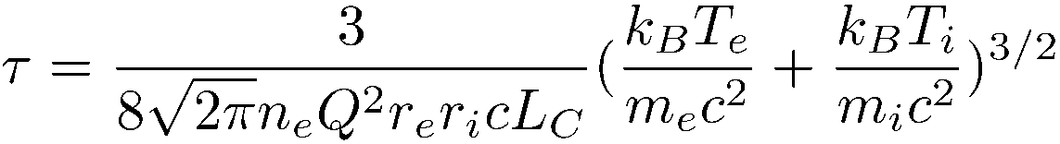

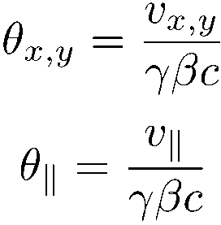
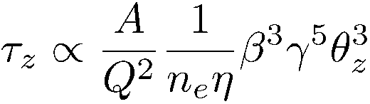
Electron Cooling Time
first estimate:
(Budker 1967)
for large relative velocities
cooling time
cooling rate (τ⁻¹):
slow for hot hadron beams ∝ θ⁻³
decreases with energy ∝ γ⁻² (β⋅γ⋅θ is conserved)
linear dependence on electron beam intensity n_{e} and cooler length η=L_{ec}/C
favorable for highly charged ions Q²/A
independent of hadron beam intensity
for small relative velocities
cooling rate is constant and maximum at small relative velocity
F ∝ v_{rel} ⇒ τ = Δt = p_{rel}/F = constant

Slide 14
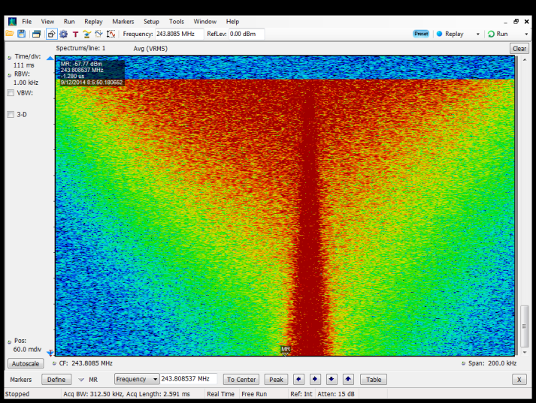
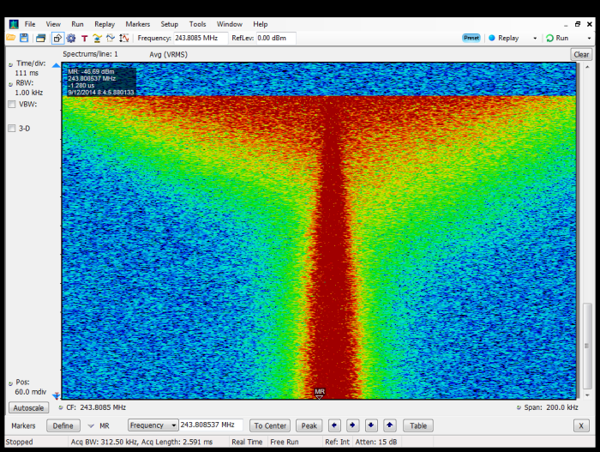
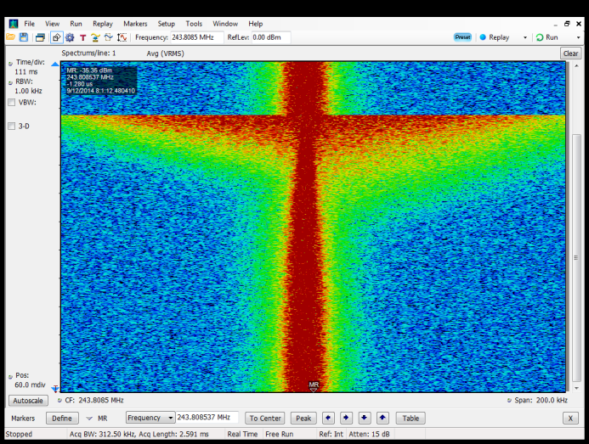
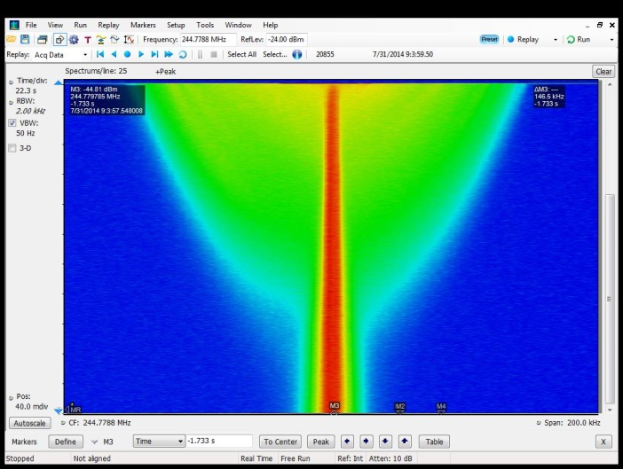
Longitudinal Cooling
Xe⁵⁴⁺ 350 MeV/u (Q=54)
measurement time 20 s
I_{e}= 100 mA
I_{e}= 250 mA
I_{e}= 500 mA
protons 400 MeV (Q=1)
measurement time 650 s
I_{e}= 250 mA

Slide 15
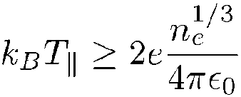
Electron Beam Properties
electron beam temperature
is determined by the thermal cathode temperature k_{B}T_{cat}
transverse temperature k_{B}T⊥ = k_{B}T_{cat ,}
can be reduced by transverse magnetic expansion with (∝ B_{c}/B_{gun})
longitudinal temperature k_{B}T║ = (k_{B}T_{cat})²/4E₀ << k_{B}T⊥
lower limit :
typical values:
transverse k_{B}T⊥ ≈ 100 meV (1100 K)
with magnetic expansion k_{B}T⊥ ≈ 1 meV
longitudinal k_{B}T║ ≈ 0.1 - 1 meV

Slide 16

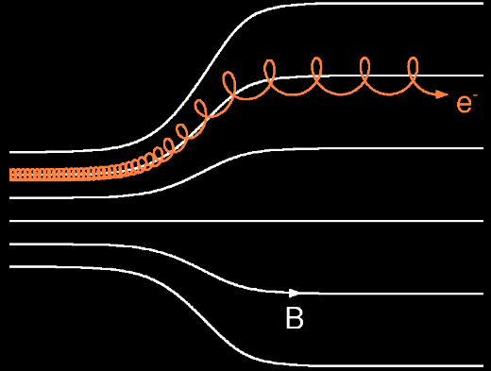


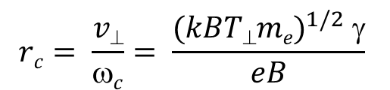
Electron Motion in
Longitudinal Magnetic Field
single particle cyclotron motion
cyclotron frequency
cyclotron radius
electrons follow the magnetic field line adiabatically
⇒ transverse magnetic expansion
results in a reduction of the
transverse temperature
• e⁻
$$c=\frac{eB}{γme}$$
r_{c} ≈ 10 μm
$$rc= \frac{v⊥}{ωc}= \frac{{(kBT⊥me)}^{1/2} γ}{eB}$$
B
$$\frac{mv⊥2}{B}=const.$$
another important consequence:
for interaction times which are long compared to the cyclotron period the ions do not sense the transverse electron temperature
⇒ magnetized cooling ( T_{eff} ≈ T║ << T⊥)

Slide 17
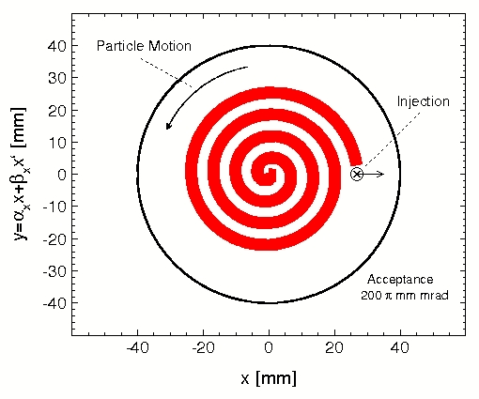
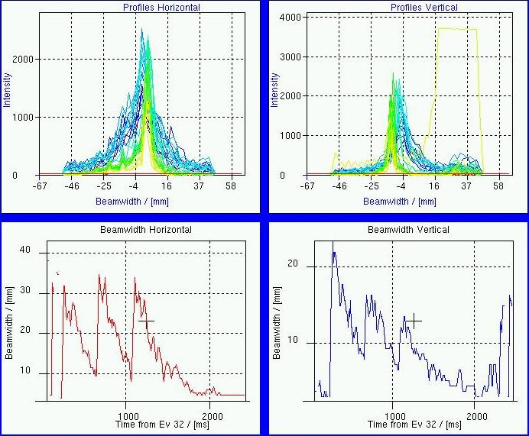
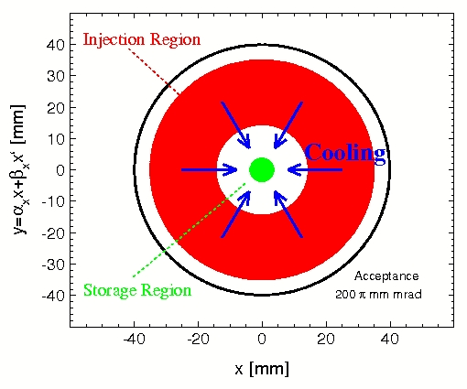
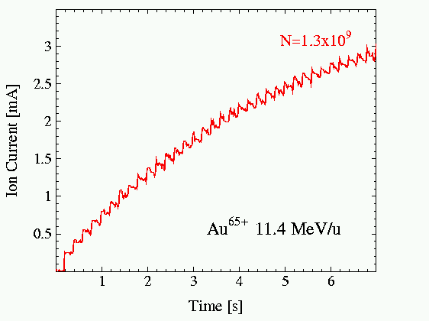
Accumulation of Low Energy Heavy Ions
by Electron Cooling before Acceleration
standard multiturn injection in
SIS18 (GSI) Au⁶⁵⁺ at 11.4 MeV/u
fast transverse cooling
horizontal-longitudinal stacking
supported by electron cooling In
LEIR (CERN) Au⁵⁴⁺ at 4.2 MeV/u
horizontal vertical
profile
beam size
fast accumulation by
repeated multiturn injection
with electron cooling
beam accumulation
intensity increase
by a factor of ≈ 10
in 5 seconds
limitations:
space charge tune shift,
recombination (REC)

Slide 18
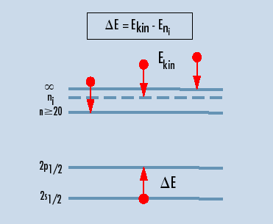
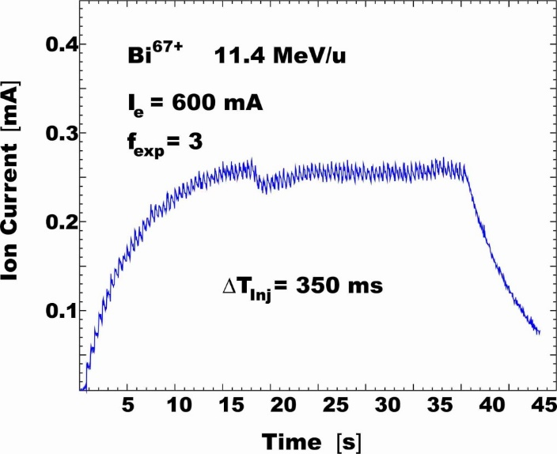
Atomic Physics Limitation of
Electron Cooling
Radiative Electron Capture (REC)
Dielectronic Recombination (DR)
A^{Q+} + e⁻ → A^{(Q-1)+} + hν
A^{q+} + e⁻ → [A^{(q-1)+}]** → A^{(q-1)+} + hν
E_{KIN}
Continuum
change of the ion
charge results in
particle loss
⇒ different orbit
M
bound states
L
emission of a photon
K
loss rate
τ⁻¹ = γ⁻² α_{REC} n_{e}η
$REC= \frac{{1.92 × 10}^{−13} Q2}{\sqrt{kBT}} \left(\ln{\frac{5.66 Q}{\sqrt{kBT}}}+0.196{(\frac{kBT}{Q2})}^{1/3}\right)[cm3 s_1]$
losses by recombination (REC)

Slide 19
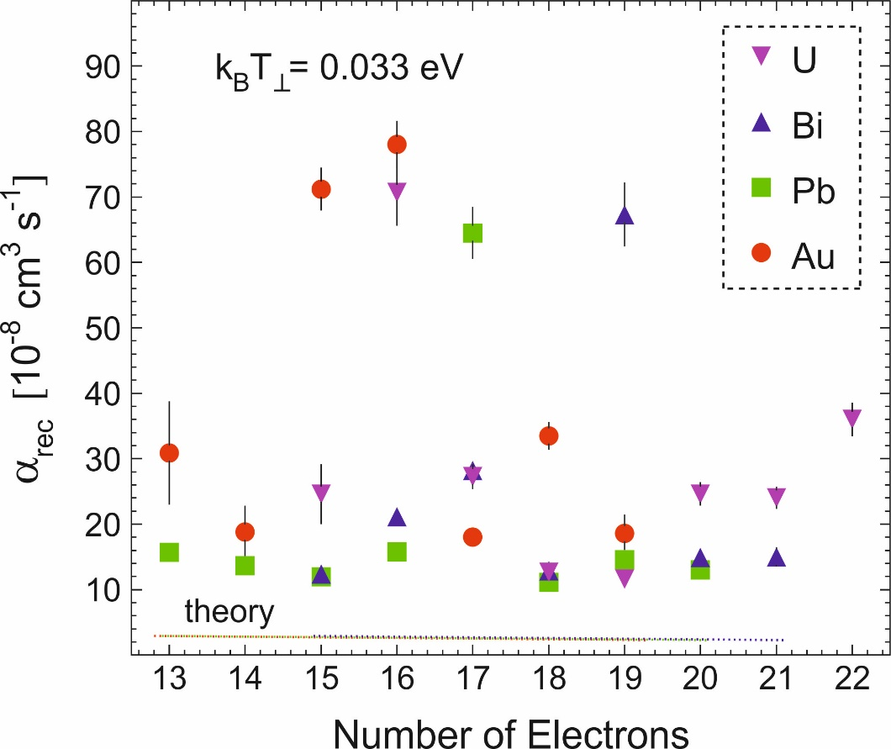
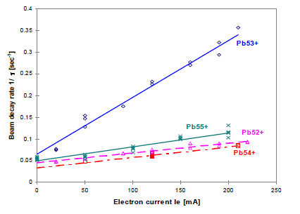
Recombination Coefficient of
Incompletely Stripped Heavy Ions
SIS18, GSI
measurement at the injection energy 11.4 MeV/u
LEAR, CERN
lead ion accumulation for LHC
theoretical value for REC
LEAR result, J. Bosser et al. EPAC 98
increased recombination rate for Pb⁵³⁺
beam lifetime is inversely proportional to the recombination coefficient
recombination of incompletely stripped ions is hard to predict,
it determines the lifetime of the cooled ion beam and limits accumulation

Slide 20
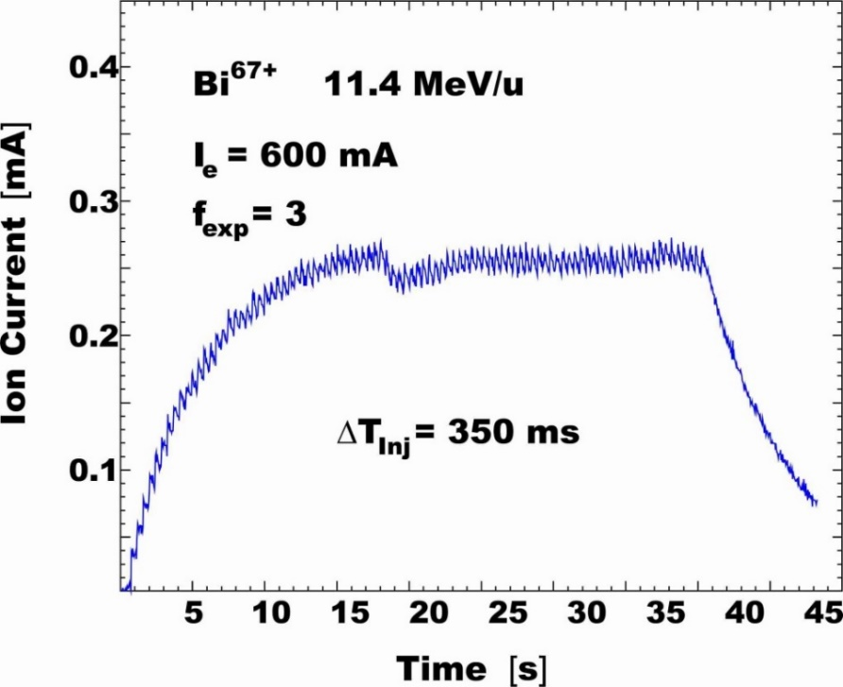
Limits of Beam Accumulation
accumulation saturates when injection rate is balanced by loss rate
τ_{loss}⁻¹ = τ_{inj}⁻¹
various process result in finite beam lifetime τ_{beam}
losses due to atomic interaction in vacuum (ionization, capture)
nuclear lifetime of rare isotopes (can range from microseconds to years)
interaction with electron beam (radiative electron capture)
equilibrium intensity N_{eq} is achieved when
N_{inj}/T_{rep} = N_{eq}(1 - exp(-T_{rep}/τ_{beam}))/T_{rep}
production/injection rate N_{inj}/T_{rep}
loss rate N_{eq}(1-exp(-T_{rep}/τ_{beam}))/T_{rep}
beam accumulation is most beneficial for
low intensity or secondary beams with
sufficiently long lifetime
saturation
T_{rep}=0.4 s
T_{rep}=350 ms
τ_{beam}
beam
lifetime

Slide 21
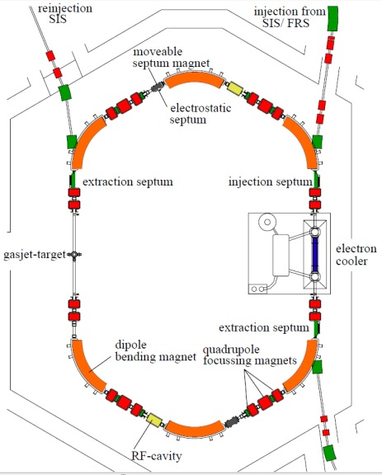
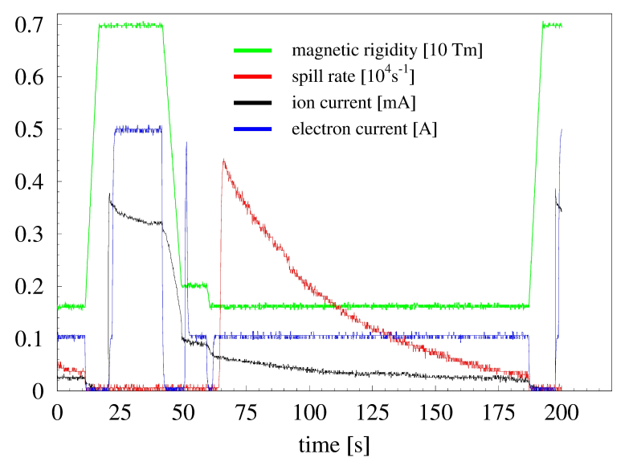
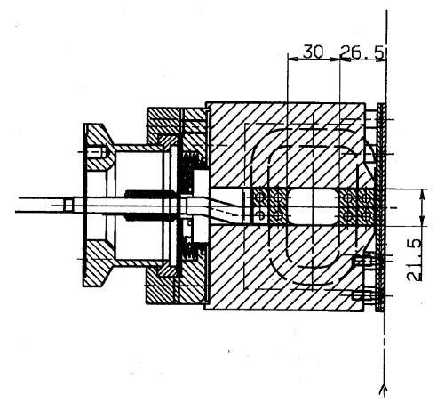

Slow Extraction by Charge Change
septum magnet
installed in UHV
electron capture in the cooling system
provides a cooled beam for ultraslow extraction at any energy at which beam can be stored and cooled
(depending on the ring acceptance)
small emittance
good control of extraction rate
extraction time minutes to hours

Slide 22


Electron Cooled Beams in Equilibrium with Intrabeam Scattering (IBS)
different ions (Q,A)
different energies (β, γ)
δp/p α N^{0.3}
ε_{x,y} α N^{0.5}
IBS: total phase space volume increases
with ion beam intensity and ion charge

Slide 23



Intensity Limit of Cooled Ion Beam
electron cooling of U⁸⁹⁺ at 75 MeV/u, including bunched beam
Δp/p α N^{1/3}
ε_{x} α N^{2/3}
ε_{y} α N^{1/3-2/3}
bunched
unbunched
number of ions / ring circumference N/B
longitudinal stability
$\left[\frac{Δp}{p}\right]2$≥$\frac{Q^{2}e²}{Amnc²}$ $\frac{N2f0}{βγ}$ |$\frac{Zn}{n}$|
transverse stability
$\left[\frac{Δp}{p}\right]$ ≥$\frac{Q2 e2}{4π2 Amncγ}$ $\frac{N}{qy(η\left(n−qy\right)+qyξ)}$ |$Z$|
space charge tune shift
$Qx −$ $\frac{rnQ^{2}N}{2πABβ^{2}γ^{3}εx}$
with increasing intensity the cooled beam approaches the unstable regime

Slide 24



Low Intensity, High Brilliance Beam
The phase space density below
the transition point is dramatically increased
momentum spread
reduction for less
than 1000 particles
(Schottky noise)
for small particle number:
increase of phase space
density by 4 orders
of magnitude
Intrabeam scattering must be absent for
low ion beam intensity.
For higher intensity the cooling rate cannot
be increased corresponding to the IBS
heating rate.
beam temperature for C⁶⁺ at 4800 MeV is below 1 meV

Slide 25



Collective Effects in
High Intensity Cooled Beams
Ar¹⁸⁺ at 400 MV/u cooled with 300 mA electron current
electron cooled beam in TSR
2×10⁷ cooled ions
width of the Schottky signal corresponds
to a momentum spread of Δp/p= 3 × 10⁻⁵
6×10⁸ cooled ions
double peak structure
with signal suppression
peak distance increases
with particle number N^{1/2}
long tails of particle
distribution
this beam is stable, no increased loss rate

Slide 26

Bunched Beam Electron Cooling
Electron cooling with electrostatic acceleration is limited in energy (5-10 MeV).
A bunched electron beam offers the extension of the electron cooling method
to higher energy (linear rf accelerator to increase the electron energy).
new scheme
ion bunch (some ten ns)
or coasting ion beam
traditional
continuous electron beam
electron bunches (some ns)
continuous (or bunched) ion beam
issues:
high intensity bunches (production, transport)
momentum spread and emittance of bunches
beam alignment
magnetized ↔ non-magnetized (magnetic shielding)
synchronization of electron and ion bunches
Low Energy RHIC e-Cooler
(LEReC) project at BNL
two counter-propagating
ion beams
super-conducting
rf gun
two opposite cooling sections
5 MeV, 250 kW beam dump

Slide 27


Low-Energy RHIC electron Cooler (LEReC) at BNL
LEReC is the first electron cooler based on the RF acceleration of electron beam .
State of the art electron accelerator which uses photocathode high-current gun, high-power laser and several RF cavities.
Electron beam parameters suitable for cooling were successfully generated and transported to the cooling sections in RHIC.
First electron cooling of hadron beams using a bunched electron beam was demonstrated on April 5, 2019.
Both longitudinal and transverse cooling was achieved.
Cooling of ion bunches in two separate RHIC rings (Yellow and Blue) using single electron beam was demonstrated.
LEReC cooling sections
A. Fedotov et al.
demonstration of cooling

Slide 28
Stochastic Cooling
Fluctuations in Phase Space
phase space is not homogeneously filled with particles
⇒ fluctuations of local particle density
x'
2D phase space x-x‘
x'
x
x
cooling
compression of total phase space volume by reduction of
locally empty phase space volume

Slide 29

Stochastic Cooling
First cooling method which was successfully used for beam preparation
S. van der Meer, D. Möhl, L. Thorndahl et al.
(1925 – 2011) (1936 - 2012)
Conditions:
Betatron motion phase advance
(pick-up to kicker): (n + ½) π
Signal travel time = time of flight of particle
(between pick-up and kicker)
Sampling of sub-ensemble of total beam
pick-up
kicker
amplifier
kick
deviation
Principle of transverse cooling:
measurement of deviation from ideal orbit
is used for correction kick (feedback)

Slide 30







Stochastic Cooling
position
in time domain
correction kick
correction kick
(unlimited time resolution)
time
-
Nyquist ⇒ the time resolution for
a system of bandwidth W is ΔT = (2W)⁻¹
correction kick with bandwidth W
-
Correction kick
For exponential damping ( ):
$$x\left(t\right)=x\left(t0\right)×e^{−(t−t0)/τ}$$
cooling
rate

Slide 31





Stochastic Cooling
some refinements of cooling rate formula
noise: thermal or electronic noise adds to the beam signal
mixing: change of relative longitudinal position of particles
due to momentum spread
M mixing factor
U noise to signal ratio
cooling rate
cooling heating
maximum of cooling rate
further refinement (wanted ↔ unwanted mixing):
with wanted mixing
and unwanted mixing
(kicker to pick-up)
(pick-up to kicker)

Slide 32





Mixing
unwanted mixing
(from pick-up to kicker)
wanted mixing
(from kicker to pick-up)
∼ half a turn
from pick-up
to kicker
pick-up
(at s₁)
pick-up
pick-up
kicker
(at s₂)
kicker
kicker
mixing is determined by
the ion optical functions
∼ half a turn
from kicker
to pick-up
⇒ η_{eff} ~ 0
⇒ η_{k-pu} > 0, (Tη(Δp/p)_{rms})⁻¹ ∼ 1

Slide 33
Requirements Stochastic Cooling
large bandwidth (typically one octave in the GHz range)
good transfer function in gain and phase
high sensitivity (high impedance) of pick-ups and kickers
low electronic noise (cold pick-ups, low noise amplifiers)
large, but adjustable gain
special ion optical properties of the ring
betatron phase advance between transverse pick-up and kicker
small momentum slip factor (large wanted and little unwanted mixing)
for Palmer cooling: large dispersion value at pick-up

Slide 34
Longitudinal Stochastic Cooling
1) Palmer cooling
pick-up in dispersive section detects horizontal position
⇒ acceleration/deceleration kick corrects momentum deviation
2) Notch filter cooling
filter creates notches at the harmonics of the nominal
revolution frequency
⇒ particles are forced to circulate at the nominal frequency
notches at harmonics
of the revolution frequency
with 180º phase jump
transmission line
short circuit at all harmonics
of the revolution frequency
3) ToF cooling
simplified scheme without notches allows efficient pre-cooling

Slide 35



Comparison of Longitudinal Cooling Methods
Ar¹⁸⁺ 400 MeV/u
longitudinal momentum distribution versus time
measured at the ESR
heavy ion storage ring
Schottky signal observed
at 245 MHz (h=124)
Palmer cooling
Time-of-Flight cooling
Notch filter cooling
large momentum capture range
fast cooling
good final momentum spread
drawback: horizontal heating
needs to be compensated
by horizontal cooling
large momentum capture range
slower cooling
moderate final momentum spread
simple set-up
no special lattice requirement
reduced momentum capture range
good cooling rate
smallest final momentum spread
most elaborate rf hardware
issue of notch filter stability

Slide 36

Basic Studies of Stochastic Cooling
summary of initial
stochastic cooling
studies at CERN
with (anti-)protons
cooling time
(normalized to 1 GHz bandwidth)
mixing limit regime
noise limit regime
(depending on gain)
τ α N
⇒ cooling rate decreases
for high intensity beams
particle number

Slide 37
Antiproton Accumulation
by Stochastic Cooling
accumulation of 8 GeV antiprotons at accumulator ring, FNAL, shut down 09/2011
a similar facility AC/AA at CERN was operated until 11/1996
momentum distribution of
accumulated antiproton beam
kicker array
cryogenic microwave
amplifier
with stochastic cooling:
accumulation of up to 6×10¹¹ antiprotons
about 60 mA
microwave electronics
power amplifiers (TWTs)

Slide 38
Fermilab’s Antiproton Production Chain
6⋅10¹¹
ρ= 2⋅10⁸
1⋅10⁸
ρ= 1
8 GeV
Proton beam 7⋅10¹² protons every 2 sec
120 GeV
1⋅10⁸
ρ= 300
8 GeV
Nickel target
Debuncher (stochastic cooling)
Accumulator (stochastic cooling)
until 2005
8 GeV
1 TeV
150 GeV
4⋅10¹²
ρ= 4⋅10⁹
Tevatron
Recycler (stochastic and electron cooling)
Main injector
Electron cooling in the Recycler Ring resulted in faster cooling
and a factor of 3 more accumulated antiprotons

Slide 39




High Energy Electron Cooling
electron cooling of 8 GeV antiprotons
cooling with 0.2 A, 4.4 MeV electron beam
FNAL Recycler electron cooling system
Pelletron
high voltage tank
electron cooling time of order ten minutes
stochastic cooling time ≥ N/2W
20 m long
solenoid section

Slide 40









Stochastic Cooling for Bunched Heavy Ions
longitudinal pickup
3 tanks with longitudinal
(narrow band) kicker units
70 GHz carrier
with 16 GHz
local oscillator
RHIC
ion collider
longitudinal kicker
open for injection and ramping (left), closed during cooling (right)
horizontal and
vertical pickups

Slide 41


RHIC Luminosity Increase
luminosity of ions colliding at 100 GeV/u is limited by intrabeam scattering
in the intense beam of highly charged ions
luminosity with/without stochastic cooling
beam emittance during store
For Uranium-on-Uranium collisions
the cooling increased the integrated luminosity per store by a factor of 5
The transverse emittances were reduced by x 4 with a cooling time of ½ hour
M. Brennan et al.

Slide 42
Increase of Stochastic Cooling Rate
A more powerful cooling or cooling of large particle number
requires an increase of the bandwidth W
of the cooling system τ⁻¹ α 2W/N
Electronic cooling systems were developed for
8 and 16 GHz bandwidth, but larger bandwidth systems
are not available
Alternative approaches are proposed to provide faster cooling
at relativistic energies

Slide 43
Coherent Electron Cooling
A combination of electron and stochastic cooling concepts
proposed for fast cooling at highest energies
energy range several 10 – 100 GeV
E < E_{h}
E_{h}
E < E_{h}
Dispersion section
( for hadrons)
E_{h}
E > E_{h}
λ
Hadrons
Modulator
E > E_{h}
Kicker
l₁
High gain FEL (for electrons)
l₂
Electrons
The Coherent Electron Cooling system
has three major subsystems
    modulator: the ions imprint a “density bump”
    on the electron distribution
    amplifier: FEL interaction amplifies a density bump
    by orders of magnitude
    kicker: the amplified & phase-shifted electron charge
    distribution is used to correct the velocity offset
    of the ions
electron-ion
collider
BNL-EIC

Slide 44


Optical Stochastic Cooling Concept
benefit:
high bandwidth of
optical cooling system
first experimental demonstration with 100 MeV electron beam in IOTA (FNAL) Nature 608 287-292 (2022)
option for cooling hadron beams of highest energy

Slide 45




Stochastic Cooling
of Rare Isotopes at GSI
fast pre-cooling of hot rare isotopes
energy 400 (-550) MeV/u
bandwidth 0.8 GHz (range 0.9-1.7 GHz)
δp/p = ±0.35 % → δp/p = ±0.01 %
ε = 10 × 10⁻⁶ m → ε = 2 × 10⁻⁶ m
electrodes installed in the
ultrahigh vacuum
inside magnets
combination of signals from electrodes
power amplifiers
for generation of
correction kicks

Slide 46
Combination of
Stochastic and Electron Cooling
stochastic pre-cooling + final electron cooling
immediately after injection
One trace every 120 ms
5.52 s in total
Stochastic pre-cooling
reduces the total cooling time to a few seconds,
electron cooling only
takes 10 - 60 s
5 s
Subsequent electron cooling
3 s
Fast stochastic pre-cooling
Primary Uranium beam
heated in thick target
Inj.

Slide 47


Beam Accumulation of a Rare Isotope Beam
longitudinal stacking for beams transferred between ring accelerators
stack orbit
electron cooling
injection orbit
stochastic cooling
Δp/p ≈ 1.6%
62 injections: 2×10⁶ ²⁰⁵Tl⁸¹⁺ ions
accumulation over 40 minutes
this accumulation scheme requires two cooling systems and a large momentum acceptance of the ring, one cooling system cools the injected beam and the second cooling system the stacked beam on a different orbit
a powerful combination for the accumulation of
(long-lived) rare isotope beams

Slide 48

Equilibrium Beam Parameters of the Cooled Beam in the ESR
Electron cooling results in
smaller momentum spread and
smaller emittance.
The equilibrium is a balance between the cooling rate and the heating rate by intrabeam scattering.
calculated IBS-heating/cooling rate [s⁻¹]
longit. transv.
stochastic cooling 0.9 - 2.2 0.5 - 1.3
el. cool. [25 mA] 2.0 - 6.0 1.4 - 3.3
el. cool. [250 mA] 18 - 58 7 - 10
electron cooling is more powerful
in producing cold beams,
it provides higher (more than an order
of magnitude) cooling rate
for cold ion beams
limited by Intrabeam Scattering

Slide 49
Cooling Methods of Hadron Beams
Stochastic Cooling Electron Cooling
Useful for: low intensity beams low energy
all intensities
hot (secondary) beams warm beams (pre-cooled)
high charge high charge
full 3 D control bunched beams
Limitations: high intensity beams space charge effects
/problems beam quality limited recombination losses
bunched beams (ions) high energy

