Slide 1
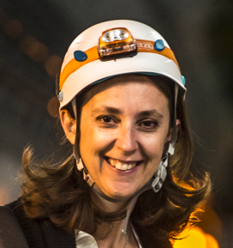
On behalf of Katy Foraz,
Head of the EN Department,
Welcome
to all of you!

Slide 2
The Engineering Department in a Nutshell
Katy Foraz

Slide 3
Who are we?

Slide 4
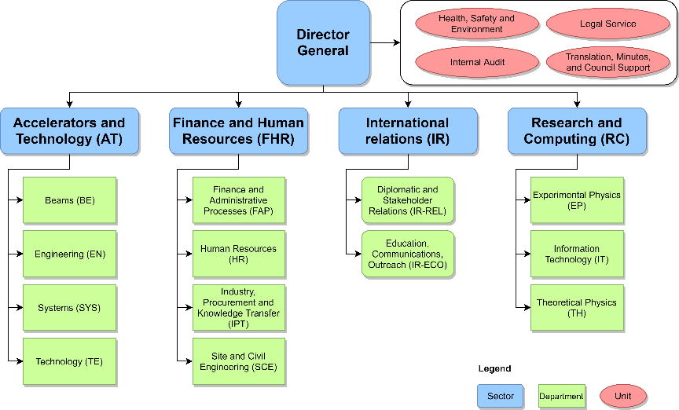
CERN Structure

Slide 5

CERN Structure
Directorate
Director-General | Fabiola Gianotti
Director for Finance and Human Resources | Raphaël Bello
Director for Accelerators and Technology | Mike Lamont
Director for Research and Computing | Joachim Mnich
Director for International Relations | Charlotte Warakaulle

Slide 6
CERN Structure
Heads of departments
Accelerator Systems | Brennan Goddard
Beams | Rhodri Jones
Engineering | Katy Foraz
Experimental Physics | Manfred Krammer
Finance and Administrative Processes | Florian Sonnemann
Human Resources | James Purvis
Industry, Procurement and Knowledge Transfer | Christopher Hartley
Information Technology | Enrica Porcari
Site and Civil Engineering | Mar Capeans Garrido
Technology | José Miguel Jiménez
Theoretical Physics | Gian Francesco Giudice

Slide 7

Head of Department: K. Foraz
Deputy: M. Nonis
Access and Alarms
(EN-AA)
GL: P. Ninin
DGL: R. Nunes
Accelerator Coordination & Engineering
(EN-ACE)
GL: J.-Ph. Tock
DGL: S. Chemli
Planning, Administration & Safety
(EN-PAS)
GL: M. Nonis
DGL: S. Knoops
Cooling & Ventilation
(EN-CV)
GL: I. Ruehl
DGL: S. Deleval
Information Management
(EN-IM)
GL: D. Widegren
DGL: J. de Jonghe
Electrical Engineering
(EN-EL)
GL: J. Voght
DGL: M. Parodi
DGL: D. Ricci
Handling Engineering
(EN- HE)
GL: C. Colloca
DGL: C. Bertone
Mechanical & Materials Engineering
(EN-MME)
GL: S. Atieh
DGL: A. Bertarelli
Department Head Office
(EN-HDO)
Assistant: J. Madden
Department Head:
Katy Foraz
Operation
  Infrastructure
  Accelerators
Projects
  Consolidation
  Upgrades
  New facilities
  Design & Manufacturing
Studies
5
61
67
11
27
32
78
76
37

Slide 8
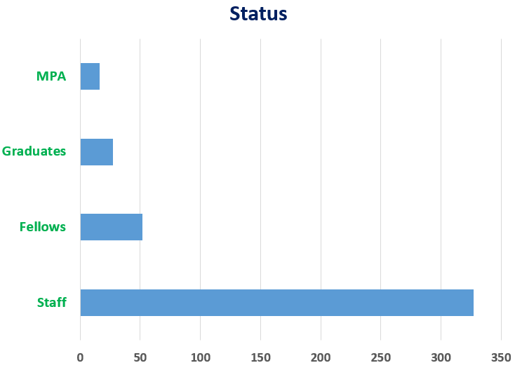
Who are we in EN?
28 Nationalities
AT | BE | BG | CH | CZ | DE | DK | EE | ES | FI | FR | GB | GR | HU | IN | IT | MT | NL | NO | PK | PL | PT | RO | RS | SE | SK | TR | UA
4 | 21 | 2 | 22 | 1 | 11 | 2 | 1 | 34 | 5 | 189 | 20 | 7 | 3 | 2 | 41 | 1 | 4 | 1 | 2 | 19 | 16 | 3 | 3 | 3 | 1 | 3 | 1
Professional Category
Office and Administrative work | 15 | 3%
Technical work | 197 | 47%
Scientific and Engineering work | 210 | 50%

Slide 9

AA : Access and Alarms
The AA group is in charge of the specification, engineering, installation and maintenance of the systems that ensures the Safety of the CERN Personnel,
Users and Visitors, on all its site and facilities.
The Safety Systems concerns:
          Fire and Gas/ODH detection, emergency phones and evacuation, alarm transmission and monitoring,
          Interlocks to protect people radioactivity, X rays, lasers, electricity and cryogenics hazards,
          Access control to all CERN conventional or nuclear facilities and sites,
          Video surveillance, protection and intrusion detection,
          Access data management applications.
Group Leader
Pierre Ninin
Notes:
Machines & Experimental Facilities: is responsible for planning and coordinating all maintenance and installation activities in the CERN Accelerator Complex, providing support to the experiments using the CERN accelerators.

Slide 10
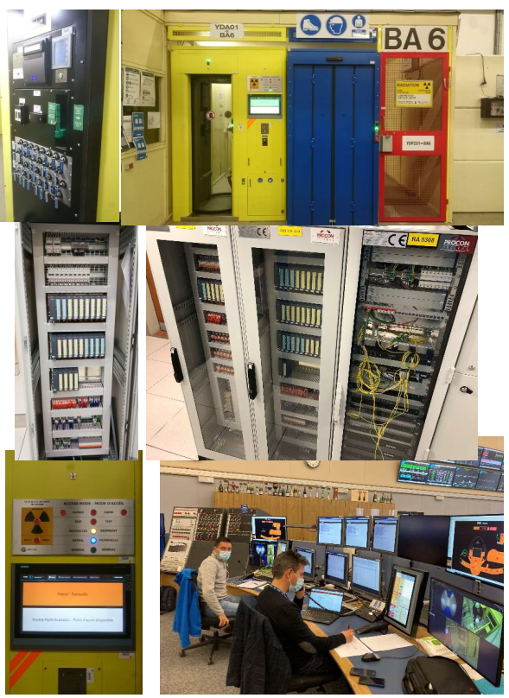
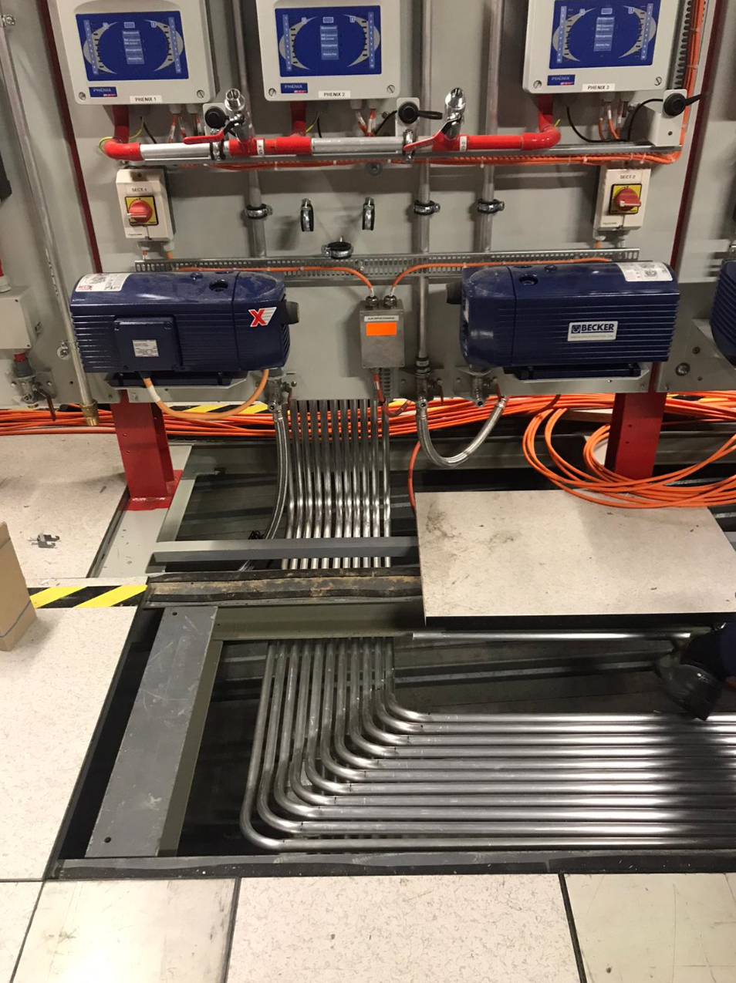
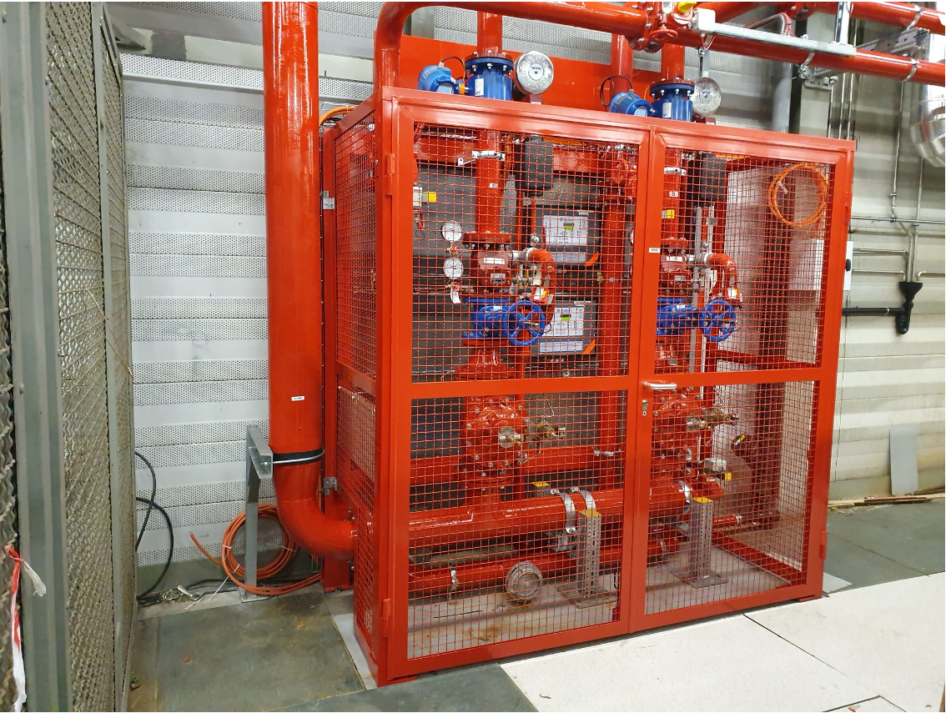
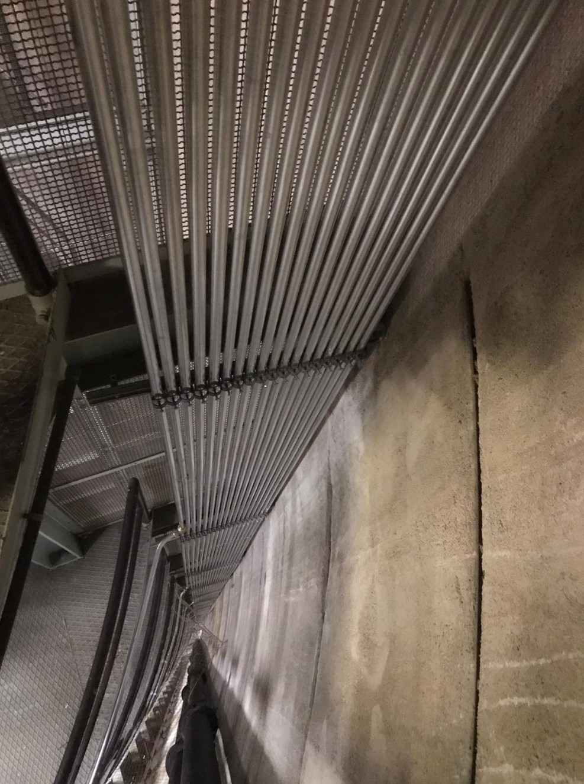
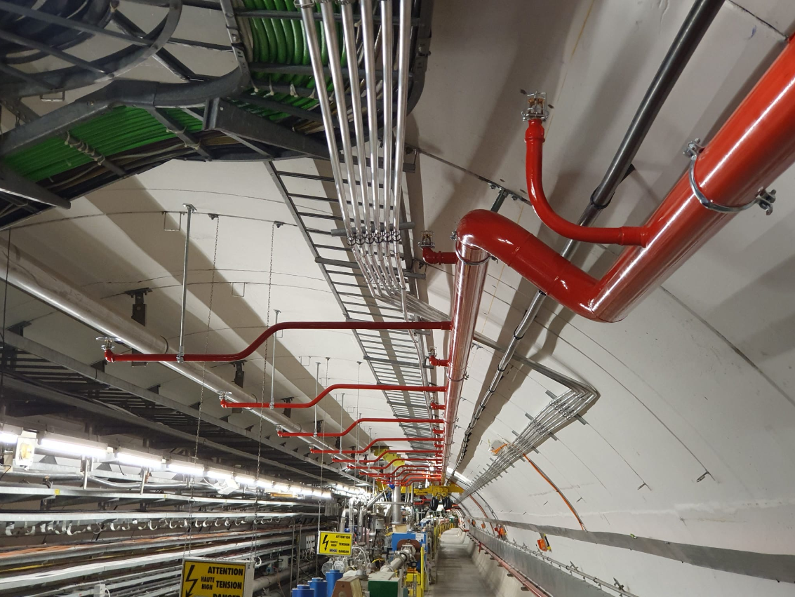
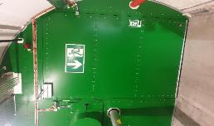
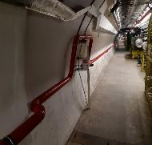
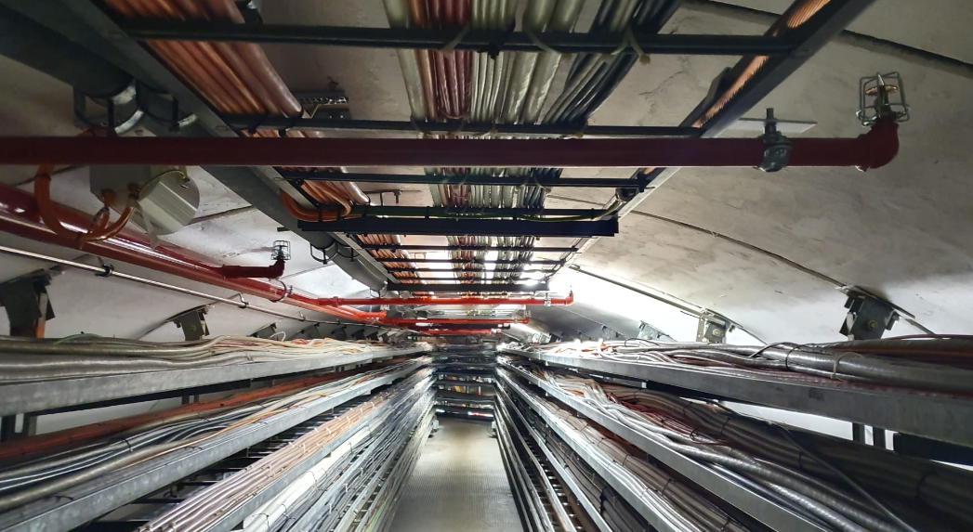
SPS-FIRE Safety Project: new automatic fire detection & fire protection
SPS-ACCESS Project: new access and safety system to the SPS underground areas
Notes:
Machines & Experimental Facilities: is responsible for planning and coordinating all maintenance and installation activities in the CERN Accelerator Complex, providing support to the experiments using the CERN accelerators.

Slide 11
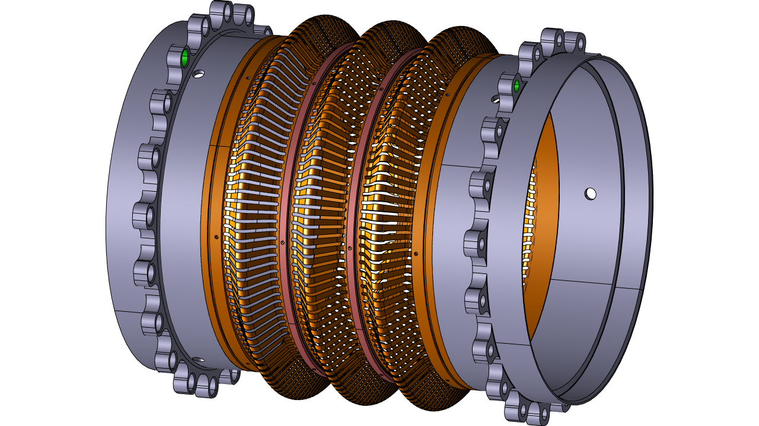
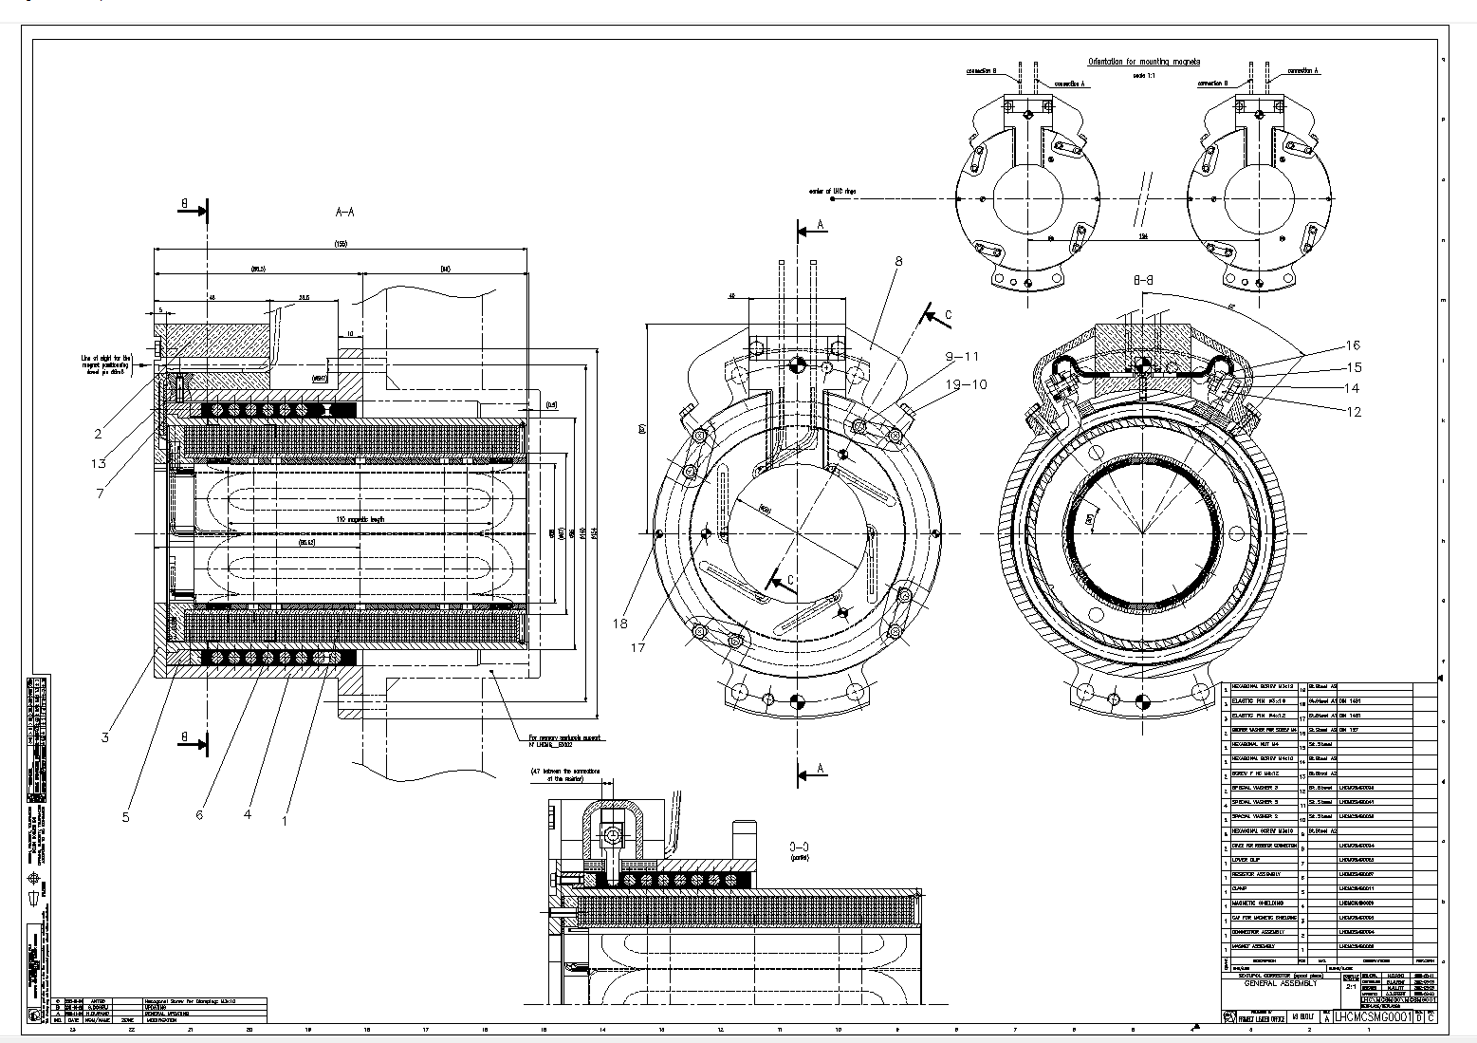
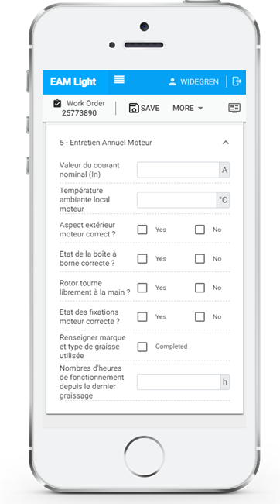
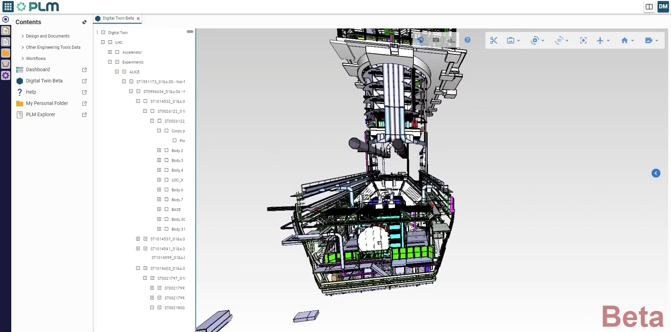

IM : Information Management
The IM group provides applications and support for engineering information management throughout the whole Organization and its different projects.
This includes for example mechanical CAD tools (such as CATIA), Product Lifecycle Management systems (Smarteam / Aras), the Engineering Data Management Service (EDMS) as well as the Enterprise Asset Management platform (EAM).
The group helps implementing and configuring these tools according to user needs while ensuring that coherent processes are applied and provides user training.
Group Leader
David Widegren
Notes:
Machines & Experimental Facilities: is responsible for planning and coordinating all maintenance and installation activities in the CERN Accelerator Complex, providing support to the experiments using the CERN accelerators.

Slide 12
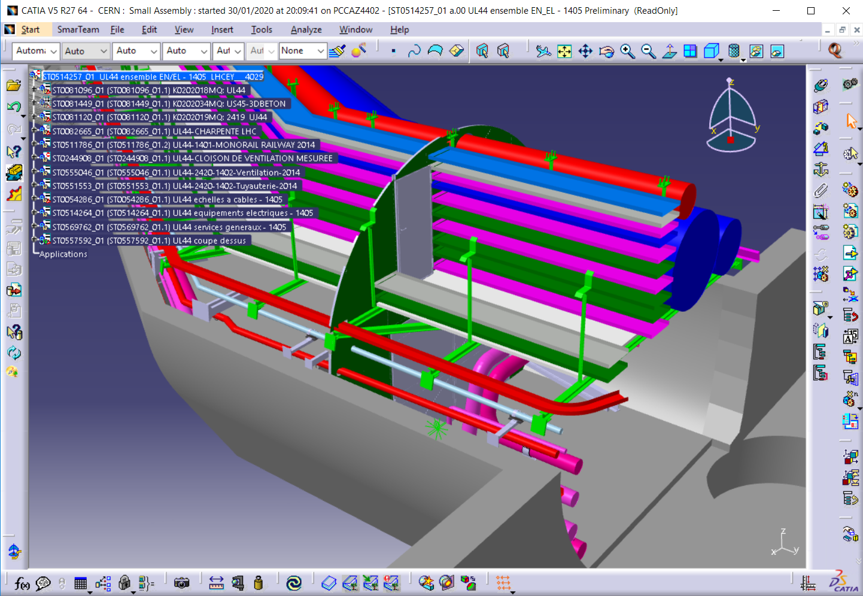
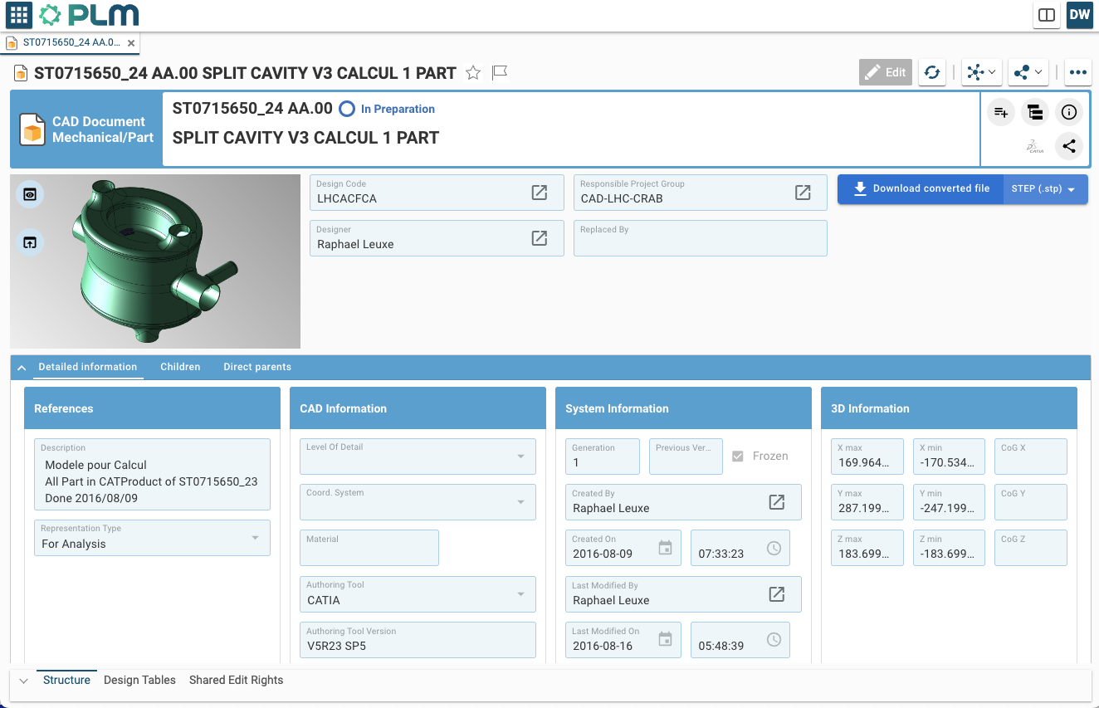
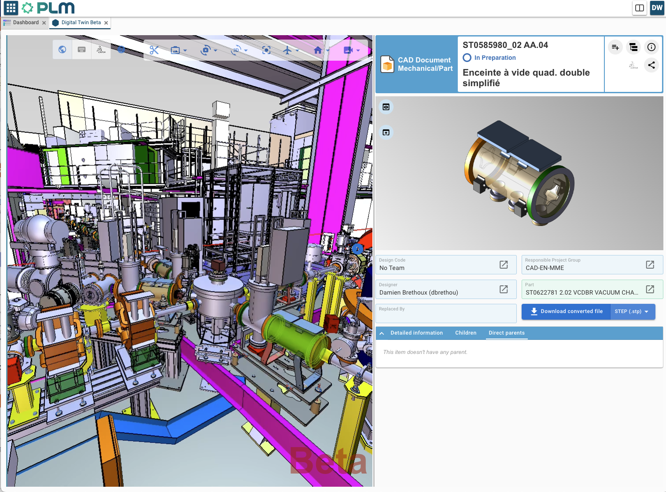
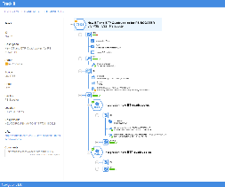
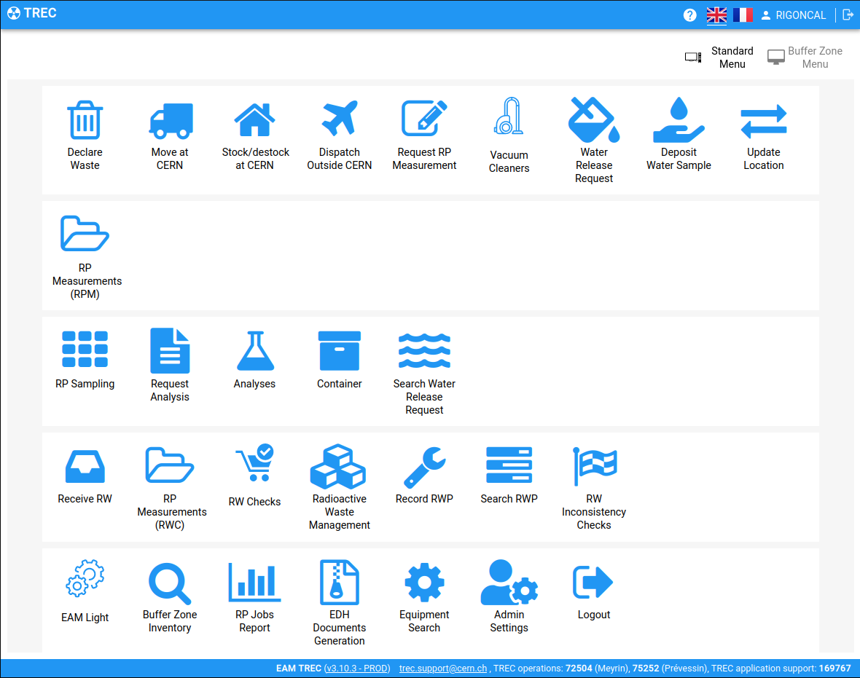
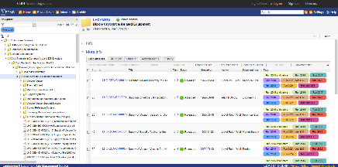
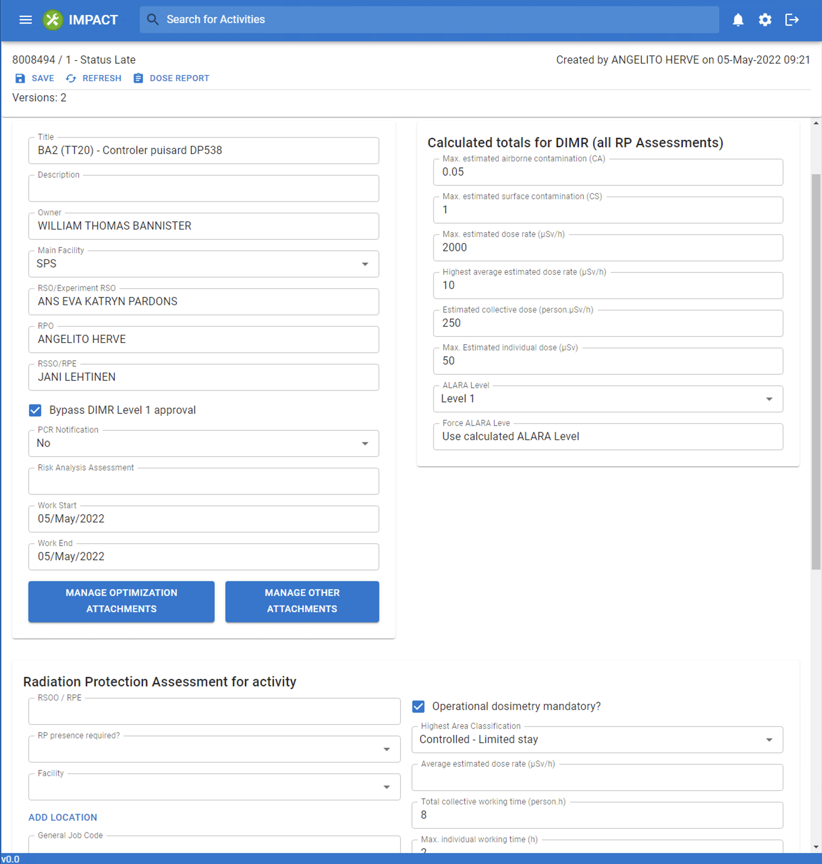
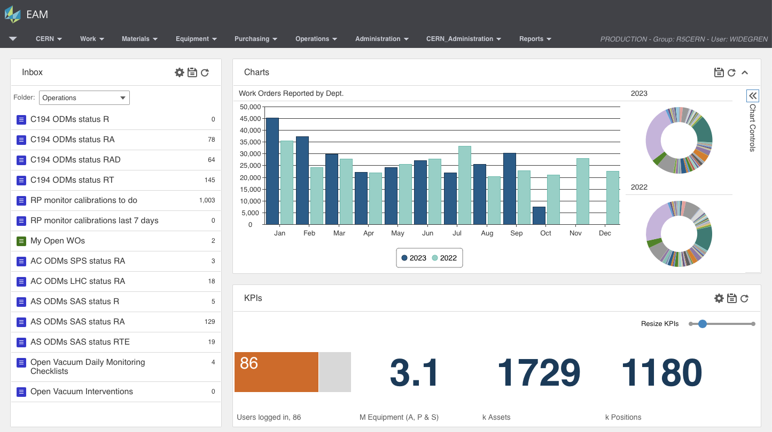
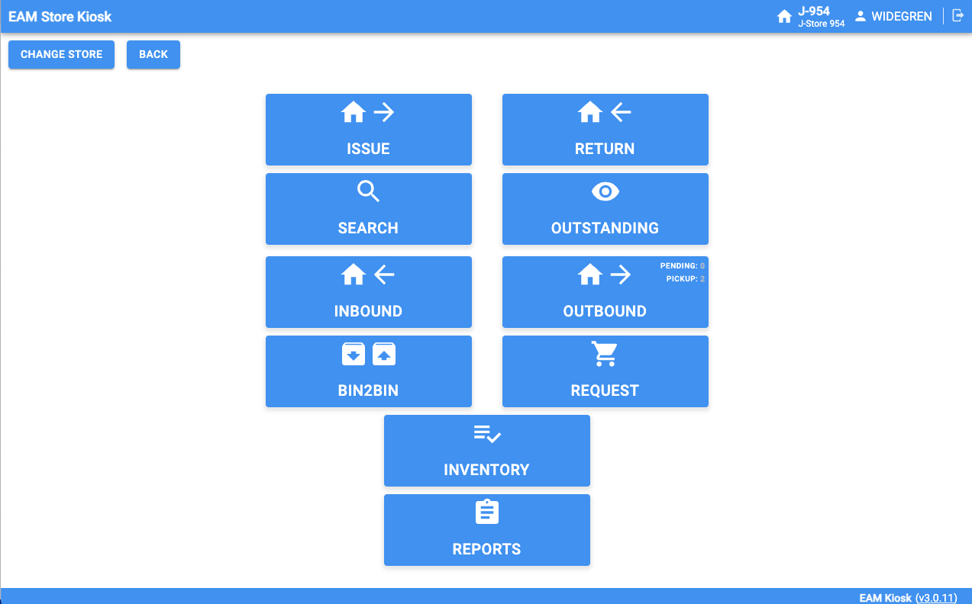
IM : Information Management
A key goal is to provide the tools required to manage and document the entire lifecycles of CERN’s equipment and installations – also known as “Digital Thread”.
CAD
Mechanical 3D CAD
PLM
Product Lifecycle Management
3D Digital Twins
Navigation / Visualization of Product Data
Track It
Activity Coordination
TREC
Radioactive Traceability
EDMS
Engineering Document Management
IMPACT
Work Permit Management
EAM
Enterprise Asset Management
EAM Store Kiosk
Spare Part Management
EAM Light
Simplified / Mobile EAM Interface
Notes:
Machines & Experimental Facilities: is responsible for planning and coordinating all maintenance and installation activities in the CERN Accelerator Complex, providing support to the experiments using the CERN accelerators.

Slide 13

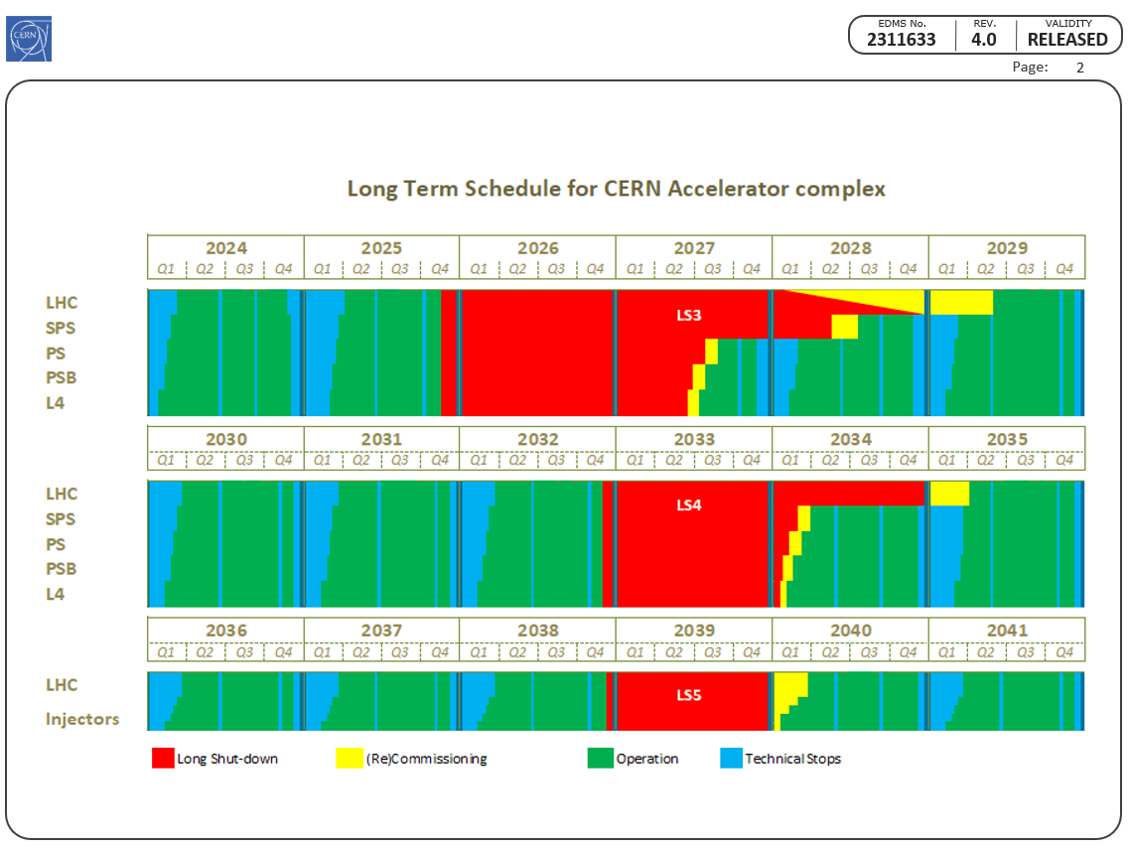
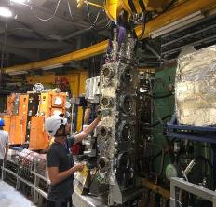
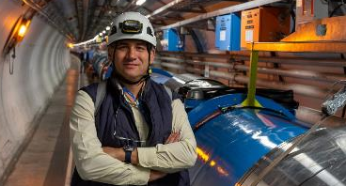
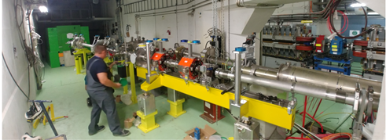
ACE : Accelerator Coordination & Engineering Group
The group coordinates the activities for the interventions and changes to the LHC and its injectors. This includes configuration & layout management, integration studies and maintenance of the related 3D-CAD representations, organization and scheduling of programmed stops, management of the mid- and long-term schedule, worksites follow-up and management of the LHC sites, management of electrical lock-out in LHC and operational safety coordination.
The group is responsible for the ATS Quality Service, giving support to the stakeholders of the ATS.
The group also provides support and/or advices in its key competencies.
Group Leader
Jean-Philippe Tock
Notes:
Machines & Experimental Facilities: is responsible for planning and coordinating all maintenance and installation activities in the CERN Accelerator Complex, providing support to the experiments using the CERN accelerators.

Slide 14
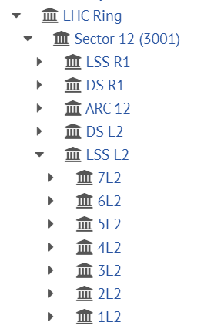
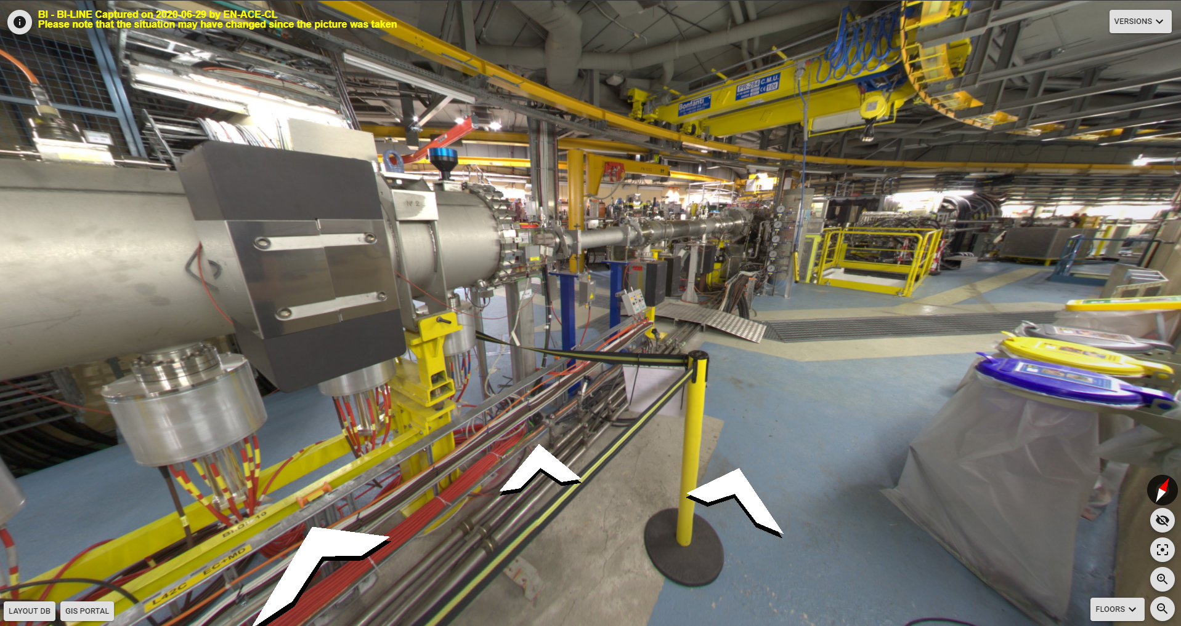
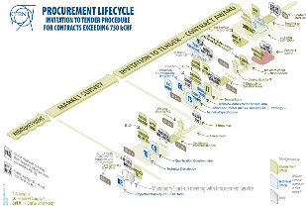
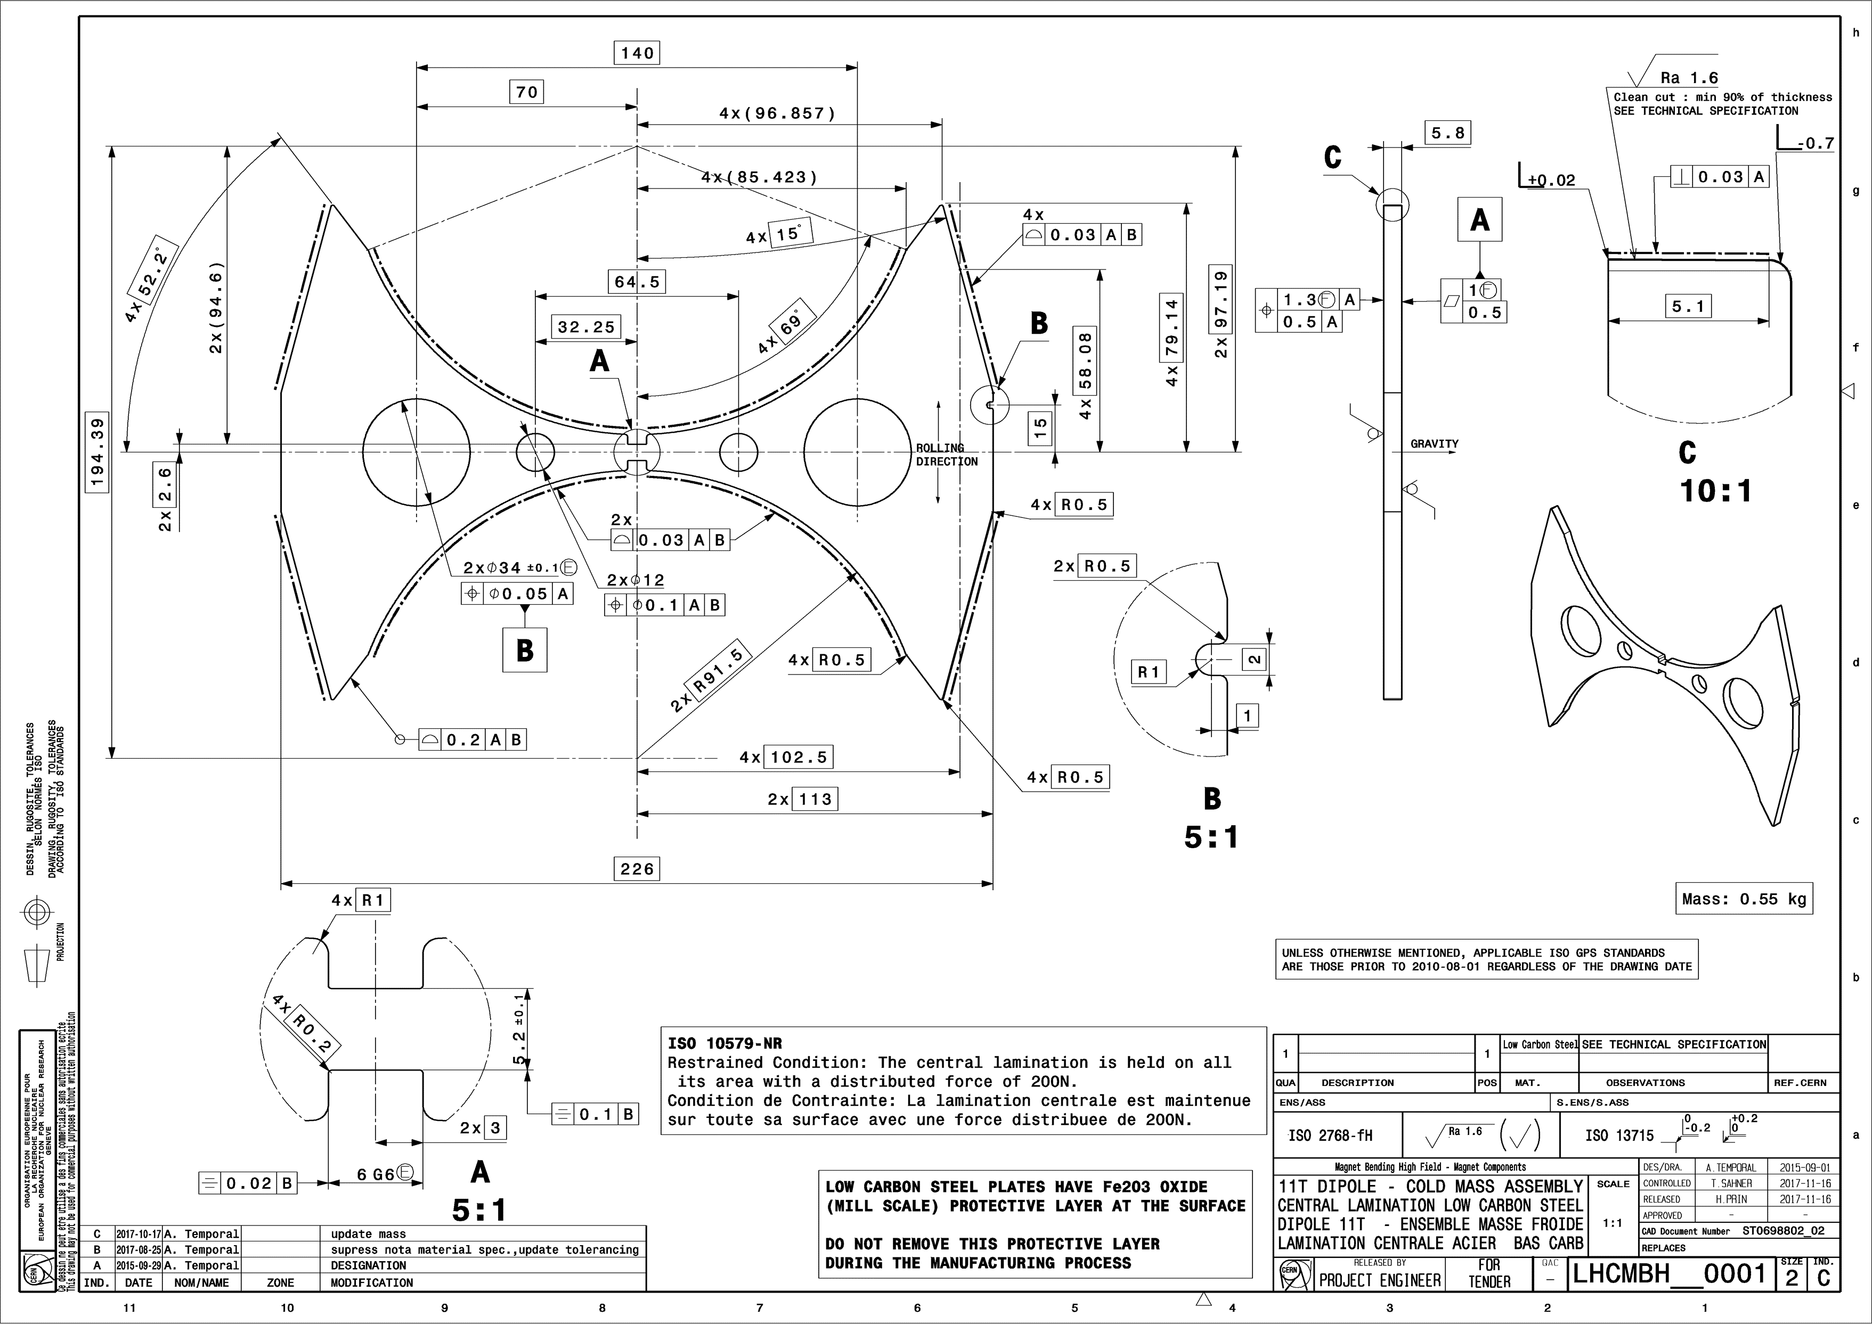
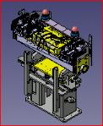
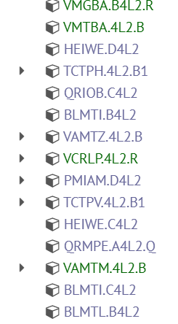

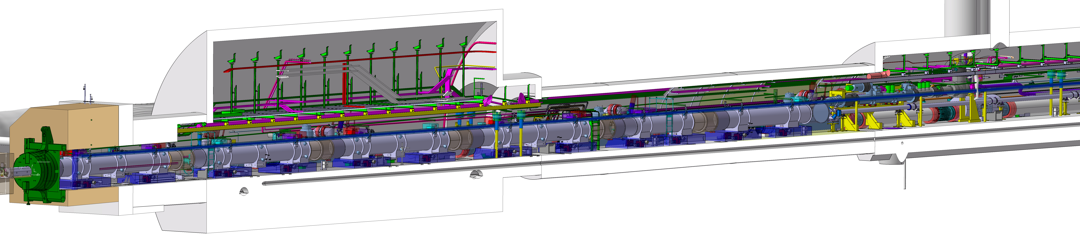
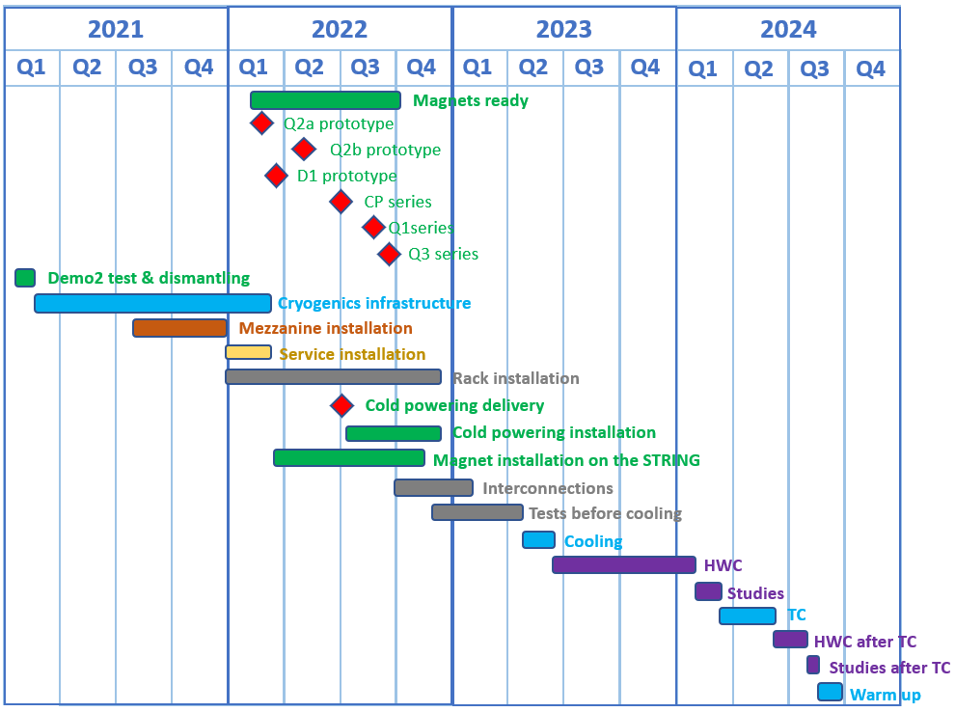
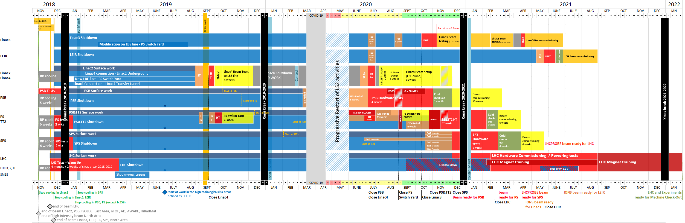
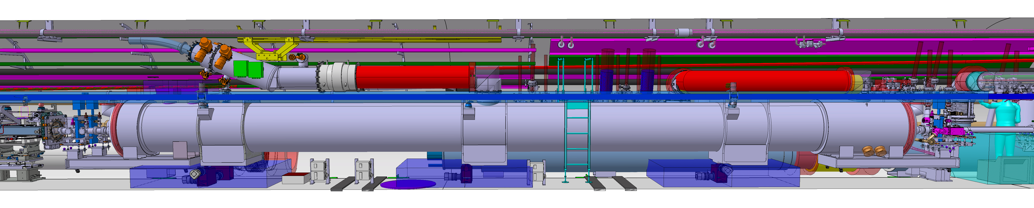
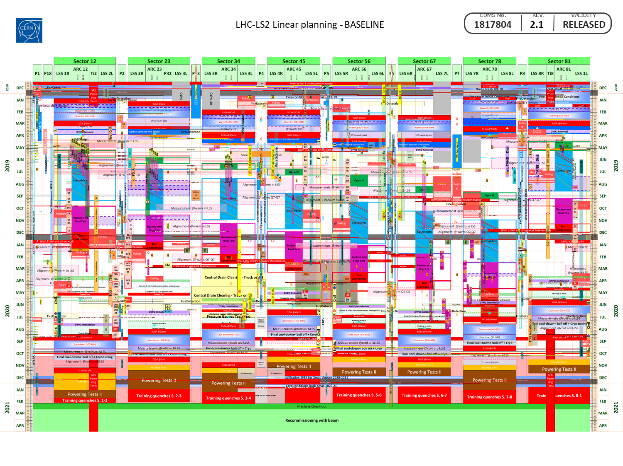
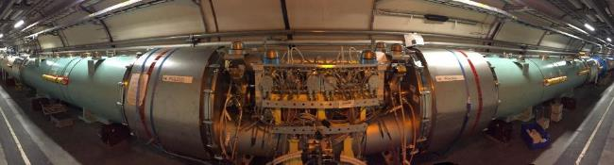
ACE : Accelerator Coordination & Engineering Group
Configuration, Layout, Naming and Integration
Specification Committee
Organisation and Scheduling
Notes:
Machines & Experimental Facilities: is responsible for planning and coordinating all maintenance and installation activities in the CERN Accelerator Complex, providing support to the experiments using the CERN accelerators.

Slide 15
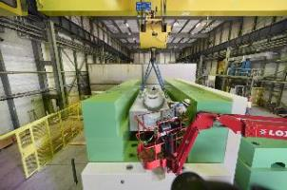
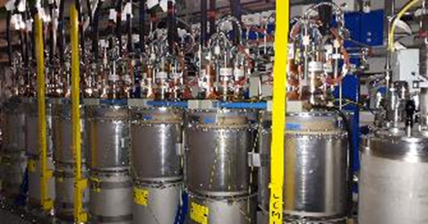
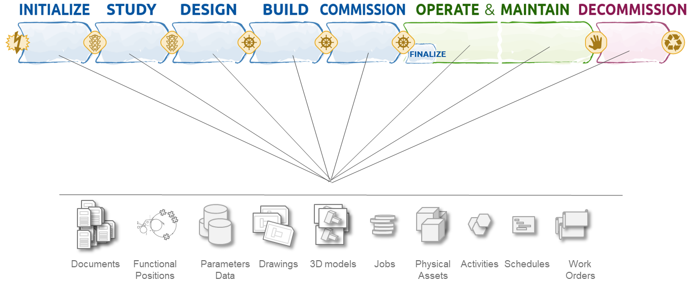
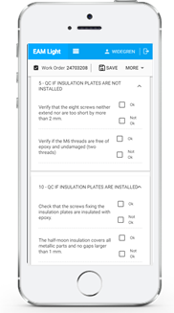
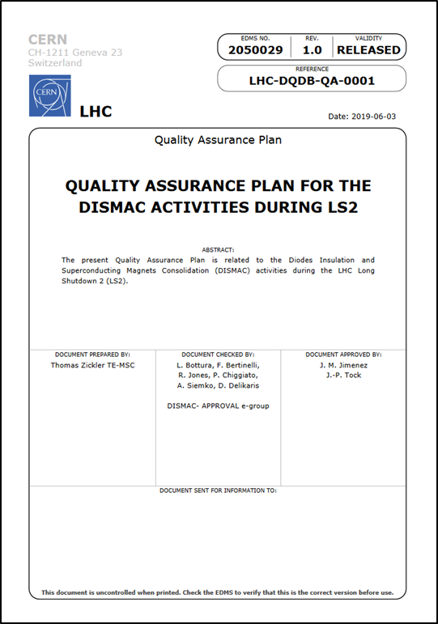
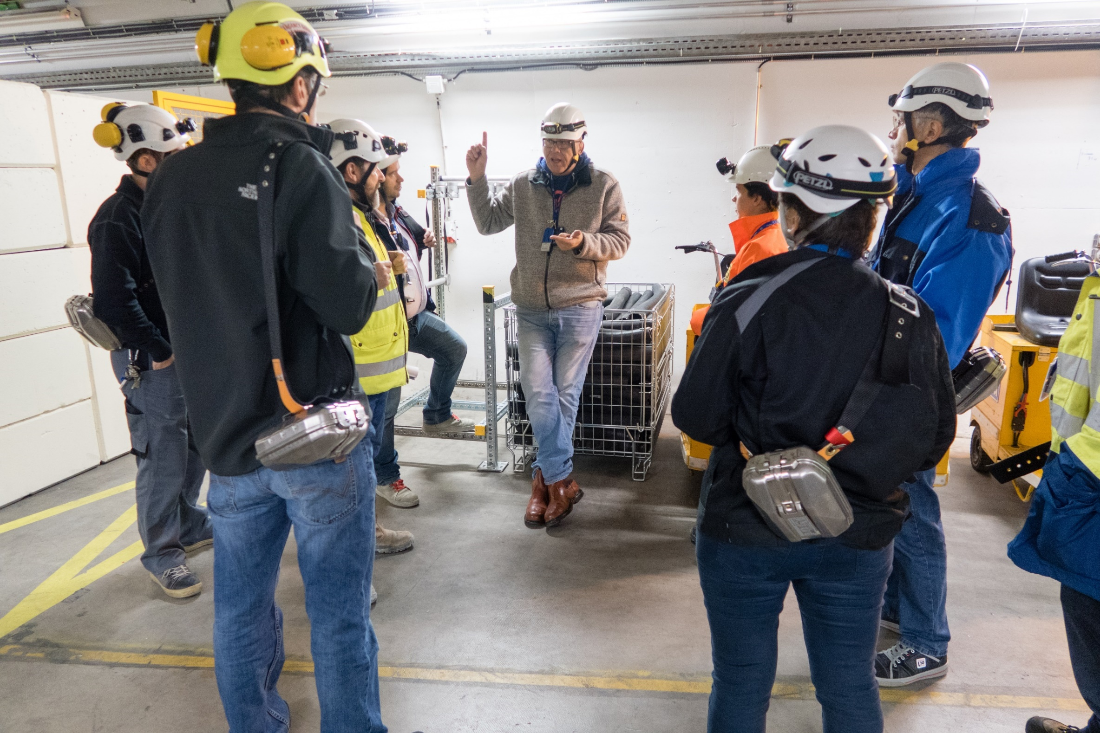
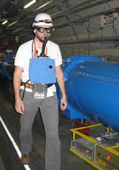
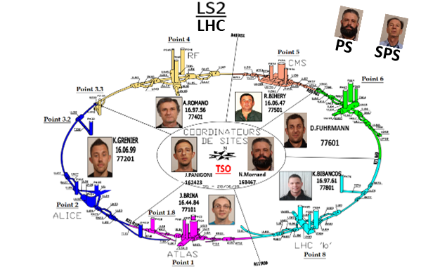
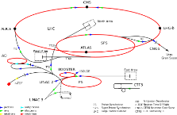
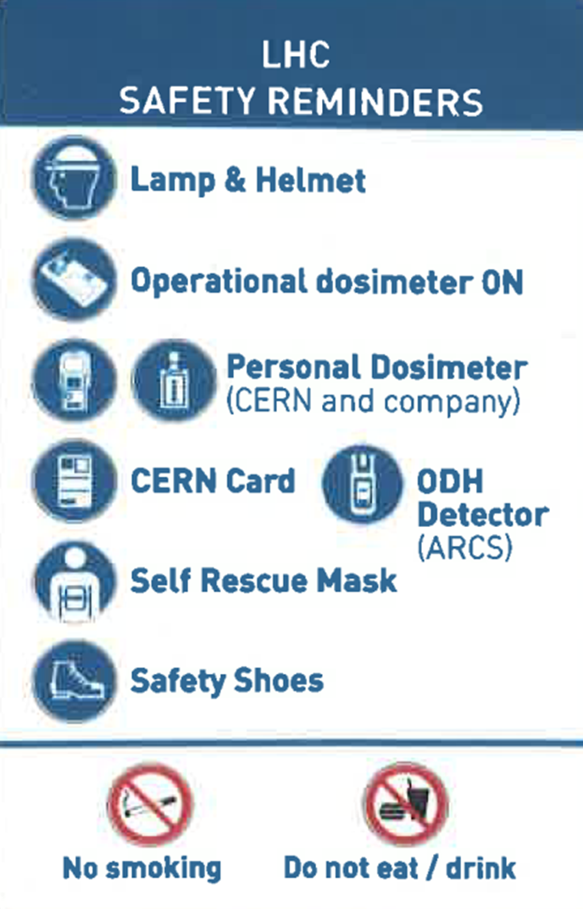



ACE : Accelerator Coordination & Engineering Group
Electrical lock-out
Quality Assurance Service
Operational Safety
Worksite management
Notes:
Machines & Experimental Facilities: is responsible for planning and coordinating all maintenance and installation activities in the CERN Accelerator Complex, providing support to the experiments using the CERN accelerators.

Slide 16



PAS : Planning, Administration and Safety
The group is responsible for supporting the Department Head in the management and planning of the department’s material and personnel resources, as well as for all matters related to safety and environment. It represents the department in CERN-wide or inter-departmental bodies dealing with administrative, personnel, budget and safety matters. It also defines and implements safety and administrative procedures, for both the personnel and the material within the Department.
People
Group Leader
Mauro Nonis

Slide 17




PAS : Planning, Administration and Safety
Safety
Budget

Slide 18




CV: Cooling and Ventilation Group
The group is in charge of:
Design, installation, commissioning, operation and maintenance of the cooling systems, pumping stations, air conditioning plants and fluid distribution systems of all accelerators, their experimental areas and some of the special cooling systems of LHC sub-detectors.
Computational fluid dynamics (CFD) simulations, as well as studies on fluid dynamics, ventilation, heat transfer, smoke behavior, gas and radio nuclides propagation are performed by the group.
Group Leader
Ingo Ruehl
Notes:
Cooling & Ventilation Group (Groupe Refroidissement et Ventilation):
is in charge of the operation, maintenance and innovation of cooling systems, pumping stations, air conditioning installations.

Slide 19



Cooling
Cooling plants (raw, demin. water, C₃F₈, C₆F₁₄) | 150
Pipelines | 800 km
Hydrants | 800 points
Cooling towers (450 MW) | 22
Chilled water plants 6-12 °C (73 MW) | 35
Water consumption (annual) | 2’800’000 m³
Water network (3 pumping stations capacity) | 7’398 m³/h
Equivalent to a small town of ~50’000 inhabitants.

Slide 20




Ventilation
Heating, ventilation and air conditioning | > 1’500 units from 2’000 to 120’000 m³/h each
Compressed air | 14 stations 200 km network
 | km | m³/h
Eurotunnel | 50 | 540’000
LHC | 27 | 72’000

Slide 21




EL : Electrical Engineering Group
The mandate concerns the electrical distribution network from 400 kV to 400/230 V. Its main missions are to operate, maintain, extend and renovate the network, analyse and make projections for CERN electrical energy consumption and manage relations with the energy suppliers.
Group Leader
Jan De Voght
Notes:
Electrical Engineering Group: is responsible for the CERN electrical distribution network from 400kV to 230V including all CERN cabling and fiber optic activities.

Slide 22
Electricity Distribution
Genissiat
Chamoson
Verbois
BOIS-TOLLOT
400kV - RTE
400kV - CERN
Normal source EDF > 200 MW
EHT1
90MVA
EHT2
90MVA
EHT3
90MVA
EHT4
110MVA
EHT5
110MVA
BEQ3
BEQ2
BEQ1
BE -18kV
SEH9 - 66kV
SPS
NA
MP10
G
L2
L4
L6
L8
BE – BE9
60MVA
BE91
EHT7
70MVA
EHT102
38MVA
EHT103
38MVA
EHT102
38MVA
EHT102
38MVA
EHT102
38MVA
SPS
NA
BE9 - 18kV
Prévessin
LHC2 -18kV
18kV- LHC4
LHC5 -18kV
LHC6 -18kV
18kV- LHC8
MP6
EHT102
70MVA
LHC Loop
MP7 - 30MVA
LHC1 -18kV
EHT102
70MVA
MP10
West
Area
Annual Consumption 1.2 TWh
1/3 of Geneva
ME59 - 18kV
MP5
60MVA
PS
ISOLDE
MP6
Comput.
Center
b.543
Admin.
Area
G
ME9 – 18kV
ME10 – 18kV
EHT611
63MVA
EHT612
63MVA
Poste CERN
130kV - SIG
Emergency source SIG/ALPIQ ≤ 60 MW
Zimeyza/Verbois
Verbois

Slide 23



EL : Electrical Engineering Group
The mandate also concerns the cabling activities. Its main missions are to install control cables, water cooled cables, and fibre optics for users. This activities include the management of infrastructures (cable trays, ducts, patch panels,etc.) and the necessary removal of old and unused installations.
EN-EL is also in charge of the controls of their distribution network.

Slide 24














HE : Handling Engineering Group
From enormous pieces of equipment with unconventional shapes, to extremely delicate detector parts, the careful handling and transportation of components is essential at CERN.
The Handling Engineering (HE) Group prepares, organizes and coordinates all transport and handling operations for the CERN accelerators and experiments as well as the transport of thousands of conventional items, chemical and radioactive products per year.
The Group is specialized in the design, integration and feasibility studies related to the transport and handling operations. Both standard industrial and custom-built transport and handling equipment is being procured, installed and commissioned.
The Group manages and maintains all the industrial transport, handling and lifting equipment to ensure the perfect performance all along its lifecycle.
With the accelerator complex deep underground and about 700 buildings on surface, both passenger and goods lifts are very important. The HE Group is responsible for the purchase, installation and maintenance of all of them, regularly checking their performance.
Group Leader
Cristiana Colloca
Notes:
Handling Engineering Group: provides transport and handling services for the technical infrastructure of CERN, the accelerators, the experiments.

Slide 25















HE : Handling Engineering Group
132 Personnel & Goods Lifts
83 Forklifts
381 Cranes
158 Tractors
2000 Lifting Beams
5 Mobile Cranes,
23 Mobile Working Platforms
About 6000 assets in Total
52 Special Vehicles

Slide 26





MME: Mechanical and Materials Engineering Group
The mandate of the MME group is to provide to the CERN community specific engineering solutions combining mechanical design, fabrication and material sciences, using in-house and industry facilities, for beam accelerator components and physics detectors.
Prototypes and development work
Beam
Design
Measurements
Simulations
Group Leader
Said ATIEH
Fabrication & Assembly
Notes:
Mechanical & Materials Engineering: provide the CERN community specific engineering solutions combining mechanical design, production facilities and material sciences.

Slide 27

MME : Domains of activities
Design
Fabrication
Materials
Design Office
  50+ designers and 15+ engineers
  CATIA v5 / SmarTeam, ANSYS, LS-Dyna
Mechanical Measurements Lab.
Mechanical workshop (4000 m²)
  60+ technicians and 10+ engineers
  CNC machining
  Assembly & metal forming
  Metal Additive Manufacturing
  Welding (TIG, MIG, electron beam, laser, vacuum brazing)
Technical Subcontracting unit
Material science consultancy
  metallurgical analyses, microscopy including FIB, mechanical tests
NDT: UT, radiography, microtomography
Metrology: 350 m² Lab., several CMM

Slide 28
When will we be doing
what we are expected to do?

Slide 29

A long-term perspective

Slide 30

?
?
?
?
4

Slide 31
MAGIC OF CERN
Science is an extraordinary human endeavor
Our understanding of nature at the fundamental level has reached astounding results
The complexity of science requires a combined effort technology + experiments + theory
CERN is a superb example of this combined effort at work
The scientific success of CERN belongs to all of us

Slide 32
What are our priorities?

Slide 33


Our priorities
1
2
3

Slide 34

CERN Safety responsabilities
Responsibilities and organisational structure in matters of Safety at CERN are defined in Safety Regulation SR-SO
The Department Leader and your Group Leader have the overall responsibility for your safety conditions at work
Each of us is responsible for safety in our work so YOU are the first person involved in your own safety
Each person participating in the activities of the Organization or present on its site shall actively contribute to the implementation of the CERN Safety Policy through exemplary conduct and, in particular, compliance with the CERN Safety Rules, the CERN Safety Objectives and best practices, actively seeking information to minimise risks, avoiding dangerous situations for herself/himself and others and exercising the responsibilities assigned to her/him safely.

Slide 35


Safety organization

Slide 36


Safety first steps
The first steps to do when arriving at CERN regarding safety matters:
  Define your activity and identify the hazards associated to it with your supervisor
      Fill the documents (https://edh.cern.ch/Document/General/OHS)
  Purchase the needed safety equipment via the CERN catalogue(https://edh.cern.ch)
      Ask your supervisor for a budget code
      Wear the appropriate PPE according to potential risks
      Self-rescue mask, ODH detector and personal dosimeter are mandatory for particular activities
  Once the hazards have been identified: Follow the appropriate safety training courses via Learning Hub
Mandatory training:
      Safety at CERN
      Emergency Evacuation
      Radiation Protection –Awareness
    Recommanded training
      First Aid – Life Saving Actions
  Request access permission via ADaMS
  Always follow the appropriate safety training courses before requesting the access and mention
  a clear justification (otherwise the access will not be approved)

Slide 37



Workplace
Be familiar with your working environment & make sure that you know:

Slide 38


Reliability techniques

Slide 39

In case of emergency
KEEP CALM
Call the fire brigade n°(+41 22 76) 74444 and communicate
  Who you are (CERN ID, phone number)
    Where you are (building, number on the door)
      What is going on
      Never hang up without fire brigade authorization
Important: Do not use the European Emergency call 112 ➔Your call will be treated outside CERN
1
2
3

Slide 40

Incident report
Must be done within 48 hours
« Incident declaration » via EDH
        4 topics
          Circumstances (Date/Time/Location/Description)
              Allows to understand the event
          Consequences (Personal injury/Material damage/Environmental consequences)
              To determine whether an accident or near miss has occurred
              Allows to determine the routing of information
          Witnesses
          Comments
        Don’t forget to fill in the declaration of occupational accident if necessary (In case of injury/consultation)

Slide 41



Slide 42


Conclusions
What is expected from you?

Slide 43
Warm welcome again!

