Slide 1
Overview of lossmaps and BLM thresholds for upcoming B1 proton quench test
C.E. Montanari, S. Morales Vigo, B.M. Salvachua Ferrando
BLMTWG - 15 October 2024

Slide 2
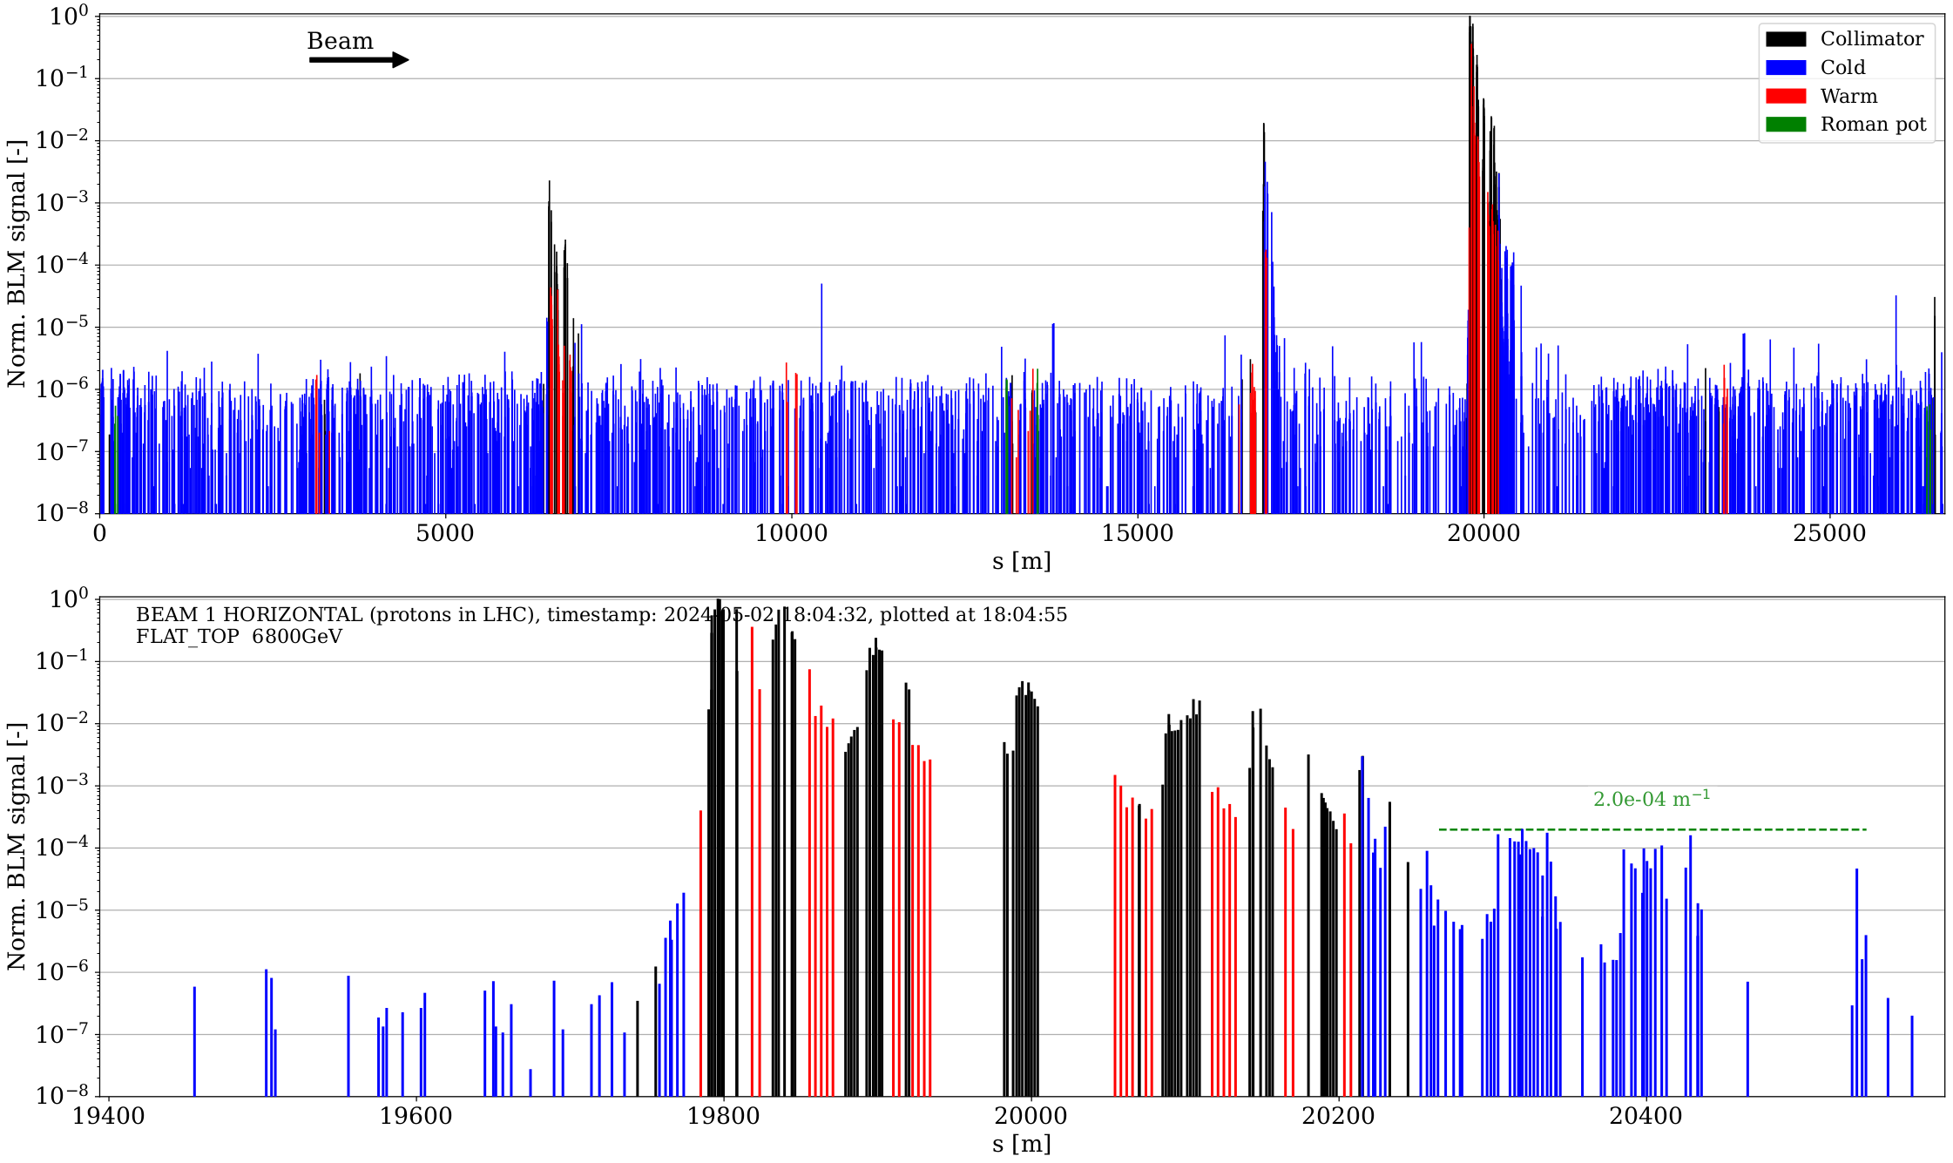
Relaxed B1H
Strong losses here on IR6...

Slide 3
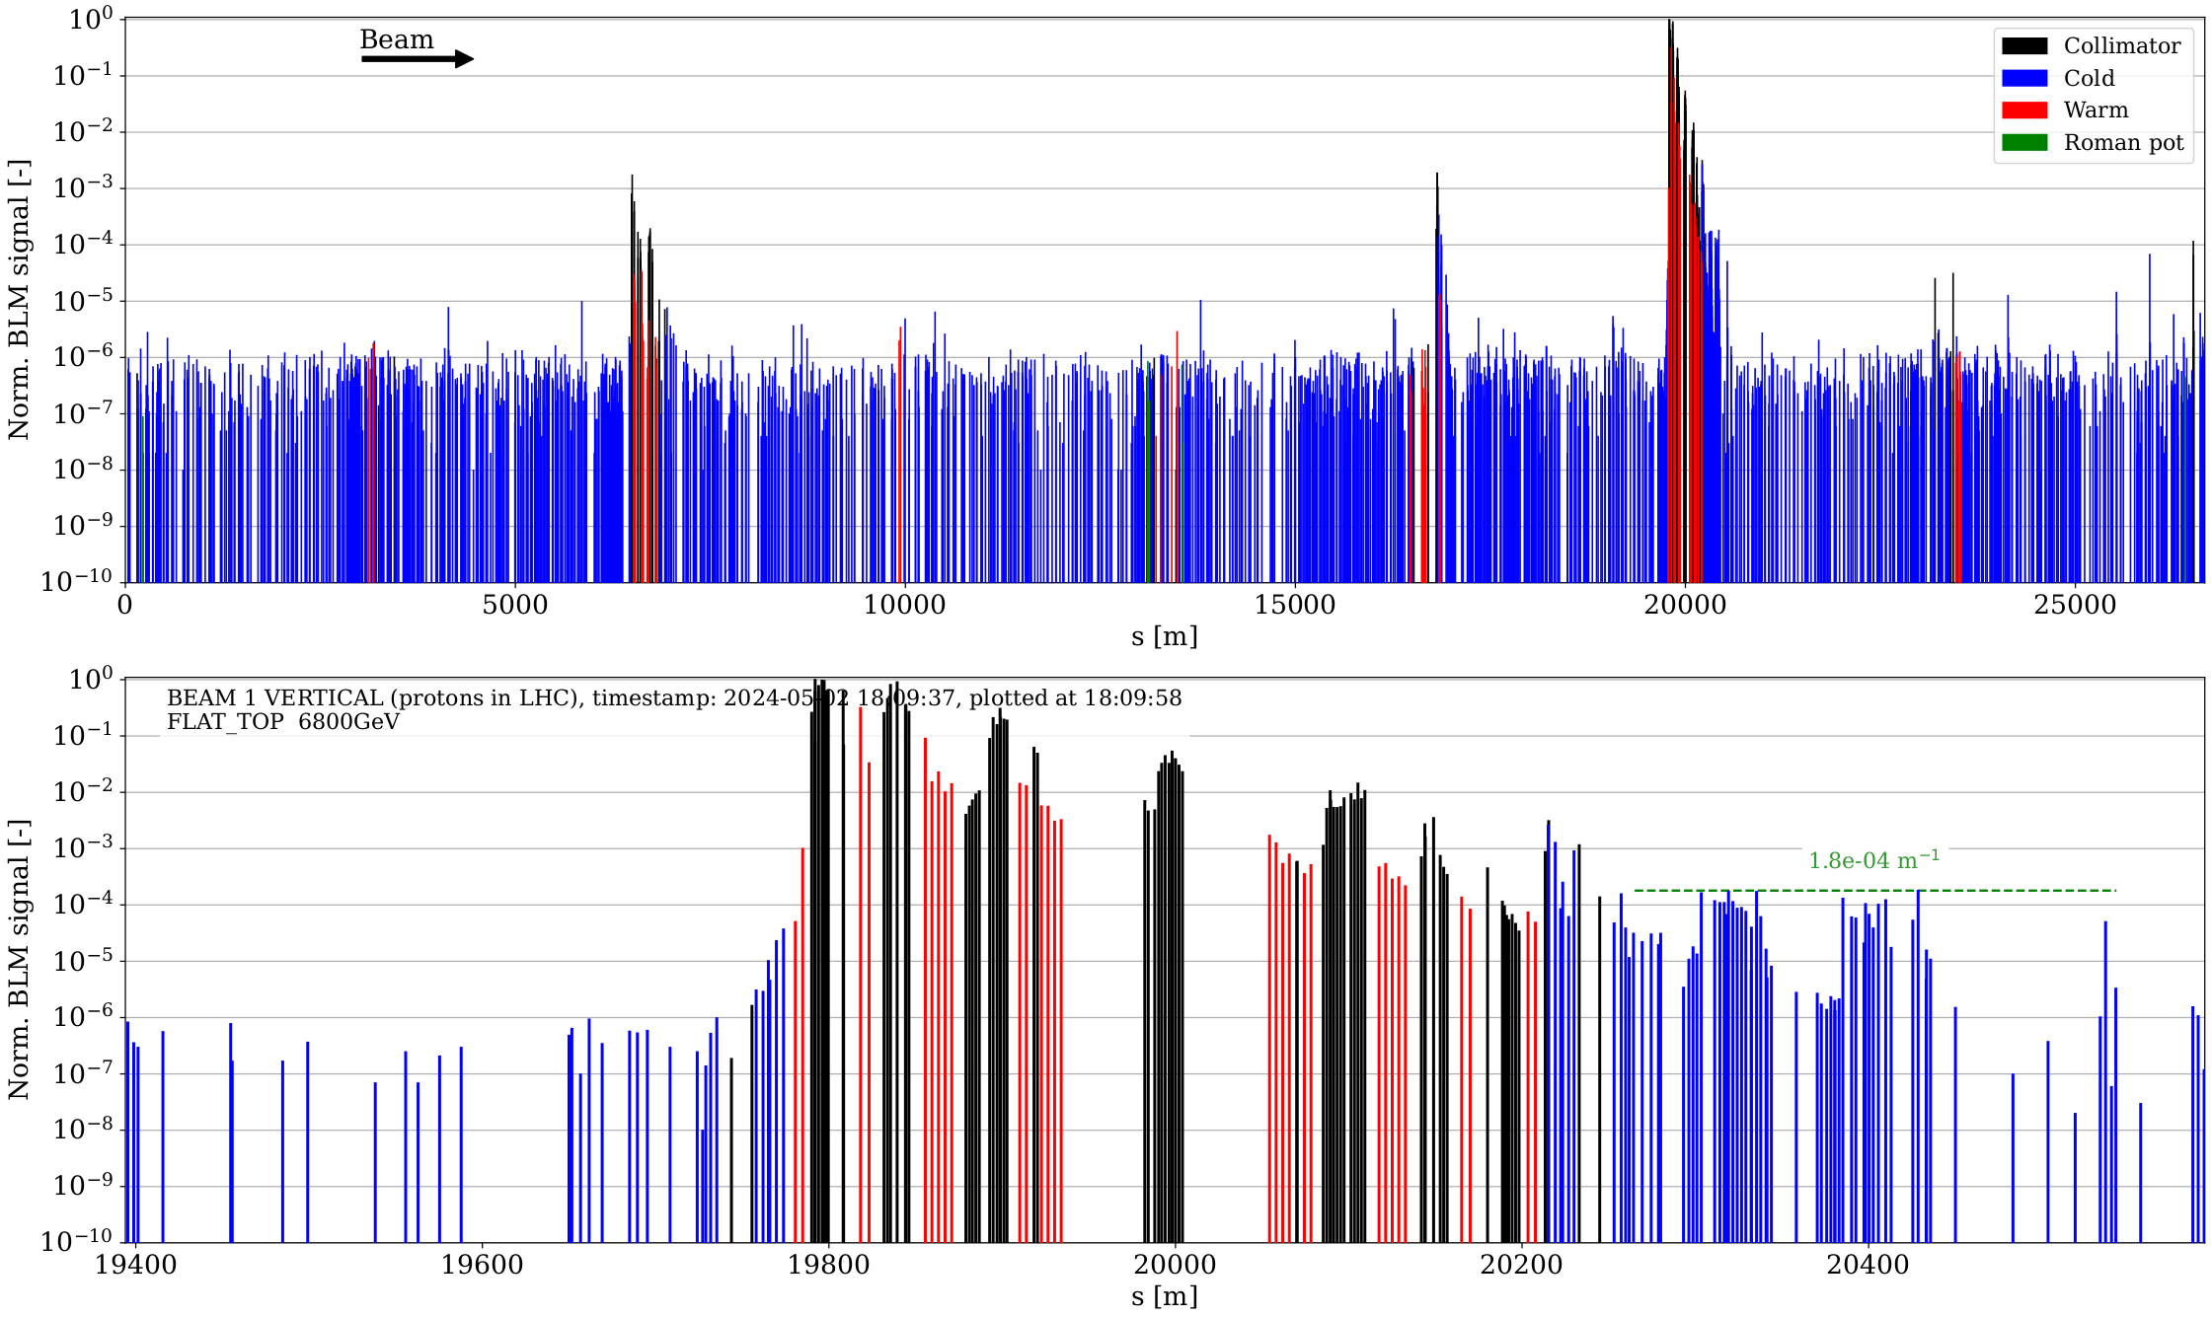
Relaxed B1V
Lower here!
Cleaning inefficiency still comparable with H plane

Slide 4
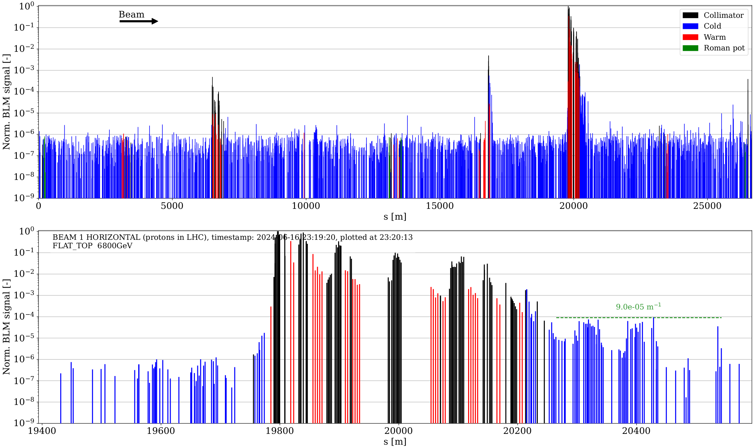
Nominal B1H
Same can be observed (relatively) in nominal loss maps

Slide 5
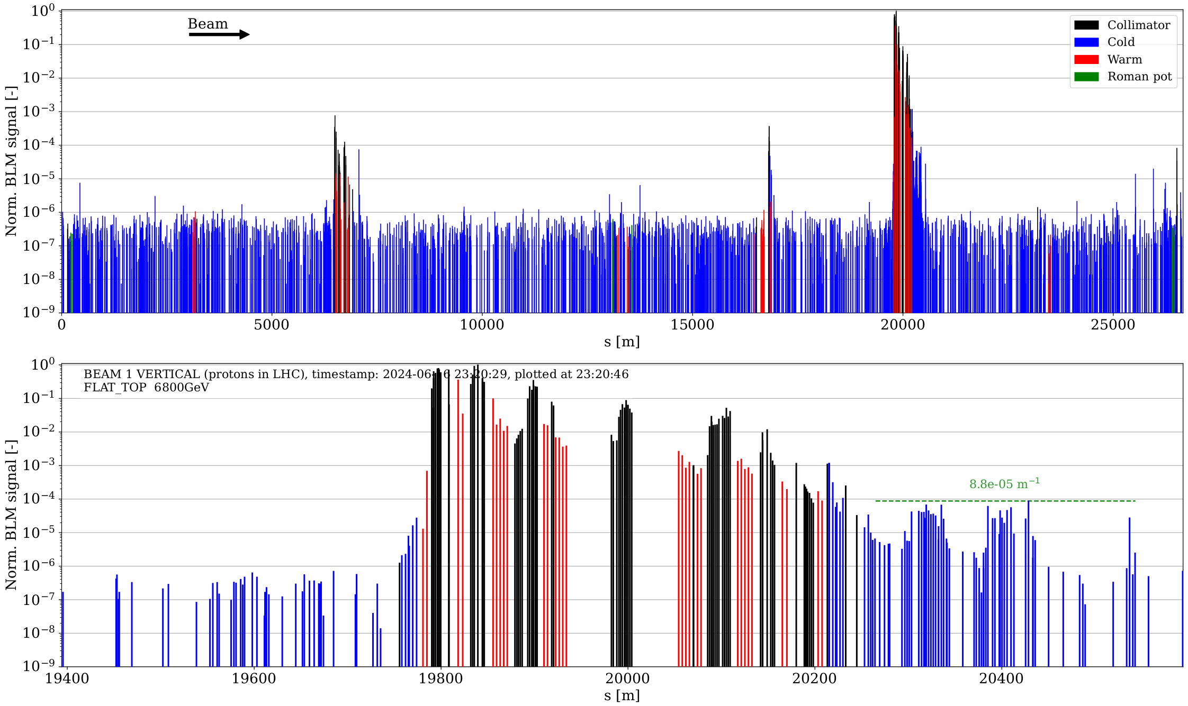
Nominal B1V
Same can be observed (relatively) in nominal loss maps

Slide 6
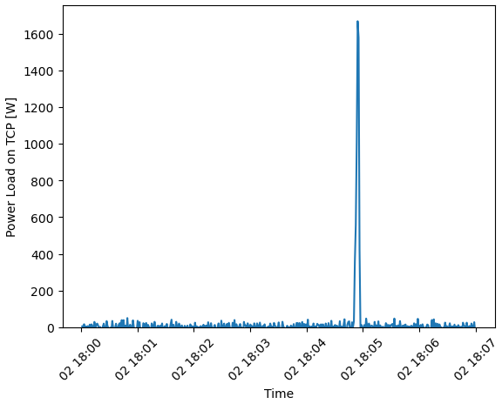
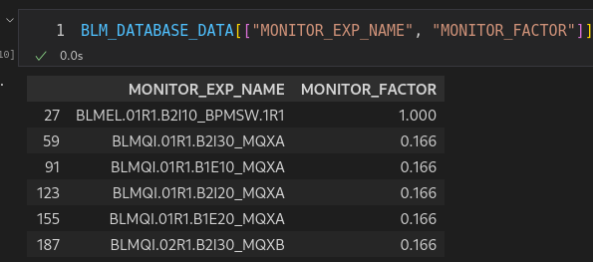
Inspecting BLM threshold with rescaled losses
Quick recall of the steps used to perform this analysis:
From a lossmap, gather the peak loss in W from FastBCT signal
Evaluate BLM Gy rescaling factor from observed peak power loss (1200kW / observed loss)
Apply rescaling factor to BLM signal observed @ peak loss time - bkg signal
Compare rescaled BLM signals and RS with:
  Original thresholds applied
  Original thresholds with Monitor Factor considered (i.e. threshold / monitor_factor)
Plots shown are currently considering RS from 4 and above (but data for lower RS is available as well!)
Peak power load from lossmap

Slide 7
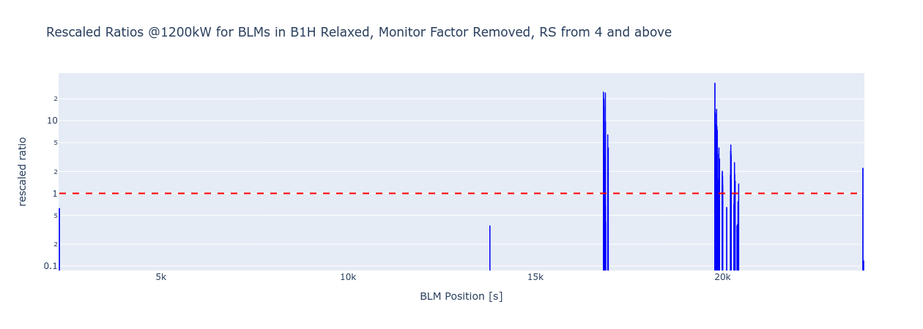
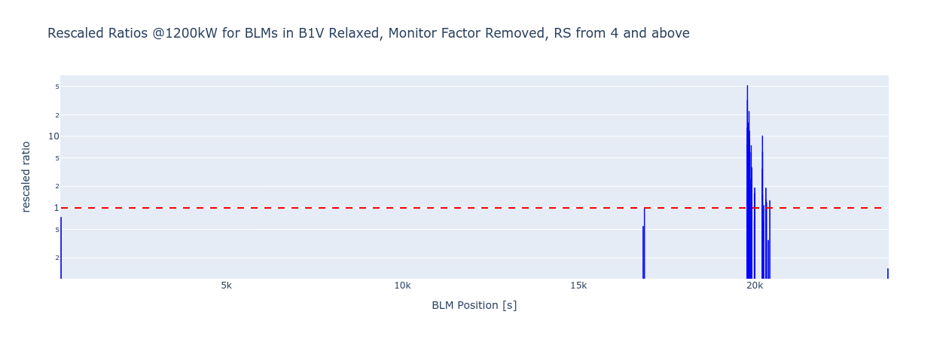
Ratios for relaxed settings, monitor factor removed
Clear strong leakage in IR6
when considering H plane
In V plane, situation looks more
under control...

Slide 8
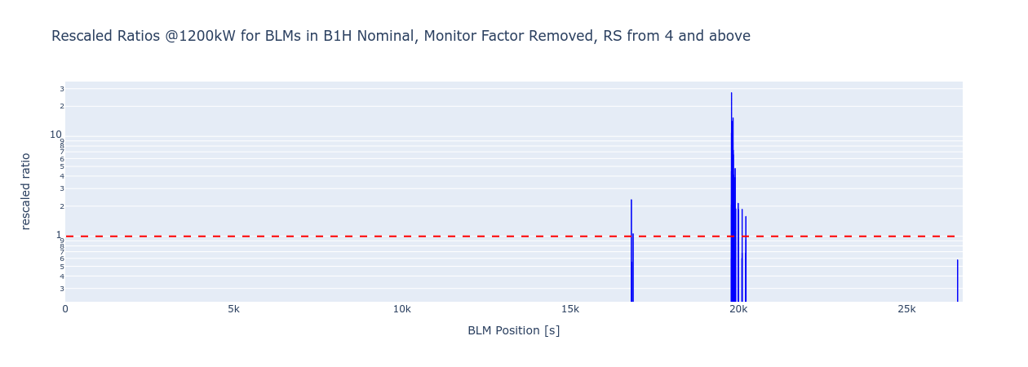
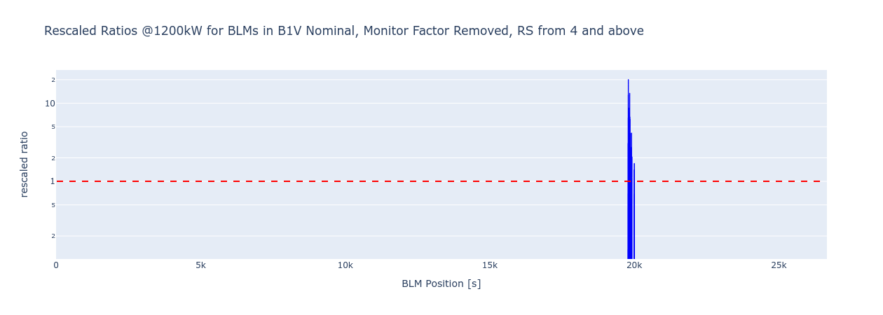
Ratios for Nominal settings, monitor factor removed
IR6 losses still present
in H plane

Slide 9
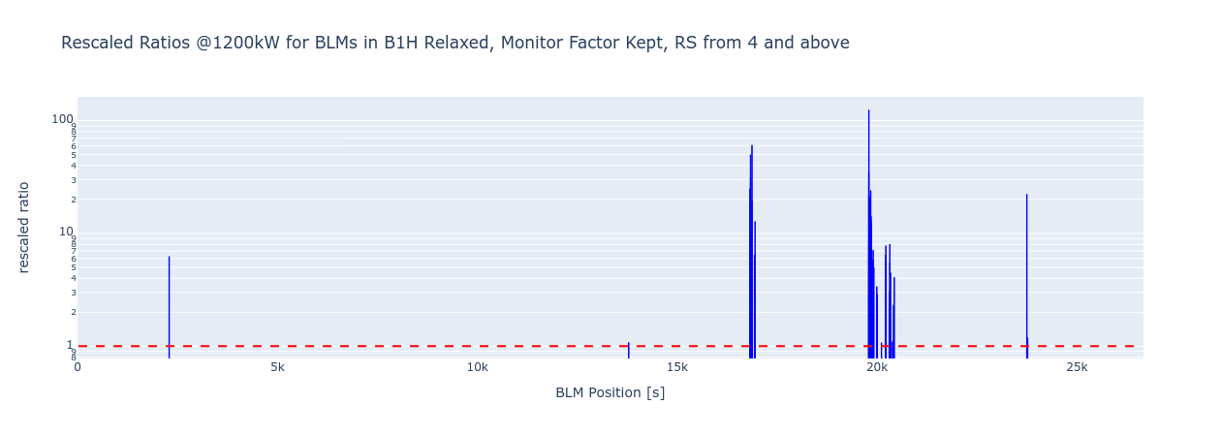
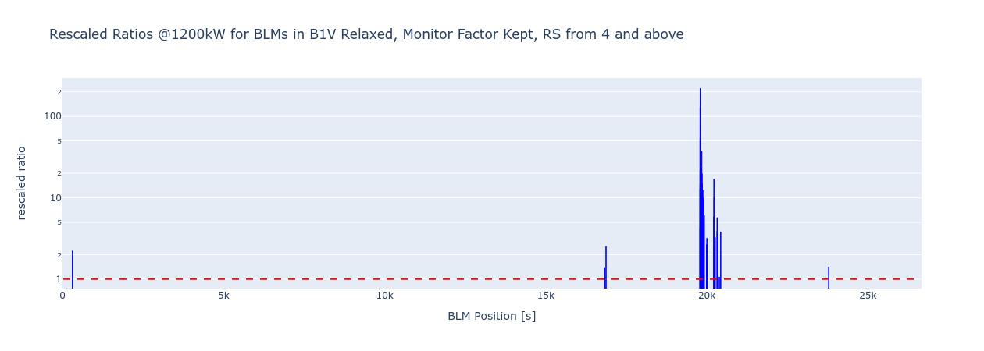
Ratios for relaxed settings, monitor factor kept
For completeness, thresholds
with original monitor factors can be considered
In this case, individual BLMs above threhsold appear around the machine...

Slide 10
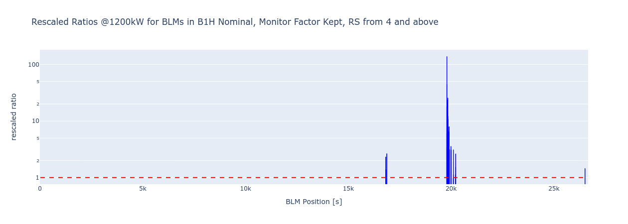
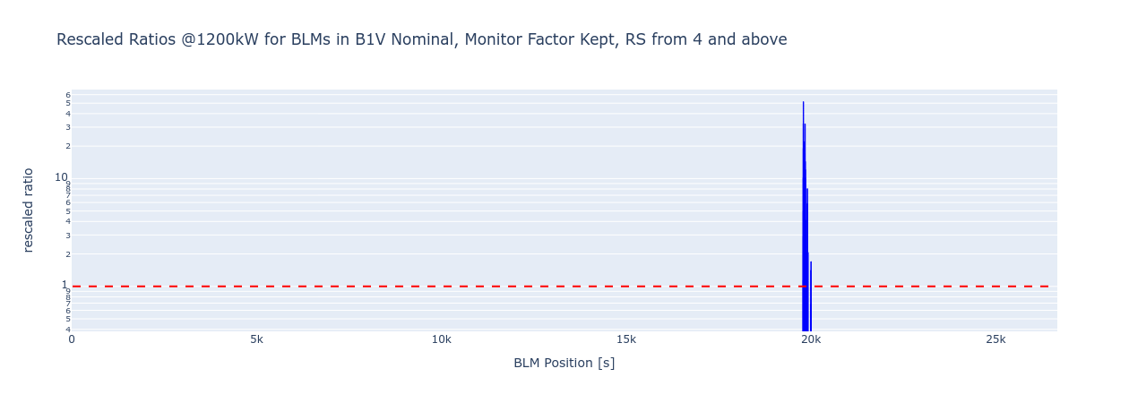
Ratios for nominal settings, monitor factor kept
      Similar results in nominal settings...

Slide 11
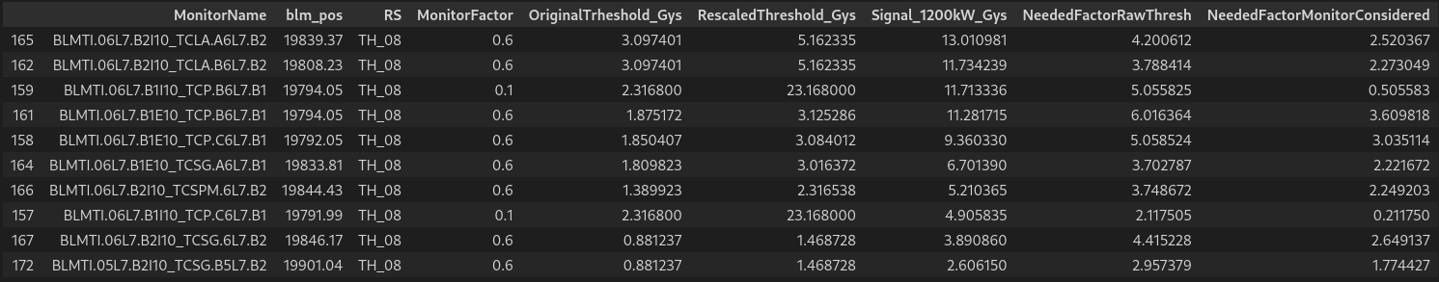
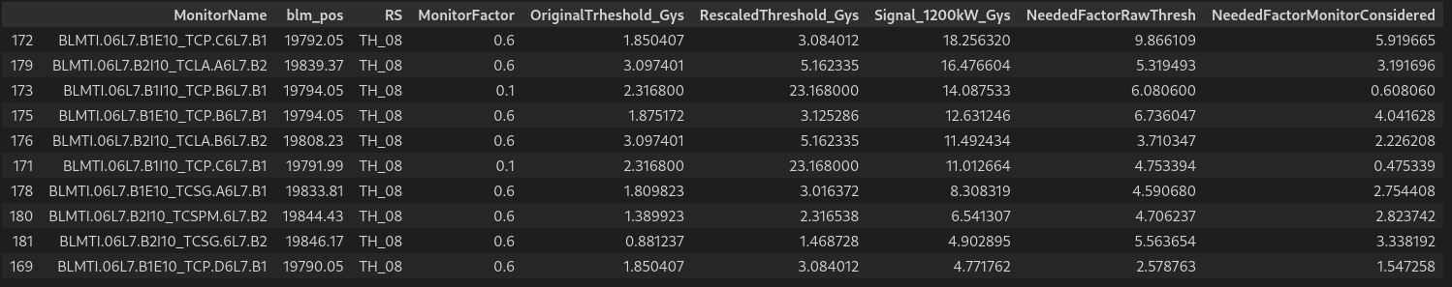
BLMs with highest signals - Relaxed settings - RS08
Horizontal Plane
Vertical Plane

Slide 12
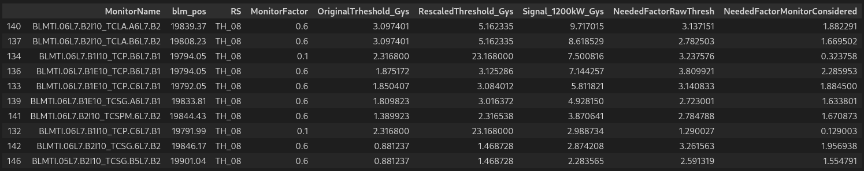
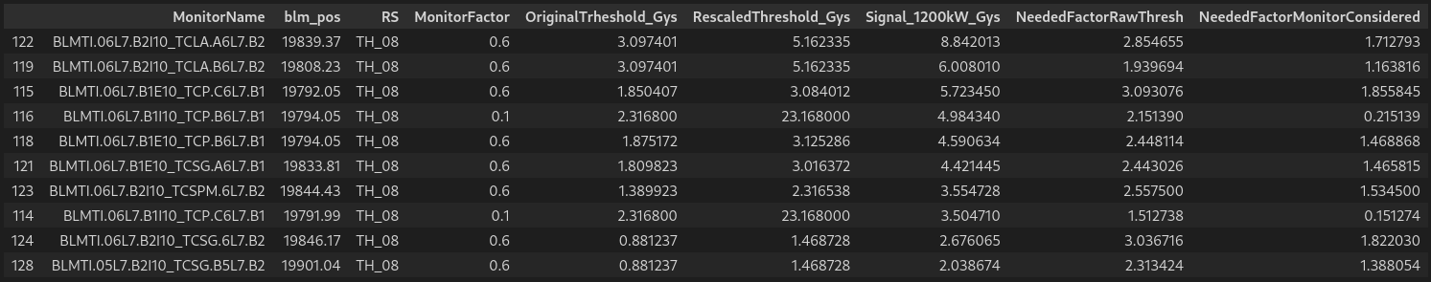
BLMs with highest signals - Nominal Settings - RS08
Horizontal Plane
Vertical Plane

Slide 13
Datasets/Notebooks/Interactive plots
available @
https://cernbox.cern.ch/s/vvfD7xnjcj80BIf
(relies on Lossmaps library)

