Slide 1
2024 BLM thresholds for
Quench Test 6.8 TeV Beam 1
B.Salvachua, S.Morales, C.E.Montanari
Discussions with F.Carra, P.Hermes, A.Lechner, S.Redaelli
BLMTWG 15/10/2024

Slide 2
Introduction
BLM thresholds in IP7 are today set as :
  Master Thresholds to 500 kW
  Applied Thresholds to 300 kW with Monitor Factor = 0.6
Strategy for Quench Test 2024:
  Monitor Factor: keep it at 0.6
  Build Master Thresholds using RELAXED Collimation settings to allow for:
    1200 kW for BLMs with response > 1e-14 Gy/proton
    3x1200 kW for BLMs with response < 1e-14 Gy/proton
  Warm magnets, Q6 : adjust to Collimation losses
  DS and IR6
Same approach as 2022

Slide 3
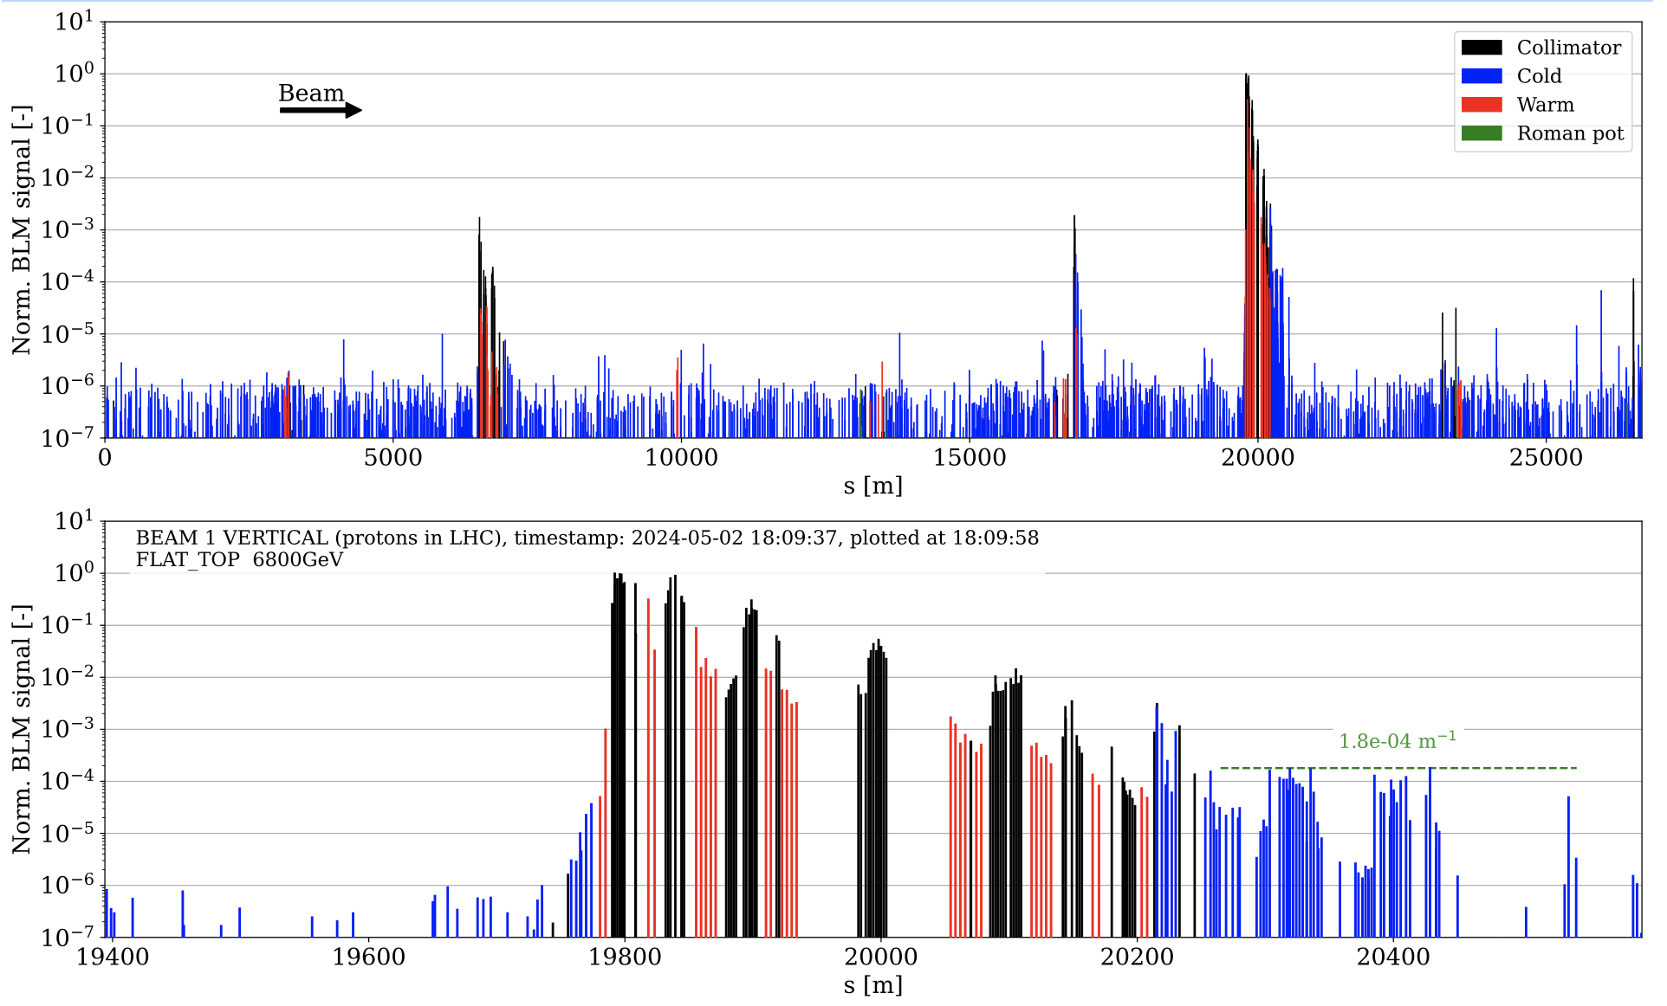
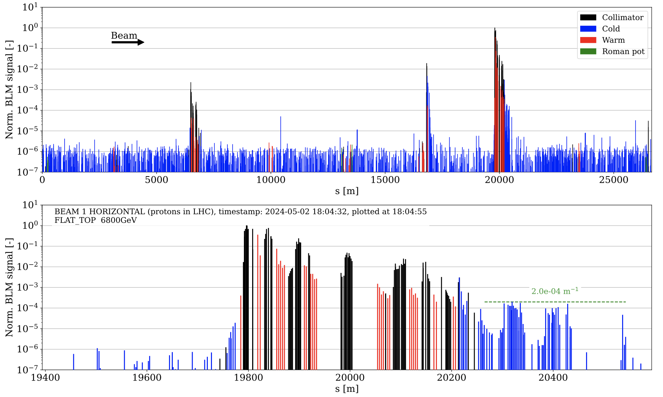
Loss maps
B1H RELAXED: 2024-05-02 18:04:55
B1V RELAXED: 2024-05-02 18:09:58
Carlo Emilio Montanari

Slide 4
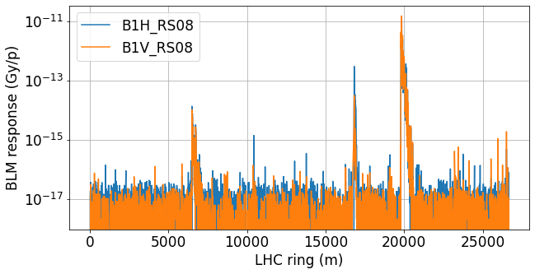
Relaxed settings: B1H and B1V
Max FR dI/dt = 2.88 kW

Slide 5
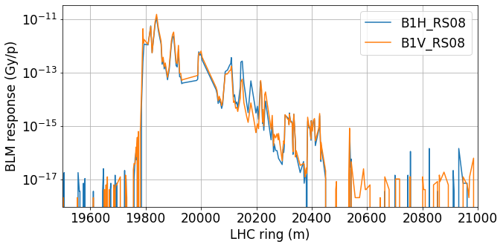
Relaxed settings: B1H and B1V (zoom)
Max FR dI/dt = 2.88 kW

Slide 6
B1V - RELAXED SETTINGS

Slide 7
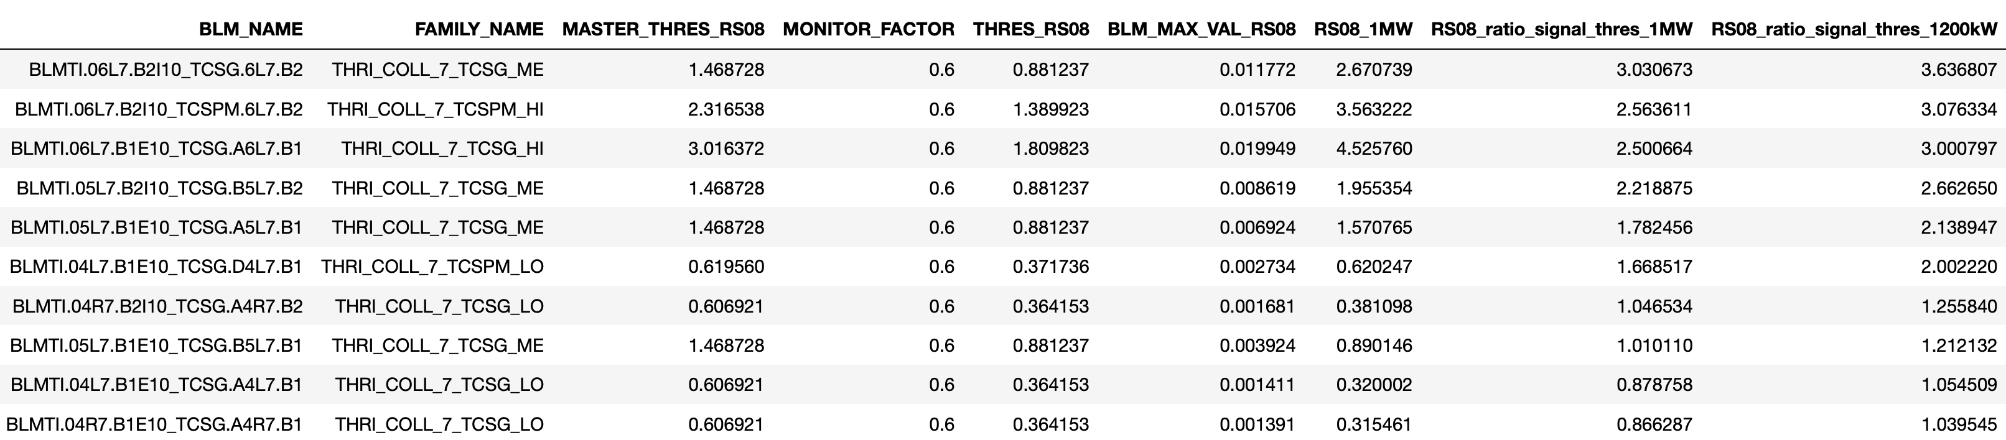
Primary, Secondary, Absorbers Collimators (B1V)
Scaling of Applied Thresholds from 300 kW to 1MW x 1.2 factor margin
Keep Monitor Factor at 0.6 and add all the scaling in the master tables.

Slide 8
IP7: MQW and MQTL (B1V)
Scaling of Applied Thresholds from 300 kW to 1MW x 3.6 factor margin -> to avoid premature dumps due to low signal during loss maps

Slide 9
IP6 (B1V)
Secondary collimator thresholds in IP6 does not need to be increased
MQY thresholds would allow for 1MW but for 1MW x 3.6 margin we would need a factor increase:
Family Name | Factor |  | Family Name | Factor
THRI_TCSG | - |  | THRI.LS.P1_MQY_FT | 2.95 (Scale to 3.6 MW)
THRI_TCD_RC | - |  | THRI.LS.P2_MQY | -
 |  |  | THRI_B1.1_MB | -

Slide 10
Summary of B1V thresholds proposal
DS bottlenecks - they do not appear in the loss maps. The same increase of 2022 will be applied which comes from previous quench tests.
Propose to Mask the 2 bottlenecks BLMs found during 2022 test that should protect for Beam 2 losses:
BLMTI.06L7.B2I10_TCLA.A6L7.B2
BLMTI.06L7.B2W10_TCLA.B6L7.B2
Family Name | Factor |  | Family Name | Factor
THRI_COLL_7_TCPPM | 1.68 |  | *THRI_COLL_7_TCLA_HI | 3.7 - BLMTI.06L7.B2I10_TCLA.A6L7.B2
THRI_COLL_7_TCPPM_WALL | 5.34 |  | *THRI_COLL_7_TCLA_HI_WALL | 3.5 - BLMTI.06L7.B2W10_TCLA.B6L7.B2
THRI_COLL_7_TCP_WALL | 5.07 |  | THRI_COLL_7_TCLA_LO | 1.90
THRI_COLL_7_TCSG_HI | 3.08 |  | THRI.IP7_MQW_FT | 3.78
THRI_COLL_7_TCSG_ME | 3.64
THRI_COLL_7_TCSG_LO | 1.26
THRI_COLL_7_TCSPM_HI | 3.07 |  | THRI.IP7.P1_MQTL_FT | 10.19 (Scale to 3.6 MW)
THRI_COLL_7_TCSPM_LO | 2.00 |  | THRI.IP7.P2_MQTL_FT | 8.94 (Scale to 3.6 MW)
Family Name | Factor |  | Family Name | Factor
THRI_TCSG | - |  | THRI.LS.P1_MQY_FT | 2.95 (Scale to 3.6 MW)
THRI_TCD_RC | - |  | THRI.LS.P2_MQY | -
 |  |  | THRI_B1.1_MB | -

Slide 11
B1H - RELAXED SETTINGS

Slide 12
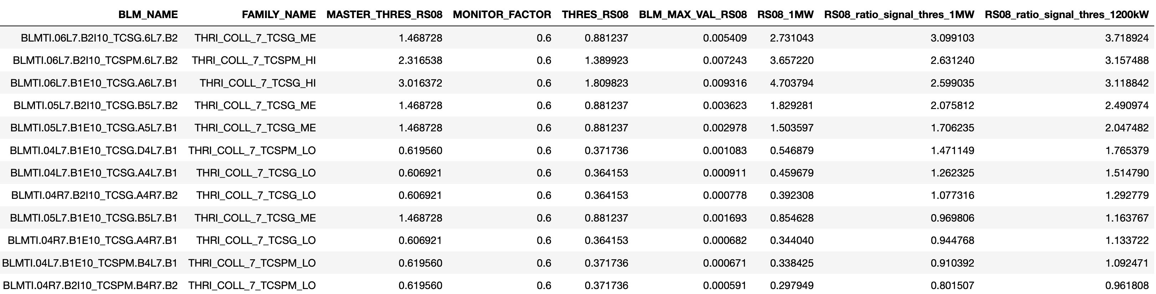
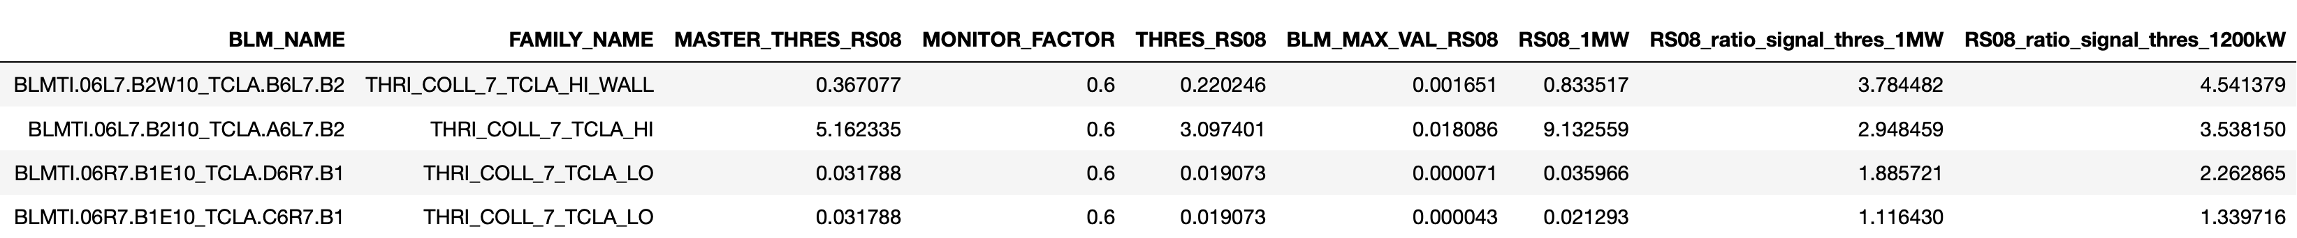
Primary, Secondary, Absorbers Collimators (B1H)

Slide 13
IP7: MQW and MQTL (B1H)

Slide 14
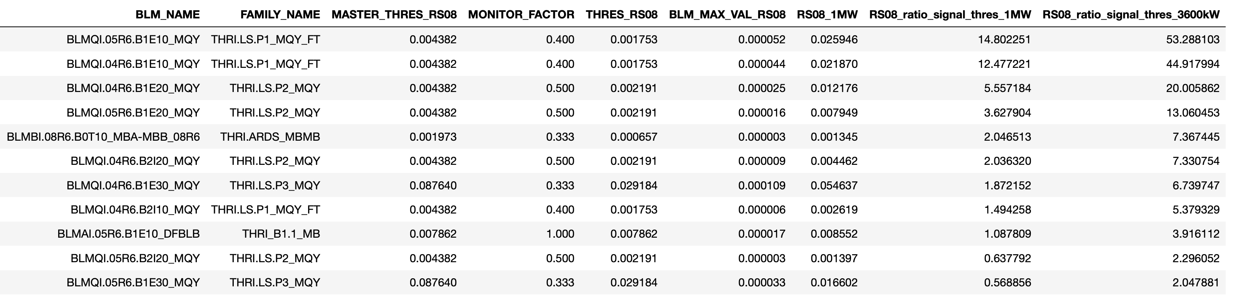
IP6 (B1H)

Slide 15
Summary of B1H thresholds proposal
DS bottlenecks - they do not appear in the loss maps. The same increase of 2022 will be applied which comes from previous quench tests.
Family Name | Factor |  | Family Name | Factor
THRI_COLL_7_TCPPM | - |  | *THRI_COLL_7_TCLA_HI | 3.53 - BLMTI.06L7.B2I10_TCLA.A6L7.B2
THRI_COLL_7_TCPPM_WALL | 2.99 |  | *THRI_COLL_7_TCLA_HI_WALL | 4.54 - BLMTI.06L7.B2W10_TCLA.B6L7.B2
THRI_COLL_7_TCP_WALL | 4.40 |  | THRI_COLL_7_TCLA_LO | 2.26
THRI_COLL_7_TCSG_HI | 3.11 |  | THRI.IP7_MQW_FT | 3.82
THRI_COLL_7_TCSG_ME | 2.49
THRI_COLL_7_TCSG_LO | 1.51
THRI_COLL_7_TCSPM_HI | 3.16 |  | THRI.IP7.P1_MQTL_FT | 6.07 (Scale to 3.6 MW)
THRI_COLL_7_TCSPM_LO | 1.76 |  | THRI.IP7.P2_MQTL_FT | 5.96 (Scale to 3.6 MW)
Family Name | Factor |  | Family Name | Factor
THRI_TCSG | 9.71 |  | THRI.LS.P1_MQY_FT | 53 (Scale to 3.6 MW)
THRI_TCD_RC | 2.55 |  | THRI.LS.P2_MQY | 20.00
 |  |  | + OTHERS | +

Slide 16
Summary
Factors needed to allow 1000 kW with Relaxed collimator settings presented
BLM thresholds proposed contain some margin:
  High response channels they are set to 1000 kW x 1.2 margin
  Low response channels they are set to 1000 kW x 3.6 margin
B1V has less leakage into IR6
Next steps:
  Create new families _QT24 with the required factors applied to ALL RS
  Fix RS08-RS12 to RS08
  Monitor factors remain unchanged (i.e. MF = 0.6)
During test:
  Before test: DB state will be acquired.
  After recovery: DB state will be compared to the one applied.

