Slide 1

Welcome to the
1st DRD3 TCT school
CERN, Geneva, Switzerland, 4.-6. March 2025
Ruddy Costanzi, Leena Diehl, Marcos Fernandez Garcia, Bojan Hiti, Marco Mandurrino, Michael Moll, Raul Montero, Marie Muehlnikel, Niels Sorgenfrei, Ivan Vila, Moritz Wiehe

Slide 2
Organization of the school
Tuesday morning 4.3.2025 [IT Auditorium]
  8:30 Welcome
  8:35 Introduction to Lasers,
    Raul Montero
  9:20 Signal formation
    Bojan Hiti
  10:05 SPA – Single Photon Absorption
    Marcos Fernandez Garcia
  10:50 Group photo
  11:00 Coffee Break
  11:30 TPA – Two Photon Absorption
    Moritz Wiehe
  12:15 TCAD simulations
    Marco Mandurrino
Tuesday afternoon - Hands-on session 1
Tuesday evening - Dinner
Wednesday morning - Hands-on session 2
Wednesday afternoon - Hands-on session 3
Thursday morning [IT Auditorium]
  9:00 – 10:30 Student presentations
  Coffee Break
  11:00 – 12:00 Demonstration of data analyses;
  Question and answer session
  12:00 – 13:00 Lunch Break
Thursday afternoon [ATLAS visit]
  13:00 – 14:00 Visit to the ATLAS cavern
  (2 groups)
    Niels Sorgenfrei - CERN

Slide 3
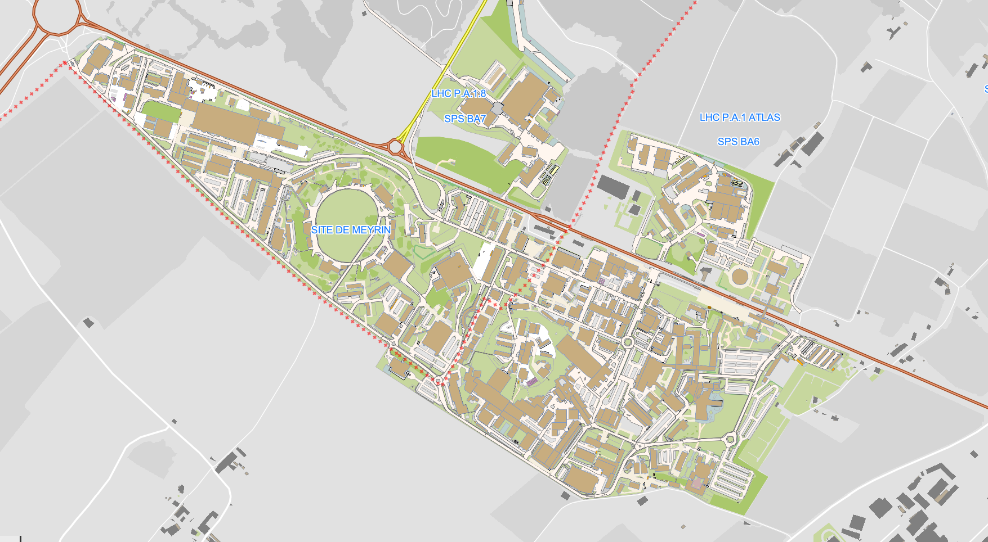
Hands-on sessions
3 groups with 6 participants each
(rotating through the lab sessions: 3 x ½ day)
  Lab 1 [Bojan]
    Bldg.28 – 2nd floor – Room 2-16
  Lab 2 [Leena & Marie]
    Bldg.28 – 2nd floor – Room 2-26
  Lab 3 [Marcos & Moritz]
    Bldg. 186 – Ground floor – Room R-025
  Common Coffee Breaks in bldg. 186
  Lunch in Restaurant 2
    not included in registration fee
28-2
Lab1 & Lab2
186 – Ground Floor
Lab3 & Coffee
IT Auditorium
31/3-004
CERN
Restaurant 2 (Lunch)

Slide 4
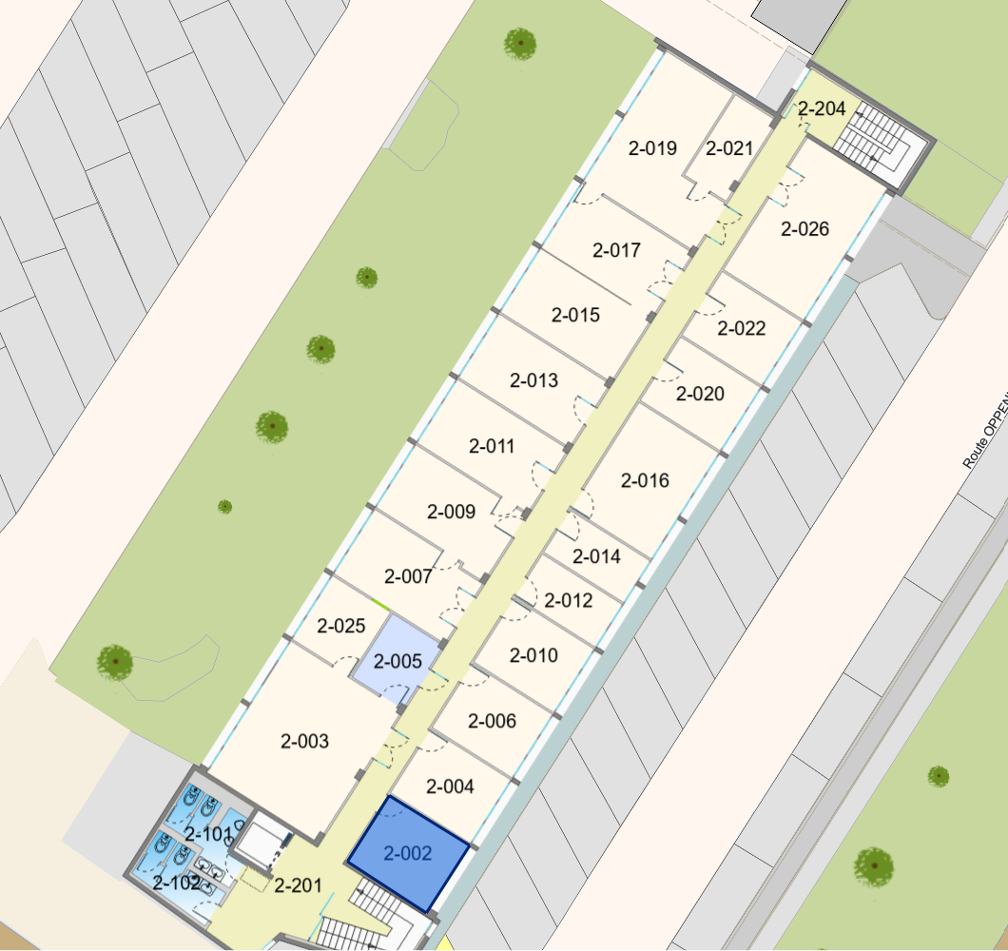
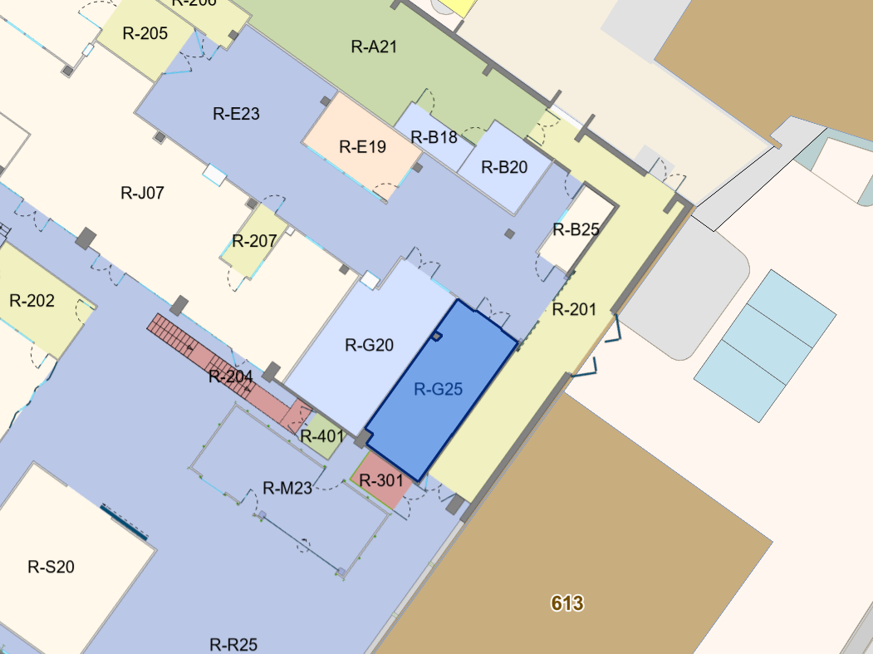
Hands-on sessions
  Lab 1 [Bojan]
    Bldg.28 – 2nd floor – Room 2-16
  Lab 2 [Leena & Marie]
    Bldg.28 – 2nd floor – Room 2-26
  Lab 3 [Marcos & Moritz]
    Bldg. 186 – Ground floor – Room R-025
  Common Coffee Breaks in bldg. 186
28-2nd Floor
Lab1 & Lab2
Entrance
from 28
Coffee
Lab3
186 – Ground Floor
Lab3 & Coffee

Slide 5
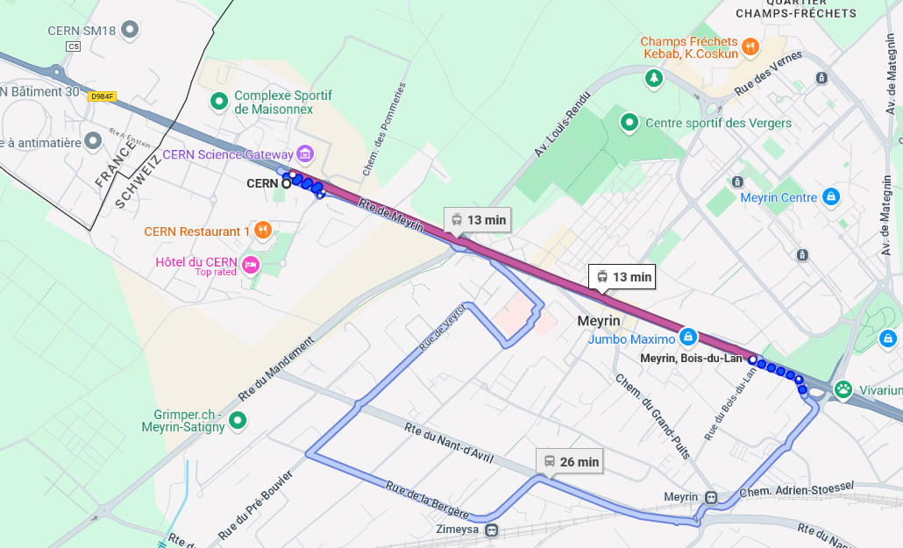
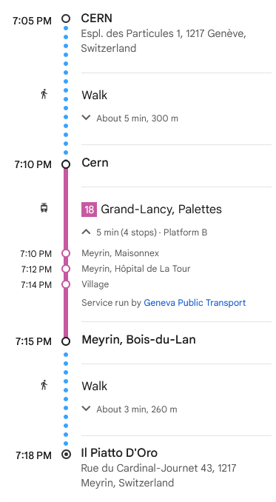
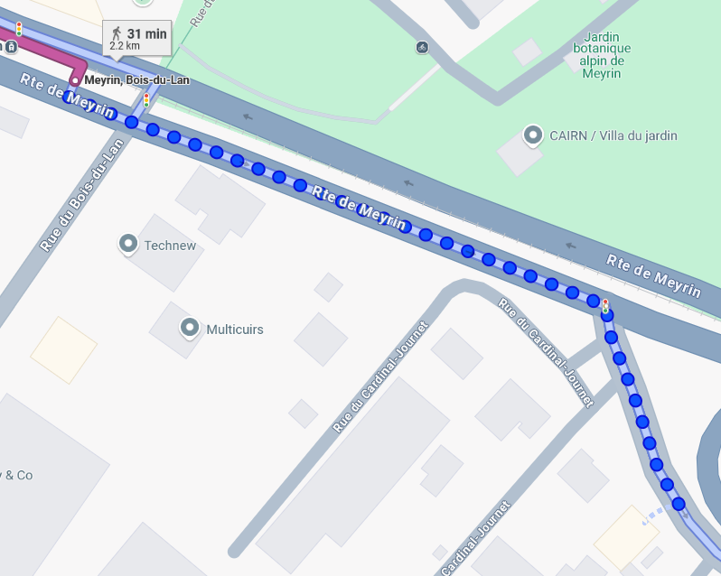
Dinner – Today at 19:30
TRAM ≈ every 12 min
Restaurant: Piatto d’Oro
  Piatto d’Oro
  Rue du Cardinal-Journet 43
  CH - 1217 Meyrin
  Today at 19:30
  Included in registration fee
  Reachable by Tram 18
Bois-du-Lan
Piatto d’Oro

