Slide 1
Transient Current Technique: Signal Formation
Bojan Hiti (Jožef Stefan Institute, Ljubljana)
DRD3/AIDAInnova TCT School,
CERN March 2025

Slide 2
What constitutes TCT?
Transient Current Technique measurement:
Deducing system properties by measuring the shape of the induced signal
(shape, rise time, integral, etc.)
1.) laser + optical system
3.) DAQ
digital oscilloscope
HV
sample
2.) Biasing & amplifier
This talk: signal generation, propagation through the system, examples of sensor parameter extraction, simulation

Slide 3
Contents
Silicon particle sensors and charge generation in silicon
Signal formation: Shockley-Ramo’s theorem
Laser and electronics transfer function
Charge mobility
Signal analysis in timing
Signal Formation lab course contents + KDetSim simulation library

Slide 4
Silicon sensors and charge generation

Slide 5

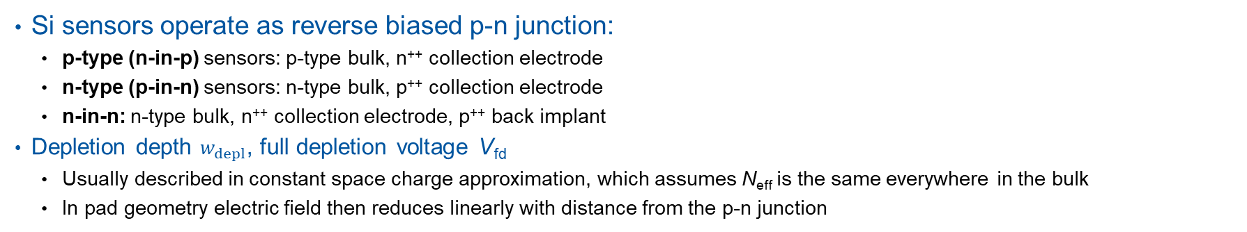
p-type and n-type Si sensors
+ V_{bias}
p-type sensor example
p-n junction
n⁺⁺-type guard ring
E
n⁺⁺-type electrode
$w_{depl}=\sqrt{\frac{2{εε}_{0}}{q_{0}N_{eff}}V_{bias}}$
electric field
p-type bulk
w_{depl}
N_{eff} is the effective doping concentration in the bulk
p⁺⁺- back implant (for good Al contact)
Aluminum (metal) back plane
w
GND (0 V)
Si sensors operate as reverse biased p-n junction:
  p-type (n-in-p) sensors: p-type bulk, n⁺⁺ collection electrode
  n-type (p-in-n) sensors: n-type bulk, p⁺⁺ collection electrode
  n-in-n: n-type bulk, n⁺⁺ collection electrode, p⁺⁺ back implant
Depletion depth $w_{depl}$, full depletion voltage V_{fd}
  Usually described in constant space charge approximation, which assumes N_{eff} is the same everywhere in the bulk
  In pad geometry electric field then reduces linearly with distance from the p-n junction

Slide 6
Charge generation in silicon
e-h generation along entire sensor
e-h generation close to sensor surface
MIP
Alpha particle
80 e-h pairs/µm on average in 300 µm thick sensors
3.6 eV/e-h pair
Non uniform distribution along the flight path (Landau fluctuations)
  Hole injection – if holes have a long drift path
  Electron injection – vice versa
  (depends on sensor type)
+
-
-
-
+
+
+
+
-
-
-
+
+
-
Red laser (660 nm)
Infrared laser (1064 nm)
+
-
-
-
+
+
Front side injection
Amount of charge depends on laser power, generally not known
Uniform distribution along the beam path
+
-
+
-
-
+
+
-
Back side injection
+
-
-
-
+
+

Slide 7
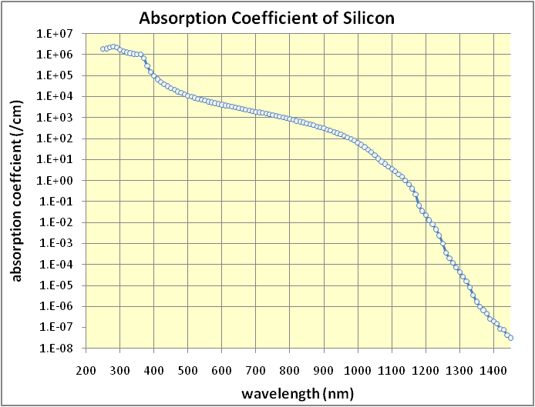
Light absorption in silicon
Band gap in silicon is 1.12 eV
  Indirect band gap (transitions include phonons)
  No abrupt changes of absorption coefficient
Light penetration depths in Si:
Samples require an optical window (nonmetallized part of surface)
  DIY method by etching a window in aluminum with NaOH (~ 1 mm)
MIP like
100 µm
near surface
surface
  1064 nm
  980 nm
  660 nm
  405 nm
Band gap in other materials:
  SiC (4H) 3.2 eV (direct)
  GaN 3.4 eV (direct)
  Diamond 5.5 eV (indirect)

Slide 8
Shockley-Ramo’s theorem

Slide 9
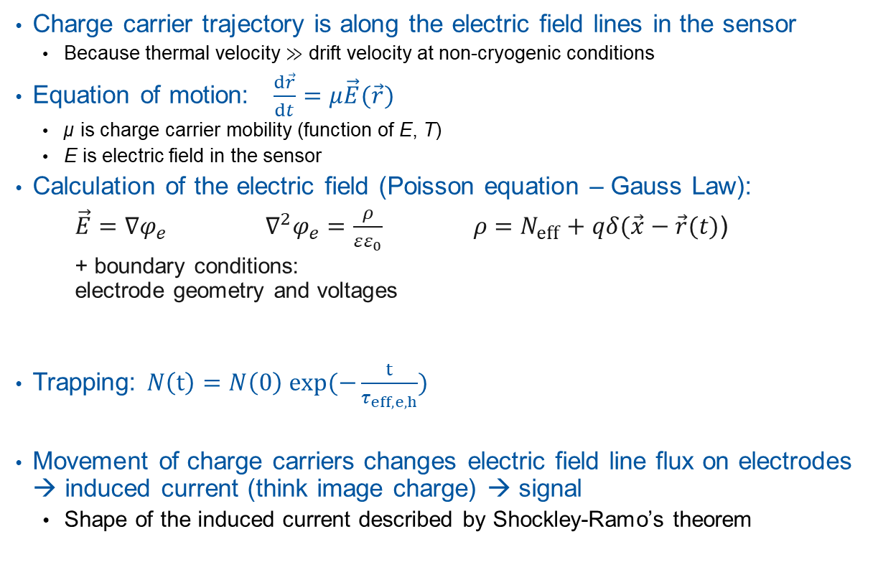
Movement of charge carriers
?
Charge carrier trajectory is along the electric field lines in the sensor
  Because thermal velocity ≫ drift velocity at non-cryogenic conditions
Equation of motion: $\frac{d\vec{r}}{dt}=μ\vec{E}(\vec{r})$
  µ is charge carrier mobility (function of E, T)
  E is electric field in the sensor
Calculation of the electric field (Poisson equation – Gauss Law):
$\vec{E}=∇φ_{e}$ $∇^{2}φ_{e}=\frac{ρ}{εε_{0}}$ $ρ=N_{eff}+qδ(\vec{x}−\vec{r}(t)$)
+ boundary conditions:
electrode geometry and voltages
Trapping: $N\left(t\right)=N\left(0\right) exp(−\frac{t}{τ_{eff, e,h}})$
Movement of charge carriers changes electric field line flux on electrodes → induced current (think image charge) → signal
  Shape of the induced current described by Shockley-Ramo’s theorem
trajectories along E
“Plasma effect” electric field modified by injected e-h pairs (often negligible)
image charge (r₁)
image charge (r₂)
charge (r₂)
charge (r₁)

Slide 10

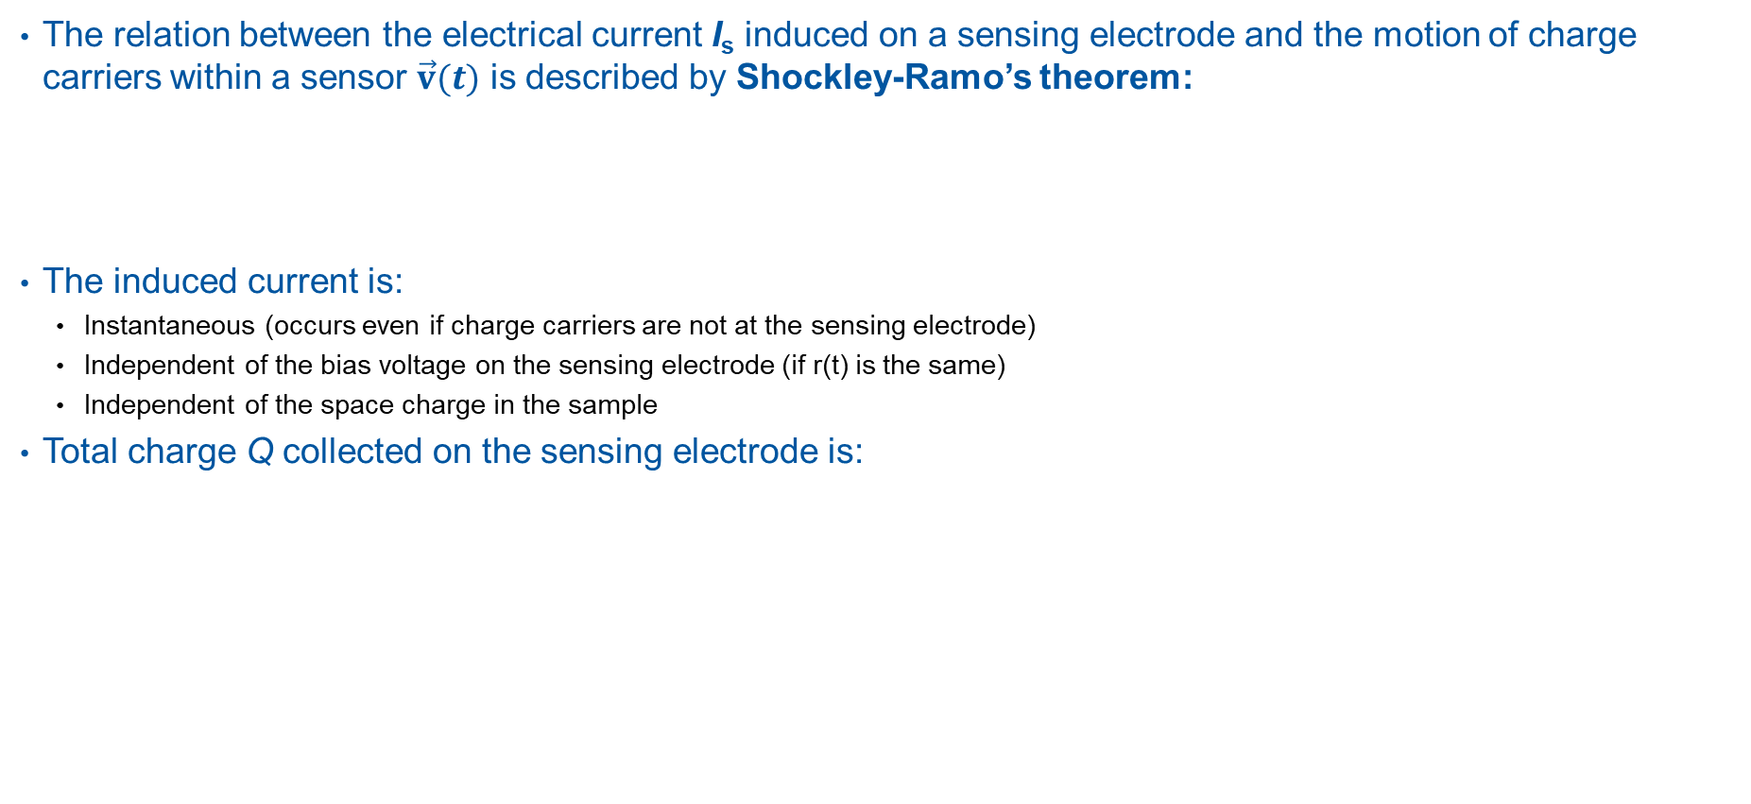
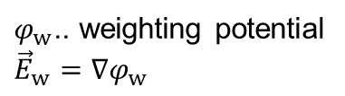


Shockley-Ramo’s theorem
The relation between the electrical current I_{s} induced on a sensing electrode and the motion of charge carriers within a sensor $\vec{v}(t)$ is described by Shockley-Ramo’s theorem:
The induced current is:
  Instantaneous (occurs even if charge carriers are not at the sensing electrode)
  Independent of the bias voltage on the sensing electrode (if r(t) is the same)
  Independent of the space charge in the sample
Total charge Q collected on the sensing electrode is:
q moving charge
v(t) drift velocity of the charge carrier
E_{w} weighting field (next slide)
r(t) drifting charge trajectory
$$I_{s}(t)=q\vec{v}(t)∙{\vec{E}}_{w}(\vec{r}\left(t\right))$$
Q > 0: drift ends on sampling electrode: I_{s} unipolar
$$Q=\int_{0}^{t_{max}}{I_{s}dt}$$
t_{max} typically few ns to few 10 ns
Q = 0: drift does not end on sampling electrode: I_{s} bipolar
$$Q=q\left(φ_{w}\left({\vec{r}}_{final}\right)−φ_{w}\left({\vec{r}}_{init}\right)\right)=q∆φ_{w}$$
$φ_{w}$.. weighting potential
$${\vec{E}}_{w}=∇φ_{w}$$
[1] W. Shockley, J. Appl. Phys. 9 (1938) 635.
[2] S. Ramo, proc. I.R.E. (1939), p. 584.
[3] Z. He, NIM A 63 (2001) 250–267.

Slide 11


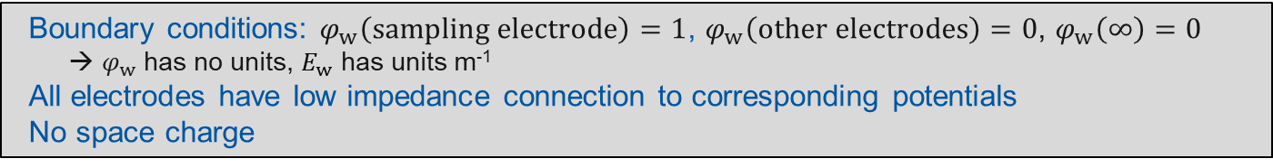
Weighting field and weighting potential
Weighting field describes electrostatic coupling of charge carriers to the sampling electrode at given position
  In general much different shape than electric field in the sensor
Calculation of the weighting potential (Laplace equation):
Weighting field examples:
  Pad detector (thickness d): $E_{w}=1/d$
  Strip detector: $E_{w} \sim 1/r$ at a distance $r$≫ strip width
  Pixel detector: $E_{w} \sim 1/r^{2}$ at a distance $r$≫ pixel size
1
$${\vec{E}}_{w}=∇φ_{w}$$
$$∇^{2}φ_{w}=0$$
sampling electrode
  Boundary conditions: $φ_{w}\left(sampling electrode\right)=1$, $φ_{w}\left(other electrodes\right)=0$, $φ_{w}\left(∞\right)=0$
    → $φ_{w}$ has no units, $E_{w}$ has units m⁻¹
  All electrodes have low impedance connection to corresponding potentials
  No space charge
Electrodes without low impedance connections:
[4] E. Gatti et al., NIM A 193 (1982) 651
in segmented detectors most of the signal comes from the drift close to the electrode

Slide 12
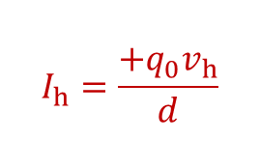


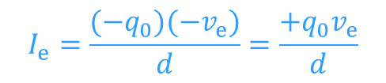
Example: Pad detector
Example:
  Pad detector (thickness d)
  Single e-h pair injected at depth x₀ from the readout electrode
  Saturated drift velocity v_{e}, v_{h}
  No charge trapping
$$I_{e,h}(t)=q_{e,h}{\vec{v}}_{e,h}(t)∙{\vec{E}}_{w}(\vec{r}\left(t\right))$$
$E_{w}=\frac{1}{d}$ $φ_{w}=\frac{x}{d}$
$$I_{h}=\frac{+q_{0}v_{h}}{d}$$
$$I_{e}=\frac{(−q_{0})(−v_{e})}{d}=\frac{{+q}_{0}v_{e}}{d}$$
I
x = d
$φ_{w}$(d) = 1
x = x₀
t
+
-
$$Q_{h}=q_{0}\left(φ_{w}\left(d\right)−φ_{w}\left(x_{0}\right)\right)=q_{0}(1−\frac{x}{d})$$
x = 0
$φ_{w}$(0) = 0
$$Q_{e}={−q}_{0}\left(φ_{w}\left(0\right)−φ_{w}\left(x_{0}\right)\right)=q_{0}\frac{x}{d}$$
$Q=Q_{h}+Q_{e}=$ $q_{0}$

Slide 13
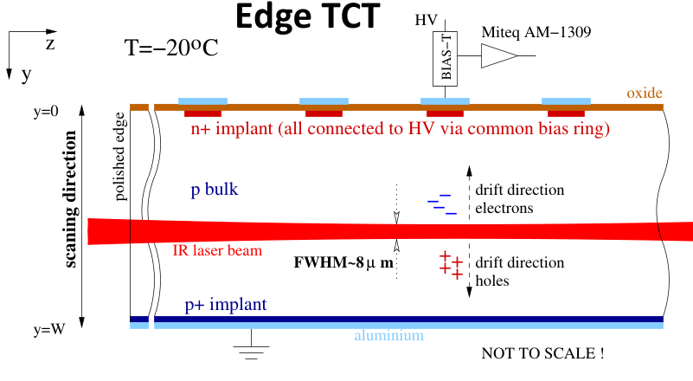
Special case: Strips with Edge-TCT
Single strip read out, others biased to the same voltage (SPA-TCT lab course)
Infrared charge injection (Edge-TCT) perpendicular to strips
  Charge generated at fixed depth uniformly under all strips
Due to symmetry the induced current corresponds to pad geometry (not strip)
  Weighting field is constant 1/d

Slide 14
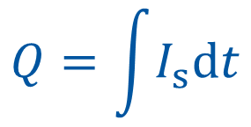
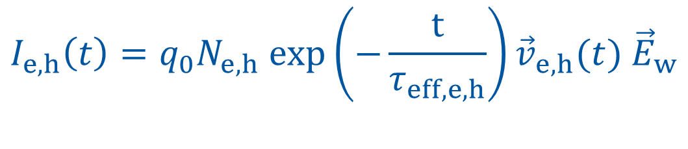

Recap
$$I_{e,h}\left(t\right)=q_{0}N_{e,h} exp\left(−\frac{t}{τ_{eff, e,h}}\right){\vec{v}}_{e,h}(t){ \vec{E}}_{w}$$
Geometry
Generation
Electric field
Trapping
$$I_{s}=I_{e}+I_{h}$$
$$Q=\int{I_{s}dt}$$

Slide 15
Laser and electronics transfer function

Slide 16

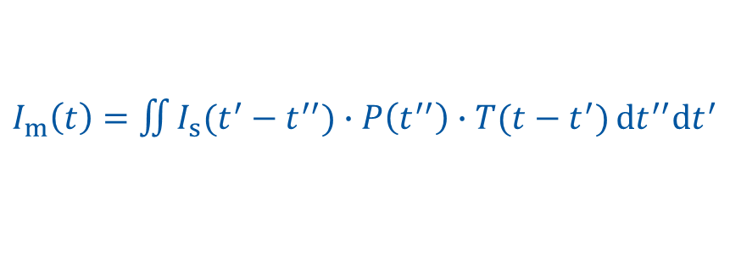

Measured signals
TCT signals measured with an oscilloscope are the result of:
I_{s}(t)
P(t)
T(t)
  Induced current I_{s} from drifting charge carriers
  Physical process we want to measure
  Temporal shape of the laser pulse
  Typically 0.5 ns or (much) less
  Transfer function of the electronics
  Main contributions: amplifier, bias-T, oscilloscope, detector capacitance
I_{m}(t)
In general $I_{s}\left(t\right)$ can be extracted using Fourier transforms (complicated):
  Approximations:
  If timescale is longer than few 100 ps: $I_{s}\left(t\right)≈I_{m}\left(t\right)$
$I_{s}\left(t\right)={FT}^{−1}\left(\frac{FT(I_{m})}{FT(T)FT(P)}\right)$
$P\left(t\right)=Bδ(t)$ $T\left(t\right)=\frac{A}{RC}exp⁡(−\frac{t}{RC})$
$I_{m}\left(t\right)=$ $\iint{I_{s}(t^{′}−t^{′′})∙P\left(t^{′′}\right)∙T(t−t^{′})}dt^{′′}dt^{′}$

Slide 17
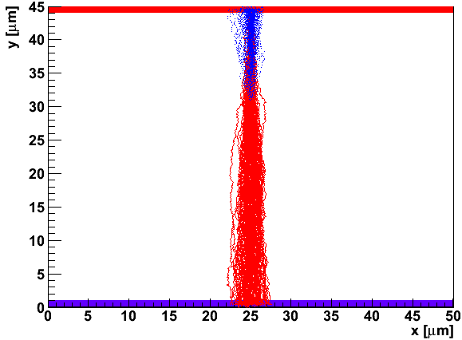
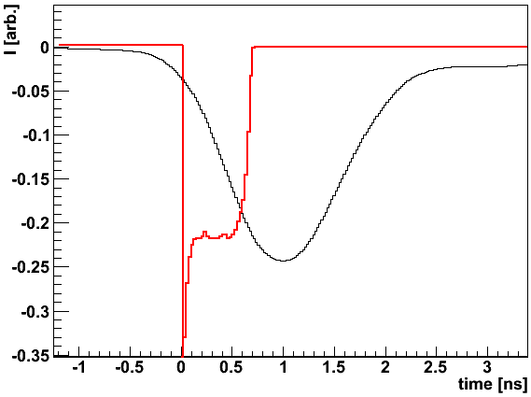
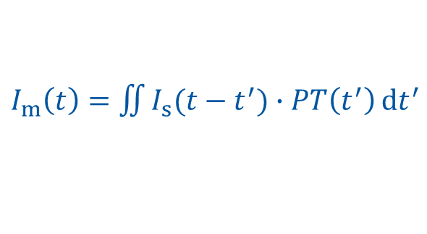

Extraction of the transfer function
$I_{m}\left(t\right)=$ $\iint{I_{s}(t−t^{′})∙PT\left(t^{′}\right)}dt^{′}$
Laser and electronics transfer functions PT can be extracted from $I_{m}\left(t\right)$in a very thin detector (25 µm), where $I_{s}\left(t\right)$ is very short, i.e. $I_{s}\left(t\right)=I_{o}δ\left(t\right)$
Use simulation of the same device to extract PT
  Adjust the simulated transfer function to get optimal agreement of the measured/simulated pulses
[5] C. Scharf and R. Klanner NIMA 799 (2015) p. 81-89.
simulation (KDetSim)
$$I_{s}\left(t\right)$$
Example (extreme case):
n-on-p sensor 3×3 mm²
thickness 50 µm
V_{fd} = 20 V
V_{bias} = 300 V
660 nm top side (hole) injection
$$I_{m}\left(t\right)$$

Slide 18
Charge carrier mobility

Slide 19
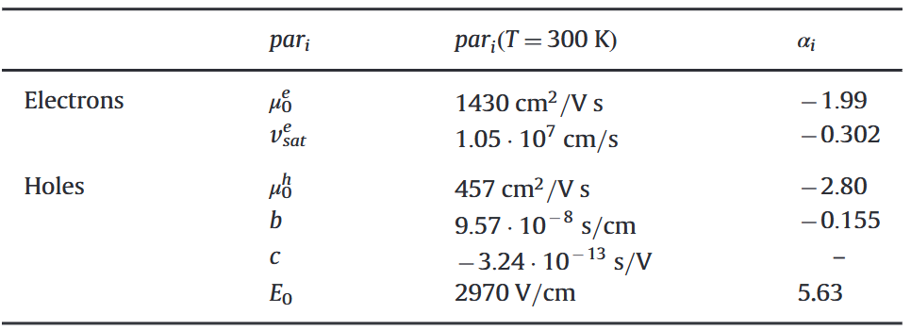





Charge carrier velocity and mobility
Charge carrier drift velocity depends on electric field – described by mobility $μ$:
Mobility is a function of the electric field and temperature
  At low E (< 0.2–0.3 V/µm at room T) drift velocity increases linearly with E
  At high E (≫ 1 V/µm at room T) drift velocity saturates
  Mobility reduces with increasing temperature – higher phonon scattering probability
Different parametrizations and models:
$$v_{e,h}=μ_{e,h}(E,T)∙E$$
[6] C. Canali, G. Ottavian, A. Alberigi, J. Phys. Chem. Solids, vol. 32, p. 1707, 1971.
[7] Jacoboni et al., Solid State Electron. 20, 2(1977) 77-89
[8] S. Selberherr et al., Solid-State Electron., vol. 33, no. 11, pp. 1425–1436, 1990.
[9] WF2 - T. Bauer, M. Friedl, and M. Krammer, 2000.
[5] C. Scharf, R. Klanner, NIM A 799 (2015) p. 81-89
(T = 300 K)
µ_{0,h} ≈ 480 cm²/Vs
µ_{0,e} ≈ 1400 cm²/Vs
v_{sat,h} ≈ 80 µm/ns
v_{sat,e} ≈ 105 µm/ns
Klanner-Scharf (KS):
$$\frac{1}{μ_{e}}=\left\{\begin{aligned}\frac{1}{μ_{0}};E<E_{0} \\ \frac{1}{μ_{0}}+\frac{1}{v_{sat}}\left(E−E_{0}\right);E>E_{0}\end{aligned}\right.$$
$$\frac{1}{μ_{h}}=\left\{\begin{aligned}\frac{1}{μ_{0}^{h}};E<E_{0} \\ \frac{1}{μ_{0}^{h}}+b\left(E−E_{0}\right)+{c(E−E_{0})}^{2}; E>E_{0}\end{aligned}\right.$$
Caughey-Thomas:
$$μ=\frac{μ_{0}}{{\left(1+{\left(\frac{μ_{0}E}{v_{sat}}\right)}^{β}\right)}^{\frac{1}{β}}}$$
KS: ${par}_{i}\left(T\right)={par}_{i}\left(300 K\right)∙{\left(\frac{T (K)}{300 K}\right)}^{α_{i}}$

Slide 20
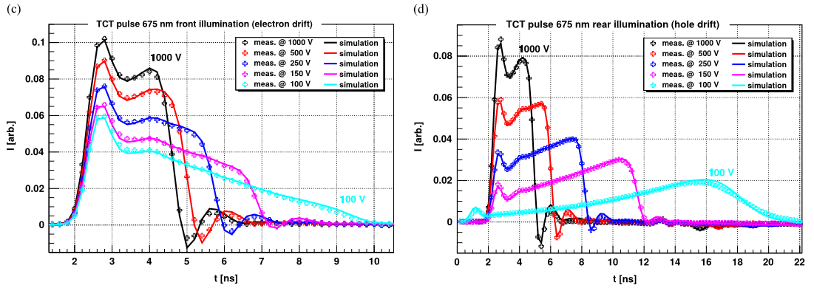
Mobility measurement with TCT
Single carrier type injection (red light, front/back side)
Electric field dependence on position (v_{e,h}, I_{s} changes, E is known)
Fitting of the pulse shape to determine parameters of a model
  Example: time-of-flight method, time of arrival very sensitive on mobility
[5] C. Scharf and R. Klanner NIMA 799 (2015) p. 81-89.

Slide 21
Timing measurements

Slide 22
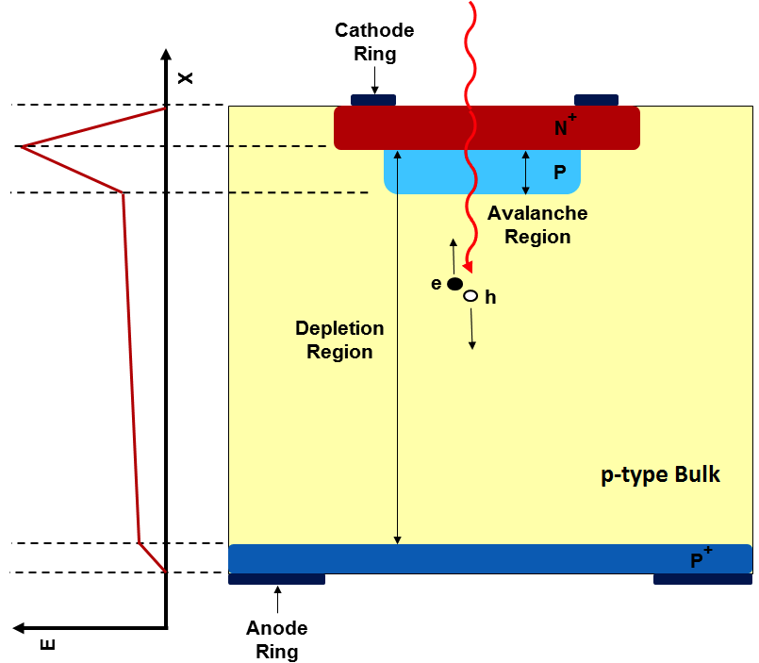
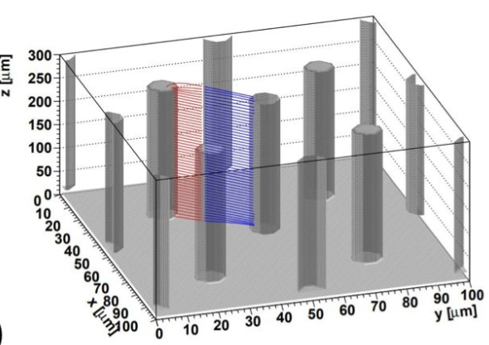
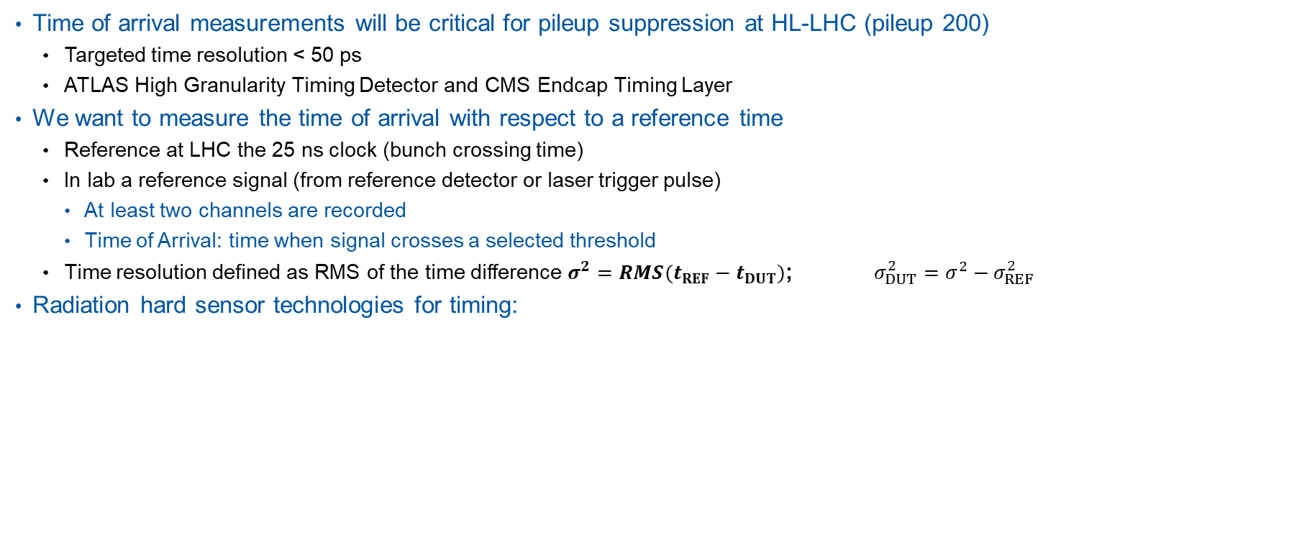
Time of Arrival measurements
Time of arrival measurements will be critical for pileup suppression at HL-LHC (pileup 200)
  Targeted time resolution < 50 ps
  ATLAS High Granularity Timing Detector and CMS Endcap Timing Layer
We want to measure the time of arrival with respect to a reference time
  Reference at LHC the 25 ns clock (bunch crossing time)
  In lab a reference signal (from reference detector or laser trigger pulse)
    At least two channels are recorded
    Time of Arrival: time when signal crosses a selected threshold
  Time resolution defined as RMS of the time difference $σ^{2}=RMS(t_{REF}−t_{DUT})$; ${σ_{DUT}^{2}=σ}^{2}−σ_{REF}^{2}$
Radiation hard sensor technologies for timing:
Low Gain Avalanche Diode (LGAD)
Internal charge multiplication by impact ionization in the p+ gain layer
→Gain
3D sensor
Short drift path, independent of thickness
Radiation hard

Slide 23
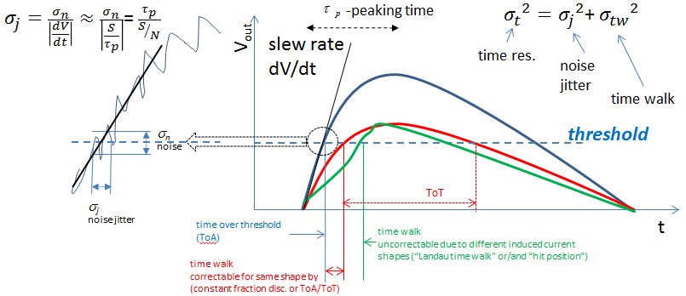
Contributions to time resolution
$${σ_{det}}^{2}=σ_{jitter}^{2}+σ_{pulse shape}^{2}+σ_{TDC}^{2}$$
Jitter contribution minimized by high signal-to-noise ratio, fast signal rise time
Pulse shape contribution:
Time walk (signal size) – correctable (constant fraction discriminator)
LGAD: nonhomogenous MIP charge deposition (Landau fluctuations) – uncorrectable – not present in laser measurements
3D: Weighting field distortion (weighting field not constant within a cell) – focused laser good tool to probe this

Slide 24
Signal Formation Lab Course

Slide 25
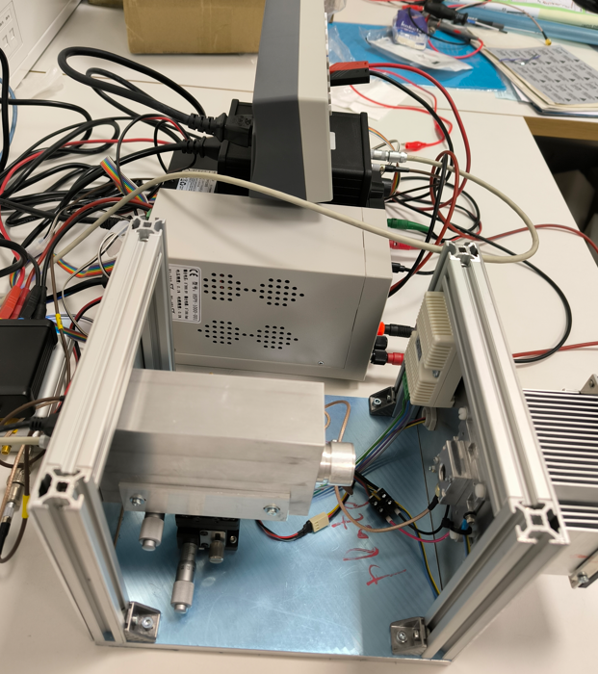
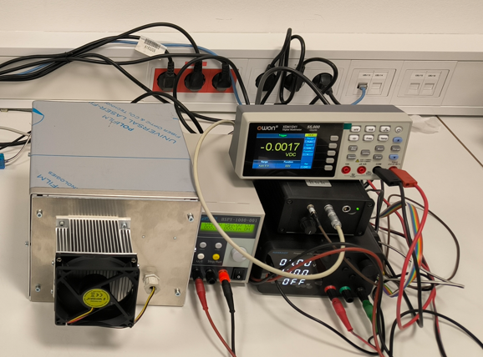
Compact TCT setup
Fixed laser TCT setup
Beam spot size 1 mm
Interchangeable laser (660 nm and 1064 nm)
Interchangable sample (PIN diode, LGAD)
Amplifier and bias-T (not visible)
DRS4 oscilloscope
Current meter
Laser
LV
Sample on temperature controlled block
HV

Slide 26
KDetSim simulation tool
C++ ROOT based tool for charge collection/signal simulations
  http://kdetsim.org/
  Developed and maintained by G. Kramberger (JSI Ljubljana)
  Other similar tools: AllPix2, TRACS, Weightfield
It is not a TCAD simulator, but a lightweight tool complementary to TCAD
Inputs:
  sensor geometry (pad, strip, pixel, 3D, LGAD, etc.), thickness
  electrode configuration (read out / neighbor electrodes) and bias voltages
  N_{eff} (unlike TCAD, where N_{eff} is calculated from physical laws)
Solver for the electric and weighting fields (Poisson and Laplace equations)
Simulation of charge carrier propagation and induced current
  Arbitrary ionization patterns (front/back side, MIP, etc.)
  Different mobility models, diffusion (step-wise propagation of individual charges)
  Impact ionization can be enabled
  Electronics transfer functions from TCTAnalyse (Particulars library for TCT analysis)
Basic exercises will be done during the lab course
  CERNbox: Ubuntu virtual machine with set up environment (6 GB) and Analysis scripts

Slide 27
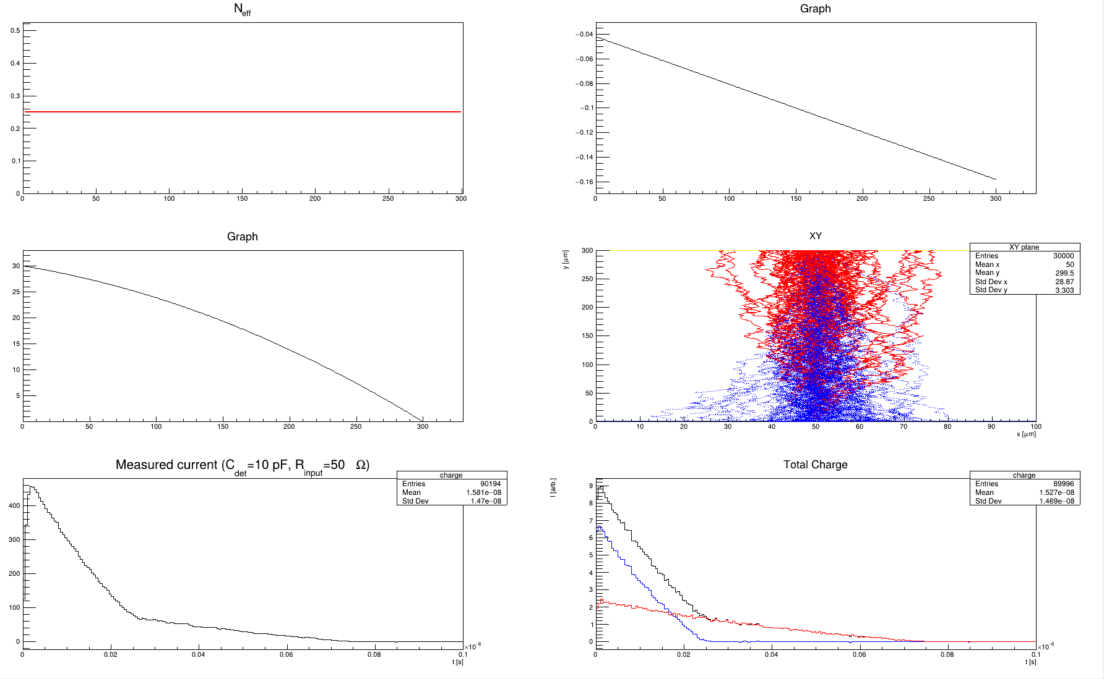
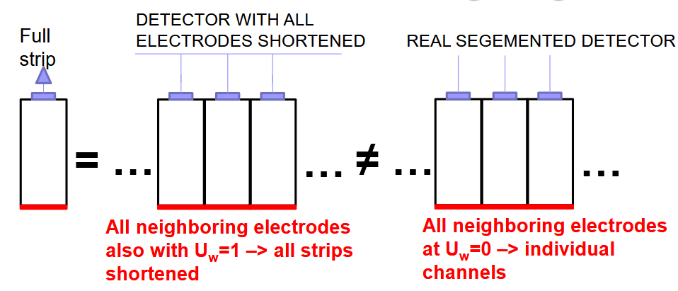
KDetSim example
E-field
Keep in mind:
Reflective boundary conditions
(no field lines escaping through sample sides)
E-potential
To simulate weighting field of a segmented detector create basic cell with several electrodes (sensing central electrode, other electrodes not sensing)

Slide 28
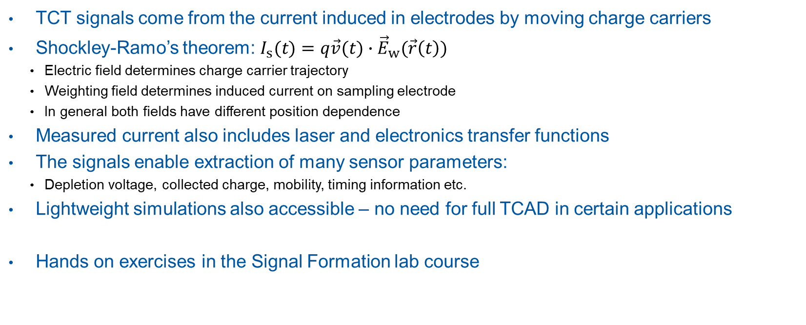
Summary
TCT signals come from the current induced in electrodes by moving charge carriers
Shockley-Ramo’s theorem: $I_{s}(t)=q\vec{v}(t)∙{\vec{E}}_{w}(\vec{r}\left(t\right))$
  Electric field determines charge carrier trajectory
  Weighting field determines induced current on sampling electrode
  In general both fields have different position dependence
Measured current also includes laser and electronics transfer functions
The signals enable extraction of many sensor parameters:
  Depletion voltage, collected charge, mobility, timing information etc.
Lightweight simulations also accessible – no need for full TCAD in certain applications
Hands on exercises in the Signal Formation lab course

