Slide 1

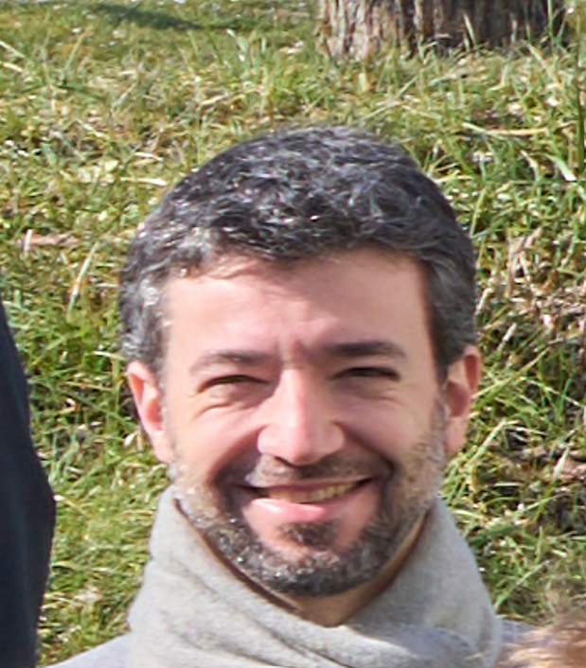
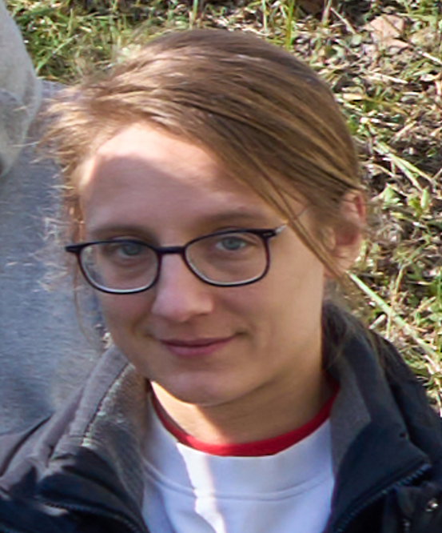
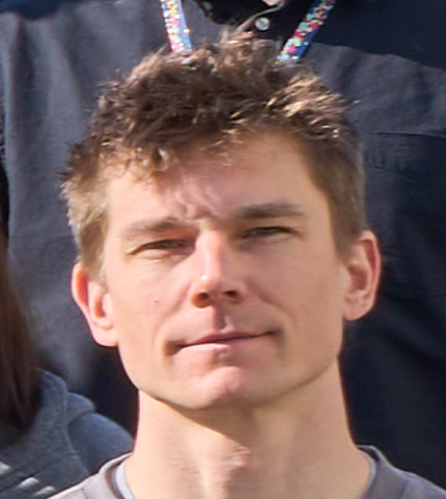
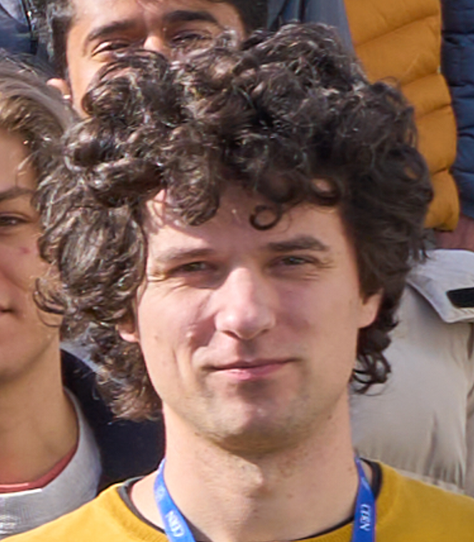
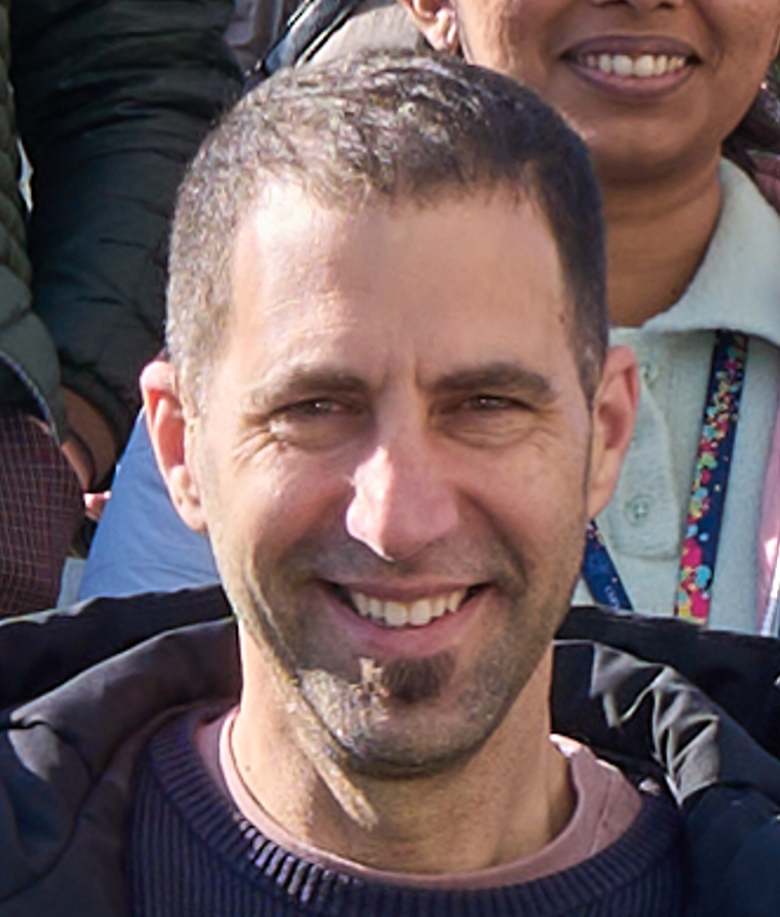
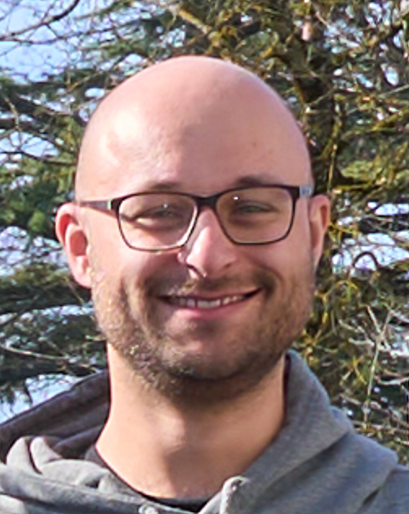
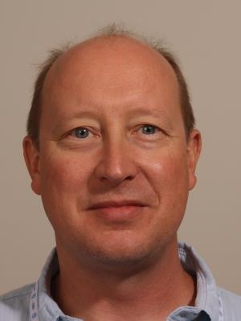
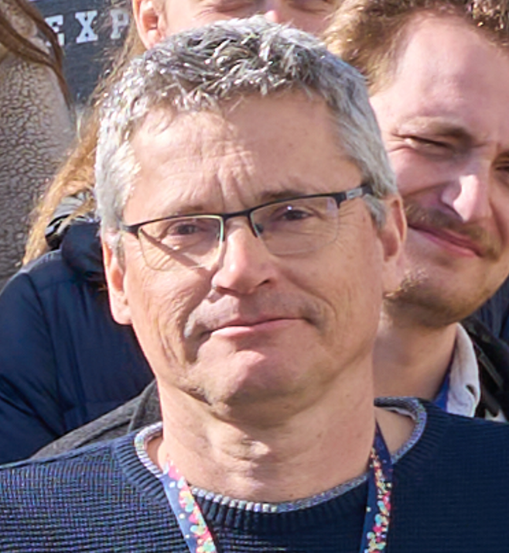
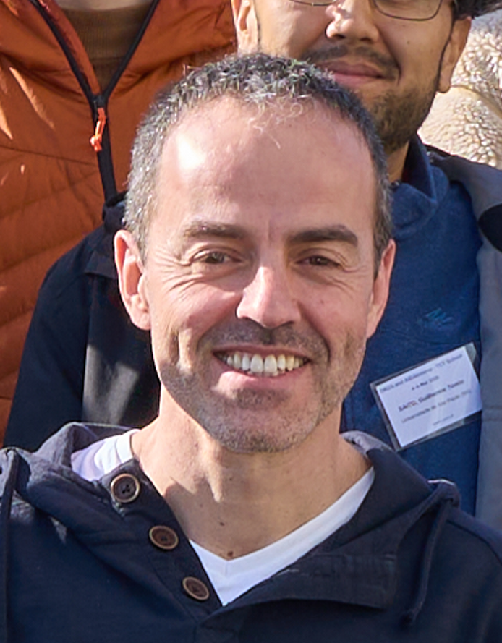
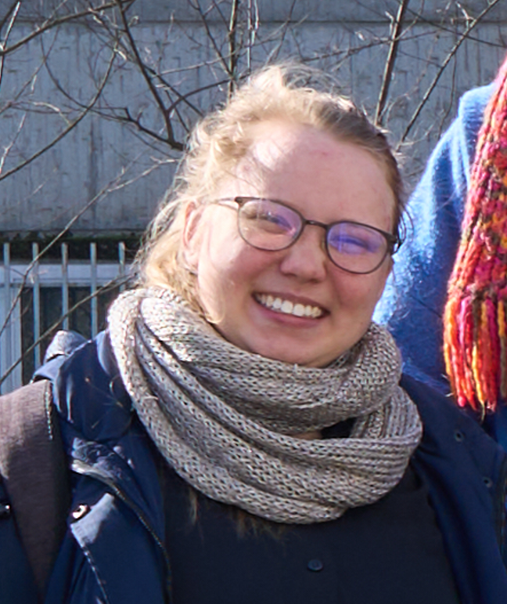
1st DRD3 TCT school
CERN, Geneva, Switzerland, 4.-6. March 2025
Ruddy Costanzi, Leena Diehl, Marcos Fernandez Garcia, Bojan Hiti, Marco Mandurrino, Michael Moll, Raul Montero, Marie Muehlnikel, Niels Sorgenfrei, Ivan Vila, Moritz Wiehe
Marco
Leena
Moritz
Bojan
Raul
Niels
Ivan
Ruddy
Michael
Marcos
Marie

Slide 2
Organization of the school
Tuesday morning 4.3.2025 [IT Auditorium]
  8:30 Welcome
  8:35 Introduction to Lasers,
    Raul Montero
  9:20 Signal formation
    Bojan Hiti
  10:05 SPA – Single Photon Absorption
    Marcos Fernandez Garcia
  10:50 Group photo
  11:00 Coffee Break
  11:30 TPA – Two Photon Absorption
    Moritz Wiehe
  12:15 TCAD simulations
    Marco Mandurrino
Tuesday afternoon - Hands-on session 1
Tuesday evening - Dinner
Wednesday morning - Hands-on session 2
Wednesday afternoon - Hands-on session 3
Thursday morning [IT Auditorium]
  9:00 – 10:30 Student presentations
  Coffee Break
  11:00 – 12:00 Demonstration of data analyses;
  Question and answer session
  12:00 – 13:00 Lunch Break
Thursday afternoon [ATLAS visit]
  13:00 – 14:00 Visit to the ATLAS cavern
  (2 groups)
    Niels Sorgenfrei - CERN

Slide 3
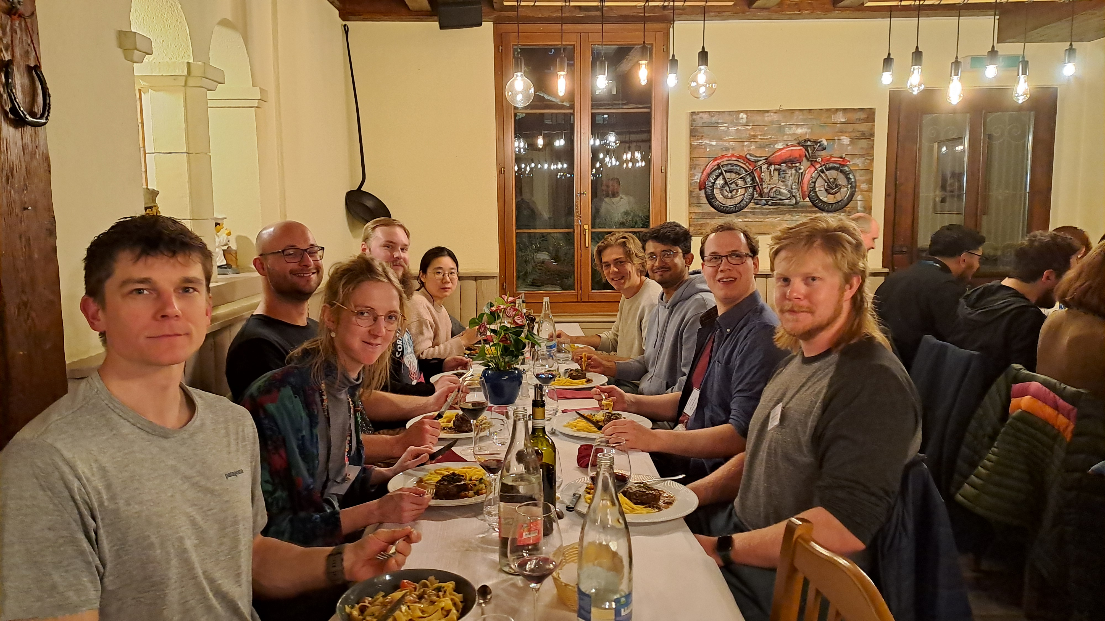
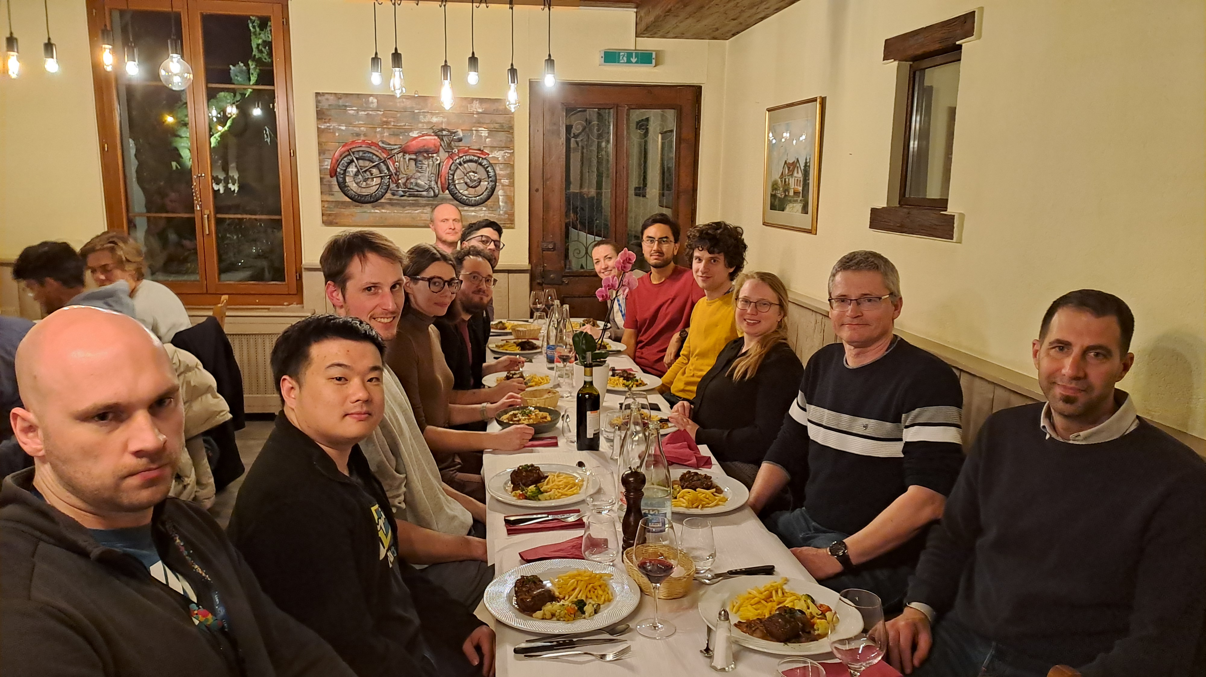
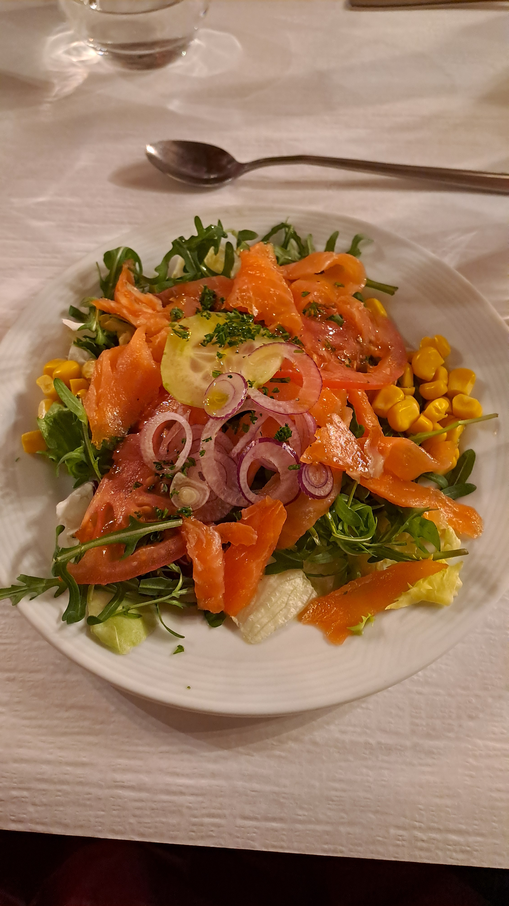
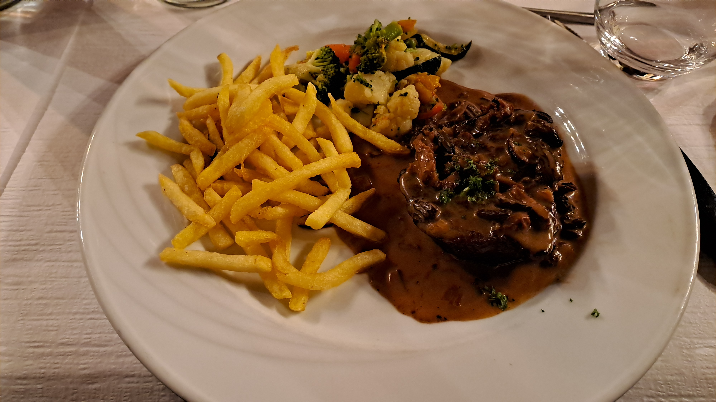
Dinner – Tuesday
Restaurant: Piatto d’Oro

Slide 4
Participants
18 participants
  from 18 different institutes located in 13 different countries
    Anusree Vijay; Indian Institute of Technology Madras (IN)
    Benjamin Stuart Urbach; The University of Edinburgh (UK)
    Fabian Simon Lex; University of Freiburg (DE)
    FLORENT DOUGADOS; CNM Barcelona (ES)
    Guilherme Tomio Saito; Universidade de Sao Paulo (BR)
    Jiayu Hu; Universita e INFN, Perugia (IT)
    Josef Daniel Sorenson; University of New Mexico (US)
    Kestutis Zilinskas; Vilnius University (LT)
    Long Li; University of Birmingham(UK)
    Miguel Gallo; INFN e Universita Genova (IT)
    Mika Väänänen; LUT University (FI)
    Niraj Kakoty; Institut de Física d'Altes Energies (IFAE) (ES)
    Oleksandr Borysov; Weizmann Institute of Science (IL)
    Pavla Federicova; Czech Academy of Sciences (CZ)
    Robert Stephen White; INFN Torino (IT)
    Sebastian Onder; Austrian Academy of Sciences (AT)
    Shuqi Li; Paul Scherrer Institut (CH)
    Sophie Rohletter; ETH Zurich (CH)

Slide 5
Additional Material
..uploaded to EOS folder:
  https://cernbox.cern.ch/s/qTJDHU2Rf8dBc8r (password was distributed)
  Raul: Lasers – references given in the talk + book
  Marco: TCAD – examples + more extensive TCAD lectures + chapter of book
  Photos
Photos taken by photograph will appear on CDS:
  http://cds.cern.ch/record/2925863 (group photos already uploaded)

Slide 6
Feedback
This was our first TCT school, we need your feedback to understand what was good and what was not so good and what can be improved;
  Feedback now …
  … and in form of email to any of us is much appreciated.

Slide 7
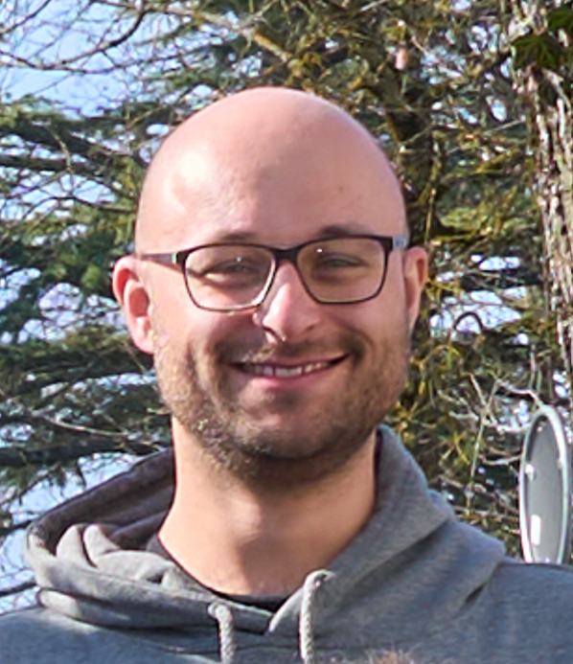
ATLAS visit
Details: see dedicated slides from Niels Sorgenfrei
Niels – you ATLAS tourguide

Slide 8
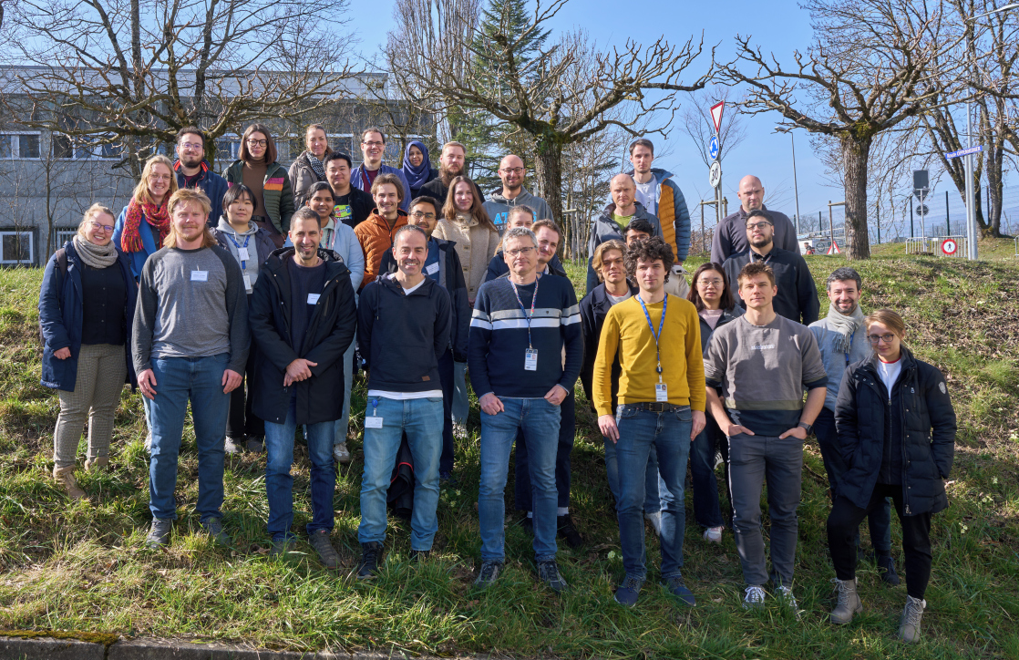
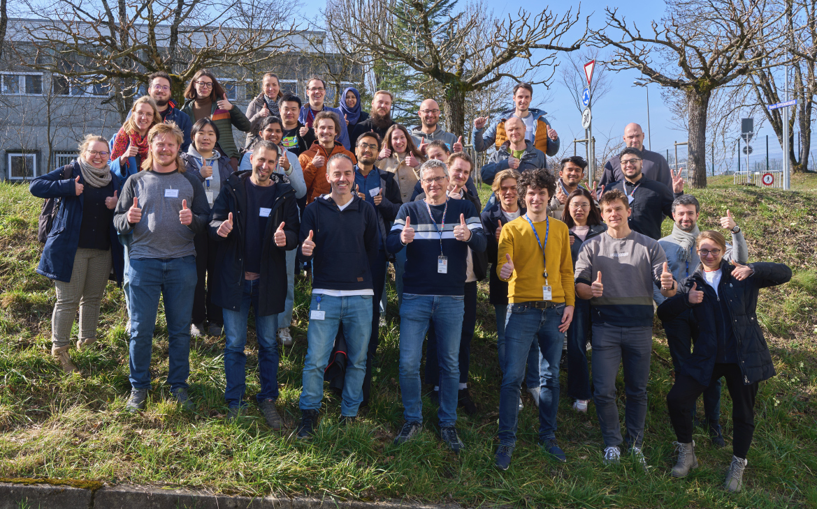
TCT-school
before school
after school

Slide 9
Goodbye and thanks for your participation!

