Slide 1
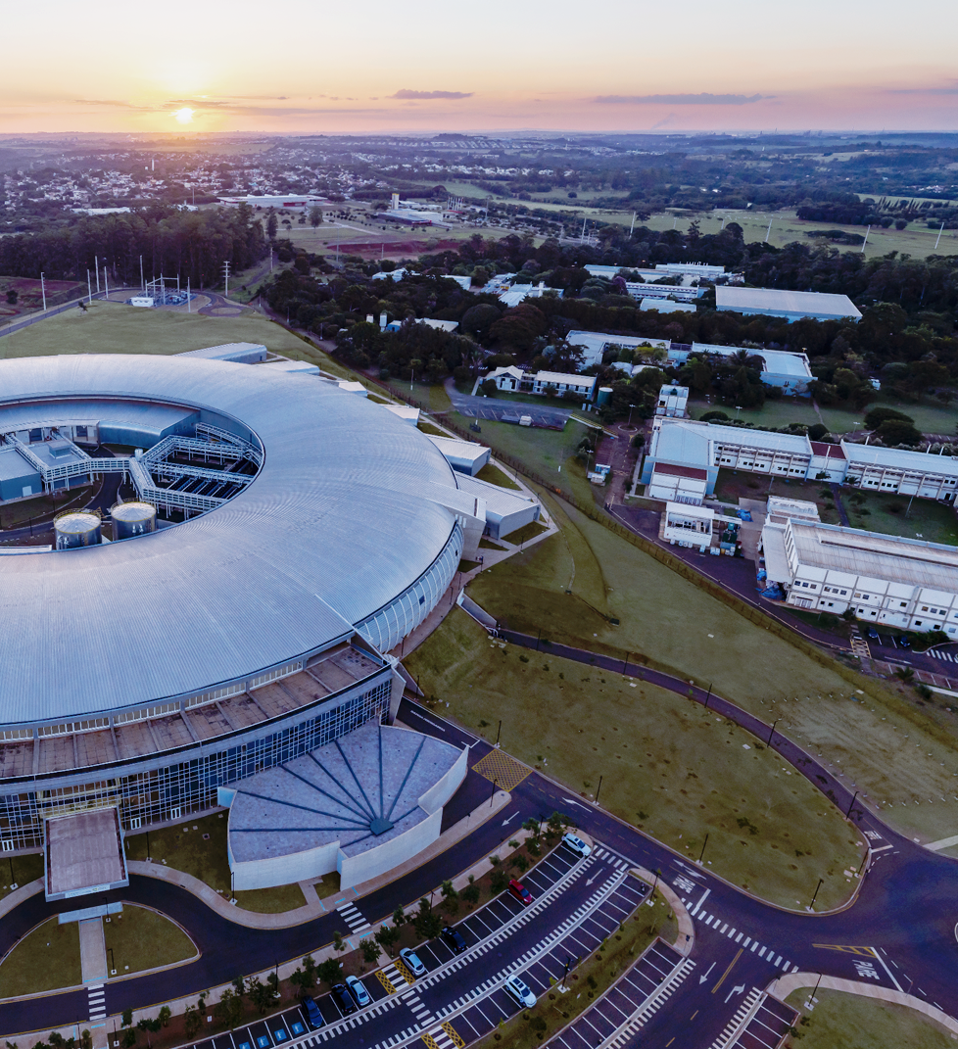

An Overview of the CNPEM’s Superconducting Wavelength Shifter (SWLS)
`
CNPEM’s Superconducting Wavelength Shifter (SWLS)
Technical Design Review
4–5th November 2024
Rafael Molena Seraphim
(Head of the Systems Engineering Division)
On behalf of the Technology Unit

Slide 2
Outline
Brief Overview of CNPEM and Sirius
SWLS Overview
  Motivation, Design Premises and Performance Goals
  Electromagnetic design
  Coils fabrication
  Mechanical design
  Cryogenic design
  Electrical systems
  Magnetic characterization approach
  Assembly, alignment, and fiducialization
  Sirius Installation
Schedule and summarized development status

Slide 3
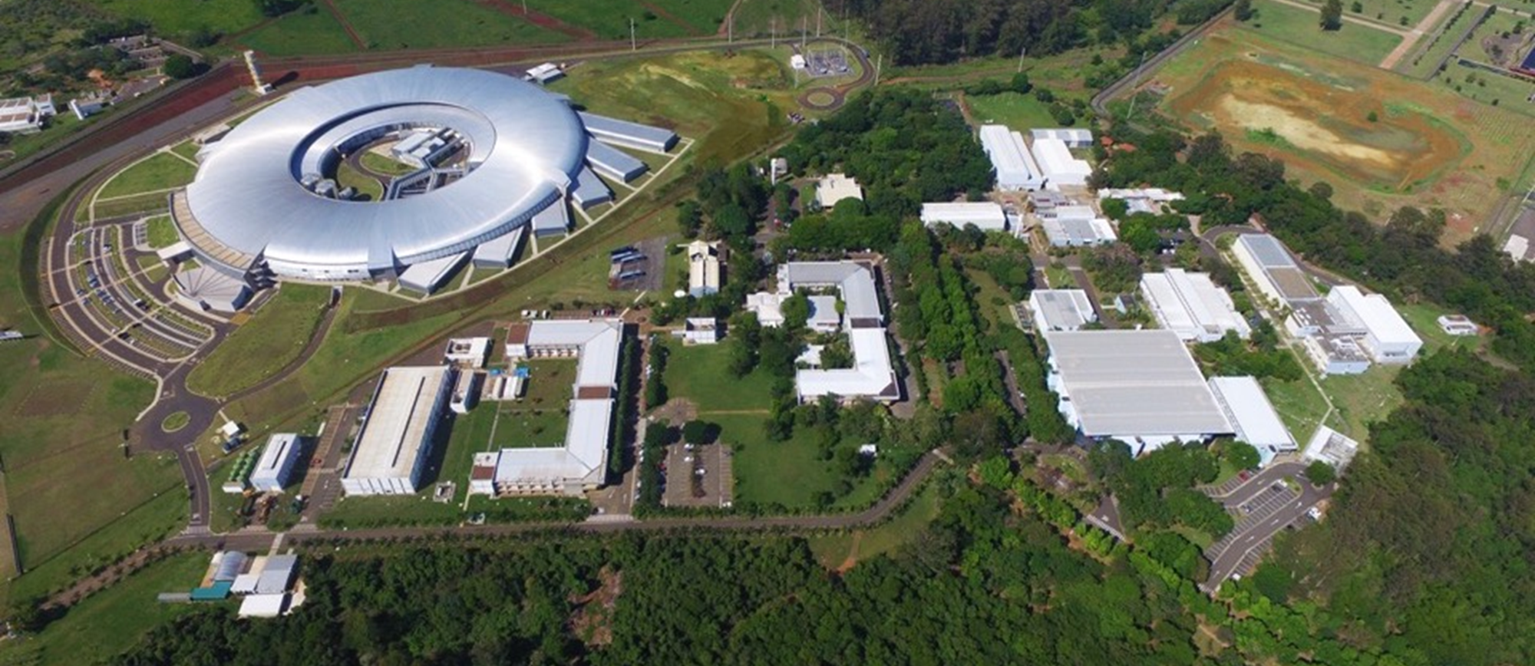










CNPEM is a private, nonprofit organization, working under contract with the Brazilian Ministry of Science, Technology, Innovation (MCTI)
Technology Unit
Systems Eng.
Mechanical Eng.
Materials Eng.
Electrical Eng.
Computational Eng.
DSC
~1000 employees
~450-560 trainees, pos-docs, students and outsourced personnel

Slide 4
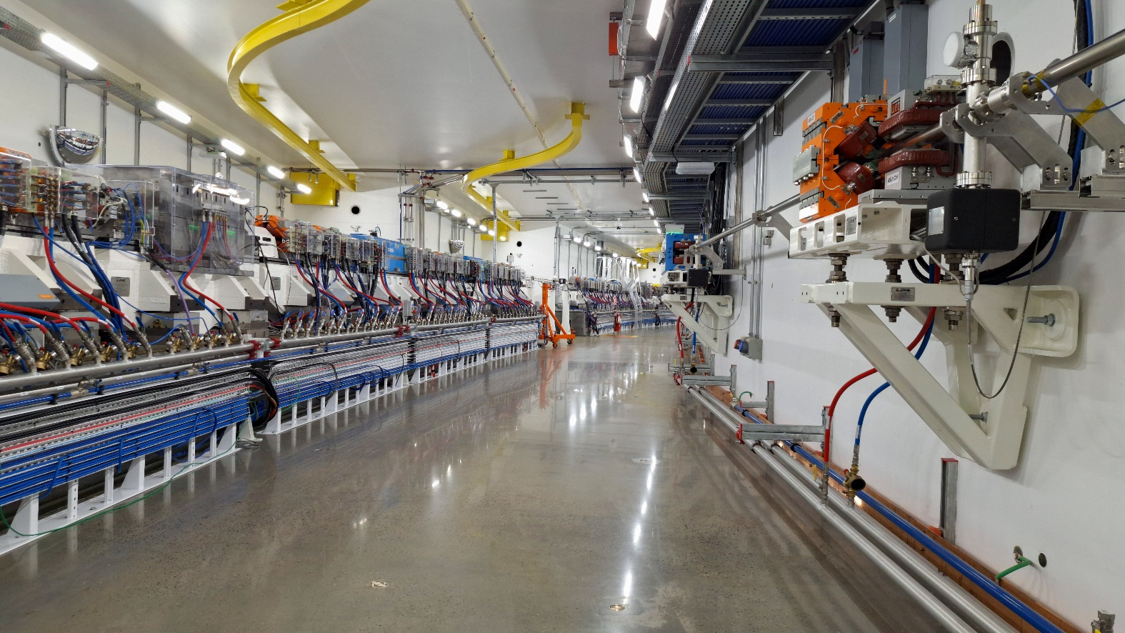
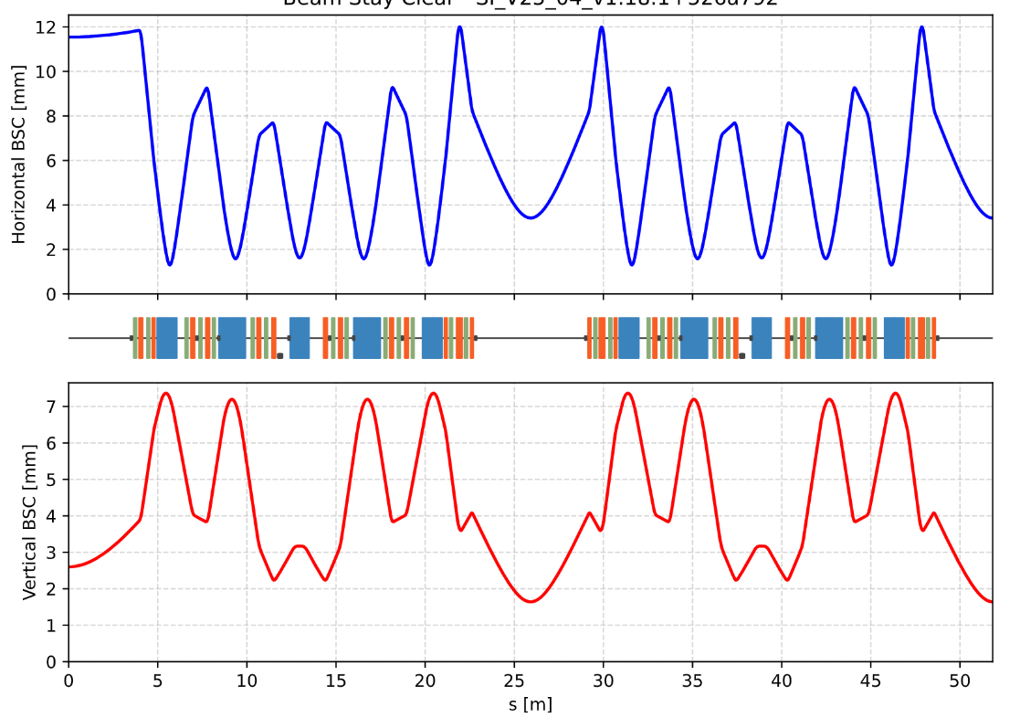
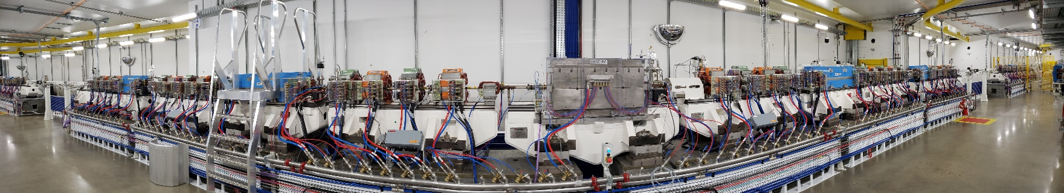
Sirius Overview
STORAGE RING
E = 3 GeV
Emit = 0.25 nm.rad
20 straight sections:
1x injection
2x RF cavities
17x straight sections for installing IDs
Diameter 165 m
BOOSTER
E = 3 GeV
Emit = 3.5 nm.rad
~85% index of nationalization
4th generation
LINAC
E = 150 MeV
Storage Ring
Energy | 3.0 GeV
Circumference | 518.4 m
Current, top-up | 350 mA
Hor. emittance | 0.250 nm.rad
Straight section free length Low β / High β | 5.8 m / 6.5 m
20x 5 Bend Achromat
(magnetic lattice)
Beam-stay clear in the center of the Low-beta straight sections:
Low beta: 3.40 (H) x 2.60 (V) mm²
High beta: 11.55 (H) x 2.60 (V) mm²

Slide 5
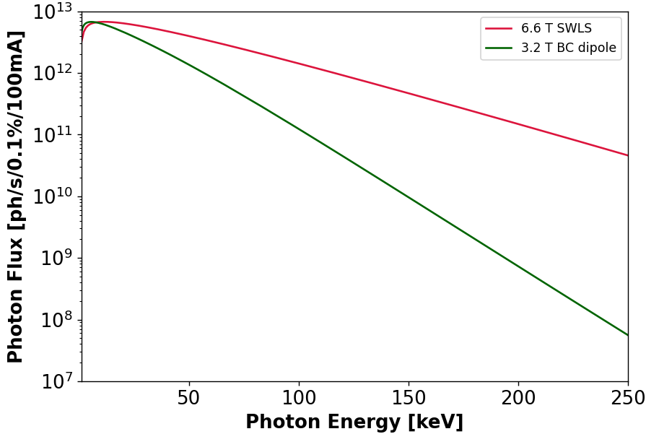
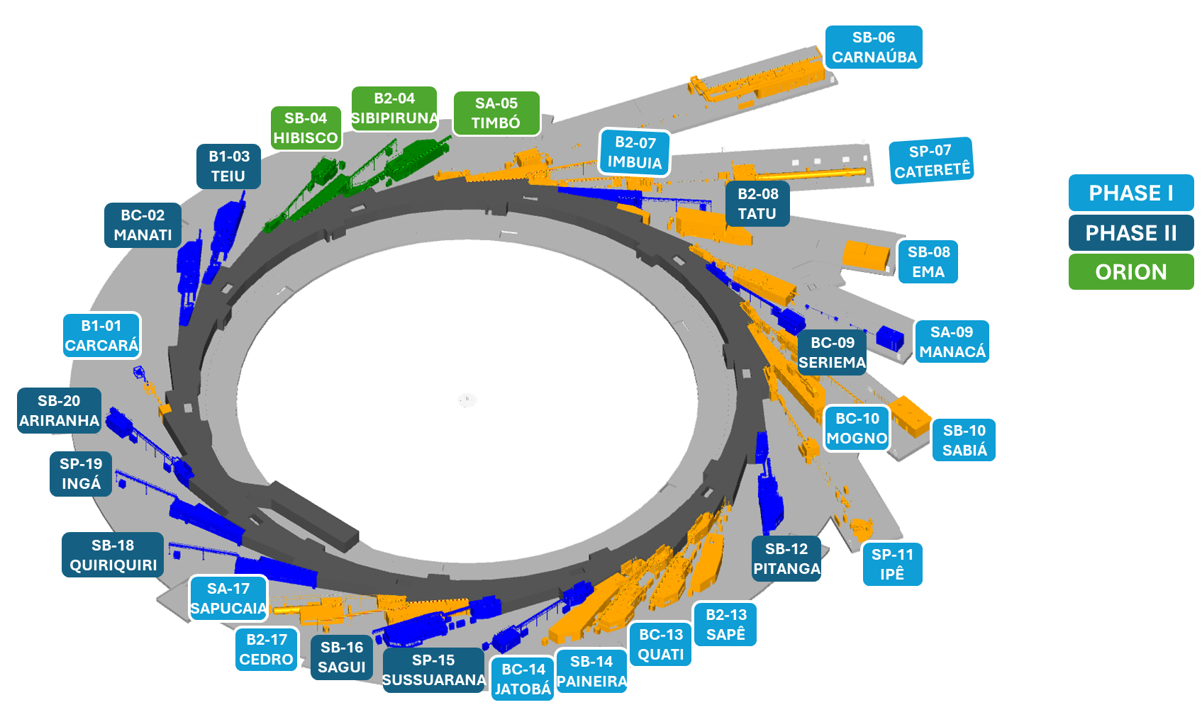
SWLS - Motivation
Sirius phase 2 - new hard X-ray beamlines -> Need for high energy photons
Current non-superconducting magnets of 3.2 T do not produce reasonable photon flux above 100 keV
Beamline candidate
Beamline | Exp. Technique | Energy Range [keV]
SUSSUARANA | X-ray Diffraction | 30 - 200
11x
(current beamlines focus on photon energies below 70 keV)
49x
204x
15 beamlines
10 beamlines
3 beamlines
Aperture: 1x1 mrad²
Sector 15: low-beta straight section

Slide 6
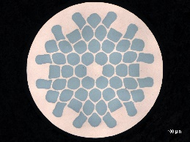
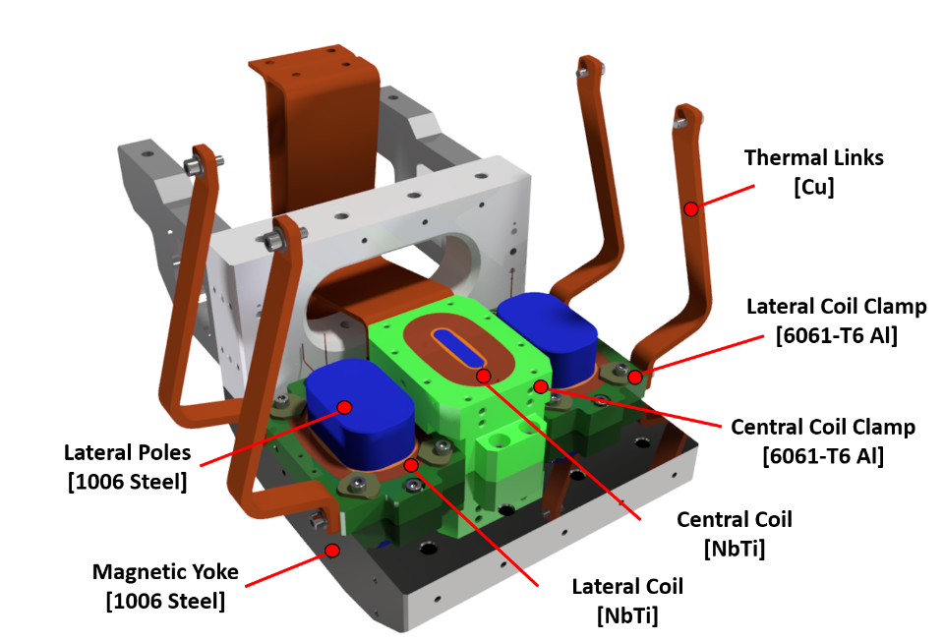
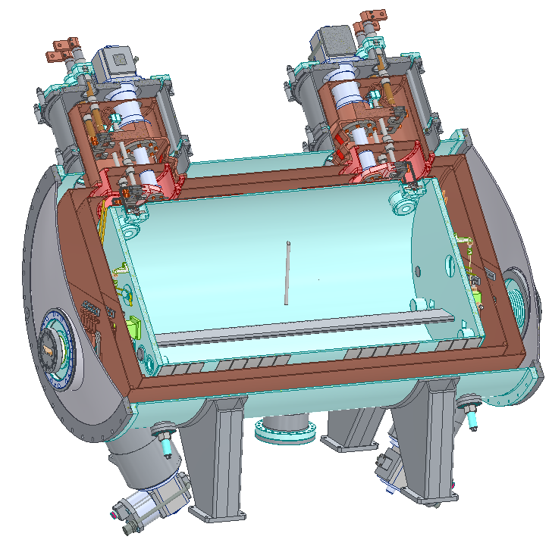
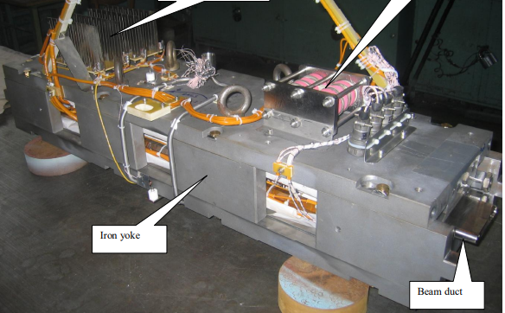
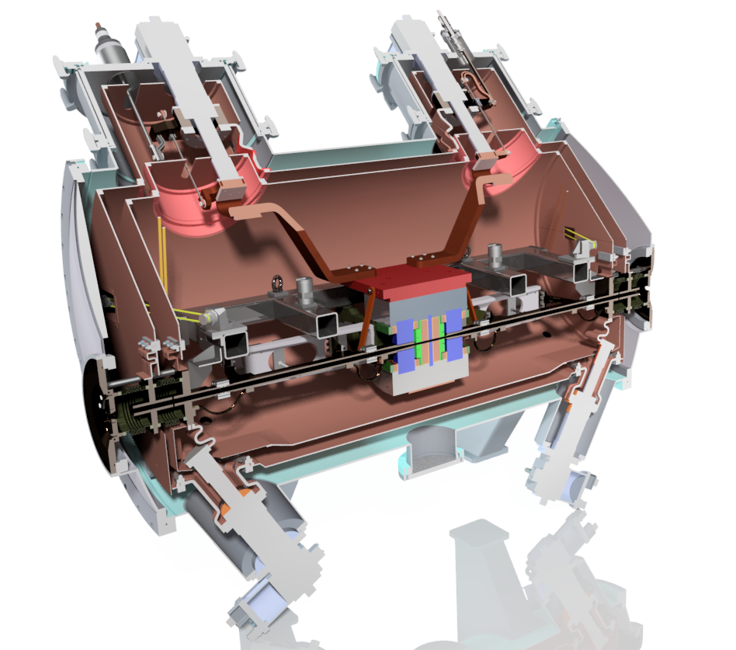
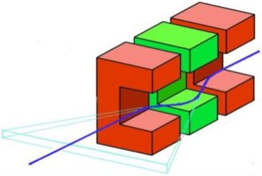
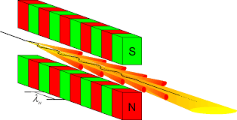
SWLS – Design Premises
Build a superconducting magnet, cryogen-free, with magnetic field higher than 6 T and compatible with one of the Sirius low-beta straight sections
The magnet must not impact the Sirius emittance and beam dynamics
Use NbTi wires
Reuse components from a deactivated 4 T Superconducting Wiggler
SWLS NbTi wire
Ø = 0.90 mm
Cu/NbTi = 0.97
New Electromagnetic structure
4 T SCW
SWLS
Cold mass
(In LHe bath)
Schematic of a WLS
Bought from Budker Institute of Nuclear Physics
Schematic of a Wiggler

Slide 7
SWLS – Performance goals / requirements
Magnetic peak field | > 6.0 T
Operating current | < 300 A
Central peak field profile (FWHM) | < 30 mm
Maximum 1st field Integral (w/o correctors) | < 200 G.cm
Maximum 2nd field Integral (w/o correctors) | < 20 kG.cm²
Operating marging @ 5 K | > 20%
Critical energy | > 30 keV
Maximum total emited power | < 5 kW
Coils operating temperature | < 5 K
Cooldown time | < 80 horas
Warm-up time | < 40 horas
Current ramping time, up or down | > 8 minutos
Lifespan | > 20 years, with a minimal number of quenches and a maximum number of cool down and warm up of 1 per year
Magnetic
Emited Radiation
Operation / Cryogenic

Slide 8
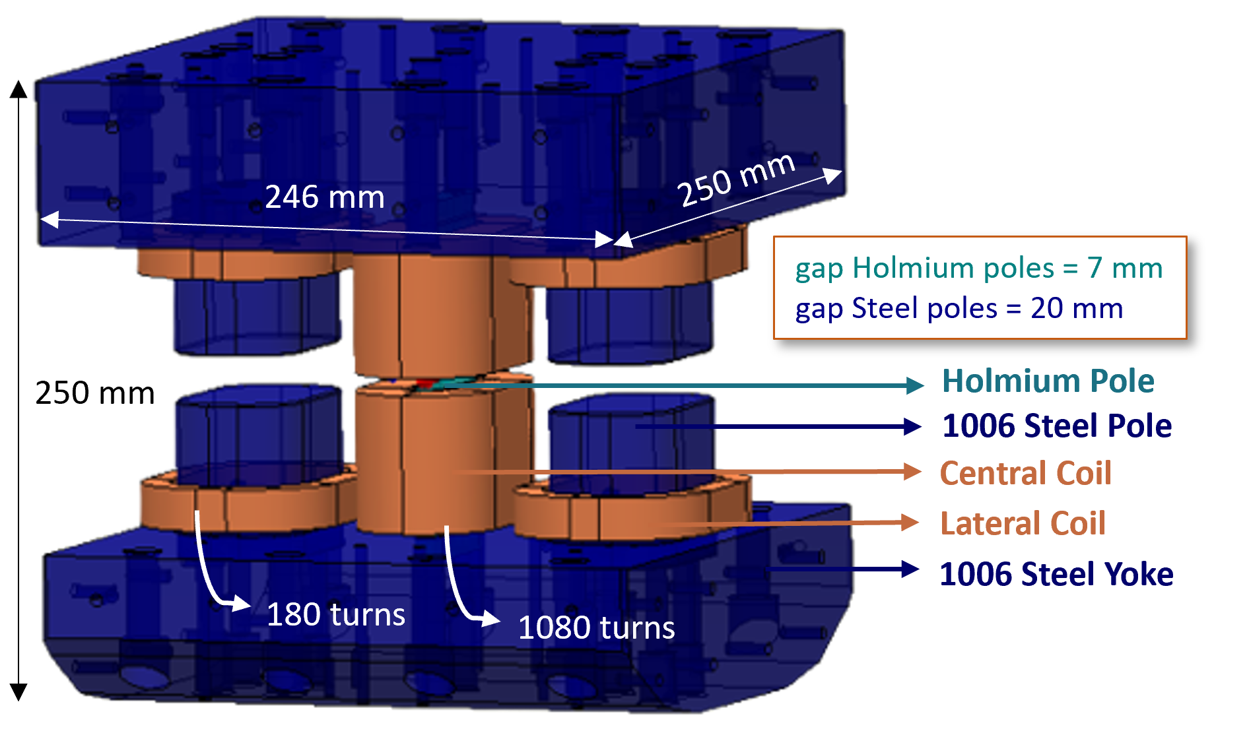
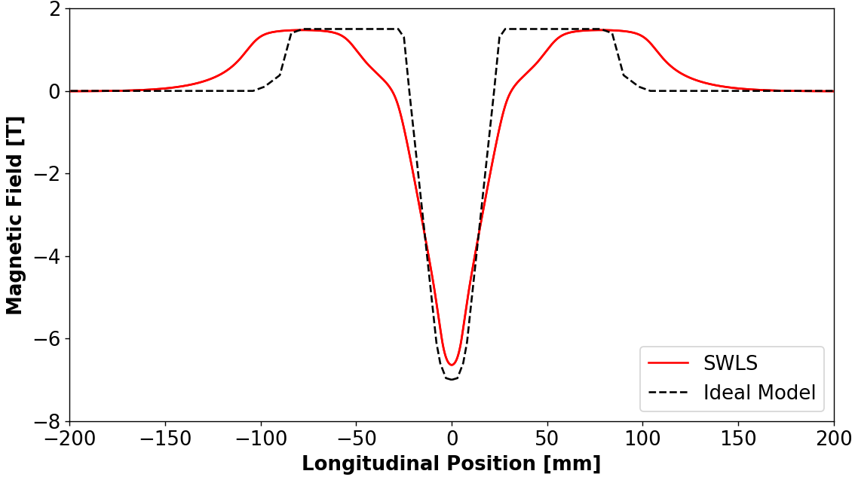
Electromagnetic Design
Electromagnetic Design Analysis and Optimization:
Geometry of the model
Magnetic field plots
Field integrals and multipoles
Fabrication errors
Load line operating margin
Energy Losses
SME and Inductance
Photon flux emission
Proposed electromagnetic model
Ho pole (12 mm) ferromagnectic below 20 K
  Challenges:
  High peak field
  Field integrals and multipoles requirements
  A very narrow central peak field not to impact the beam emittance
Simulated field profile
Main results
Parameters | Targets | Results
Current | < 300 A | 228 A
Peak field | > 6 T | 6.6 T
FWHM of central peak | < 30 mm | 29.6 mm
1st magnetic field integral | < 200 G.cm | 72 G.cm
Margin @ 5.0 K | > 20% | 24%
1.4 T
29.6 mm
6.6 T

Slide 9
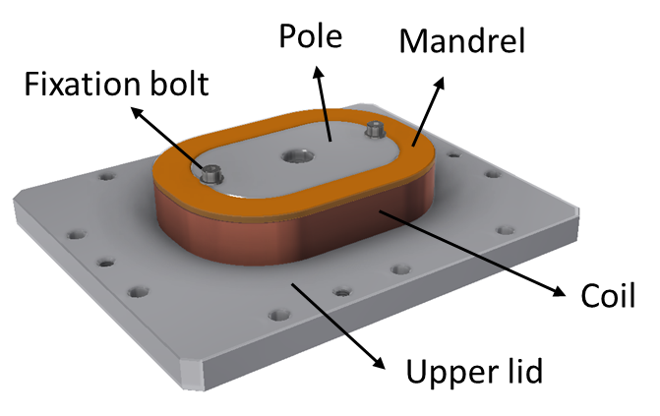
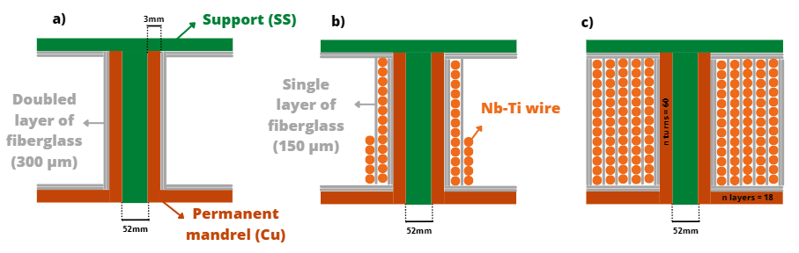
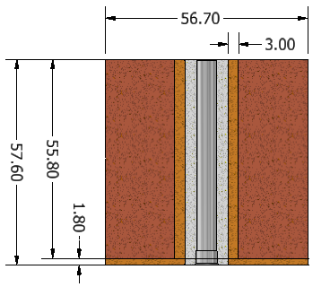
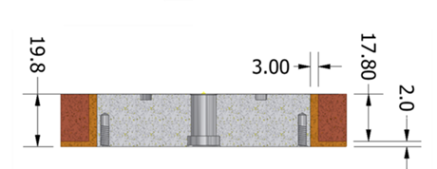
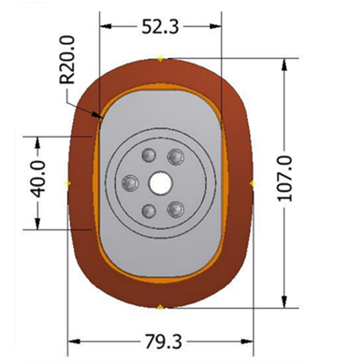
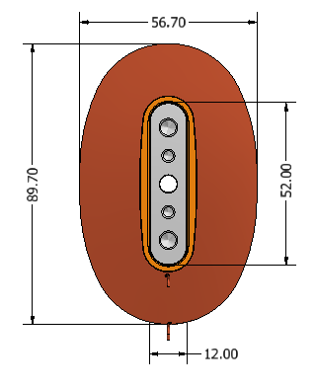
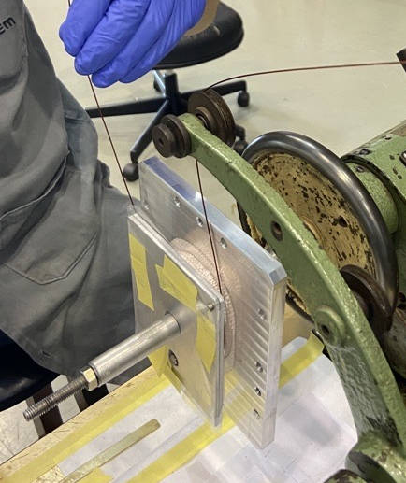
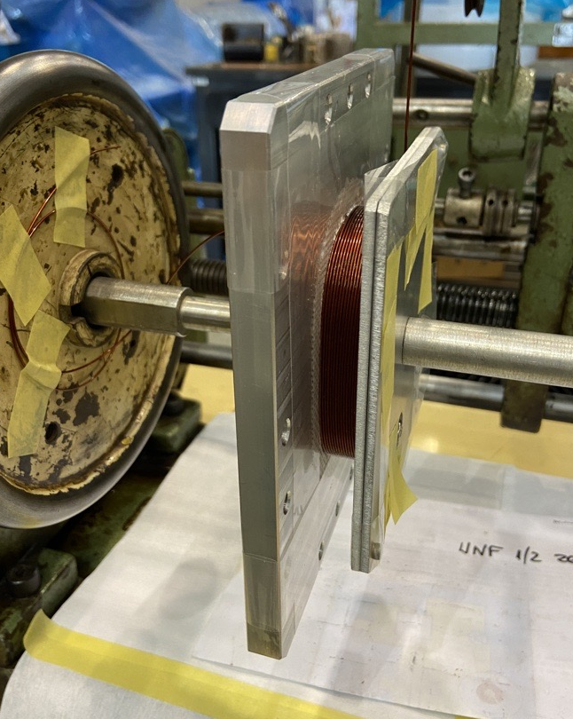
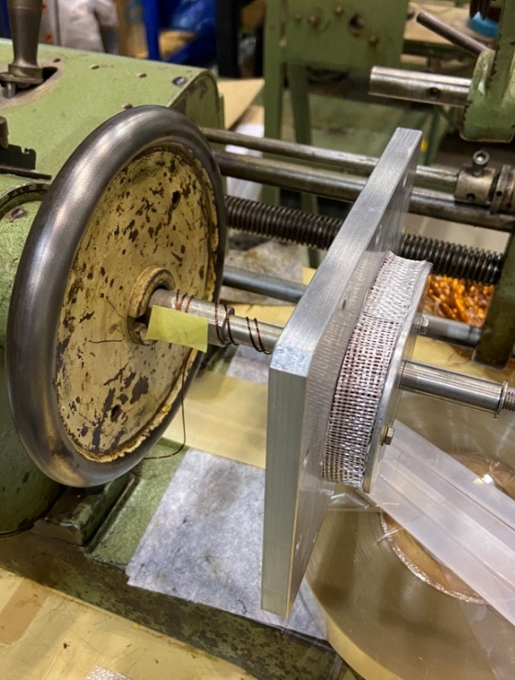
Coils fabrication
The coils have slightly oval shape to better maintain the tension on the wires during winding process
Layer by layer winding process
Geometry and dimensions
Lateral coil (180 turns)
Central coil (1080 turns)
Notes:
Slide status e validações futuras

Slide 10

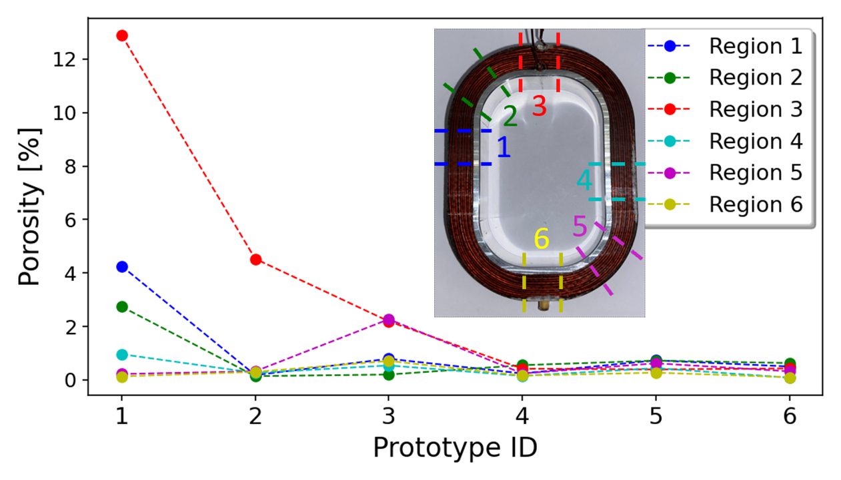
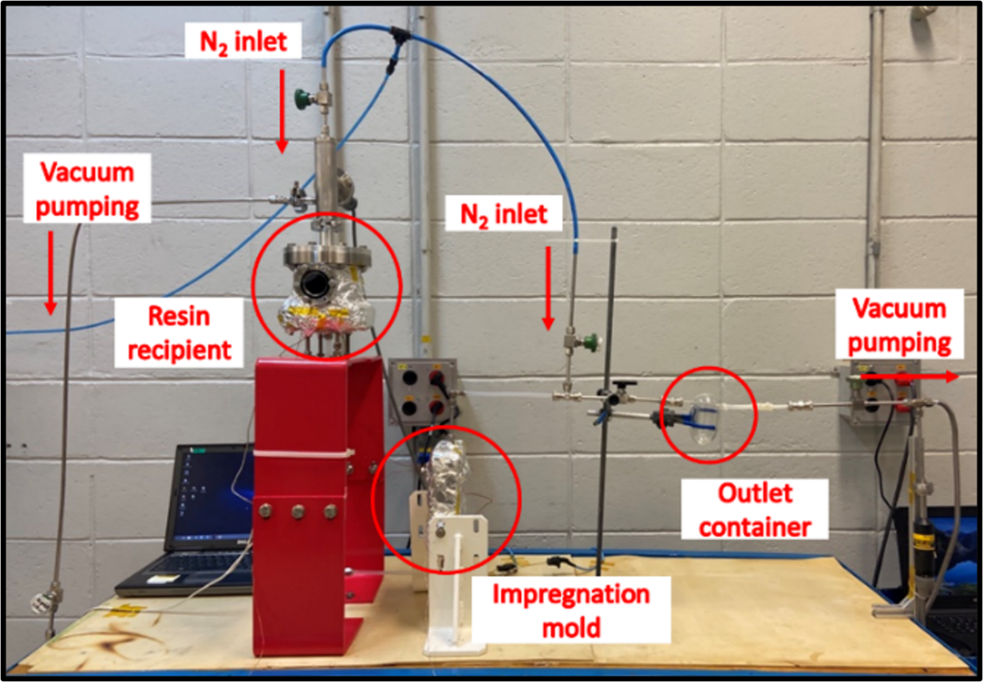
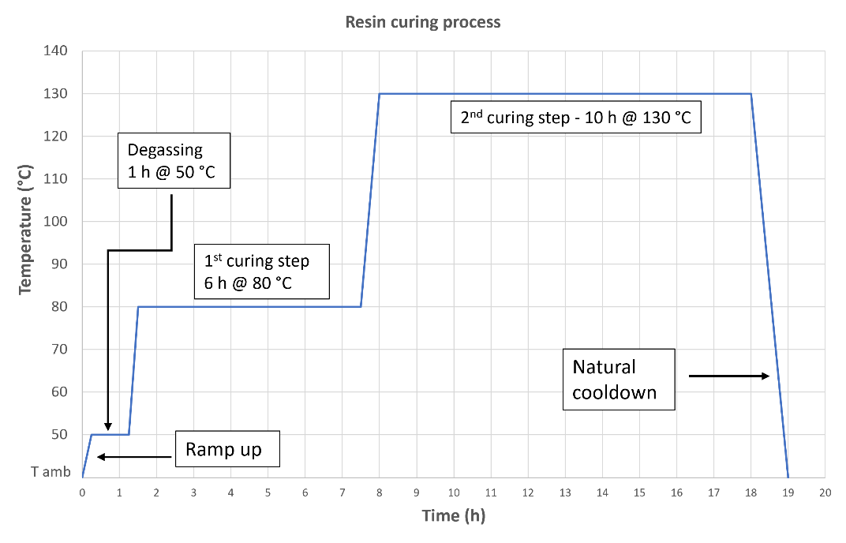
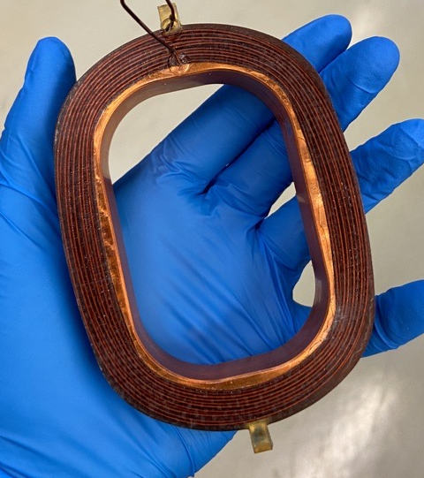
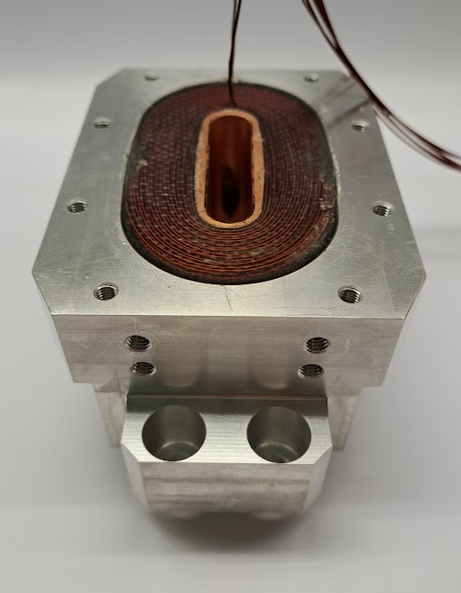
Coils fabrication
Pre-impregnation process:
Room temperature pump down (24h) and bake-out (24h@80°C): pressure 10⁻² mbar
Resin (Araldite F) overnight at room temperature with vacum pump
Impregnation process:
Degass the resin: 1h@50°C
Open valve and apply 100 mbar nitrogen pressure to control the velocity of the flow
Milking and reversed milking with 1 atm pressure (about 5 – 7 times)
Prototyped coils with low porosity level
Impregnation process was optimized using copper prototypes
Prototyped coils were successfully tested at the vertical cryostat
Copper prototyoes – porosity evolution
Resin curing process (resin: Araldite F)
NbTi coil prototypes
Notes:
Isa

Slide 11
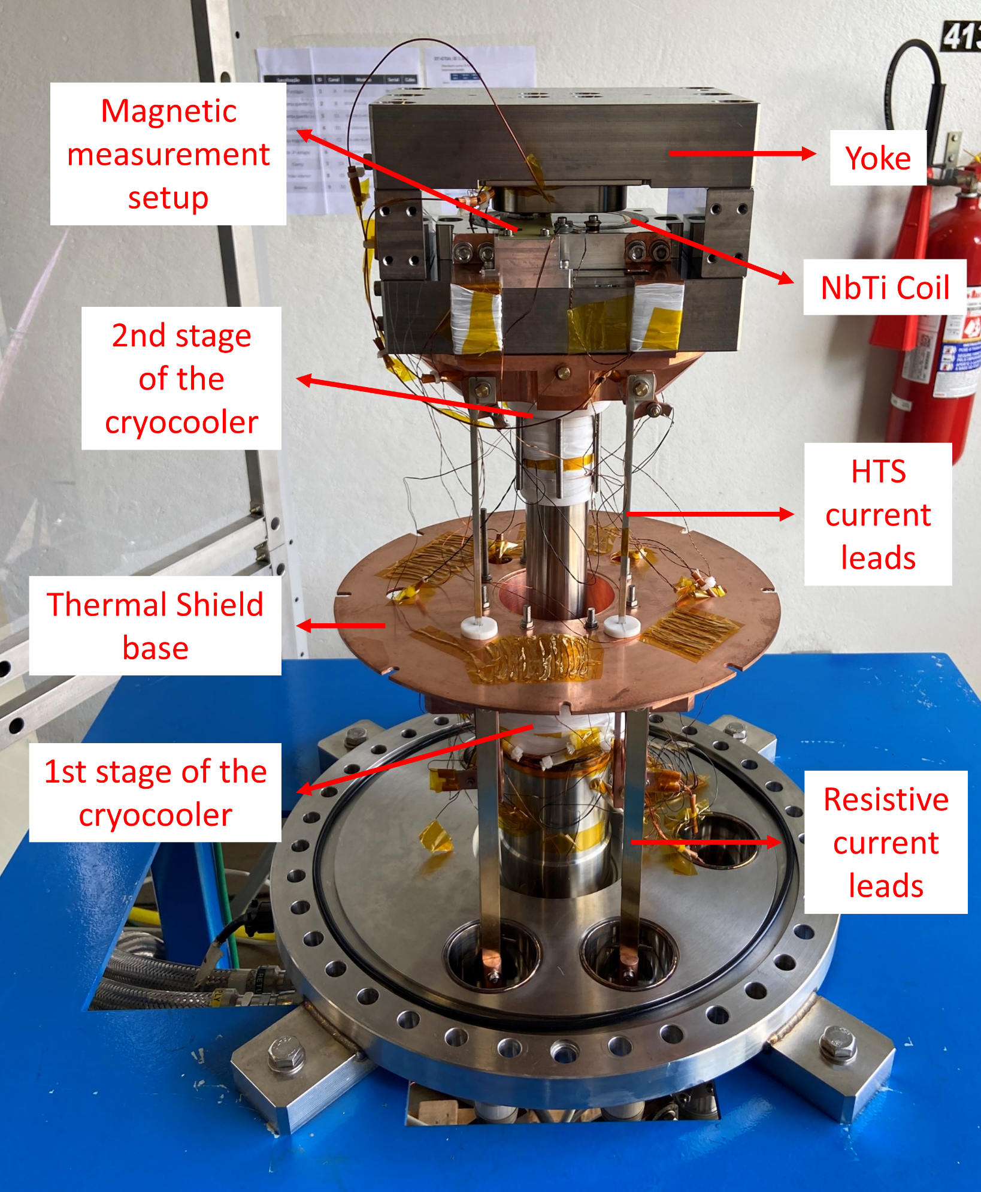
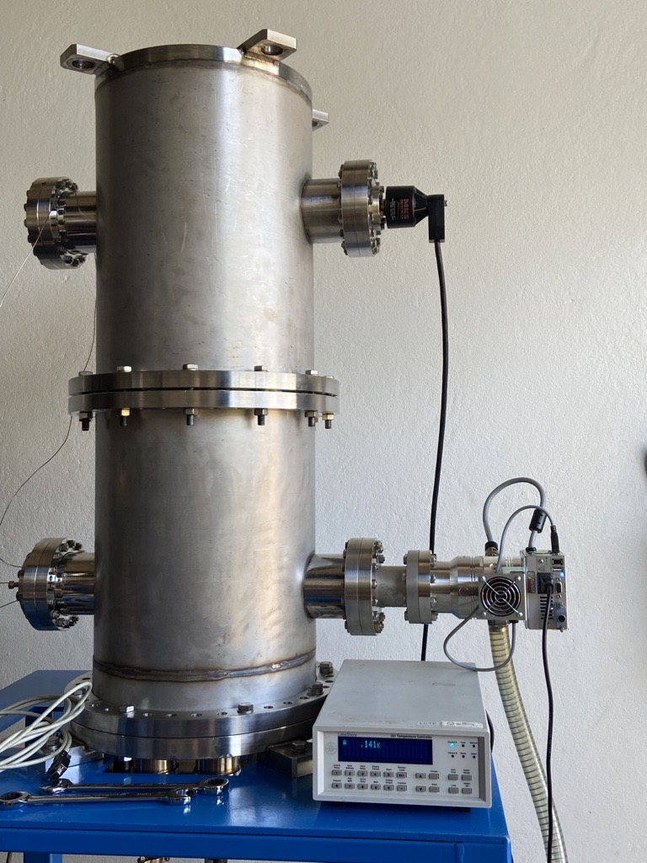
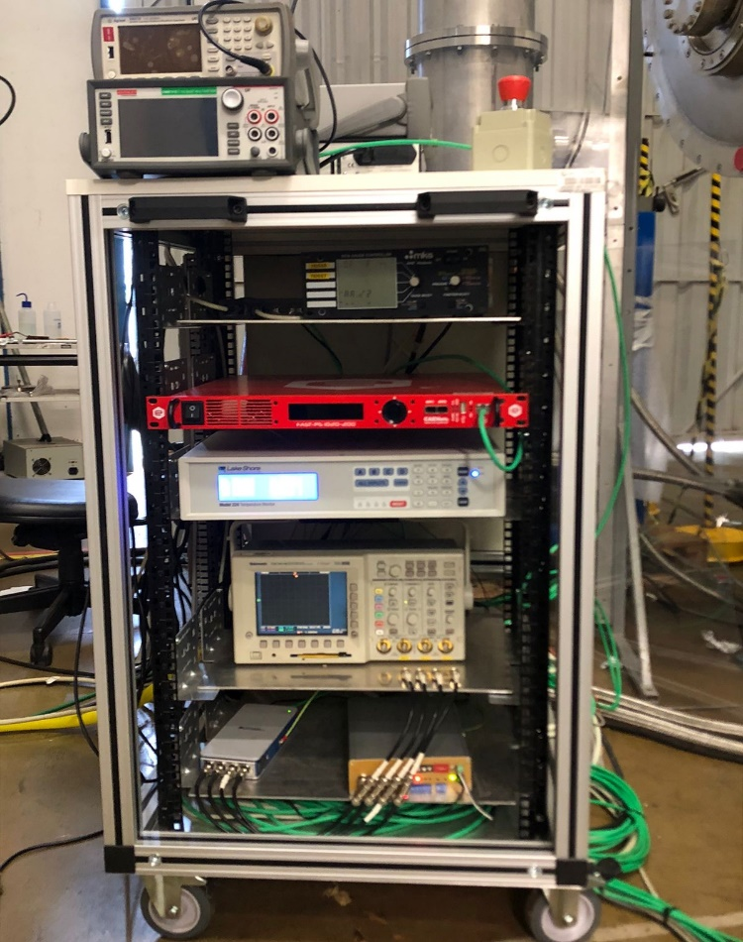
Vertical Cryostat – tests and validations
Cryostat Design and Features:
The cryostat follows the same principles as the SWLS: conduction cooling, current leads, thermal shield, etc.
Applications and tests planned
Thermal and magnetic tests of superconducting coils
Thermal performance of components at cryogenic temperatures
Mechanical component fixation at cryogenic temperatures
Splice box performance evaluation
Quench protection system testing
Control system testing and evaluation
Notes:
Slide status e validações futuras

Slide 12
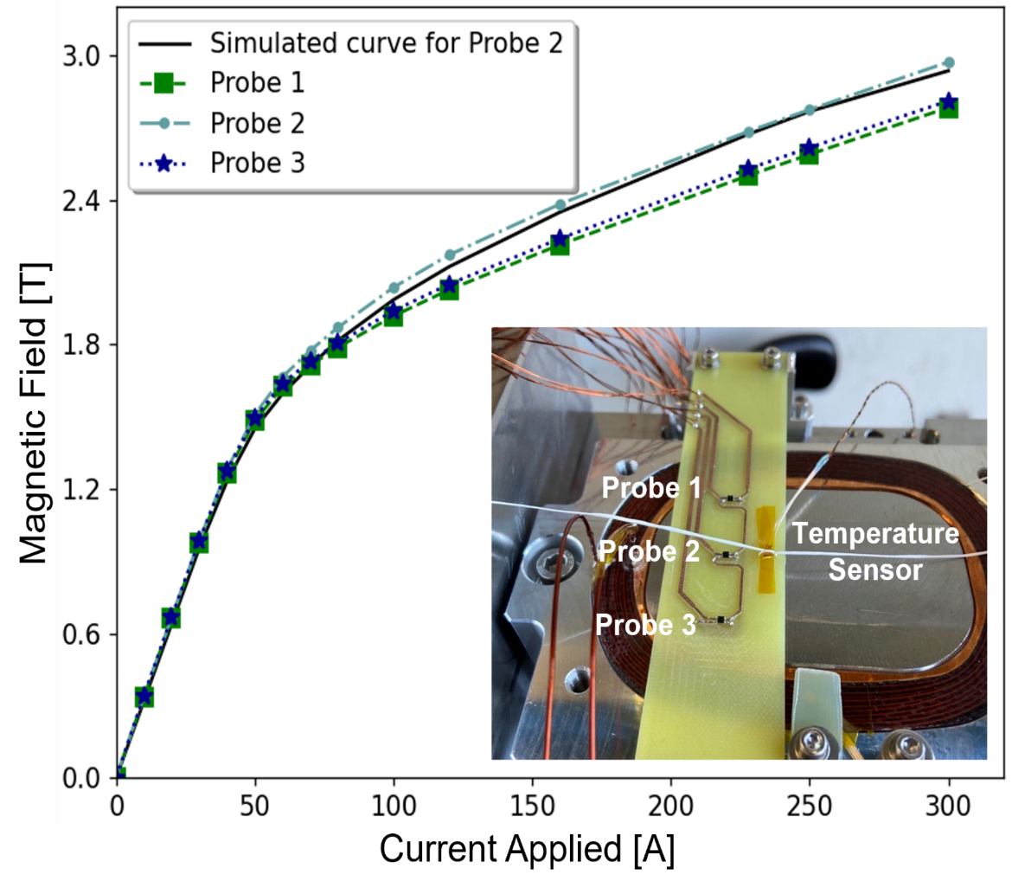
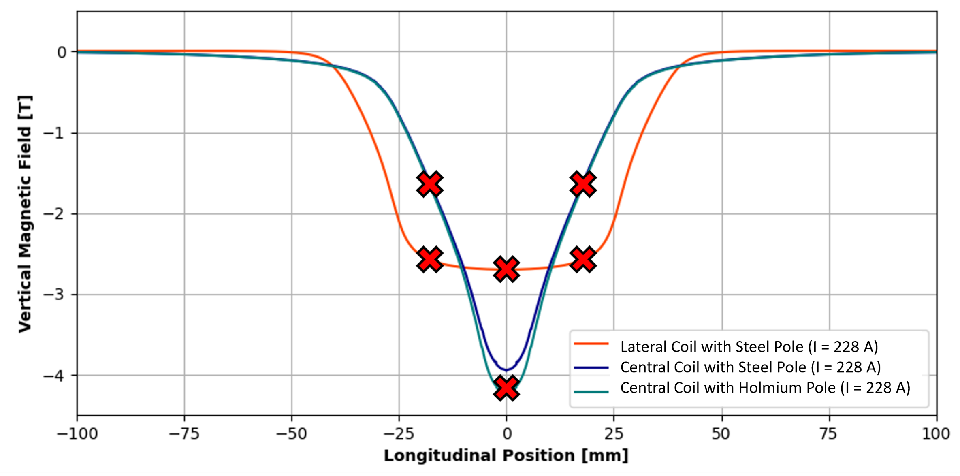
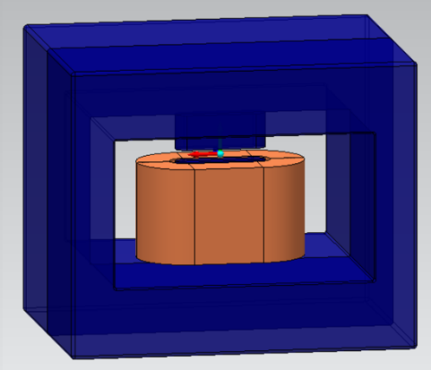
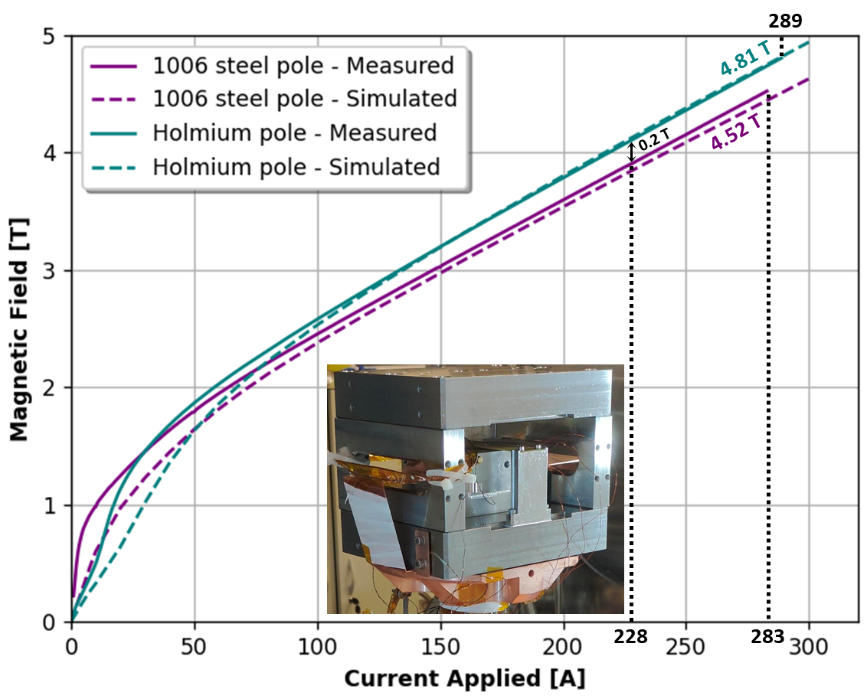
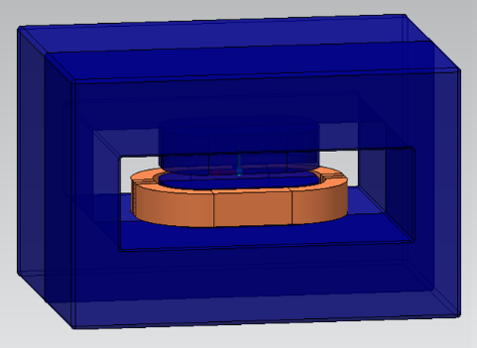
Coils tests in the vertical cryostat
  Flux return yokes were designed to test the coils
  PCB boards with 3 calibrated HGT-2101 Hall Probes were used to measure the magnetic field within the gap of flux return yokes
Results:
Lateral coil
Simulated magnetic profile for the mirror yokes
2 coils tested
Hall Probes
Results: Central coil
3 coils tested

Slide 13
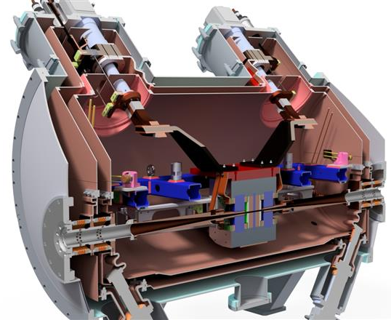
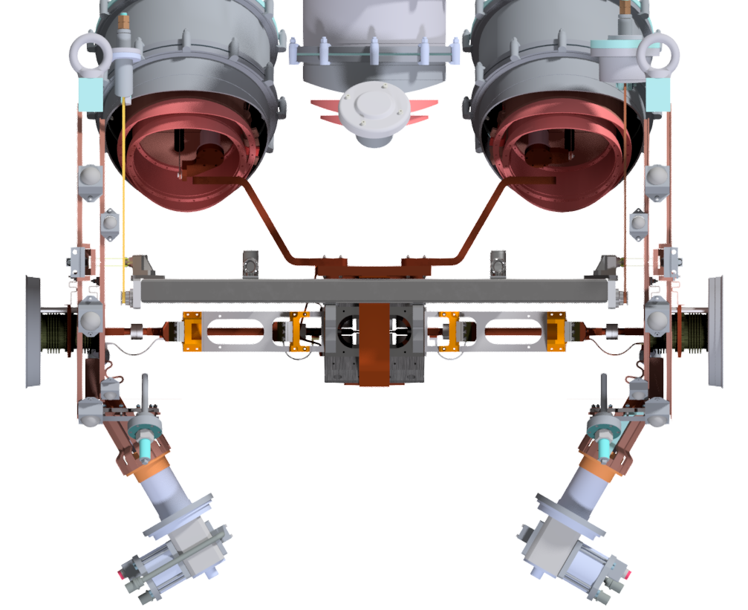
Mechanical design
Electromagnetic structure
Electron beam vacuum chamber
1
3
Thermal circuit
Supports
2
4
2
4
1
3

Slide 14
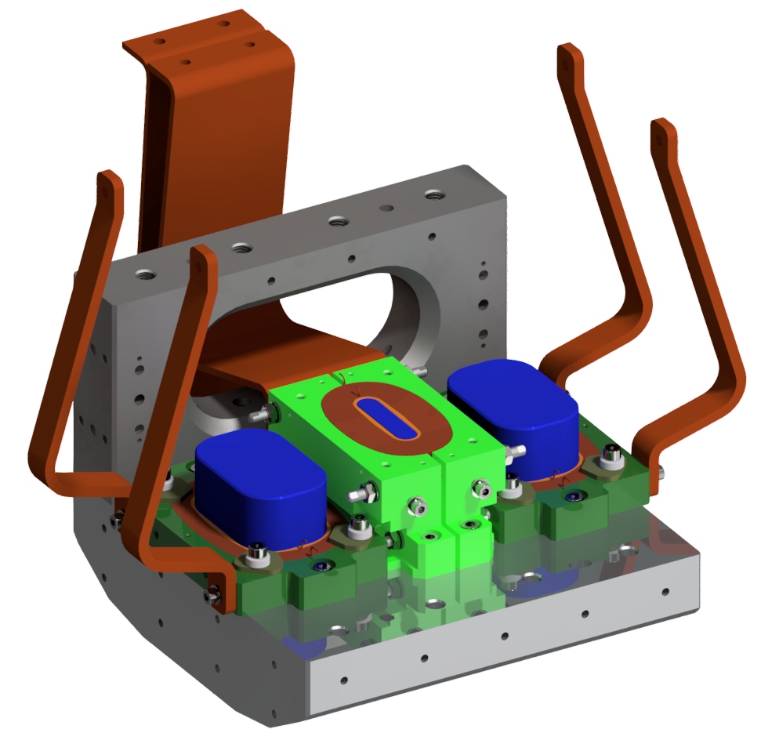
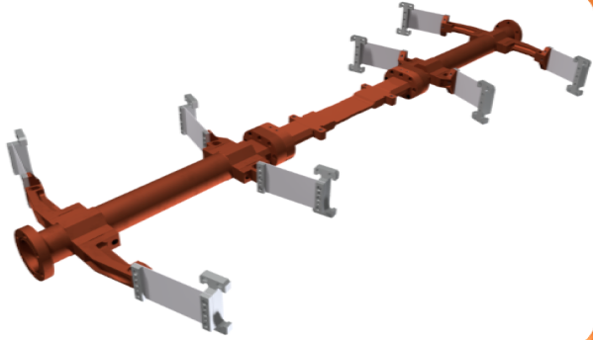
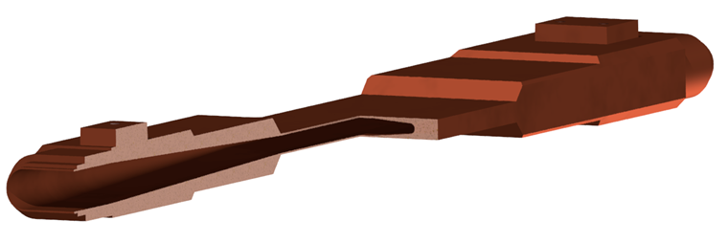
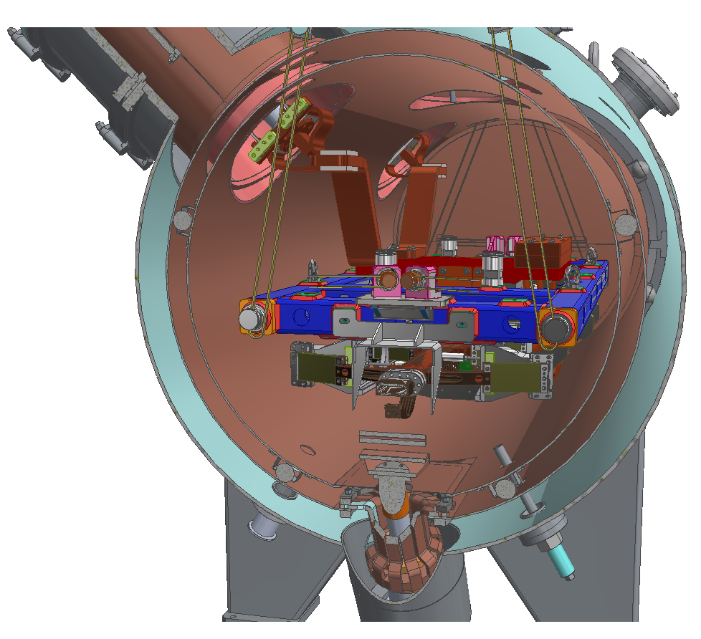
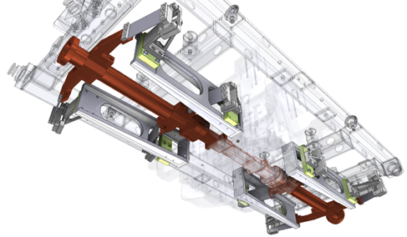
Mechanical design
Electron beam vacuum chamber
1
Electromagnetic structure
3
Main Concepts
Al and bipartite clamps to pre-load the coils
Central coils’ clamps with conical shape to prevent magnet’s gap closing
Invar washers to prevent bolt loosening
Thermal Links
(Cu)
Lateral Coil Clamp
(6061-T6 Al)
Central Coil Clamp
(6061-T6 Al)
Lateral poles
(1006 Steel)
Tripartite CuCrZr chamber
Total length of 1.2m
Central Coil
(NbTi)
6mm
Magnetic Yoke
(1006 Steel)
Lateral Coil
(NbTi)
0.5mm
2
Thermal circuit
4
Supports
Chamber Supports
[316L SS]
Base frame
[304 SS]
Main Concepts
Base frame supports the whole structure
Kevlar straps suspension:
    Minimize thermal conduction with low thermal contraction
    Provide vertical (adjustable out of vacuum) and horizontal alignment
Lateral Yoke serves as an anchoring point for the supports (unique connection between base frame, vacuum chamber and yoke)
Kevlar Straps
(See the following slides)

Slide 15
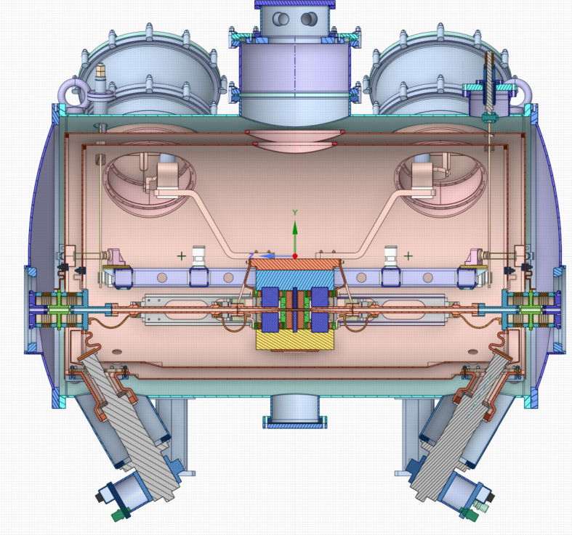
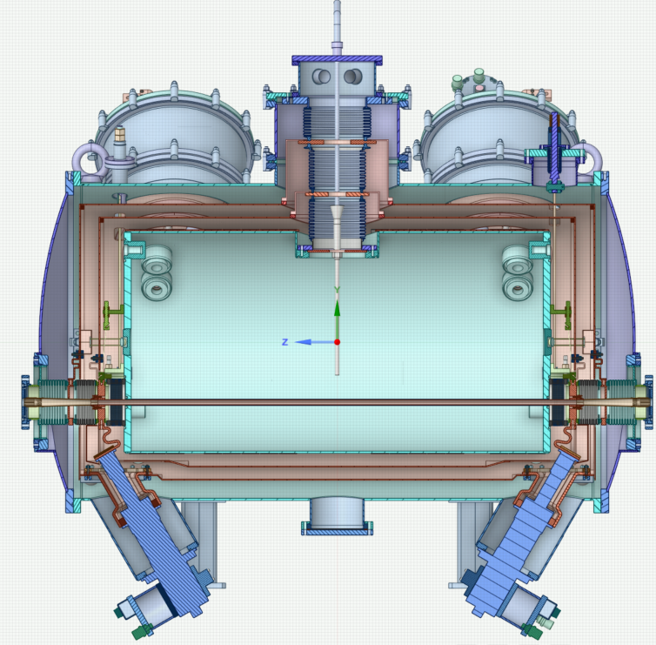
Cryogenic concept
SRDK-415D
(55W @ 60K & 1.5W @ 4.2K, 60 Hz)
300K
Cryostat Vac Vessel 10⁻⁶ ~ 10⁻⁸ mbar
Central flange – access to the central Lhe tank
LHe tank for the coils ~4.2 K
Kevlar supports
60K
1st Thermal Shield:
Cooled by 1st stage of the 4 cryocoolers
20K
E beam vac. Chamber and supports: Cooled by the 2nd stages of SRDK-408S
20K
2nd Thermal shield:
Cooled by the 2nd stage of SRDK-408S
4K
Cold mass:
Cooled by the 2nd stages of SRDK-415D
4 T SCW
(in bath cooling)
SRDK-408S
(50W @ 60K & 12.5W @ 20K, 60 Hz)
300K – 20 K
e- beam chamber transition inner: 10⁻¹⁰ mbar
outside: 10⁻⁸ mbar
6.6 T SWLS
(cryogen-free cooling)

Slide 16
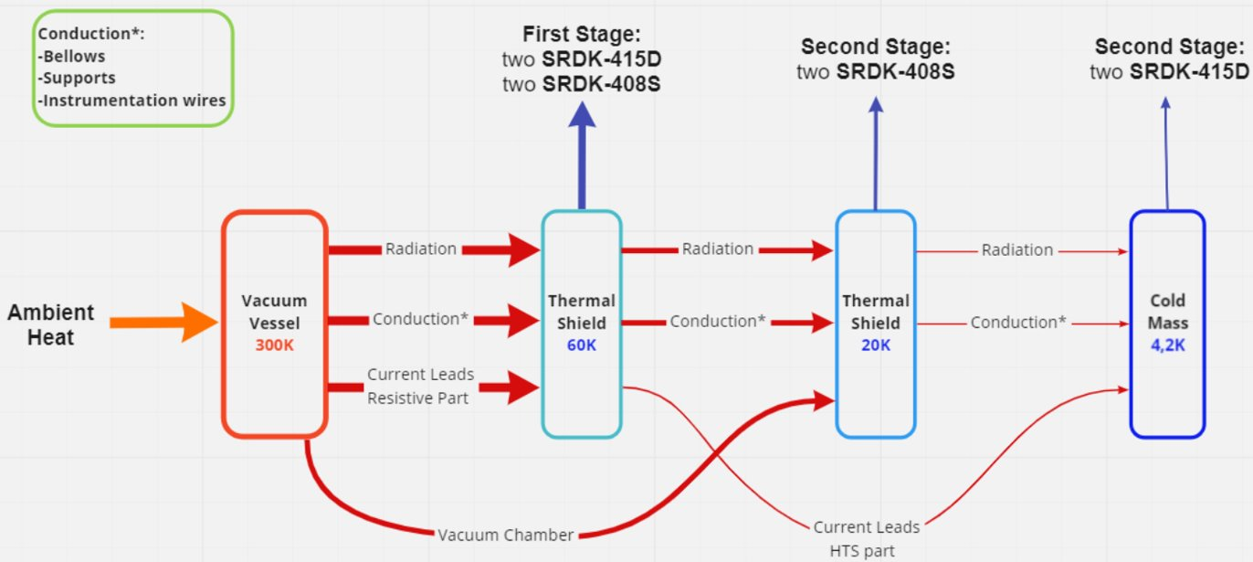
Heat Loads and Cooling Circuits
Heat loads
Design Temperatures
Cooling Circuits
Heat Source | 60 K [W] | 20 K [W] | 4 K [W]
Radiation | 7.95 | 0.3 | 0.007
Conduction | 13.82 | 0.77 | 0.17
Current leads@228A | 39 | - | 0.65
Beam Chamber | 37.2 | 8.65 | -
Total | 97.97 | 9.72 | 0.827
Cooling Capacity | 210 | 25 | 3
Cooling capacity higher than the heat loads

Slide 17
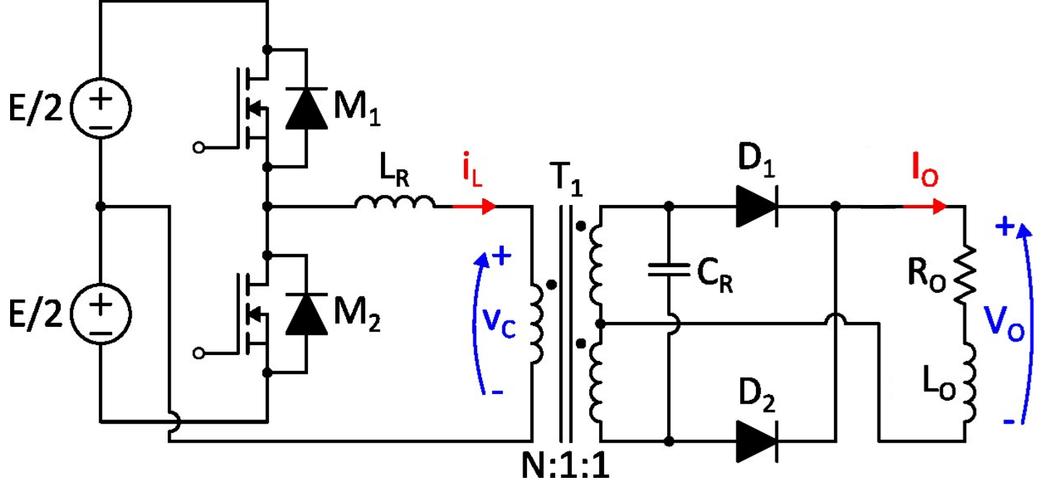
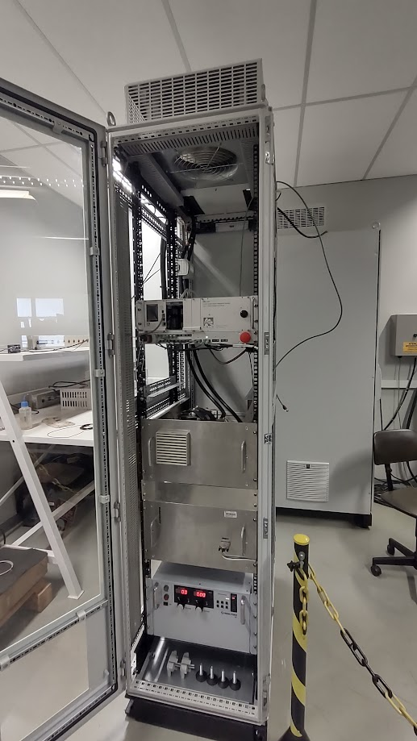

Power supply
Plan A
Resonant converter (discontinuous parallel resonant converter): in-house development
  3 kW, 300 A, and 10 V, and ripple lower than 10 ppm
4T SCW power supplies: Danfysik MP8443
  3 kW, 300 A and 10 V, ripple of 25 ppm
  Obsolete hardware and software
  No technical support anymore
Plan B
Control system
Can operate with the load in short-circuit
Topology of the developed resonant converter
Ripple ~ 4 ppm (1 ppm = 0.3 mA)
Resonant converter
  Next step:
  Ensure realible and stable operation using superconducting coils
DC Link
(300 V)

Slide 18





Quench protection
Redundant voltage taps
Detection by overvoltage and coil imbalance
Redundant extraction switches
Premises:
  Provide redundant detection and protection
  Design to keep max hot-spot temp < 100 K
Detection: voltage measurement – voltage taps
  Detection circuit: Analog vs Digital using FPGA:
    FPGA can be scalable and optimizable for the SWLS
Protection: Active method with external energy extraction
  The detection circuit sends a signal to the extraction circuit
  The power supply is turned off, and the contactors are activated
  Dump resistors in the extraction circuit dissipate the stored energy
Quench Detection prototype (analog circuit) and Extraction circuit
Detected quench during tests of the coils
  Next step:
  The FPGA solution will be also validated and well tested in the vertical cryostat before its final implementation for the device’s magnetic characterization in 2nd semester of next year
Quench protection architecture

Slide 19








Magnetic characterization plans
Two proposed solutions: Characterization in air (“Plan A”); Characterization in vacuum (“Plan B”)
Measurements: Mapping of the magnetic field profile; measurement of field integrals
Developments of mechanical rod and antichamber for
Plan A
Challenges:
Small gap
Cold vacuum chamber
High field calibration
Fiducialization (magnetic center)
1782 mm
with Hall Sensor and Scan/Insert Coil
Plan A
Plan B
Plan B
PCB coils and Hall sensors developments for
Antichamber for RT* measurements
Measurements inside SWLS vacuum chamber
$f$ ~ 4, 20, 60 Hz preliminary study
Hall sensor setup adaptations
New Hall sensor setup and calibration at CT**
Mechanical rod or Hall sensor carriage
In-vacuum positioning and moving system
Stretched wire for field integrals measurements
PCB coils for field integrals measurements
* Room Temperature
** Cryogenic Temperature

Slide 20

Assembly, alignment and fiducialization
Challenges
  Centering the magnetic field:
    Before cooldown: ensuring precise alignment with geometric references
    After cooldown: maintaining precise positioning with limited access for correction
Main Concepts
  Measurement-assisted alignment concept (before cooldown):
    Geometric center alignment: measured reference points transferred from the electromagnetic structure to the external cryostat
    Magnetic center alignment: correlate the magnetic center of externally assembled permanent magnet fiducials with measured device’s magnetic center - using the same magnetic measurement system
  Accommodation of thermal contraction (after cooldown):
    Position the structure considering simulated thermal contractions (validation needed)
    Vertical alignment can be adjusted using screws outside the cryostat (validation needed)
Alignment tolerances are still being defined together with the Accelerator Physics Group

Slide 21

Sirius installation
Sirius current sector valve
Sirius current sector valve
Ion pump
Additional sector valve
Additional sector valve
NEG-coated chambers
NEG-coated chambers
e⁻ beam
Tapers
BPM
BPM
Correctors are still missing in the drawing

Slide 22
Schedule

Slide 23
Summarized development status
PROGRESS
Electromagnetic Design
Development of the SC coils
Final validation of the electromagnetic design of the SWLS
Development of the hor/ver correctors
80% completed
Mechanical and Cryogenic Design
Development of the thermal links and fixturing concepts
Development of the electron beam vacuum chamber
Disassembly and inspection of the superconducting wiggler structure
Impact of the device vibration on the machine
75% completed
Electrical Systems
Development of the cryogenic electrical circuit
Development of the resonant power converter
Development of the quench detection and protection system
Development of the hardware and software for control and monitoring
75% completed
Integration and Mag. Characterization
Integration, assembly, and fiducialization strategy
Development of the setup for magnetic characterization
70% completed

Slide 24


Thank you!
Acknowledgements:
David Tommasini
Gerard Willering
CERN
CNPEM development team
Reviewers
cnpem.br

