Slide 1
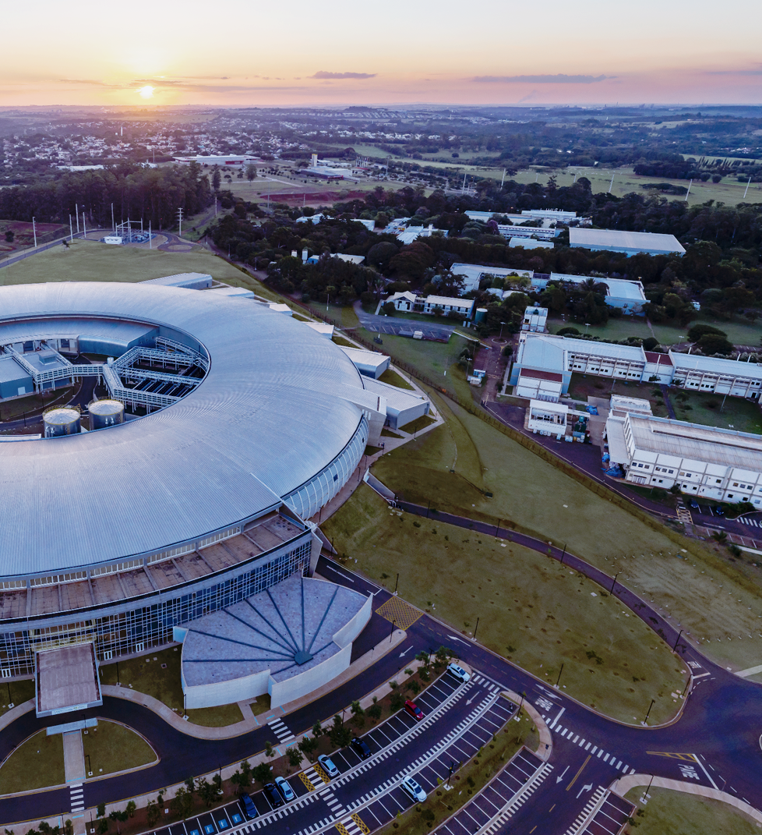

`
CNPEM’s Superconducting Wavelength Shifter (SWLS)
Technical Design Review
4–5th November 2024
Instrumentation and Cryogenic Electrical Circuit
Juan Gansauskas Galvez
Magnetic and Electromagnetic Systems Group
On behalf of the Technology Unit

Slide 2
Outline
Overview of the SWLS circuit
Cryogenic Electrical Circuit
  Current Leads
  Links and Splices
Cryostat Instrumentation
Measurement, Control and Automation

Slide 3
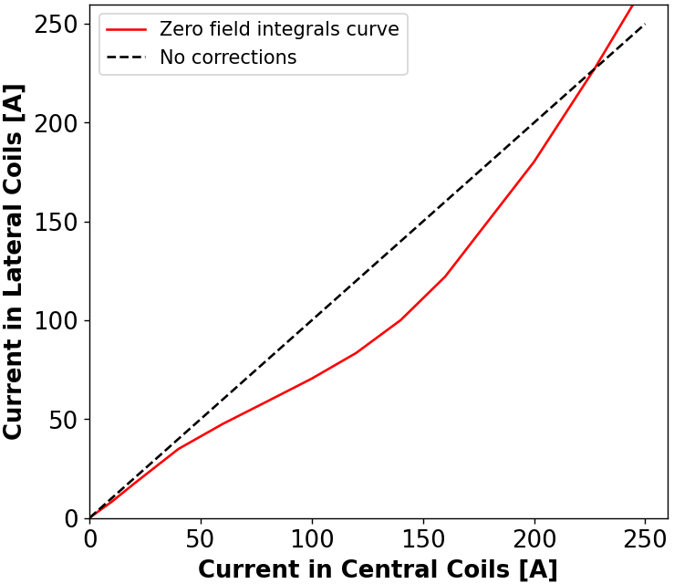
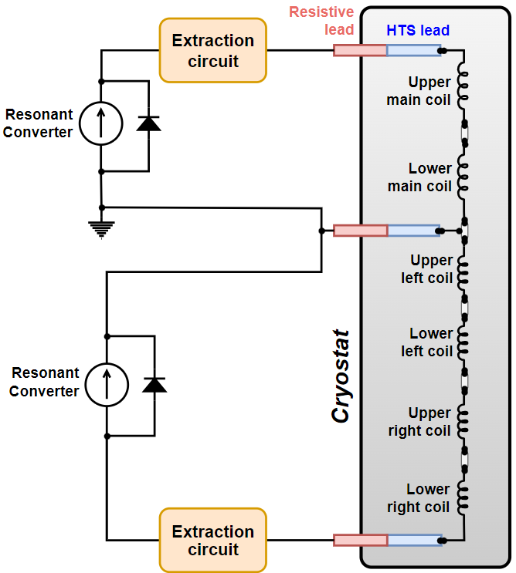
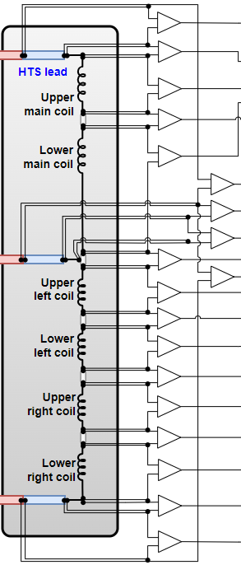
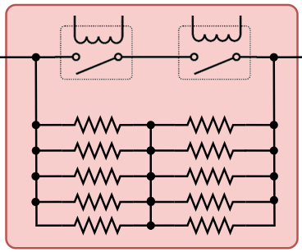
Overview of the SWLS circuit
Operating current
Operating current: 228 A
  Circuit rated for 300 A and 1 kV
Two power supplies
  Power Supply – Today 16:20 CET
Main and side coils current controlled separately
  Electromagnetic Design – Tomorrow 14:00 CET
External energy dissipation
  Quench Protection – Today 17:00 CET

Slide 4
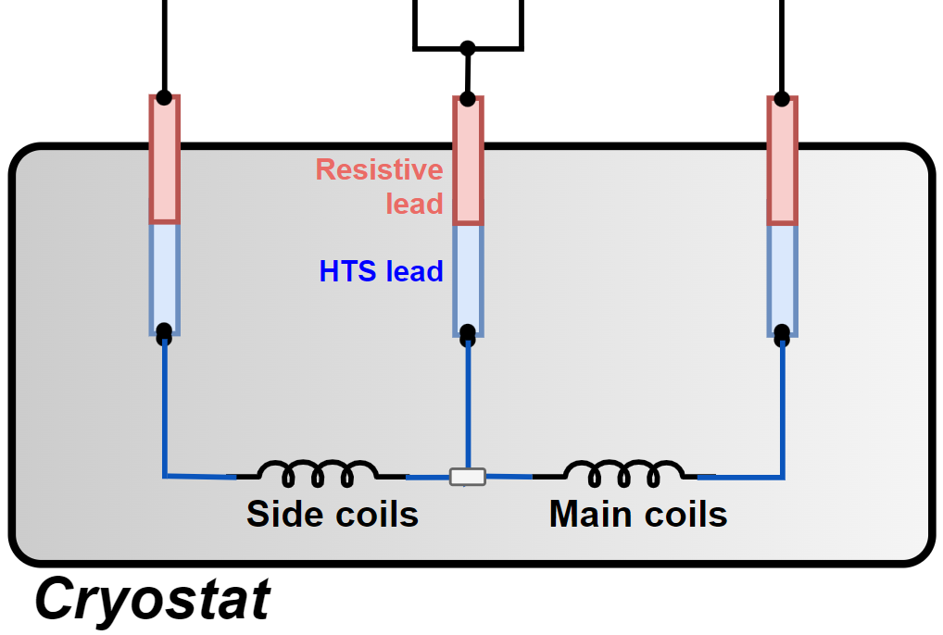

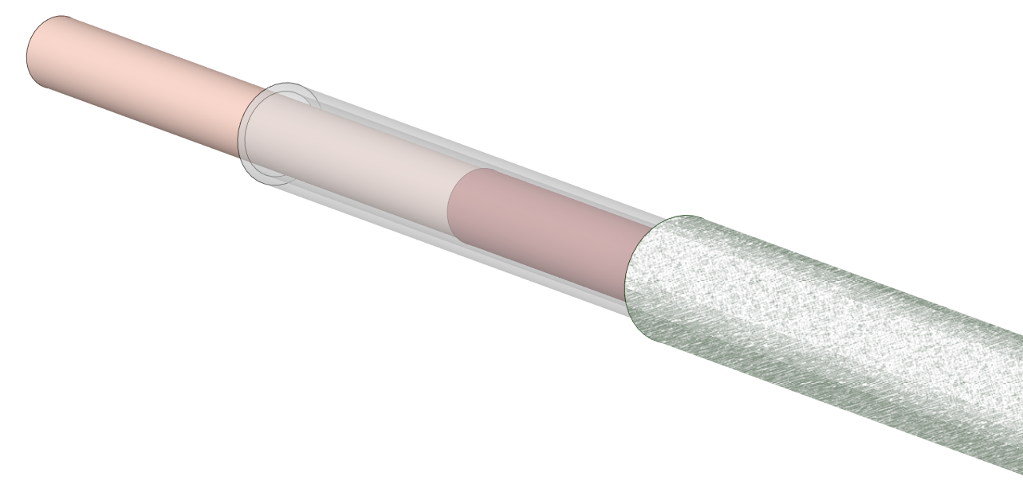

Cryogenic Electrical Circuit
Current Leads
Positive, negative and balance
Balance lead may experience full current
Ballast required for external energy extraction
Links
NbTi wire connecting coils and to the leads
Coils wound with excess wire to minimize splices
Splices
Soft-soldering links into a copper stabilizer
Includes one three-wired splice
Negative
Balance
Positive
Ballast
Splice
NbTi Link
Bare wire
Teflon heat-shrink tubing
Project premisse:
Complete redundancy in the insulation of the circuit wires
Fiberglass sleeve
Enamel insulation

Slide 5
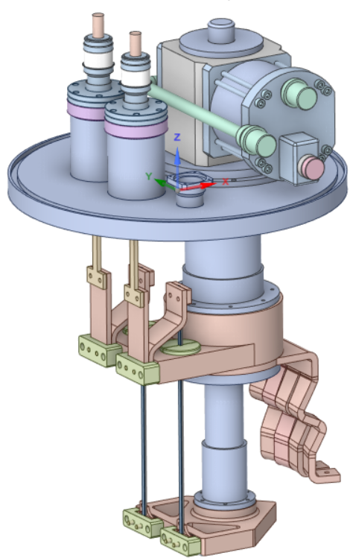
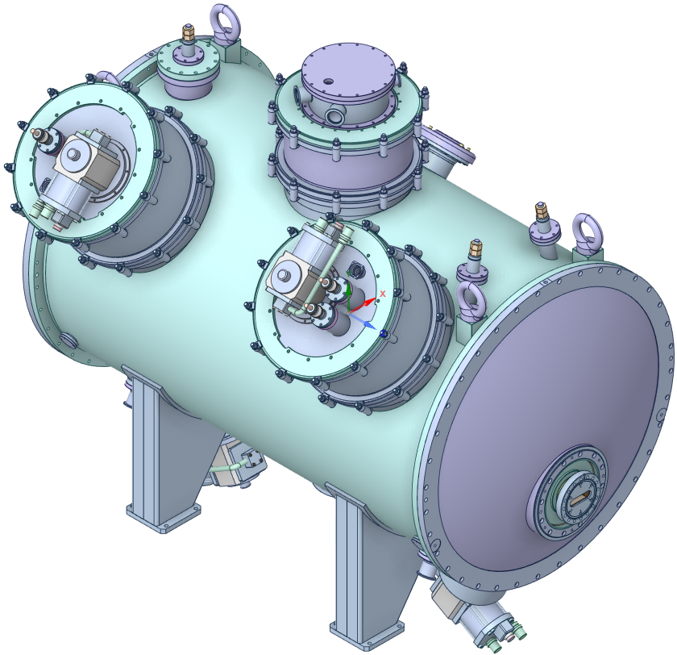
Current Leads – Overview
Hybrid conduction-cooled design
Resistive part: Brass alloy
Low (L/A)_{opt}
Q_{c,min} = 11.31 W @ 228 A (per lead)
6 W @ 0 A (per lead)
HTS part: Custom model from HTS-110
300 A @ 70 K
< 50 mW @ 4.2 K – 70 K (per lead)
Stainless steel ballast
Assembly:
SRDK-415D flange, 45° necks
One assembly w/ positive and balance leads
One assembly w/ negative lead
Negative lead
Positive and Balance leads

Slide 6
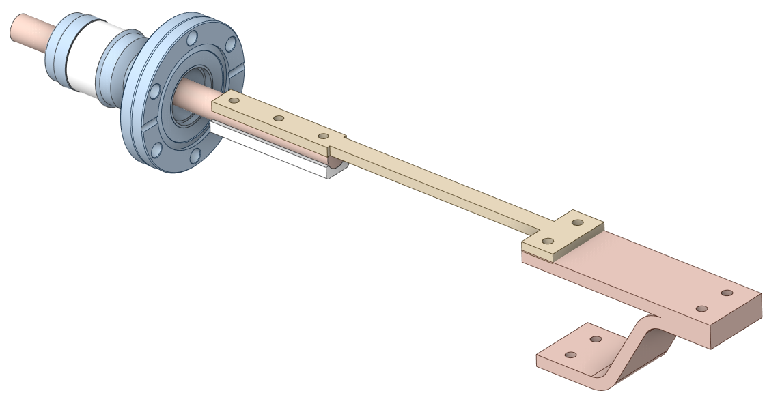
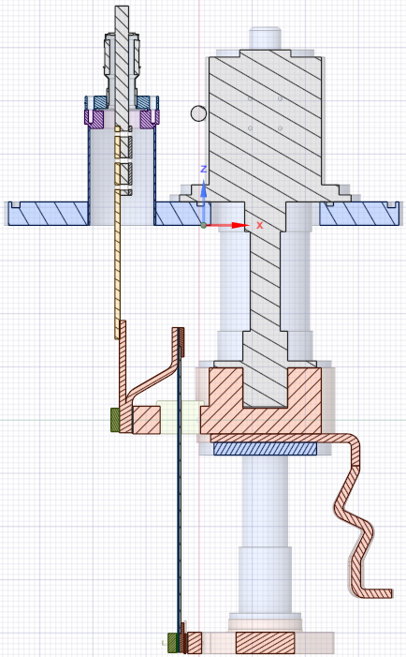
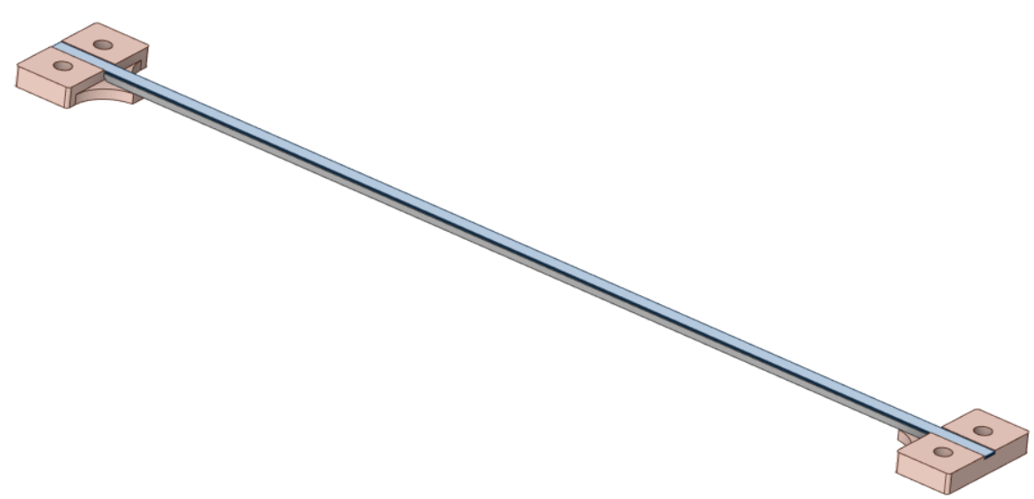
Current Leads – Overview
Vacuum power feedthrough
Copper flexible termal-electric link
Brass resistive part
60 K Thermalization
Bi-2223 tapes
Copper terminal
4 K
Thermalization
SS ballast

Slide 7
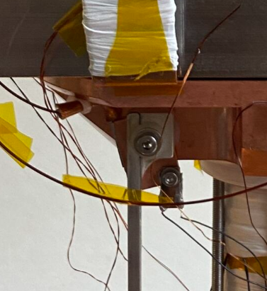
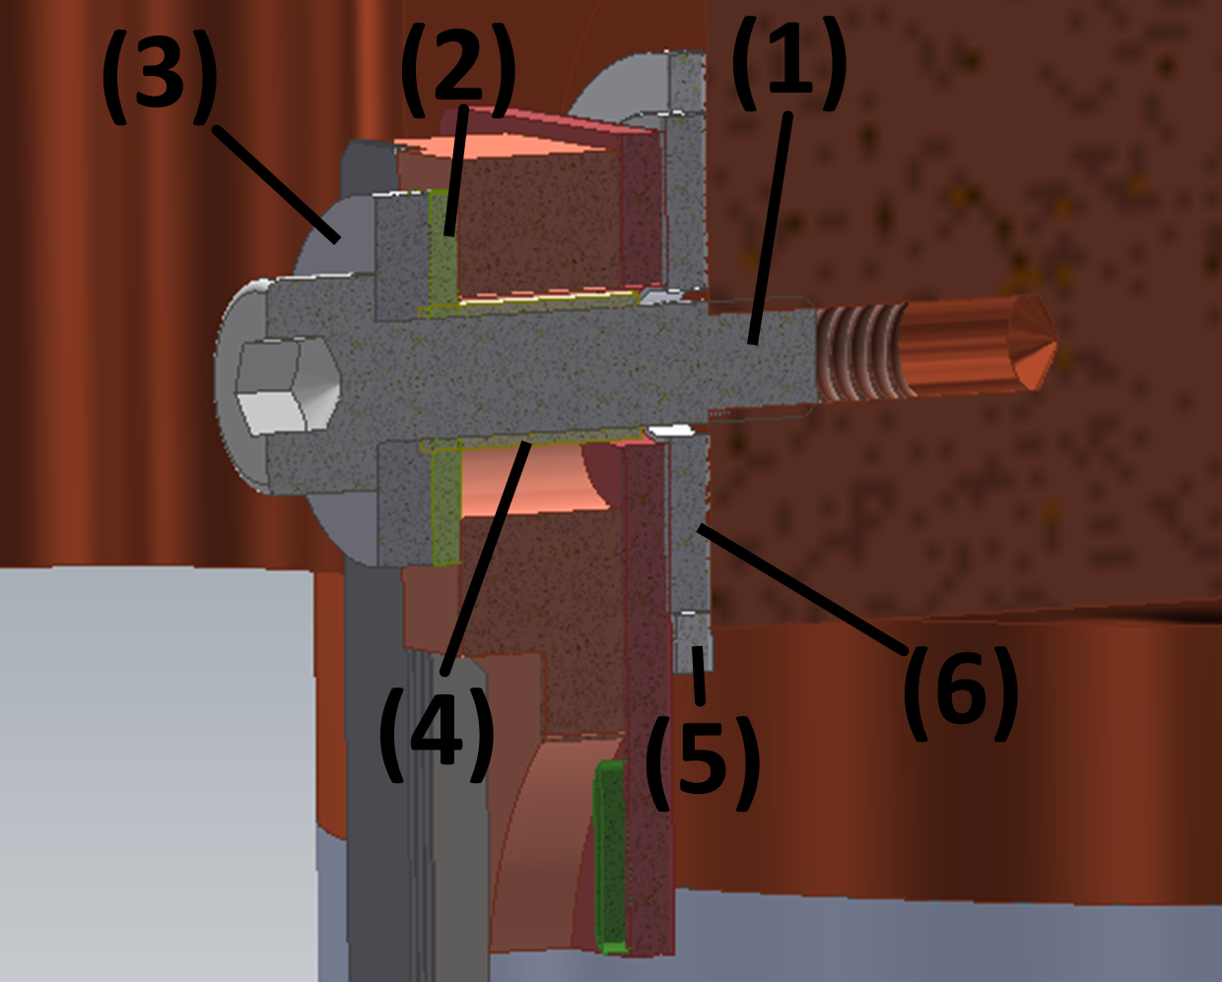


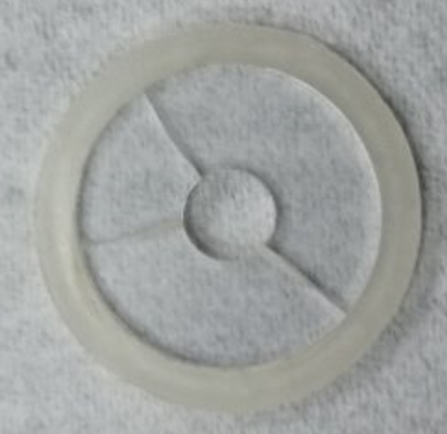
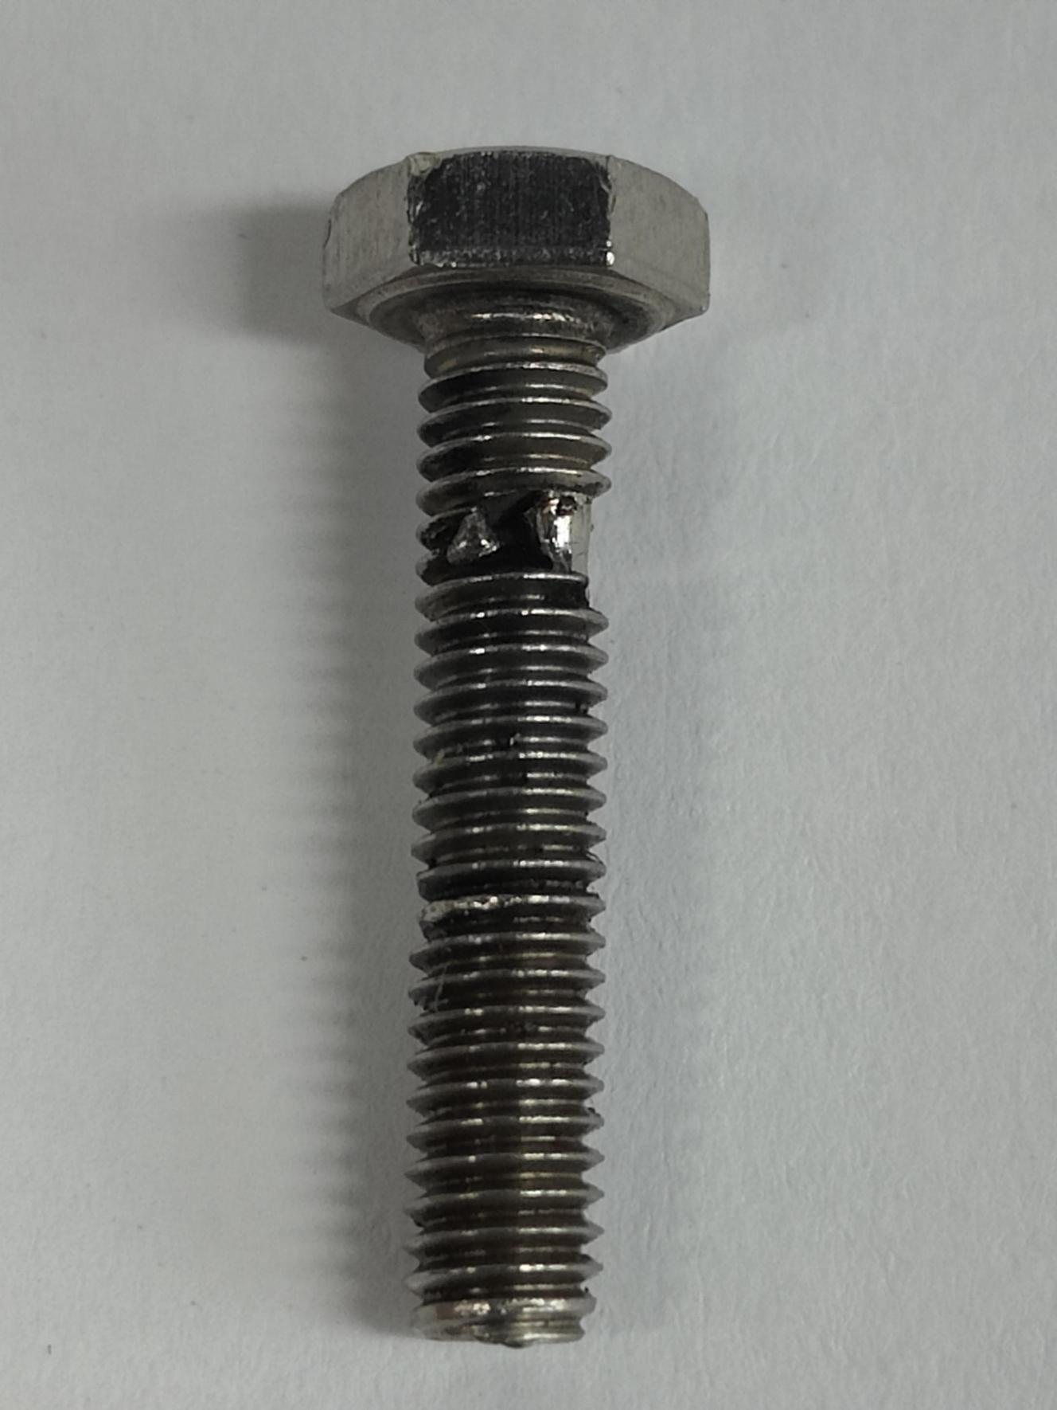
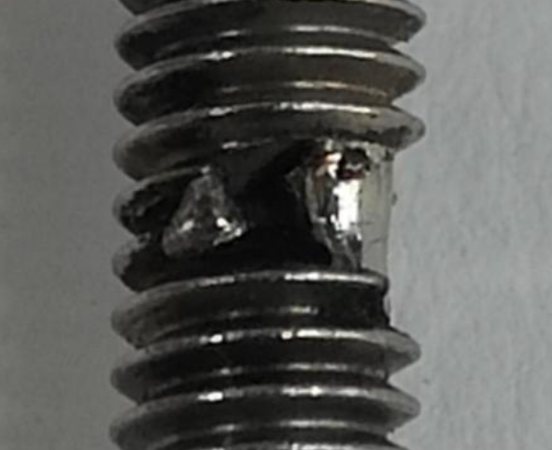
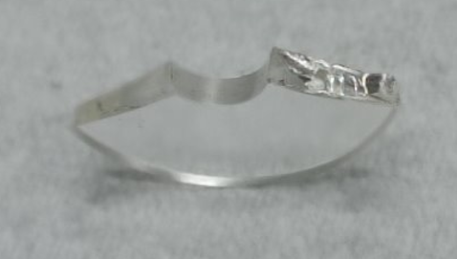
Current Leads – Mounting
Former mounting method: “insulated bolt”
SS M4 bolt
FRP washer
Invar washer
Nylon bush
Retaining ring
Sapphire washer
Indium from the current tab interfaces gets easily in the way when bolting.
It also seems to creep over time.
Sapphire washer that was short-circuiting through it
“Melted” bolt discovered after a test run
Is Indium foil recommended, even though the washers are susceptible to cracking?
We suspect that the indium may not have creeped, but rather melted
Indium

Slide 8
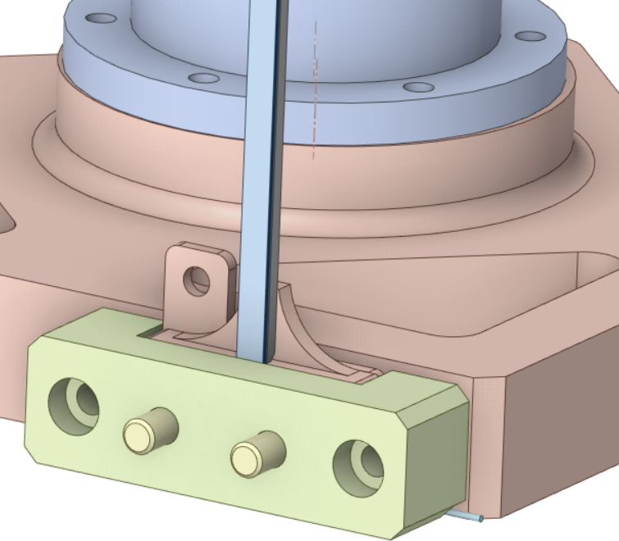
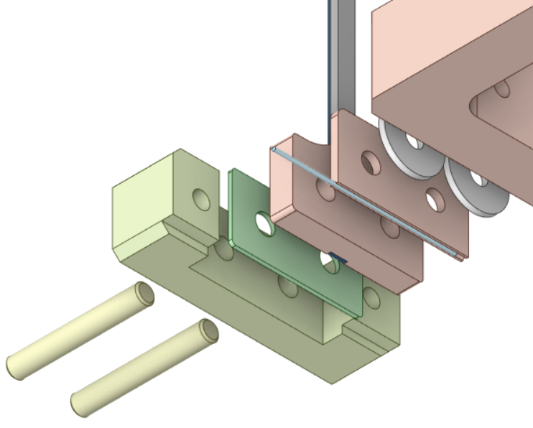
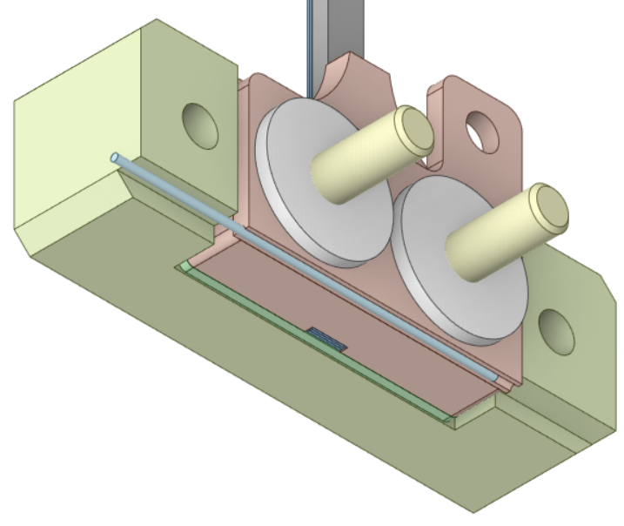
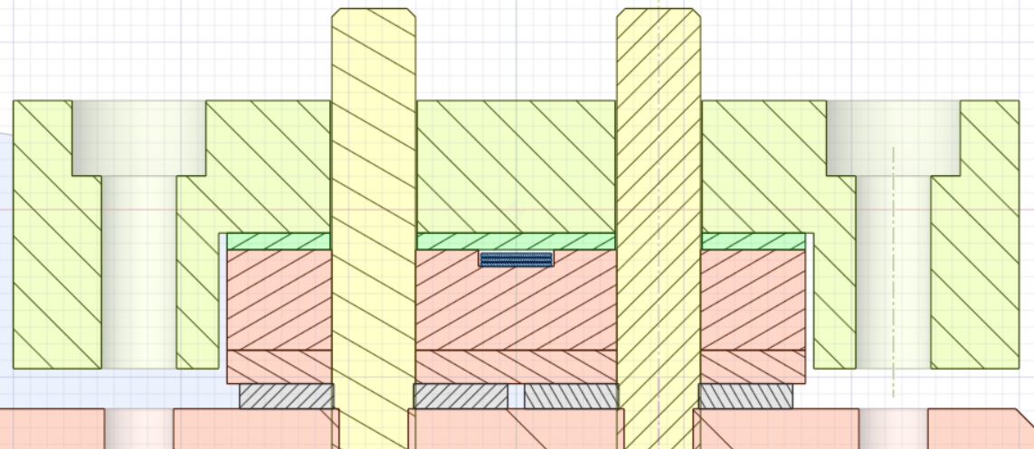
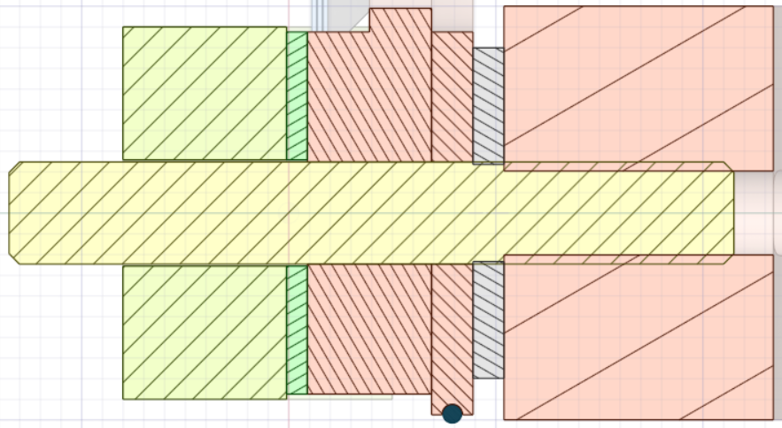
Current Leads – Mounting
2
3
4
5
6
7
1
Teflon alignment pin
SS clip
FRP spacer
HTS lead terminal
Current tab
Sapphire washer
NbTi link
The gap allows force transfer from the clip to the sapphire washers
1
4
2
3
5
6
2
3
1
4
5
6
7

Slide 9
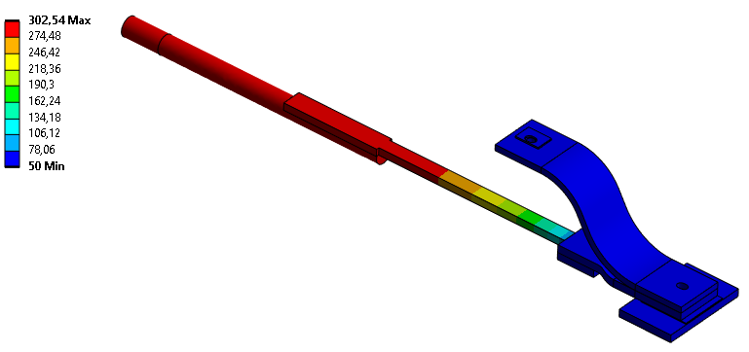
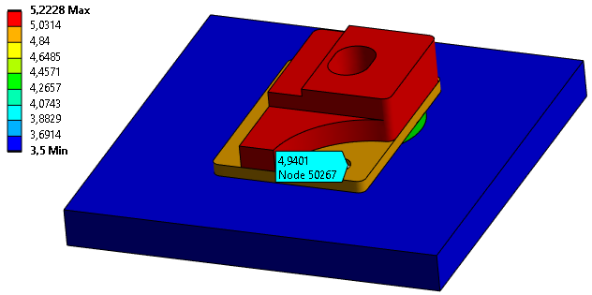
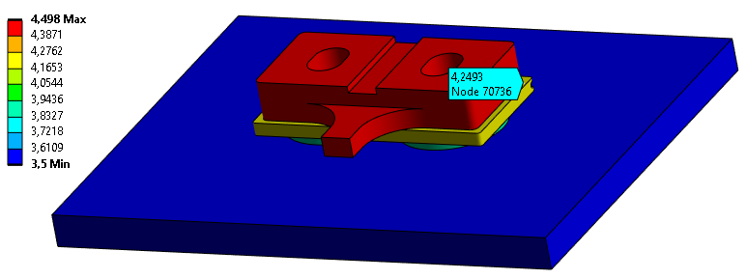
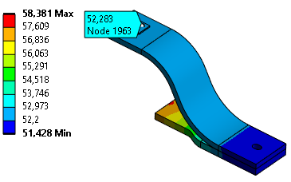
Current Leads – Simulation results
Resistive part
HTS part
Vertical cryostat HTS lead
Air-side near RT
HS @ 50 K
Simulated:
4.94 K @ 228 A
Experimental:
4.72 K @ 228 A
HS @ 3.5 K
11.2 W
SWLS HTS lead
HTS hot end @ 52.3 K
HS @ 50 K
Simulated:
4.25 K @ 228 A
HS @ 3.5 K

Slide 10
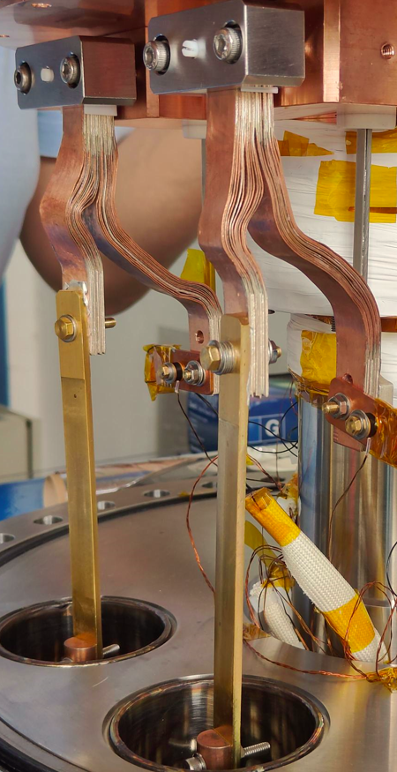
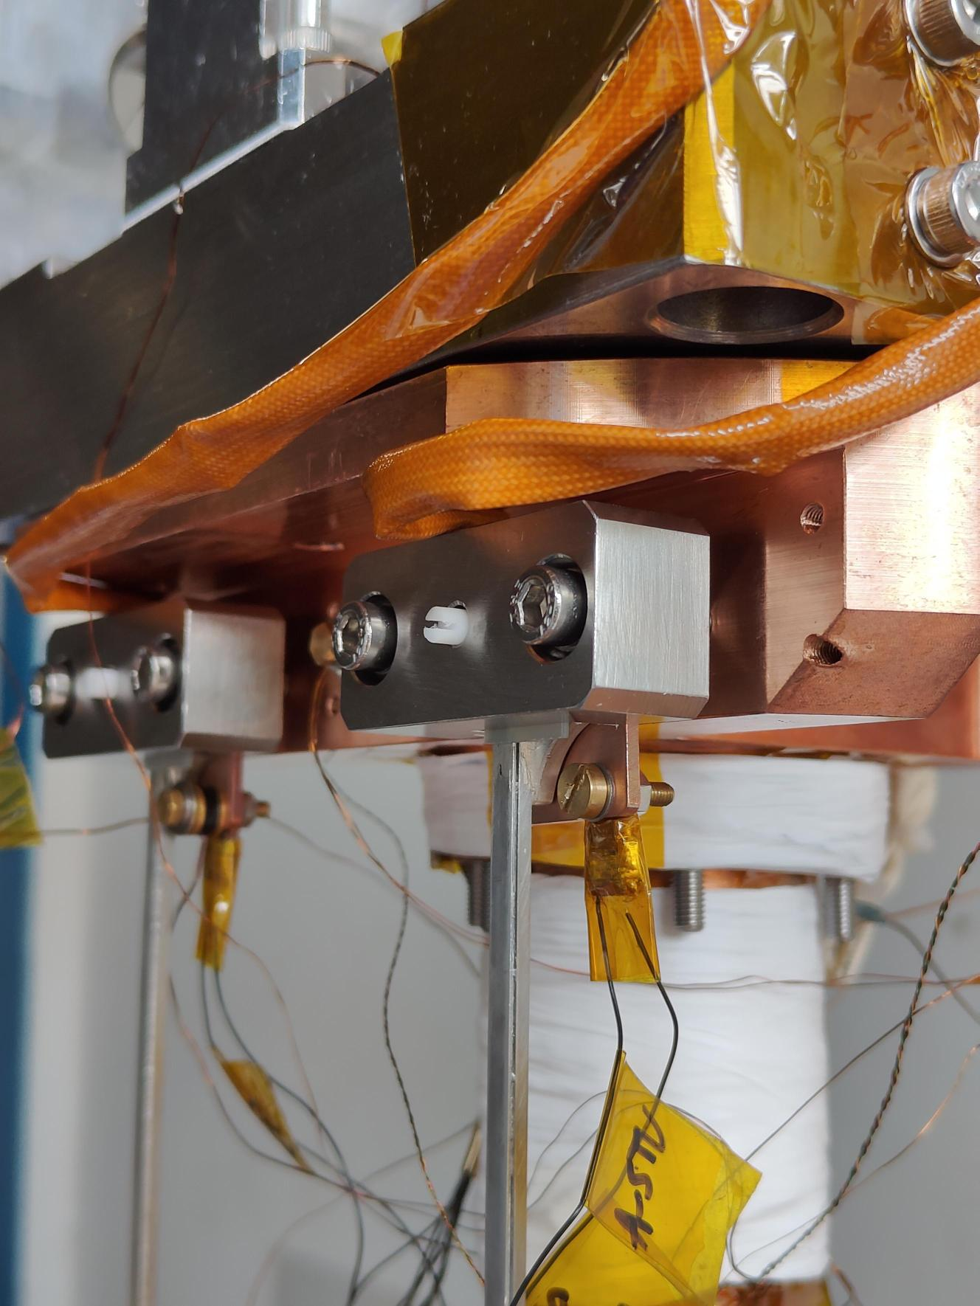
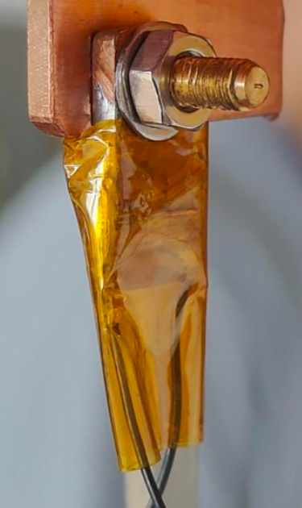
Current Leads – Vertical Cryostat
60 K Thermalization
Copper flexible termal-electric link
4 K Thermalization
HTS part
Voltage Taps tab
Brass resistive part
Vacuum power feedthrough

Slide 11
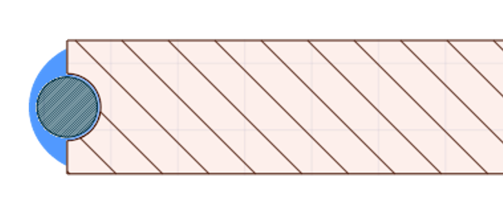
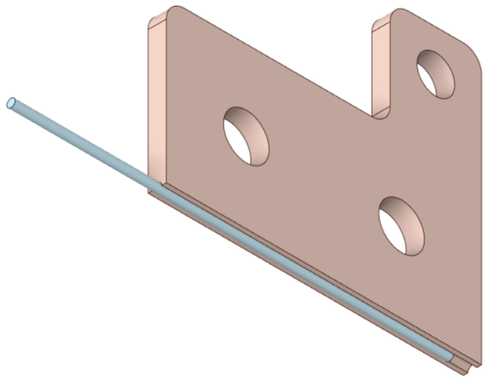
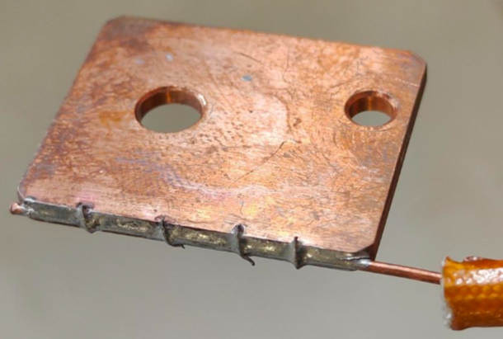
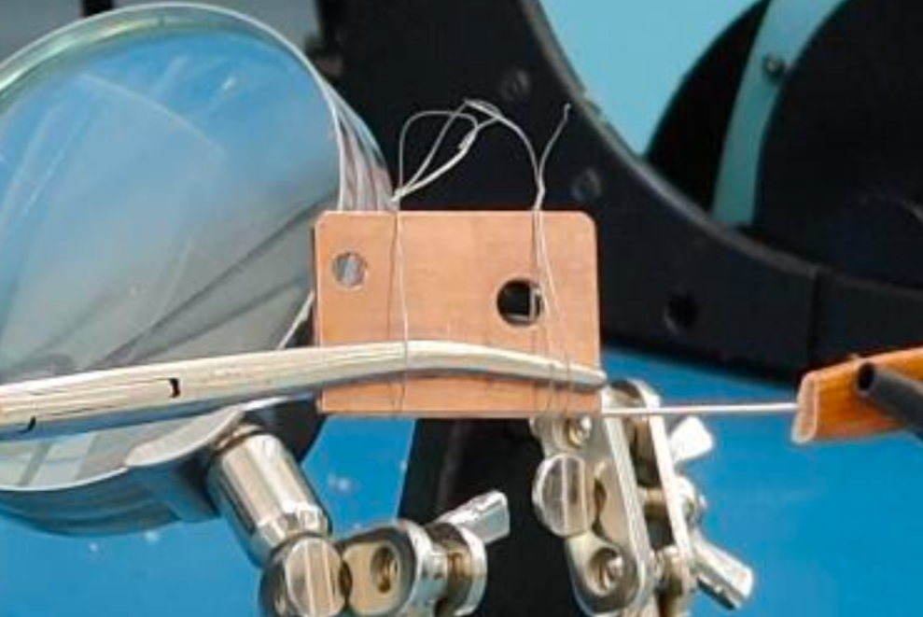
Links and Splices – NbTi link
Current tab – NbTi link interface
SnPb
The Formvar insulation burns away during soldering
Vertical Cryostat concept
Reliable soldering procedure developed and validated experimentally

Slide 12
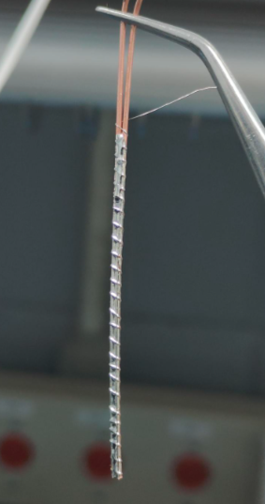
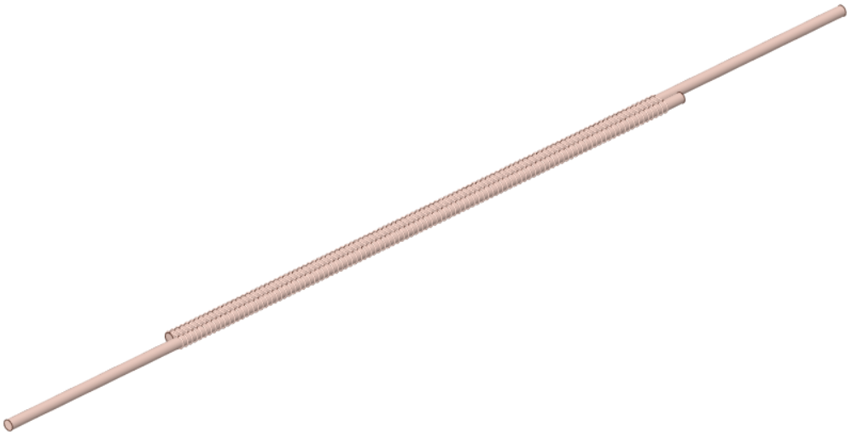
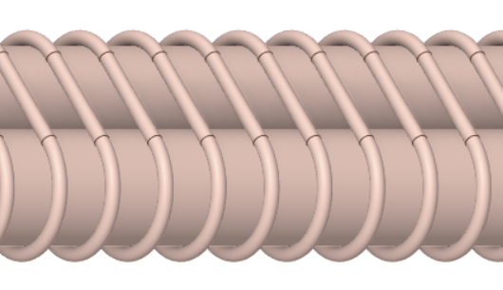
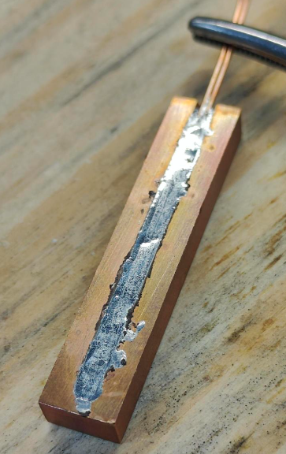
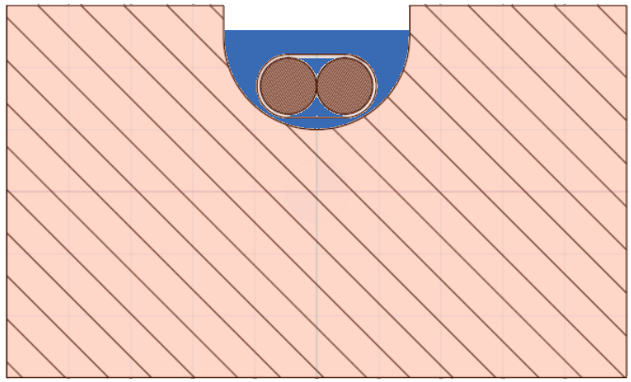

Links and Splices – Splices
1
2
“Shake-hands” splice between NbTi links
I
I
“Praying hands” concept
Tinned Cu wire
The Formvar insulation burns away during soldering
SnPb
4
3
Reliable soldering procedure developed and validated experimentally
Copper “crucible”
“Praying hands” concept

Slide 13
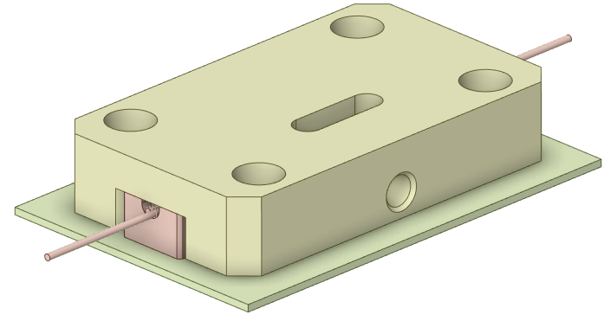
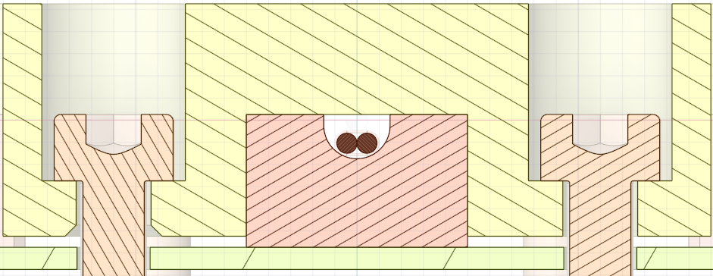
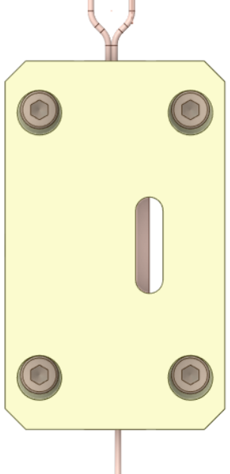
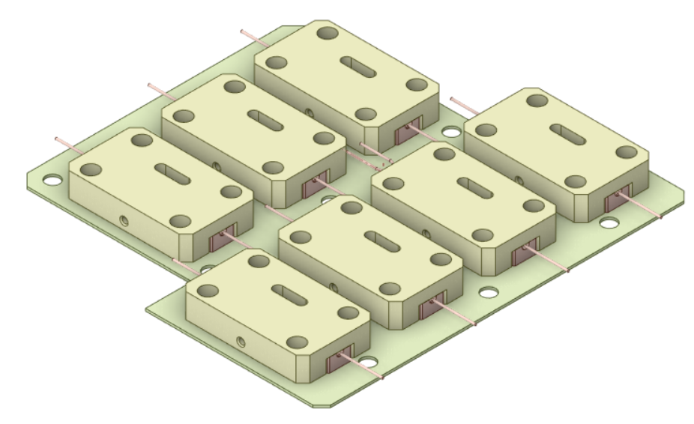
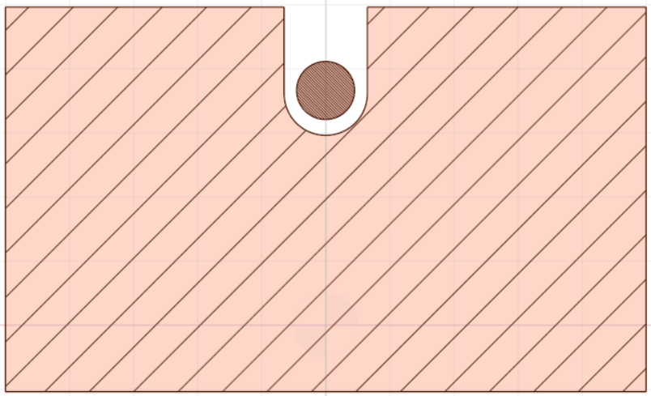
Links and Splices – Splice Box
Nylon Clip
FRP base
Threaded hole for sensor mounting
The gap allows force transfer from the clip to the copper crucible
“Splice box” concept
I_{main}
I_{side}
I_{balance}
The NbTi link could pass straight through this crucible, or we can make a splice

Slide 14
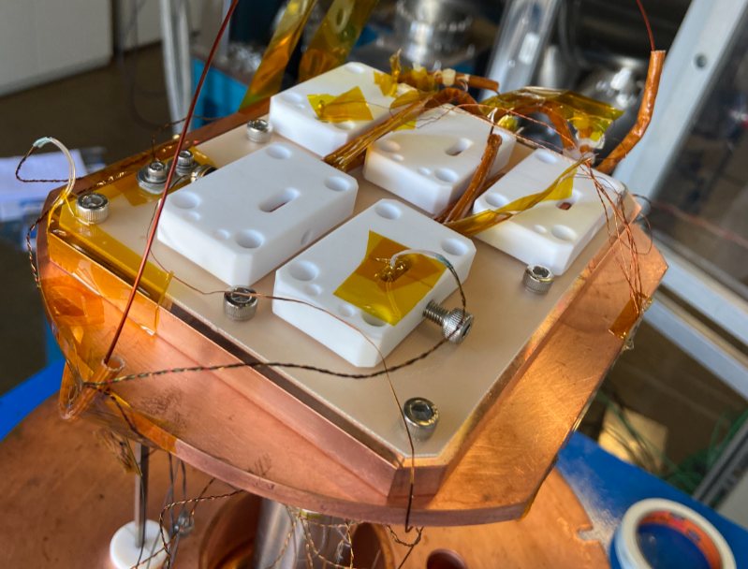
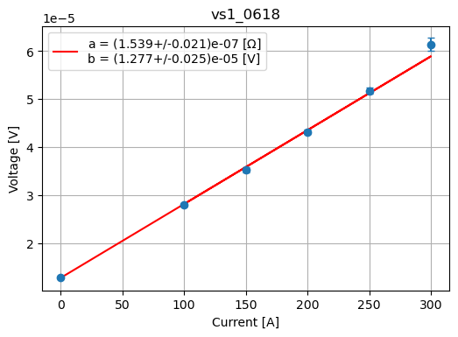
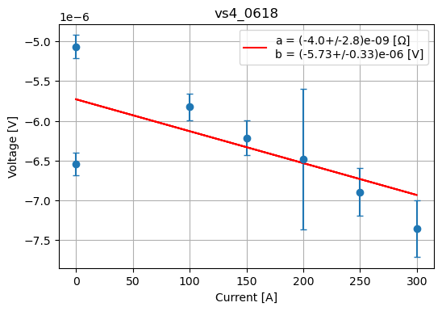
Links and Splices – Test results
Splice box test validations
Thermal performance
  Crucible @ 3.7 K w/ HS @ 3.5 K
  Little change between 0 A and 300 A
Resistance measurements
  R_{splice} < 10 nΩ
  R_{tab} ≈ 150 nΩ
Mechanical performance
Quench behavior
Splice box test setup in the vertical cryostat
Typical current tab resistance measurement
Typical splice
resistance measurement

Slide 15
Cryostat Instrumentation – Overview
The SWLS instrumentation system performs many different functions, and comprises different instruments...
System operability
System health and safety
Specific functionalities
...which interfaces with the cryostat across 16 feedthrougs...
3 power feedthroughs
12 instrumentation feedthroughs
4 vacuum feedthroughs
...with 180 instrumentation wires...
Up to 32 4-wire temperature sensors
  17 for constant monitoring
  8 for warm-up control
  7 for tests and wiggle room
38 Voltage Taps
7 Heater circuits
...that leads to the measurement, control and automation systems
They will be briefly addressed later
In this presentation, the instrumentation from “the cryostat and within” will be the main focus
Overall considerations:
Avoid ground faults and short circuits
Prioritize ease of installation and rugdeness
Sensor types: Diode and RTD
Magnetic field
Radiation incidence
Required accuracy
Sensor wire: PhBr 36 AWG
Sensor extension: Cu 34 AWG
Voltage Taps: Cu 34 AWG, 2.6 kV
Heater leads: Cu 30 AWG

Slide 16
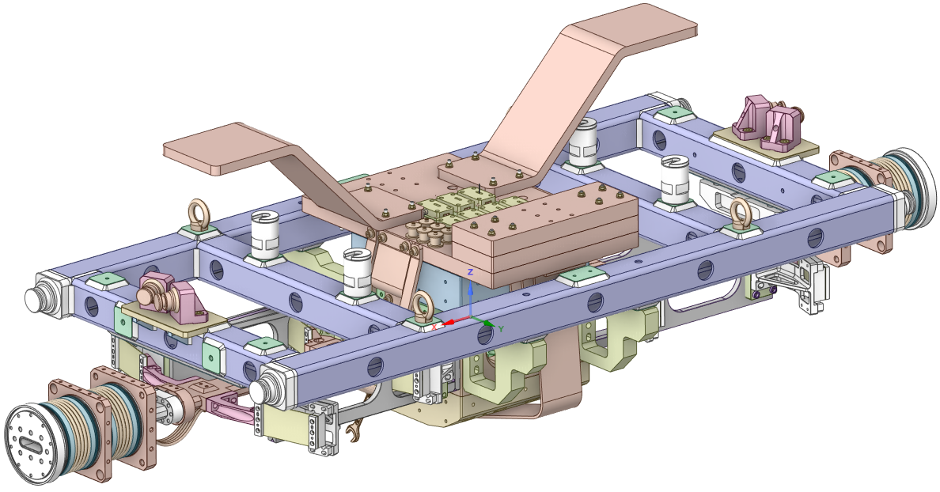
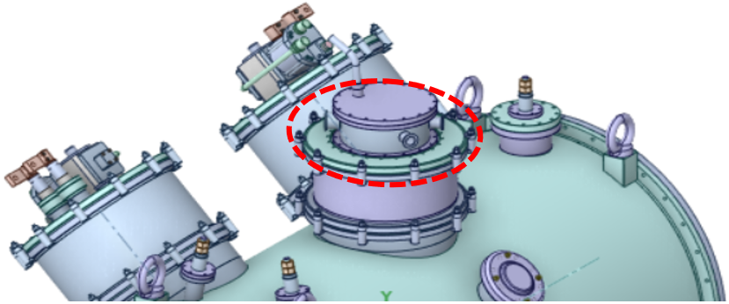
Instrumentation – Suspended Structure
Before integration:
Splice box assembly
Complete instrumentation installation
Wires’ 4 K thermalization (when applicable)
Wires bundling
After integration:
Wires’ 20 K and 60 K thermalization in the central neck
Wires routing through central neck
Feedthrough connection
116 instrumentation wires
Up to 20 temperature sensors
  10 for constant monitoring
  6 for warm-up control
  4 for tests and wiggle room
26 Voltage Taps
5 Heater circuits
Feedthroughs: Central neck
Dedicated feedthroughs for sensors, heaters and VTs

Slide 17
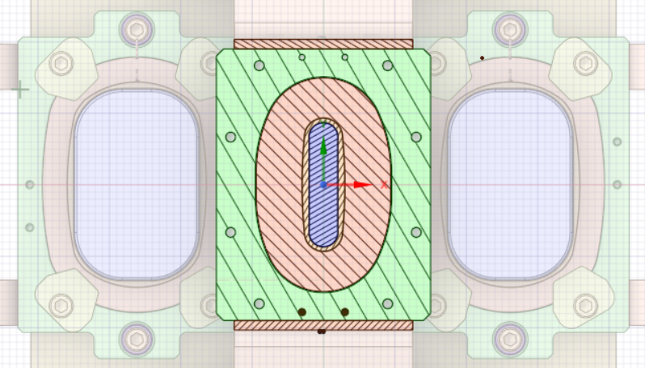




Instrumentation – Suspended Structure
Cold Mass
Sensors
Heaters
Voltage Taps
(redundant pair)
Splices
Cartridge heaters
The redundant Voltage Taps are independently routed, thermalized and fedthrough

Slide 18

Instrumentation – Suspended Structure
Supports and Beam Chamber
Sensors
Heaters
“Surface heater” (TBD)

Slide 19


Instrumentation – CL Assemblies
Before integration:
Complete instrumentation installation
Wires’ 4 K (when applicable) and 60 K thermalization
Wires bundling and routing
Feedthrough connection
After integration:
HTS cold end w/ NbTi link mounting
Sensors
Voltage Taps
(redundant pair)
Feedthroughs: Assembly flanges
Dedicated feedthroughs for sensors and VTs
32 instrumentation wires
Up to 6 temperature sensors
  4 for constant monitoring
  2 for tests and wiggle room
8 Voltage Taps
20 on the negative side

Slide 20



Instrumentation – Thermal shields
Before integration:
Shield body instrumentation installation
Wires bundling
After integration:
Shield lid instrumentation installation
Wires’ 20 K (when applicable) and 60 K thermalization
Wires routing
Feedthrough connection
Suspended structure thermalization and routing
20 K shield
Sensors
Heaters
60 K shield
Feedthroughs: Cryostat vacuum chamber
One for sensors, one for heaters
10 instrumentation wires
2 sensors
1 Heater circuit

Slide 21

Instrumentation – Vacuum
Cold cathode sensor
Pirani sensor
Mechanical + turbomolecular pumps
Ion pump

Slide 22




Instrumentation – Thermalization
Suspended structure instrumentation wire thermalization example
Heat-sink bobbin concept
Heat-sinking guaranteed
Compact design
Easy to install/uninstall
Great electrical insulation w/ fiberglass
Some interchangeability is lost
May require aditional solders in the heat-sinked wires
60 K Shield
Courtesy of Lake Shore Cryotronics
20 K Shield
Instrumentation wires
Stycast
Heat-sink bobbin

Slide 23



Measurement, Control and Automation
Automation architecture
Interlock signals are relay contacts, active-low logic
Data acquisition and device configuration over Ethernet
Fast input for quench detection trigger timestamping

Slide 24
Measurement, Control and Automation
Warm-up control
Setpoint;
Max temp. gradient;
PID gains (k_{p}, k_{i}, k_{d});
Open/closed loop;
Heater (de)activation
PID robust against parameters variation
Efficient warming-up (avoid on/off)
Avoid large temperature gradients
  Fast and slow response sensors
Many safety checks to avoid burn-out
  Communication status
  Temperature variation
  Vacuum level
  ...
PLC
PID Controller
r(k)
u(k)
y(k)
+
Heating System
-
1
Temperature monitor

Slide 25




Measurement, Control and Automation
Instrumentation and Control electronics
Lakeshore 240-8P had better cost effectiveness
MKS 937B is the standard option in Sirius
Many MEAN WELL power supplies in stock
CompactLogix is the standard option in Sirius machine interlock
Type | Model | Qty | Manufacturer
Temperature | 240-8P | 4 | Lakeshore
Vacuum pressure | 937B | 1 | MKS Instruments
Heater power supply | SPV-300-48 | 7 | MEAN WELL
Quench detector | QDS-WLS | 1 | CNPEM
Magnet power supply | DRS-UDC | 1 | CNPEM
Interlock controller | CompactLogix 5380 | 1 | Rockwell Automation
Quench Protection – Today 17:00 CET
Power Supply – Today 16:20 CET

Slide 26


Thank you!
cnpem.br

