Slide 1
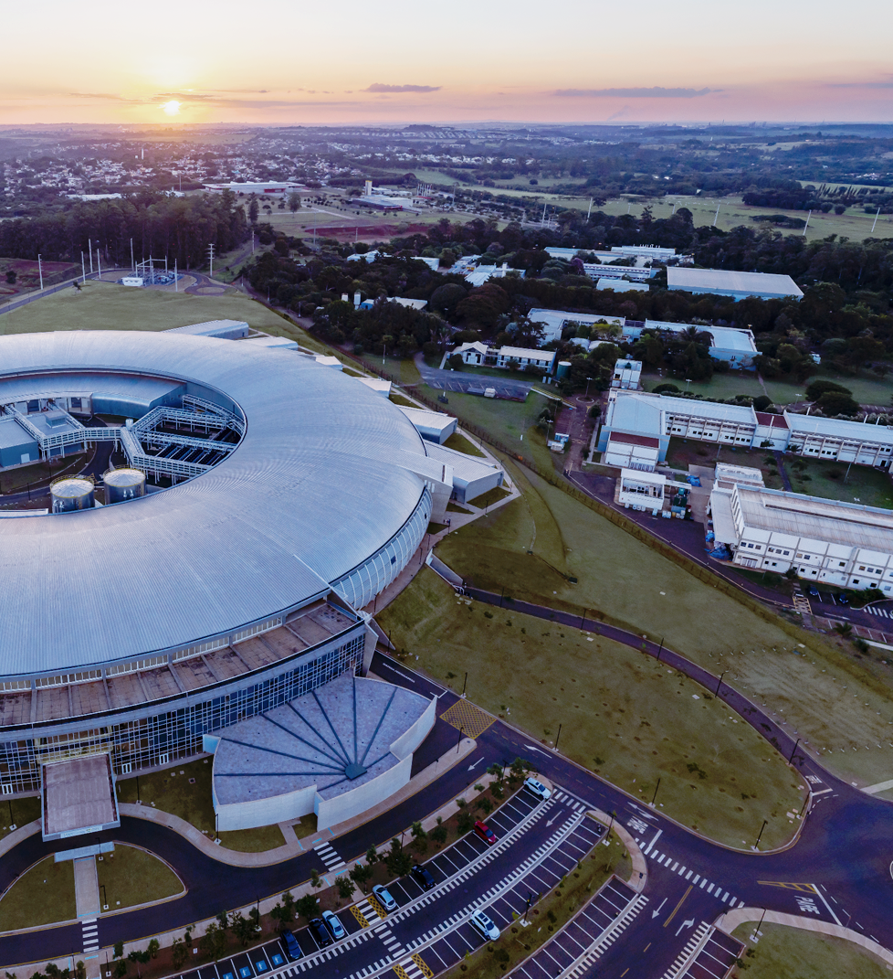

CNPEM’s Superconducting Wavelength Shifter (SWLS)
Technical Design Review
4–5th November 2024
Resonant Converter
The Power Supply for the SWLS Project
Lucas Carnevalli de Almeida
Power Converters Group
On behalf of the Technology Unit

Slide 2
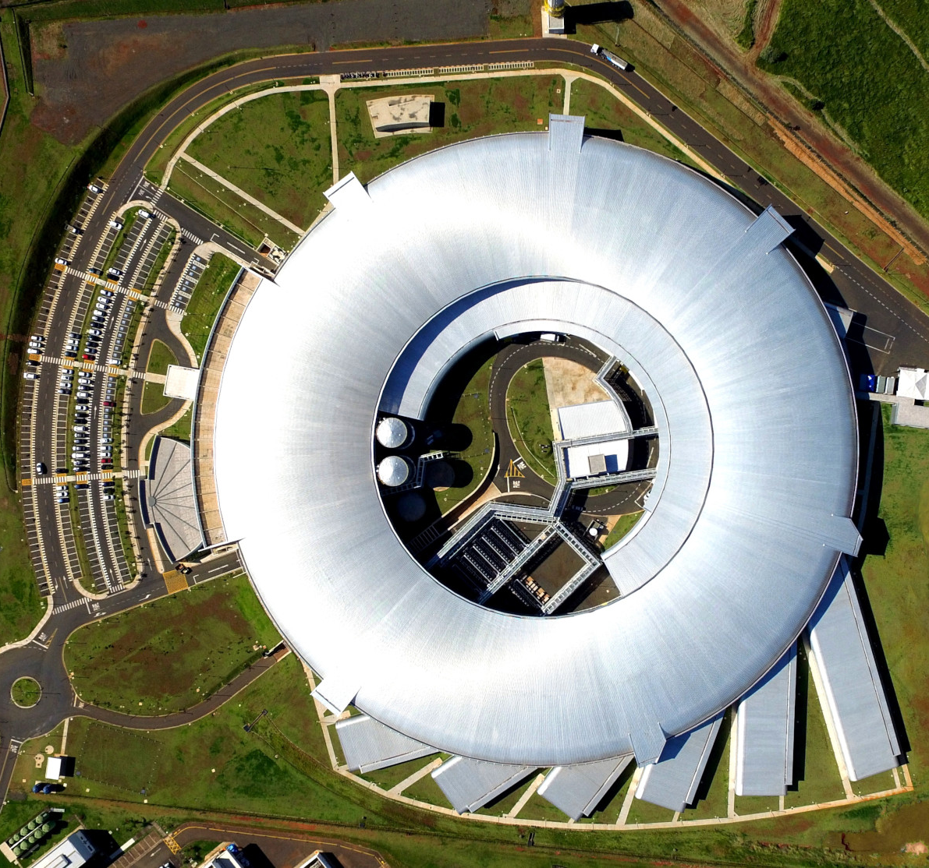


Summary
Motivation
The Resonant Converter
Results
  Article Results
  Preliminary Version
Next Steps
References

Slide 3

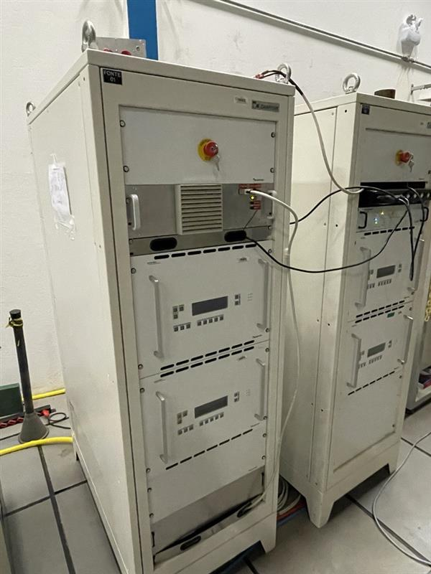
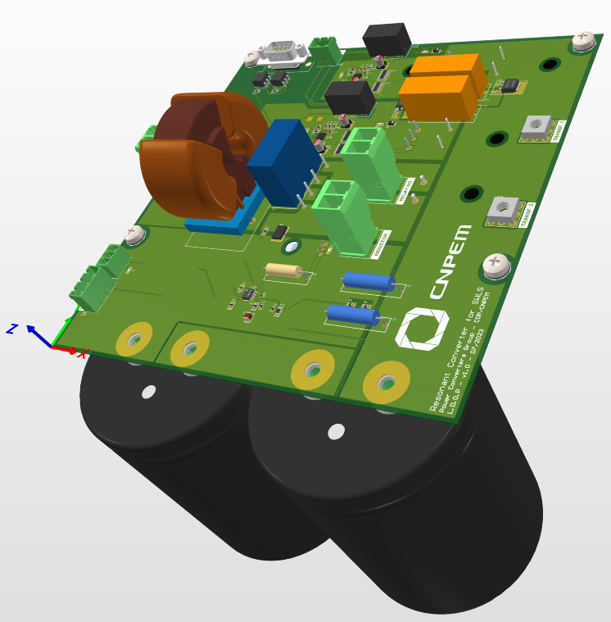

Motivation
SCW Sources: Danfysik MP8443 (Figure 1)
SPECIFICATIONS:
3 kW, 300 A and 10 V, 25 ppm stability and 1A minimum current offset;
ISSUES:
Obsolete hardware and software;
No technical support and low reliability;
Resonant Converter: In-house development
TARGET:
300 A output with voltage less than 10 V, ripple less than 10 ppm (with 3 kHz band) and similar minimum current;
New technologies were implemented, and all features were developed in-house;
Figure 2. Final PCB Design for the Resonant Converter
Figure 1. Danfysik Power Converter

Slide 4
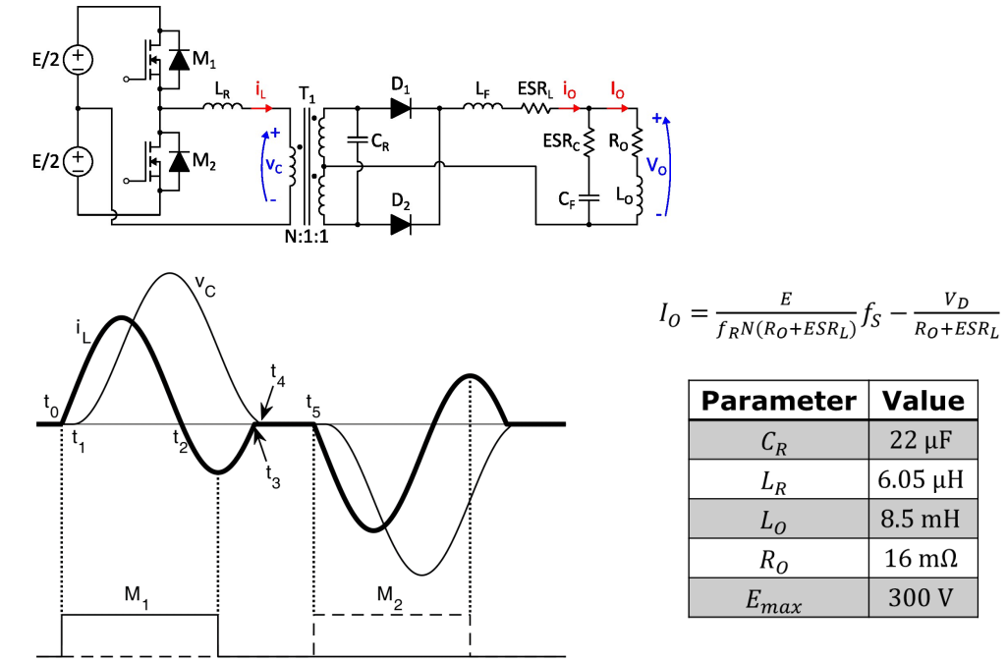
The Resonant Converter
Specifications for the project
Output current: ≤300 A;
Output voltage: ≤10 V;
Long-term stability and ripple of the output current: ≤20 ppm;
Is composed mainly of parasitic elements, which can be done by using a secondary-side resonance technique (Figure 3) [3];
Zero Current Switching (ZCS) to reduce switching losses (Figure 4).
Figure 4. Simplified Resonant Converter Waveforms [5];
Figure 3. Example of the Simplified Resonant Converter Circuit [5]

Slide 5
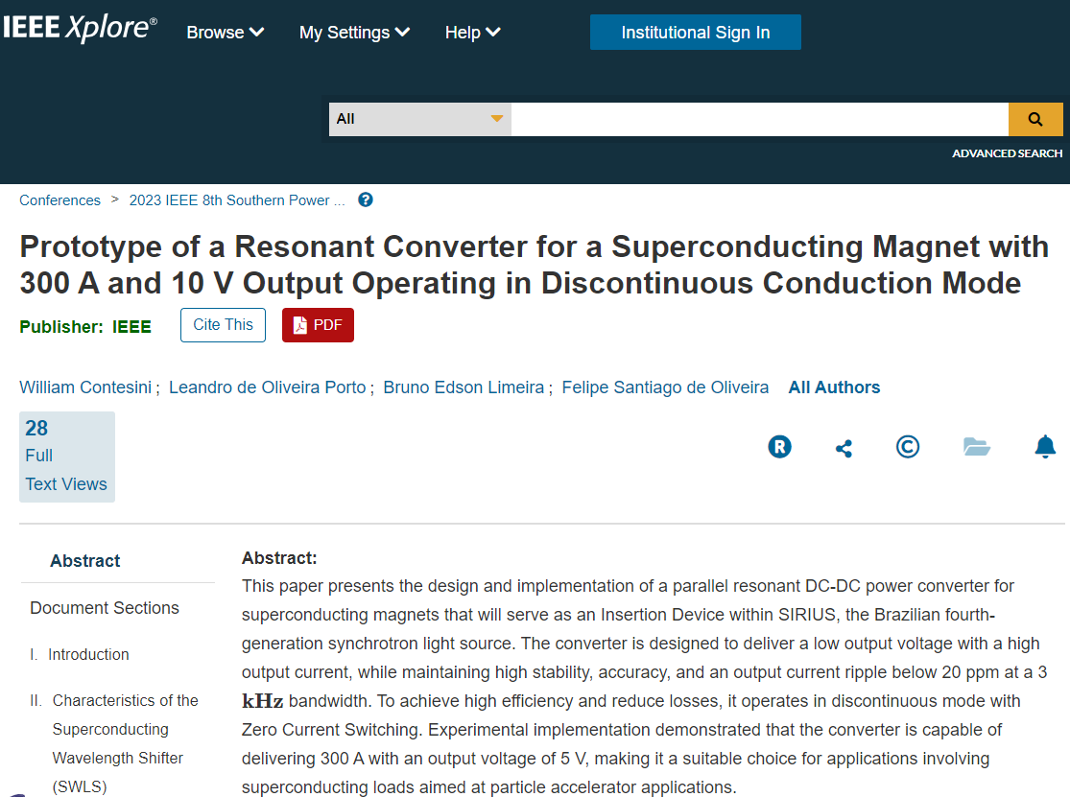

Results - Article

Slide 6
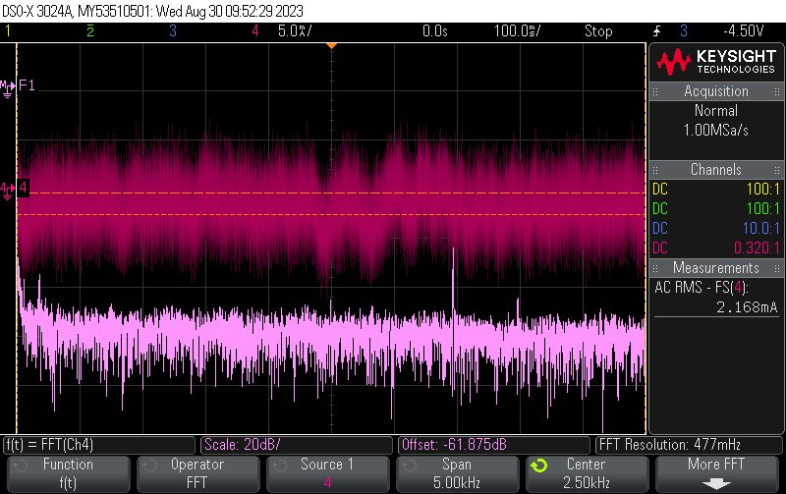
Article Results
The AC RMS ripple of the output current was $2.168 mA$, which represents $7.23 ppm;$
Figure 6. AC RMS ripple [5];

Slide 7
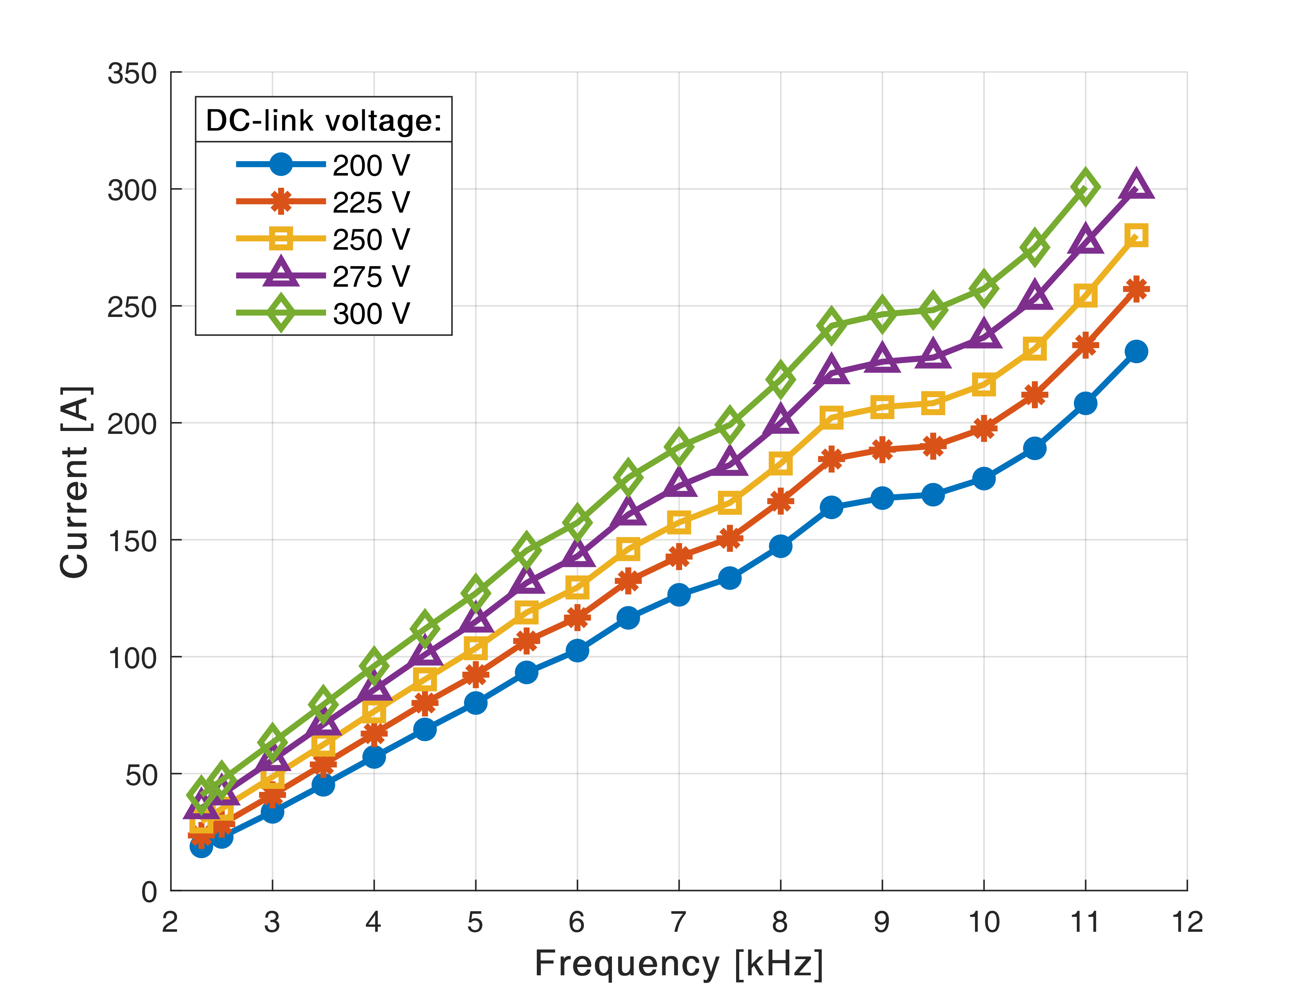
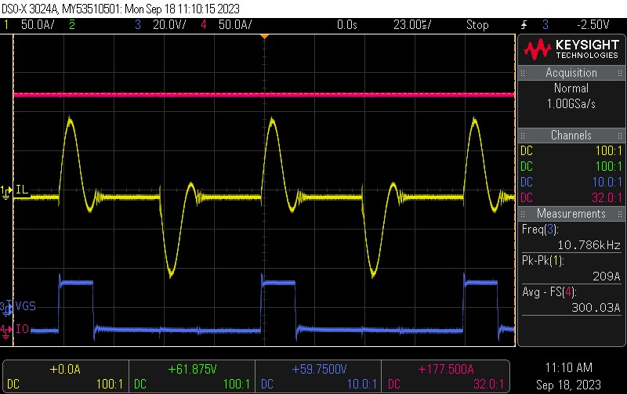
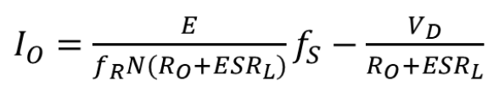
Article Results
Output current of $300 A$ was reached (Figure 7 and Figure 8);
However, the current output wasn’t completely linear, and it didn’t reach zero
f(x) = Ax + B
Figure 7. Output current as a function of the switching frequency in open-loop operation [5]
Figure 8. Waveforms in closed-loop operation (current of the resonant inductor; gate-source voltage of the high-side MOSFET; output current) [5]

Slide 8
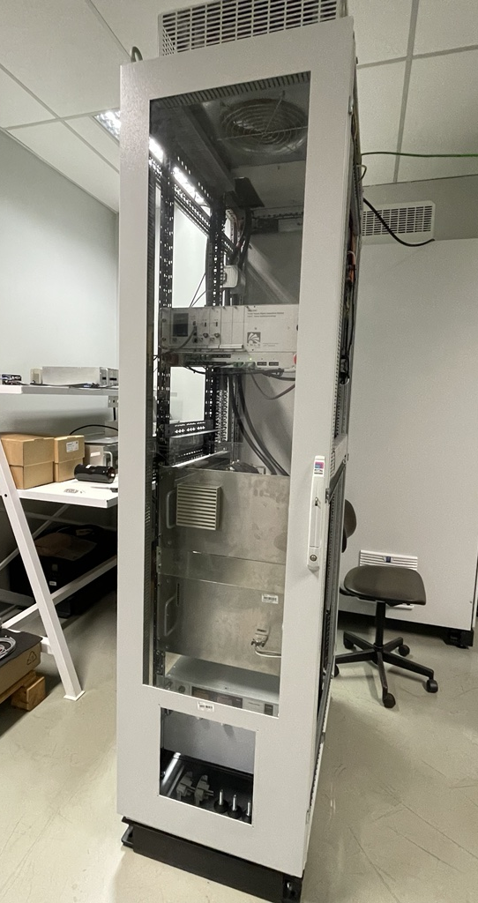
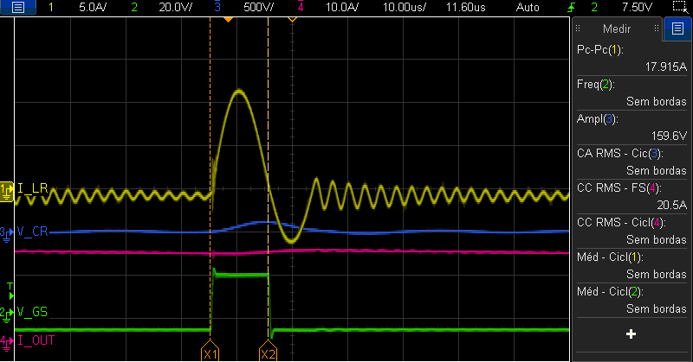
Preliminary Version
IMPROVEMENTS
Higher oscillations
278A
Lower current output
Figure 10. Converter Installation
Figure 9. Preliminary version output

Slide 9
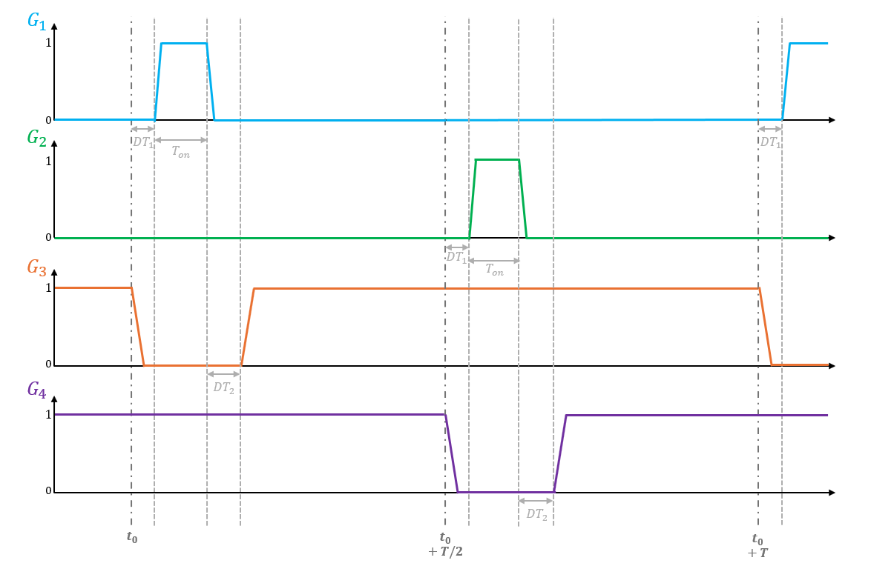
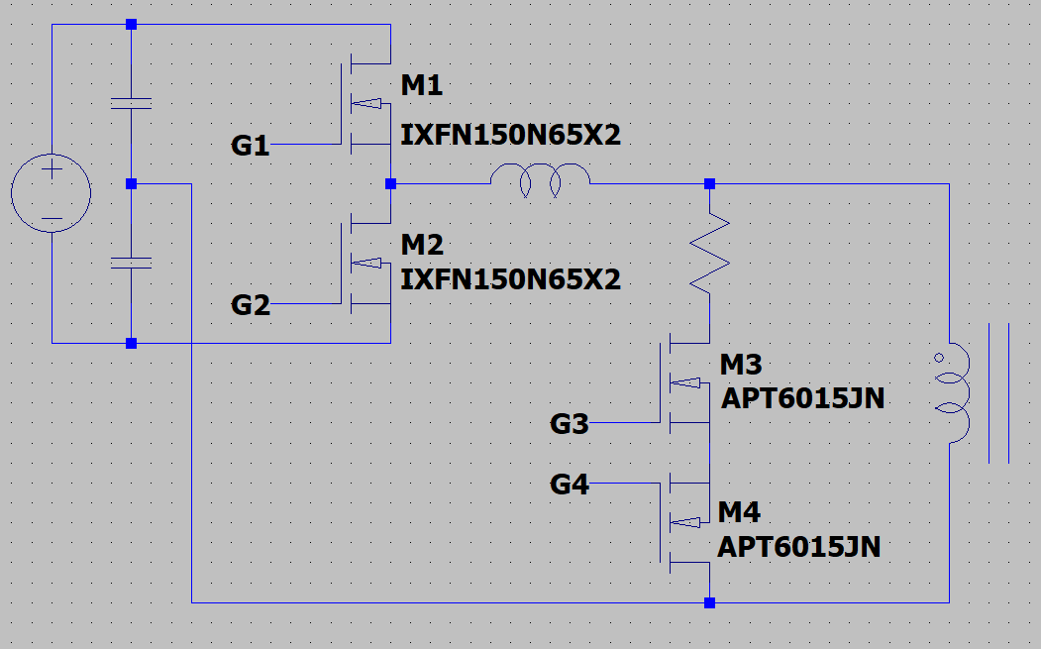
Preliminary Version
CLAMP CIRCUIT
It was designed to allow us to achieve lower output currents while effectively reducing intermodal oscillation.
The following parameters presented in the Figure 12 are defined:
  T_on: ON pulse width of the main MOSFETs (M1 and M2)
  DT_1: dead-time to turn on the main keys (M1 and M2)
  DT_2: dead-time to turn on the clamp keys (M3 and M4)
  T: Switching period
Figure 12. Switching Diagram
Figure 11. Main switches with Clamp switches

Slide 10
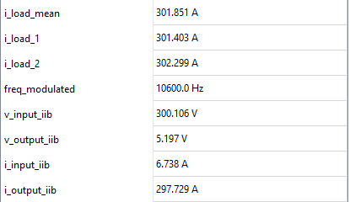


Comparing Current Output
Linear current operation
300 A output reached, even with load limitation
And more!
300 A
ZOOM
Figure 13. Current Output of the Preliminary Version

Slide 11
Minimum Current Output
This minimum value will still decrease, since
PFC Implementation
Using the superconducting coil
<2A
Figure 14. Minimum Current Output of the Preliminary Version

Slide 12
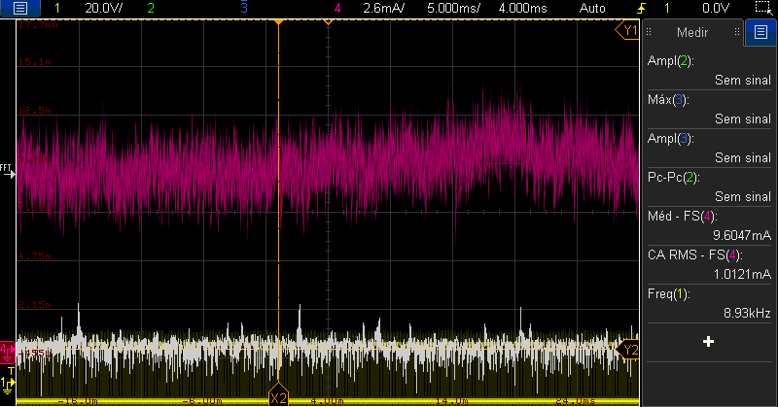
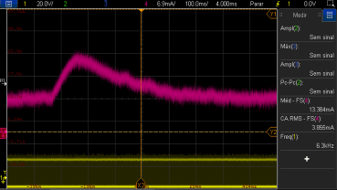

Ripple of Output Current
Figure 16. Ripple oscillation
In addition, an oscillation of more than 10 ppm was observed during operation, due to the low current in the DC-Link supplied by Magna Power.
However, this problem should be solved in the future with the implementation of the Feed Forward in the resonant converter control code.
Figure 15. Ripple with 300A of output current and 300V of DC-Link

Slide 13
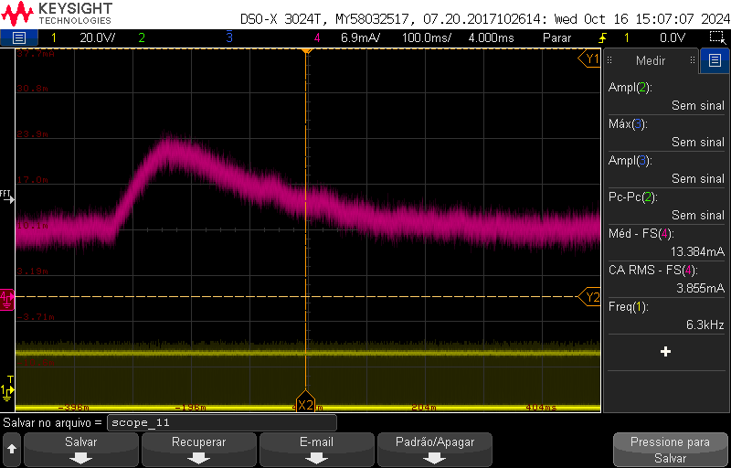

Slide 14
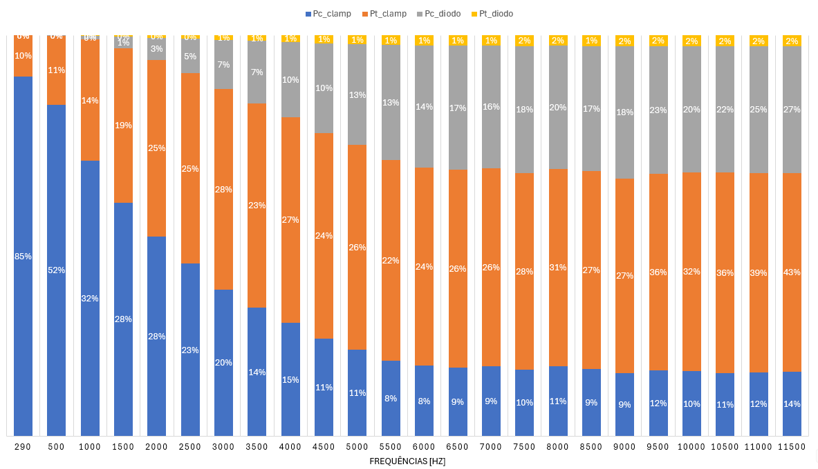
Efficiency and Losses
Increasing Dead Time (Clamp and main switches)
Decreasing parasitic inductance
Figure 17. Efficiency of the Preliminary Version
Figure 18. Loss Distribution for 300 V DC-Link

Slide 15
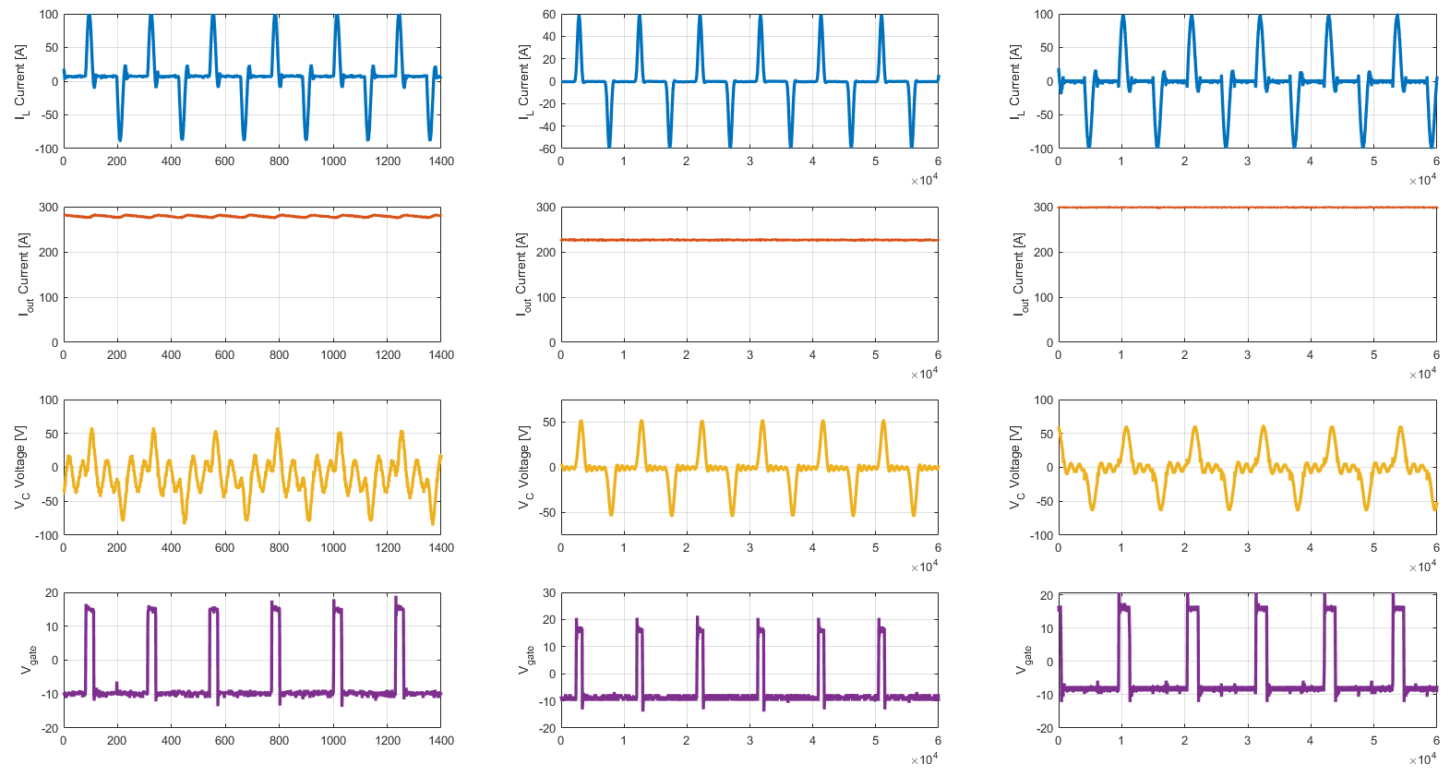
Comparing the improvements made
Preliminary Version
+ Clamp Circuit
+ Dead Time - Inductance
Figure 19. Improvements Comparison

Slide 16
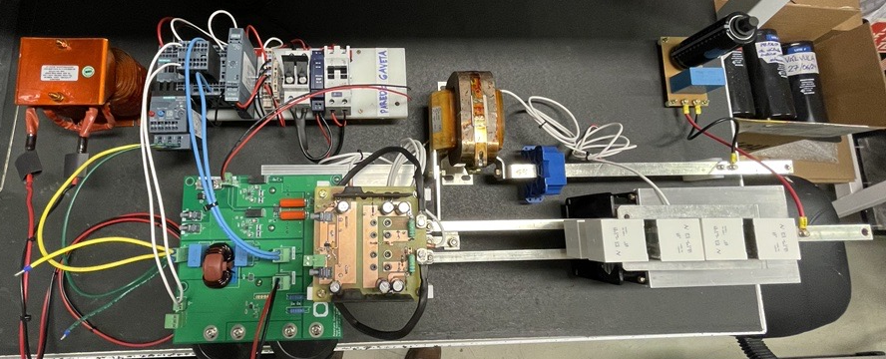
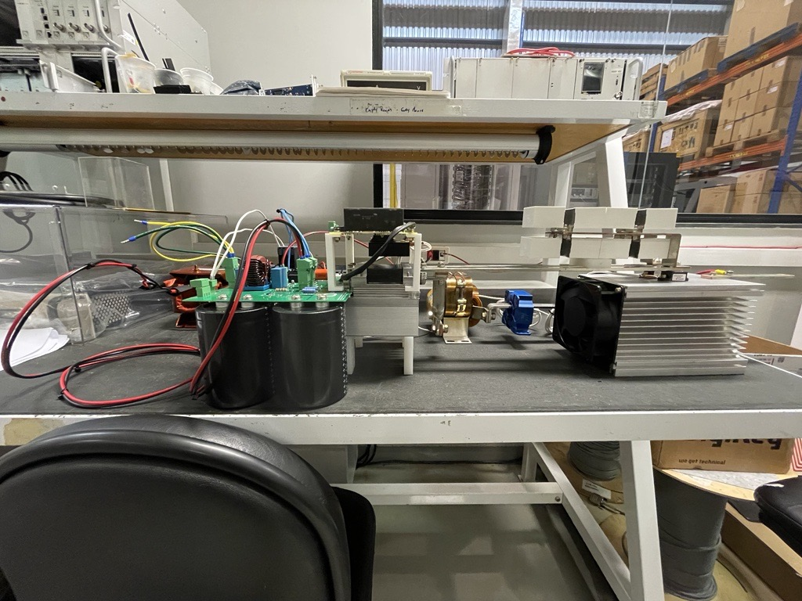
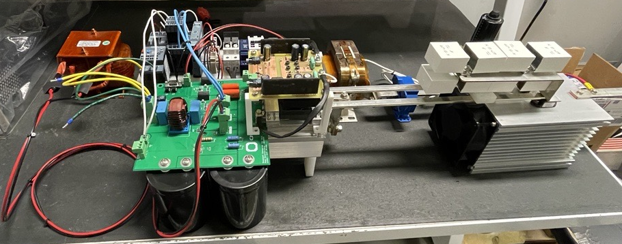
NEXT STEPS
Preliminary Version – Final results and installation
FINAL VERSION
Identify changes needed for the final version
Make adjustments for future tests with the superconductive coil.
Manufacture and optimize the final plate version;
Increase the power density of the project;
Improve installed components;
Assemble the racks for delivery.
Figure 20. Final Version tests and optimization

Slide 17
References
[1] J. G. Galvez et al., “Preliminary design of a cryogen-free 6.6 T superconducting wavelength shifter,” IEEE Transactions on Applied Superconductivity, to be published, 2023.
[2] Y. G. Kang and A. K. Upadhyay, “Analysis and design of a half-bridge parallel resonant converter,” IEEE Transactions on Power Electronics, vol. 3, no. 2, pp. 174-182, 1988.
[3] K.-H. Liu and F. C. Lee, “Secondary-side resonance for high-frequency power conversion,” in 1986 IEEE Applied Power Electronics Conference and Exposition, pp. 83-89, 1986.
[4] G. O. Brunheira, J. P. Bonaldo, J. N. H. da Rosa, C. Rodrigues and J. A. Pomilio, “Digital control system for high precision power supplies of the new Brazilian synchrotron source,” in 2013 Brazilian Power Electronics Conference, pp. 326-331, 2013.
[5] W. Contesini, L. de Oliveira Porto, B. E. Limeira and F. S. de Oliveira, "Prototype of a Resonant Converter for a Superconducting Magnet with 300 A and 10 V Output Operating in Discontinuous Conduction Mode," 2023 IEEE 8th Southern Power Electronics Conference and 17th Brazilian Power Electronics Conference (SPEC/COBEP), Florianopolis, Brazil, 2023, pp. 1-8, doi: 10.1109/SPEC56436.2023.10408187.

Slide 18


THANK YOU
Lucas Carnevalli de Almeida
lucas.carnevalli@cnpem.br

