Slide 1
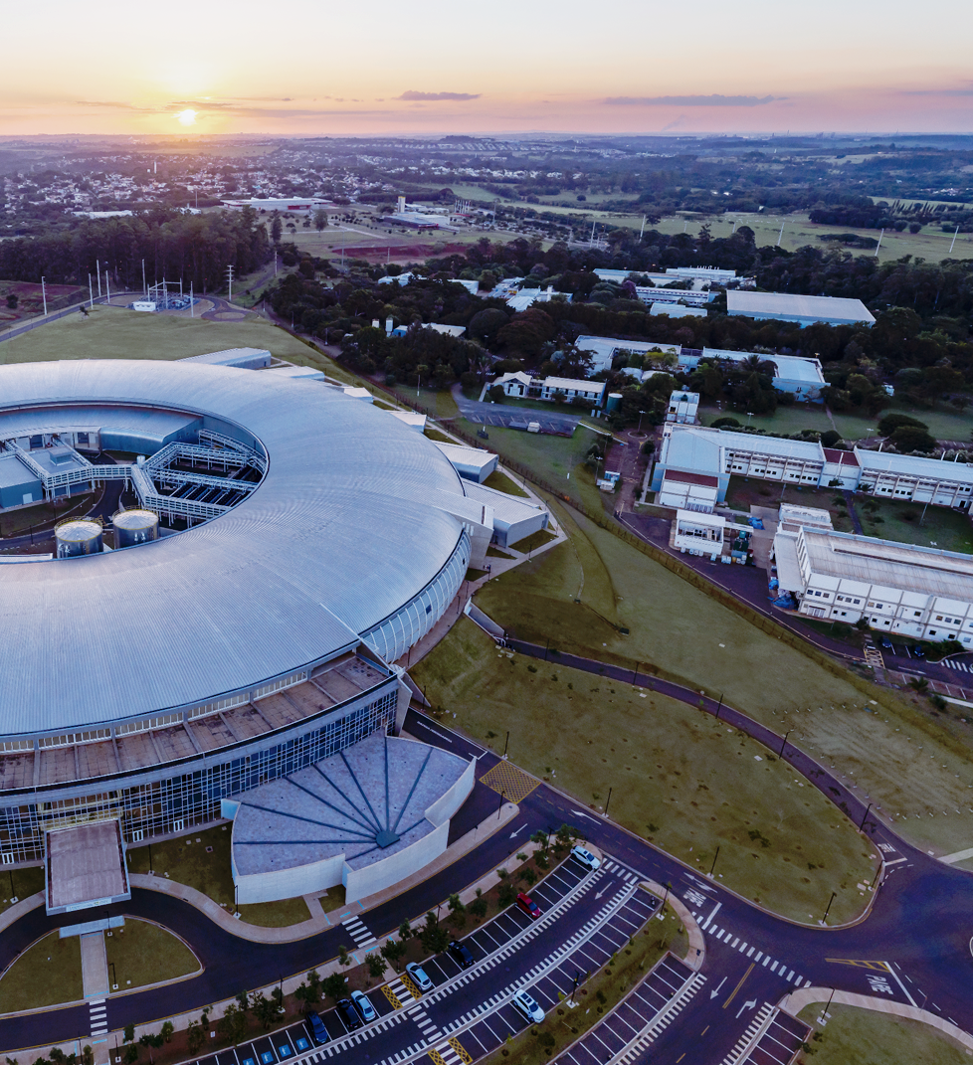

`
CNPEM’s Superconducting Wavelength Shifter (SWLS)
Technical Design Review
4–5th November 2024
Quench Protection
Samuel Fraga
Electronics Group
On behalf of the Technology Unit

Slide 2
Outline
Design Premises
Protection System Overview
Hot-spot Temperature Analysis
Dump Resistor Specification
Quench Detection Requirements
Quench Detection Architecture
Prototypes, Tests and Results

Slide 3
Design Premises
Adopt conservative requirements seeking robustness
Favor well-established solutions
Increase design complexity only as required by the project needs
Minimize the number of critical components (single points of failure)
Add redundancies whenever viable

Slide 4
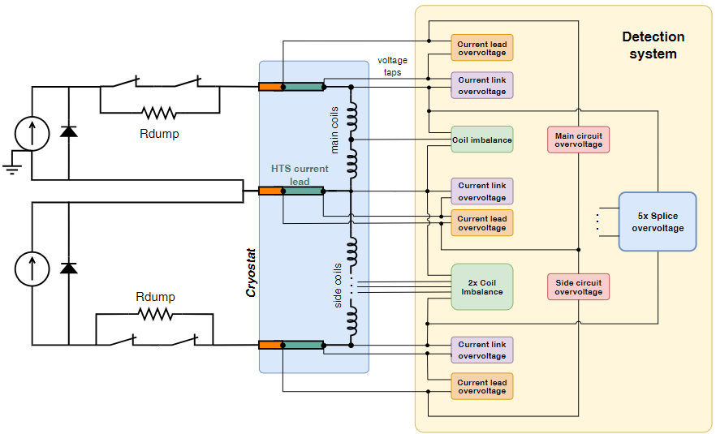
Protection System Overview
Active energy extraction with series resistor
3 current lead scheme allows treating extraction circuit as 2 independent RL circuits
2 redundant contactors per extraction circuit
Dump resistor bank specified to withstand partial failure
Grounding position to decrease maximum circuit voltage to ground
Quench detection on similar coils by voltage imbalance
Quench detection on current leads by overvoltage
Quench detection safety redundancy by overvoltage using higher threshold than imbalance detector
Overvoltage detection on current leads, current links and splices

Slide 5
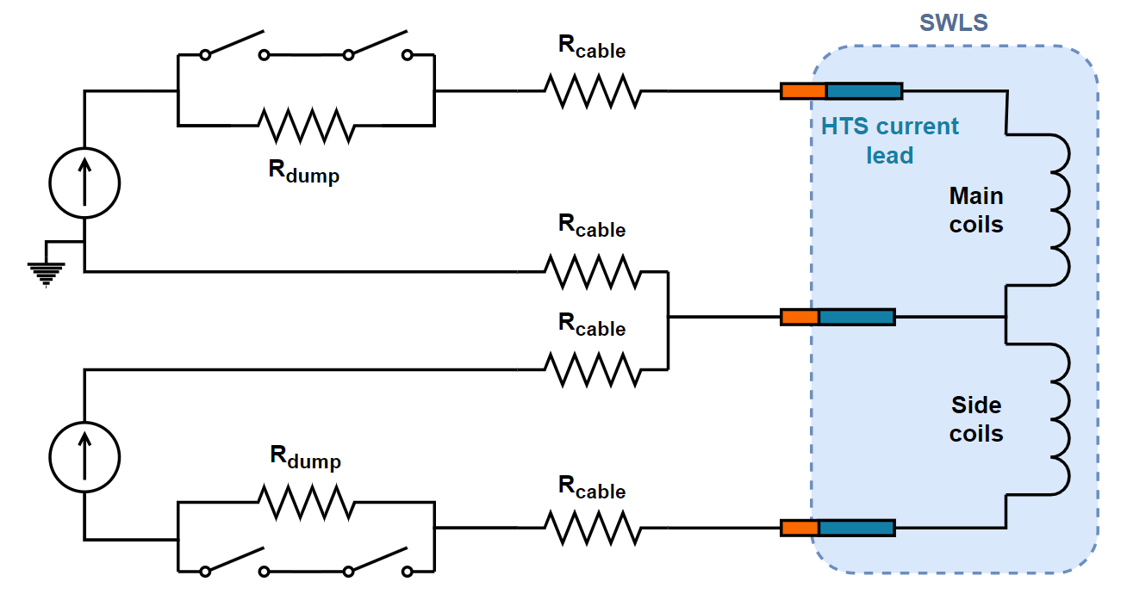
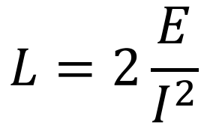
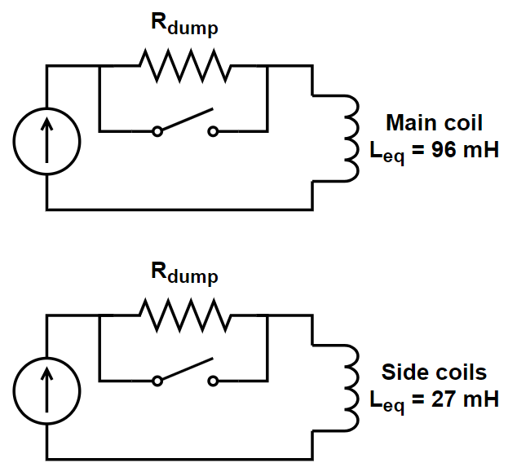
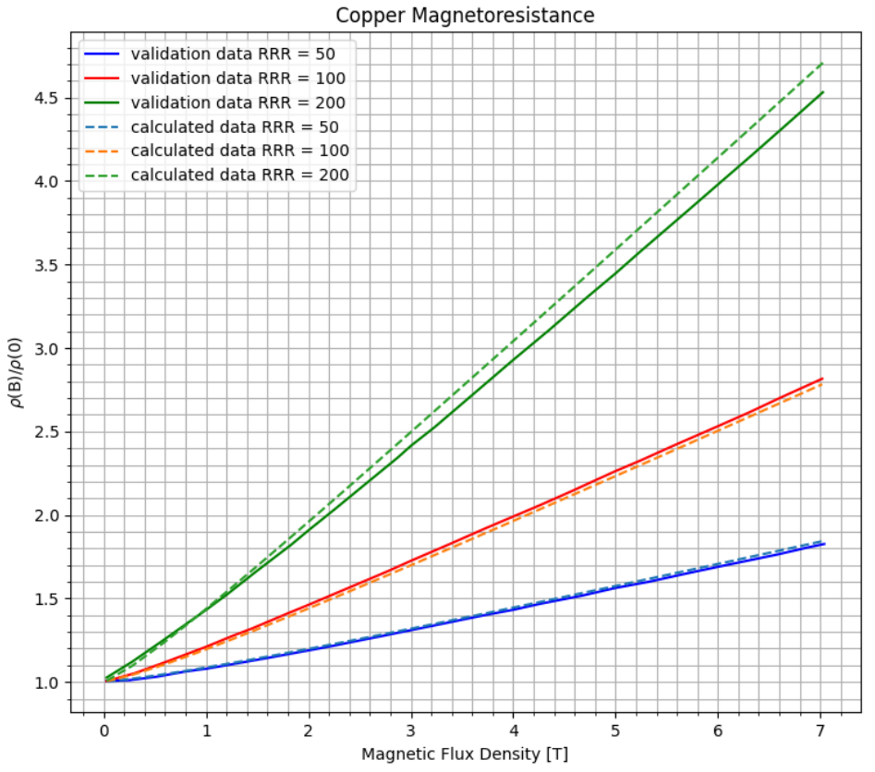
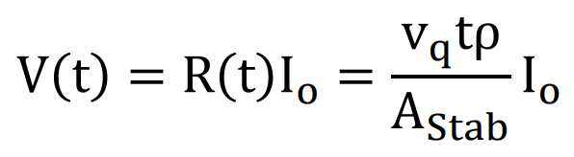
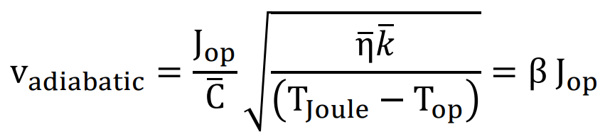
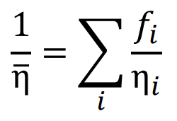
Hot-spot Temperature Analysis
Main coils: 2670 J
Side coils: 750 J
Current leads include ballast, so their resistance is negligible
Assume 2 decoupled RL circuits
Equivalent inductance obtained from stored energy at operating current
Worst-case scenario (highest inductance) is used in quench analysis
MIITS analysis script in Python calculates hot-spot temperature for a Copper and Nb-Ti composite wire considering:
  Cu and Nb-Ti specific heat as function of magnetic field density and temperature
  Cu resistivity as function of temperature, RRR and magnetic field density
  Cu and Nb-Ti density as function of temperature
  Detection time obtained from approximation of quench voltage evolution
Python script implementing a one-dimensional Wilson simulation was developed, but MIITS yielded more conservative results
Low resistance
Highest inductance loop
First approximation for normal zone voltage in adiabatic case

Slide 6
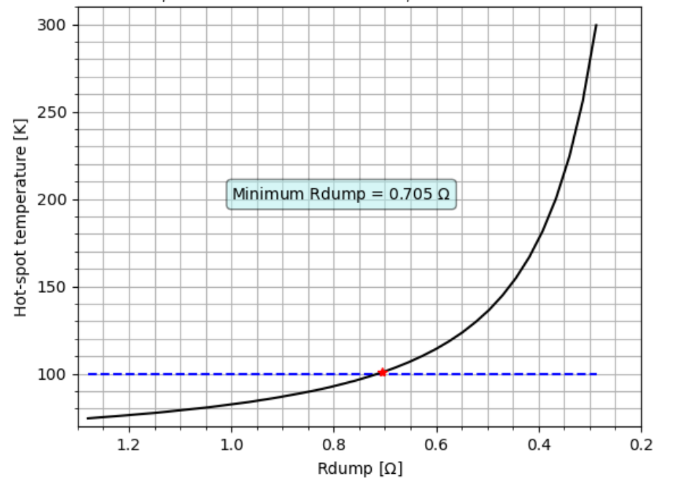
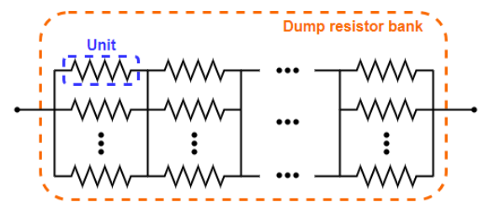
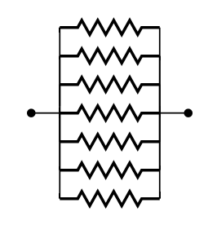
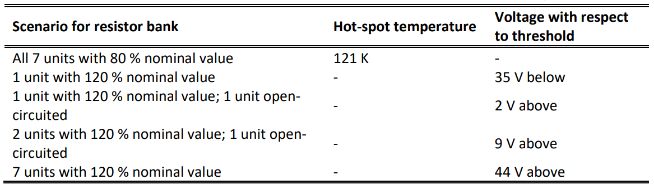
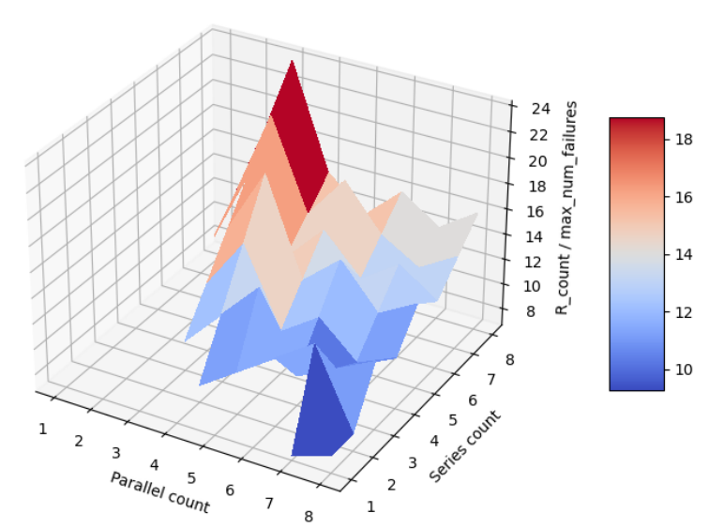
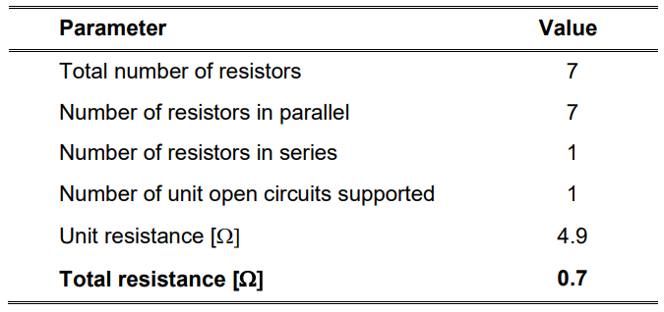
Dump Resistor Specification
Minimize dump resistance to minimize extraction voltage
Analysis uses worst-case scenario according to hot-spot temperature calculations for dump specification
Dump resistor matrix optimized to withstand the highest count of open-circuits to component count ratio
Minimum allowed dump resistance is 0.7 Ω
Voltage tap insulation is rated for 250 V (max extraction voltage)
Estimate of impact of resistor tolerance in design
Parameter | Value
Maximum hot-spot temperature | 100 K
Maximum operating current | 300 A
Critical temperature | 9.2 K
Current-sharing temperature | 6.1 K
Operating temperature | 4.2 K
Copper area on wire | 2.76144e-7 m²
Nb-Ti area on wire | 2.99794e-7 m²
Copper RRR | 131
Validation time | 40 ms
Actuation time | 12 ms
Detection voltage | 100 mV
Maximum field on wire | 5.3 T
Equivalent constant inductance | 96 mH
Effect of 20 % tolerance in resistor units
Impact is manageable

Slide 7
Quench Detection Requirements
Detection threshold configurable to <= 100 mV
Validation time configurable to <= 40 ms
Any critical failure triggers the protection system
All triggers are active in the low voltage state (safety against power failure)
Voltage inputs rated to 1 kV for robustness (max voltage between taps is 500 V in the worst case)
Broken wire detection
Redundancy of voltage taps (2 per monitored point) for robustness against broken solder joints

Slide 8
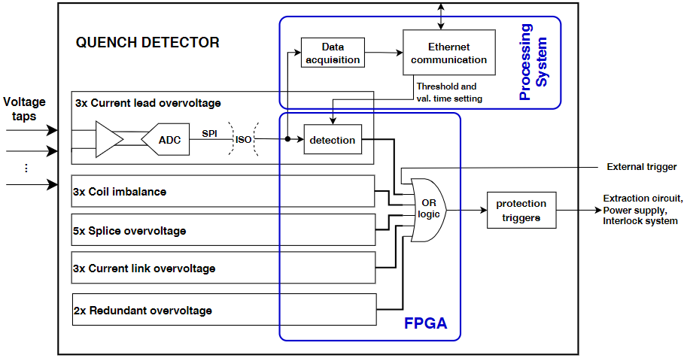
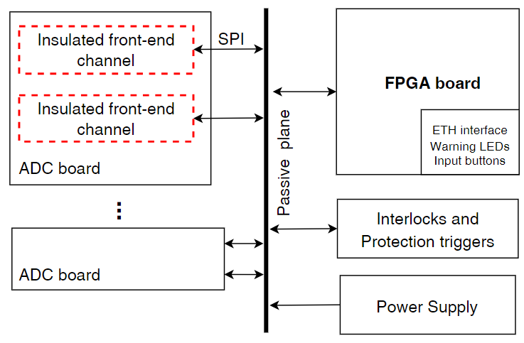
Quench Detection Architecture
Digital system based on FPGA
  Suits the large number of channels needed
  Eases the adjustment of detection parameters
  Supports data acquisition
Differential input channels, with ±20 V range, digitally isolated
18-bit resolution ADC gives LSB < 153 uV
20 kHz sampling rate, SPI data transfer
The chosen FPGA (Zynq 7000) is built in a SoC with an integrated ARM processor, used for data acquisition and setting of voltage threshold and validation time
Modular hardware: separate boards for different circuit functional blocks;
Eurocard boards are assembled in a subrack and interconnected through a passive plane
Allows fast substitution of parts of the circuit, facilitating maintenance

Slide 9
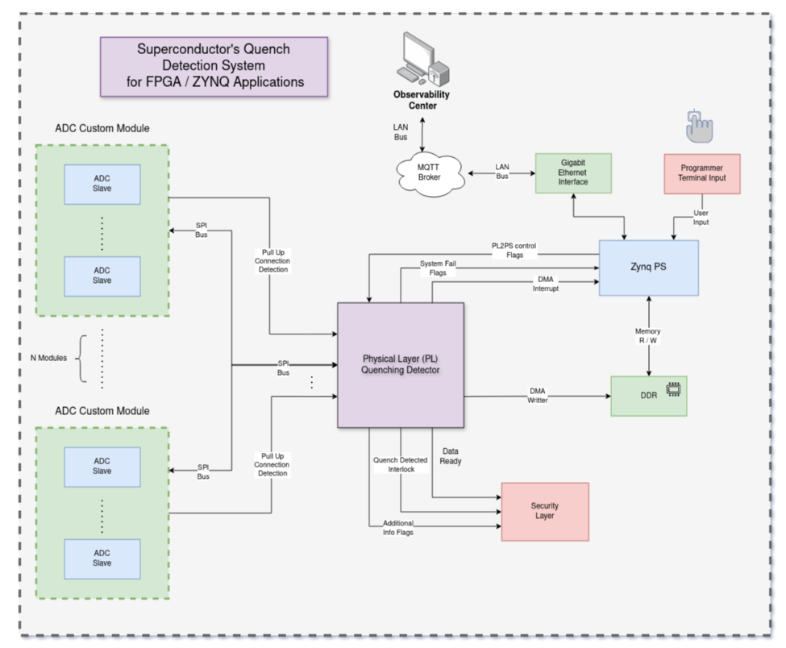
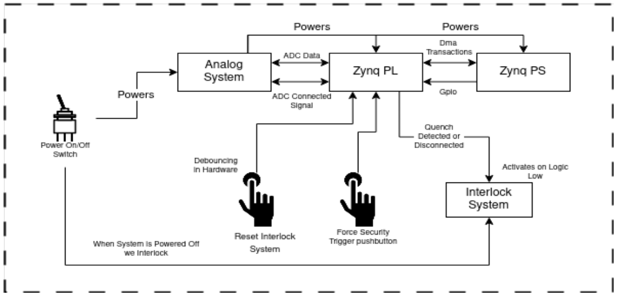
FPGA System Overview
User-Defined parameters (thresholds, validation time, channel disable) via MQTT
Channel-Separated configuration, all parallel.
Critical processing path for the interlock.
Higher Level (Petalinux) application for data pre-processing, compression, etc.
AXI-stream Compliant External Interface.
DMA implementation for efficient data transfer.
Modularized and Scalable design, all parametrized by Generics.

Slide 10
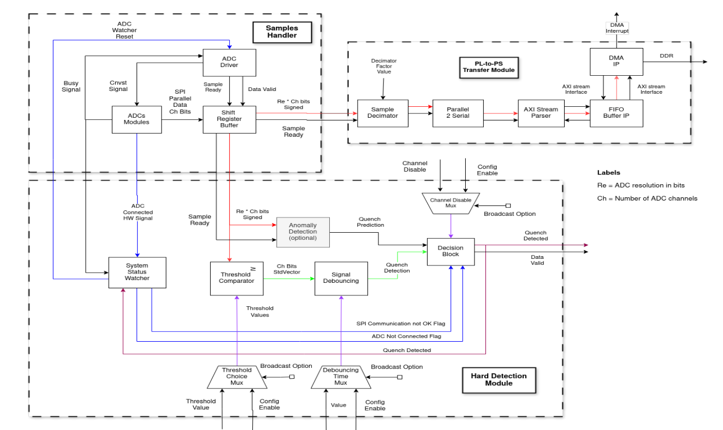
FPGA Physical Layer
The system is composed of three macro-level subsystems:
ADC driver;
Detection critical path ​;
Acquisition path to processing system.

Slide 11
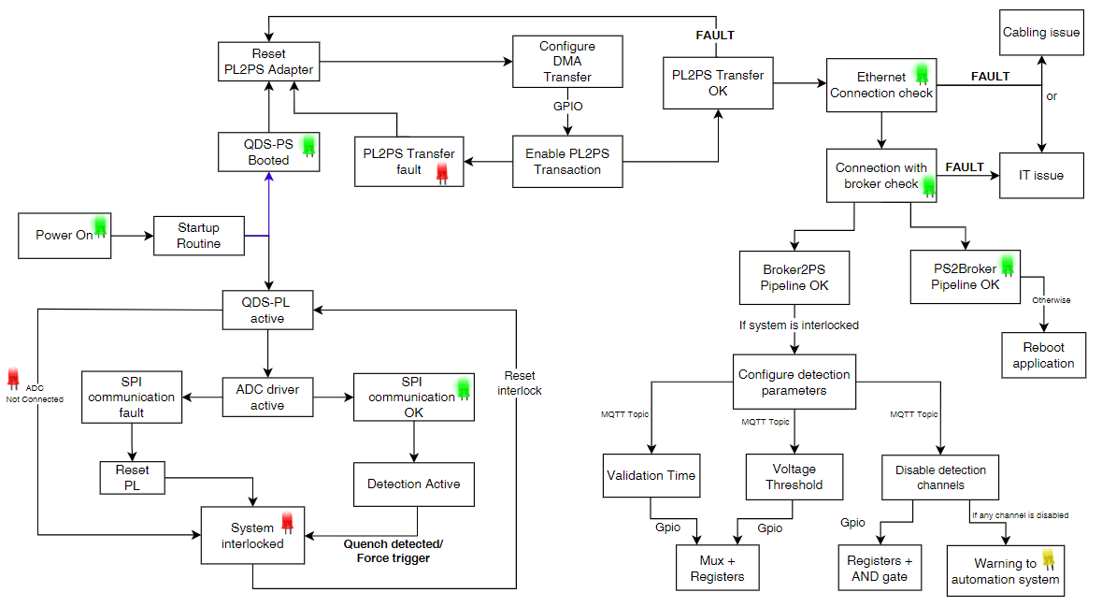
Operation Flow
Reliable self-watching mechanisms for interlock.
Protection is triggered if communication with any ADC fails.
Failures in the acquisition pipeline are signaled by LEDs and logged for debugging.

Slide 12
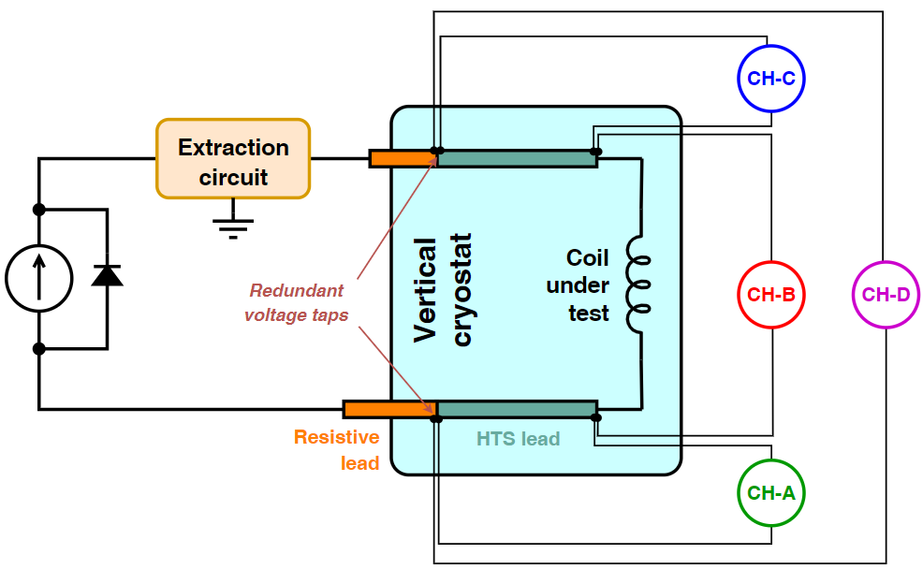
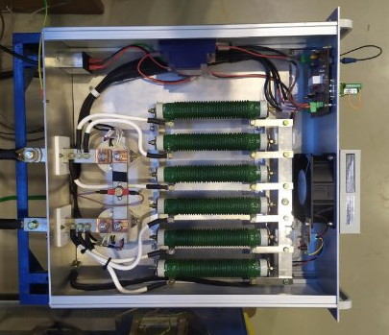
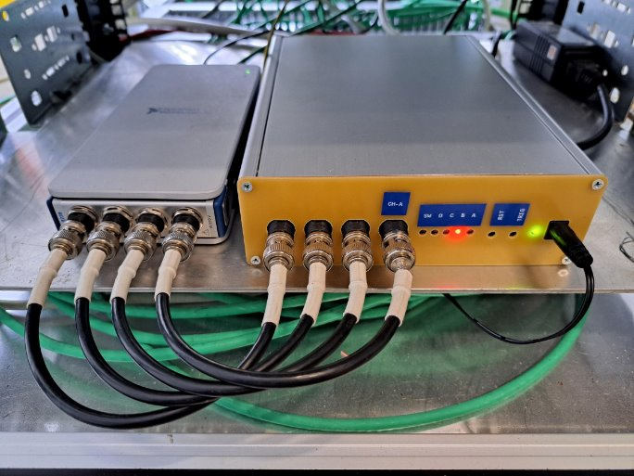
Prototypes, Tests and Results
A prototype protection system was built for the test setup of the superconducting coils
The extraction circuit is very similar to the final application, differing only on the array of parallel and series resistors and the presence of a central GND
Detection by analog circuit, with 4 overvoltage channels
Voltage signals acquired by external DAQ (National Instruments NI-9239)
Protection method and extraction circuit were validated and due to limitations of the analog detection, we decided to move to a digital solution
Analog QDS prototype (at right) + DAQ (at left)
Extraction circuit crate

Slide 13
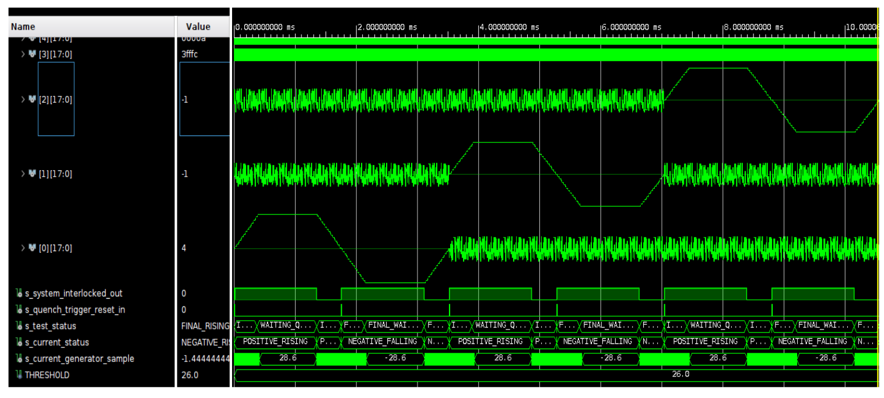
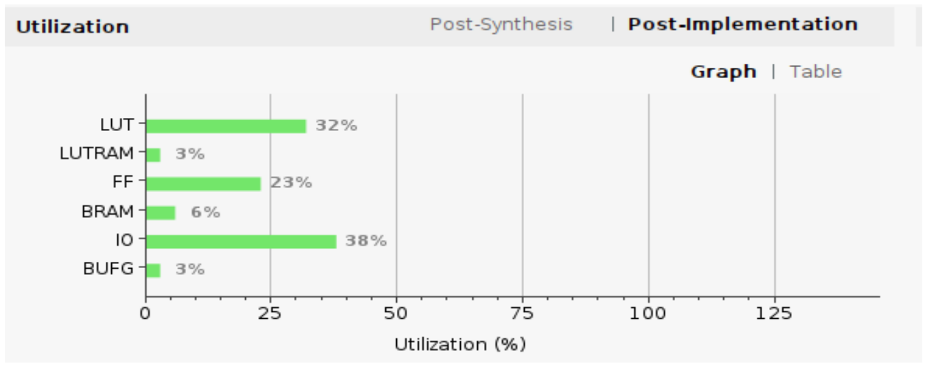
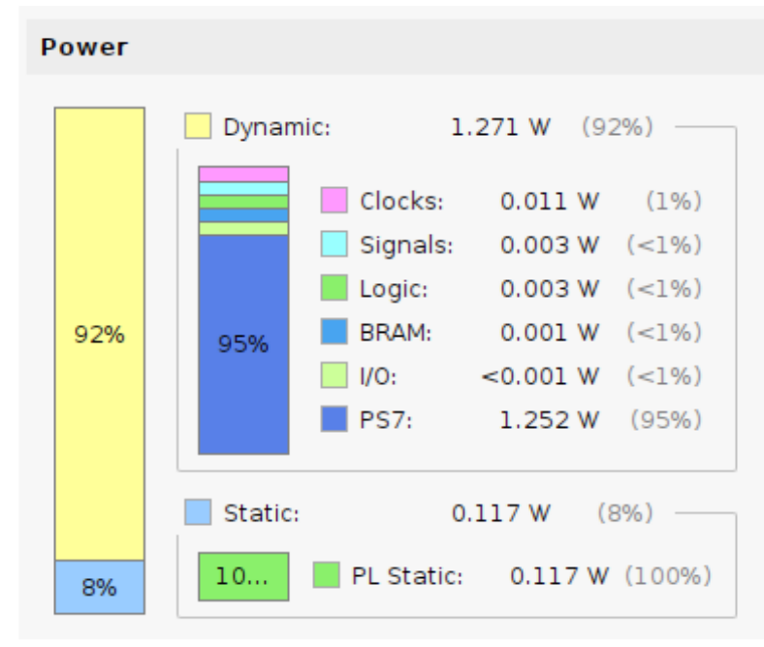
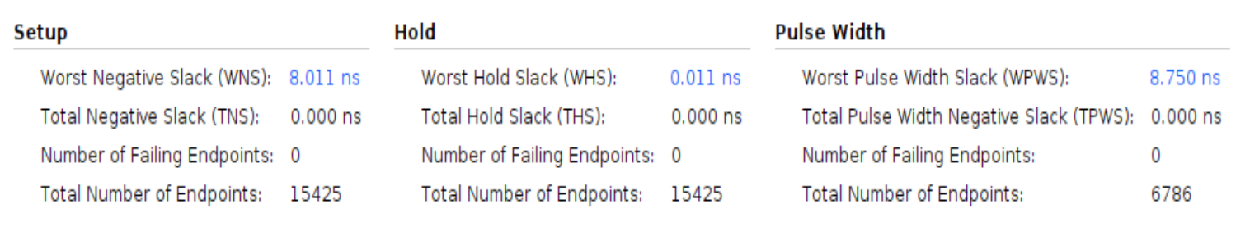
FPGA Validation Testbenches
FPGA firmware was implemented and virtual testbenches validated the following functions:
  ADC driver
  Detection path
  Threshold and validation time configuration
  System watcher
Design reports indicate moderate resource utilization, low power consumption and no timing issues.
Top level testbench
Timing analysis
Resources analysis
Power analysis

Slide 14
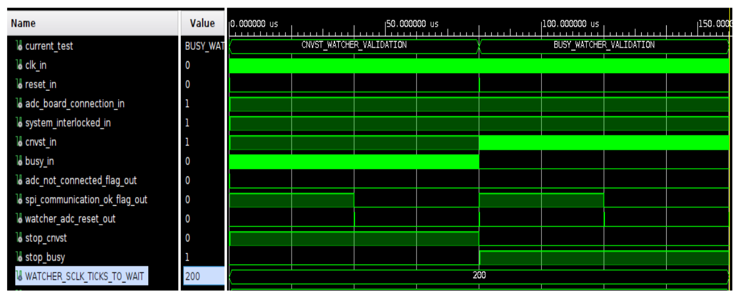
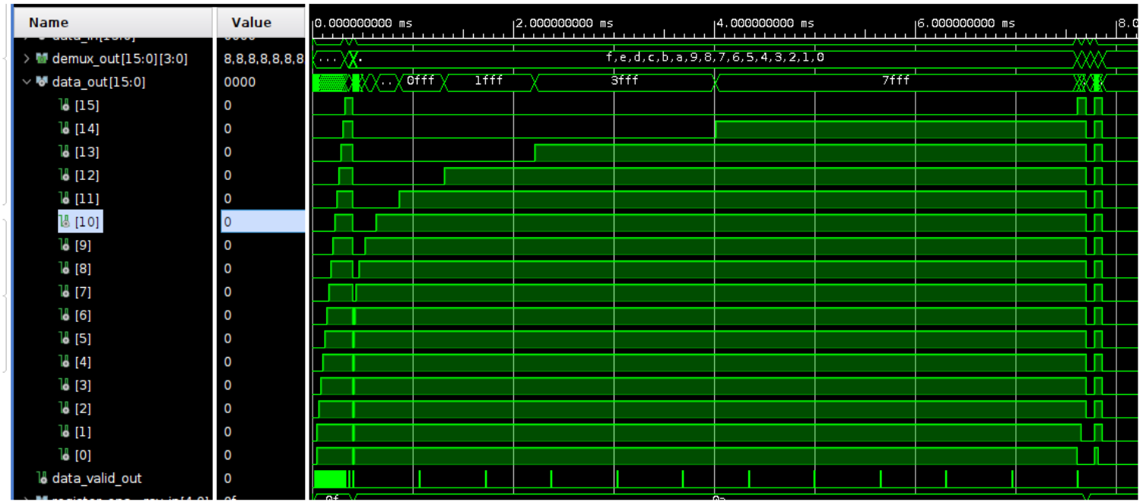
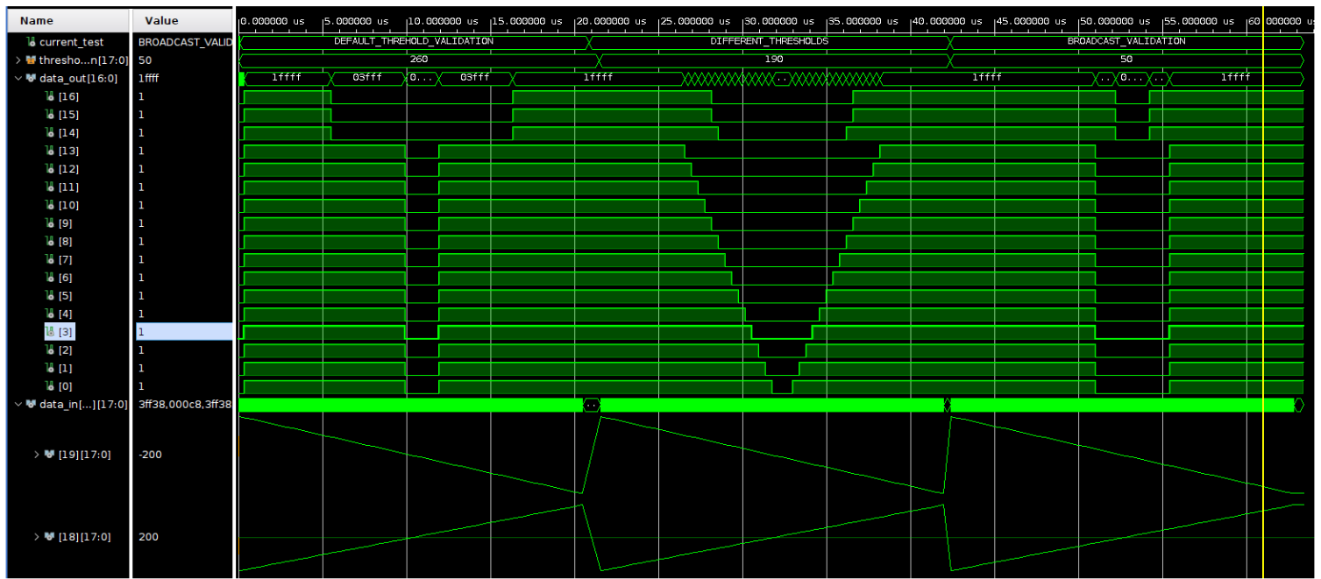
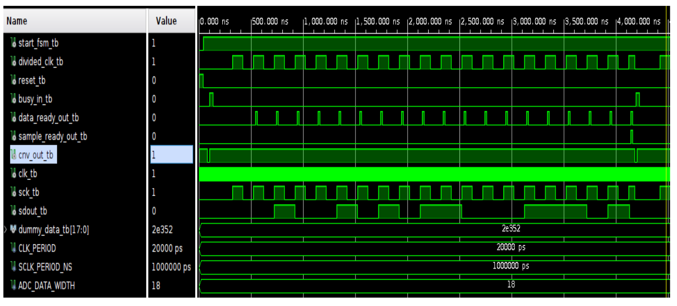
FPGA Validation Testbenches
System Watcher Testbench
Validation Time Testbench
Threshold Comparison Testbench
ADC Driver Testbench

Slide 15


Thank you!
cnpem.br

