Slide 1
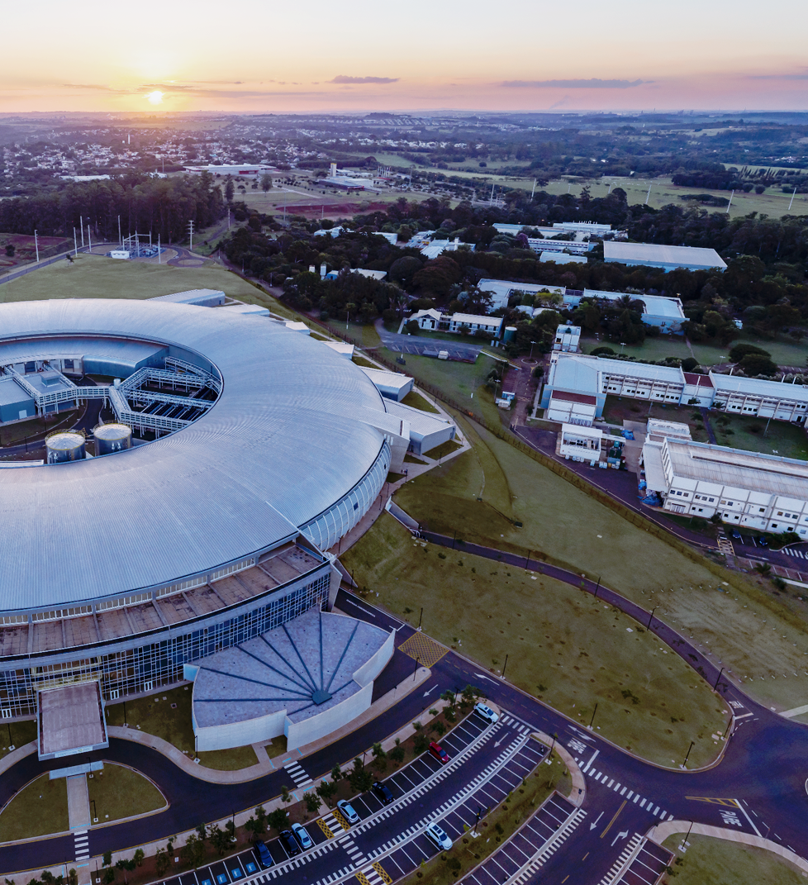

Magnetic characterization
CNPEM’s Superconducting Wavelength Shifter (SWLS)
Technical Design Review
4–5th November 2024
Lucas Henrique Francisco
Magnetic and Electromagnetic Systems Group
On behalf of the Technology Unit

Slide 2
Outline
General overview
Main concept: anti-cryostat and Hall probe rod
First prototype results
Further developments
  Scan coil
  In-vacuum PCBs for hall sensors and flux coils

Slide 3
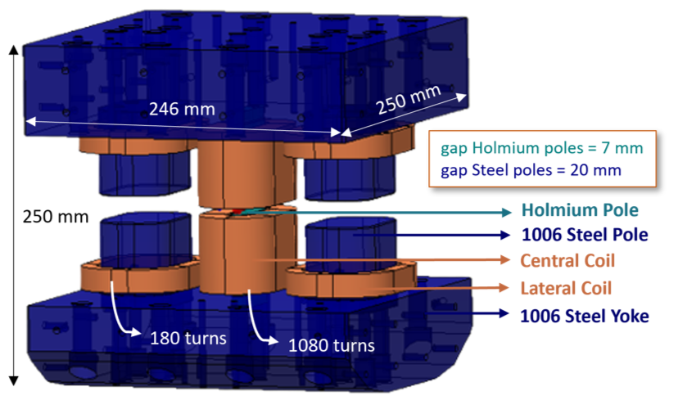
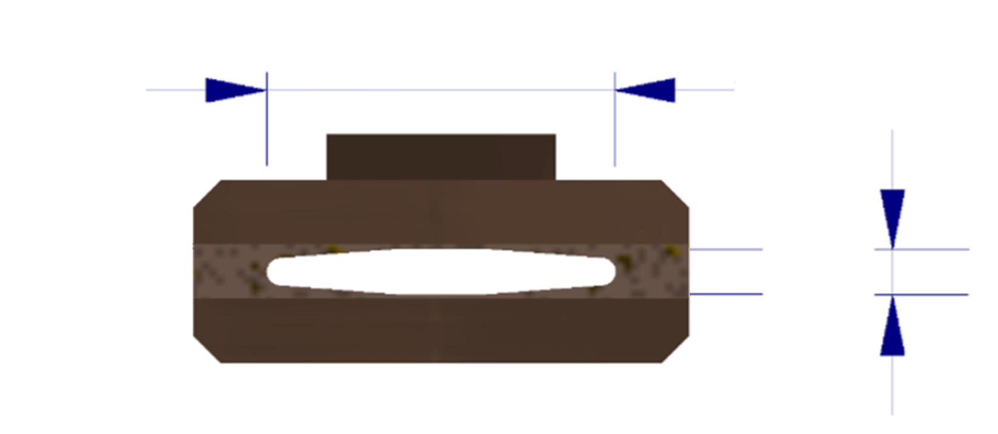
General overview
Goals
Given the necessity to measure and validate the magnetic field produced by the Superconducting Wavelength Shifter, a primary approach based on an anti-cryostat chamber for in-air characterization is being developed. The measurement setup should be capable of covering the entire field region consisting of a ± 200 mm range along the beam axis and a ± 3.5 mm range in the transverse horizontal plane. Further developments and approaches, including the use of scan coils and in-vacuum PCBs, are also being explored.
Main challenges
The 5 mm gap of the electron beam chamber limits the size of measurement devices. For in-air characterization, the use of an anti-cryostat chamber makes this even more challenging.
The electron beam chamber operates at 20 K, while the anti-cryostat used for in-air characterization will be at room temperature. Therefore, the heat load from the anti-cryostat to the beam chamber must be carefully considered.
Allowing for magnetic fiducialization (magnetic center determination)
Plan A
Plan B
Anti-chamber for RT* measurements
Measurements inside SWLS vacuum chamber
Hall sensor setup adaptations
New Hall sensor setup and calibration at CT**
38 mm
Mechanical rod or Hall sensor carriage
New vacuum actuation system
5 mm
Stretched wire for field integrals measurements
PCB coils for field integrals measurements
Electron beam chamber
* Room Temperature
** Cryogenic Temperature

Slide 4
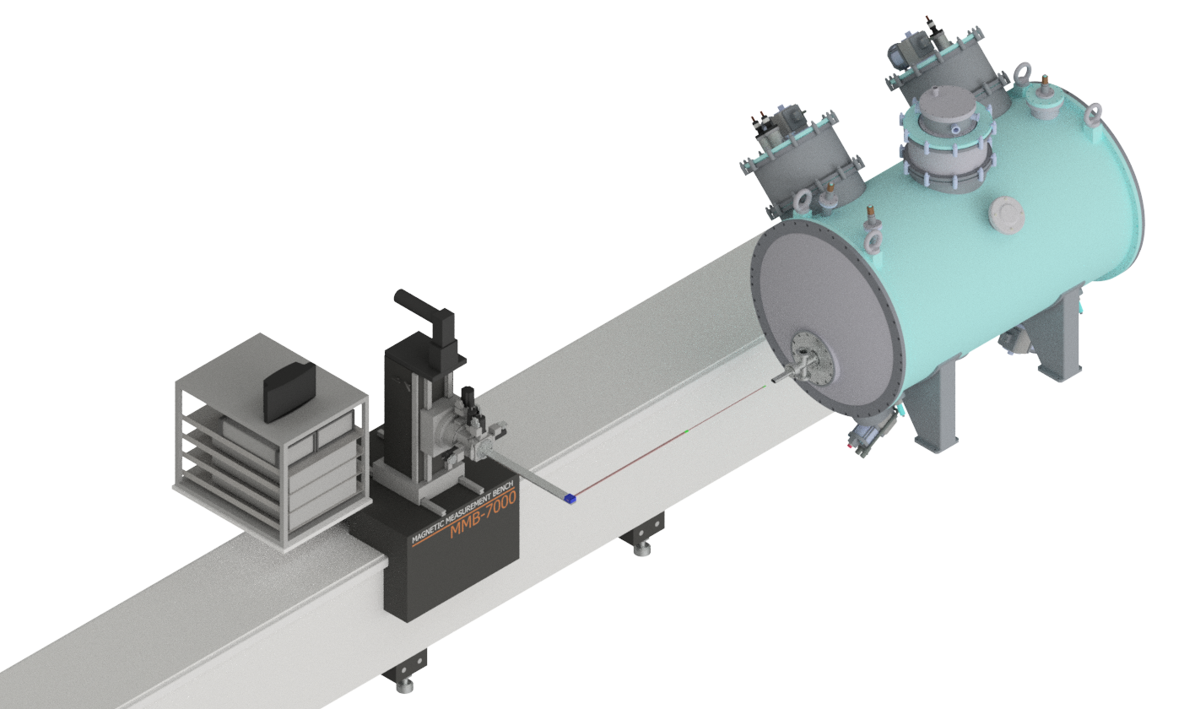
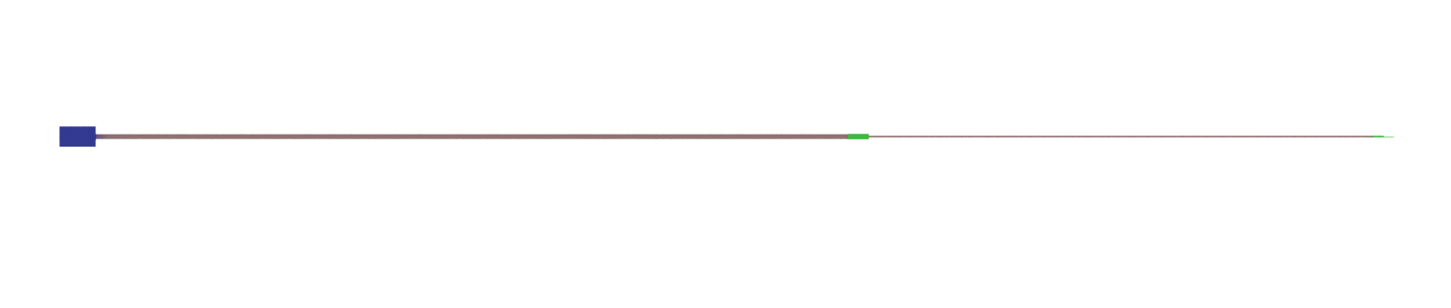
Main concept: anti-cryostat and Hall probe rod
Anti-cryostat system description:
A rod with a Hall probe attached to its end, mounted on the characterization bench, will be used to measure the SWLS field region.
The Hall probe rod will be manufactured in two parts: a thinner section to access the narrow part of the beam chamber, and a thicker section to enhance the rod’s rigidity.
Since the magnetic characterization will be conducted under ambient conditions, an "anti-cryostat" consisting of a 316L stainless steel chamber will be used to isolate the vacuum of the electron beam chamber from the surrounding environment.
1.
1.

Slide 5
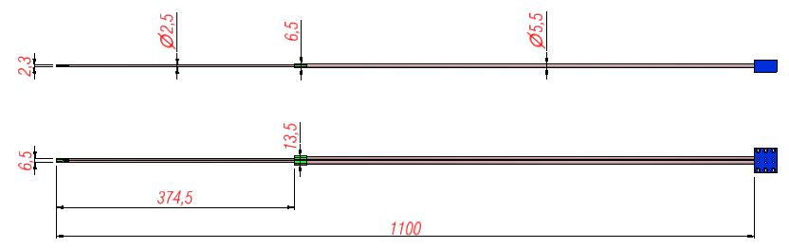
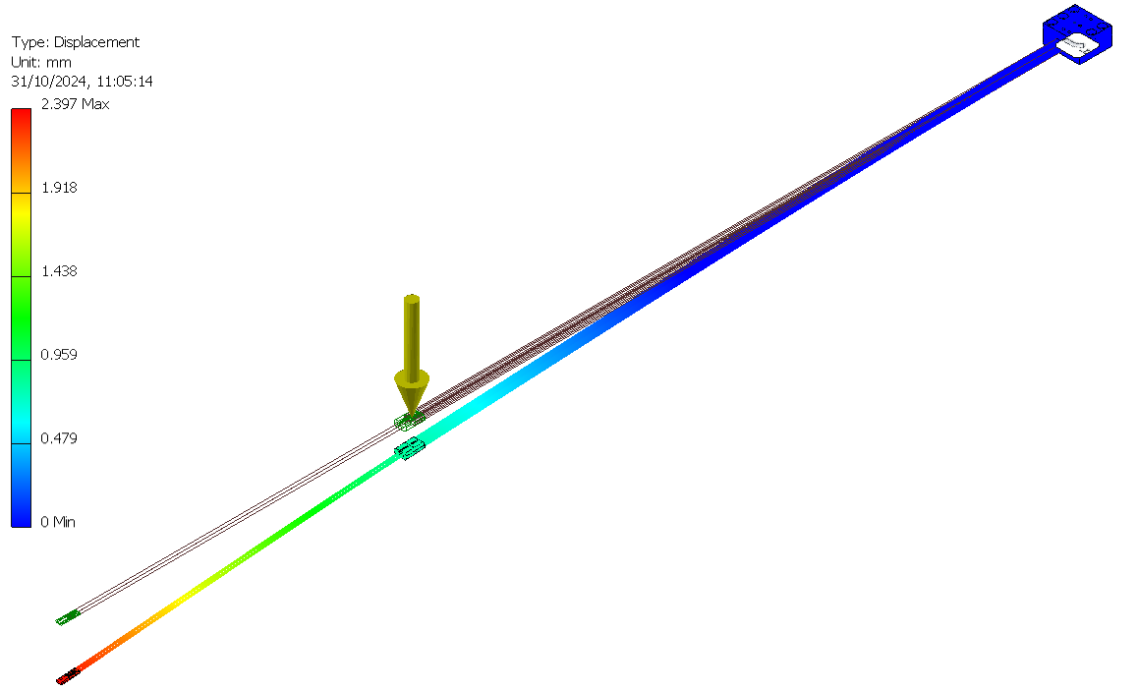
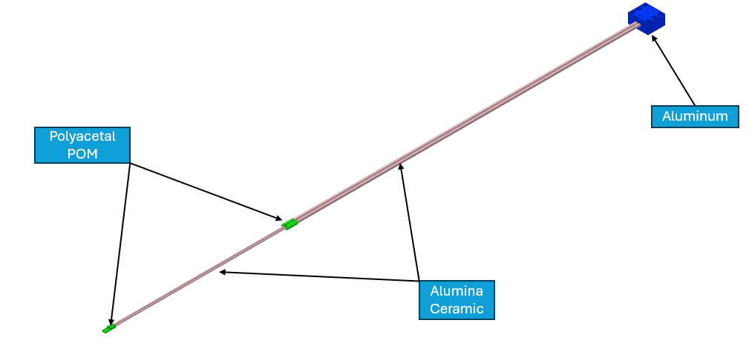

Main concept: anti-cryostat and Hall probe rod
Mechanical rod for a scalable-chamber:
A thinner part of the rod for measurements inside the field region of interest;
Evaluation of maximum displacements and vibration frequency;
Possibility of using a stretched rope for rod counter-displacement.
Side view
Top view
Displacement analysis
(From other analysis)
1st vibration mode at 16 Hz
2.4 mm (deflection due to rod weight)

Slide 6
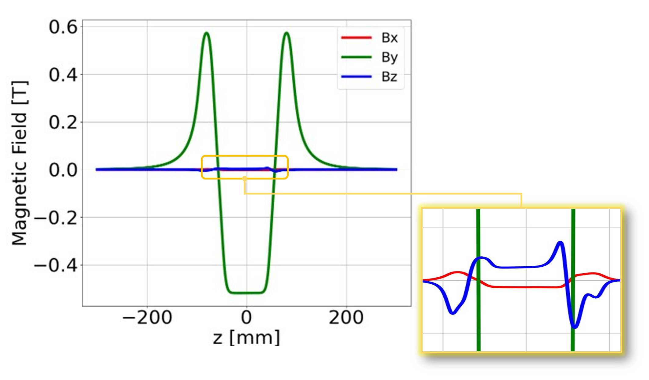
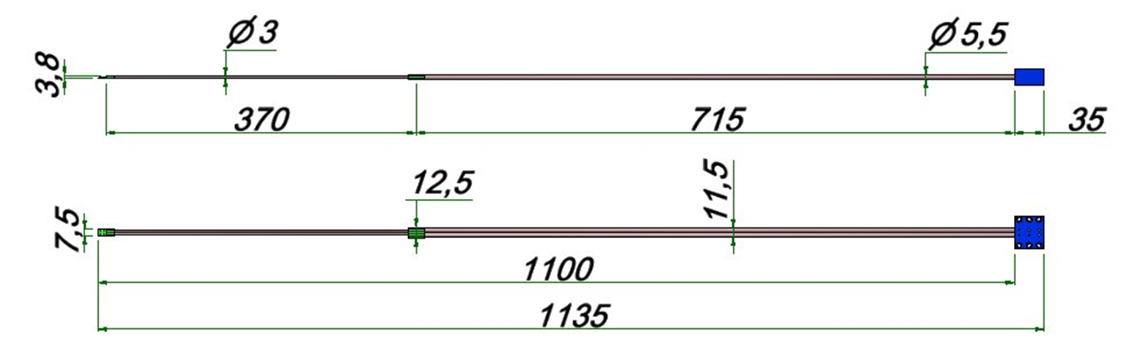
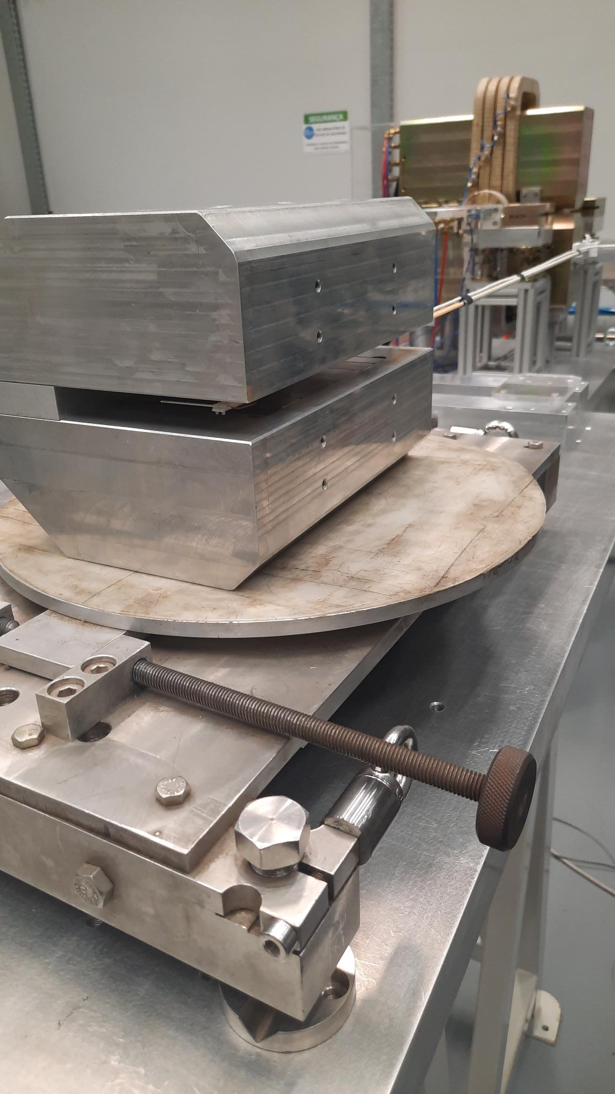
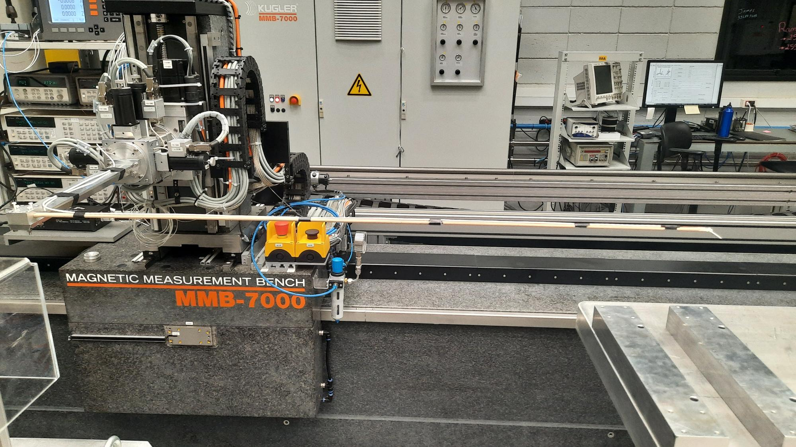
First rod prototype results
To validate the stability of the thin rod required for the anti-cryostat chamber, an initial prototype was designed, manufactured, and tested for stability.
For the stability test, a Hall probe was fixed to the rod, mounted on the standard characterization bench at CNPEM, and measurements were taken using a reference permanent calibration magnet. No high-frequency oscillations were observed in the field results, even in gradient regions, where field oscillations due to excitation of the thin rod’s vibration modes were expected.
This method will be used for checking for vibrations on the final rod.
PM calibration magnet
Simulated 1st vibration mode at 23 Hz

Slide 7
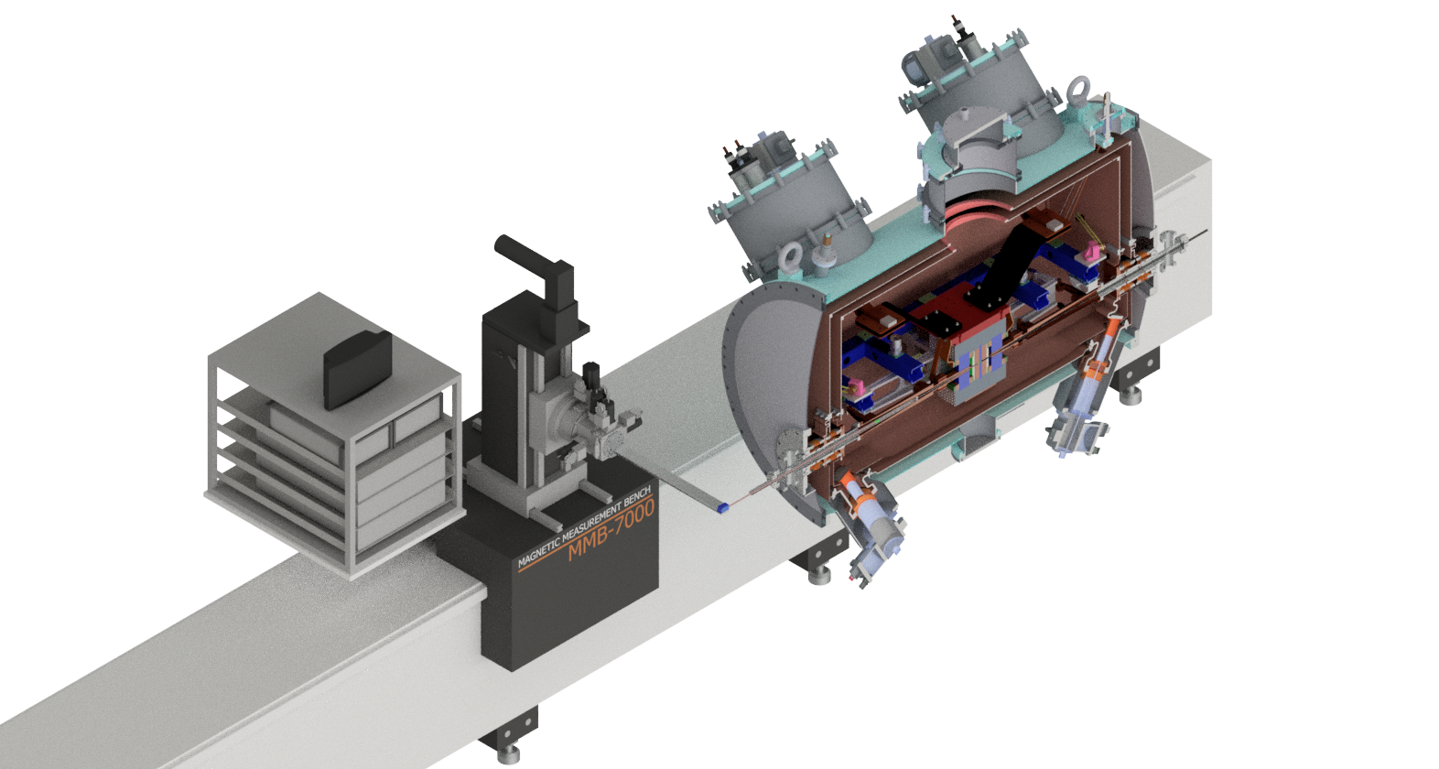
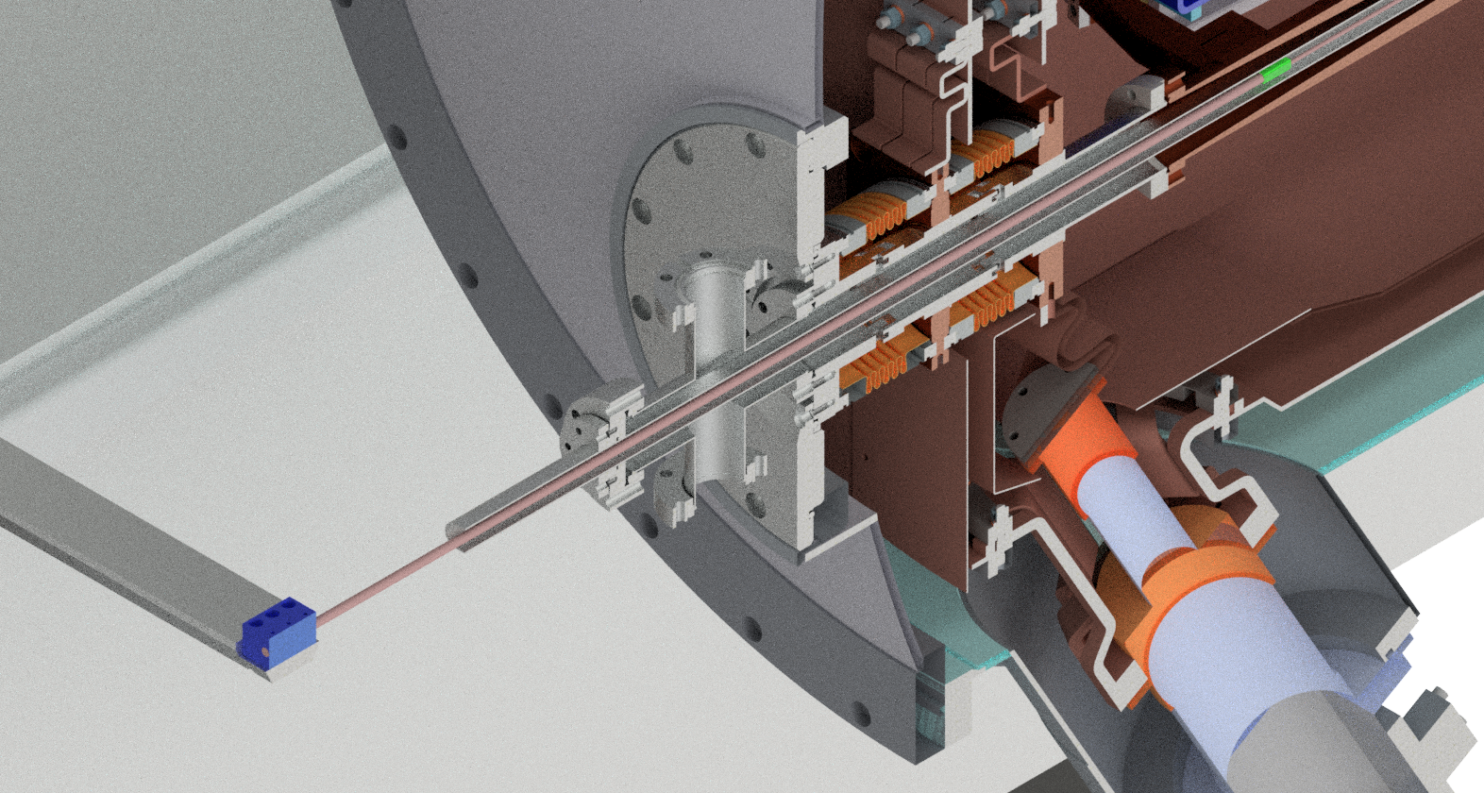
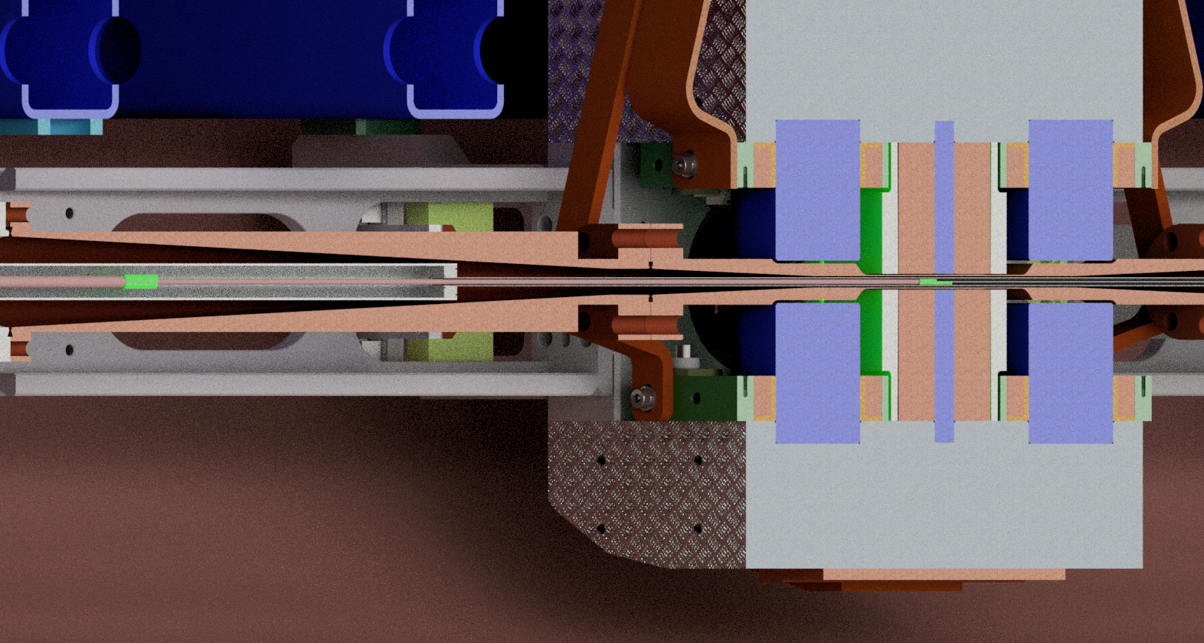
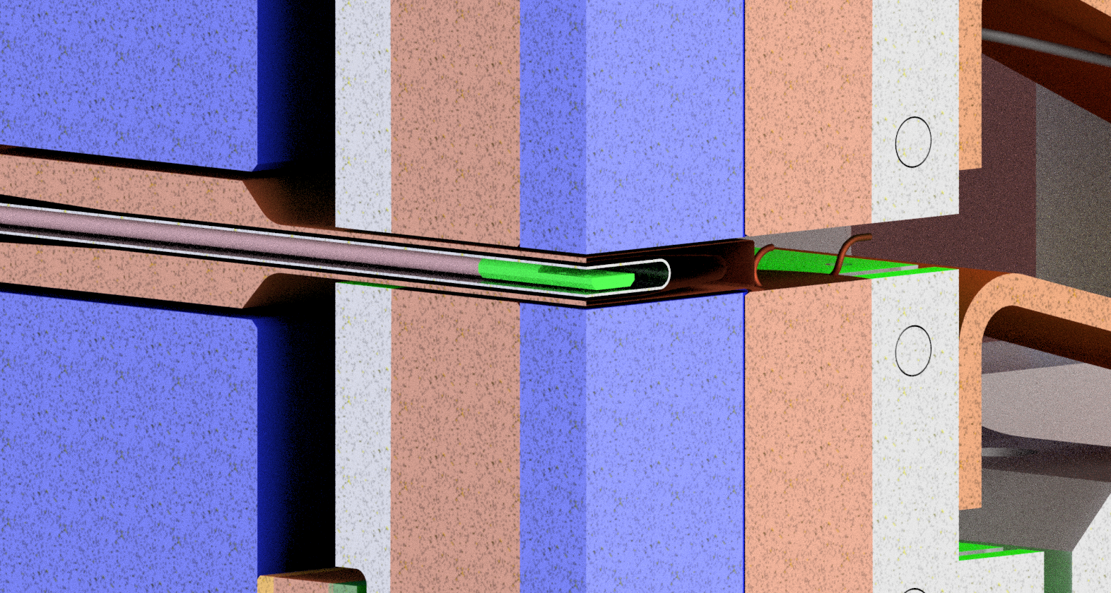
Main concept: anti-cryostat and Hall probe rod
1.
Outlet for vacuum pump
Anti-chamber
(ambient pressure)
2.
3.
1.
O’ring groove for vacuum sealing
Hall sensor rod
2.
3.
Anti-chambers
Anti-chamber
Beam chamber
Hall sensor
Hall sensor

Slide 8

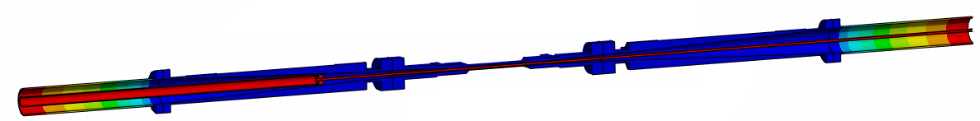


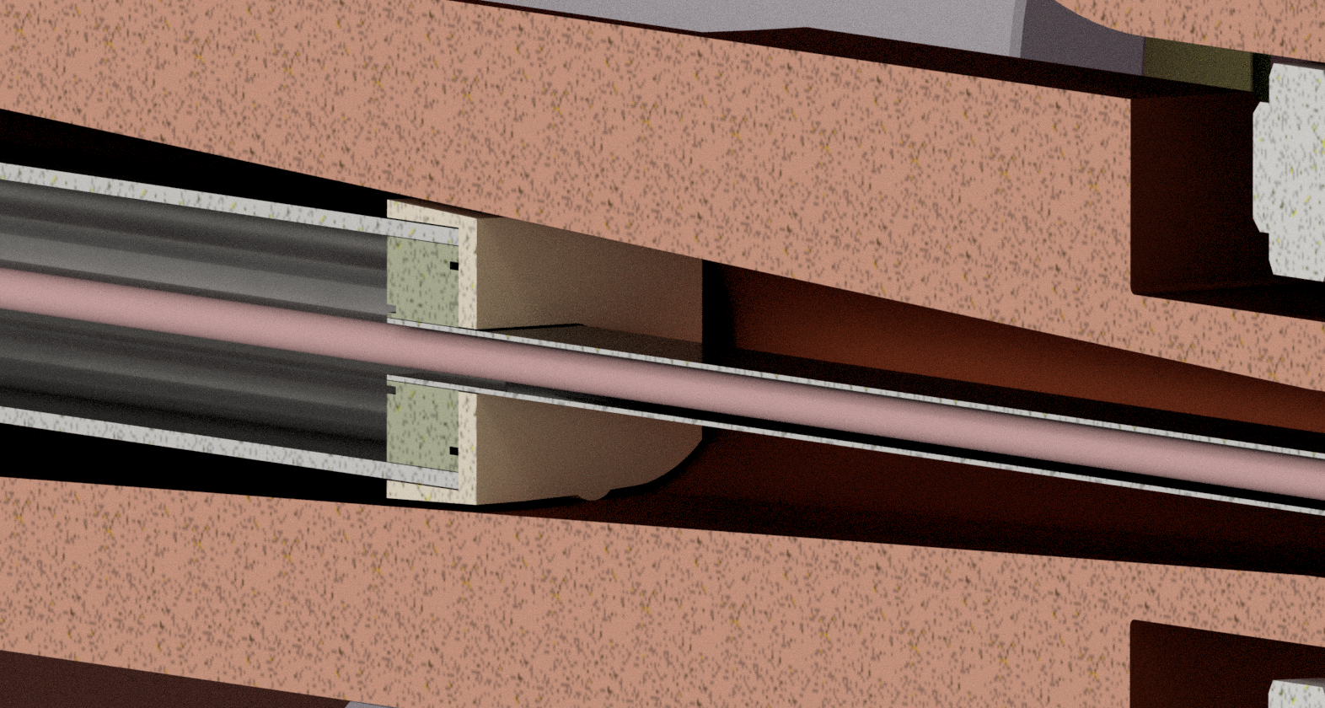
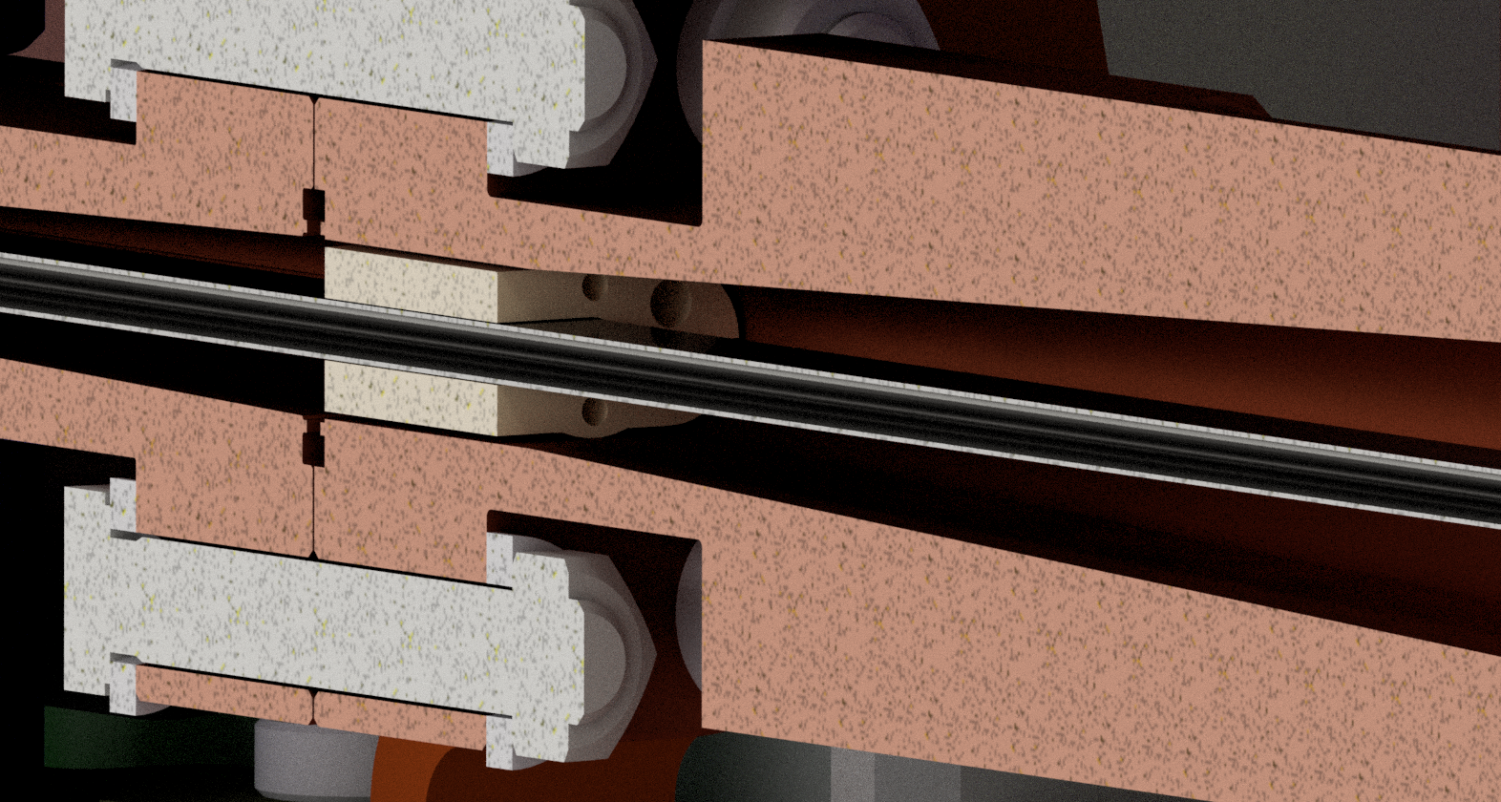
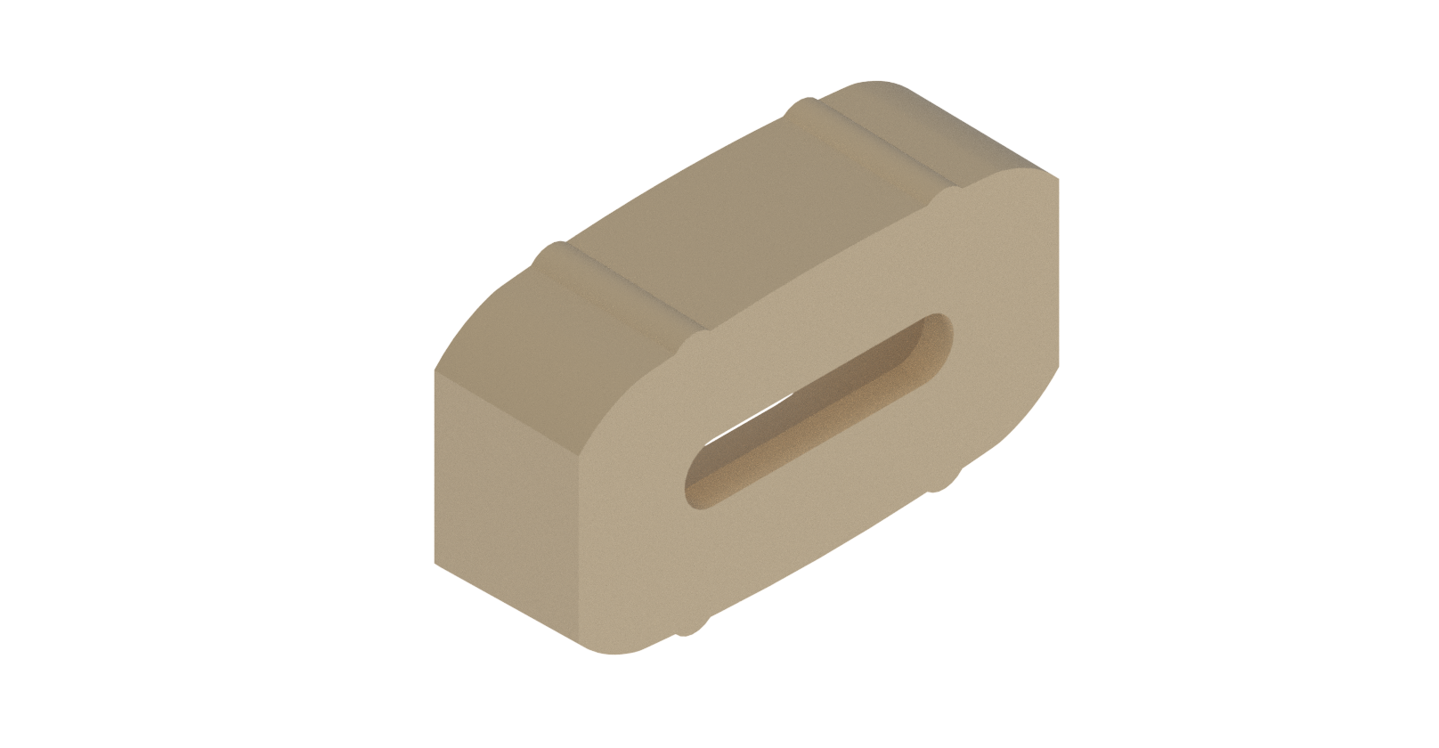
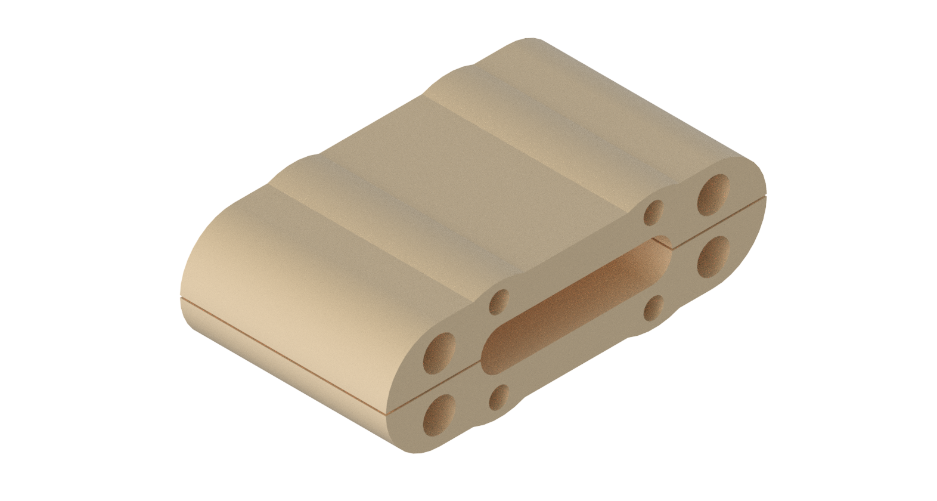
Evaluation of thermal heat loads to the anti-cryostat concept
Pessimist case: Anti-cryostat 300 K emissivity = 0.3
SWLS 20 K Vacuum Chamber emissivity = 0.3
Total heat leaving the anti-cryostat chamber at 300 K by radiation to the SWLS beam chamber at 20 K
Optimist case: Anti-cryostat 300 K emissivity = 0.3
SWLS 20 K Vacuum Chamber emissivity = 0.1
Heat exchange by conduction with Teflon/Peek anti-cryostat supports structures
Optimist case: 0.25 W on the smaller
0.5 W on the larger
Pessimist case: 1 W on the smaller
1.75 W on the larger
Total heat loads induced by the anti-cryostat on SWLS 20 K Circuit:
Optimist case: 6.1 W
Since there will be no beam heat loads on the magnetic characterization, the heat load of the anti-cryostat is smaller than the worst scenario for the SWLS beam chamber at Sirius (13.4 W, as presented in cryogenic design talk)
Pessimist case: 10.45 W
Power needed to be dissipated by a heater to maintain 300 K and avoid water condensation

Slide 9
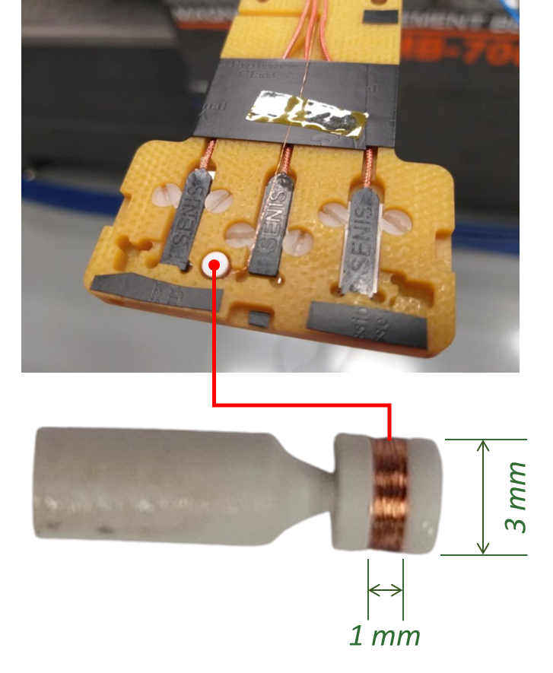
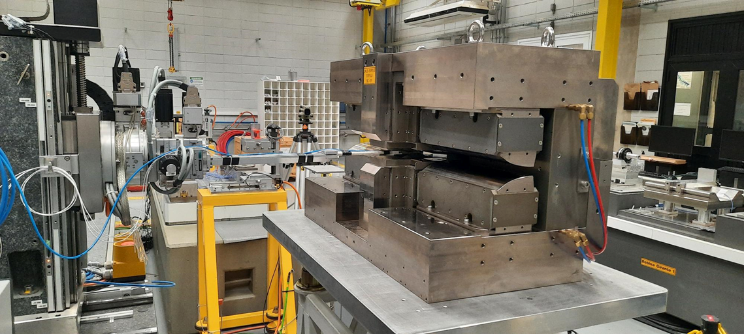
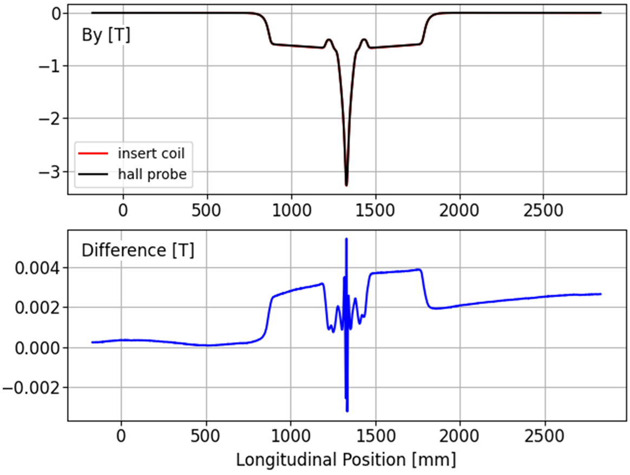
Further developments
Scan coils
A measurement test was conducted using a standard Sirius 3.2 T superbend and calibrated hall probes to compare the magnetic measurement results. A voltage signal was collected as the vertically aligned coil was moved with constant speed along the magnet and a postprocessing filter was applied to remove high frequencies, minimizing integration errors.
3.2 T BC dipole

Slide 10
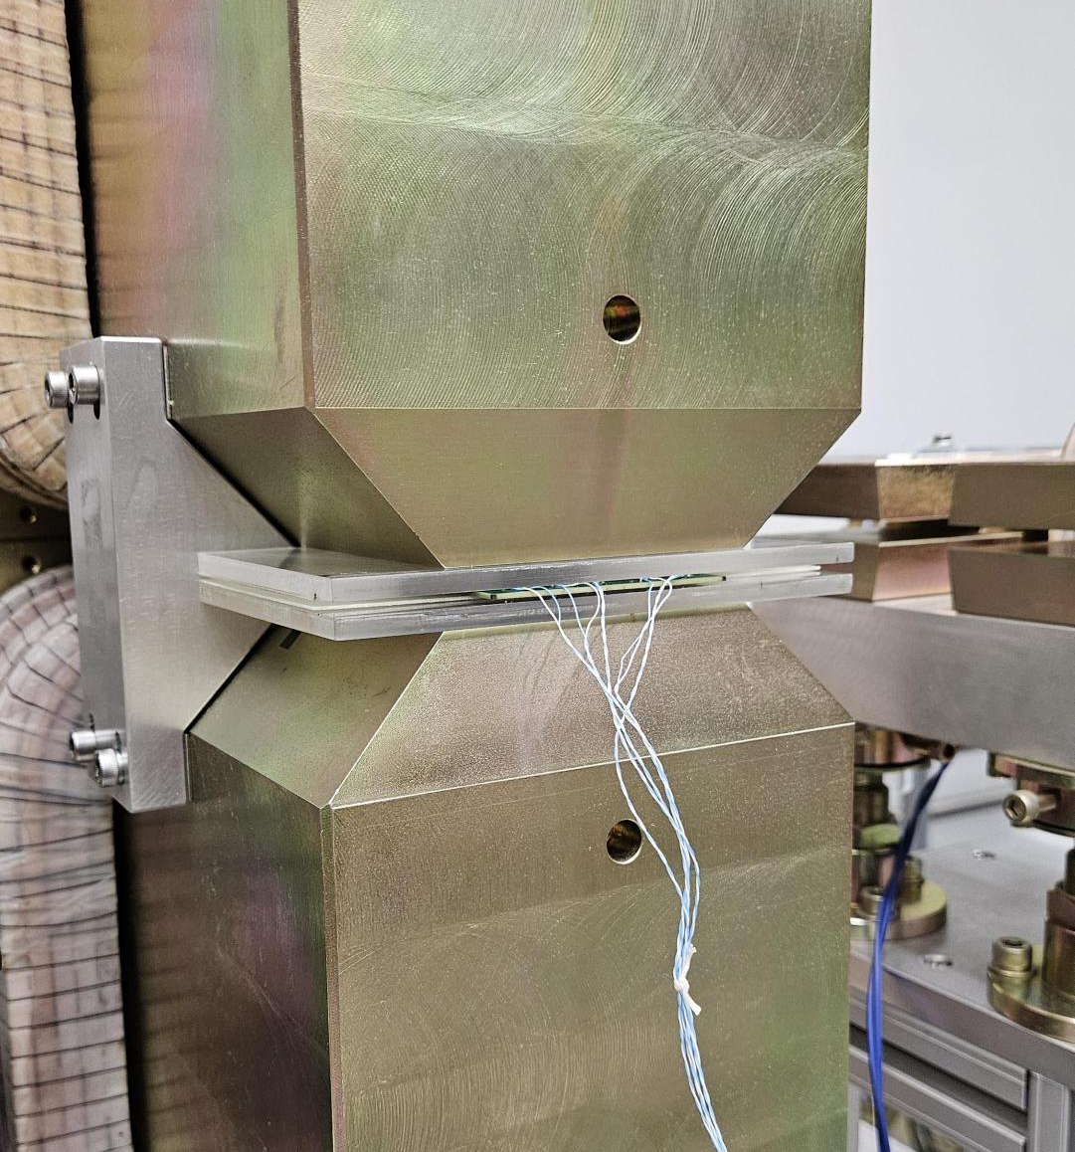
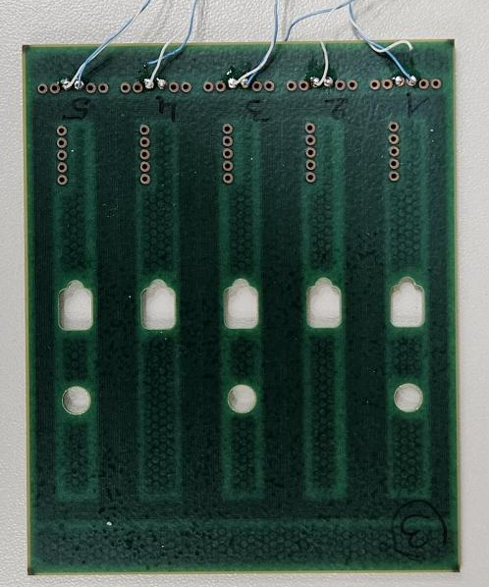
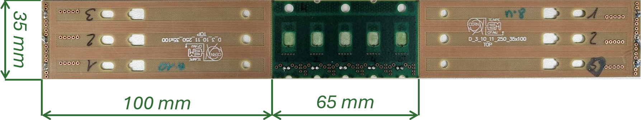
Further approach
In-vacuum PCBs for Hall sensors and flux coils
A further setup, considering measurements in vacuum and cryogenic temperatures, was proposed after discussions with the CERN team, considering the difficulties related to the small beam chamber gap (5 mm) and the low temperatures (approximately 20 K expected inside the chamber).
The setup consists of three printed circuit boards (PCBs) centered on the device field region and not moved during measurements. The central PCB contains 5 Hall probes slots and the other two contain 3 Hall probes slots, all of them contain printed coils.
The Hall probes may be used for local mapping of the magnetic field, while the PCB coils will be used for measuring field integrals in specific regions (each one corresponding to a dipole of the SWLS) during ramp-up/ramp-down, based on the voltage signal induced on each PCB coil.
Recent tests using CERN–manufactured PCBs in a calibration dipole at room temperature have been conducted, and the results are currently under analysis.

Slide 11
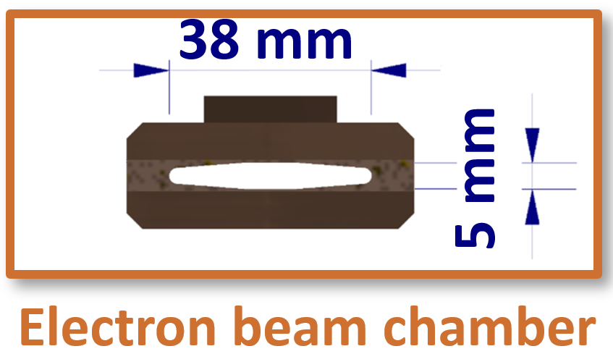
Final Overview
Plan A
Plan B
Anti-chamber for RT* measurements
Measurements inside SWLS vacuum chamber
Hall sensor setup adaptations
New Hall sensor setup and calibration at CT**
Mechanical rod or Hall sensor carriage
New vacuum actuation system
Stretched wire for field integrals measurements
PCB coils for field integrals measurements
* Room Temperature
** Cryogenic Temperature

