Slide 1
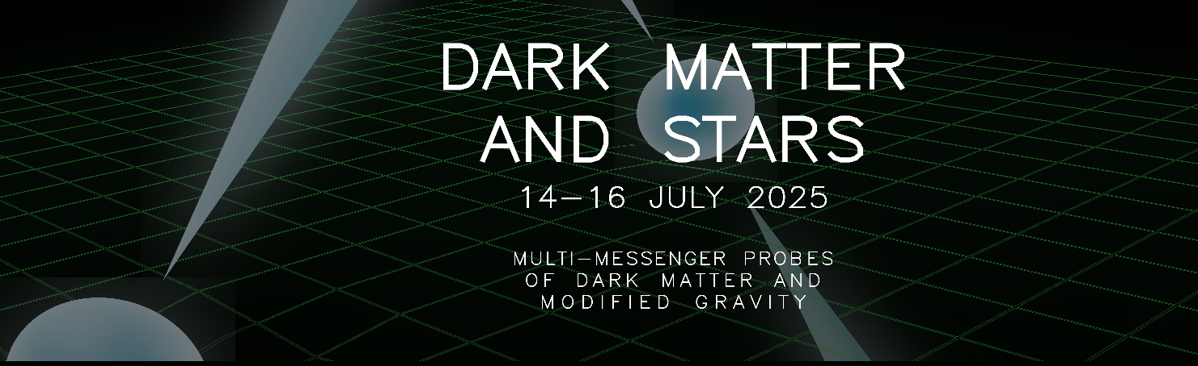



Phenomenology of Dark Matter in Neutron Stars and compact objects
Giorgio Busoni
Dark Matter and Stars, Kingston 14/07/2025

Slide 2
Outline
Why (considerer compact stars)?
What (could we observe/constrain)?
How (does DM interact with the stars)?

Slide 3
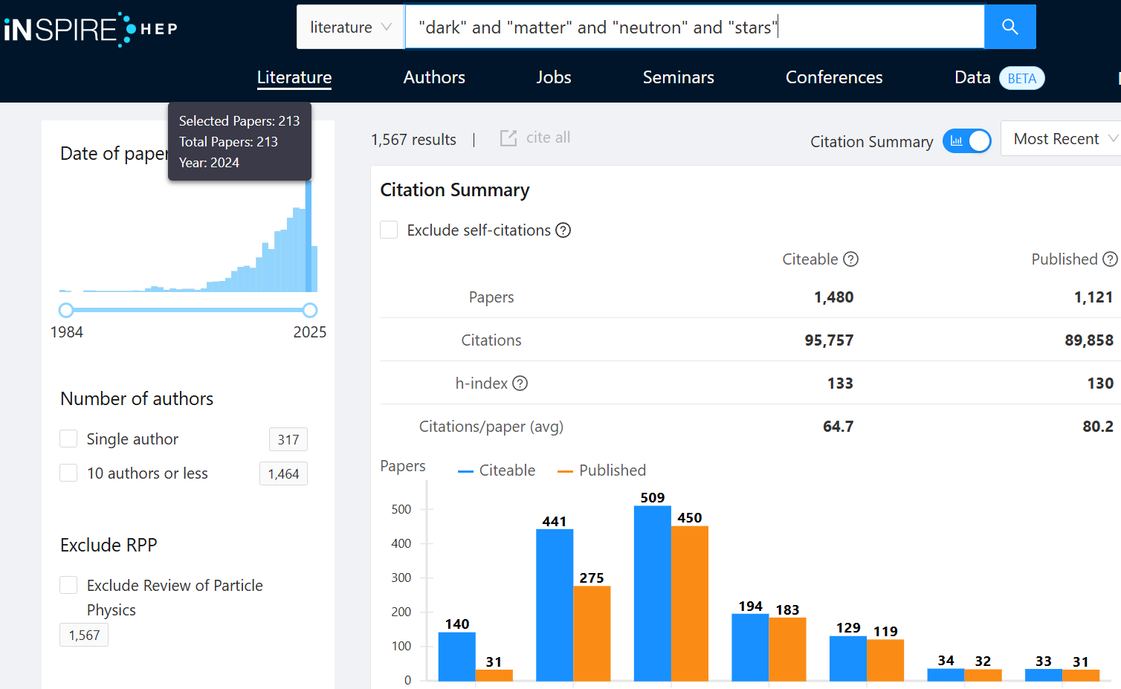
Growing interest

Slide 4



N.Bell
M. Virgato
Neutron Stars:
  JCAP 09 (2018) 018 (1807.02840)
  JCAP 06 (2019) 054 (1904.09803)
  JCAP 09 (2020) 028 (2004.14888)
  JCAP 03 (2021) 086 (2010.13257)
  Phys.Rev.Lett. 127 (2021) 11, 111803 (2012.08918)
  JCAP 11 (2021) 056 (2108.02525)
  JCAP 04 (2024) 006 (2312.11892)
  2505.06506
White Dwarfs:
  JCAP 10 (2021) 083 (2104.14367)
  JCAP 07 (2024) 051 (2404.16272)
Additional credits: T. Motta, A. Thomas, M. Ramirez-Quezada, F. Anzuini, A. Ghosh
S. Robles
See Sandra’s Talk

Slide 5
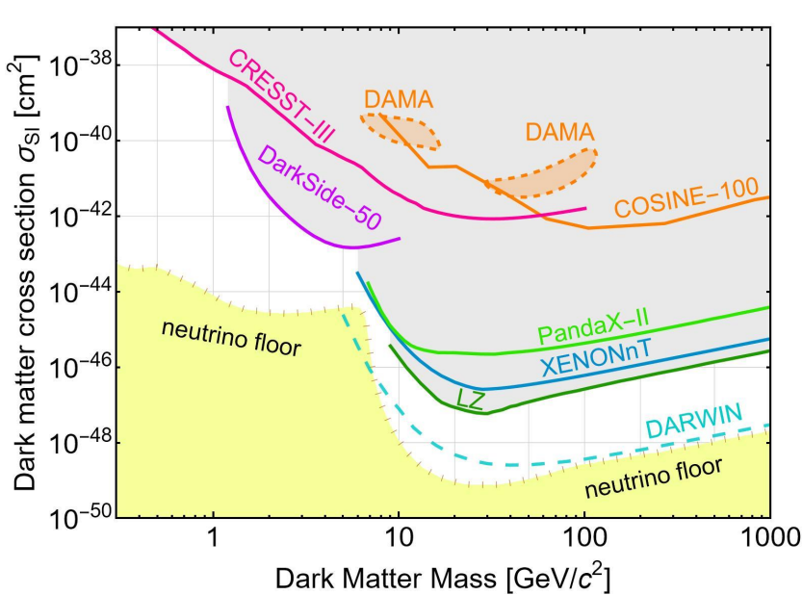

Why (stars)?
Direct Detection sensitivities closing up on the neutrino floor
  Signal $∝$ detector mass $\sim$ 1000Kg
Direct Detection $⟹$ elastic scattering $⇒$ Capture in Stars
  Star mass $\sim$ ${10}^{30}$Kg

Slide 6
Why (compact stars)?
  Neutron Stars
  Very large density
    Competing sensitivities with DD
  Relativistic kinematics
    Wash away non-relativistic suppressions of some DD operators
    Larger reach for inelastic DM
  DM interactions with different kind of matter
    No SD/SI suppression
    Interactions with muons
White Dwarfs
Large density
Degenerate, relativistic electrons
Much more common than NS!

Slide 7

Why (compact stars)?
  Neutron Stars
  Very large density
    Competing sensitivities with DD
  Relativistic kinematics
    Wash away non-relativistic suppressions of some DD operators
    Larger reach for inelastic DM
  DM interactions with different kind of matter
    No SD/SI suppression
    Interactions with muons
Maximal capture achieved for
$$σ\sim \frac{1}{nR}\sim {10}^{−45}{cm}^{2}$$

Slide 8
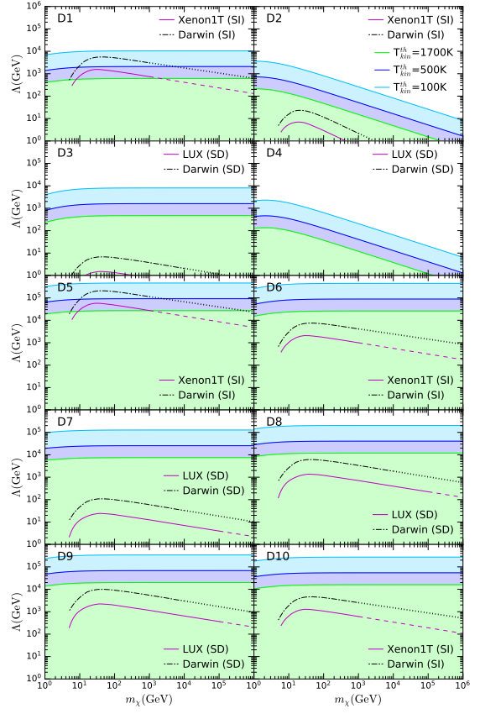
Why (compact stars)?
1807.02840
Similar sensitivities for all operators for NS
Order of magnitude differences for DD
  Neutron Stars
  Very large density
    Competing sensitivities with DD
  Relativistic kinematics
    Wash away non-relativistic suppressions of some DD operators
    Larger reach for inelastic DM
  DM interactions with different kind of matter
    No SD/SI suppression
    Interactions with muons

Slide 9
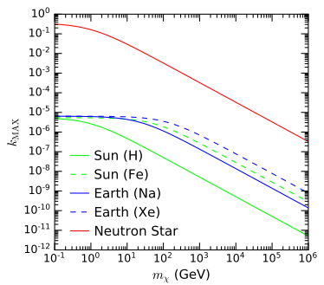

Why (compact stars)?
  Neutron Stars
  Very large density
    Competing sensitivities with DD
  Relativistic kinematics
    Wash away non-relativistic suppressions of some DD operators
    Larger reach for inelastic DM
  DM interactions with different kind of matter
    No SD/SI suppression
    Interactions with muons

Slide 10
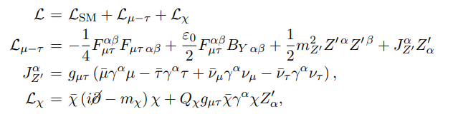

Why (compact stars)?
  Neutron Stars
  Very large density
    Competing sensitivities with DD
  Relativistic kinematics
    Wash away non-relativistic suppressions of some DD operators
    Larger reach for inelastic DM
  DM interactions with different kind of matter
    No SD/SI suppression
    Interactions with muons
Ideal to probe models with DM-muon interactions, like ${U(1)}_{μ−τ}$

Slide 11
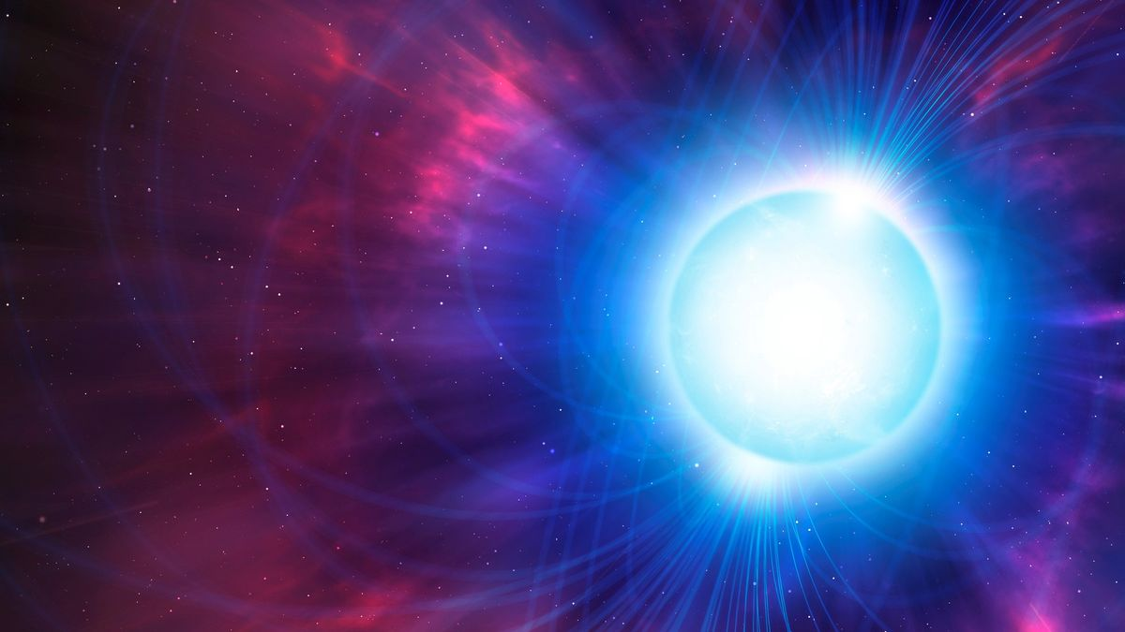
What
(could we observe/constrain)?

Slide 12
What?
Neutron Stars
Collapse to BH/instability
Altering the internal structure/EOS
Heating
White Dwarf
Core collapse/instability
Altering the internal structure
Increased luminosity

Slide 13

What?
Neutron Stars
Collapse to BH/instability
  Triggered by large DM over-density in the center
    Heavy DM at low temperature
    DM forms BEC
Altering the internal structure/EOS
Heating
Star captures
$$N=Ct_{∗}$$
DM particles
Particles thermalise and get confined in region of
$$r_{th}\sim \sqrt{\frac{3T}{4πGρm}}$$
DM density
$$ρ_{χ}\sim \frac{Nm}{r_{th}^{3}}$$

Slide 14
What?
Neutron Stars
Collapse to BH/instability
Altering the internal structure/EOS
Heating
Usually requires a considerable fraction of the star mass to be DM
  Requires a mechanism different from capture
See Steven Harris and Violetta Sagun talks today

Slide 15
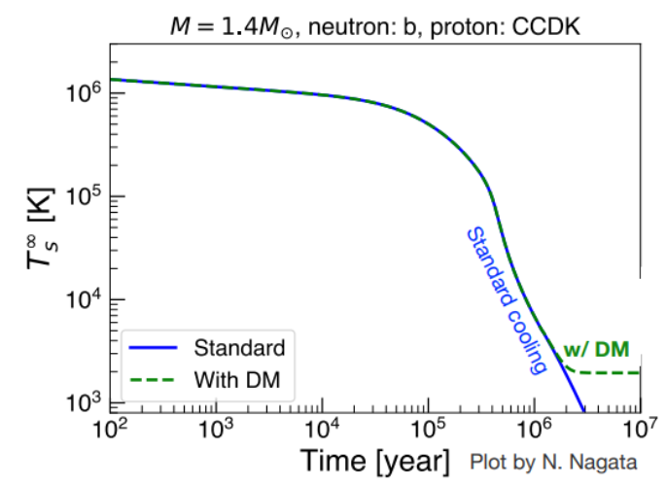

What?
Neutron Stars
Collapse to BH/instability
Altering the internal structure/EOS
Heating
  Energy from gravitational infall $\sim m_{χ}$ (kinetic heating)
  Energy from annihilation $\sim m_{χ}$ (annihilation heating)

Slide 16
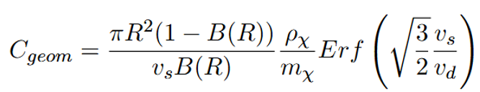

Kinetic and annihilation heating
Maximum Capture rate:
Average energy transfer
$$\left\langle δK\right\rangle \sim m_{χ}$$
Energy balance
$$C_{geom}\left\langle δK\right\rangle = \frac{πR^{2}(1−B(R))}{v_{s}B(R)}\frac{ρ_{χ}}{m_{χ}}m_{χ}=σ_{SB}{\left(T_{eq}^{MAX}\right)}^{4}πR^{2}$$
Kinetic heating: $\left\langle δK\right\rangle \sim m_{χ}$, $T_{eq}^{MAX}\sim 1800K$
Annihilation heating: an additional $\left\langle δK\right\rangle \sim m_{χ}$, $T_{eq}^{MAX}\sim 2300K$

Slide 17

How?

Slide 18
Dark Matter path in a Neutron Star
Capture
Below evap mass
Likely to evaporate
If can annihilate, reach C/A equilibrium
Above evap mass
Kinetic heating
Will slowly thermalise
Annihilation heating
If self-gravitating, can cause collapse

Slide 19
Dark Matter path in a Neutron Star
Capture
Below evap mass
Likely to evaporate
If can annihilate, reach C/A equilibrium
Above evap mass
Kinetic heating
Will slowly thermalise
Annihilation heating
If self-gravitating, can cause collapse

Slide 20




Capture in the Sun
$$σ$$
Geometric limit
Multiscatter, light
Multiscatter, heavy
$$σ_{tr}$$
Single scatter, light
Single scatter, heavy
$$m_{evap}$$
$$m_{T}$$
$$m_{χ}$$

Slide 21
Capture in the Sun
$$σ$$
Geometric limit
Multiscatter, light
Multiscatter, heavy
Simulation
Simulation
$$σ_{tr}$$
Single scatter, light
Single scatter, heavy
Press & Spergel (1985)
Gould (1987)
Press & Spergel (1985)
Gould (1987)
$$m_{evap}$$
$$m_{T}$$
$$m_{χ}$$

Slide 22



Capture in NS
$$σ$$
Geometric limit
Multiscatter, heavy
$$σ_{tr}$$
Single scatter, light
Single scatter, intermediate
Single scatter, heavy
$$m_{evap}$$
$$m_{χ}$$
$$Max[p_{f},m_{T}]$$
$$m^{∗}\sim \frac{Max[p_{f},m_{T}] }{v_{s}^{2}}$$

Slide 23


Capture probability
  Capture probability (Sun)
  $$P≤\frac{v_{e}^{2}}{u^{2}+v_{e}^{2}}$$
  In NS $v_{e}^{2}≫u^{2}$
  $$P\sim 1$$
  Even if not kinematically matched
DM kinetic energy in halo
$$K^{halo}=\frac{1}{2}mu^{2}\sim {10}^{−6}m$$
DM kinetic energy after infall
$$K^{infall}=m\left(\frac{1}{\sqrt{B}}−1\right)\sim m$$
DM energy lost in first scattering (hadron targets)
$$q_{0}\sim ℴ(μ)\sim \left\{\begin{aligned}1GeV, m_{χ}≳10GeV \\ ℴ(m_{χ}\text{)}, m_{χ}≲1GeV\end{aligned}\right.$$
Capture with single scatter for $K^{halo}<q_{0}$
$$m≲{10}^{6}GeV$$

Slide 24

Capture in NS
$$\sim 2015$$
$$σ$$
Geometric limit
Mostly considering Geometric limit case
  Cross sections for optically thin case very far from DD sensitivities
Optically thin case usually discussed using adaptions of non-relativistic formalism
Multiscatter, heavy
???
$$σ_{tr}$$
Single scatter, light
Single scatter, intermediate
Single scatter, heavy
???
???
???
$$m_{evap}$$
$$m_{χ}$$
$$Max[p_{f},m_{T}]$$
$$m^{∗}\sim \frac{Max[p_{f},m_{T}] }{v_{s}^{2}}$$

Slide 25
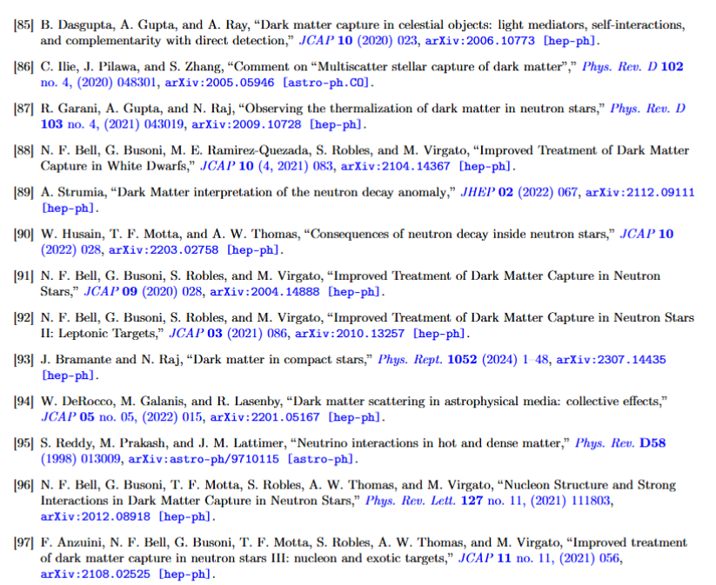
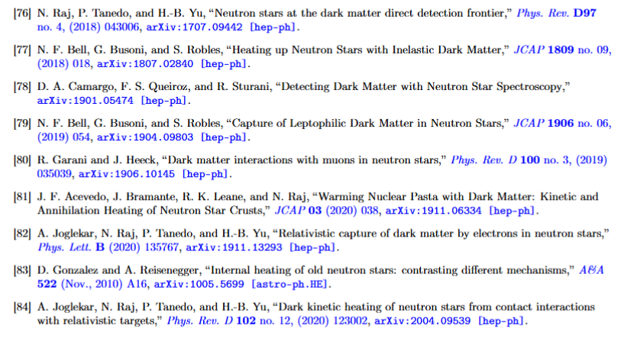

Capture in NS
Non-comprehensive list

Slide 26

Capture in NS
$$\sim 2025$$
$$σ$$
Geometric limit
  JCAP 09 (2020) 028 (2004.14888)
  JCAP 03 (2021) 086 (2010.13257)
  Phys.Rev.Lett. 127 (2021) 11, 111803 (2012.08918)
  JCAP 11 (2021) 056 (2108.02525)
Multiscatter, heavy
$$σ_{tr}$$
Single scatter, light
Single scatter, intermediate
Single scatter, heavy
$$m_{evap}$$
$$m_{χ}$$
$$Max[p_{f},m_{T}]$$
$$m^{∗}\sim \frac{Max[p_{f},m_{T}] }{v_{s}^{2}}$$

Slide 27
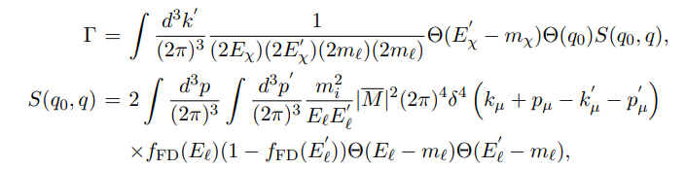
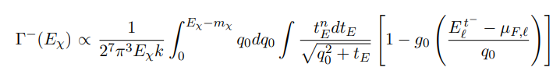
Interaction rates in degenerate matter
Derived in full generality in the relativistic regime
  JCAP 03 (2021) 086 (2010.13257)

Slide 28
Interaction rates in degenerate matter
Derived in full generality in the relativistic regime
Thermalisation time
Capture Rate
Interaction Rates
Evaporation Rate/Mass
DM distribution evolution/CA equilibrium

Slide 29
Capture in NS
$$\sim 2025$$
$$σ$$
Geometric limit
Multiscatter, heavy
The boring bit
$$σ_{tr}$$
Single scatter, light
Single scatter, intermediate
Single scatter, heavy
$$m_{evap}$$
$$m_{χ}$$
$$Max[p_{f},m_{T}]$$
$$m^{∗}\sim \frac{Max[p_{f},m_{T}] }{v_{s}^{2}}$$

Slide 30
Capture in NS
$$\sim 2025$$
$$σ$$
Geometric limit
Multiscatter, heavy
$$σ_{tr}$$
Single scatter, light
Single scatter, intermediate
Single scatter, heavy
$$m_{evap}$$
$$m_{χ}$$
$$Max[p_{f},m_{T}]$$
$$m^{∗}\sim \frac{Max[p_{f},m_{T}] }{v_{s}^{2}}$$

Slide 31
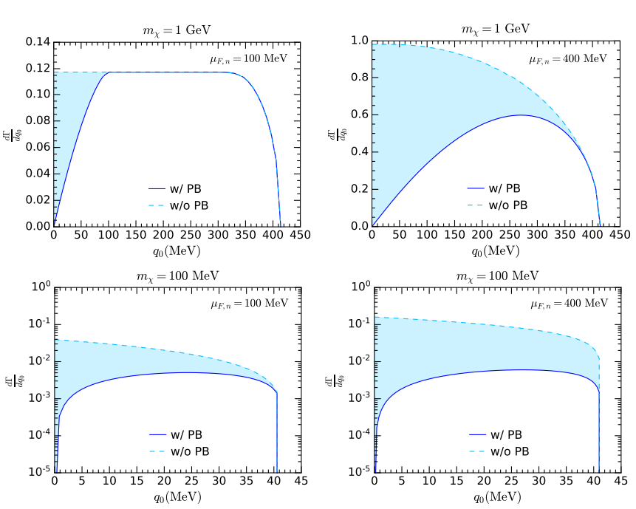

Single Scatter, light: Pauli Blocking
DM needs to transfer enough energy/momentum to scatter degenerate fermions above the Fermi surface
In capture, suppresses the rate by approximate scaling
$$\frac{m_{χ}}{Max[p_{f},m_{T}] }$$

Slide 32
Capture in NS
$$\sim 2025$$
$$σ$$
Geometric limit
Multiscatter, heavy
$$σ_{tr}$$
Single scatter, light
Single scatter, intermediate
Single scatter, heavy
$$m_{evap}$$
$$m_{χ}$$
$$Max[p_{f},m_{T}]$$
$$m^{∗}\sim \frac{Max[p_{f},m_{T}] }{v_{s}^{2}}$$

Slide 33
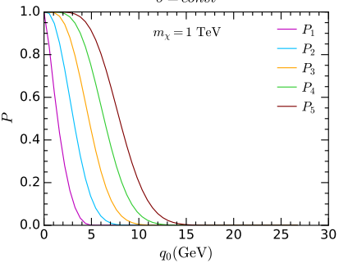

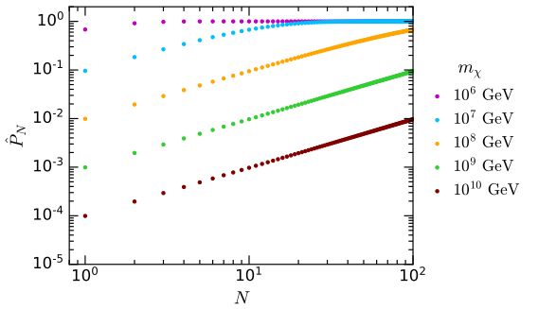

Single Scatter, heavy: energy loss
Interaction rates gives average energy loss
Energy loss function can be used to compute capture probability $P_{N}$
With
$$m^{∗}\sim ℴ\left({10}^{5−6}GeV\right)\left(hadrons\right)$$
$$m^{∗}\sim ℴ\left({10}^{4−5}GeV\right)(leptons)$$
For large mass, one has $P_{1}\sim \frac{m^{∗}}{m_{χ}}$, and signle scattering the capture rate is suppressed by $P_{1}$

Slide 34
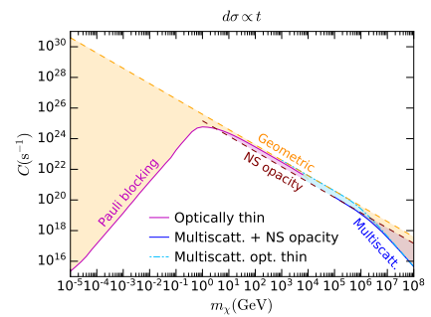
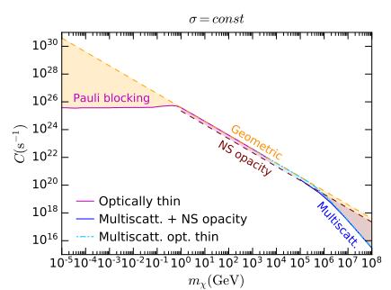

Capture in NS
Intermediate mass region
$$C∝n_{χ}∝\frac{1}{m_{χ}}$$
Low mass region, additional $m_{χ}$ factor:
$$C∝const$$
Large mass region, additional $\frac{1}{m_{χ}}$ factor:
$$C∝\frac{1}{m_{χ}^{2}}$$
Momentum dependent cross sections have additional $m_{χ}$ factors at low mass from kinematics

Slide 35
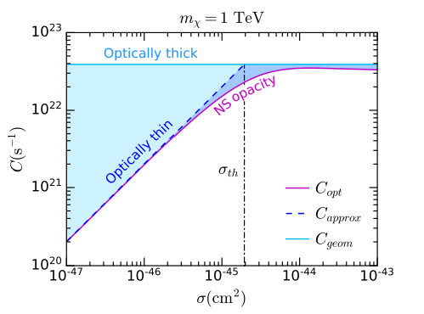

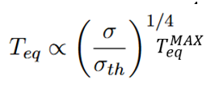

Capture in NS
Threshold cross section defined as
For Dark Kinetic Heating, Equilibrium Temperature scales as
Detect NS with $T<T_{eq}^{MAX}$
Exclude $σ>σ_{tr}>{\left(\frac{T}{T_{eq}^{MAX}}\right)}^{4}σ_{tr}$

Slide 36
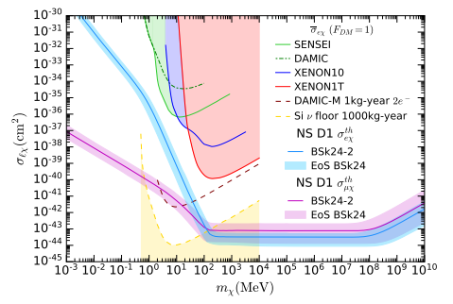
Capture in NS: leptons

Slide 37
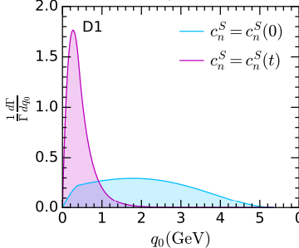
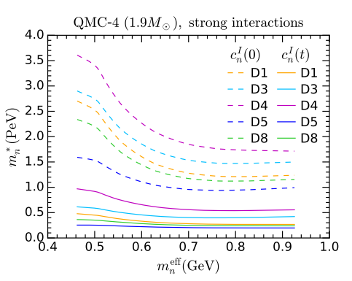

Capture in NS: hadrons
Inclusion of 2 important effects
  Form Factors for Hadrons
  Hadrons self interactions
Target mass (and $m^{∗}$) become position-dependent, as they depend on the target density
  Phys.Rev.Lett. 127 (2021) 11, 111803 (2012.08918)
  JCAP 11 (2021) 056 (2108.02525)

Slide 38
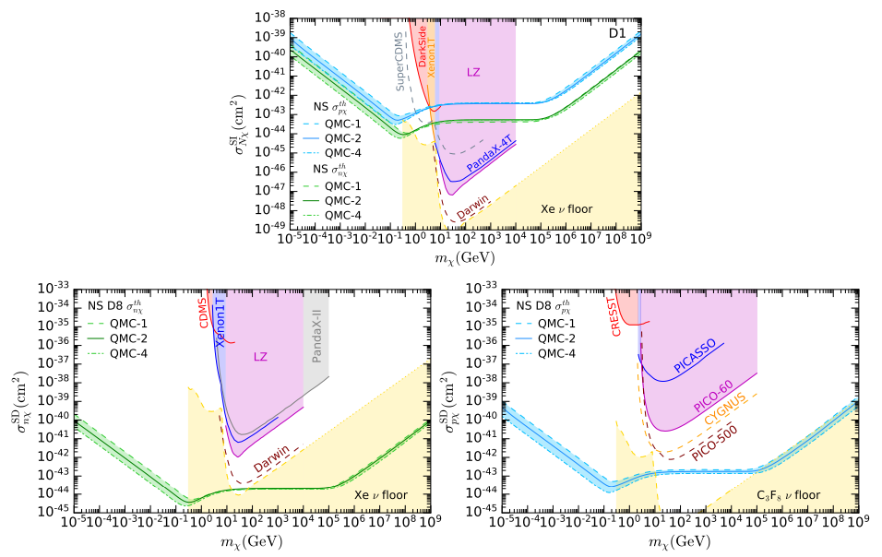
Capture in NS: hadrons

Slide 39
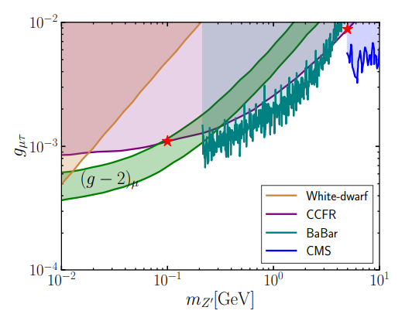
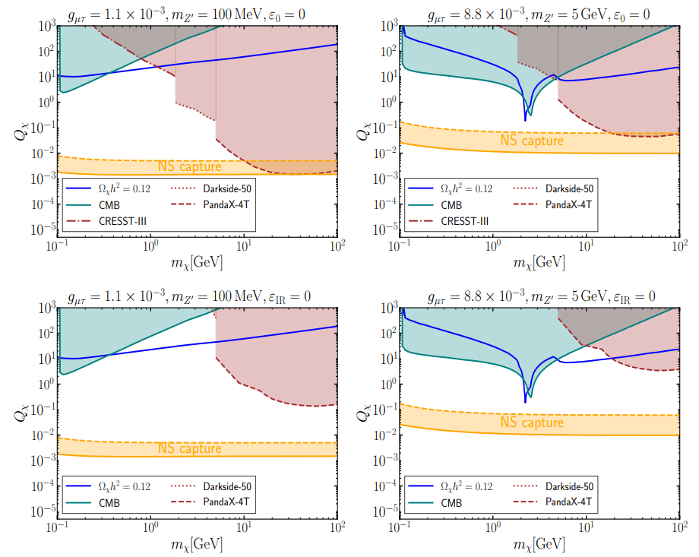

Capture in NS: muons/light mediator
$U{(1)}_{μ−τ}$ model
2505.06506

Slide 40
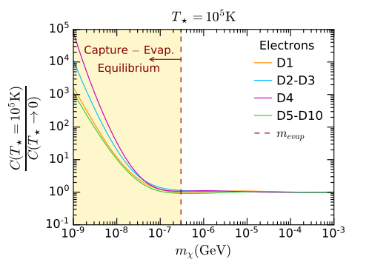

Evaporation mass is NS
Evaporation mass $\sim$ scale at which temperature effects and upscattering become relevant
Estimate:
$$m_{evap}\sim 300eV\frac{T}{{10}^{5}K}$$
Previous estimates (non-relativistic)
$$m_{evap}\sim 20eV\frac{T}{{10}^{5}K}$$

Slide 41
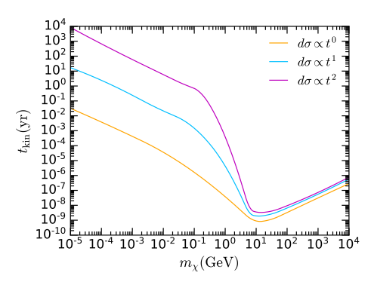

Thermalisation and C/A equilibrium
JCAP 04 (2024) 006
DM energy distribution time evolution:
  Kinetic heating always happens ($t_{kin}≪t_{star}$)
  Annihilation heating always happens ($t_{CA}≪t_{star}$)
  Thermalisation depends on the cross section scaling with $q_{tr}^{2}$

Slide 42
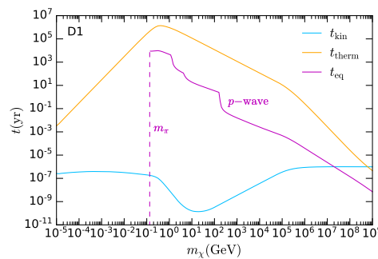
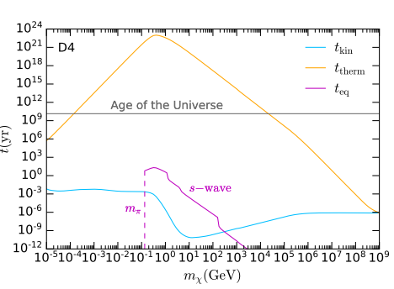

Thermalisation and C/A equilibrium
DM energy distribution evolution:
  Kinetic heating always happens ($t_{kin}≪t_{star}$)
  Annihilation heating always happens ($t_{CA}≪t_{star}$)
  Thermalisation depends on the cross section scaling with $q_{tr}^{2}$

Slide 43
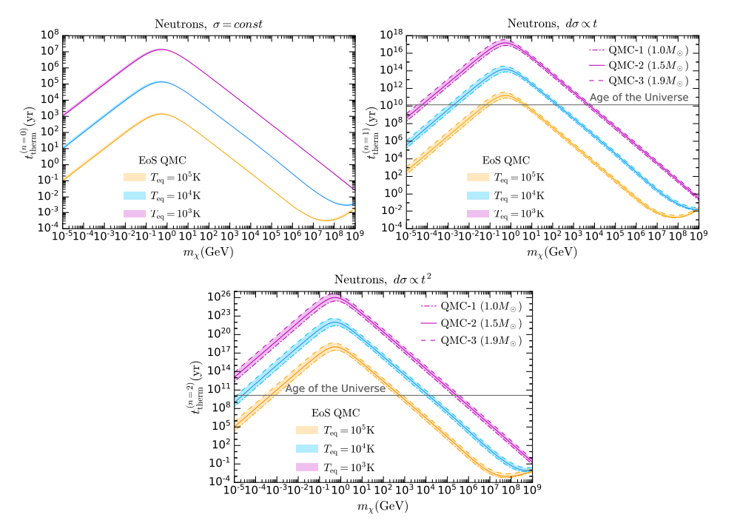

Thermalisation and C/A equilibrium
DM energy distribution evolution:
  Kinetic heating always happens ($t_{kin}≪t_{star}$)
  Annihilation heating always happens ($t_{CA}≪t_{star}$)
  Thermalisation depends on the cross section scaling with $q_{tr}^{2}$

Slide 44

Thermalisation
Pauli-blocked
  Pauli blocking activates in the late stages of the thermalization process
  Only masses above
  $$m_{χ}≳10^8\frac{{10}^{5}K}{T}GeV$$
  Not affected by PB

Slide 45
Conclusions
NS interesting astrophysical laboratory to probe and constraint DM physics
  Wash away non-relativistic suppressions in DD
  No SD suppression
  Sensitivities below neutrino floor for SD
Large interest in the field and huge theoretical progress in the last decade
  Rates for most common scenarios now available

Slide 46

Thanks
Giorgio Busoni
Adelaide University

Slide 47

Backup

Slide 48







MOTIVATIONS (NS)
01
$$\frac{dN}{dt}=C−(EN)−AN^{2}$$
Capture
Threshold Cross section
Thermalisation/
Energy Distribution
Kinetic Heating
$$\dot{E}=C×K^{G}$$
$$T_{eq}^{MAX}\sim 1700K$$
Annihilation Rate
C/A Equilibrium timescale
Annihilation Heating
$$\dot{E}=AN^{2}×K^{A}$$
$$=Cm_{χ}{Tanh}^{2}\left(\frac{t}{t_{C/A}}\right)$$
$$t_{C/A}=\frac{1}{\sqrt{CA}}$$
$$T_{eq}^{MAX}\sim 2300K$$
$$N=\sqrt{\frac{C}{A}}Tanh\left(\frac{t}{t_{C/A}}\right)$$

Slide 49




MOTIVATIONS (NS)
01
DM speed in halo $u\sim 300km/s$
DM in halo, kinetic energy $K\sim \frac{1}{2}m_{χ}u^{2}\sim {10}^{−6}m_{χ}$
DM after gravitational infall, $K^{G}∼m_{χ}\left(\frac{1}{\sqrt{B}}−1\right)\sim ℴ(m_{χ}$)
DM energy loss in recoil $q_{0}\sim ℴ(μ)\sim \left\{\begin{aligned}1GeV, m_{χ}≳10GeV \\ ℴ(m_{χ}\text{)}, m_{χ}≲1GeV\end{aligned}\right.$
If $K<q_{0}$ a single scattering is enough to capture
Requires $m_{χ}≲{10}^{6}GeV$
Energy transferred to the star by Capture $K^{G}∼m_{χ}\left(\frac{1}{\sqrt{B}}−1\right)$
Energy transferred to the star by subsequent annihilation $K^{A}∼m_{χ}$
$$T_{eq}^{MAX}\sim 1800K$$
(Kinetic Heating)
$$T_{eq}^{MAX}\sim 2300K$$
(Kinetic + Annihilation Heating)

Slide 50
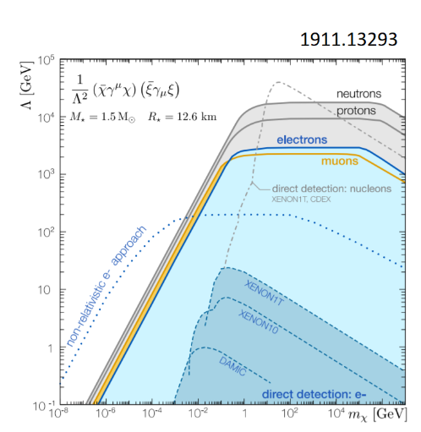
CAPTURE (NS)
02
Need to use/include:
          Schwarzschild metric
          Relativistic kinematics
          Pauli blocking
          Capture probability/average energy transfer (for multiple scattering/heavy DM)
          Hadronic Form Factors
          Target effective mass due to self-interactions
Non-relativistic kinematics vs relativistic kinematics

Slide 51

CAPTURE (NS)
02
Need to use/include:
          Schwarzschild metric
          Relativistic kinematics
          Pauli blocking
          Capture probability/average energy transfer (for multiple scattering/heavy DM)
          Hadronic Form Factors
          Target effective mass due to self-interactions
Lower average energy transfer
Large suppression at large mass
Phys.Rev.Lett. 127 (2021) 11, 111803

Slide 52
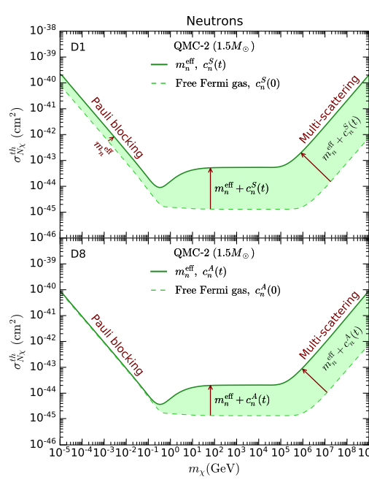
CAPTURE (NS)
02
Need to use/include:
          Schwarzschild metric
          Relativistic kinematics
          Pauli blocking
          Capture probability/average energy transfer (for multiple scattering/heavy DM)
          Hadronic Form Factors
          Target effective mass due to self-interactions

Slide 53
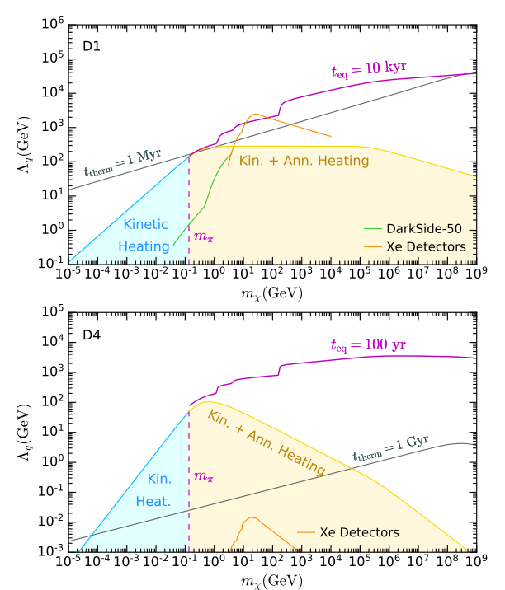
Thermalisation (NS)
03
Ultimate goal: is DM energy released in the star on a timescale smaller than the star lifetime (1Gy)?
  What about annihilation heating?
If DM thermalizes within star lifetime:
  Use DM temperature to compute annihilation rate
  Use Annihilation rate to compute the Capture-Annihilation equilibrium timescale
  Check that it is smaller than star age
If DM DOES NOT thermalize within star lifetime:
  Find DM average energy
  Use average energy to compute annihilation rate
  Use Annihilation rate to compute the Capture-Annihilation equilibrium timescale
  Check that it is smaller than star age
Result: Capture-Annihilation equilibrium is always reached if DM annihilation channels kinematically open

