Slide 1
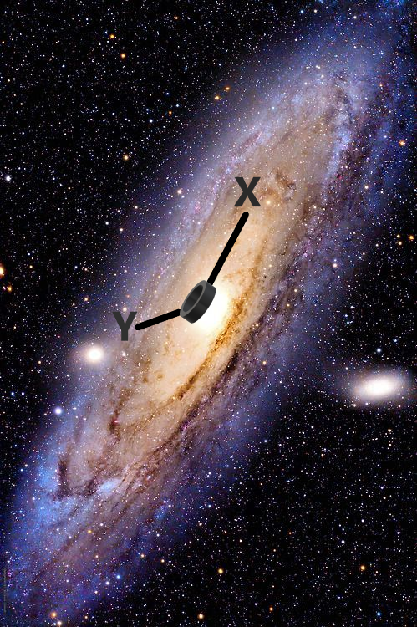
Angular-Velocity Curves A new angle of view
Dark Matter and Stars July 2025

Slide 2
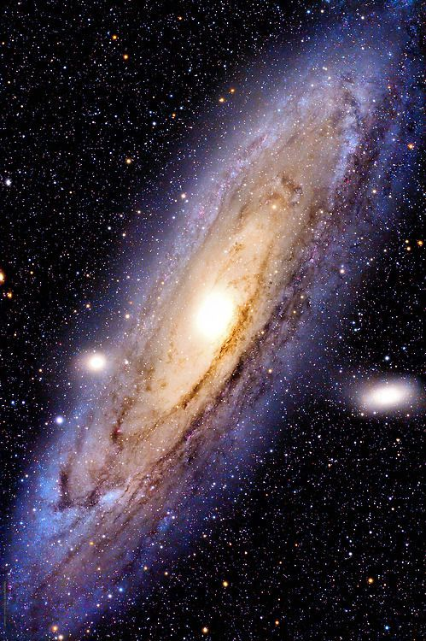
1. Introduction

Slide 3
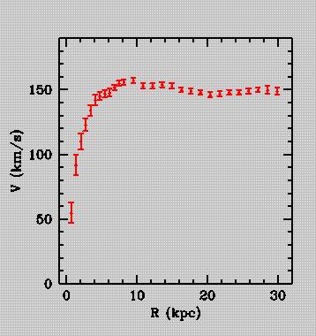
1. Introduction
Rotation Curve of NGC-3198 (Begeman 1989)

Slide 4
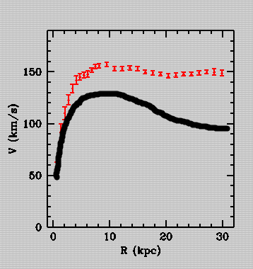
1. Introduction
Predicted Rotation Curve

Slide 5
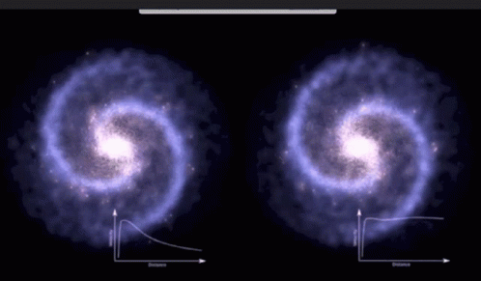
1. Rotation Curves

Slide 6
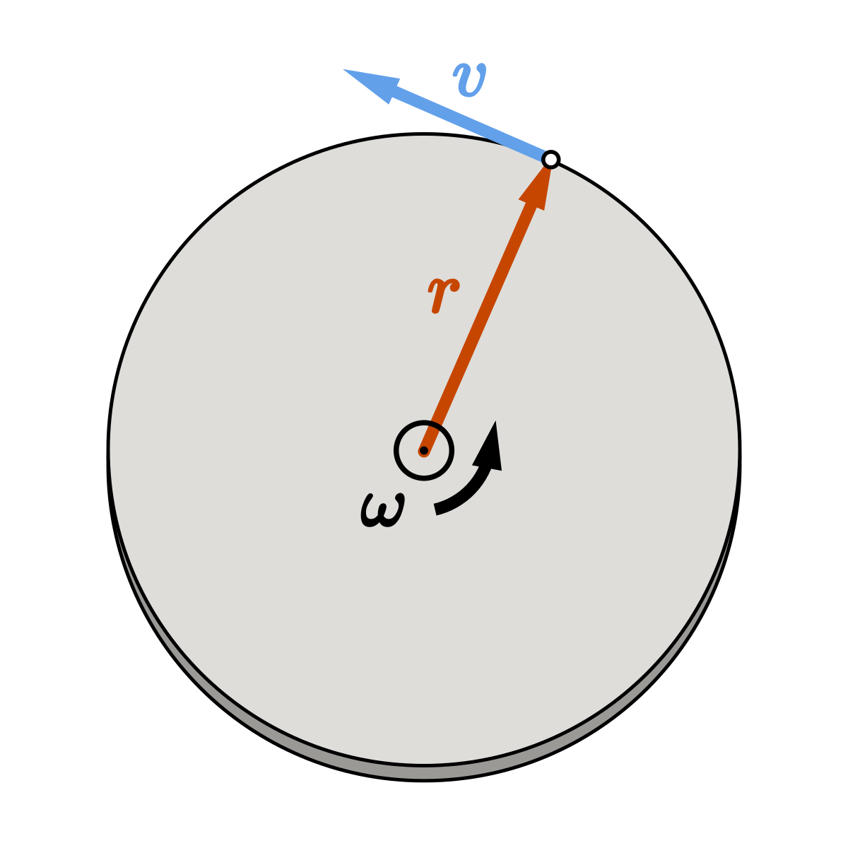

2. Angular-Velocity Curves

Slide 7
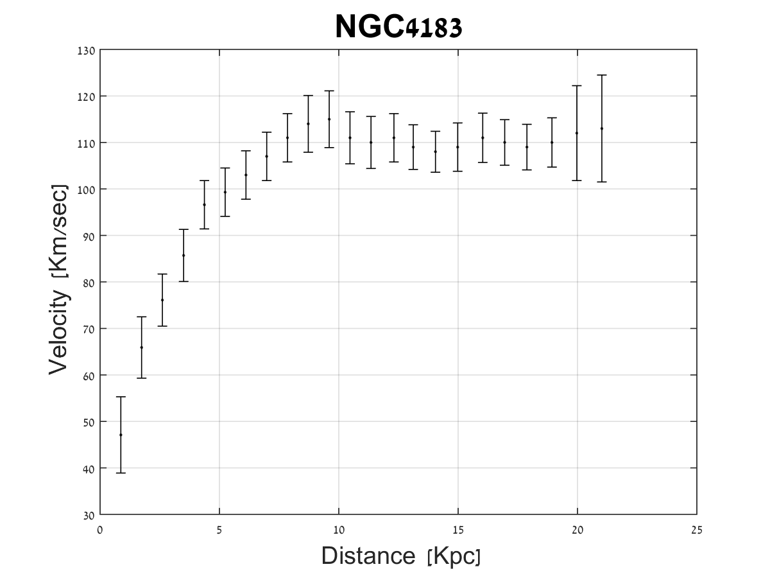
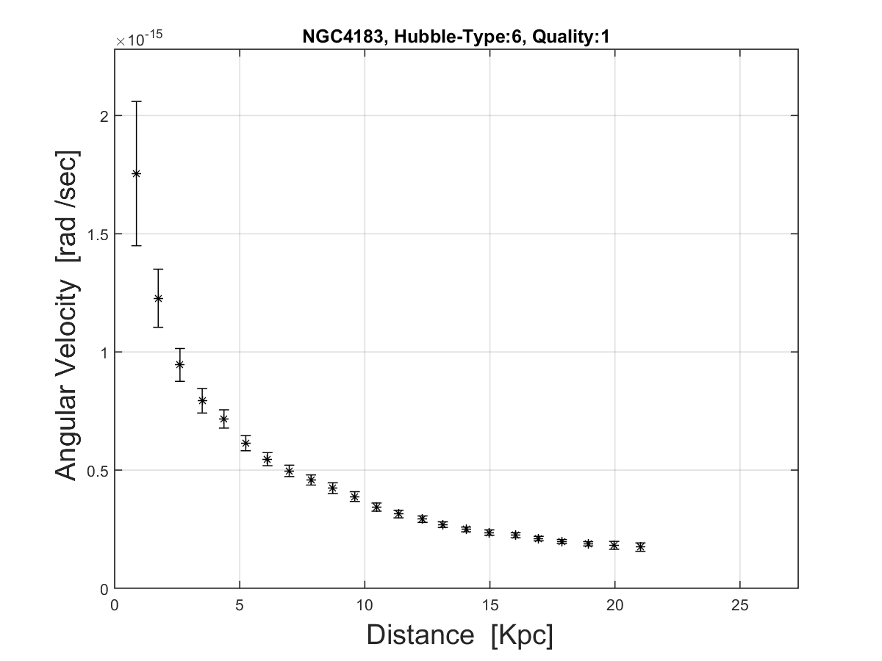
2. Angular-Velocity Curves

Slide 8
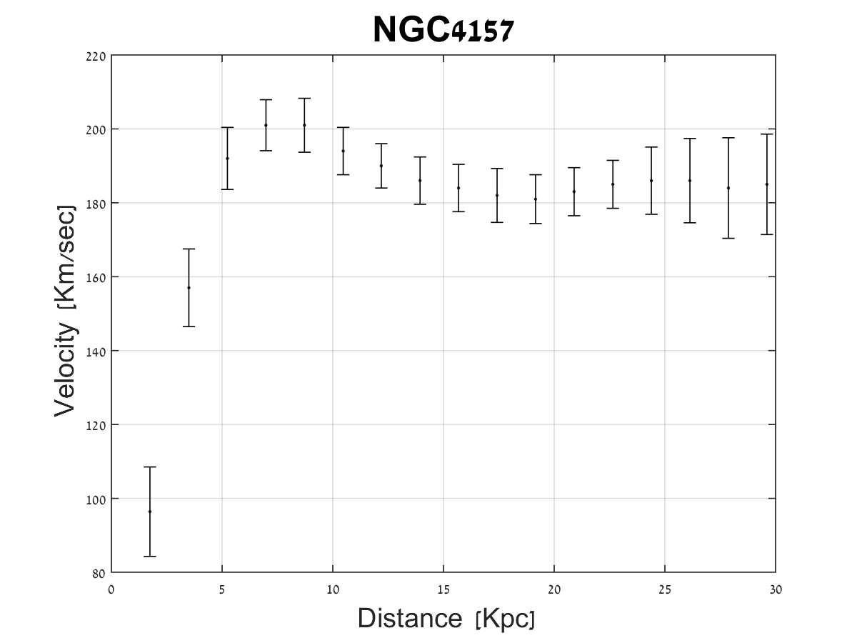
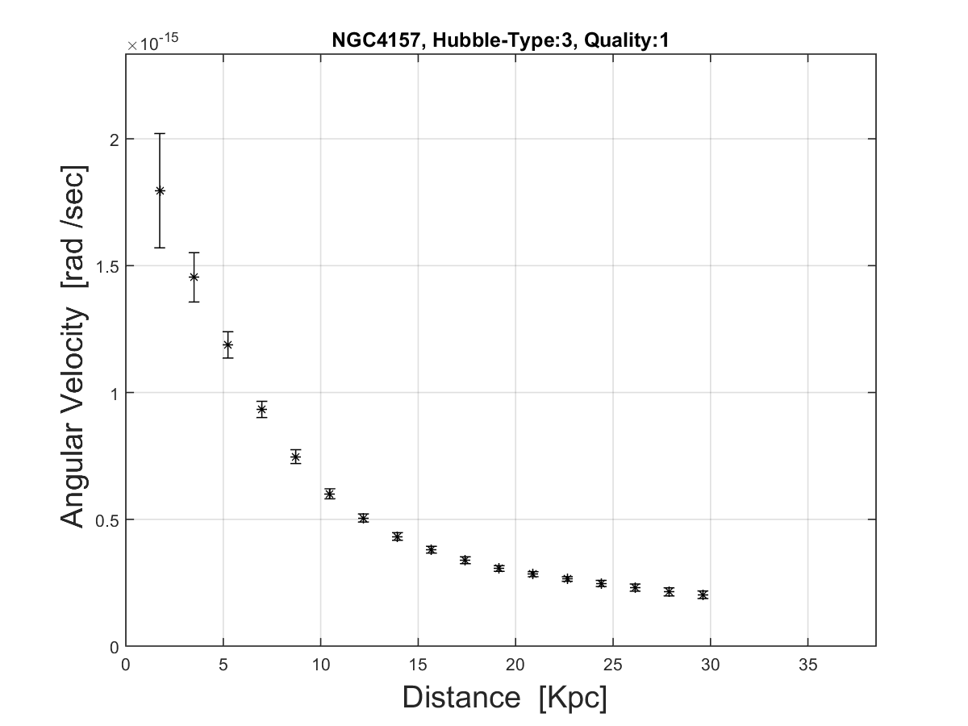
2. Angular-Velocity Curves

Slide 9
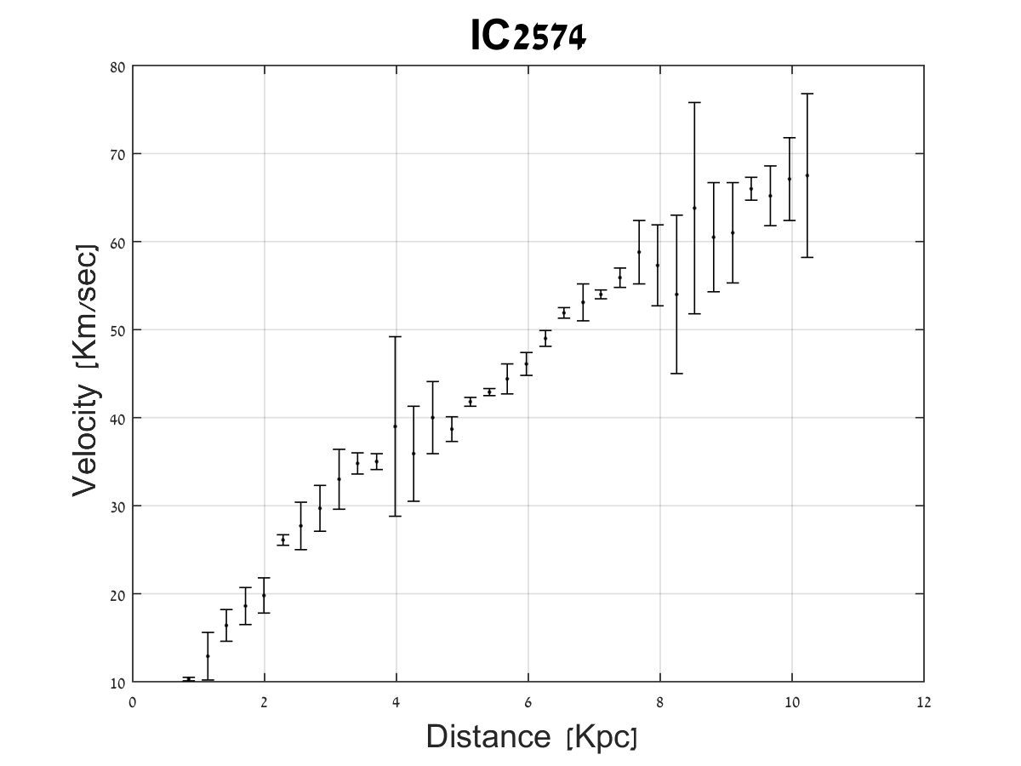
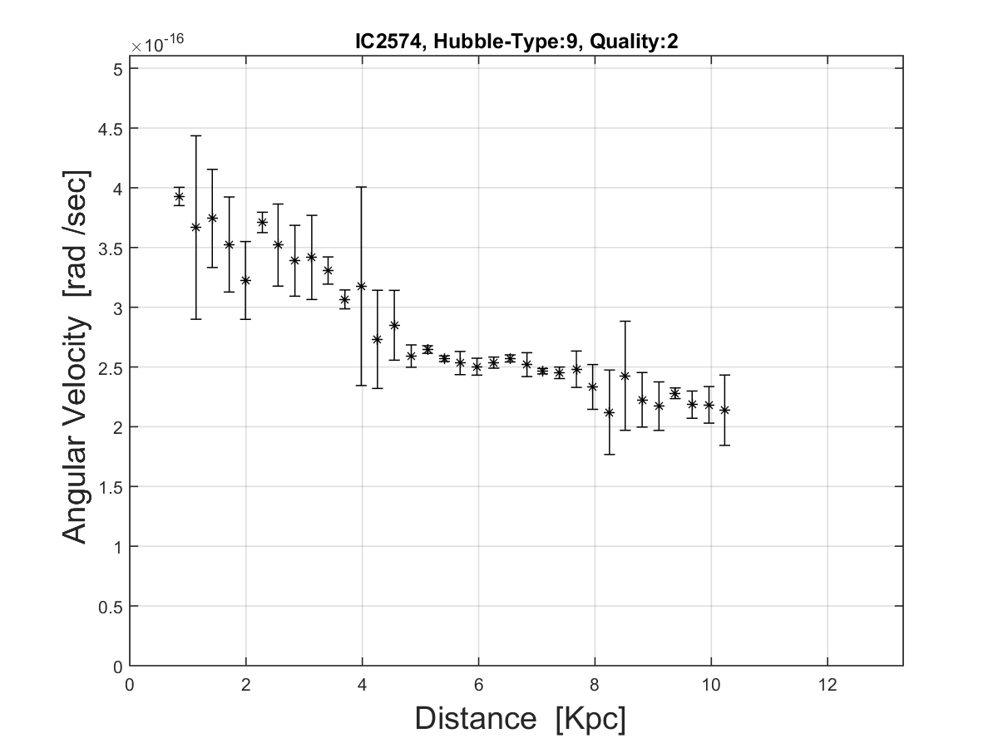
2. Angular-Velocity Curves

Slide 10
2. Angular-Velocity Curves
What about the baryons?

Slide 11
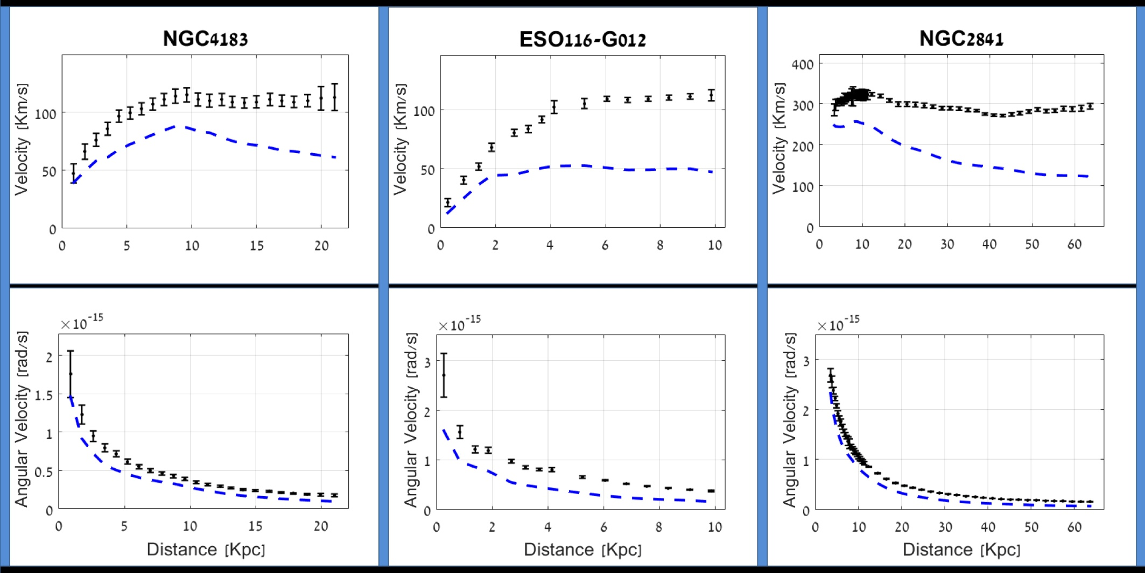
2. Angular-Velocity Curves

Slide 12

2. Angular-Velocity Curves
The statement:

Slide 13
3. Universality
MCMC simulation of ~140 galaxies:
Model
Constant term
Baryonic term (1-parameter: M/L)

Slide 14
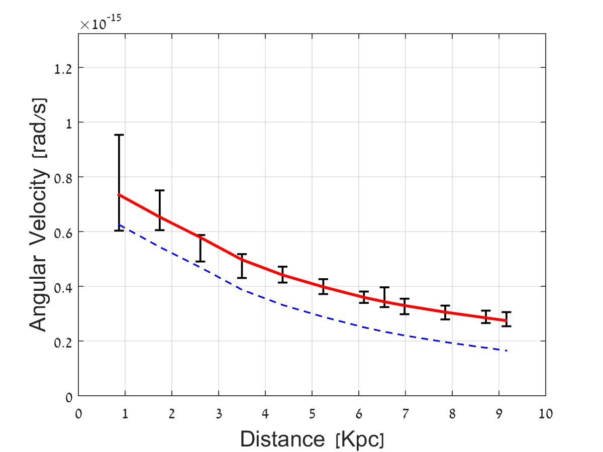
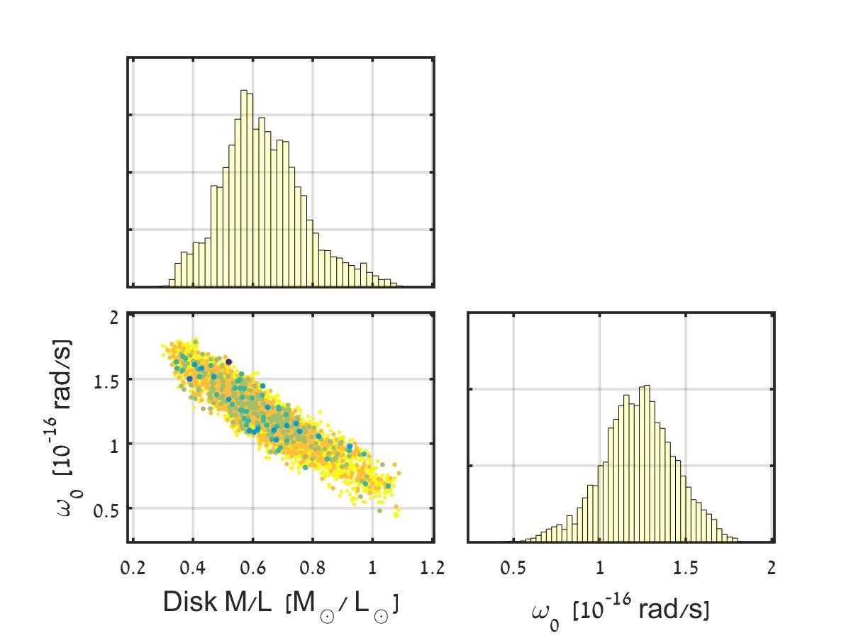
3. Universality
UGC-07089

Slide 15

3. Universality

Slide 16
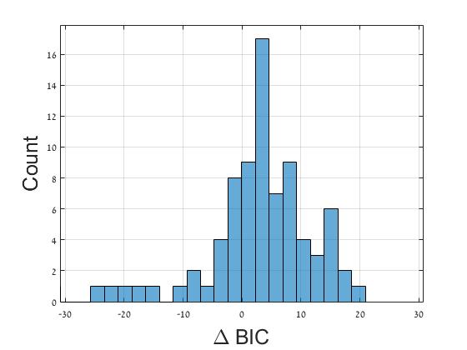
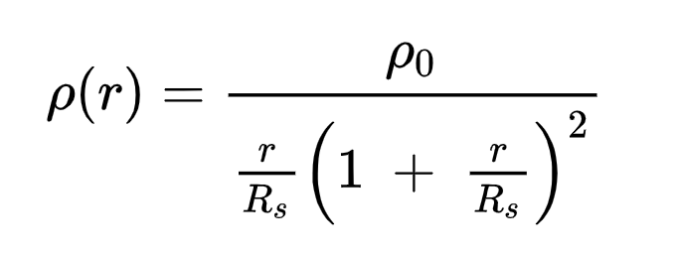
3. Universality
Comparing to NFW
Median = 3.32 ± 0.75
NFW profile:

Slide 17
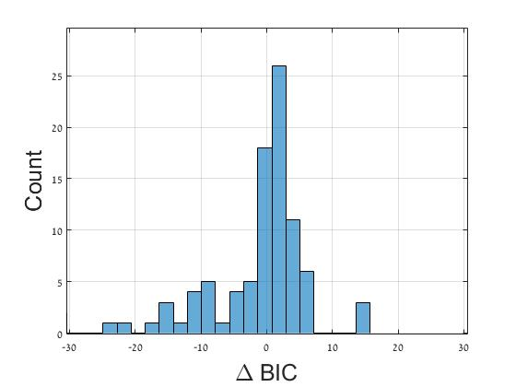
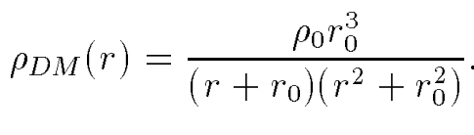
3. Universality
Comparing to Burkert
Median = 0.77 ± 0.36
Burkert profile:

Slide 18
3. Universality
It seems to be a universal (phenomenological) relation

Slide 19
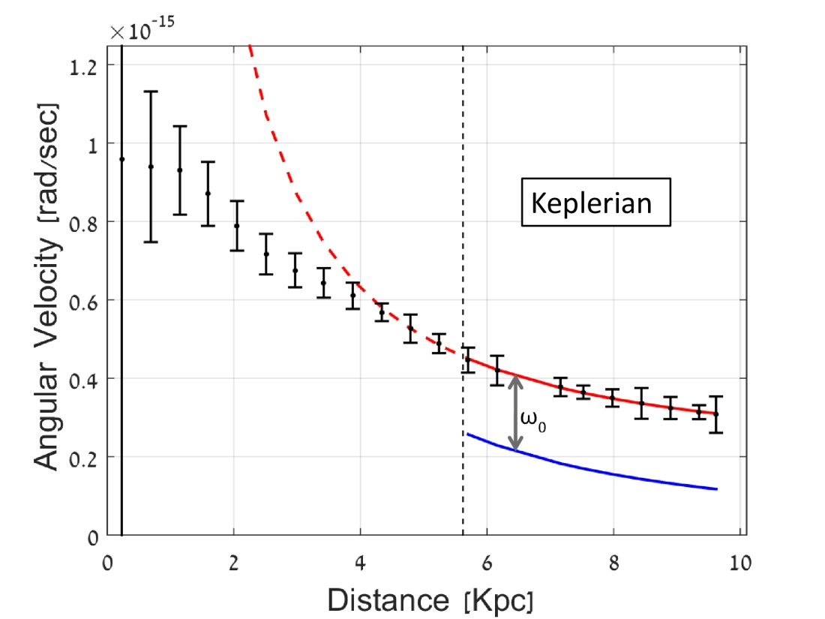



4. Applications: baryonic mass

Slide 20
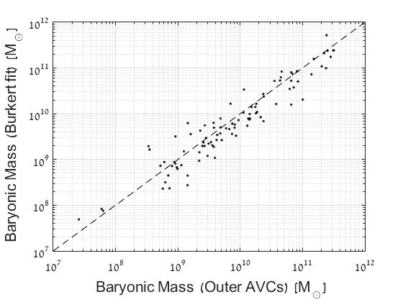
4. Applications: baryonic mass

Slide 21
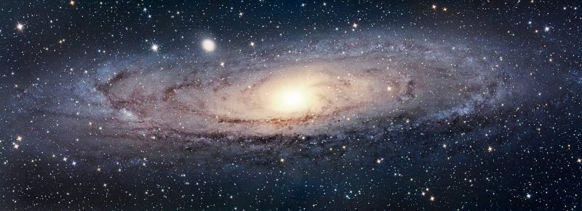




5. Applications: dark-matter halo

Slide 22
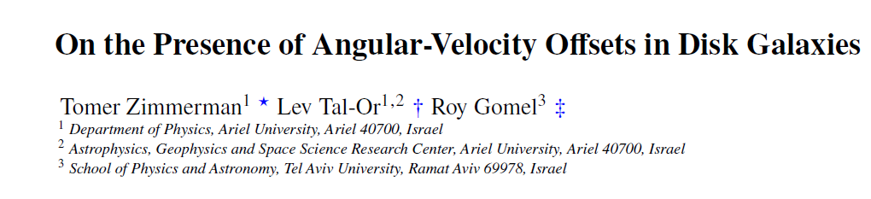
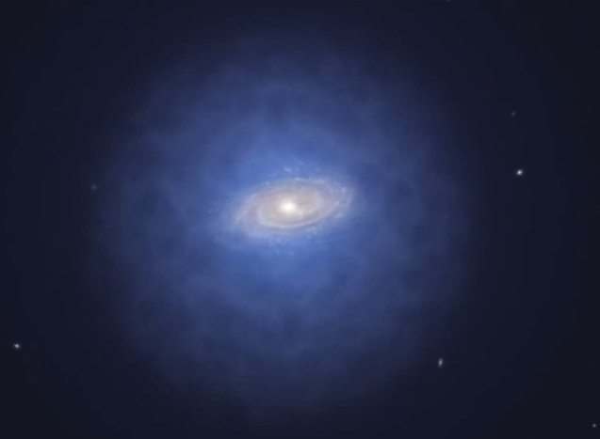
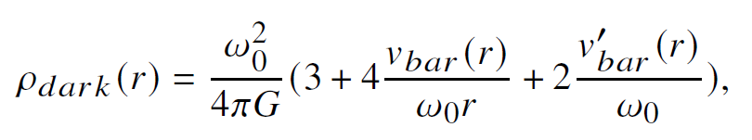
5. Applications: dark-matter halo

Slide 23
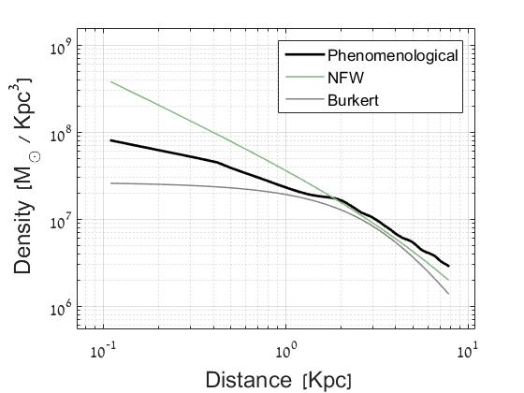
5. Applications: dark-matter halo
NGC-7793

Slide 24
Summary
Rotation curves may be presented as angular-velocity curves
Constant-offsets are found in the data
A new dark-halo profile can be constructed
Thank You!

Slide 25
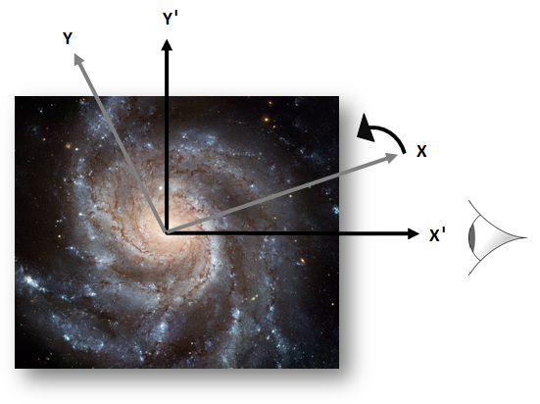
Possible interpretation

