Slide 1
Neutron Stars with
Dark Matter Halos
Shafayat Shawqi¹*, Sharon Morsink¹
ICDMS 2025
July 14, 2025
¹University of Alberta

Slide 2
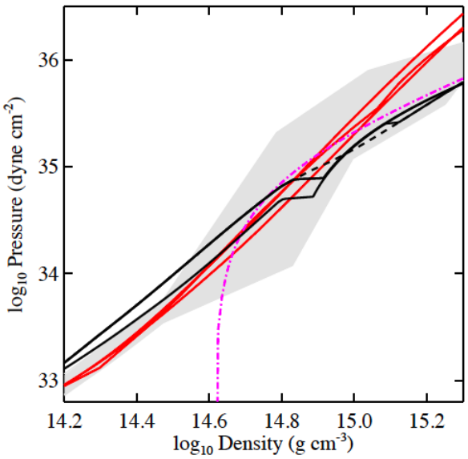
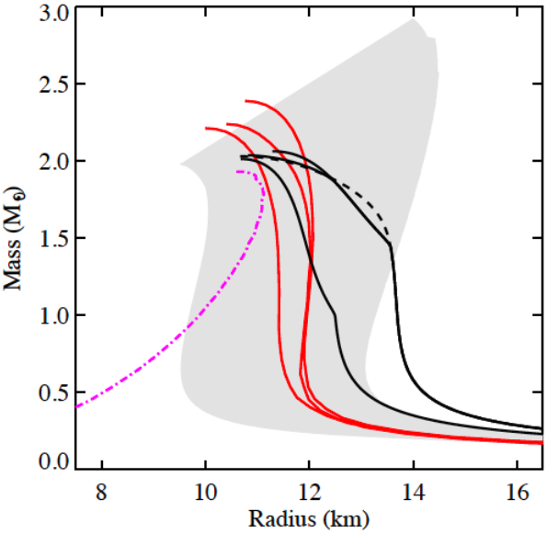
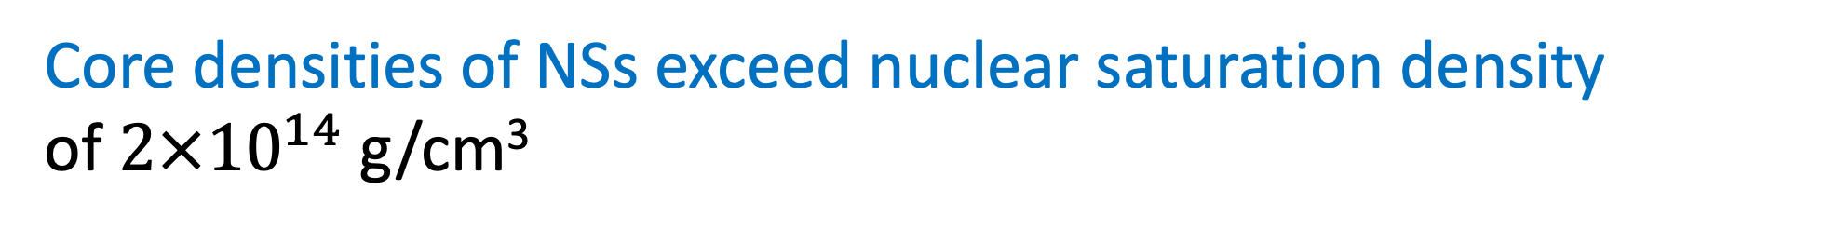
Neutron Stars
Core densities of NSs exceed nuclear saturation density
of $2×{10}^{14}$ g/cm³
Hydrostatic
Equilibrium
in GR
TOV Equations
Watts et al. 2016

Slide 3
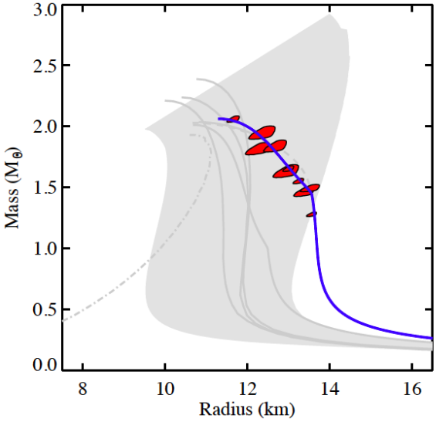
Neutron Stars
Watts et al. 2016

Slide 4
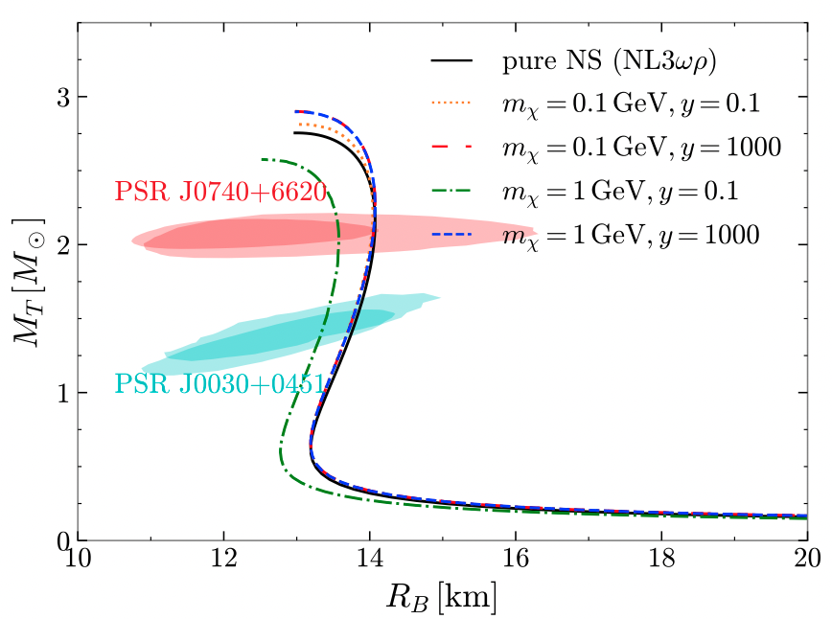
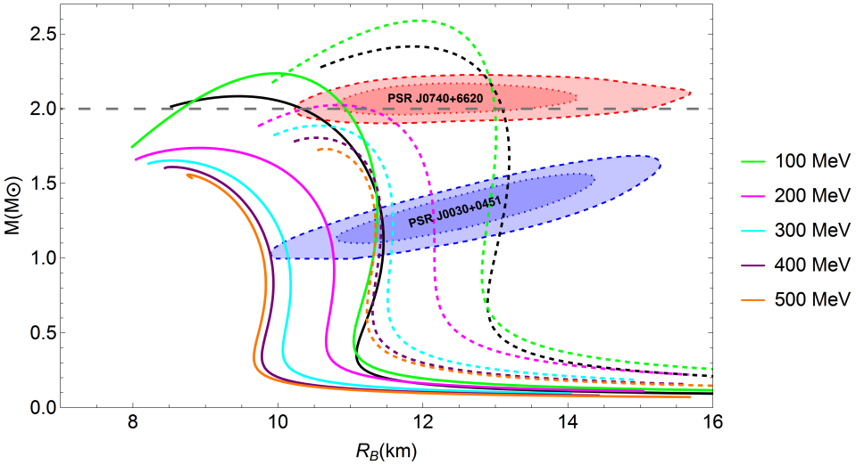
Dark Matter (DM) Admixed Neutron Stars
Miao et al. 2022
Shakeri & Karkevandi 2024
Fermionic DM
Bosonic DM

Slide 5
Dark Matter (DM) Admixed Neutron Stars
NICER Mass and Radius measurements
Miao et al. 2022
Shakeri & Karkevandi 2024
Fermionic DM
Bosonic DM

Slide 6






Dark Core or Halo
$$R_{D}$$
$$R_{D}$$
$$R_{B}$$
$$R_{B}$$
$$R_{D}≤R_{B}$$
$$R_{D}>R_{B}$$
Dark Core
Dark Halo

Slide 7
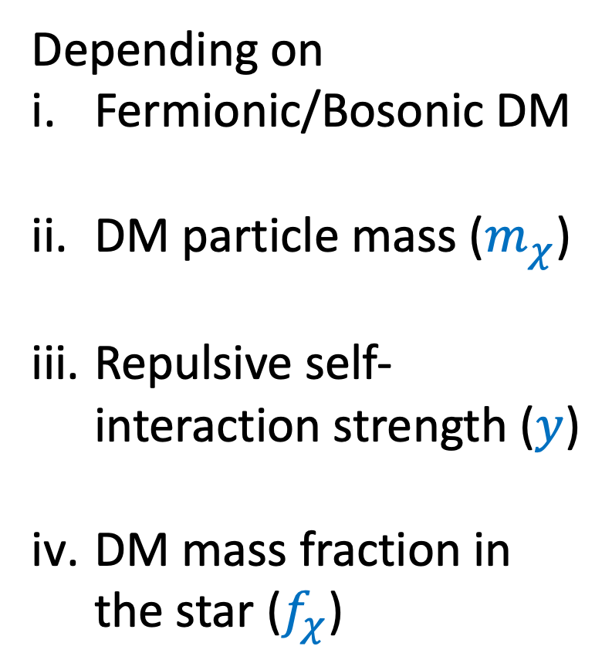




Dark Core or Halo
Depending on
Fermionic/Bosonic DM
DM particle mass ($m_{χ}$)
Repulsive self-interaction strength ($y$)
DM mass fraction in the star ($f_{χ}$)
$$R_{D}$$
$$R_{D}$$
$$R_{B}$$
$$R_{B}$$
Dark Core
Dark Halo

Slide 8
Gravitational Self-Lensing to measure NS Mass and Radius
https://svs.gsfc.nasa.gov/20268/#section_credits
Strong Gravity
Newtonian Gravity

Slide 9





X-ray Observations from NSs with DM
emitted X-rays
$$R_{D}$$
$$R_{D}$$
$$R_{B}$$
$$R_{B}$$
Dark Halo
Dark Cores
extra
light-bending

Slide 10
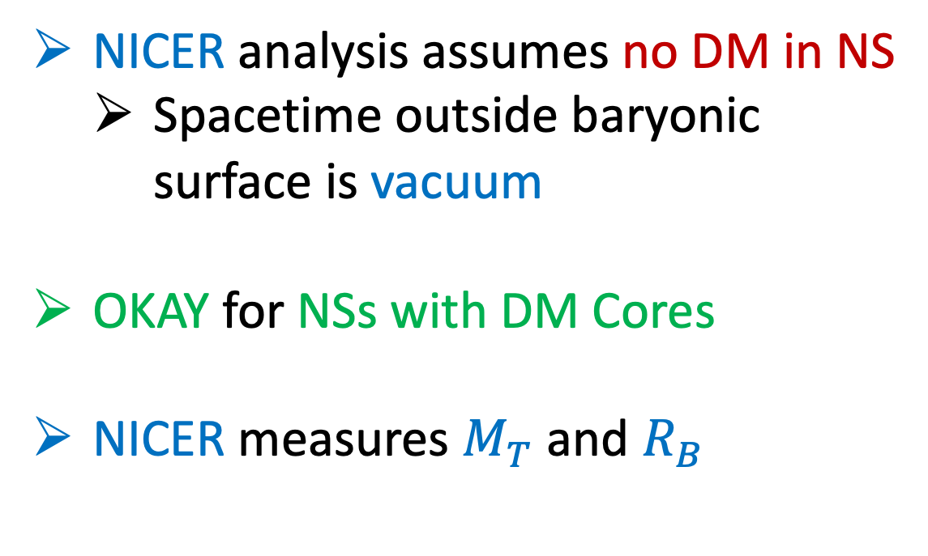
X-ray Observations from NSs with DM Cores
emitted X-rays
NICER analysis assumes no DM in NS
  Spacetime outside baryonic surface is vacuum
OKAY for NSs with DM Cores
NICER measures $M_{T}$ and $R_{B}$
$$M_{T}$$
$$R_{D}$$
$$R_{B}$$
Dark Cores

Slide 11


X-ray Observations from NSs with DM Halos
emitted X-rays
NICER analysis assumes no DM in NS
  Spacetime outside baryonic surface is vacuum
NOT OKAY!! for NSs with DM halos
$$R_{D}$$
$$R_{B}$$
extra
light-bending
Dark Halo

Slide 12


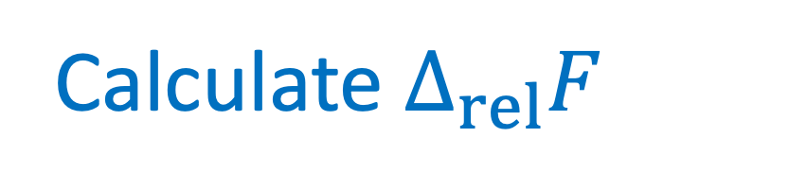
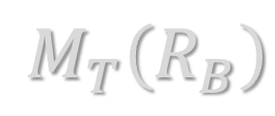


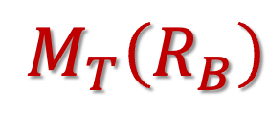

No-Halo Counterpart (Miao et al. 2022)
emitted X-rays
Calculate $Δ_{rel}F$
$${M_{T}=M}_{T}\left(R_{B}\right)+M_{cloud}$$
$$R_{D}$$
$${M_{T}=M}_{T}\left(R_{B}\right)$$
$$R_{B}$$
$$M_{T}\left(R_{B}\right)$$
$$M_{T}\left(R_{B}\right)$$
$$R_{B}$$
$$M_{cloud}$$
Dark Halo
No-Halo counterpart

Slide 13

Flux Deviation: $M_{T}\left(R_{B}\right)=2.00 M_{⊙}$, $f_{χ}=0.05$
Shawqi, S., & Morsink, S. M. 2024, ApJ, 975, 123

Slide 14
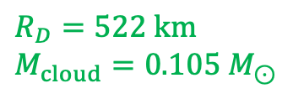
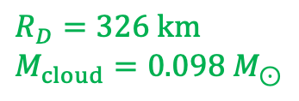
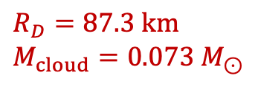
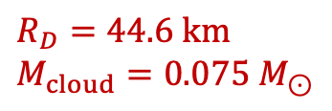
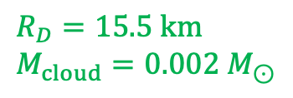
Flux Deviation: $M_{T}\left(R_{B}\right)=2.00 M_{⊙}$, $f_{χ}=0.05$
$$R_{D}=44.6 km \\ M_{cloud}=0.075 M_{⊙}$$
Shawqi, S., & Morsink, S. M. 2024, ApJ, 975, 123
$$R_{D}=87.3 km \\ M_{cloud}=0.073 M_{⊙}$$
$$R_{D}=326 km \\ M_{cloud}=0.098 M_{⊙}$$
$$R_{D}=15.5 km \\ M_{cloud}=0.002 M_{⊙}$$
$$R_{D}=522 km \\ M_{cloud}=0.105 M_{⊙}$$

Slide 15

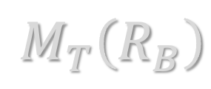
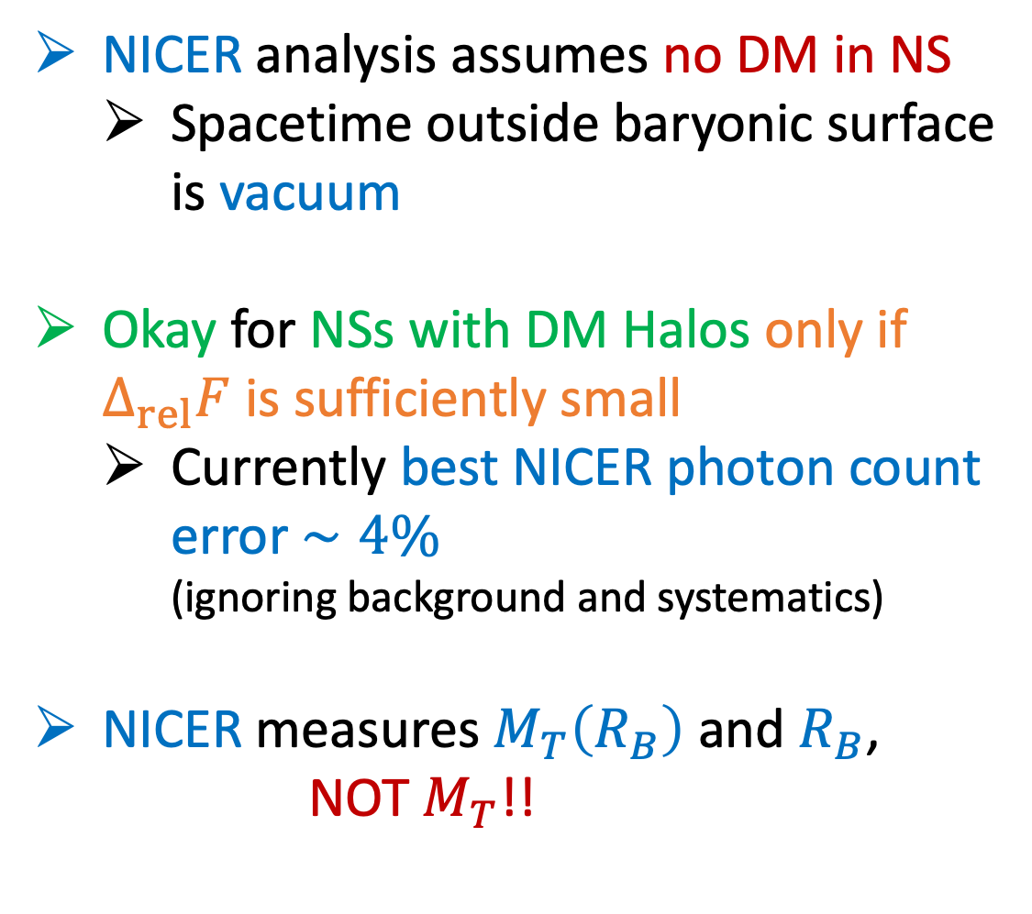


X-ray Observations from NSs with DM Halos
emitted X-rays
NICER analysis assumes no DM in NS
  Spacetime outside baryonic surface is vacuum
Okay for NSs with DM Halos only if $Δ_{rel}F$ is sufficiently small
  Currently best NICER photon count error $∼4\%$
  (ignoring background and systematics)
NICER measures $M_{T}\left(R_{B}\right)$ and $R_{B}$,
NOT $M_{T}$!!
$${M_{T}=M}_{T}\left(R_{B}\right)+M_{cloud}$$
$$R_{D}$$
$$R_{B}$$
$$M_{T}\left(R_{B}\right)$$
extra
light-bending
$$M_{cloud}$$
Dark Halo

Slide 16
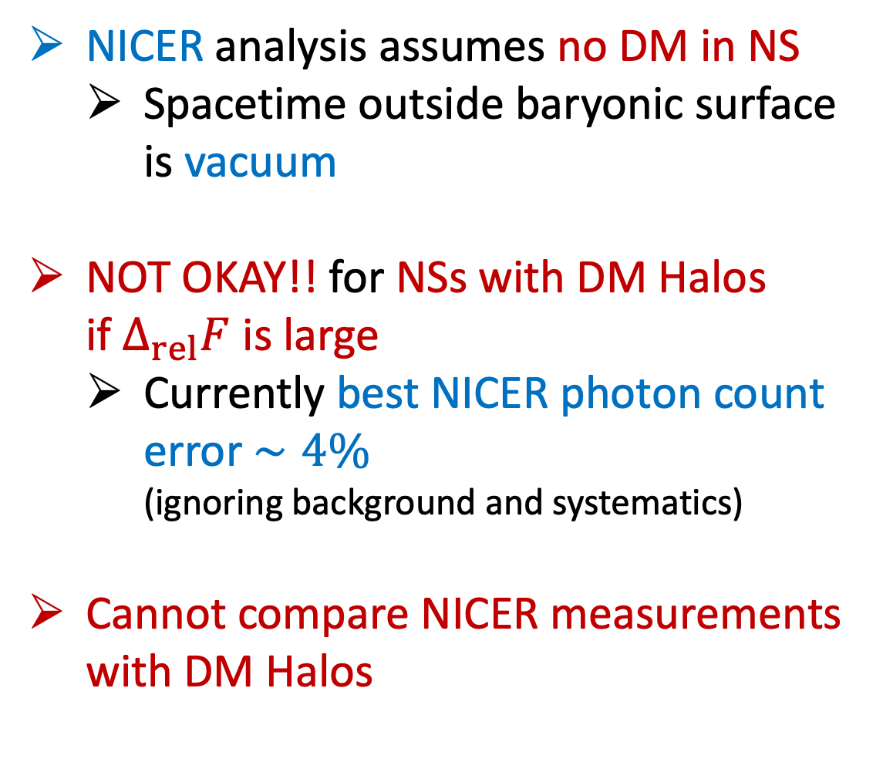

X-ray Observations from NSs with DM Halos
emitted X-rays
NICER analysis assumes no DM in NS
  Spacetime outside baryonic surface is vacuum
NOT OKAY!! for NSs with DM Halos
if $Δ_{rel}F$ is large
  Currently best NICER photon count error $∼4\%$
  (ignoring background and systematics)
Cannot compare NICER measurements with DM Halos
$${M_{T}=M}_{T}\left(R_{B}\right)+M_{cloud}$$
$$R_{D}$$
$$R_{B}$$
$$M_{T}\left(R_{B}\right)$$
extra
light-bending
$$M_{cloud}$$
Dark Halo

Slide 17
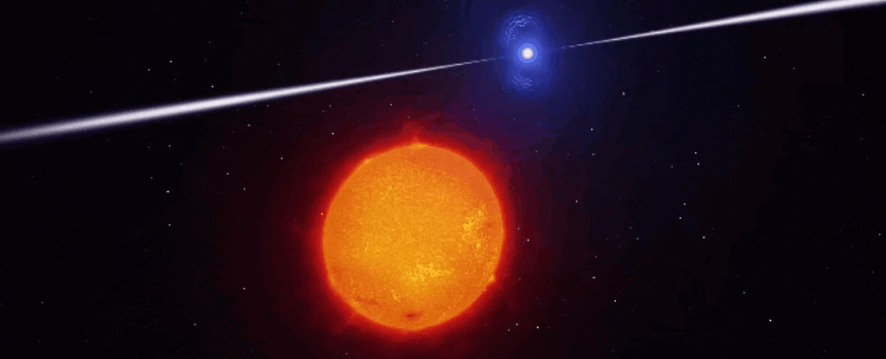
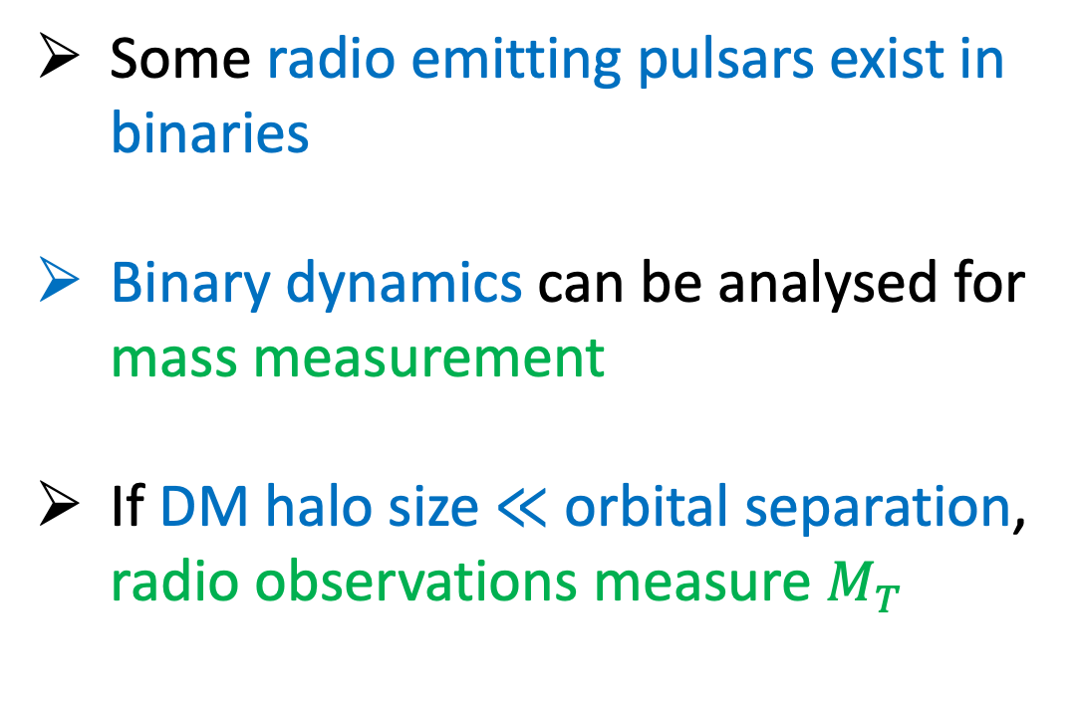
Radio Observations from NSs with DM
Some radio emitting pulsars exist in binaries
Binary dynamics can be analysed for mass measurement
If DM halo size $≪$ orbital separation,
radio observations measure $M_{T}$
ESO/L. Calcada/University of Warwick

Slide 18
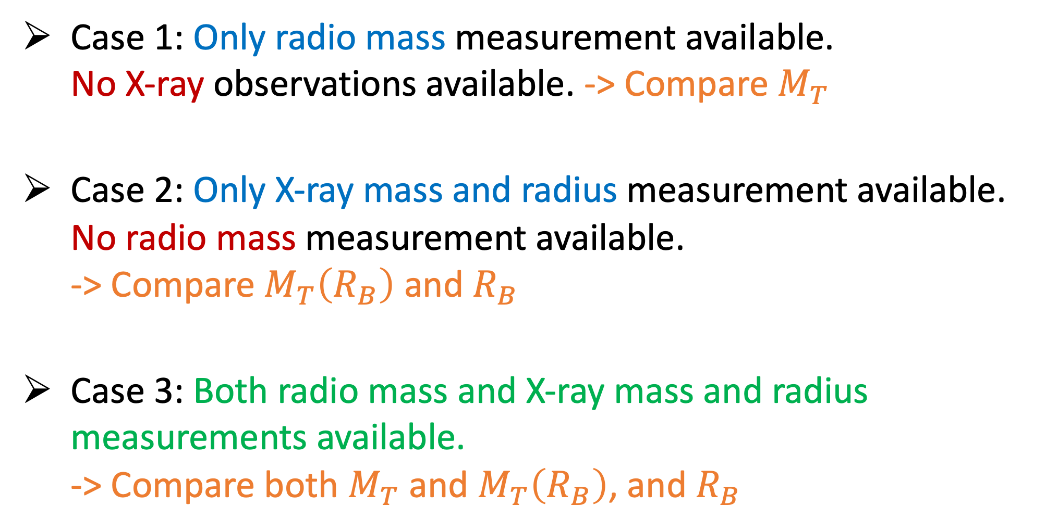
NS Mass-Radius Measurements
Case 1: Only radio mass measurement available.
No X-ray observations available. -> Compare $M_{T}$
Case 2: Only X-ray mass and radius measurement available. No radio mass measurement available.
-> Compare $M_{T}\left(R_{B}\right)$ and $R_{B}$
Case 3: Both radio mass and X-ray mass and radius measurements available.
-> Compare both $M_{T}$ and $M_{T}\left(R_{B}\right)$, and $R_{B}$

Slide 19

Case 1: Only radio mass measurement available.
No X-ray measurement.
$$f_{χ}∈\left[0, 0.2\right]$$
Cannot Constrain
DM Halo Properties
Shawqi & Morsink, 2024

Slide 20

Case 2: No radio mass measurement.
Only X-ray measurement available.
$$f_{χ}∈\left[0, 0.2\right]$$
Can Constrain
DM Halo Properties
Cannot Constrain
DM Halo Properties
Shawqi & Morsink, 2024

Slide 21
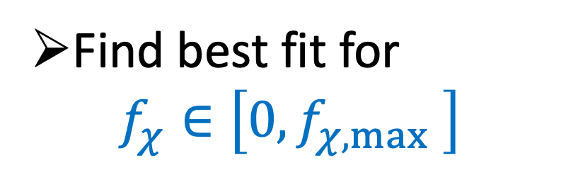
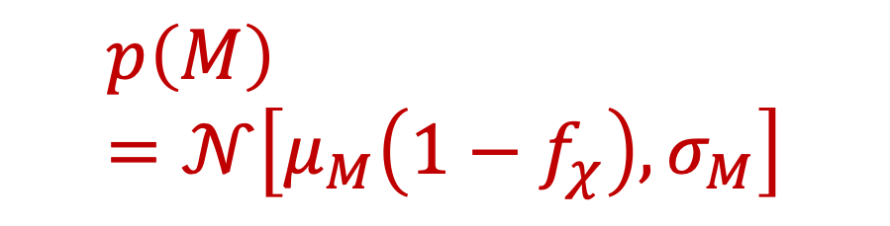
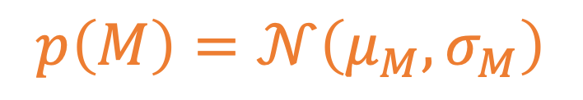
Case 3: Both Radio mass and X-ray measurements available.
$$p\left(M\right)=𝒩\left(μ_{M},σ_{M}\right)$$
$$p\left(M\right)=𝒩\left[μ_{M}\left(1−f_{χ}\right),σ_{M}\right]$$
Find best fit for
$f_{χ}∈\left[0,f_{χ,max} \right]$
Reanalysis required
Shawqi & Morsink, 2024

Slide 22
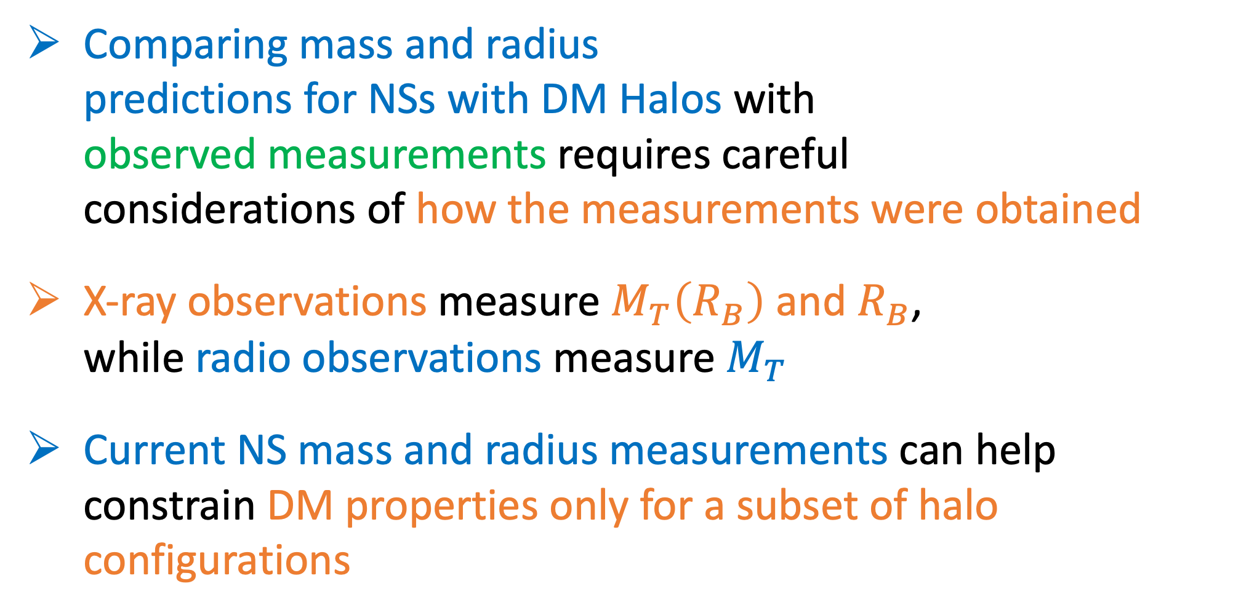
Summary
Comparing mass and radius
predictions for NSs with DM Halos with
observed measurements requires careful
considerations of how the measurements were obtained
X-ray observations measure $M_{T}\left(R_{B}\right)$ and $R_{B}$,
while radio observations measure $M_{T}$
Current NS mass and radius measurements can help constrain DM properties only for a subset of halo configurations
SCAN FOR
FULL PAPER

Slide 23
Backup Slides

Slide 24
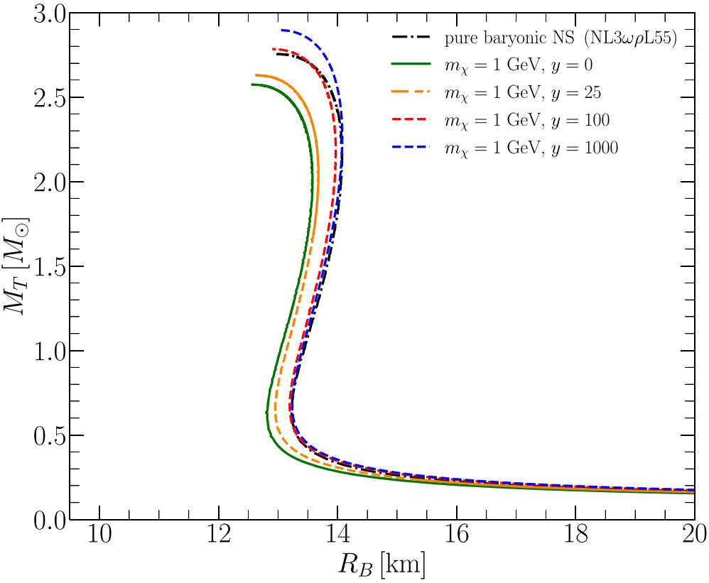


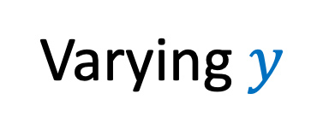
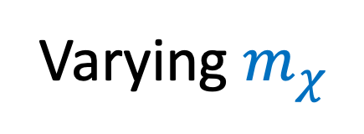
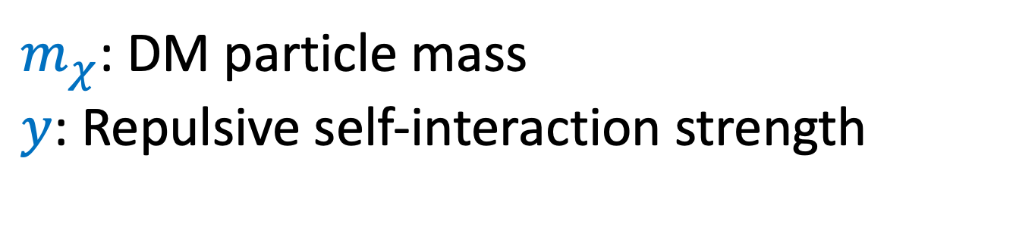
Mass-Radius Curves
$$f_{χ}=0.05$$
$$f_{χ}=0.05$$
Varying $m_{χ}$
Varying $y$
$m_{χ}$: DM particle mass
$y$: Repulsive self-interaction strength
SS & Morsink, 2024

Slide 25
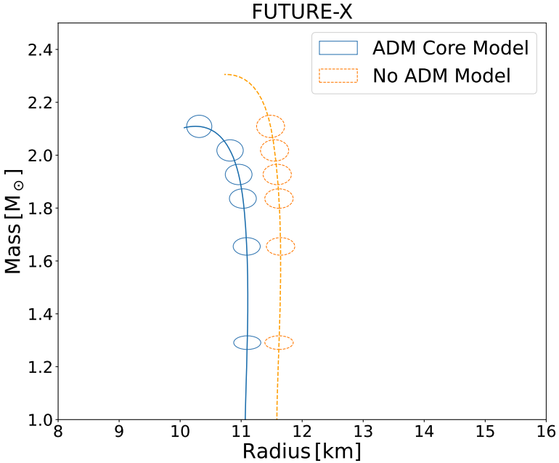
Future observations have the potential to constrain Dark Matter Admixed NSs
DM cores
DM Halos
Rutherford et al., 2024
SS & Morsink, 2024

Slide 26
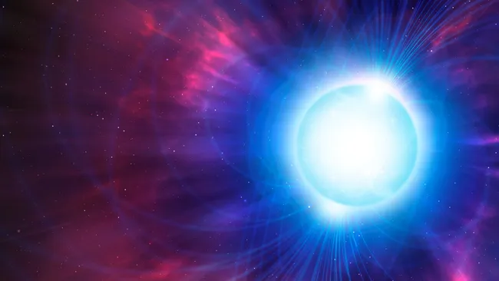
Neutron Stars
Neutron stars (NSs) are degenerate remnants of massive stars that have completed their nuclear burning stage of life
Image credit: MARK GARLICK/SCIENCE PHOTO LIBRARY via Getty Images

Slide 27

Neutron Stars
Mass$∼\text{1}−2 M_{⊙}$
Radius$∼\text{10}−15 km$
Core densities of NSs exceed nuclear saturation density of $2×{10}^{14}$ g/cm³
Image credit: MARK GARLICK/SCIENCE PHOTO LIBRARY via Getty Images

Slide 28

Neutron Stars
Temperatures$∼{10}^{5}\text{−}{10}^{9} K$
Fermi Temperatures$∼{10}^{12}K$
Can be treated effectively at $0 K$
(cold objects)
Image credit: MARK GARLICK/SCIENCE PHOTO LIBRARY via Getty Images

Slide 29
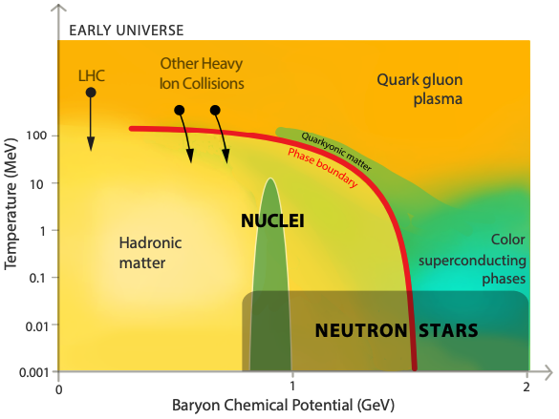

Neutron Stars
Neutron Stars
Temperatures$∼{10}^{6}\text{−}{10}^{8} K$
Fermi Temperatures$∼{10}^{12}K$
Can be treated effectively at $0 K$
(cold objects)
Watts et al. (2016)
Space.com

Slide 30
Dark Matter
Assuming Newtonian gravity or General Relativity as the theory of gravity, astronomical observations over 100 years have indicated that there is more gravitational matter in the universe than what is visible

Slide 31
Dark Matter
Assuming Newtonian gravity or General Relativity as the theory of gravity, astronomical observations over 100 years have indicated that there is more gravitational matter in the universe than what is visible
Examples include galaxy rotation curves, galaxy clusters, CMB, etc.

Slide 32
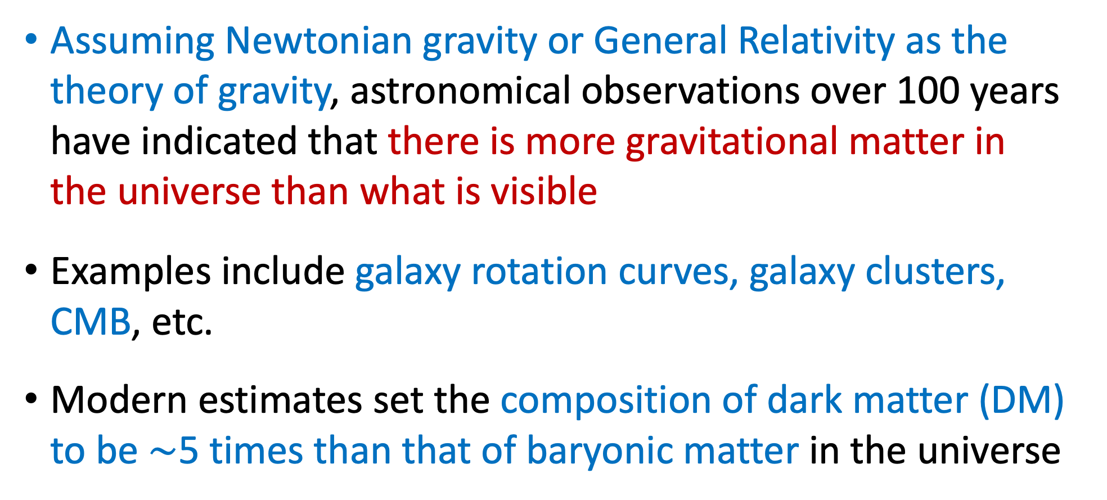
Dark Matter
Assuming Newtonian gravity or General Relativity as the theory of gravity, astronomical observations over 100 years have indicated that there is more gravitational matter in the universe than what is visible
Examples include galaxy rotation curves, galaxy clusters, CMB, etc.
Modern estimates set the composition of dark matter (DM) to be $∼$5 times than that of baryonic matter in the universe

Slide 33
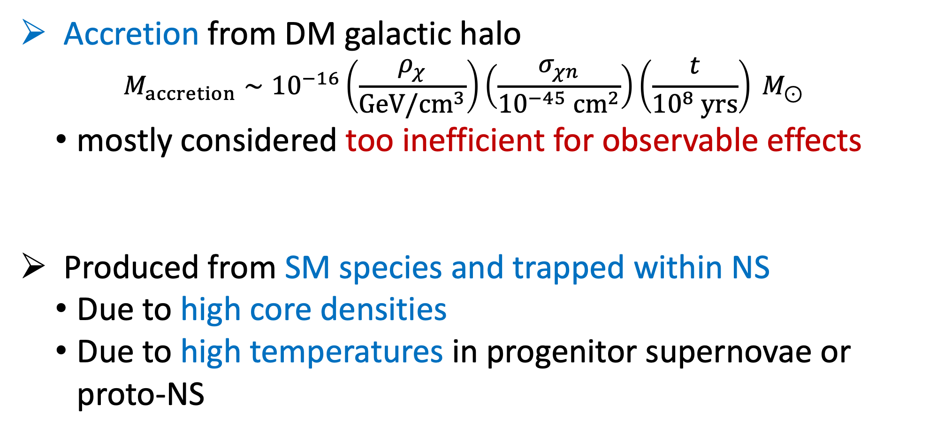
Dark Matter Accumulation
Accretion from DM galactic halo
  $$M_{accretion}∼{10}^{−16}\left(\frac{ρ_{χ}}{GeV/cm^{3}}\right)\left(\frac{σ_{χn}}{{10}^{−45} cm^{2}}\right)\left(\frac{t}{{10}^{8} yrs}\right) M_{⊙}$$
  mostly considered too inefficient for observable effects
Produced from SM species and trapped within NS
  Due to high core densities
  Due to high temperatures in progenitor supernovae or proto-NS
(Goldman & Nussinov 1989), (Kouvaris 2007), (Kouvaris & Tinyakov 2010, 2011), (Nelson et al. 2019), etc.
(Mckeen et al. 2018), (Baym et al. 2018), (Motta et al. 2018a, 2018b)
(Nelson et al. 2019), (Reddy & Zhou 2022), (Collier et al. 2022)

Slide 34
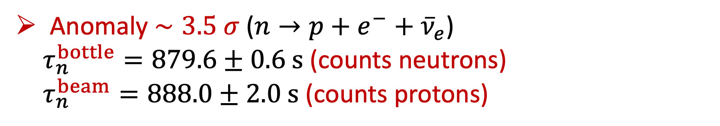
Neutron Decay
Anomaly $∼3.5 σ$ ($n→p+e^{−}+{\overline{ν}}_{e}$)
  $τ_{n}^{bottle}=879.6±0.6 s$ (counts neutrons)
  $τ_{n}^{beam}=888.0±2.0 s$ (counts protons)
(Pattie et al. 2017)
(Yue et al. 2013)

Slide 35
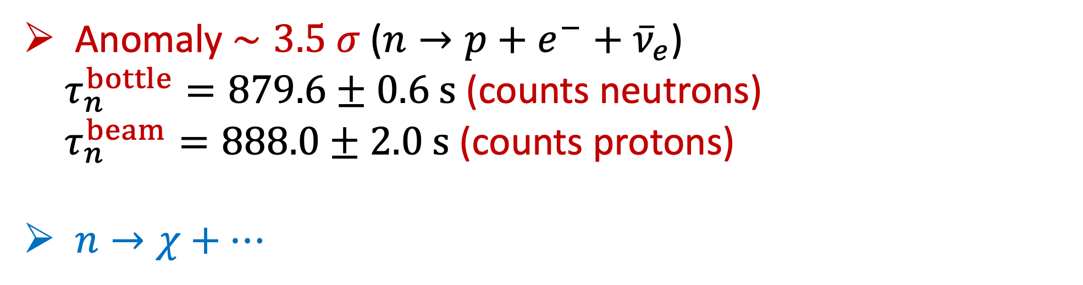
Neutron Decay
Anomaly $∼3.5 σ$ ($n→p+e^{−}+{\overline{ν}}_{e}$)
  $τ_{n}^{bottle}=879.6±0.6 s$ (counts neutrons)
  $τ_{n}^{beam}=888.0±2.0 s$ (counts protons)
$n→χ+…$
(Pattie et al. 2017)
(Yue et al. 2013)

Slide 36
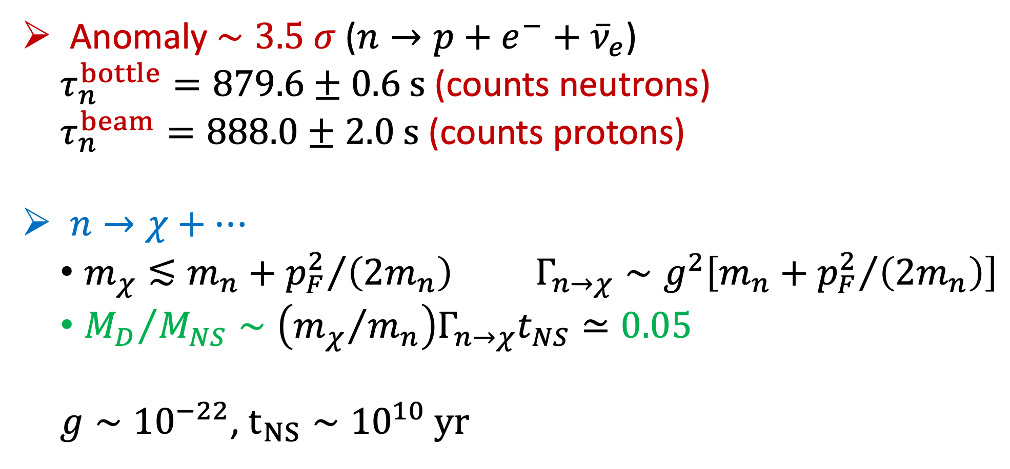
Neutron Decay
Anomaly $∼3.5 σ$ ($n→p+e^{−}+{\overline{ν}}_{e}$)
  $τ_{n}^{bottle}=879.6±0.6 s$ (counts neutrons)
  $τ_{n}^{beam}=888.0±2.0 s$ (counts protons)
$n→χ+…$
  $m_{χ}≲m_{n}+{p_{F}^{2}}/{\left(2m_{n}\right)}$ $Γ_{n→χ}∼g^{2}\left[m_{n}+{p_{F}^{2}}/{\left(2m_{n}\right)}\right]$
  ${M_{D}}/{M_{NS}}∼\left({m_{χ}}/{m_{n}}\right)Γ_{n→χ}t_{NS}≃0.05$
  $g∼{10}^{−22}$, $t_{NS}∼{10}^{10} yr$
(Pattie et al. 2017)
(Yue et al. 2013)
(Ellis et al. 2018)

Slide 37
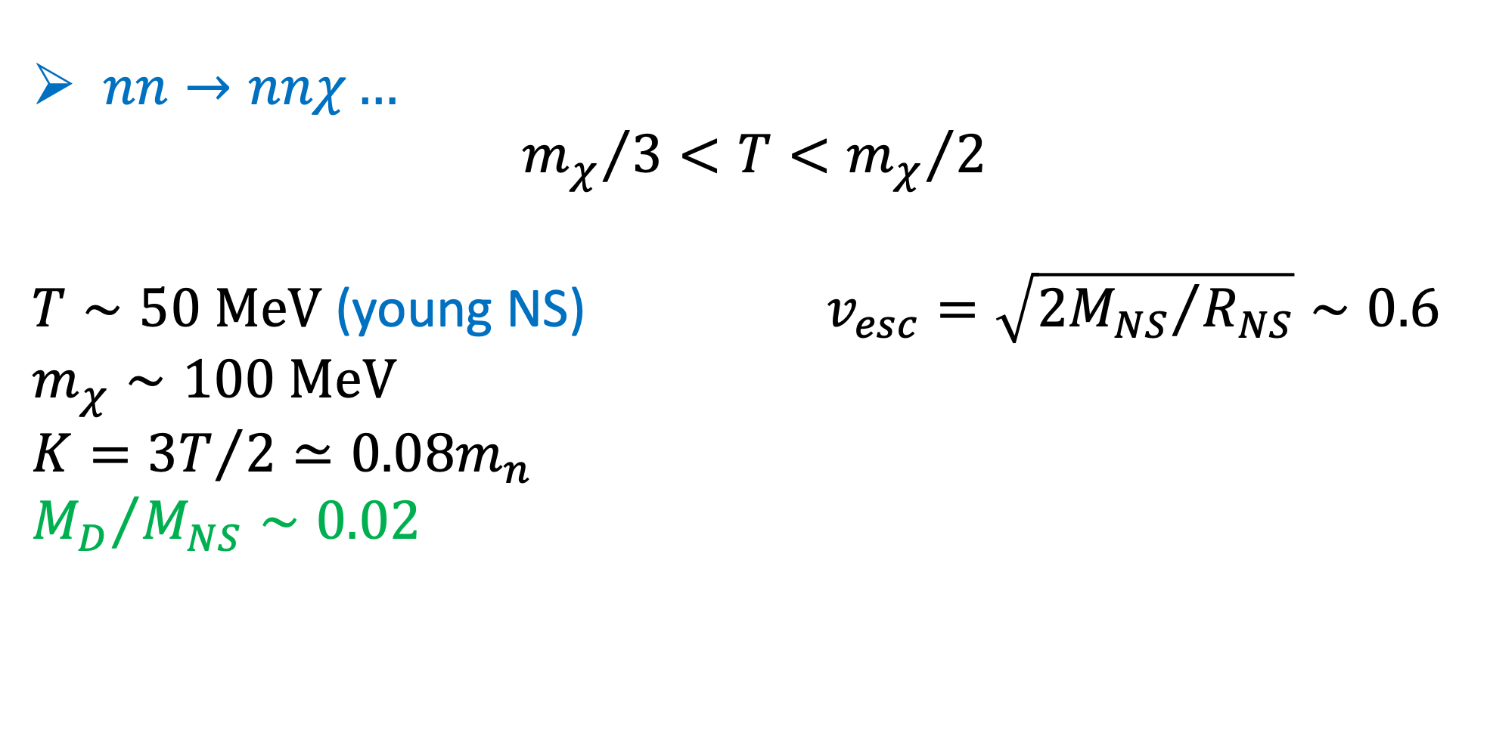
Neutron Bremsstrahlung
$nn→nnχ…$
$${m_{χ}}/3<T<{m_{χ}}/2$$
$T∼50 MeV$ (young NS) $v_{esc}=\sqrt{{2M_{NS}}/{R_{NS}}}∼0.6$
$$m_{χ}∼100 MeV$$
$$K={3T}/2≃0.08m_{n}$$
$${M_{D}}/{M_{NS}}∼0.02$$
(Ellis et al. 2018)

Slide 38
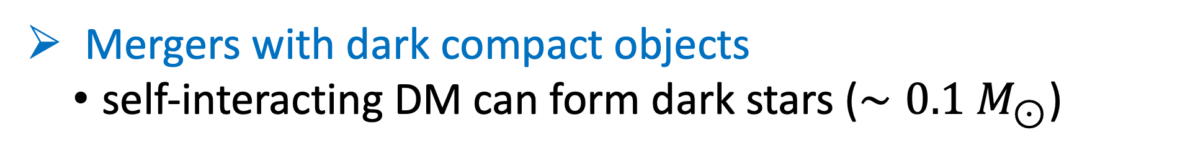
Dark Matter Accumulation
Mergers with dark compact objects
  self-interacting DM can form dark stars ($∼0.1 M_{⊙}$)
(Kouvaris & Nielsen 2015, Collier et al. 2022)

Slide 39
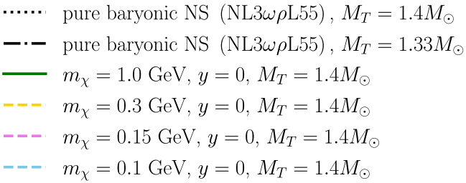
Varying $m_{χ}$, $y=0$, $f_{χ}=0.05$
SS & Morsink, 2024

Slide 40
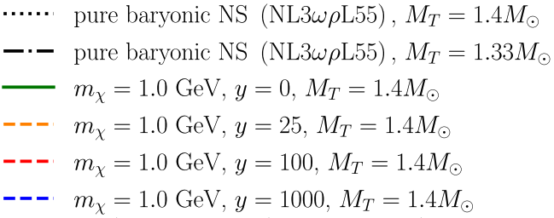
Varying $y$, $m_{χ}=1 GeV$, $f_{χ}=0.05$
SS & Morsink, 2024

Slide 41
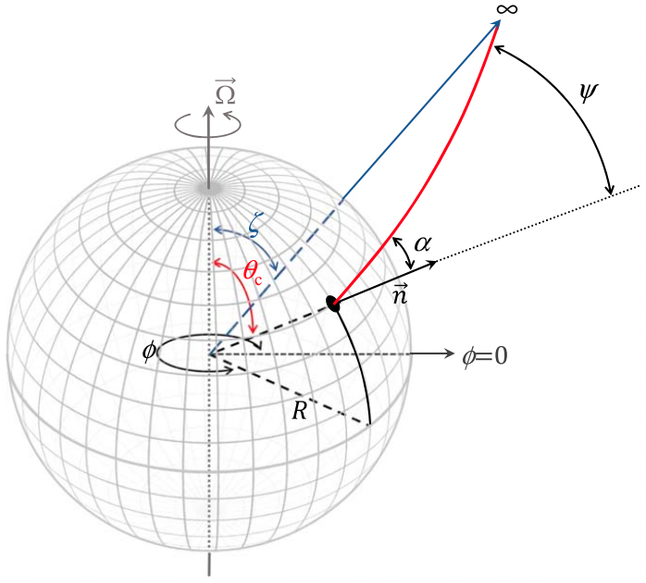
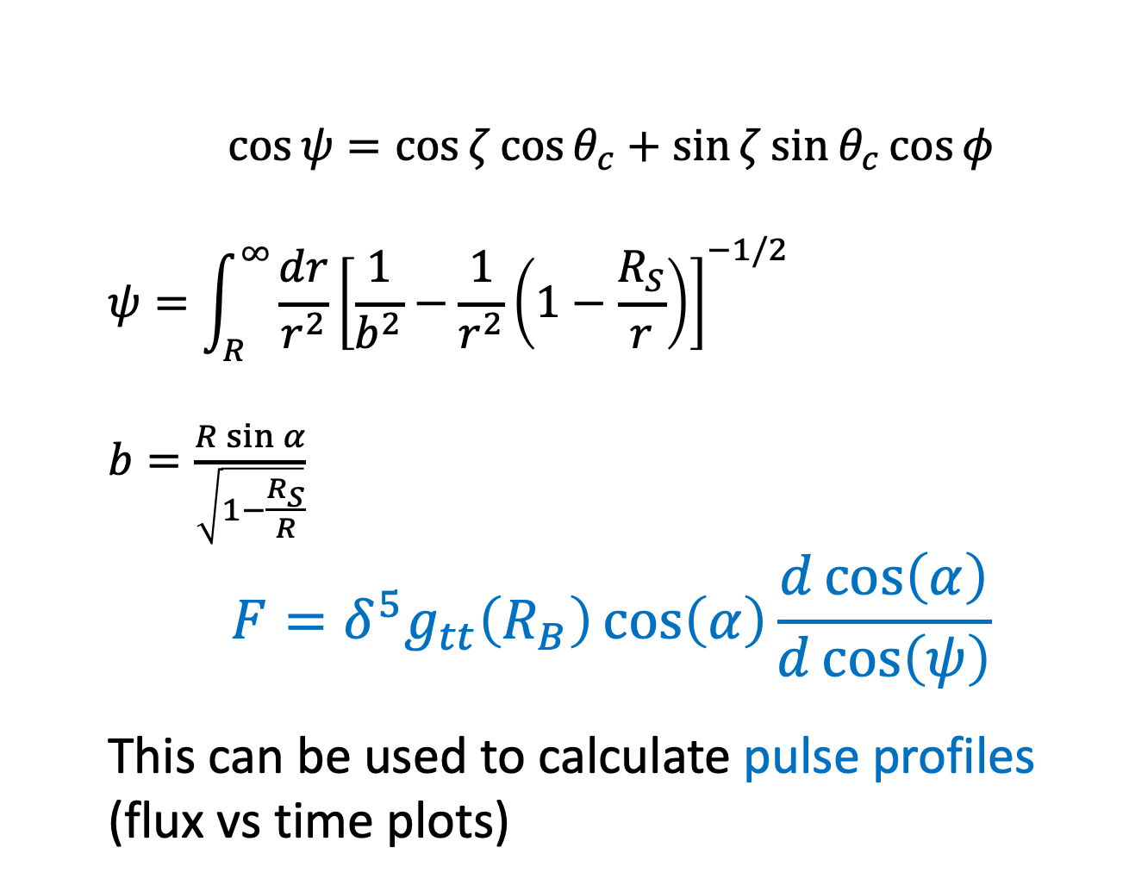
Gravitational Self-Lensing
$$\cos{ψ}=\cos{ζ}\cos{θ_{c}}+\sin{ζ}\sin{θ_{c}}\cos{φ}$$
$$ψ=\int_{R}^{∞}{\frac{dr}{r^{2}}{\left[\frac{1}{b^{2}}−\frac{1}{r^{2}}\left(1−\frac{R_{S}}{r}\right)\right]}^{−1/2}}$$
$b=\frac{R\sin{α}}{\sqrt{1−\frac{R_{S}}{R}}}$
$$F=δ^{5}g_{tt}\left(R_{B}\right)\cos\left(α\right)\frac{d\cos\left(α\right)}{d\cos\left(ψ\right)}$$
This can be used to calculate pulse profiles (flux vs time plots)
Credit: Bogdanov et al., 2022

Slide 42
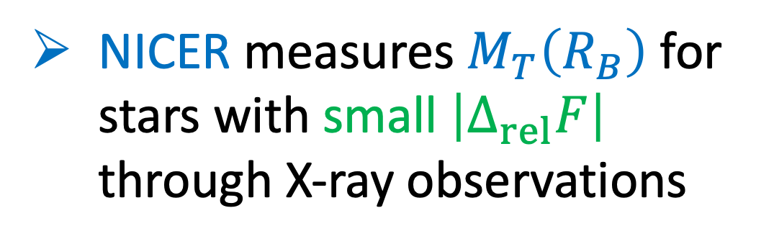





NS Mass-Radius Measurements
NICER measures $M_{T}\left(R_{B}\right)$ for stars with small $\left|Δ_{rel}F\right|$ through X-ray observations
$${M_{T}=M}_{T}\left(R_{B}\right)+M_{cloud}$$
$$R_{D}$$
$$M_{T}\left(R_{B}\right)$$
$$R_{B}$$
$$M_{cloud}$$
Dark Halo

Slide 43
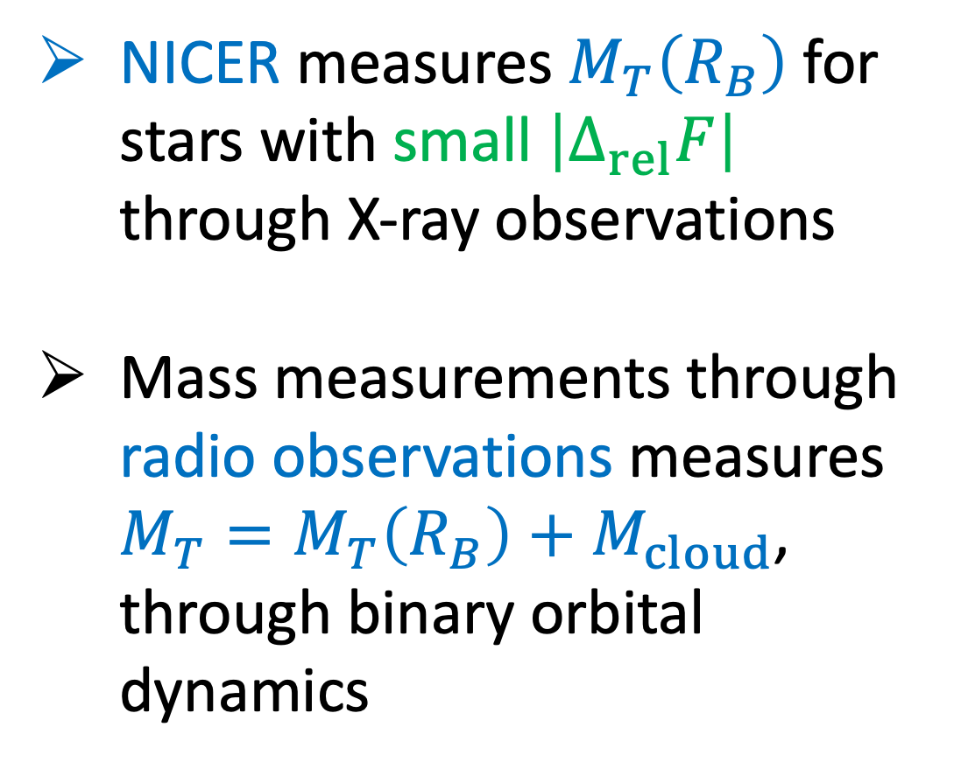
NS Mass-Radius Measurements
NICER measures $M_{T}\left(R_{B}\right)$ for stars with small $\left|Δ_{rel}F\right|$ through X-ray observations
Mass measurements through radio observations measures $M_{T}=M_{T}\left(R_{B}\right)+M_{cloud}$, through binary orbital dynamics
$${M_{T}=M}_{T}\left(R_{B}\right)+M_{cloud}$$
$$R_{D}$$
$$M_{T}\left(R_{B}\right)$$
$$R_{B}$$
$$M_{cloud}$$
Dark Halo

Slide 44
NS Mass-Radius Measurements
Case 1: Only radio mass measurement available. No
X-ray observations available.
Case 2: Only X-ray observations available. No radio mass measurement available.
Case 3: Both radio mass measurements and X-ray observations available.
$${M_{T}=M}_{T}\left(R_{B}\right)+M_{cloud}$$
$$R_{D}$$
$$M_{T}\left(R_{B}\right)$$
$$R_{B}$$
$$M_{cloud}$$
Dark Halo

Slide 45
Main Goal of Paper
We have mass measurements of neutron stars (NSs) mainly from two types of observations:
      radio pulsar observations
      X-ray observations
What mass are these observations measuring?
      Total mass including dark matter (DM) halos?
      Something else?
Based on the interpretation of mass, what are the consequences on baryonic equation of state (EOS) constraints?

Slide 46
DANS Model Formalisms
Single fluid description
  Compute equation of state with SM couplings between DM and baryonic matter
(Panotopoulos & Lopes 2017), (Quddus et al 2020),
(Das et al. 2019 ), (Das et al. 2021), (Lopes et al. 2022)

Slide 47
DANS Model Formalisms
Single fluid description
  Compute equation of state with SM couplings between DM and baryonic matter
Two-fluid description
  No SM couplings between DM and baryonic matter
  Only gravitational interaction between the two
  Our method of choice since it is more relevant for
  NICER X-ray observations!
(Panotopoulos & Lopes 2017), (Quddus et al 2020),
(Das et al. 2019 ), (Das et al. 2021), (Lopes et al. 2022)
(Sandin & Ciarcelluti 2009), (Ciarcelluti & Sandin 2011),
(Miao et al. 2022), (Shakeri et al. 2022a, 2022b), (Collier et al. 2022), (Rutherford et al. 2023)

Slide 48
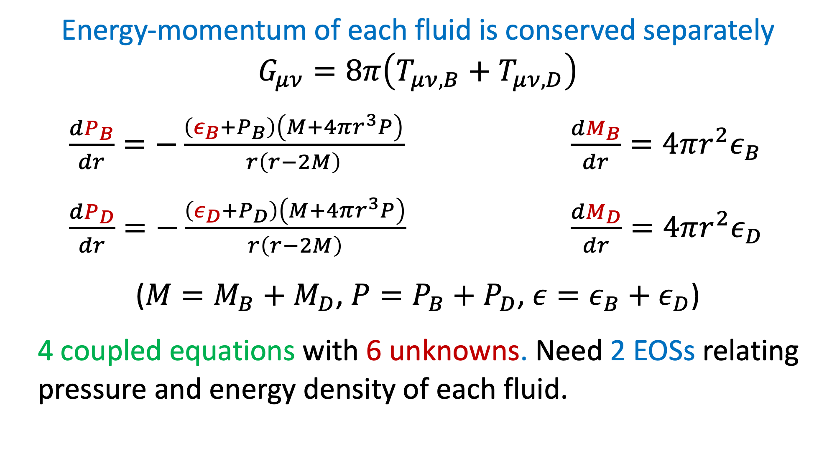
Two-Fluid TOV equations
Energy-momentum of each fluid is conserved separately
$$G_{μν}=8π\left(T_{μν, B}+T_{μν, D}\right)$$
$\frac{dP_{B}}{dr}=−\frac{\left(ε_{B}+P_{B}\right)\left(M+4πr^{3}P\right)}{r\left(r−2M\right)}$ $\frac{dM_{B}}{dr}=4πr^{2}ε_{B}$
$\frac{dP_{D}}{dr}=−\frac{\left(ε_{D}+P_{D}\right)\left(M+4πr^{3}P\right)}{r\left(r−2M\right)}$ $\frac{dM_{D}}{dr}=4πr^{2}ε_{D}$
($M=M_{B}+M_{D}$, $P=P_{B}+P_{D}$, $ε=ε_{B}+ε_{D}$)
  4 coupled equations with 6 unknowns. Need 2 EOSs relating pressure and energy density of each fluid.

Slide 49

Equation of State
Baryonic EOS – NL3$ωρ$L55
  choosing stiff EOS just to easily illustrate effects of DM in MR profile

Slide 50

Equation of State
Baryonic EOS – NL3$ωρ$L55
  choosing stiff EOS just to easily illustrate effects of DM in MR profile
DM EOS
  bosonic (requires repulsive self-interaction)
    without self-interaction collapses to a black hole at the centre of the NS
  fermionic (no self-interaction required due to degeneracy pressure)
    we choose to include self-interaction to explore effects

Slide 51

Dark Matter EOS
$$ε_{D}=ε_{D,kin}+m_{χ}n_{D}+\frac{n_{D}^{2}}{m_{I}^{2}}$$
Assume ideal Fermi gas at zero temperature (Nelson et al. 2019)
$$ε_{D,kin}=\frac{1}{π^{2}}\int_{0}^{k_{F}}{dk}k^{2}\left(\sqrt{k^{2}+m_{χ}^{2}}−m_{χ}\right)$$
$P_{D}=−ε_{D}+\frac{μ_{D}}{\sqrt{g_{tt}}}n_{D}$ $\frac{μ_{D}}{\sqrt{g_{tt}}}=\frac{∂ε_{D}}{∂n_{D}}$ $n_{D}=\frac{k_{F}^{3}}{3π^{2}}$

Slide 52

Dark Matter EOS
$$ε_{D}=\frac{m_{χ}^{4}}{8π^{2}}\left[\left(2x^{3}+x\right)\sqrt{1+x^{2}}−\operatorname{arcsinh}\left(x\right)\right]+\frac{m_{χ}^{4}y^{2}x^{6}}{{\left(3π^{2}\right)}^{2}}$$
$$P_{D}=\frac{m_{χ}^{4}}{24π^{2}}\left[\left(2x^{3}−3x\right)\sqrt{1+x^{2}}+3\operatorname{arcsinh}\left(x\right)\right]+\frac{m_{χ}^{4}y^{2}x^{6}}{{\left(3π^{2}\right)}^{2}}$$
$x=\frac{k_{F}}{m_{χ}}$ : relativity parameter
$y=\frac{m_{χ}}{m_{I}}$ : self-interaction strength
kinetic and rest mass
self-interaction

Slide 53
Dependence on $m_{χ}$

Slide 54
Flux from NS with Dark Halo

Slide 55
Flux from NS with Dark Halo

Slide 56
Flux from NS with Dark Halo

Slide 57

Flux from NS with Dark Halo
Note: Largest difference in flux, $F$, between pure NS and dark halo is at the peak ($F_{peak}$).

Slide 58




Approximate $ΔF_{peak}$
Try to approximate the pulse profile of a NS with dark halo by that of a pure NS of mass $M_{T}\left(R_{B}\right)$.
$log\left(\frac{\left|ΔF_{peak}\right|}{F_{peak}}\right)=0.998log\left(\frac{M_{halo}}{R_{D}}\right)+0.854$ (Miao et al. 2022)
For sufficiently small $\left(\frac{M_{halo}}{R_{D}}\right)$,
$ΔF_{peak}$ is small.
Largest difference in $F$ between pure NS and dark halo is at the peak flux $F_{peak}$

Slide 59

Relate $F_{peak}$ to $g_{tt}\left(R_{B}\right)$
$$ds^{2}=−g_{tt}\left(r\right)dt^{2}+g_{rr}\left(r\right)dr^{2}+r^{2}dθ^{2}+r^{2}\sin^{2}\left(θ\right)dφ^{2}$$
$F=δ^{5}g_{tt}\left(R_{B}\right)\cos\left(α\right)\frac{d\cos\left(α\right)}{d\cos\left(ψ\right)}∼g_{tt}^{2}\left(R_{B}\right)$ (at peak) $∼{\left(1+z\right)}^{−4}$ (bolometric)
$$\frac{\left|ΔF_{peak}\right|}{F_{peak}} ∼\frac{2\left|Δg_{tt}\left(R_{B}\right)\right|}{g_{tt}\left(R_{B}\right)}$$
Energy dependent flux will depend on a different power of $g_{tt}\left(R_{B}\right)$
    Even if ${M_{halo}}/{R_{D}}$ relation does not hold, $Δg_{tt}\left(R_{B}\right)$can be used to set maximum $ΔF_{peak}$
Both ${M_{halo}}/{R_{D}}$ and $g_{tt}\left(R_{B}\right)$ can be indicators towards if $ΔF_{peak}$ is small

Slide 60


NS Mass-Radius Measurements
Mass measurements through radio observations measures
$$M_{T}=M_{T}\left(R_{B}\right)+M_{halo}$$
NICER measures $M_{T}\left(R_{B}\right)$ for stars with small ${M_{halo}}/{R_{D}}$
$$R_{D}$$
$$M_{T}\left(R_{B}\right)$$
$$R_{B}$$
$$M_{halo}$$
Dark Halo

Slide 61

Can we use current NICER results to constrain
Dark Halos?
Current NICER results assume no DM exists in the NSs
If $ΔF_{peak}$ (or ${M_{halo}}/{R_{D}}$ or $g_{tt}\left(R_{B}\right)$) is large, a NICER reanalysis is required to constrain DM properties
  Current $M_{T}\left(R_{B}\right)$ and $R_{B}$ measurements significantly differ from that of NS with dark halo
If $ΔF_{peak}$ is sufficiently small, we can use current NICER results to analyse the validity of baryonic EOSs and constrain $f_{χ}$ in the NS

Slide 62

Effects on Baryonic EOS constraints
We find that
$M_{T}\left(R_{B}\right)≈M_{T,pure}$
for large parameter space of dark halo cases
In these cases, we can analyse whether baryonic EOSs are valid if a dark halo exists

Slide 63


Case 1: No radio mass measurement.
Only NICER measurement available.
Both baryonic and DM EOSs are valid, whether DM $M_{T}$ curve intersects NICER confidence region or not.
Both baryonic and DM EOSs are invalid, even if DM $M_{T}$ curve intersects NICER confidence region.

Slide 64
Case 1: No radio mass measurement.
Only NICER measurement available.
Trivial: Baryonic EOS is valid and DM EOS is invalid.
Trivial: Both baryonic and DM EOSs are valid.

Slide 65
Case 2: Only radio mass measurement available.
No NICER measurement.
Pure baryonic EOS ruled out by radio mass measurement. But adding DM makes it valid.
Trivial: Both baryonic and DM EOSs are valid.

Slide 66
Case 3: Both Radio mass and NICER measurements available.
Softer EOS is untested by NICER measurements due to strong radio mass priors.
Trivial: Both baryonic and DM EOSs are valid.

Slide 67
Case 3: Both Radio mass and NICER measurements available.
Softer EOS is untested by NICER measurements due to strong radio mass priors.
Softer EOS is valid with new mass priors.

Slide 68

Soft EOSs Untested by NICER
Assume some maximum $f_{χ}∼0.05$.
Reduce NICER mass priors by $f_{χ}$.
Redo NICER analysis to measure new $M_{T}\left(R_{B}\right)$ and $R_{B}$.
Check which EOSs are valid now.
Softer EOS is untested by NICER measurements due to strong radio mass priors.

Slide 69
Future observations have the potential to constrain Dark Matter Admixed NSs
DM cores
DM Halos
Rutherford et al., 2024
SS & Morsink, 2024

Slide 70

$$M_{T}={\text{1.33}M}_{⊙}$$

Slide 71
$$M_{T}={\text{1.33}M}_{⊙}$$
dark halo

