Slide 1
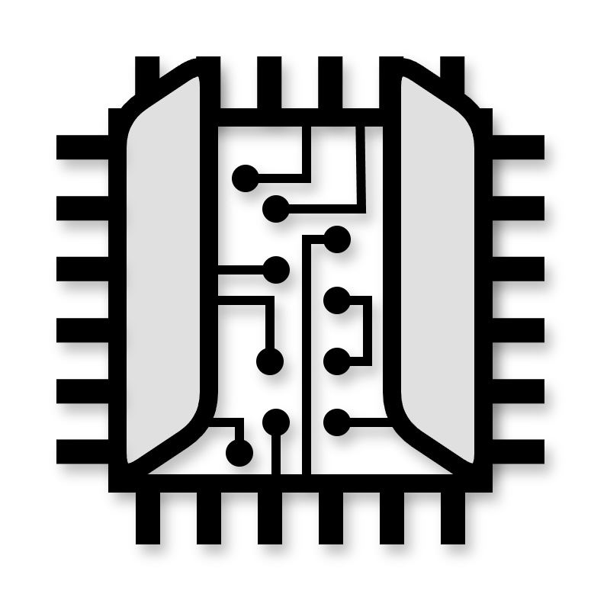
Open Logic
Open Source FPGA Standard Library
FDF2025, CERN, 20-May-2025
Oliver Bründler

Slide 2
Agenda
What is Open Logic?
What is the Motivation?
Why using Open Logic?
Content Overview
Call to Action

Slide 3
Agenda
What is Open Logic?
What is the Motivation?
Why using Open Logic?
Content Overview
Call to Action

Slide 4
What is Open Logic?
It’s for HDL what STDLIB is for C/C++
Provides Reusable Basic Elements
  CDCs, FIFOs, Width Converters, Delay-Lines, CAM, …
  SPI, I2C, AXI, …
May grow into other Areas:
  Fixed-Point Mathematics
  DSP/SDR, Video, Networking, ...
It is not Open Cores
  Not providing IP cores … but supporting you developing them!

Slide 5
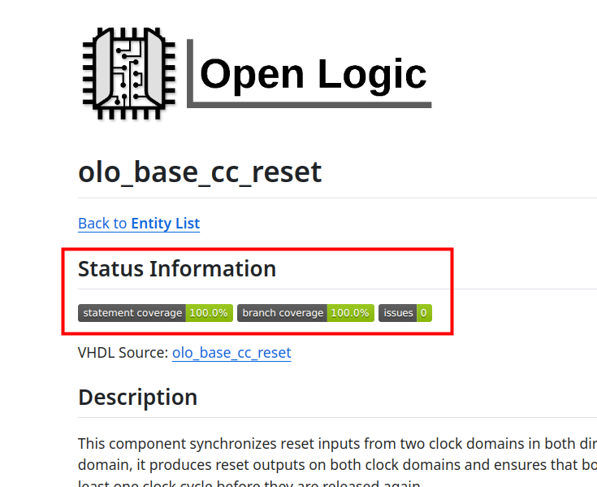
What is Open Logic?
It’s built from a Users Perspective
  Focus on thorough Documentation
  Metrics for Code Quality
  Tutorials
  Tool Integration
  Simplicity / Ease of Use
License
  PSI HDL License
  LGPL modified for FPGA Use

Slide 6
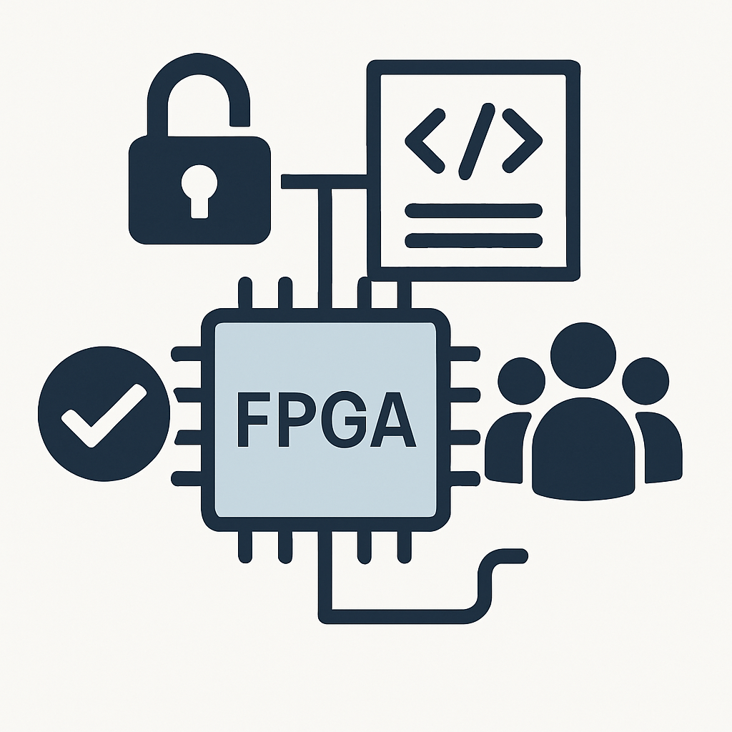
Philosophy
Pure HDL
  Any Device (AMD, Altera, Microchip, Efinix, Gowin)
  Written in VHDL
  Commitment for Usability from Verilog
Trustable Code
  Proper CI Setup (Simulation, Linting)
  100% Statement / Branch Coverage
  Issue Indicator
Free Tooling
  Enabler for Community

Slide 7
Agenda
What is Open Logic?
What is the Motivation?
Why using Open Logic?
Content Overview
Call to Action

Slide 8
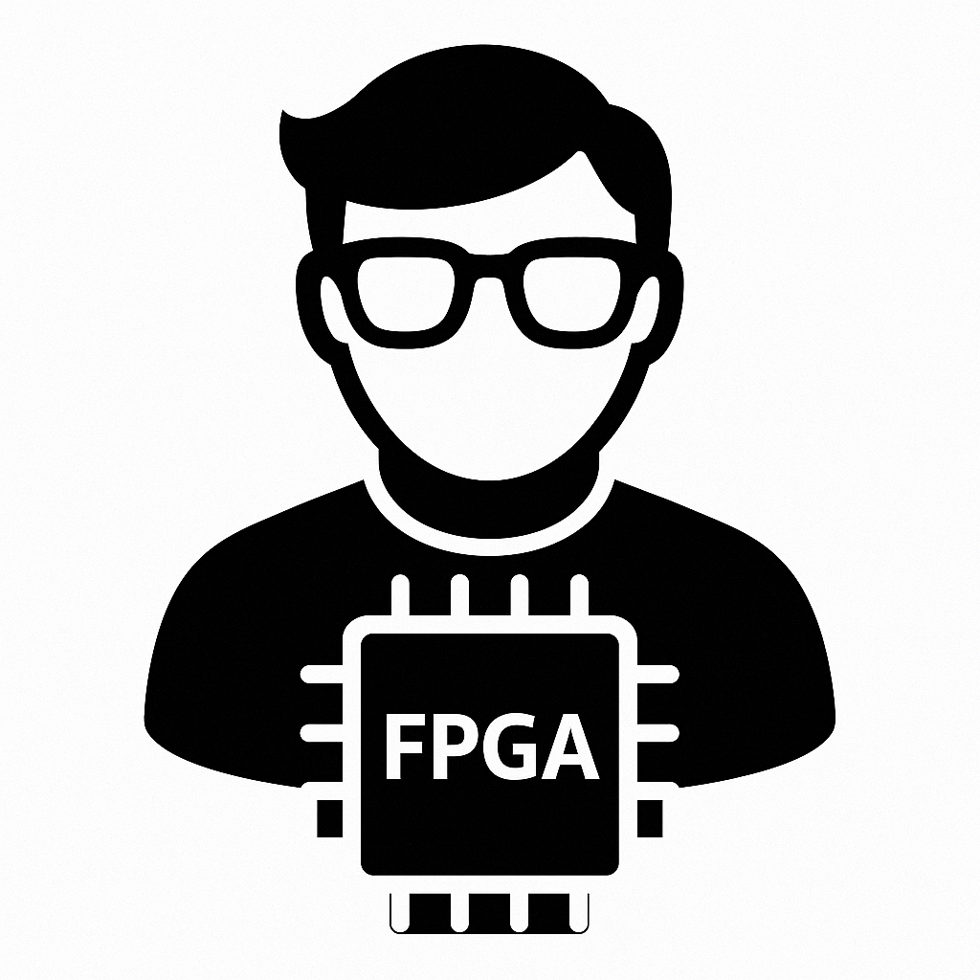


What is the Motivation?

Slide 9
I REALLY Looked for the Unicorn!
Hdl-modules (https://github.com/hdl-modules/hdl-modules)
Pile of Cores (https://github.com/VLSI-EDA/PoC)
Basejump STL (https://github.com/bespoke-silicon-group/basejump_stl)
Pulp common-cells (https://github.com/pulp-platform/common_cells)
FPGA Design Elements (https://github.com/laforest/FPGADesignElements)
SURF (https://github.com/slaclab/surf)
Quality, Vendor Independence, Documentation, Public CI/CD

Slide 10
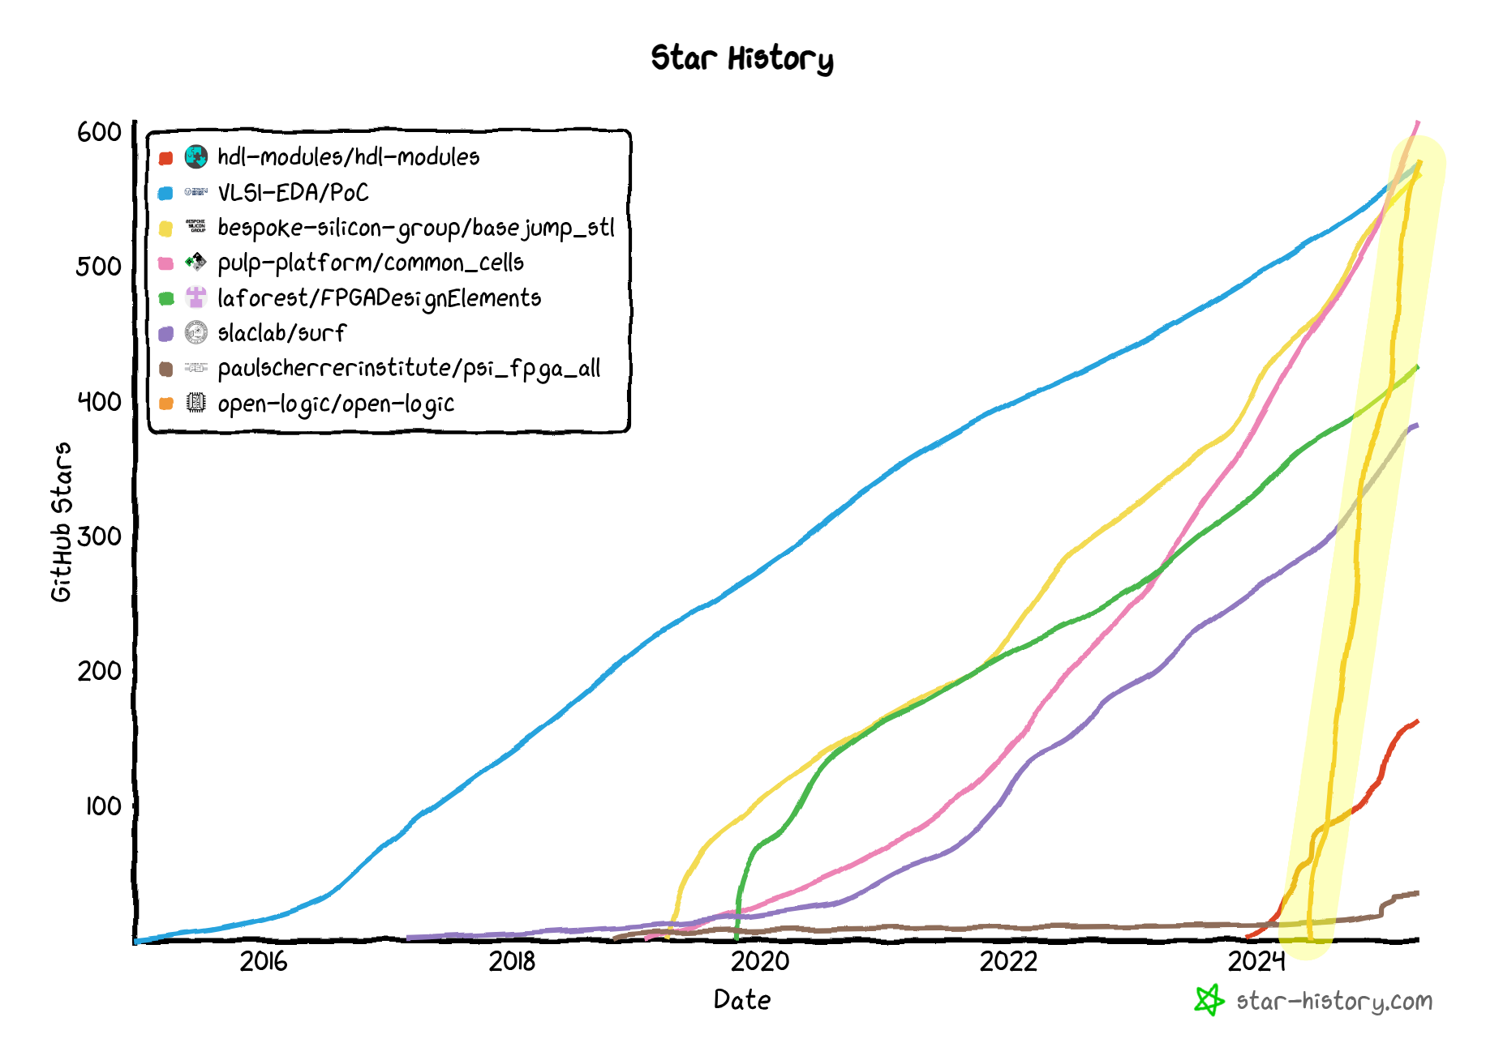
Does the World want Open Logic?
My plan was small …
… YOU made it big!

Slide 11
Agenda
What is Open Logic?
What is the Motivation?
Why using Open Logic?
Content Overview
Call to Action

Slide 12

Why using Open Logic?
Well – Why using STDLIB in C/C++?
Don’t waste Time on developing Code that exists
Don’t take Risks debugging your own CDC/FIFO/…
Spend your Time on your Application …
  … not on well known Basic Elements
Why not? It’s zero Cost!

Slide 13
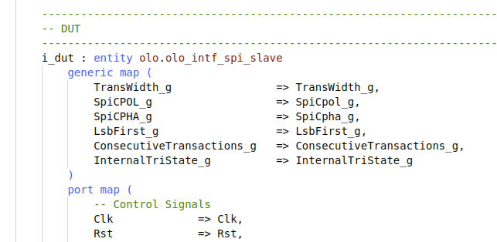
Better Quality
Portable Code
  Move along with Technology
  Choose the best fitting Device
Reusable Code
Reward innovative Vendors

Slide 14

Lower Cost
Reduced Development Effort
Reduced Maintenance Effort
image: Freepik.com

Slide 15

Reduce Risk
Less Risk for Debugging
  FIFOs, CDCs, …
Any FPGA is a Second Source
  Supply Chain Problems
  Trade Restrictions
  EOL
image: Freepik.com

Slide 16
Agenda
What is Open Logic?
What is the Motivation?
Why using Open Logic?
Content Overview
Call to Action

Slide 17
Structure of Open Logic
Currently 3 Areas
  base
  intf
  axi
Each Component has
  Documentation (in /doc/<area>)
  VUnit test-bench (in /test/<area>)

Slide 18
Live Tour
<Live Tour through GitHub>

Slide 19
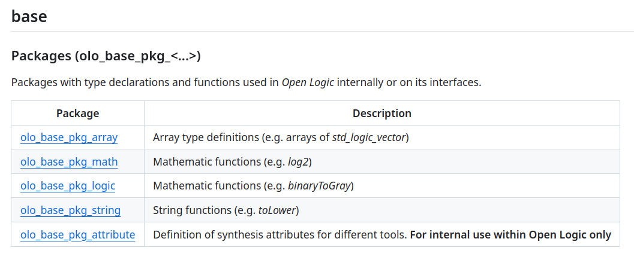
Content - base

Slide 20
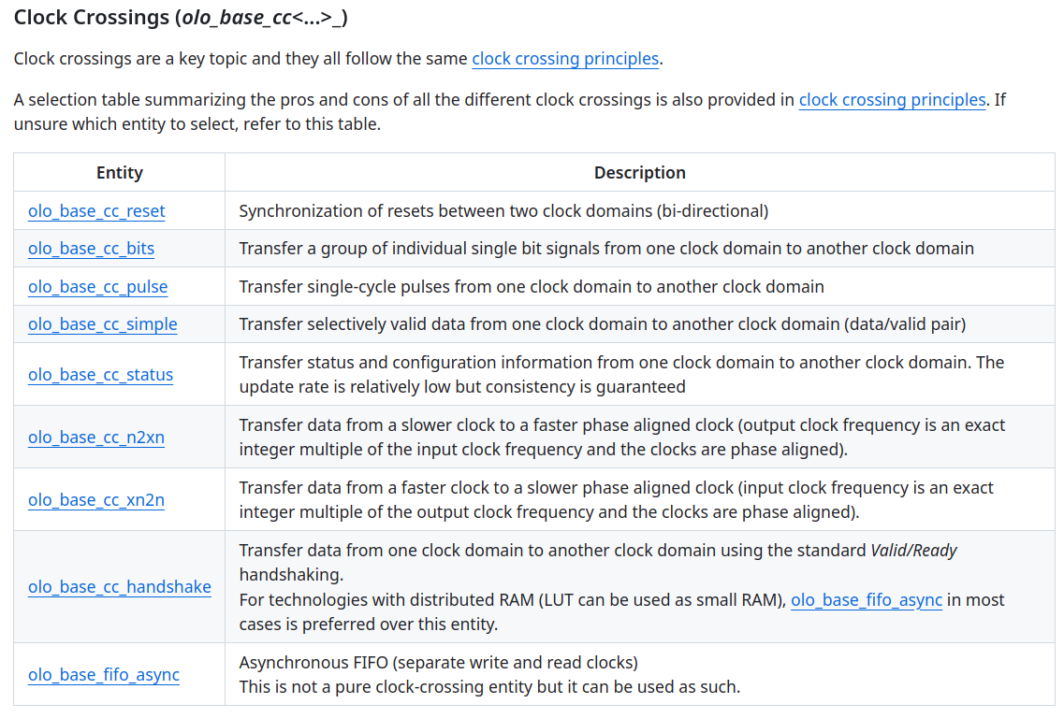
Content - base

Slide 21
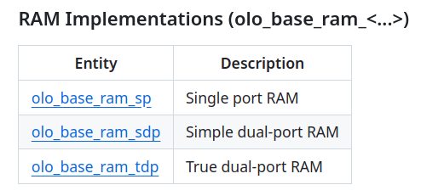
Content - base

Slide 22
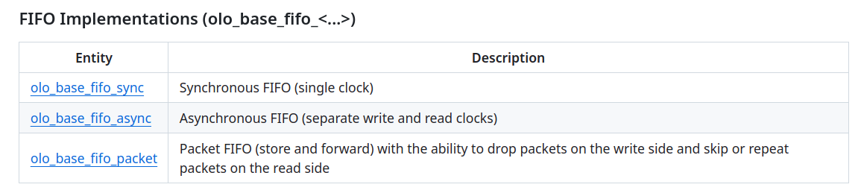
Content - base

Slide 23
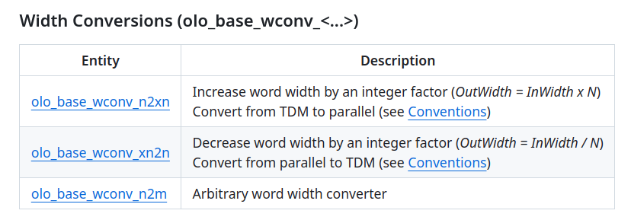
Content - base

Slide 24
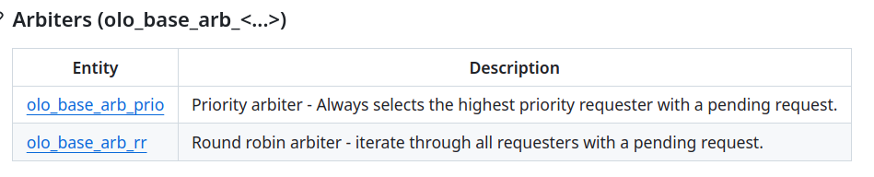
Content - base

Slide 25
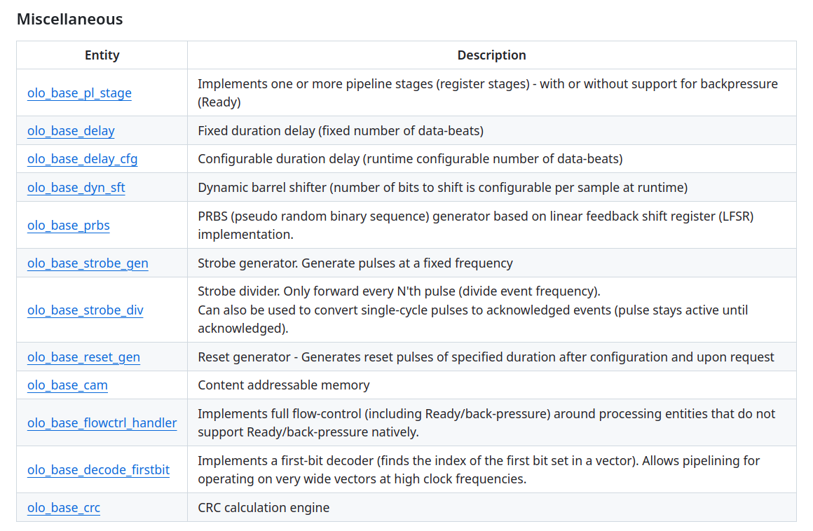
Content - base

Slide 26
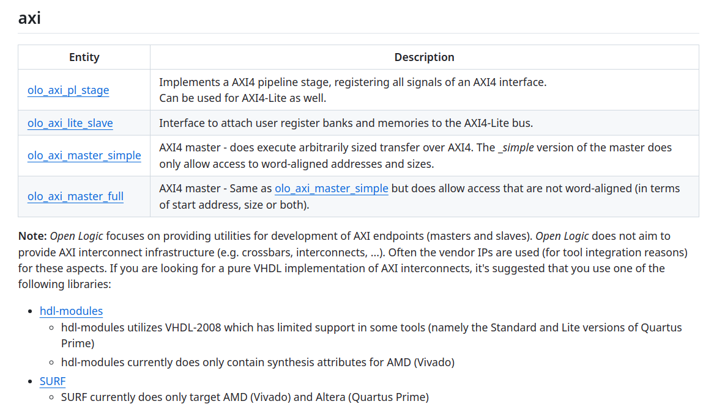
Content - axi

Slide 27
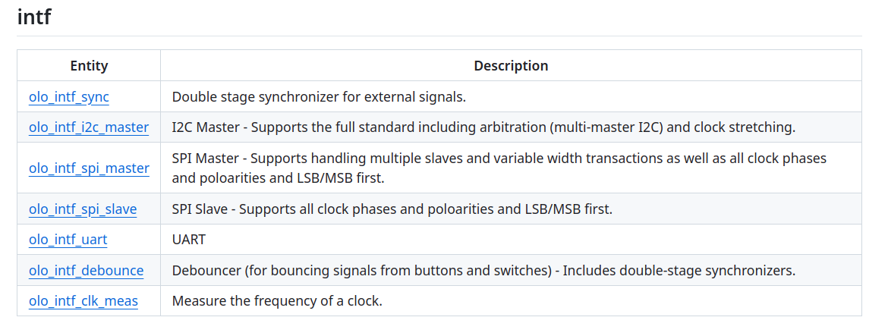
Content - intf

Slide 28
Agenda
What is Open Logic?
What is the Motivation?
Why using Open Logic?
Content Overview
Call to Action

Slide 29
Call to Action
Use Open Logic
  Get it from GitHub (https://github.com/open-logic/open-logic)
  Or through FuseSoc (https://github.com/fusesoc/fusesoc-cores)
Inform yourself
  Documentation on GitHub
  YouTube Channel (https://www.youtube.com/@OpenLogicFPGA)
Spread the Word
  Let your Friends know
  (Re-)post on LinkedIn
  Give it a Star on GitHub

Slide 30

Call to Action
Contribute
  Report / Feature Requests
  Contribute Code
Donate
  GitHub Sponsors (also offers Priority Support and Workshops)
  Campaign for dedicated GitHub Runner
  https://www.gofundme.com/f/dedicated-github-runner-for-open-logic-fpga-standard-library

Slide 31
Kudos and Sneak Peek
What’s next in Open Logic?
  Fixed-Point Mathematics
Kudos to:
  VUnit (https://github.com/VUnit/vunit)
  GHDL (https://github.com/ghdl/ghdl)
  NVC (https://github.com/nickg/nvc)
  VSG (https://github.com/jeremiah-c-leary/vhdl-style-guide)
  WaveDrom (https://github.com/wavedrom/wavedrom)

Slide 32
Thank You!
Questions?

