Slide 1
The PandABlocks framework for flexible run-time configuration of Zynq SoCs
Glenn Christian,
Diamond Light Source,
FDF, 20 May 2025

Slide 2
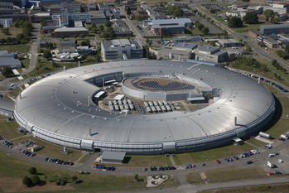
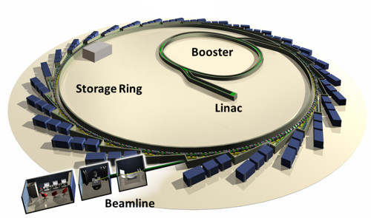
Diamond Light Source
UK national (third generation) synchrotron light source in Oxfordshire
Started operation in 2007
Currently 33 X-ray beamlines serving myriad of science research areas
3-GeV 562-m circumference SR with 100 MeV linac and booster synchrotron
Diamond-II upgrade approved and underway – c. £500M upgrade to 4th gen light source starting end of 2027 (18 months)

Slide 3
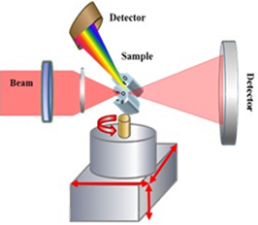
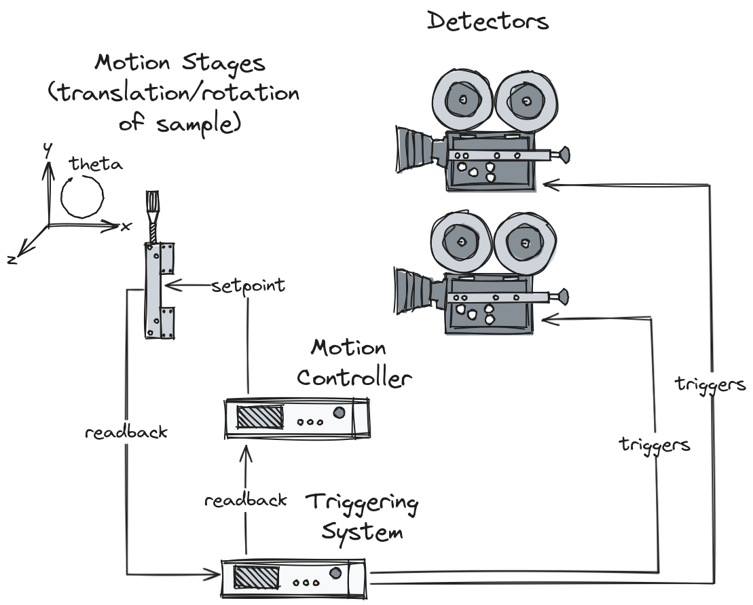
PandA Motivation
Hardware triggered scanning
  Move samples and trigger detectors continuously during scan
  Decreases detector deadtime, and speeds up scans (fast dynamics)
  Requires precise synchronisation between motion control and detectors
‘PandABox’ hardware development
  PandA = Position and Acquisition
  Flexible FPGA based encoder processing platform
    Triggers aligned on time or position
  Collaboration between DLS and Soleil (Started 2015)
  Now includes MAX-IV, ALBA, and DESY – PandABox-2

Slide 4

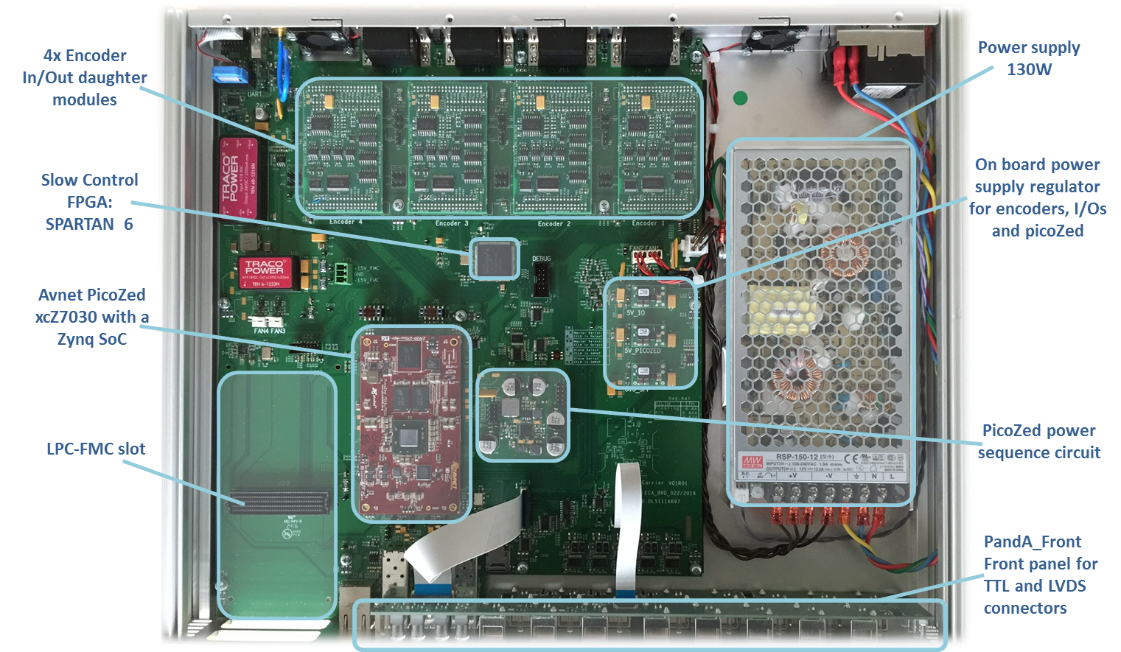


PandABox hardware
REAR
Housed in 1U 19” rack
Avnet PicoZed SoM – Xilinx Zynq 7030 SoC
  Kintex-fabric FPGA and ARM Cortex A9 processor
Four removable encoder modules:
  Quadrature, SSI, and BiSS protocols
  RS-485 line driver/receivers
  Site customisable daughter cards
Front-panel TTL and LVDS I/O for detector triggering
Xilinx Spartan-6 (“slow”) FPGA for IO expansion
  SPI link to Zynq-PL
3 front-panel SFPs (fast comms)
LPC-FMC (ADCs/DACs, additional I/O) etc
FRONT
Hardware design available on OWHR:
https://www.ohwr.org/project/pandabox/wikis/home
Commercially available from Quantum Detectors:

Slide 5
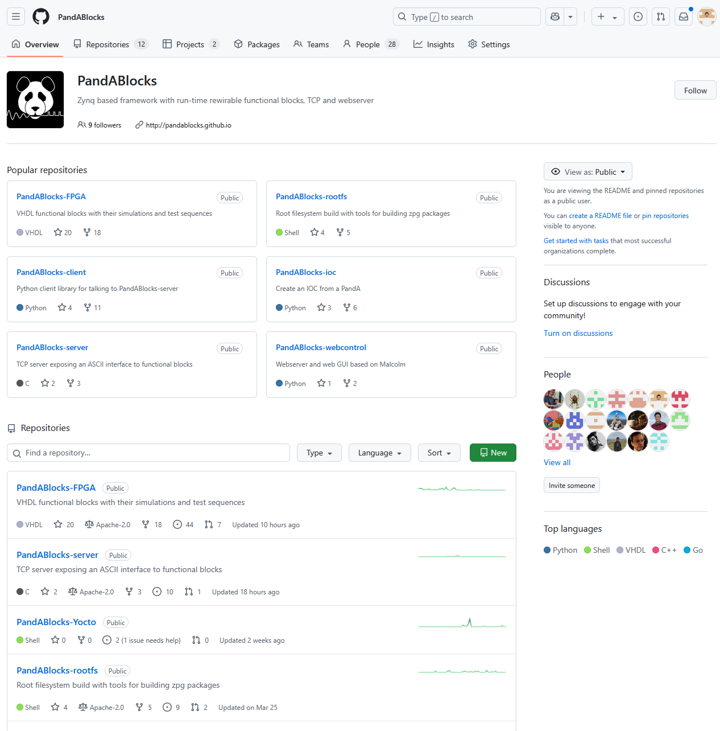
PandABlocks framework
Available from public repo: https://github.com/PandABlocks
rootfs
fpga
TCP server
Python client
webserver
TANGO/EPICS areaDetector
FPGA firmware (more in coming slides!)
Rootfs:
  FSBL, uboot, linux kernel image, root filesystem for the Zynq PS (Arm core)
TCP server and kernel driver:
  interface to Configuration and Status Registers in firmware
  streaming captured data via DMA

Slide 6
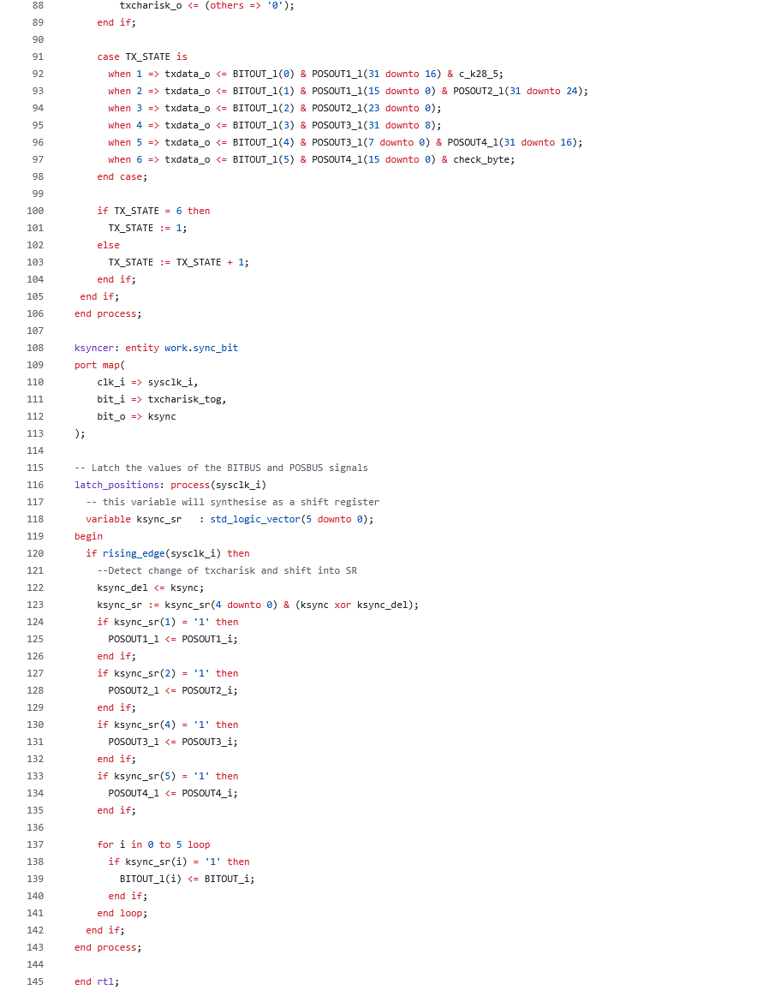

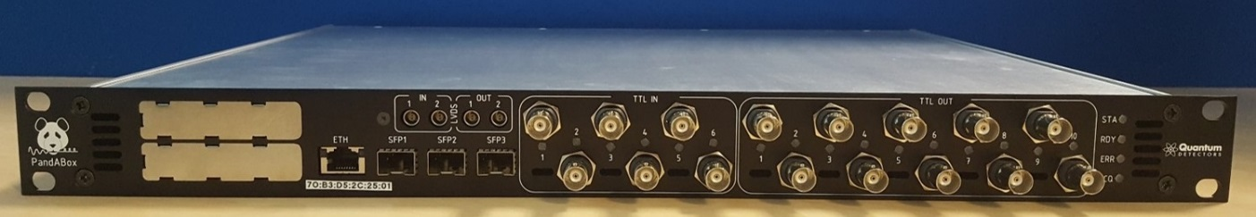
PandABlocks
PandABox

Slide 7
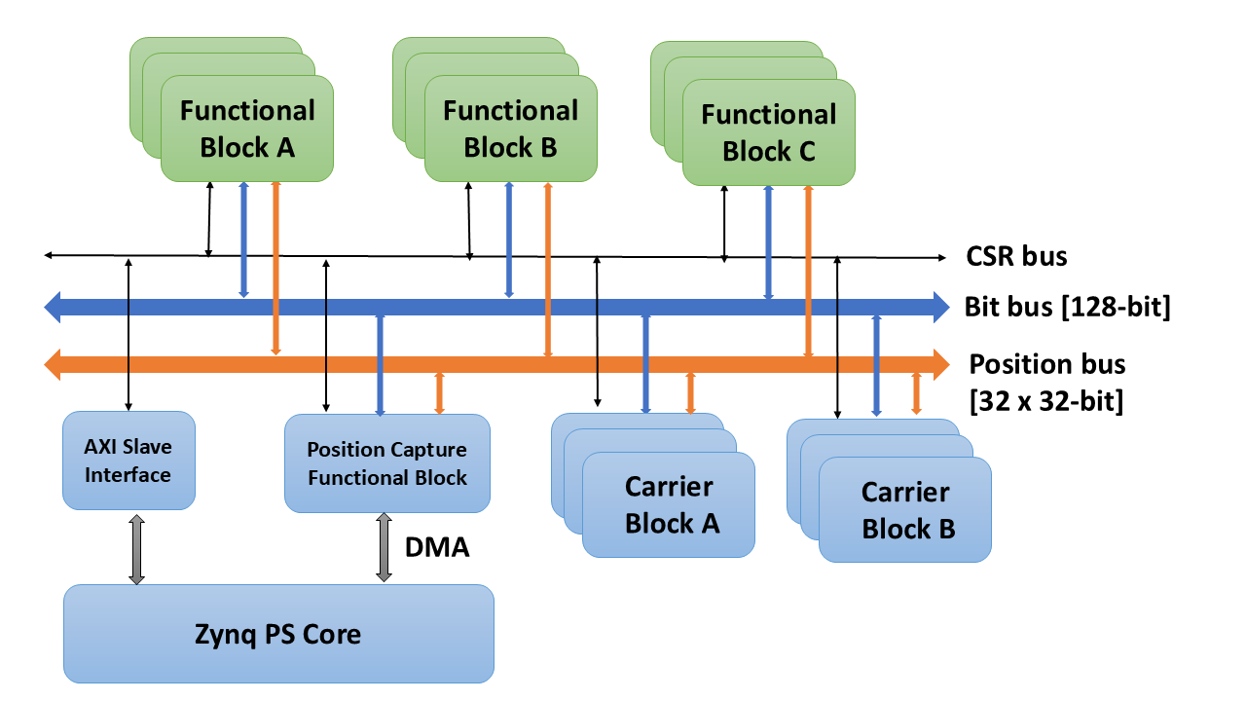
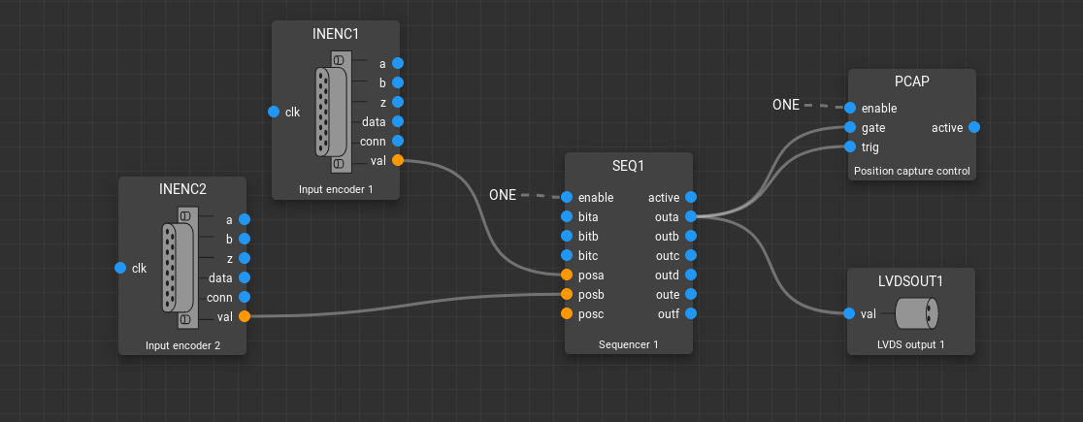
PandABlocks Architecture
Specific functions and hardware resources represented by functional blocks
  Hardware specific base blocks, eg TTL, LVDS
  ‘Soft’ function blocks, eg LUT, SRgate, pulsegen etc
Functional blocks configurable and re-wirable at run-time via multiplexed control and data buses, and Configuration/Status register (CSR) interface
  32 x 32-bit data bus (Position bus)
  128-bit control bus (Bit Bus)
  CSR interface uses 128 KB, addressing up to 32 design blocks
Lots of MUXs! Modest clock speed 125 MHz

Slide 8
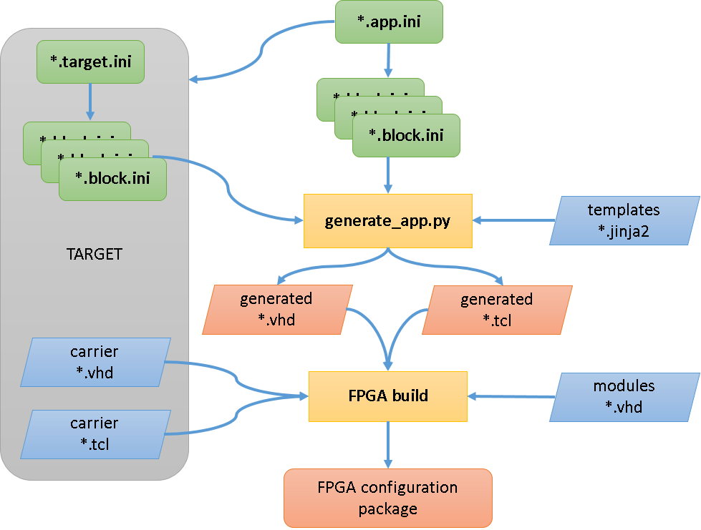

FPGA auto-generation framework
Goals
  Simplify inclusion of user-generated functional blocks
  Implement arbitrary combinations of ‘soft’ and hardware blocks
  Simplify targeting other Zynq-based hardware platforms
Implementation
  Set of text-based “ini” files
  “app.ini” – set of ‘soft’ function blocks in design
  “target.ini” – set of ‘carrier blocks’ available on the hardware
  “block.ini” – defines register interface for each block + other information, eg IP, constraints required
HDL wrappers and register interfaces for each block generated from templates using Python and jinja2 template engine
Top-level Makefile drives the build flow

Slide 9
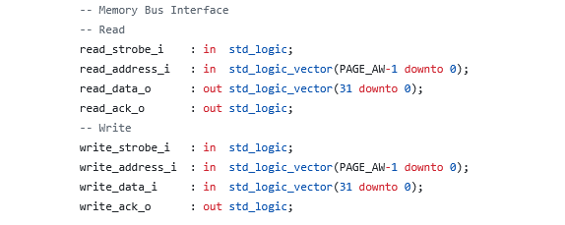
Register Interface
128 KB memory-mapped registers:
  Supports up to 16 instances of 32 design blocks; 64 x 32-bit regs per block
  AXI-lite interface to PS
  Translated to simple STRB/ACK interface at the block level

Slide 10
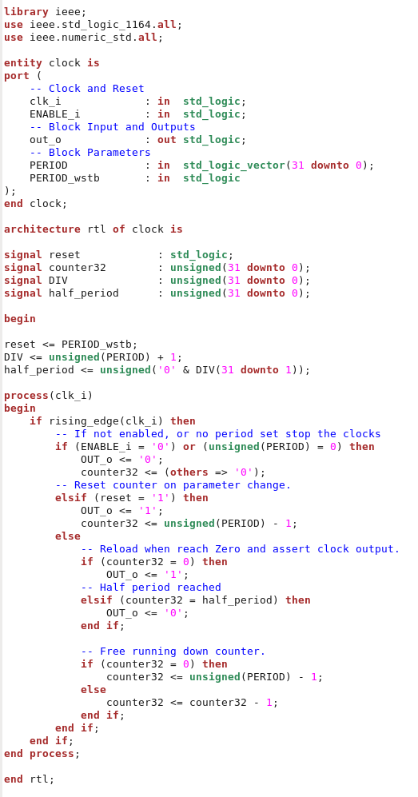
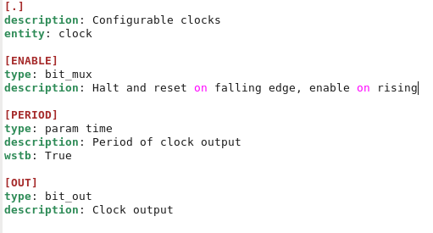
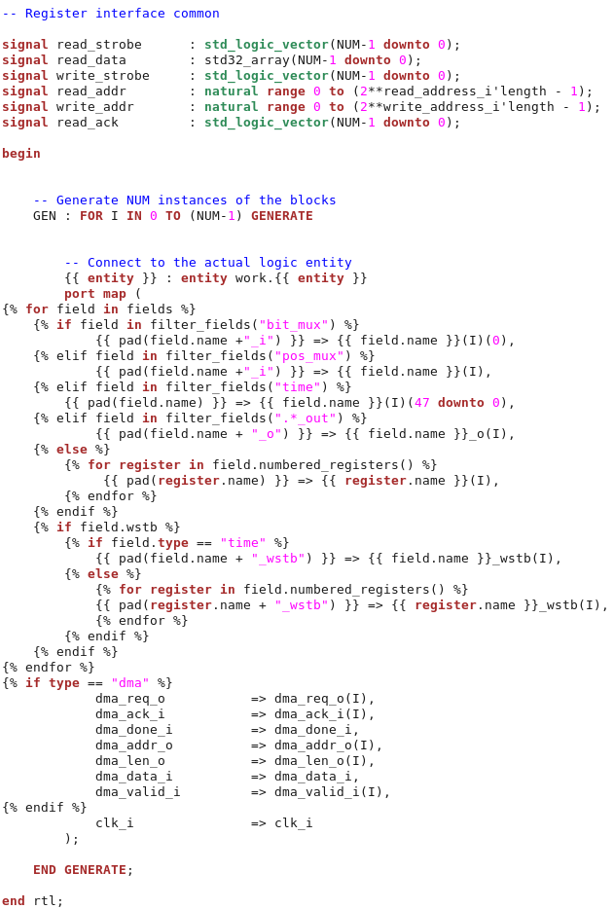
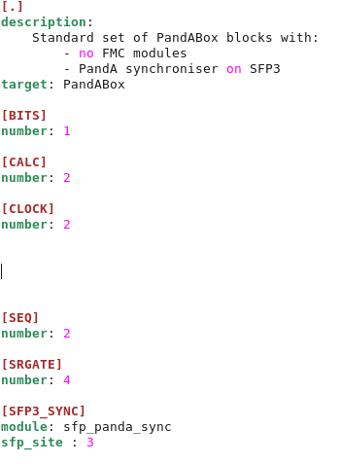
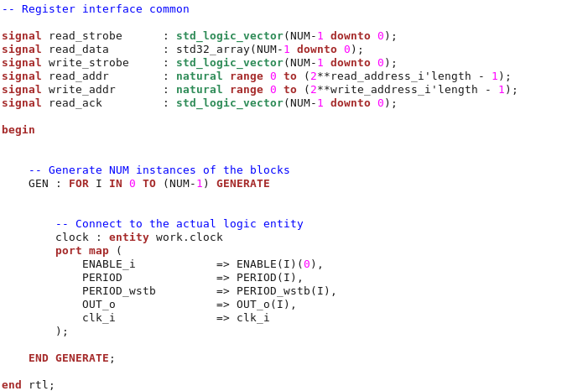
Example: adding new block (new framework)
clock.vhd
clock.block.ini
PandA-no-fmc.app.ini
clock_wrapper.vhd
block_wrapper.vhd.jinja2
Notes:
[.] section describes block as a whole. [FIELD] sections define the field present in the block.

Slide 11
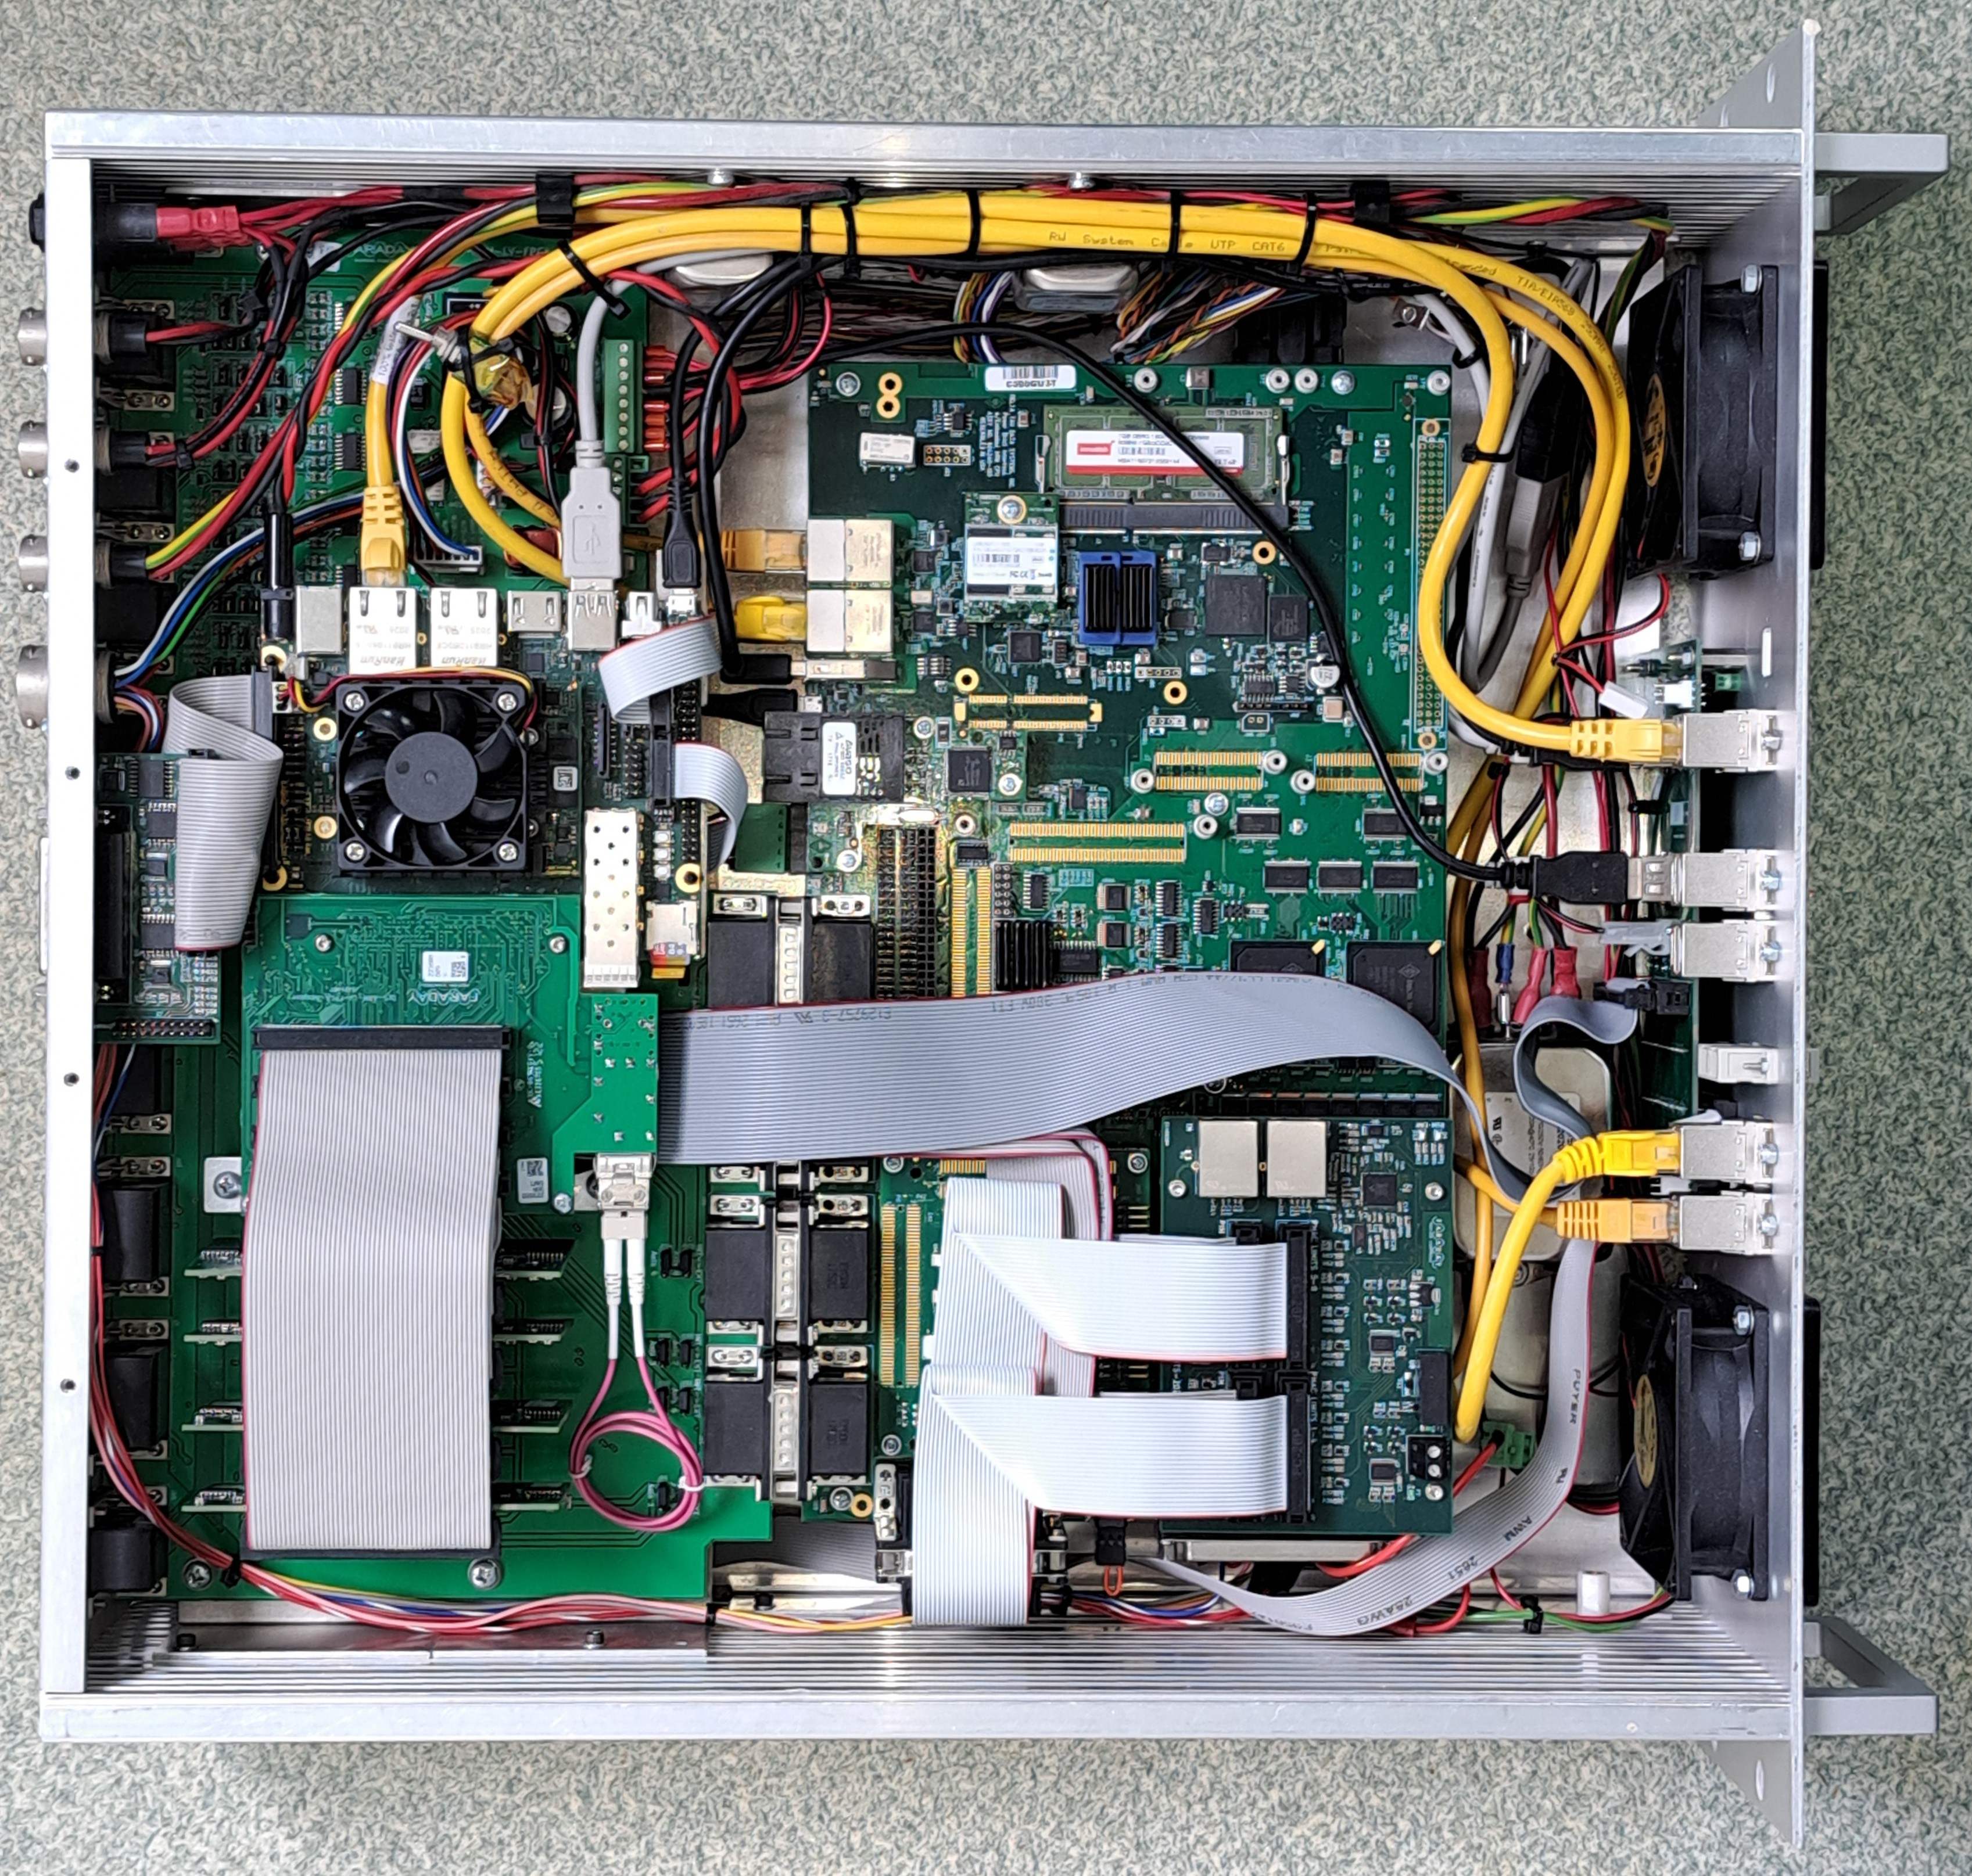
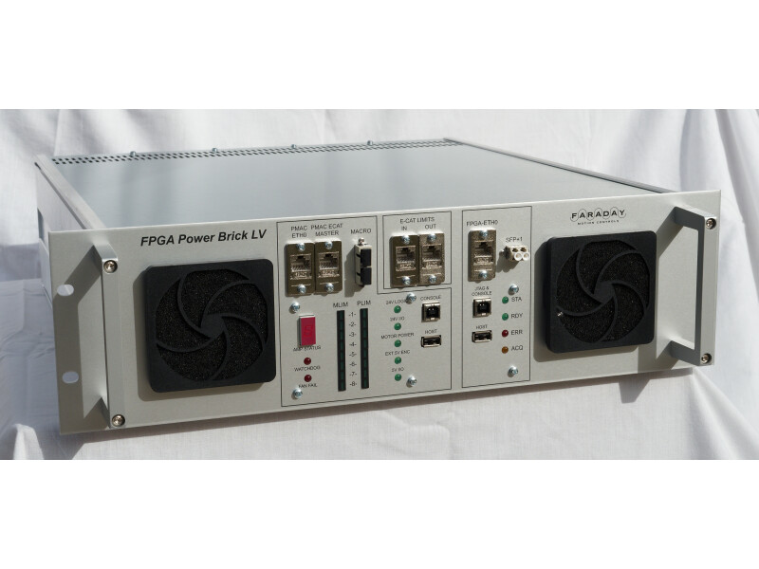
FPGA Power Brick
Enclustra XU6/ST1 integrated into PowerBrick Motion Controller (developed by Faraday Motion Controls and DLS)
ST1
Custom FMC
Line Driver Cards

Slide 12
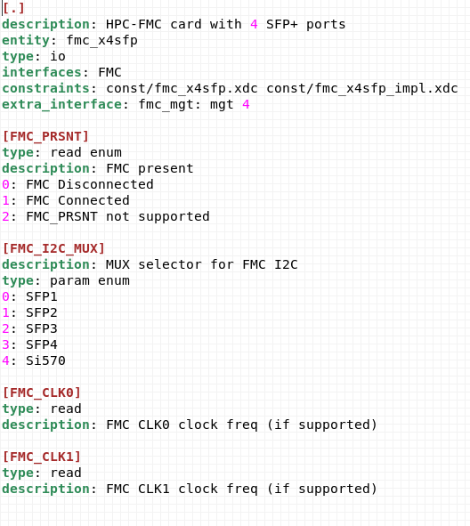
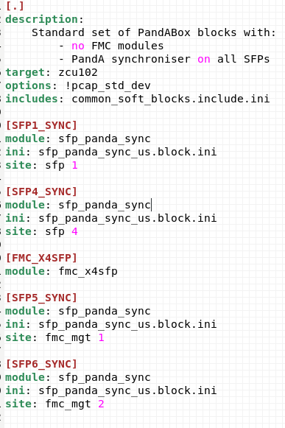
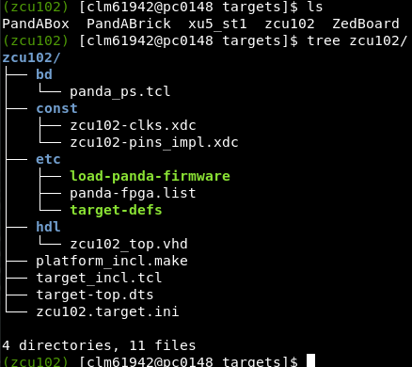
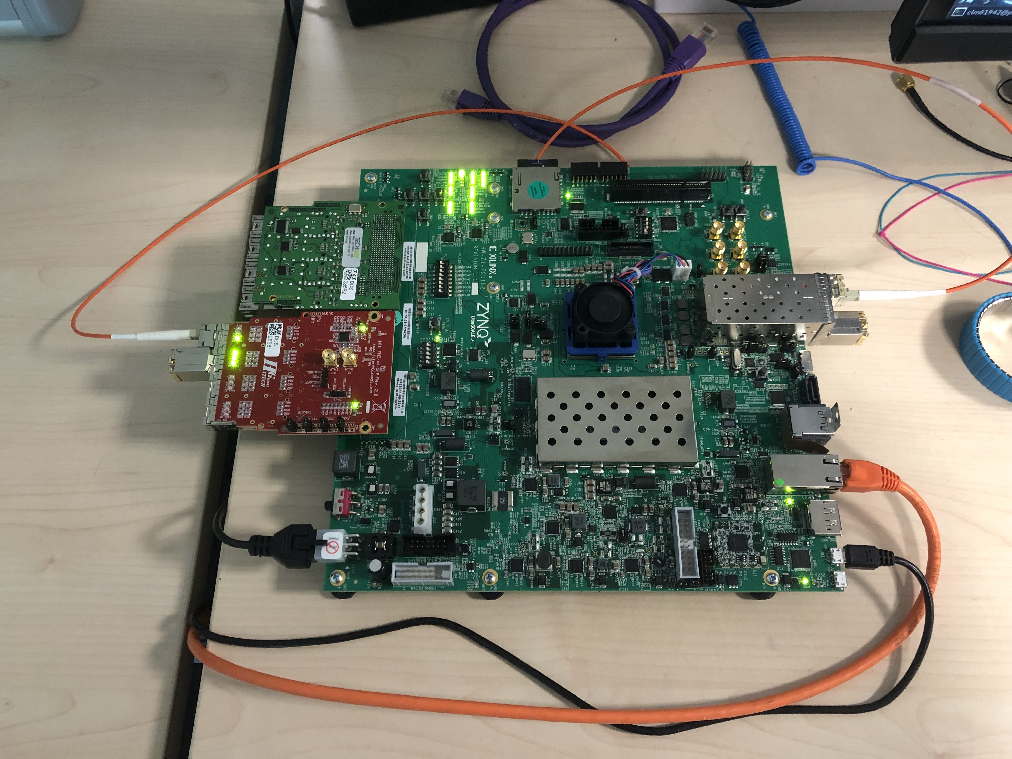
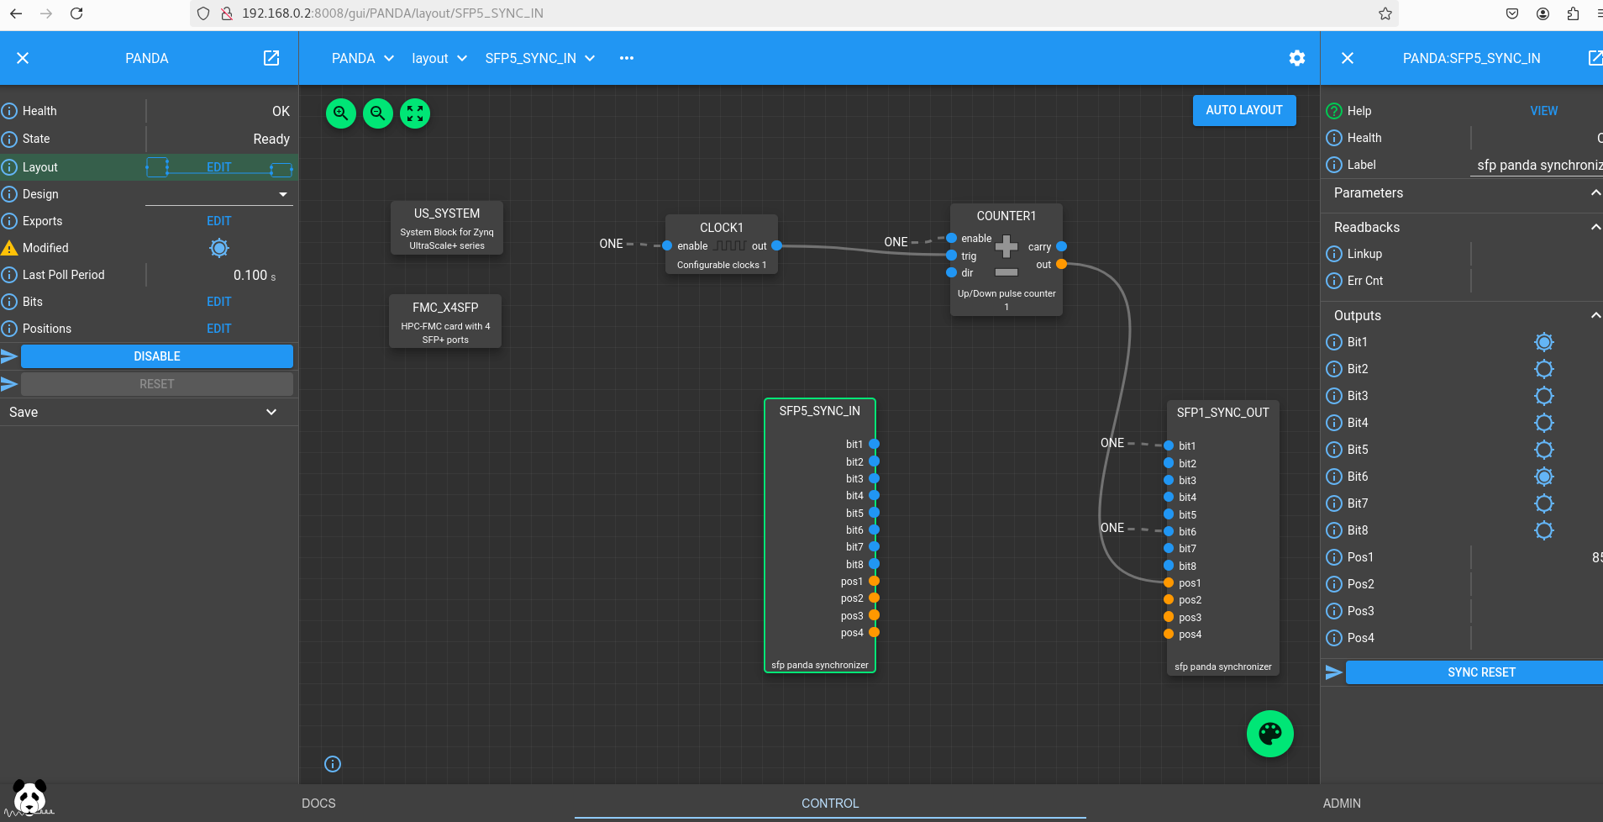
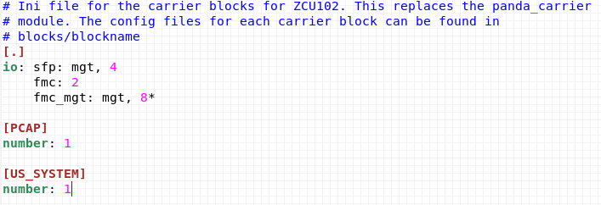
Targeting new hardware platforms - ZCU102
zcu102-fmc_x4sfp.target.ini
fmc_x4sfp.block.ini
zcu102.target.ini

Slide 13
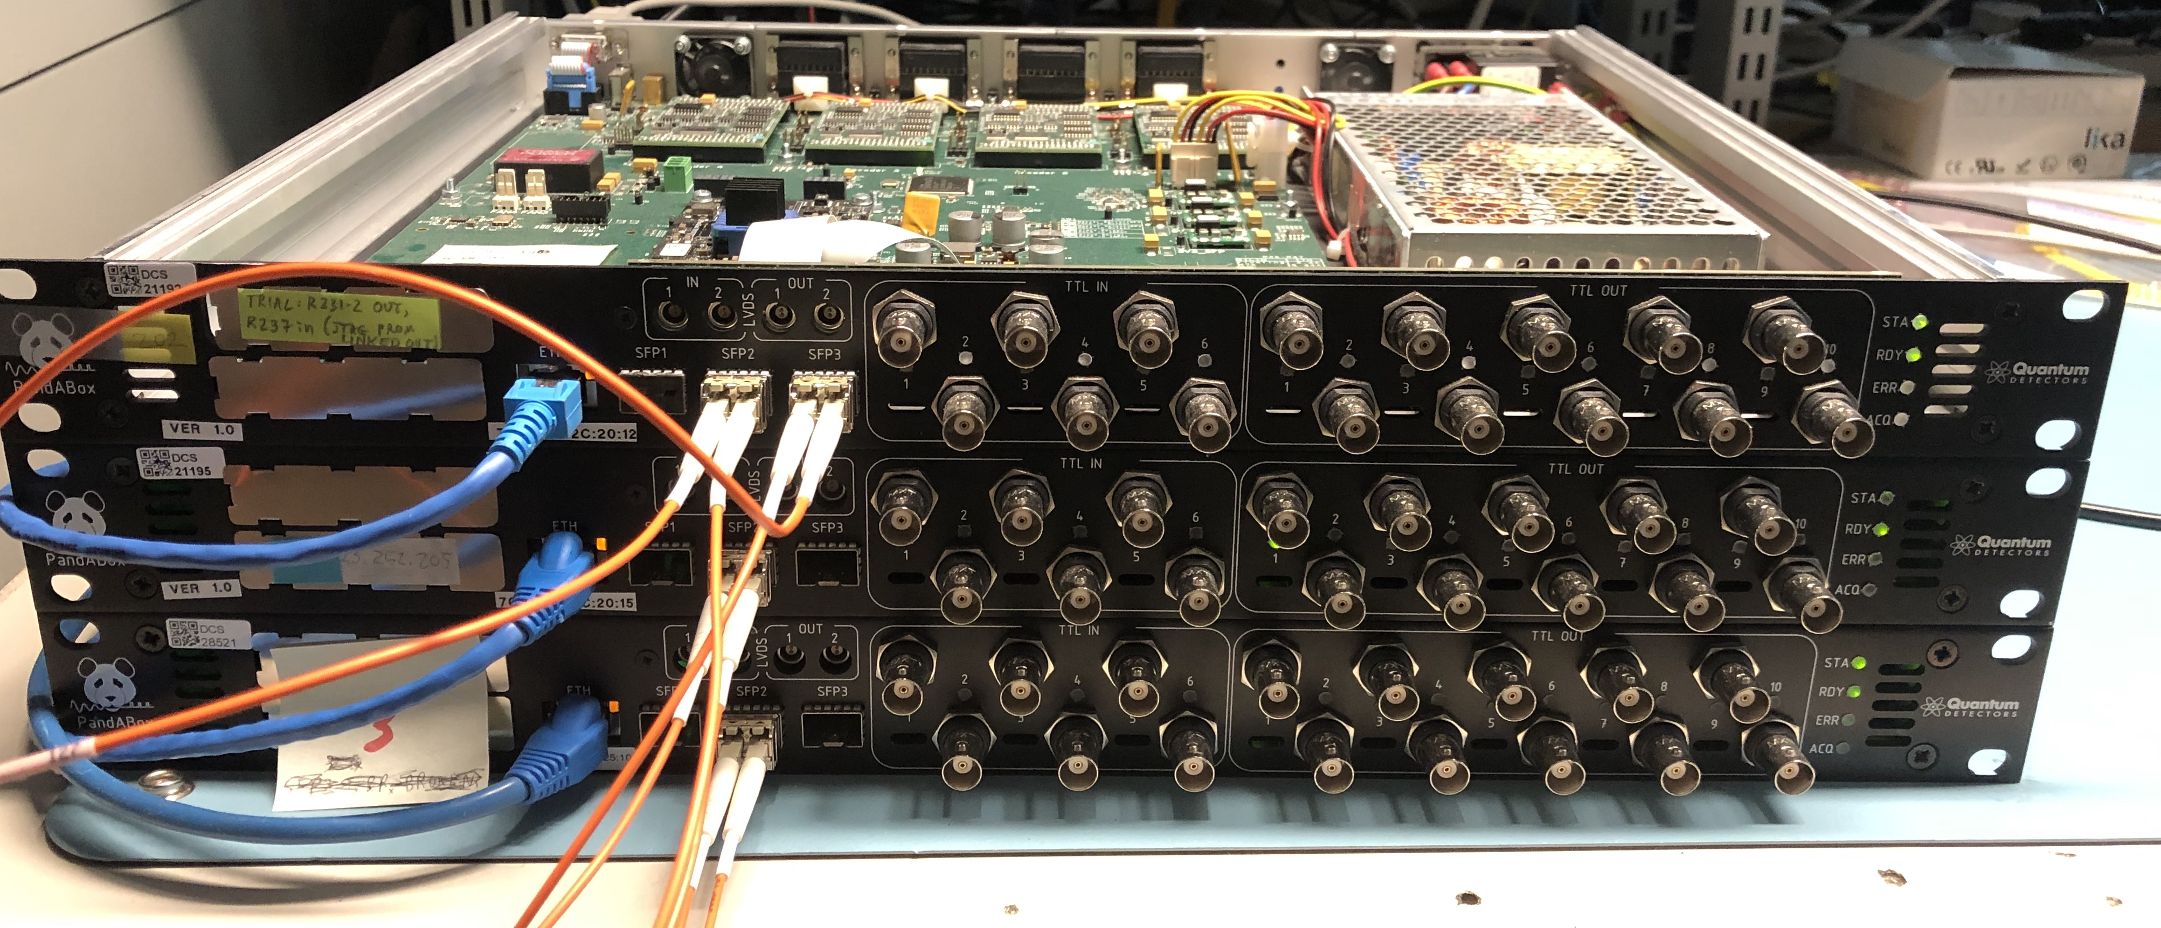
Synchronisation
SFP-based blocks for synchronisation and data sharing
PandA-EVR (event receiver): port of MRF timing protocol used at DLS
  Event based system 2-byte (1 DBUS, 1 event code) @ 125 MHz – 2.5Gbps
  Can use recovered clock as system clock
PandASync – lightweight protocol for data sharing
  Share 8 bitbus and 4 posbus signals between PandAs; 6 cycle repeating pattern
  4-byte (bitbus + some combination of posbus) @ 125MHz – 5 Gbps
  Requirement for < 1 clock cycles jitter between systems
    PICXO – Phase Interpolator Controlled Xstal Oscillator (Xilinx IP)
    Uses TXPI PPM controller
    ~20 ps timing jitter between TTL outputs
In development – ultra-fine delay (~3 ps) from MGT outputs
  Plan to use for fast injection scheme on Diamond-II accelerators
  MGT -> electrical signals, custom FMC design

Slide 14
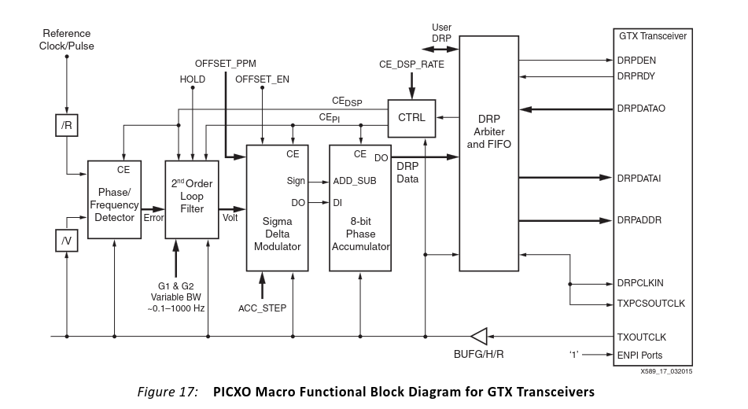
Synchronisation
SFP-based blocks for synchronisation and data sharing
PandA-EVR (event receiver): port of MRF timing protocol used at DLS
  Event based system 2-byte (1 DBUS, 1 event code) @ 125 MHz – 2.5Gbps
  Can use recovered clock as system clock
PandASync – lightweight protocol for data sharing
  Share 8 bitbus and 4 posbus signals between PandAs; 6 cycle repeating pattern
  4-byte (bitbus + some combination of posbus) @ 125MHz – 5 Gbps
  Requirement for < 1 clock cycles jitter between systems
    PICXO – Phase Interpolator Controlled Xstal Oscillator (Xilinx IP)
    Uses TXPI PPM controller
    ~20 ps timing jitter between TTL outputs
In development – ultra-fine delay (~3 ps) from MGT outputs
  Plan to use for fast injection scheme on Diamond-II accelerators
  MGT -> electrical signals, custom FMC design
Xilinx XAPP589

Slide 15
Synchronisation
SFP-based blocks for synchronisation and data sharing
PandA-EVR (event receiver): port of MRF timing protocol used at DLS
  Event based system 2-byte (1 DBUS, 1 event code) @ 125 MHz – 2.5Gbps
  Can use recovered clock as system clock
PandASync – lightweight protocol for data sharing
  Share 8 bitbus and 4 posbus signals between PandAs; 6 cycle repeating pattern
  4-byte (bitbus + some combination of posbus) @ 125MHz – 5 Gbps
  Requirement for < 1 clock cycles jitter between systems
    PICXO – Phase Interpolator Controlled Xstal Oscillator (Xilinx IP)
    Uses TXPI PPM controller
    ~20 ps timing jitter between TTL outputs
In development – ultra-fine delay (~3 ps) from MGT outputs
  Plan to use for fast injection scheme on Diamond-II accelerators
  MGT -> electrical signals, custom FMC design
Xilinx XAPP589

Slide 16
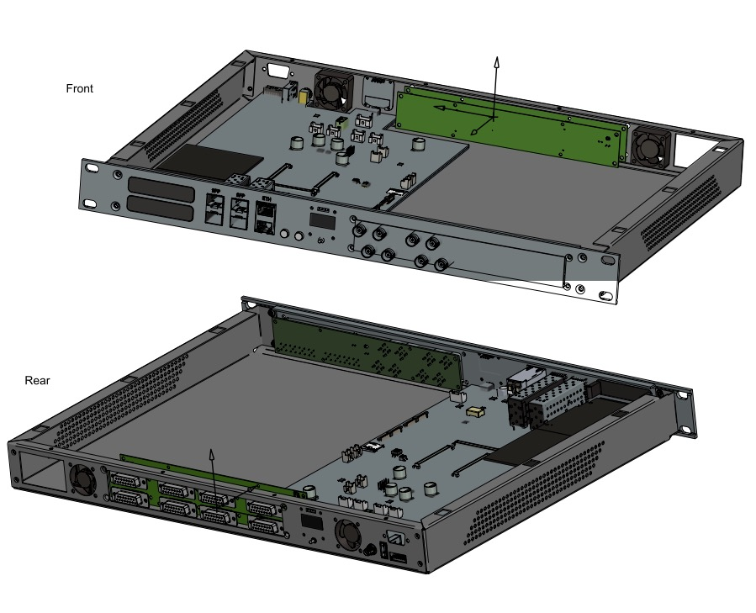
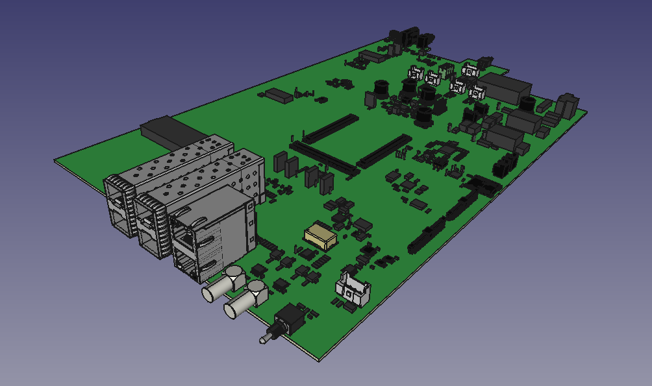
PandABox-2 (UltraPandA)
1U 19-inch form factor (half width variant)
Interchangable front (Digital I/O) and rear (encoder) panels
  Symmetrical 50-way ribbon cable
  Opportunity for customisable I/O panels
LED screens on both front and rear
Four native SFP+ sockets on front
LPC-FMC+ socket with 12 MGTs pinned out
Clocking Support for White Rabbit
Soliel (main board), ALBA (encoder + DI/O boards), DESY (Mechanics), DLS (software/firmware), MAX-IV

Slide 17
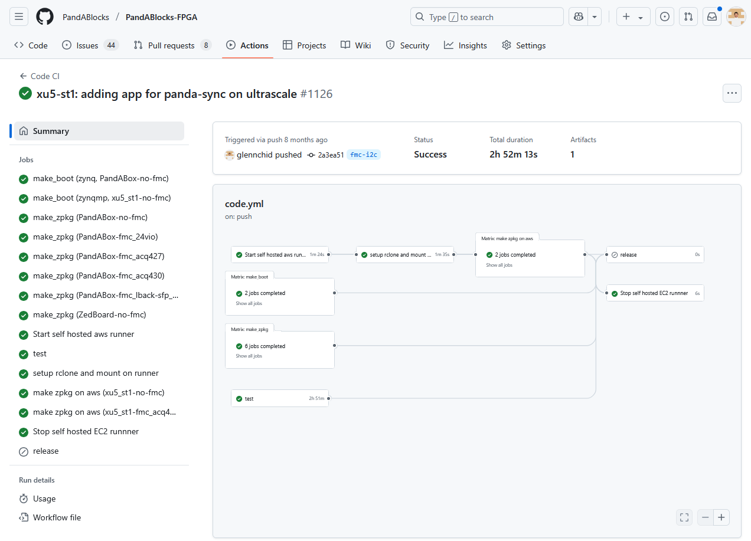
Development environment
Development container for all PandABox related builds
  Rocky8 image with standard packages (gcc etc)
  ARM cross-compiler; AMD kernel, device-tree, uboot sources
  Source code for all rootfs packages Zynq-PS
  Static python environment!
  NOT AMD tools eg (Vivado, Vitis etc)
Continuous Integration
  Github Actions
  CI builds for FPGA, rootfs and server repos
  Includes python tests (framework) and HDL tests (functional block sims)
  CI builds of the firmware images
    Github runner uses Vivado on local-hosted cluster
    De-facto source for releases

Slide 18


Recent developments
Yocto
  Current rootfs : Buildroot inspired system used at DLS for many years
    Small and maintainable, but not so accessible for external collaborators
  Yocto more industry standard
  Remove burden of maintaining packages
  Hoping to avoid headaches with upgrading kernel versions, Vivado versions, new hardware etc
    Issues may have addressed already in petalinux based distros
    We may just be exposing new issues …
CocoTB
  Block level HDL tests previously used Vivado simulator (xsim)
    Original testbenches in Verilog (mixed language support)
  Moved these to CocoTB (open-source python simulation framework)
    Easier verification for python developers
    Can now use GHDL or NVC– speed increase!
    Coverage reports (with NVC)
  Not clear how to deal with simulations of hard blocks (Xilinx IP, primitives etc)

Slide 19
Summary
Flexible framework to support multitude of beam line applications with a single firmware image (per hardware variant)
Re-useable software/firmware stack, can be targeted to any Zynq-7000 or ZU+ platform
  Easy way to bring up new systems, and get access to hardware features such as I2C
Reusable hardware – new PandA more customisable I/O
  Finding uses on Diamond-II storage ring for accelerator systems as well as beam lines
Growing collaboration; welcome new contributors to the framework!!

Slide 20
Acknowledgements
PandA Collaboration
  DLS: Michael Abbott, Famous Alele, Glenn Christian, Tom Cobb, Chris Colborne, Oliver Copping, Andrew Cousins, Emilio Perez Juarez, Adedamola Sode, James Souter, Tom Trafford
  Soliel: Yves-Marie Abiven, Aicha Ammar, Jerome Bisou
  MAX-IV: Valerio Bassetti, Peter Sjöblom
  ALBA: Jose Avila Abellan, Víctor Maín Nadal, Xavier Serra Gallifa
  DESY: Linus Pithan, Iris Schwark, Oliver Seeck, Tobias Spitzbart
Thank you for your attention!

