Slide 1

The new CI4FPGA service
Gitlab CI for FPGA/SoC Projects
Carmen Marcos¹, Christos Gentsos¹*, Konstantinos Evangelou², Ismael Posada Trobo² (¹: IT-CA-GES, ²: IT-PW-WA)
21 May 2025
Notes:
Hey everyone, thanks for coming! My name is Christos Gentsos, and I work for the IT department at CERN. Today, I’m really excited to talk about something we've been working on that should make life a bit easier for anyone doing FPGA or SoC development here at CERN – it's our new CI4FPGA service.

Slide 2
Why CI Matters for Your FPGA Projects
Wait, what is CI again?
CI involves regularly integrating code changes from multiple contributors into a shared codebase, followed by automatic testing and building of the result. This practice is a cornerstone of modern development, particularly for automated repository-level checks.
Key Benefits for FPGA Development
🛠 Consistent Automated Systems
Robust framework for various tests (unit, system-level, linting, code coverage) and builds (bitstream, drivers, utilities)
Triggered at key points in the workflow
⏱ Efficient Job Handling
Easy launching of job sets, despite long build times
⇨ frequent usage ⇨ less breakage, quicker regression bug-hunting
🗫 Enhanced Collaboration
Facilitates common development practices and seamless code sharing
Ideal for IP core libraries and team projects.
2nd FDF meeting
Notes:
So, 'CI4FPGA' – the 'CI' stands for Continuous Integration. Just a quick refresher: CI is all about regularly merging code changes from everyone on a team into one shared place, and then – crucially – automatically testing and building the result.
Why is this a big deal for FPGAs? Well, a few key things:
You get consistent, automated systems. This means a solid framework for all sorts of tests – unit tests, system-level, linting, you name it – plus builds for bitstreams, drivers, and so on. And these can be triggered automatically whenever you push code.
It makes job handling much more efficient. FPGA builds can take ages, right? CI lets you launch these jobs easily and often. The more often you build and test, the less stuff breaks, and when it does, you find those pesky regression bugs way faster.
And it really boosts collaboration. It helps everyone adopt common development practices and makes sharing code, especially for things like IP core libraries, so much smoother.

Slide 3
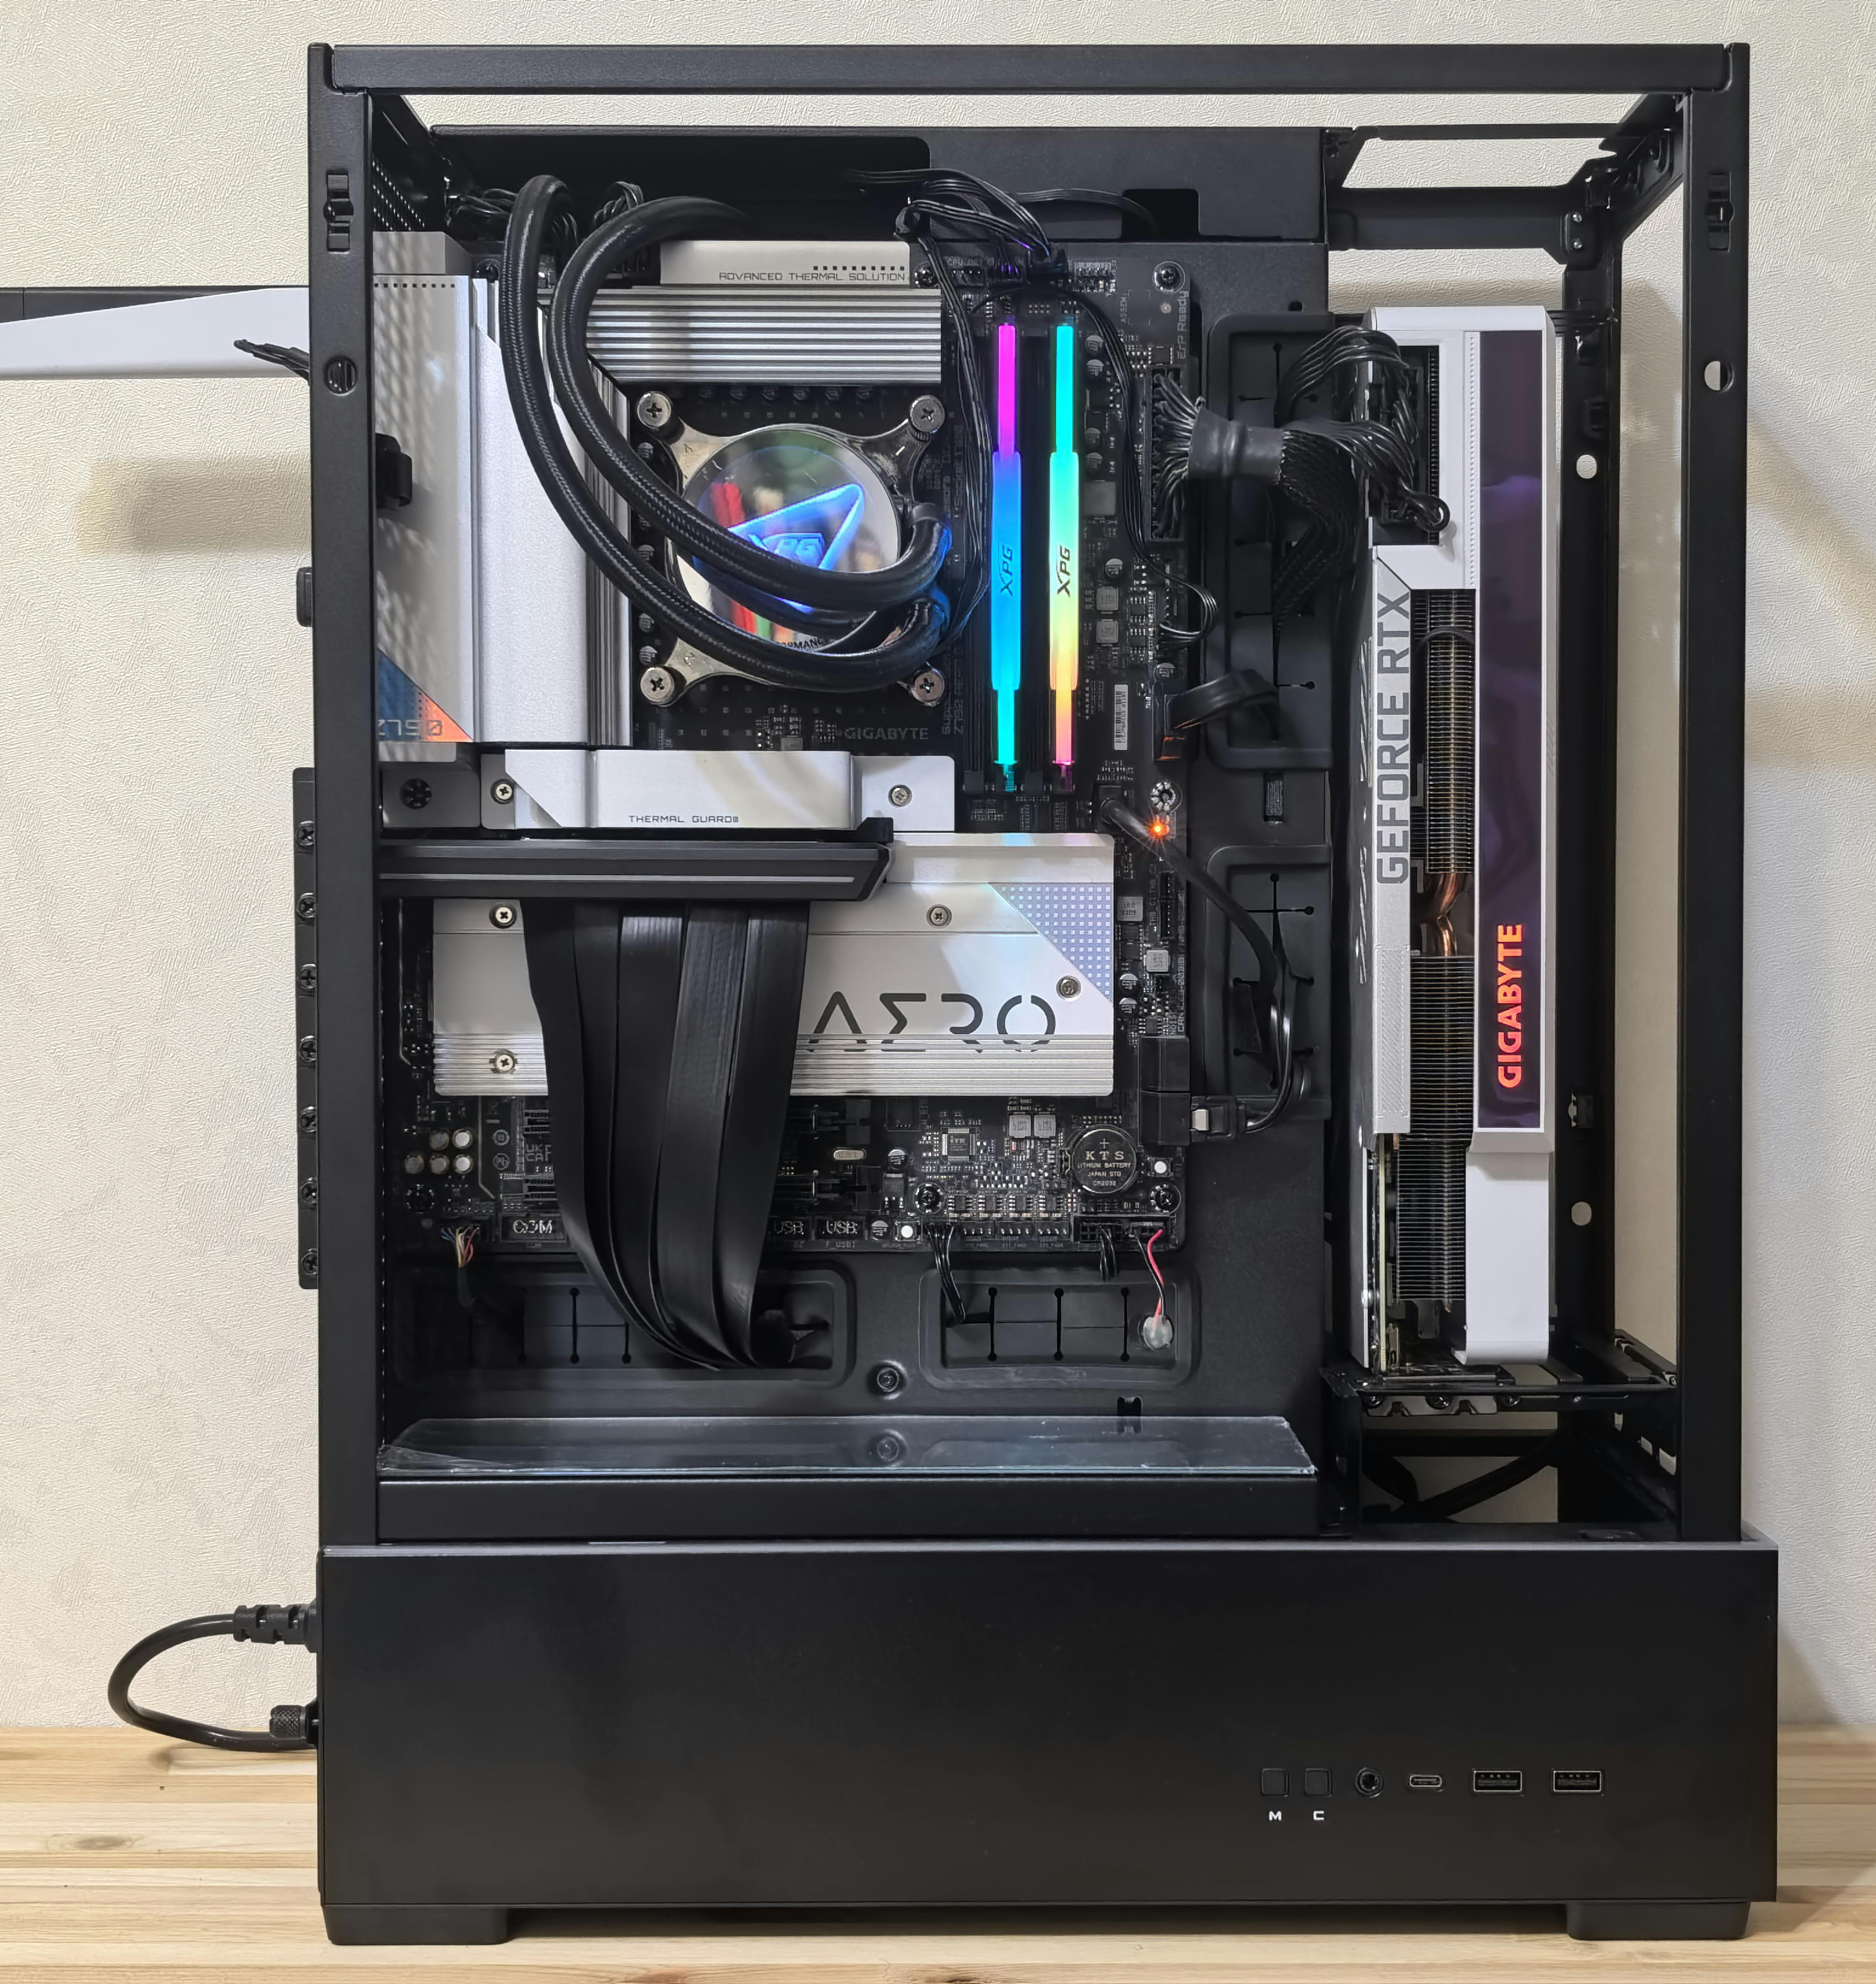
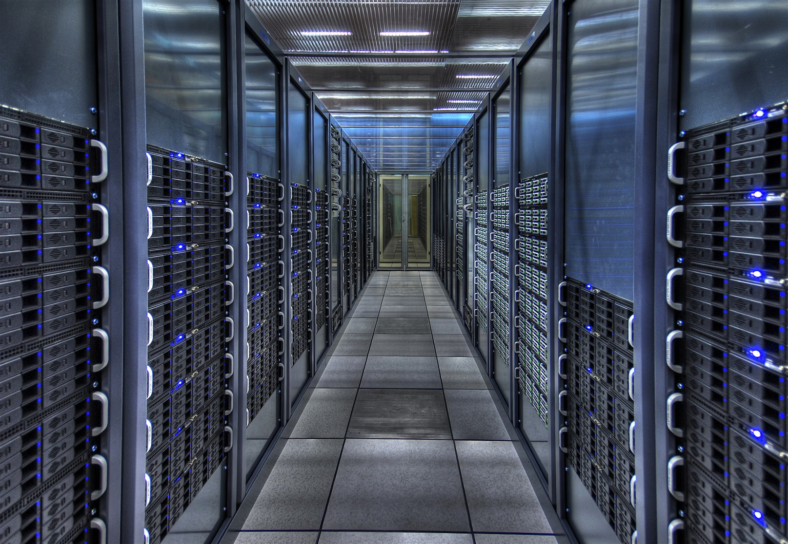
Beyond the Lab Machine: Scaling Challenges
Single lab machine: not that hard
🖒 Get a beefy machine, install tools, gitlab-runner, it works
🖓 Each team has to roll their own
  Machines often left unmaintained
  Still significant barrier to entry
  Fragmented efforts
  Unusable at scale
Scaling for a broad audience on k8s clusters… not that easy
Huge toolchains, O(100GB)
Can’t use publicly available flavors, lack of RAM
Many releases ⇨ OS compatibility
Tricks needed to use on containers
Maintaining and monitoring clusters not FPGA work
2nd FDF meeting
Notes:
Now, if you've ever tried to set up a robust CI system for FPGAs, especially for a wider audience, you'll know it's... not exactly a walk in the park.
On one hand, setting up a single, beefy lab machine with some tools and a GitLab runner? Yeah, that works for a small team. But then every team ends up reinventing the wheel, machines often go unmaintained, and it’s still a barrier to entry for many. It just doesn't scale.
When you try to scale it – say, using Kubernetes clusters – you hit other walls:
EDA toolchains are massive, we're talking hundreds of gigabytes!
You often can't use the standard public Docker images because they don't have enough RAM allocated for our tools.
There are so many releases of tools, and each might need a specific OS, so OS compatibility becomes a headache.
Getting these tools to play nice inside containers often requires some special tricks.
And frankly, maintaining and monitoring these clusters isn’t really what FPGA designers should be spending their time on.

Slide 4

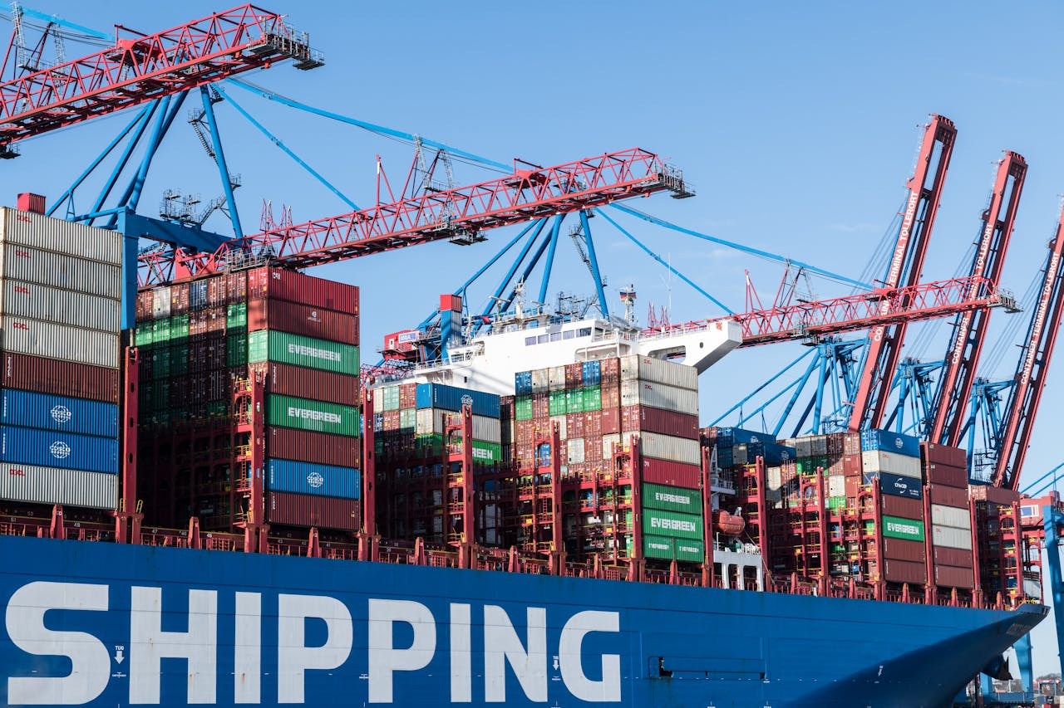
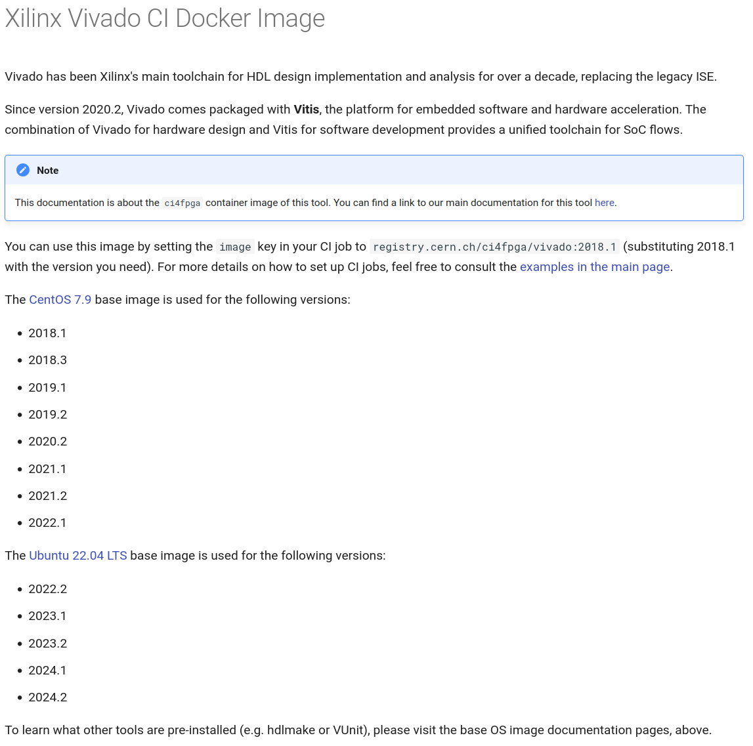
Project Purpose and Objectives
🖧 Scalable VM-based k8s clusters
Develop scalable, maintained VM-based clusters for CI jobs, adapted to EDA tool resource requirements
Purpose:
Accessible CI for all FPGA designers at CERN
🛠 Easy-to-Use Docker Images
Provide user-friendly Docker images for EDA tools, including simulators, toolchains and utilities
◻ Comprehensive Documentation
Create clear and thorough docs to support the 100+ (then projected) users of the system
2nd FDF meeting
21 May 2025
IT-CA-GES | The new CI4FPGA service
Notes:
So, that’s where CI4FPGA comes in. The project had three main objectives: to provide a production service that features:
Develop scalable, maintained VM-based Kubernetes clusters that are actually built for the kind of resources EDA tools demand.
Provide user-friendly Docker images for all the EDA tools you need – simulators, toolchains, utilities, the works.
And, of course, create clear and thorough documentation to support everyone using the system. We were initially projecting over 100 users, so good docs are key!

Slide 5
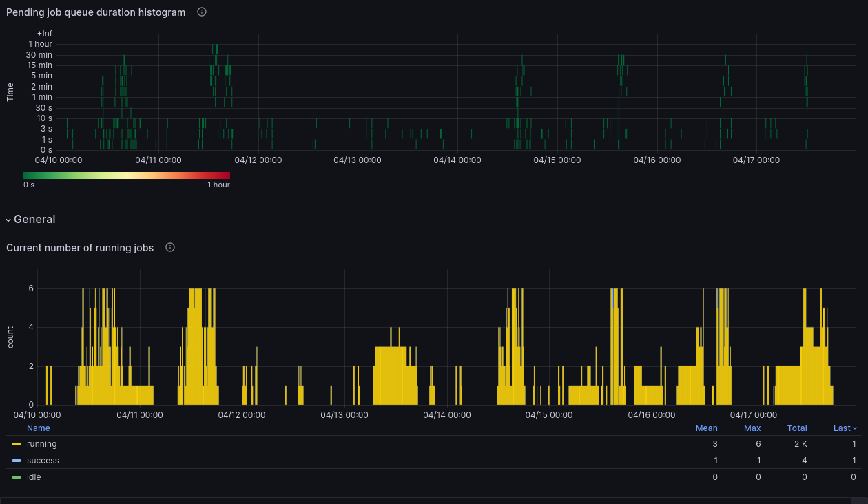
Scalable VM-based k8s clusters
Core platform & capabilities
☞ Robust Foundation
Kubernetes OpenStack VM runners
Located at the PDC (Prevessin Data Centre)
 Advanced Features
Lazy pulling for efficient container image handling
Seamless EOS (CERN's distributed storage) access
Optimized Resource Allocation
🖧 Dual Cluster Design
Two distinct clusters ensure optimal cloud resource utilization:
fpga-mid: 10 nodes, each with 25GB RAM
fpga-large: 6 nodes, each with 55GB RAM
⏱ High Performance & Availability
CI jobs are typically picked up within seconds
Job wait times rarely exceed 5 minutes, ensuring rapid feedback
2nd FDF meeting
Notes:
Let's look at the backbone: the clusters. We've set up Kubernetes OpenStack VM runners, and they're located right here at the Prévessin Data Centre.
We actually have a dual cluster design to make the best use of cloud resources:
There’s fpga-mid: this has 10 nodes, and each node packs 25GB of RAM.
And then for the really heavy lifting, there’s fpga-large: 6 nodes, each with a hefty 55GB of RAM.
Performance-wise, things are looking good. CI jobs are usually picked up within seconds. And even when things get busy, job wait times rarely go over 5 minutes, so you get that rapid feedback.
We’ve also got some nice advanced features like lazy pulling for container images (which speeds things up, especially for smaller jobs, and allows us to build richer images without performance impact) and seamless access to EOS, CERN's distributed storage.

Slide 6
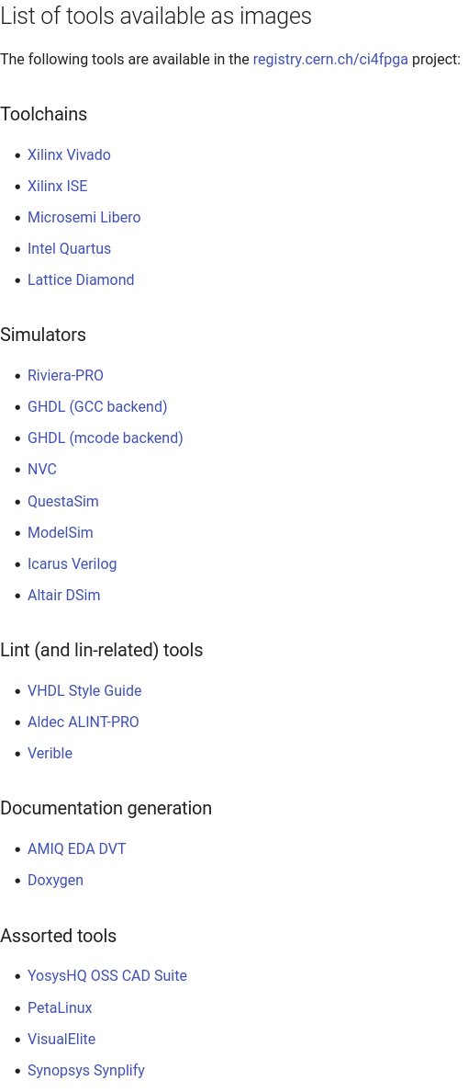
Easy-to-Use Docker Images
🛠 Pre-configured Docker images
Extensive library: images for all needed tools, multiple versions per tool (85 images and counting)
Simple to use: no need for any setup instructions in job scripts (license, paths)
Careful: measures to prevent depriving real users from licenses
◻ Comprehensive User Documentation
Automatically generated from image sources, ensuring consistency
User-focused: Extensive FAQ
2nd FDF meeting
Notes:
Alright, let's talk about the Docker images, because this is what is most visible to you, the user.
We’ve built up an extensive library – we're at 85 images and counting! – covering all the tools you'd typically need, with multiple versions for each tool. You can see a list on the slide: Xilinx Vivado, ISE, tools from Microsemi, Intel, Lattice, a whole suite of simulators like Riviera-PRO, QuestaSim, ModelSim, open-source ones like GHDL and Icarus Verilog, plus linting tools, documentation generators, and more.
The best part? They're super simple to use. There's no need for complicated setup instructions in your job scripts to handle licenses or paths – that’s all taken care of. And we've been careful and created scripts that are injected before jobs are started and make sure this doesn't step on the toes of real users needing licenses for interactive work.
We’ve put a lot of effort into documentation. It’s auto-generated from the image sources, so it's always consistent, and there's a big FAQ section to help you out.

Slide 7
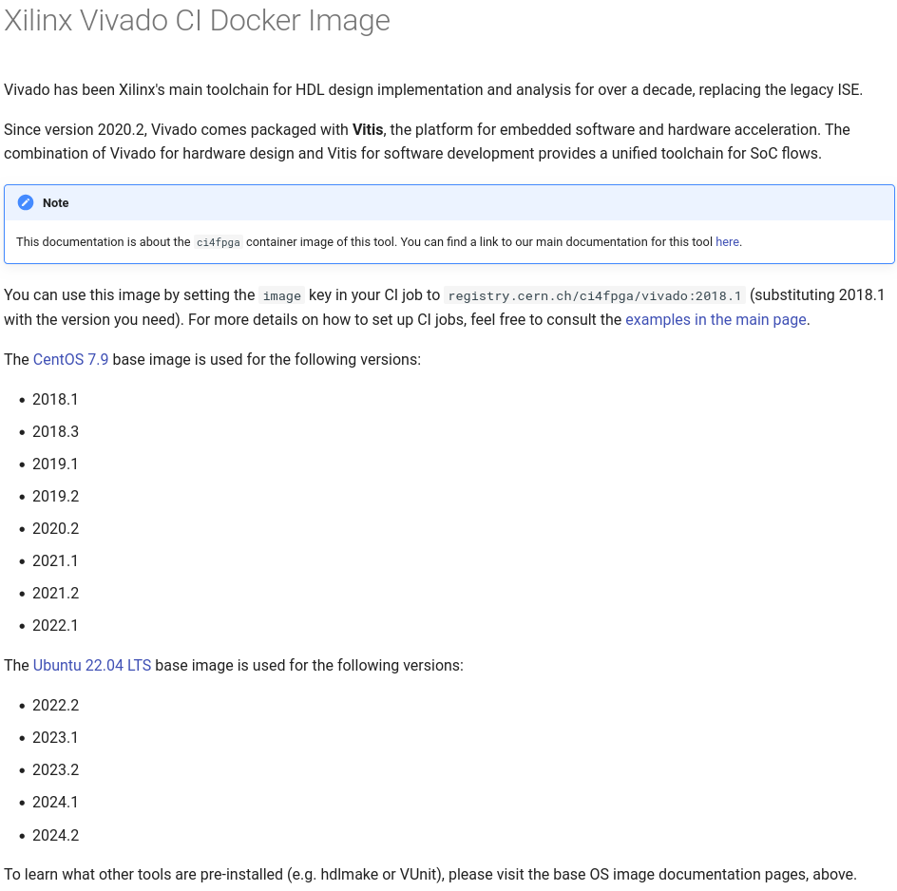
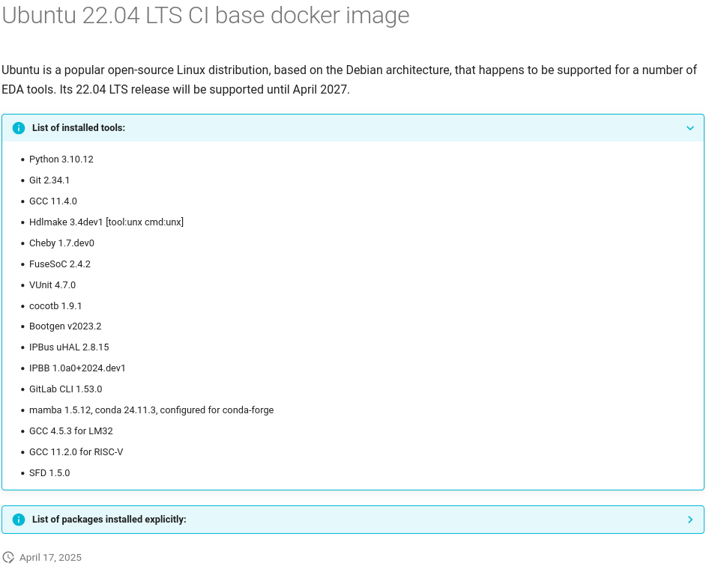
Easy-to-Use Docker Images
🛠 Multiple releases
Supported OS used for each release
OS for each release clearly documented
🛠 Base OS images rich in utilities
Base images feature commonly used tools, like
  hdlmake
  Cheby
  Vunit
  Cocotb
  Embedded toolchains
Versions clearly documented
2nd FDF meeting
Notes:
For each tool release, we use a supported OS, and that's clearly documented. For instance, if you look at the Xilinx Vivado images, versions from 2018.1 up to 2022.1 use CentOS 7.9. But from 2022.2 onwards, we're using the Ubuntu 22.04 LTS base image. That Ubuntu base, comes packed with useful stuff like Python 3.10, Git, GCC 11.4, Hdlmake, Cheby, VUnit, cocotb – the list goes on.

Slide 8
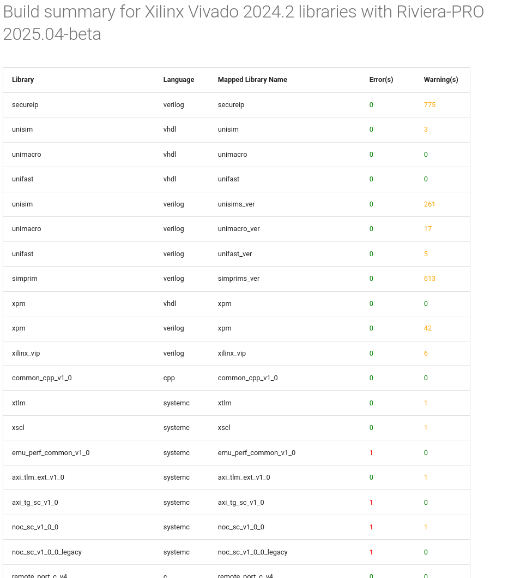
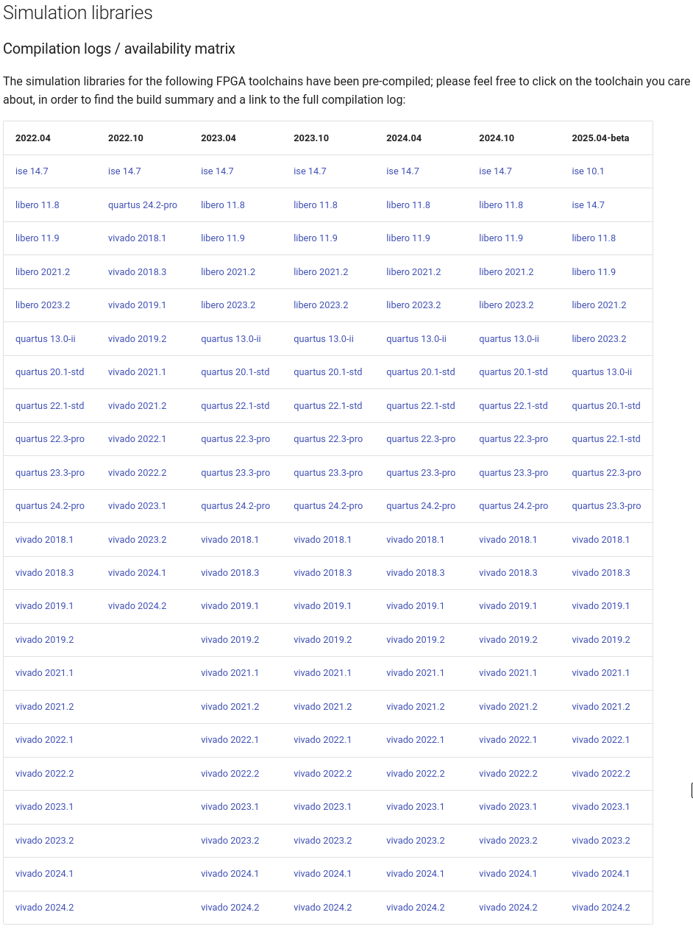
Easy-to-Use Docker Images
🛠 Pre-compiled simulation libraries
Simulator images come with pre-compiled simulator libraries for most toolchains
Greatly simplifies simulation tasks
Simulation logs parsed and presented in the documentation
2nd FDF meeting
Notes:
And one more really handy thing: our simulator images come with pre-compiled simulation libraries for most toolchains. This is a huge time saver and greatly simplifies getting your simulations up and running. We even parse the simulation logs and present them in the documentation. You can see an example of the matrix on the screen now. (Allow a moment for people to see the matrix if displayed).

Slide 9
Defining / Moving CI Jobs
build-job:
tags:
- fpga-mid
image: registry.cern.ch/ci4fpga/vivado:2022.2
script:
- vivado -mode batch -source build.tcl
artifacts:
paths:
- "*.rpt"
- "*.bit"
⇧ Simple to begin with CI
Assuming you have a command / script you can run, something like that is all it takes
If you already have a CI implementation, only things need to be changed are the tag and the image
  Feedback on the migration has been great; in some cases, it just took 5 minutes
No need to register anywhere, just go to the
documentation, everything should be there – please open a ticket if it isn’t
2nd FDF meeting
Notes:
So, how do you actually use this? It's incredibly simple to get started.
Assuming you have a command or a script that builds your FPGA project, like vivado -mode batch -source build.tcl, this YAML snippet here is pretty much all it takes to define a job.
You just add a tags section – here we're using fpga-mid to target that cluster. Then you specify the image you want from our registry – registry.cern.ch/ci4fpga/vivado:2022.2 in this case. Pop your command in the script section, tell it which artifacts to save, and you're good to go.
If you already have a CI setup, migrating is usually just a matter of changing the tag and the image path. The feedback we’ve had on migration has been fantastic – in some cases, it literally took just 5 minutes!
And the best part? No need to register anywhere. Just head to the documentation – everything you need should be there. If it isn't, please open a ticket and let us know!

Slide 10
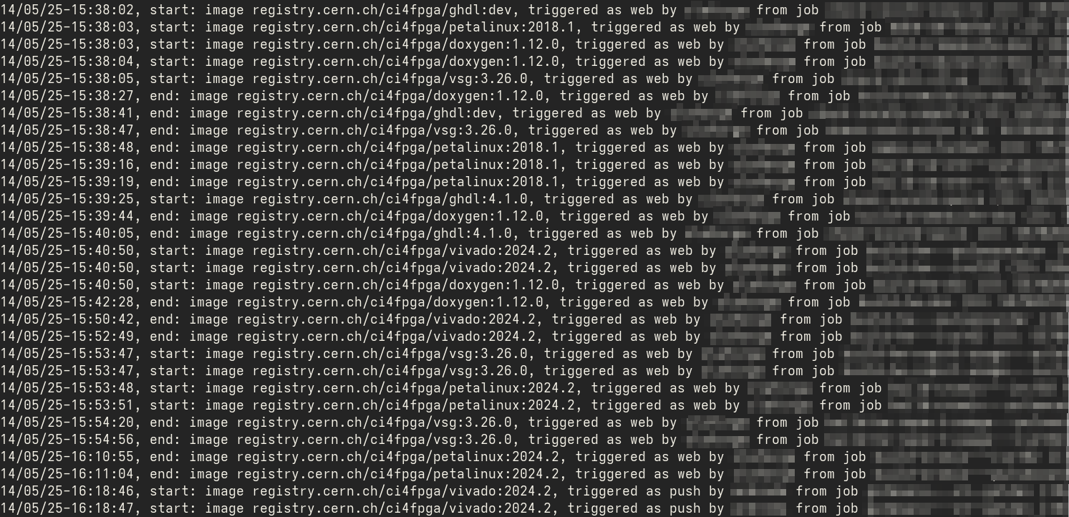
Existing Users
 119 users are already using CI4FPGA with 130 projects; more than 20k jobs completed so far
2nd FDF meeting
Notes:
And people are using it! We're really pleased with the uptake so far.
We currently have 119 users who are actively using CI4FPGA across 130 different projects. And together, they've completed more than 20,000 CI jobs! So it's definitely getting some good use.

Slide 11
Future Plans
 Governance
Strategy for which images should be actively maintained, which should be frozen and when, missing
If we only continue to add images without putting some aside as “legacy”, documentation will become unusable after some years
Somebody needs to decide (how to decide)
◻ Other ideas
Identify shareable CI job “recipes”, share centrally?
Add clusters w/more RAM? (needs official request for resources)
???
2nd FDF meeting
Notes:
Looking ahead, we've got a few things on our minds.
First, Governance. As we add more and more images, we need a clear strategy for which ones should be actively maintained, which ones can be frozen, and when some should be considered 'legacy'. If we don't manage this, the documentation will become a beast in a few years.
We're also thinking about other ideas, like identifying common CI job 'recipes' and sharing them centrally to help everyone out.
And there's the question of whether we should add clusters with even more RAM. This would need an official request for resources, but it's something we're considering based on demand.

Slide 12
Many thanks!
Any questions?
Notes:
So, that's the new CI4FPGA service in a nutshell. We hope it’ll be a valuable tool for the FPGA community here at CERN.
Many thanks for listening, and now we'd be happy to answer any questions you might have!

