Slide 1
Low Jitter Frame Clock Recovery in Xilinx UltraScale+ Transceivers
Paul Bachek – Electrical Engineer
FPGA Developers’ Forum 2025 – CERN
May 21, 2025

Slide 2
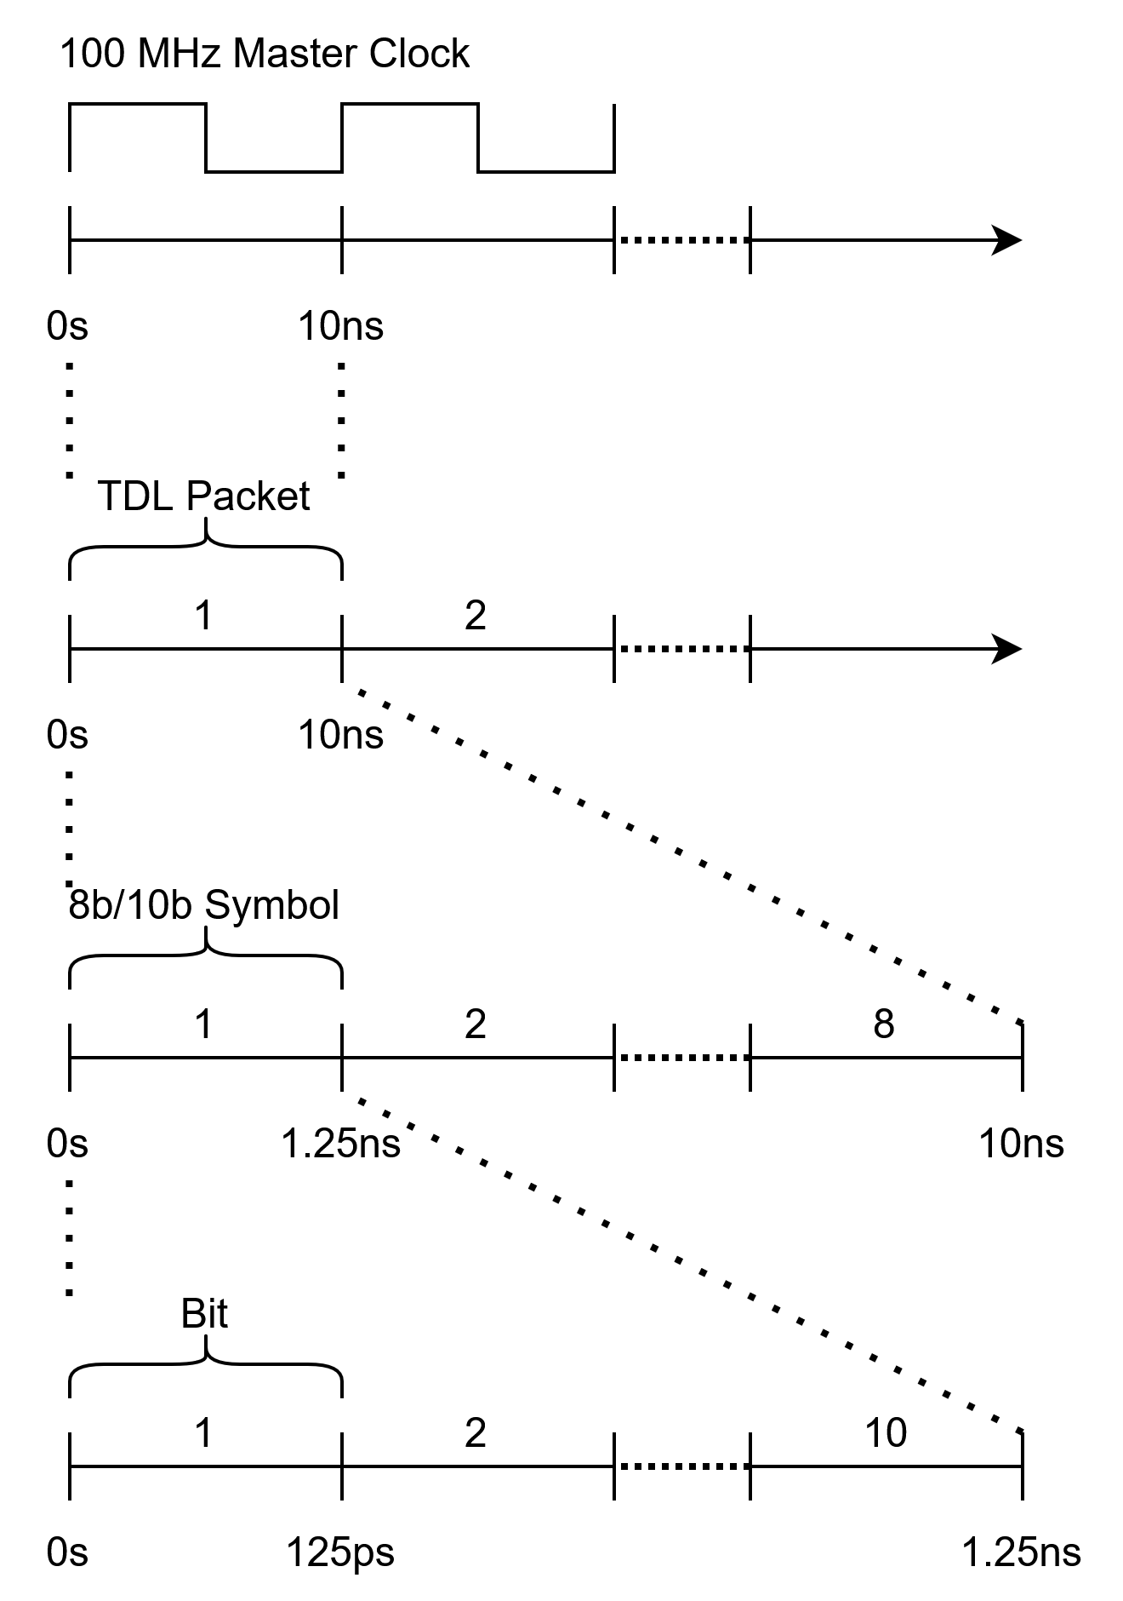
EIC Timing Data Link (TDL)
100 MHz Accelerator Master Clock
  Used to synthesize RF and Beam Sync clocks
64-bit TDL Packets transmitted continuously
8b/10b byte encoding yields 80 bits per TDL Packet
Line rate of 8 Gbps
  100 MHz * 80 bits = 8 Gbps
Transmitted long distances via SFP+ fiber modules
FPGA Developers’ Forum 2025
Paul Bachek

Slide 3
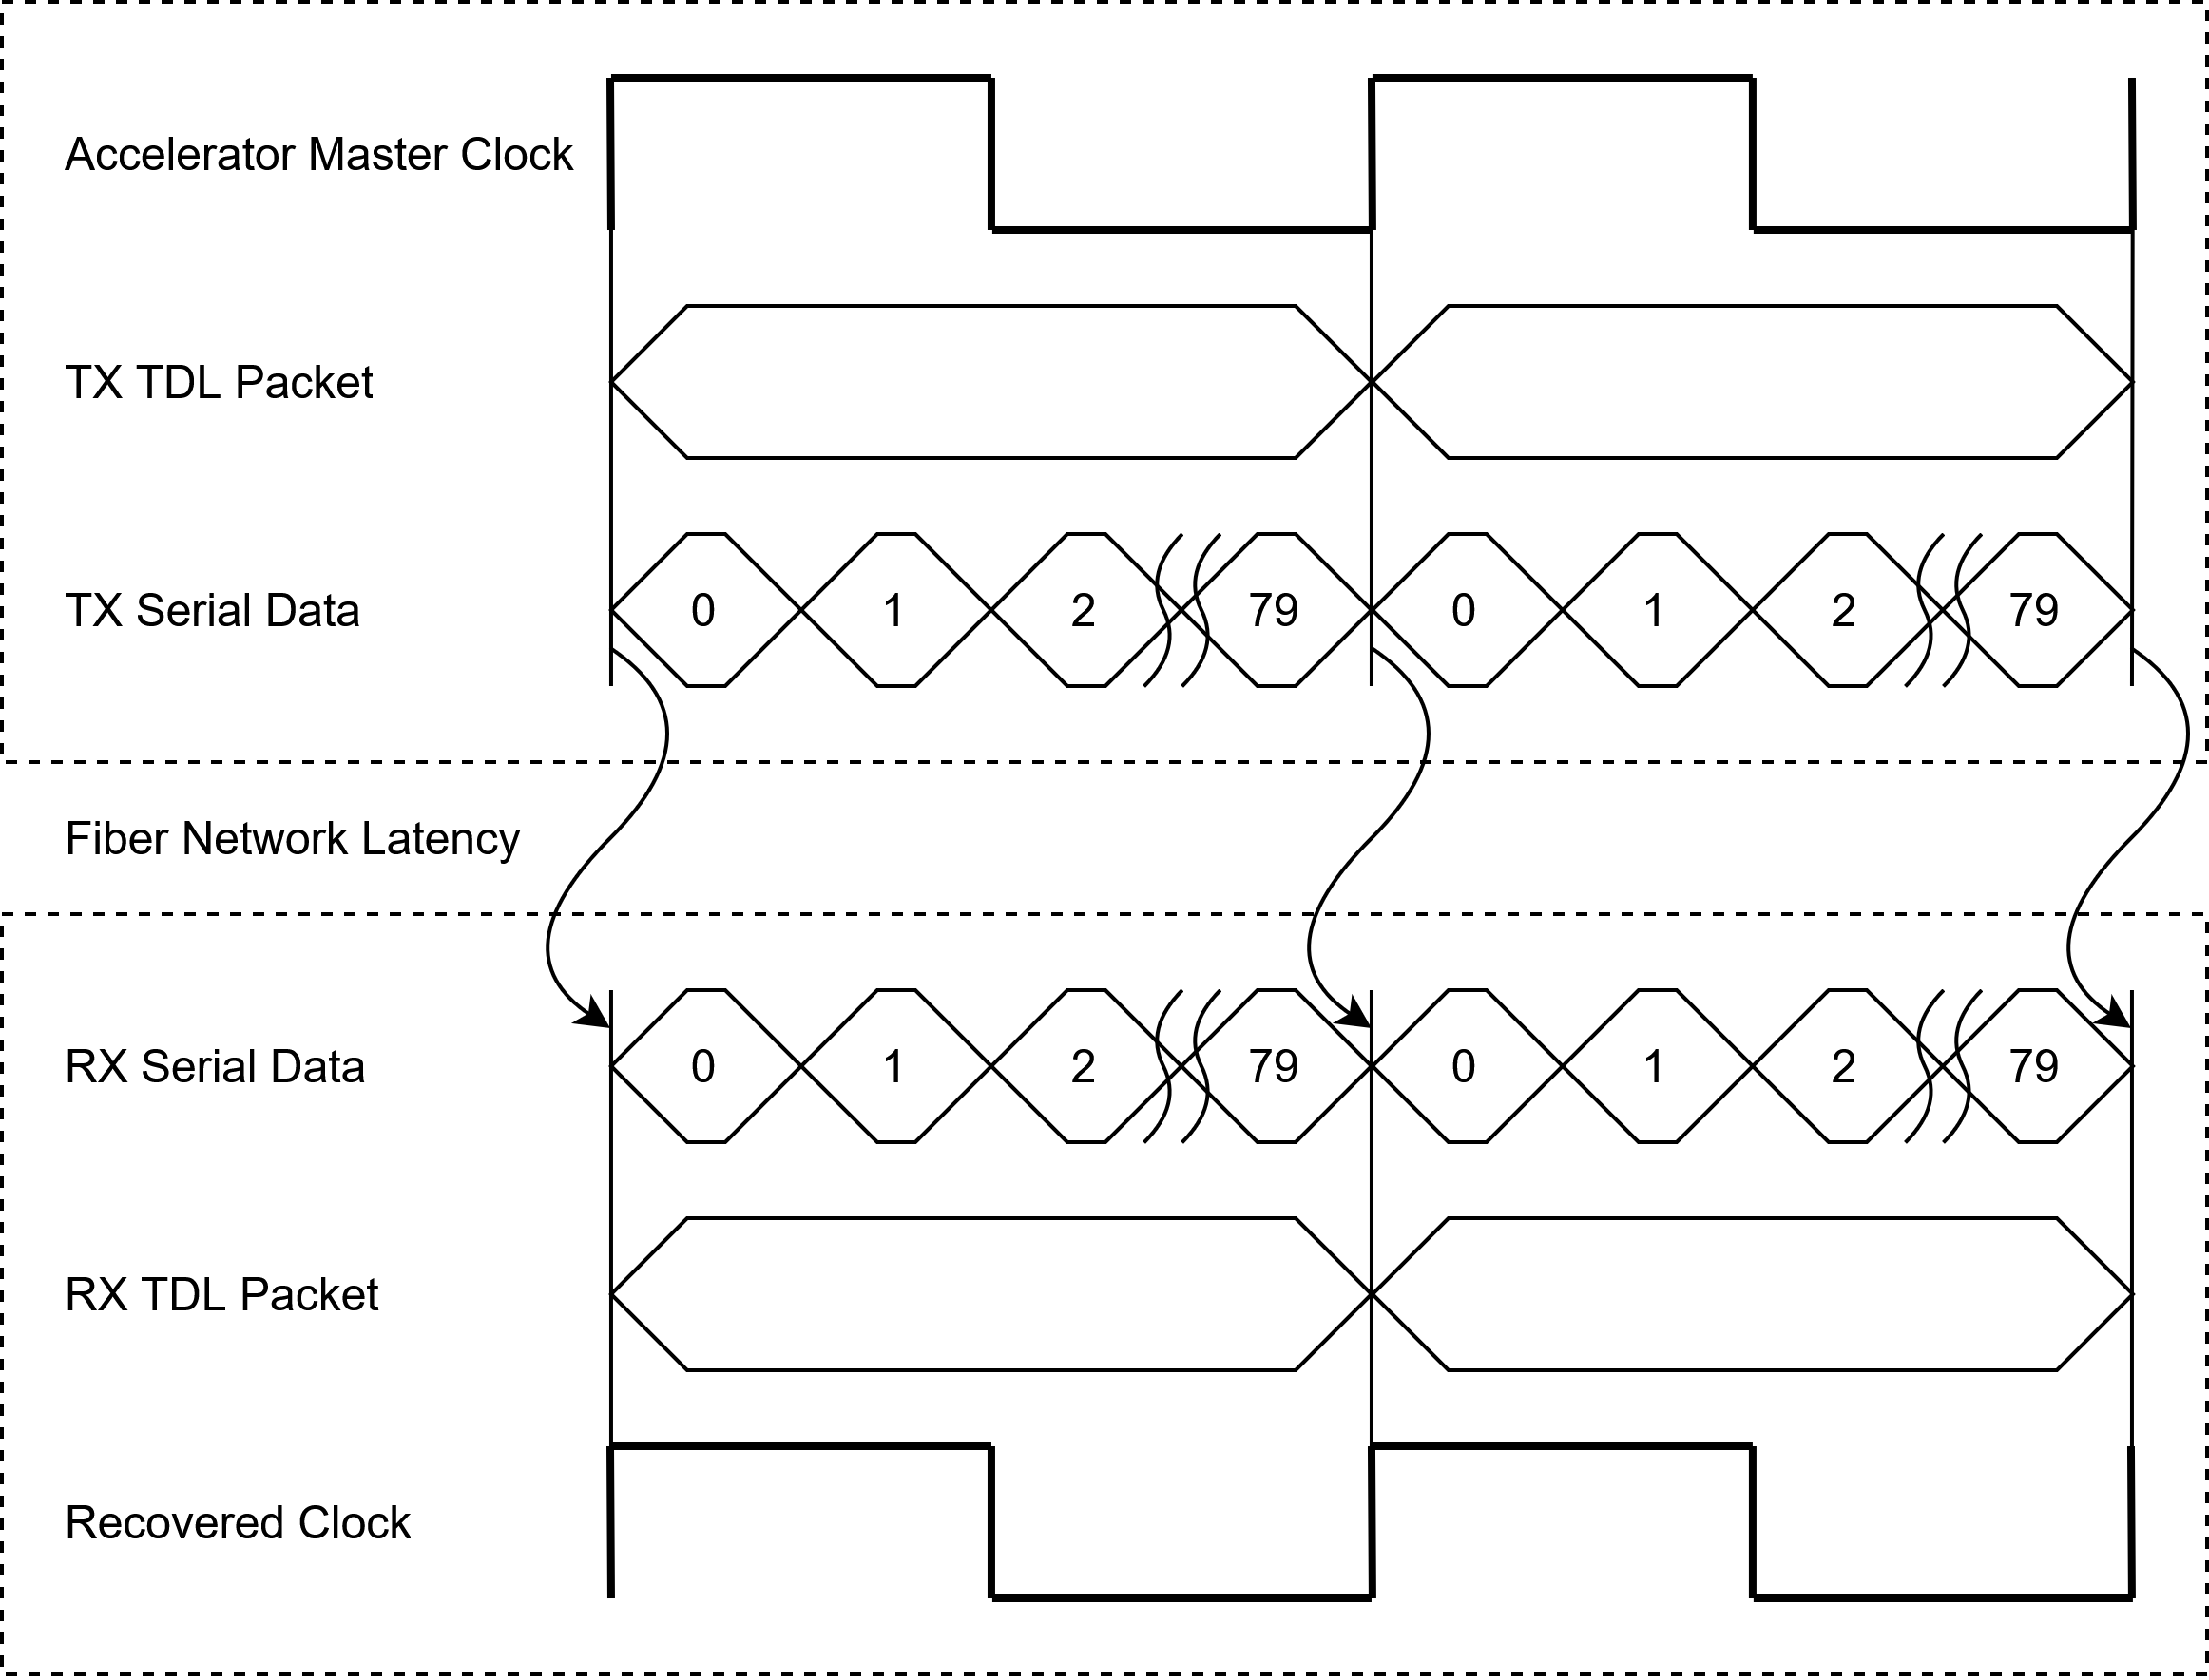
Clock Distribution
Transmitter serializes TDL Packet frames synchronous with master clock
Receiver deserializes TDL Packet frames and recovers master clock from data frame clock
Synchronous clock recovery is trivial
Deterministic phase alignment requires careful consideration
FPGA Developers’ Forum 2025
Paul Bachek

Slide 4
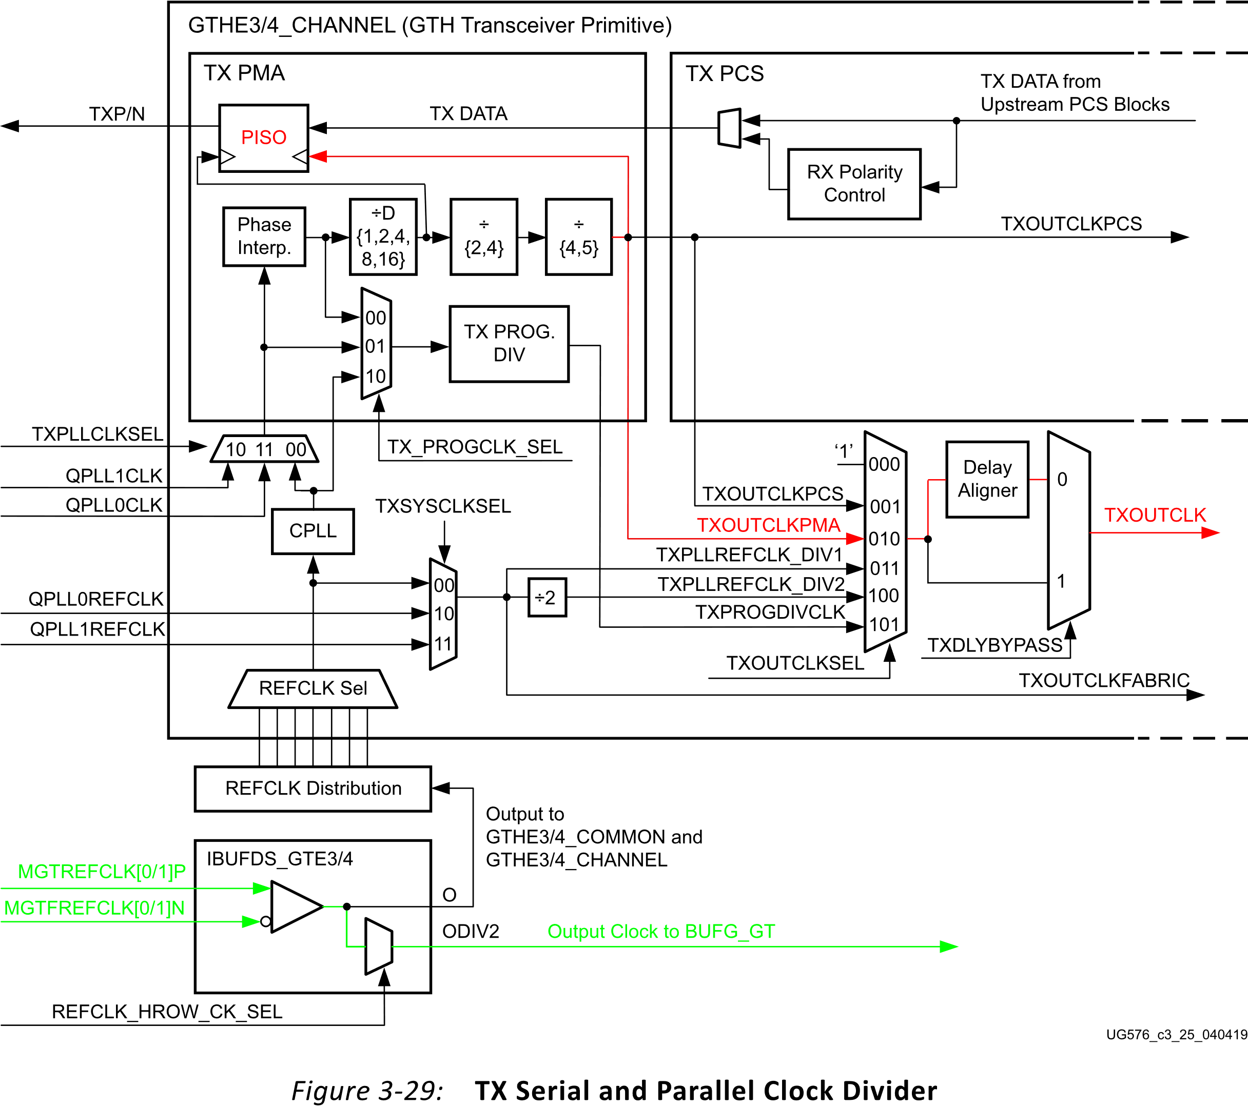
Transmitter Clock
PISO parallel clock controls data framing
  Internally divided down serial clock
  Nondeterministic phase relationship with MGTREFCLK
Set TXOUTCLK to TXOUTCLKPMA
Must align TXOUTCLK with Accelerator Master Clock
Accelerator Master Clock drives MGTREFCLK
The Phase Interpolator (PI) can be manually controlled via the Dynamic Reconfiguration Port (DRP)
Source: UG576 UltraScale Architecture GTH Transceivers User Guide
FPGA Developers’ Forum 2025
Paul Bachek

Slide 5
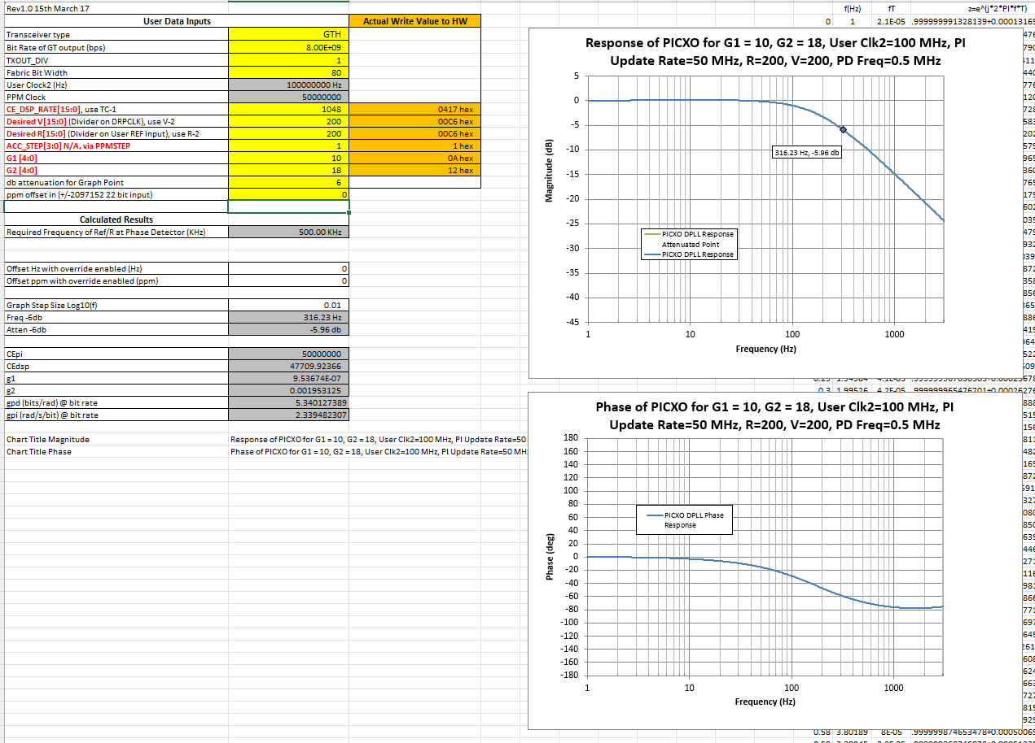
Transmitter Phase Control
Xilinx PICXO FRACXO IP Core provides TXOUTCLK alignment functionality by modulating PI
Allows the GT TXOUTCLK to be phase aligned to a reference clock from fabric
  MGTREFCLK routed to fabric via BUFG_GT
Convenient tool provided for calculating optimal digital PLL loop gains
FPGA Developers’ Forum 2025
Paul Bachek

Slide 6
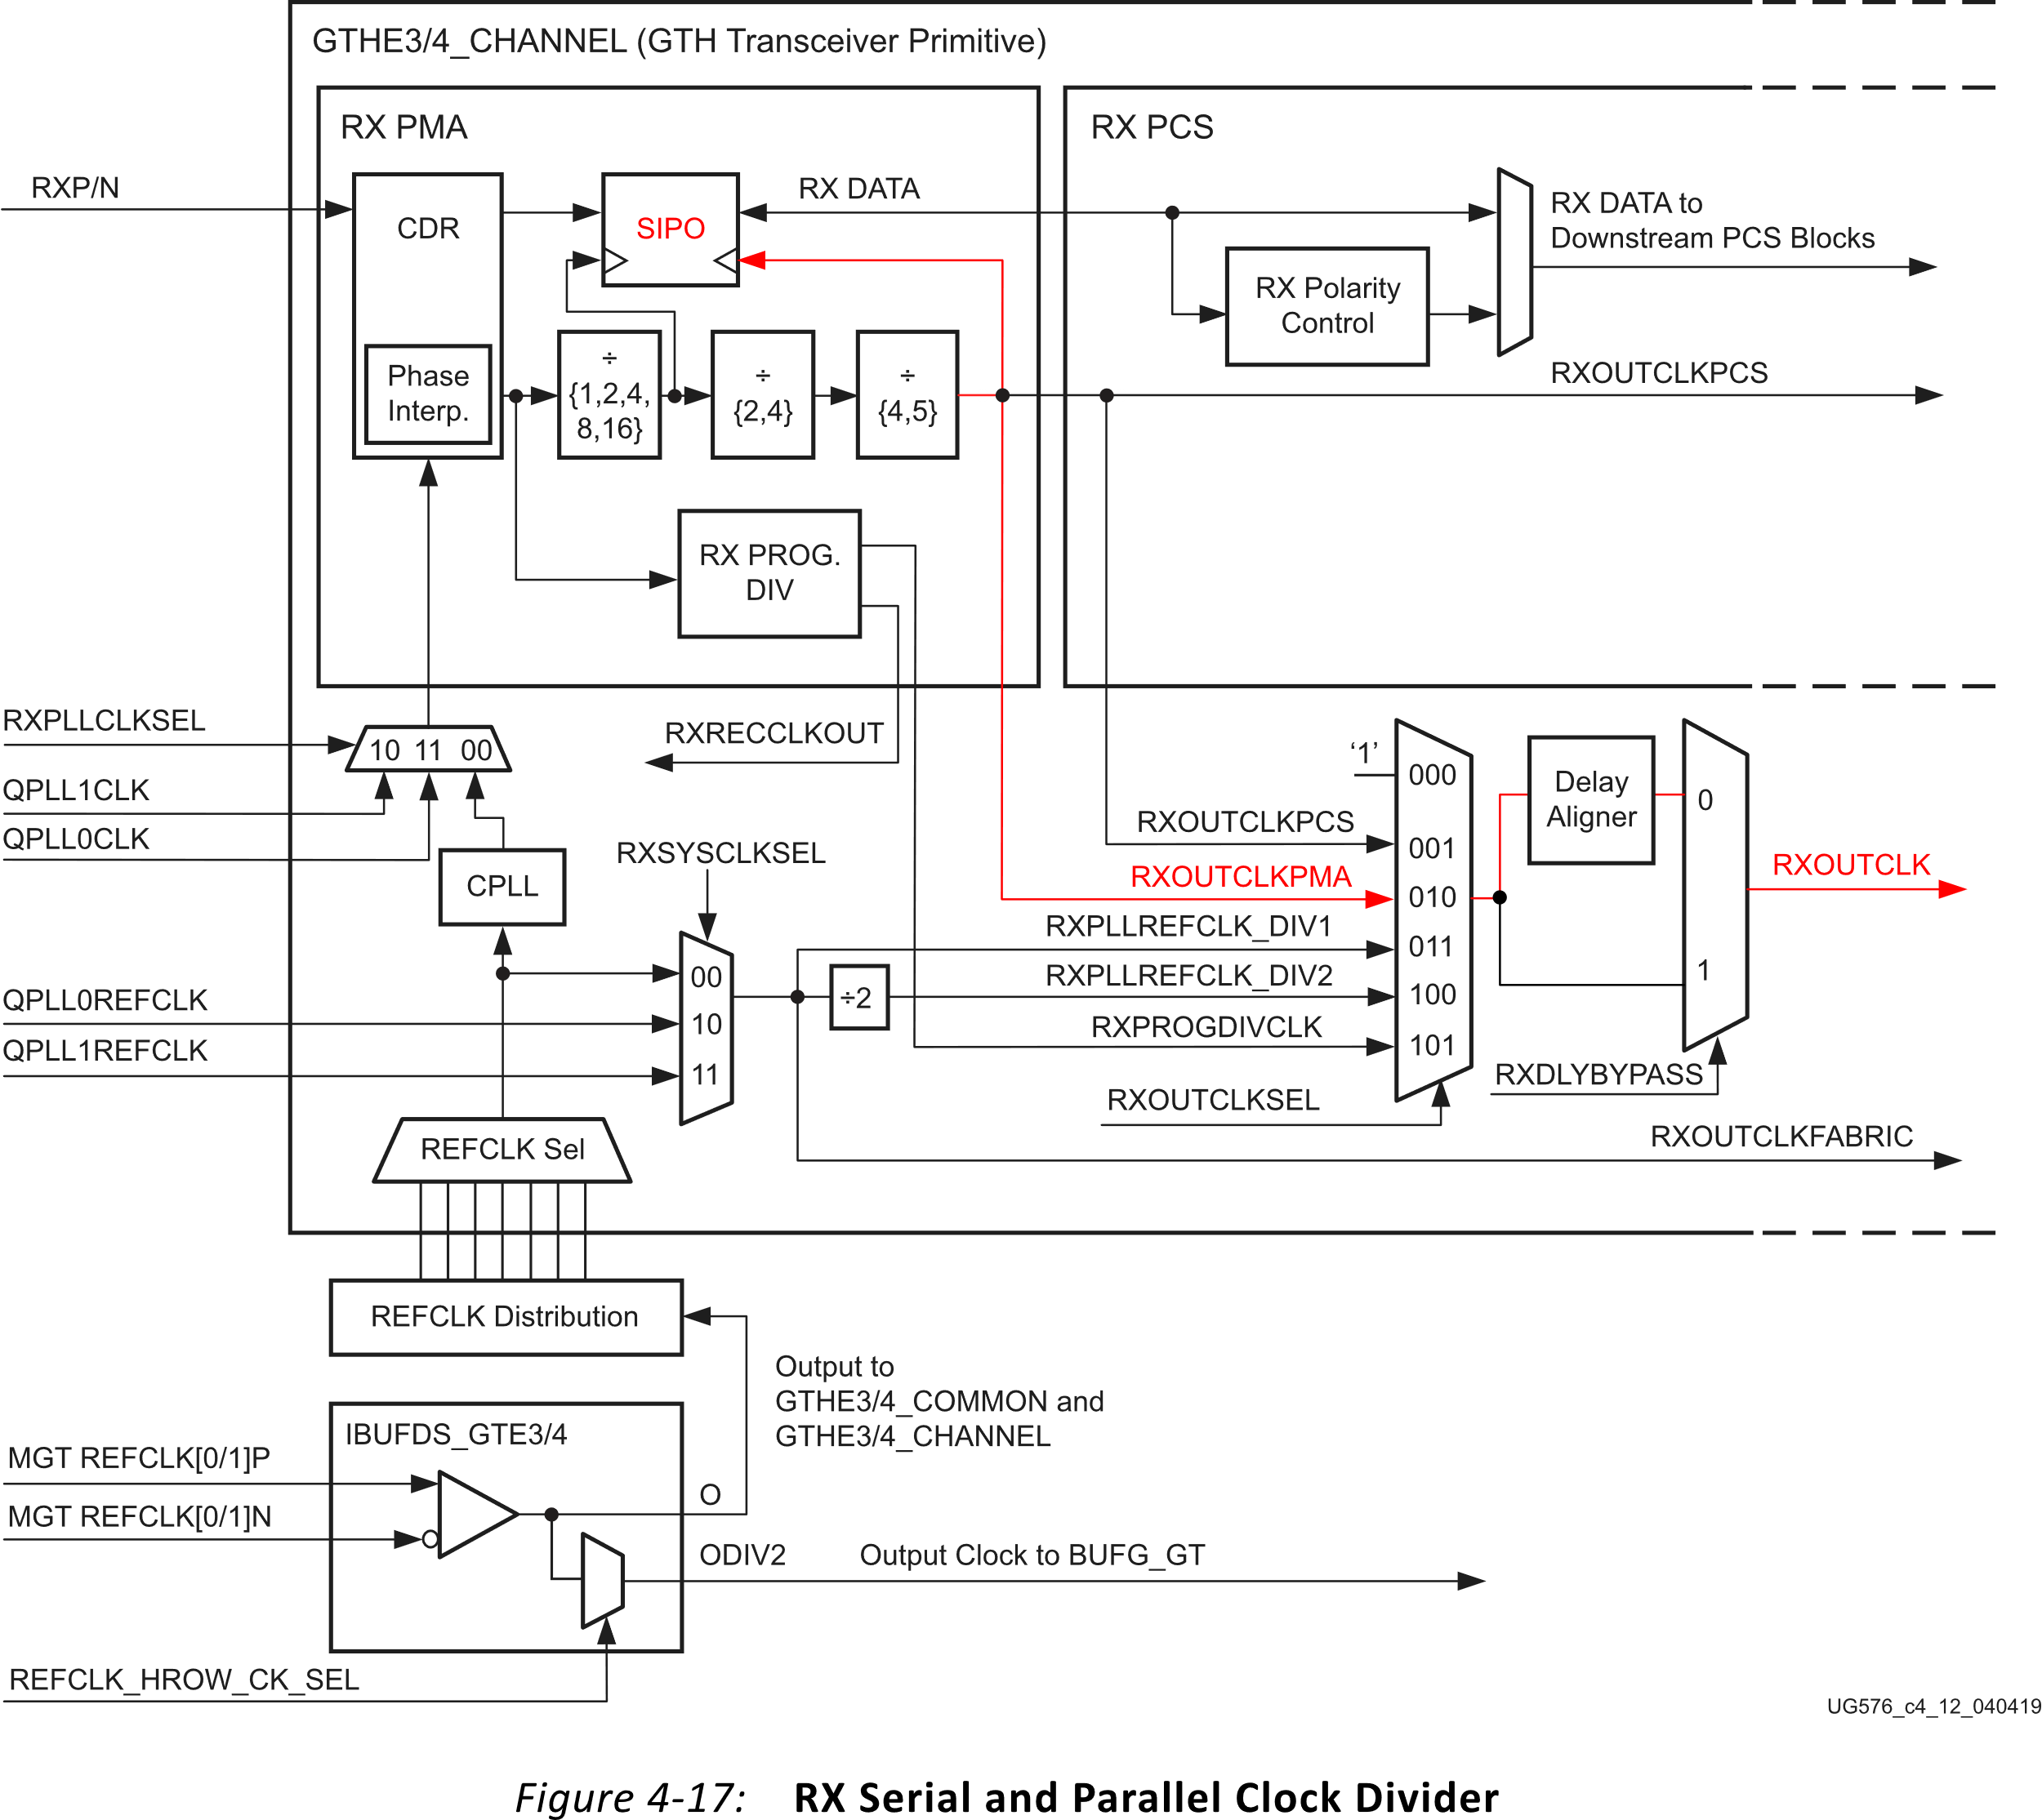
Receiver Clock Recovery
SIPO Parallel Clock controls data framing
  Internally divided down serial clock
  Can be sent to fabric via RXOUTCLK then output via OBUFDS to IO pins
Phase shift SIPO Parallel Clock to align data
  Buffer Bypass with RXSLIDE PMA mode
  Phase shift granularity is limited by the SIPO Serial Clock period
  Reset and retry if aligned on alternate edge
Problems
  RXSLIDE PMA can cause the Buffer Bypass Delay Aligner to lose alignment
  Inconsistent phase across resets due to Auto Alignment algorithm
  Delay Aligner introduces nonlinear phase drift
  FPGA clocking network introduces phase jitter
Source: UG576 UltraScale Architecture GTH Transceivers User Guide
FPGA Developers’ Forum 2025
Paul Bachek

Slide 7
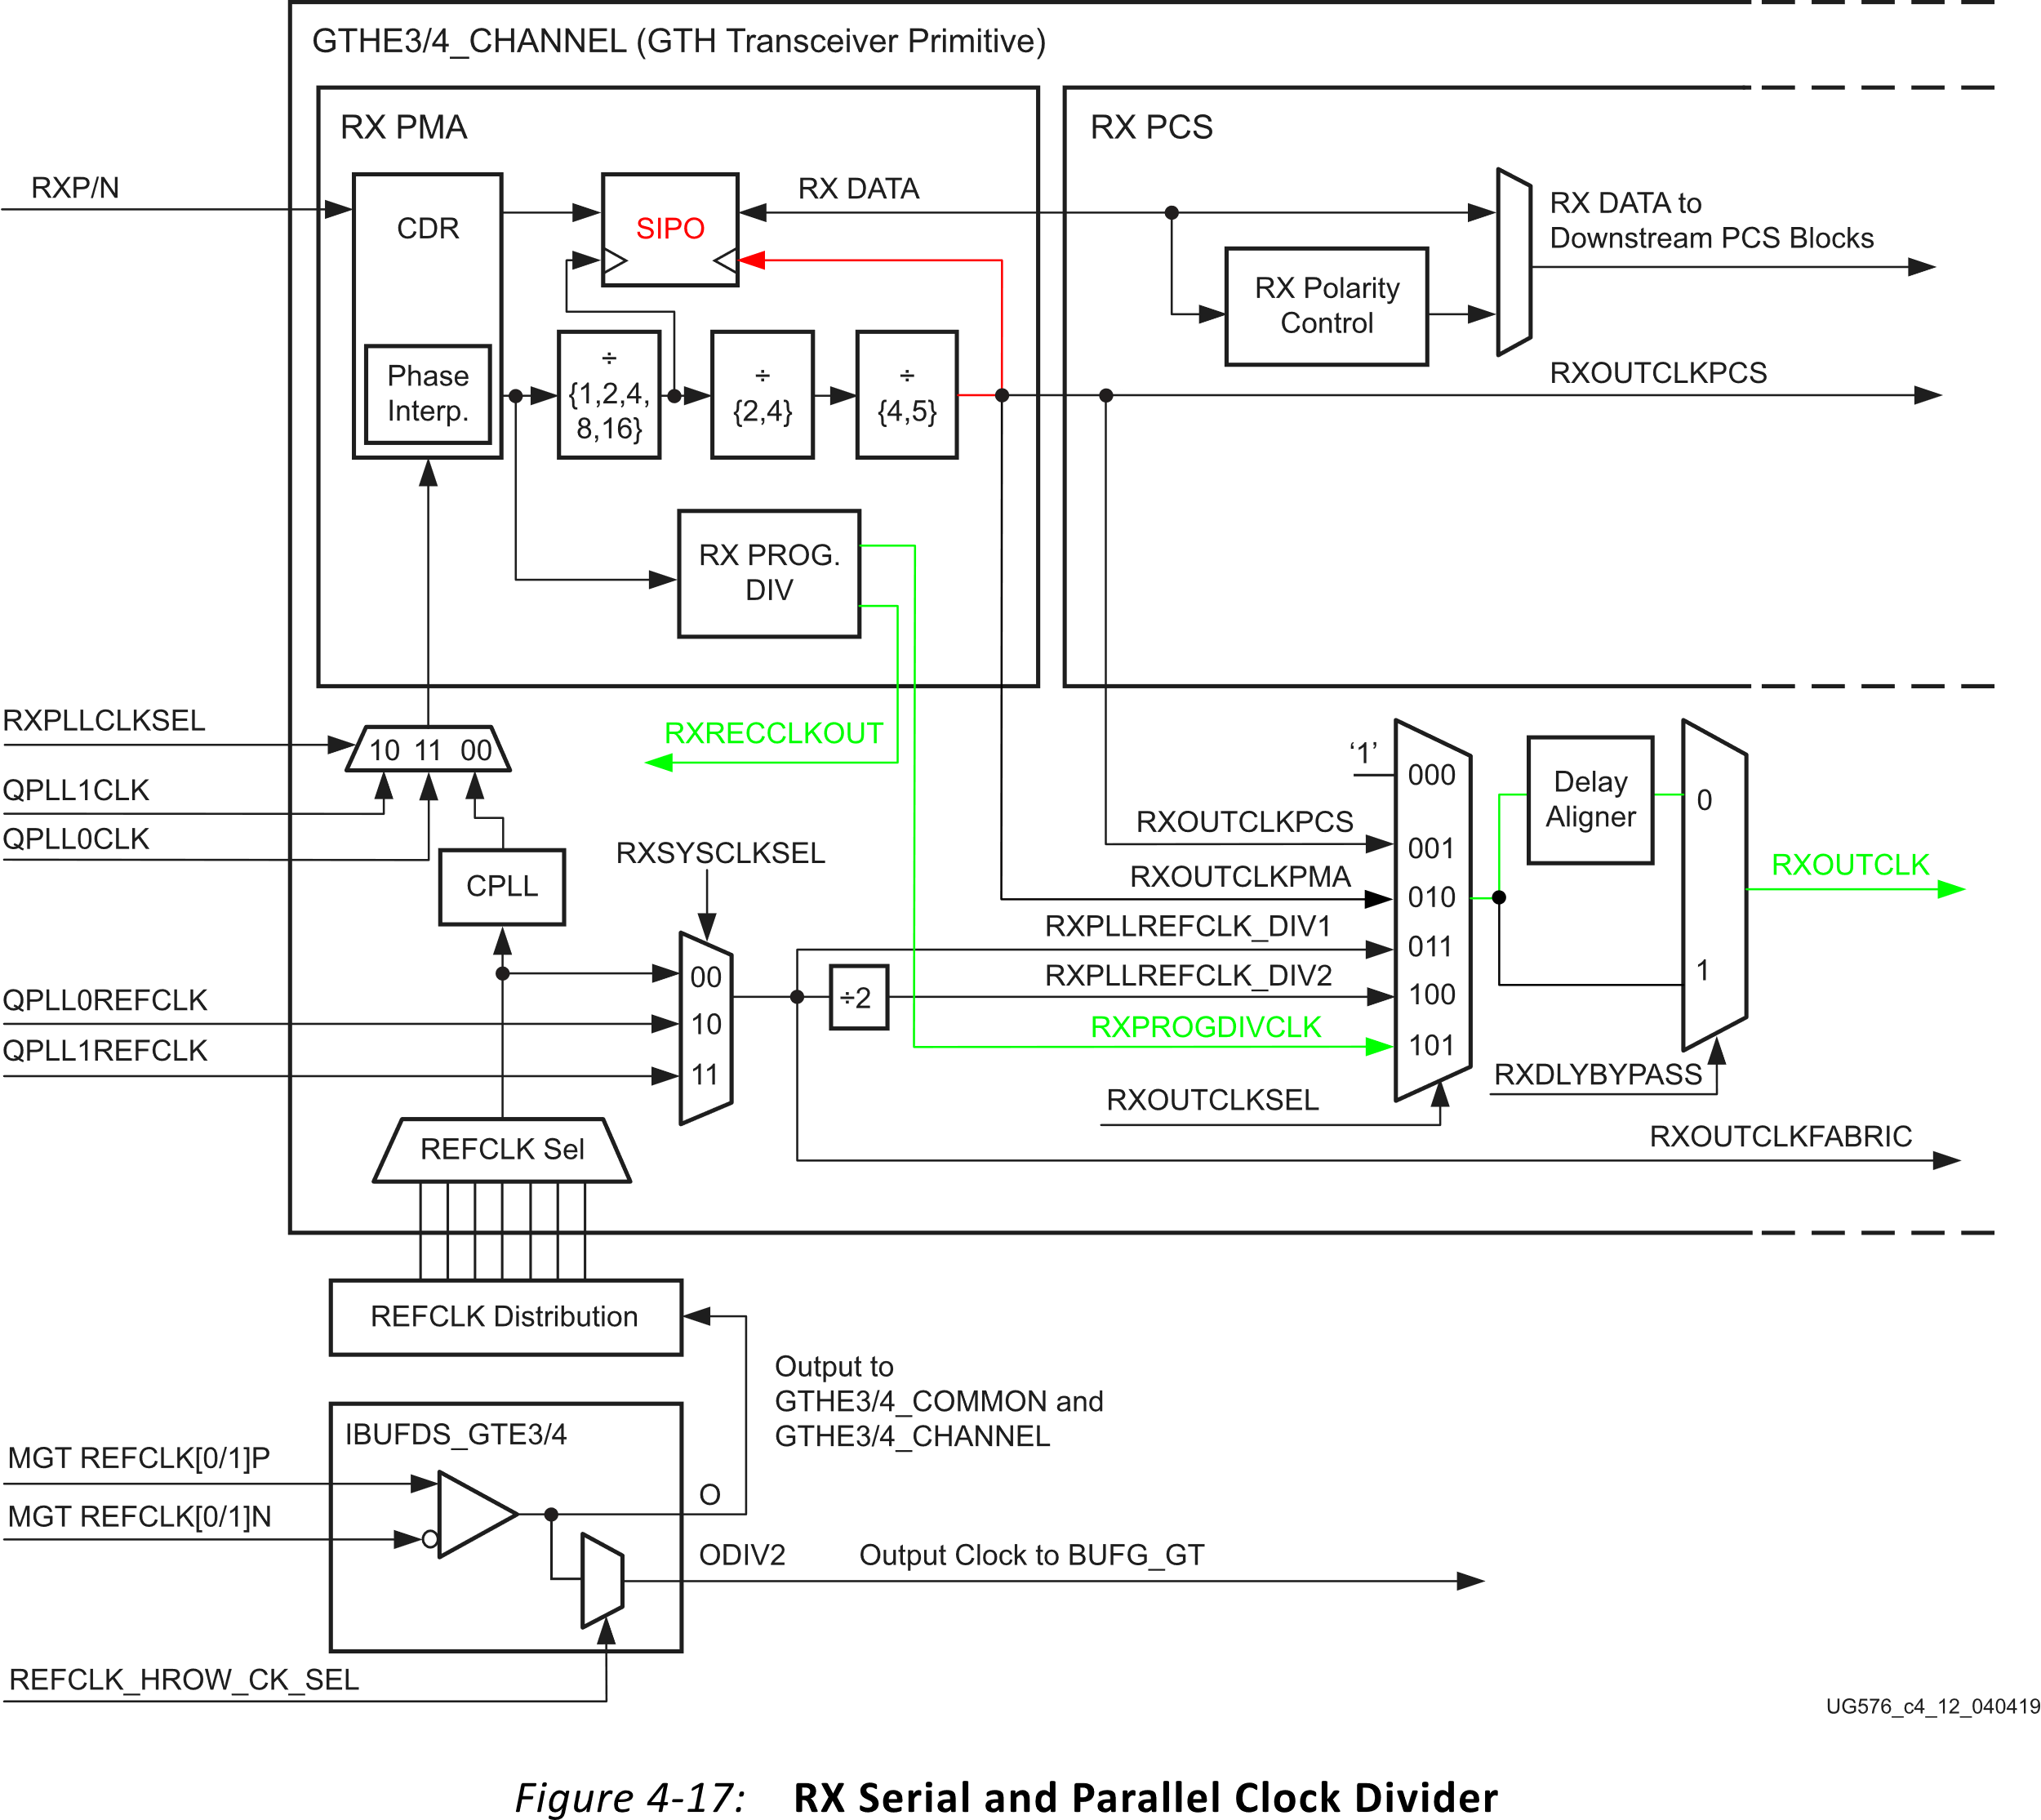
Receiver RXRECCLKOUT
Benefits
  Dedicated clock routing within GT
  Output via OBUFDS_GTE4 to MGTREFCLK pins
  Not affected by Delay Aligner
  Does not change between builds
Problem
  No phase relationship with SIPO Parallel Clock for alignment with data frames
Solution
  Manually align SIPO Parallel Clock with RXRECCLKOUT
Source: UG576 UltraScale Architecture GTH Transceivers User Guide
FPGA Developers’ Forum 2025
Paul Bachek

Slide 8
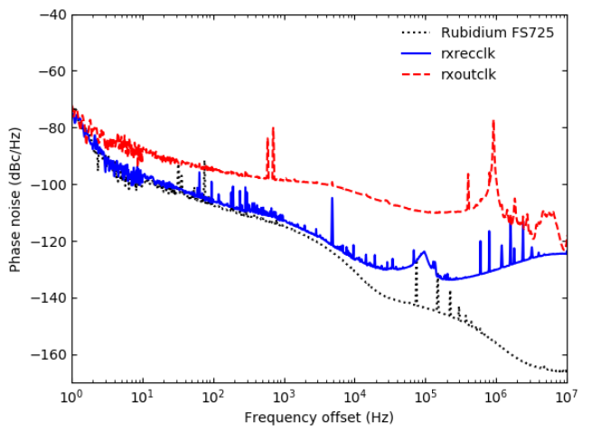
Phase Noise Comparison
Measurements taken by the High Precision Timing Distribution (HPTD) project group at CERN
Up to 20 dB phase noise improvement of RXRECCLKOUT vs RXOUTCLK
Lower integrated phase noise eases requirements on the subsequent clock cleaner PLL
Credit: E. Mendes, S. Baron, C. Soos, J. Troska, and P. Novellini, “Achieving picosecond-level phase stability in timing distribution systems with Xilinx ultrascale transceivers,” IEEE Trans. Nucl. Sci., vol. 67, no. 3, pp. 473–481, Mar. 2020.
FPGA Developers’ Forum 2025
Paul Bachek

Slide 9
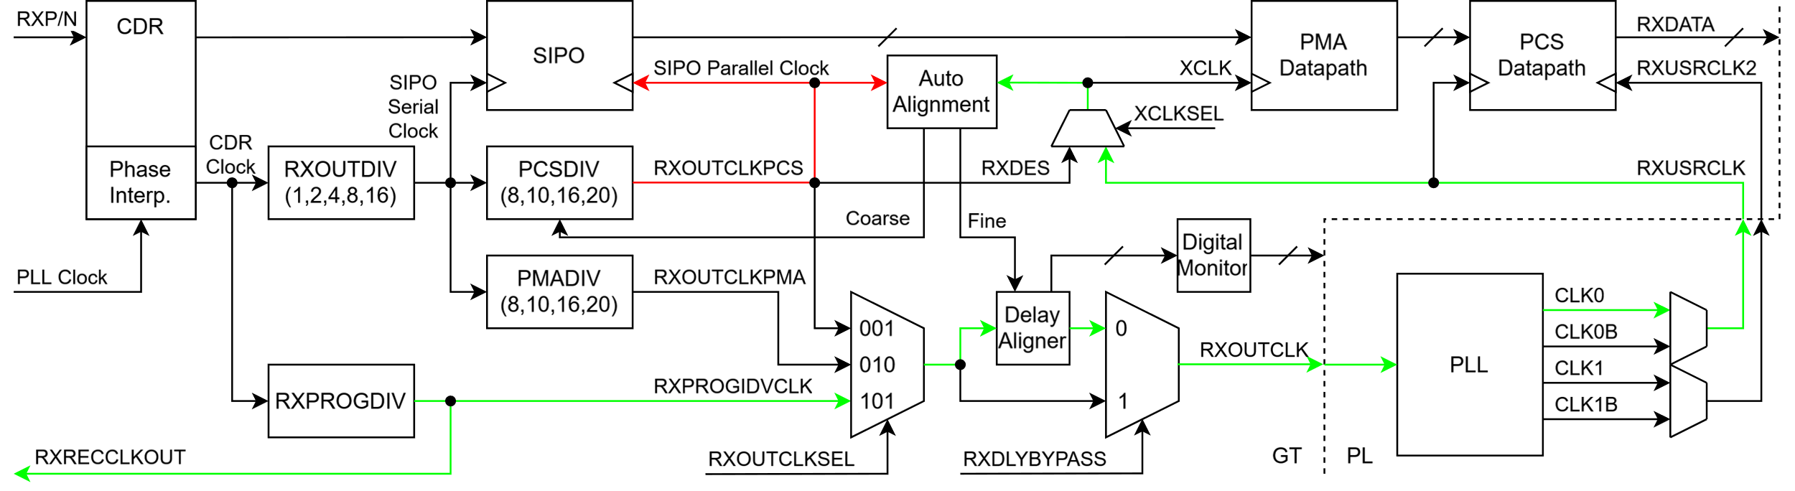
RXRECCLKOUT Phase Alignment
How to align SIPO Parallel Clock and RXRECCLKOUT
  Enable Buffer Bypass mode
  Set RXOUTCLK to RXRECCLKOUT by selecting RXPROGDIVCLK
  Enable Auto Alignment to shift the SIPO Parallel clock in phase with XCLK
Problems
  RXPROGDIVCLK is delayed through the clock routing to XCLK before alignment
  RXSLIDE PMA mode cannot be used for data alignment without also losing RXRECCLKOUT phase alignment
FPGA Developers’ Forum 2025
Paul Bachek

Slide 10
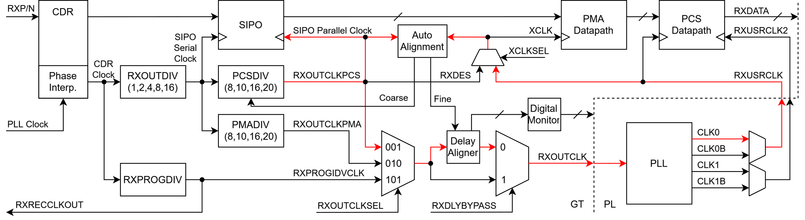
XCLK Skew Measurement
How to measure XCLK skew
  Set RXOUTCLK to SIPO Parallel Clock by selecting RXOUTCLKPCS
  Enable Auto Alignment
  Read the stable Delay Aligner tap number
Coarse phase shift has no effect
Fine phase shift must compensate for entire path delay using Delay Aligner
GT configuration
  RXPH_MONITOR_SEL = 0x03
  DMONITOR_CFG1 = 0x03
  DMONITOR[7:0] outputs an 8-bit value representing the Delay Aligner tap number
Delay Aligner is a 256-tap calibrated delay chain with a 4 ns range
  Each delay tap is 15.625 ps
FPGA Developers’ Forum 2025
Paul Bachek

Slide 11
RXRECCLKOUT Phase Measurement
How to measure relative phase between SIPO Parallel Clock and RXRECCLKOUT
  Set RXOUTCLK to RXPROGDIVCLK
  Enable RXSLIDE PMA mode via DRP to manually shift SIPO Parallel Clock
  Count the number of RXSLIDE shifts required for the Delay Aligner tap number to match the measured XCLK skew
  Shift to restore original clock alignment
Clock Data Recovery (CDR) Clock generates both SIPO Parallel Clock and RXRECCLKOUT
The measured number of RXSLIDE shifts represents the relative clock phase in integer number of CDR Clock periods
Original phase set by Auto Alignment must be restored for proper Clock Domain Crossing (CDC)
FPGA Developers’ Forum 2025
Paul Bachek

Slide 12
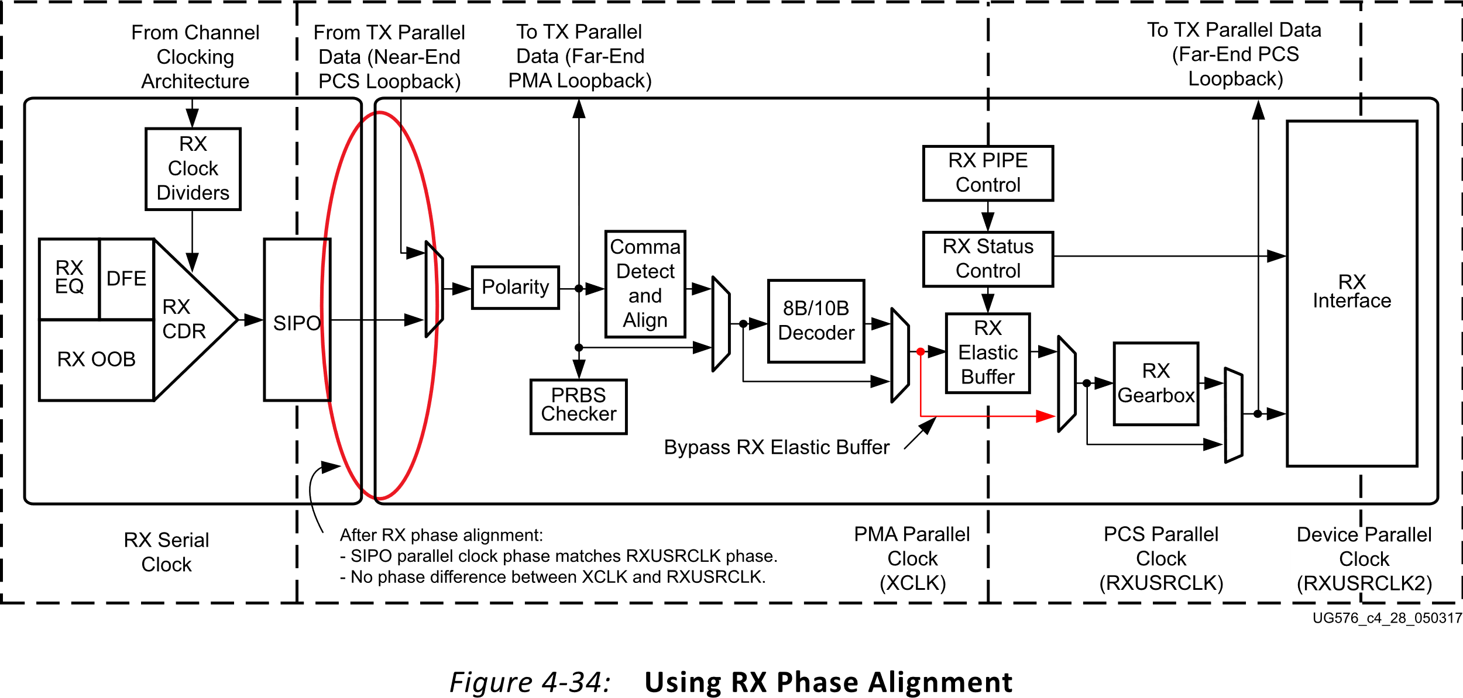


RXRECCLKOUT Phase Compensation
Cannot have SIPO Parallel Clock aligned with RXRECCLKOUT while maintaining valid CDC
But the ultimate goal is to align RXRECCLKOUT with RXDATA frames
  Can be achieved by compensating for SIPO Parallel Clock relative phase
How to align RXRECCLKOUT with RXDATA frames
  Enable RXSLIDE PCS mode via DRP to manually barrel shift RXDATA
  Shift RXDATA by the measured number of CDR Clocks between SIPO Parallel Clock and RXRECCLKOUT phase
RXDATA now appears as if SIPO Parallel Clock and RXRECCLKOUT are aligned
  Independent of XCLK skew
Source: UG576 UltraScale Architecture GTH Transceivers User Guide
FPGA Developers’ Forum 2025
Paul Bachek

Slide 13
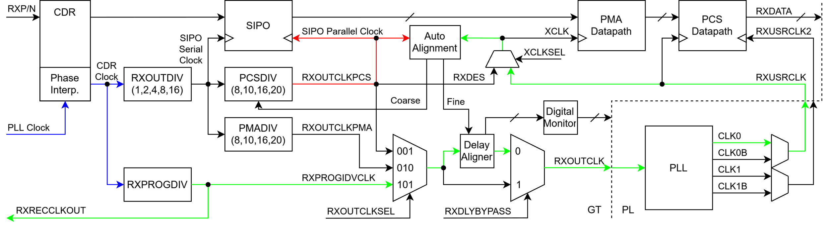
RXDATA Comma Alignment
RXRECCLKOUT and RXDATA frames can now be deterministically aligned
  But RXDATA is not yet comma aligned
  Cannot use RXSLIDE PCS or PMA without losing RXRECCLKOUT alignment
Must manually phase shift CDR Clock
  Shifts SIPO Parallel Clock and RXRECCLKOUT simultaneously maintaining alignment
CDR Clock
  Generated from PLL Clock through CDR PI
  PI is a 128-tap calibrated delay chain
    Each delay tap is 1/128th of one PLL Clock period
  Can be phase shifted by manually controlling the PI tap number
Burst-Mode Clock Data Recovery with GTH and GTY Transceivers XAPP1252
  Demonstrates how to read and control the PI tap number
FPGA Developers’ Forum 2025
Paul Bachek

Slide 14
CDR Clock Phase Shift
GT configuration
  DMONITOR_CFG1 = 0x01
  DMONITOR[6:0] outputs a 7-bit value representing the PI tap number
  See XAPP1252 for all required attribute settings
Manual CDR PI control
  RXCDR_CFG1[15:9]
    DRP register 0x00F
    Write new value for 7-bit PI tap number
  Pulse RXCDROVRDEN high to apply the new PI tap number
How to manually phase shift CDR Clock in Unit Interval (UI) increments
  Read the current PI tap number
  Write new values for the PI tap number in quick succession starting with the current value and incrementing until rollover at 128
  Continue incrementing until it is returned to its original value
This procedure affects a single UI phase shift in the CDR Clock
FPGA Developers’ Forum 2025
Paul Bachek

Slide 15
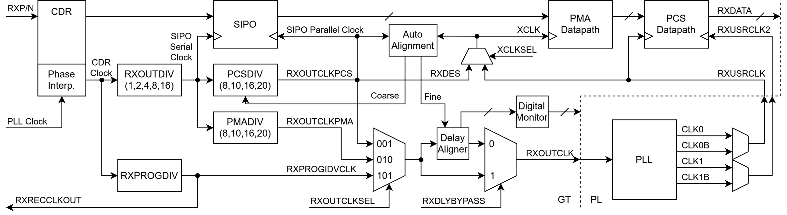
Summary
Align SIPO Parallel Clock and RXRECCLKOUT using Buffer Bypass Auto Alignment
Measure and compensate for XCLK skew using RXSLIDE
Comma align RXDATA by manually phase shifting CDR Clock
Potential Complications
  If one RXRECCLKOUT half period is larger than the 4 ns Delay Aligner range
    XCLK skew measurement may require a phase shifted version of RXOUTCLK
  SIPO Parallel Clock RXSLIDE PMA phase shift granularity limited by RXOUTDIV
    May have to reset RXPROGDIV and retry if they are on alternate CDR Clock edges
  If RXUSRCLK2 different than RXUSRCLK
    SIPO Parallel Clock frequency must be temporarily changed for XCLK skew measurement
    PLL or MMCM required to generate RXUSRCLK
FPGA Developers’ Forum 2025
Paul Bachek

Slide 16
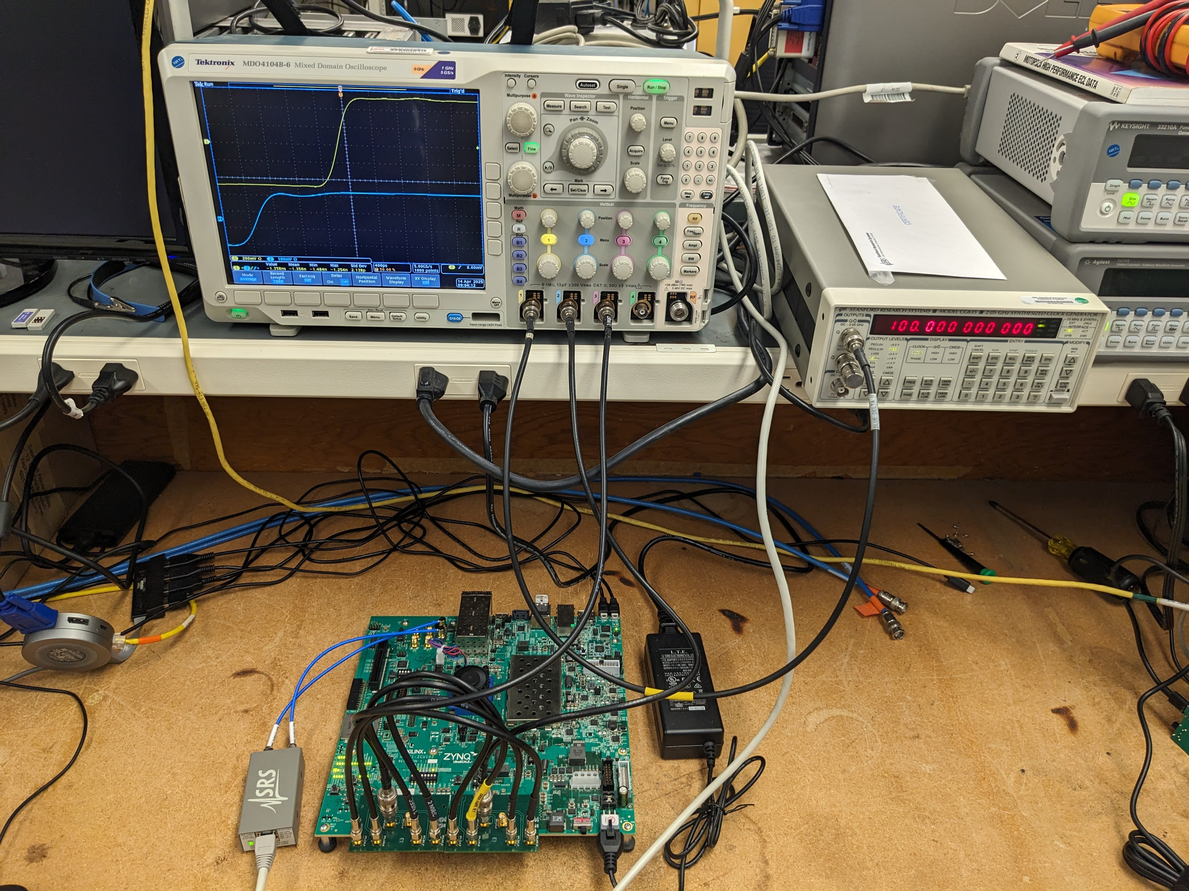
Testing
Clock recovery test with 2 independent GTH transceiver channels
  64-bit words, 100 MHz MGTREFCLK, 8 Gbps line rate, 40-bit GTH internal datapath, 200 MHz RXUSRCLK, equalizer in LPM mode
  Copper SMA loopback via FMC breakout
  No clock skew variations measured across hundreds of reset cycles down to 1 ps measurement resolution of oscilloscope
Equipment
  Zynq UltraScale+ ZCU102 Evaluation Board XCZU9ED-FFVB1156-2-E
  Stanford Research Systems CG635 Clock Generator with 0.0001 ppm Rb timebase
  Tektronix MDO4104B-6 5 GS/s oscilloscope with acquisition averaging enabled
FPGA Developers’ Forum 2025
Paul Bachek

Slide 17
References
[1] E. Mendes, S. Baron, C. Soos, J. Troska, and P. Novellini, “Achieving picosecond-level phase stability in timing distribution systems with Xilinx ultrascale transceivers,” IEEE Trans. Nucl. Sci., vol. 67, no. 3, pp. 473–481, Mar. 2020.
[2] Xilinx, “UltraScale Architecture GTH Transceivers User Guide UG576 (v1.7.1),” Aug. 18, 2021. https://docs.amd.com/v/u/en-US/ug576-ultrascale-gth-transceivers
[3] Xilinx, “Burst-Mode Clock Data Recovery with GTH and GTY Transceivers XAPP 1252 (v1.3),” Apr. 12, 2019. https://docs.amd.com/v/u/en-US/xapp1252-burst-clk-data-recovery
FPGA Developers’ Forum 2025
Paul Bachek

