Slide 1
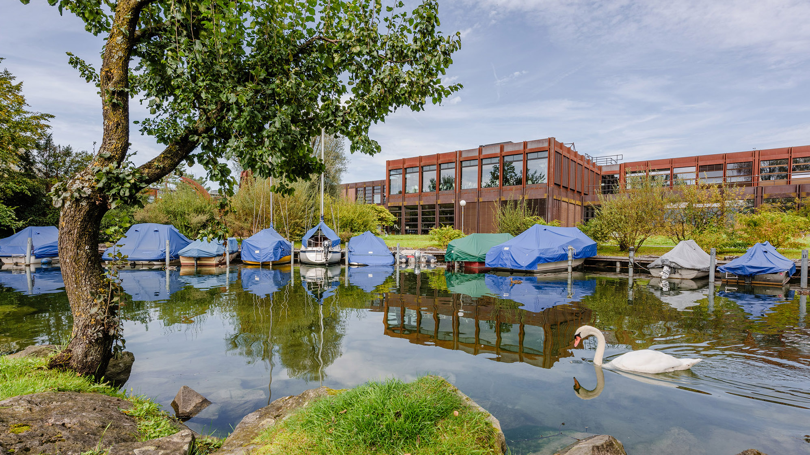
Exploring Stability in Time-to-Digital Converters
FDF2025
Gian-Luca Brazerol, Lukas Leuenberger, Paul Zbinden
IMES

Slide 2
Agenda
Introduction
Considerations for Linearity
Temperature Stability
Performance Overview
Conclusion

Slide 3
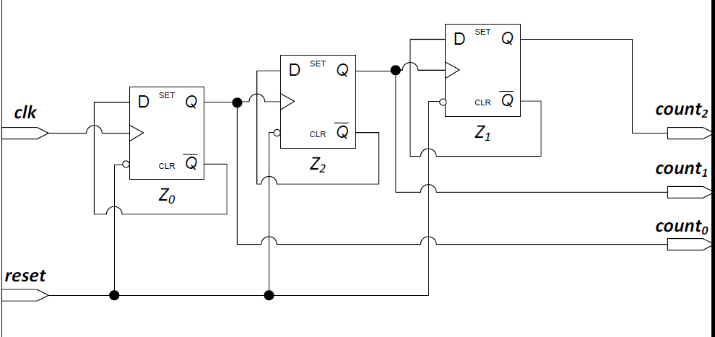
Motivation - Applications
Introduction
Time-of-Flight (ToF)
  LiDAR / RADAR [1]
  Landscape Mapping (Multipixel)
Time-Resolved Biomedical Imaging
  Fluorescence Lifetime Imaging (FLIM)
    Neurophotonics [2]
  Positron Emission Tomography (PET)
Misc.
  FPGA as ADC [3]
  Fault injection / detection (Cryptography) [4]
[1] Innosuisse - EastPeak
[2] A low-cost FPGA-based approach for pile-up corrected high-speed in vivo FLIM imaging
[3] An FPGA-based 7-ENOB 600 MSample/s ADC without any External Components
[4] Sneaky Glitch: A Clock Glitch Generator to attack the AMD-Xilinx PLL

Slide 4
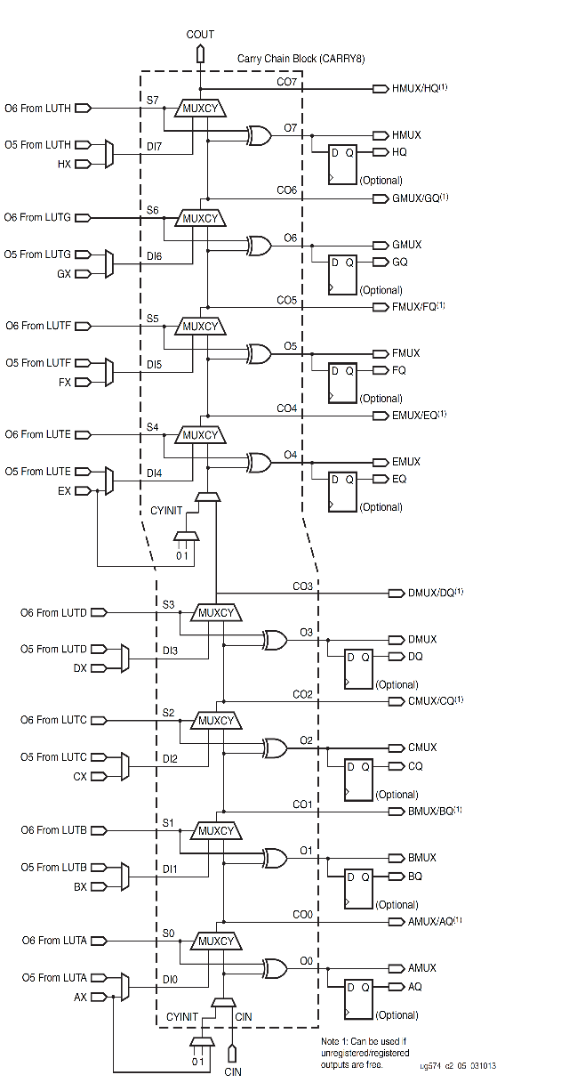





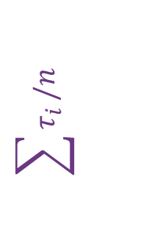





Key Performance Indicators
Introduction
$$τ_{7}$$
Measuring Range
Resolution
  LSB (mean delay)
Dead Time
Bubbles
  001001111 → 000011111
  110101000 → 111100000
Nonlinearities
  DNL
  INL
Precision
  ${σ^{2}}_{TDC}∝{σ^{2}}_{clk}+{σ^{2}}_{INL}$ [5]
$$τ_{6}$$
$$τ_{5}$$
$$τ_{4}$$
$$\sum{τ_{i}}/n$$
$$\sum{τ_{i}}$$
$$τ_{3}$$
$$τ_{2}$$
$$τ_{1}$$
$$τ_{0}$$
[5] 128-Channel High-Linearity Resolution-Adjustable Time-to-Digital Converters for LiDAR Applications: Software Predictions and Hardware Implementations

Slide 5
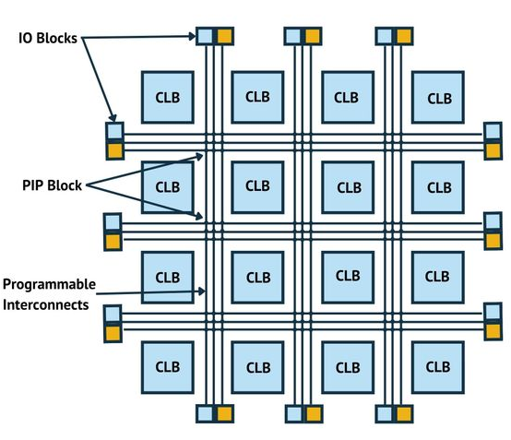
TDC: ASIC vs. FPGA
Introduction
ASIC | FPGA
✓ Linearity | ✗ Linearity
✗ Fixed Design | ✓ Scalability & Flexibility
✗ High-Cost | ✓ Cost-Effective
✗ Long Development Time | ✓ Fast Prototyping
[6] What is an FPGA and how does it work

Slide 6
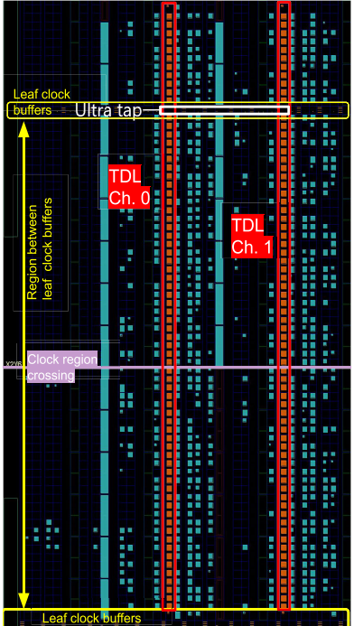
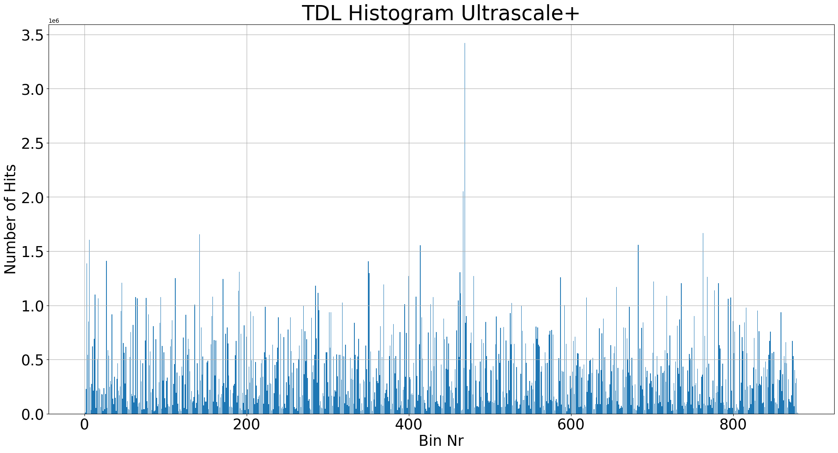
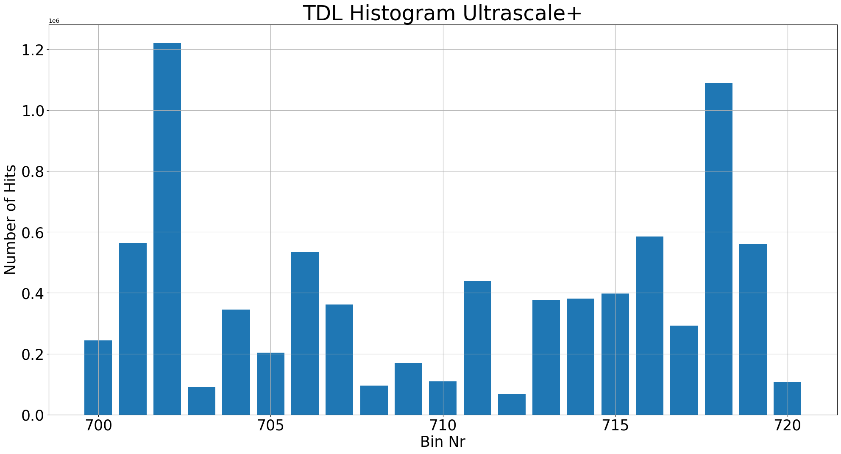
Nonlinearity Effects
Considerations for Linearity
[7] High-Performance Time-to-Digital Conversion on a 16-nm Ultrascale+ FPGA

Slide 7
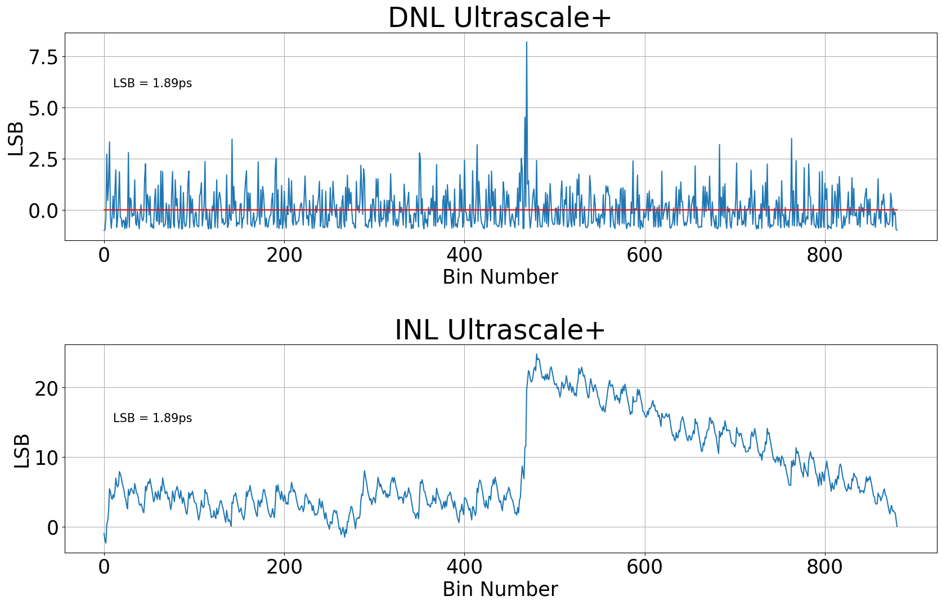

DNL and INL
Considerations for Linearity
$DNL\left[k\right]=\frac{N_{k}∙L_{TDL}}{N}−1$
$INL\left[k\right]=\sum_{i=0}^{k}{DNL[i]}$
[8] Time-to-Digital Converter Using a Tuned-Delay Line Evaluated in 28-, 40-, and 45-nm FPGAs
[9] Calibration Methods for Time-to-Digital Converters

Slide 8
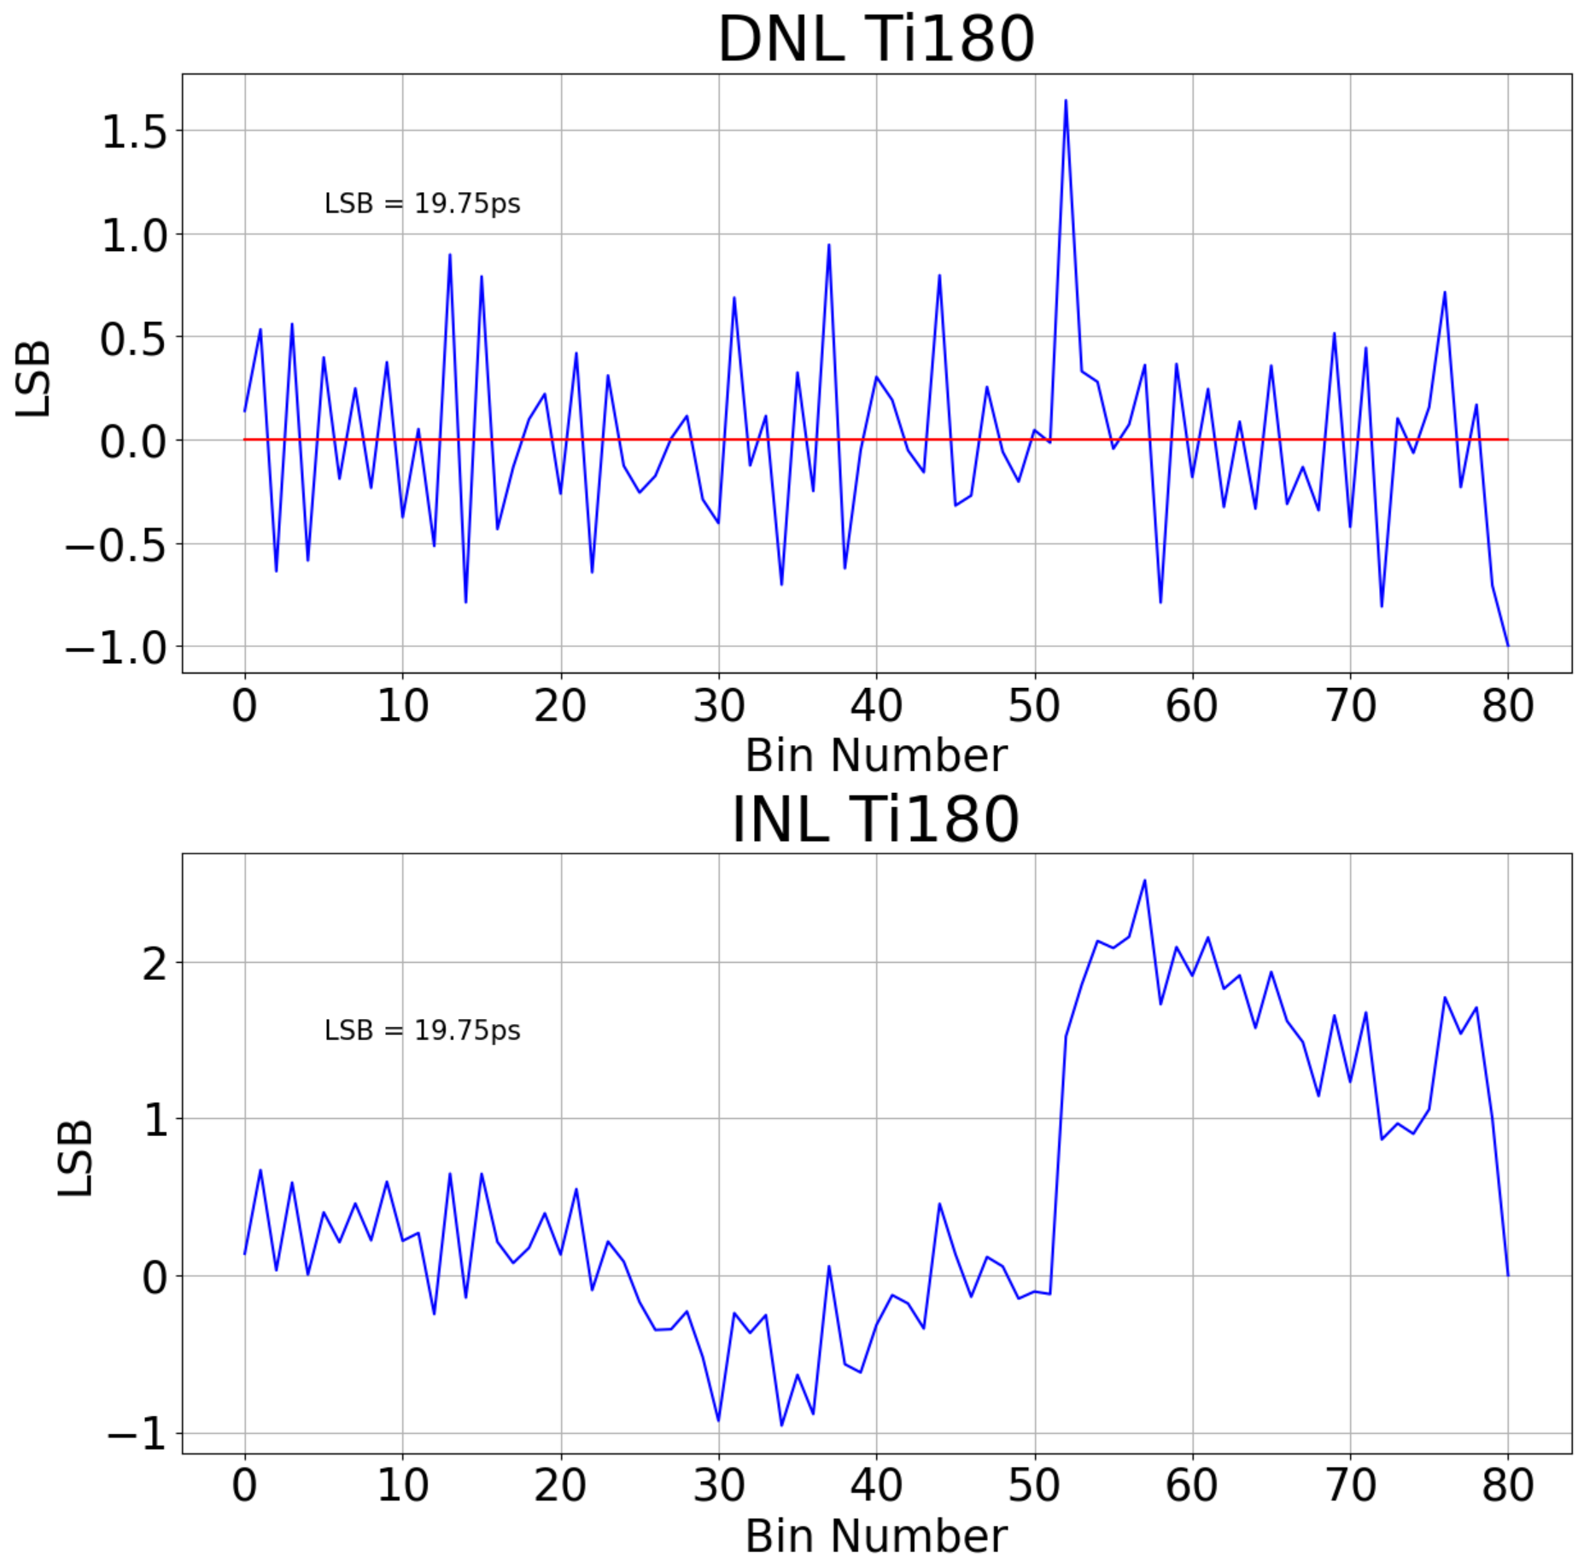
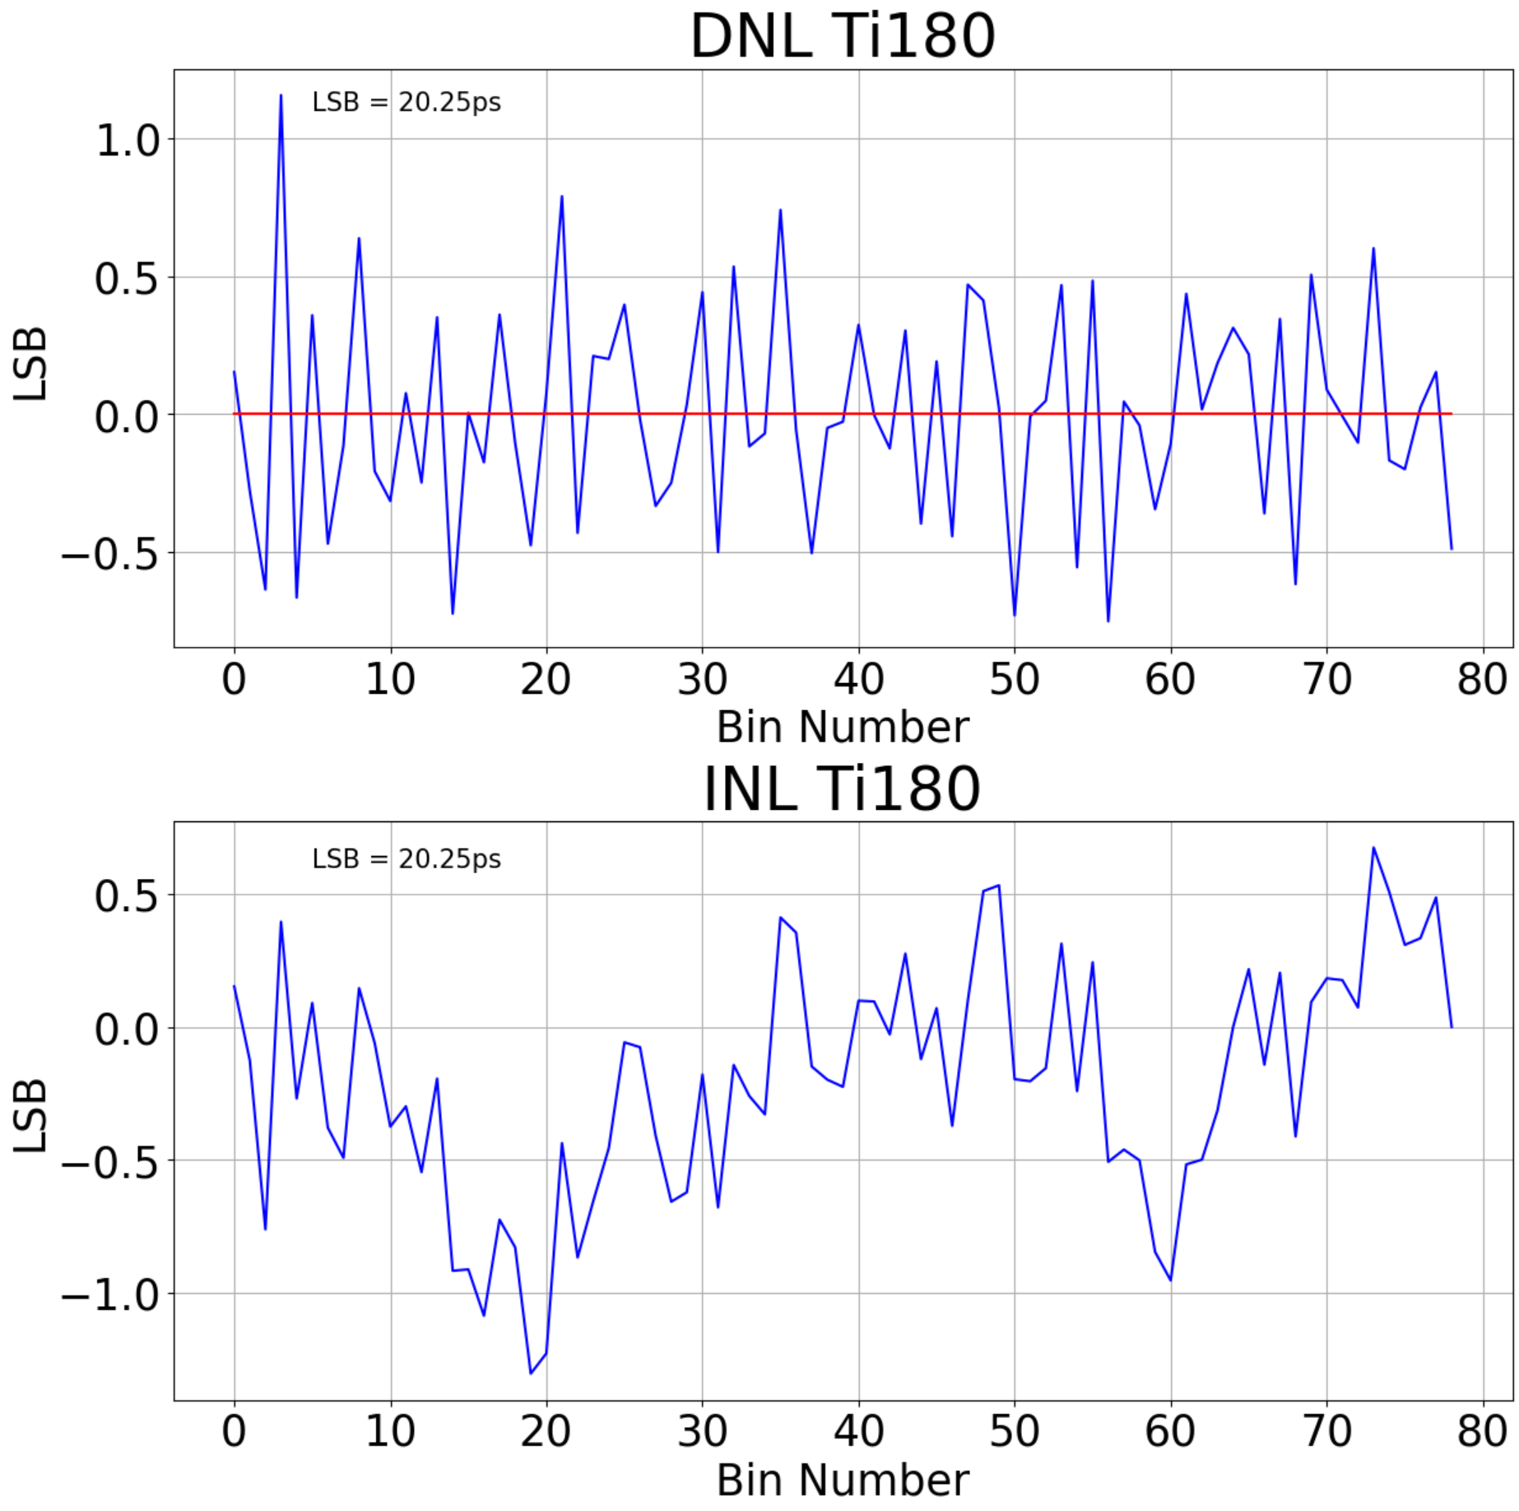
TDL Placement
Considerations for Linearity

Slide 9
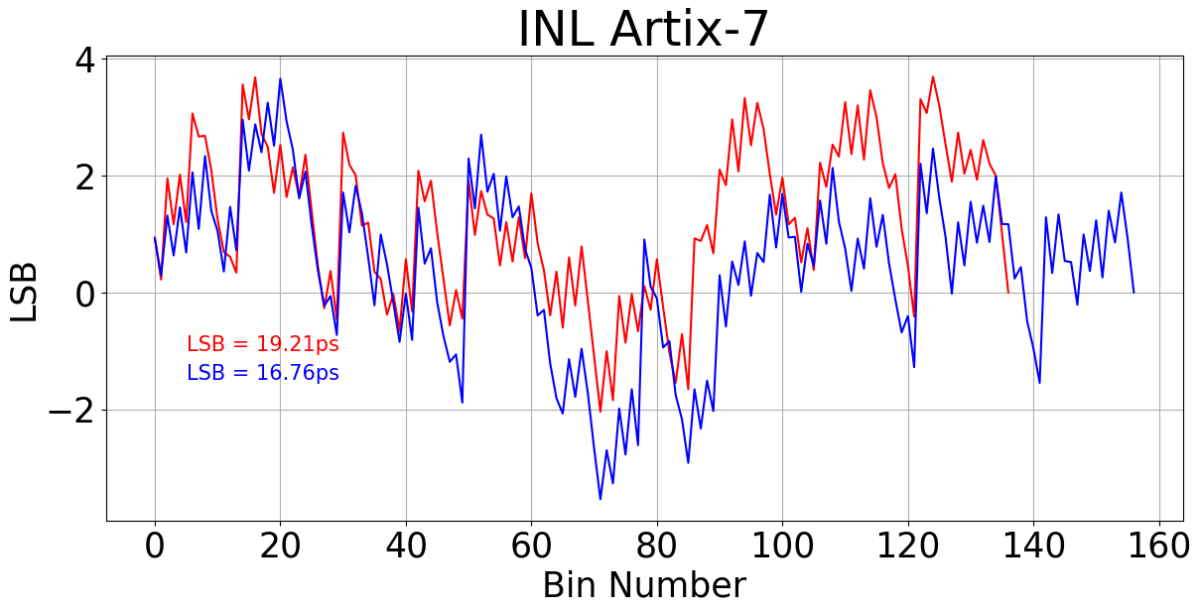
Die vs. Die
Considerations for Linearity

Slide 10
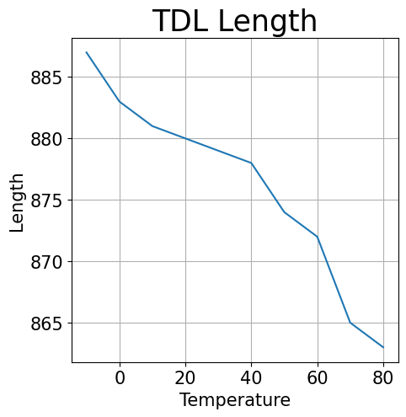
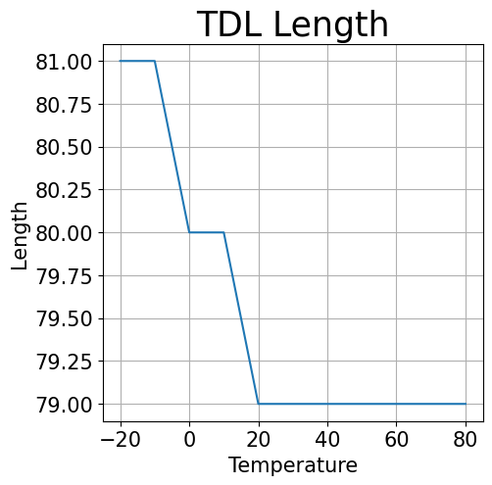
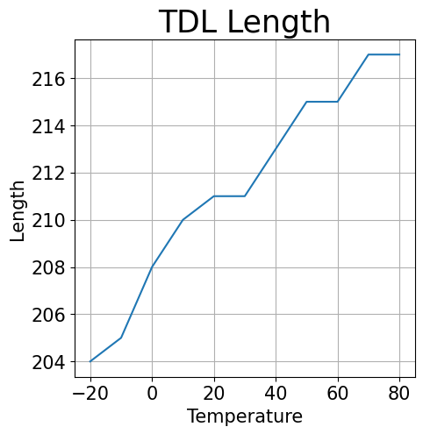
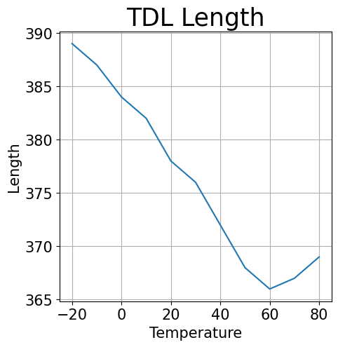
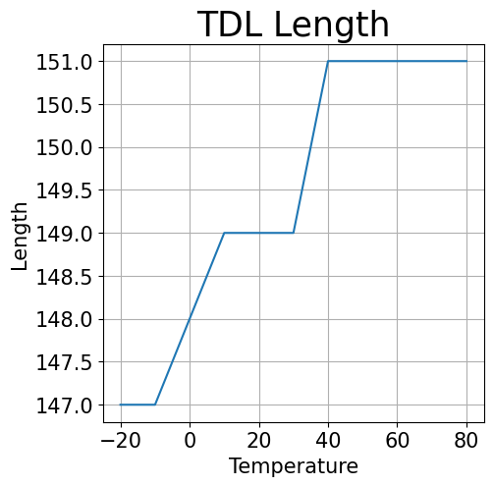
TDL Length vs. Temperature
Temperature Stability
Determination of the number of delay elements required to map one period of a 600MHz (Ultrascale+ & Arria10), 625MHz (Ti180), 400MHz (Cyclone V), 380MHz (Zynq7000) clock
 | Ultrascale+ [16nm] | Ti180 [16nm] | Arria10 GX [20nm] | Cyclone V [28nm] | Artix-7 [28nm]
TDL Length | 863 - 887 | 79 - 81 | 204 - 217 | 366 - 389 | 147 - 151
LSB | 1.88ps – 1.93ps | 19.75ps – 20.25ps | 7.68ps – 8.17ps | 6.77ps – 7.19ps | 17.43ps – 17.90ps
Relative Variation | 2.78% | 2.53% | 6.37% | 6.26% | 2.72%

Slide 11
Overview
Performance Overview
Measurements from -20°C to 80°C
 | Ultrascale+ [16nm] |  | Ti180 [16nm] |  | Arria10 GX [20nm] |  | Cyclone V [28nm] |  | Artix-7 [28nm]
Bezeichnung | Min | Max | Min | Max | Min | Max | Min | Max | Min | Max
TDL Length | 863 | 887 | 79 | 81 | 204 | 217 | 366 | 389 | 147 | 151
LSB | 1.88ps | 1.93ps | 19.75ps | 20.25ps | 7.68ps | 8.17ps | 6.77ps | 7.19ps | 17.43ps | 17.90ps
DNL min | -0.99 | -0.99 | -0.79 | -0.73 | -1 | -0.99 | -1 | -1 | -0.99 | -0.97
DNL max | 7.24 | 9.92 | 0.80 | 1.48 | 7.82 | 9.67 | 4.4 | 5.95 | 3.03 | 3.26
INL min | -3.23 | -2.26 | -1.63 | -1.11 | -4.07 | -2.03 | -30.78 | -21.97 | -4.04 | -1.38
INL max | 23.58 | 28.99 | 0.55 | 1.11 | 10.64 | 13.59 | 17.43 | 22.91 | 1.87 | 4.64

Slide 12
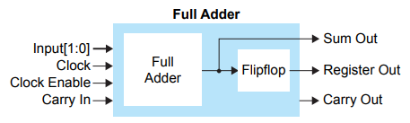
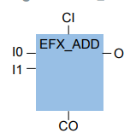
Different Families
Performance Overview
Xilinx Ultrascale+
Efinix Titanium Family
[10] UltraScale Architecture Configurable Logic Block User Guide (UG574)
[11] Efinity Quantum Ti primitives ug v2.0

Slide 13
Take-Aways
Conclusion
Deep Understanding of Low-Level Architecture Required
Precise TDL Placement is Critical
Each TDL Requires Individual Calibration
Efinix Ti180 [16nm] | Artix-7 [28nm] | Ultrascale+ [16nm] | Arria10 GX [20nm] | Cyclone V [28nm]
~ Big LSB | ~ Big LSB | ✓ Low LSB | ✓ Low LSB | ✓ Low LSB
✓ Good Linearity | ✓ Good Linearity | ✗ Bad Linearity | ~ Moderate Linearity | ✗ Bad Linearity
✓ Good Temperature Stability | ✓ Good Temperature Stability | ✓ Good Temperature Stability | ~ Moderate Temperature Stability | ~ Moderate Temperature Stability
✓ Almost no Bubbles | ✓ Small Bubbles | ~ Moderate Bubbles | ~ Moderate Bubbles | ✗ Big Bubbles

Slide 14
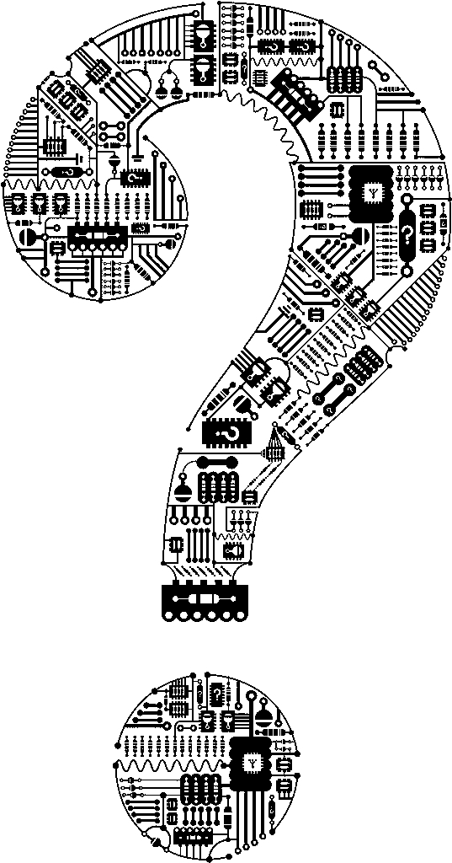

Questions
Conclusion
IMES
Oberseestrasse 10
8640, Rapperswil SG
Schweiz
SAFRAN VECTRONIX AG

Slide 15
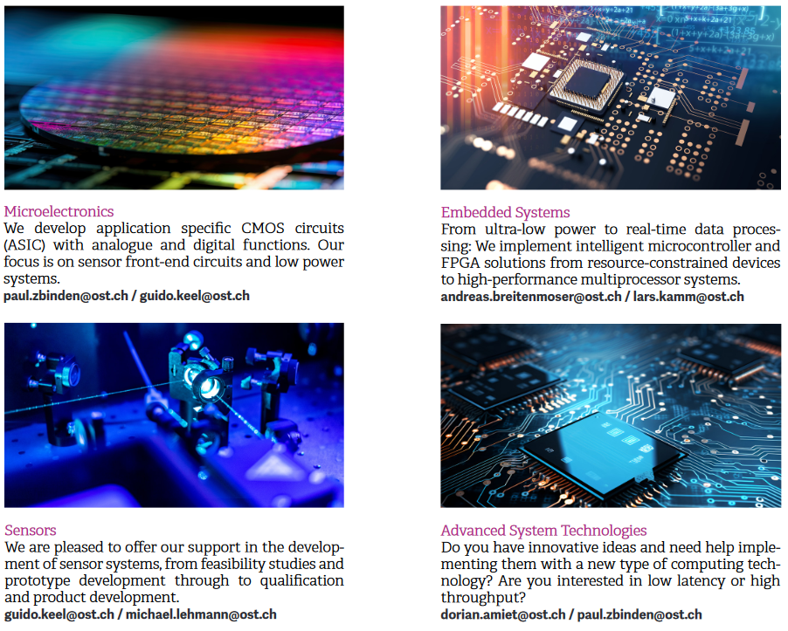
IMES: Overview Expertise
Introduction
Microelectronics:
  ASIC Design Analog
  ASIC Design Digital
  ASIC Design Mixed – Signal
  Design for Test
Embedded Systems:
  Ultra Low Power Systems
  Edge Computing
  Robotics and Smart Drives
  Embedded Artificial Intelligence
  Real-Time Data Processing
    Sensors
  Photonics
  Medical
  Inductive Sensors
  Capacitive Sensors
  Ultrasonic Sensors
  Further Sensor Principles
    Advanced System Technologies
  FPGA Design
  Hardware acceleration for cryptographic systems
  Side Channel analysis in cryptographic systems
  Time to Digital Converters
  Hardware acceleration for stream-based data processing
  Hardware acceleration for machine learning/deep learning

Slide 16
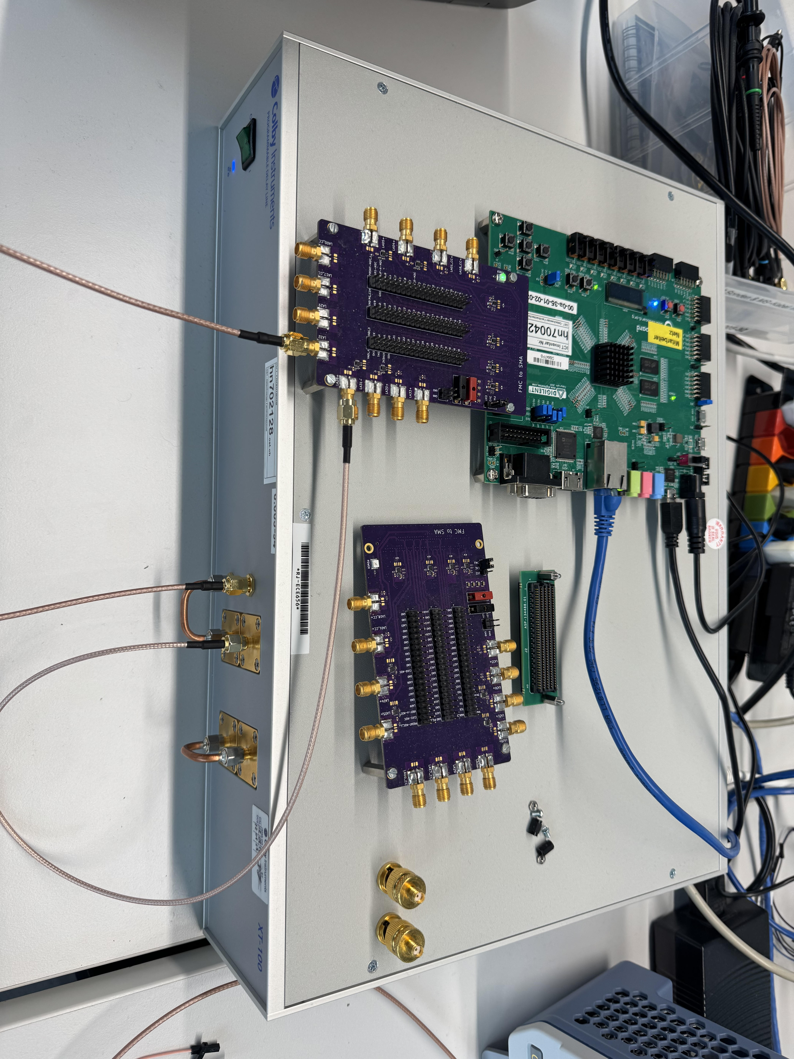
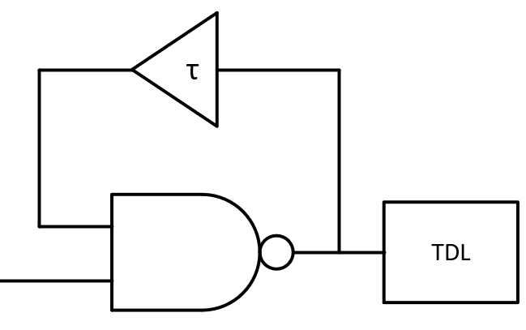
Code Density Test
Considerations for Linearity

Slide 17
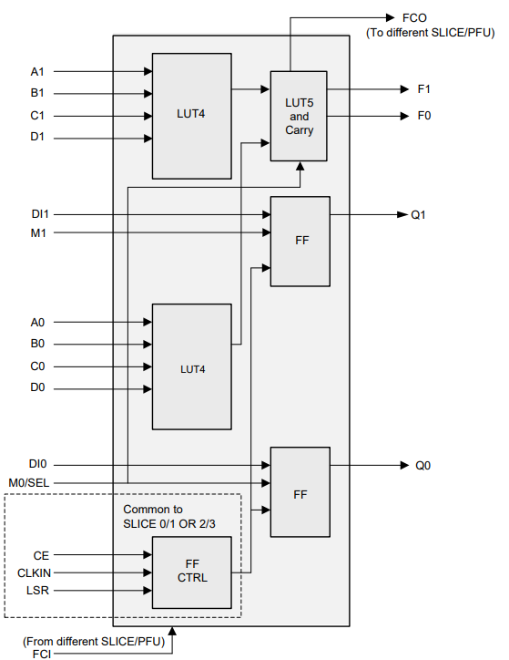
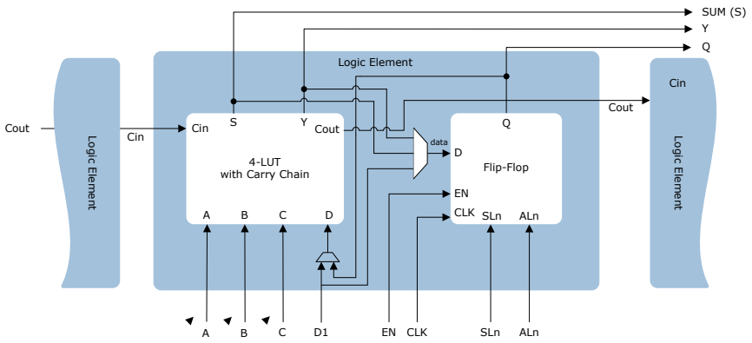
Different Families
FPGA Families
Microchip PolarFire
Lattice Certus-NX
[12] PolarFire SoC Fabric UG VB
[13] Certus-NX Family Data Sheet

