Slide 1




Logobereich
A Reconfigurable FPGA-based ML Library for Kernel Methods
  —
    Yousef Alnaser^{1, 2} , Jan Langer¹, Anna Zuchna²
    1 Fraunhofer-Institut für Elektronische Nanosysteme ENAS, Technologie-campus 3, 09126 Chemnitz
    2 Technische Universität Chemnitz, Str. der Nationen 62, 09111 Chemnitz

Slide 2
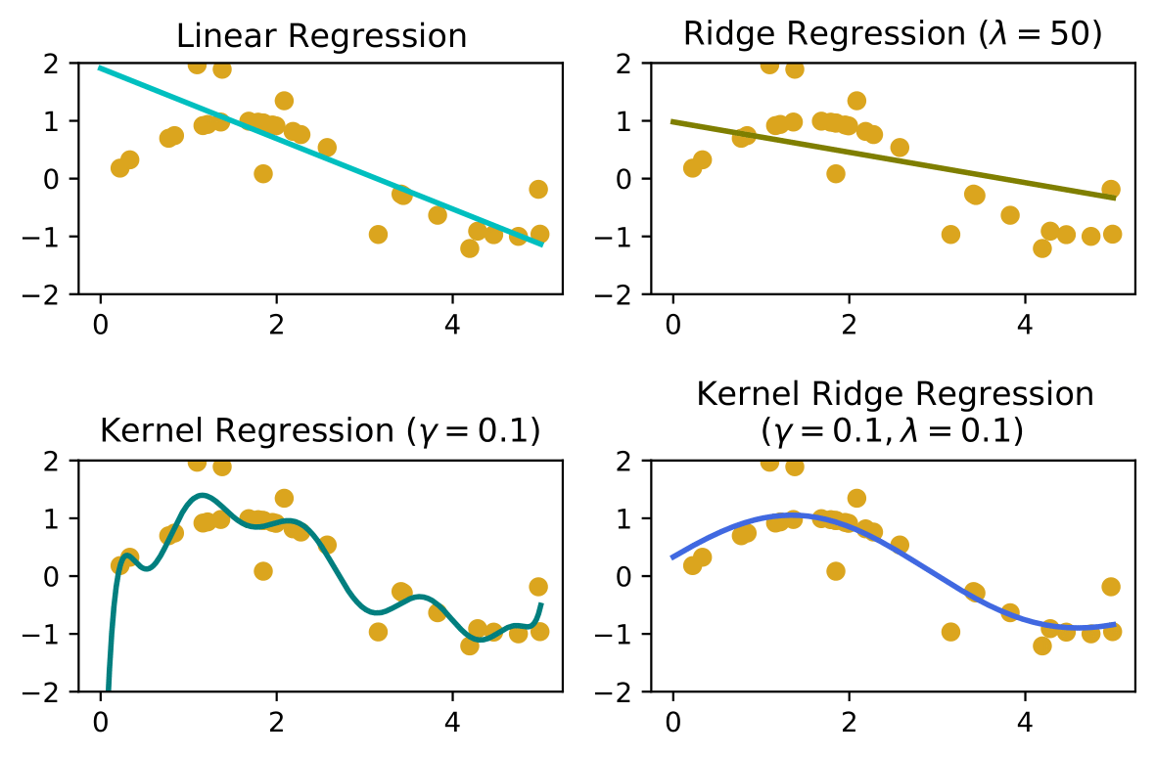

Introduction
Very useful for non-linear and complex data
Kernel Methods Intuition
Kernel Ridge Regression (KRR) Example
    Linear Regression
  Finds the best-fit line with least prediction error.
    Ridge Regression
  Introduce a bias to the estimator to resolve overfitting.
    Kernel Regression
  Better fits data than linear estimators. But may lead to overfitting.
    Kernel Ridge Regression
  Fits data better, and resolves overfitting by introducing a bias to the estimators

Slide 3
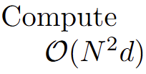
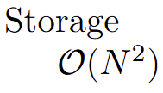

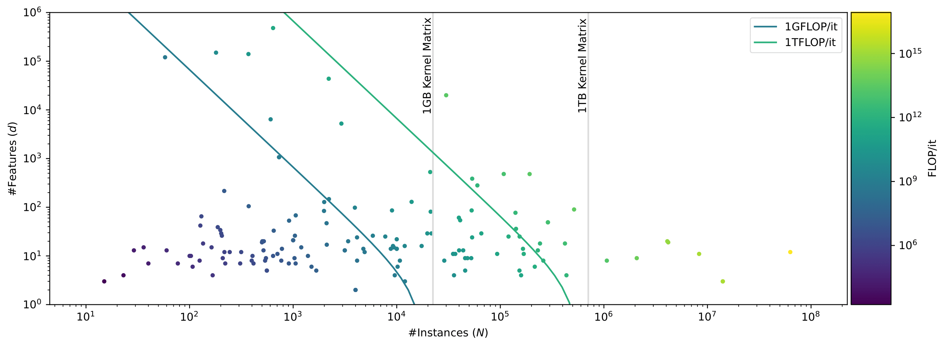
Introduction
Scale poorly for large datasets
Kernel Matrix Complexity
Radial Basis Kernel (RBF)

Slide 4



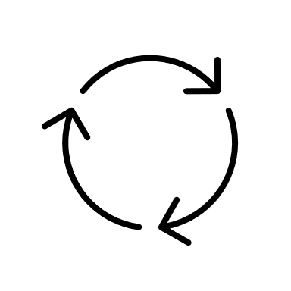


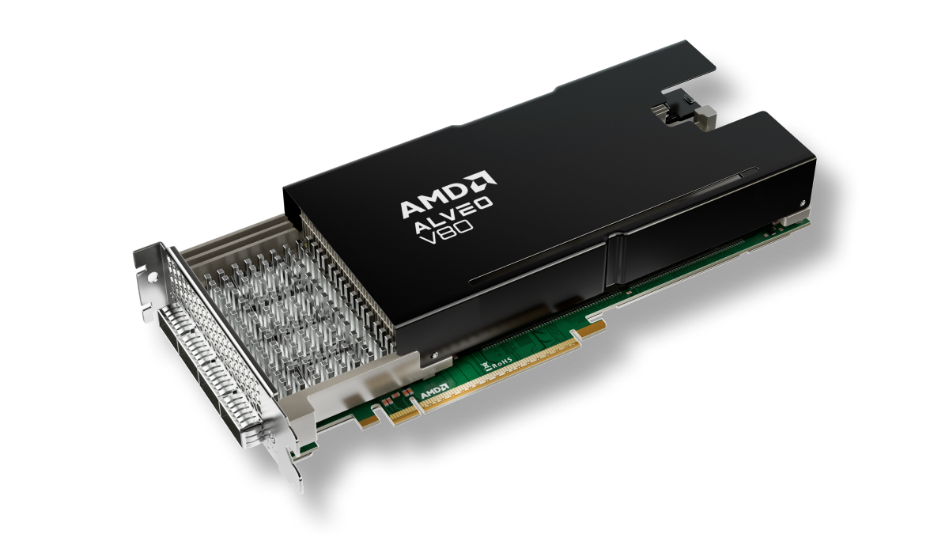
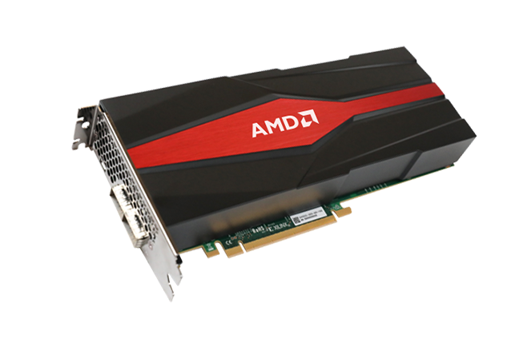
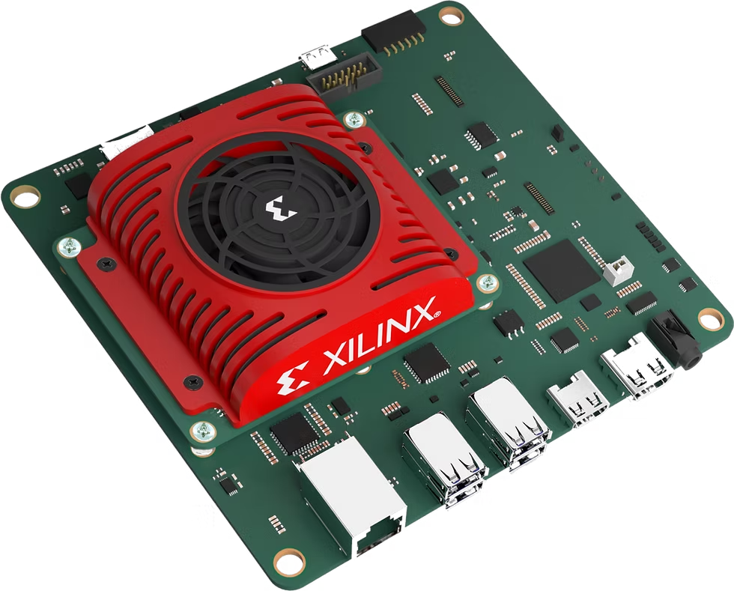

ML FPGA Library for Kernel Methods
Accelerated kernel learning from Python — without hardware complexity.
Hardware acceleration of kernel ML
FPGA Library
Why this library?
    Main Advantages
      Up to 30× faster than Python CPU libraries
      Partial reconfiguration
        Support different kernels
        Reduce Library Size
      Modular design: easy to extend with new solvers and kernels
      Works with big data, no FPGA knowledge needed
Modular, hardware-accelerated blocks for common kernel methods
KRR
SVM
GP
PCA
Plug-and-play Python interface via PYNQ
from fpgakernel import SVM
model = SVM(‘rbf’)
model.fit(X, y)
Runs on various edge and accelerator cards
Kria SOM
Alveo V80
VCK5000 Versal

Slide 5
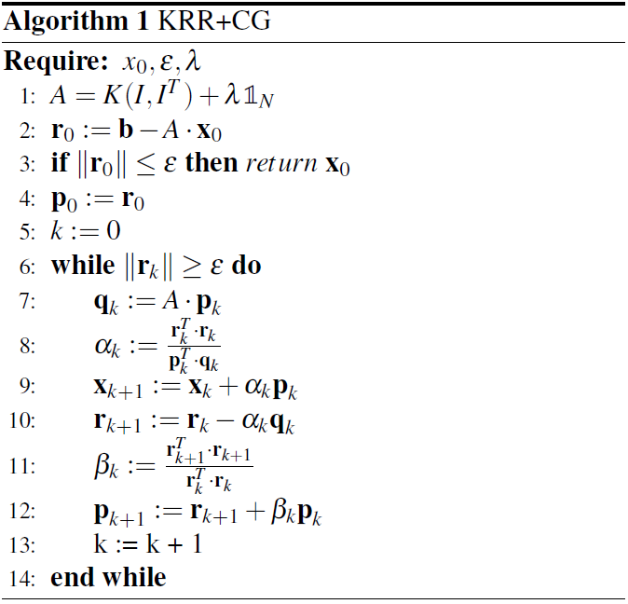
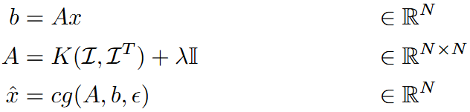
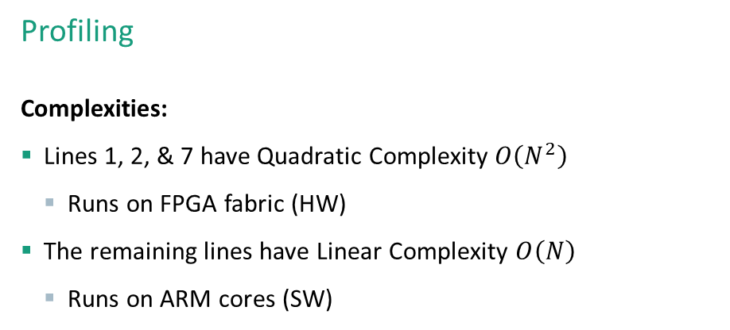
Use Case
Only operations with quadratic complexity are accelerated
Kernel Ridge Regression
Formulation
Profiling
    Complexities:
      Lines 1, 2, & 7 have Quadratic Complexity $O\left(N^{2}\right)$
        Runs on FPGA fabric (HW)
      The remaining lines have Linear Complexity $O\left(N\right)$
        Runs on ARM cores (SW)

Slide 6
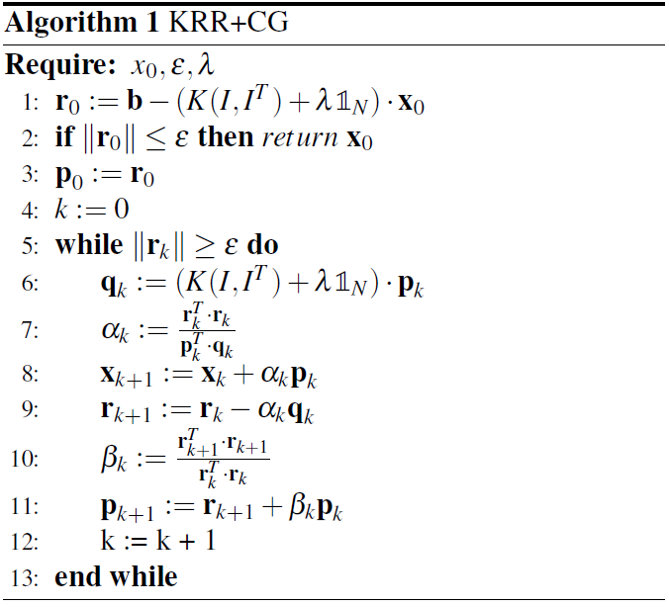

Introduction
HW/SW Partitioning
    Operations of Interest:
      Kernel-Matrix (KM) Construction
      Matrix-Vector (MV) Multiplication
On-the-fly calculation → High memory BW requirements
Matrix Tiling/Partitioning → Reduced BW requirements

Slide 7
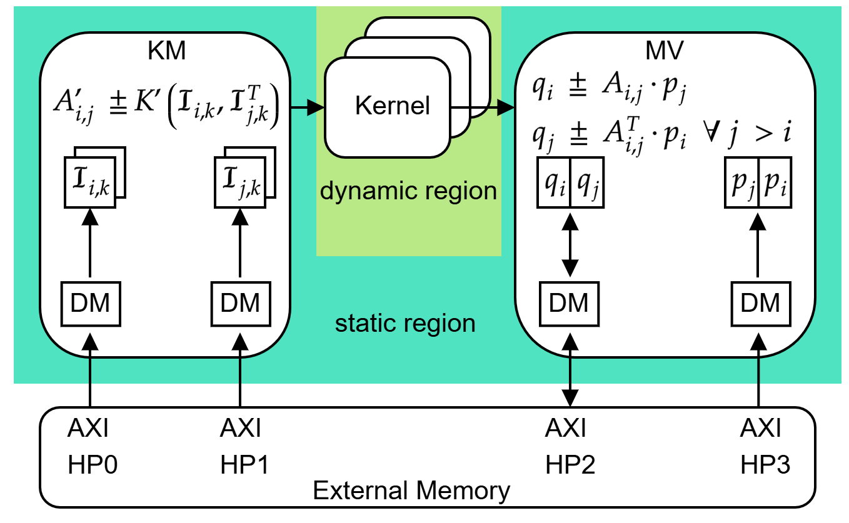
Accelerator Implementation
Design Overview
Accelerator hardware
      Kernel Matrix (KM) Construction
      Reconfigurable Kernel Module
      Matrix-Vector (MV) Multiplication
      Implemented in HLS in 300 LoC
      Compile-time configurable
      Run-time compatible with any arbitrary dataset
© Markus Jürgens

Slide 8
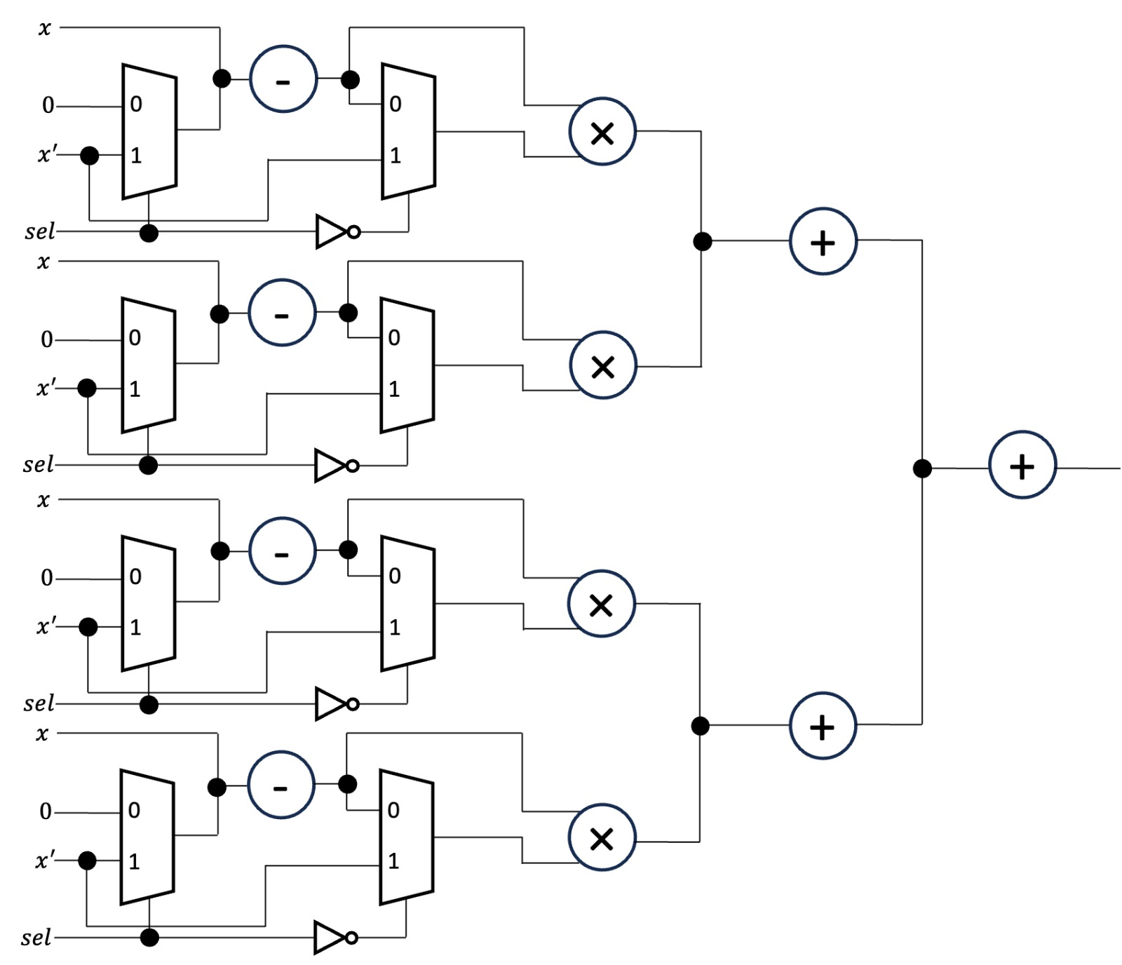
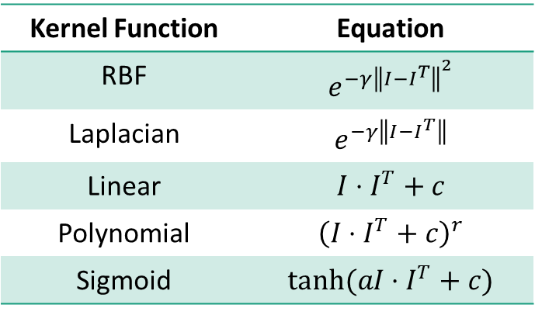
Accelerator Implementation
Common Operations in Supported Kernels
$$I$$
Table 1 – Supported Kernels
Kernel Function | Equation
RBF | $$e^{−γ{\left\|I−I^{T}\right\|}^{2}}$$
Laplacian | $$e^{−γ\left\|I−I^{T}\right\|}$$
Linear | $$I⋅I^{T}+c$$
Polynomial | $${\left(I⋅I^{T}+c\right)}^{r}$$
Sigmoid | $$tanh(aI⋅I^{T}+c)$$
$$I^{T}$$
$$I$$
$$I^{T}$$
$$I$$
$$I^{T}$$
$$I$$
$$I^{T}$$
Fig. 4 – Kernel Implementation

Slide 9
Accelerator Implementation
Common operations are combined in a single implementation
Common Operations in Supported Kernels
$$I$$
Table 1 – Supported Kernels
Kernel Function | Equation
RBF | $$e^{−γ{\left\|I−I^{T}\right\|}^{2}}$$
Laplacian | $$e^{−γ\left\|I−I^{T}\right\|}$$
Linear | $$I⋅I^{T}+c$$
Polynomial | $${\left(I⋅I^{T}+c\right)}^{r}$$
Sigmoid | $$tanh(aI⋅I^{T}+c)$$
$$I^{T}$$
$$I$$
$$I^{T}$$
$$I$$
$$I^{T}$$
$$I$$
$$I^{T}$$
Fig. 4 – Kernel Implementation

Slide 10
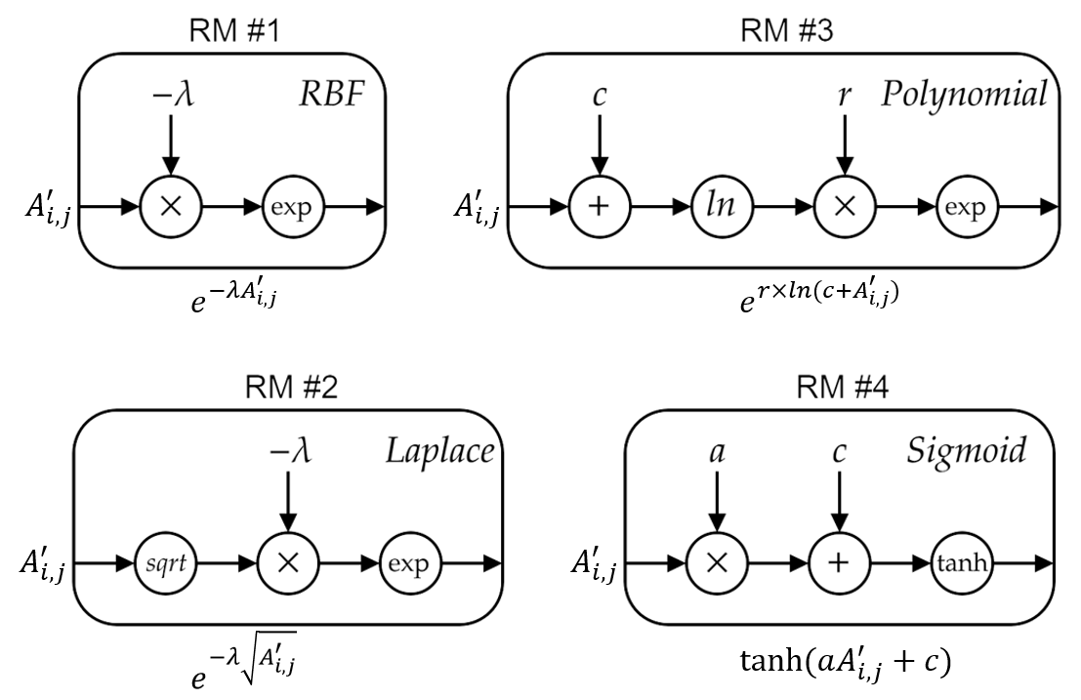
Accelerator Implementation
Common operations → kernel specific operations
Kernels Calculations
$$I$$
$$I^{T}$$
$$I$$
$$I^{T}$$
…
$$I$$
$$I^{T}$$
$$I$$
$$I^{T}$$
Fig. 4 – Kernel Implementation
Fig. 5 – Reconfigurable modules for supported kernels

Slide 11
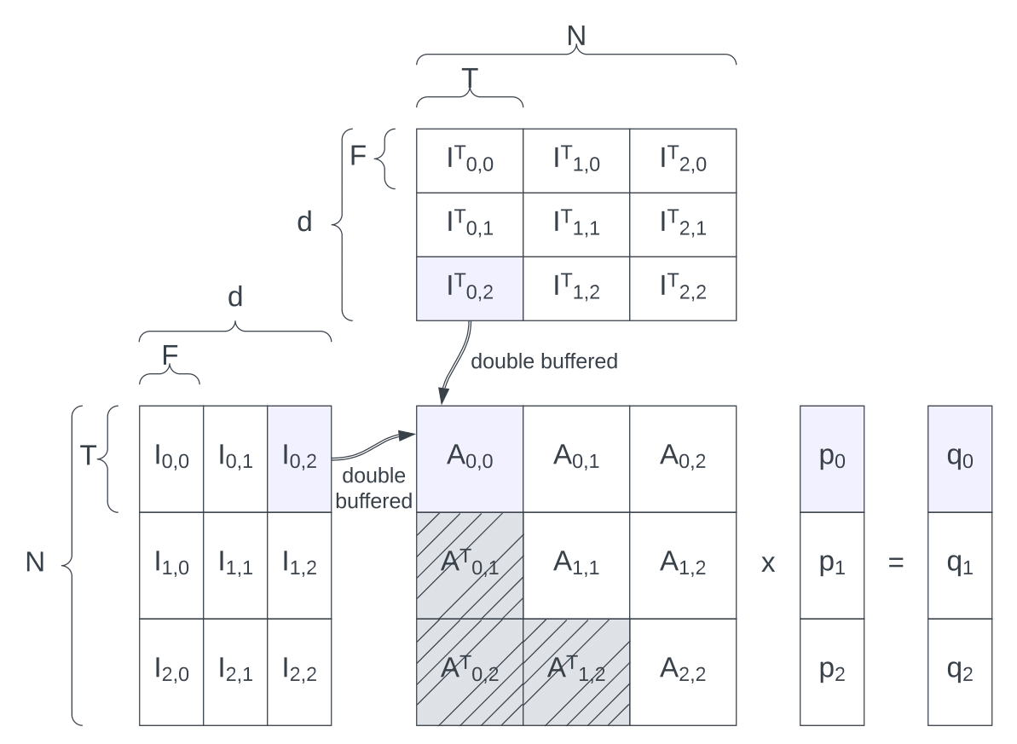
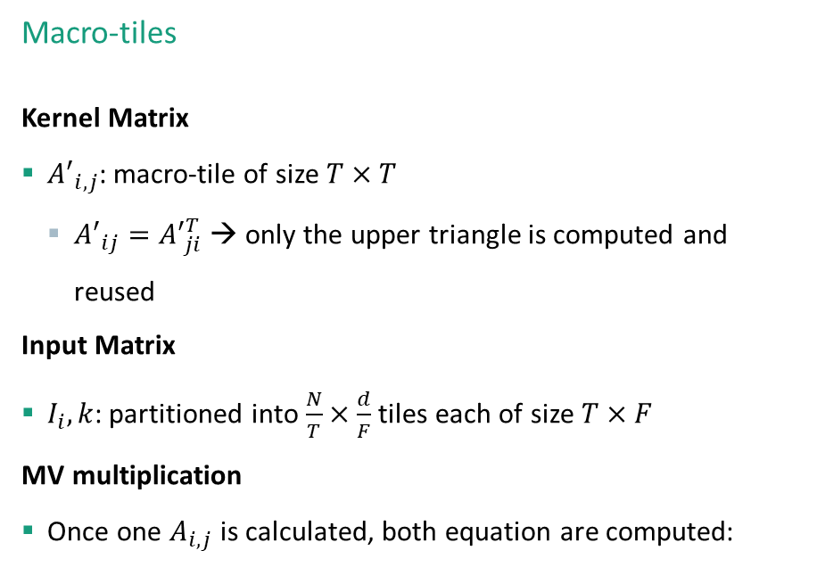

Accelerator Implementation
Macro tiles for storage and BW
Matrix Partitioning
Macro-tiles
    Kernel Matrix
      ${A′}_{i,j}$: macro-tile of size $T×T$
        ${A′}_{ij}={A′}_{ji}^{T}$ → only the upper triangle is computed and reused
      Input Matrix
      $I_{i},k$: partitioned into $\frac{N}{T}×\frac{d}{F}$ tiles each of size $T×F$
      MV multiplication
      Once one $A_{i,j}$ is calculated, both equation are computed:
© Markus Jürgens
‘

Slide 12
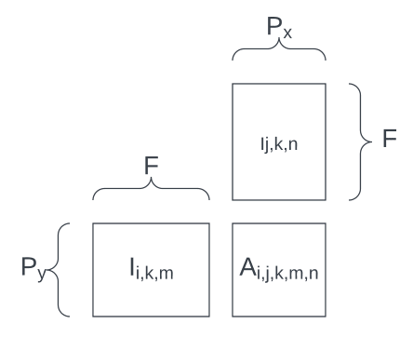
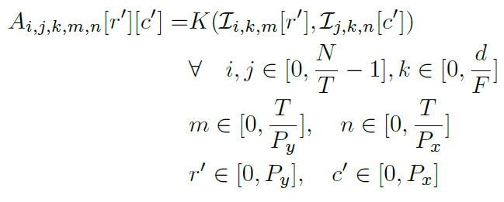
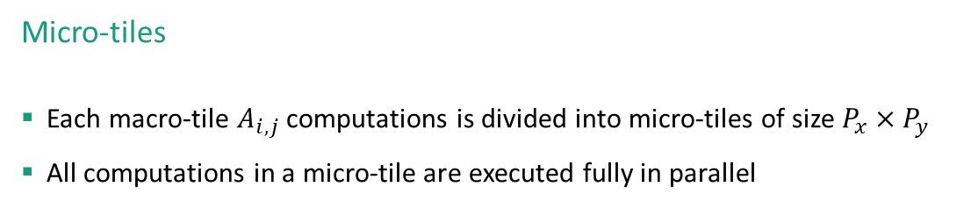
Accelerator Implementation
Micro tiles for parallelism
Matrix Partitioning
Micro-tiles
      Each macro-tile $A_{i,j}$ computations is divided into micro-tiles of size $P_{x}×P_{y}$
      All computations in a micro-tile are executed fully in parallel
© Markus Jürgens

Slide 13

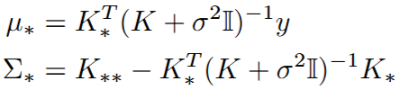
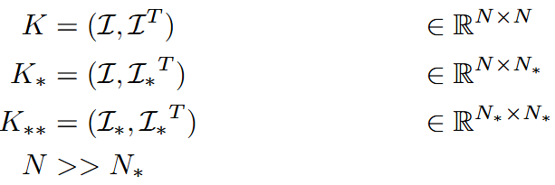
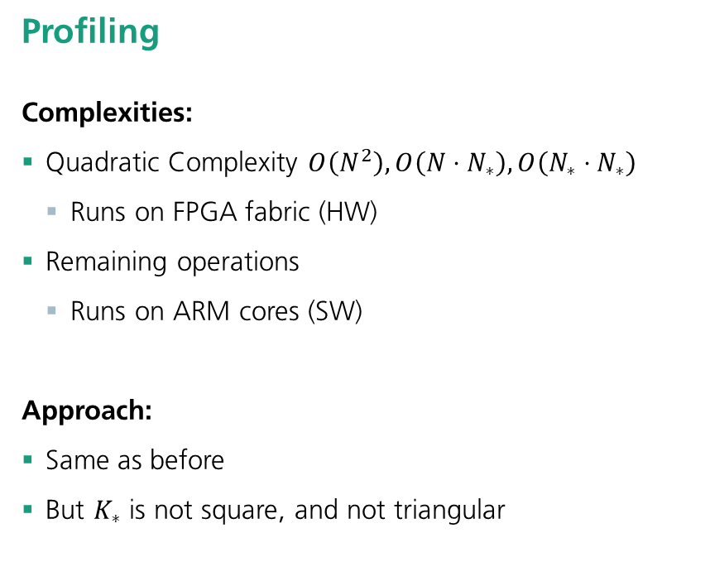
Use Case 2
Same approach as KRR
Gaussian Process
Formulation
Profiling
    Complexities:
      Quadratic Complexity $O\left(N^{2}\right),O\left(N⋅N_{∗}\right),O\left(N_{∗}⋅N_{∗}\right)$
        Runs on FPGA fabric (HW)
      Remaining operations
        Runs on ARM cores (SW)
    Approach:
      Same as before
      But $K_{∗}$ is not square, and not triangular
Posterior mean:
Variance:

Slide 14
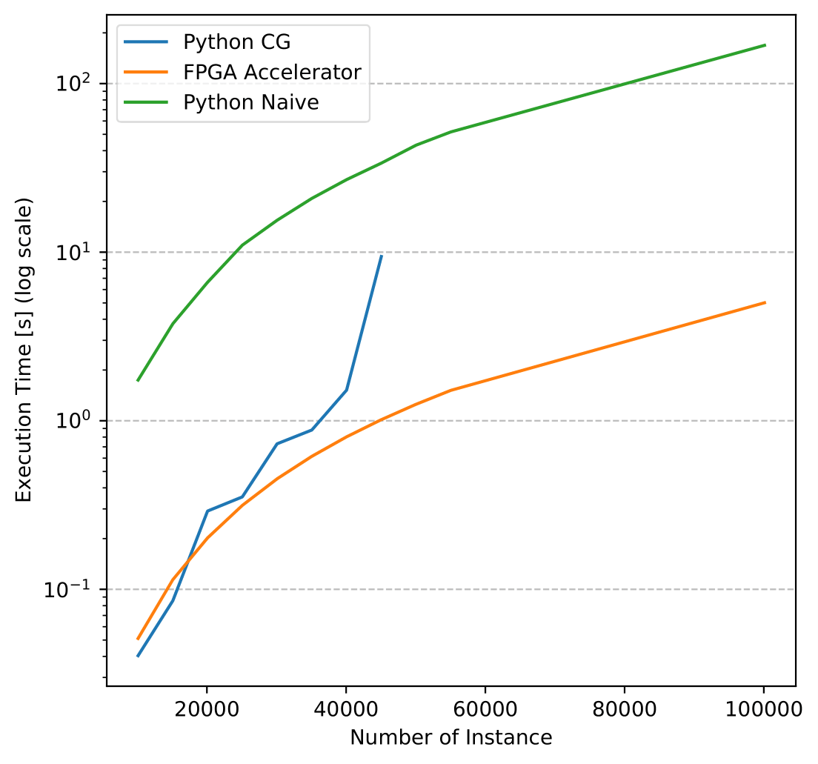
Results
30x faster
Performance Evaluation
Comparison
      Python Cholesky (cubic complexity – not shown)
        From scikit-learn
        requires large memory storage
      Python CG – 30x slower for big data
        Precomputes the kernel matrix
        scikit-learn, SciPy and NumPy
        requires large memory storage
      Python Naïve - 80x slower
        Matrix partitioning to improve caching
        scikit-learn and NumPy
Kria SOM

Slide 15
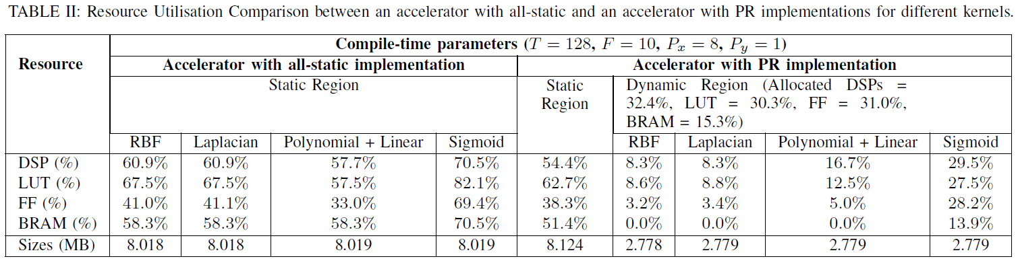
Results
Reduced library size. Tradeoff: increased resources
Utilization

Slide 16
Conclusion
Challenges
Partial Reconfiguration
      Rigid Resource Allocation
        Must accommodate the largest RM
      Manual Floorplanning
        Must manually assign PR regions
      Toolchain Limitations
        PR in Vivado is not well-documented and buggy
HLS
      Single-cycle accumulation of floating point
        Must be manually handled.
      Loop dependencies
        Predicts incorrect dependencies
Data Movement
      Manual Data handling
      Xilinx DMA LogiCore
        Requires large amount of storage, for big data

Slide 17


Conclusion
Summary
Library
ML Algorithms
Impl. #1
KM-MV
KRR
upper triangle
Impl. #2
upper triangle
GP
full matrix
Impl. #3
…
SVM
AI Engines
More Kernels
What’s next?!
PCA

Slide 18
Logobereich
Thank you for your attention
—
    Contact
    Yousef Alnaser
    yousef.alnaser@enas.fraunhofer.de

