Slide 1
FPGA Implementation of NGRC for predicting dynamical systems
By João Folhadela and Daniel Köglmayr – DLR KI-EXE
2nd FPGA Developers' Forum (FDF) meeting (CERN)

Slide 2
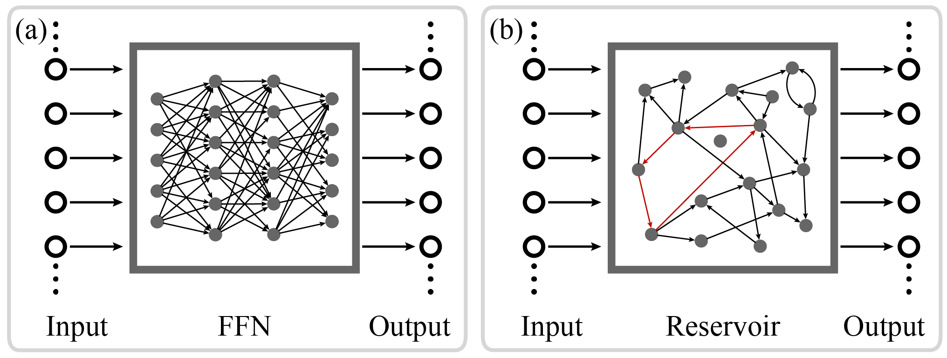






Introduction – Reservoir Computing (RC)
$$r\left(t\right)$$
$$W_{in}$$
$$W_{out}$$
$$A, b$$
$$x\left(t\right)$$
$$y\left(t\right)$$

Slide 3







Reservoir Computing
Optimize $W_{out}$ via Ridge regression. Minimize loss:
${\sum_{t=−T}^{0}{∥}W_{out}r(t)−y_{R}(t)∥}^{2}+β∥{W_{out}∥}^{2}$
  $y_{R}(t)$: known real output
  $β$: regularization parameter
$W_{out}$ is then obtained via:
$W_{out}={ (r^{⊺}r+β I)}^{−1}r^{⊺}y$
An analytic solution is usually much faster
to compute than gradient descent.
$$r\left(t\right)$$
$$W_{in}$$
$$W_{out}$$
$$A, b$$
$$x\left(t\right)$$
$$y\left(t\right)$$
Notes:
Do explain every line, no need to go into every term.

Slide 4
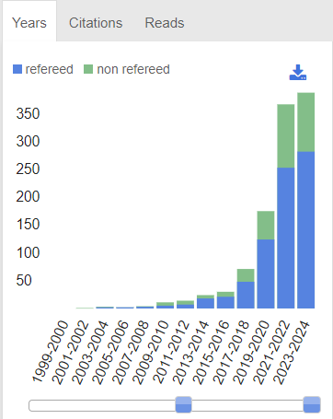
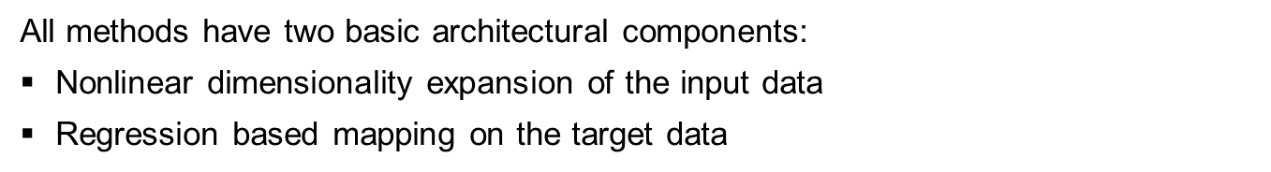
RC SOTA
Next Generation Reservoir Computing
Next Generation Reservoir Computing
Deep Reservoir Computing
Reservoir Computing
Quantum Reservoir Computing
Hybrid Reservoir Computing
Random Signatures
Reservoir
Minimal Reservoir Computing
Notes:
Vector Auto Regression

Slide 5
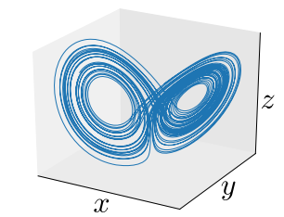
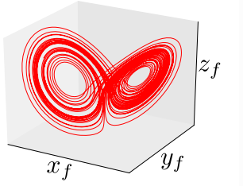
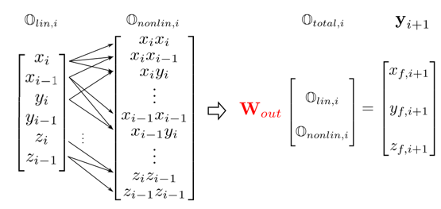
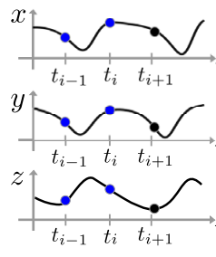
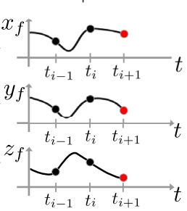
Introduction – Next Generation Reservoir Computing (NGRC)
Efficient
Less training data required
D. Gauthier et al., Nat. Comm., 2021

Slide 6
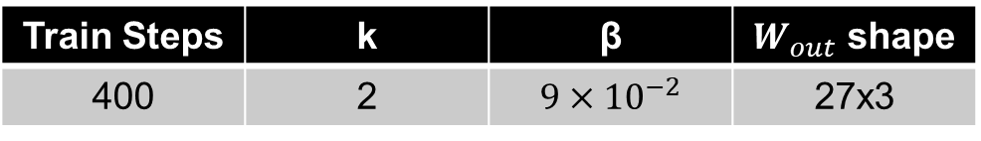


Introduction – NGRC on Lorenz Attractor
We train with Python‘s numpy‘s linalg solver
Some parameters:
Then inference is performed on FPGA
  Transfer $W_{out}$ and first linear state to FPGA memory
  Prediction loop
$W_{out}={ (r^{⊺}r+β I)}^{−1}$ $r^{⊺}Y_{train}$
Train Steps | k | β | $W_{out}$ shape
400 | 2 | $$9×{10}^{−2}$$ | 27x3
k – timesteps β - regularization parameter
prediction loop

Slide 7
Implementation – The NGRC prediction loop
prediction loop
Creating the Reservoir
  Read linear state from memory – current and previous timestep
  Non-linear expansion – multiplying and powering the linear state
Predicting
  Matrix multiplication, several vector dot products – Multiply and Accumulate (MACs)
Save prediction
  In red – arithmetics are performed in float 32 with Vivado floating-point IP

Slide 8
Implementation – The FSM
IDLE
NGRC
IDLE
  Sets linear state
  Waits for prediction loop to begin/continue
EXPAND
  Performs the non-linear expansion
PREDICT_AND_SAVE
  Calculates predicton
  Saves it
SEND
  Send the current prediction via UART
CLEANUP
  Resets all counters and variables
predict_en || predicting_flag
EXPAND
nle_done
prediction_counter < 3000 & sent
PREDICT_AND_
SAVE
matrix_mul_done
SEND
sent & prediction_counter == 3000
CLEANUP

Slide 9
Implementation – The FSM
EXPAND
Implemented as a module that expands a vector of size 6 into size 27 (6+21)
Each multiplication is computed in parallel, with 32-bit float numbers:
  Vivado Floating-point IP
    Multiply operation
    Full DSP usage (21 multiplications x 2 DSP = 42 DSPs)
    Maximum Latency used (8 clock cycles)
Concatenate the input vector with each of the multiplication results.

Slide 10
Implementation – The FSM
IDLE
NGRC
IDLE
  Sets linear state
  Waits for prediction loop to begin/continue
EXPAND
  Performs the non-linear expansion
PREDICT_AND_SAVE
  Calculates predicton
  Saves it
SEND
  Send the current prediction via UART
CLEANUP
  Resets all counters and variables
predict_en || predicting_flag
EXPAND
nle_done
prediction_counter < 3000 & sent
PREDICT_AND_
SAVE
matrix_mul_done
SEND
sent & prediction_counter == 3000
CLEANUP

Slide 11
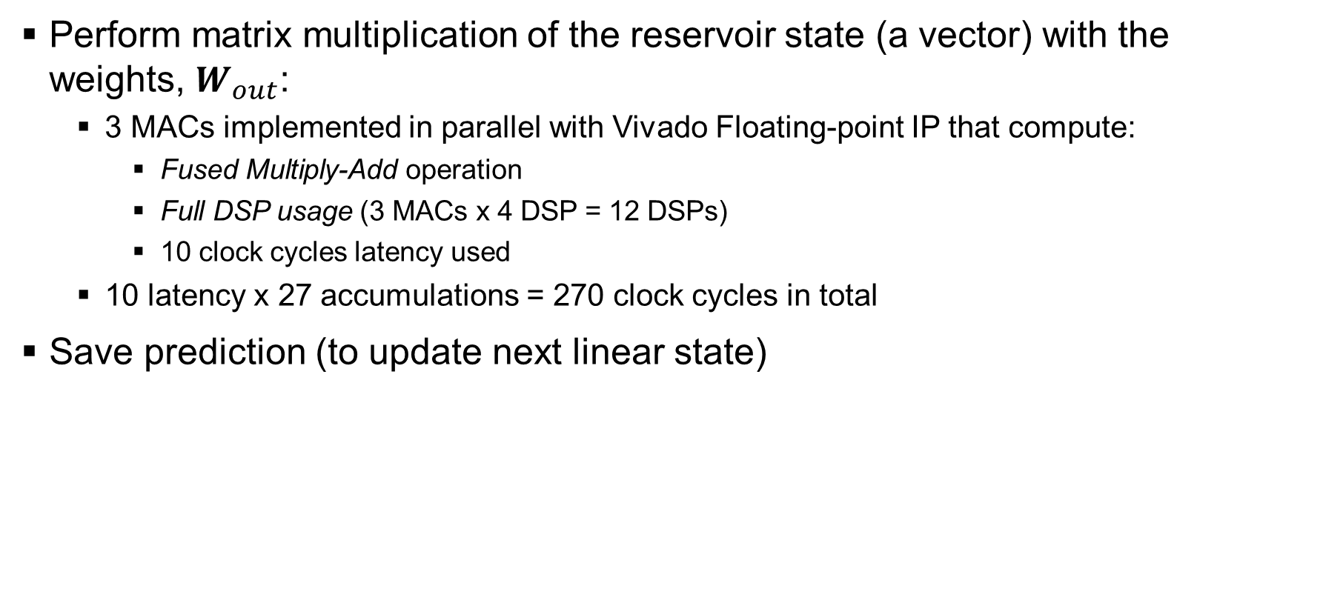
Implementation – The FSM
PREDICT_AND_
SAVE
Perform matrix multiplication of the reservoir state (a vector) with the weights, $W_{out}$:
  3 MACs implemented in parallel with Vivado Floating-point IP that compute:
    Fused Multiply-Add operation
    Full DSP usage (3 MACs x 4 DSP = 12 DSPs)
    10 clock cycles latency used
  10 latency x 27 accumulations = 270 clock cycles in total
Save prediction (to update next linear state)

Slide 12
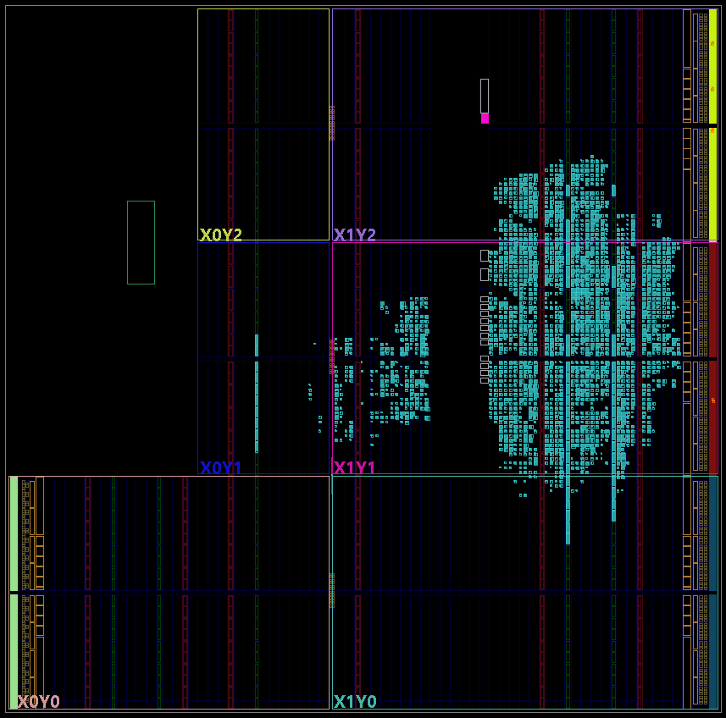
Resource usage
Resource | Used / Available
LUT | 5,132 / 53,200
LUTRAM | 270 / 17,400
FF | 6,475 / 106,400
DSP | 54 / 220

Slide 13
Other reports
Property | Value
On-Chip Power | 0.294 W
Dynamic | 0.186 W
Static | 0.109 W
Clock Speed | 125 MHz
Worst Negative Slack | 1.3 ns

Slide 14
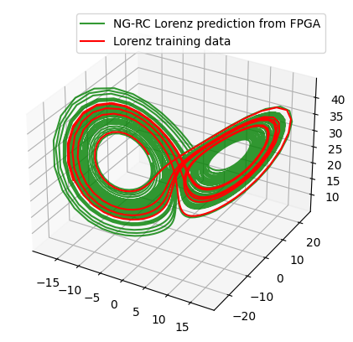
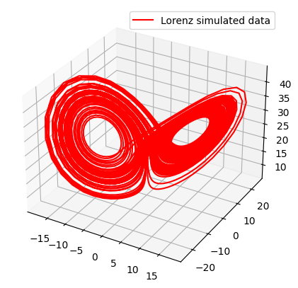
Evaluation – Simulated vs. Predicted Lorenz
Prediction over 3000 timesteps

Slide 15
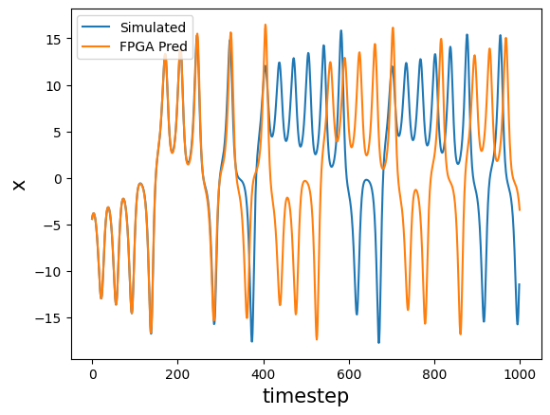
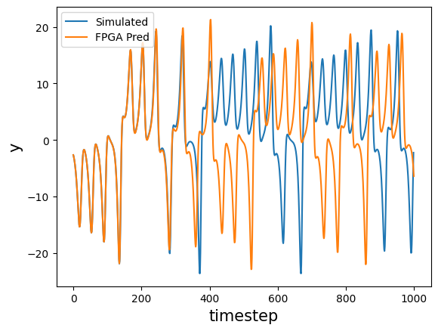
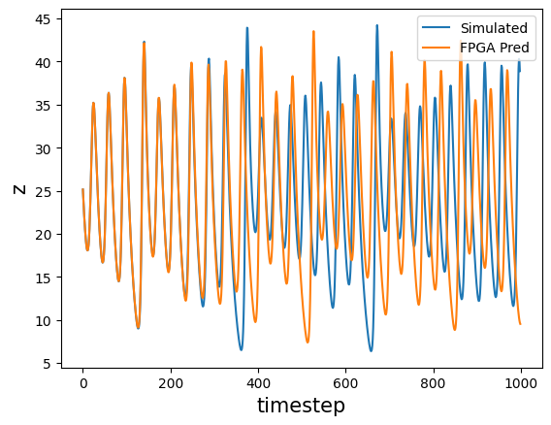
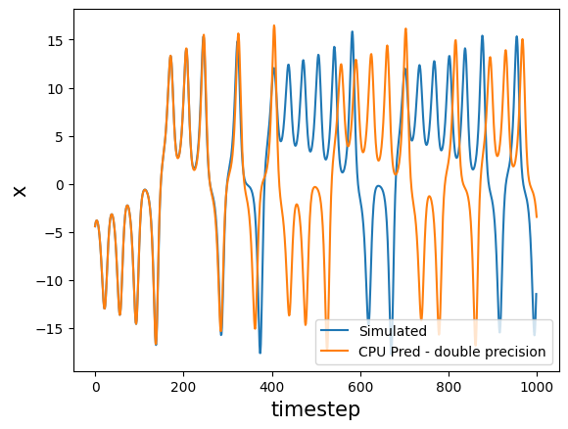
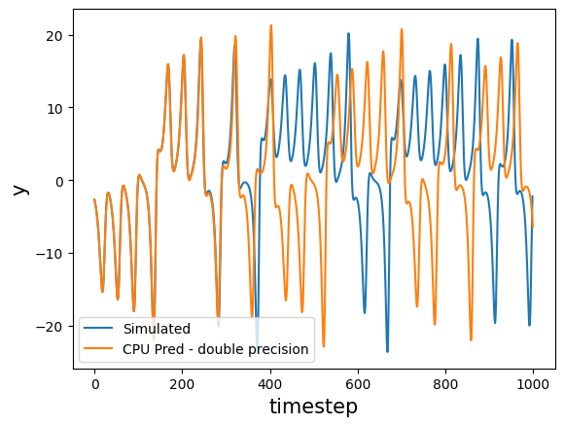
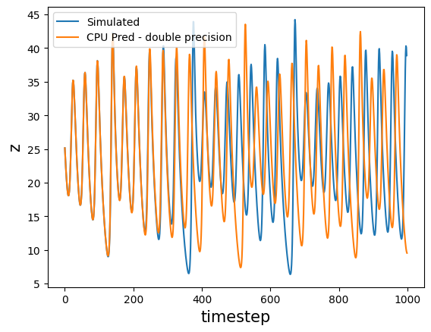
Evaluation – Simulated vs. Predicted Lorenz
On FPGA
On CPU – with double precision

Slide 16
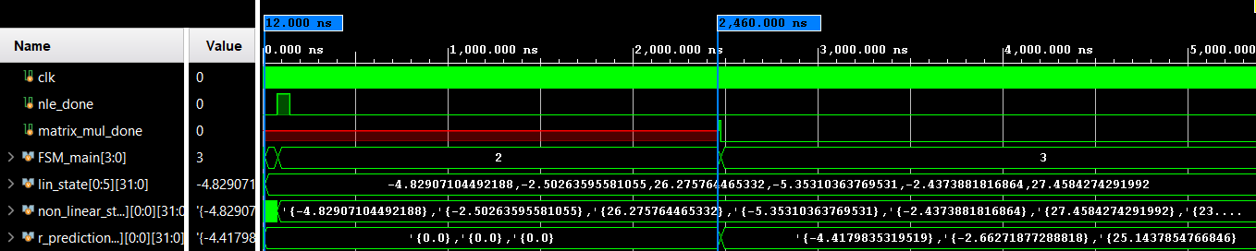
Latency Evaluation – Simulated vs. Predicted Lorenz
 | FPGA | CPU
Device | Zynq7000-20 | i7-1365U 13th Gen
Clock Speed | 125 MHz | 4.8 GHz
Inference time | 2.5 µs | 50 µs

Slide 17





Evaluation – Predicting the Lorenz attractor
Easy to implement
Low power
Fast
And real applications?

Slide 18
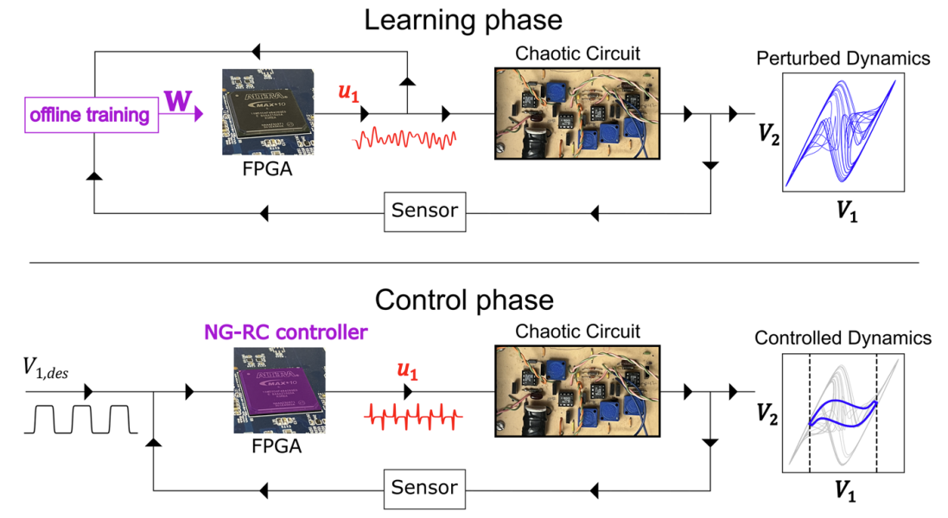
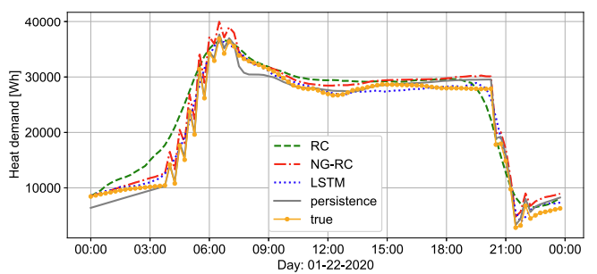
Applications of NGRC
Control of chaotic circuit dynamics
Kent, R.M. et. al Controlling chaos using edge computing hardware
Nat Commun 15, 3886 (2024)
Energy demand forecasting
Karoline Brucke et. al Benchmarking reservoir computing for residential energy demand forecasting
Energy and Buildings 314 (2024)
Financial markets, weather, costal line erosion, robotic control, etc.

Slide 19
Thank you!
Questions?

