Slide 1

Enhancing FPGA Verification by
Combining VUnit and UVVM
Markus Leiter
P2L2 GmbH
leiter@p2l2.com

Slide 2
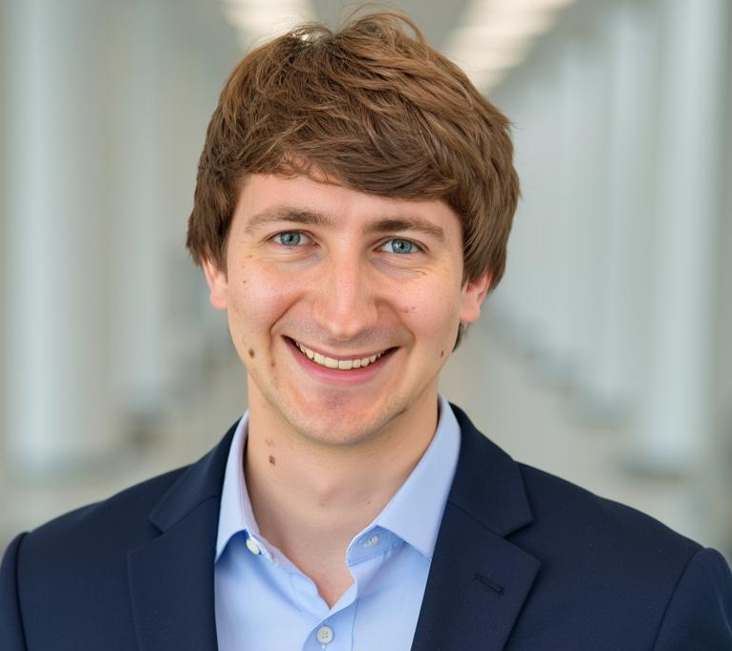


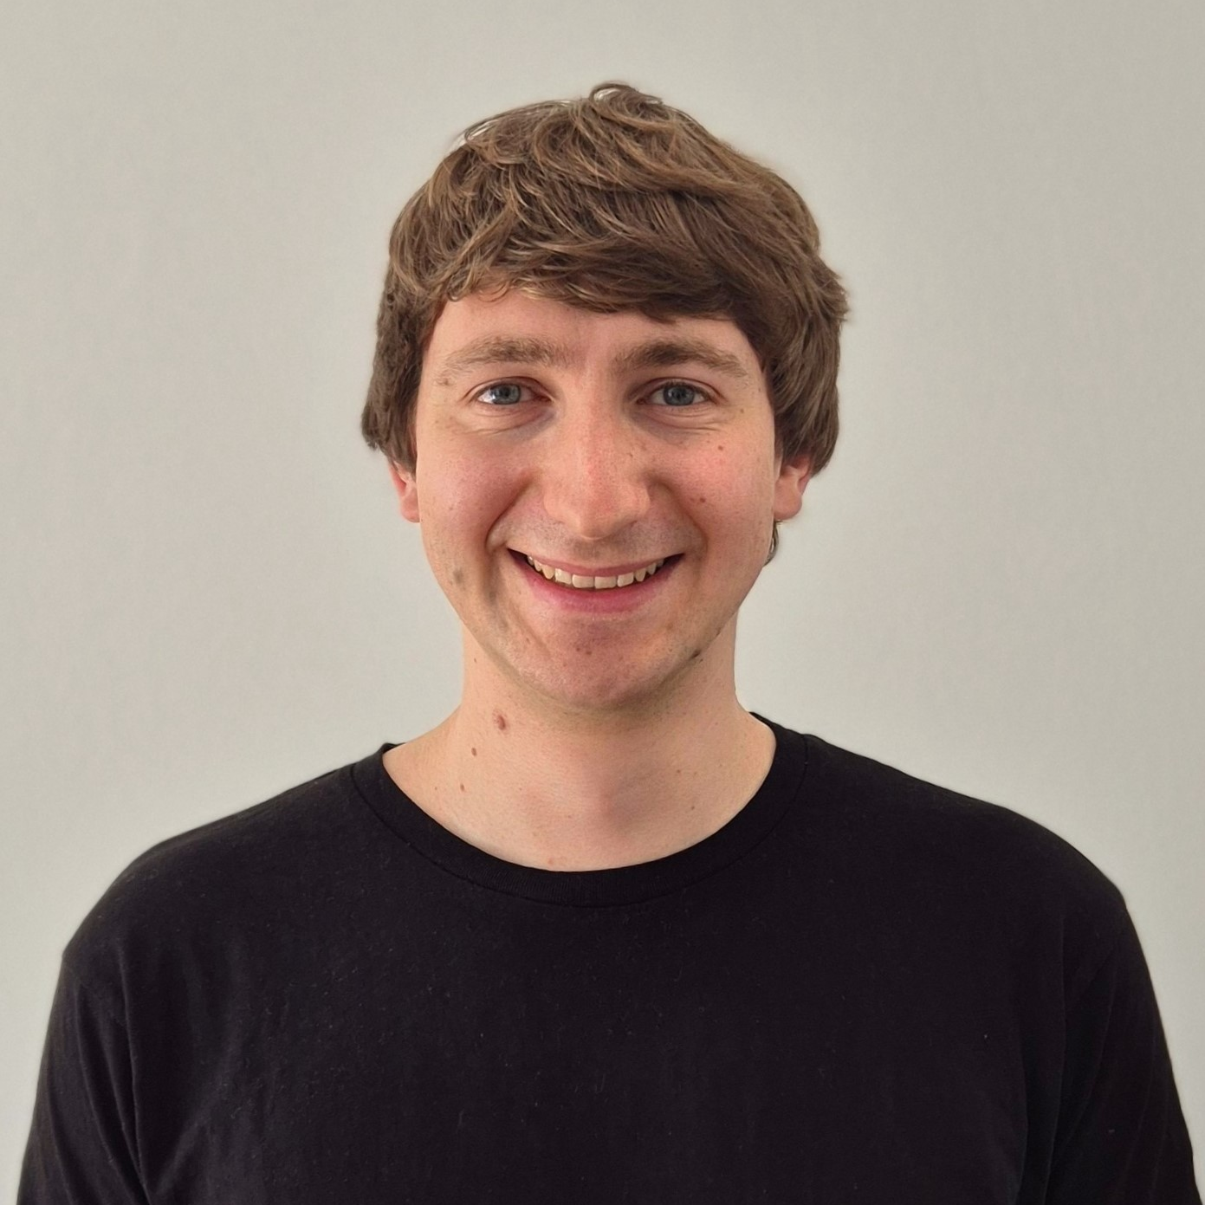
Speaker Bio
Academic Background:
  Master‘s degree from University of Applied Sciences Upper Austria (FH Hagenberg)
  Degree program: Embedded Systems Design
  (embedded software, RTL implementation and verification, signal processing & telecommunications)
Lecturer for Chip Design and Verification
Co-Founder and CEO of P2L2 GmbH
Markus Leiter
📧leiter@p2l2.com
2

Slide 3


EFFICIENT.
STRUCTURED.
DOCUMENTED.
VERIFIED.
📍 Hagenberg in Upper Austria since 2022
📅 Founded by Dr. Markus Pfaff and Markus Leiter
🚀 Over 35 years of professional FPGA experience
👨‍💼 A team of 7 professionals
Signal Processing
Tooling and
Automation
FPGA Design Services
Trainings
FPGA Best Practice
Design Methodology
Verification
System Architecture
VHDL Verification
and
Co-Simulation
Embedded Software
www.p2l2.com
info@p2l2.com
P2L2 GmbH
Softwarepark 35
4232 Hagenberg im Mühlkreis
Notes:
FPGA-focused embedded design center. With a lot of expertice in signal processing and algorithmic optimizations

Slide 4
Agenda
Recap of “Which Open-Source Tools Should I Use?”
The strengths of VUnit and UVVM
What’s needed to combine the tools
Questions and discussion
Examples and tips

Slide 5
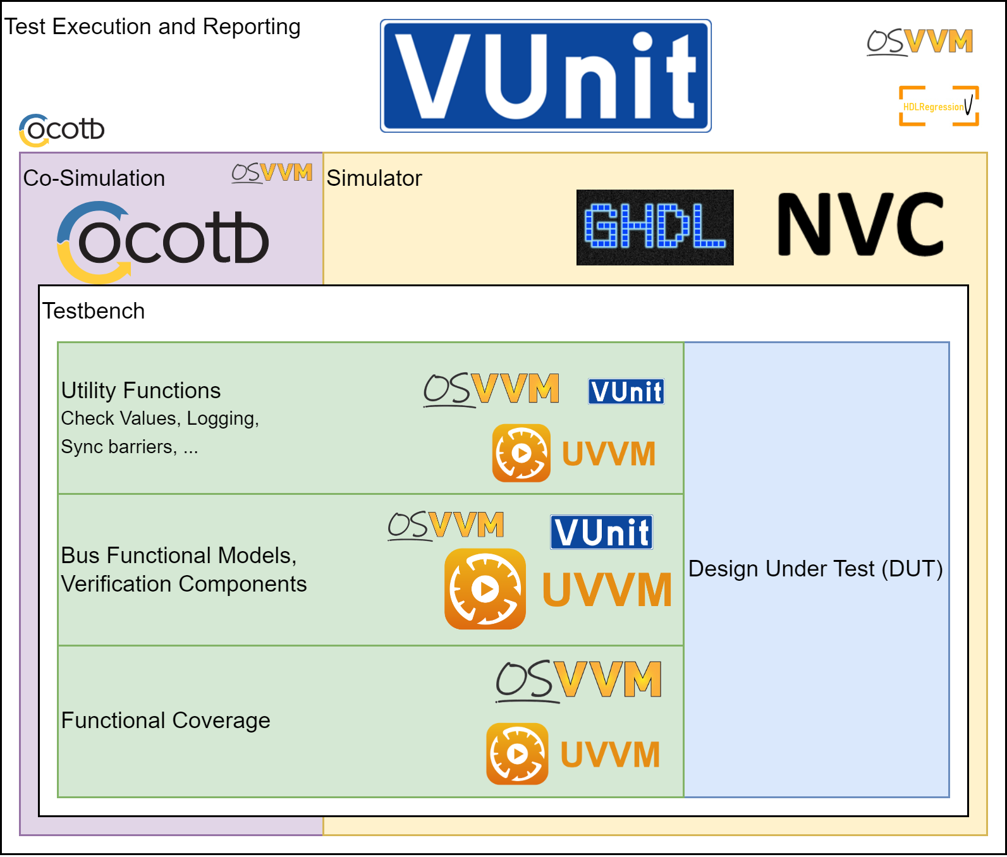
Which Open-Source Tool Should I Use?
Each tool has their unique strength
VUnit for test execution and CI/CD integration
OSVVM and UVVM for testbench implementation
GHDL and NVC as simulators

Slide 6
Which Open-Source Tool Should I Use?
Each tool has their unique strength
VUnit for test execution and CI/CD integration
OSVVM and UVVM for testbench implementation
GHDL and NVC as simulators
“VUnit doesn’t replace but rather complements
traditional testing methodologies by supporting
a ’test early and often’ approach through automation.”
Notes:
We will look in particular into VUnit for Test Execution and UVVM for testbench implementation.
Keep in mind that using OSVVM instead of UVVM is also possible, both tools have many similarities and only some small differences.

Slide 7

VUnit –Test Execution Steps
Scan
Scan through all files and build a dependency tree
Search
Search for testbenches
Compile
Compile the source files in the correct order
Start
Start the simulation (in parallel)
Report
Report the test results

Slide 8
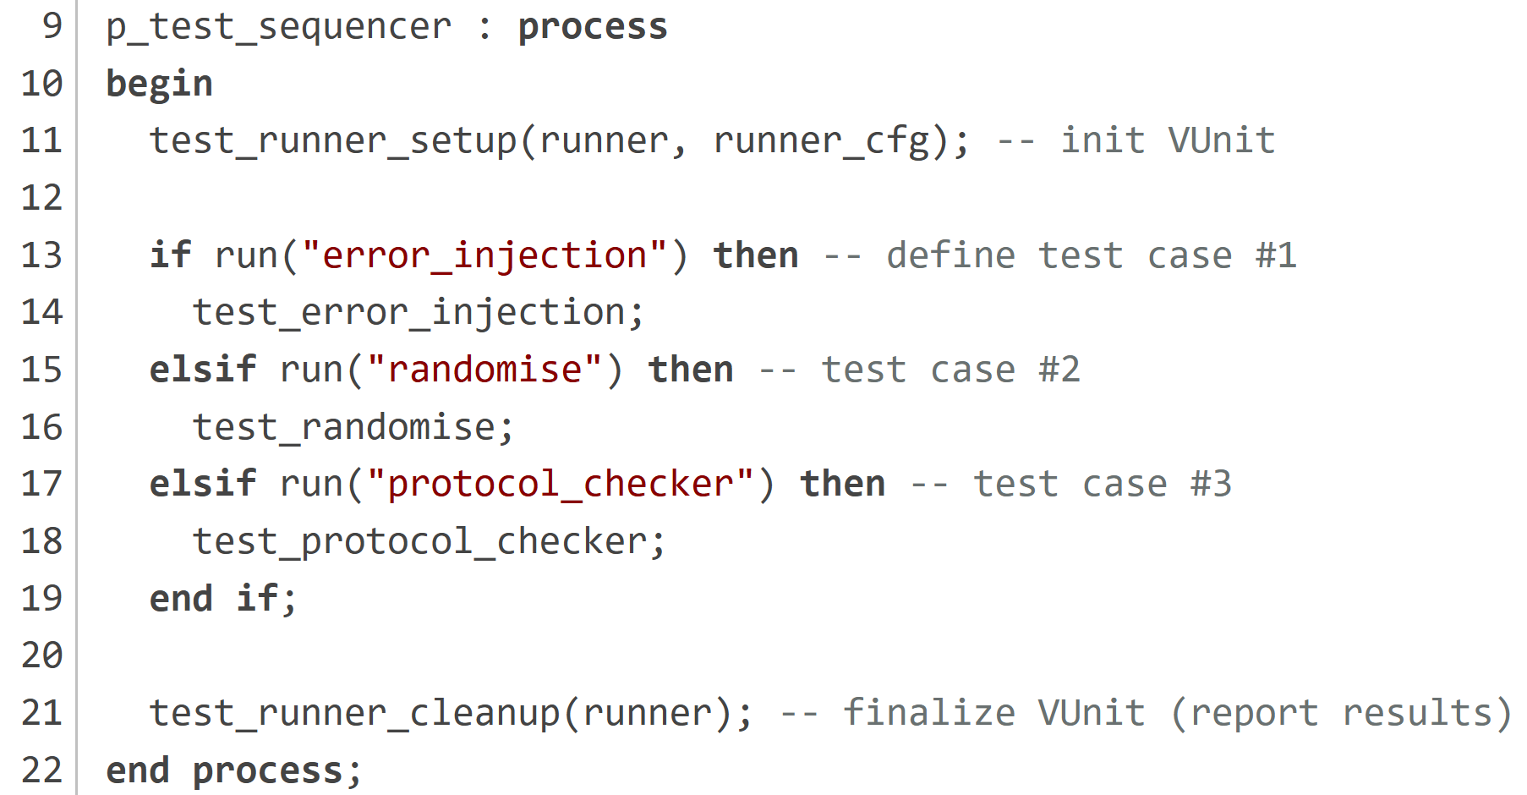
VUnit – Define multiple Tests
Define test cases using the run(…) function:

Slide 9
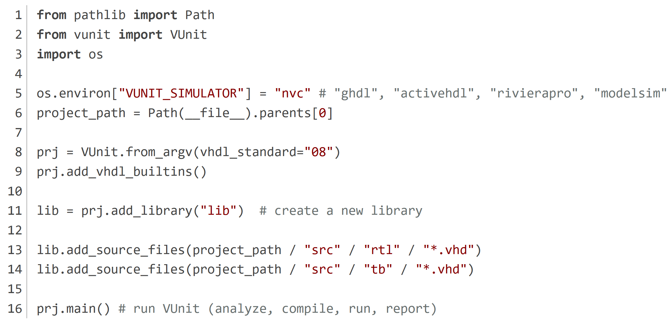
VUnit –Configuration Script
VUnit is configured and executed using a python script (run.py):

Slide 10
VUnit: Output
$ python run.py
…
Compiling into lib: src\tb\tb_uart.vhd passed
Compile passed
(18:13:32) Starting lib.uart.error_injection
pass (P=1 S=0 F=0 T=3) lib.uart.error_injection (0.5 s)
(18:13:32) Starting lib.tb_uart.randomise
pass (P=2 S=0 F=0 T=3) lib.tb_uart.randomise (0.5 s)
==== Summary ==========================================
pass lib.tb_uart.error_injection (0.5 s)
pass lib.tb_uart.randomise (0.5 s)
=======================================================
Elapsed time was 1.5 s
=======================================================
All passed!

Slide 11

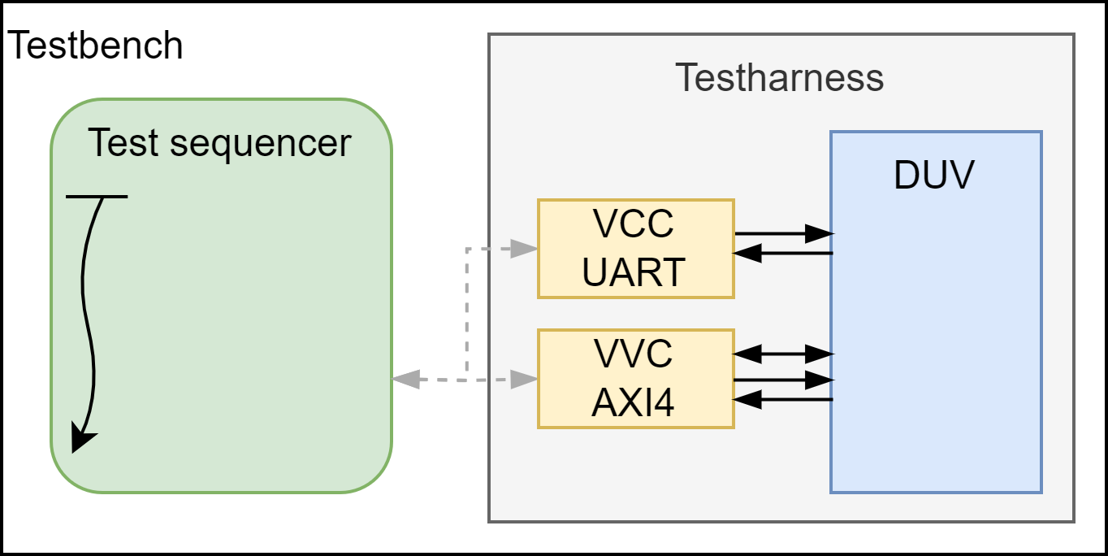
UVVM - Testbench Structure
test_sequence: process is
begin
uart_transmit(x“00“);
uart_transmit(x“AB“);
await_completion(UART_VVCT);
axi_check(addr => x“00“, data_exp => x“AB“);
await_completion(ALL_VVCS);
end process;

Slide 12
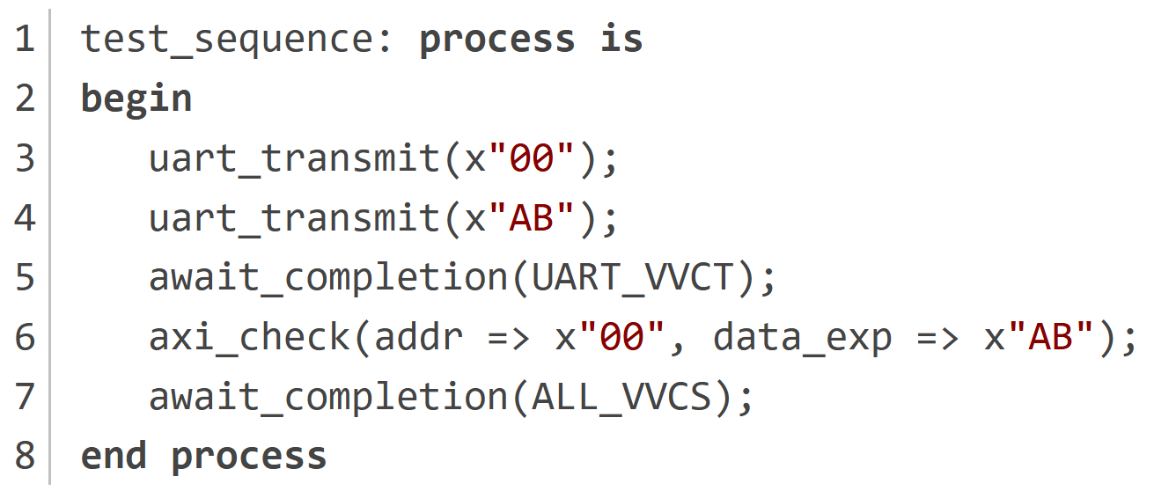
UVVM – The Test Sequence
test_sequence: process is
begin
uart_transmit(x“00“);
uart_transmit(x“AB“);
await_completion(UART_VVCT);
axi_check(addr => x“00“, data_exp => x“AB“);
await_completion(ALL_VVCS);
end process;
test_sequence: process is
begin
uart_transmit(x“00“);
uart_transmit(x“AB“);
await_completion(UART_VVCT);
axi_check(addr => x“00“, data_exp => x“AB“);
await_completion(ALL_VVCS);
end process;

Slide 13
Challenges in Combining and VUnit
Compile and run both frameworks in parallel
Make it simulator independent
Allow multiple testcases in a single test bench file

Slide 14
Compiling UVVM using VUnit
Option 1: Precompile UVVM and link it to VUnit (as external library)
  Precompile results are simulator dependent (needed for every simulator)
Option 2: Let VUnit handle the compilation of UVVM
  Works with every simulator
  Easy to integrate custom UVVM verification components
  Each lib must be created in the VUnit configuration script
    Helper function is provided in the add-on pypi package VUnit-Helpers

Slide 15
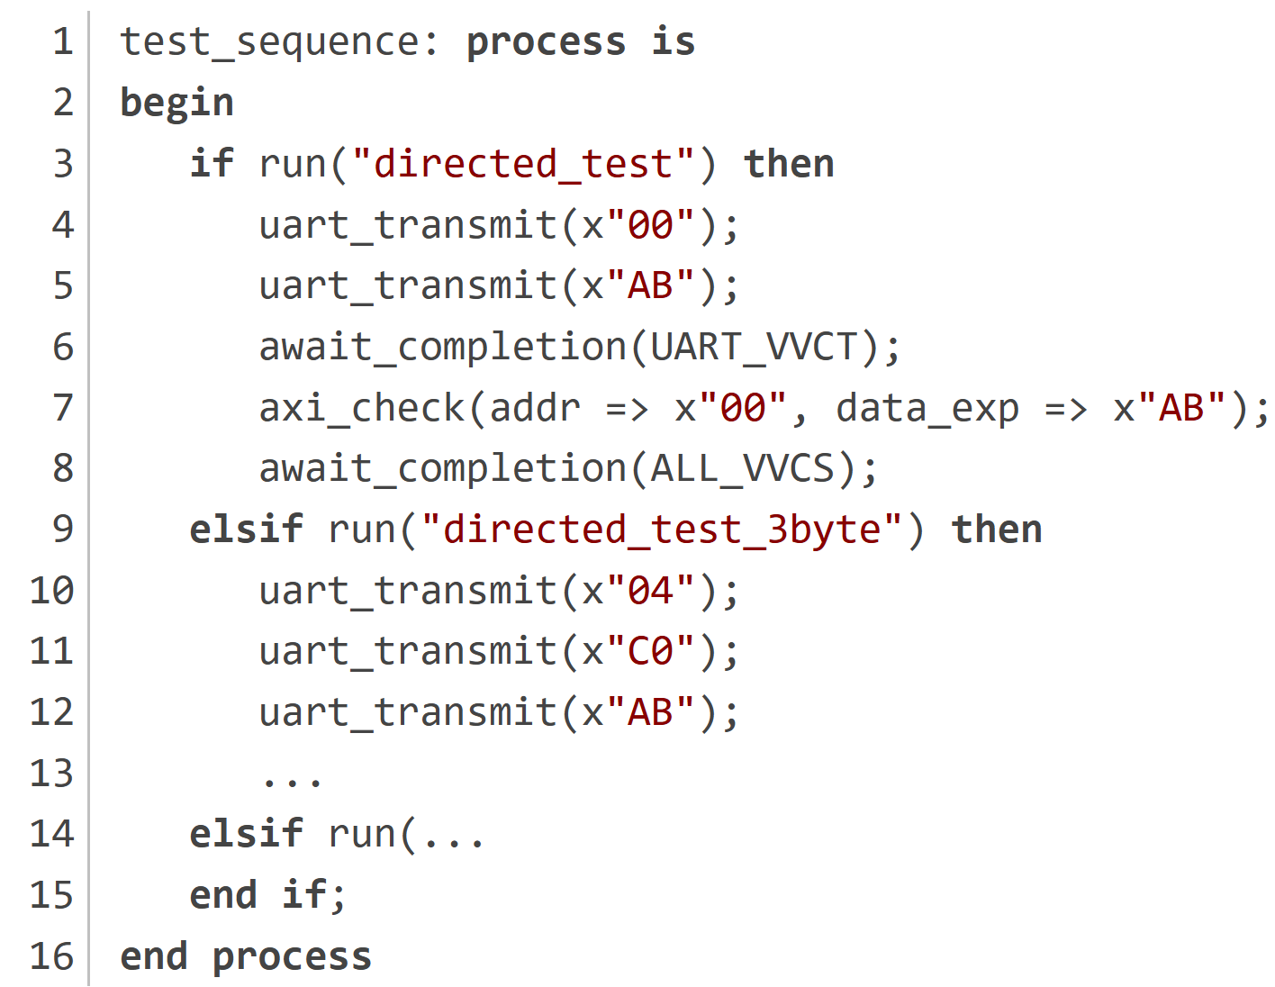
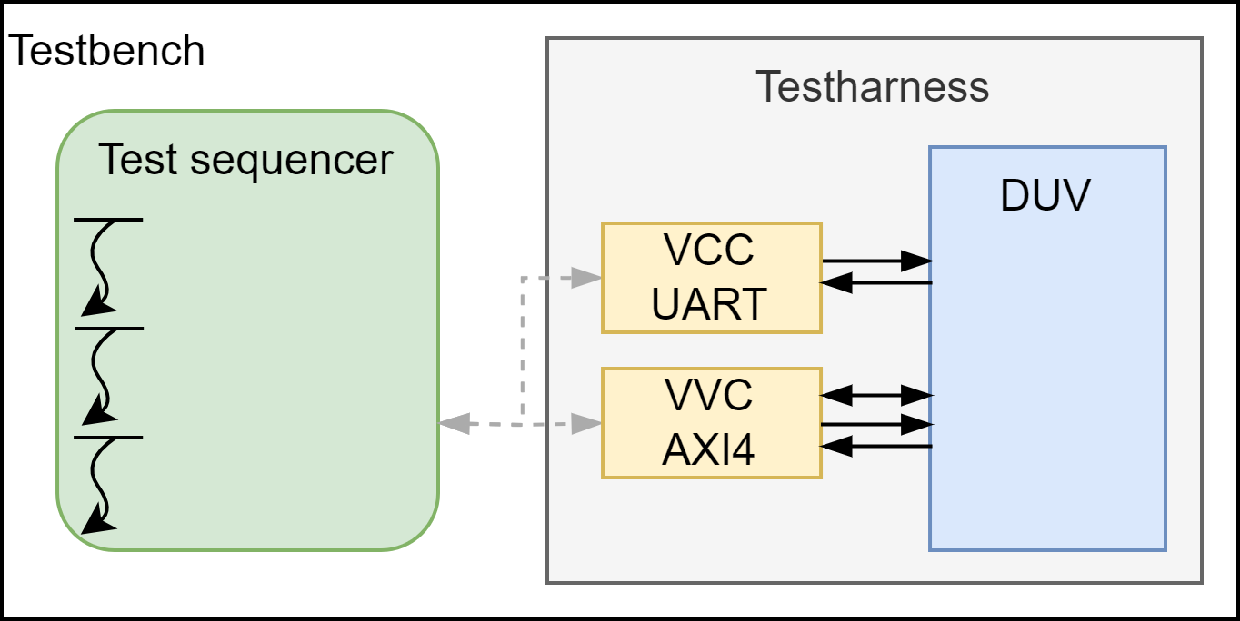
Multiple UVVM Testcases
test_sequence: process is
begin
uart_transmit(x“00“);
uart_transmit(x“AB“);
await_completion(UART_VVCT);
axi_check(addr => x“00“, data_exp => x“AB“);
await_completion(ALL_VVCS);
end process;
test_sequence: process is
begin
uart_transmit(x“00“);
uart_transmit(x“AB“);
await_completion(UART_VVCT);
axi_check(addr => x“00“, data_exp => x“AB“);
await_completion(ALL_VVCS);
end process;

Slide 16
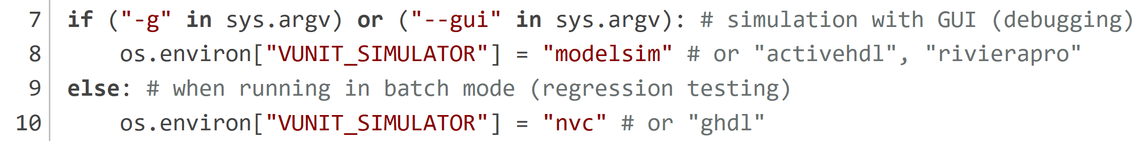
Tip: Open-Source Simulator
Commercial simulators (Riviera, Questa, …)
  Great for debugging
  Simulation is single-core
  Every license is expensive
  Running regression tests in parallel requires many licenses
Use an Open-Source simulator (NVC, GHDL) for regression testing:

Slide 17
Tip: CI/CD Integration
python run.py --xunit-xml=results.xml -p=4 -m
Generates a Jenkins style results file.
This report is readable by all CI/CD tools.
Minimal: Compile only the sources needed for the simulation
Parallel: Runs 4 test cases in parallel.
This starts 4 simulator instances.

Slide 18
Tip: Gui.do
VUnit supports simulator specific TCL scripts
  load the correct wave configuration automatically
  Add custom TCL commands for debugging (save_wave, vunit_restart, …)
modelsim_gui.do is included in the provided sample project

Slide 19
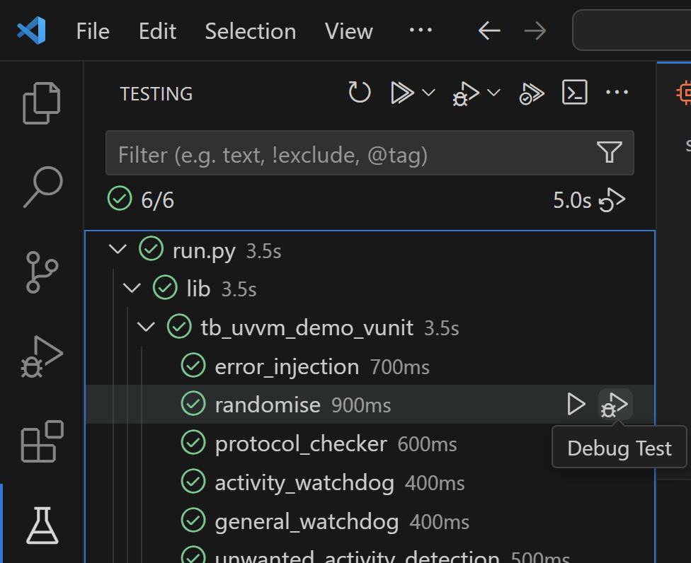
Tip: VUnit VS-Code Plugin
Integration into the VS-Code
Test Explorer
Run tests with and without GUI
Developed at the University in Hagenberg
github.com/HSD-ESD/VUnit-by-HGB
“Test early and often”

Slide 20
Recap &
Structured testbench
Well tested verification components
CI/CD Integration
Simulator independent
Parallel test execution
VUnit for compile and test automation
UVVM for testbench implementation
Send me a mail to get a ready to use sample project:
📧leiter@p2l2.com

Slide 21
STRUCTURED.
DOCUMENTED.
VERIFIED.
Markus Leiter
P2L2 GmbH
Softwarepark 35, 4232 Hagenberg
office@p2l2.com
www.p2l2.com

