Slide 1

2nd FPGA Developers’ Forum
Meeting
CERN - 20-23 May 2024
Davide Cieri (Max-Planck-Institute for Physics)
on behalf of the FDF organising team

Slide 2

The FPGA Developers’
Forum
The Forum has been established with the goal of creating an open community of FPGA developers from any background (industry and academia).
FDF2025 is the 2nd annual meeting of the forum
Meeting website: https://cern.ch/fdf25

Slide 3
Agenda
20/05
21/05
22/05
23/05
14.00 Introduction
15.10 Coffee break
15.40 Shareable HDL Cores
18.10 Group Photo
18:30 Welcome Reception
9.00 Algorithm 1
10:50 Coffee break
11.20 Algorithm 2
12.50 Lunch
14.00 Algorithm 3
14.40 Digital Solutions 1
16.00 Tea Break
16.30 Digital Solutions 2
19.00 Social Dinner
9.00 HDL Tools 1
10.30 Coffee Break
11.00 HDL Tools 2
12.50 Lunch
14.10 Hardware Development
14.40 Verification 1
16.00 Campus Visits
9.00 Verification 2
10.25 Coffee Break
10.55 Verification 3
11.35 Conclusions
More Information
More Information
More Information
More Information

Slide 4




FDF Activities
Regular Seminars
Newsletter
Regular online seminars, with the same spirit of the forum are held during the year.
A newsletter to stay informed about all the activities of the forum: Register here!
More than 500 registrations!
Discourse Forum
Annual meeting
An online open forum to discuss all the aspects related to FPGA programming.
https://fpga-developers-forum.web.cern.ch/
The annual occasion to meet other developers, and to discuss in person.

Slide 5
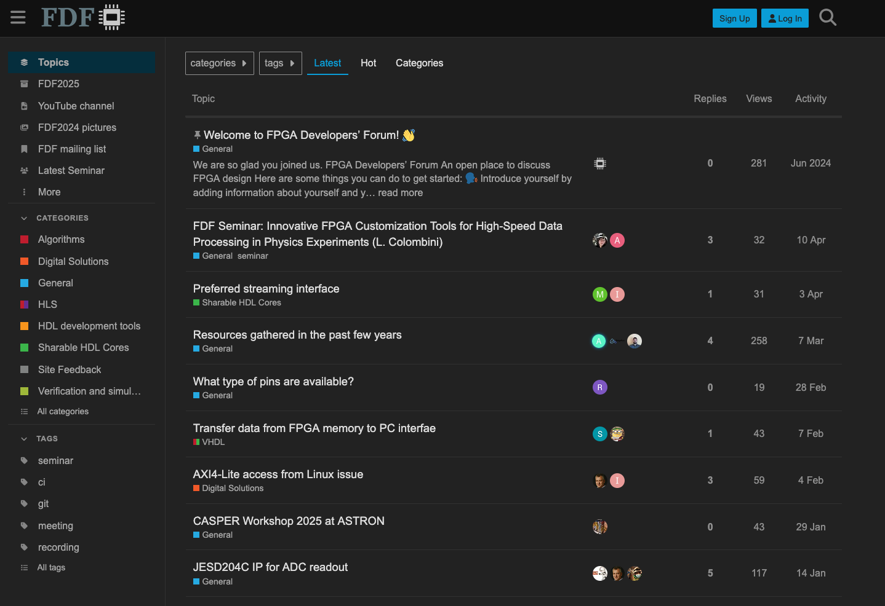
Discourse Forum: https://cern.ch/fdf
Important Links
Forum Categories

Slide 6
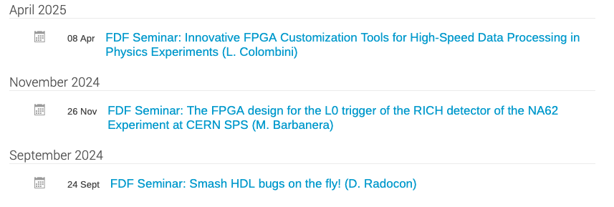
FDF Seminars
Three online seminars have been held so far. More are scheduled for this year. If you wish to present something, please let us know!

Slide 7
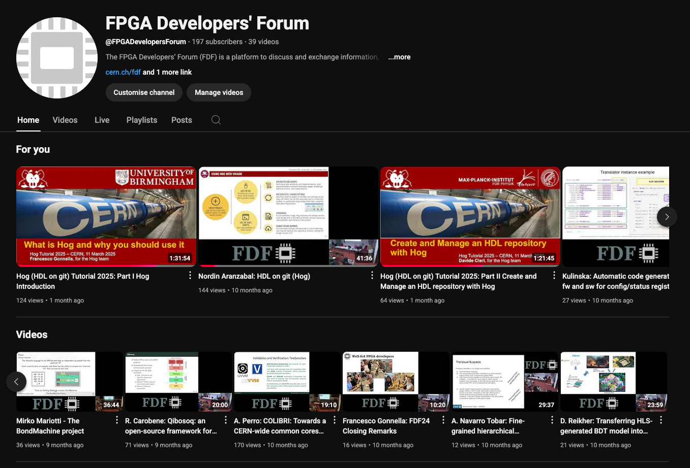
YouTube Channel
Unless requested, all FDF’s talks are live streamed and recorded, and published later on our YouTube Channel.
cern.ch/fdf-youtube

Slide 8
Meeting’s Format
The atmosphere of the meeting should be friendly to foster discussion.
For this reason, the allocated time for the talks is most of the times longer than in standard (physics) conference.
All speakers kindly agreed to receive questions during the talk. Just raise your hand, and wait to be called.

Slide 9
Recording and Photos
The meeting is live-streamed at https://cern.ch/fdf-webcast.
To ask a question from remote, login to our Discourse website and use the dedicated chat: https://cern.ch/fdf-qa.
A recording of the meeting will be published later, on the CERN website and on YouTube: https://cern.ch/fdf-youtube
  We will also take photographs during the meeting. Please, let us know if you prefer not to be photographed.
  Meeting photo will be today at 18.10 on the stairs in front of the auditorium.

Slide 10
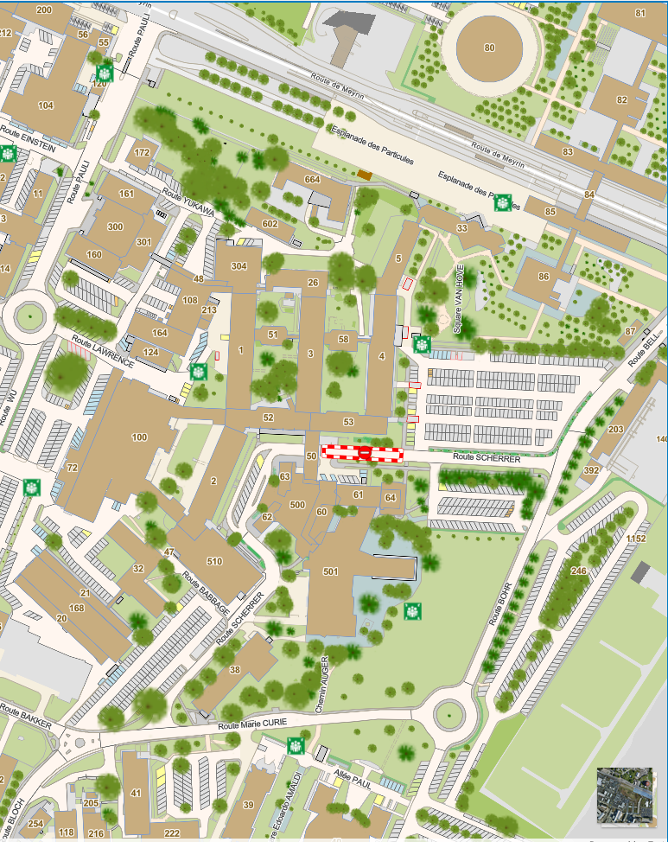
Main Entrance
CERN Logistics
Science
Gateway
Move around with maps.cern.ch
Main buildings
B500 – Main Auditorium and exhibition
B501 – R1 Restaurant
B38-39-41 – CERN Hotel
B83 - Science Gateway
Main Auditorium
R1 Restaurant
CERN Hotels

Slide 11
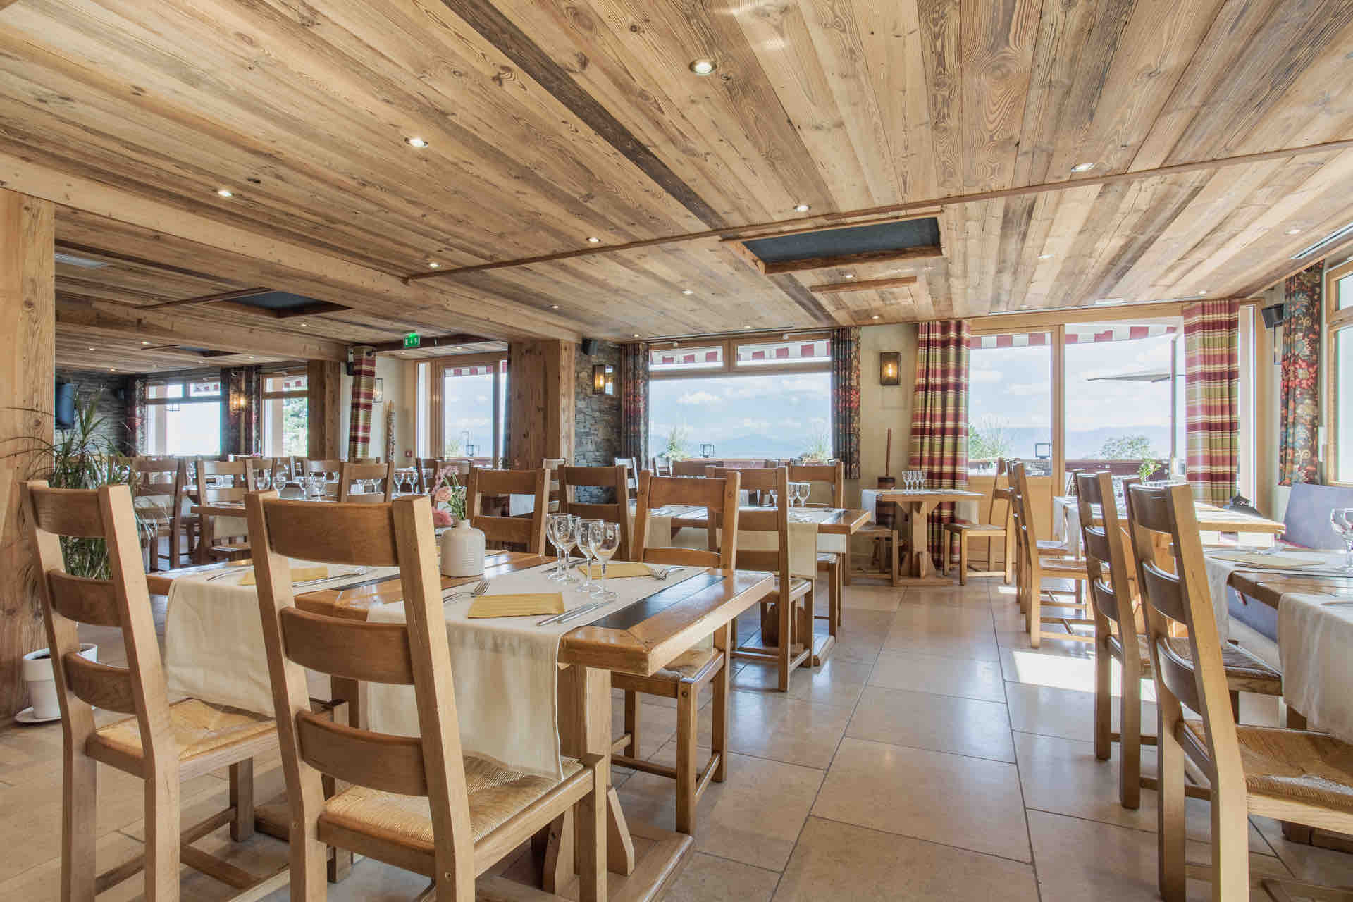
FDF25 Dinner
Dinner will be tomorrow at the Bois Joly Restaurant in Crozet at 19.00.
Two buses will leave from CERN b.39 (Hotel Receptions) at 18.30 and come back at 22.00.

Slide 12











Gold Sponsors
Silver Sponsors
A huge thanks to our sponsors to make this event possible.
Visit our sponsor exhibition during the breaks and talk with their experts for more insights!

Slide 13
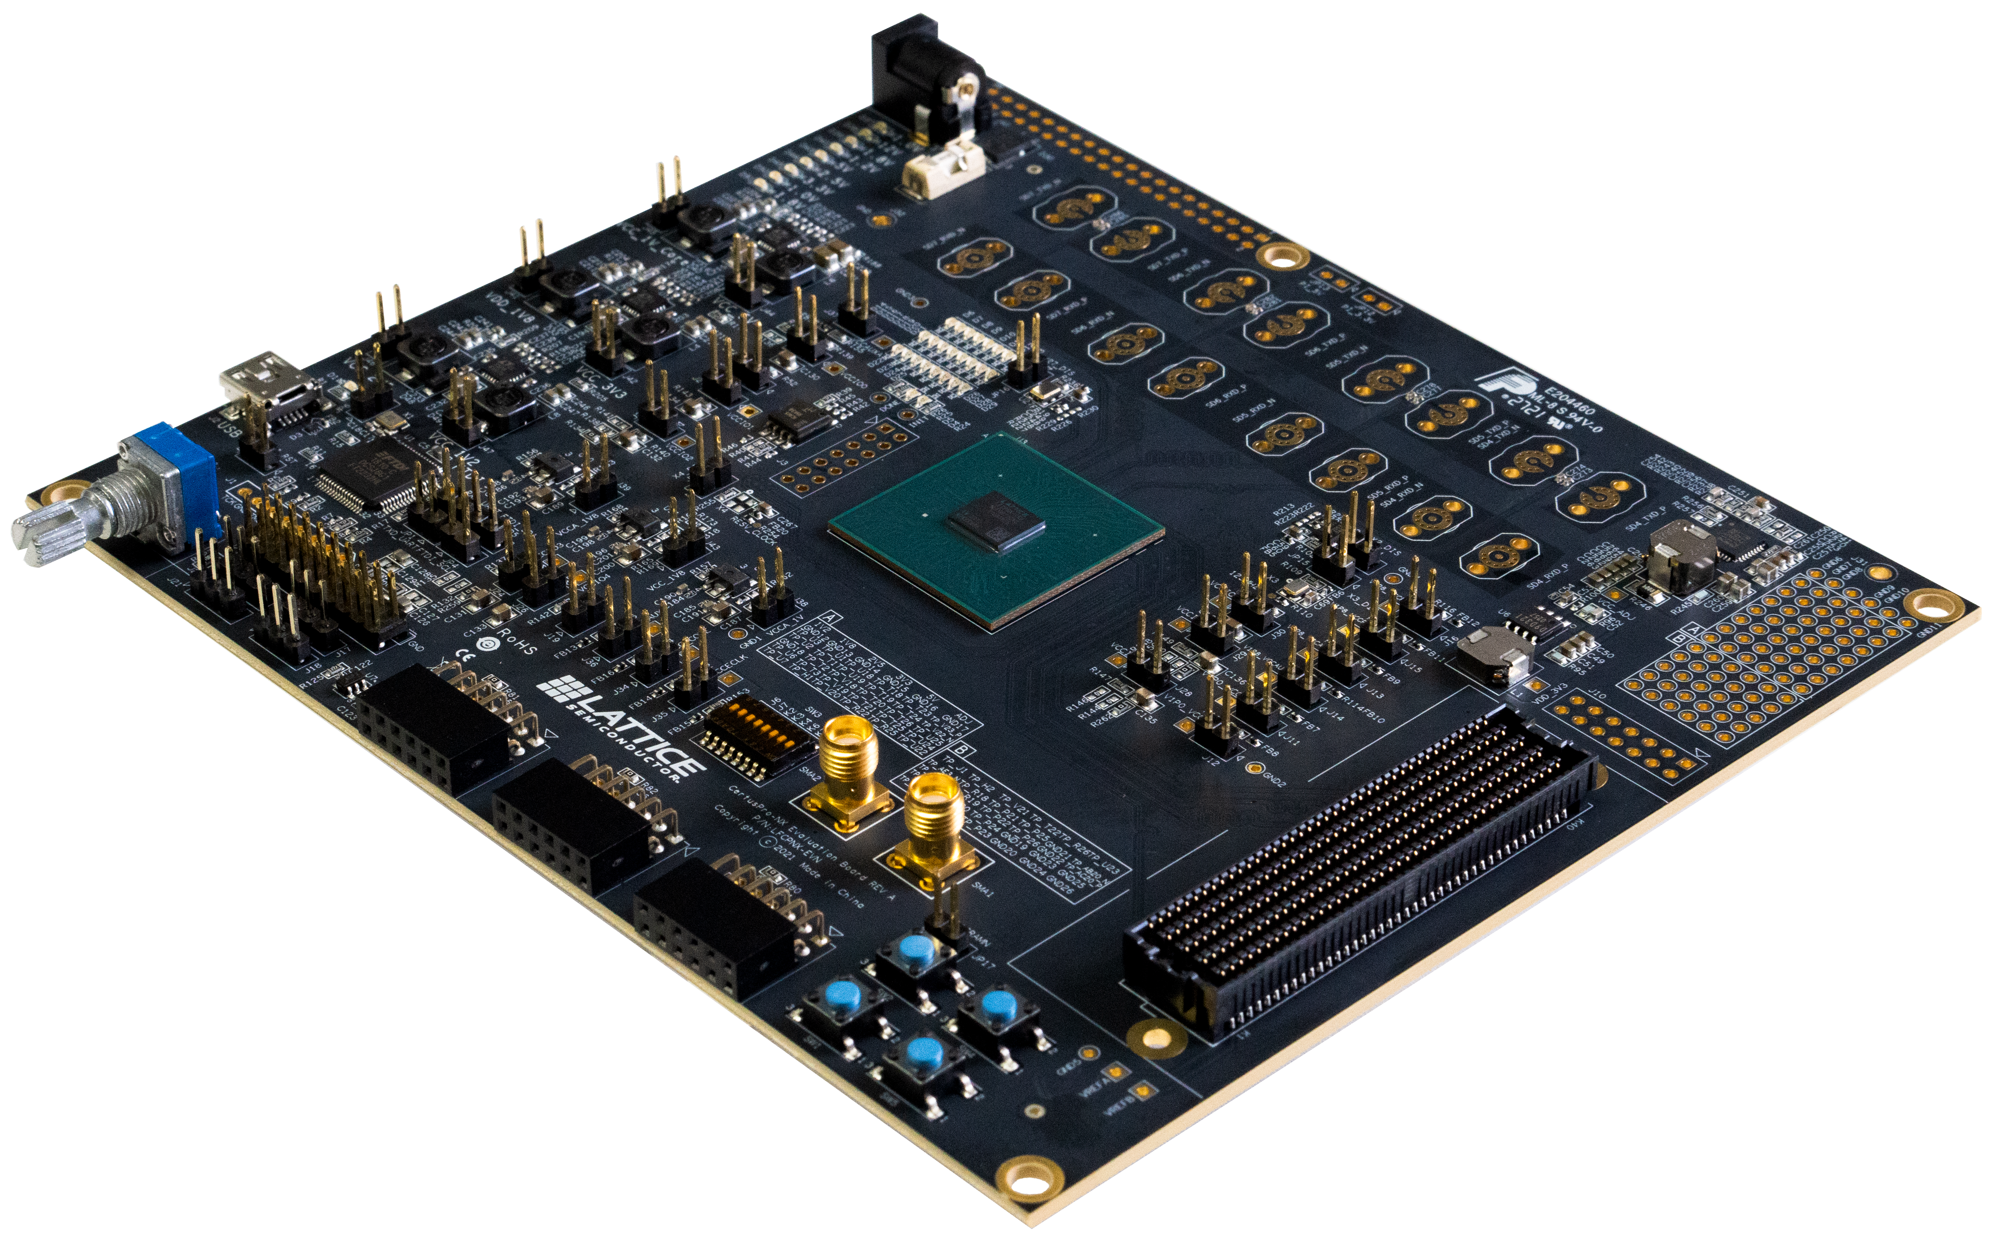
FDF25 Awards
The three best talks of this year, will be awarded with an evaluation boards, kindly sponsored by Lattice Seminconductor
1st Prize: CertusPro-NX Evaluation board
3rd prize MachXO3-9400 Development Board
3rd Prize: Crosslink-NX Evaluation board
3x iCE40 UltraPlus Breakout Board prizes on QnA on Lattice demo show.

Slide 14
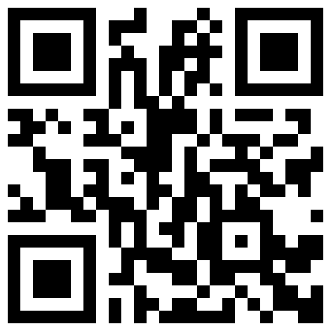
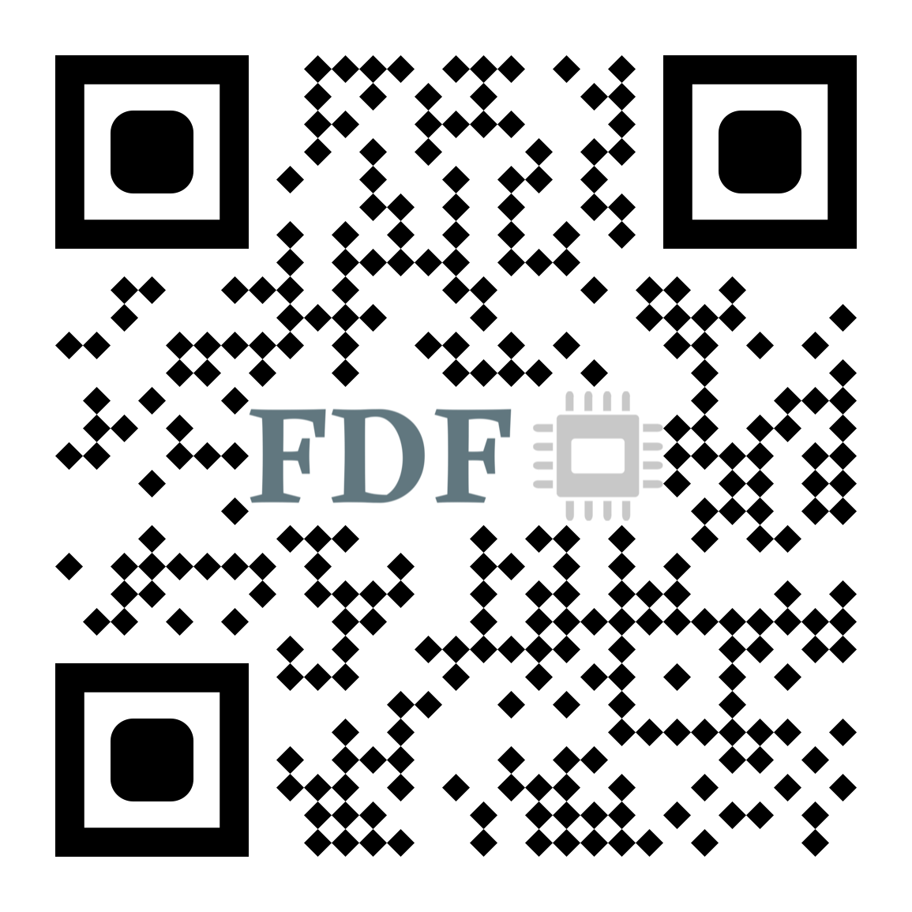
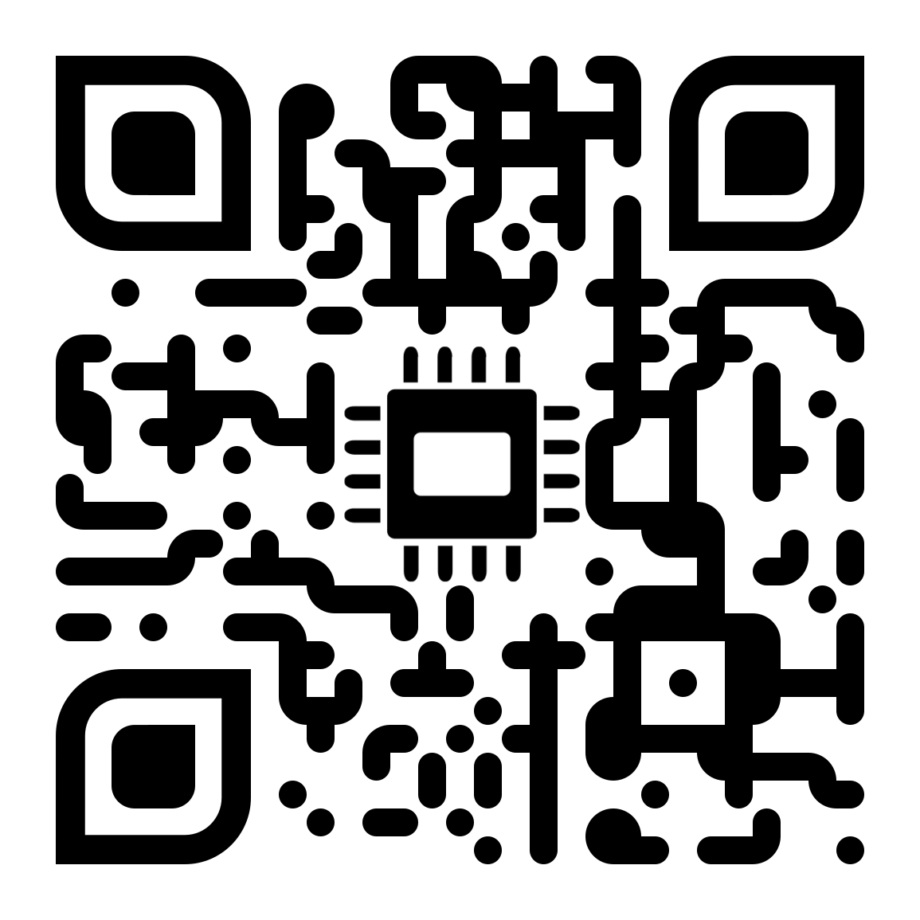
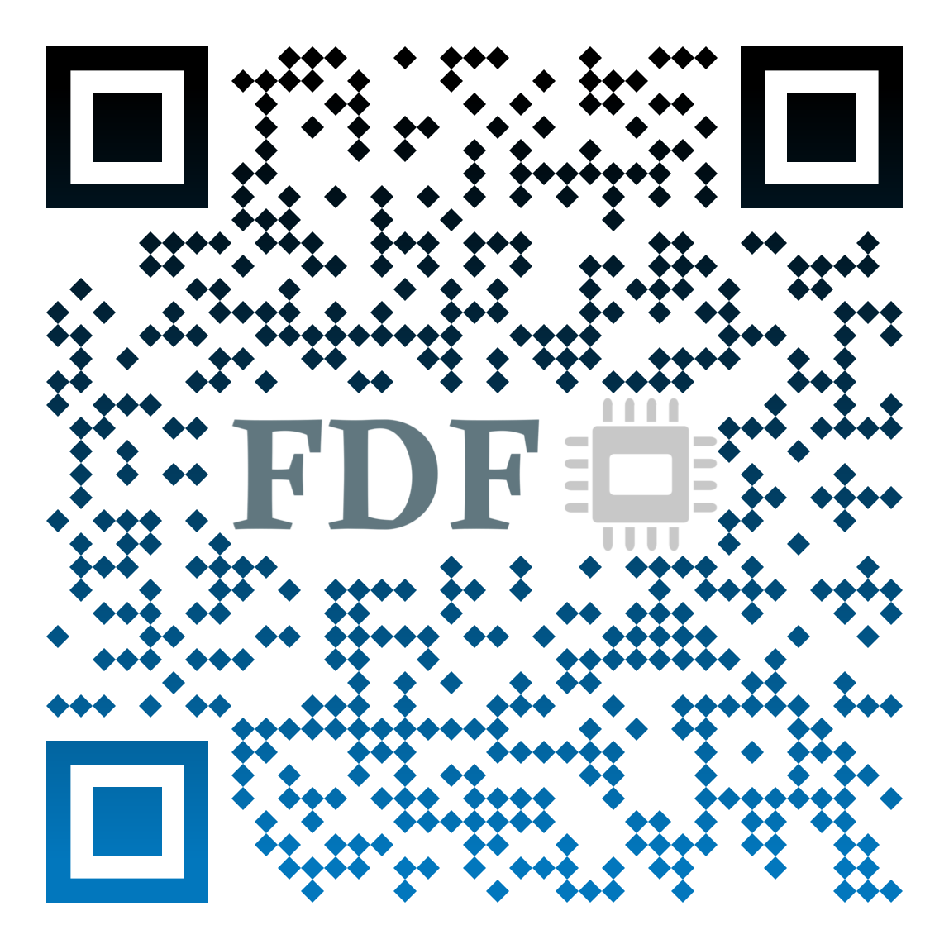
Newsletter
Q&A Chat
Enjoy the forum!
Forum’ s agenda
Discourse Forum

