Slide 1
Architecting FPGAs for Low Power Leadership
22 May, 2025
CERN, Switzerland
Dr. Hardik Shah
Regional Sales Manager

Slide 2







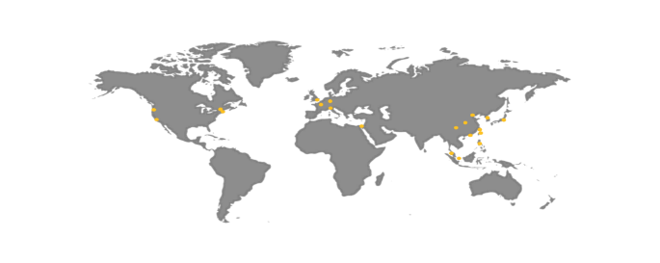






























Lattice Semiconductor Overview
APPLICATIONS & MARKETS
WORLD CLASS SUPPLIER
We enable secure control, flexible connectivity,
and low power compute acceleration
#1
World’s largest volume supplier of FPGA
Tier 1
Supplier with 40+ years
of innovation
COMMUNICATIONS & COMPUTING
INDUSTRIAL & AUTOMOTIVE
CONSUMER
45%
46%
9%
GROWING CUSTOMER BASE
GLOBAL SUPPORT
Applications & Markets percentages based on FY2024 revenue breakdown by reporting segment.

Slide 3



Lattice insights – register and win
The Official Lattice FPGA Training Program
https://www.latticesemi-insights.com

Slide 4


Dr. Hardik Shah
Let’s connect on LinkedIn

Slide 5
Why low power ?
extended battery life
simplified heat sink requirements
reduced complexity of the PCB power network
the potential for smaller package sizes
increased component longevity
minimized heat-related measurement errors
}
Cost reduction

Slide 6
How ?
Company strategy
Target market
Technology node
Architecture features
… Low Power Programmable Leader

Slide 7
At what cost ?
Largest FPGA device
Fastest Fabric
Latest technology node

Slide 8
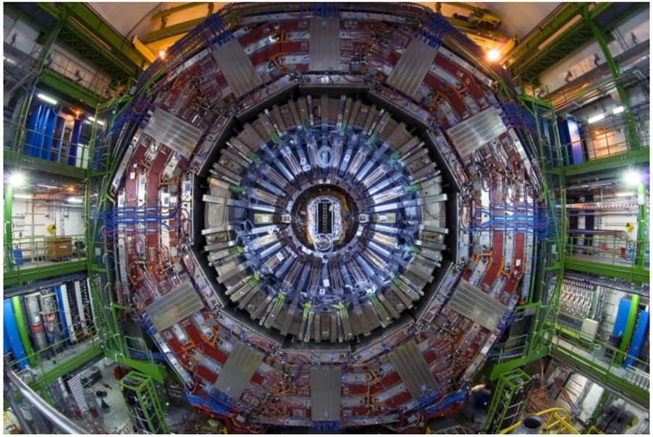

Motivating Example (Data Acquisition System)
Detector
Aggregator
Detector
Server/Processor
Detector
Aggregator
Detector
Edge processing
  Aggregator is often close to detector in a confined space
  Less data volume close to detector
  Requires low power and small size
Post Quantum Cryptography, Board Management Controller
  Low power, small footprint, flexibility and quick boot-up time
CPU
Peripherals
GPU
….
ASICs
BMC/PQC

Slide 9
Avant Families
Avant-E
Edge
Optimized for edge
processing applications
DDR4, LPDDR4 memory interface
Fast and flexible IO: 1.8 Gbps MIPI D-PHY, 1.6 Gbps LVDS, 3.3 V support
Avant-G
General Purpose
Mid-range FPGA with
12.5 Gbps SERDES
Avant-E features, plus:
  12.5 Gbps SERDES: up to PCIe Gen3, 10GE
  Advanced Bitstream Authentication and Encryption
  SED/SEC
Edge +
12.5 Gbps SERDES
General Purpose +
25 Gbps SERDES
Avant-X
eXtra Speed
Mid-range FPGA with
25 Gbps SERDES
Avant-G features, plus:
  DDR5 memory interface
  25 Gbps SERDES (up to PCIe Gen4, 25GE)
  Advanced security (bitstream + user security)

Slide 10
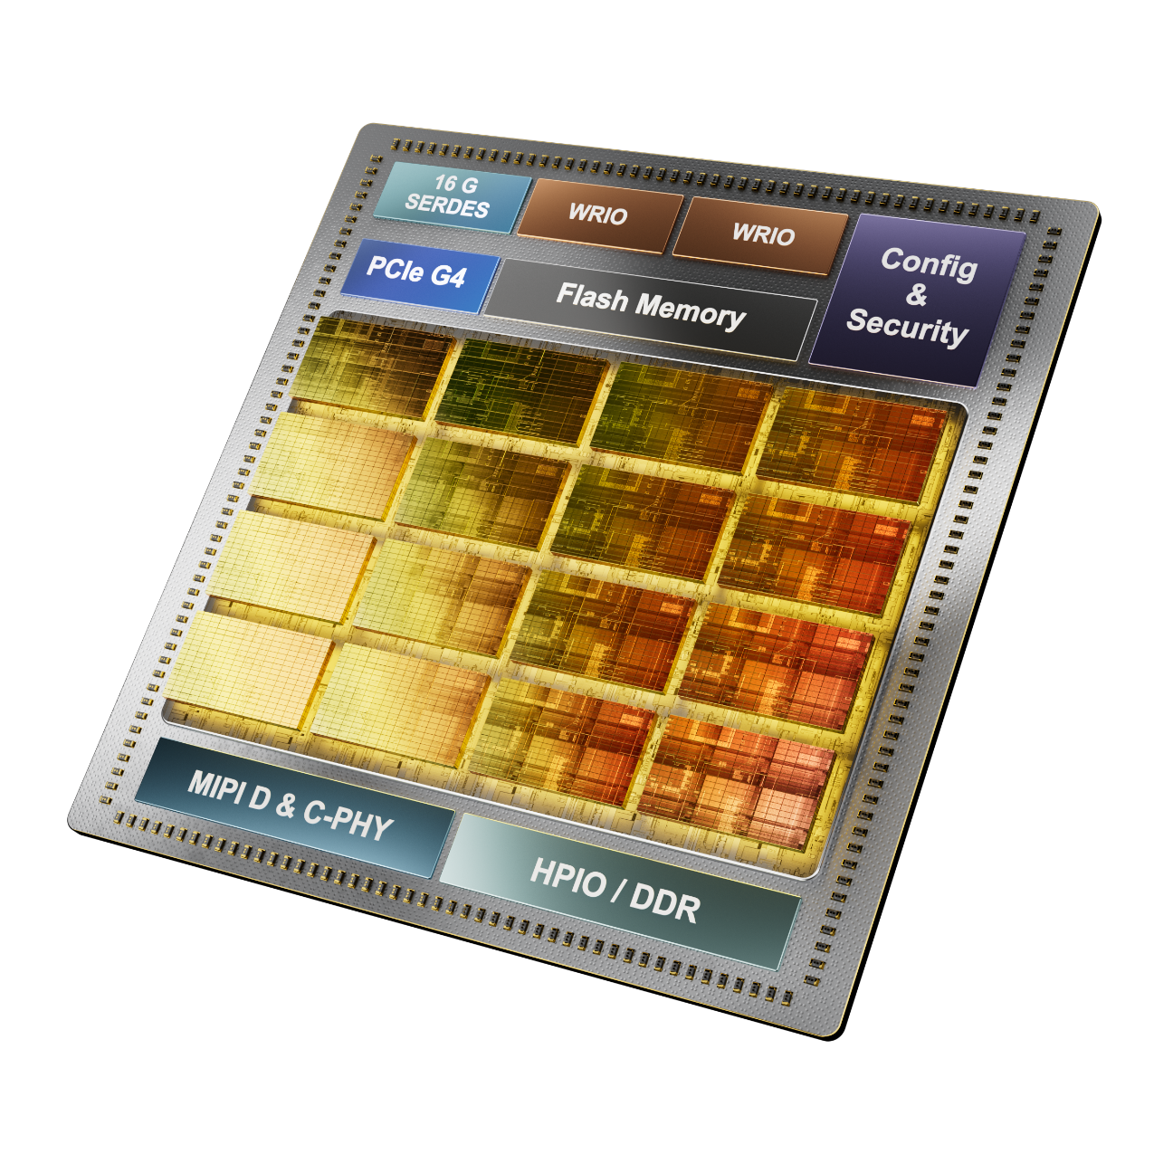

Lattice Nexus 2 Platform Key Capabilities
16G SERDES
PCIe Gen 4
10 Gb Ethernet
Generic 8b/10b, 64b/66b, 128b/130b
JESD204B, DP, SLVS-EC, CoaXPress, CPRI, eCPRI
Advanced Security
Higher strength authentication (ECC521) & encryption (AES-GCM)
SHA3-512 PQC ready
PUF, Anti-Tamper
Higher Performance Fabric
300MHz+ Timing Closure
Scale to 220K SLC
Lower dynamic power
Improved DSP
2x DSP per LC
4x INT8 per block
Upgraded MIPI C/D-PHY
Up to 4.5Gbps MIPI D-PHY
Up to 7.98Gbps MIPI C-PHY
Split Tx/Rx for more Use Cases
Enhanced Memory Interfaces
DDR4, LPDDR4
Up to 2400Mbps
2x Bandwidth vs Nexus

Slide 11
Platform Positioning

Slide 12
Agenda
Introduction to Lattice Semiconductor
  Call to register at Lattice Insights
Low power why/how/at what cost?
Motivating example for low power usecase
Basics of power consumption in digital ICs
Techniques used to achieve low power consumption by Lattice
Summary

Slide 13
Power Consumption
Static & Dynamic Power

Slide 14
What Impacts Power Consumption?
Temperature
Power consumption increases exponentially with temperature
Capacitance or
Logic Density
Logic density
(more logic = bigger capacitive load)
Process technology (impacts transistor characteristics)
Transitions or
Activity Factor (AF)
Number of status change per clock cycle
Higher activity factor = more power consumed
Notes:
https://www.edn.com/how-to-design-an-fpga-architecture-tailored-for-efficiency-and-performance/

Slide 15
Power Components in FPGAs
Static Power: Static power related to leakage current, is consumed in the absence of any design activity (no active clock). It is mainly related to leakage current associated with transistors in idle mode (Proportional to Junction temperature Tj).
Bias Power: Related to a voltage applied to the substrate and is independent of temperature (depends on technology node – constant – usually associated with static power)
Dynamic Power: Related to design activity and status change of internal registers or transistors. At a lower level it could be explained as switching capacitive loads between two different voltage states (independent of Tj, proportional to frequency).
Total Power: Total chip power is given by combining static, bias, and dynamic power of all blocks and power rails
Power = V x I
I = A.e^{BT} + D + C.Vf
Static
Bias
Dynamic

Slide 16
Architecture decisions for low Power
Selection of LUT4 vs LUT6
Selection of process node
Architecture features
… Low Power Programmable Leader

Slide 17
LUT4 vs LUT6

Slide 18
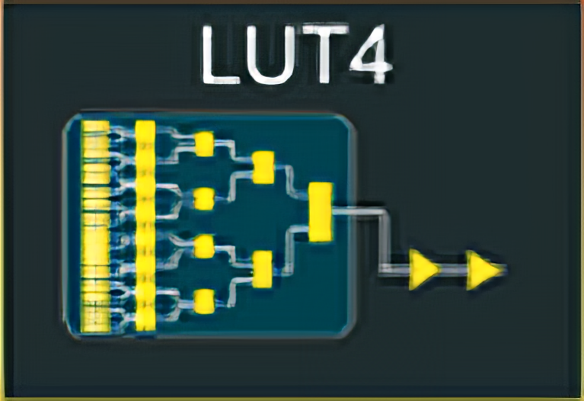
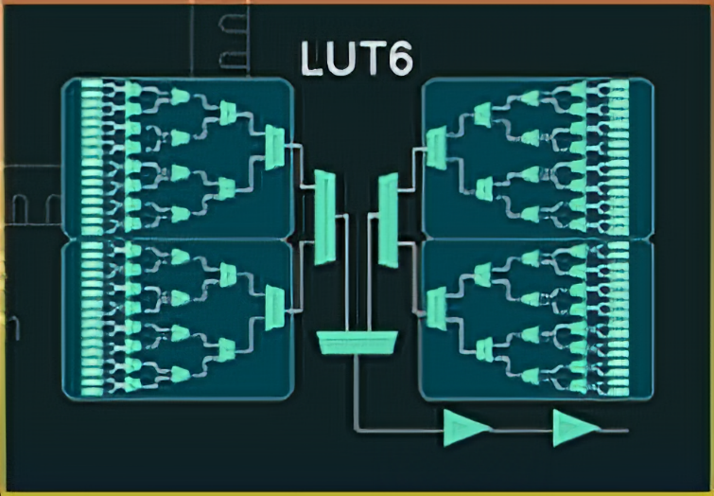
LUT4 Architecture Optimal for Small & Mid-Range FPGAs
LUT6 – is ~4X the size of a LUT4 in Silicon
LUT4 is faster performance vs LUT6
For the same design implementation
  More logic levels when using LUT4 vs LUT6
  Power advantage of LUT4 vs LUT6
LUT6 – offers 4X distributed Memory per logic cell
(64 bits vs 16 bits)
On the same technology LUT4 is 1/4th static power of LUT6

Slide 19
Why LUT4 has been the standard for so long?
Balance Between Complexity and Efficiency:
Routing Simplicity
Power Consumption:
  Bigger LUT => More transistors for logic => higher static power consumption
Notes:
https://www.edn.com/how-to-design-an-fpga-architecture-tailored-for-efficiency-and-performance/

Slide 20


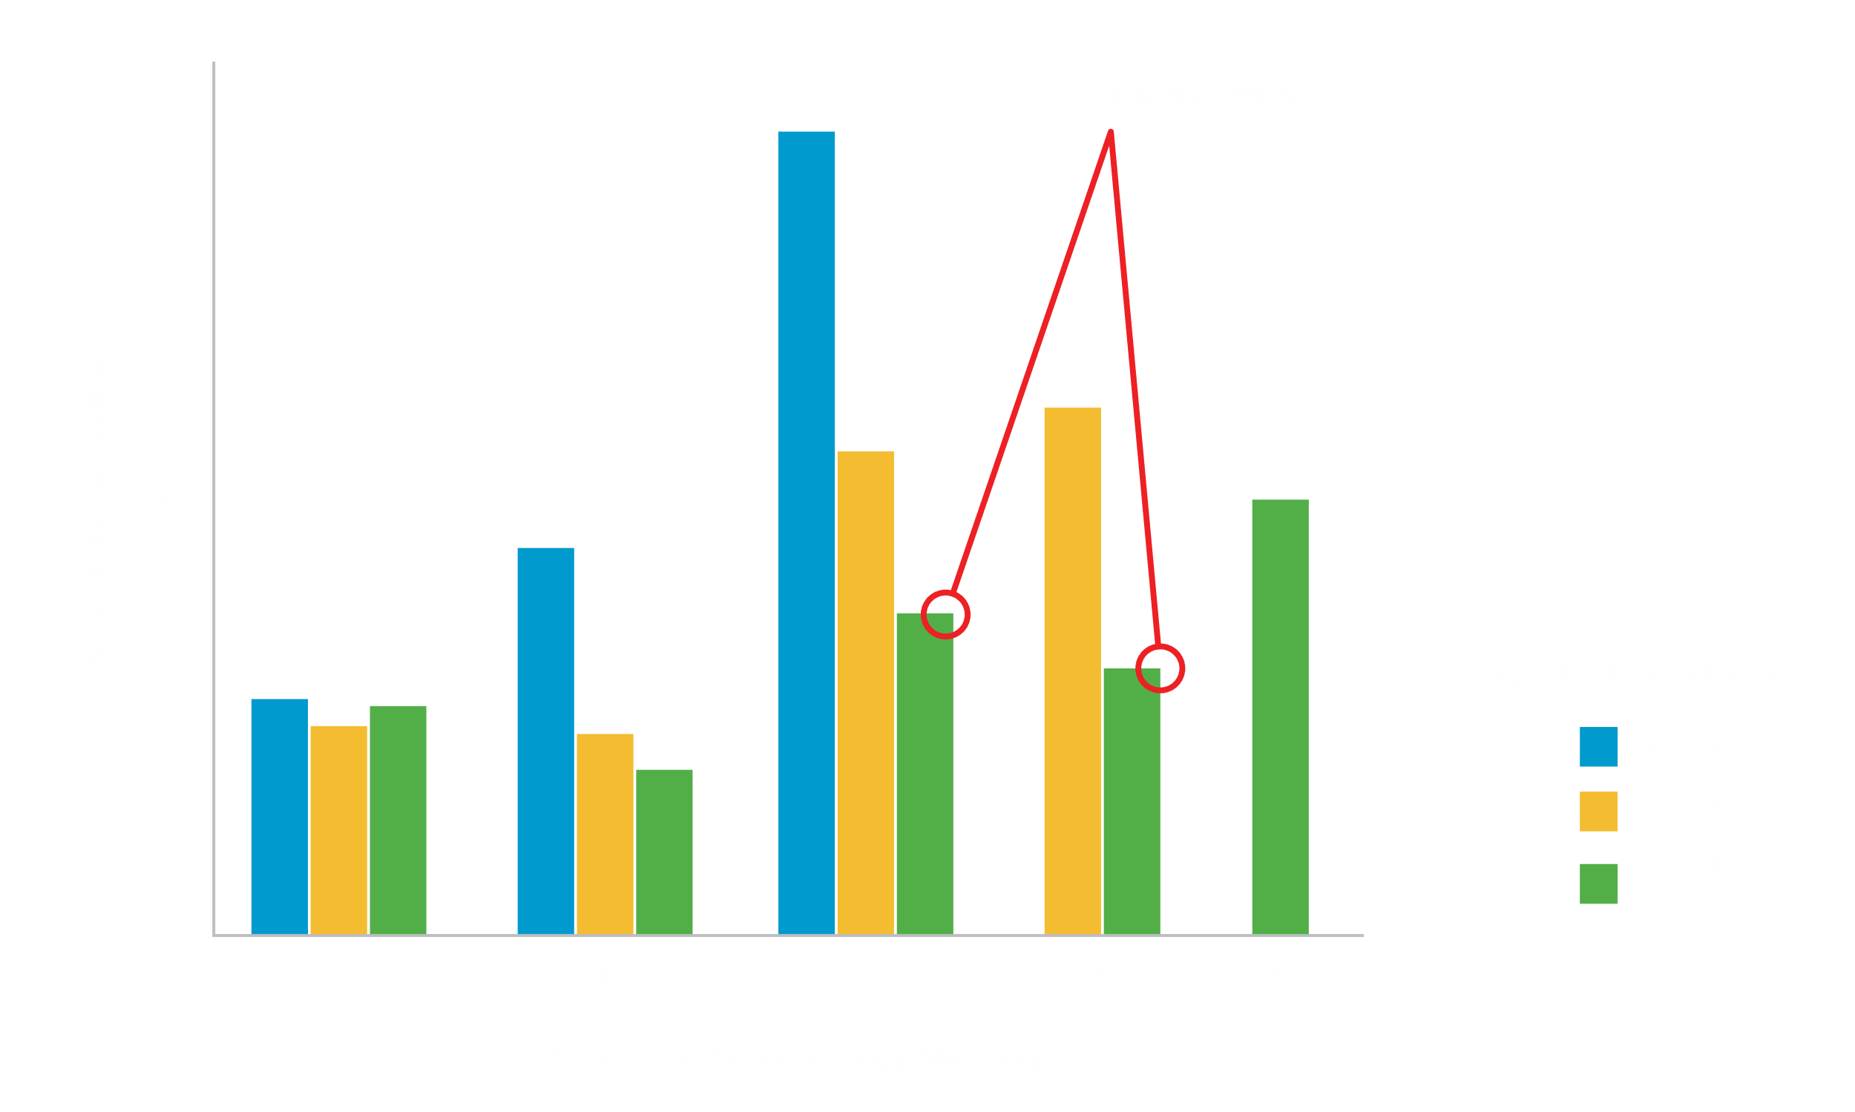
Public Articles
Lattice Targets Low Power Edge AI with New Small FPGA
“Nexus 2’s focus on small FPGA use cases enabled Lattice to take advantage of a LUT4 architecture, which is better for static power and area efficiency while enabling sufficient performance for the targeted use cases.”
https://www.eetasia.com/embeddednews-lattice-targets-low-power-edge-ai-with-new-small-fpga/
How to design an FPGA architecture tailored for efficiency and performance
“Simply increasing the LUT size to a basic 6-LUT from a 4-LUT or 5-LUT is highly inefficient.“
https://www.edn.com/how-to-design-an-fpga-architecture-tailored-for-efficiency-and-performance/
Notes:
https://www.edn.com/how-to-design-an-fpga-architecture-tailored-for-efficiency-and-performance/
https://www.eetasia.com/embeddednews-lattice-targets-low-power-edge-ai-with-new-small-fpga/

Slide 21
Process node selection

Slide 22
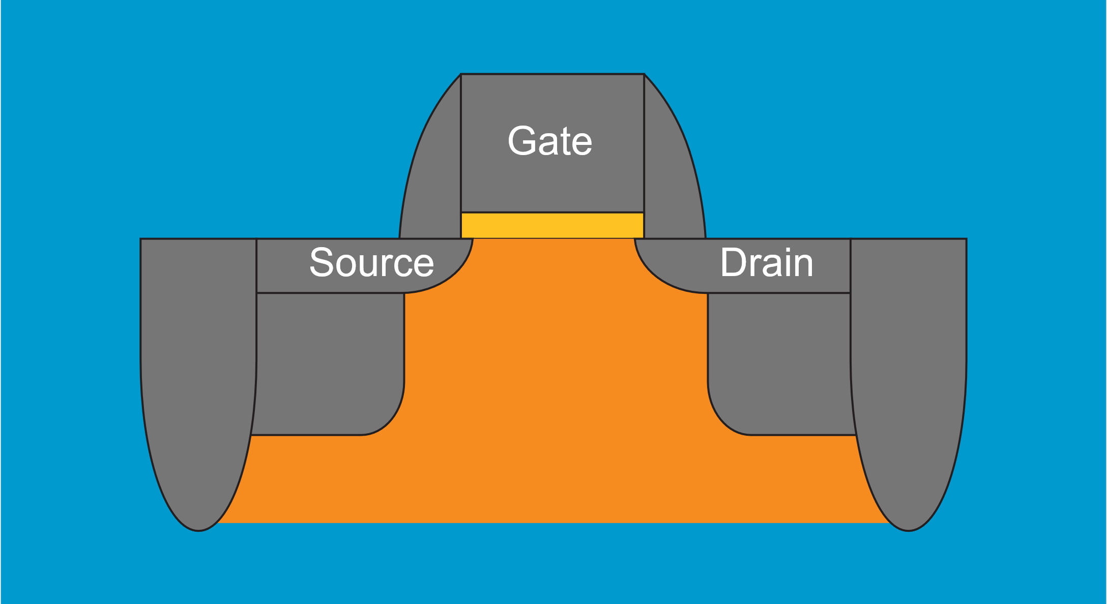
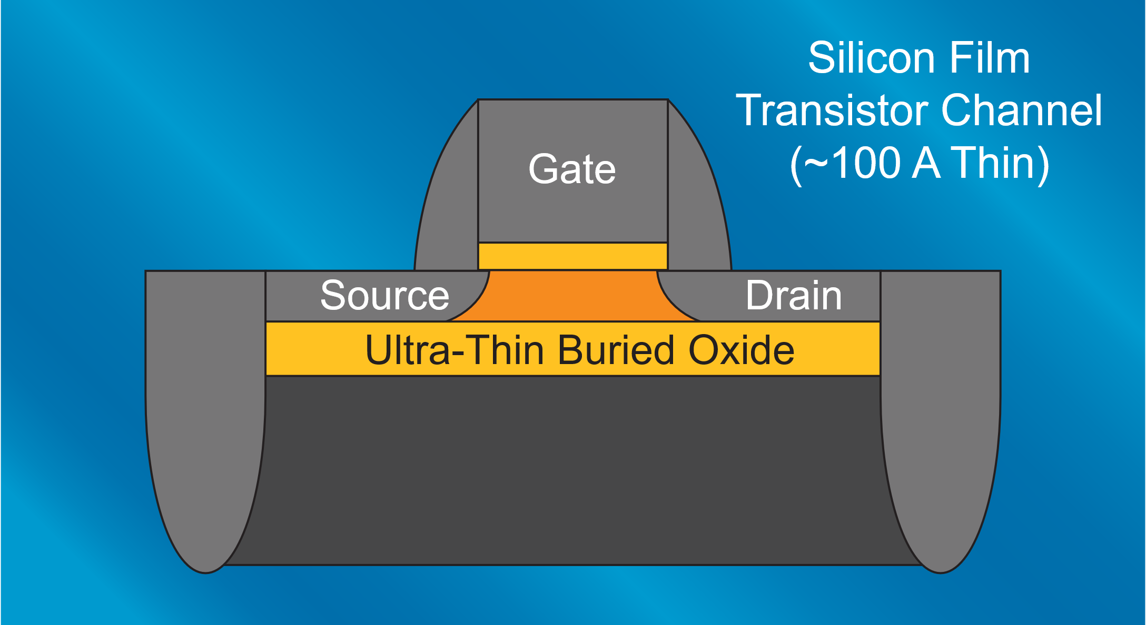
Process node selection: FD-SOI Benefits (Lattice Nexus™ Family)
Fully Depleted Silicon On Insulator (FD-SOI) Technology choice is one of the major factors that contribute to the power advantage for the Lattice Nexus platform
Significantly less leakage current – lower power
Reduced temperature dependency
Less Vt variability (threshold voltage for charge conduction)
High reliability due to smaller channel surface area
Back Biasing enables tuning the silicon for two operating modes:
  High performance
  Low Power option
Notes:
https://www.edn.com/how-to-design-an-fpga-architecture-tailored-for-efficiency-and-performance/

Slide 23
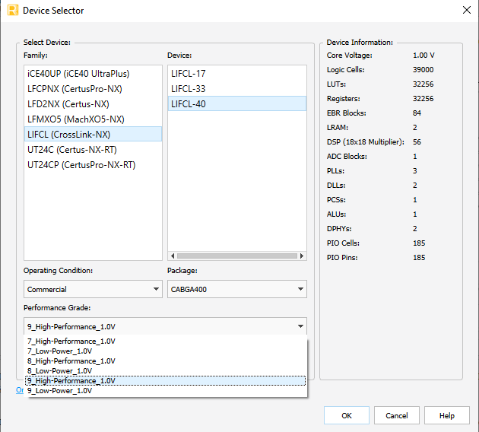
Software enabled high performance or low power operation
Nexus Device options for same speed grade
(HP or LP)
Software controlled bias voltage
Ability to switch the device from High Performance (HP) to Low Power (LP) mode by changing the technology back bias via a performance grade selection.

Slide 24
Architecture features

Slide 25
Device Architecture decision
Both Lattice Avant™ and Lattice Nexus™ integrate features to dynamically reduce power usage of a design.
Lattice Nexus™ features example:
  Dynamic Clock Control (DCC, DCS)
  PLL: Keep PLL in reset, VCO OFF
  LRAM: Shuts down the internal memory
  ADC: Disables the clocking within the block
  I/O Bank (Bottom bank): It allows you to turn OFF referenced and differential input.
Power calculator integrate EF (%)
  Estimate how much the block will be used for power consumption estimation
PLL
pllpd_en_n_i
User logic
State Machine/soft processor to Control User Standby Mode
LRAM
dps_i
STDBYINR
BNKREF18
STDBYINR
ADC
adc_en_i
Notes:
https://www.edn.com/how-to-design-an-fpga-architecture-tailored-for-efficiency-and-performance/

Slide 26
Quick boot-up for low power consumption
Task period
τ_{i}
τ_{i+1}
τ_{i+2}
τ_{in}
Device | Configuration time
CertusPro™-NX | 30 ms
CrossLink™-NX | 8 ms
MachXO3™ | 1 ms
FPGA turned of
_{ON}
_{ON}
_{ON}
_{ON}
FPGA booting up
FPGA shutting down
Lattice FPGAs can be entirely shut-down within the task period to save power

Slide 27
Summary
Low power is the key focus of Lattice
  LUT4 vs LUT6
  Technology node selection with software controlled bias voltage
  Selective turn on/off of on-chip modules
  Quick boot-up of Lattice FPGA results in significant power savings
Register for Lattice Insights – 3 lucky draw winners to receive Lattice FPGA Evaluation board

