Slide 1

2nd FPGA Developers’ Forum Meeting
Concluding remarks
CERN - 19-23 May 2025
Francesco Gonnella - University of Birmingham UK
on behalf of the FDF organising team

Slide 2
FDF 2025’s numbers
299 registered participants
  61 CERN users, 85 high energy physics
  29 non-HEP Academia
  124 from industry
~170 in person participants
  106 people eating together
92 connected to the webcast (peak)
59 submitted abstracts, 30 accepted
  7 algorithms, 11 tools, 5 HDL cores, 7 solutions
  6 sponsor talks
  ~18 hours talking time

Slide 3
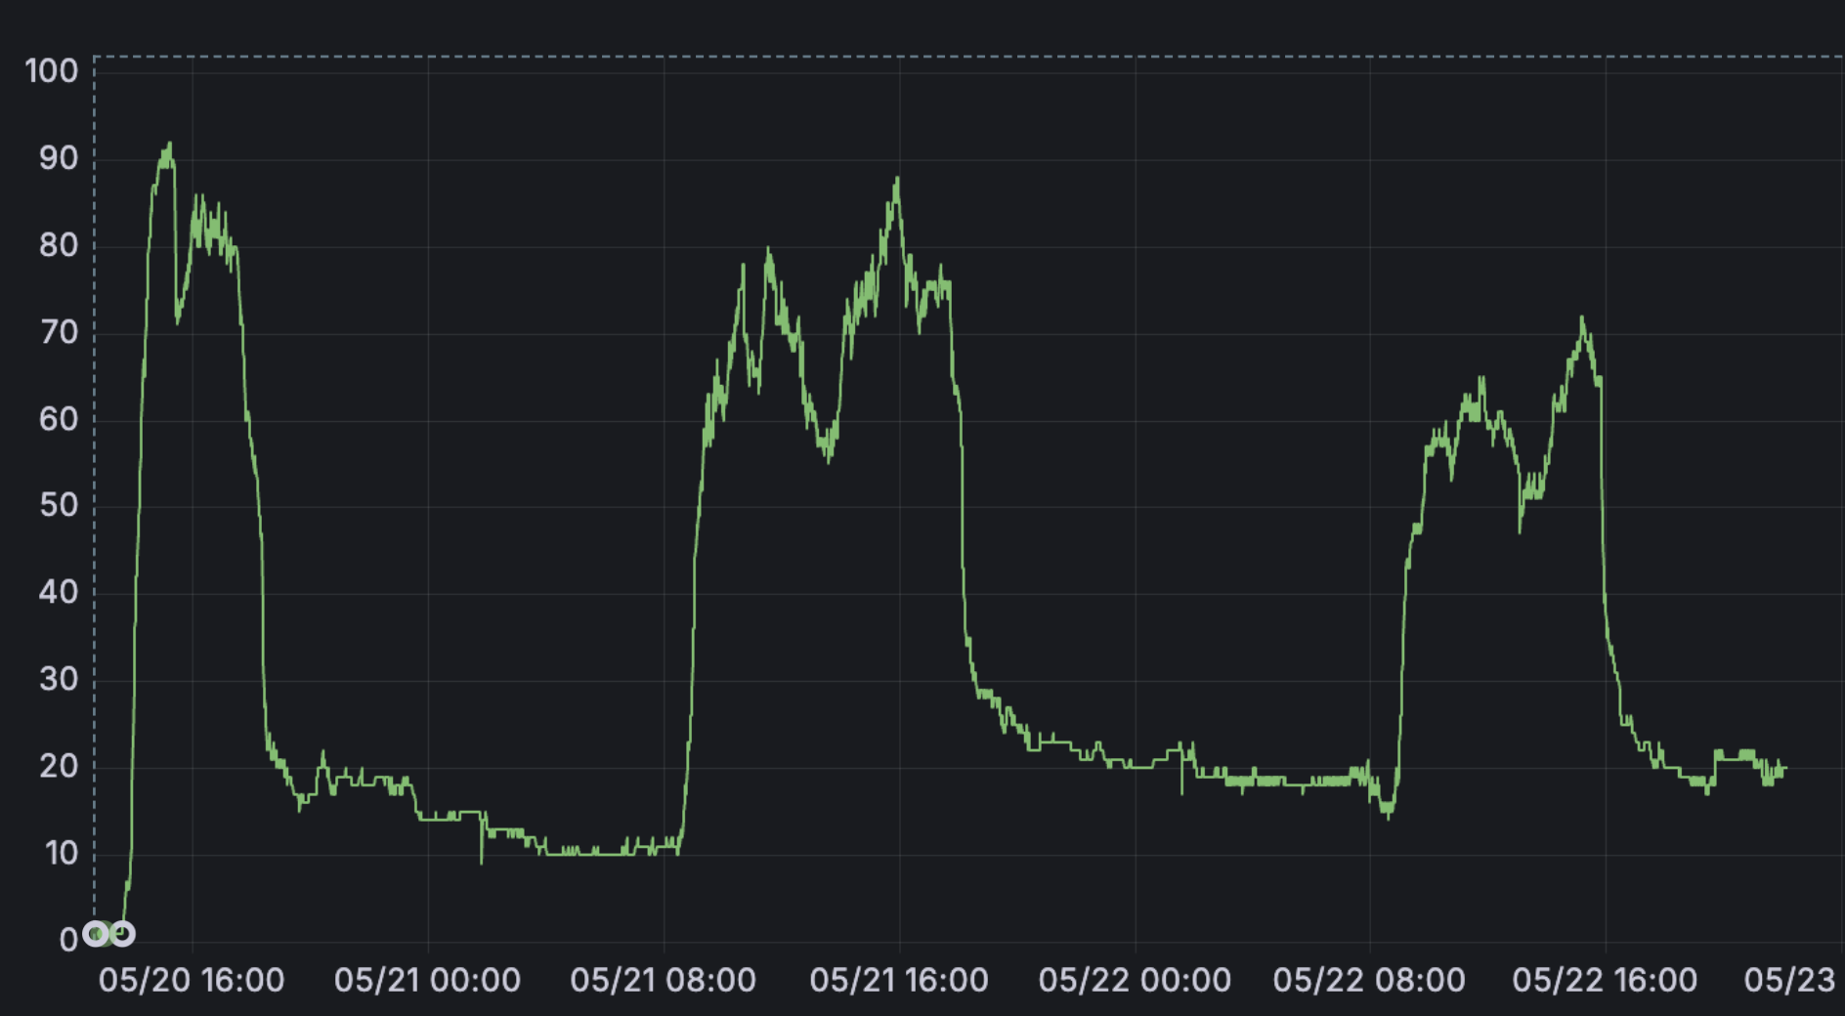
Web stream

Slide 4
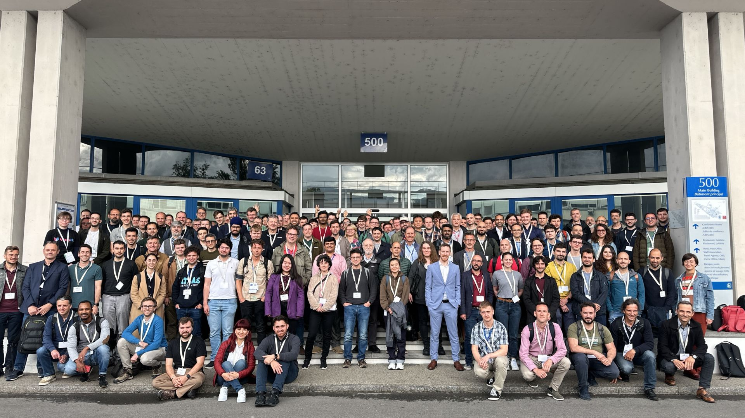
Good-looking FPGA developers

Slide 5
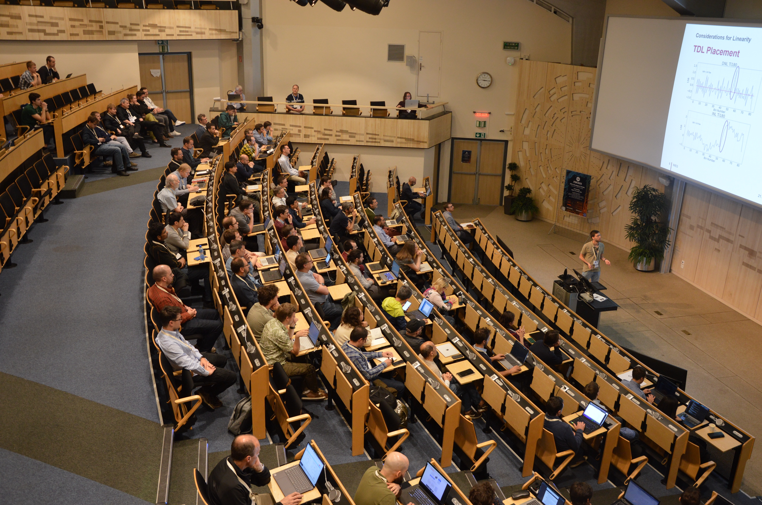
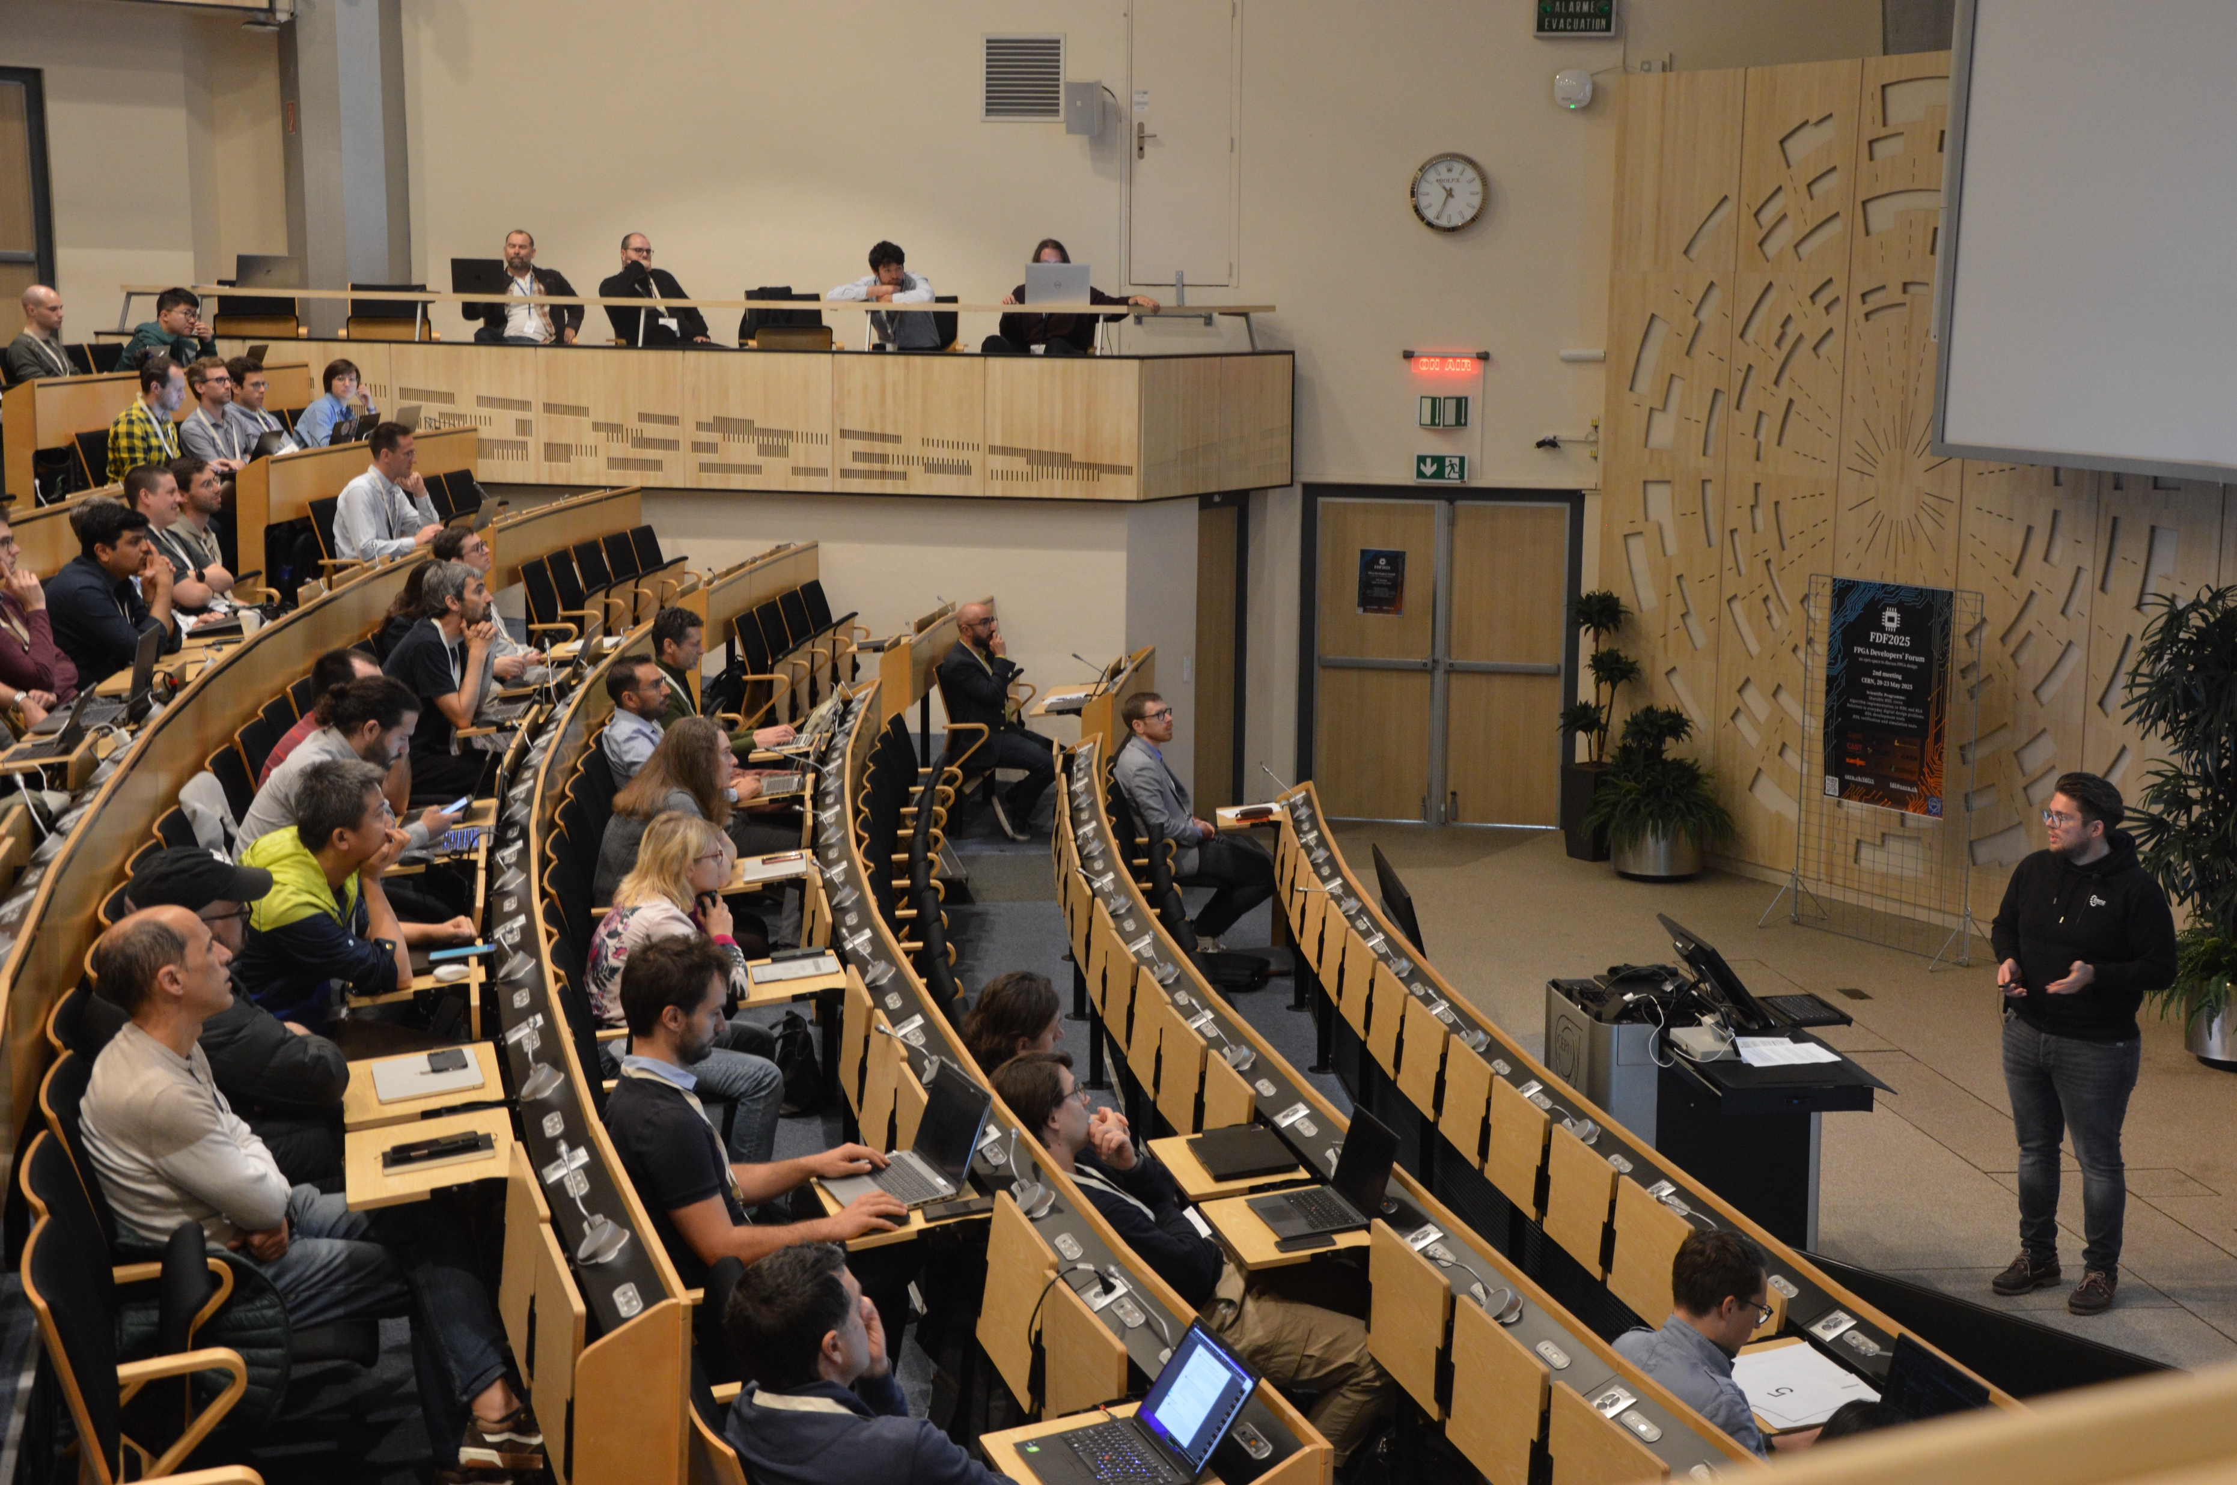
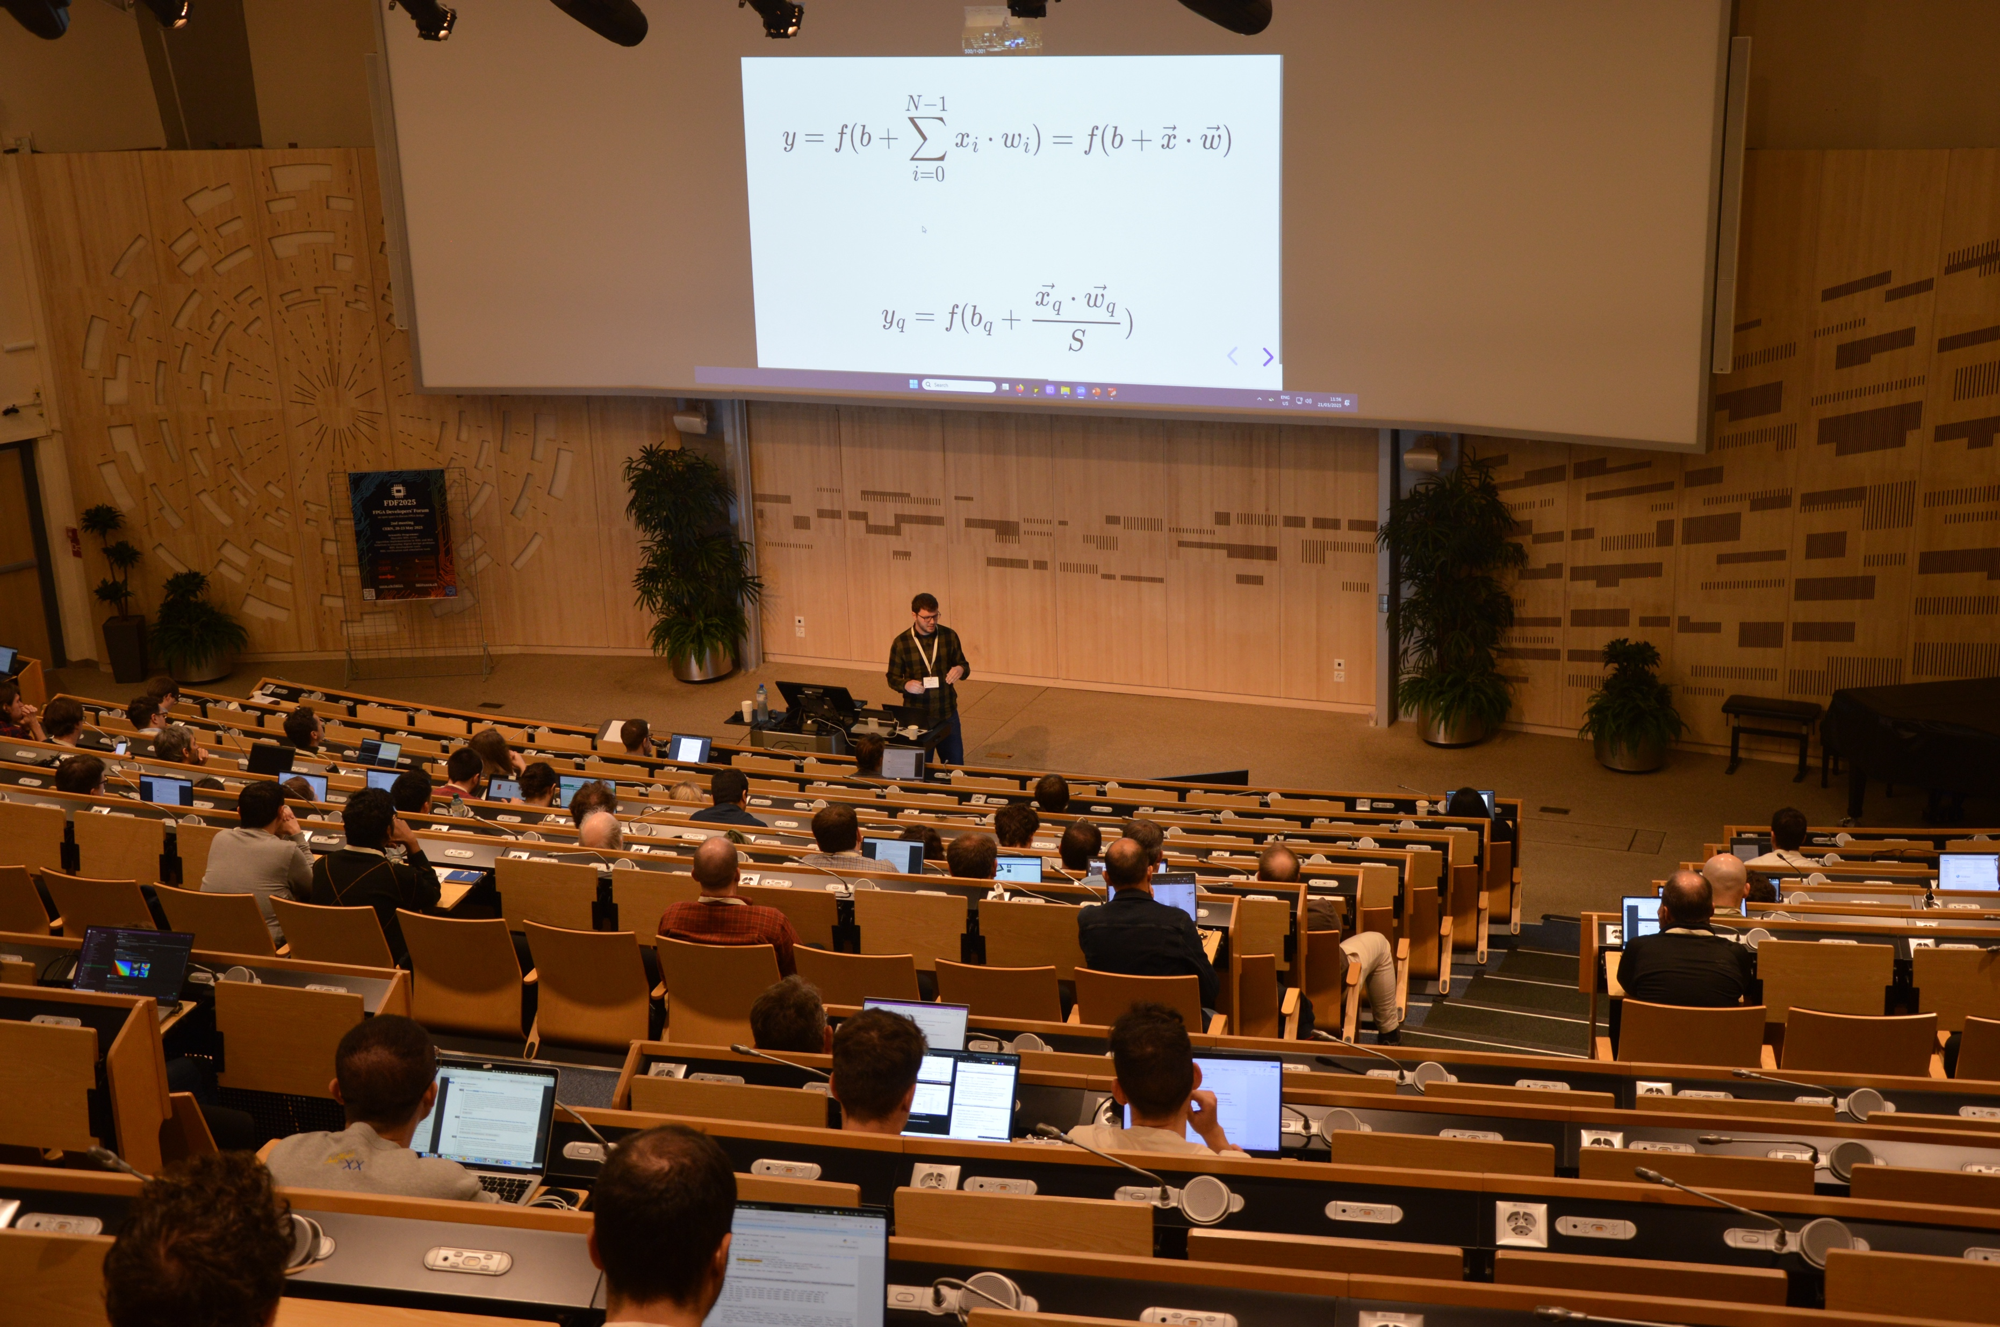
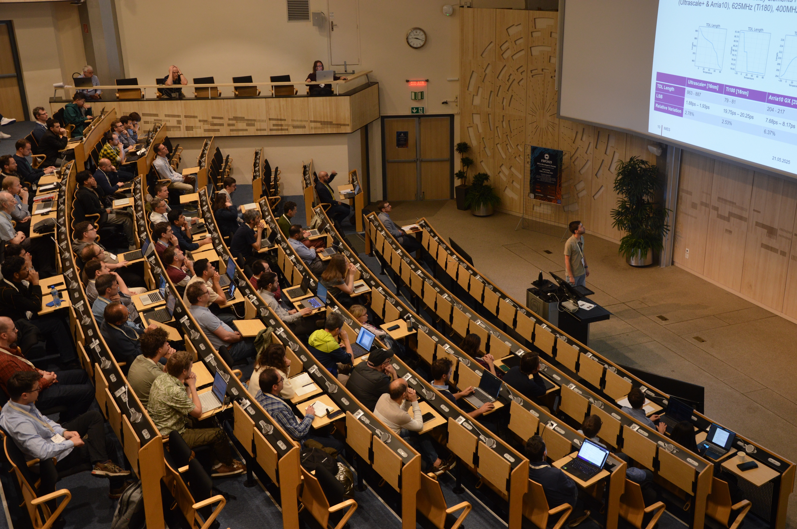
FPGAs at CERN auditorium 1/2

Slide 6
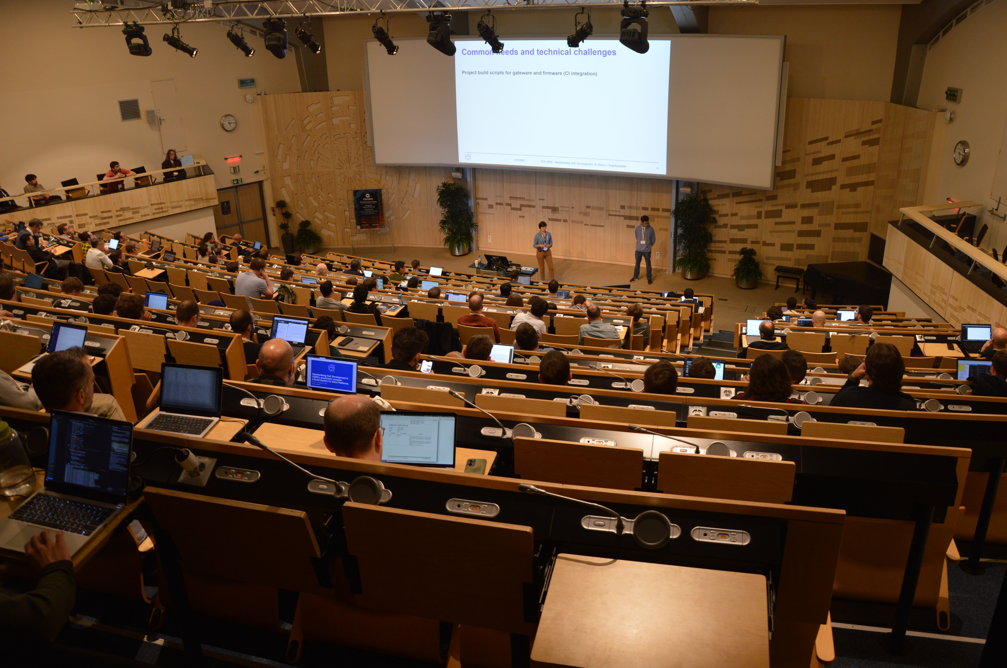
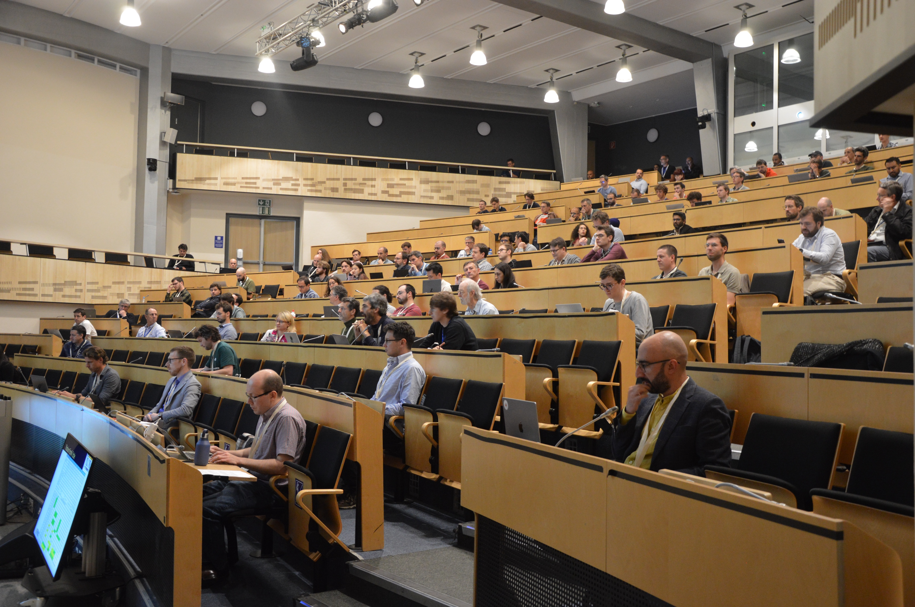
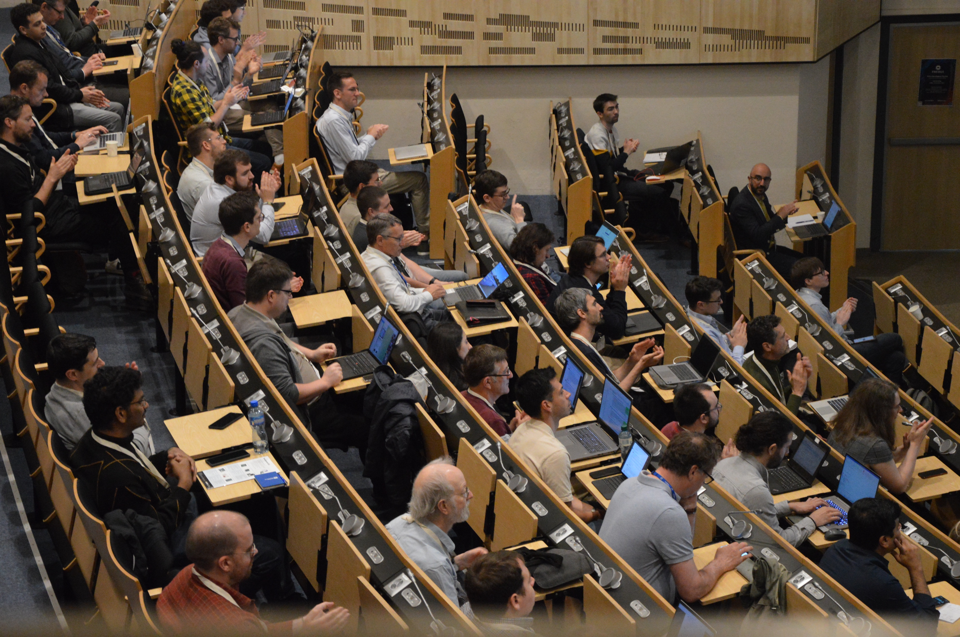
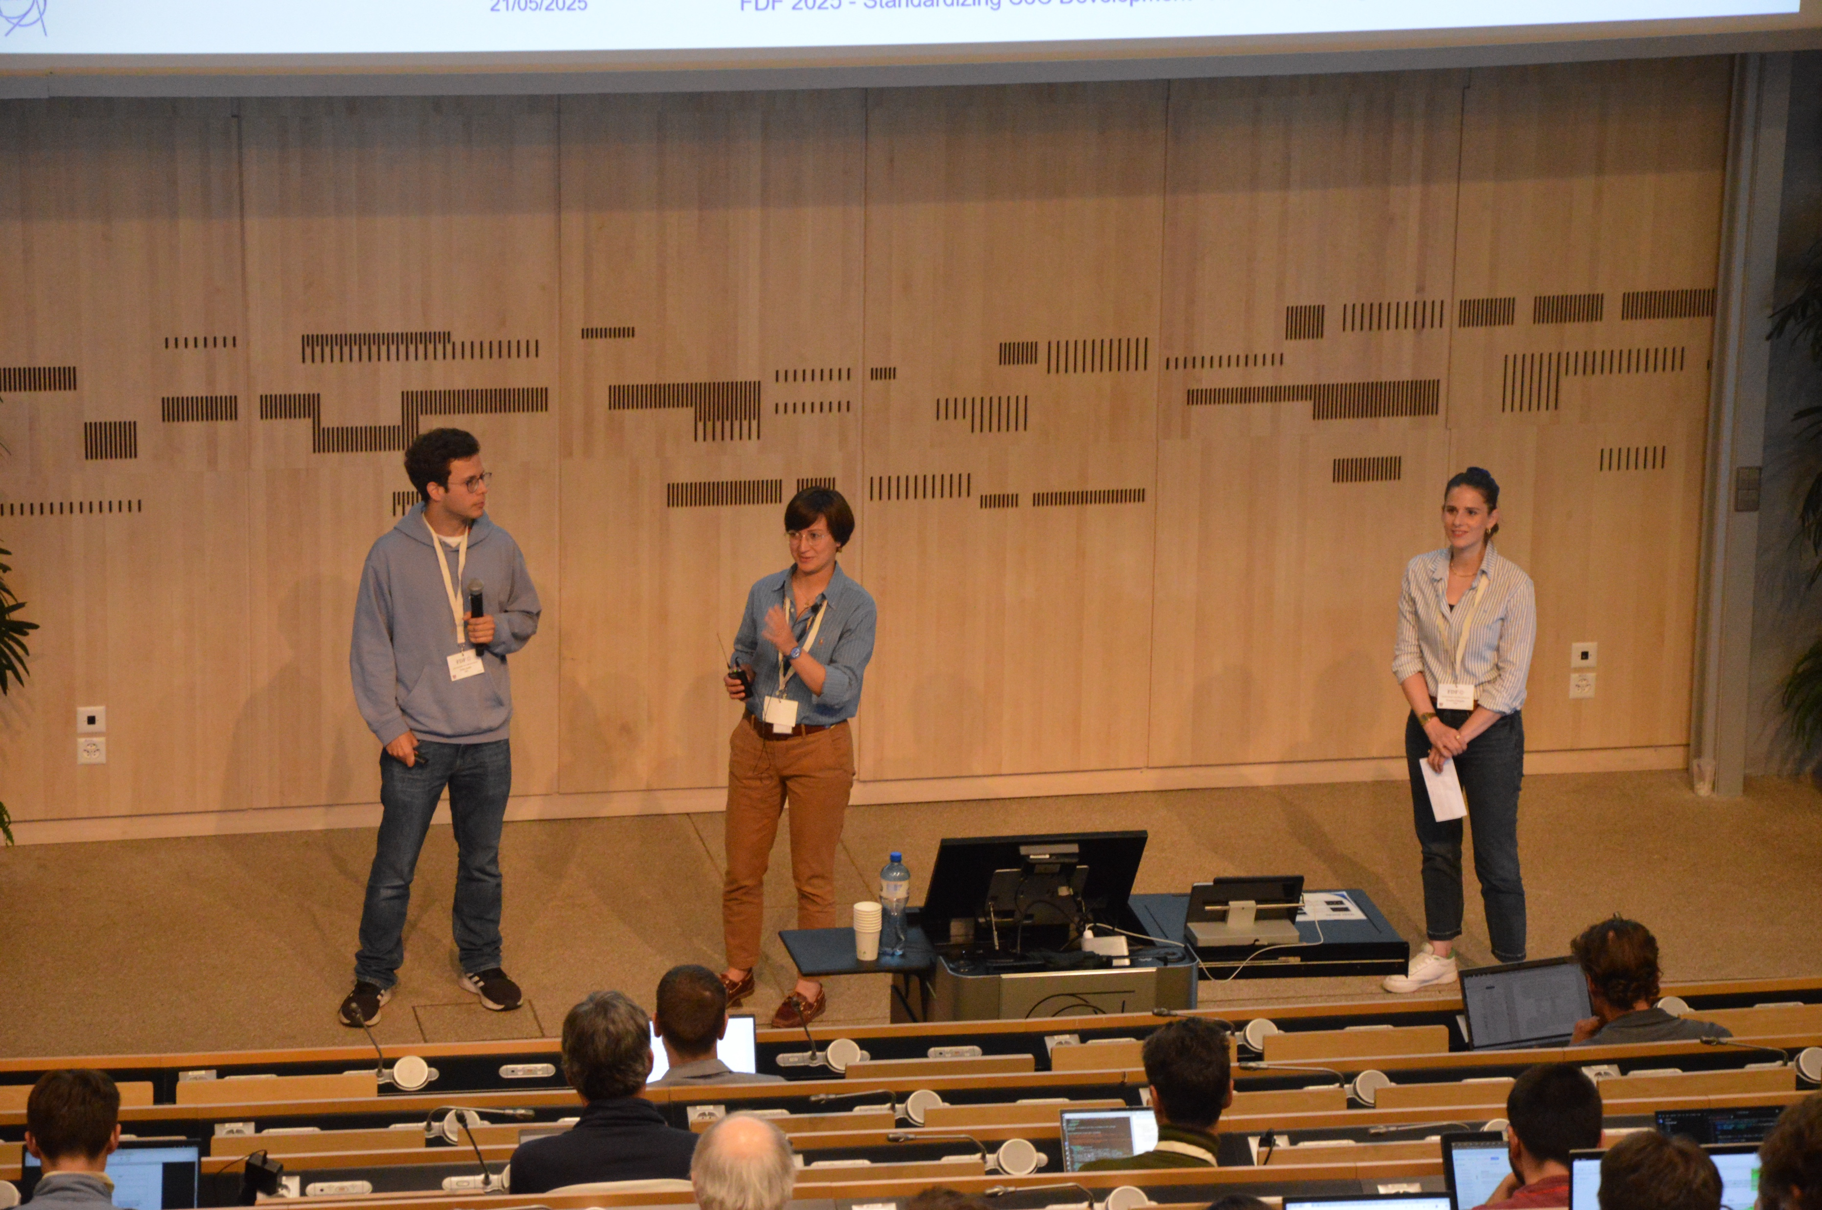
FPGAs at CERN auditorium 2/2

Slide 7
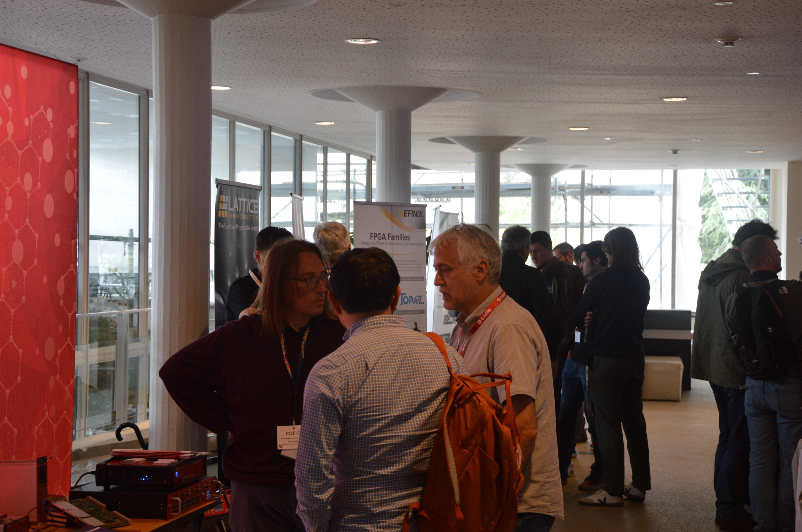
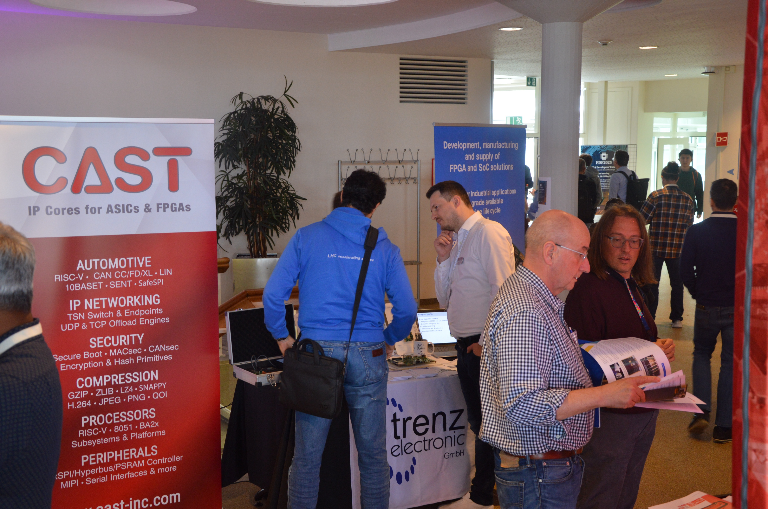
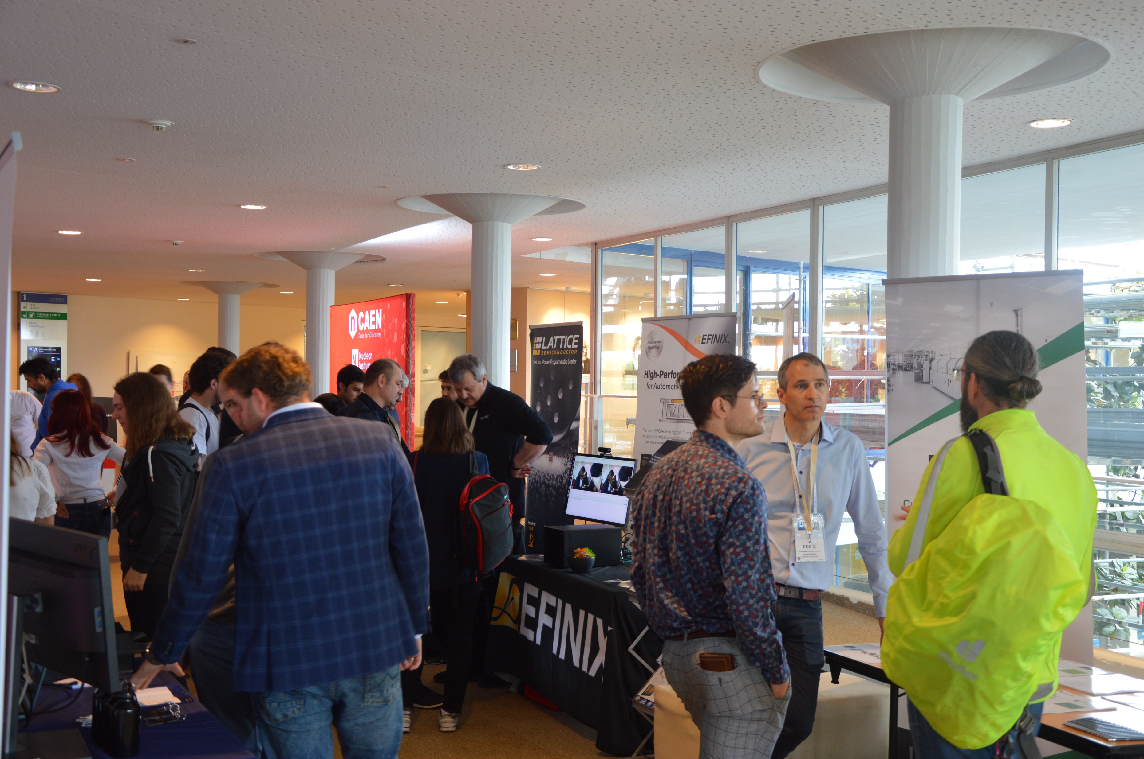
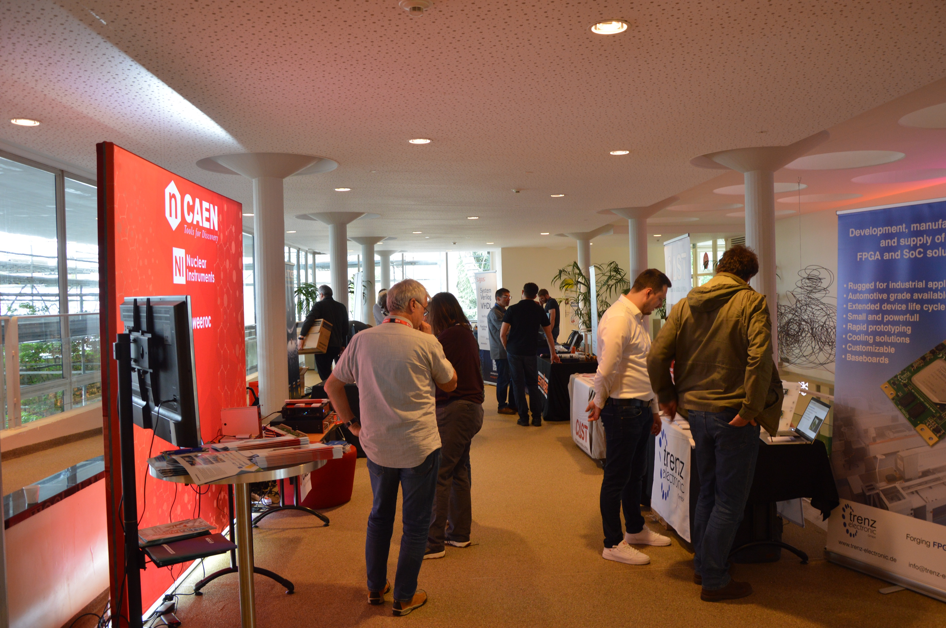
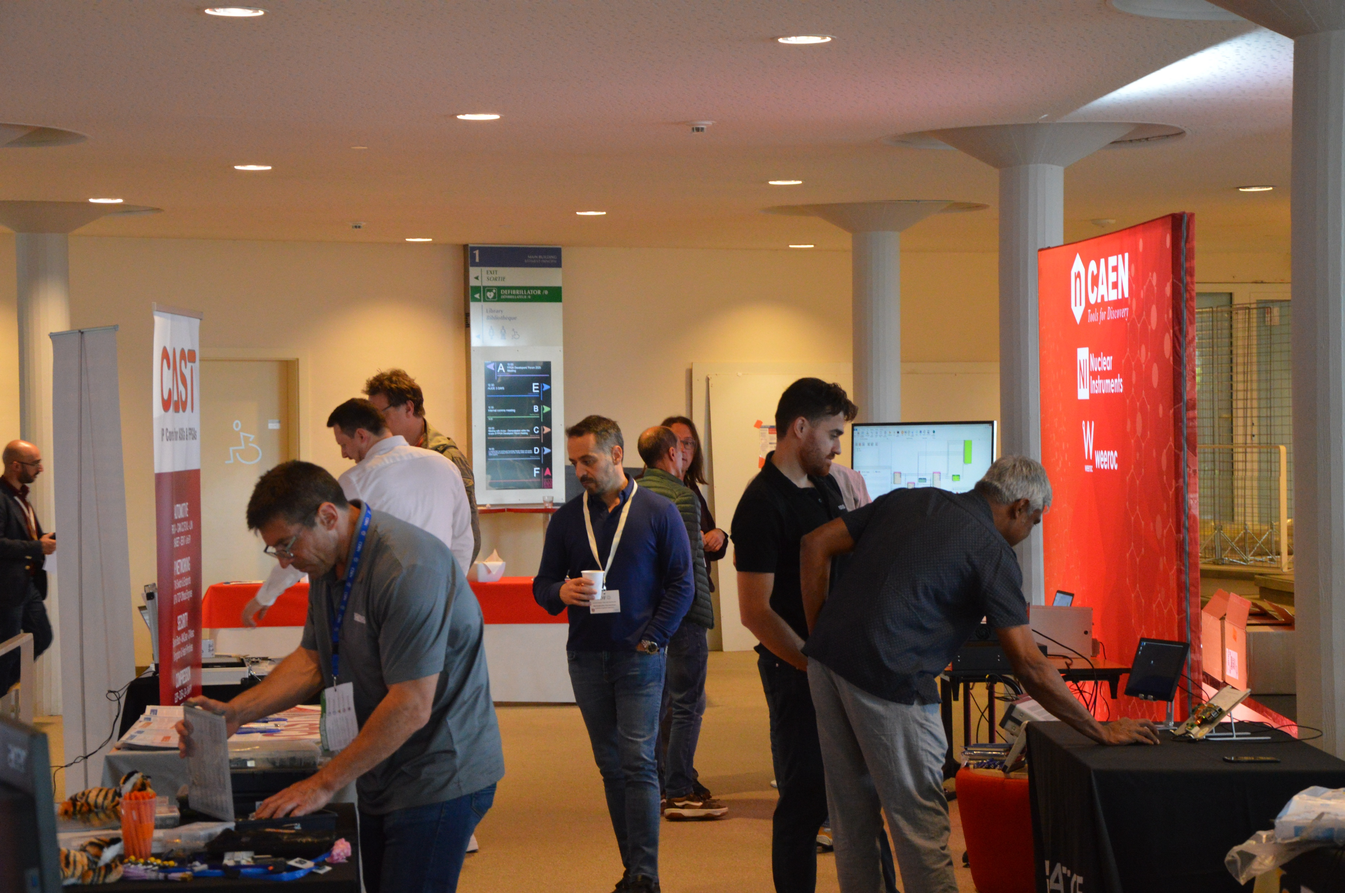
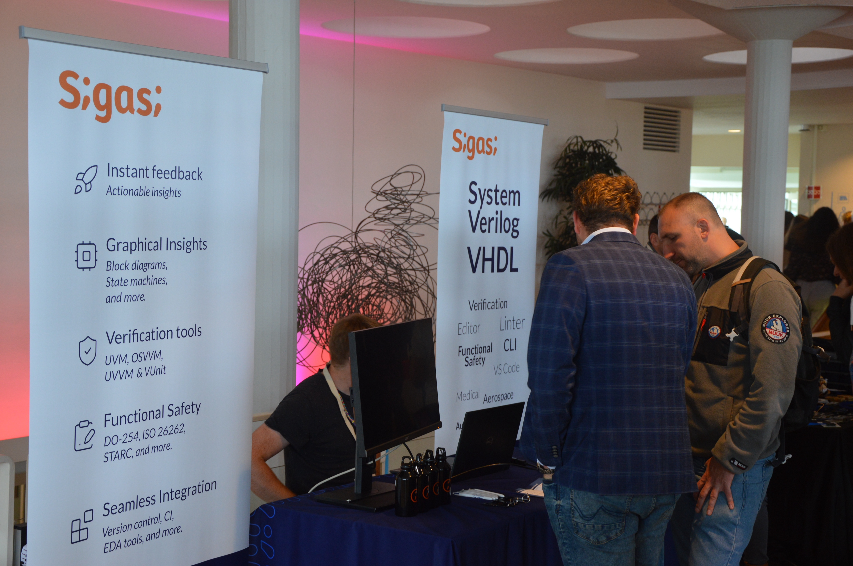
FDF Sponsors

Slide 8
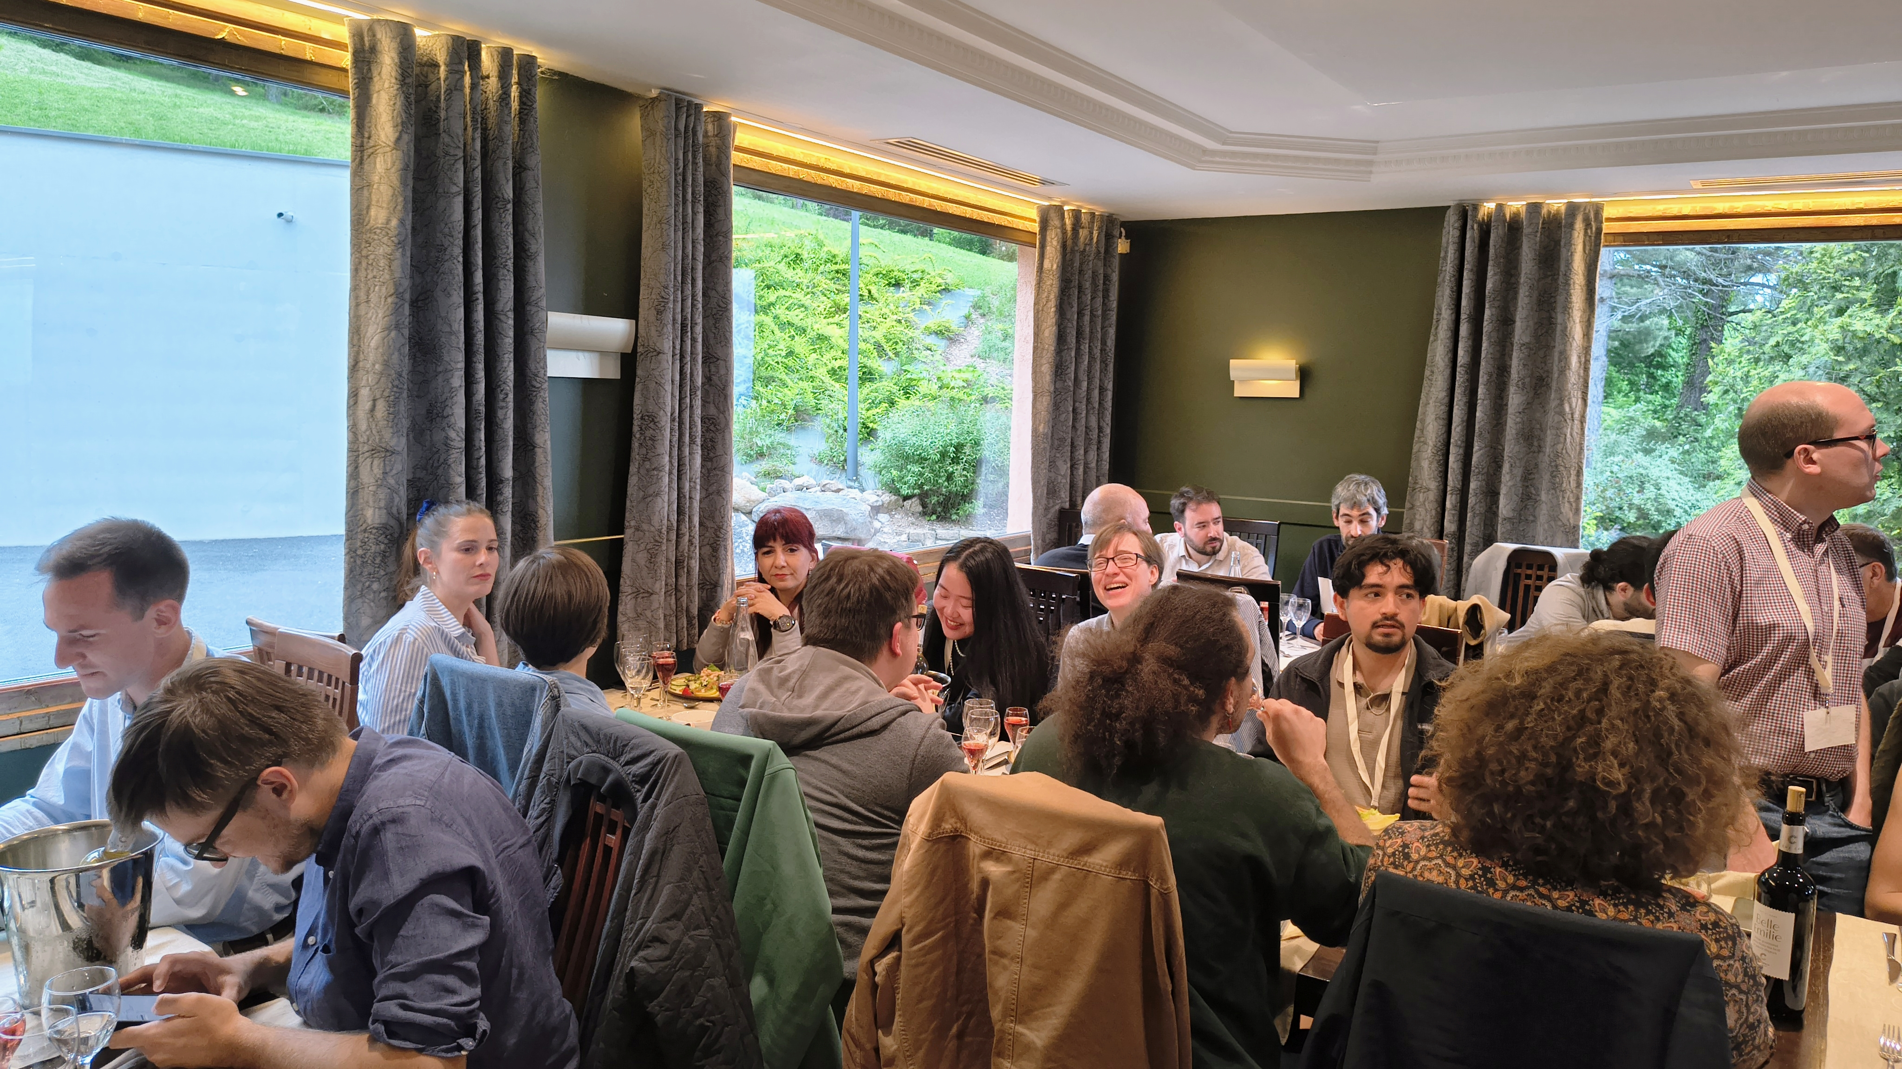
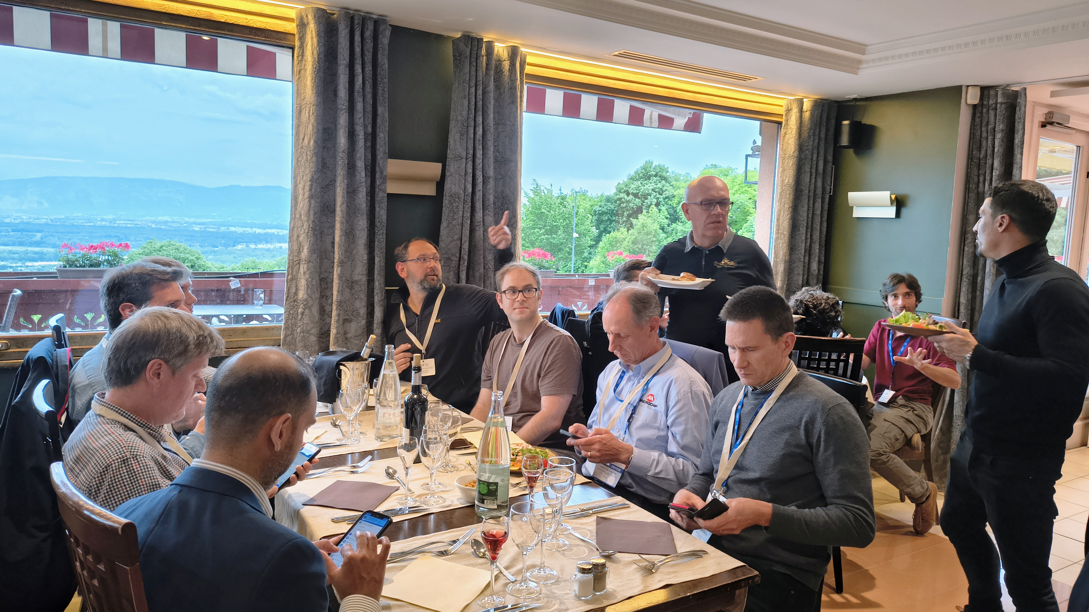
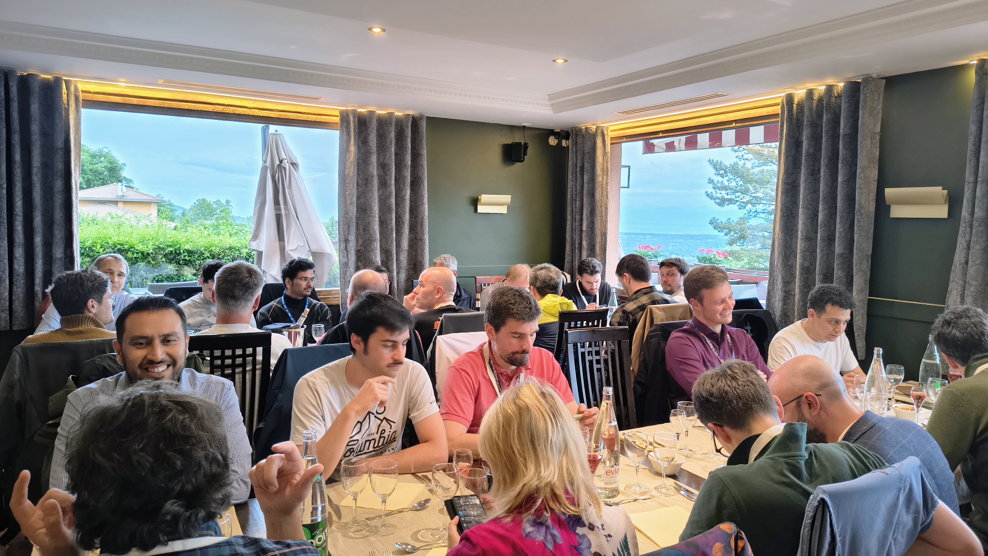
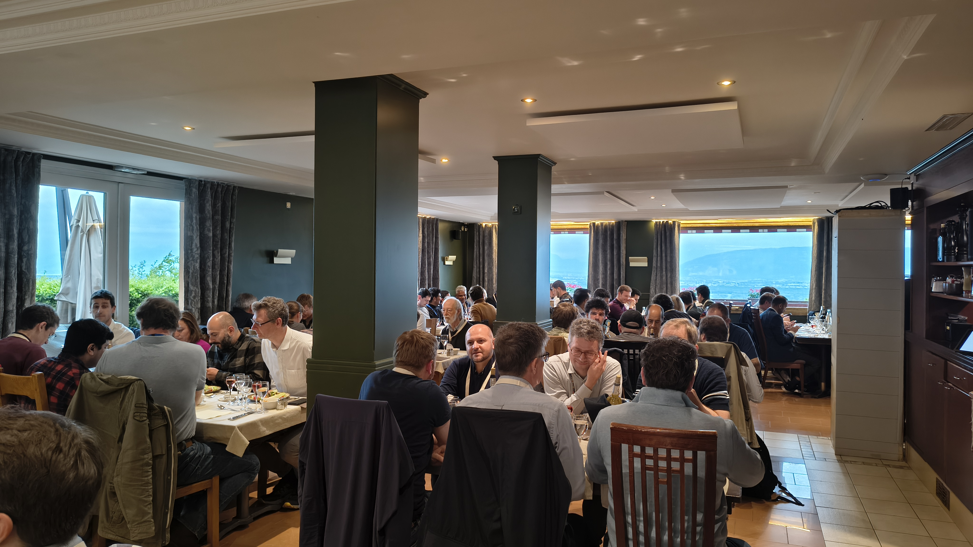
FPGA developers at dinner
0x4110

Slide 9
FDF 2025: impressions
Great quality talks, good details and well delivered
The atmosphere felt very friendly
People looked interested in the talks and Q&A was very interesting
  Having the main auditorium was a big improvement with respect to last year!
People were happily chatting during coffee breaks

Slide 10
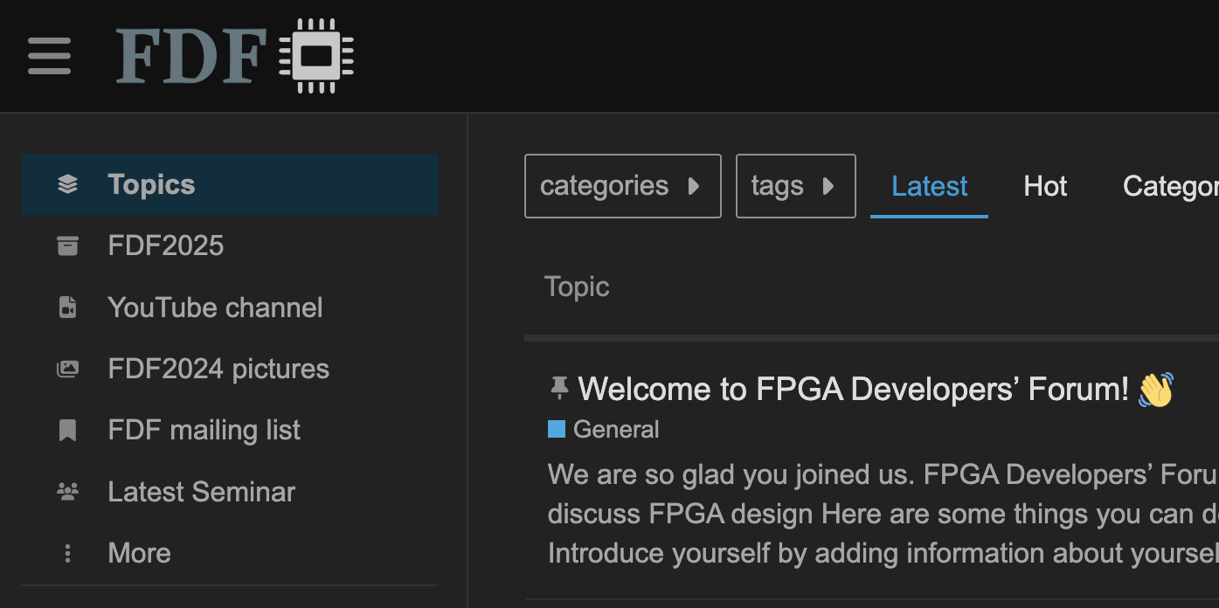
The FPGA Developers’ Forum
The forum’s goal is to create an open community of FPGA developers from any background.
Use the online open forum to discuss all the aspects of FPGA programming.
It hasn’t reached it’ potential… suggestions?
FDF website: https://cern.ch/fdf Up-to-date links will be in the side bar.

Slide 11

FDF newsletter
We will keep you up to date with our newsletter (~500 members).
All the participant of FDF2025 are already added
(go to https://cern.ch/fdf-news to manage your registration).
Send us a message at fdf@cern.ch and (after moderation) we will forward it to the community.
We can share FPGA related news, upcoming events, opening job positions, etc.

Slide 12

FDF seminars
Regular seminars are held during the year. Talks are done with the same spirit of this meeting: detailed, open, friendly. Plenty of time for discussion foreseen.
We will get in touch with the authors of the high-quality talks that couldn’t make it to this meeting because of time.
However, send us a message at fpga.developers.forum@cern.ch if you’d like to present something!

Slide 13

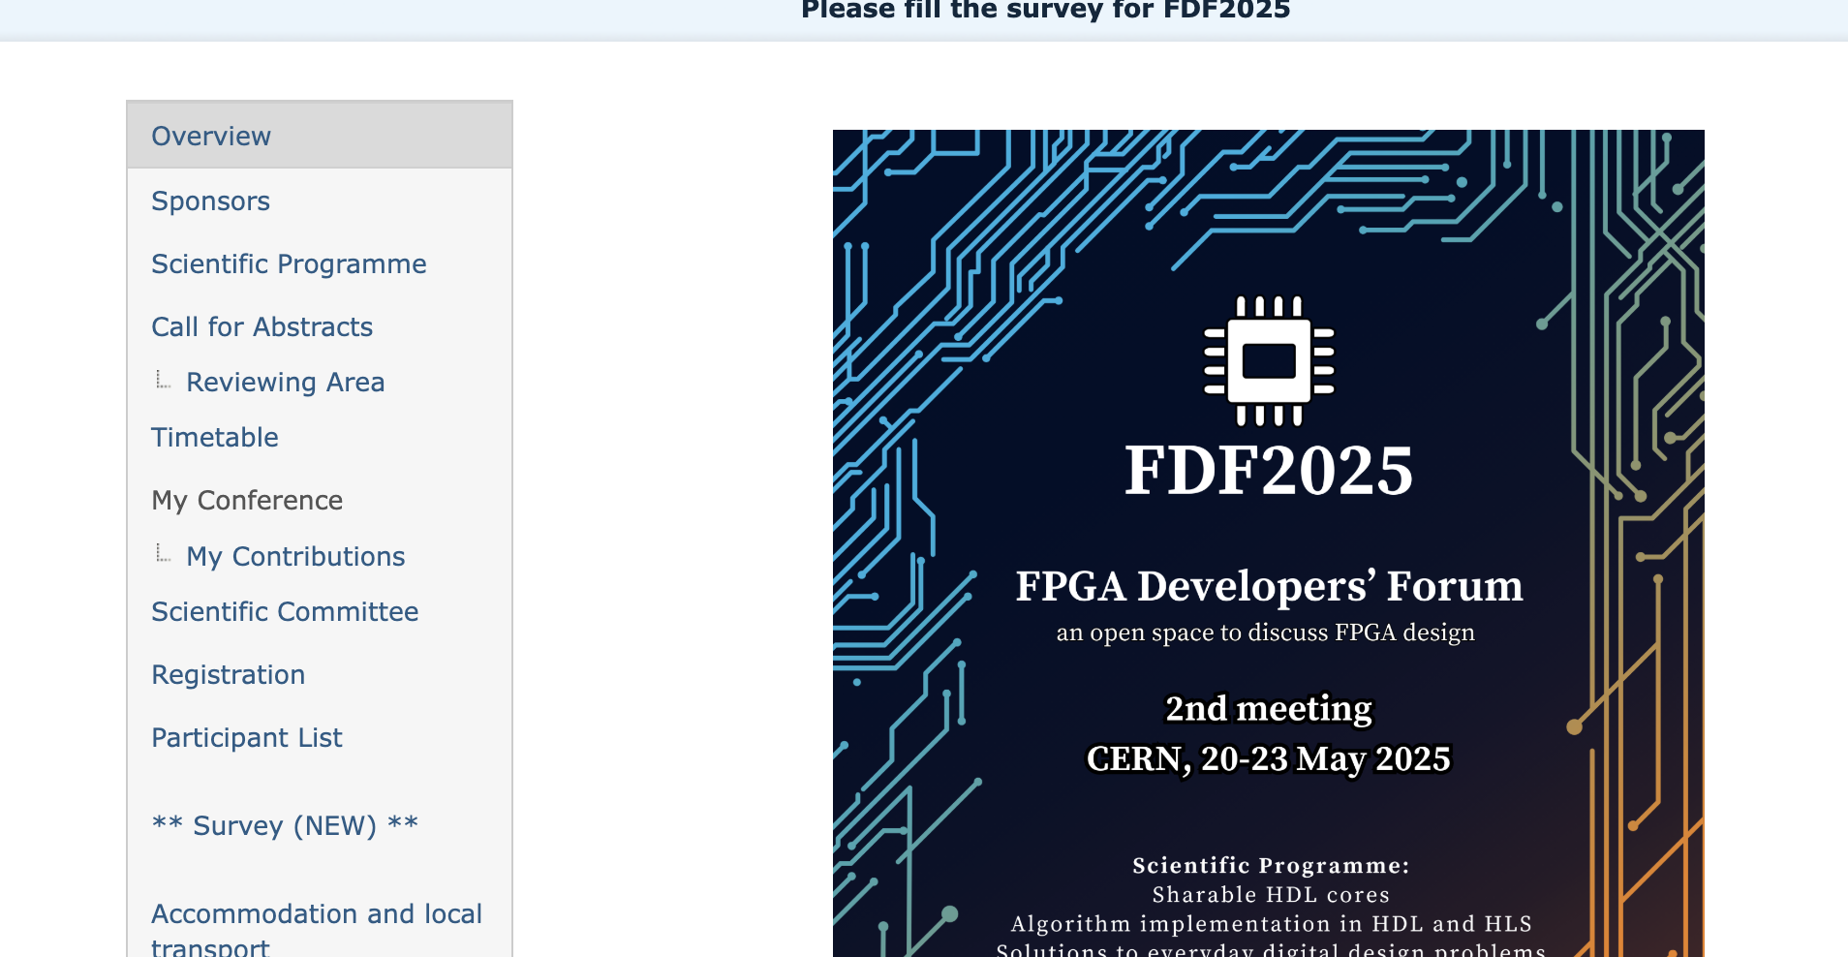
FDF annual meeting
We are already thinking of FDF26...
Save the date:
May 26-28 2026 (TBC)
Please fill in the survey that was published today,
let’s improve FDF!

Slide 14
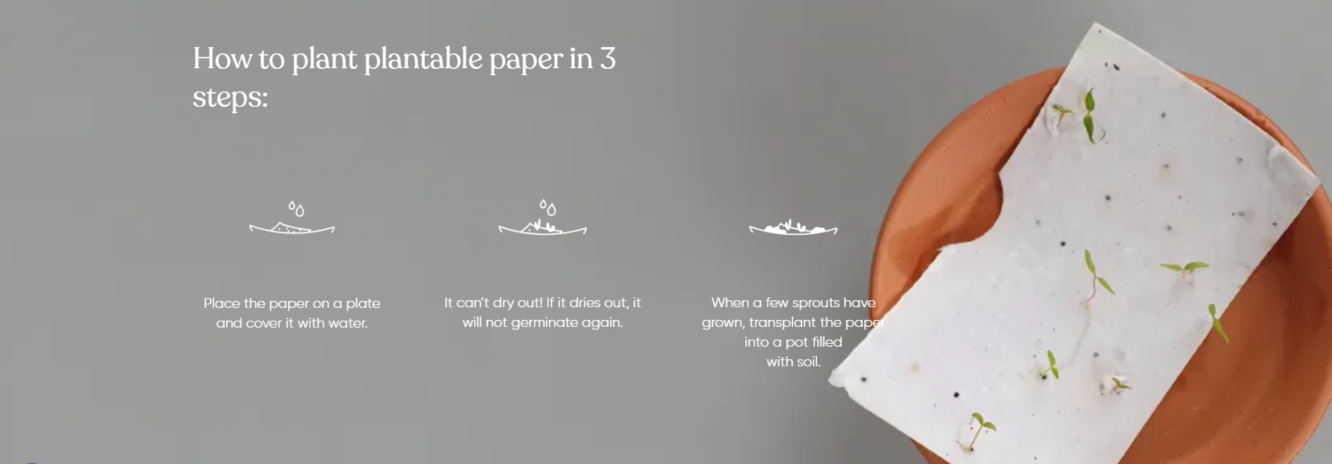
Plant FDF!

Slide 15











Huge Thanks to Our Sponsors!
Gold Sponsors
Silver Sponsors

Slide 16
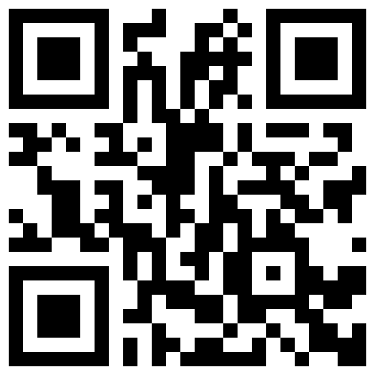
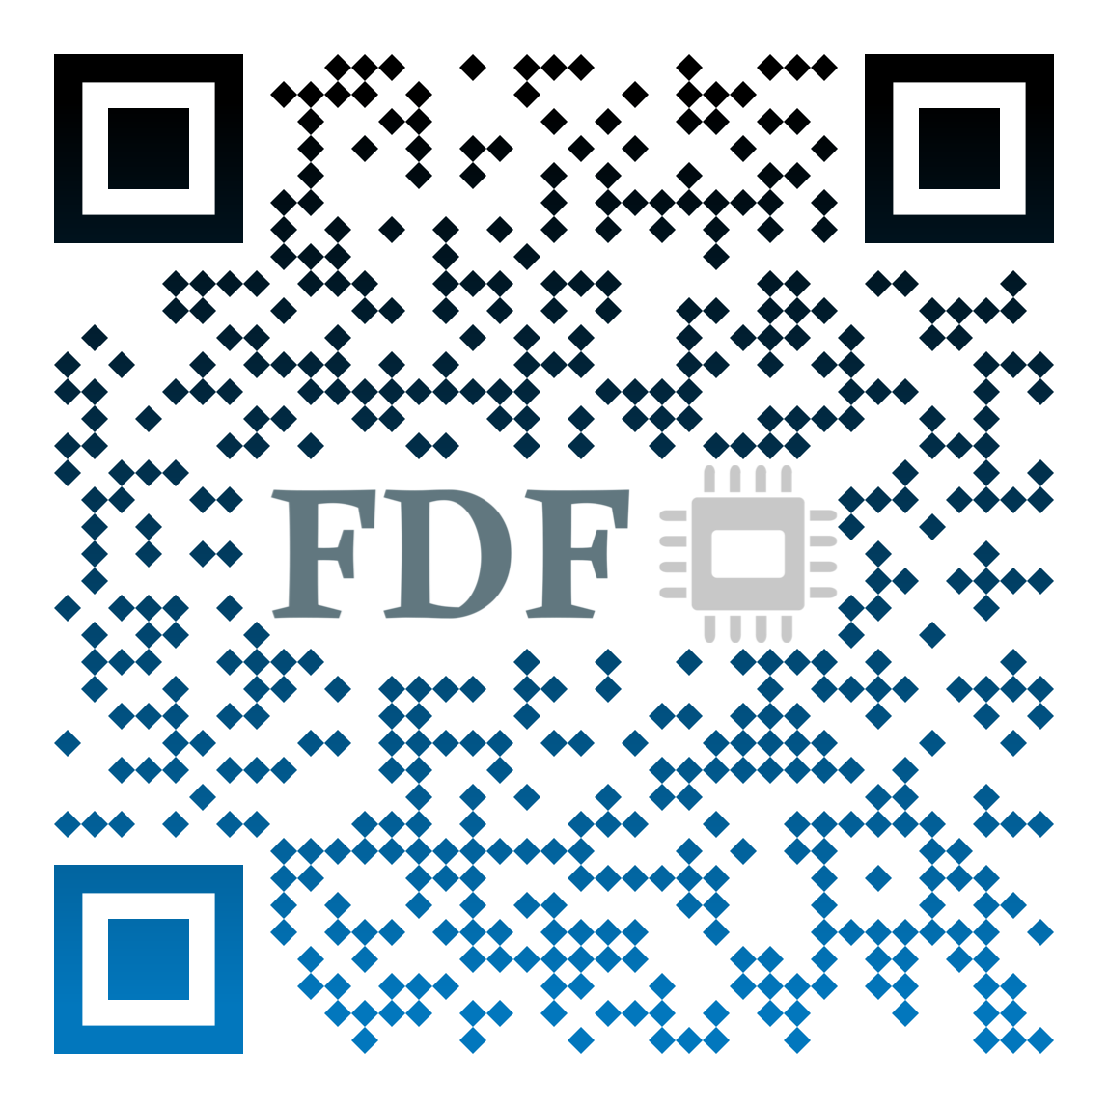
Newsletter
Stay in touch!
Discourse Forum

