Slide 1
CERN ABT’s lazy git workflow for equipment-specific designs
Pieter Van Trappen, Léa Strobino
2nd FPGA Developers’ Forum – https://indico.cern.ch/event/1467417

Slide 2
Presentation content
Context
Project structure
Examples and use cases
Future
Motivation: present the current, sub-optimal but relatively lazy efficient, git workflow hoping for ideas for improvement. Or maybe inspire others. All sources available to CERN colleagues, open to share publicly.

Slide 3
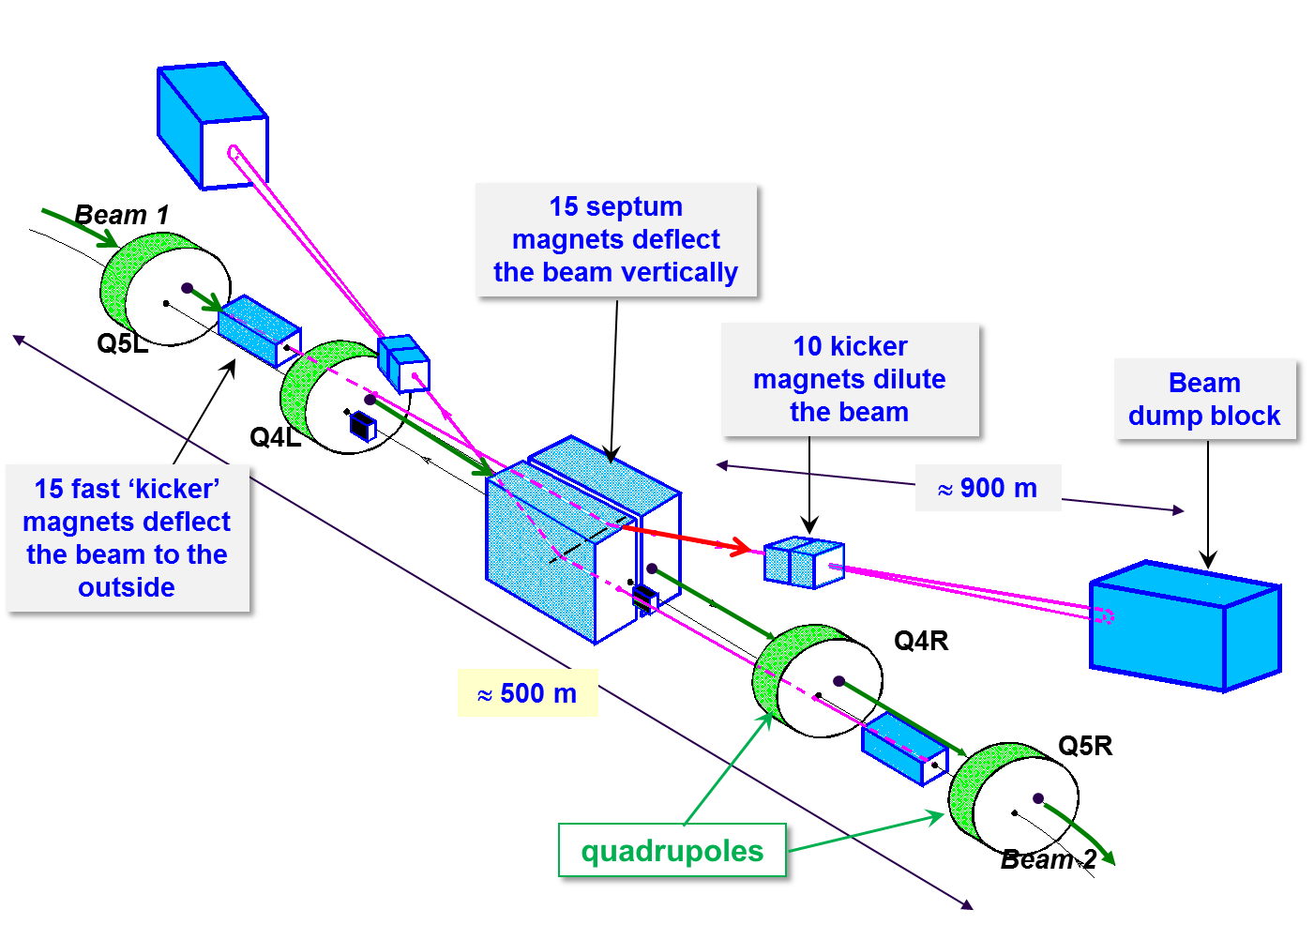
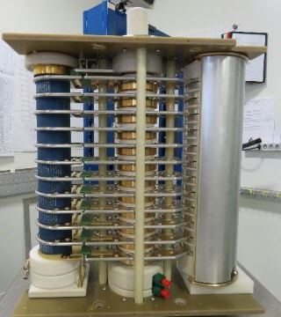
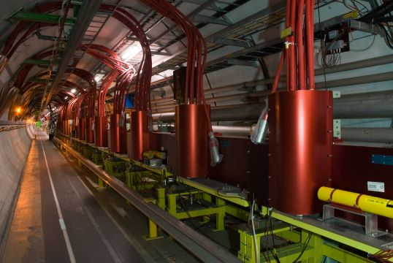
Context – CERN SY-ABT
Accelerator Systems, Beam Transfer Group (SY-ABT)
The ABT group is in charge of the design, development, construction, installation, exploitation
and maintenance of injection and extraction related equipment and beam-transfer systems.
The electronics section designs, among others, cards and gateware for such ‘fast
pulsed transfer systems’.
Wide variety of hardware of the ‘70s being consolidated and newer hardware; due to protection latency and timing synchronisation FPGAs in use since 20+ years.
ABT handles about 50 installations (aka equipment) and strives for reusable, modular designs for obvious reasons (limited time, knowledge retention, reduce support vector).
Main focus here will be on two projects, though there’s more with similar structure
A Fast Interlock Detection System for high-power switch protection (FIDS) - paper
A Generic Timing Software/Gateware for fast pulsed magnet systems (KiTS/R) - paper

Slide 4
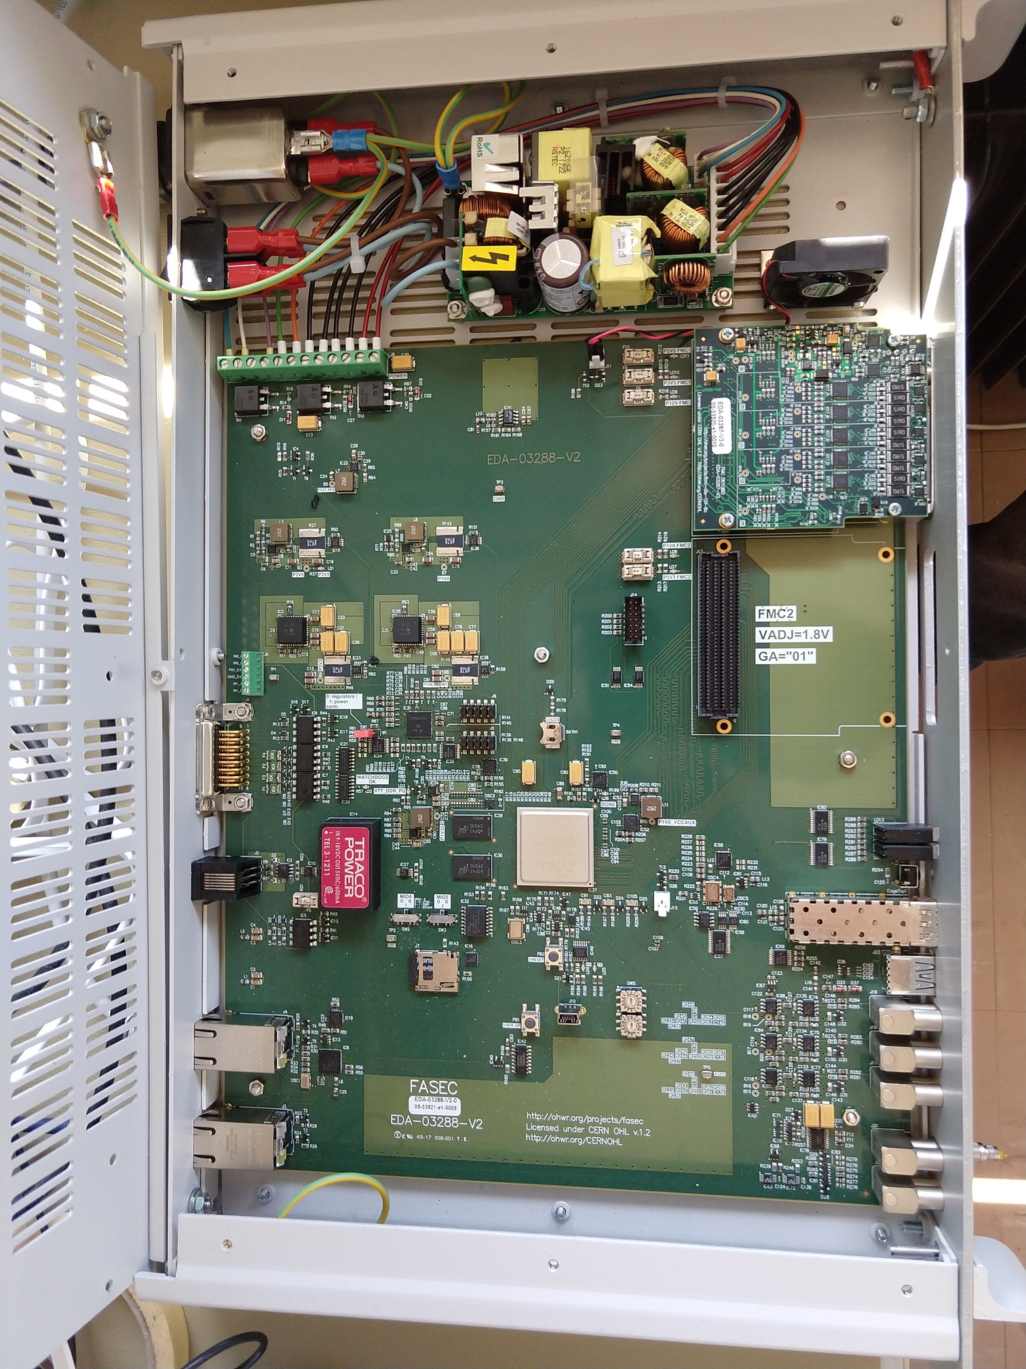
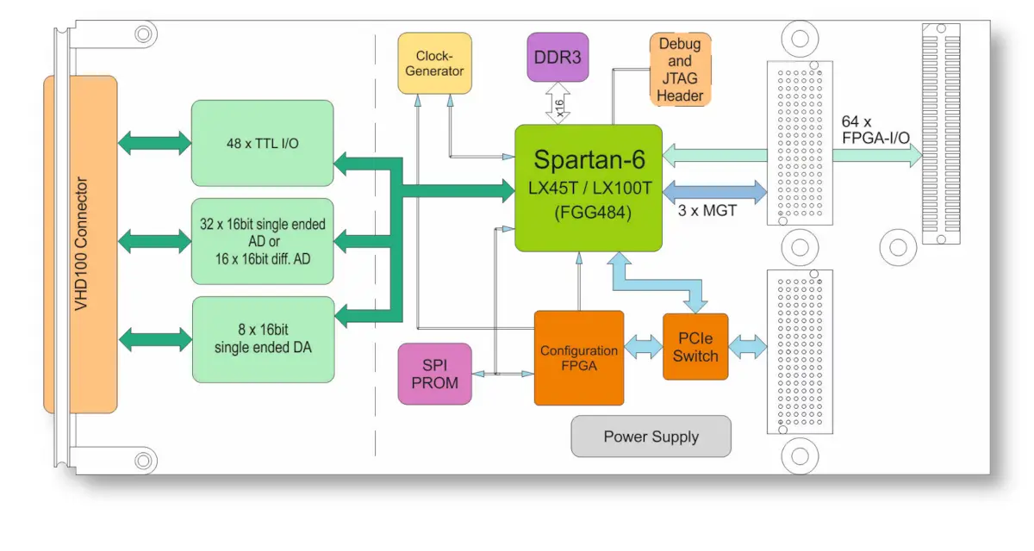
Context – Hardware
FIDS
OHWR FASEC (FPGA & ARM SoC FMC Carrier) platform
AMD Zynq-7000 SoC
KiTR
Uses TEWS’ TXMC635 ‘mixed GPIO’ XMC,
hosted on VME or PCIe carriers
Reconfigurable FPGA with Analog Input (16 bit), Analog Output (16 bit), and TTL I/O
AMD Spartan-6 FPGA

Slide 5
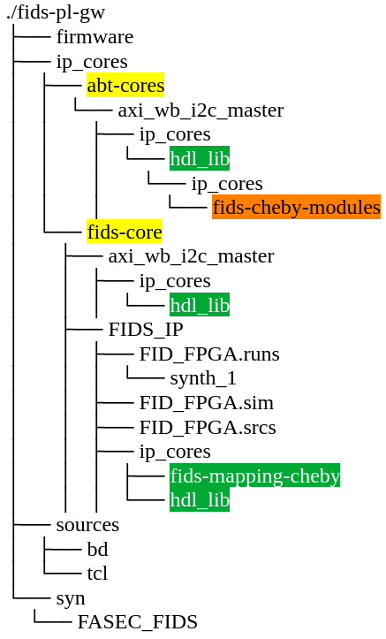
Project structure
Our typical gateware project structure is composed as follows
  one or multiple common and dedicated IP/HDL cores
  a top-level design, specific for each installation
    specific: HW IO interconnections, cores instantiation, (cheby) memmap, AXI4 interconnects, etc.
    common: HW IO interface, abt_card_header, submodules, etc.
Some projects predate wider ABT/CERN git adaptation
  No use of git or any other version control system; common files were copied around (though often modified).
  Some had an IP-based structure, but such ‘common cores’ were managed at the level of the designer’s HDD with a common, single folder for multiple projects.
    No use of git submodules thus once such a dependency had advanced for one project, all remaining projects required implementing similar API changes (e.g. modules’ port); zero reproducibility.
  Recently we’ve seen substantial efforts to migrate to the common ‘modern’ approach i.e. git submodules with a GitLab CI/CD pipeline to obtain (~reproducible) bitstreams.

Slide 6
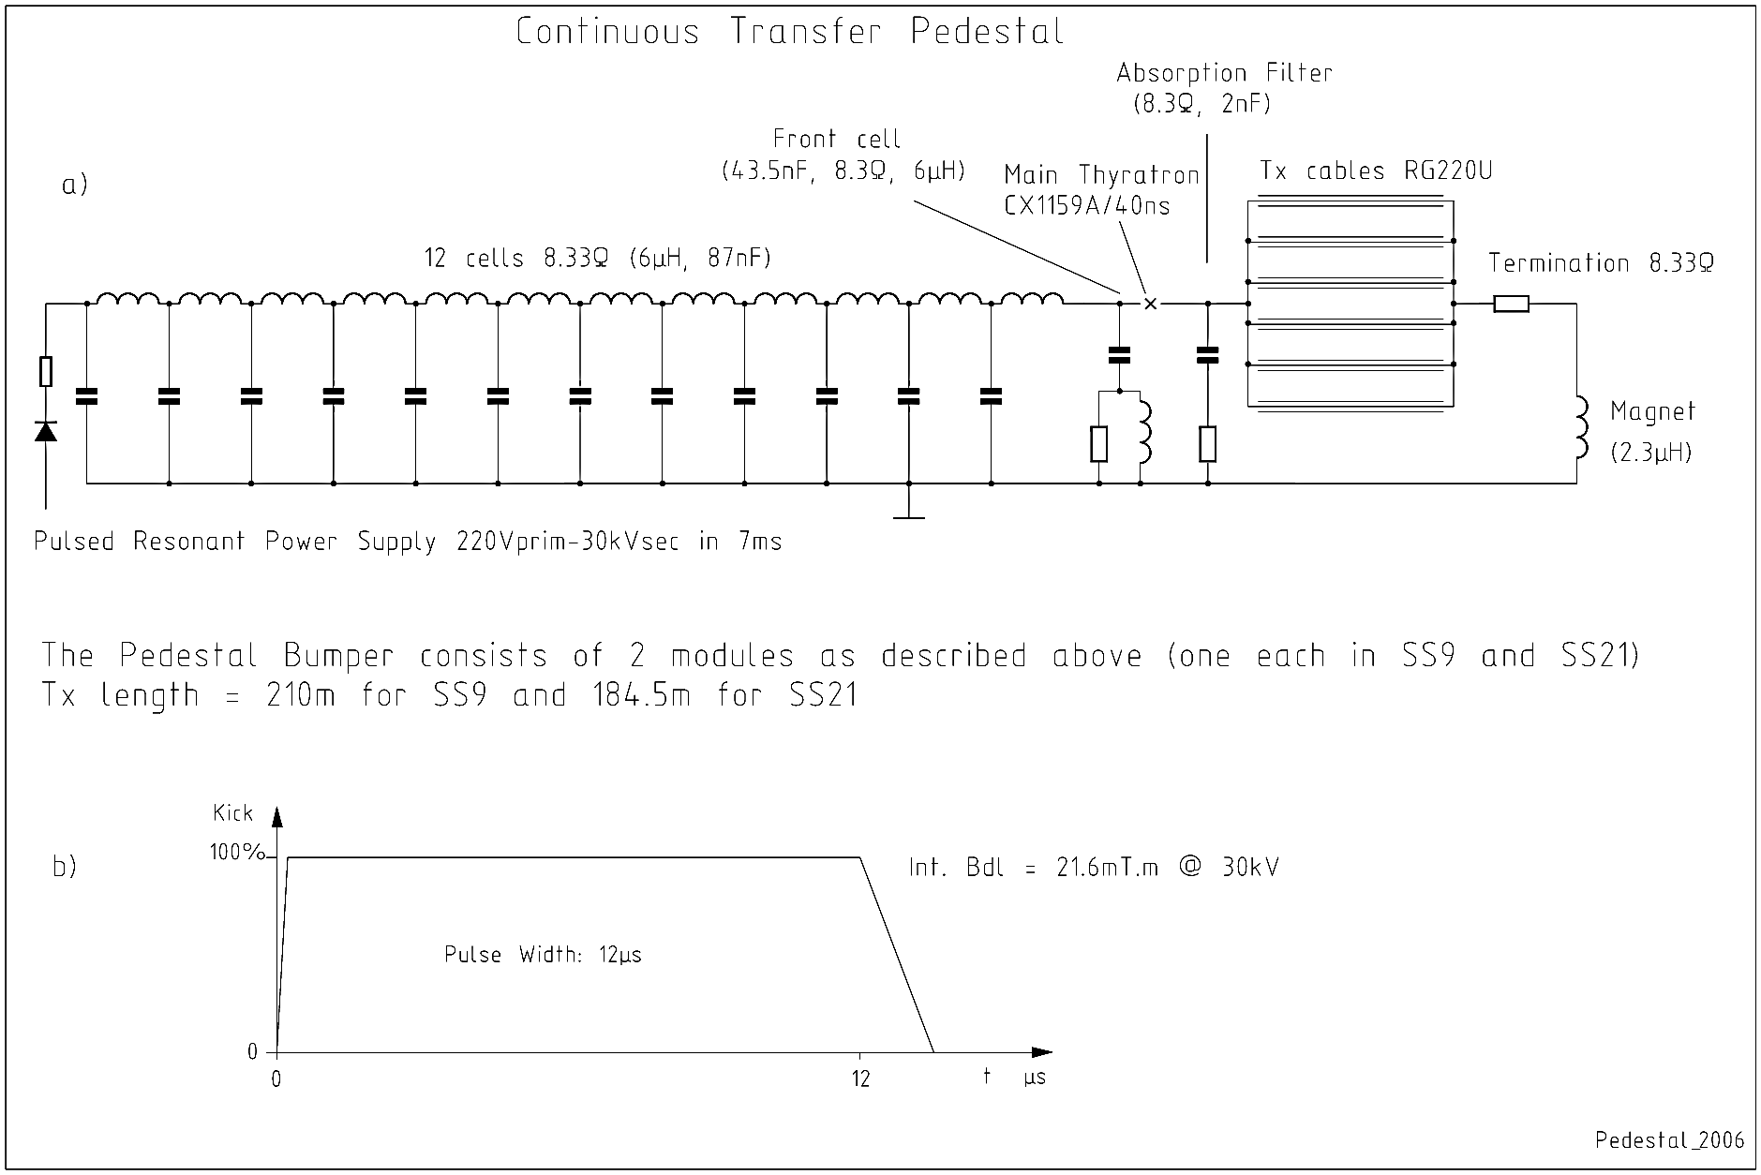
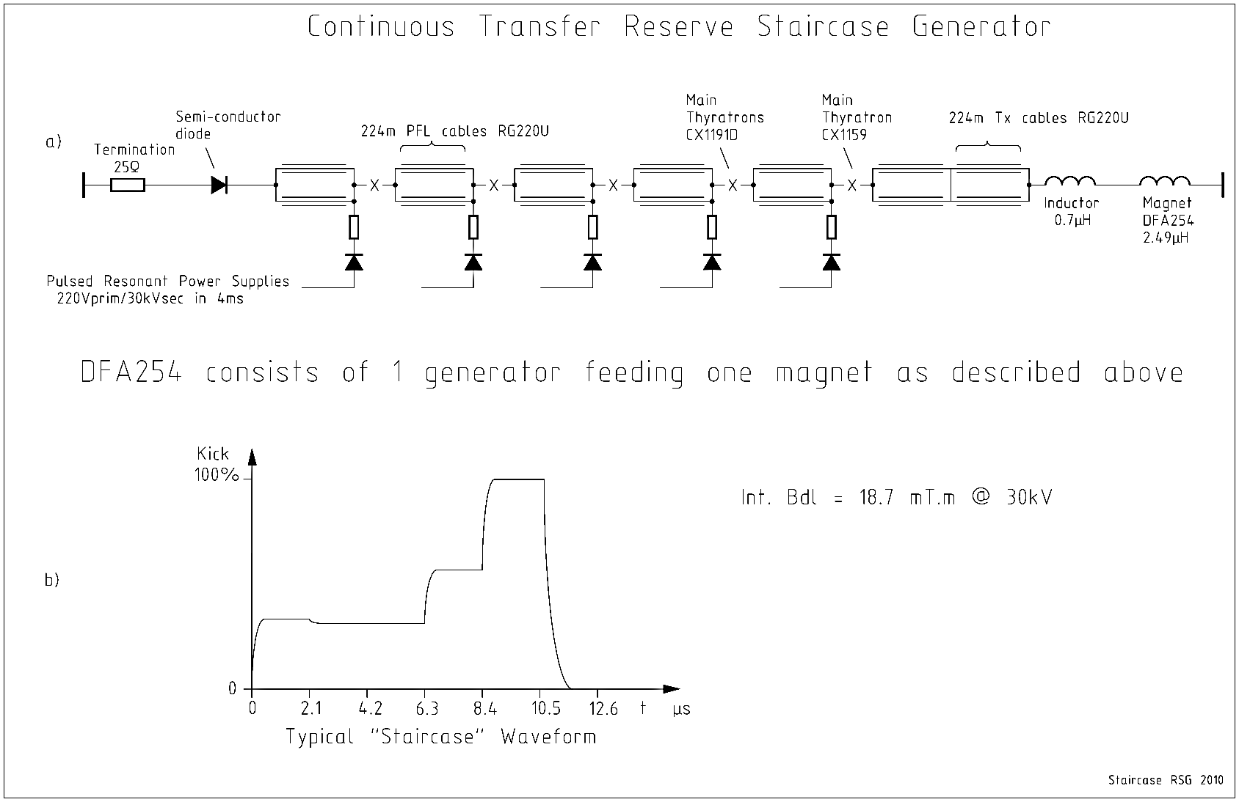
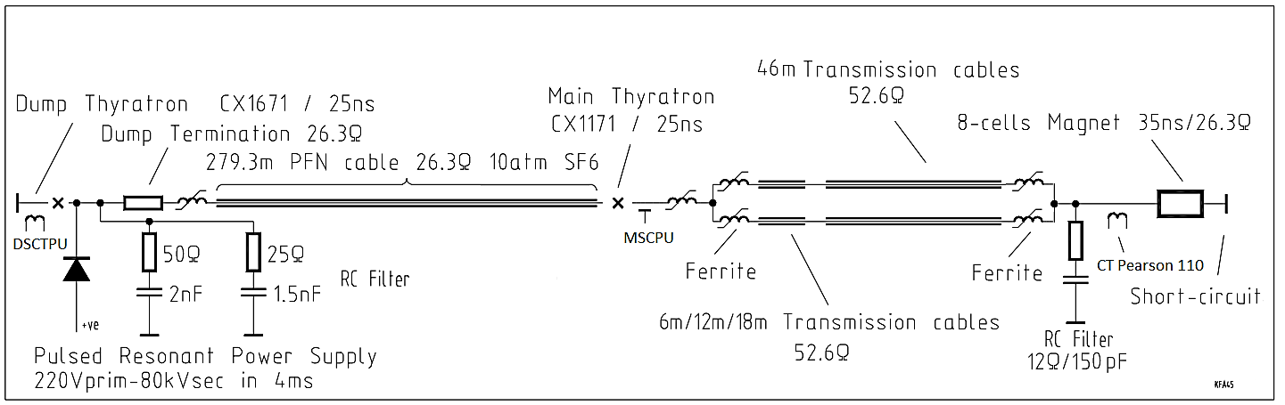
Project structure
ABT gateware projects are very similar but still different!
The project’s top-level design contains both common and project-specific parts (not including the submodules), such as
  HW IO interconnections
  cores instantiation, through (cheby) memmap
  AXI4 interconnects
  project peculiarities such as additional gating, muxing, etc.
As such, for each project/installation there’s a dedicated git branch.

Slide 7
Project structure – branch-per-installation
Pros
Apply changes to the common part relatively fast using git cherry-pick
No need to abstract away all peculiarities into a generic module (in a submodule)
Common GitLab CI/CD repository pipeline configuration
Cons
Cherry-pick not as fast as rebase and still manual, time consuming e.g. 10+ branches for FIDS
Not all commits apply cleanly, need to pay attention to git commit best practices
Difficult to use git tags
  Tags are unique per repo, thus tags à la `v1.2.3` for such a branch-per-installation IP repo cannot be used; workaround being branch-name prefix à la `foo_v1.2.3`.
  GitLab’s multi-project pipeline does not work reliably with tag pipelines (if: $CI_COMMIT_TAG) which one commonly would use to trigger the downstream build → downstream will be triggered but fetch the latest BRANCH artifacts, not necessarily the TAG ones.

Slide 8
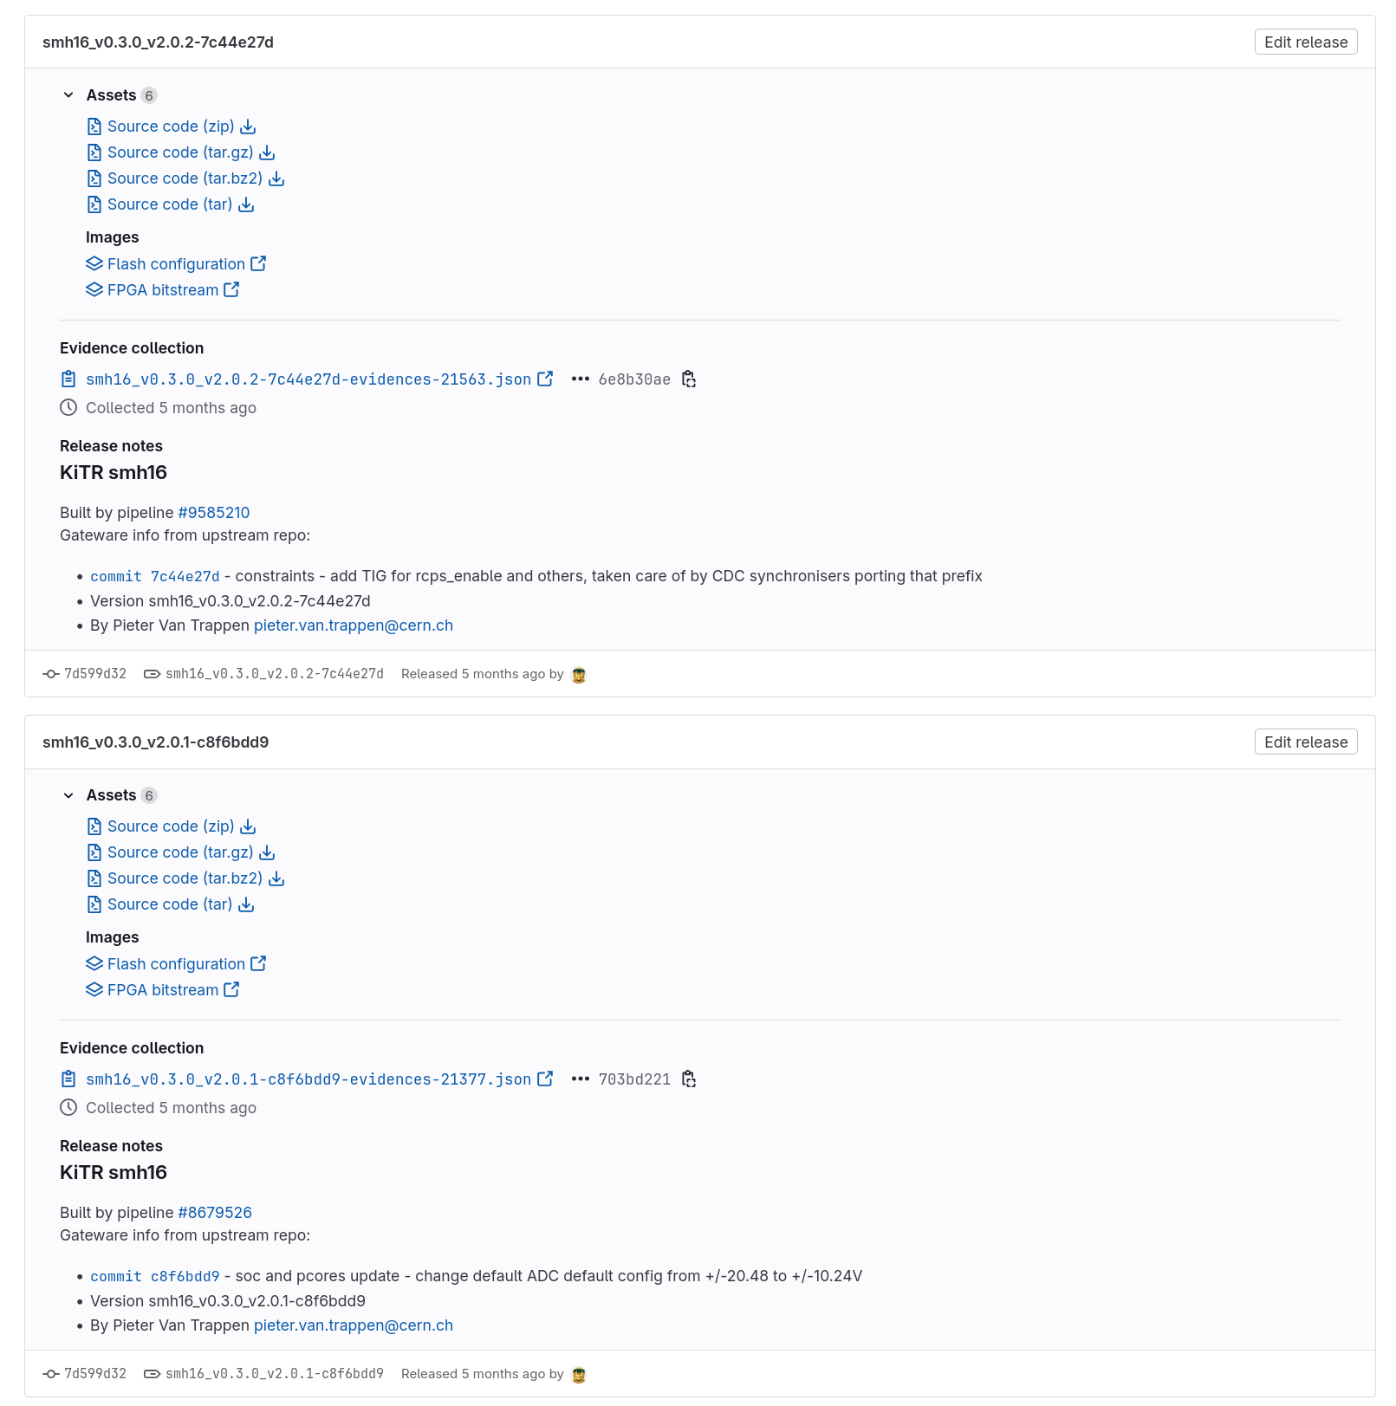
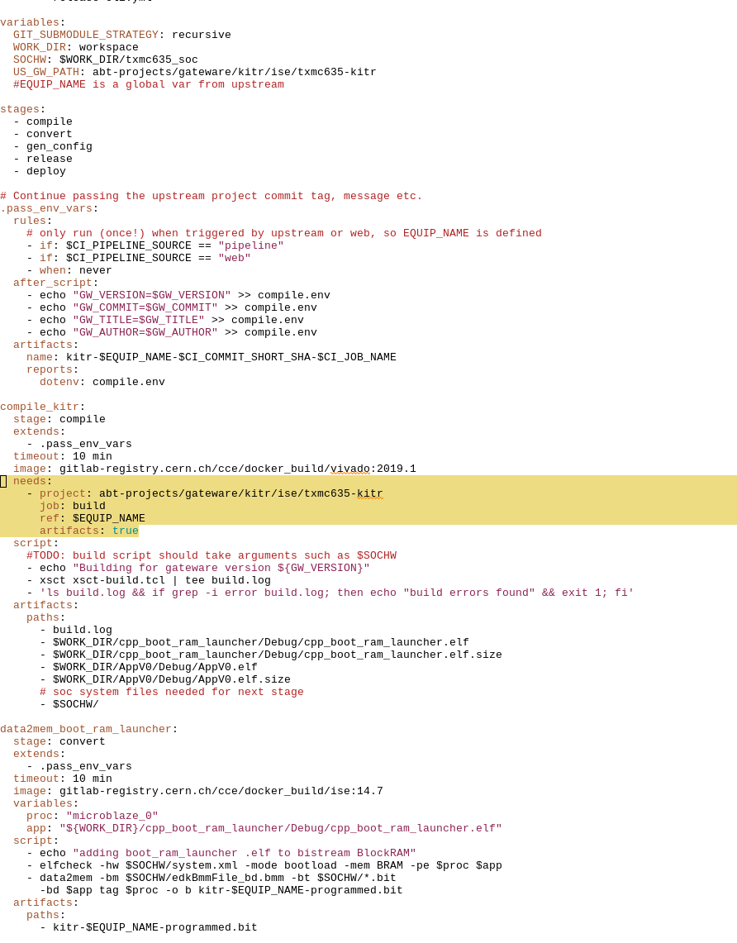
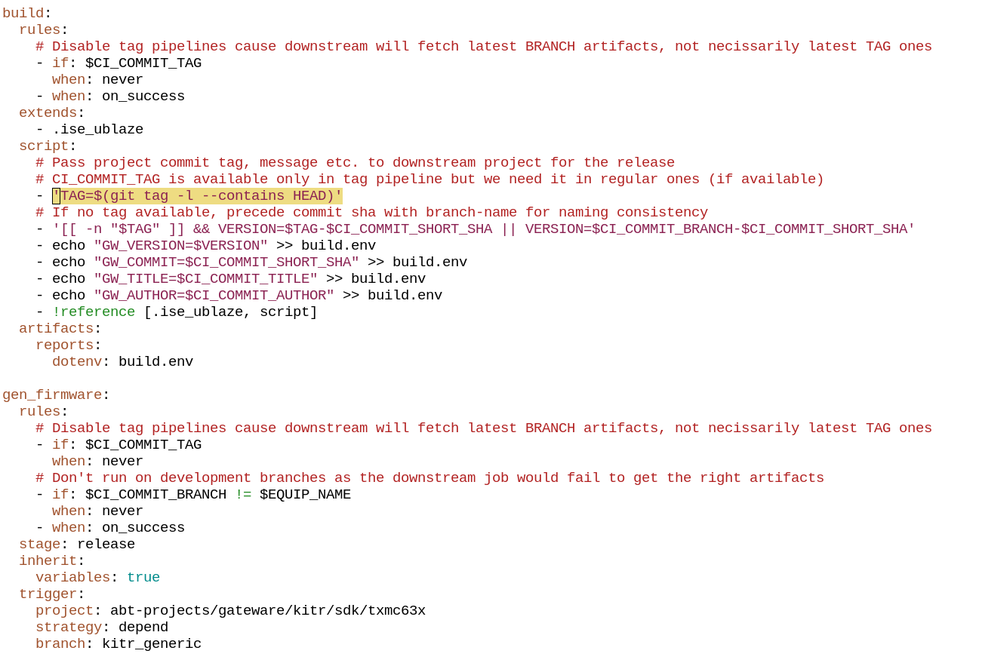
Use case – TXMC635 semi-tag pipeline
Project where gateware commits/tags trigger downstream softcore firmware compilation, to be included in bitstream
GitLab’s multi-project pipeline incompatible with tag pipelines → downstream will be triggered but fetch the latest BRANCH artifacts, not necessarily the latest TAG ones
Current workaround for such multi-project pipelines
  Disable tag pipelines
  Custom job rules
  Push atomically
  git push --atomic origin <branch> <tag>
To-do: make a GitLab feature request for tag support for needs: ref:, similarly to $CI_MERGE_REQUEST_REF_PATH (docs)

Slide 9
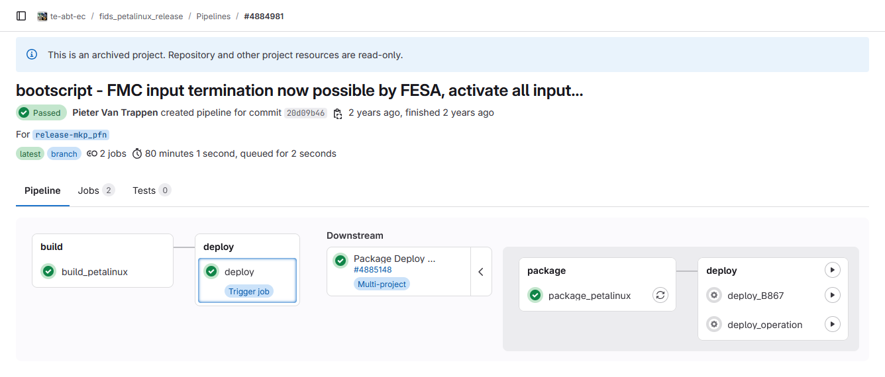
Use case – fids-ps-sw (old pipeline)
Downstream pipeline from gateware, one branch per installation
80 minutes to build the software, must run for each branch (10+)
Triggers one downstream pipeline to package and deploy
Not reproducible

Slide 10
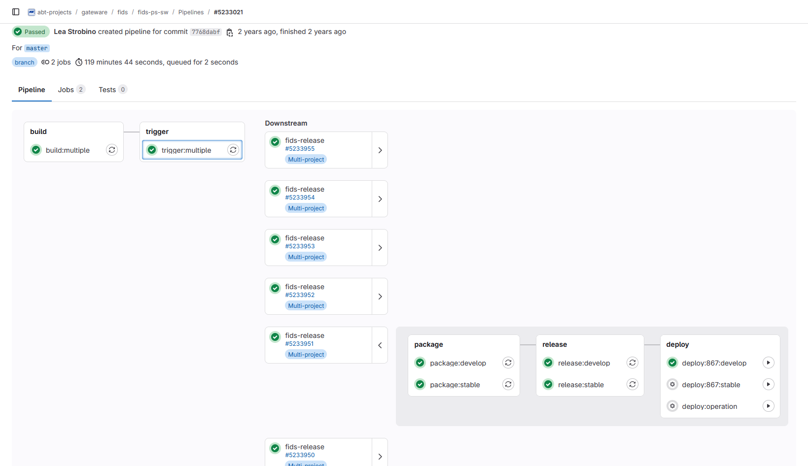
Use case – fids-ps-sw (new pipeline)
Single branch, loops over a list of installations
Configures the Yocto recipes
and submodules branches
within the recipes
Saves identification files with
git hashes of all dependencies
120 minutes to build
all 9 “branches”
Triggers one downstream
pipeline per “branch”
to package and deploy
More reproducibility (docs)

Slide 11
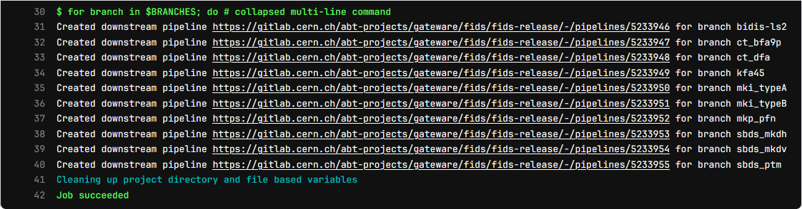
Use case – fids-ps-sw (new pipeline)
Additional ‘trigger’ stage
Downstream pipelines are created dynamically using GitLab API, authenticated with the job token
Also possible to pass variables

Slide 12
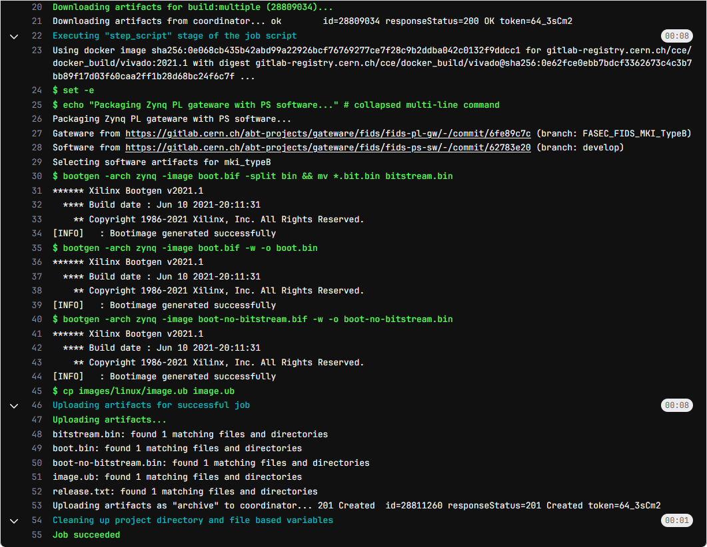
Use case – fids-release
► package & release jobs
Main branch containing global CI config
One branch per installation with
installation-specific mappings
(gw & sw branches → devices)
Combines gateware and software artifacts, creates boot images, uploads to GitLab package registry
  Selects one software artifact from upstream pipeline (all included in the same archive because of the loop)
Generates release text from identification files of each artifact
Creates a release using the job ID as tag
Passes this tag to next job in .env

Slide 13
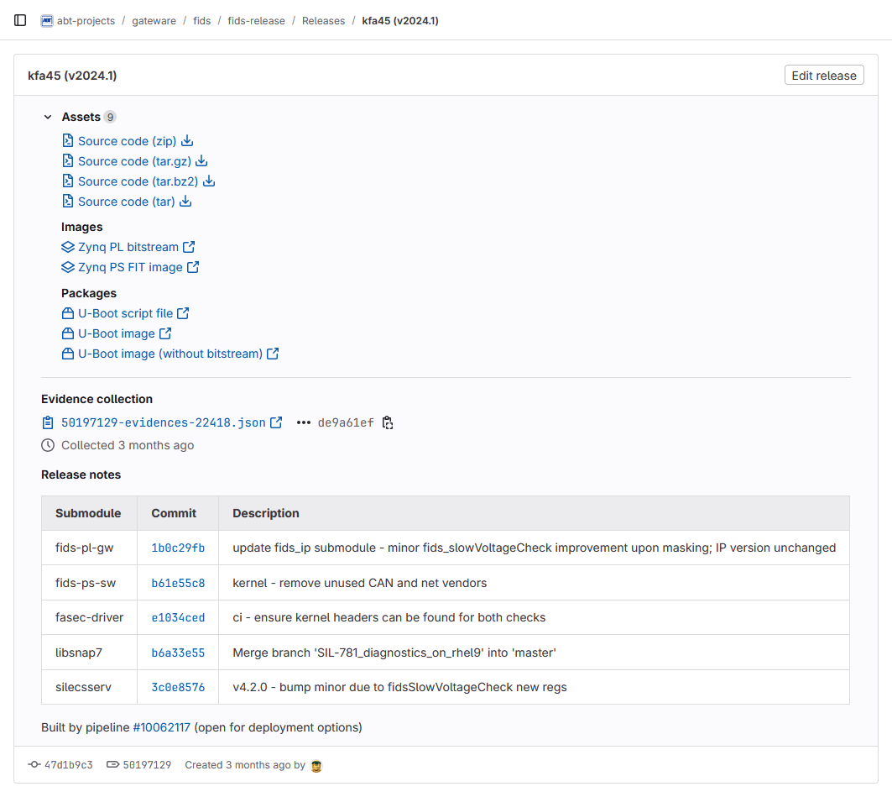
Use case – fids-release
► GitLab release
All releases attached to the ‘fids-release’ repository, which doesn't contain any code (just config files)
Direct links to artifacts stored in
GitLab package registry
Table summarizing gw & sw git hashes,
incl. dependencies, with links to commits
in their respective repository
Link to pipeline containing deployment jobs

Slide 14
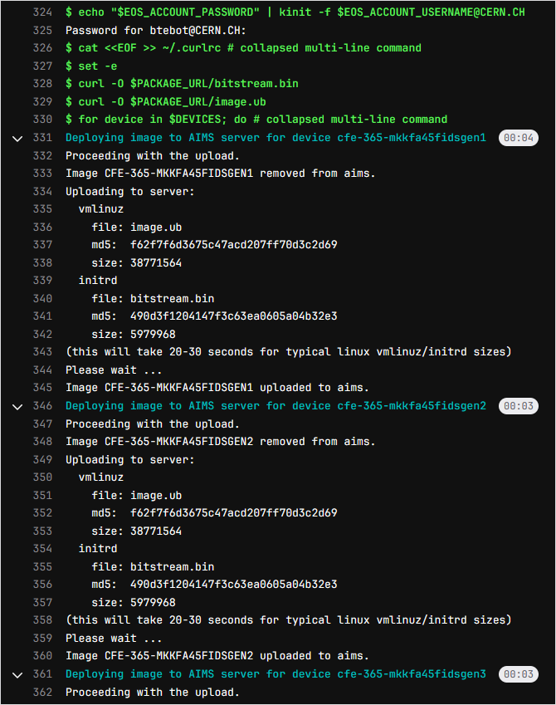
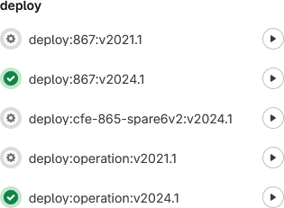
Use case – fids-release
► deploy job
1-click deployment to operational and test devices, from pre-configured mappings: no risk to deploy a development version in operation
Downloads artifacts from GitLab package registry, using release tag passed from previous job in .env
Uploads the bitstream and boot image to CERN’s TFTP server, for each configured device
  Example here: same image for devices
  cfe-365-mkkfa45fidsgen1 to cfe-365-mkkfa45fidsgen4

Slide 15
Use case – fids-release
► identification
From AIMS boot server:
deployed image with release tag
From FASEC devices (SSH):
gw & sw git hashes (incl. submodules)
[lstrobin@cwe-513-vml321 ~]$ aims2client showimage cfe-ua*-*fids*
Image Name Arch UEFI Description
----------------------------------------------------------------
CFE-UA23-MKIFIDSA1 armv7 N FIDS-RELEASE-MKI_TYPEA-44971639
CFE-UA23-MKIFIDSA2 armv7 N FIDS-RELEASE-MKI_TYPEA-44971639
CFE-UA23-MKIFIDSB1 armv7 N FIDS-RELEASE-MKI_TYPEB-44971650
CFE-UA23-MKIFIDSB2 armv7 N FIDS-RELEASE-MKI_TYPEB-44971650
CFE-UA87-MKIFIDSA1 armv7 N FIDS-RELEASE-MKI_TYPEA-44971639
CFE-UA87-MKIFIDSA2 armv7 N FIDS-RELEASE-MKI_TYPEA-44971639
CFE-UA87-MKIFIDSB1 armv7 N FIDS-RELEASE-MKI_TYPEB-44971650
CFE-UA87-MKIFIDSB2 armv7 N FIDS-RELEASE-MKI_TYPEB-44971650
[lstrobin@cwe-513-vml321 ~]$ ssh cfe-867-mkfa45fids
================================================================================
cfe-867-mkfa45fids - 172.18.210.112 - FASEC FIDS v10.6.2 - kfa45_gpiod
================================================================================
FIDS gateware commit: 1b0c29fb date: Fri Jan 31 13:02:25 UTC 2025
PetaLinux commit: b61e55c8 date: Mon Oct 21 15:24:00 UTC 2024
FASEC driver commit: e1034ced date: Tue Jun 11 13:11:22 UTC 2024
SILECS server commit: 3c0e8576 date: Thu Dec 12 15:18:42 UTC 2024
Snap7 library commit: b6a33e55 date: Mon May 6 14:52:47 UTC 2024
================================================================================
Xilinx Zynq(R)-7000 XC7Z030, Kintex(TM)-7 FPGA, 125K logic cells
2x ARM(R) Cortex(R)-A9 MPCore(TM) CPU @ 333 MHz, 1006 MB memory
PetaLinux 2024.1
Linux cfe-867-mkfa45fids.cern.ch 6.6.10-xilinx-v2024.1-g62eec70a4258 armv7l
Up since: Sat Mar 22 07:02:46 UTC 2025
cfe-867-mkfa45fids:~$ sudo peek 0x43c10008
0x1b0c29fb
cfe-867-mkfa45fids:~$ ls -l /etc/revision/
-rw-r--r-- 1 root root 78 Oct 21 2024 fasec-driver
-rw-r--r-- 1 root root 59 Oct 21 2024 libsnap7
-rw-r--r-- 1 root root 53 Oct 21 2024 petalinux
-rw-r--r-- 1 root root 64 Oct 21 2024 silecsserv

Slide 16
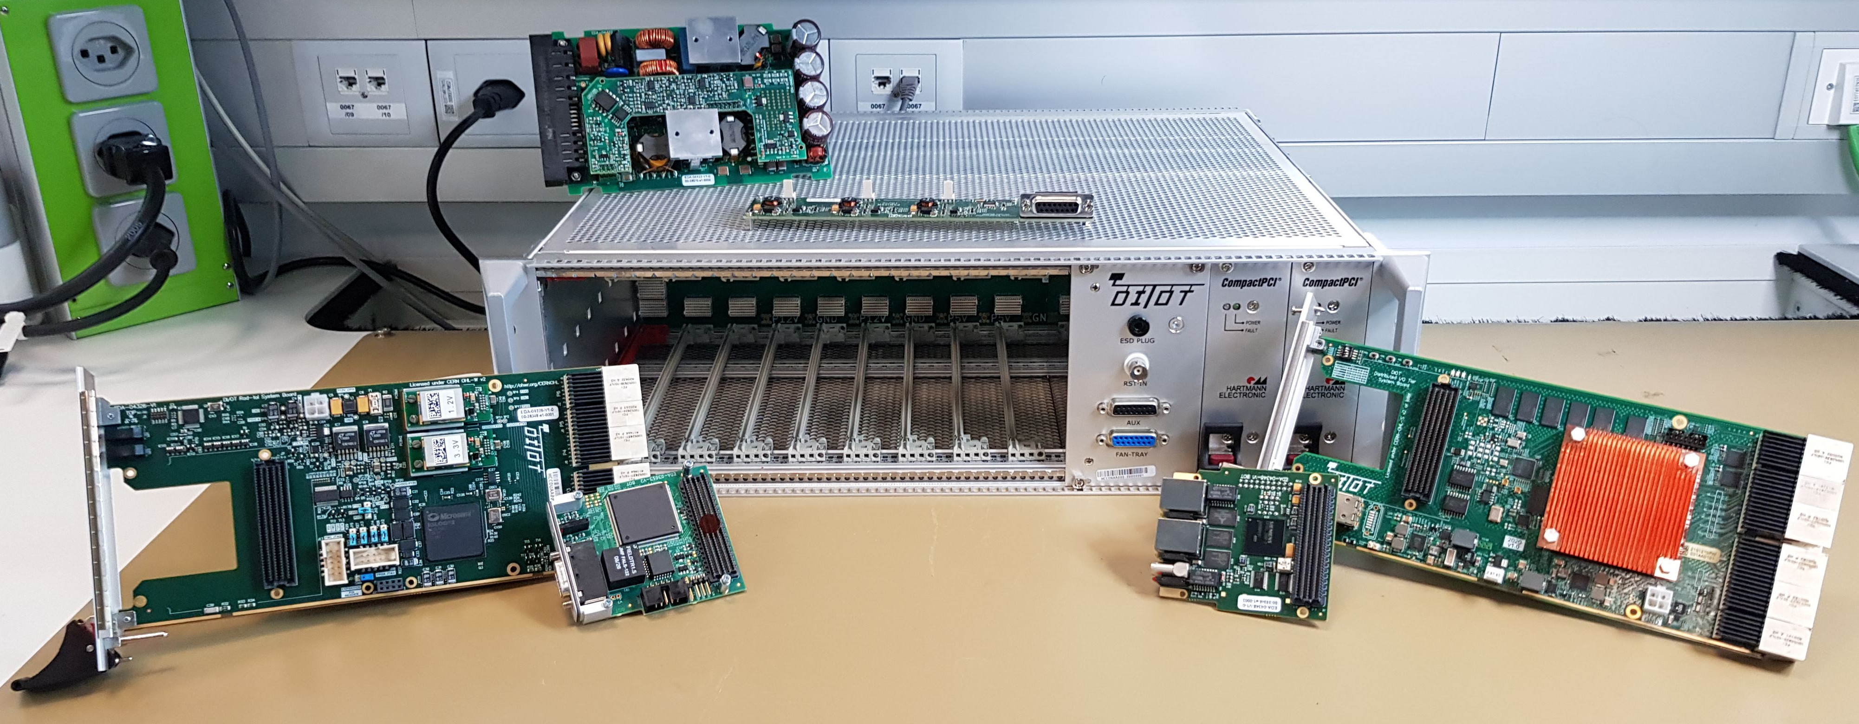

Future
Migration of both projects to DI/OT, little impact on project structure
  Distributed Kicker Fast Control (DKFC), using CERN common DI/OT hardware
  and ABT specific hardware
  ZynqMP System Board allows for a user script (block design compatible?) – docs
    Branch-per-installation approach still required...
Possible improvements to the branch-per-installation approach
  To be investigated but with considerable design effort, all gateware variations between projects/installations could be embedded in the (bigger) ZynqMP PL/FPGA.
    Software could configure MUXs and enable/disable modules to cater for installation differences.
    Software in any case already today requires a hand-crafted (FESA3) Deploy Unit i.e. the instances.
  Better separation between generic and specific parts so git rebase can be used? Technically not feasible since git uses snapshots and not differences. New version control systems could help:
    Jujutsu VCS (jj) – ‘experimental’ but stable and well-advanced, most promising
      can be hosted on git forges
      simultaneous multi-branch rebasing would allow for more laziness efficiency
      submodule support lacking but can still be done using git native commands

Slide 17
Thank you for your attention!
Questions?

