Slide 1
FRAS Engineering Specification
Hélène Mainaud Durand, on behalf of WP19
HL-LHC TCC– 17 October 2024

Slide 2
Introduction
FRAS Functional Specification, released in 2019, available here LHC-ES-0044
FRAS Engineering Specification proposed for comments, here LHC-_-ES-0049
Process followed:
Document preparation until mid of August 2024,
Interface sub-chapters sent to WPLs for comments between mid of August and mid of September 2024 (INDICO).
Presentation of the document during the WGA 18/09/24 (INDICO), and presentation of the feedback received, and improvements during the WGA 02/10/24 mainly from WP2 (INDICO)
Improved version launched for comments under EDMS. Deadline: 23/10.

Slide 3
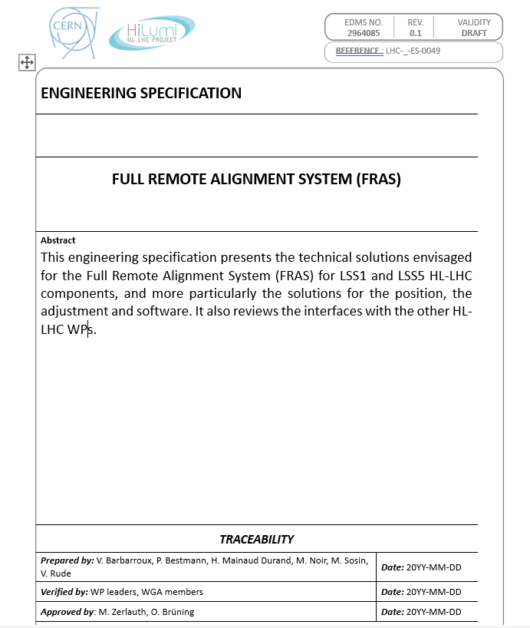
Introduction to the document
Team work for the preparation.
Document divided into 8 chapters:
  Scope, life cycle overview, etc.
  Applicable documents
  Requirements & sols. for position determination
  Requirements & sols. for adjustment
  FRAS control system
  Interfaces with WPs
  References
  Annexes:
    Layout of component per FRAS classes
    Number of sensors per component
    Adjustment system per component
    Jacks’ layout

Slide 4
Thank you very much

