Slide 1
The Upgraded CERN DC-current Calibrator
Marinko Kovačić ¹, Miguel Cerqueira Bastos ², Michele Martino ², Nikolai Beev ^{2,3},
Daniel Valuch ^{2,3}, Valerio Nappi ², and John R. Pickering ⁴
¹ University of Zagreb, Faculty of Electrical Engineering and Computing, Croatia
² European Organization for Nuclear Research - CERN, Geneva, Switzerland
³ Slovak University of Technology, Bratislava, Slovakia
⁴ Metron Designs Ltd., Norwich, UK
203rd HL-LHC Technical Coordination Committee (TCC) 17th October 2024

Slide 2
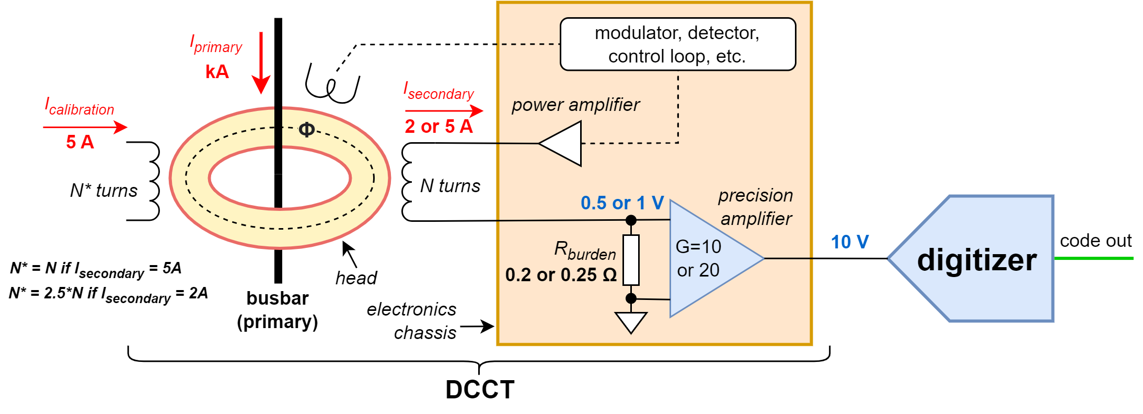

Introduction
Extremely precise (ppm-level) high currents (kA) are needed for magnet powering
The high (primary) current is stepped down to a lower (secondary) current using a Direct Current Current Transformer (DCCT)
The secondary current is converted to voltage, then digitized.
A digital current regulation loop is closed around the power converter / magnet circuit. The measurement chain (DCCT + digitizer) directly determines the precision of the delivered primary current
DCCTs can be tested / calibrated by injecting a reference current in an auxiliary winding to simulate primary current
There are no commercial current sources or meters with the required precision and stability, either at the primary (kA) or secondary (few A) current levels → the CERN DC-current Calibrator (CDC) was developed for LHC [1]
Accuracy class | Circuits | I_{primary} (kA) | I_{secondary} (A) | N turns | R_{burden} (Ω)
LHC Class 1 | main dipoles, main quadrupoles | 13 | 5 | 2600 | 0.2
LHC Class 1 & 2 | inner triplets, insertion quads, separation/ recombination dipoles | 4 5 6 7 | 2 | 2000 2500 3000 3500 | 0.25
HL-LHC Class 0 | separation/ recombination dipoles | 14 | 5 | 2800 | 0.2
HL-LHC Class 0 | inner triplet quadrupoles | 18 | 5 | 3600 | 0.2
$$U_{out(DCCT)}=\frac{I_{primary}}{N_{turns}}×R_{burden}×G_{precision amp}$$

Slide 3
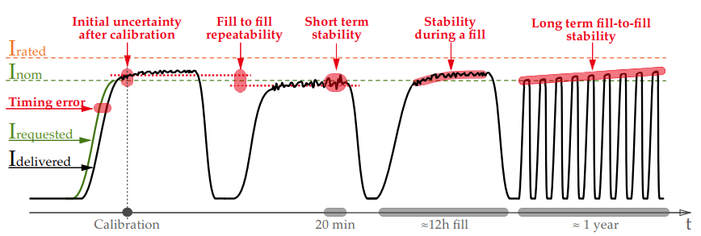
HL-LHC Class 0 DCCT Requirements
Stricter precision powering requirements than existing in LHC [2]. In particular:
  short-term stability (20 minutes)
  fill stability (12 hours)
  noise
  fill-to-fill repeatability
  temperature coefficient
New ADC developed [7] and already presented at the 92nd HL-LHC TCC (13.02.2020)
Improved DCCT test infrastructure needed, targeting the enhanced performance
Performance and functional improvements needed for the
>20 year-old CDC
Parameter | DCCT
Initial uncertainty after cal [2xrms ppm] | 1.0
Linearity [|.|max ppm] | 1.0
Stability during a fill (12h) [|.|max ppm] | 0.5
Short term stability (20min) [2xrms ppm] | 0.1
Noise (<500Hz) [2xrms ppm] | 2.0
Fill to fill repeatability [2xrms ppm] | 0.3
Long term fill to fill stability [|.|max ppm] | 4.0
Temperature coefficient [max abs ppm/°C] | 0.8
isothermal

Slide 4
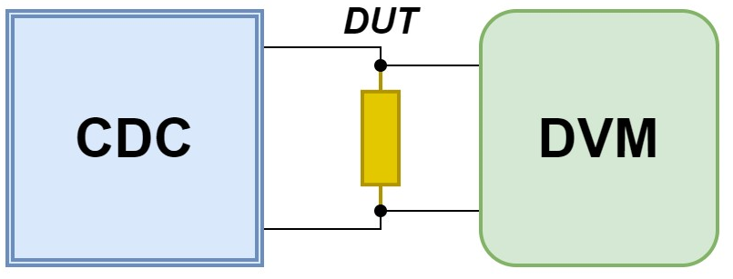
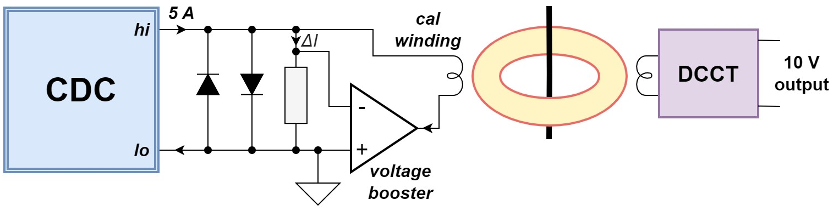
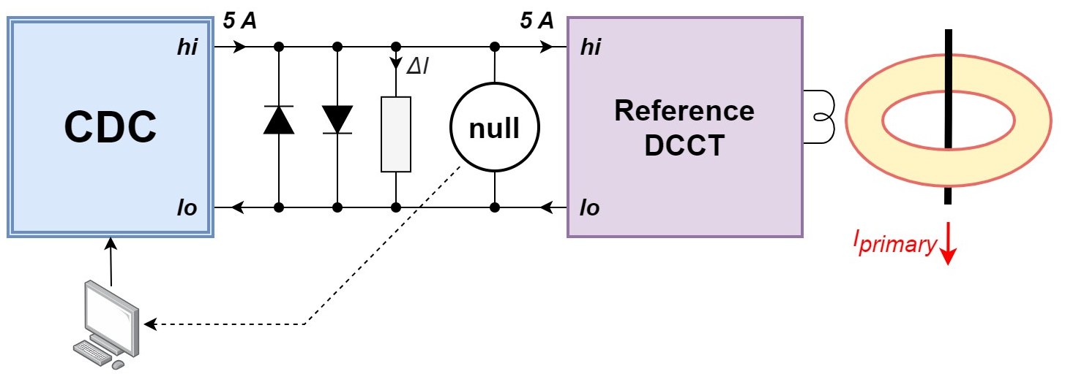
How the CDC is used
Direct measurements of burden resistors at ppm level (characterization - temperature/power coefficient)
Testing and calibration of DCCTs
  Feeding the calibration winding of a DCCT with precise current (using a voltage booster)
  e.g. in-situ calibration of LHC dipole magnet current measuring chain
  Back-to-back measurement (compensation of DCCT secondary current ) – excludes the burden
Measurement of primary current using the back-to-back method [3]

Slide 5
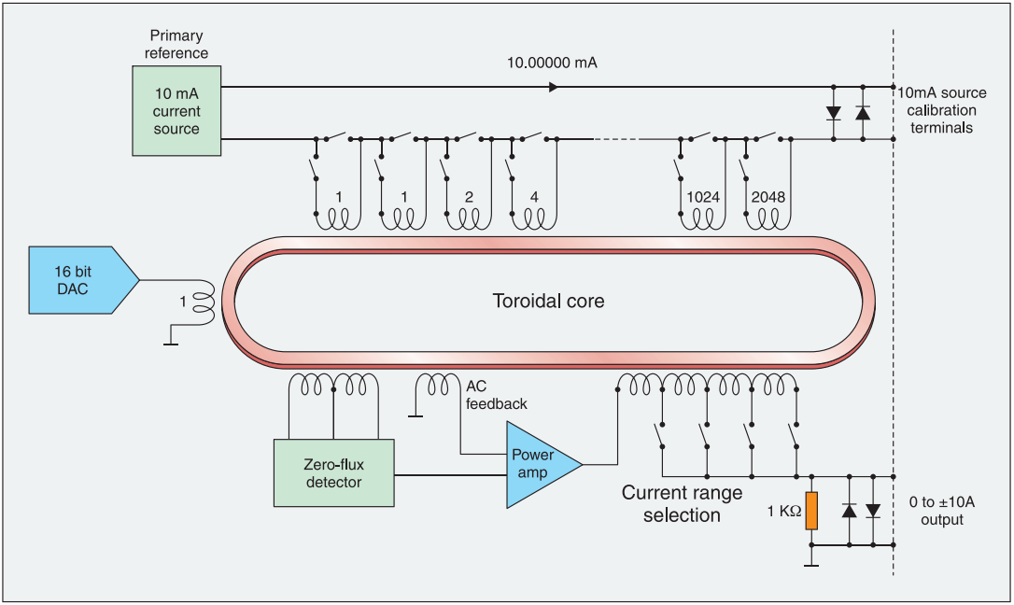
Principle of operation
Zero Flux Detector (ZFD)
  two matched cores, modulated in opposite directions
  2nd harmonic proportional to DC flux
  closed-loop system with DC and AC feedback paths
10 mA primary reference current
Resolution: >24 bits (theoretically 28 bits)
coarse: binary-encoded windings (12 b)
fine: one-turn DAC (16 b)
Output ranges:
b)
N_{P} = 1/2/…4096
c)
d)
N_{S} = 4/8/16/40
e)
Current (A) | ±1 | ±2.5 | ±5 | ±10
N_{S} (turns) | 40 | 16 | 8 | 4
N_{P} / N_{S} at full scale (N_{P} = 4096) | 102.4 | 256 | 512 | 1024
a)
Nominal (DCCT)

Slide 6
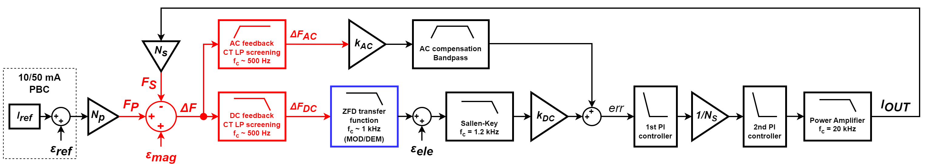
The control loop
Objectives:
  High DC gain – minimize steady-state error
  Very good AC response – reduce the effects of transients during the primary relay actuations
  Variable gain – due to different output ranges (numbers of secondary turns)
  Integrator clamps – during startup and range changes
b)
d)
c)
a)

Slide 7
Error sources – low-frequency noise
Origin | Sources | Scaling (at low frequencies)
Electronics | 1/f noise of the operational amplifiers, offset, drift, thermal noise, ground sensing | $$\frac{ε_{{ele}_{2}}}{ε_{{ele}_{1}}}=\frac{N_{S_{1}}}{N_{S_{2}}}$$
Magnetics | Magnetic (Barkhausen) noise, BH curve temperature dependence, remanence | $$\frac{ε_{{mag}_{2}}}{ε_{{mag}_{1}}}=\frac{N_{S_{1}}}{N_{S_{2}}}$$
Primary current reference | Internal voltage reference (LTZ1000 or ADR1000), U→U conversion (~7 V to 10 V), U→I conversion (10 V to 10 mA) | $$\frac{ε_{{ref}_{2}}}{ε_{{ref}_{1}}}=\frac{N_{P2}N_{S1}}{N_{P1}N_{S2}}$$
b)
c)
a)

Slide 8

Improvement of low-frequency noise
LF noise directly determines the short-term stability of I_{out} and contributes significantly to mid-term stability
Tests confirmed that the dominant sources are magnetic noise and current noise of the primary current reference
Solutions:
Improve the 10 mA primary current reference
then magnetic noise becomes the limit
Operate with higher I_{ref} on a lower range
  50 mA on 1 A range → I_{out} = 5 A
  → magnetic noise is 5x lower
  Use of 5 x 10 mA reference current sources
  → Further improvement by $\sqrt{5}$
  → Estimated equal contributions of both noise sources
b)
c)
a)
d)

Slide 9
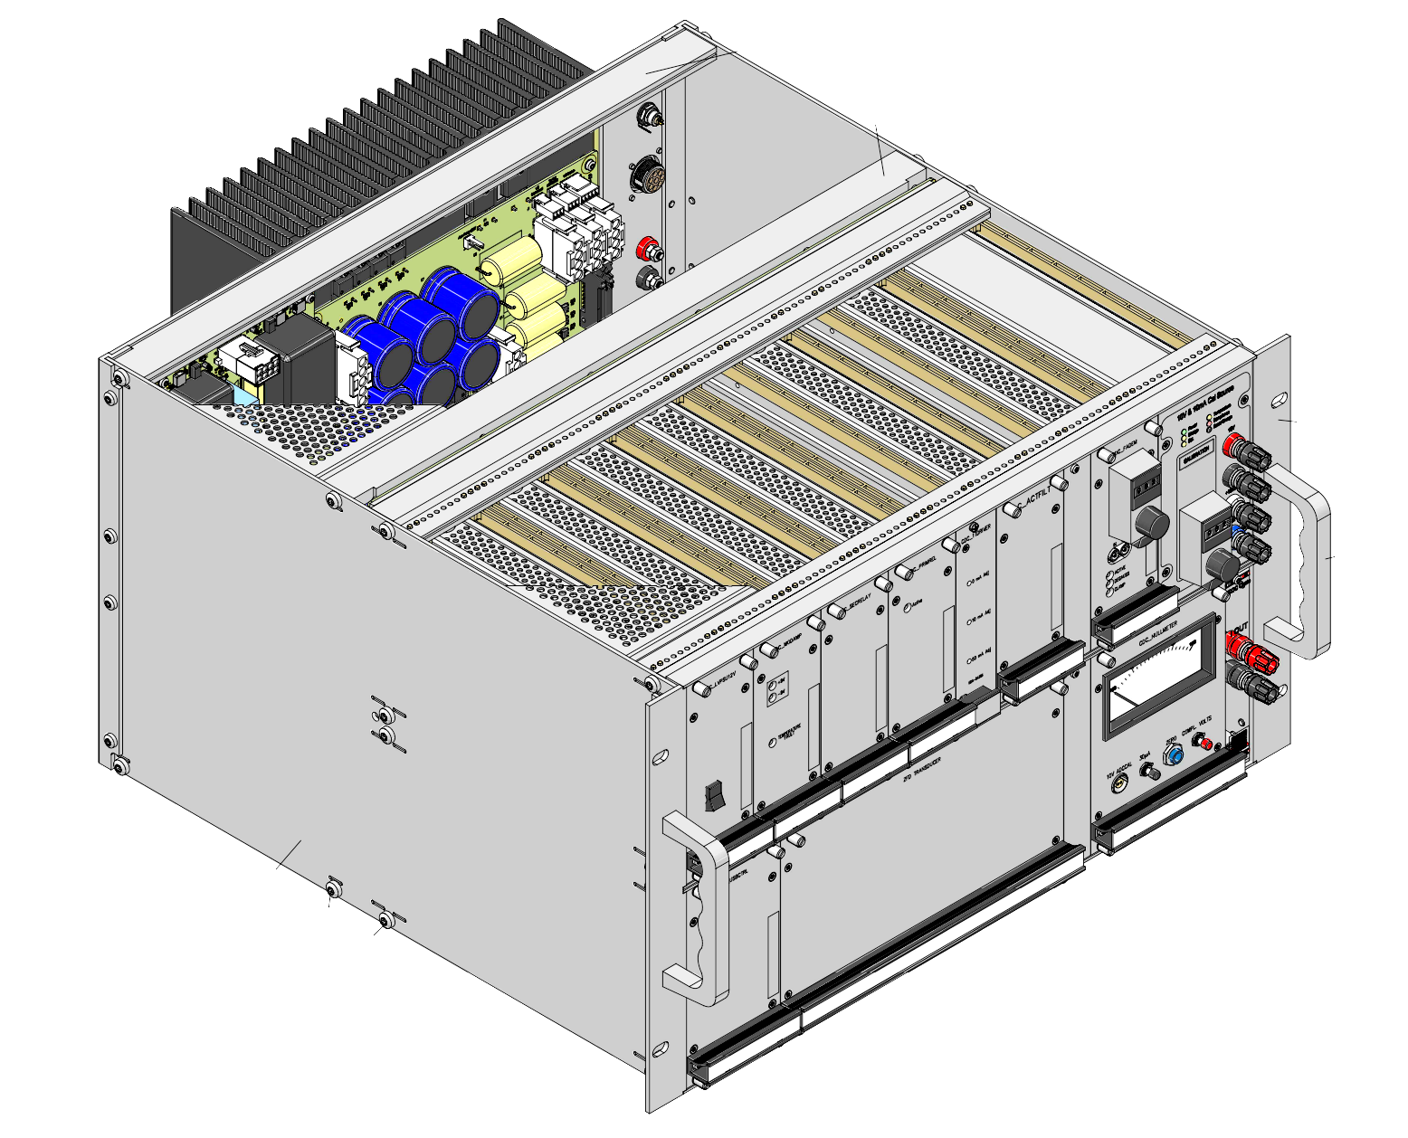
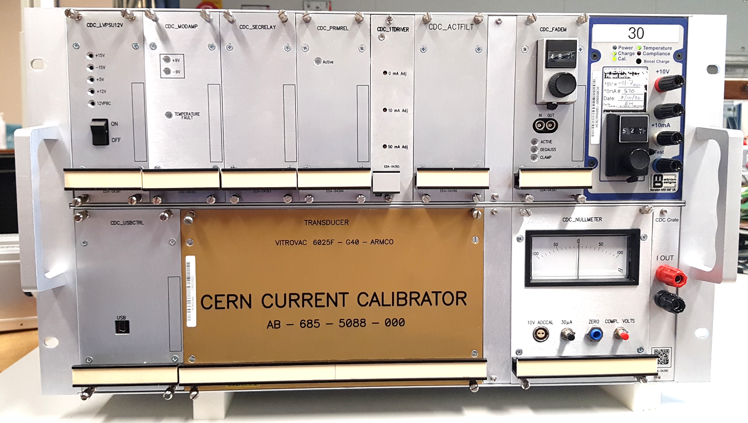
The upgrade of the CDC
Electronics
  redesign of all modules (12 in total)
  controller – new System on Chip-based module, new software
  new primary current reference
ZFD module
  improved secondary windings (to reduce heating)
Integration
  optimized module placement for reduced thermal coupling
  1-wire bus for local temperature monitoring
  thermal decoupling between the power amplifier heatsink and chassis
heat sources
sensitive
modules

Slide 10
Upgrade of the electronic modules
Replacement of obsolete components (CPLD, power amplifiers, etc.)
Use of modern components, particularly precision auto-zero operational amplifiers in the DC signal path
The most sensitive DC signal path is kept within a single module
Differential signaling between modules for lower noise and better EMI immunity
Differential drive for the ZFD cores → reduced modulation noise
Higher flexibility due to local FPGAs, e.g. for generation of the 10 kHz modulation waveform
(but basic architecture remains analog)
Improved linear power supply for lower CM noise at mains frequencies

Slide 11
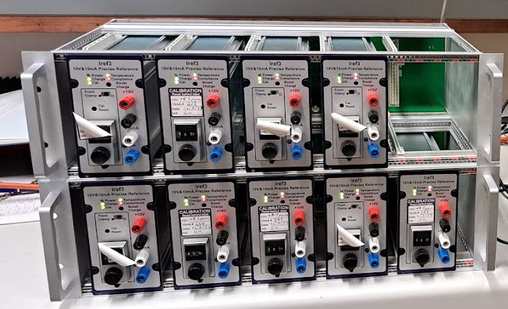
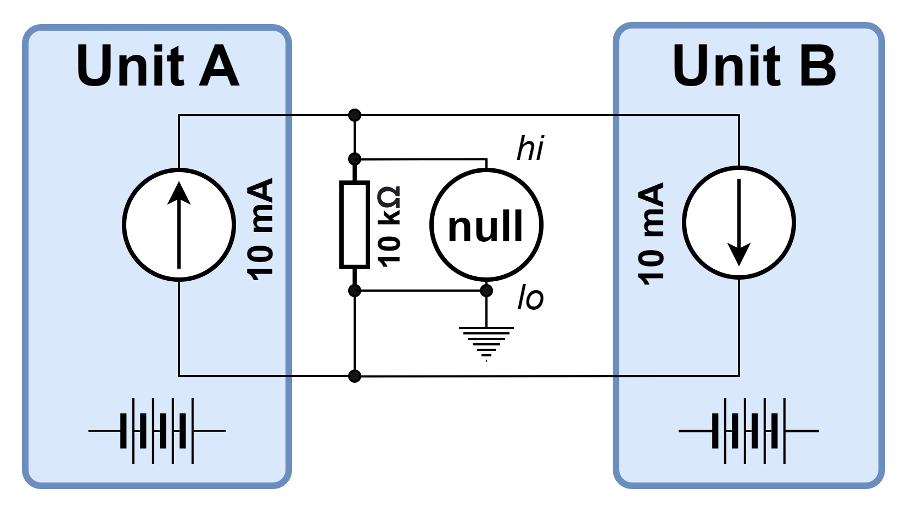
New primary current reference
Developed together with Metron Designs Ltd., based on the previous version developed for LHC in the early 2000s
Lower-noise voltage reference: Analog Devices Inc. ADR1000 (vs LTZ1000)
Improved 6.665 V → 10 V and 10 V → 10 mA conversion stages
Overall improvement: 3 – 5 times lower LF current noise compared to the older LTZ1000-based variant
Chassis with 5 units (50 mA) was prepared for the upgraded CDC
(additional bonus of external chassis: separation from CDC heat sources)

Slide 12

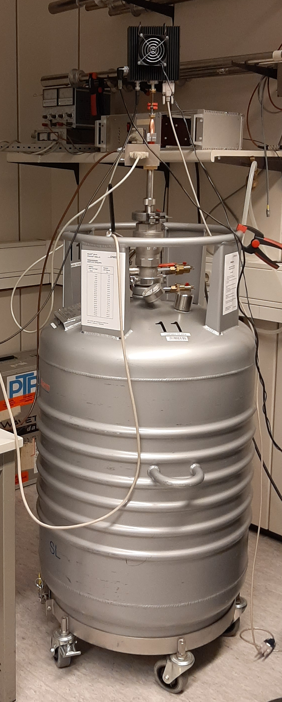
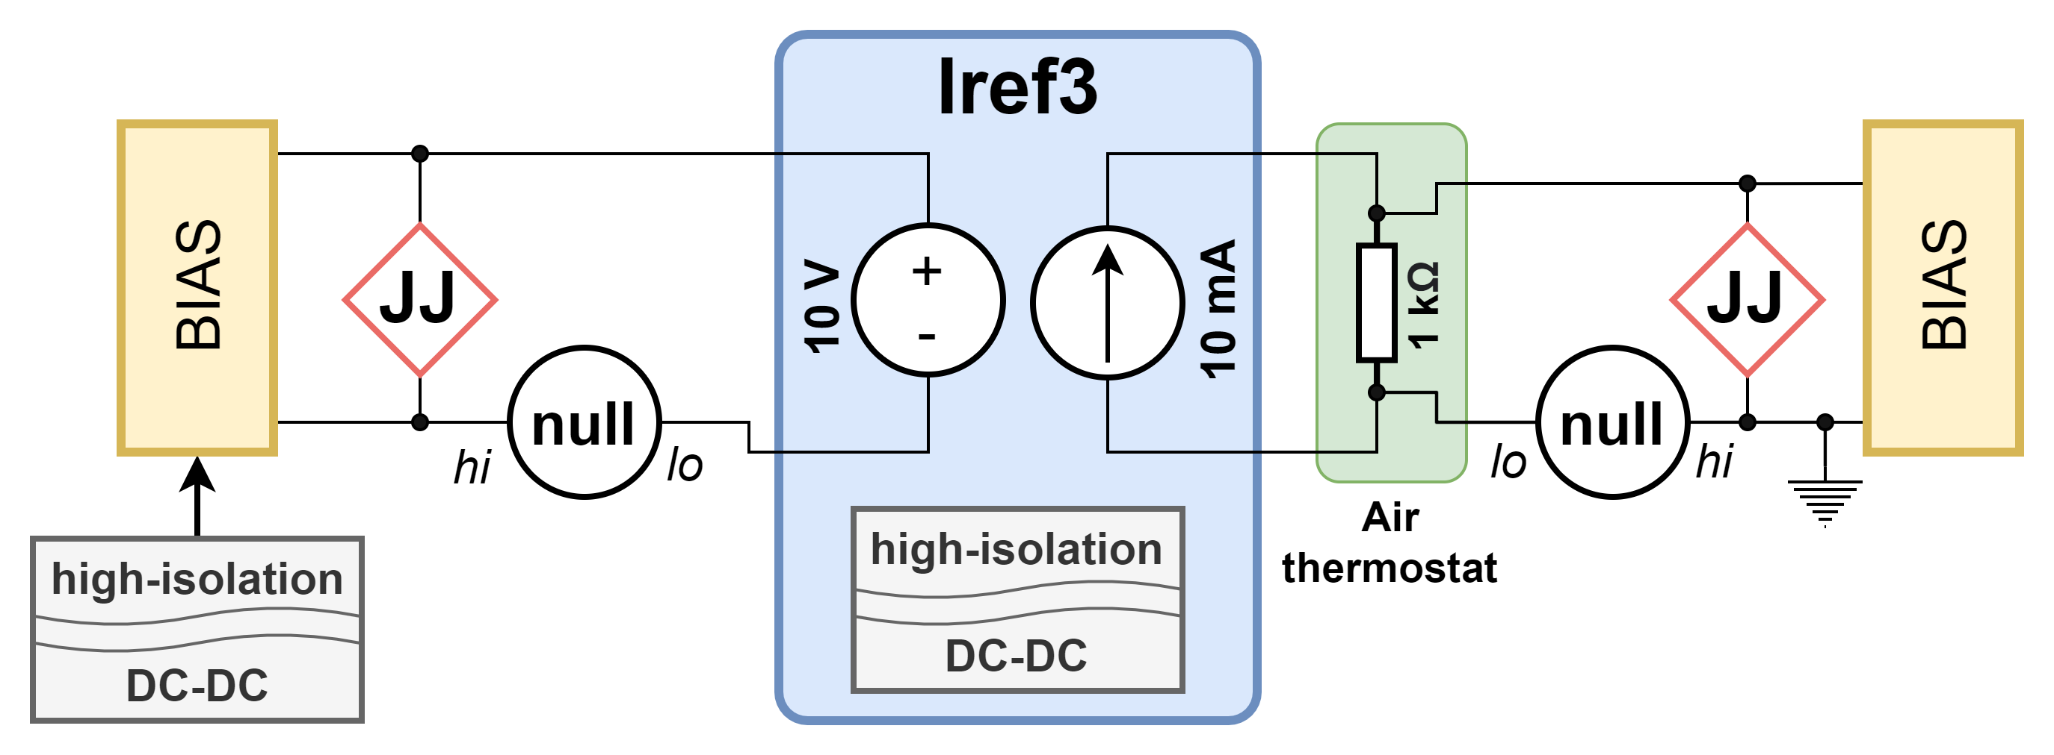
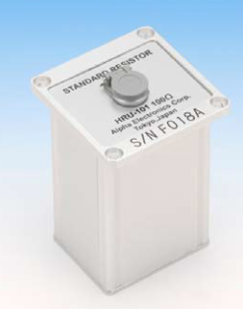
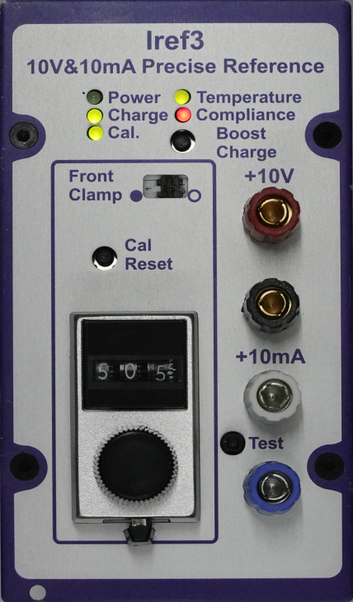




New primary current reference
Test with two Josephson systems at PTB - Braunschweig
Ultimate confirmation of short-term stability of both
outputs (10 V and 10 mA) on the level of few times 10⁻⁹
Probably the lowest-noise non-quantum current
standard ever built and tested
Also presented at CPEM-2024 [4]

Slide 13
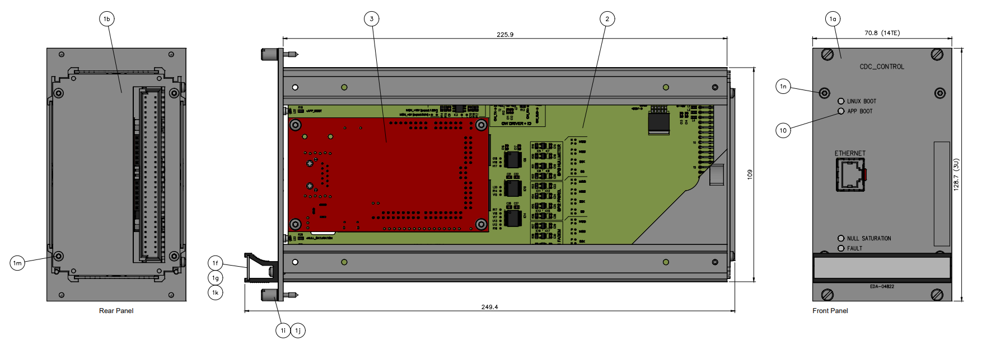
New controller board and software
Based on Xilinx Zynq-7000 System-on-Chip
Supports Ethernet network connection
Programmable Logic (FPGA) – controls the other modules through SPI (2x FPGAs, 1 DAC, 1 ADC)
Processing System (ARM core) – runs Python software on Linux, parses and executes commands sent over TCP
More information available in [5]

Slide 14
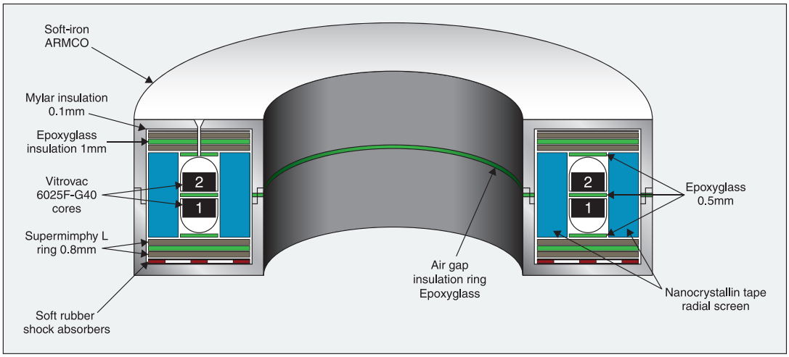
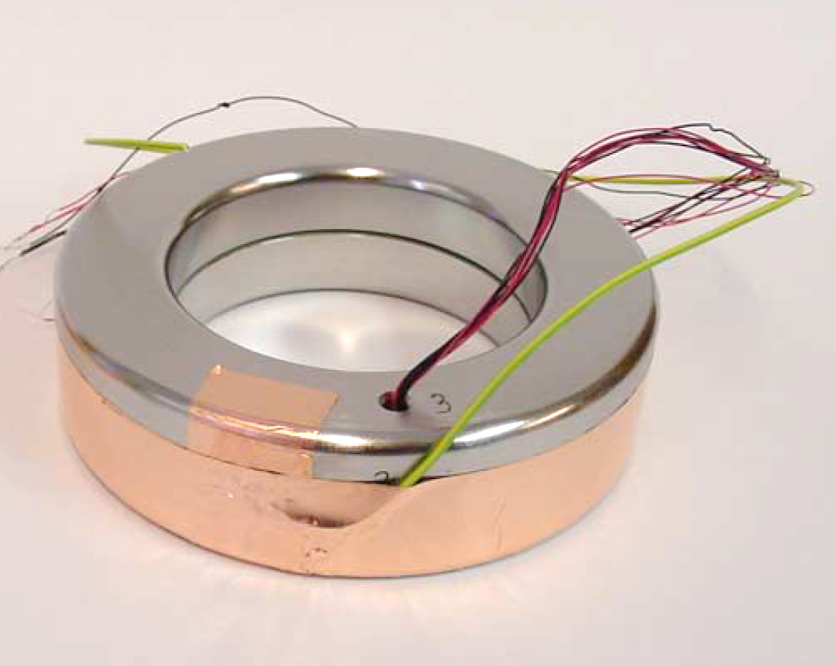
The ZFD assembly
The availability of magnetic materials has been declining over the years
As of 2024 the assembly can be produced, but there is no replacement yet for the obsolete radial shield material (Nanophylm)
The cross-section of the secondary windings was increased to reduce heating when using 40 turns in the 1 A range for 5 A output
from [6]

Slide 15
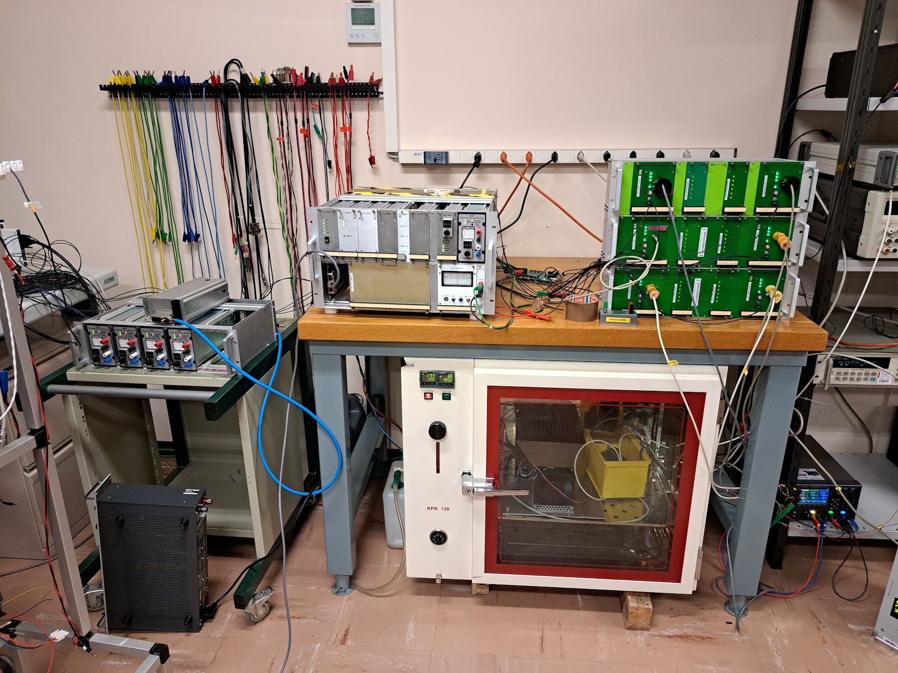
Preliminary characterization results
Precision 0.2 Ω resistor (Alpha FNP series) on heatsink + fan, temperature-stabilized in an oven and pre-heated with 5 A from a power supply prior to the CDC test
Precision auto-zero amplifier with G = 10 V/V
MOSFET bridge for CDC output current reversals
5x HPM7177 metrology-grade digitizers [7], digital reconstruction of signal from the recorded data
Disregarding the initial thermal transient in the 0.2 Ω resistor, the output current stability is within the
12-hour target of 0.2 µA/A p-p, but the measurement is still limited by the test setup [5]
d)
Time scale | Target | Measured
20 min | 0.05 µA/A rms | <0.026 µA/A rms
12 hours | 0.2 µA/A p-p | <0.14 µA/A p-p
c)
a)
b)

Slide 16
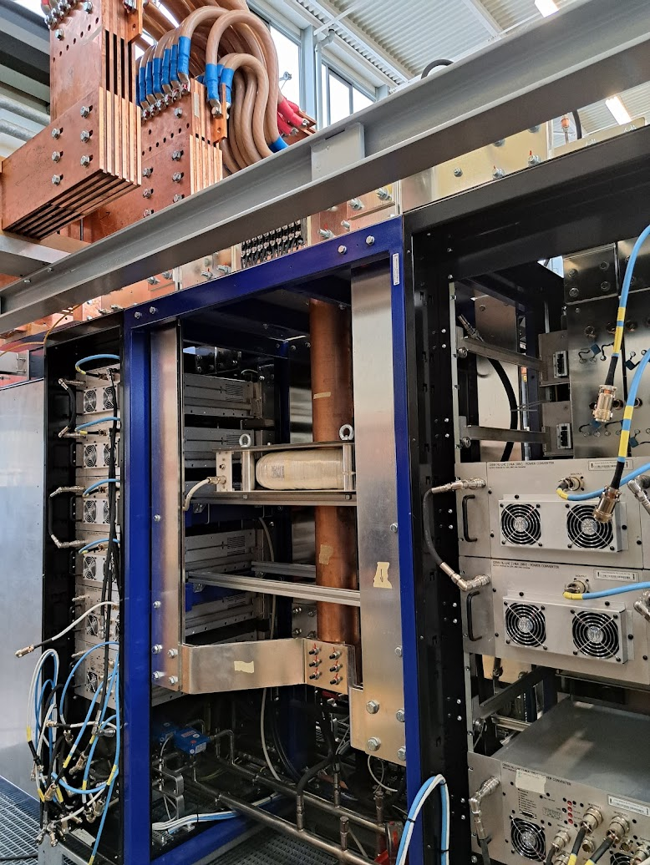
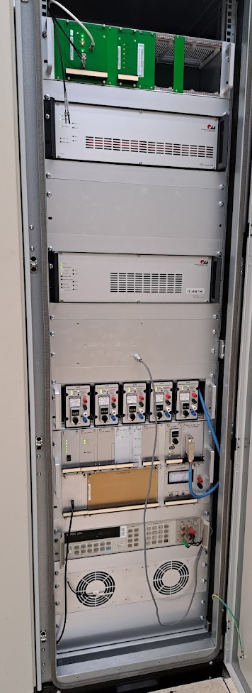
Preliminary results of PC tests
ADC chassis
Regulation DCCT chassis
Reference DCCT chassis
Regulation DCCT head
5x 10 mA PBCs
First test >12 h
with high current
Upgraded CDC
HL-LHC 14 kA
prototype PC
Temperature- controlled rack

Slide 17
Conclusions
The CDC was improved in terms of functionality and performance
The new design is not constrained by electronic component obsolescence or backward compatibility issues
The upgraded CDC is now functionally tested, and preliminary performance tests show good results
Further characterization is needed to fully qualify the upgraded CDC for testing of HL-LHC Accuracy Class 0 DCCTs
The upgraded CDC was already used for testing the prototype 14 kA power converter in P-hall

Slide 18
References
[1] G. Fernqvist, B. Halvarsson, and J. Pett. The CERN current calibrator - a new type of instrument. In Conference on Precision Electromagnetic Measurements (CPEM) Digest, pages 410–411, 2002.
[2] I. Béjar Alonso, O. Brüning, P. Fessia, M. Lamont, L. Rossi, L. Tavian, and M. Zerlauth (EDS). High- Luminosity Large Hadron Collider (HL-LHC). Technical Design Report. Ch. 6B. CERN-2020-010, 2020.
[3] G. Fernqvist, B. Halvarsson, J. Pett, and J. R. Pickering. A novel current calibration system up to 20 kA. IEEE Transactions on Instrumentation and Measurement, 52(2):445–448, 2003.
[4] J. R. Pickering, N. Beev, M. C. Bastos, D. Valuch, G. Hudson, L. Palafox, and R. Behr. An Improved 10 mA / 10 V Standard for the CERN DC-current Calibrator. In Conference on Precision Electromagnetic Measurements (CPEM), Denver, CO, USA, 2024.
[5] V. Nappi. Design and implementation of a new Controller for CERN's sub-ppm stable Current source. MSc Thesis, 2023. Available online: https://hdl.handle.net/10589/214506
[6] M. C. Bastos, G. Fernqvist, G. Hudson, J. Pett, A. Cantone, F. Power, A. Saab, B. Halvarsson, and J. R. Pickering. High accuracy current measurement in the main power converters of the Large Hadron Collider: tutorial 53. IEEE Instrumentation and Measurement Magazine, 17(1):66– 73, 2014.
[7] N. Beev, M. C. Bastos, M. Martino, D. Valuch, L. Palafox and R. Behr. Design and Metrological Characterization of a Digitizer for the Highest Precision Magnet Powering in the High Luminosity Large Hadron Collider. IEEE Transactions on Instrumentation and Measurement, vol. 73, pp. 1-10, 2024.

Slide 19
Thank you!

