Slide 1
Edge Welded Bellows for Series Collimators – Deployment Strategy
C. Piccinni on behalf of WP 5.2
17/10/2024

Slide 2
Outline
  Introduction to Edge Welded Bellows
  Outcome of Cycling campaign
  Decision of deployment

Slide 3
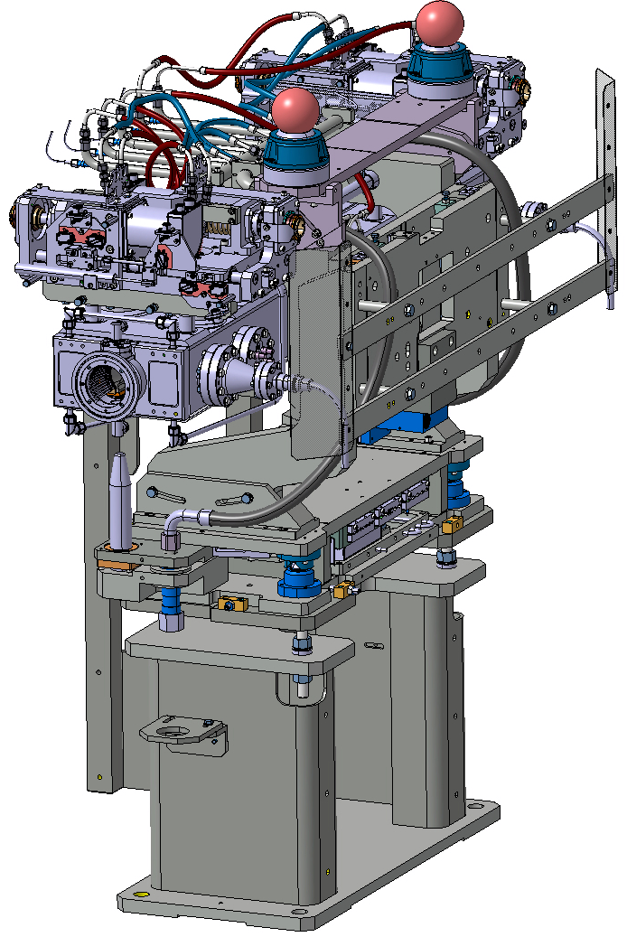
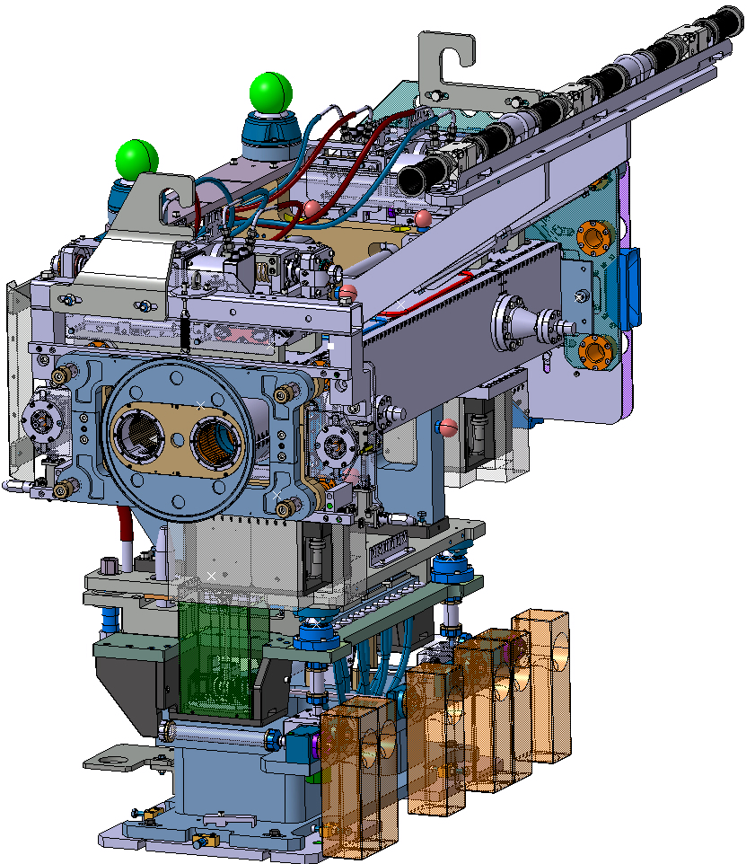
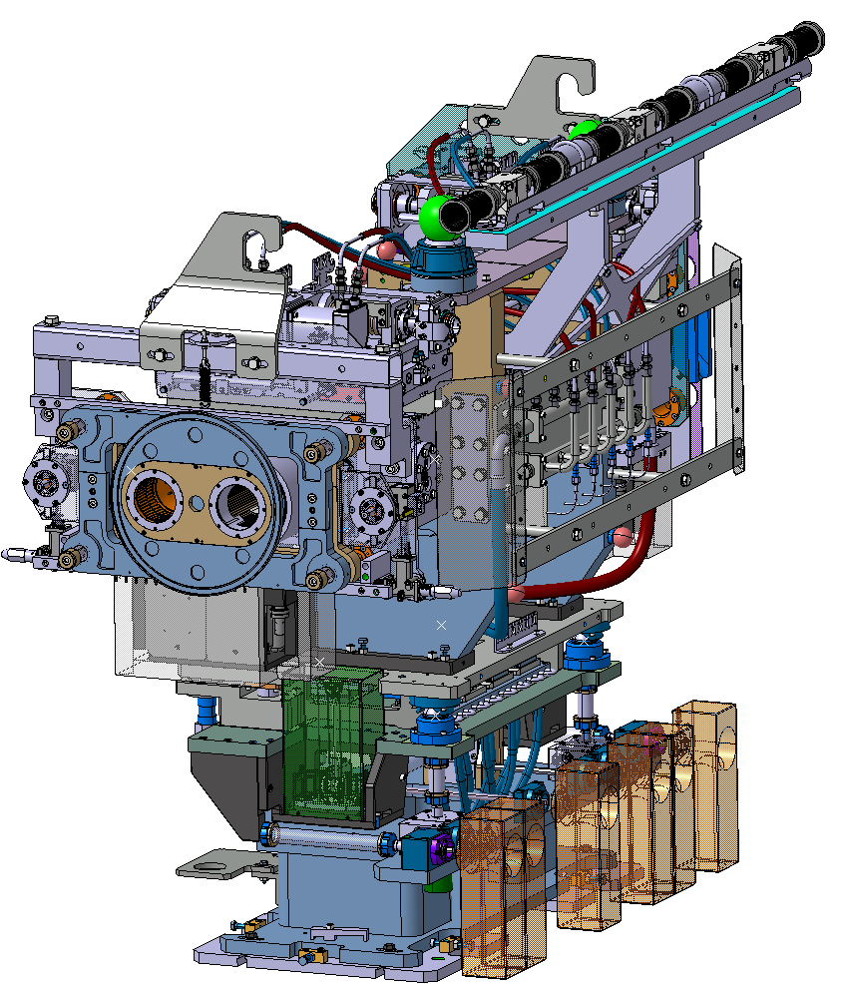
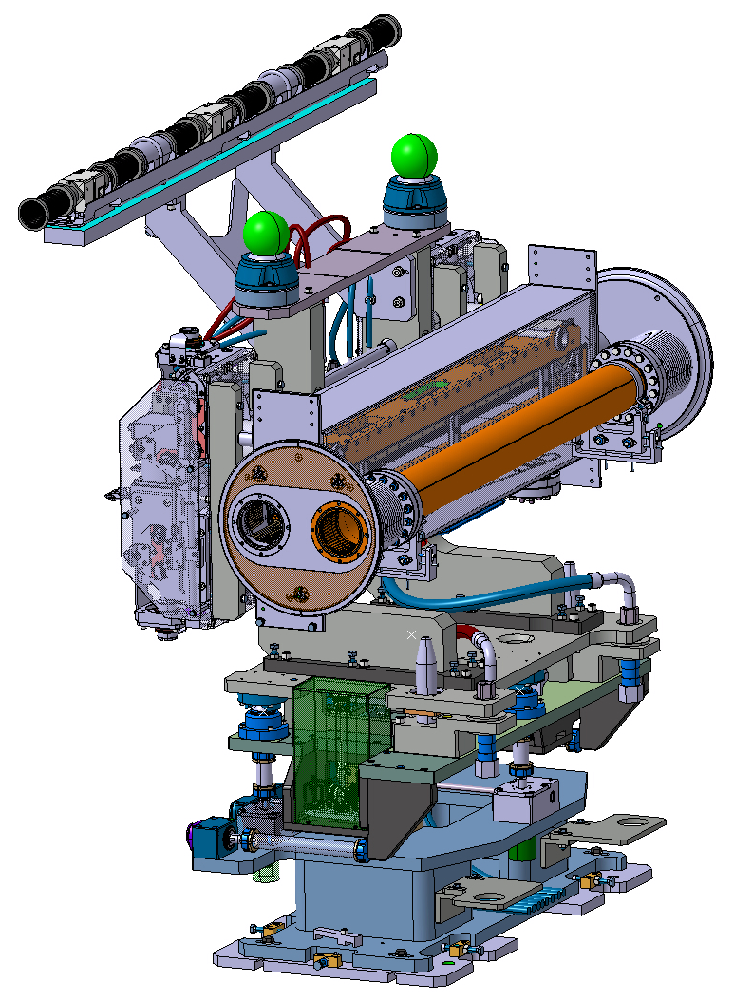
WP5.2: Production of Collimators
  Production of 36 collimators including 5 different designs, for 2026-2027
  Build to print contract: CERN provides the design and the raw materials and components
Double beam collimator (3 versions)
Single beam collimator (2 versions)
TCSPM & TCTPM
TCTPXH
TCLPX
TCTPXV

Slide 4
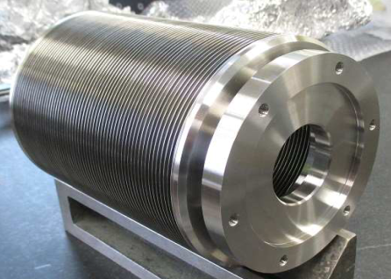
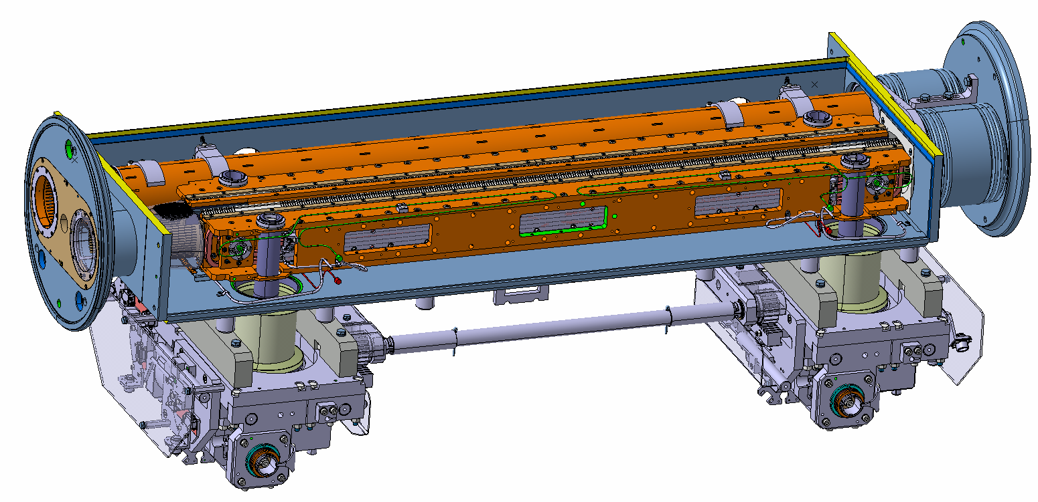
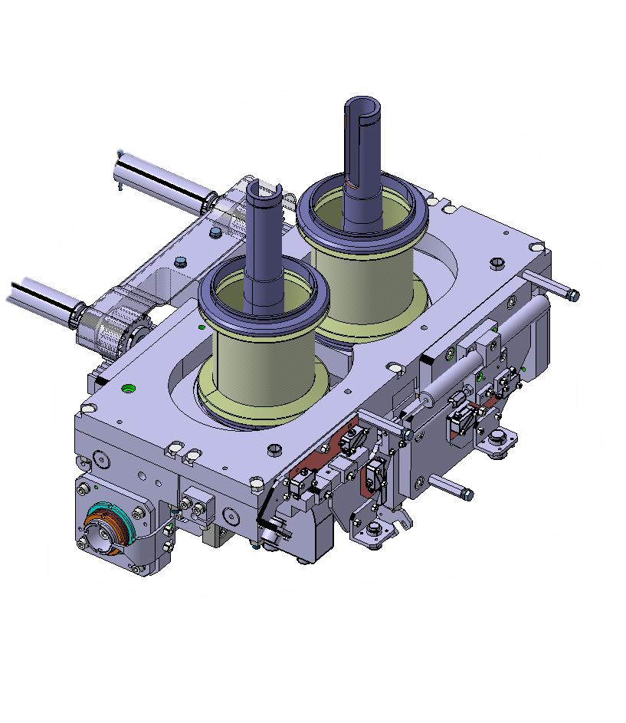
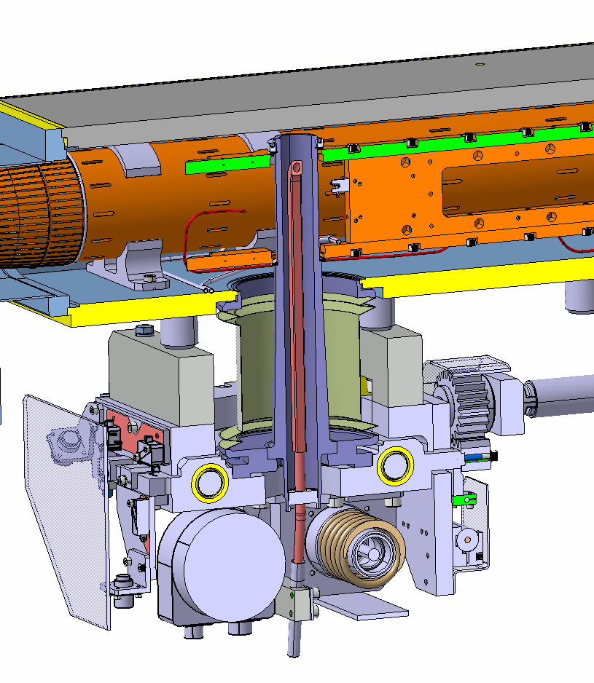
Edge Welded Bellows for Collimators
  Procurement and quality control of 168 new bellows for series collimators
  Allow the displacement of the shaft → lateral movement
  Interface Vacuum – Atmospheric Pressure
Cooling pipe
Mobile table
Jaw
Shaft

Slide 5
CERN orders with VAT
Series bellows received at CERN in April 2024
For “single beam” collimators
Bellow type | Configuration | Series Quantity
LHCTCTP_0054 | 58 convolutions | 101
LHCTCLPX__0160 | 61 convolutions | 67
For “double beam” collimators
Lifetime requirement: 50 000 cycles
(according to specs and supplier datasheet)

Slide 6
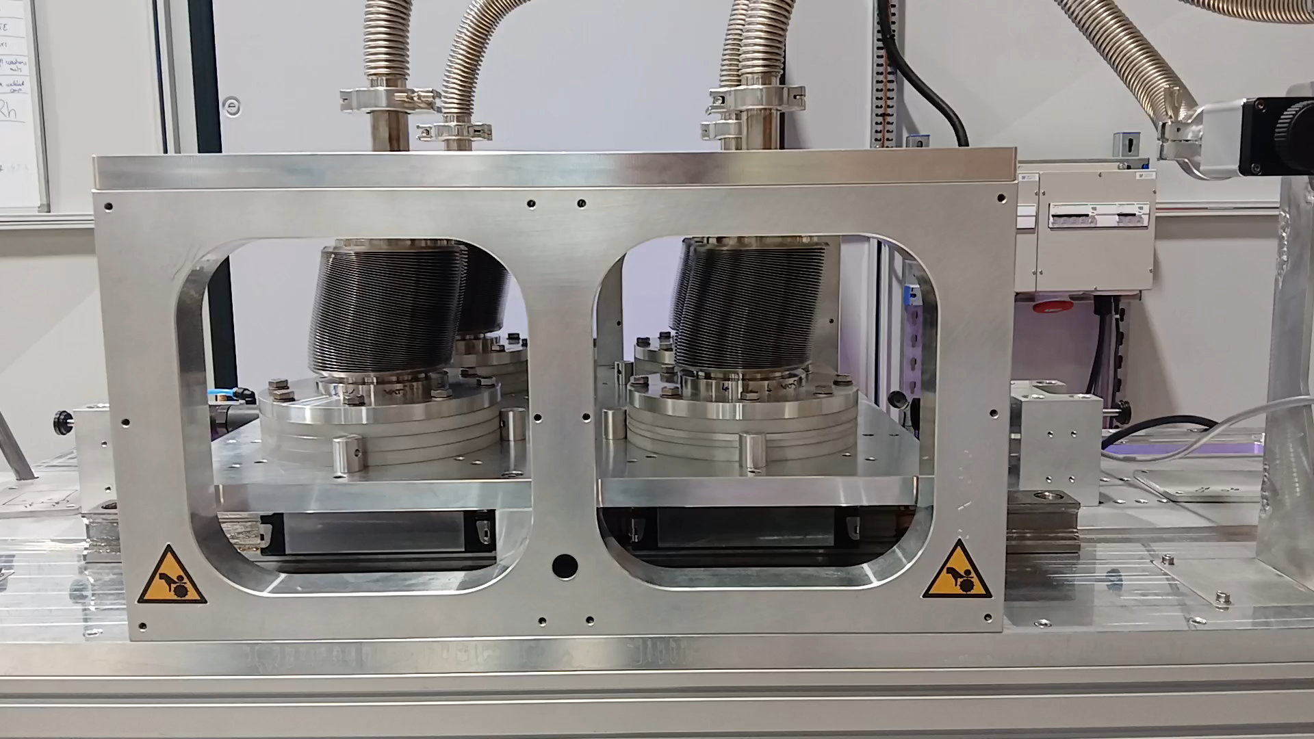
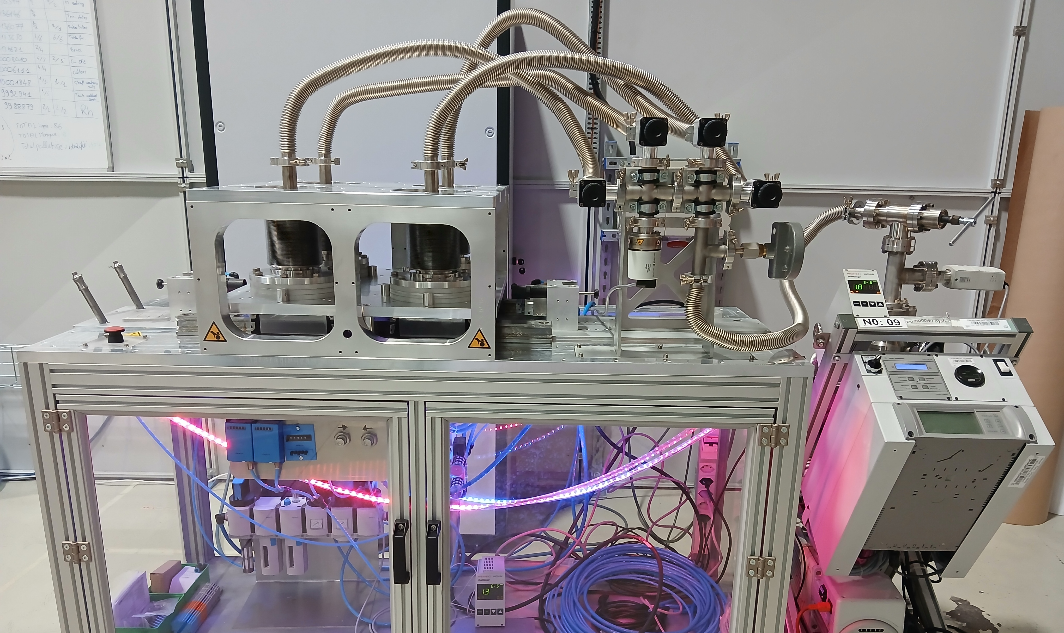
Cycling campaign at CERN & VAT
Cycling campaign in the framework of bellows validation;
Three main scenario identified (for both types of bellows):
Definition | Objective
Full stroke (according to specification and datasheet) | Verify lifetime wrt specification
Stroke closer to machine operation (limited stroke) | Study on collimator performance reduction on bellow lifetime
Symmetric limited stroke

Slide 7
Cycling campaign at CERN & VAT
Type LHCTCTP_0054 (Single beam bellows)
Type LHCTCLPX__0160 (Double beam bellows)
Scenario |  | Number of cycles reached before leak
Full stroke | ±20 mm | 31.2 k 58.3 k 71.5 k 88.3 k 88.7 k 2 x 108 k cycles with no leak 2 x 90.7 k cycles with no leak
Symmetric limited stroke | ±14.5 mm | 4 x 117 k cycles with no leak
Scenario |  | Number of cycles reached before leak
Full stroke | ±26mm | 11.9 k 12.4 k 14.0 k | 16.2 k 27.8 k 33.6 k
Symmetric limited stroke | ±19 mm | 29.5 k 29.4 k 31.5 k 36. 6 k 39.3 k | 46. 8 k 44.3 k 58.4k 63.8 k 81 k
Limited stroke | +18.8/-4.6 mm | 3 x 116 k cycles with no leak
Reference lifetime: 50 000 cycles
VAT to identify, validate and produce new bellows (with improved configuration) for series collimators

Slide 8
Cycling campaign at CERN & VAT
Double beam bellows
New configuration at 82 convolutions conceived (vs 61):
  4 bellows cycled at full stroke and reached →
  148 k cycles
  120 k cycles
  119 k cycles
  97 k cycles
  Further tests being conducted to validate performances
Single beam bellows
New configuration at 70 convolutions conceived (vs 53):
  Tests will be carried out to validate the performances

Slide 9
Conclusions & outlook
Bellows received in April 2024 will be used for pre-series collimators only
New improved configuration bellows will be used for series collimators
Activities for new production being started;
Reception of new production at CERN expected for Q1/Q2 2025
The proposal requires endorsement by the TCC

Slide 10
Thank you for your attention

Slide 11
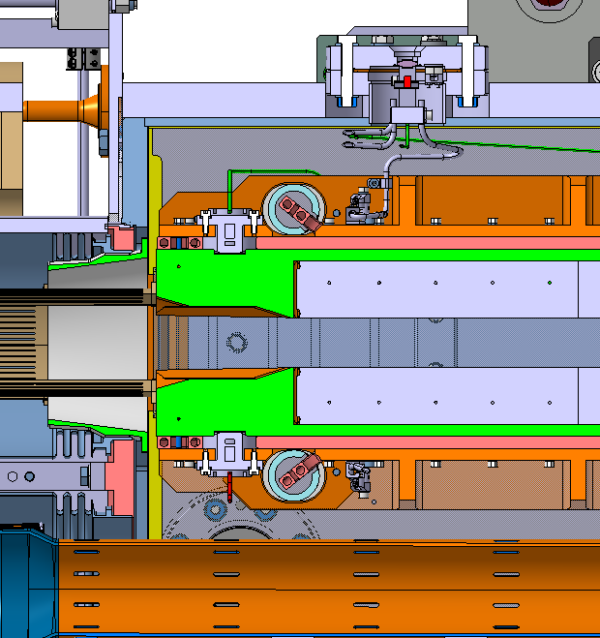
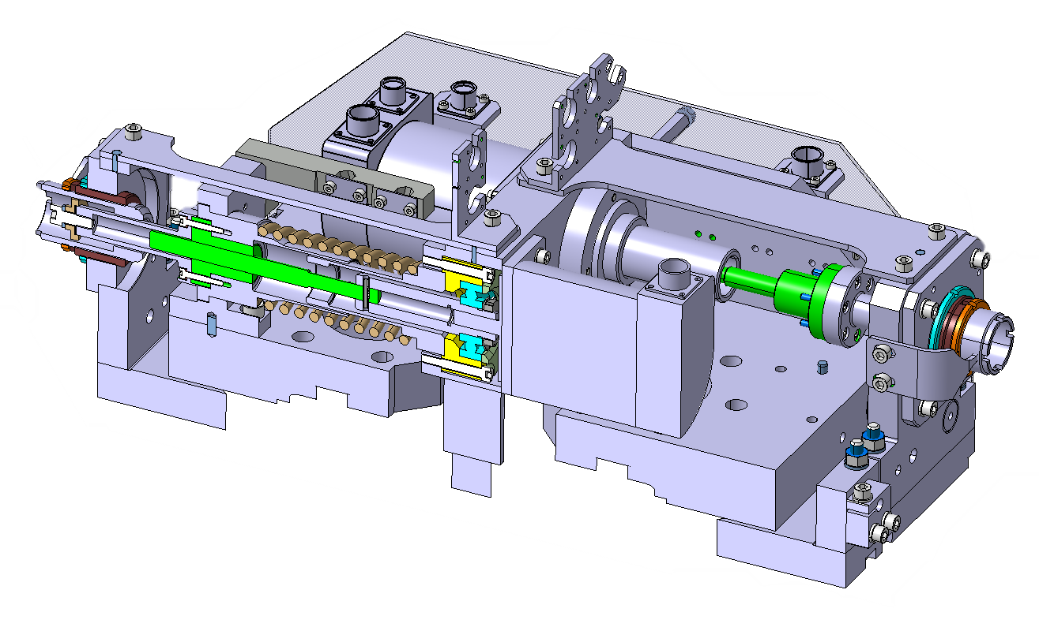
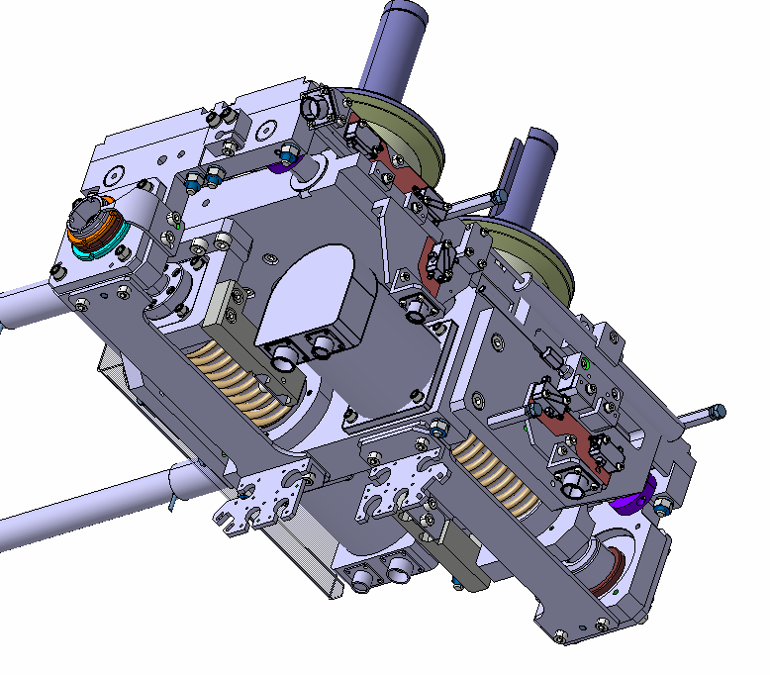
What is a Collimator: the mechanical tables
  Detailed cross section
Shaft 1
Lead Screws
Jaw 1
Mobile table
Beam
Cooling pipe
Jaw 2
Lead Screw
Mobile table
Shaft 2
Mobile table
Leadscrews
Stepper motor
Jaw
Shaft

Slide 12
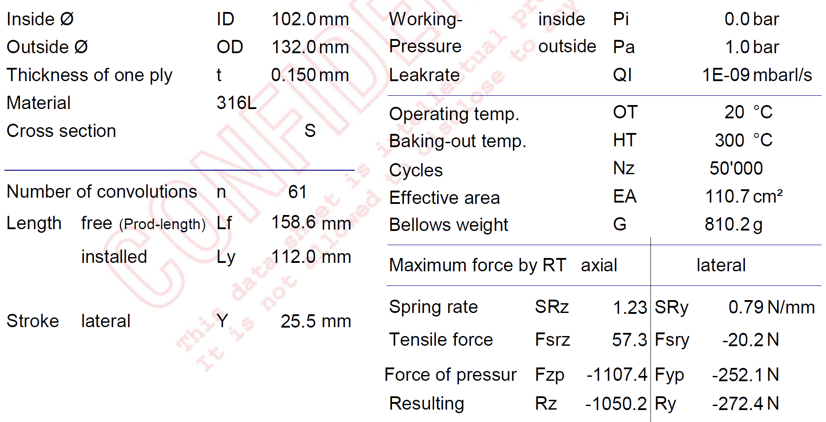
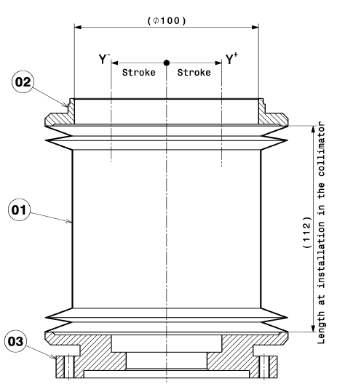
Bellow VAT datasheet
Type LHCTCLPX__0160 (Double Beam bellows) x 67

Slide 13
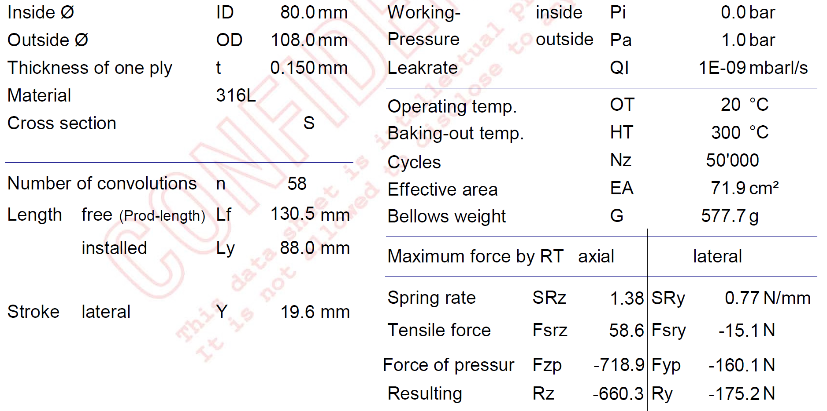
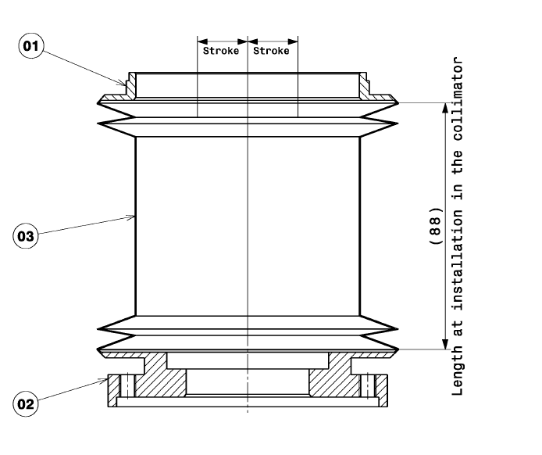
Bellow VAT datasheet
Type LHCTCTP_0054 (Single Beam bellows) x 101

Slide 14
Cycling campaign at CERN & VAT
Type LHCTCTP_0054 (VAT # C156636_B):
Scenario |  | Number of cycles reached before leak
 |  | Serial part (VAT # C156636_B) | Test part (VAT #1262468)
A | ±20mm No bake-out | 31.2 k 58.3 k 88.3 k 88.7 k | 71.5 k cycles
B | ±20mm With bake-out |  | 2x 108 k cycles with no leak 2x 90.7 k cycles with no leak
C | +14.5 /-11.9 mm No bake-out
D | +/-14.5 mm With bake-out | Planned*
E | ±14.5 mm No bake-out | Planned*

Slide 15
Cycling campaign at CERN & VAT
Type LHCTCLPX_0160 (VAT #1233543_C):
Scenario |  | Number of cycles reached before leak
 |  | Serial part (VAT #1233543_C) |  | Test part (VAT #1262479)
A | ±26mm No bake-out | 11.9 k 12.4 k 14.0 k |  | 16.2 k
B | ±26mm, With bake-out |  |  | 27.8 k 33.6 k
C | +18.8/-4.6 mm No bake-out | 3x 116 k cycles with no leak
D | ±19 mm With bake-out |  |  | 39.3 k 63.8 k
E | ±19 mm No bake-out | 29.5 k 29.4 k 31.5 k 36.6 k | 46. 8 k 44.3 k 58.4k 81 k

Slide 16
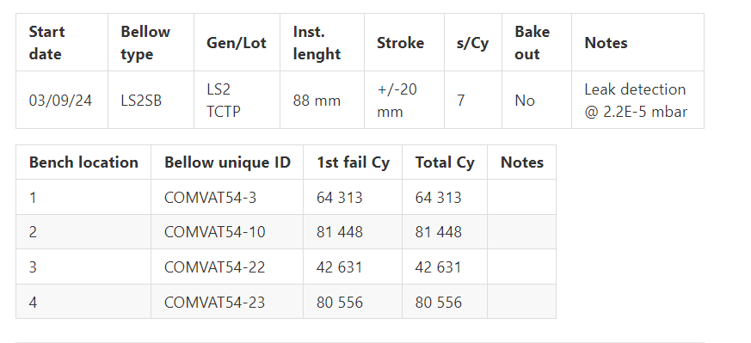
Cycling campaign at CERN & VAT

Slide 17
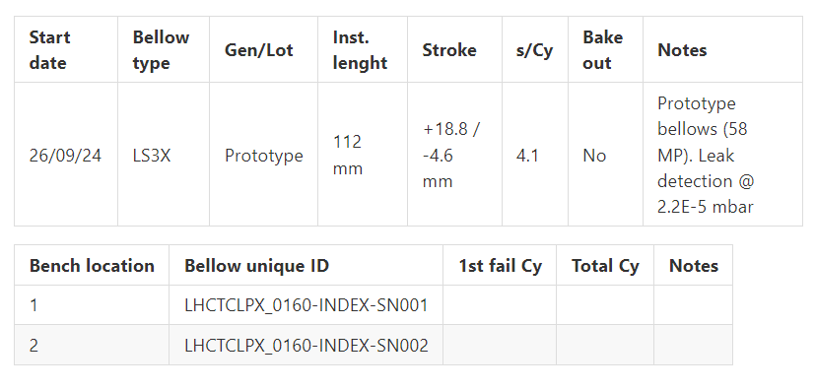
Cycling campaign at CERN & VAT
Cycling still ongoing → 600 k cycles reached with no leak

