Slide 1
Reva and CERNBox
Developments and prospected evolution
Giuseppe Lo Presti, Jesse Geens
March 20, 2025
CS3 2025, Munich

Slide 2
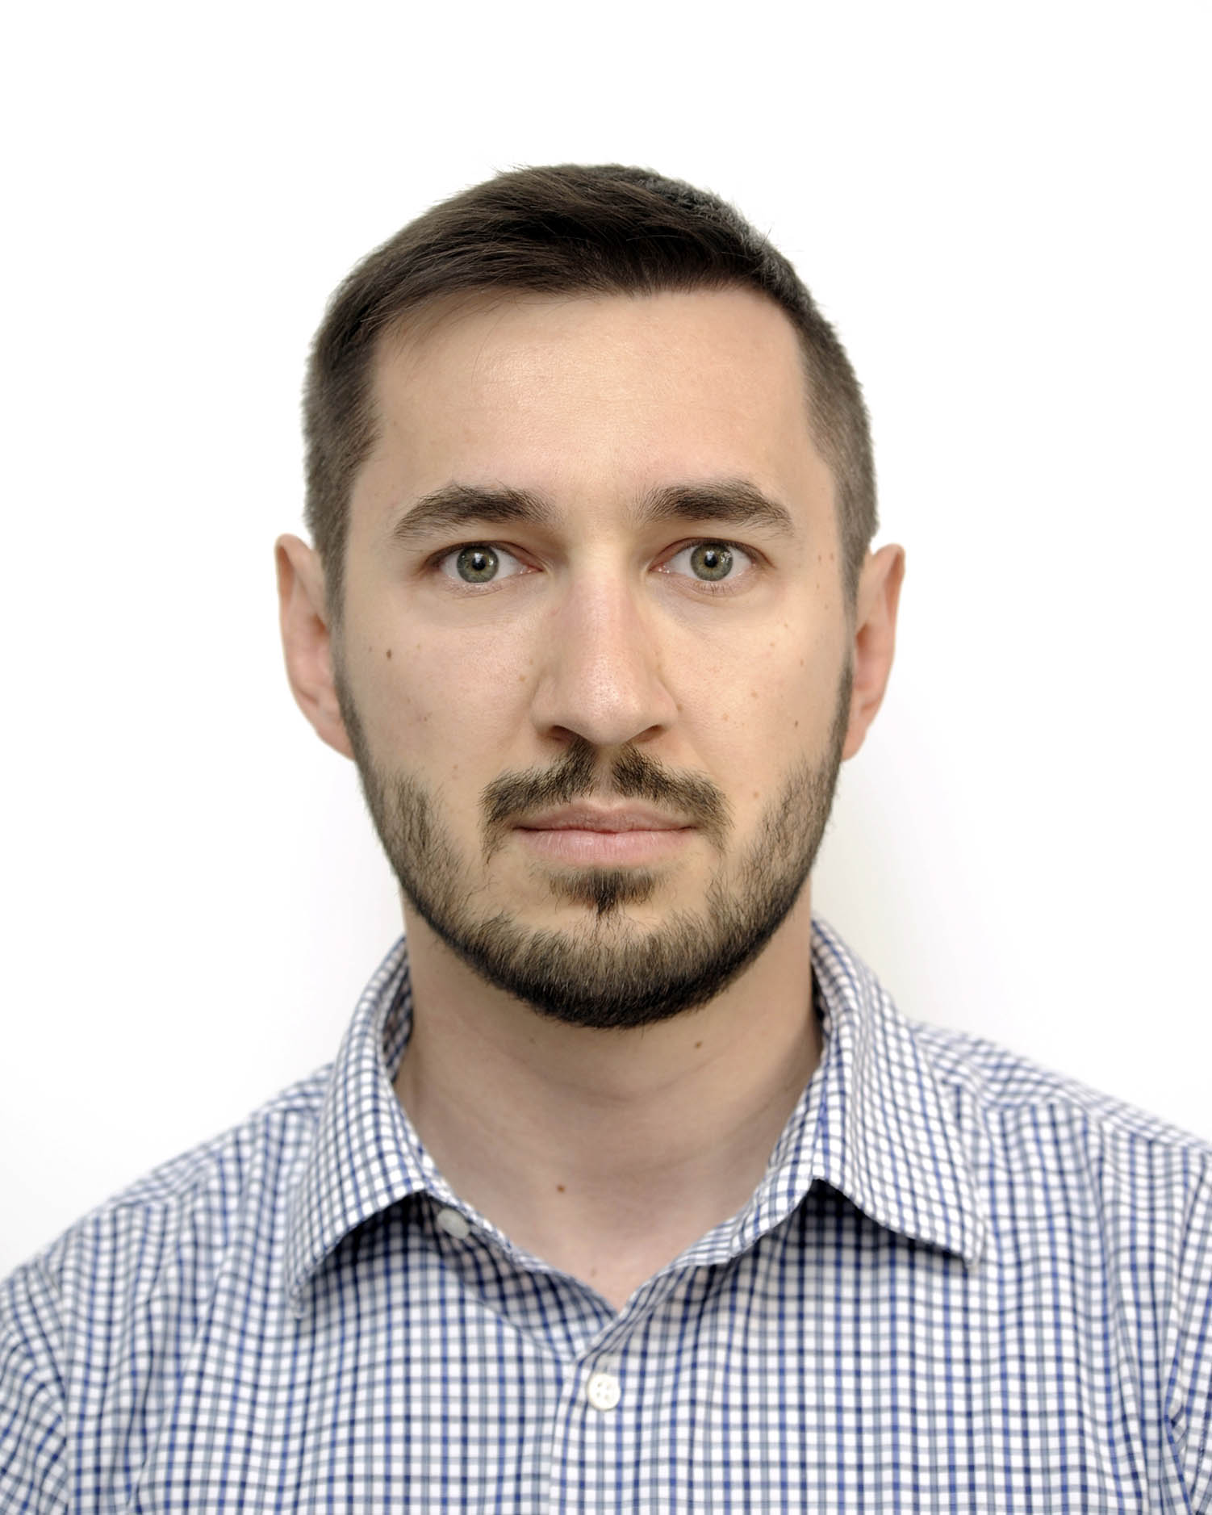
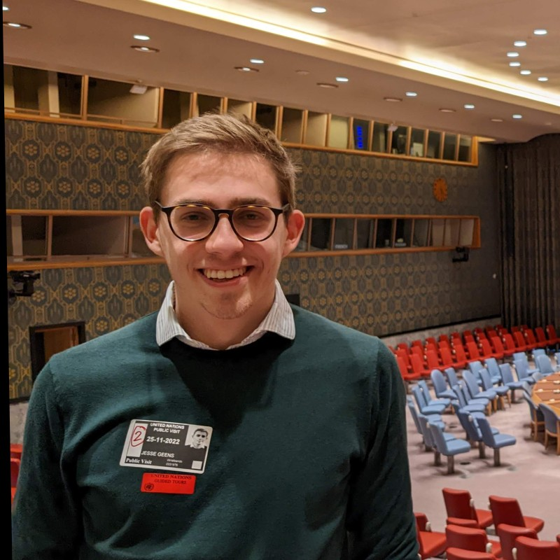


The team
Some reshuffling
Giuseppe is the Project Leader and point of contact for the CS3 Community
Diogo is the Deputy and CERN Service Manager
New members!
Sebastian Bukowiec
Focus on Windows
Jesse Geens
Focus on Reva
Rodrigo Nunes
Focus on front-end
Rasmus Welander
Focus on EOSC

Slide 3

The CERNBox Service
CERN's cloud collaboration storage platform
1 TB for every user, up to 50 TB on demand
Built purely with open-source components
  ownCloud sync clients for “Dropbox" use-case
  Reva for the back-end
  EOS and CephFS for storage
Data safely stored on CERN premises
Strong integration with scientific platforms
  Jupyter notebooks, computing farms, HPC clusters
16K+ monthly users
12 PB Data
4 Billion Files

Slide 4











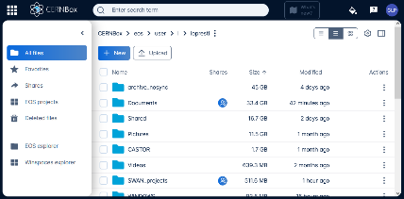



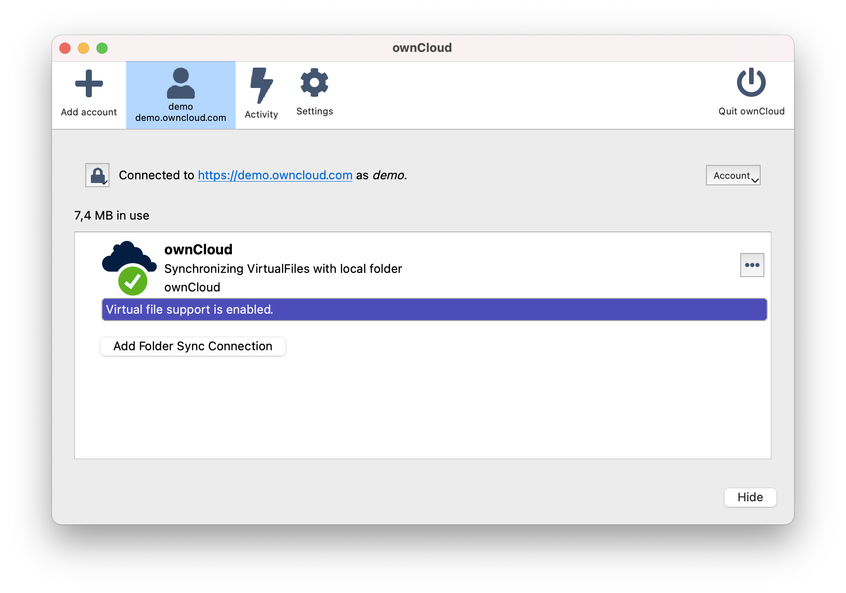
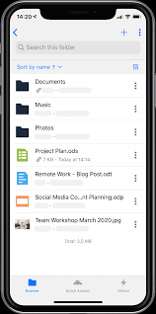


The CERNBox Galaxy
HTTP / REST (WOPI)
gRPC / XRoot
FUSE
Applications
WOPI
HTTP / REST
Kernel
WebUI
(metadata, shares)
libcephfs
WEBDAV
Sync Client / App
Backup:
cback
The Andromeda Galaxy
Source: Wikimedia

Slide 5
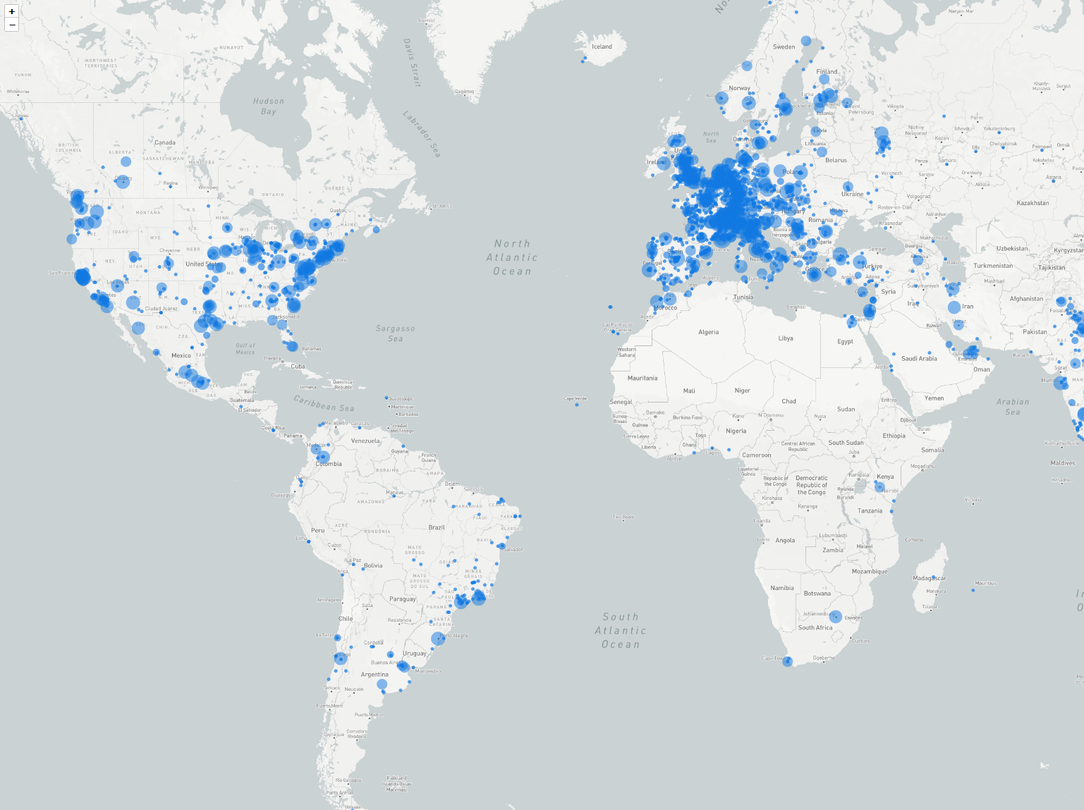
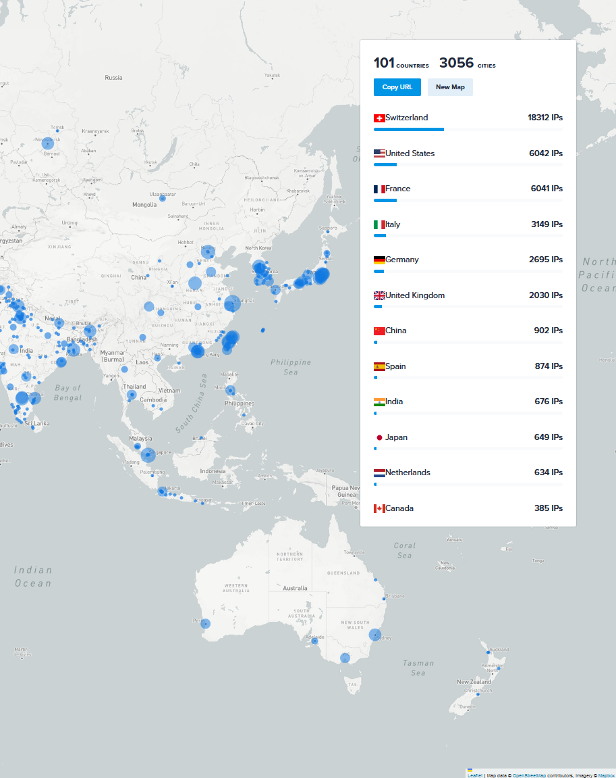
One week of traffic (3-9/03/2025)
50K unique IPs
Generated at https://ipinfo.io

Slide 6
Operational experience

Slide 7
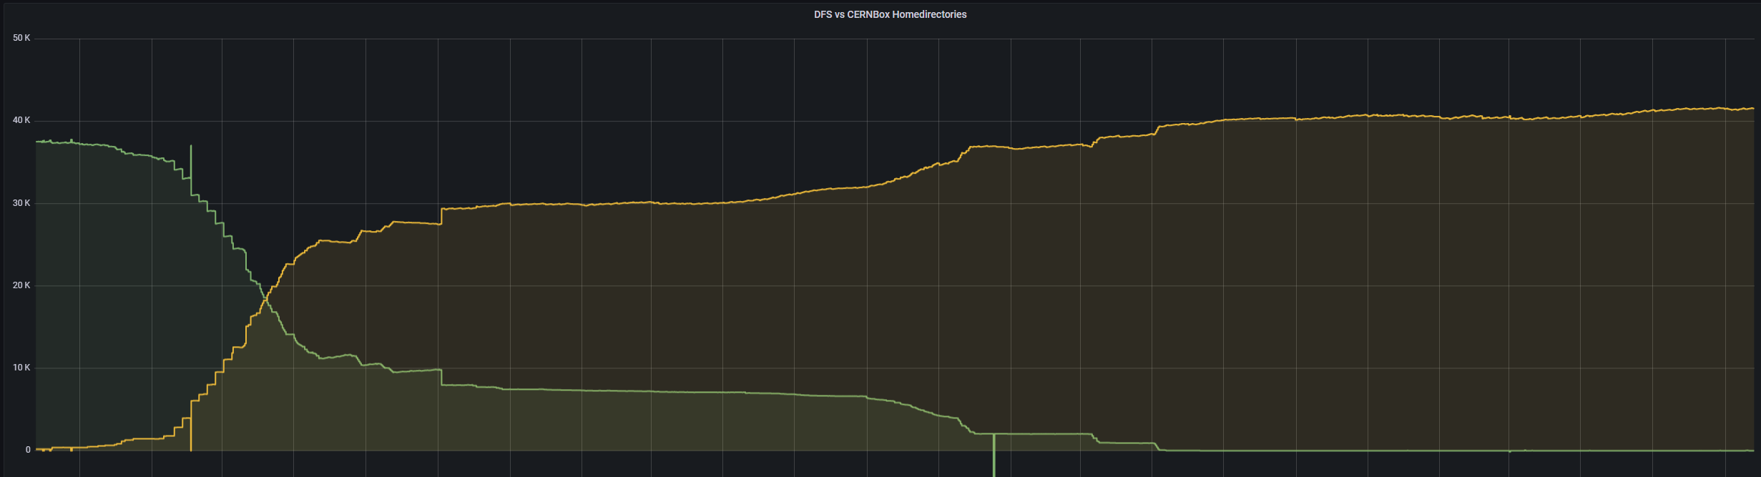
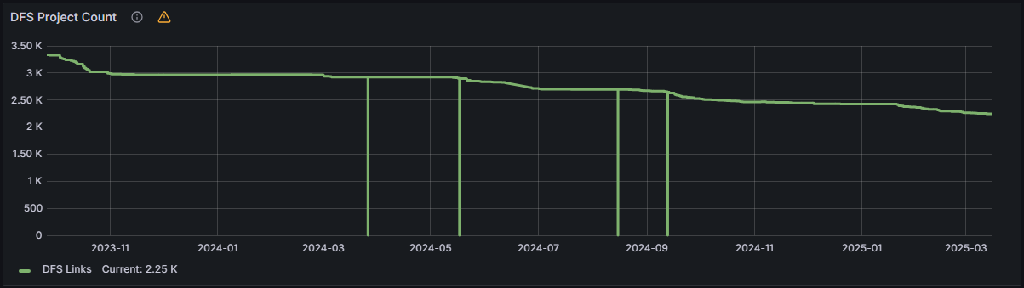
DFS Migration
Objective: consolidate all Windows-based workflows in CERNBox
  All details in Sebastian’s talk
Workspaces
Personal spaces

Slide 8

Microsoft Office
CERN has got a campus-wide license with Microsoft, including the full Office and productivity suites
Microsoft Office 365 Online integrated in CERNBox years ago
Best compatibility with the Microsoft Office for Desktop suite, on paper…
  Reality is different: from formatting issues and font mismatches to crashes of the web browser
  Legacy (binary) format ceased to be supported for editing/conversion
  Collaborative editing of large office documents is hard…
A recent issue: some firewalls break the TLS
handshake when TLS 1.3 ("post-quantum")
is enabled.
Visible with Microsoft Office endpoints.

Slide 9
Recent developments

Slide 10
EOS over gRPC
We now run EOS over gRPC in nearly all our instances!
Multi-year effort, opportunity to revisit the security model
  Used to run most operations as root, now we apply a least privilege approach
Some issues still surfaced in production
  Inconsistent authz requirements for Set / Unset xattrs
  Recursion not working for Set xattr
  Will be fixed in EOS 5.3
Performance improvements
  More than an order-of-magnitude improvement in metadata operations
  Downloads are now unbuffered: straight from EOS to client

Slide 11
Shares Object-Relational Mapping (ORM)
Moved from OC 10 schema: now split between shares and public links
Migrated sharing logic to use an ORM
  Schema now defined in the application code:
  no more need for init.sql scripts
  Enforce compatibility between client (Reva) and database
  Compiler can check queries
Challenge: OC Web currently expects ID across
shares and public links to be unique
Currently in cernbox reva-plugins repository,
will be ported to reva
db.AutoMigrate(&model.Share{})
type ProtoShare struct {
BaseModel
UIDOwner string `gorm:"size:64"`
UIDInitiator string `gorm:"size:64;index"`
ItemType ItemType `gorm:"size:16;index"`
InitialPath string
Inode string `gorm:"size:32;index"`
Instance string `gorm:"size:32;index"`
Permissions uint8
Orphan bool
Expiration datatypes.NullTime
}
type Share struct {
ProtoShare
ShareWith string `gorm:"size:255;index:i_share_with"`
SharedWithIsGroup bool
Description string `gorm:"size:1024"`
}

Slide 12

Open Cloud Mesh
Partial support for OCM 1.2 merged into Reva master
  Deployed on the CERNBox QA infrastructure at
  https://qa.cernbox.cern.ch
WebDAV access works with bearer token, and we will test webapps as well
In the plans: support the code flow with signed requests
  Allows clients to exchange a code for a short-lived bearer token: server can validate the client is what it claims to be
  Cf. yesterday’s session for more details

Slide 13
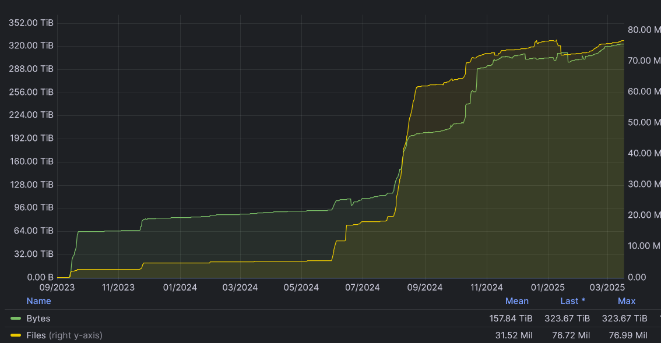
WinSpaces and CephFS
Picking up from Sebastian’s talk:
Major investment in the Reva CephFS storage provider
Planned features
  Chunked uploads
  Recycle bin
  Shares
Opportunity for synergy
  With vendors
  With sites

Slide 14
Future plans

Slide 15
WinSpaces and CephFS
CephFS plans for the coming year: bring the CephFS storage provider to production level
  Primary use case: serve the Windows-based community
  Equally important: support the CS3 community in deploying CERNBox on CephFS
Also, evaluate and compare performance of Reva cephfs driver vs Reva localfs over a kernel-mounted CephFS
  Potential benefit: kernel cache, piggyback on the CephFS kernel mount performance improvements

Slide 16
CephFS and ACLs
ACLs in CephFS pose some issues:
ACLs are only implemented at the client (FUSE / Kernel) level, and not as part of the libcephfs API
  This is bad, because it forces implementers (such as us!) to reinvent the wheel
  Solution is to become root and implement access control in Reva
If we use localfs over a CephFS mount, this would not be a problem
  The performance tests may tell us whether that should be the way to go

Slide 17
Spaces
Our next top priority: aligning with upstream web and supporting EOS without compromising performance. This implies adopting the Spaces concept and API
Development mostly on hold during last year because of lack of resources
Recently revamped: back-end support for Spaces soon to be merged (#4404)
A key feature is the mapping spaceID <> resourceID: we don't want to
maintain a space registry and execute look-ups
  Instead, we treat them as an encoding:
  Space ID: <storage_id>$base32(<path>)
  Resource ID: <storage_id>$base32(<path>)!<item_id>

Slide 18
CS3APIs Governance

Slide 19
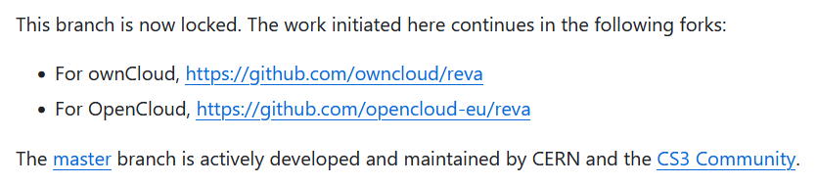
CS3APIs Governance
Status Quo: the cs3apis repo @ cs3org is maintained by CERN, with active contributions by the community
  Gentlemen agreement: a PR is not merged without approval from different team
    E.g. will propose a change in the share API as some inconsistencies were revealed when implementing the ORM in Reva
  What about the LibreGraph–based HTTP API? What about publishing it to the community?
Reva: the cs3org edge branch
has been forked and locked
  We now have 3 active forks implementing
  the CS3 APIs! ...albeit with "opaque variants"
Possible synergies on focused plugins/components:
  e.g. the CephFS storage provider, implementing the FS interface

Slide 20
Final words

Slide 21
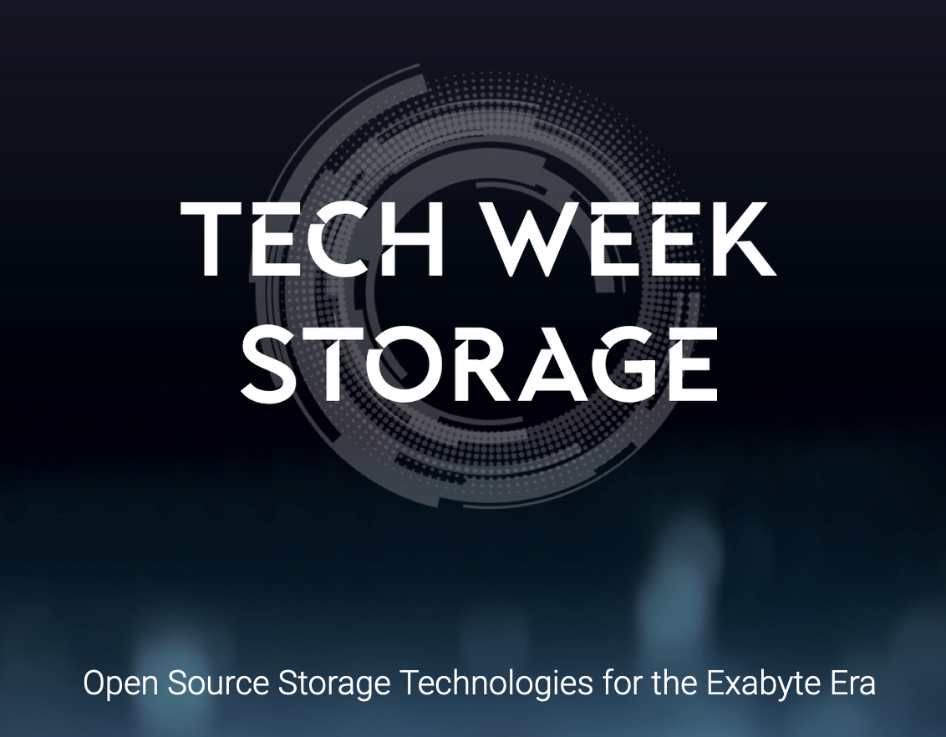
Conclusions
New team members, more development effort available
Focus on CephFS and Spaces for this year
Opportunities for synergies with the community
Thank you! Hope to see you next week
at TechWeekStorage25 at CERN!

