Slide 1
Computational Intelligence Architecture for Continuous Learning in Medical Centres
Filip Katulski, Jose Sousa, Adam Nowak
Personal Health Data Science team​
Sano - Centre for Computational Personalised Medicine
International Research Foundation, Poland​ ​

Slide 2
Abstract
In the early days of artificial intelligence (AI) during the 1950s, two primary approaches emerged. One was engineering-oriented, while the other focused on computational modeling of human decision-making processes, later termed "computational intelligence", and is strongly determined by three fundamental time-constrained limitations: data, computation, and communication. Modern AI development emphasizes scaling data and computational resources, operating on the premise that machines are not bound by the constraints of limited data and computational capacity.
This work presents a Computational Intelligence Architecture used to support continuous learning processes and deployment of classification models within Medical and Research Centers on health data, and presents mechanism of communicating findings between these centers.
The architecture implements a distributed network of Agents that run containerized classification models on local medical data stored on Medical Center's premises, display the obtained results locally for doctors' decision making process support and share results via a knowledge data bank available to all participating centers without sharing the data itself. Additionally, the system allows for models' meta-analysis for further improvement with a growing number of medical cases.

Slide 3
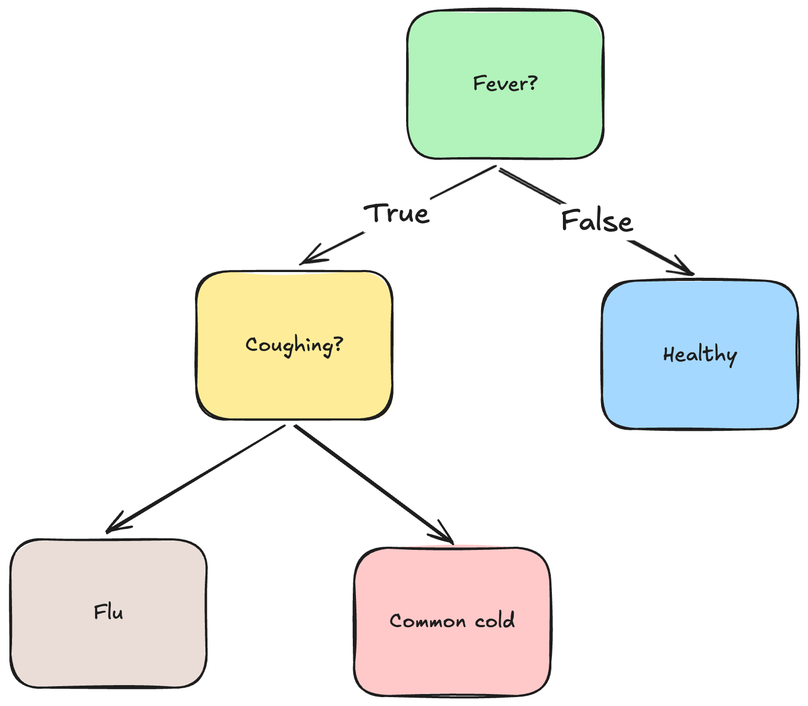

Introduction
Motivation
Doctors and hospitals need tools to speed up and reduce costs of patient’s diagnosis.
Medical data is spread across different places. Can we distil their knowledge to improve the treatment across all centres in the System?
How can we share knowledge while preserving the privacy of patients’ data?

Slide 4







Introduction
Motivation

Slide 5
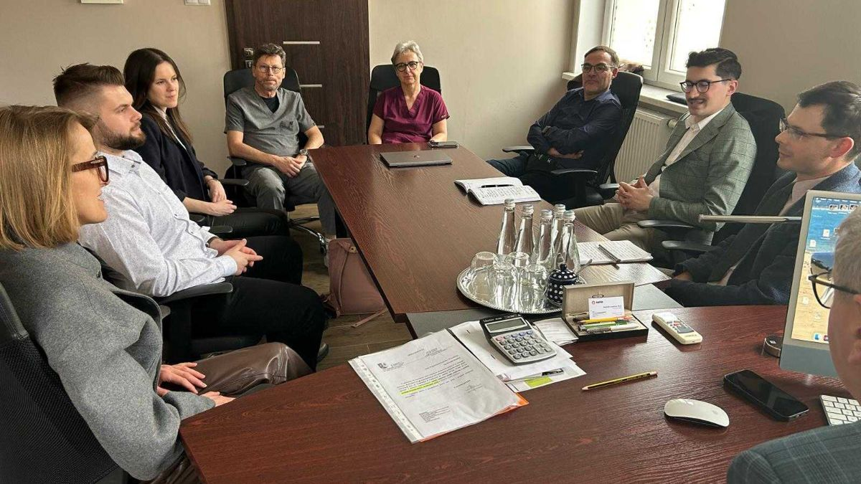
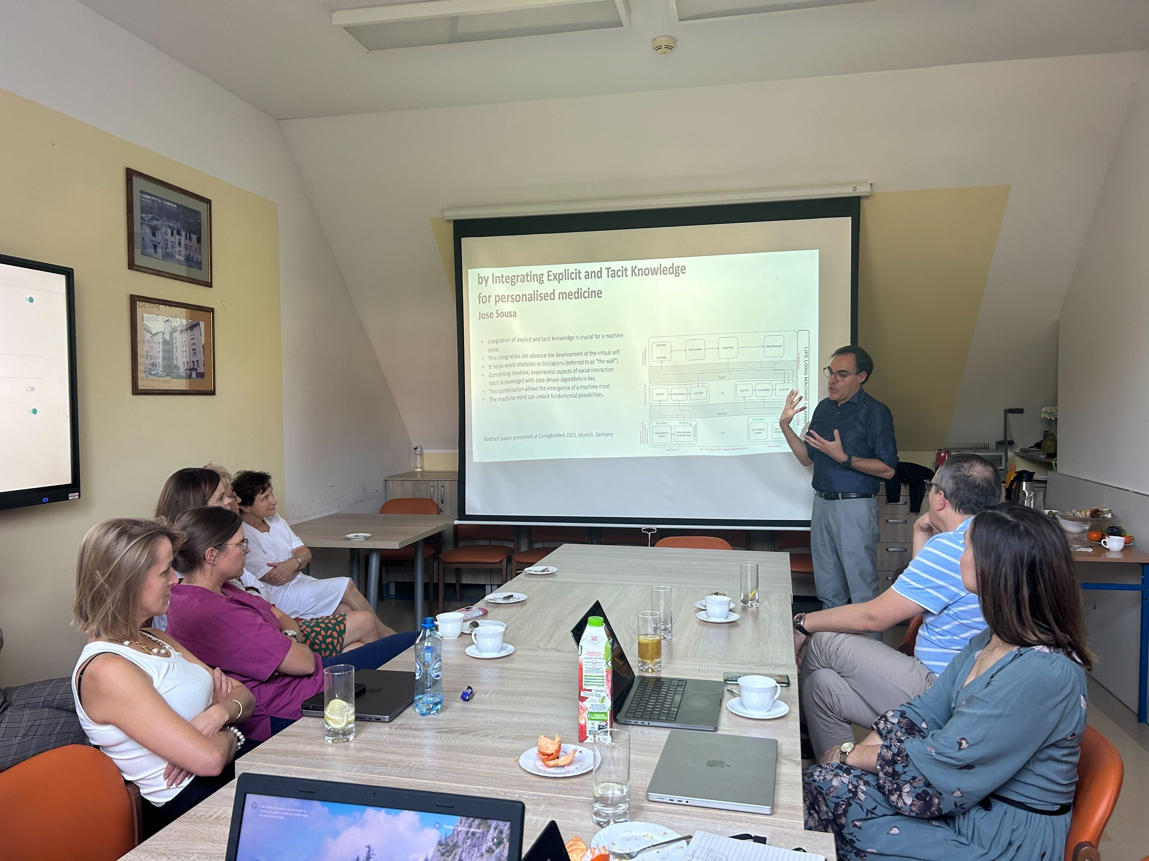


Cooperation with Hospitals
szpitaltuchola.pl
ameryka.com.pl

Slide 6
Cooperation with Hospitals
 | Szpital Tucholski | Ameryka
Ward type | Pediatric | Allergology-Rehabilitation up to 18yo
Impact | ~700 patients per year | ~6000 patients per year
Daily work | Broad spectrum of pediatric problems | Narrow, specialised treatments

Slide 7
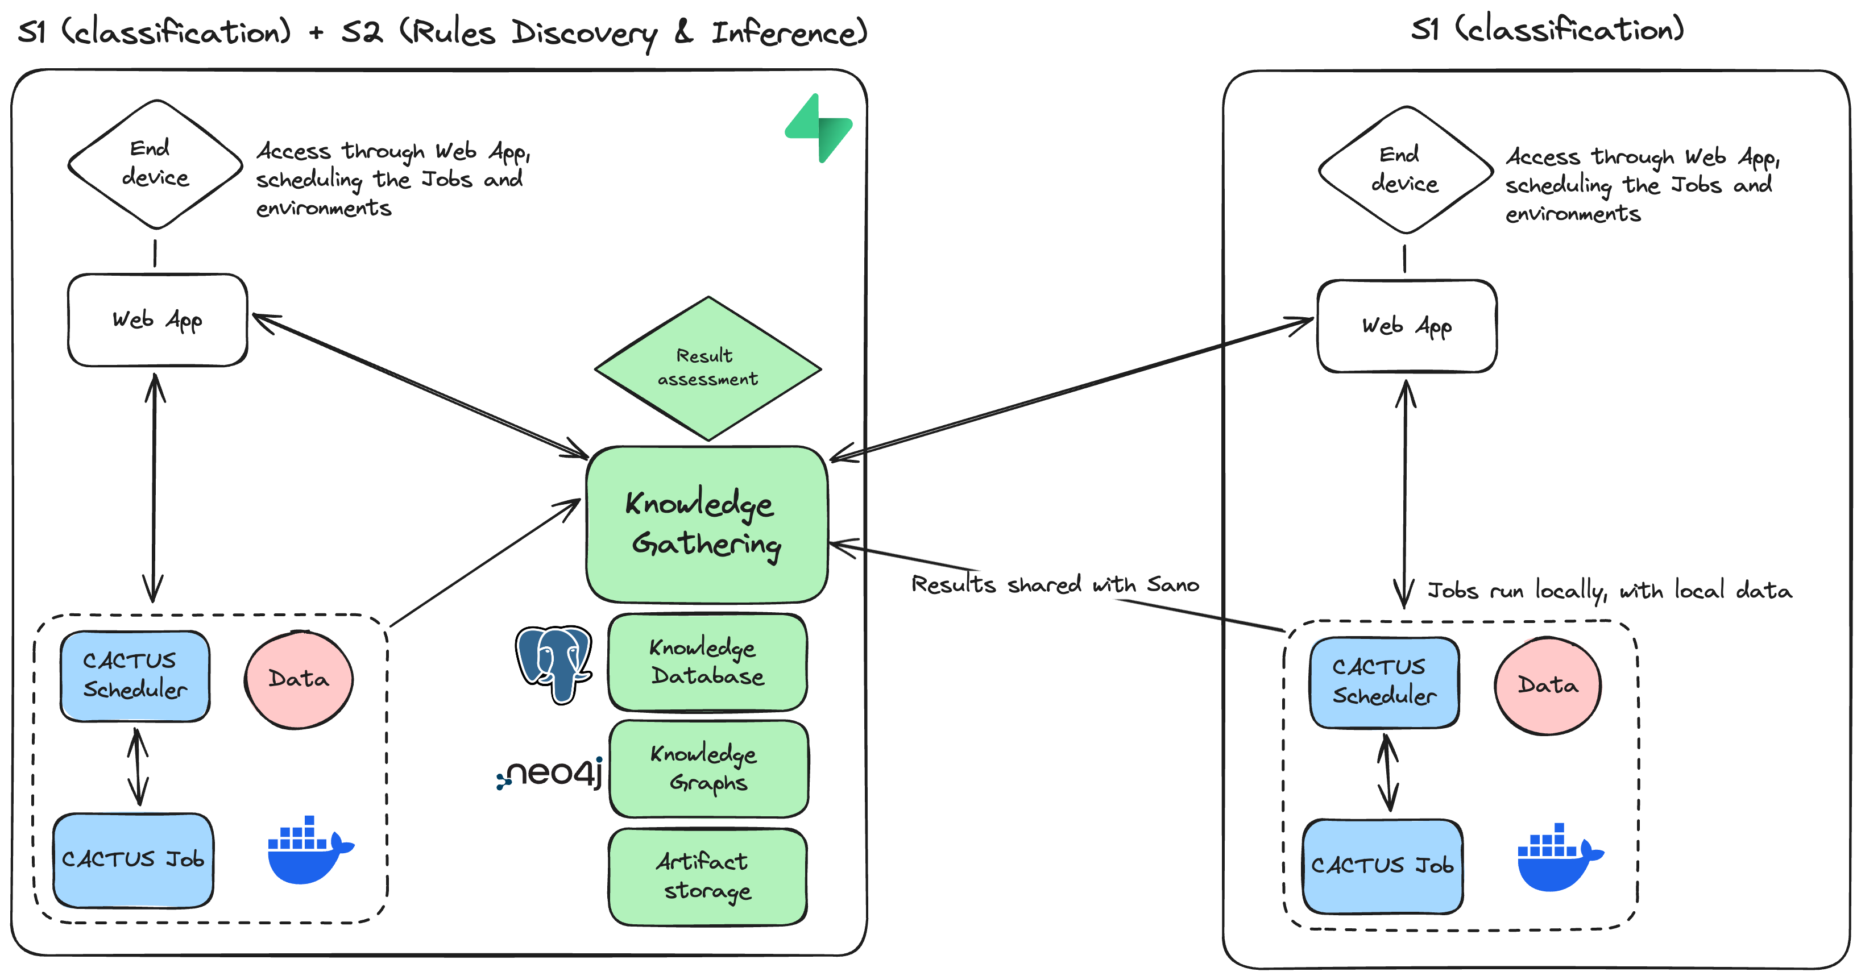
Proposed Architecture – Work in Progress
Luca Gherardini, Varun Ravi Varma, Karol Capała, Roger Woods, and Jose Sousa. 2024. CACTUS: A Comprehensive Abstraction and Classification Tool for Uncovering Structures.
ACM Trans. Intell. Syst. Technol. 15, 3, Article 46 (June 2024), 23 pages. https://doi.org/10.1145/3649459

Slide 8
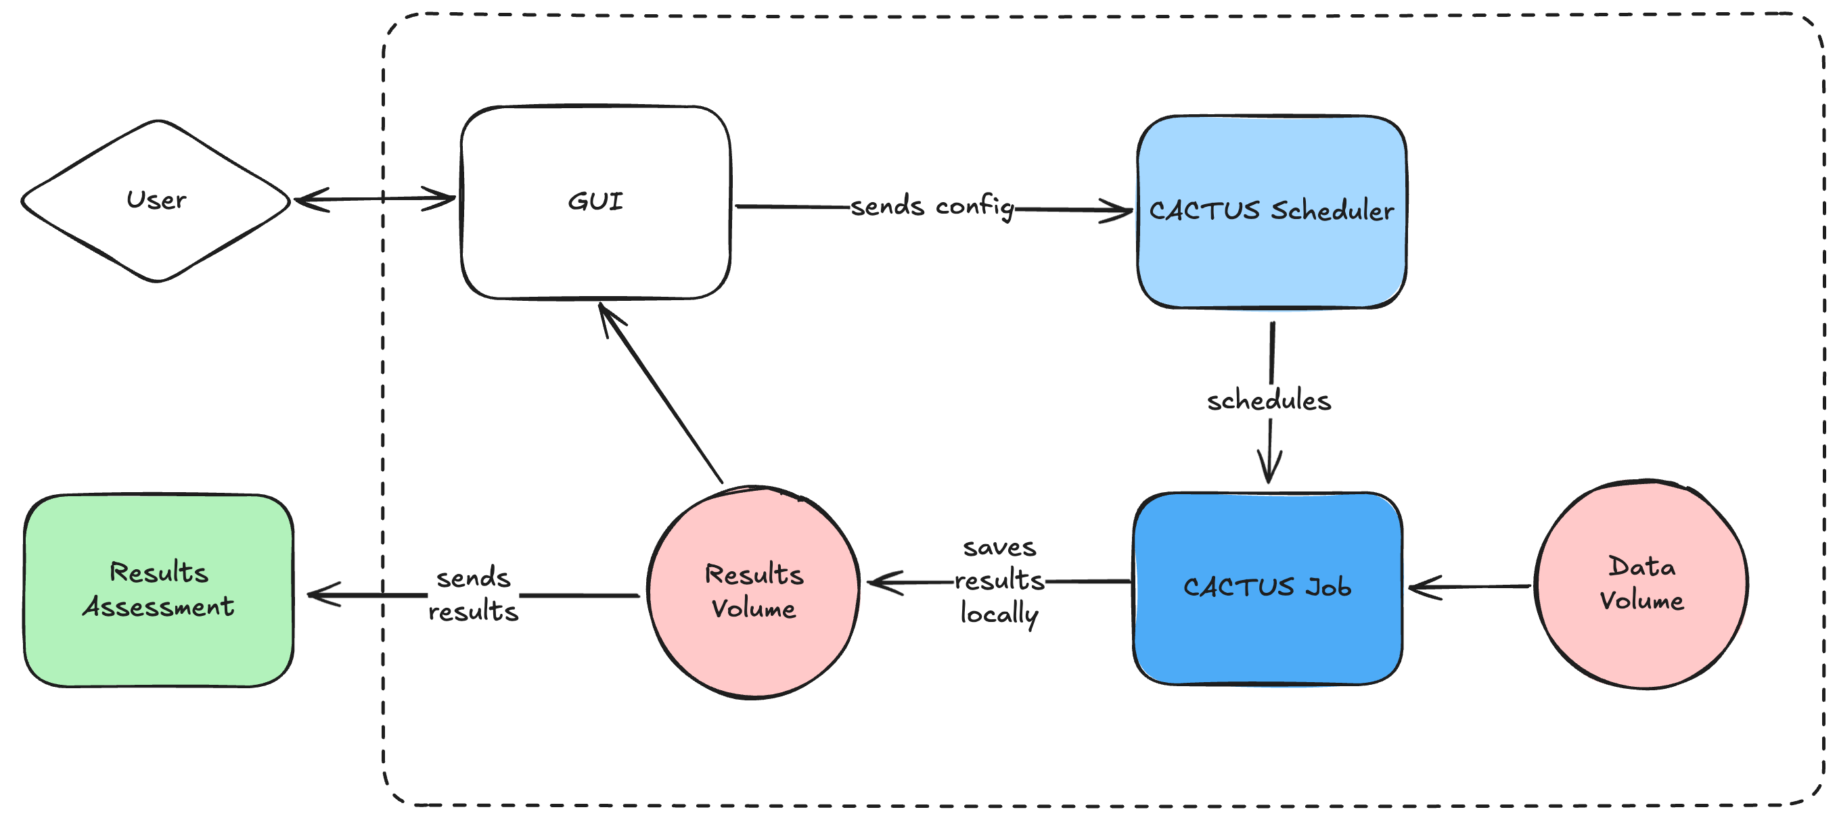
Proposed Architecture

Slide 9
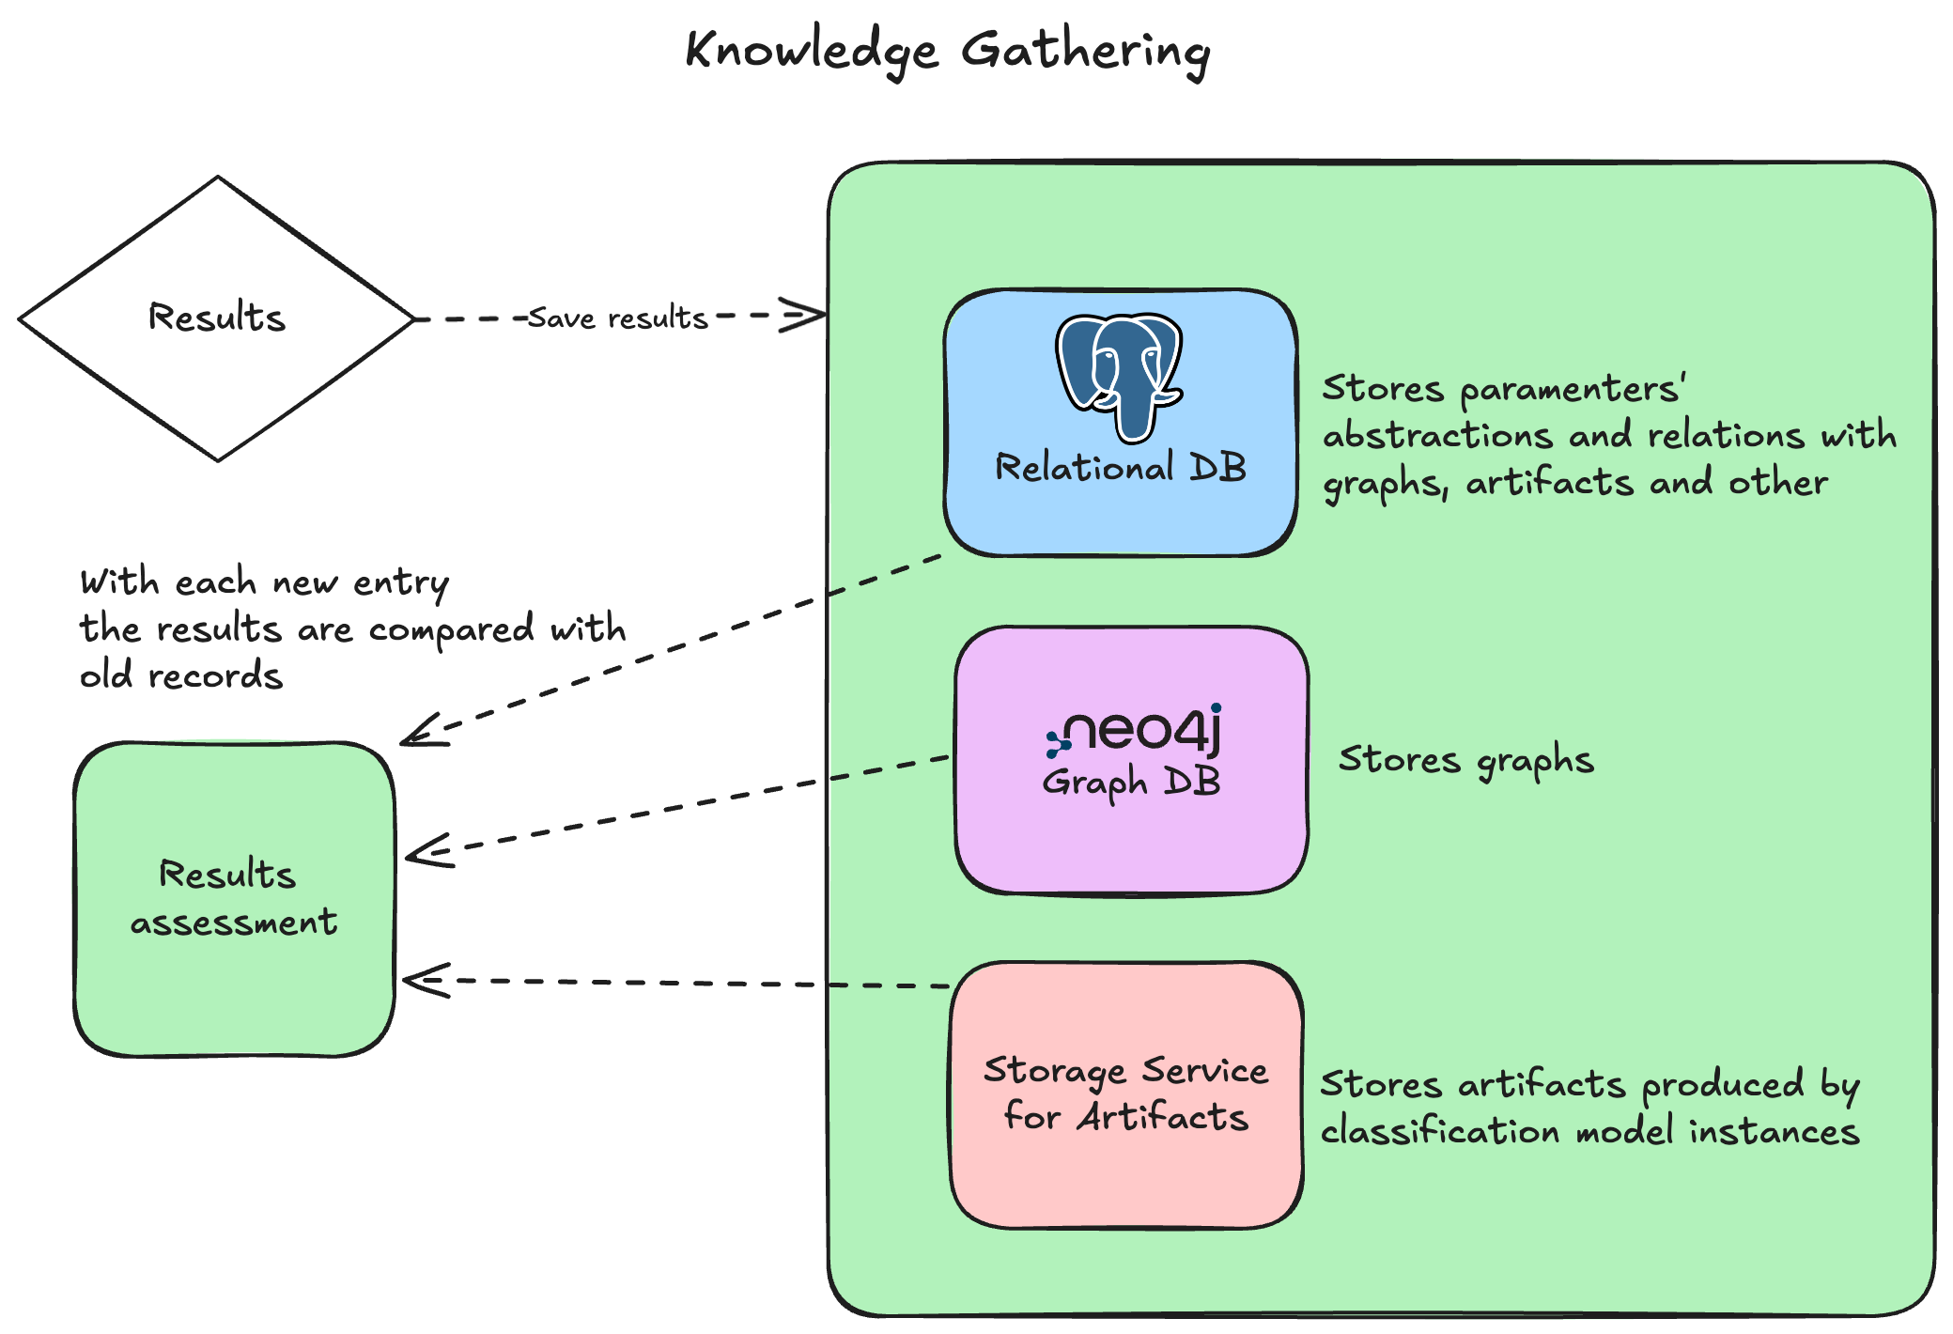
Proposed Architecture

Slide 10
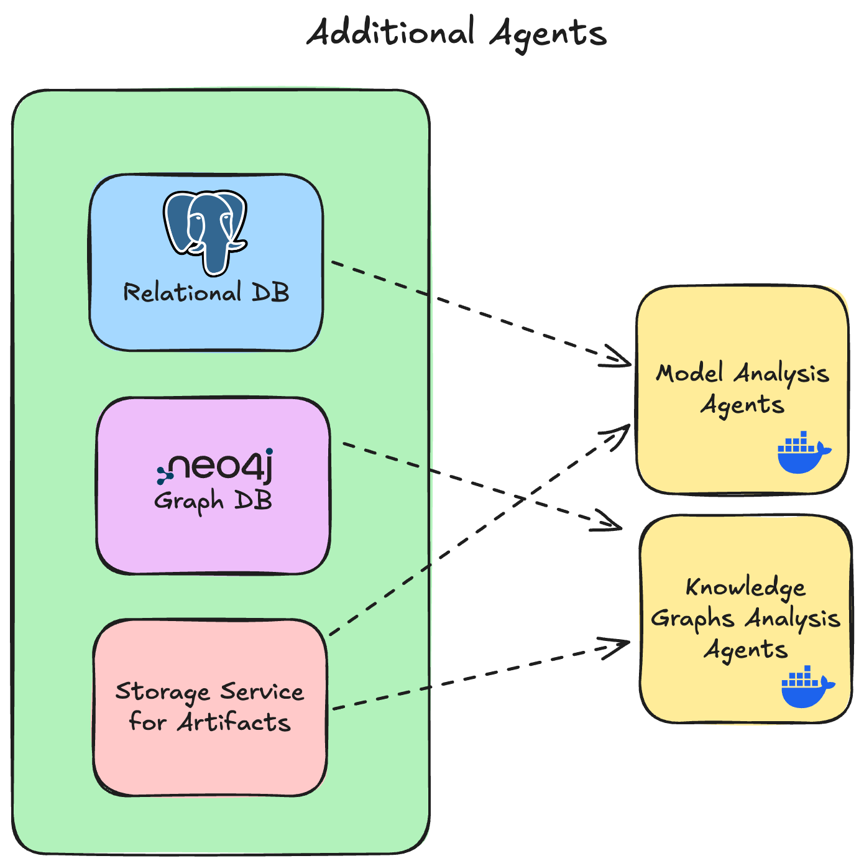
Proposed Architecture

Slide 11
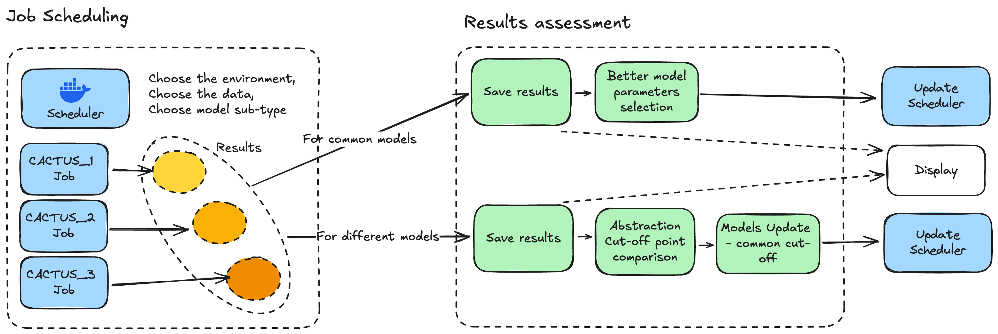
Proposed Architecture

Slide 12
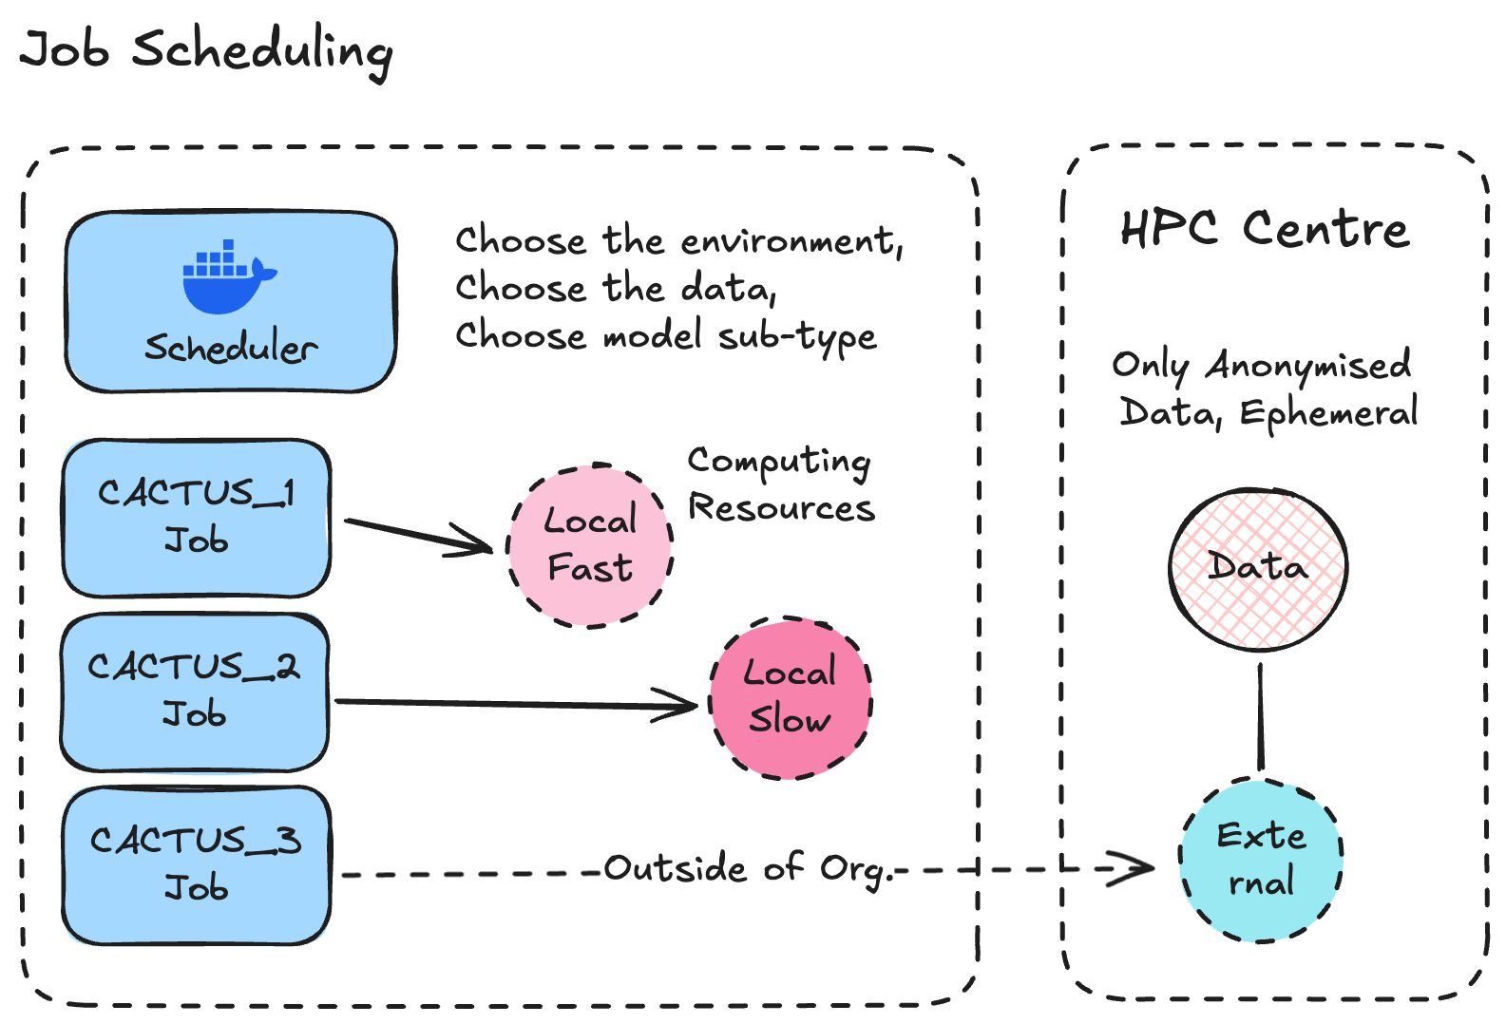
Proposed Architecture

Slide 13
Known Challenges
For the proposed architecture
Initial System would have a limited number of participants,
Large variety of medical cases,
Data as “free text” with no standardization,
Different centres have different hardware and software solutions,
How do we communicate the new Knowledge to relevant doctors across the System?

Slide 14
Future plans
Development of the Architecture for hosting other AI models,
Test Bed Implementation and in-situ experiments on different hardware configurations,
LLM usage for free text epicrisis classification,
Publication of results

Slide 15

Thank you for your attention
Filip Katulski
PhD Student @ Sano
e-mail: f.katulski@sanoscience.org

