Slide 1

Data transfer, synchronization and sharing solution for
PSDI
Amali Pawula Hewage, Vasily Bunakov, Alexander Belozerov, Paul Wright, Stuart Meacham, Tom Underwood
19-21 March 2025
CS3 2025 Conference, LMU Munich

Slide 2
About Us
STFC (Science and Technology Facilities Council)
PSDI ( Physical Sciences Data Infrastructure)
STFC is a part of UKRI (UK Research and Innovation). We operate large-scale facilities: ISIS neutron and muon source, Central Laser Facility, also co-own Diamond Light Source (synchrotron)
STFC do research beyond facilities:
in Particle Physics Department, Space Department, Scientific Computing Department
More about STFC Scientific Computing: https://www.sc.stfc.ac.uk/
STFC Scientific Computing co-deliver PSDI with a few other partners in the UK
What PSDI do: engage with research communities, promote best practices, offer training, develop services
What is presented today is a part of PSDI service development: we foresee a need in Data Transfer, Synchronisation and Sharing (DTSS) solution
More about PSDI: www.psdi.ac.uk

Slide 3
Overview of technology trials and use cases of PSDI DTSS Solution
Ceph S3 Object Storage
Data Transfer
Own cloud Infinite Scale (OCIS)
Data Synchronisation
JuiceFS
Data Sharing
Goofys
S3FS
Rclone
S3cmd
Cyber duck
Rclone
Boto3
Purpose of Experiments Each tool was assessed to understand its strengths and limitations in handling data workflows, including:
Data Transfer: Efficiently moving large datasets between storage systems.
Data Synchronization: Keeping data in sync across distributed locations or multiple devices.
Data Sharing: Facilitating collaboration and secure data access for users across our network
Notes:
Purpose of Experiments Each tool was assessed to understand its strengths and limitations in handling data workflows, including:
Data Transfer: Efficiently moving large datasets between storage systems.
Data Synchronization: Keeping data in sync across distributed locations or multiple devices.
Data Sharing: Facilitating collaboration and secure data access for users across our network

Slide 4
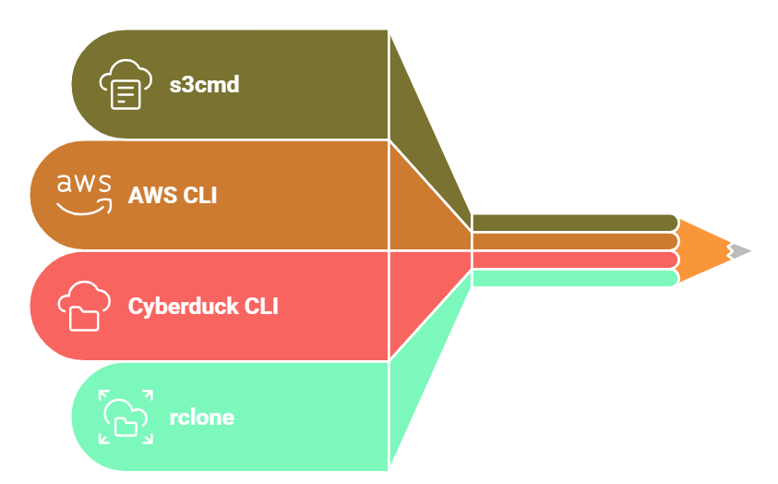






Docker & Apptainer containers for data transfer
Docker Format
  The Docker format is specifically designed for running the data transfer container using the Docker runtime and infrastructure
Singularity/Apptainer
  Apptainer is particularly well-suited for High-Performance Computing (HPC) environments and shared clusters where many users share the same resources, and security is a primary concern

Slide 5

Data Sharing : OCIS
Enabling effective and secure data sharing among teams, departments, and even external partners
Why oCIS?
  Works well with Ceph Object Storage.
  Open-source and customizable.
  Supports scalability & Kubernetes deployment.
Use Cases:
  e.g., research data management, collaboration.
  Integrations with other PSDI components e.g., Indexing / Computational Notebooks

Slide 6
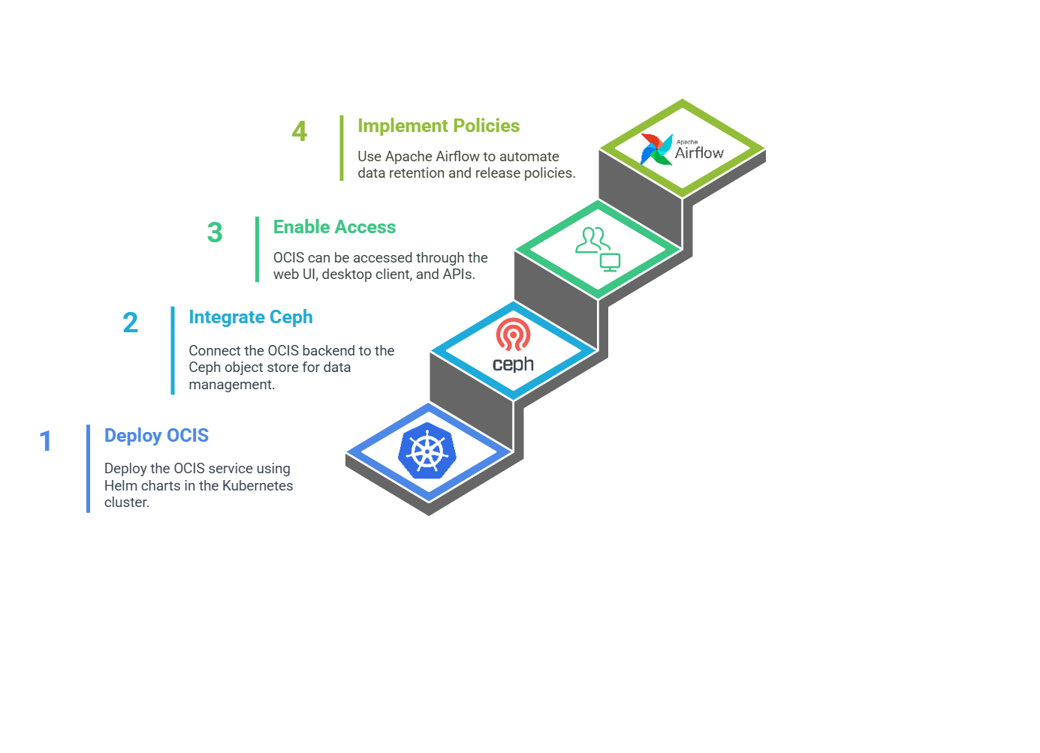
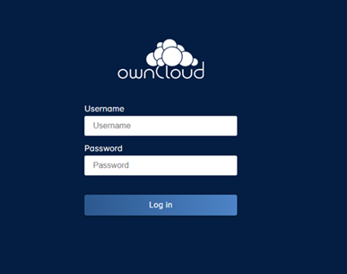

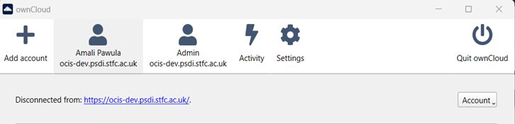
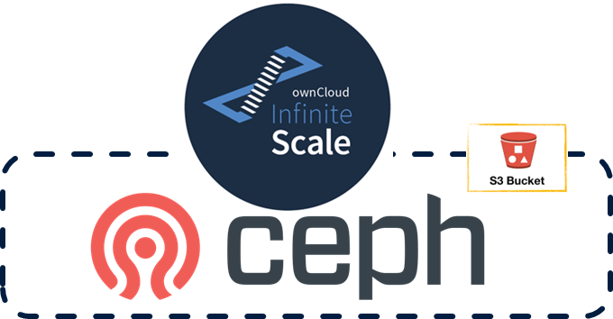
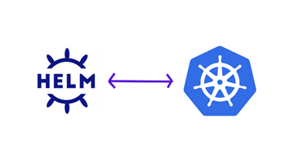
Architecture & Deployment

Slide 7
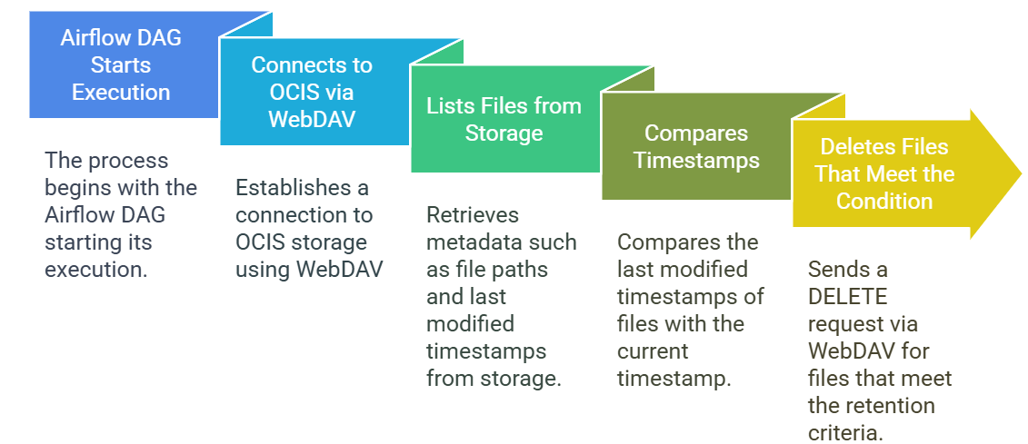

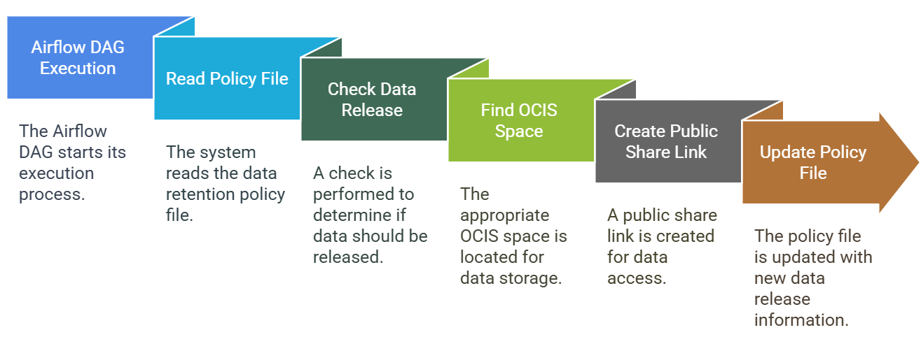
DTSS solution can be combined with workflows solution for defining (and operating) data policies
Data retention policy
WebDAV
Data release policy
WebDAV
LibreGraph
Notes:
Mention about Gentle Reminders that we send (future implementation) to the users before deleting files from the spaces
Similar to these policies we will implement → As the data transfer, synchronisation and sharing solution administrator, I want to define and operate data indexing policy

Slide 8

Performance & Challenges
Load Testing - Aggregate Report for Login Request with 100 concurrent users – GET HTTP Request
Label | # Samples | Average | Median | 90% Line | 95% Line | 99% Line | Min | Max | Error % | Throughput | Received KB/sec | Sent KB/sec
OCIS Login Request | 100 | 78 | 70 | 105 | 125 | 169 | 62 | 179 | 0.00% | 48.87586 | 69.16 | 24.1
TOTAL | 100 | 78 | 70 | 105 | 125 | 169 | 62 | 179 | 0.00% | 48.87586 | 69.16 | 24.1
Aggregate Report for File Uploading Request with 100 concurrent users – PUT HTTP Request
Label | # Samples | Average | Median | 90% Line | 95% Line | 99% Line | Min | Max | Error % | Throughput | Received KB/sec | Sent KB/sec
OCIS File Upload Request | 100 | 290 | 281 | 414 | 441 | 461 | 162 | 463 | 0.00% | 19.33862 | 12.35 | 7.88
TOTAL | 100 | 290 | 281 | 414 | 441 | 461 | 162 | 463 | 0.00% | 19.33862 | 12.35 | 7.88
Aggregate Report for File Downloading Request with 100 concurrent users – GET HTTP Request
Label | # Samples | Average | Median | 90% Line | 95% Line | 99% Line | Min | Max | Error % | Throughput | Received KB/sec | Sent KB/sec
OCIS File Download Request | 100 | 307 | 289 | 425 | 508 | 582 | 168 | 595 | 0.00% | 30.75977 | 29.83 | 9.22
TOTAL | 100 | 307 | 289 | 425 | 508 | 582 | 168 | 595 | 0.00% | 30.75977 | 29.83 | 9.22
Notes:
By testing like this, we will understand:
How fast files can be saved or retrieved under different loads.
When does the system start to slow down.
What is the maximum number of researchers it can handle smoothly.
Do we need to expand storage space

Slide 9
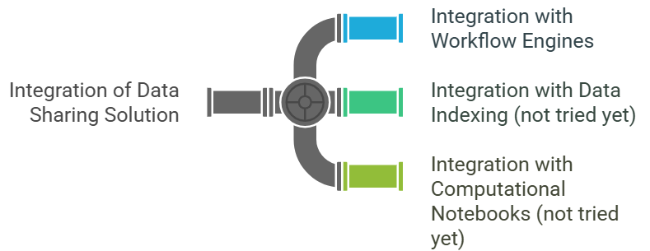
Conclusion and next steps
Containerised DTSS tools offered on top of Ceph storage can be an interim DTSS solution for our project, especially with newer versions of Ceph that support multitenancy *)
The adoption of a feature-rich data sharing solution like OCIS or OpenCloud will be of course advantageous, and we will keep looking into it
Integrations of a data sharing solution with other components will be of interest:
*) See https://ceph.io/en/news/blog/2025/enhancing-ceph-multitenancy-with-iam-accounts/

Slide 10
Thank you

