Slide 1
Collective infrastructure makes you stronger
European infrastructure proposals for data transfer & object storage
Jan Meijer, Sikt – Norwegian Agency for Shared Services in R&E
Task lead service concepts
CS3 conference, Münich
19 March 2025
Public (PU)
Notes:
Establish cred – initiated several European collaborative service effors, e.g. ssl certificates, FileSender, part of others, e.g. joint procurement engine.

Slide 2
Changing European R&E landscape
societal
R&E context
technology
Notes:
Societal: sovereignty, Trump, AI, tech dependency, research critical
R&E context: digital infra key, need for high standard services, transnatinoal integration (EOSC, policy initiativ), NRENs from tech pioneers to R&E digital service providers
Tech: commoditisation, SaaS, infra-as-code

Slide 3
Main challenge for NRENs in cloudy (ad)ventures
no individual European NREN will be large enough to
provide Above-the-Net services cost-effectively over time, at ever-increasing compliance, quality and
functionality levels.
Notes:
Changes in customer base: digital transformation (not only physics), amount of data exploded, AI, integration across national borders

Slide 4
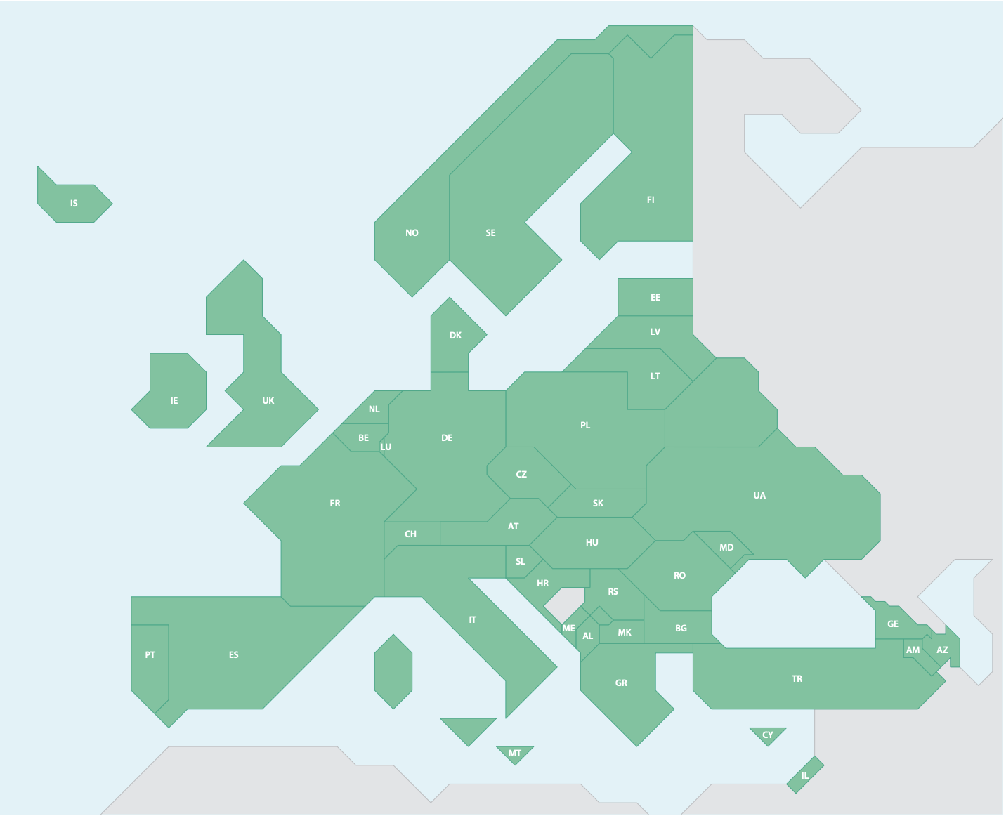
NREN perspective on European research landscape
43 countries
–5.000 research organisations
–1.2M researchers
European Research Area
–50 pan-European RIs
–150 large storage / processing plants
- 250 Trustworthy Data Repositories
- ? institutions producing digital services
GEANT Association service delivery
43 NRENs + GÉANT organisation
4.100+ employees
€1.000M+ budget
Notes:
ca. 900 research institutes (research institutes: count number of pages: https://en.wikipedia.org/wiki/Category:Research_institutes_by_country
universities in europe:
ERA: “Europe is home to close to 5,000 higher education institutions, 17.5 million tertiary education students, 1.35 million people teaching in tertiary education and 1.17 million researchers. ”

Slide 5
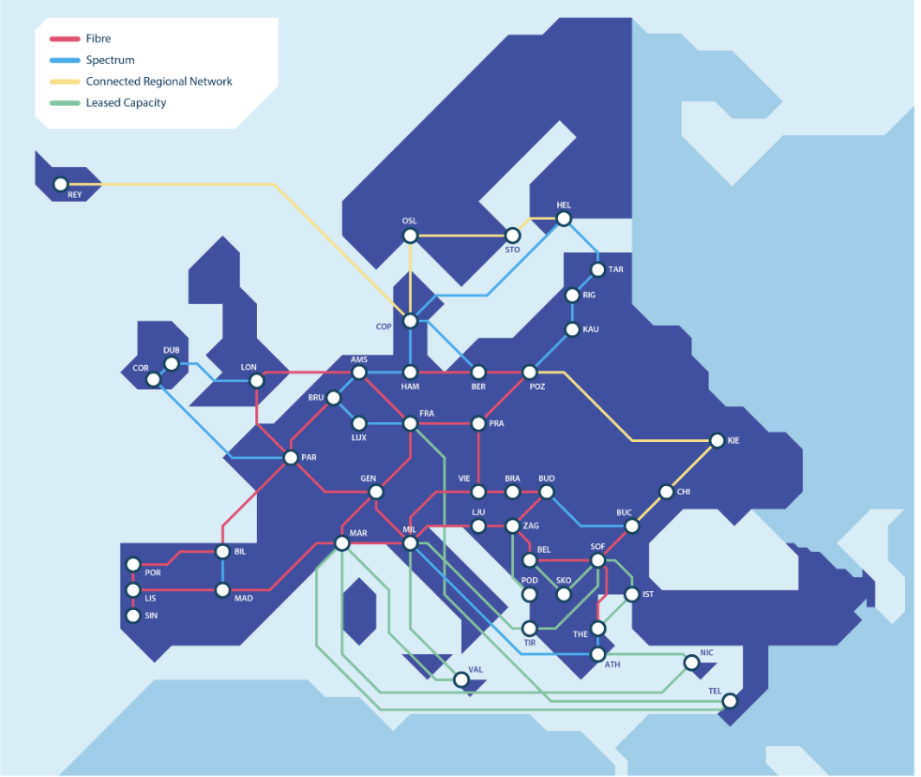
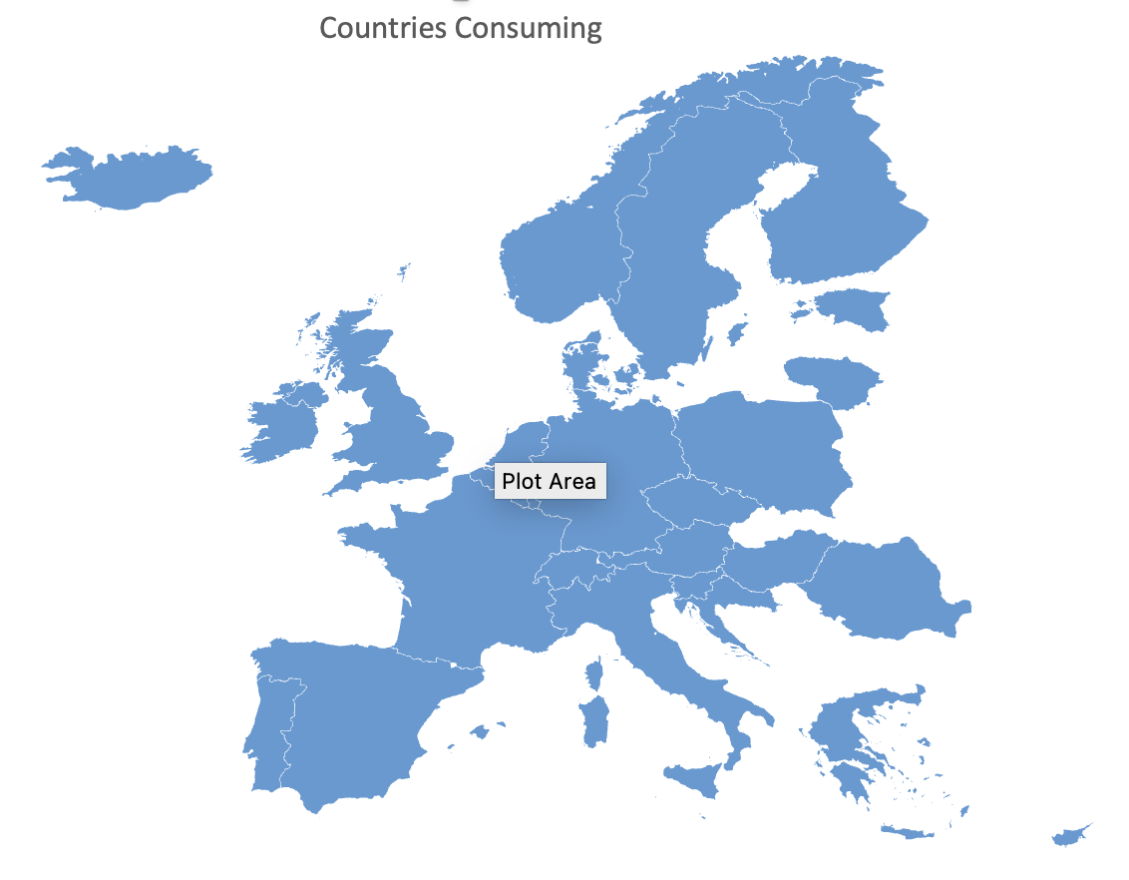
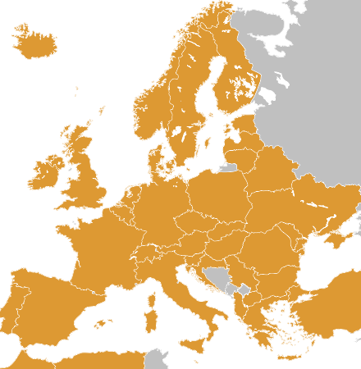

Strategic assets GÉANT Association
infrastructures
unique assets & skills
OCRE
procurement
track record
trust & commitment
eduGAIN
ability to scale

Slide 6
Promising approach: from federated to joint platform
Joint research cloud orchestrator software / SaaS
Data movement infrastructure
Very large European sovereign object storage infrastructure
current: federated: network, T&I
future: joint platform?
Faster community-wide deploy?
Cheaper to run?
Easier to maintain at scale?
up-front political, business and technical alignment
10+ years deploy at scale
most efficient way?

Slide 7
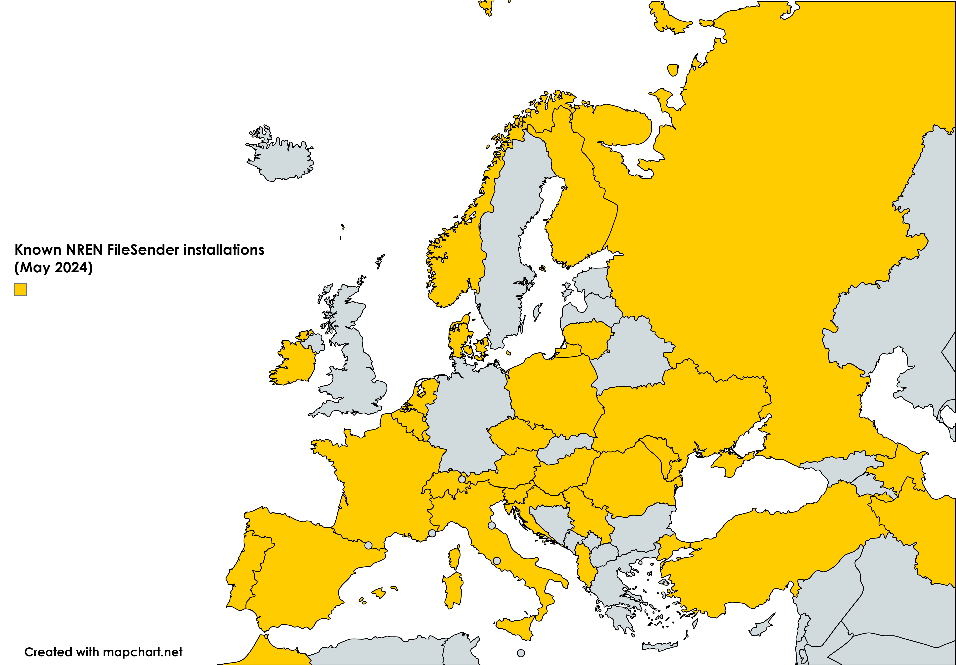
Data movement infrastructure
1st itch: terabit networks != fast 100 terabytes transfers
2nd itch: data movement is for happy few
FileSender NREN deployments
Notes:
different solution paths for different problem spaces
where is the storage, where are the processing sites? Consolidation seems key

Slide 8
Investment proposal: Data Movement infrastructure
Make it trivial for all researchers to transfer large datasets:
integrated with network
file transfer -> data movement
ubiquitous
infrastructure
10 year perspective
where is 80% of the problem?
  10s of TBs or 100s of TBs?
source and origin points?
  how many, where?
Notes:
different solution paths for different problem spaces
where is the storage, where are the processing sites? Consolidation seems key

Slide 9
investment proposal: joint large European sovereign object storage infrastructure
The itch: how to make cost-effective sovereign cloudy infra that can compete with commercials over time
simple storage interface, other services as customer
single coherent service - one technical platform – operations – business layer
collective = cheaper & better than any individual (national) organisation can achieve?
sovereign deployment
joint financing
common blueprints for storage pod
joint procurement components
single technical platform
operations
finances
sales
complexity & benefits
low
high

Slide 10
Investment proposal: large-scale European object storage infrastructure
Early observations
43 countries
–5.000 R&E organisations
–1.2M researchers
European Research Area
technical: can be done, “just engineering”
producers & consumers
challenge: organising, business layer, politics
  up-front federation
likely key customers: research data repos
economy of scale & scope
  risk vs. reward?
start with coalition of willing and grow
  make it more interesting to join than invest in new local infra, when that time comes
GEANT Association
43 NRENs + GÉANT org
4.100+ employees
€1.000M+ budget
–50 pan-European RIs
–150 large storage / processing plants
- 250 Trustworthy Data Repos
- ? institutions producing digital services
Notes:
different solution paths for different problem spaces
where is the storage, where are the processing sites? Consolidation seems key

Slide 11
Next?
Collective infrastructure makes us stronger
Thank You
Investment proposal = tech + business + endorsement
part of GN5-2 (January 2025 – June 2027)
  good draft by Feb 2026
  limited budget for PoCs
  timing good
Interested? Opiniated? Think this is fantastic/disastrous/meh?
  jan.meijer@sikt.no
Recommendations collective cloud strategy GÉANT Association membership
  https://zenodo.org/records/14793806

