Slide 1
File sync and share solutions integrated into end-to-end researcher workflows
RSpace & OwnCloud (and more)
CS3, Munich, 2025-03-21
Guido Aben
Senior strategy officer
SUNET
Tilo Mathes
Product Manager & Open-source Lead
Research Space
Rory Macneil
CEO
Research Space

Slide 2

Outline
Addressing current RDM challenges with integrated research infrastructure and research tools
RSpace – an active phase research tool designed around vertical interoperability and a ‘frontend’ for (research) file store solutions
New functionality, current development, and next steps

Slide 3
Developments and Aspirations of Research Data Management
Funders focussed on data sharing initially
→ AI emerging to leverage research data
Research Clouds / Commons as an infrastructure concept
  → Delivering integrated research data ecosystems
Notes:
Tools → data repositories and data management planning tools
Organizationally → the digital library
Research IT/HPC/Research Computing → growing involvement
People → professionalisation of research data managers/data stewards; research software engineer (RSE) emerging
FAIR as a unifying concept → professional organizations/activities, e.g. RDA, GO FAIR, Open Science NL, FDO Forum, driving discussion, development of standards, innovation

Slide 4
Unsolved issues in Research Data Management
Most research data produced today is still not well described, both for humans and machines, stored in largely inaccessible locations, meaning it can’t be reused, yet creates costs and management overhead
How might we create integrated digital research infrastructure to efficiently manage research data and make it actionable?
Notes:
RDM tools have been developed as standalone resources, unconnected to each other and tools used in research
Researchers generally view RDM (tools) as a burden b/c they are not integrated into their workﬂows, but operate as a separate, additional administrative overhead of the research process
Research data management becomes harder/more effort at late stages of research
There is no clarity in the RDM community about how the RDM tools and infrastructure could or should interoperate with other tools used in research

Slide 5
Research data management is not concerted
RDM tool
Sync and share service
ELN
RDM tool
Sync and share service
ELN
Efficiently managed, discoverable, and reusable research data with high quality metadata
Tools and services are often set up to work in isolation or in sequence with little overlap, rather than coordinated around a shared goal.
If tools/services work together they can create and mutually benefit from efficiently managed FAIR research data, and address issues of dark and invisible data.

Slide 6
Concerted research data management right from the early research phase
RDM tool
Sync and share service
ELN
Data curation
PIDs
Discoverability
…
Context
Scientific record
Provenance
…
Active data management
Optimised storage
…
Specialised tools bring in different aspects and values for research data management

Slide 7
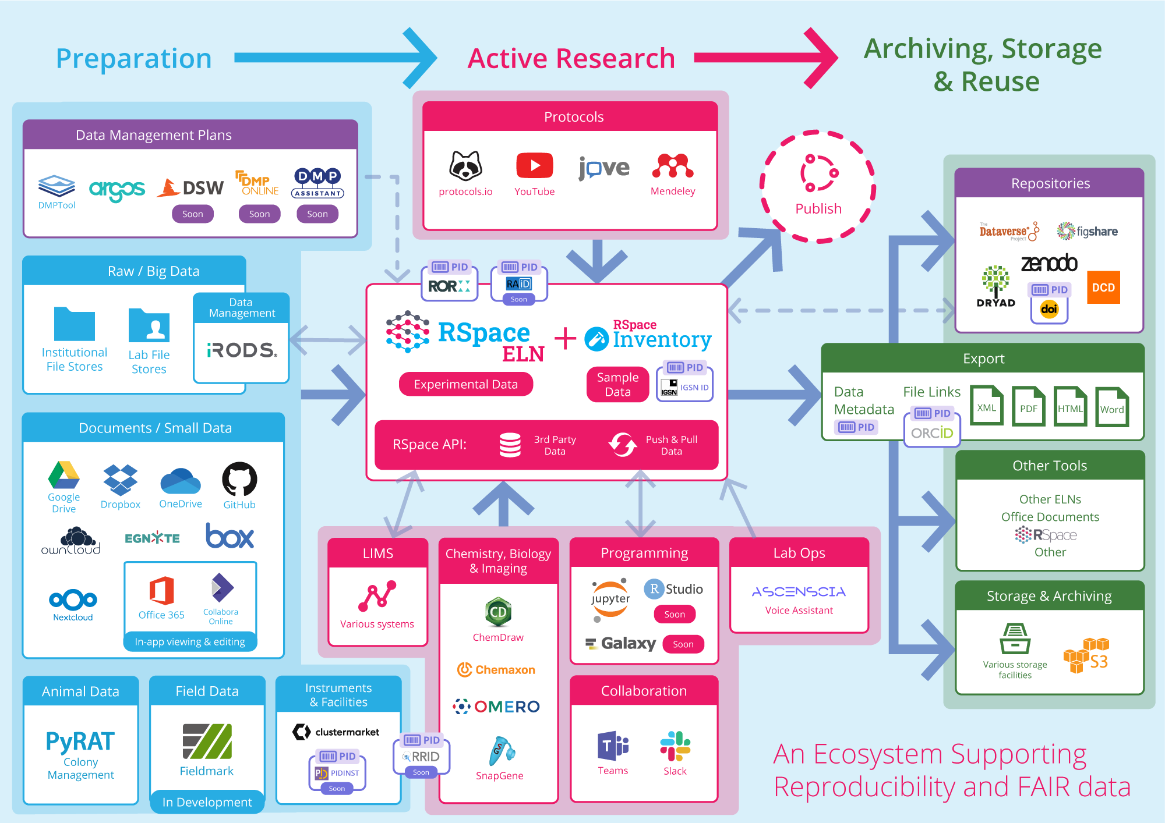
RSpace
Open-source research platform for institutional Research Data Management
Electronic lab notebook + sample management system at its core
A hub for recording the scientific process
Enabled by vertical interoperability with other research tools and infrastructure

Slide 8
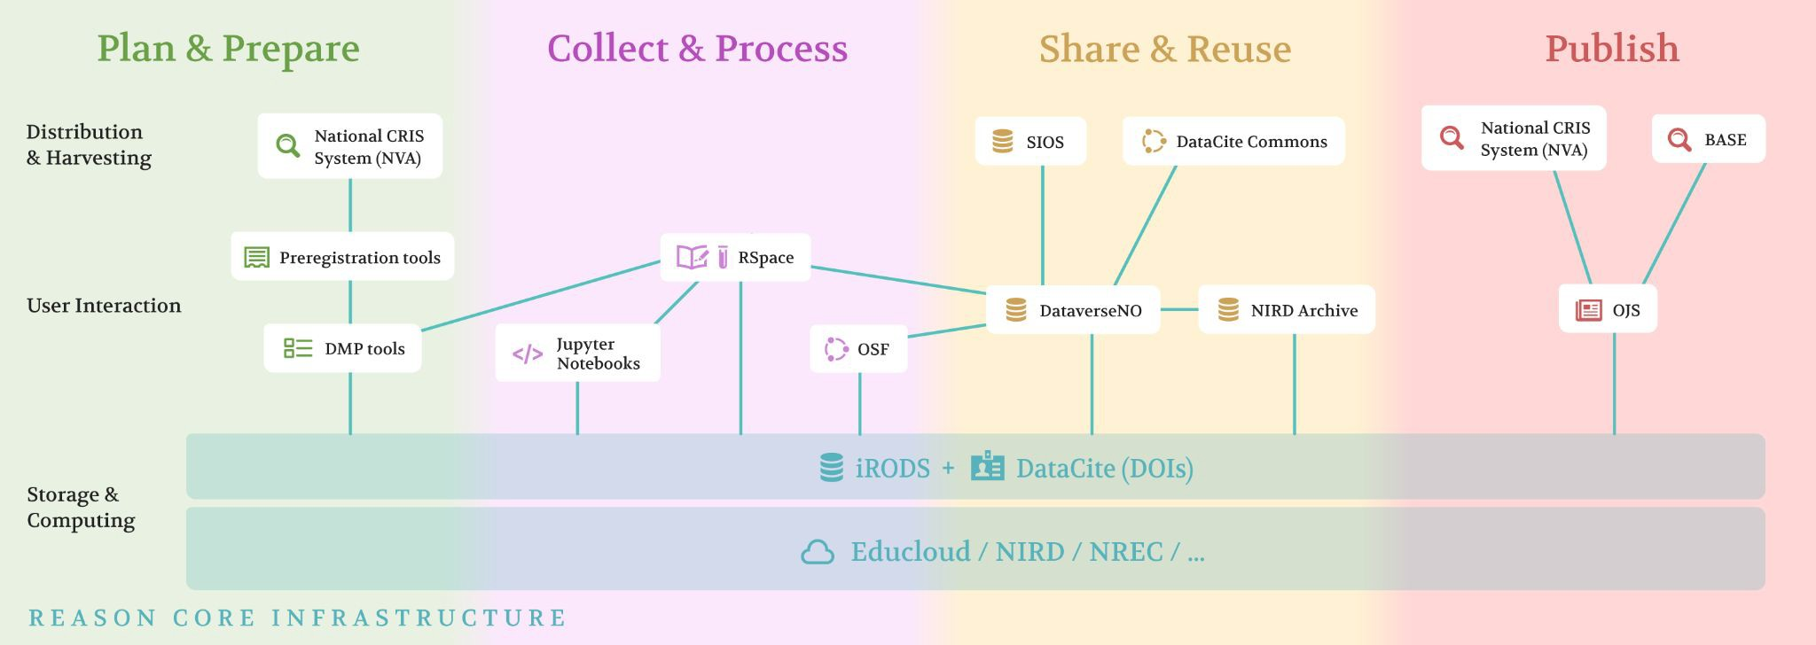
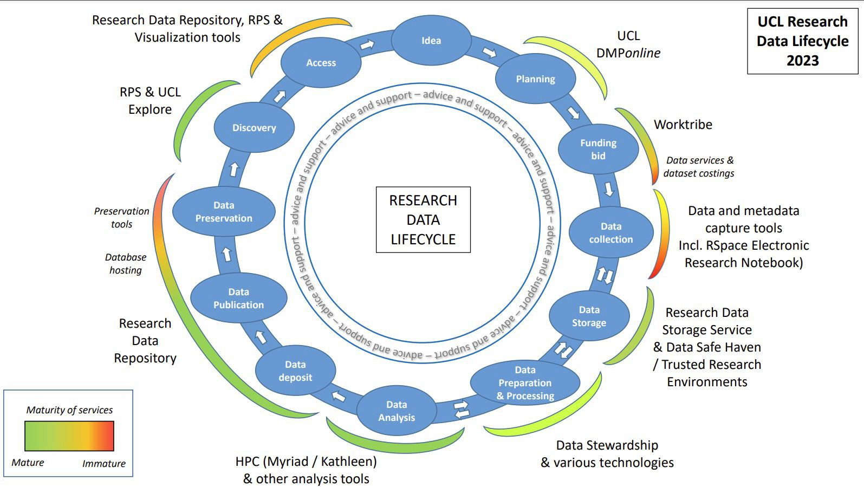
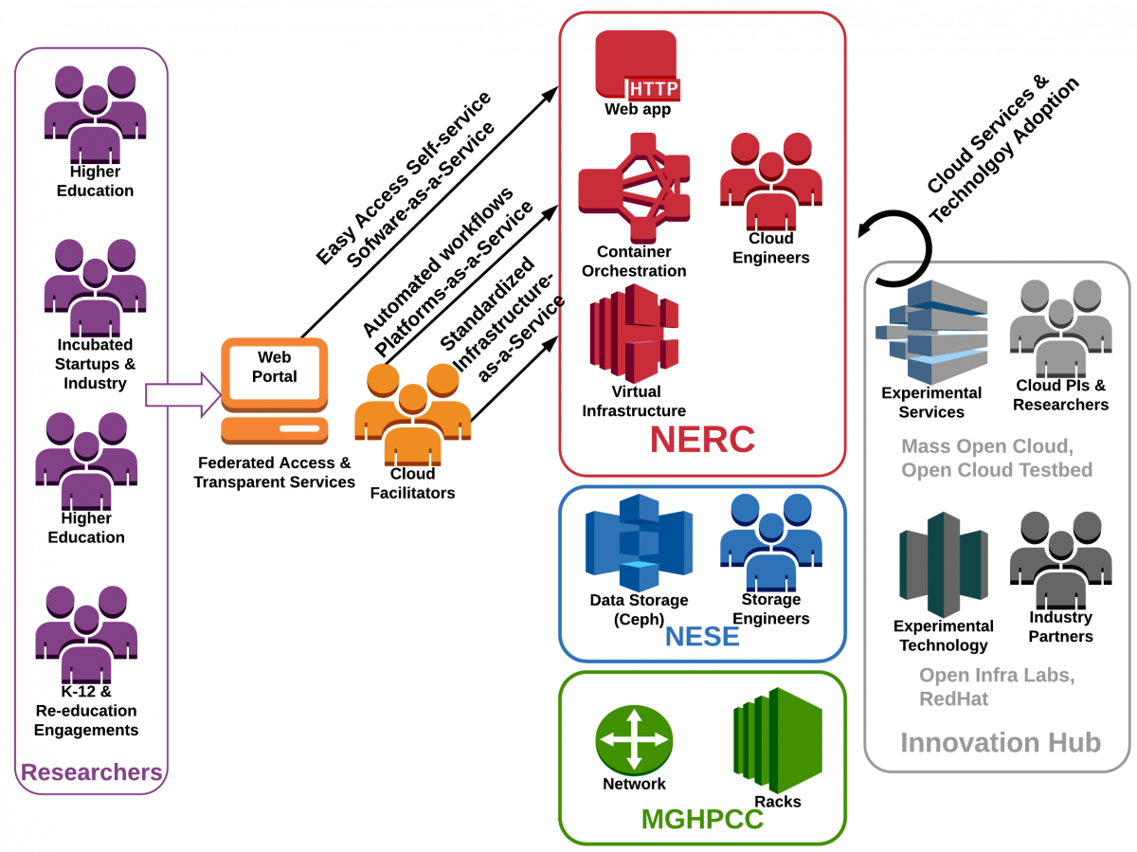
RSpace supporting institutional and (inter-)national research infrastructure through vertical interoperability
Further initiatives
Alliance Cloud Connect Pilot (Canada)
BioFAIR UK
EOSC
…

Slide 9
A user’s perspective
“[…] it would be of much interest to us if the […] RSpace […] gallery could act as a front end for iRODS to allow upload of data to iRODS (possibly even defaulting to storage in iRODS).
[…] to allow retrieval of data from the iRODS interface (outside of RSpace), it would be good if RSpace were to update a specific metadata field in the iRODS catalogue when files are linked to experiment entries, so that querying the metadata catalogue for a particular document identifier could retrieve all data associated with that document”
Dr. Sam Eyley, PI, KU Leuven

Slide 10
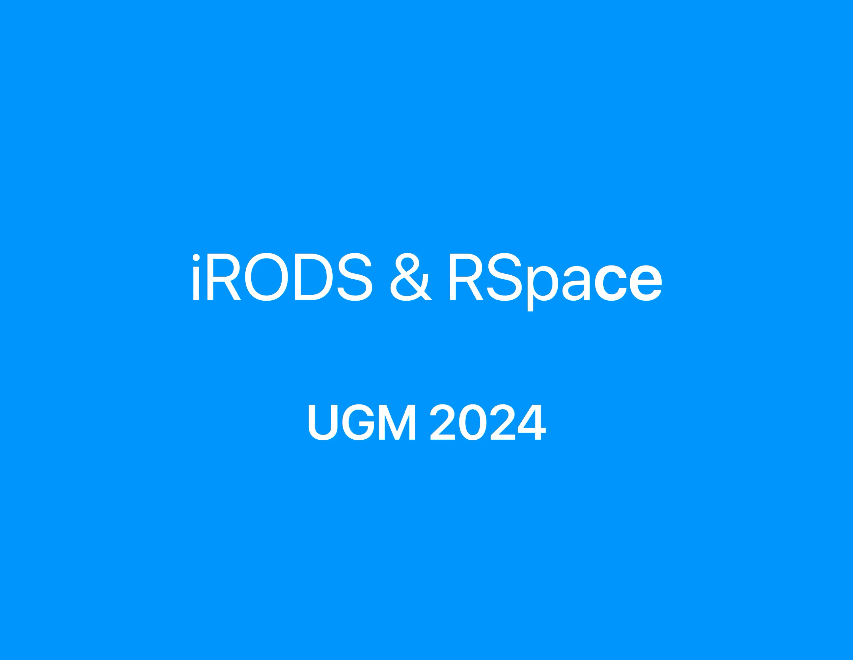
RSpace:iRODS integration
Making remotely stored data available for active research, research documentation and RDM workflows
Persistent links preventing link-rot
Storage management taken off the researcher's ‘plate'
Notes:
Demo

Slide 11
Towards RSpace as a unified frontend for institutionally managed research data file stores
Enabling RSpace users to persistently link to files stored in ownCloud, Nextcloud, OpenCloud, …
Defaulting to managed file stores for RSpace attachments
Metadata exchange and synchronisation between RSpace (&ecosystem) and file stores
Notes:
Demo

Slide 12
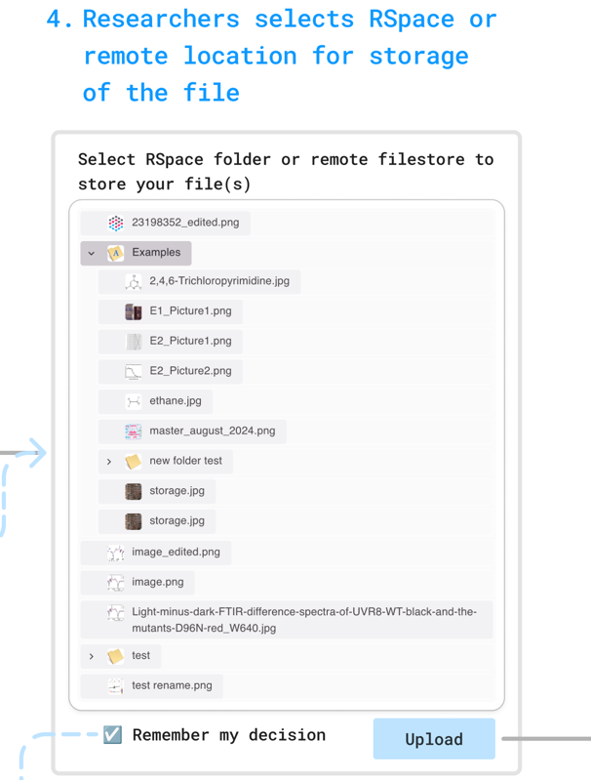
🔜 Integrate remote storage directly into ELN workflows
Typically, attachments are stored first in the ELN file store, and transferred to a repository or remote file store later
If a file store(s) is connected to an ELN, attachments can be directly uploaded to the file store
Optionally, we can default/enforce the storage on the ELN side to a desired destination and ensure all data is stored consistently

Slide 13

Vision: Coordinated metadata improvement leveraging unique strengths of multiple tools and services
File
  Intrinsic metadata
Share and sync solution
  Unique ID
  URL
  Filesystem metadata
  Other metadata
RDM tool
  PIDs
  Collection metadata
ELN
  Notebook / Document IDs (where the file has been referenced)
  Project metadata
  Experiment metadata
  Contributors
  Affiliations
  Keywords

Slide 14
Conclusions
Active phase research tools can serve as ‘front ends’ to research infrastructure by leveraging their technological benefits ‘under the hood’
  More research data stored on a solution managed by an organization
  Improved metadata of digital assets covering the entire research process
  Increased robustness of the scientific record
  Better discovery of research data → higher reuse of research data
🚀 Impact
More efficiently managed IT resources
Transforming bytes into rocket fuel for research and innovation

Slide 15
Thank you!
Tilo Mathes (he/him)
https://www.linkedin.com/in/tilo-mathes
https://www.researchgate.net/profile/Tilo-Mathes
https://orcid.org/0000-0002-9694-748X
✉️ tilo.mathes@researchspace.com
https://www.researchspace.com
https://github.com/rspace-os

Slide 16
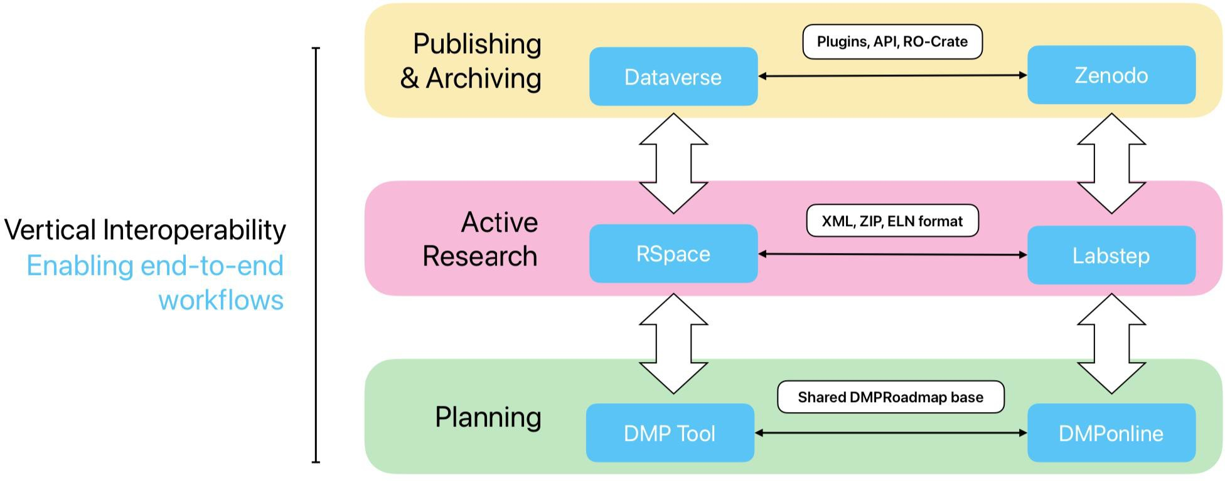
Vertical Interoperability
A prerequisite to streamlined and effortless flow of data and metadata through the research lifecycle
https://upstream.force11.org/the-time-is-now-vertical-interoperability-between-research-tools-an-essential-enabler-for-the-fairification-of-data/

Slide 17
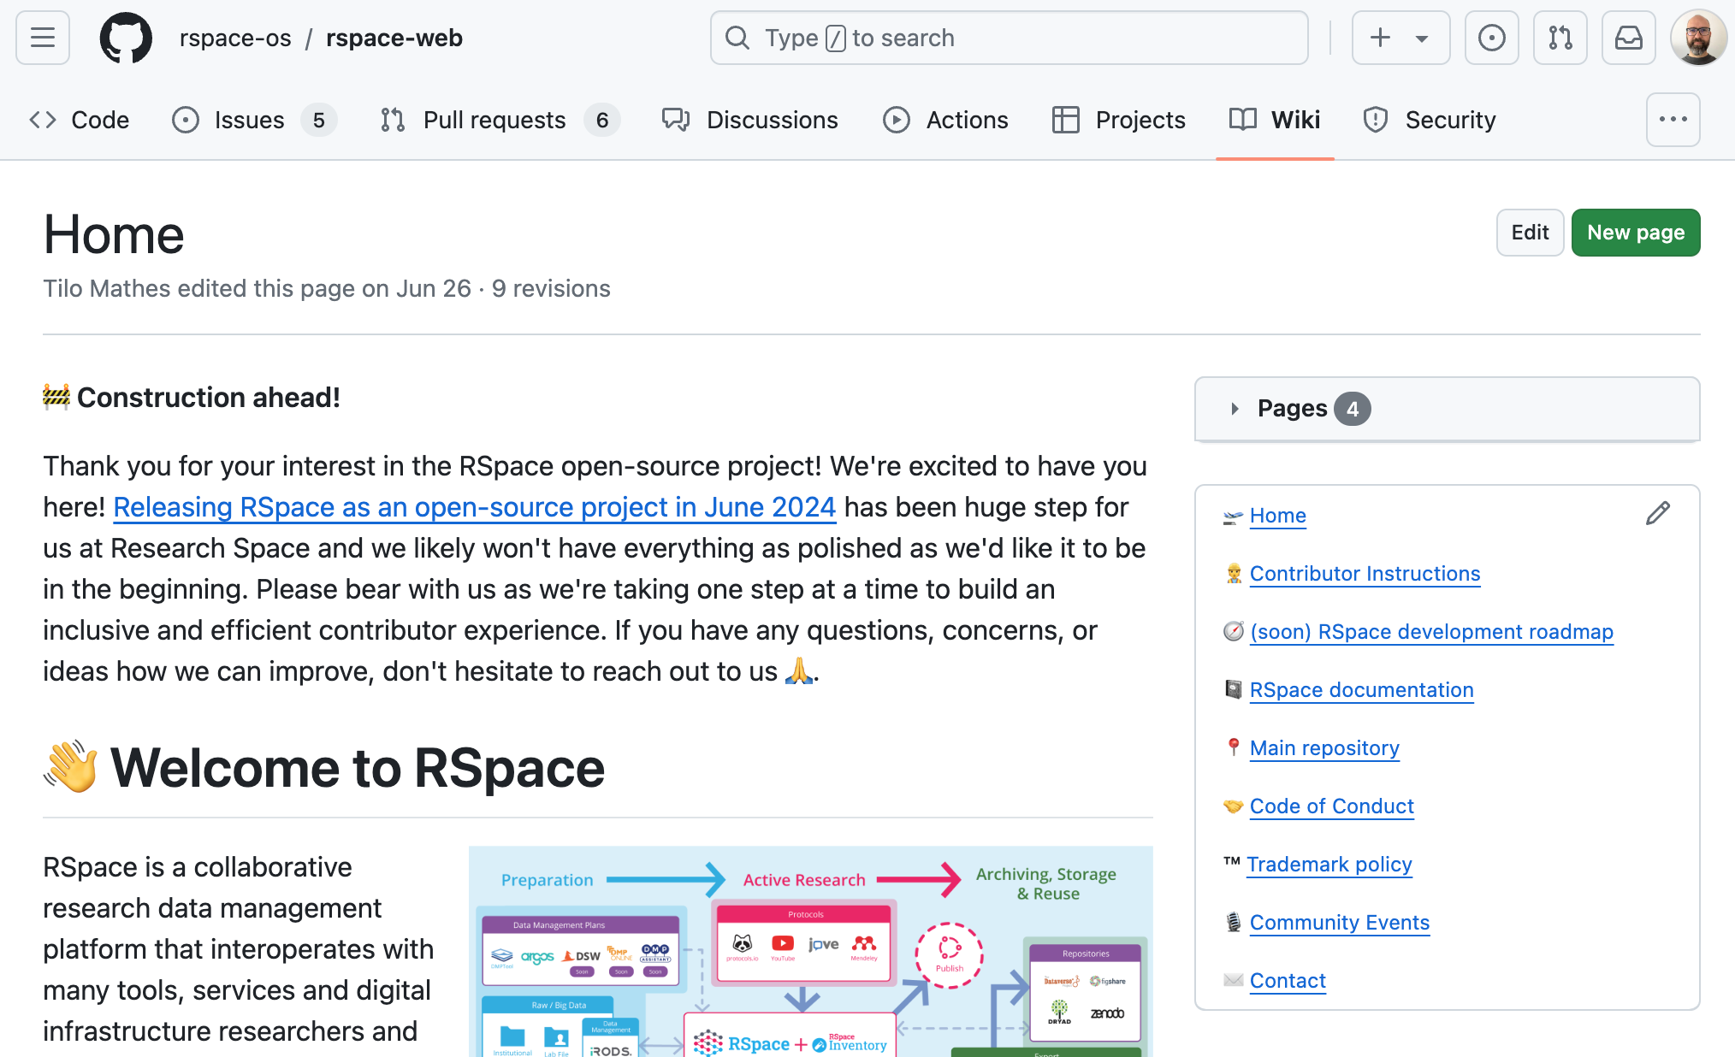

RSpace is open-source since June 2024
Open Source model
  Licenced under AGPL v3
  Research Space maintains RSpace on GitHub
  Research Space provides services to implement, adopt, and maintain RSpace
Collaborating with institutional partners
  Co-development of solutions with customers and partners (Leibniz Institute on Aging , Leiden, TU Delft,..)
Individual contributions
  Pitch ideas / share feedback & experiences / contribute code / support the community
👋 open-source office hour: May 7th, 11:30am CET
opensource@researchspace.com
https://github.com/rspace-os

